Slide 1
Diagnostic and Management Challenges in Patients With Chronic Migraine

Slide 3
This program will include a discussion of data that were presented in abstract form. These data should be considered preliminary until published in a peer-reviewed journal.

Slide 4
Stigma and Quality of Life in Patients With Frequent Migraine

Slide 5
CaMEO Study: Background

Slide 6
CaMEO Study: Patient Demographics

Slide 7
CaMEO Study: Effect of Migraine on Life if I Didn't Have Migraine

Slide 8
CaMEO Study: Effect of Migraine on Personal Career and Finances

Slide 9
CaMEO Study: Effect of Migraine on Partner's Career and Finances

Slide 10
CaMEO Study: Effect of Migraine on Relationships

Slide 11
Conclusions

Slide 12
Considerations in Preventive Therapy for Migraine

Slide 13
Patterns of Preventive Therapy Use: IBMS-II

Slide 14
Weighing Treatment Efficacy and Tolerability

Slide 15
Measuring Migraine Burden in All Phases

Slide 16
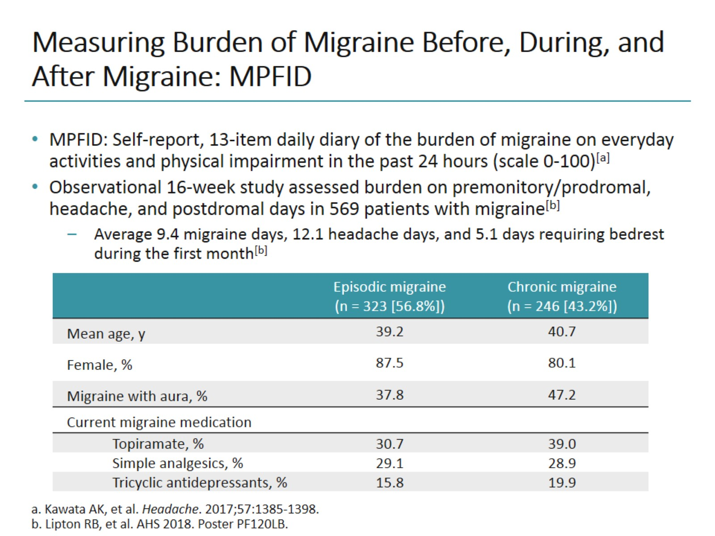
Measuring Burden of Migraine Before, During, and After Migraine: MPFID

Slide 17
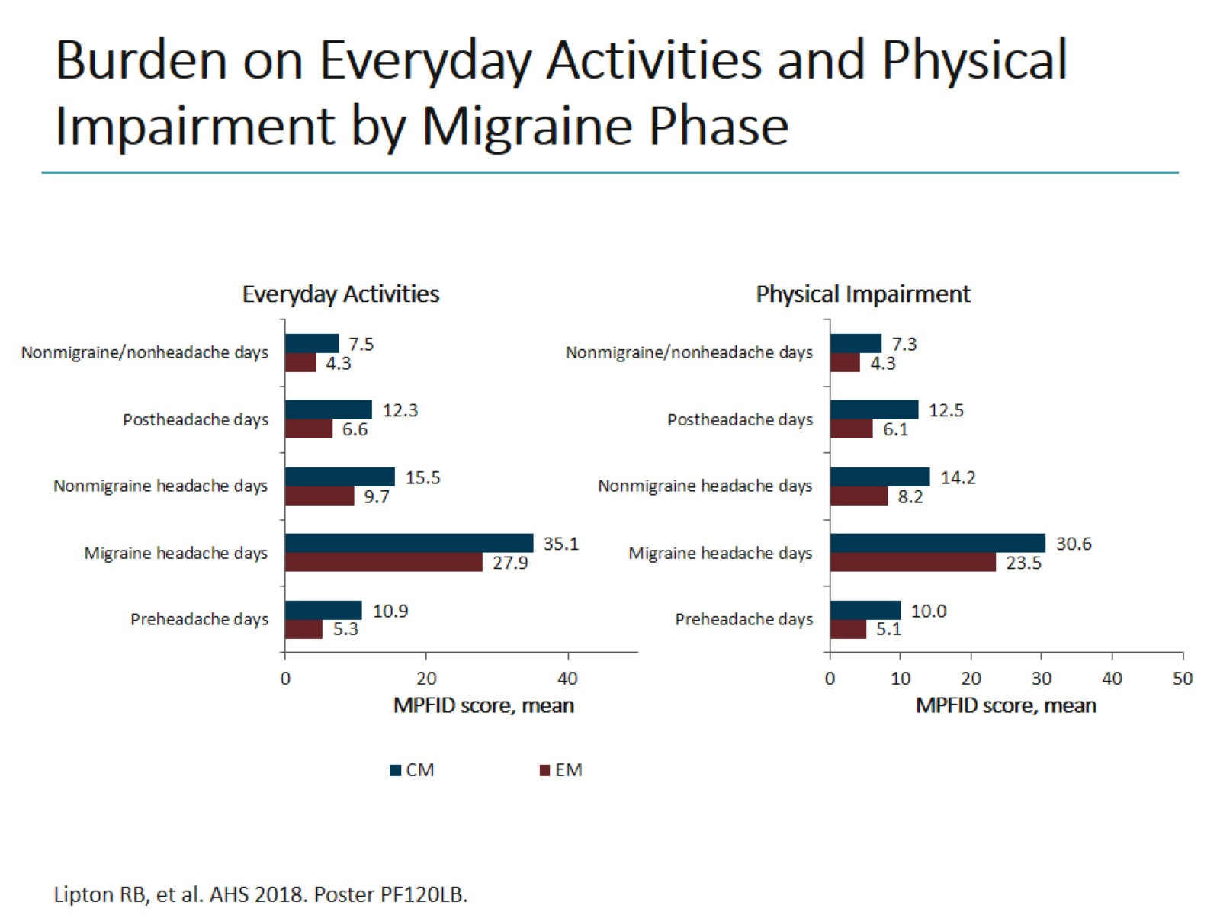
Burden on Everyday Activities and Physical Impairment by Migraine Phase

Slide 18
Identifying Natural Subgroups of Migraine

Slide 19
Natural Subgroups of Migraine: Overall Results

Slide 20
Natural Subtype of Migraine: Likelihood of Progression to CM

Slide 21
Looking Ahead

Slide 22
Migraine Headache

Slide 23
Lasmiditan for Acute Treatment of Migraine

Slide 24
Lasmiditan: Phase 3 Study Results

Slide 25
Rimegepant for Acute Treatment of Migraine: Phase 3 Study Results

Slide 26
Ubrogepant for Acute Treatment of Migraine: Phase 3 Study Results

Slide 27
CGRP-Targeting mAbs for Migraine Prevention

Slide 28
Early Rapid Onset of CGRP-Targeting mAbs

Slide 29
Benefit of CGRP-Targeting mAbs in Difficult-to-Treat Populations

Slide 30
Conclusions

Slide 31
Emerging Approaches for Preventive Therapy of CM

Slide 32
CM: Features and Challenges

Slide 33
Fremanezumab for Prevention of CM: HALO CM

Slide 34
Reversion From CM to EM With Fremanezumab in HALO CM

Slide 35
Eptinezumab for Prevention of CM: PROMISE-2

Slide 36
Conclusions

Slide 37
Abbreviations

Slide 38
Abbreviations (cont)

