Slide 1
Stroke Prevention in Atrial Fibrillation

Slide 3
Overview of Stroke in Patients With AF

Slide 4
What Do the Guidelines Say About NOACs?

Slide 5
NOAC Dosing Challenges in Patients With Renal Impairment

Slide 6
Dose Reduction for Stroke Reduction in NVAF

Slide 7
Implications of Renal Impairment on Stroke Risk

Slide 8
Patients With Moderate Renal Impairment Across NOAC Phase 3 RCTs

Slide 9
Detrimental Effects of VKAs on Renal Function

Slide 10
VKAs Contribute to Vascular Calcification

Slide 11
Warfarin and ESRD Risk for Stroke and Bleeding

Slide 12
Vascular Calcification NOACs

Slide 13
US Claims and EHR Datasets Show Better Renal Outcomes With NOAC Use

Slide 14
Renal Outcomes Should Be Considered When Selecting an OAC in AF

Slide 15
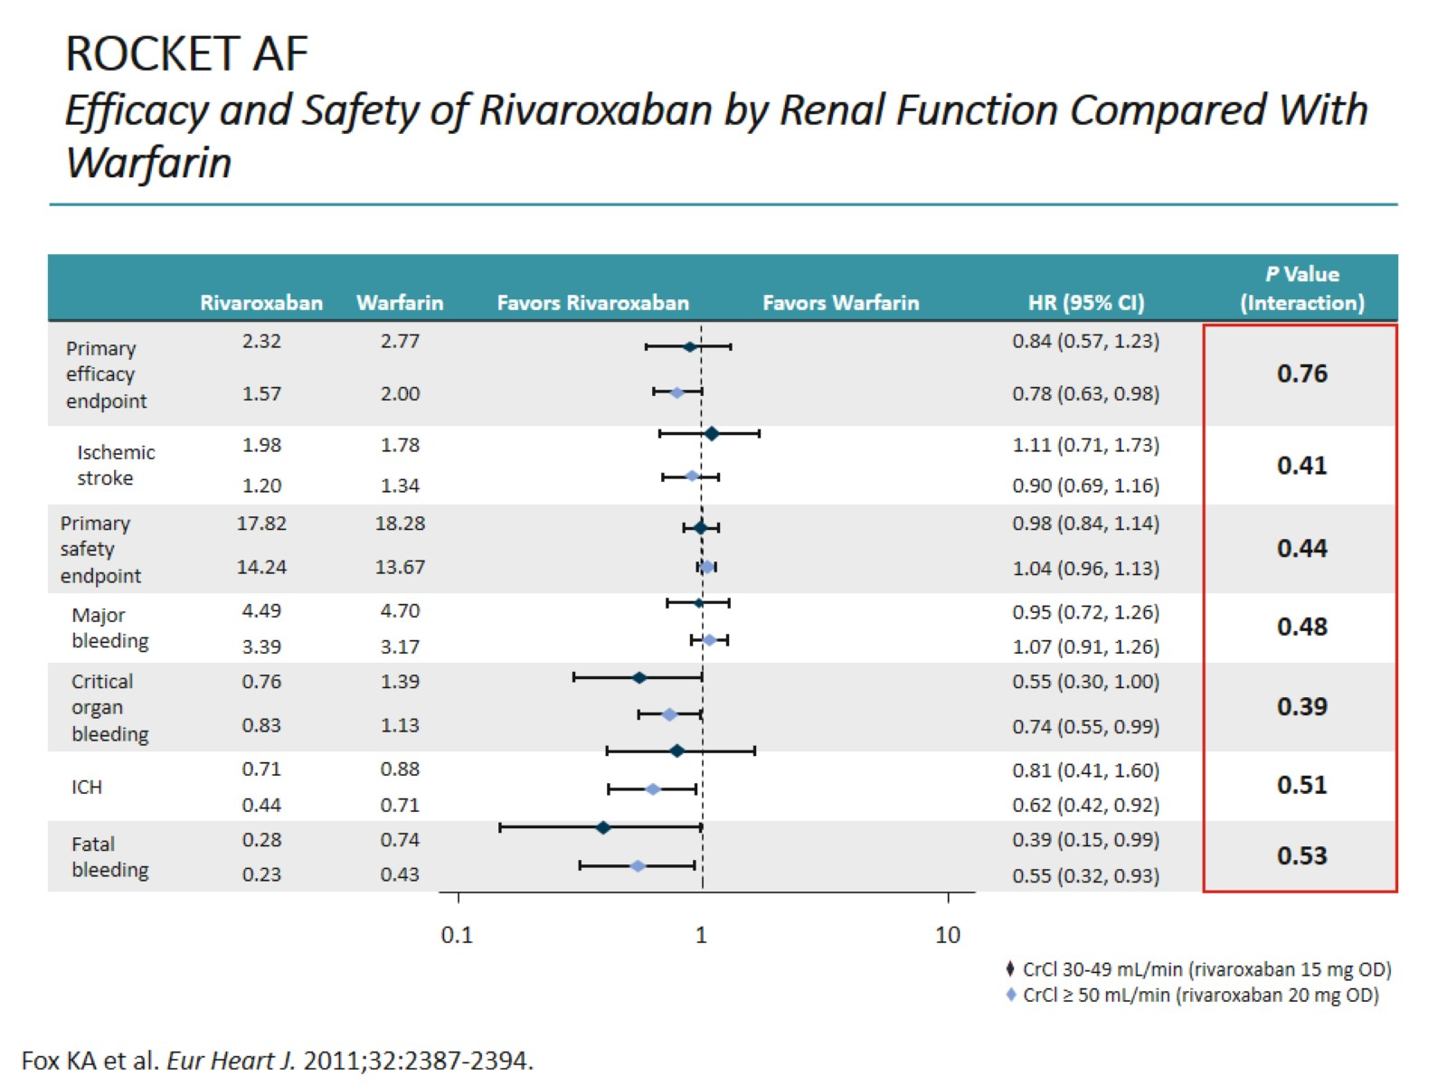
ROCKET AF Efficacy and Safety of Rivaroxaban by Renal Function Compared With Warfarin

Slide 16
Real-World Data 1-Year Outcomes for Reduced-Dose NOAC Treatment in Patients With Renal Impairment

Slide 17
NOACs May Reduce Major Bleeding Risk in Patients With NVAF With Severe Kidney Disease

Slide 18
NOACs in Renal Insufficiency US Guidelines

Slide 19
NOACs in Renal Insufficiency European Union, Canada Prescribing

Slide 20
NOAC Follow-Up

Slide 21
Conclusion

Slide 22
Abbreviations

Slide 23
Abbreviations (cont)

Slide 24
Abbreviations (cont)

