Slide 1
Expert Perspectives on AL Amyloidosis

Slide 3
Background on AL Amyloidosis

Slide 4
Epidemiology of AL Amyloidosis (2007-2015)

Slide 5
AL Amyloidosis Survival and Prognosis

Slide 6
Gaps in Patient Care

Slide 7
Delays in the Diagnosis of AL Amyloidosis

Slide 8
Specialists and Symptoms That Can Lead to a Diagnosis of Amyloidosis

Slide 9
Specialists and Symptoms That Can Lead to a Diagnosis of Amyloidosis (cont)

Slide 10
Specialists and Symptoms That Can Lead to a Diagnosis of Amyloidosis (cont)

Slide 11
Specialists and Symptoms That Can Lead to a Diagnosis of Amyloidosis (cont)

Slide 12
Differentiating AL Amyloidosis From ATTR Amyloidosis

Slide 13
Differentiating AL Amyloidosis From ATTR Amyloidosis

Slide 14
Differentiating AL Amyloidosis From ATTR Amyloidosis (cont)

Slide 15
Differentiating AL Amyloidosis From ATTR Amyloidosis (cont)

Slide 16
Differentiating AL Amyloidosis From ATTR Amyloidosis (cont)

Slide 17
Diagnosing AL Amyloidosis

Slide 18
Diagnosing AL Amyloidosis (cont)

Slide 19
Diagnosing AL Amyloidosis (cont)

Slide 20
Diagnosing AL Amyloidosis (cont)

Slide 21
Diagnosing AL Amyloidosis (cont)

Slide 22
Diagnosing AL Amyloidosis (cont)

Slide 23
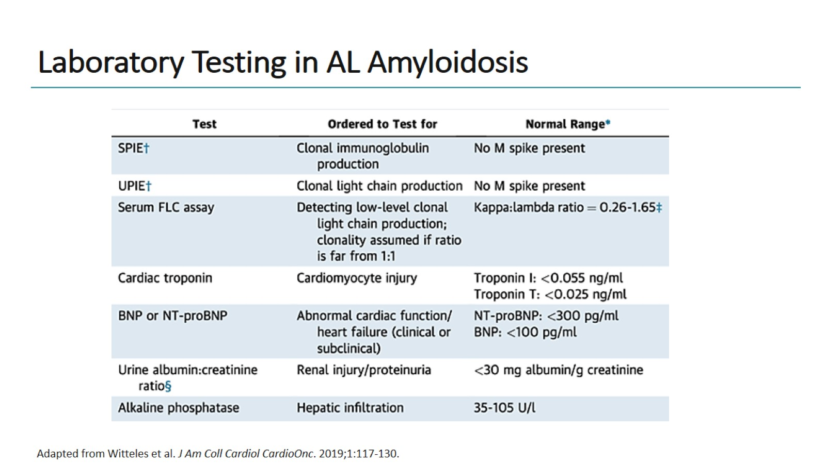
Laboratory Testing in AL Amyloidosis

Slide 24
Imaging of Cardiac Amyloidosis

Slide 25
Imaging of Cardiac Amyloidosis (cont)

Slide 26
Imaging of Cardiac Amyloidosis (cont)

Slide 27
Imaging of Cardiac Amyloidosis (cont)

Slide 28
Presentations: Soft Tissue Types and Incidental Masses

Slide 29
Presentations: Soft Tissue Types and Incidental Masses

Slide 30
Presentations: Soft Tissue Types and Incidental Masses (cont)

Slide 31
Presentations: Soft Tissue Types and Incidental Masses (cont)

Slide 32
Two Treatment Strategies: Parallel Paths

Slide 33
Cardiac-Specific Treatment

Slide 34
Cardiac-Specific Treatment (cont)

Slide 35
Cardiac-Specific Treatment (cont)

Slide 36
Cardiac-Specific Treatment (cont)

Slide 37
Treating the Underlying Clone in AL Amyloidosis

Slide 38
Treating the Underlying Clone in AL Amyloidosis (cont)

Slide 39
Treating the Underlying Clone in AL Amyloidosis (cont)

Slide 40
Rationale for Daratumumab in AL Amyloidosis

Slide 41
Andromeda

Slide 42
ANDROMEDA: Results Response to Dara-CyBorD in AL Amyloidosis

Slide 43
Daratumumab and Hyaluronidase-fihj

Slide 44
Novel Therapies in Clinical Trials for AL Amyloidosis

Slide 45
Novel Therapies in Clinical Trials for AL Amyloidosis (cont)

Slide 46
Novel Therapies in Clinical Trials for AL Amyloidosis (cont)

Slide 47
Concluding Thoughts

Slide 48
Concluding Thoughts

Slide 49
Concluding Thoughts

Slide 50
Concluding Thoughts

Slide 51
Concluding Thoughts

Slide 52
Thank you for participating in this activity.

