Slide 3
Background: Anti-VEGF-A Injections for nAMD and DME/DR

Slide 4
Real-World Analysis of Patients With Treatment-Naive nAMD (49,485 Eyes) Treated With Anti-VEGF Monotherapy in Year 1

Slide 5
Change in Visual Acuity vs Number of Anti-VEGF Injections in the First Year of Treatment

Slide 6
CATT Follow-Up Study: 5-Year Outcomes of Anti-VEGF Treatments for nAMD

Slide 7
Literature on Treatment Lapses in nAMD

Slide 8
Anti-VEGF Treatments for DME in Protocol T Mean Number of Injections Over 2 Years

Slide 9
Typical Treatment Course for a Patient With DME

Slide 10
Typical Treatment Course for a Patient With DME (cont)

Slide 11
Literature on Treatment Lapses in DME/DR

Slide 12
Extending Anti-VEGF Durability

Slide 13
Extending Anti-VEGF Durability

Slide 14
PDS Sustained Delivery Device*

Slide 15
Ladder: Phase 2 Trial of PDS vs Monthly Intravitreal Ranibizumab

Slide 16
Ladder: Median Time to First PDS Refill

Slide 17
Ladder: Visual and Anatomical Results

Slide 18
Archway: Phase 3 RCT of PDS Every 24 Weeks for nAMD

Slide 19
Archway: Visual and Anatomical Outcomes Through 72 Weeks

Slide 20
Ranibizumab Concentrations Over Refill Interval With PDS 100 mg/mL Every 24 Weeks

Slide 21
Archway: Supplemental Treatments in PDS Arm

Slide 22
Archway: PDS Preference Questionnaire

Slide 23
Archway: Ocular Adverse Events

Slide 24
Archway: Ocular Adverse Events

Slide 25
Archway: Ocular Adverse Events

Slide 26
Archway: Ocular Adverse Events

Slide 27
Archway: Ocular Adverse Events

Slide 28
Archway: Ocular Adverse Events

Slide 29
Archway: Ocular Adverse Events

Slide 30
Ongoing and Upcoming Clinical Trials of PDS

Slide 31
Video: PDS Insertion in the OR

Slide 32
PDS Surgical Implantation: Step by Step

Slide 33
PDS Surgical Implantation: Step by Step

Slide 34
PDS Surgical Implantation: Step by Step

Slide 35
PDS Safety and Implant Dislocation

Slide 36
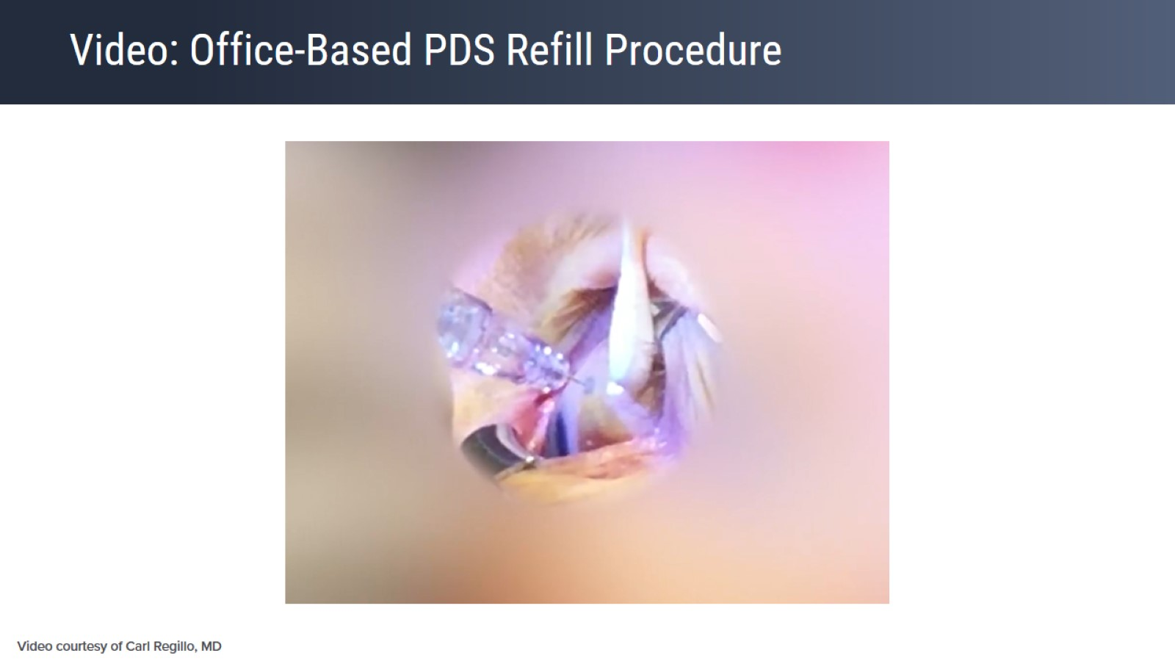
Video: Office-Based PDS Refill Procedure

Slide 37
Office-Based PDS Refill Procedure

Slide 38
Faculty Perspectives: PDS in Clinical Practice

Slide 39
Gene Therapy: RGX-314*

Slide 40
RGX-314 Phase 1/2a Trial Visual Results

Slide 41
RGX-314 Phase 1/2a Trial Anatomical Results

Slide 42
Faculty Perspectives on Subretinal Gene Therapy Surgery

Slide 43
Concluding Remarks

