Slide 2
Learning Objectives

Slide 3
Inflammation in HIV

Slide 4
HIV Promotes Inflammation

Slide 5
HIV Promotes Inflammation

Slide 6
HIV Promotes Inflammation

Slide 7
HIV Promotes Inflammation

Slide 8
Biomarkers of Inflammation

Slide 9
CD4:CD8 Ratio Predicts Events and Mortality in PLWH Who Achieve Viral Load Suppression With ART

Slide 10
Factors Associated With T-Cell Subset Normalization

Slide 11
Duration of Untreated HIV Infection Influences Inflammation

Slide 12
ART Adherence Affects Inflammation US Multicenter AIDS Cohort Study

Slide 13
Triggers of Inflammation

Slide 14
VAT Directly Contributes to Inflammation-Related Conditions

Slide 15
Body Composition Changes in the History of HIV Care

Slide 16
Body Composition Changes in the History of HIV Care

Slide 17
Body Composition Changes in the History of HIV Care

Slide 18
The Crossroad Between Inflammation and Metabolism

Slide 19
Assessing Immunometabolic Disorders in the Clinic

Slide 20
NAFLD and NASH

Slide 21
NAFLD and NASH

Slide 22
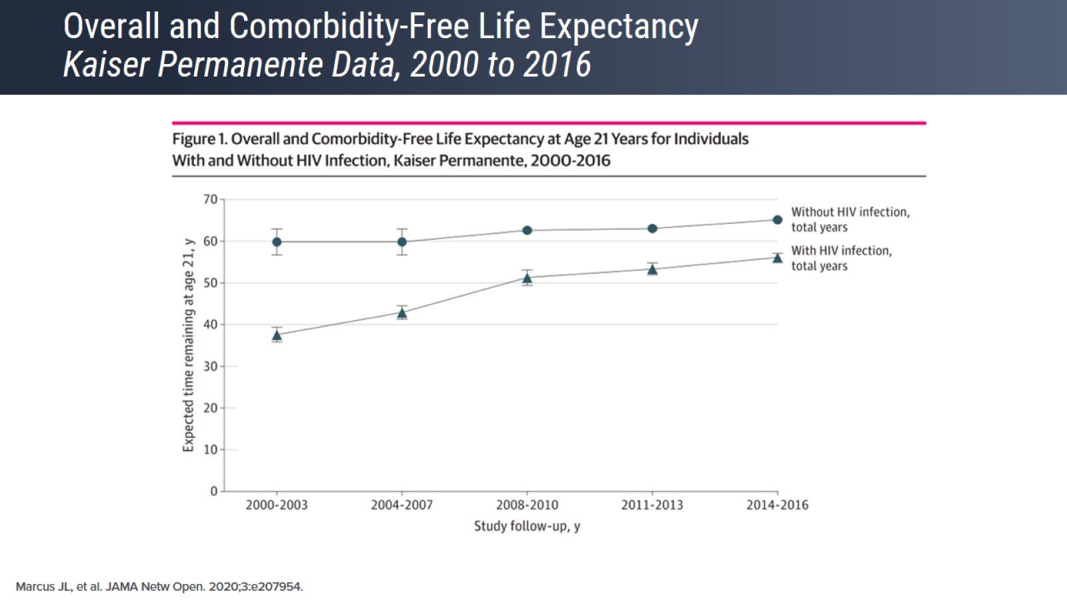
Overall and Comorbidity-Free Life Expectancy Kaiser Permanente Data, 2000 to 2016

Slide 23
Overall and Comorbidity-Free Life Expectancy Kaiser Permanente Data, 2000 to 2016

Slide 24
Some Comorbidities Are More Prevalent in PLWH

Slide 25
Inflammation, Metabolism, and Aging in PLWH

Slide 26
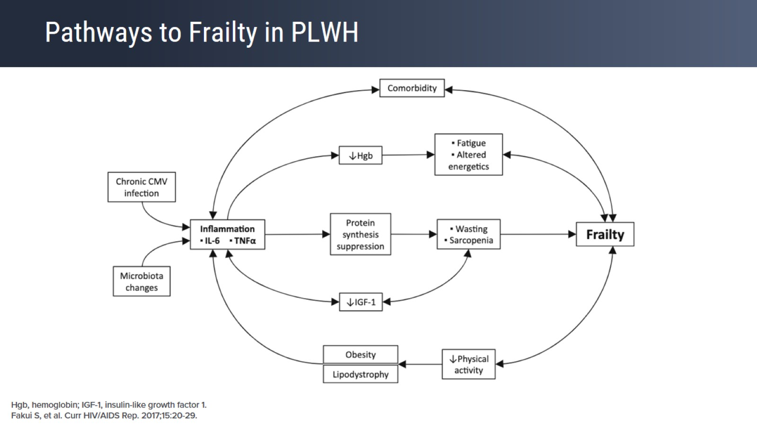
Pathways to Frailty in PLWH

Slide 27
NAFLD With Fibrosis Is Associated With Frailty and Certain Comorbidities in PLWH

Slide 28
NAFLD With Fibrosis is Associated With Frailty and Certain Comorbidities in PLWH

Slide 29
Predictors of Frailty in PLWH

Slide 30
Moving From HIV Care to Primary Care

Slide 31
The Five Ms for Managing Aging PLWH

Slide 32
Weight Gain in PLWH Is a Multifactorial Process

Slide 33
Relative Contribution of INSTI Switch and Conventional Risk Factors for Weight Gain

Slide 34
CDC Lifestyle Change Program: Diabetes Prevention Plan

Slide 35
Ornish Lifestyle Medicine Program (Intensive Cardiovascular Rehabilitation)

Slide 36
Lifestyle Prescriptions: Encouraging Physical Activity in PLWH

Slide 37
ADHOC Mindfulness-Based Research

Slide 38
The 90-90-90 Paradigm

Slide 39
Expanding the "Fourth 90" of the 90-90-90 Paradigm

Slide 40
Concluding Remarks

Slide 41
Concluding Remarks

Slide 42
Concluding Remarks

Slide 43
Concluding Remarks

