Slide 2
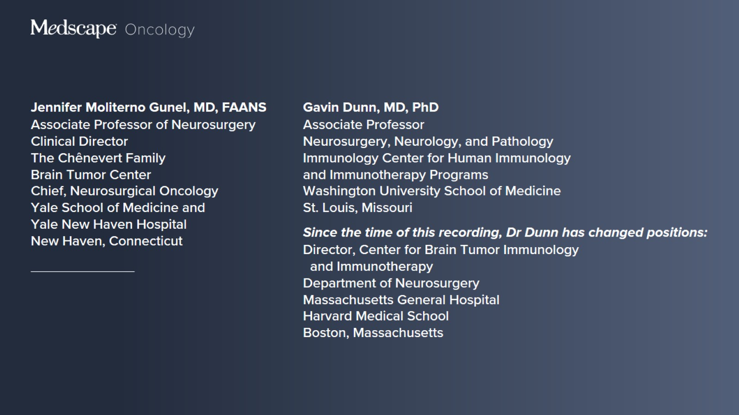

Slide 3
How We Treat Glioblastoma

Slide 4
Glioblastomas

Slide 5
Glioblastomas

Slide 6
Glioblastomas

Slide 7
Glioblastoma Epidemiology

Slide 8
Molecular Pathogenesis

Slide 9
Pathological Hallmarks

Slide 10
Multiple Types of Glioblastoma

Slide 11
Clinical Presentation

Slide 12
Clinical Presentation

Slide 13
Clinical Presentation

Slide 14
Clinical Presentation

Slide 15
Clinical Presentation

Slide 16
Clinical Presentation

Slide 17
Diagnosis of Glioblastoma

Slide 18
Medical Management and Supportive Care

Slide 19
Medical Management and Supportive Care

Slide 20
Medical Management and Supportive Care

Slide 21
Standard-of-Care Treatment Algorithm

Slide 22
Standard-of-Care Treatment Algorithm (cont)

Slide 23
Standard-of-Care Treatment Algorithm (cont)

Slide 24
Standard-of-Care Treatment Algorithm (cont)

Slide 25
Standard-of-Care Treatment Algorithm (cont)

Slide 26
Standard-of-Care Treatment Algorithm (cont)

Slide 27
Standard-of-Care Treatment Algorithm (cont)

Slide 28
Standard-of-Care Treatment Algorithm (cont)

Slide 29
Surgery

Slide 30
Surgery

Slide 31
Surgery

Slide 32
Surgery

Slide 33
Postsurgical Management

Slide 34
Postsurgical Management

Slide 35
Postsurgical Management

Slide 36
Postsurgical Management

Slide 37
Treatment of Glioblastoma in Older Adult Patients

Slide 38
Treatment of Glioblastoma in Older Adult Patients

Slide 39
Treatment of Glioblastoma in Older Adult Patients

Slide 40
Treatment of Glioblastoma in Older Adult Patients

Slide 41
Recurrent Glioblastoma

Slide 42
Updated WHO Classification of Central Nervous System Tumors

Slide 43
WHO Classification of Tumors of the CNS, Fifth Edition (WHO CNS5)

Slide 44
Changes in CNS Tumor Taxonomy Hybrid/Mixed Nosological Organization

Slide 45
Changes in CNS Tumor Taxonomy New Classification Naming System

Slide 46
Changes in CNS Tumor Taxonomy CNS Tumor Nomenclature

Slide 47
Changes in CNS Tumor Taxonomy CNS Tumor Nomenclature

Slide 48
Changes in CNS Tumor Taxonomy CNS Tumor Nomenclature

Slide 49
Changes in CNS Tumor Taxonomy Gene and Protein Nomenclature

Slide 50
Changes in CNS Tumor Taxonomy Key Diagnostic Features in Major Primary CNS Tumors

Slide 51
CNS Tumor Grading Changes in WHO CNS5

Slide 52
CNS Tumor Grading Changes in WHO CNS5

Slide 53
CNS Tumor Grading Changes in WHO CNS5

Slide 54
CNS Tumor Grading Grading Within Types

Slide 55
CNS Tumor Grading Clinicopathologic Grading

Slide 56
CNS Tumor Grading Clinicopathologic Grading

Slide 57
CNS Tumor Grading Clinicopathologic Grading

Slide 58
Nonspecific Suffixes

Slide 59
Nonspecific Suffixes

Slide 60
Nonspecific Suffixes

Slide 61
Newly Recognized Entities and Revised Nomenclature Classification of Gliomas, Glioneuronal Tumors, and Neuronal Tumors

Slide 62
Newly Recognized Entities and Revised Nomenclature Classification of Gliomas, Glioneuronal Tumors, and Neuronal Tumors (cont)

Slide 63
Newly Recognized Entities and Revised Nomenclature Classification of Gliomas, Glioneuronal Tumors, and Neuronal Tumors (cont)

Slide 64
Newly Recognized Entities and Revised Nomenclature Classification of Gliomas, Glioneuronal Tumors, and Neuronal Tumors (cont)

Slide 65
WHO CNS5 Gliomas, Glioneuronal Tumors, and Neuronal Tumors

Slide 66
Molecularly Targeted Therapy for CNS Tumors

Slide 67
Targeted Therapy Challenges in Glioblastoma

Slide 68
Targeted Therapy Challenges in Glioblastoma

Slide 69
Targeted Therapy Challenges in Glioblastoma

Slide 70
Targeted Therapy Challenges in Glioblastoma

Slide 71
Targeted Therapy Challenges in Glioblastoma

Slide 72
Strategies for Molecular Targeting in Glioblastoma

Slide 73
Strategies for Molecular Targeting in Glioblastoma

Slide 74
Rationale for Targeting the DNA Damage Response

Slide 75
DNA Damage Repair Pathways

Slide 76
Inhibitors of the DNA Damage Response

Slide 77
Strategies for Molecular Targeting in Glioblastoma

Slide 78
Rationale for Targeting Tumor Metabolism

Slide 79
Rationale for Targeting Tumor Metabolism

Slide 80
Rationale for Targeting Tumor Metabolism

Slide 81
NTRK Oncogenic Fusions in CNS Tumors

Slide 82
Targeting NTRK Fusions

Slide 83
Histone Mutations

Slide 84
Other Molecularly Targeted Therapies

Slide 85
Clinical Trials Investigating Molecular Targets

Slide 86
Platform Trials in Glioblastoma

Slide 87
Immunotherapy in CNS Tumors

Slide 88
Immunotherapy in Glioblastoma

Slide 89
Immunotherapy in Glioblastoma

Slide 90
Immunotherapy in Glioblastoma

Slide 91
Immunotherapy in Glioblastoma

Slide 92
CheckMate-143 Evaluating Nivolumab Monotherapy

Slide 93
Pembrolizumab in an Investigator-Led Study

Slide 94
Novel Immunotherapy Strategies Are Needed

Slide 95
Novel Immunotherapy Strategies Are Needed

Slide 96
CAR T Cells

Slide 97
Investigational CAR T-Cell Therapies in Glioblastoma

Slide 98
Novel Immunotherapy Strategies Are Needed

Slide 99
Oncolytic Viruses

Slide 100
Investigational Oncolytic Viruses in Glioblastoma

Slide 101
Novel Immunotherapy Strategies Are Needed

Slide 102
Anticancer Vaccines

