Slide 2
Antibody-Drug Conjugates for Urothelial Carcinoma

Slide 3
Enfortumab Vedotin vs Chemotherapy in Advanced/Metastatic UC EV-301 Phase 3: Study Design

Slide 4
Enfortumab Vedotin Improved Survival vs Chemotherapy EV-301 Phase 3: OS and PFS

Slide 5
Enfortumab Vedotin FDA Approval

Slide 6
Sacituzumab Govitecan in Locally Advanced/Metastatic UC TROPHY-U-01: Cohort 1

Slide 7
Sacituzumab Govitecan in Advanced/Metastatic UC TROPHY-U-01, Cohort 1: Efficacy

Slide 8
Sacituzumab Govitecan FDA Approval

Slide 9
Enfortumab Vedotin Safety

Slide 10
Sacituzumab Govitecan Safety

Slide 11
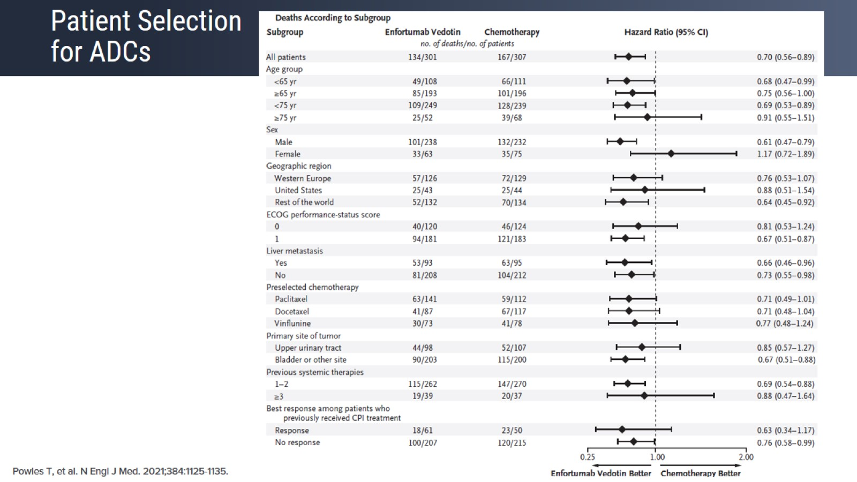
Patient Selection for ADCs

Slide 12
Erdafitinib in Selected Patients with Advanced/Metastatic UC BLC2001 Phase 2 Trial: Study Design

Slide 13
Responses With Erdafitinib in Patients With FGFR3 Mutation or FGFR2/3 Fusion

Slide 14
BLC2001 Long-Term Outcomes

Slide 15
Erdafitinib vs Chemotherapy or Pembrolizumab THOR Phase 3 Trial

Slide 16
Erdafitinb BLC2001 Safety

Slide 17
Erdafitinb BLC2001 Safety

Slide 18
Enfortumab Vedotin + Pembro in Cisplatin-Ineligible Patients EV-103

Slide 19
Sacituzumab Govitecan + Pembrolizumab TROPHY-U-01: Cohort 3

Slide 20
FGFR Inhibitor + Immunotherapy Combination Strategies

