Slide 2
Nonsurgical Skin Tightening: Who, What, Where, and When?

Slide 3
What Causes Skin Laxity?

Slide 4
What Causes Skin Laxity?

Slide 5
What Causes Skin Laxity?

Slide 6
What Causes Skin Laxity?

Slide 7
What Causes Skin Laxity?

Slide 8
What Causes Skin Laxity?

Slide 9
Where Can You Get Skin Laxity?

Slide 10
Overview of Skin Tightening

Slide 11
Overview of Skin Tightening

Slide 12
Overview of Skin Tightening

Slide 13
Overview of Skin Tightening

Slide 14
Overview of Skin Tightening

Slide 15
Micro-Focused Ultrasound

Slide 16
How Does Ultrasound Cause Skin Tightening?

Slide 17
How Does Ultrasound Cause Skin Tightening?

Slide 18
How Does Ultrasound Cause Skin Tightening?

Slide 19
How Does Ultrasound Cause Skin Tightening?

Slide 20
Ultrasound for Skin Tightening

Slide 21
Ultrasound for Skin Tightening

Slide 22
Ultrasound for Skin Tightening

Slide 23
Ultrasound for Skin Tightening

Slide 24
Ultrasound for Skin Tightening

Slide 25
Ultrasound for Skin Tightening

Slide 26
Ultrasound for Skin Tightening

Slide 27
Ultrasound for Skin Tightening

Slide 28
Ultrasound for Skin Tightening

Slide 29
Ultrasound for Skin Tightening

Slide 30
Ultrasound for Skin Tightening

Slide 31
Ultrasound for Skin Tightening

Slide 32
Ultrasound for Skin Tightening

Slide 33
Before and After Micro-Focused Ultrasound

Slide 34
Before and After Micro-Focused Ultrasound

Slide 35
Before and After Micro-Focused Ultrasound

Slide 36
Before and After Micro-Focused Ultrasound

Slide 37
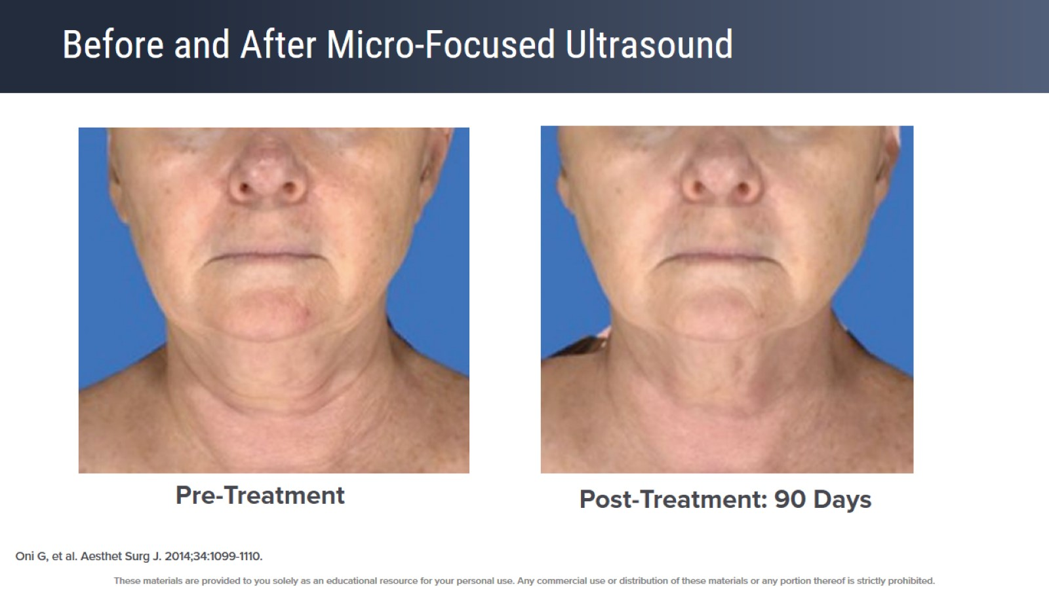
Before and After Micro-Focused Ultrasound

Slide 38
Before and After Micro-Focused Ultrasound

Slide 39
Before and After Micro-Focused Ultrasound

Slide 40
Before and After Micro-Focused Ultrasound

Slide 41
Before and After Micro-Focused Ultrasound

Slide 42
Before and After Micro-Focused Ultrasound

Slide 43
Who Is An Ideal Candidate?

Slide 44
Who Is An Ideal Candidate?

Slide 45
Who Is An Ideal Candidate?

Slide 46
Who Is An Ideal Candidate?

Slide 47
Ultrasound Practical Pearls

Slide 48
Ultrasound Practical Pearls

Slide 49
Ultrasound Practical Pearls

Slide 50
Ultrasound Practical Pearls

Slide 51
Radiofrequency

Slide 52
What Is Radiofrequency?

Slide 53
What Is Radiofrequency?

Slide 54
What Is Radiofrequency?

Slide 55
What Is Radiofrequency?

Slide 56
What Is Radiofrequency?

Slide 57
What Is Radiofrequency?

Slide 58
What Is Radiofrequency?

Slide 59
What Is Radiofrequency?

Slide 60
Radiofrequency for Skin Tightening

Slide 61
Radiofrequency for Skin Tightening

Slide 62
Monopolar Radiofrequency for Skin Tightening

Slide 63
Monopolar Radiofrequency for Skin Tightening

Slide 64
Monopolar Radiofrequency for Skin Tightening

Slide 65
Monopolar Radiofrequency for Skin Tightening

Slide 66
Monopolar Radiofrequency for Skin Tightening

Slide 67
Monopolar Radiofrequency for Skin Tightening

Slide 68
Monopolar Radiofrequency for Skin Tightening

Slide 69
Monopolar Radiofrequency for Skin Tightening

Slide 70
Monopolar Radiofrequency for Skin Tightening

Slide 71
Monopolar Radiofrequency for Skin Tightening

Slide 72
Who Is An Ideal Candidate?

Slide 73
Who Is An Ideal Candidate?

Slide 74
Who Is An Ideal Candidate?

Slide 75
Who Is An Ideal Candidate?

Slide 76
Monopolar Radiofrequency Practical Pearls

Slide 77
Monopolar Radiofrequency Practical Pearls

Slide 78
Monopolar Radiofrequency Practical Pearls

Slide 79
Monopolar Radiofrequency Practical Pearls

Slide 80
Monopolar Radiofrequency for Skin Tightening

Slide 81
Radiofrequency for Skin Tightening

Slide 82
Radiofrequency for Skin Tightening

Slide 83
Radiofrequency Microneedling for Skin Tightening

Slide 84
Radiofrequency Microneedling for Skin Tightening

Slide 85
Radiofrequency Microneedling for Skin Tightening

Slide 86
Radiofrequency Microneedling for Skin Tightening

Slide 87
Radiofrequency Microneedling for Skin Tightening

Slide 88
Radiofrequency Microneedling for Skin Tightening

Slide 89
Radiofrequency Microneedling for Skin Tightening

Slide 90
Radiofrequency Microneedling Practical Pearls

Slide 91
Radiofrequency Microneedling Practical Pearls

Slide 92
Radiofrequency Microneedling Practical Pearls

Slide 93
Radiofrequency Microneedling

Slide 94
Laser Resurfacing

Slide 95
Ablative Laser Resurfacing

Slide 96
Ablative Laser Resurfacing

Slide 97
Ablative Laser Resurfacing

Slide 98
Ablative Laser Resurfacing

Slide 99
Ablative Laser Resurfacing

Slide 100
Micro-Coring

Slide 101
Micro-Coring

Slide 102
Micro-Coring

Slide 103
Micro-Coring

Slide 104
Micro-Coring

Slide 105
Micro-Coring Practical Pearls

Slide 106
Micro-Coring

Slide 109
Body Contouring

Slide 110
Common Contouring Concerns

Slide 111
Common Contouring Concerns

Slide 112
Common Contouring Concerns

Slide 114
Body Contouring Spectrum

Slide 115
Body Contouring Spectrum

Slide 116
Ultrasound

Slide 117
Ultrasound Mechanism of Action

Slide 118
Ultrasound MFU

Slide 119
Ultrasound MFU

Slide 120
Ultrasound MFU Efficacy

Slide 121
Ultrasound MFU Efficacy

Slide 122
Ultrasound MFU Efficacy

Slide 123
Ultrasound – SUPERB

Slide 124
Ultrasound – SUPERB

Slide 125
Ultrasound – SUPERB Efficacy

Slide 126
Ultrasound – SUPERB Efficacy

Slide 127
Ultrasound Ideal Candidate

Slide 128
Ultrasound Ideal Candidate

Slide 129
Cryolipolysis

Slide 130
Cryolipolysis Popsicle Panniculitis

Slide 131
Cryolipolysis Mechanism of Action

Slide 132
Cryolipolysis Mechanism of Action

Slide 133
Cryolipolysis Mechanism of Action

Slide 134
Cryolipolysis Treatment

Slide 135
Cryolipolysis Treatment

Slide 136
Cryolipolysis Paradoxical Adipose Hyperplasia

Slide 137
Cryolipolysis Paradoxical Adipose Hyperplasia

Slide 138
Cryolipolysis Role of Massage

Slide 139
Cryolipolysis Role of Massage

Slide 140
Cryolipolysis Role of Massage

Slide 141
Cryolipolysis Ideal Candidate

Slide 142
Cryolipolysis Ideal Candidate

Slide 143
Cryolipolysis Ideal Candidate

Slide 144
Laser Lipolysis

Slide 145
Laser Lipolysis Mechanism of Action

Slide 146
Laser Lipolysis Mechanism of Action

Slide 147
Laser Lipolysis Ideal Candidate

Slide 148
Injectable Lipolysis

Slide 149
Injection Lipolysis Mechanism of Action

Slide 150
Injection Lipolysis Mechanism of Action

Slide 151
Injection Lipolysis Treatment

Slide 152
Injection Lipolysis Treatment

Slide 153
Injection Lipolysis Ideal Candidate

Slide 154
Muscle Toning

Slide 155
Muscle Toning Mechanism of Action

Slide 156
Muscle Toning Technologies

Slide 157
Muscle Toning Applicators

Slide 158
Do Muscle Stimulation Devices Work?

Slide 159
Do Muscle Stimulation Devices Work?

Slide 160
Do Muscle Stimulation Devices Work?

Slide 161
Do These Devices Make Happy Patients?

Slide 162
Muscle Toning Ideal Candidate

Slide 163
Muscle Toning Ideal Candidate

Slide 164
Conclusion

Slide 165
Conclusion

Slide 166
Conclusion

Slide 167
Conclusion

Slide 168
Conclusion

Slide 171
Prejuvenation: Topical and Preventative Measures

Slide 172
What Is "Prejuvenation"?

Slide 173
Prejuvenation Demand

Slide 174
Prejuvenation Demand

Slide 175
Prejuvenation Demand

Slide 176
Prejuvenation Demand: Social Media

Slide 177
Prejuvenation Demand: Social Media

Slide 178
Prejuvenation Demand: Social Media

Slide 179
Prejuvenation Demand: Selfie Culture

Slide 180
Prejuvenation Demand: Zoom Effect

Slide 181
Prejuvenation Strategies

Slide 182
Topical Regimen

Slide 183
Prejuvenation Regimen

Slide 184
Sunscreen and Prevention of Aging

Slide 185
Sunscreen and Prevention of Aging

Slide 186
Suncreen and Prevention of Aging

Slide 187
Prejuvenation Regimen

Slide 188
Prejuvenation: Topical Retinoids

Slide 189
Prejuvenation: Topical Retinoids

Slide 190
Prejuvenation: Topical Retinoids

Slide 191
Prejuvenation: Topical Retinoids

Slide 192
Prejuvenation: Topical Retinoids

Slide 193
Prejuvenation: Topical Retinoids

Slide 194
Prejuvenation: Topical Retinoids

Slide 195
Prejuvenation: Topical Retinoids

Slide 196
Prejuvenation Regimen

Slide 197
Prejuvenation: Antioxidants

Slide 198
Prejuvenation: Antioxidants

Slide 199
Prejuvenation: Topical Antioxidants

Slide 200
Prejuvenation: Topical Antioxidants

Slide 201
Prejuvenation: Topical Antioxidants

Slide 202
Prejuvenation Strategies

Slide 203
"High Yield" Prejuvenation Treatments

Slide 204
"High Yield" Prejuvenation Treatments

Slide 205
Prejuvenation: Neuromodulators

Slide 206
Prejuvenation: Neuromodulators

Slide 207
Prejuvenation: Neuromodulators

Slide 208
Prejuvenation Neuromodulator Efficacy

Slide 209
Prejuvenation Neuromodulator Efficacy

Slide 210
Prejuvenation Neuromodulator Efficacy

Slide 213
Prejuvenation: Filler

Slide 214
Prejuvenation: Filler

Slide 215
Prejuvenation: Filler

Slide 216
Prejuvenation: Laser Treatment

Slide 217
Prejuvenation: Laser Treatment

Slide 218
Prejuvenation: Tissue Tightening

Slide 219
Prejuvenation: Tissue Tightening

Slide 220
Prejuvenation: Long-Term Data?

Slide 221
Prejuvenation: Long-Term Data?

Slide 222
Prejuvenation: Final Thoughts

Slide 223
Prejuvenation: Final Thoughts

Slide 224
Prejuvenation: Final Thoughts

Slide 225
Prejuvenation: Final Thoughts

Slide 228
Combination Treatments for Targeting Cellulite

Slide 229
How Far Have We Come?

Slide 230
Cellulite Treatment Landscape: Past and Present

Slide 231
Cellulite Structure

Slide 232
Normal Adult Skin Architecture

Slide 233
Normal Female Skin Architecture: Impact on Cellulite Formation

Slide 234
What Do We Know About Cellulite Pathophysiology?

Slide 235
Cellulite Severity Scale: The Challenges of Grading Cellulite Accurately

Slide 236
Skin Laxity Scale

Slide 237
The Cellulite Trinity: Dimple Number, Dimple Depth, Skin Laxity

Slide 238
TS-GS: Effectiveness Results

Slide 239
Tissue Stabilized-Guided Subcision

Slide 240
TSGS: Pre-Treatment

Slide 241
TSGS: Markings

Slide 242
TSGS: Post Treatment 6 Months

Slide 243
TSGS

Slide 244
Controlled Focal Fibrous Band Release

Slide 245
Targeting the Fibrous Septae

Slide 246
Controlled Focal Fibrous Band Release

Slide 247
Controlled Focal Fibrous Band Release: 3-Mo Clinical Results

Slide 248
3-Mo Clinical Results

Slide 249
3-Mo Clinical Results

Slide 250
3-Mo Clinical Results

Slide 251
Laser

Slide 252
Chemical Subcision

Slide 253
Collagenase Clostridium Histolyticum

Slide 254
Collagenase Clostridium Histolyticum

Slide 255
Phase 2b Patient A (CCH): 2-Level Composite Response*

Slide 256
Phase 3, Patient A Skin Surface Texture After CCH Treatment

Slide 257
Phase 3, Patient A: Skin Surface Texture After CCH Treatment

Slide 258
Acoustic Subcision

Slide 259
Acoustic Subcision: Rapid Acoustic Pulse

Slide 260
Acoustic Disruption of Septa -- Time/Dose Response

Slide 261
Acoustic Subcision

Slide 262
Acoustic Subcision: Results

Slide 263
Acoustic Subcision: Results

Slide 264
Filler Options for Targeting Cellulite Expert Insights

Slide 265
PLLA: 2 Treatments, 2 Bottles Each

Slide 266
PLLA: 2 Treatments, 2 Bottles Each

Slide 267
PLLA: 2 Treatments, 2 Bottles Each

Slide 268
Cellulite: Conclusions

