Slide 1
Vessel Wall Imaging of the Head and Neck Approach and Applications

Slide 4
Agenda

Slide 5
Speaker Disclosures

Slide 7
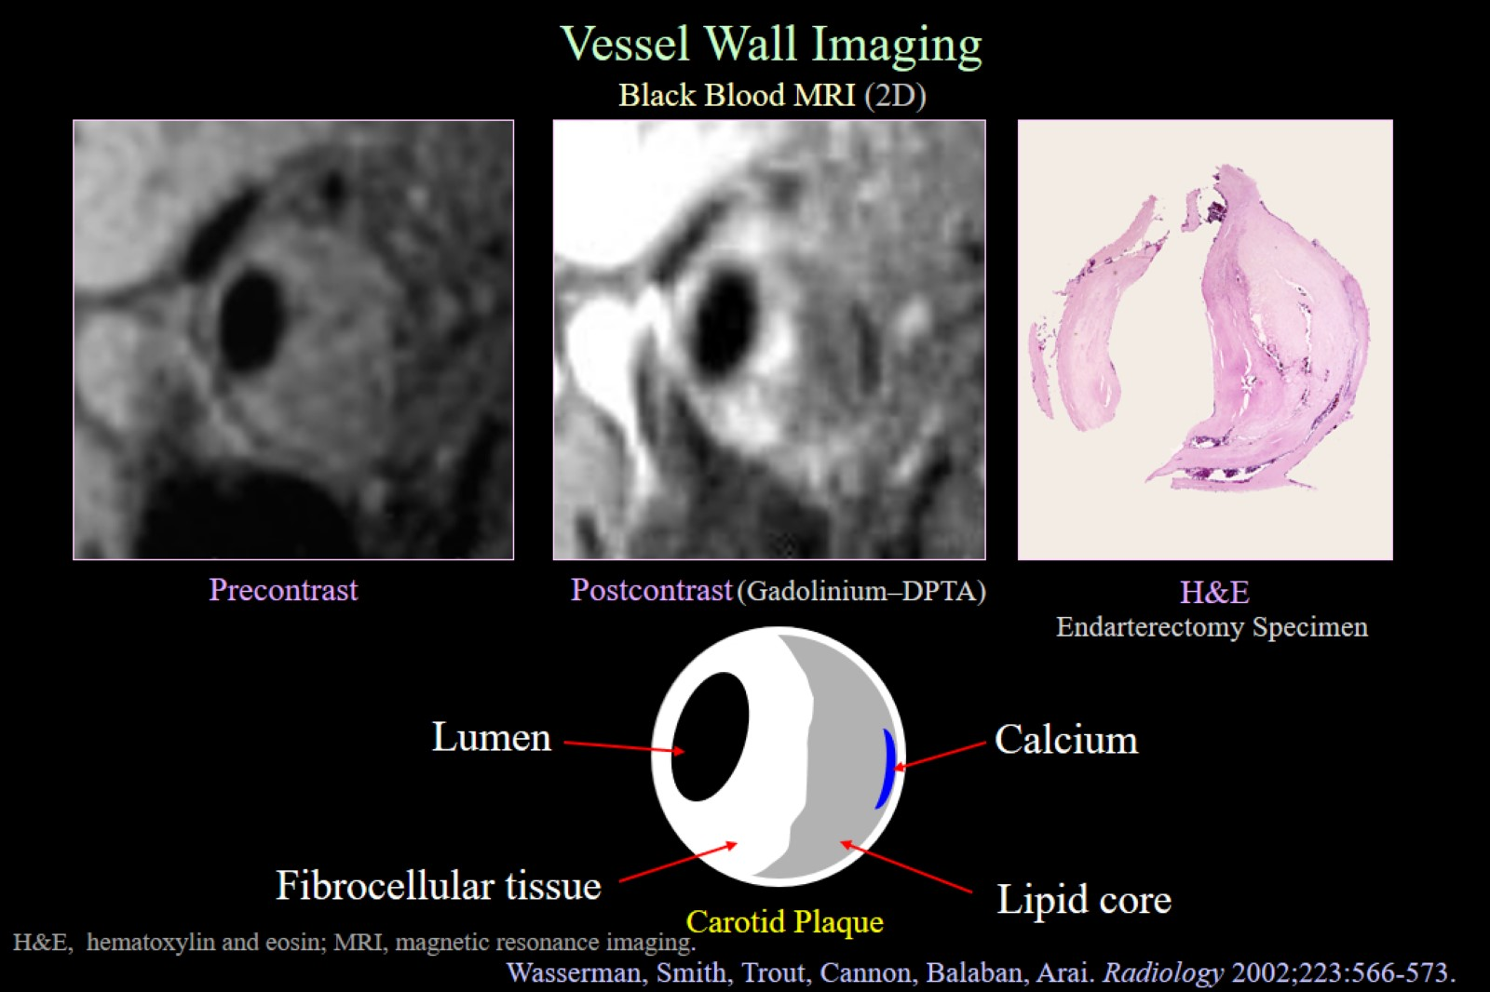

Slide 8
Vessel Wall Imaging (VWI)

Slide 11
VWI of Intracranial Vessels

Slide 12
VWI of Intracranial Vessels

Slide 14
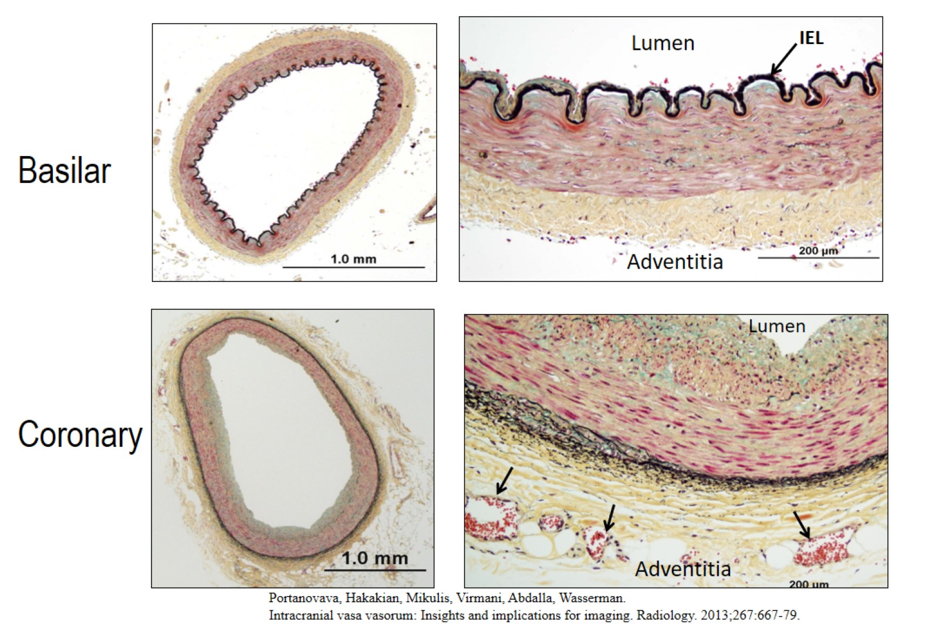

Slide 15
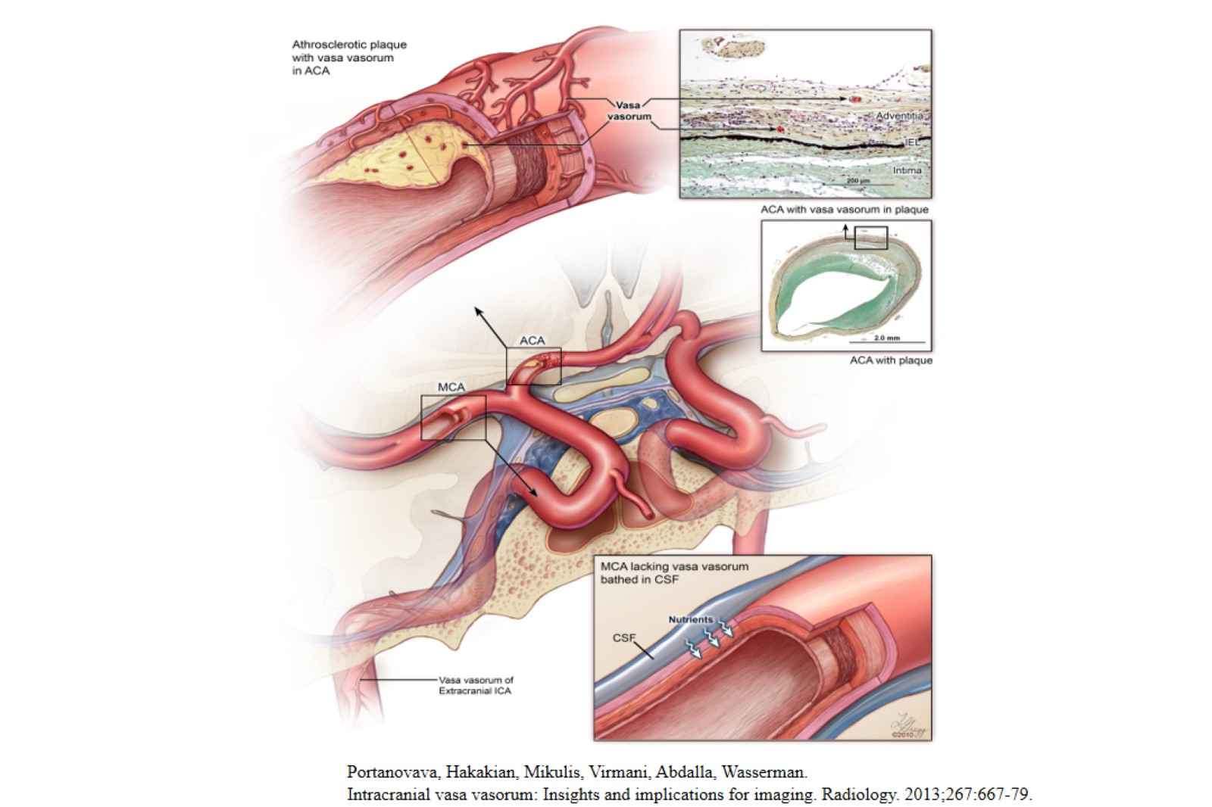

Slide 16
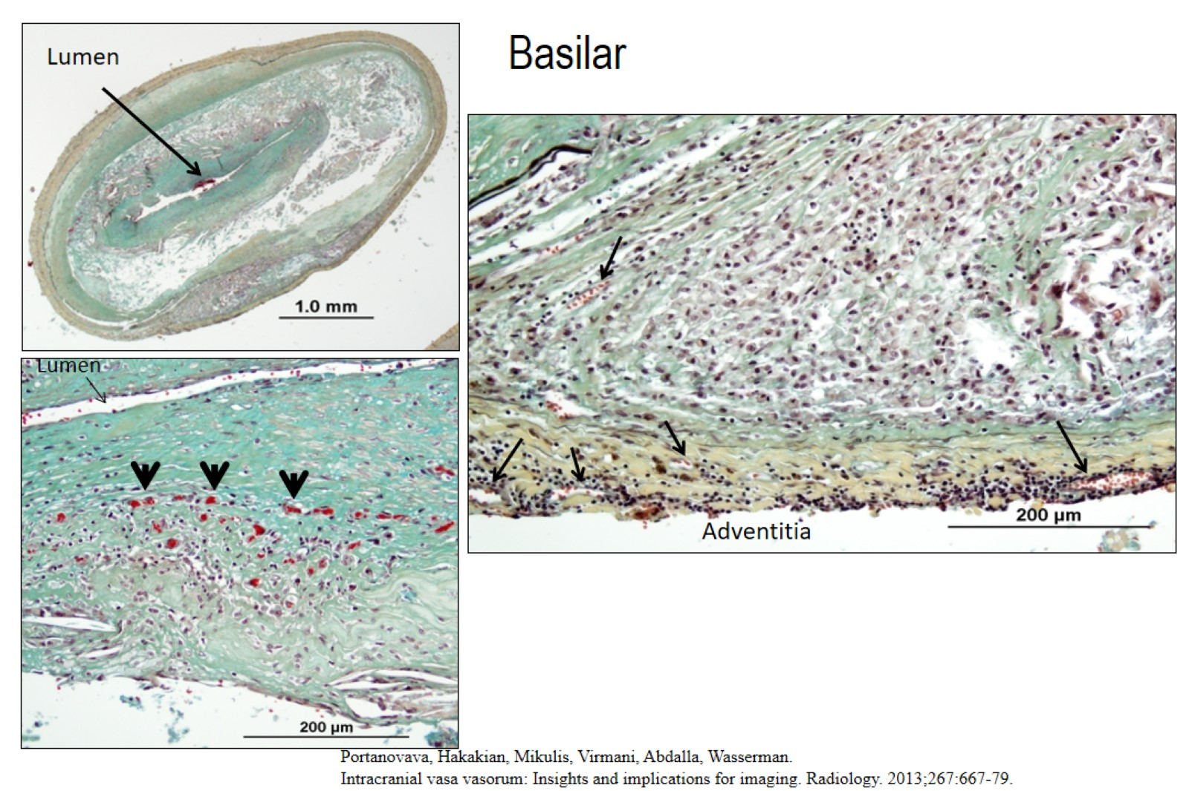

Slide 17
Intracranial VWI

Slide 18
Intracranial VWI

Slide 19
Intracranial VWI

Slide 32
Pitfalls

Slide 33
Pitfalls

Slide 35
Intracranial vessel wall enhancement

Slide 36
Intracranial vessel wall enhancement

Slide 37
Intracranial vessel wall enhancement

Slide 38
Intracranial vessel wall enhancement

Slide 39
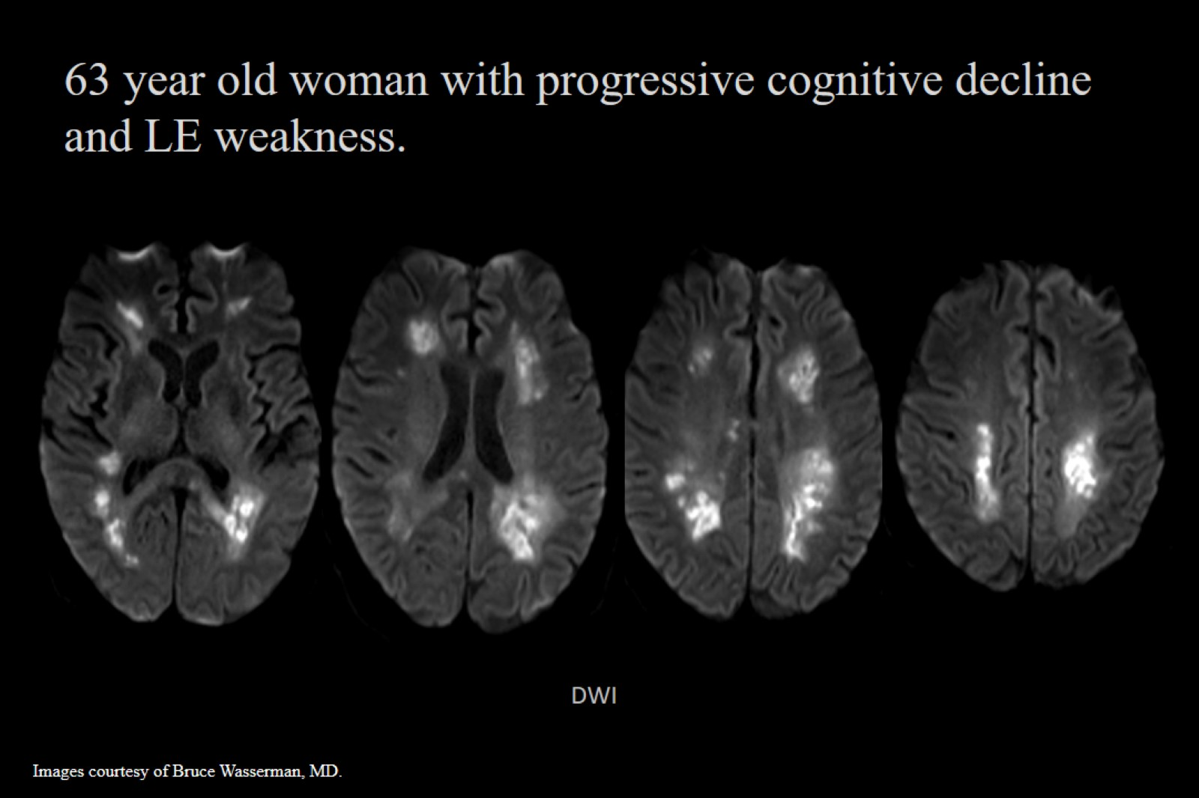

Slide 46
Acknowledgments

Slide 47
ASNR Cervical and Intracranial Vessel Wall Imaging Study Group

Slide 49
Vessel Wall Imaging of the Neck

Slide 51
Vessel Wall Imaging of the Neck

Slide 52
Vessel Wall Imaging of the Neck

Slide 53
Vessel Wall Imaging of the Neck

Slide 54
Vessel Wall Imaging of the Neck

Slide 55
Vessel Wall Imaging of the Neck

Slide 57
Vessel Wall Imaging of the Neck

Slide 58
Vessel Wall Imaging of the Neck

Slide 59
Vessel Wall Imaging of the Neck

Slide 60
CT and MR Evaluation of Carotid Plaque

Slide 61
Why Is Carotid Plaque Imaging Important

Slide 62
Why Is Carotid Plaque Imaging Important

Slide 63
Why Is Carotid Plaque Imaging Important

Slide 65
Why Is Carotid Plaque Imaging Important

Slide 66
Why Is Carotid Plaque Imaging Important

Slide 67
Carotid Plaque Imaging Changing Management

Slide 68
Carotid Plaque Imaging Changing Management

Slide 70
Carotid Plaque Imaging Changing Management

Slide 71
CT and MR Evaluation of Carotid Plaque

Slide 74
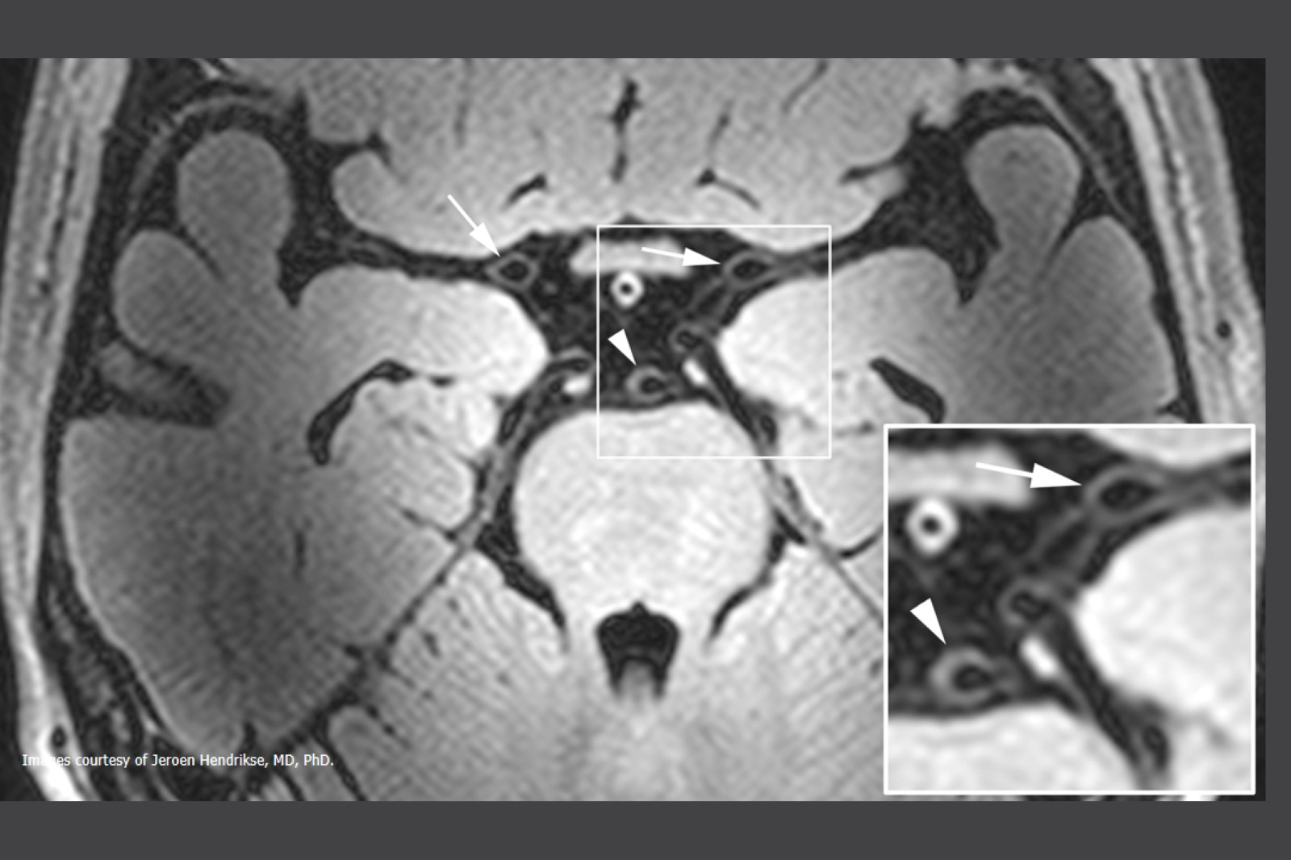

Slide 75
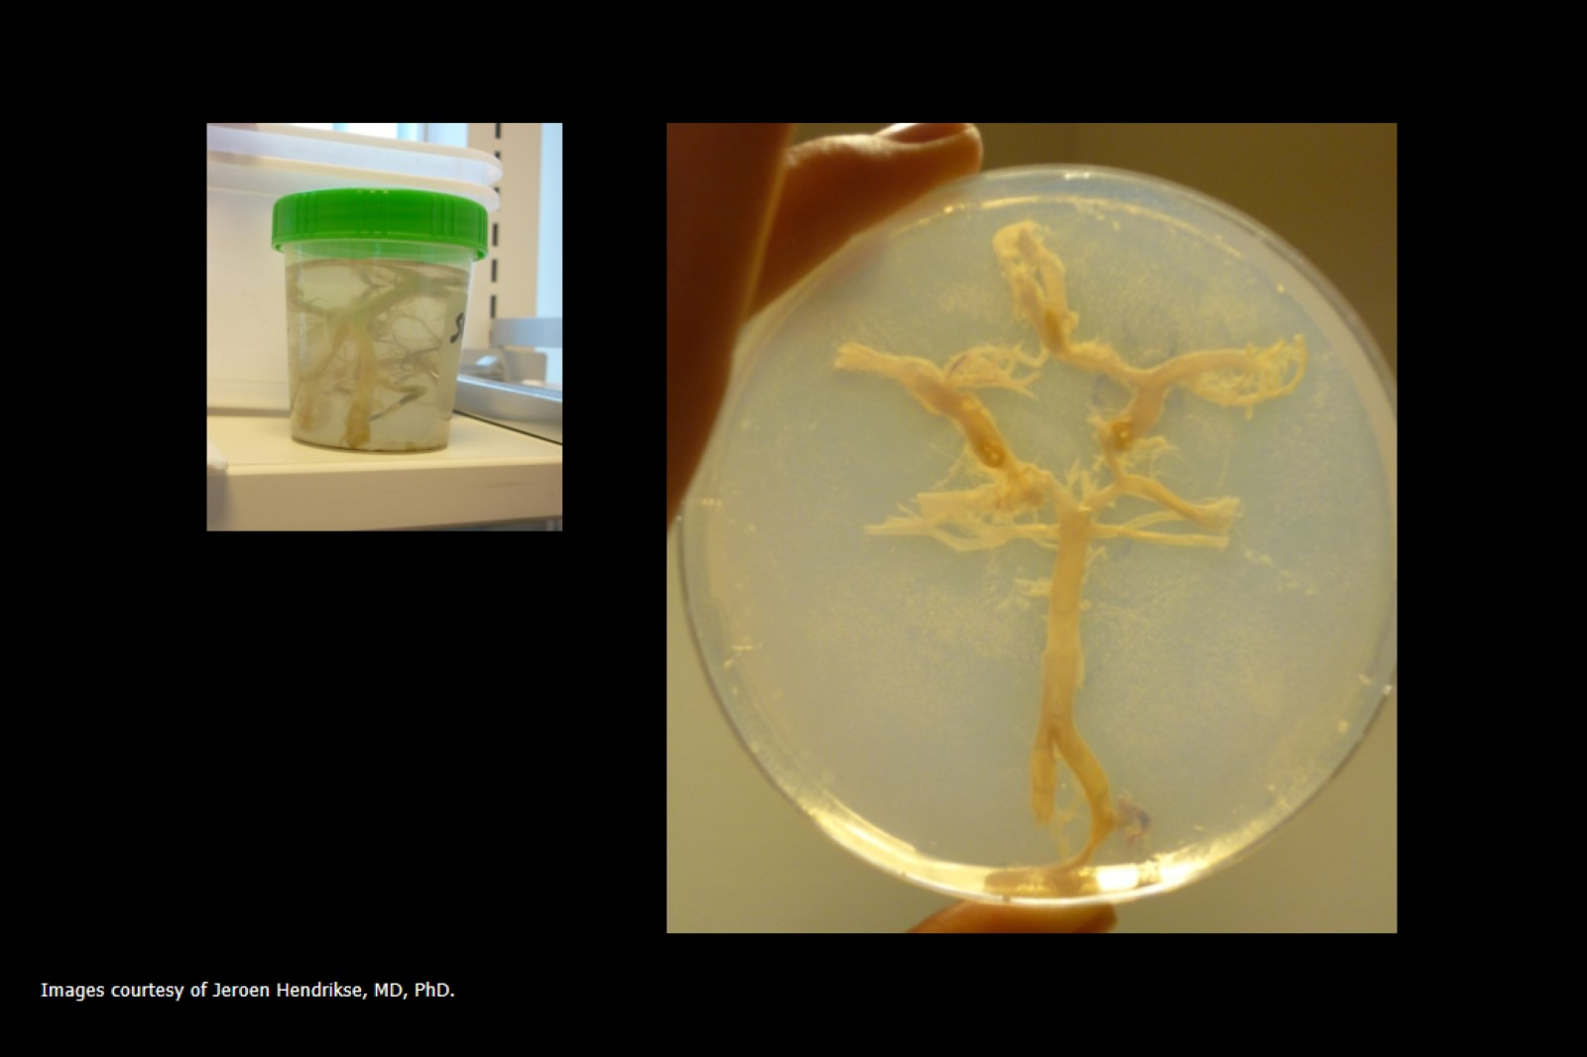

Slide 76
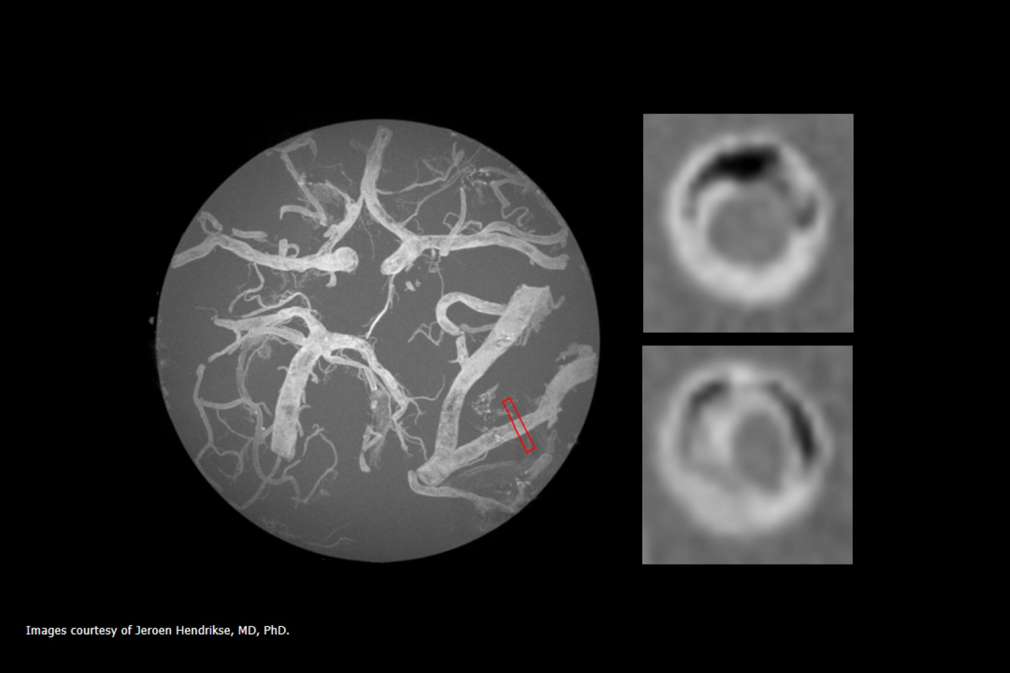

Slide 77
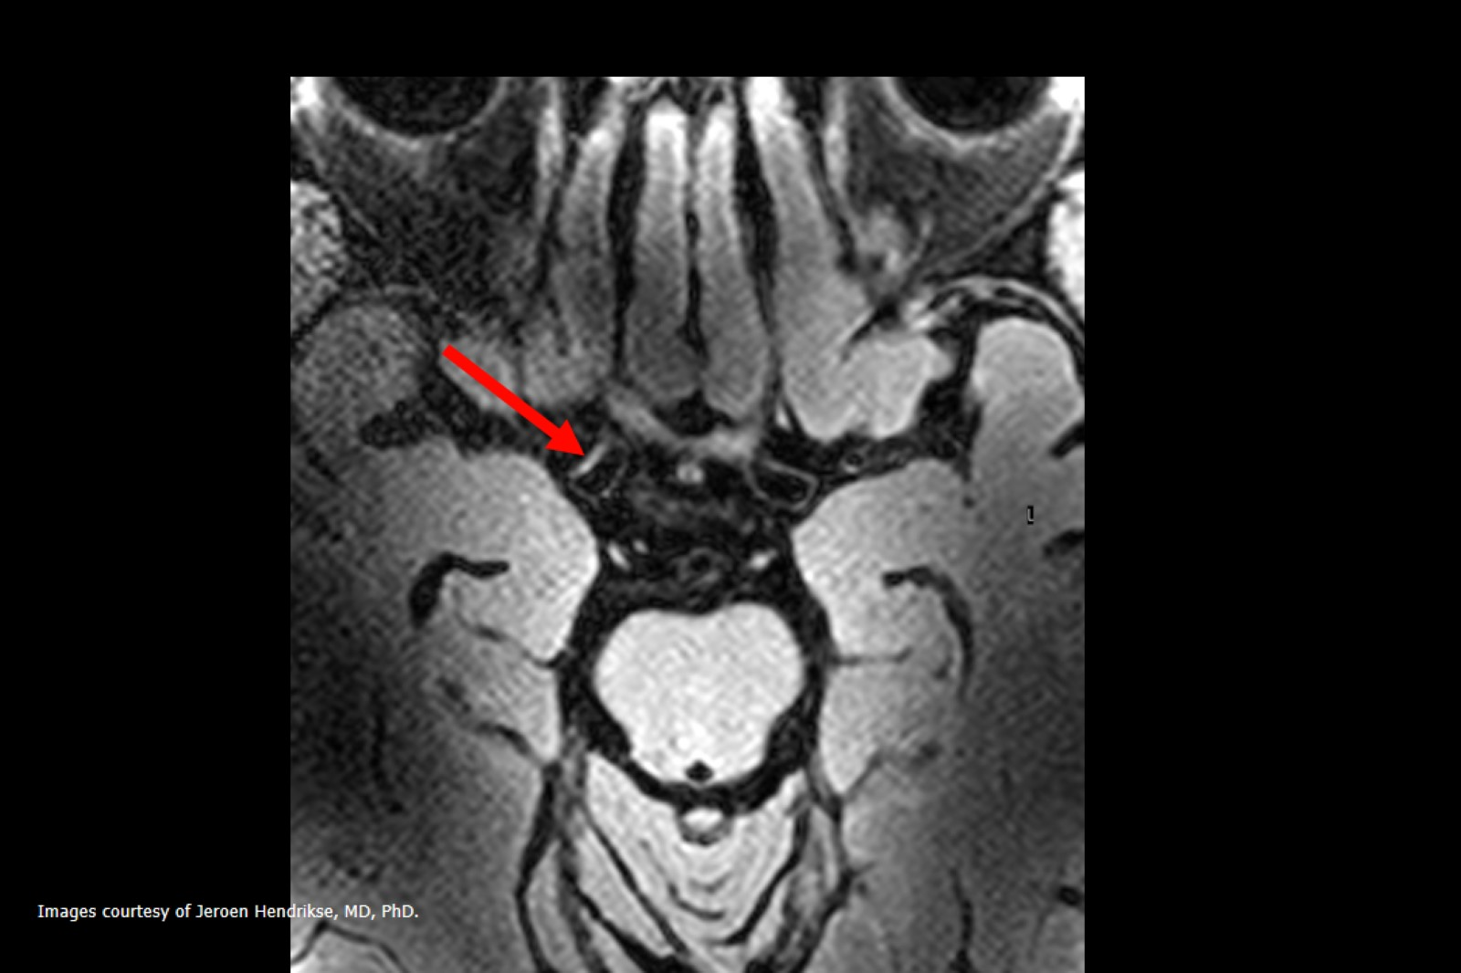

Slide 78
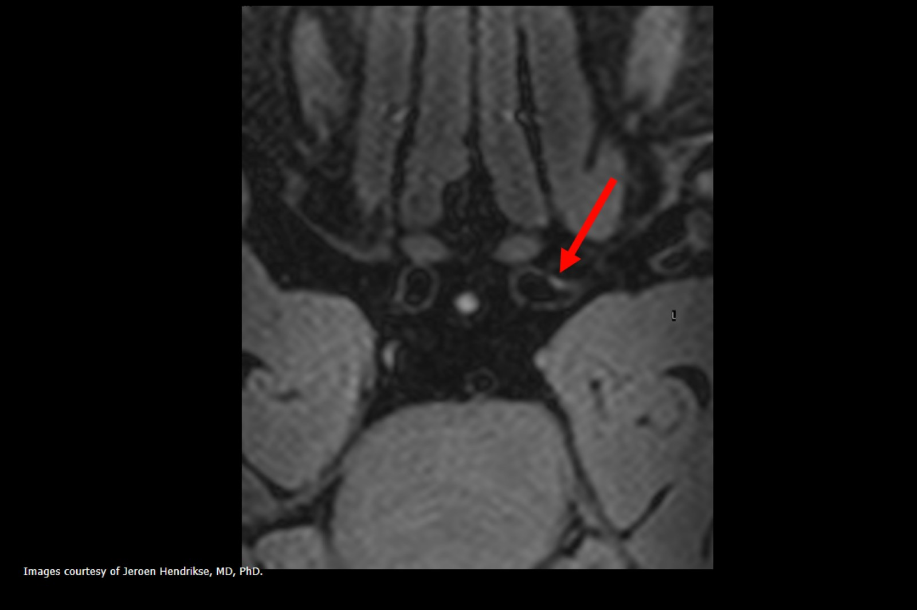

Slide 79
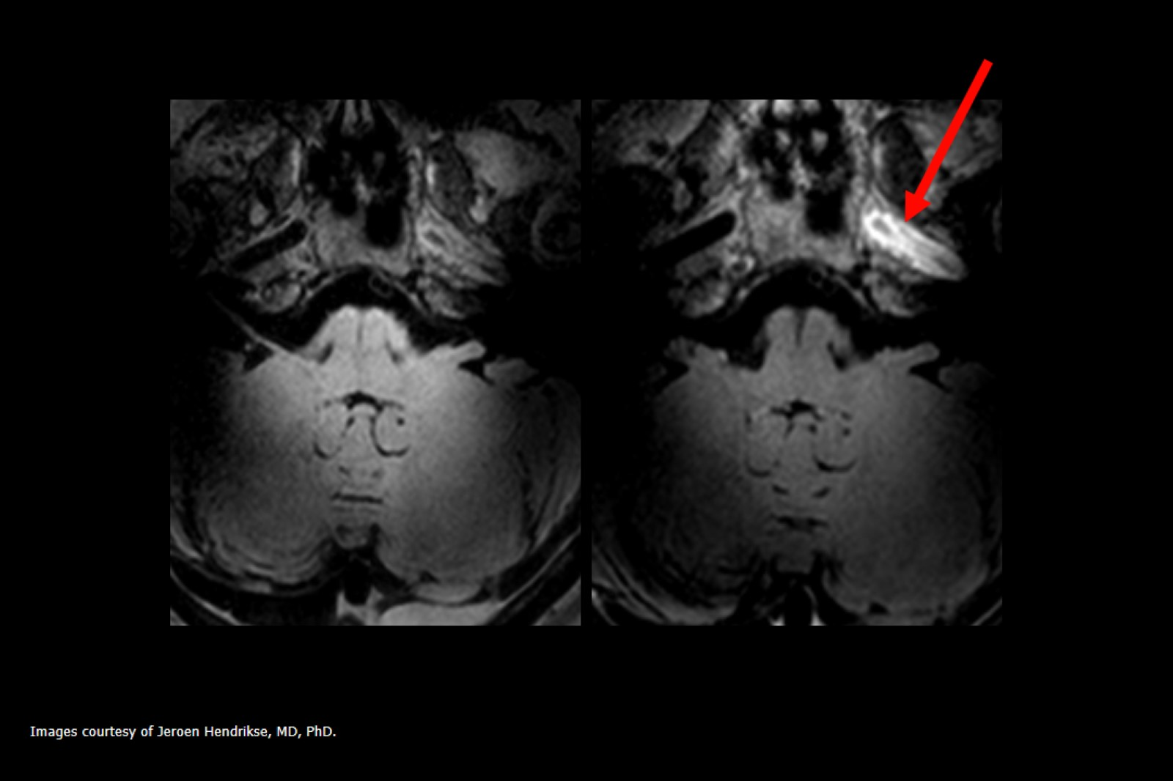

Slide 80
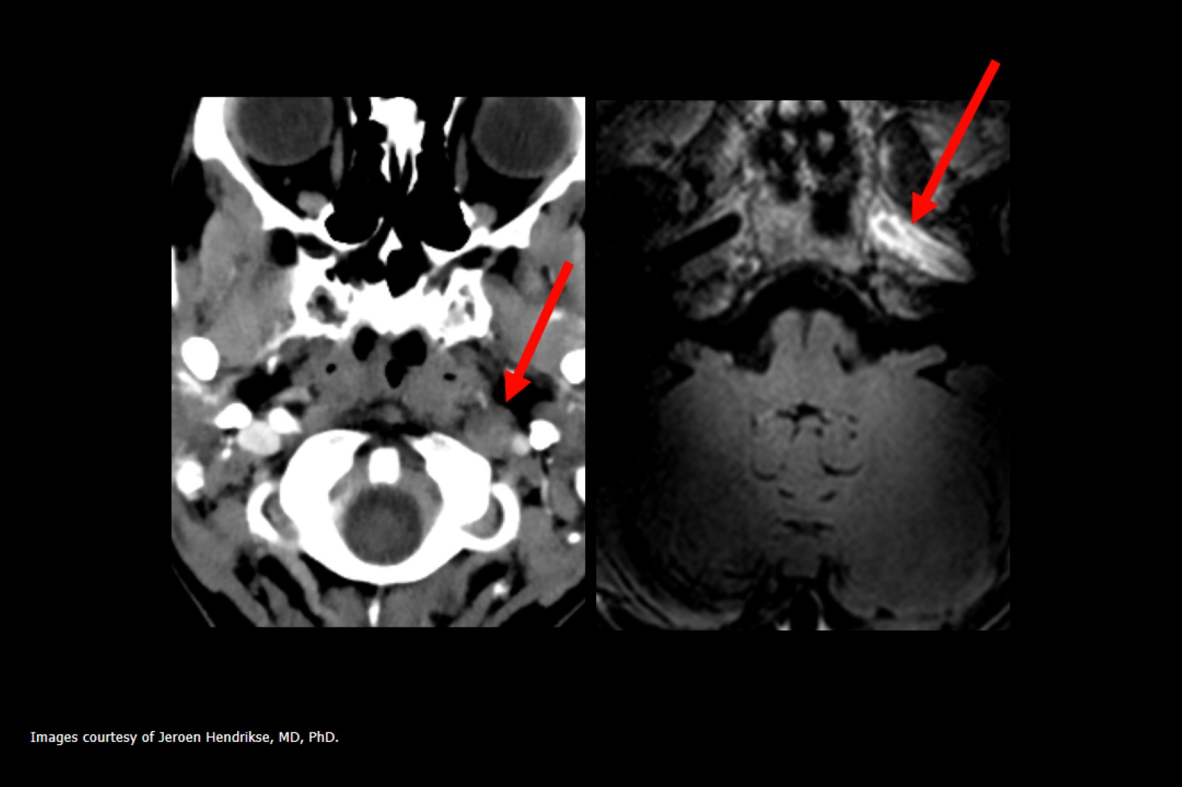

Slide 81
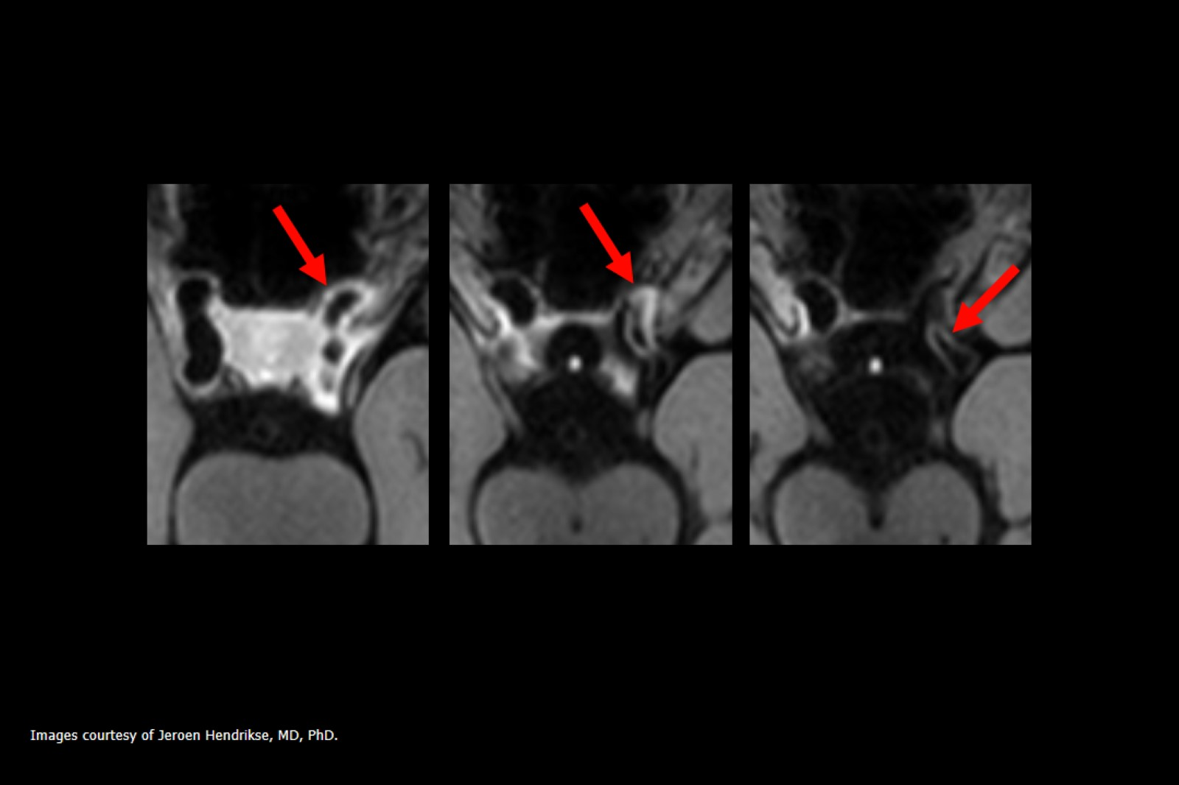

Slide 82
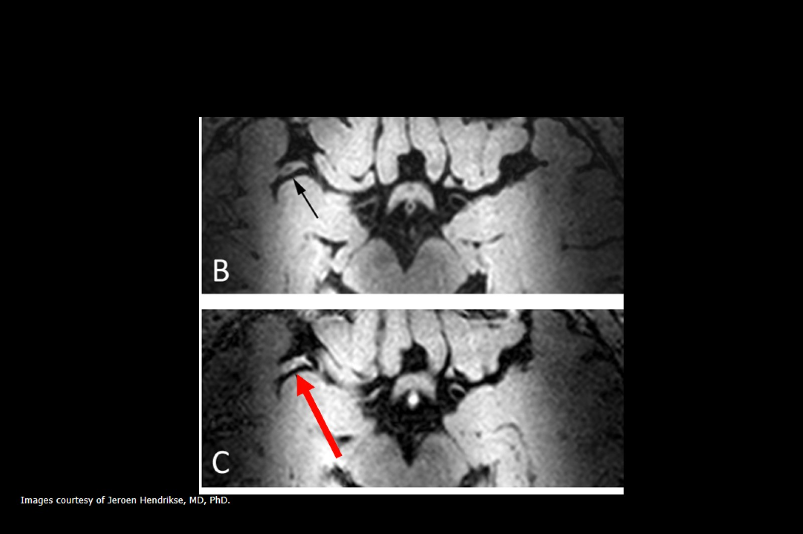
Other determined causes: …

Slide 83
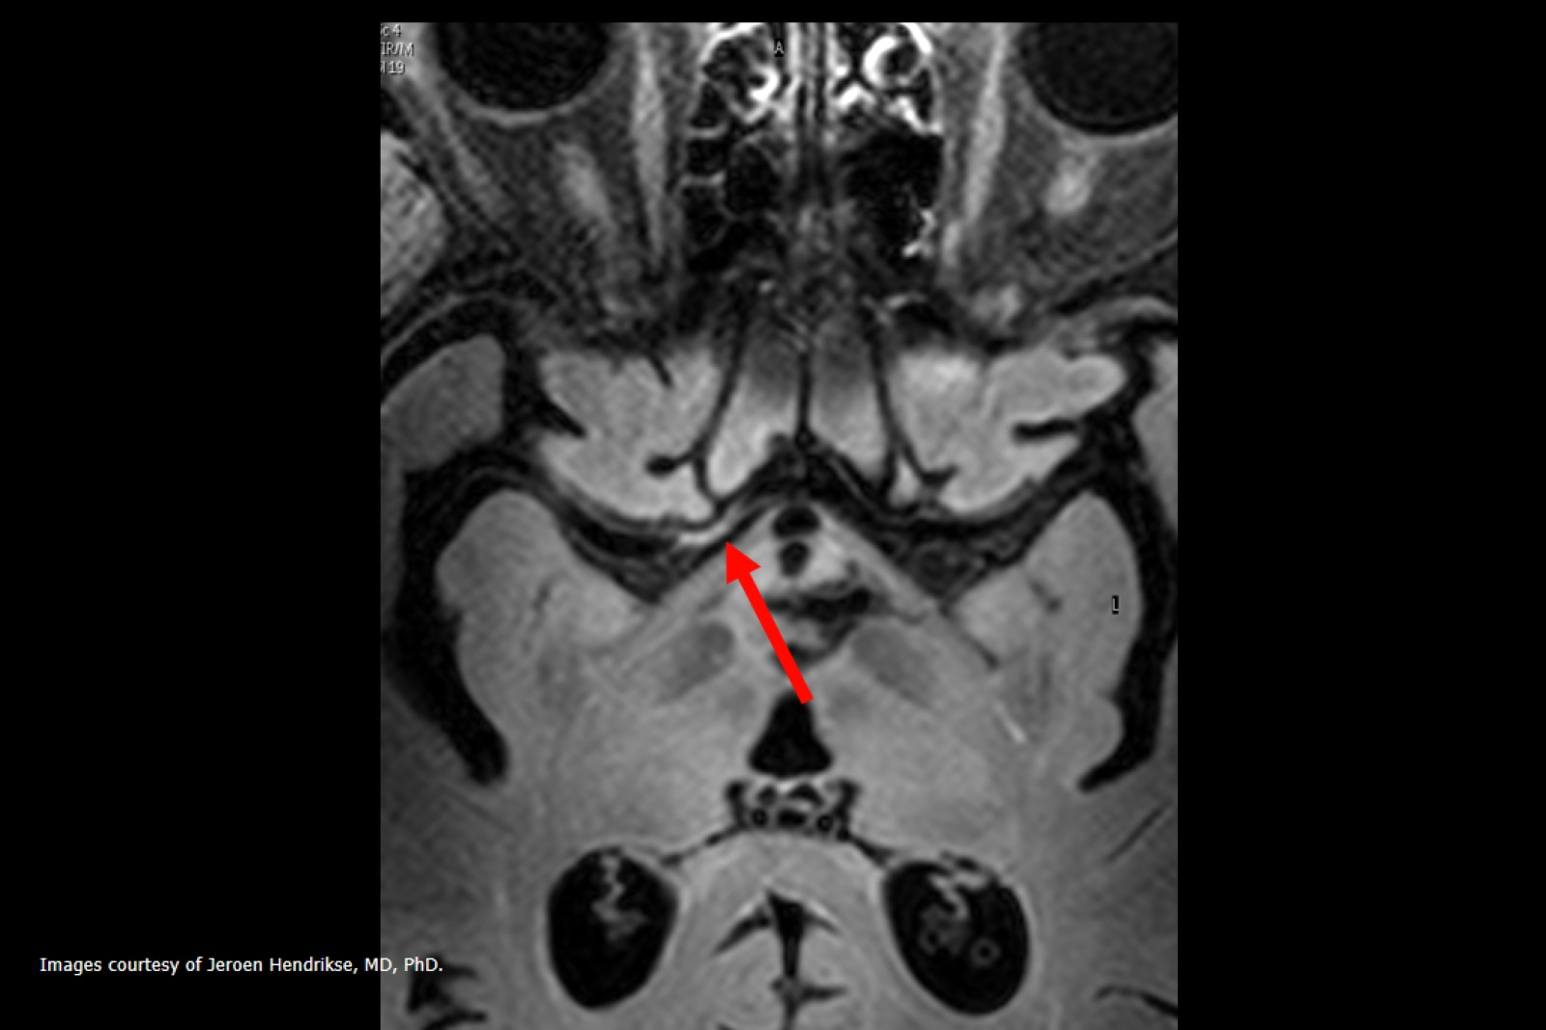

Slide 85
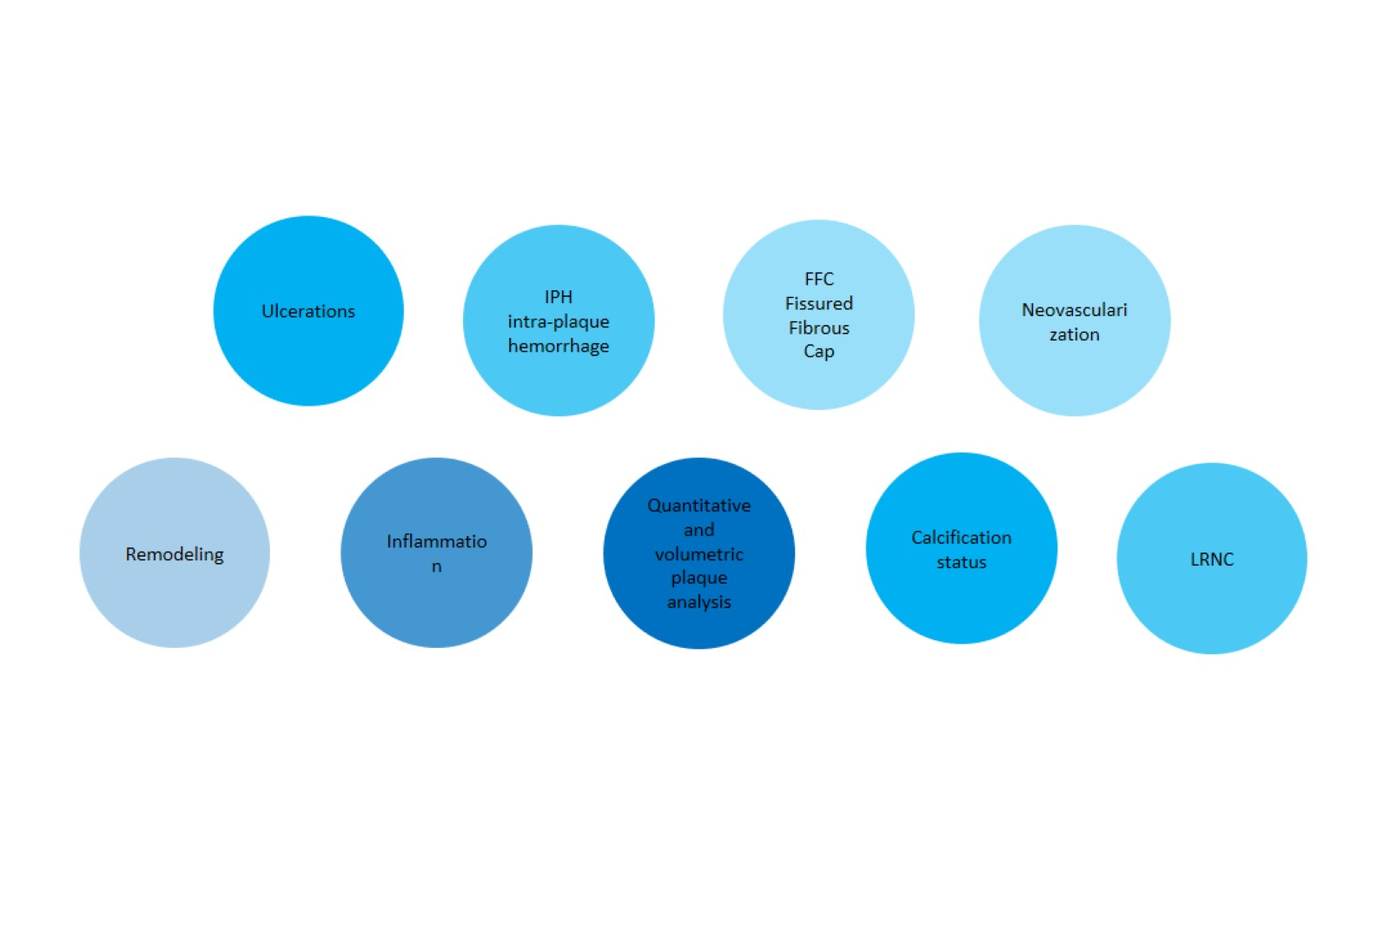

Slide 86
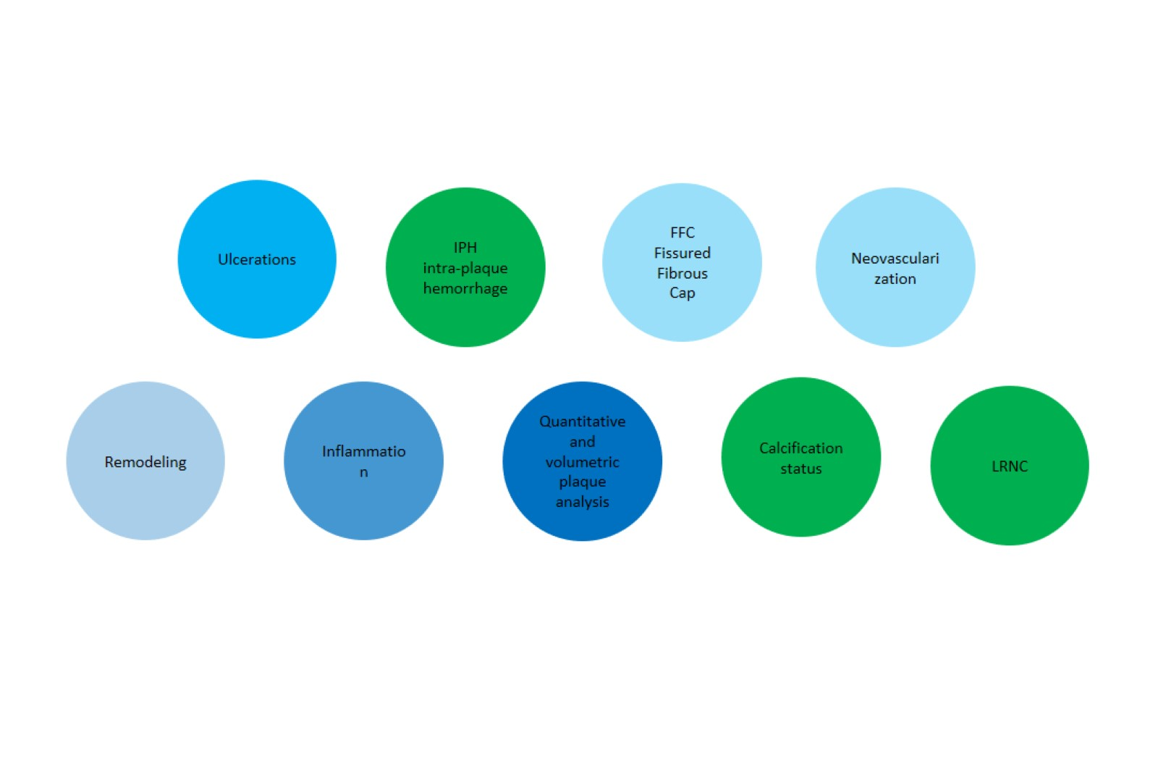

Slide 87
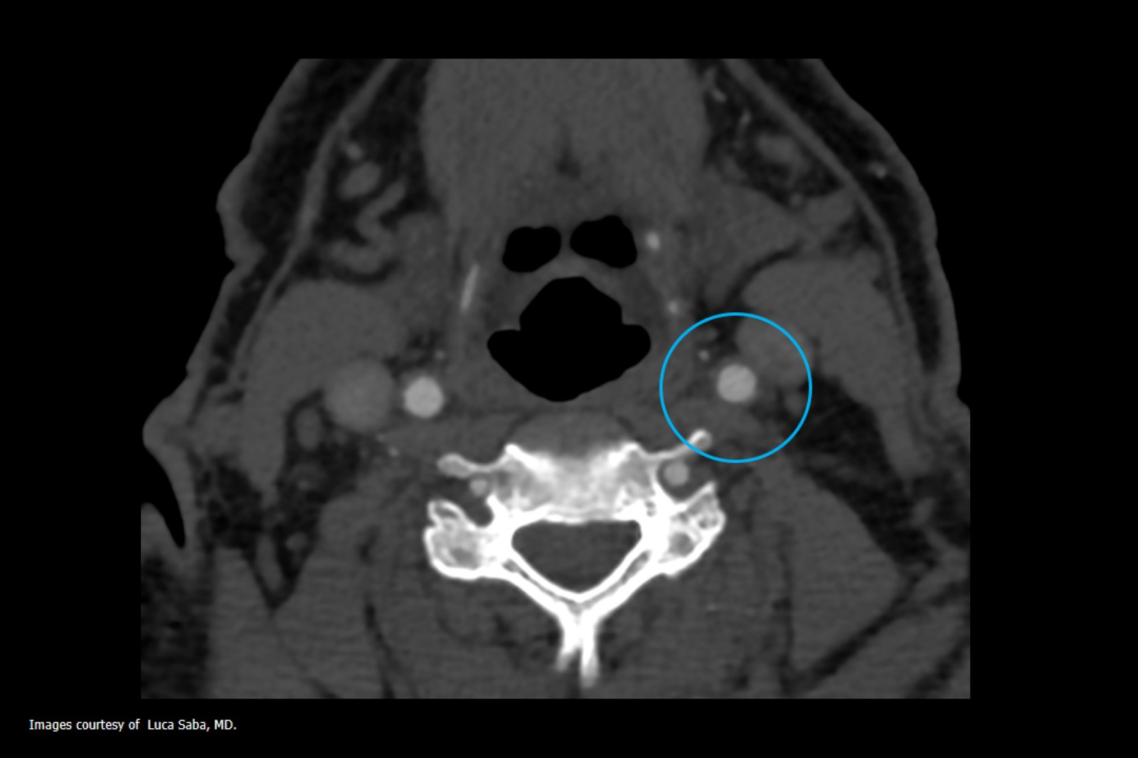

Slide 88
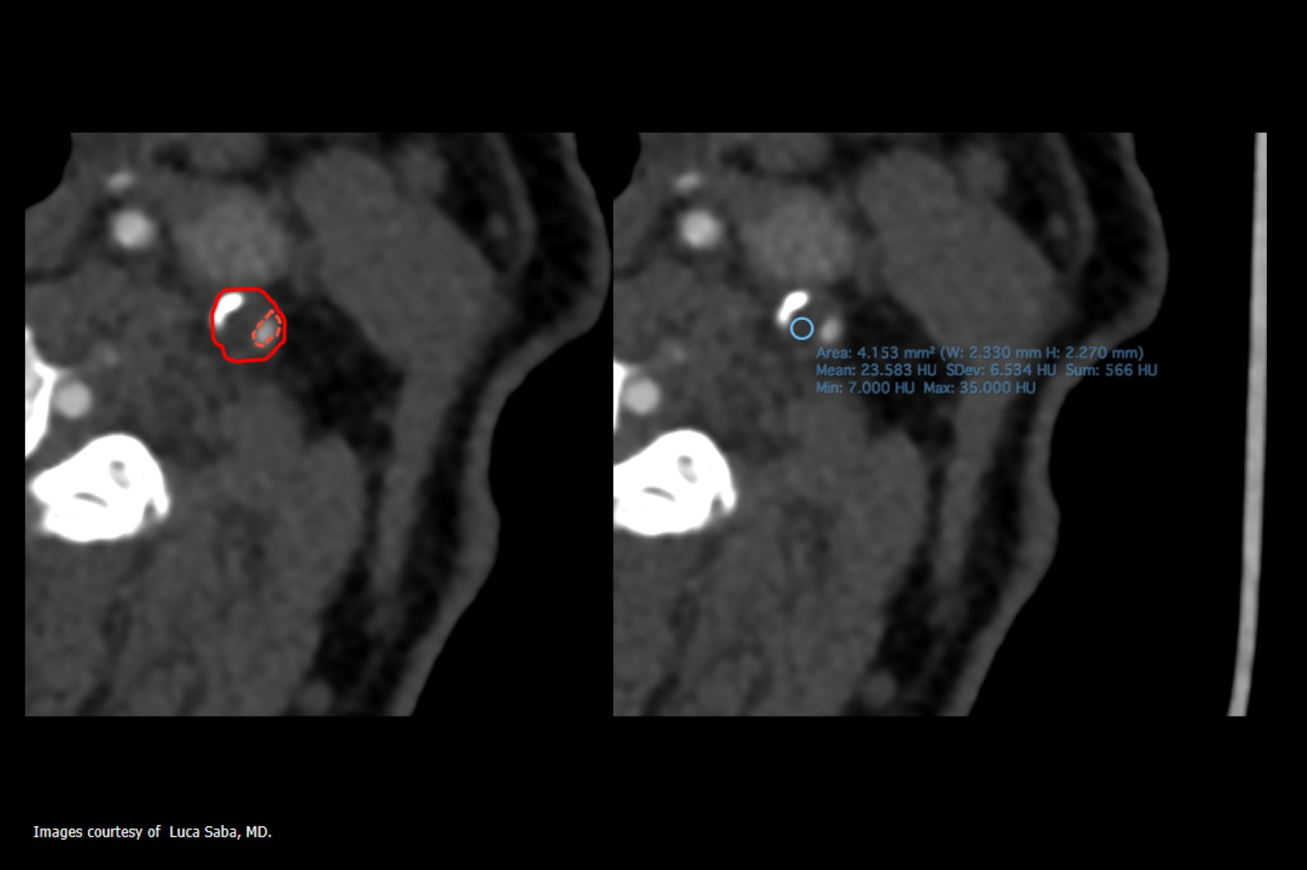

Slide 89
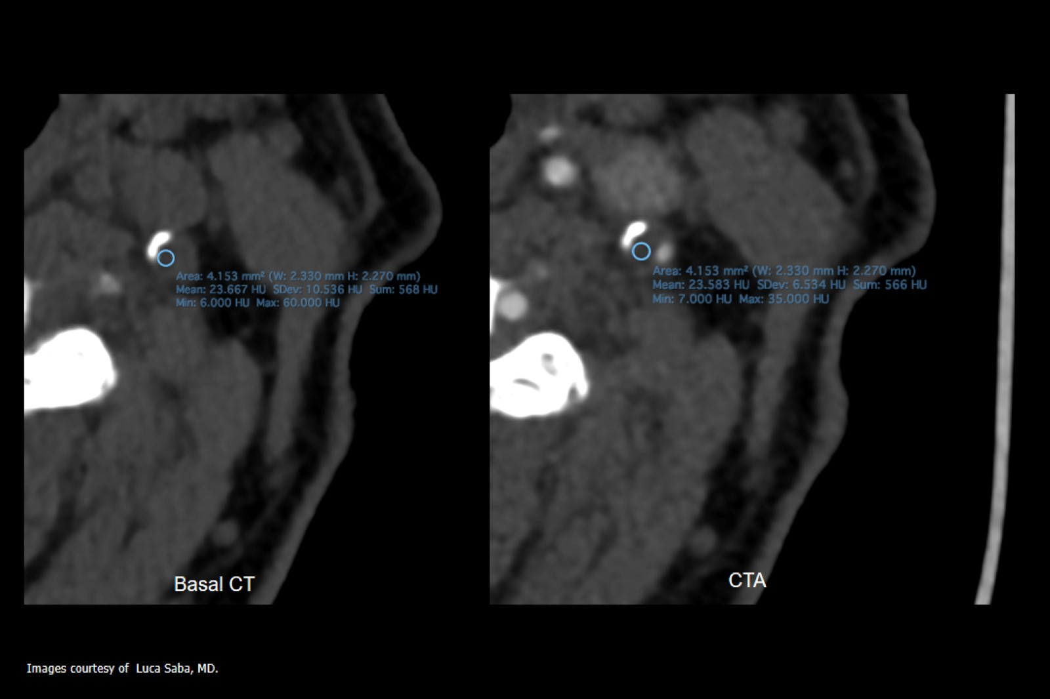

Slide 90
CT Attenuation Analysis of Carotid Intraplaque Hemorrhage

Slide 91
Association Between Carotid Atherosclerotic Plaque Calcification and Intraplaque Hemorrhage

Slide 92
Different Types of “Spatial” Calcium Configuration…

Slide 93
Impact Analysis of Different CT Configurations of Carotid Artery Plaque Calcifications on Cerebrovascular Events

Slide 94
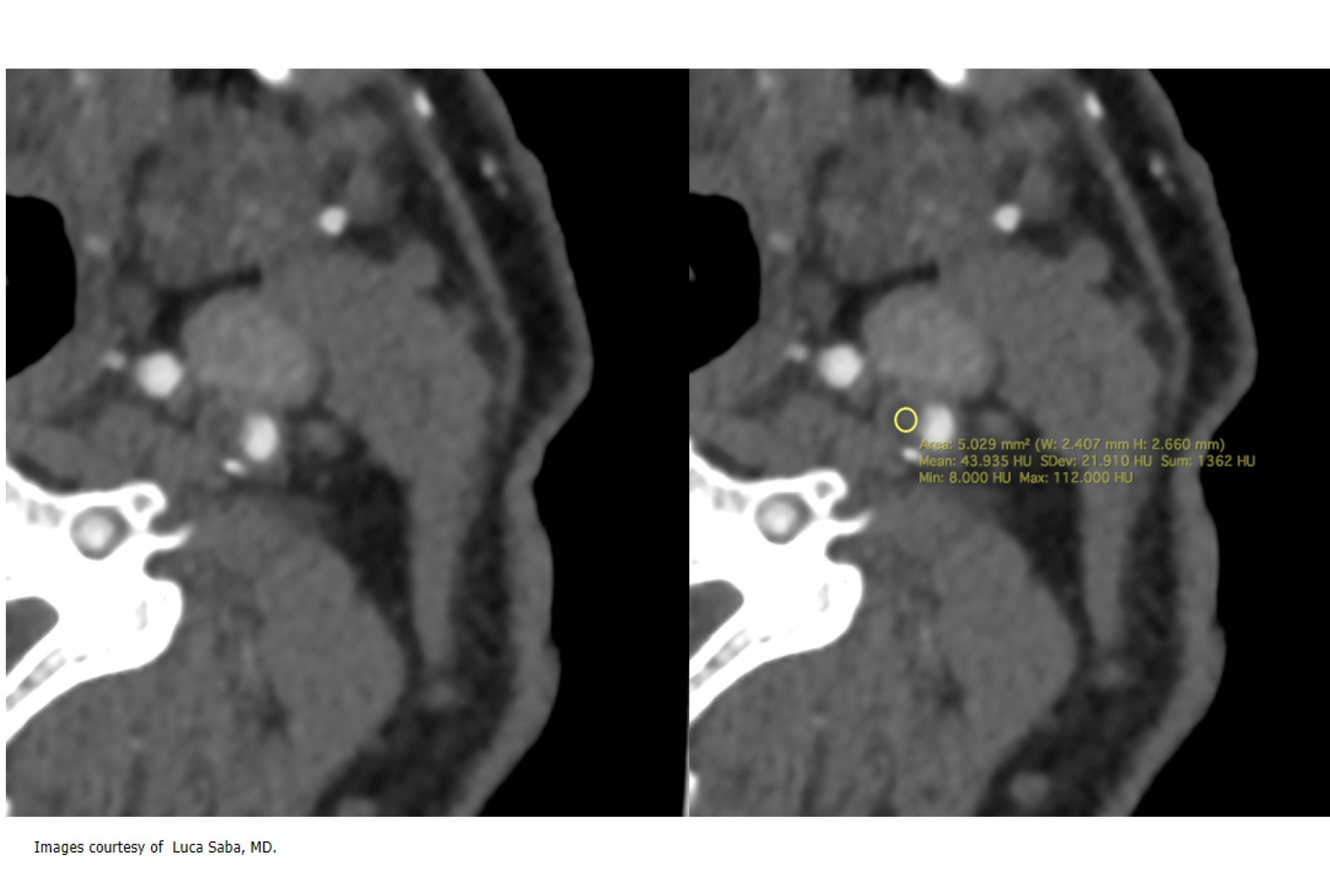

Slide 95
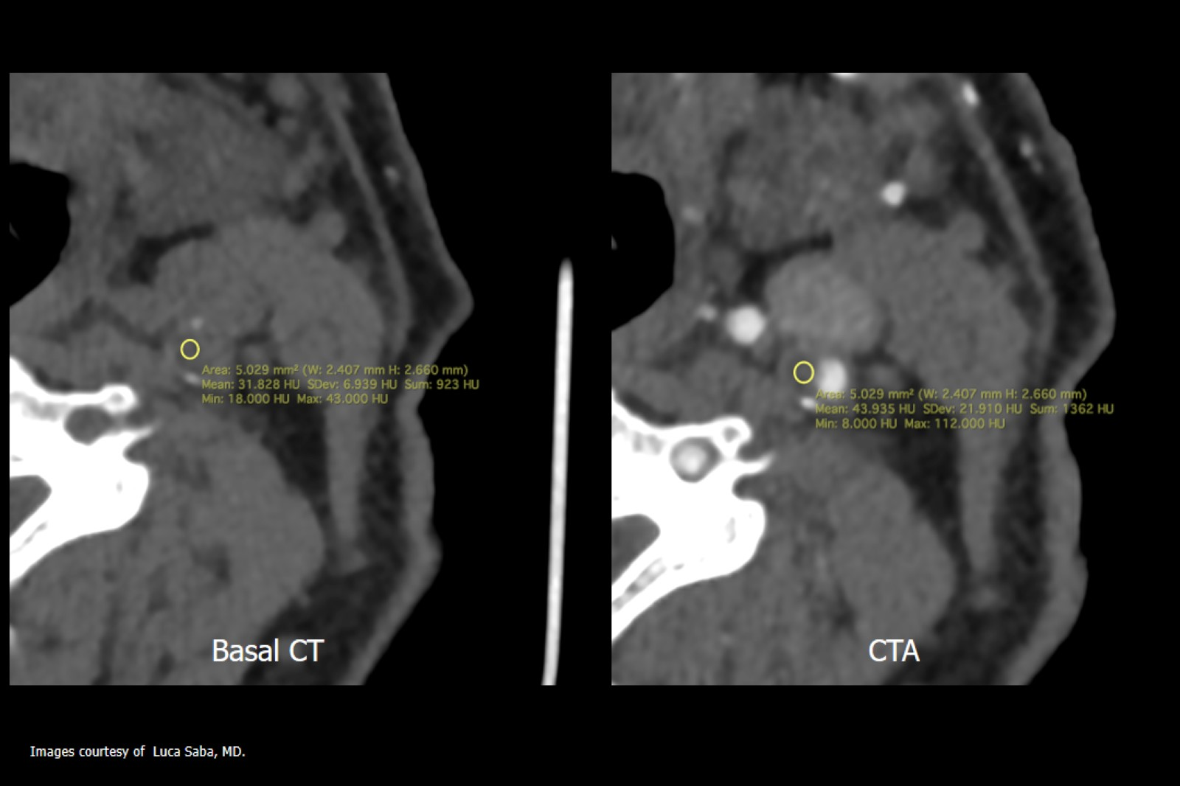

Slide 96
