Slide 1
Innovations in ADHD

Slide 2
Learning Objectives

Slide 3
Life Is a Journey… You Are Never Quite Sure What Is Next

Slide 4
ADHD Is Prevalent in All Age Groups

Slide 5
Adult Onset or Adult Diagnosis of ADHD

Slide 6
Polygenic Risk for ADHD and Associated Traits

Slide 7
Comorbidities in College-Age Adults Important Considerations in Our Differential

Slide 8
Suicide, Homicide, and Unintentional Injury

Slide 9
Psychiatric Comorbidities Increase the Risk of Premature Mortality in Adults With ADHD

Slide 10
Psychiatric Comorbidities Increase the Risk of Premature Mortality in Adults With ADHD

Slide 11
Psychiatric Comorbidities Increase the Risk of Premature Mortality in Adults With ADHD

Slide 12
ADHD Treatment Reduces the Risk of Suicidality in Patients With Comorbid ADHD and BD/SZD

Slide 13
Motor Vehicle Trauma and ADHD Medication Usage

Slide 14
The Benefits of Treating ADHD

Slide 15
Whom Should You Screen?

Slide 16
Catherine

Slide 17
What Do You Do Next?

Slide 18
Further Questions

Slide 19
What Do You Do Next?

Slide 20
Catherine's Response

Slide 21
Optimizing ADHD Symptom Reduction Can Minimize Functional Impairment

Slide 22
Optimizing ADHD Symptom Reduction Can Minimize Functional Impairment

Slide 23
Optimizing ADHD Symptom Reduction Can Minimize Functional Impairment

Slide 24
Methylphenidate vs Amphetamine?

Slide 25
Currently Approved ADHD Medications Reflect Limited Distinct Approaches for Adult Patients

Slide 26
Network Meta-Analysis: Results of ADHD Treatment

Slide 27
Transition From Methylphenidate to Amphetamine Occurs in Adolescence

Slide 28
Methylphenidate Preparations

Slide 29
Amphetamine Preparations

Slide 30
Nonstimulant Options

Slide 31
FDA-Approved Medications With Clinical Data for Adults With ADHD

Slide 32
How About the New Kids on the Block?

Slide 33
Serdexmethylphenidate C-IV/d-Methylphenidate C-II: A 70/30 Prodrug/d-MPH Combination

Slide 34
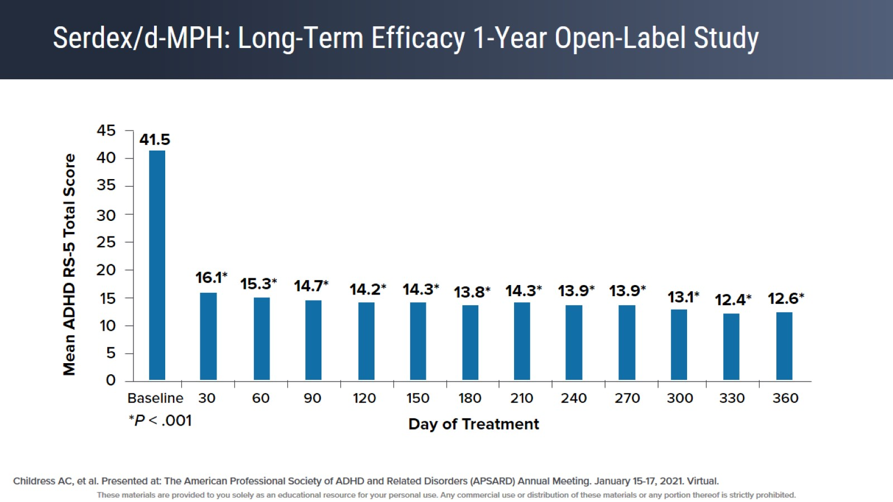
Serdex/d-MPH: Long-Term Efficacy 1-Year Open-Label Study

Slide 35
70/30 Serdex/d-Methylphenidate: Adverse Events

Slide 36
Transdermal d-Amphetamine Patch

Slide 37
Transdermal d-Amphetamine Patch

Slide 38
Allows Flexible Wear Time on Weekends

Slide 39
Transdermal d-Amphetamine Patch Adverse Events

Slide 40
Viloxazine XR

Slide 41
Viloxazine XR: 100 mg to 400 mg Daily

Slide 42
Viloxazine 200 mg to 600 mg Daily in Adult ADHD

Slide 43
Improvement in Both Inattentive and Hyperactive/Impulsive Symptoms

Slide 44
Viloxazine XR ADHD Score and BRIEF-A

Slide 45
Viloxazine XR Long-Term Adult Data

Slide 46
Adult Adverse Events of Viloxazine

Slide 47
Mental Health Digital Therapeutics: FDA-Cleared SaMD

Slide 48
Digital Therapeutics

Slide 49
Digital Therapeutics

Slide 50
Digital Therapeutics

Slide 51
Stimulant Misuse In College Students

Slide 52
Non-Medical Use of Prescription Stimulants Among College Students

Slide 53
Clinical Pearls

Slide 54
Barriers to ADHD Recognition

Slide 55
Case Conundrums in ADHD:

Slide 56
Objectives

Slide 57
ADHD + Comorbidities

Slide 58
Case Studies

Slide 59
Is It ADHD or Depression?

Slide 60
Is It ADHD or Depression or Thyroid Disorder?

Slide 61
Is It ADHD or Depression?

Slide 62
Is It ADHD or Depression?

Slide 63
Emotional Dysregulation

Slide 64
Emotional Dysregulation

Slide 65
It Is ADHD!

Slide 66
ADHD and/or Bipolar Disorder?

Slide 67
ADHD and/or Bipolar Disorder?

Slide 68
ADHD and Bipolar Disorder?

Slide 69
ADHD and Bipolar Disorder

Slide 70
ADHD and Anxiety

Slide 71
Depression and Anxiety?

Slide 72
Depression and Anxiety?

Slide 73
Depression and Anxiety

Slide 74
Anxiety and Depression

Slide 75
ADHD, Anxiety, and Depression

Slide 76
ADHD, Anxiety, and Depression

Slide 77
ADHD, Anxiety, and Depression

Slide 78
ADHD?

Slide 79
ADHD?

Slide 80
ADHD?

Slide 81
ADHD?

Slide 82
ADHD?

Slide 83
Clinical Pearls

Slide 84
Supporting Patients With ADHD Through the Transition to Independence

Slide 85
ADHD and the Transition to Young Adulthood: The Gap Widens

Slide 86
ADHD in Adulthood Transition

Slide 87
Need for Preventative Measures

Slide 88
Milestones of Young Adulthood

Slide 89
Adolescence: "Twilight Zone^{[a]"} of ADHD Treatment

Slide 90
ADHD in Adolescence: Treatment Utilization

Slide 91
ADHD in Adolescence: Treatment Utilization

Slide 92
Reasons for Poor Utilization

Slide 93
Willingness to Utilize Treatment

Slide 94
Retention in Traditional Behavior Therapy

Slide 95
What Makes CBT/Behavior Therapy for ADHD a Challenge?

Slide 96
Barriers to CBT Treatment Among Adolescents With ADHD

Slide 97
How Can We Prepare Adolescents for Young Adult Transition?

Slide 98
First: Focus on Treatment Engagement

Slide 99
First: Focus on Treatment Engagement

Slide 100
Effect of CBT Strategy on Engagement

Slide 101
First: Focus on Treatment Engagement

Slide 102
Effect of CBT Strategy on Outcome

Slide 103
Results From STAND Community Study

Slide 104
Component Model for STAND

Slide 105
Engagement Strategies in STAND

Slide 106
Motivational Interviewing

Slide 107
Motivational Interviewing (cont)

Slide 108
Thinking About Values

Slide 109
Goal Setting

Slide 110
Strength-Based Approach

Slide 111
Help Parents See Their Role in the Problems So They Want to Work On Themselves, Too

Slide 112
Menu-Based Approach

Slide 113
Practice Skills at Home

Slide 114
Building in Rewards

Slide 115
Imagine Before You Do It!

Slide 116
IF/THEN Plans for What Can Go Wrong

Slide 117
Second: Focus on Building Age-Appropriate Skills

Slide 118
Communication Skills

Slide 119
Executive Function Skills

Slide 120
Third: Focus on Transition Planning

Slide 121
Key Transition Planning Questions

Slide 122
Fourth: Promote Age-Appropriate Parenting

Slide 123
Key Parenting Considerations

Slide 124
Clinical Pearls

Slide 125
The Role of Team-Based Care in Facilitating ADHD Management

Slide 126
Acknowledgements

Slide 127
THANK YOU

