Slide 1
Early Diagnosis and the Need for Novel Therapeutics in ALS

Slide 4
Introduction

Slide 5
Transform ALS Into a Livable Disease

Slide 6
Strategies and Perspectives on the Early Recognition of ALS

Slide 7
Polling Question

Slide 8
ALS Diagnostic Delays and Initial Misdiagnosis Rates Have Not Improved Over the Past 2 Decades

Slide 9
Why Diagnostic Delay Matters in ALS

Slide 10
Some Reasons for ALS Diagnostic Delay

Slide 11
ALS: Heterogenous Disease With Complex Pattern Recognition Elements and Required Detailed Neuromuscular Examination

Slide 12
How Can We Make It Easier for Non-ALS Neurologists and Advanced Care Providers to Think of ALS Early and Refer to ALS Clinics Urgently?

Slide 13
thinkALS

Slide 14
thinkALS: Reduce Time to Diagnosis

Slide 15
Referral: Clinical Suspicion for ALS

Slide 16
Referral: Clinical Suspicion for ALS

Slide 18
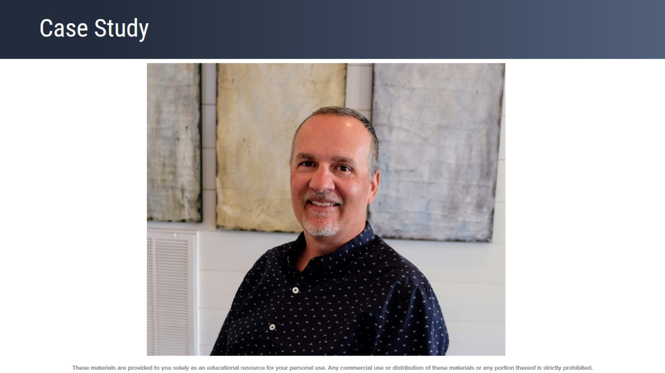
Case Study

Slide 19
Case Summary: Symptom Onset to ALS Diagnosis and Genetic Confirmation of SOD1 ALS Was 4+ Years

Slide 20
Non-ALS Physicians Are Important Links in Determining Diagnostic Timelines for ALS

Slide 21
Focused History, Exam, Testing, and Specific Mention of “Suspicion for ALS” on Urgent Referrals to ALS Clinics

Slide 23
Breaking the News of an ALS Diagnosis

Slide 24
ALS Standard of Care: The Multidisciplinary Clinic

Slide 25
Benefits of ALS Multidisciplinary Care

Slide 26
Quality of Life Is a Complex Concept

Slide 27
Quality of Life Is Determined by the Individual Affected

Slide 28
Quality of Life in ALS Is Not Related to Physical Function

Slide 29
Specialty ALS Clinics Can Optimize QoL by Asking About Hope to Direct Goals of Care

Slide 30
Persons With ALS Have Identified Many Favorable Aspects of ALS Clinic

Slide 31
For Some Persons With ALS, There Are Concerns We Must Address

Slide 32
Telemedicine Has the Potential to Maintain Benefits and Reduce Burdens

Slide 33
Implementing Telemedicine in Routine ALS Care

Slide 34
Remote Monitoring: “Digital Health”

Slide 35
Remote Pulmonary Function Testing

Slide 36
Wearable Sensors to Assess Gait and Falls

Slide 37
Remote Assessment of Speech and Swallowing Using Wearable Microphones

Slide 38
Assessment of Home Nocturnal Transcutaneous Carbon Monoxide Levels

Slide 39
Summary

Slide 40
Discussion

Slide 42
Outline

Slide 43
FDA-Approved “DMTs” Riluzole and Edavarone

Slide 44
FDA Approved “DMTs” Dextromethorphan Hydrobromide and Quinidine Sulfate?

Slide 45
Emerging Therapies for ALS in Late Development

Slide 46
Emerging Therapies for ALS in Late Development (cont)

Slide 47
Barriers to Developing New ALS Therapies

Slide 48
Progress Around These Barriers Improved Understanding of Causes: Genetic ALS

Slide 49
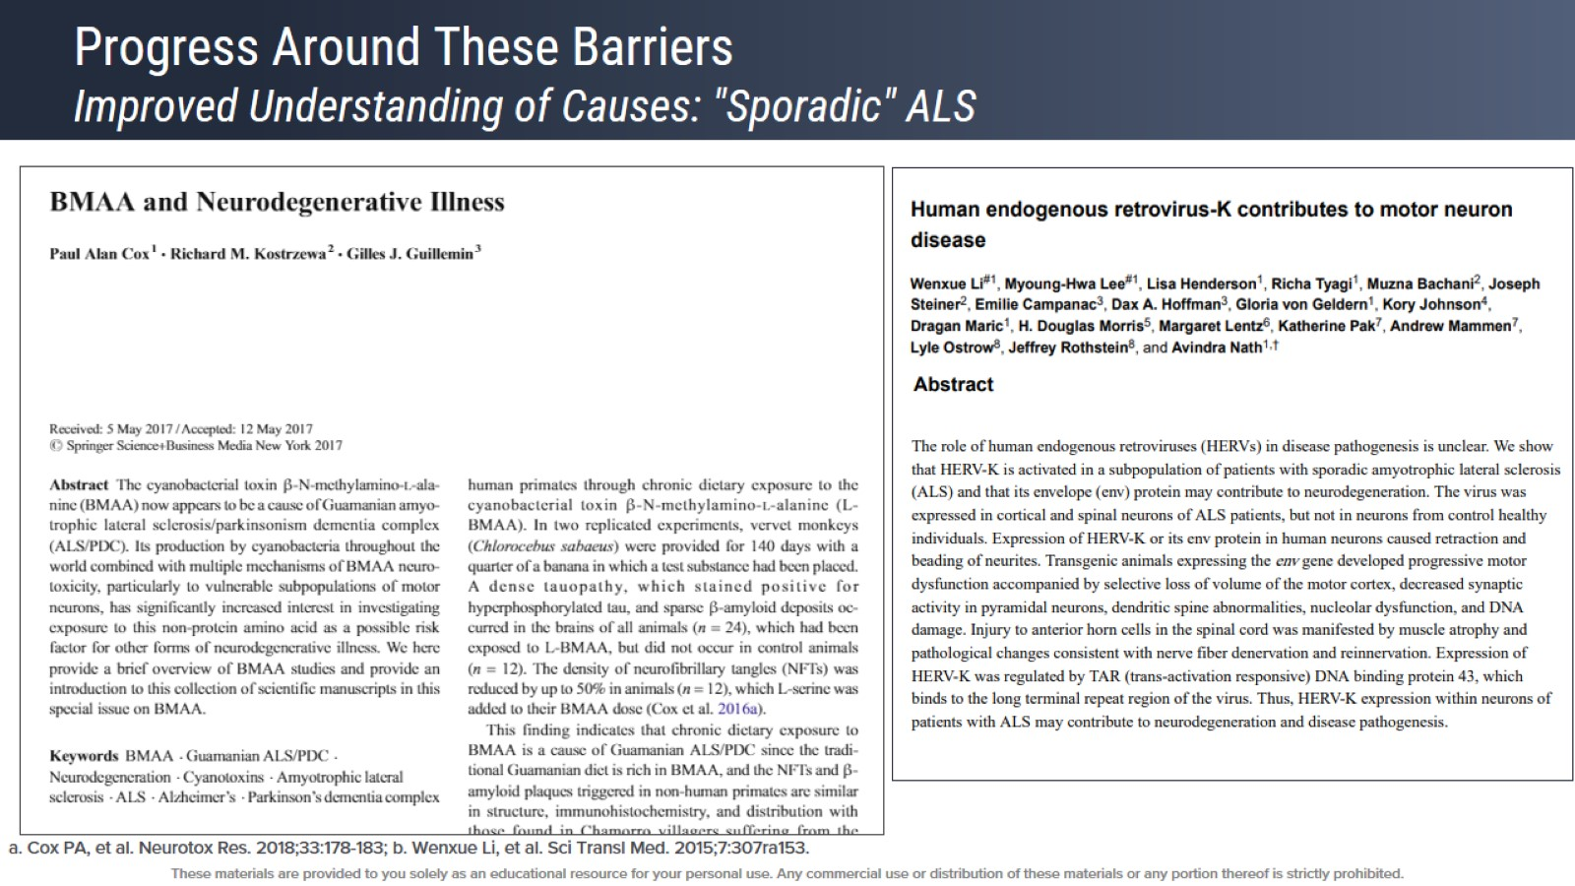
Progress Around These Barriers Improved Understanding of Causes: "Sporadic" ALS

Slide 50
Progress Around These Barriers Improved Understanding of Causes: Downstream Pathways

Slide 51
Progress Around These Barriers Biomarkers

Slide 52
Progress Around These Barriers Platform Trials

Slide 53
Progress Around These Barriers Empowering Patients to Be Partners

Slide 54
Progress Around These Barriers Expanding Access

Slide 55
Discussion

Slide 56
Acknowledgements

