Slide 3
Agenda

Slide 4
The Problem…

Slide 5
Percentage of US Population With a Completed COVID-19 Primary Series

Slide 6
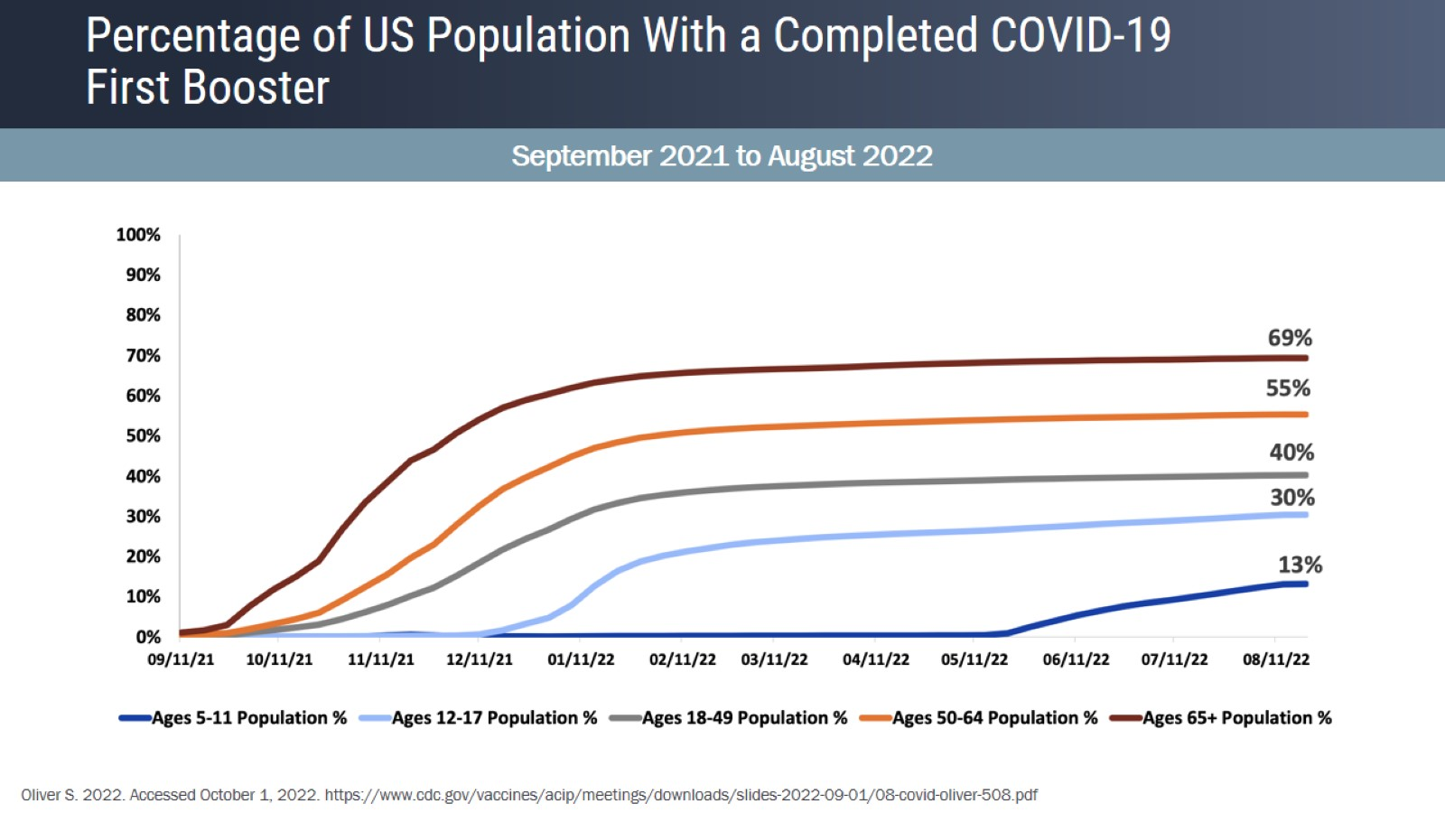
Percentage of US Population With a Completed COVID-19 First Booster

Slide 7
Percentage of US Population With a Completed COVID-19 First Booster

Slide 8
Vaccination Rates in Children and Adolescents

Slide 9
Vaccination Rates in Children and Adolescents (cont)

Slide 10
Equity and Vaccinations

Slide 11
Available Vaccines and Vaccine Technology

Slide 12
COVID-19 Vaccines in the United States

Slide 13
Challenges of the Omicron Variant

Slide 14
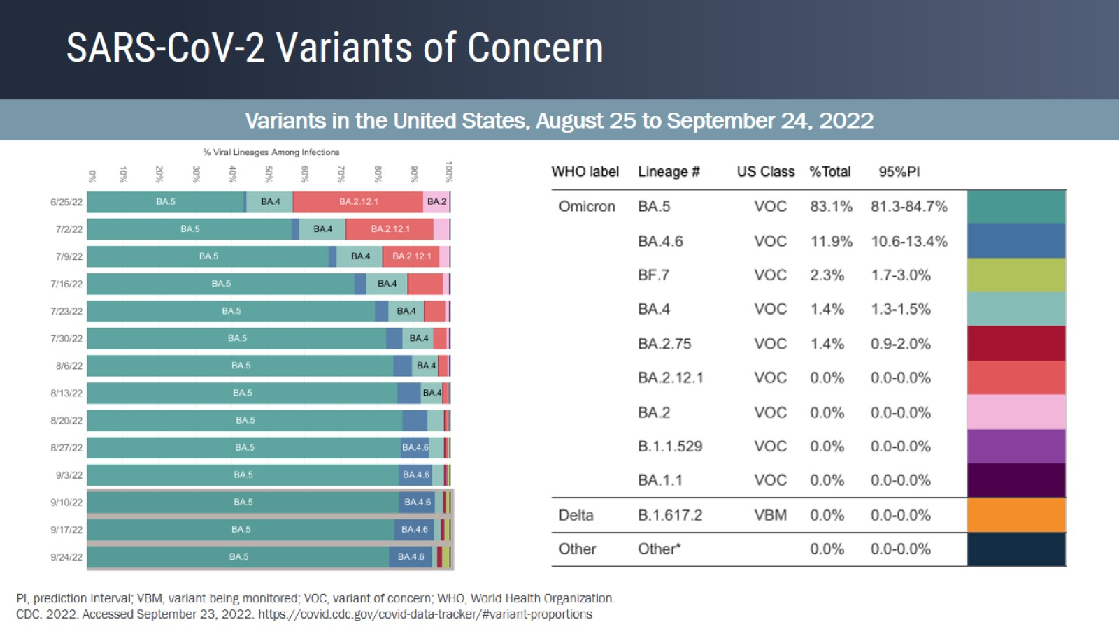
SARS-CoV-2 Variants of Concern

Slide 15
Weekly Trends in COVID-19 Associated Hospitalization Rates by Age Group

Slide 16
Vaccine Effectiveness in SARS-CoV-2 Variants

Slide 17
Vaccine Effectiveness Against the Omicron B.1.1.529 Variant in Children Aged 5 to 11 Years

Slide 18
Summary of Available Bivalent Booster Clinical Trial Data

Slide 19
Phase 2/3 Trial of Moderna Bivalent Omicron Booster Vaccine Study Design and Immunogenicity

Slide 20
Phase 2/3 Trial of Moderna Bivalent Omicron Booster Vaccine Safety

Slide 21
Pfizer-BioNTech Bivalent Booster Trial With BA.1 (Study C4591031) Study Design and Immunogenicity

Slide 22
Pfizer-BioNTech Bivalent Booster Trial With BA.1 (Study C4591031) Safety

Slide 23
Current COVID-19 Vaccine Recommendations

Slide 24
Addressing Parent Concerns About New Vaccines

Slide 25
Addressing Teenage Concerns About New Vaccines

Slide 26
COVID-19 Vaccination Schedule for Most People Those Not Moderately or Severely Immunocompromised

Slide 27
Booster Recommendations for Most People, October 2022

Slide 28
Discussion Questions

Slide 29
Overcoming Barriers to Vaccination

Slide 30
Strategies to Identify Pediatric Patients Eligible for a Booster Expert Opinion

Slide 31
Tailoring the Immunization Message Addressing Common Concerns of Hesitant Parents/Caregivers

Slide 32
Efficacy of COVID-19 Vaccines

Slide 33
Benefits and Risks After Dose 2, by Age Group

Slide 34
Benefits and Risks After mRNA Vaccine, by Age Group and Sex

Slide 35
Common Side Effects of COVID-19 Vaccines

Slide 36
Real-World Data of AEs Following Vaccination

Slide 37
Myocarditis Postmarketing Reports With BNT162b2

Slide 38
Potential Myocarditis Risk Following Booster Dose

Slide 39
Rare Serious AEs With COVID-19 Vaccines

Slide 40
Communication Strategies for Hesitant Parents and Caregivers to Optimize Coverage and Promote Equity

Slide 41
Social Media

Slide 42
Addressing Misinformation About Vaccines

Slide 43
The Principles of Motivational Interviewing​

Slide 44
How to Talk With Patients Expert Opinion

Slide 45
Resources for Providers and Patients

Slide 46
Looking Ahead

Slide 47
What Is in the "Crystal Ball" for Vaccination?

Slide 48
What Have We Learned From COVID-19?

Slide 49
Healthcare Equity

Slide 50
Rapid Questions

Slide 52
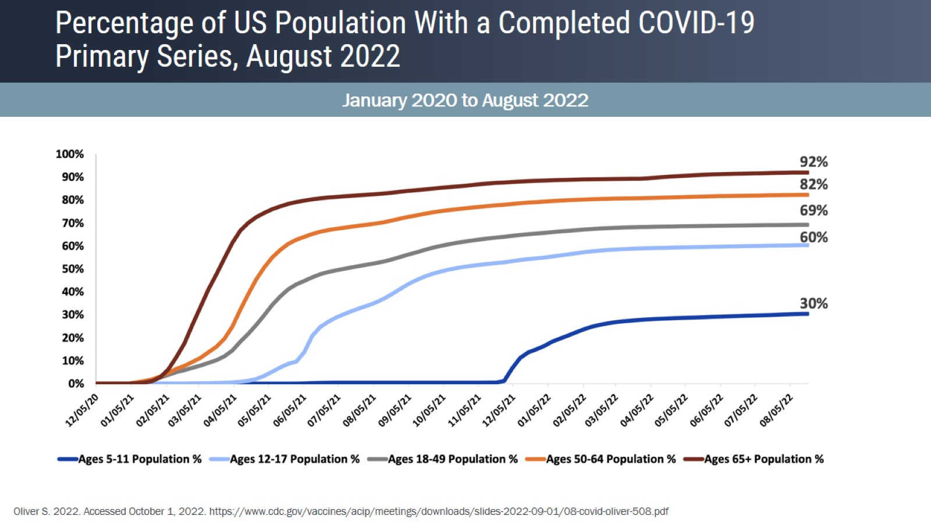
Percentage of US Population With a Completed COVID-19 Primary Series, August 2022

Slide 53
Percentage of US Population With a Completed COVID-19 Primary Series

Slide 54
Historical Strategies for Discussion Vaccination

Slide 55
Discussion

