Slide 4
1962

Slide 5
Clinical Pathways of Prognosis in HCM

Slide 6
Low HCM Mortality Rates Are Virtually the Same at All Ages

Slide 7
Clinical Pathways of Prognosis in HCM

Slide 8
2020 AHA/ACC Sudden Death Risk Markers

Slide 9
Unfortunate Duo

Slide 10
Heart Failure in HCM: The Unmet Need

Slide 11
Patient With HCM and Heart Failure Symptoms

Slide 12
Obstructive HCM

Slide 13
Obstructive HCM

Slide 14
Impact of LV Outflow Obstruction (≥ 30 mm Hg) on Progression to Advanced Heart Failure and Death

Slide 15
Treatment Gaps in Obstructive HCM

Slide 16
Nonobstructive HCM

Slide 17
Identifying Nonobstructive HCM

Slide 18
Treatment Gaps in Nonobstructive HCM

Slide 19
Summary: Unmet Treatment Needs in HCM

Slide 21
What Have We Learned About Cardiac Myosin Inhibition?

Slide 22
Sarcomere Dysfunction Leads to Excess Myosin-Actin Cross-Bridging in HCM

Slide 23
MOA of Myosin Inhibitors: Mavacamten (MYK-461)

Slide 24
Clinical Trials of Myosin Inhibitors for Symptomatic, Obstructive HCM

Slide 25
EXPLORER-HCM: Study Design Mavacamten in Symptomatic Patients With Obstructive HCM

Slide 26
EXPLORER-HCM Primary and Secondary Endpoints

Slide 27
EXPLORER-HCM Results

Slide 28
Mavacamten Markedly Improved Health Status (KCCQ)

Slide 29
Mavacamten Improved Measures of Diastolic Function

Slide 30
Mavacamten Improved Measures of Diastolic Function

Slide 31
Mavacamten Improved Measures of Diastolic Function

Slide 32
Mavacamten Improved Measures of Diastolic Function

Slide 33
Mavacamten Improved Measures of Diastolic Function

Slide 34
EXPLORER-HCM CMR Substudy

Slide 35
MAVA-Long Term Extension (LTE) (EXPLORER-LTE)

Slide 36
Rapid and Sustained Improvements in LVOT Gradients With Mavacamten Out to 84 Weeks

Slide 37
Stable Reduction in LVEF and Improvement in NT-proBNP

Slide 38
2/3 of Patients Had Improvement in NYHA Class

Slide 39
VALOR-HCM Study Design

Slide 40
VALOR-HCM Efficacy Endpoints

Slide 41
VALOR-HCM Secondary Efficacy Endpoints

Slide 42
Selected AEs and Endpoints in Safety Population

Slide 43
MAVERICK HCM: Evaluation of Mavacamten in Symptomatic Patients With Nonobstructive HCM

Slide 44
MAVERICK-HCM: Cardiac Biomarkers

Slide 45
Summary

Slide 47
Clinical Trials of Cardiac Myosin Inhibitors in HCM

Slide 48
Mavacamten Safety: A Pooled Analysis of 5 Clinical Trials

Slide 49
Mavacamten Is Now FDA Approved

Slide 50
REDWOOD-HCM Cohorts 1 and 2 (oHCM) Aficamten

Slide 51
Baseline Characteristics in REDWOOD-HCM Cohorts 1 and 2

Slide 52
Early and Sustained Reduction in Resting and Valsalva LVOT Gradient

Slide 53
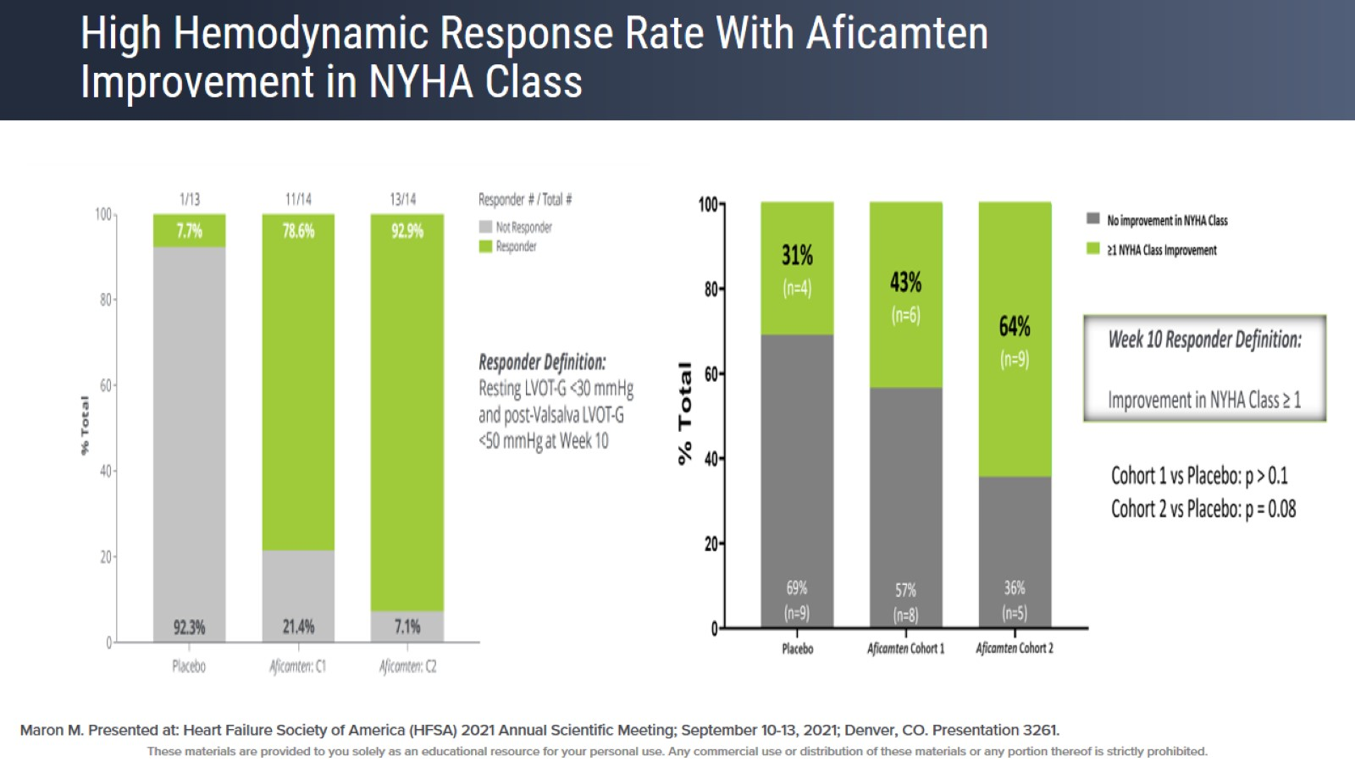
High Hemodynamic Response Rate With Aficamten Improvement in NYHA Class

Slide 54
REDWOOD-HCM Cohort 3

Slide 55
Aficamten Is Safe and Effective When Added on Top of Disopyramide + BB/CCB

Slide 56
REDWOOD-HCM Cohort 4: nHCM

Slide 57
REDWOOD-OLE: An Open-Label Extension Study of REDWOOD-HCM and SEQUOIA-HCM Current Dose Range: 5 mg to 20 mg

Slide 58
Rapid and Sustained Reduction of LVOT Gradients

Slide 59
Minimal and Stable Reduction of LVEF

Slide 60
Improvement in NYHA Class

Slide 61
Substantial Improvement in KCCQ in All Domains in REDWOOD-OLE

Slide 62
Aficamten Safety: LVEF < 50%

Slide 63
Withdrawal of Background Medical Therapy in REDWOOD-HCM OLE

Slide 64
SEQUOIA-HCM Trial (N = 270)

Slide 65
Why Do We Need Another CMI?

Slide 66
Conclusions

Slide 67
How to Utilize CMI Therapy

Slide 69
Case 1

Slide 70
Resting and Valsalva Gradients

Slide 71
Audience Polling Question 1 & Discussion

Slide 72
What Happens Next

Slide 73
Audience Polling Question 2 & Discussion

Slide 74
Case 1 With Lower EF

Slide 75
Case 2

Slide 76
Resting and Valsalva Gradients

Slide 77
Audience Polling Question 3 & Discussion

Slide 78
Case 3

Slide 79
Resting and Valsalva Gradients

Slide 80
Audience Polling Question 4 & Discussion

