Slide 2
Introduction

Slide 3
Epidemiology of NAFLD

Slide 4
Epidemiology of NAFLD

Slide 5
Epidemiology of NAFLD

Slide 6
Epidemiology of NAFLD

Slide 7
Epidemiology of NAFLD

Slide 8
Epidemiology of NAFLD

Slide 9
Definition of NAFLD

Slide 10
Natural History of NAFLD

Slide 11
Natural History of NAFLD

Slide 12
Natural History of NAFLD

Slide 13
Natural History of NAFLD

Slide 14
Natural History of NAFLD

Slide 15
Natural History of NAFLD

Slide 16
Natural History of NAFLD

Slide 17
Natural History of NAFLD

Slide 18
NAFLD and NAFLD-Related Liver Fibrosis Are Heritable

Slide 19
Should We Screen for Advanced Fibrosis Among First-Degree Relatives of Patients With Advanced Fibrosis?

Slide 20
Should We Screen for Advanced Fibrosis Among First-Degree Relatives of Patients With Advanced Fibrosis?

Slide 21
The Case for Routine Screening for Advanced Fibrosis in First-Degree Relatives of Patients With Advanced Fibrosis

Slide 22
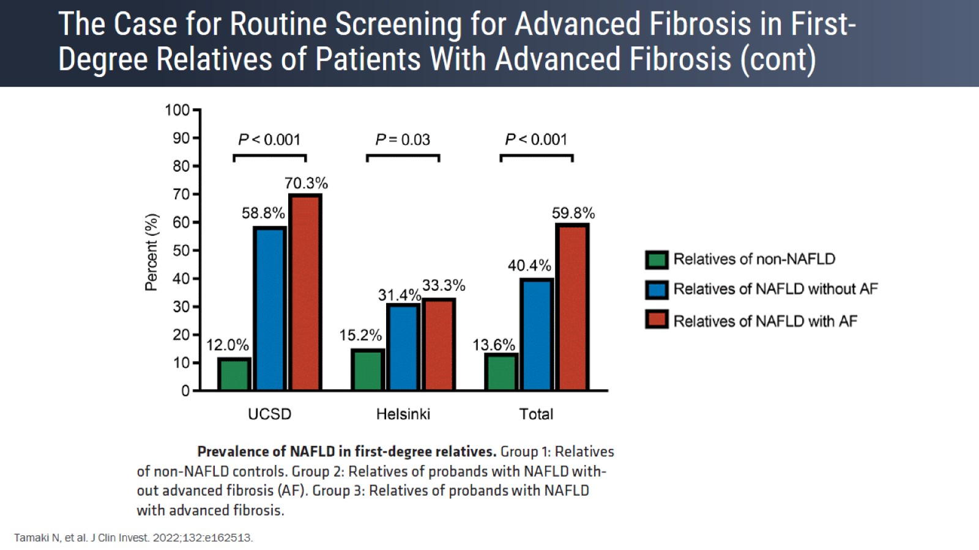
The Case for Routine Screening for Advanced Fibrosis in First-Degree Relatives of Patients With Advanced Fibrosis (cont)

Slide 23
Updated 2022 AASLD Updated Guidance

Slide 24
Liver Fibrosis

Slide 25
Progression of Liver Disease

Slide 26
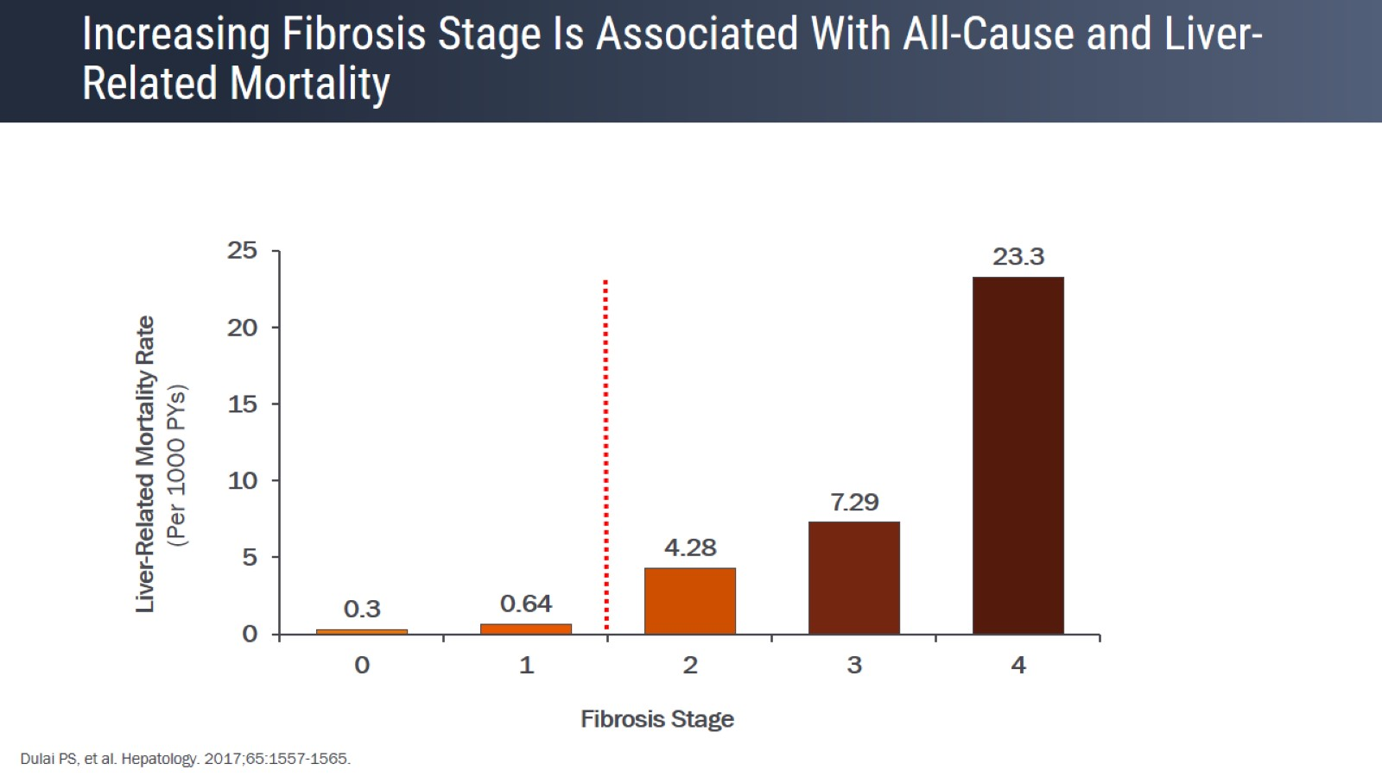
Increasing Fibrosis Stage Is Associated With All-Cause and Liver- Related Mortality

Slide 27
Increasing Fibrosis Stage Is Associated With All-Cause and Liver- Related Mortality

Slide 28
Liver Biopsy

Slide 29
Liver Biopsy The Reference Standard for Staging Liver Fibrosis

Slide 30
Liver Biopsy The Reference Standard for Staging Liver Fibrosis

Slide 31
Liver Biopsy The Reference Standard for Staging Liver Fibrosis

Slide 32
Noninvasive Tests to Risk-Stratify Liver Fibrosis

Slide 33
Diagnose "At-Risk" NASH = NASH With Stage 2 Fibrosis

Slide 34
Management of Patients With NAFLD

Slide 35
AGA and AACE Recommendations for NAFLD

Slide 36
AGA: Clinical Care Pathway -- Modified

Slide 37
AGA: Clinical Care Pathway -- Modified

Slide 38
AGA: Clinical Care Pathway -- Modified

Slide 39
AGA: Clinical Care Pathway -- Modified

Slide 40
AGA: Clinical Care Pathway -- Modified

Slide 41
AGA: Clinical Care Pathway -- Modified

Slide 42
AGA: Clinical Care Pathway -- Modified

Slide 43
AGA: Clinical Care Pathway -- Modified

Slide 44
AGA: Clinical Care Pathway -- Modified

Slide 45
Presence of NAFLD

Slide 46
Presence of NAFLD

Slide 47
Presence of NAFLD

Slide 48
Presence of NAFLD

Slide 49
Presence of NAFLD

Slide 50
Imaging Biomarkers

Slide 51
Exploring Noninvasive Tests Fibrosis-4 (FIB-4) Index

Slide 52
Exploring Noninvasive Tests Fibrosis-4 (FIB-4) Index

Slide 53
Exploring Noninvasive Tests Enhanced Liver Fibrosis (ELF) Test

Slide 54
Exploring Noninvasive Tests Enhanced Liver Fibrosis (ELF) Test

Slide 55
Exploring Noninvasive Tests Enhanced Liver Fibrosis (ELF) Test

Slide 56
ELF Predicts Progression More Accurately Than Biopsy Phase 2 Simtuzumab in NASH and F3-F4

Slide 57
ELF Predicts Progression More Accurately Than Biopsy Phase 2 Simtuzumab in NASH and F3-F4

Slide 58
Noninvasive Assessment of Liver Fibrosis Elastography-Based Methods to Estimate Liver Stiffness

Slide 59
Liver Stiffness as a Noninvasive Biomarker of Fibrosis A Cross-Sectional Study of 452 Patients With Liver Biopsy

Slide 60
Liver Stiffness as a Noninvasive Biomarker of Fibrosis A Cross-Sectional Study of 452 Patients With Liver Biopsy

Slide 61
Validating MRE for Prediction of Advanced Fibrosis

Slide 62
Clinical Recommendations for the Diagnosis of NAFLD in Adults

Slide 63
AACE and AASLD Recommendations for Diagnosis and Management of NAFLD in Adults

Slide 64
AACE and AASLD Recommendations for Diagnosis and Management of NAFLD in Adults

Slide 65
AACE and AASLD Recommendations for Diagnosis and Management of NAFLD in Adults

Slide 66
Conclusion

Slide 67
Conclusion

Slide 68
Conclusion

Slide 69
Conclusion

