Slide 2
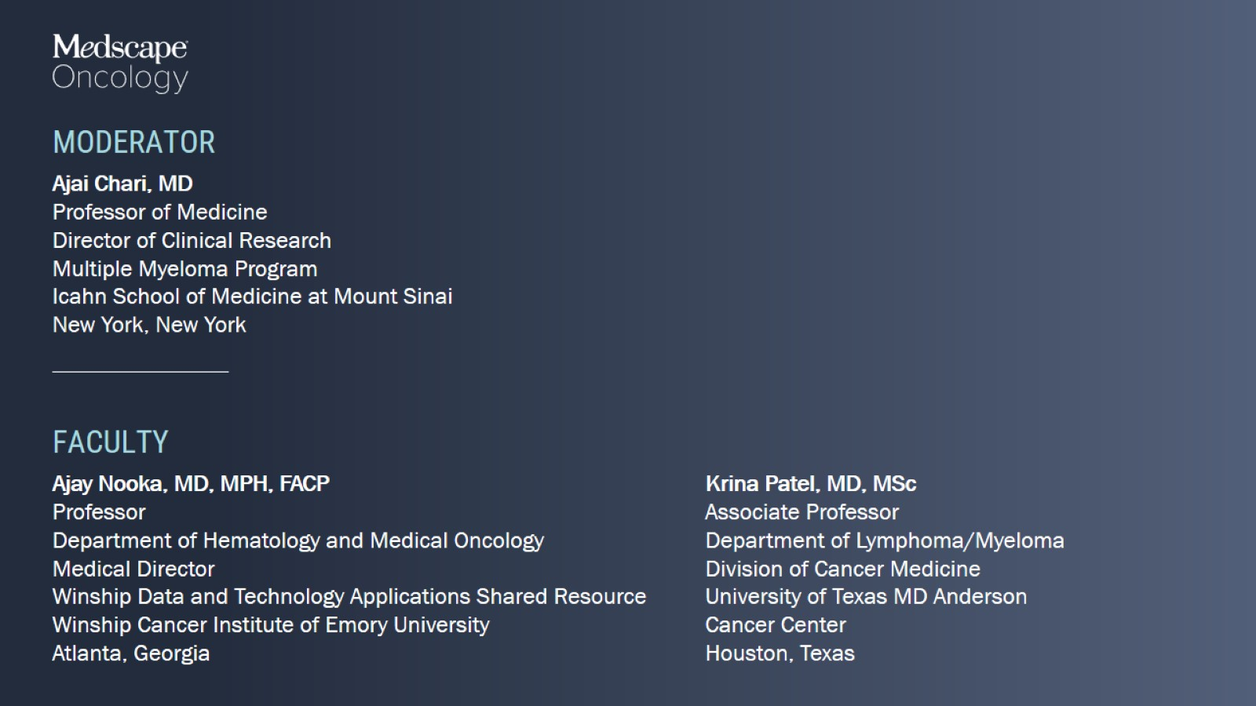

Slide 4
Agenda

Slide 5
Current Challenges

Slide 6
Lymphoma Envy: Expected vs Observed Overall Survival

Slide 7
Ever Increasing Factors to Consider in Treatment Selection

Slide 8
Low Probability of Cures: Unmet Needs in MM

Slide 9
Continually Improving Baseline Risk Stratification Helping to Identify Cure Fraction

Slide 10
Continually Improving Baseline Risk Stratification Helping to Identify Cure Fraction

Slide 11
Continually Improving Baseline Risk Stratification Helping to Identify Cure Fraction

Slide 12
Impact of MRD Across MM Patient Subgroups

Slide 13
New Response Criteria: IMWG 2016

Slide 14
Initial Treatment Is Historically Best Chance for Deep and Durable Remission/Cure

Slide 15
Available Anti-Myeloma Agents When I Began Fellowship

Slide 16
Currently Available Anti-Myeloma Agents in 2022 Innumerable Combinations and Sequences

Slide 17
Overall Survival With Stem Cell Transplant

Slide 18
Median PFS and OS Not Reached for D-RVd or RVd (GRIFFIN)

Slide 19
NCI SEER-9 Data: Overall Survival 1973 to 2009 by Age

Slide 20
Questions to Move Forward

Slide 21
Pomalidomide/Carfilzomib Backbone Randomized Studies

Slide 22
Therapies for Triple Class Refractory MM

Slide 23
PFS and DOR Delta of Recently Approved RRMM Therapies*

Slide 24
The Delta Between Expected and Observed Overall Survival

Slide 26
Epidemiology of Myeloma

Slide 27
MM Treatment Paradigm

Slide 28
IFM-2009

Slide 29
DETERMINATION

Slide 30
RVD Induction Therapy (N = 1000 Patients)

Slide 31
FORTE

Slide 32
FORTE: After R1 PFS Benefit With KRd/ASCT

Slide 33
FORTE: After R2 PFS Benefit With KR Maintenance

Slide 34
GRIFFIN

Slide 35
GRIFFIN: Deepening Responses Over Time

Slide 36
GRIFFIN: PFS in the ITT Population

Slide 37
CASSIOPEIA

Slide 38
CASSIOPEIA: PFS and OS

Slide 39
MASTER

Slide 40
MASTER: Best MRD Response by Phase of Therapy

Slide 41
MASTER: PFS and OS

Slide 42
GMMG-HD7 Phase 3 Trial

Slide 43
GMMG-HD7: MRD Negativity Primary Endpoint

Slide 44
Overview: NDMM With Transplant

Slide 45
Optimal Management of Transplant-Ineligible Patients

Slide 46
Overall Survival

Slide 47
Treatment Algorithm for Elderly MM

Slide 48
SWOG S0777 (RVd vs Rd)

Slide 49
MAIA

Slide 50
MAIA: PFS and OS Benefit With DRd vs Rd

Slide 51
ALCYONE

Slide 52
ALCYONE: Overall Survival

Slide 53
Overview: NDMM Without Transplant

Slide 54
Meta-Analysis of Non-Transplant Trials

Slide 55
Association of Efficacy With Toxicity

Slide 56
Emory Algorithm for Newly Diagnosed Patients

Slide 57
Conclusions: Frontline Therapy in NDMM

Slide 58
Case Challenges in NDMM

Slide 59
Dr Nooka: Case 1

Slide 60
Faculty Roundtable Discussion

Slide 61
Faculty Roundtable Discussion

Slide 62
Faculty Roundtable Discussion

Slide 63
Dr Nooka: Case 2

Slide 64
Faculty Roundtable Discussion

Slide 65
Faculty Roundtable Discussion

Slide 66
Faculty Roundtable Discussion

Slide 68
NCCN Guidelines for Management of Relapsed MM

Slide 69
NCCN Guidelines for Management of Relapsed MM

Slide 70
NCCN Guidelines for Management of Relapsed MM

Slide 71
Natural History in Multiple Myeloma

Slide 72
Early Relapses (Lines 2 – 4)

Slide 73
Randomized Studies With Pom/Dex or Car/Dex as Control Arms

Slide 74
Randomized Studies With Bortezomib/Dex Control Arms

Slide 75
PI + IMiD + Dex Triplet Efficacy in RRMM

Slide 76
Randomized Studies With Lenalidomide/Dex Control Arms

Slide 77
Venetoclax*: Precision Medicine in RRMM

Slide 78
Later Relapse (Lines 4+)

Slide 79
Selinexor-Based Regimens

Slide 80
Managing Gastrointestinal Toxicities With Selinexor

Slide 81
BCMA-Directed Therapies Recommended After 4+ Prior Lines

Slide 82
Safety With Belantamab Compassionate Use

Slide 83
BCMA CAR T Cell Characteristics and Efficacy

Slide 84
BCMA CAR T Cell Safety

Slide 85
Management of Immune-Related Toxicities ASCO Guidelines

Slide 86
BCMA CAR T Infectious Complications

Slide 87
BCMA-Directed Bispecifics

Slide 88
BCMA Bispecifics in Development

Slide 89
Immunodeficiency and Infection With Bispecifics

Slide 90
Sequencing BCMA-Directed Therapies

Slide 91
Ide-Cel After Prior BCMA: PFS by MOA

Slide 92
Ide-Cel: Connecting Manufacturing Clusters to Clinical Efficacy

Slide 93
Cilta-Cel After Prior BCMA (CARTITUDE-2)

Slide 94
Outcomes After BCMA CAR T Relapse

Slide 95
BCMA Bispecifics After Prior BCMA

Slide 96
Teclistamab After Prior BCMA

Slide 97
Conclusions: Treating RRMM

Slide 98
Case Challenges in RRMM

Slide 99
Dr Patel: Case Study

Slide 100
Faculty Roundtable Discussion

Slide 101
Faculty Roundtable Discussion

Slide 102
Faculty Roundtable Discussion

Slide 103
Dr Patel: Case Continues to Next Line of Therapy

Slide 104
Faculty Roundtable Discussion

Slide 105
Faculty Roundtable Discussion

Slide 106
Dr Patel: Case Continues to Next Line of Therapy

Slide 107
Faculty Roundtable Discussion

Slide 108
Faculty Roundtable Discussion

Slide 109
Faculty Roundtable Discussion

Slide 111
Applying Current Myeloma Data in the Clinic Expert Perspectives

Slide 112
Applying Current Myeloma Data in the Clinic Expert Perspectives

