Slide 2
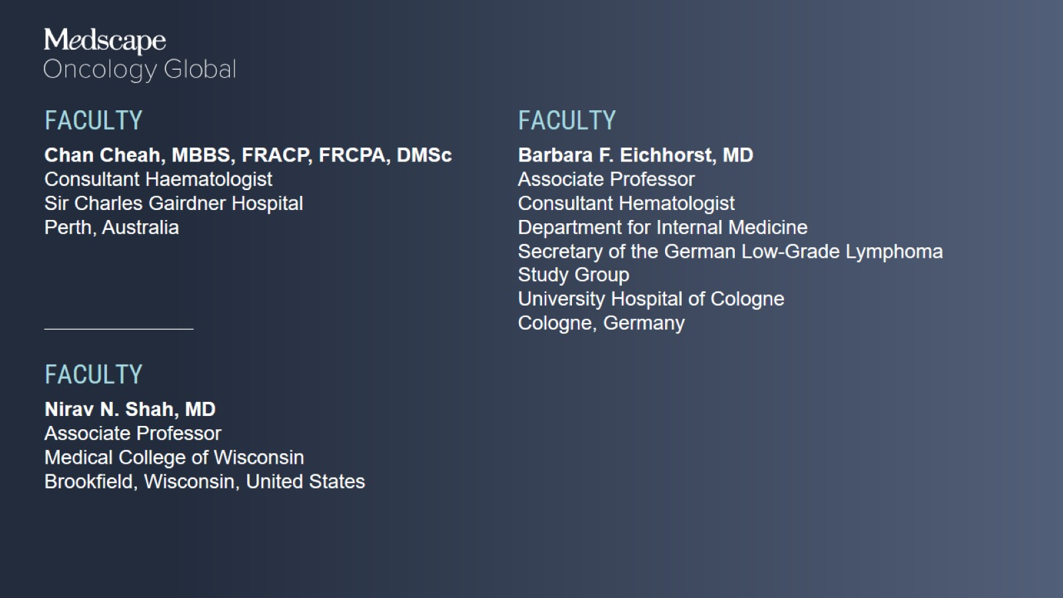

Slide 3
Program Overview

Slide 4
Covalent vs Noncovalent BTK Inhibitors

Slide 5
Selected Covalent and Noncovalent BTK Inhibitors for Treatment of CLL/SLL and MCL

Slide 6
Covalent BTK Inhibitors in CLL/SLL

Slide 7
Acalabrutinib Monotherapy in R/R CLL ACE-CL-001: PFS

Slide 8
Acalabrutinib Monotherapy in R/R CLL ACE-CL-001: Safety

Slide 9
Acalabrutinib vs Ibrutinib in Previously Treated CLL ELEVATE-RR: Burden of AEs

Slide 10
Acalabrutinib vs Ibrutinib in Previously Treated CLL ELEVATE-RR: Burden of AEs

Slide 11
Zanubrutinib vs Ibrutinib in R/R CLL/SLL ALPINE: ORR

Slide 12
Zanubrutinib vs Ibrutinib in R/R CLL/SLL ALPINE: PFS

Slide 13
Zanubrutinib vs Ibrutinib in R/R CLL/SLL ALPINE: PFS (Subgroups)

Slide 14
Noncovalent BTK Inhibitors in CLL/SLL

Slide 15
Pirtobrutinib in Covalent BTK Inhibitor Pretreated R/R CLL/SLL BRUIN: PFS

Slide 16
Pirtobrutinib in Covalent BTK Inhibitor Pretreated R/R CLL/SLL BRUIN: PFS (Subgroups)

Slide 17
Pirtobrutinib in Covalent BTK Inhibitor Pretreated R/R CLL/SLL BRUIN: Safety

Slide 18
Pirtobrutinib in Covalent BTKi-Intolerant B-Cell Malignancies BRUIN: TEAEs Recurring in the Same Patient

Slide 19
Pirtobrutinib in Covalent BTKi-Intolerant B-Cell Malignancies BRUIN: PFS

Slide 20
Pirtobrutinib in Richter Transformation BRUIN: Efficacy

Slide 21
Pirtobrutinib in Richter Transformation BRUIN: OS, DoR

Slide 22
Pirtobrutinib in Richter Transformation BRUIN: Safety

Slide 23
Nemtabrutinib in Pretreated B-Cell Malignancies Bellwave-001: ORR

Slide 24
Nemtabrutinib in Pretreated B-Cell Malignancies Bellwave-001: Safety

Slide 25
Covalent BTK Inhibitors in MCL

Slide 26
Time-Limited Ibrutinib and Tisagenlecleucel in R/R MCL TARMAC: CR at 4 Months

Slide 27
Time-Limited Ibrutinib and Tisagenlecleucel in R/R MCL TARMAC: CR at 4 Months

Slide 28
Time-Limited Ibrutinib and Tisagenlecleucel in R/R MCL TARMAC: CAR-T Cellular Kinetics

Slide 29
Zilovertamab and Ibrutinib in MCL/CLL/MZL TEAEs ≥ 20%

Slide 30
Zilovertamab and Ibrutinib in MCL/CLL/MZL Efficacy

Slide 31
Noncovalent BTK Inhibitors in MCL

Slide 32
Pirtobrutinib in Covalent BTKi-Pretreated R/R MCL BRUIN: Efficacy

Slide 33
Pirtobrutinib in Covalent BTKi-Pretreated R/R MCL BRUIN: DoR

Slide 34
Pirtobrutinib in Covalent BTKi-Pretreated R/R MCL BRUIN: Safety

Slide 35
Clinical Implications

Slide 36
Choosing the Right BTK Inhibitors for CLL/SLL

Slide 37
Choosing the Right BTK Inhibitors for CLL/SLL

Slide 38
Choosing the Right BTK Inhibitors for CLL/SLL

Slide 39
Choosing the Right BTK Inhibitors for MCL

Slide 40
Choosing the Right BTK Inhibitors for MCL

Slide 41
Choosing the Right BTK inhibitors for MCL

Slide 42
ALPINE: PFS Benefits With Zanubrutinib Over Ibrutinib

Slide 43
Managing the Side Effects of BTK Inhibitors

Slide 44
Managing the Side Effects of BTK Inhibitors

Slide 45
Managing the Side Effects of BTK Inhibitors

Slide 46
Managing the Side Effects of BTK Inhibitors

Slide 47
Noncovalent BTK Inhibitors: Evolving Treatment Paradigm

Slide 48
Noncovalent BTK Inhibitors: Evolving Treatment Paradigm

Slide 49
Noncovalent BTK Inhibitors: Evolving Treatment Paradigm

