Slide 2
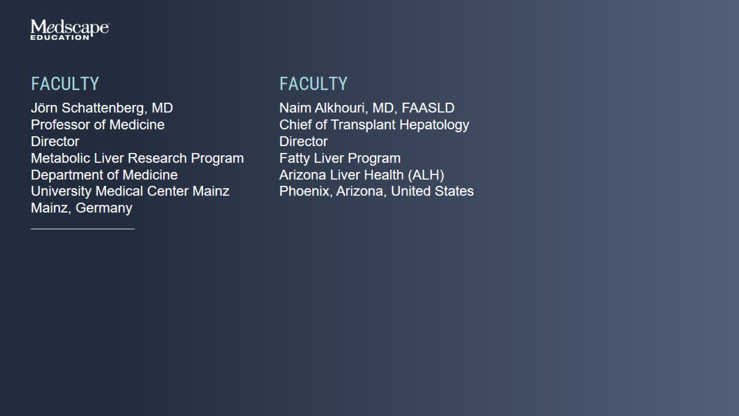

Slide 3
Introduction

Slide 4
Nonalcoholic Fatty Liver Disease

Slide 5
Nonalcoholic Fatty Liver Disease

Slide 6
Nonalcoholic Fatty Liver Disease

Slide 7
Nonalcoholic Fatty Liver Disease

Slide 8
Increasing Prevalence of NAFLD

Slide 9
Global Prevalence of NAFLD Variable and Correlates With Caloric Intake

Slide 10
Global Prevalence of NAFLD Variable and Correlates With Caloric Intake

Slide 11
Global Prevalence of NAFLD Variable and Correlates With Caloric Intake

Slide 12
Risk Factors for NAFLD

Slide 13
Risk Factors for NAFLD

Slide 14
NAFLD: A Multisystem Disease

Slide 15
NAFLD Affects Extrahepatic Organs and Regulatory Pathways

Slide 16
Natural History of NAFLD

Slide 17
Natural History of NAFLD

Slide 18
Natural History of NAFLD

Slide 19
Natural History of NAFLD

Slide 20
Natural History of NAFLD

Slide 21
Liver Fibrosis Is Associated With Long-Term Outcomes in Patients With NAFLD

Slide 22
Liver Fibrosis Is Associated With Long-Term Outcomes in Patients With NAFLD

Slide 23
Liver Fibrosis Is Associated With Long-Term Outcomes in Patients With NAFLD

Slide 24
Liver Fibrosis Is Associated With Long-Term Outcomes in Patients With NAFLD

Slide 25
Fibrosis Stage Predicts Adverse Disease Outcomes in NAFLD

Slide 26
Fibrosis Stage Predicts Adverse Disease Outcomes in NAFLD

Slide 27
Death and Decompensation in NAFLD Through the Stages

Slide 28
Noninvasive Tests for Liver Fibrosis

Slide 29
Importance of Fibrosis Screening

Slide 30
Importance of Fibrosis Screening

Slide 31
Evaluation for Liver Fibrosis Guidance for Using Noninvasive Tests (NITs)

Slide 32
Evaluation for Liver Fibrosis Guidance for Using Noninvasive Tests (NITs)

Slide 33
Evaluation for Liver Fibrosis Guidance for Using Noninvasive Tests (NITs)

Slide 34
Invasive Tool for Staging Fibrosis

Slide 35
Invasive Tool for Staging Fibrosis

Slide 36
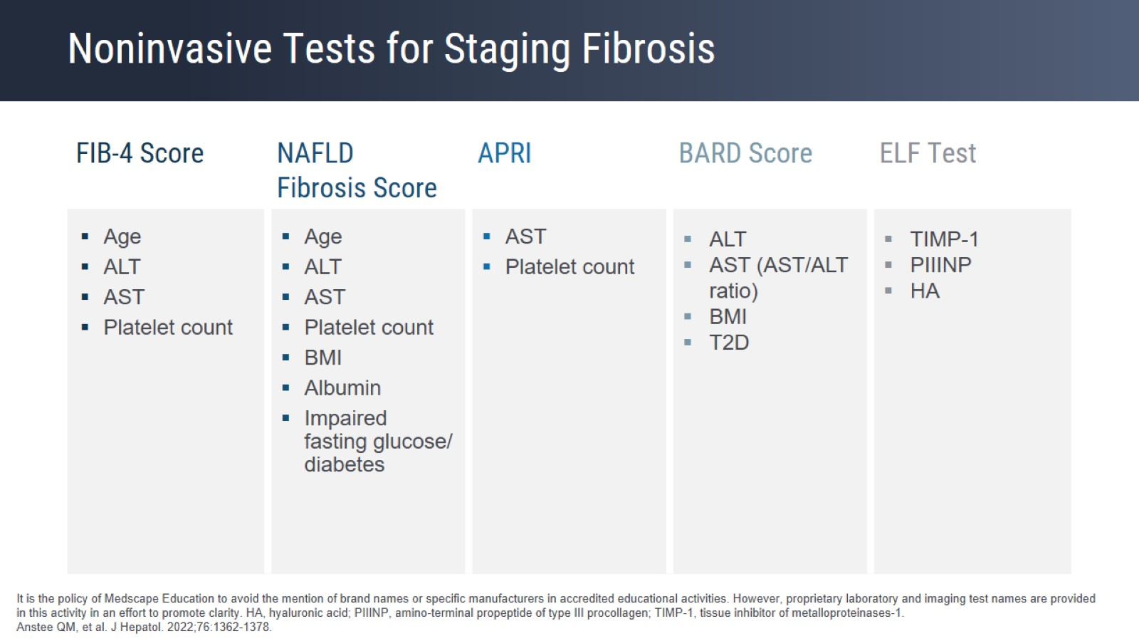
Noninvasive Tests for Staging Fibrosis

Slide 37
FIB-4 Score

Slide 38
FIB-4 Score

Slide 39
FIB-4 Score

Slide 40
FIB-4 Score

Slide 41
FIB-4 Score

Slide 42
Enhanced Liver Fibrosis (ELF) Test

Slide 43
Enhanced Liver Fibrosis (ELF) Test

Slide 44
Enhanced Liver Fibrosis (ELF) Test

Slide 45
Enhanced Liver Fibrosis (ELF) Test

Slide 46
ELF Predicts Progression More Accurately Than Biopsy Phase 2 Simtuzumab in NASH and Advanced Fibrosis

Slide 47
FIB-4 Predicts Long-Term Outcomes

Slide 48
Vibration-Controlled Transient Elastography

Slide 49
Vibration-Controlled Transient Elastography

Slide 50
Vibration-Controlled Transient Elastography

Slide 51
Machine Learning Model for Early Prediction of NASH Patients Using Noninvasive Clinical Parameters

Slide 52
Guidance From Professional Societies

Slide 53
Noninvasive Evaluation of Fibrosis and Follow-Up

Slide 54
Determining the Risk of Progression in Patients With NAFLD Facilitates Appropriate, Timely Referral

Slide 55
Determining the Risk of Progression in Patients With NAFLD Facilitates Appropriate, Timely Referral

Slide 56
Determining the Risk of Progression in Patients With NAFLD Facilitates Appropriate, Timely Referral

Slide 57
Determining the Risk of Progression in Patients With NAFLD Facilitates Appropriate, Timely Referral

Slide 58
Determining the Risk of Progression in Patients With NAFLD Facilitates Appropriate, Timely Referral

Slide 59
Determining the Risk of Progression in Patients With NAFLD Facilitates Appropriate, Timely Referral

Slide 60
Determining the Risk of Progression in Patients With NAFLD Facilitates Appropriate, Timely Referral

Slide 61
Determining the Risk of Progression in Patients With NAFLD Facilitates Appropriate, Timely Referral

Slide 62
2-Step Pathway for NAFLD: FIB-4 Followed by ELF

Slide 63
2022 AASLD Updates for NAFLD in Adults

Slide 64
Close

