Slide 2
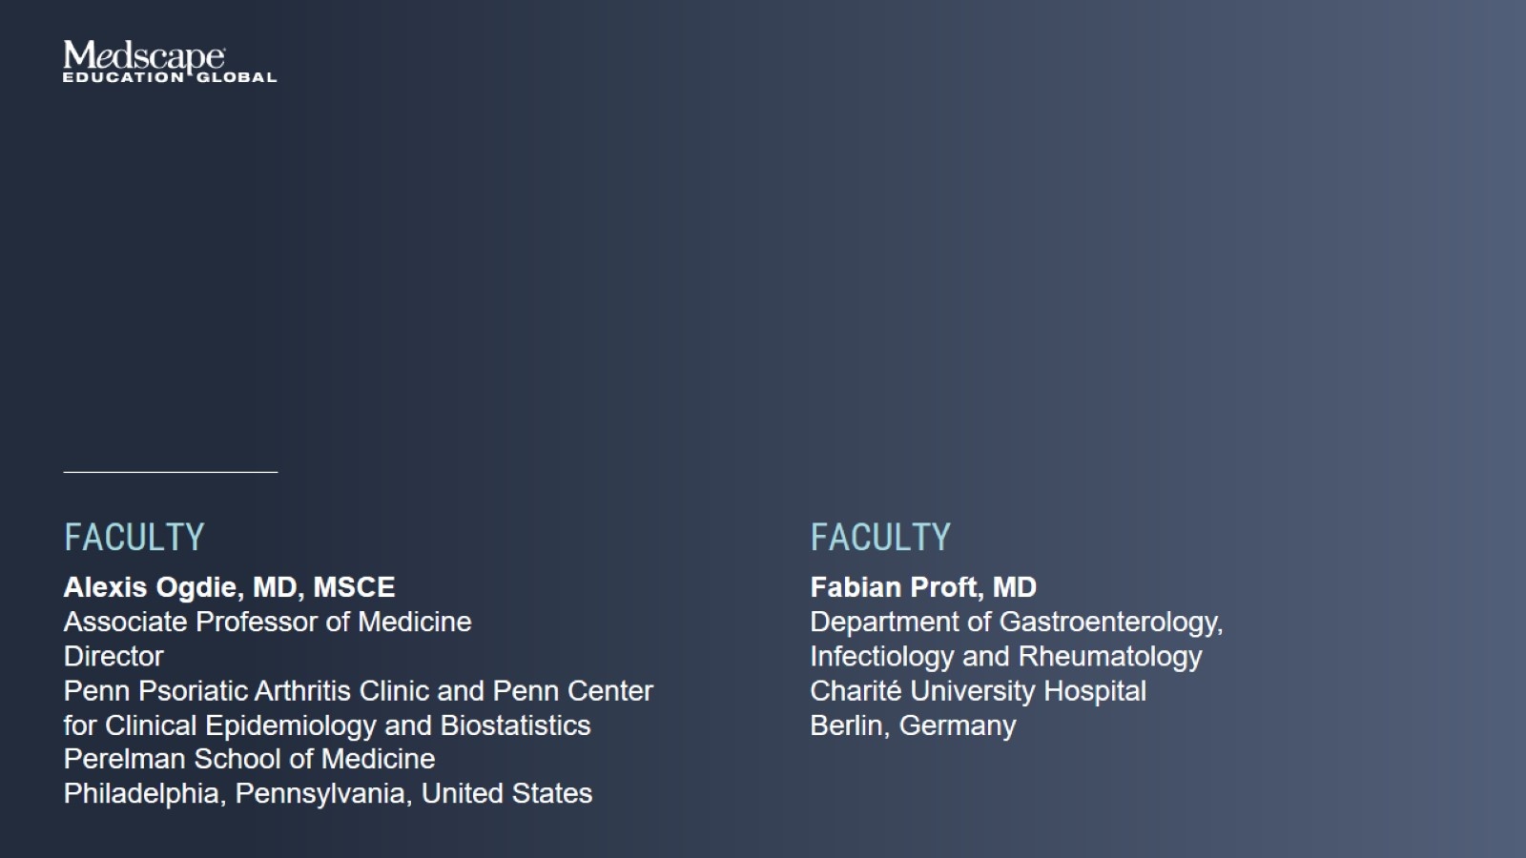

Slide 3
Spondyloarthritis Overlapping Clinical Features

Slide 4
Current Therapeutic Landscape in SpA

Slide 5
Current Therapeutic Landscape in SpA

Slide 6
Current Therapeutic Landscape in SpA

Slide 7
Current Therapeutic Landscape in SpA

Slide 8
Current Therapeutic Landscape in SpA

Slide 9
Current Therapeutic Landscape in SpA

Slide 10
Current Therapeutic Landscape in SpA

Slide 11
Current Therapeutic Landscape in SpA

Slide 12
Current Therapeutic Landscape in SpA

Slide 13
Current Understanding of Underlying Immunopathology in SpA

Slide 14
Current Understanding of Underlying Immunopathology in SpA

Slide 15
Potential Synergistic Activity of IL-17A and TNF-α in the SpA Joint

Slide 16
Structure of the IL-23, IL-12, and IL-17 Family of Cytokines, Their Receptors, and the Mechanism of Their Inhibition

Slide 17
Role of JAK Inhibitors and Influence on IL-17/-23 Directly or Indirectly via Innate Immune Cells

Slide 18
Oral, Selective TYK2 Inhibitor Deucravacitinib Phase 2 Trial in PsA

Slide 19
Oral, Selective TYK2 Inhibitor Deucravacitinib Phase 2 Trial in PsA

Slide 20
GRAPPA Guideline Recommendations for PsA

Slide 21
GRAPPA Guideline Recommendations for PsA

Slide 22
GRAPPA Guideline Recommendations for PsA

Slide 23
ASAS-EULAR Guideline Recommendations for axSpA Phase 1

Slide 24
ASAS-EULAR Guideline Recommendations for axSpA Phase 2

Slide 25
ASAS-EULAR Guideline Recommendations for axSpA Phase 3

Slide 26
Efficacy of bDMARDs and tsDMARDs Against Different Manifestations of SpA

Slide 27
Efficacy of bDMARDs and tsDMARDs Against Different Manifestations of SpA

Slide 28
Efficacy of bDMARDs and tsDMARDs Against Different Manifestations of SpA

Slide 29
Unmet Needs in SpA and Rationale for Novel Therapies

Slide 30
Unmet Needs in SpA and Rationale for Novel Therapies

Slide 31
Bimekizumab: Dual IL-17A and IL-17F Inhibitor in PsA BE OPTIMAL

Slide 32
Bimekizumab: Dual IL-17A and IL-17F Inhibitor in PsA BE OPTIMAL

Slide 33
Bimekizumab: Dual IL-17A and IL-17F Inhibitor in PsA BE OPTIMAL

Slide 34
Bimekizumab: Dual IL-17A and IL-17F Inhibitor in PsA BE COMPLETE

Slide 35
Bimekizumab: Dual IL-17A and IL-17F Inhibitor in PsA BE COMPLETE

Slide 36
Brodalumab Phase 3 Studies AMVISION-1 and 2

Slide 37
Brodalumab Phase 3 Studies AMVISION-1 and 2

Slide 38
Head-to-Head Comparisons in PsA SPIRIT-H2H

Slide 39
Head-to-Head Comparisons in PsA EXCEED

Slide 40
BKZ: BE MOBILE 1 Phase 3 Study in Patients With nr-axSpA

Slide 41
BKZ: BE MOBILE 2 Phase 3 Study in Patients With AS

Slide 42
BKZ: 3 Years Result in Patients With AS From BE AGILE

Slide 43
Brodalumab in axSpA Phase 3 Study in 48 Sites in Japan, South Korea, and Taiwan

Slide 44
Other Novel Therapies in Development in SpA

Slide 45
IL-23 Inhibitors and axSpA

Slide 46
Head-to-Head Comparisons in axSpA SURPASS Study

Slide 47
Head-to-Head Comparisons in axSpA SURPASS Study

Slide 48
Efficacy of IL-17 Inhibitors in Patients With axPsA MAXIMISE Trial

Slide 49
Efficacy of IL-17 Inhibitors in Patients With axPsA MAXIMISE: Imaging at Week 12

Slide 50
Understanding axPsA and the Impact of Therapies

Slide 51
Understanding axPsA and the Impact of Therapies

Slide 52
Understanding axPsA and the Impact of Therapies

Slide 53
Understanding axPsA and the Impact of Therapies

Slide 54
Treatment Class Comparisons in PsA and axSpA Comment on Safety

Slide 55
Treatment Class Comparisons in PsA and axSpA Comment on Safety

Slide 56
Key Considerations for Treatment Selection and Sequencing in Patients With SpA

Slide 57
Key Considerations for Treatment Selection and Sequencing in Patients With SpA

Slide 58
Gender Differences in SpA

Slide 59
Gender Differences in SpA

Slide 60
Gender Differences in SpA

Slide 61
Gender Differences in SpA

