Slide 2
Introduction

Slide 3
Why Screen?

Slide 4
Health Care Has Evolved

Slide 5
Chronic Care Model Leads to Improved Outcomes

Slide 6
Chronic Care Model Leads to Improved Outcomes

Slide 7
Chronic Diseases in America

Slide 8
Ask Yourself…

Slide 9
Cardiometabolic Diseases Are Interrelated

Slide 10
Cardiometabolic Diseases Increases Risk for CVD

Slide 11
Multifactorial Approach to Patients With Diabetes

Slide 12
Link Among CKD, Diabetes, and Heart Disease

Slide 13
CKD Is Common in Patients With Diabetes

Slide 14
Diabetes and Heart Disease

Slide 15
Cardiometabolic Risk Factors

Slide 16
Risk Factors

Slide 17
Risk Factors (cont)

Slide 18
Make Time to Listen

Slide 19
Active Listening in Health Care

Slide 20
Active Listening in Health Care

Slide 21
Active Listening in Health Care (cont)

Slide 22
Make Efficient Use of Your Patients' Time

Slide 23
Make Efficient Use of Your Time

Slide 24
Make Efficient Use of Your Time

Slide 25
Make Efficient Use of Your Time

Slide 26
Make Efficient Use of Your Time

Slide 27
Key to Success

Slide 28
Chronic Kidney Disease and Type 2 Diabetes

Slide 29
Urine Albumin-to-Creatinine Ratio (UACR) and eGFR

Slide 30
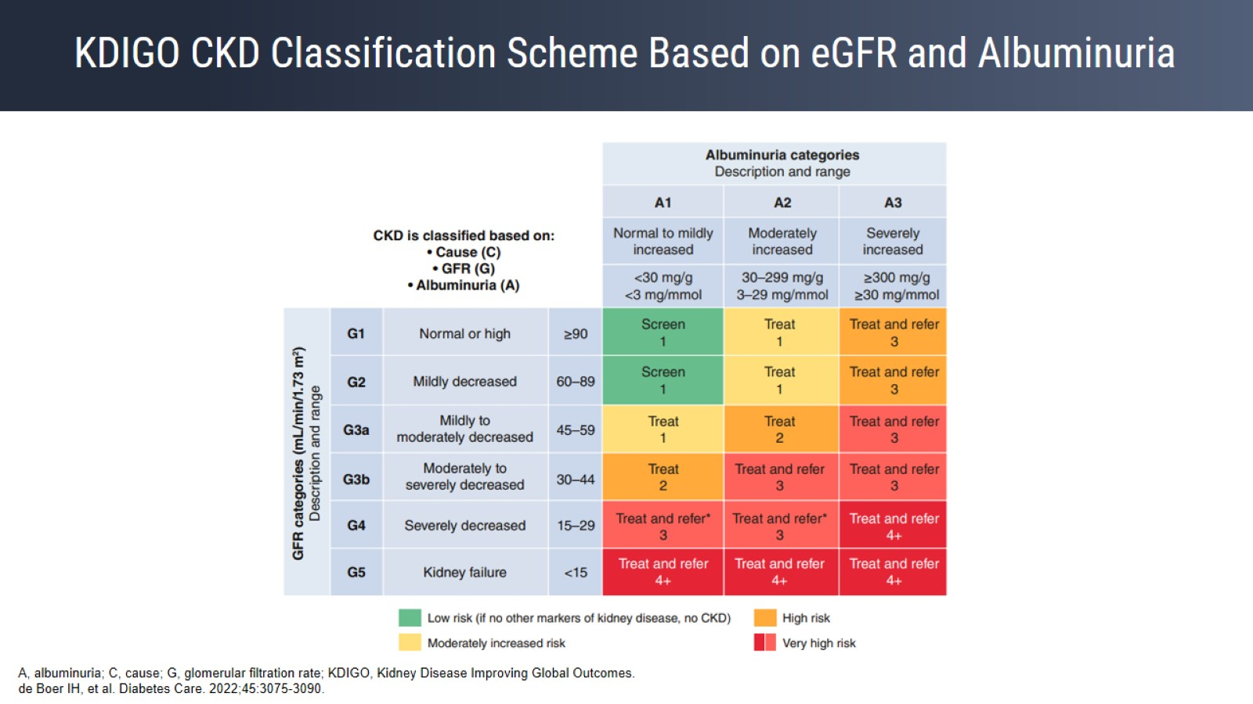
KDIGO CKD Classification Scheme Based on eGFR and Albuminuria

Slide 31
CKD Screening Guidelines

Slide 32
Heart Failure

Slide 33
Heart Health

Slide 34
2013 ACCF/AHA Guidelines

Slide 35
NAFLD

Slide 36
Screening for NAFLD in Primary Care

Slide 37
Management of NAFLD

Slide 38
Do I Need to Refer?

Slide 39
Management of T2D and CKD

Slide 40
Medical Management of T2D and CKD

Slide 41
Safety of SGLT2 Inhibitors

Slide 42
Heart-Healthy Diet

Slide 43
Medical Management of Heart Failure

Slide 44
Heart Failure Screening Is Easy

Slide 45
Medical Management of Hyperlipidemia

Slide 46
Role of Primary Care

Slide 47
Primary Care Plays a Key Role

Slide 48
Are We Equipped in the United States to Manage Cardiometabolic Diseases?

Slide 49
Are We Equipped in the United States to Manage Cardiometabolic Diseases?

Slide 50
Are We Equipped in the United States to Manage Cardiometabolic Diseases?

Slide 51
Are We Equipped in the United States to Manage Cardiometabolic Diseases?

Slide 52
Are We Equipped in the United States to Manage Cardiometabolic Diseases?

Slide 53
Approach to Comprehensive Assessment

Slide 54
Approach to Comprehensive Assessment (cont)

Slide 55
Approach to Comprehensive Assessment (cont)

Slide 56
It Is Worth It

