Slide 5
Agenda

Slide 6
Maternal Glycemic Control Is Key

Slide 7
Maternal Glycemic Control Is Key

Slide 8
Self-Monitoring of Blood Glucose

Slide 9
Self-Monitoring of Blood Glucose

Slide 10
Self-Monitoring of Blood Glucose

Slide 11
Self-Monitoring of Blood Glucose

Slide 12
Self-Monitoring of Blood Glucose

Slide 13
Continuous Glucose Monitoring

Slide 14
Different Types of CGM Devices

Slide 15
FDA Approval for Use in Pregnancy

Slide 16
ADA Standards of Care 2023

Slide 17
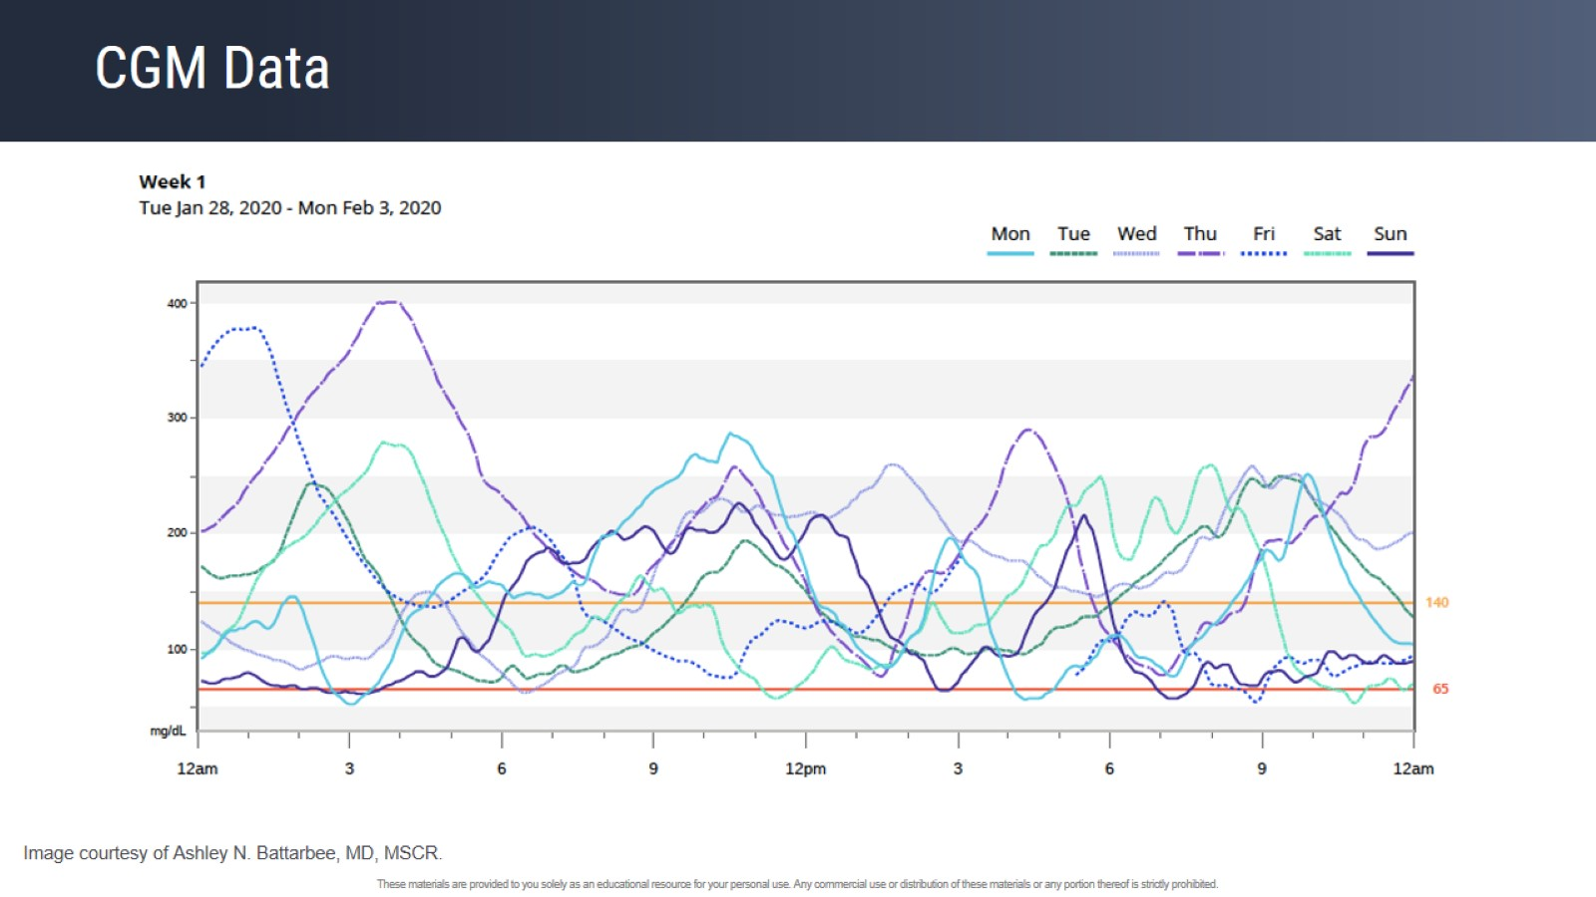
CGM Data

Slide 18
CGM Download Software and AGP Reports

Slide 19
Decoding CGM Reports Where to Start?

Slide 20
Decoding CGM Reports Where to Start?

Slide 21
Decoding CGM Reports Overview and AGP Reports

Slide 22
Decoding CGM Reports Time in Range

Slide 23
Decoding CGM Reports Time in Range

Slide 24
Decoding CGM Reports Time in Range

Slide 25
Things Not (Always) in CGM Reports

Slide 27
Case Gestational Diabetes Mellitus

Slide 28
Data Feedback From CGM

Slide 29
Data Feedback From CGM

Slide 30
What Does the Patient See?

Slide 31
Data Feedback to Help With Glycemic Management

Slide 32
Time in Range

Slide 33
Time in Range

Slide 34
Time in Range

Slide 35
Temporary Periods of Potential Glucose Mismatch

Slide 36
Case Gestational Diabetes Requiring Hypoglycemic Agents

Slide 37
Case GDMA2

Slide 38
What Are We Trying to Achieve?

Slide 40
Characteristics and Neonatal Outcomes of Women With Type 1 or Type 2 Diabetes: A 5-Year National Population-Based Cohort Study

Slide 41
Characteristics and Neonatal Outcomes of Women With Type 1 or Type 2 Diabetes: A 5-Year National Population-Based Cohort Study

Slide 42
Time in Range Targets

Slide 43
Case Type 2 Diabetes

Slide 44
Patient’s AGP Report

Slide 45
Patient’s AGP Report

Slide 46
CGM and Glucose Trends

Slide 47
Additional Insulin Dosing With Meals Based on Trend Arrows

Slide 48
Correction Postprandially AVOID Stacking / "The Angry Bolus”

Slide 49
Correction Postprandially AVOID Stacking / "The Angry Bolus”

Slide 50
Titration of Insulin

Slide 51
Individualizing Alarms for Patients to Avoid Fatigue

Slide 52
Individualizing Alarms for Patients to Avoid Fatigue

Slide 53
Individualizing Alarms for Patients to Avoid Fatigue

Slide 54
Individualizing Alarms for Patients to Avoid Fatigue

Slide 55
Take-Home Points for Insulin, CGM in Pregnancy, and CGM

Slide 56
Insulin, Food, Activity, and rtCGM

Slide 57
Top Practical Tips for Using CGM in Pregnancy

Slide 58
CGM Use With and Without Remote Monitoring in Pregnant Women With Type 1 Diabetes: A Pilot Study

Slide 59
You Are Doing the Work — Bill for Your Time

Slide 60
You Are Doing the Work — Bill for Your Time

Slide 61
Smart Phrase Example

Slide 62
Smart Phrase Example

Slide 63
CGM as an Empowerment Tool for Patient and Provider

Slide 64
CGM as an Empowerment Tool for Patient and Provider

Slide 65
CGM as an Empowerment Tool for Patient and Provider

