Slide 3
US Breast Cancer Incidence and Mortality

Slide 4
Disparities in Mortality Between Black and White Women With Breast Cancer by Age and Stage at Diagnosis

Slide 5
Trends in US Breast Cancer Incidence by Race/Ethnicity

Slide 6
Trends in US Breast Cancer Mortality by Race/Ethnicity

Slide 7
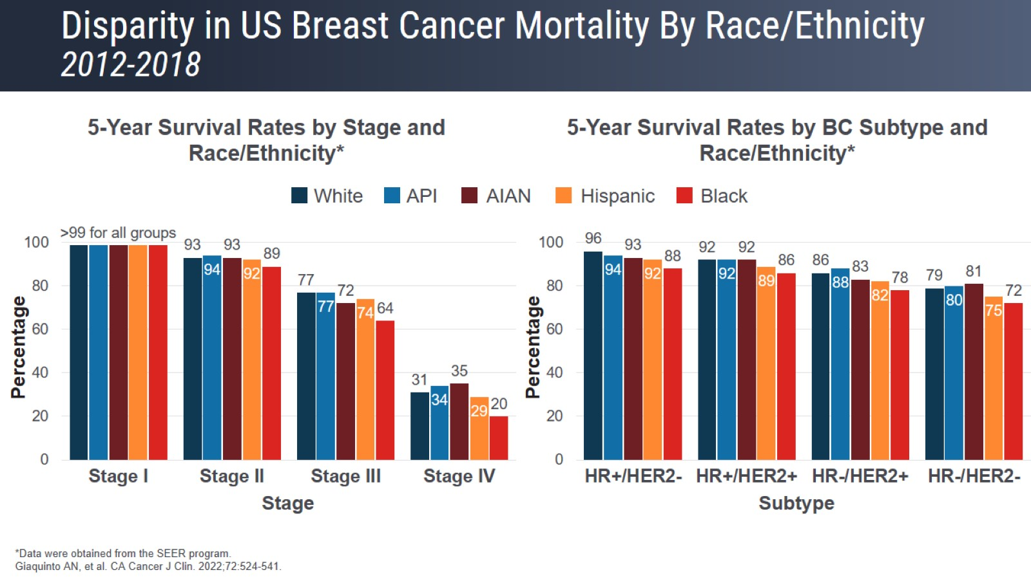
Disparity in US Breast Cancer Mortality By Race/Ethnicity 2012-2018

Slide 8
Change in Breast Cancer Mortality for White vs Black Women 1975-2020

Slide 9
Change in Breast Cancer Mortality for White vs Black Women 1975-2020

Slide 10
Other Racial Disparities in Breast Cancer Diagnostics Black vs White Women

Slide 11
Distribution of Breast Cancer by Subtype and Race/Ethnicity

Slide 12
Four Primary Molecular Subtypes of Breast Cancer Proportion of Diagnoses and Characteristics

Slide 13
Four Primary Molecular Subtypes of Breast Cancer Proportion of Diagnoses and Characteristics

Slide 14
Pitfalls of TNBC

Slide 15
Data Show Significant Ethnic/Racial Disparities in TNBC Incidence

Slide 16
Reporting of Race and Ethnicity in Medical Research

Slide 17
Reporting of Race and Ethnicity in Medical Research

Slide 18
Germline Mutations That Are Overrepresented in TNBC

Slide 19
Genetic Drivers of TNBC More Common in Black Women

Slide 20
Disparities Exist in Access to BRCA1/2 Testing

Slide 21
The Role of Allostatic Load in Breast Cancer

Slide 22
Social Determinants of Health (SDOH) Nonmedical Factors That Influence Health Outcomes

Slide 23
Social Determinants of Health (SDOH) Nonmedical Factors That Influence Health Outcomes

Slide 24
Systemic Racism How it Contributes to Disparities in SDOH in the United States

Slide 25
Disparities in Uninsurance Rates by Race/Ethnicity

Slide 26
Lack of Healthcare Coverage Contributes to Breast Cancer Mortality

Slide 27
Medicaid Expansion Led to Reductions in Breast Cancer Disparities Income, Race, and Age

Slide 28
Contributors to Poor Mammography Screening Adherence

Slide 29
Other Inequalities in Breast Cancer Care Are Linked to SDOH

Slide 30
Barriers to BRCA Testing for Women With TNBC Real-World Study

Slide 31
Barriers to Genetic Counseling in Black Women With Breast Cancer

Slide 32
COVID-19 Caused Major Disruptions in Breast Cancer Care

Slide 33
COVID-19 Caused Anxiety in Women With Breast Cancer

Slide 34
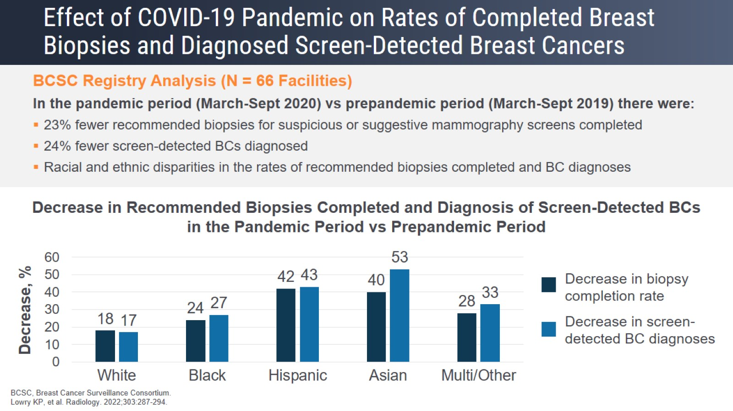
Effect of COVID-19 Pandemic on Rates of Completed Breast Biopsies and Diagnosed Screen-Detected Breast Cancers

Slide 35
Effect of COVID-19 on US Mammography Screening Rates

Slide 36
Encourage Patients to Get Back on Track With Their Screening Expert Perspective

Slide 37
Encourage Patients to Get Back on Track With Their Screening Expert Perspective

Slide 38
What Are Explicit and Implicit Biases?

Slide 39
Explicit and Implicit Biases Perpetuate Healthcare Disparities

Slide 40
Implicit Biases Lead to Underrepresentation of Patients From Racial/Ethnic Minority Groups in Cancer Clinical Trials

Slide 41
Many Advocacy Organizations at the National and State Level Are Promoting Better Breast Cancer Care for Underserved Groups

Slide 42
Having Young Children Hinders Optimal Breast Cancer Care Black Women Are More Likely to Head Single-Parent Households

Slide 43
Elder Care Obligations Cause Delays in Cancer Care

Slide 44
Ways to Address System-Wide Barriers to Health Equity

Slide 45
Ways Advocacy Organizations Are Working to Reduce Disparities Patient Advocate Perspective

Slide 46
An Interprofessional Team Is Invaluable for Breast Cancer Care Oncologist’s Perspective

Slide 47
What a Breast Oncology Clinical Specialist Pharmacist Does

Slide 48
Educating the Patient From a Pharmacy Specialist Perspective

Slide 49
One of the Most Important Roles of the Pharmacy Specialist Is Making Sure Patients Can Access Their Treatment

Slide 50
One of the Most Important Roles of the Pharmacy Specialist Is Making Sure Patients Can Access Their Treatment

Slide 51
Role of the Nurse/NP in Managing Patients With Breast Cancer

Slide 52
Rely on the Interprofessional Team for Help

Slide 53
The Greater Goals in Eliminating Disparities Nursing Perspective

Slide 54
The Role of the Patient Navigator in Improving Equity in Cancer Care

Slide 55
Perspective of Dr Toni Willis as a Breast Cancer Survivor

Slide 56
Conclusions

Slide 57
How to Contact Living Beyond Breast Cancer

Slide 58
Additional Resources

