Slide 1
New Horizons and Expert Insights on the Management of Recurrent Clostridioides difficile Infection

Slide 2
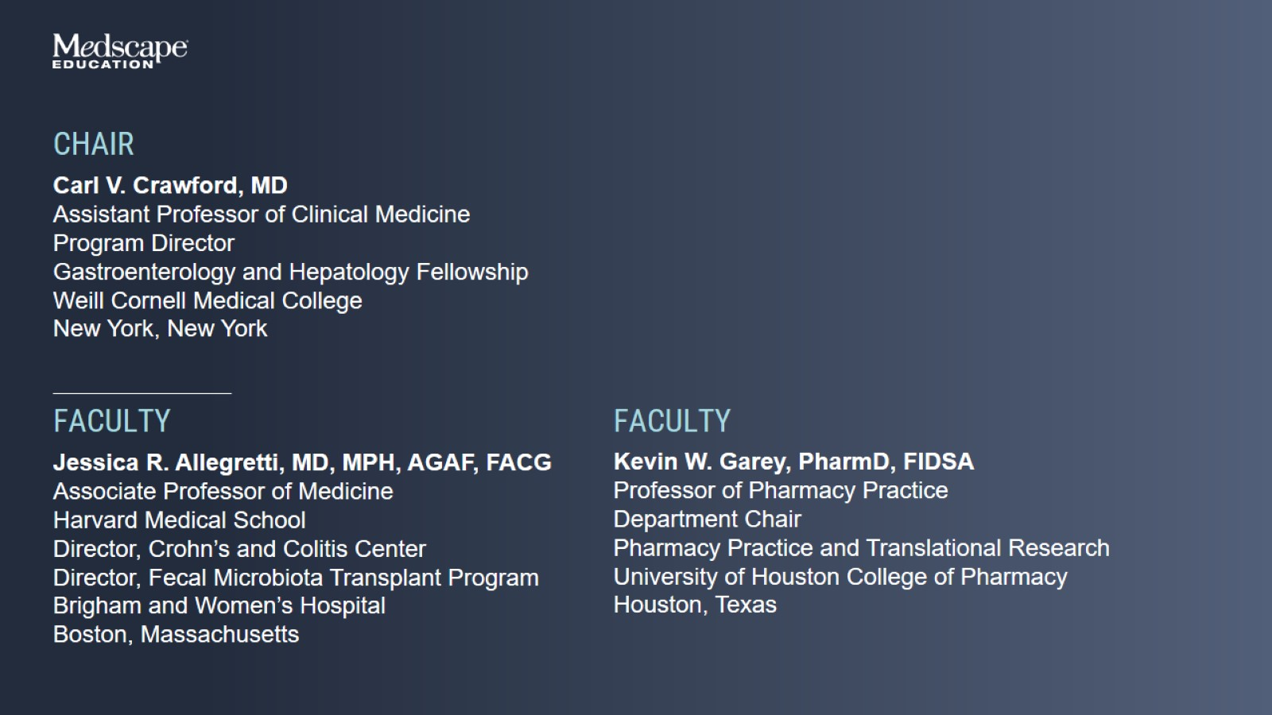

Slide 3
Agenda

Slide 6
Important Terminology

Slide 7
Composition and Function of the Gut Microbiome

Slide 8
Examples of Taxonomic Gut Microbiota Composition

Slide 9
Overview of Microbiota-Mediated Colonization Resistance

Slide 10
Microbiome Diversity May Not Fully Recover After Antibiotics

Slide 11
C difficile Facts

Slide 12
Annual Incidence Rate of CDI Among Medicare Advantage Enrollees: 2012 to 2019

Slide 13
C difficile Overview and Etiology

Slide 14
C difficile Life Cycle

Slide 15
Bile Acid Metabolism and C difficile Infection

Slide 16
Bile Acid Metabolism and C difficile Infection

Slide 17
Dysbiosis Increases With Each Recurrent C difficile Episode

Slide 18
Case 1 Presentation Mary

Slide 19
C difficile Infection Testing Algorithm ACG 2021 Guidelines

Slide 20
Advantages and Pitfalls of CDI Tests

Slide 21
Case 1 Continues

Slide 22
Treatment of First C difficile Infection ACG 2021 Guidelines

Slide 23
Treatment of Initial C difficile Infection

Slide 25
Case 2 Presentation John

Slide 26
Risk Factors for Recurrent CDI Are Similar to Those for Initial Infection

Slide 27
American College of Gastroenterology, 2021 Recurrent CDI

Slide 28
Strategies for Managing Recurrent CDI

Slide 29
Bezlotoxumab for Prevention of CDI Recurrence MODIFY I and II

Slide 30
Model of Microbiota Restoration

Slide 31
Microbiome-Based Therapies FMT and LBPs

Slide 32
Indications for FMT in Recurrent C difficile Infection ACG 2021 Guidelines

Slide 33
Efficacy of FMT for Recurrent CDI Meta-Analysis of 37 Studies

Slide 34
Adverse Events Reported After FMT

Slide 35
Preparing a Patient for FMT

Slide 36
FMT for CDI Where Do We Stand in 2023?

Slide 38
Case 2 Continues 4 Months Later

Slide 39
Current Live Biotherapeutic Landscape

Slide 40
LBPs vs Probiotics

Slide 41
Fecal Microbiota, live-jslm (Formerly RBX2660) Indications for Use

Slide 42
Fecal Microbiota, live-jslm Safety

Slide 43
Fecal Microbiota, live-jslm Phase 3 Clinical Trial in Recurrent CDI PUNCHCD3

Slide 44
Fecal Microbiota, live-jslm Phase 3 Clinical Trial: PUNCHCD3 Rates of Treatment Success at Week 8

Slide 45
Fecal Microbiota, live-jslm Phase 3 Clinical Trial: PUNCHCD3 Time to CDI Recurrence Through 6 Months

Slide 46
Fecal Microbiota, live-jslm Phase 3 Clinical Trial: PUNCHCD3 Restoration of Bile Acid Composition

Slide 47
Fecal Microbiota, live-jslm Phase 3 Clinical Trial: PUNCHCD3 HRQOL Outcomes

Slide 48
Fecal Microbiota, live-jslm PUNCHCD3 Open-Label Study

Slide 49
Fecal Microbiota Spores, Live-brpk Capsules (Formerly SER-109) Indications for Use

Slide 50
Fecal Microbiota Spores, Live-brpk Capsules Safety

Slide 51
Fecal Microbiota Spores, Live-brpk Capsules Phase 3 Trial: ECOSPOR III

Slide 52
Fecal Microbiota Spores, Live-brpk Capsules: ECOSPOR III Efficacy Outcomes

Slide 53
Fecal Microbiota Spores, Live-brpk Capsules: ECOSPOR III Compositional and Metabolic Changes

Slide 54
Fecal Microbiota Spores, Live-brpk Capsules: ECOSPOR III Efficacy Maintained Through Week 24

Slide 55
Fecal Microbiota Spores, Live-brpk Capsules: ECOSPOR III Quality-of-Life Outcomes at Week 8

Slide 56
Fecal Microbiota Spores, Live-brpk Capsules Single Arm, Open-Label, Phase 3 Trial: ECOSPOR IV

Slide 57
VE303 Placebo-Controlled Phase 2 Study

Slide 58
VE303: Placebo-Controlled Phase 2 Study Rate of Recurrence Through Week 8

Slide 60
Concluding Remarks

