Slide 2
Indications for Breast MRI

Slide 3
Breast MRI (AB-MRI)

Slide 4
MRI Visualizes Tumor Angiogenesis

Slide 5
Breast MRI Is an Effective Screening Tool

Slide 6
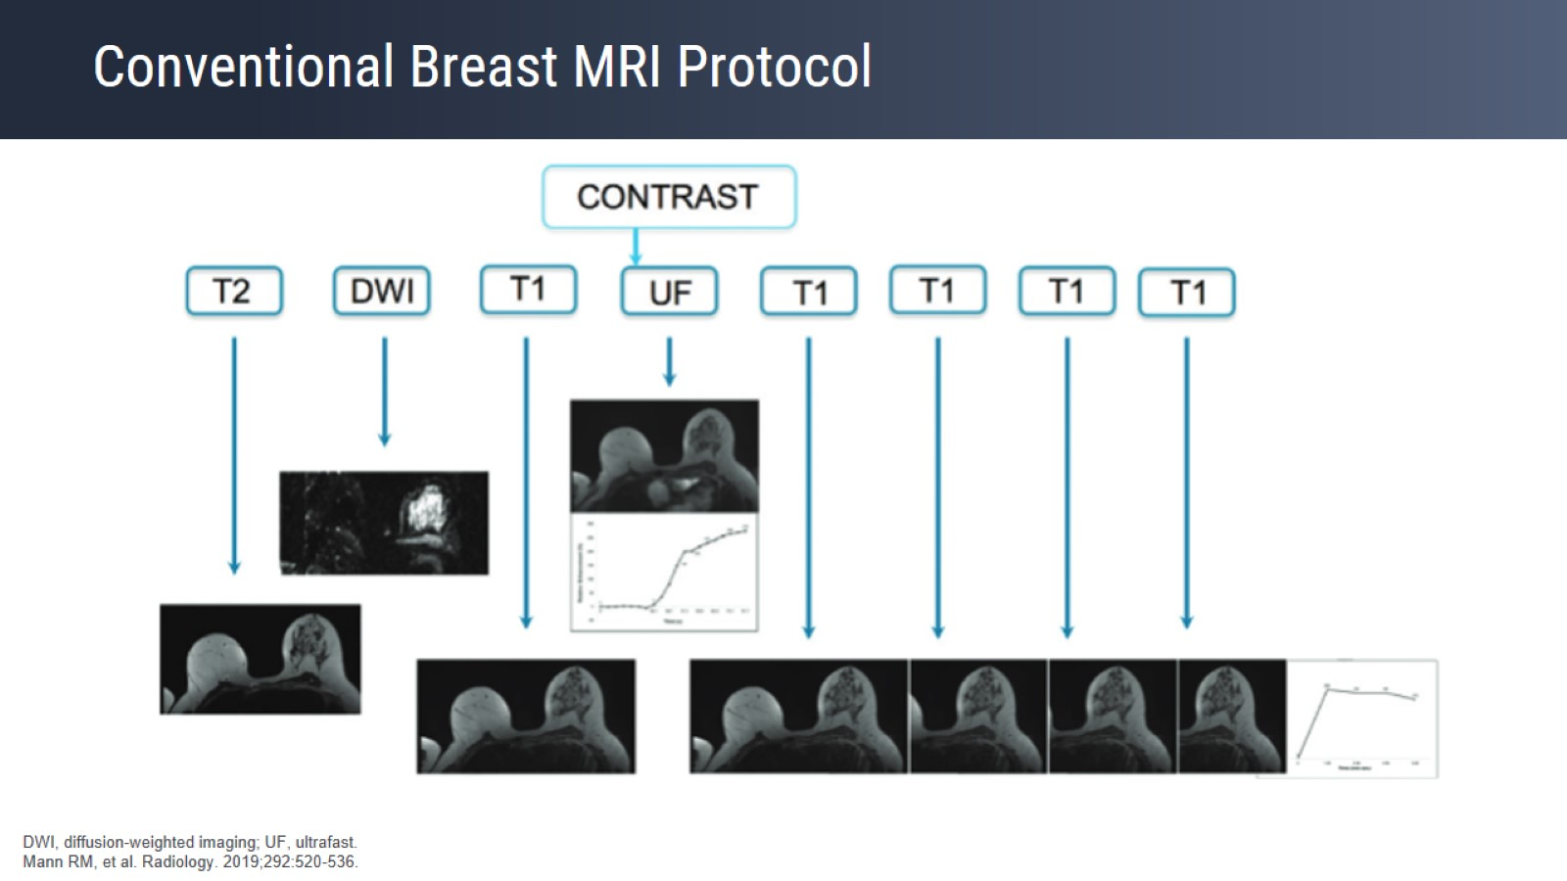
Conventional Breast MRI Protocol

Slide 7
Conventional Breast MRI Protocol

Slide 8
Signal Intensity Time Curve Is Predictive of Malignancy

Slide 9
Breast Cancer Biology

Slide 10
Clinical Indications for Breast MRI

Slide 11
Clinical Indications for Breast MRI

Slide 12
Breast MRI Screening Guidelines American Cancer Society

Slide 13
Breast MRI Screening Guidelines American Cancer Society

Slide 14
Breast MRI Screening Guidelines American Cancer Society

Slide 15
Breast MRI Screening Guidelines American Cancer Society

Slide 16
MRI Screening in Dense Breasts

Slide 17
DENSE Trial

Slide 18
DENSE Trial

Slide 19
DENSE Trial Results

Slide 20
DENSE Trial Second Screening Round

Slide 21
European Society of Breast Imaging (EUSOBI) Guidelines

Slide 22
European Society of Breast Imaging (EUSOBI) Guidelines

Slide 23
European Society of Breast Imaging (EUSOBI) Guidelines

Slide 24
What About Women at Average Risk?

Slide 25
Breast MRI Screening in Women at Average Risk

Slide 26
MRI Screening in Women at Average Risk Observational Cohort Study

Slide 27
Why Abbreviated Breast MRI?

Slide 28
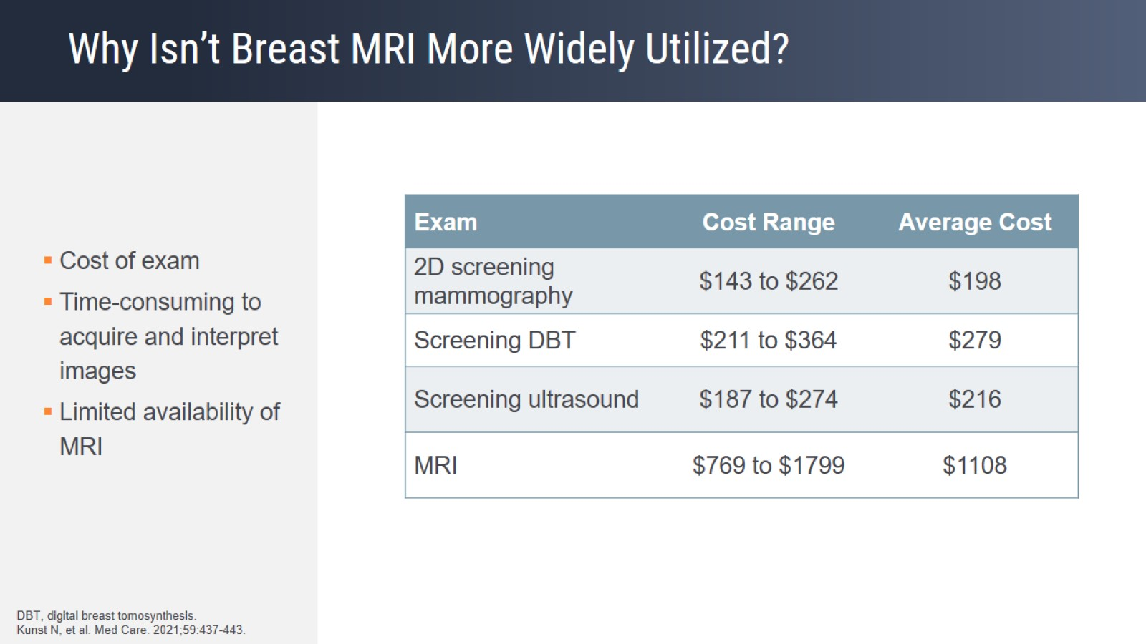
Why Isn’t Breast MRI More Widely Utilized?

Slide 29
Limitations and Considerations of Conventional Breast MRI

Slide 30
Limitations and Considerations of Conventional Breast MRI

Slide 31
Limitations and Considerations of Conventional Breast MRI

Slide 32
Goal of Abbreviated MRI

Slide 33
Observational Reader Study

Slide 34
Observational Reader Study Results

Slide 35
Observational Reader Study Results

Slide 36
AB-MRI of the Breast: Does It Provide Value?

Slide 37
Review Study Heterogeneity of Women at Intermediate and High Risk

Slide 38
Review Study Heterogeneity of Imaging Protocol

Slide 39
Review Study Sensitivity and Specificity

Slide 40
Review Study Follow-Up Data and Specificity

Slide 41
Review Studies Conclusions

Slide 42
EA1141 ECOG-ACRIN Trial

Slide 43
EA1141 ECOG-ACRIN Trial Results

Slide 44
EA1141 ECOG-ACRIN Trial Results

Slide 45
Pros and Cons of AB-MRI and Ultrafast MRI

Slide 46
Pros^{[a]} and Cons^{[b]} of AB-MRI vs Conventional Breast MRI

Slide 47
Kinetic Information Acquired With AB-MRI

Slide 48
Value of Early Enhancement

Slide 49
Fast Temporal Resolution

Slide 50
Ultrafast Breast MRI

Slide 51
Time to Enhancement (TTE)^{[a]}

Slide 52
NYU Ultrafast Protocol

Slide 53
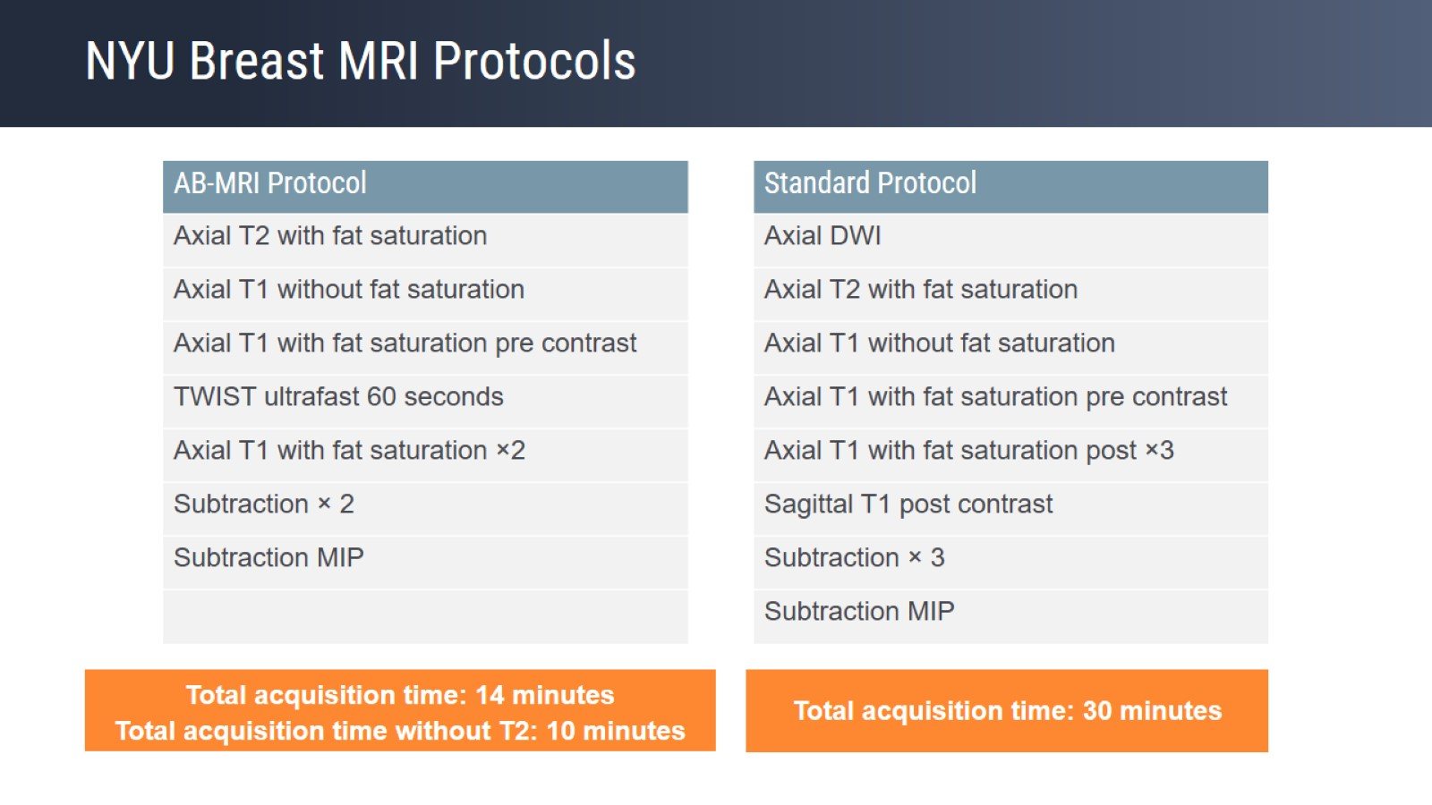
NYU Breast MRI Protocols

Slide 54
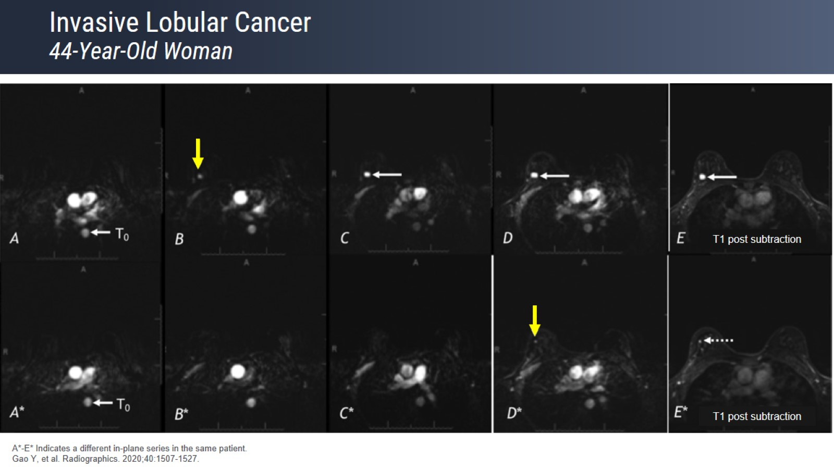
Invasive Lobular Cancer 44-Year-Old Woman

Slide 55
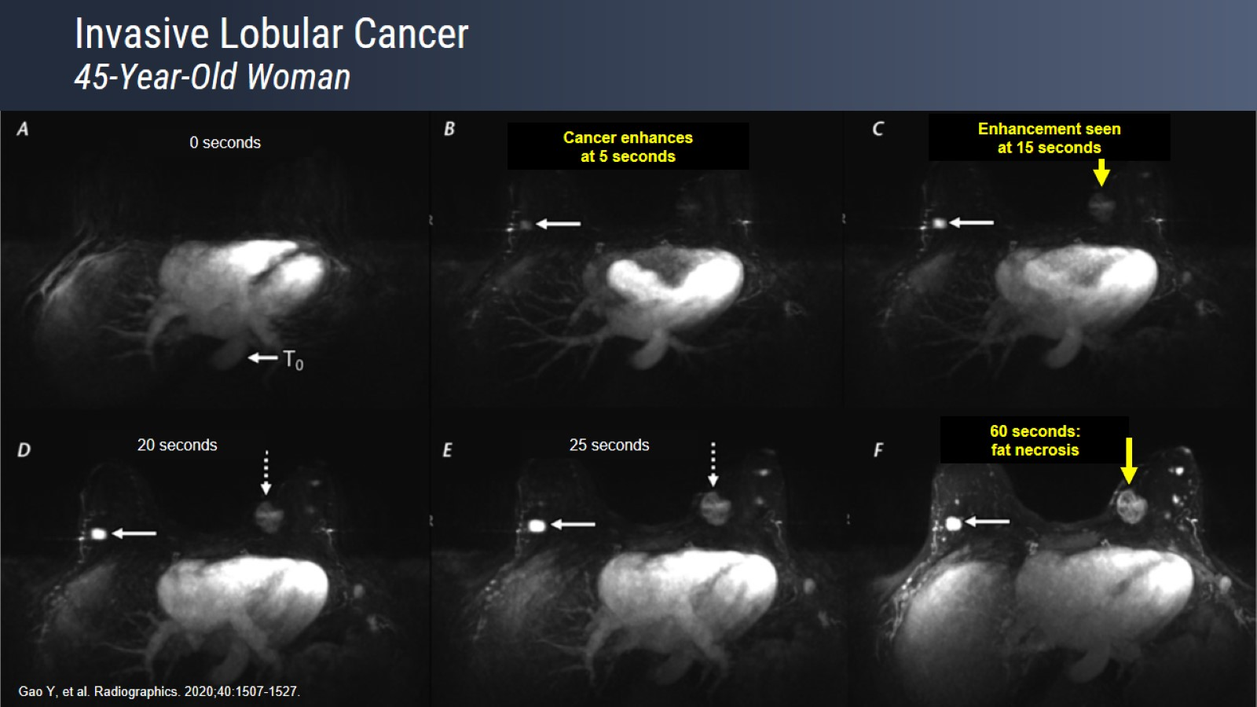
Invasive Lobular Cancer 45-Year-Old Woman

Slide 56
Ultrafast MRI for Predicting Pathologic Response After Neoadjuvant Chemotherapy

Slide 57
Current Indications for Breast MRI Expert Opinion

Slide 58
Challenges to Implementation of AB-MRI Expert Opinion

Slide 59
Take-Home Points

