Slide 3
Introduction

Slide 4
Myalgic Encephalomyelitis/Chronic Fatigue Syndrome

Slide 5
Underlying Biological Abnormalities in ME/CFS

Slide 6
CNS Involvement in ME/CFS

Slide 7
Immunological Abnormalities in ME/CFS

Slide 8
Cardiopulmonary Abnormalities

Slide 9
Metabolic Abnormalities

Slide 10
Low-Grade Chronic Gut Inflammation

Slide 11
Program Objectives

Slide 12
Recognizing ME/CFS

Slide 13
Clinical Diagnostic Criteria for ME/CFS

Slide 14
ME/CFS Clinical Diagnostic Criteria

Slide 15
Common Descriptions From Patients for the Major Symptoms

Slide 16
Common Descriptions From Patients for the Major Symptoms (cont)

Slide 17
Common Descriptions From Patients for the Major Symptoms (cont)

Slide 18
Common Descriptions From Patients for Other Common Symptoms

Slide 19
Case Example Describing Impaired Function in a Questionnaire

Slide 20
ME/CFS Symptoms and Manifestations Detailed in the IOM/NAM Report

Slide 21
Relevance to PASC, aka "Long COVID"?

Slide 22
Comorbid Conditions That Can Be Present in Patients With ME/CFS

Slide 23
Helpful Tools for Understanding the Impact of ME/CFS

Slide 24
New ICD-10-CM CODES as of October 1, 2022

Slide 25
Optimizing the Workup of Persons with ME/CFS Symptoms

Slide 26
Optimizing the Workup for ME/CFS

Slide 27
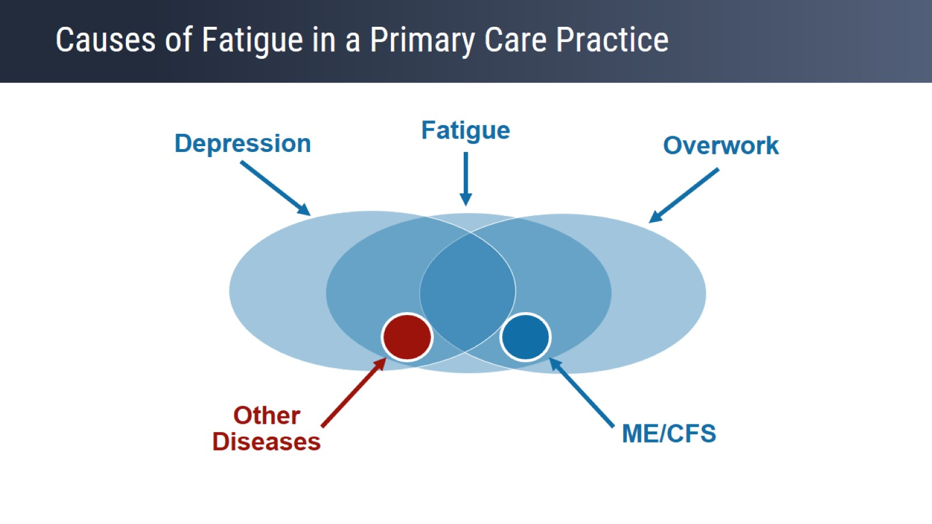
Causes of Fatigue in a Primary Care Practice

Slide 28
Differential Diagnosis The Ones I Look for First

Slide 29
Illnesses That Can Be Followed by ME/CFS or Similar Chronic Illnesses

Slide 30
Developing Individualized Treatment Plans for Persons With ME/CFS

Slide 32
Diagnose and Treat Comorbidities

Slide 33
ME/CFS Clinician Coalition

Slide 34
Considerations in Developing Individualized Treatment Plans for Persons With ME/CFS

Slide 35
Cognitive Impairment and Fatigue

Slide 36
PEM and Fatigue

Slide 37
Orthostatic Intolerance

Slide 38
Orthostatic Intolerance (cont)

Slide 39
Orthostatic Intolerance (cont)

Slide 40
Immune Dysfunction

Slide 41
Pain

Slide 42
Pain (cont)

Slide 43
Future Directions: Omics?

Slide 44
Future Directions: Omics? (cont)

Slide 45
Conclusion

Slide 46
Conclusion

