Slide 2
Cardiac MRI Techniques

Slide 3
Cardiac MRI (CMR) Techniques

Slide 4
Standard CMR Protocol

Slide 5
Accelerated CMR Protocol

Slide 6
Accelerated CMR Protocol

Slide 7
Accelerated CMR Protocol

Slide 8
Clinical Stress CMR Protocol

Slide 9
CMR Clinical Indications

Slide 10
CMR Clinical Indications

Slide 11
CMR Clinical Indications

Slide 12
CMR Clinical Indications

Slide 13
CMR Clinical Indications

Slide 14
CMR Clinical Indications

Slide 15
CMR Clinical Indications

Slide 18
Case History

Slide 19
Cardiac MRI

Slide 20
Cardiac MRI

Slide 21
Cardiac MRI

Slide 22
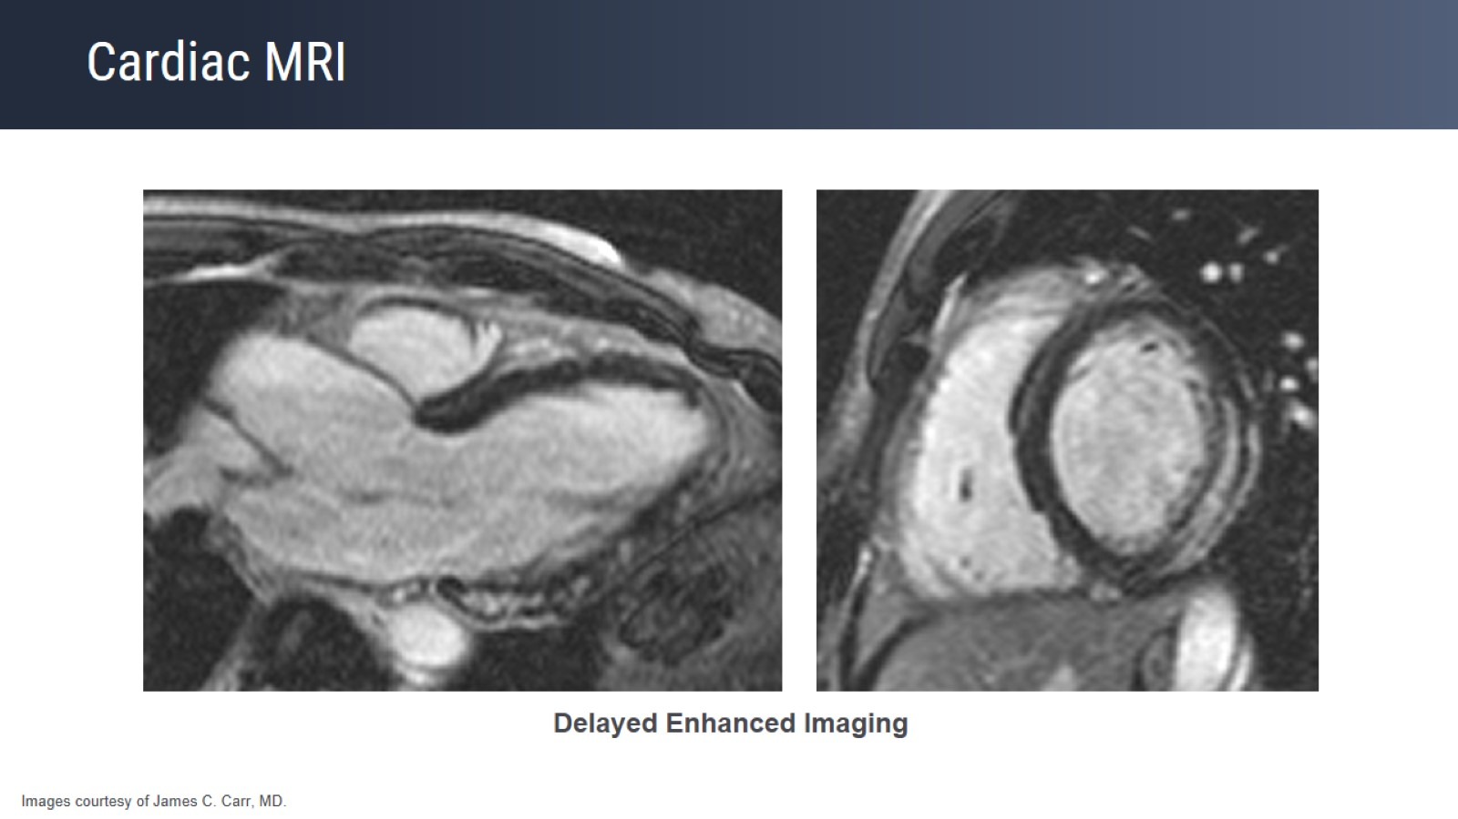
Cardiac MRI

Slide 23
Myocarditis

Slide 24
Myocarditis

Slide 25
Myocarditis T2 Measurement Detects Edema

Slide 26
Giant Cell Myocarditis

Slide 27
2018 Lake Louise Criteria for Myocardial Inflammation

Slide 28
2018 Lake Louise Criteria for Myocardial Inflammation

Slide 29
Chest Pain Differential Diagnosis

Slide 30
Chest Pain Differential Diagnosis

Slide 31
Chest Pain Differential Diagnosis

Slide 32
Chest Pain Differential Diagnosis

Slide 33
Key Points

Slide 34
Please continue to the next segment of this activity

Slide 36
Patient With History of Heart Block CMR Ordered to Assess for Cardiac Sarcoidosis

Slide 37
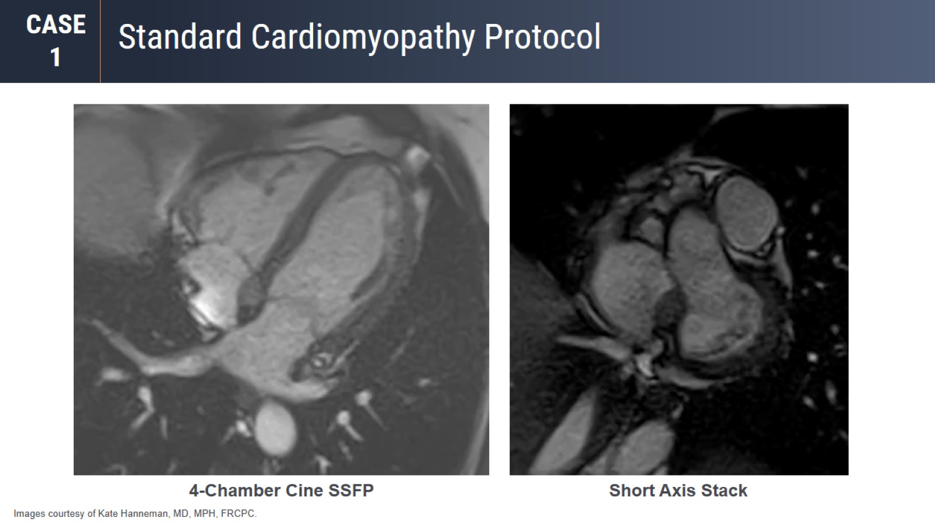
Standard Cardiomyopathy Protocol

Slide 38
Standard Cardiomyopathy Protocol

Slide 39
Standard Cardiomyopathy Protocol

Slide 40
Tissue Characterization

Slide 41
Rule Out Cardiac Sarcoidosis

Slide 42
Rule out Cardiac Sarcoidosis

Slide 43
Rule out Cardiac Sarcoidosis

Slide 44
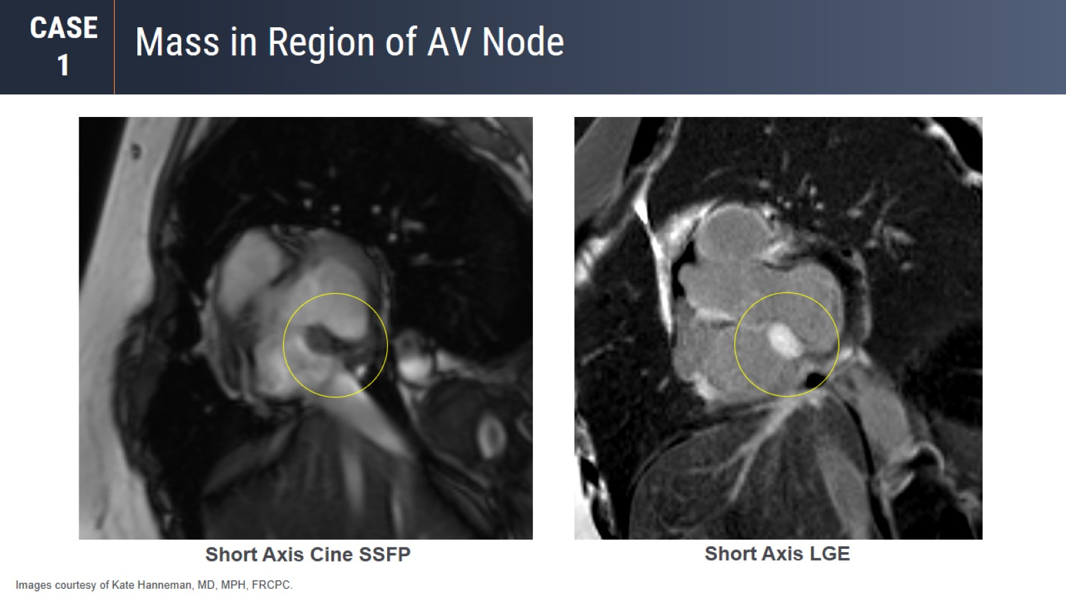
Mass in Region of AV Node

Slide 45
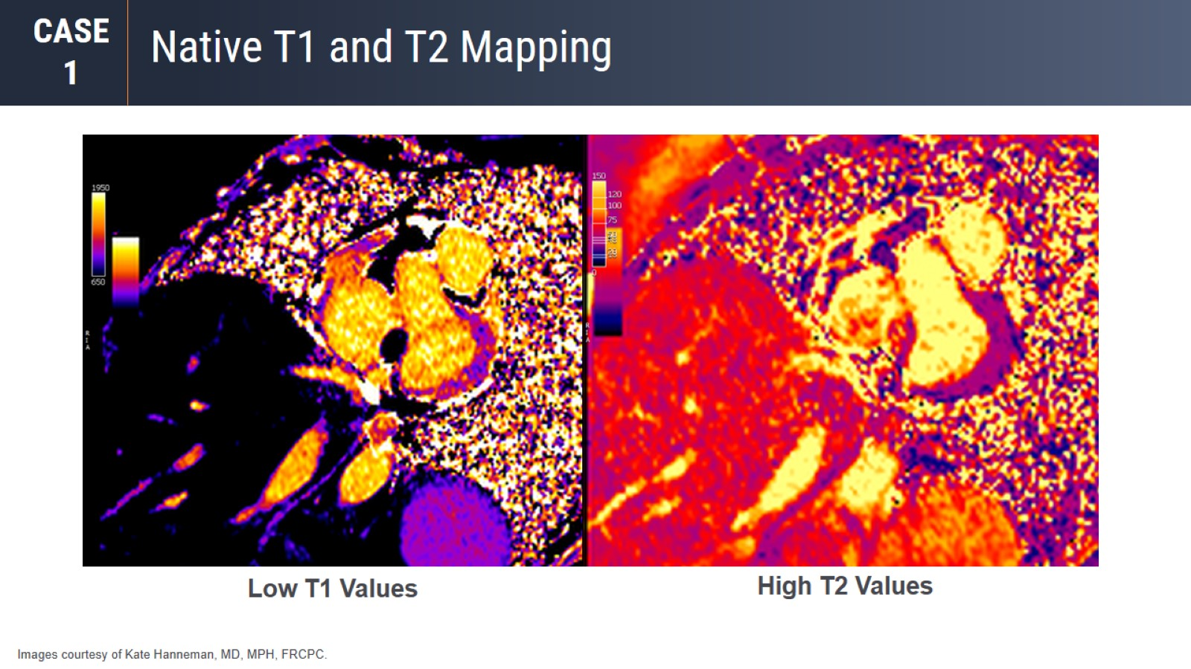
Native T1 and T2 Mapping

Slide 46
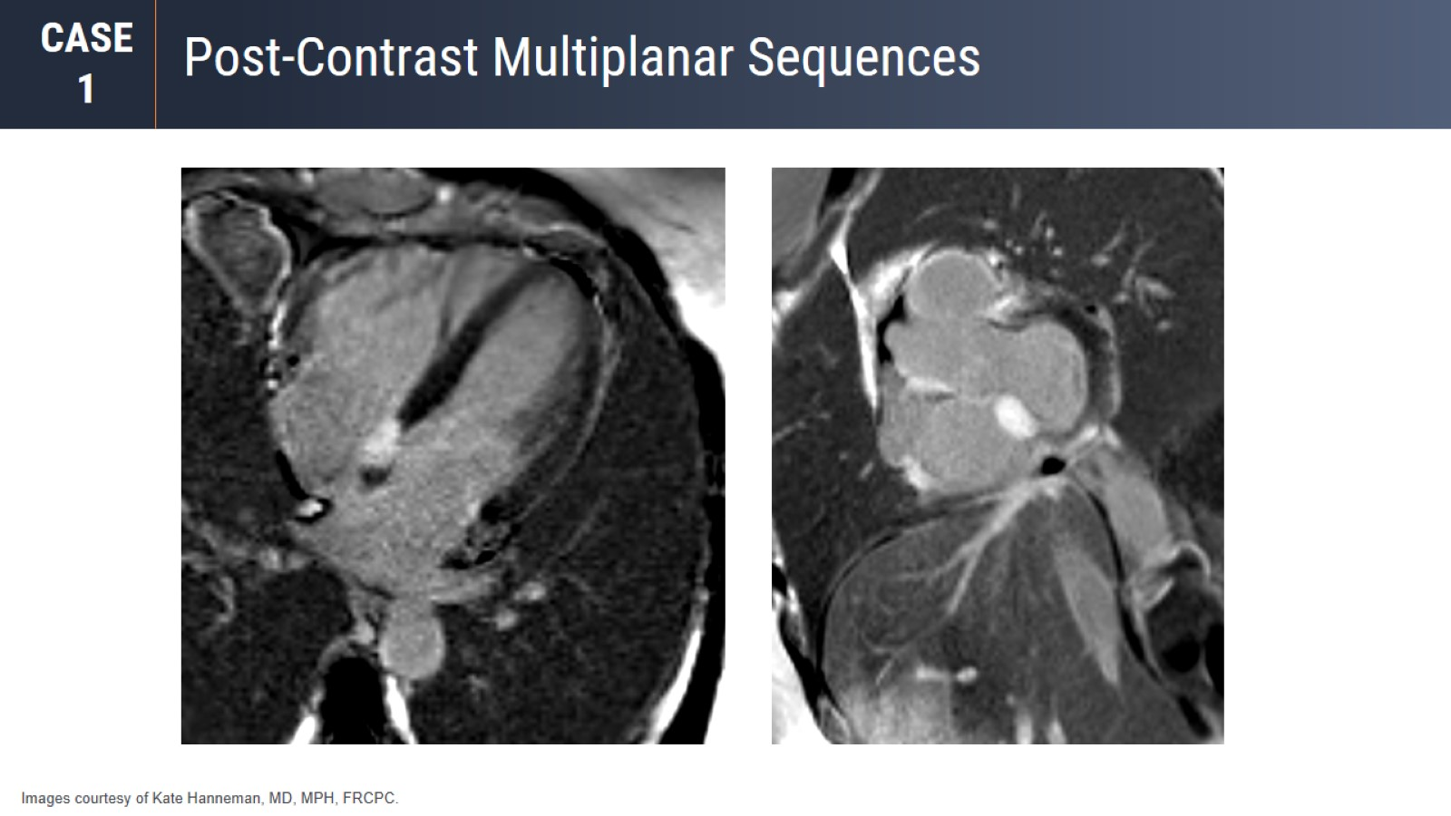
Post-Contrast Multiplanar Sequences

Slide 47
Diagnosis: AV Node Tumor

Slide 48
Key Points

Slide 49
Key Points

Slide 50
Key Points

Slide 51
Patient With Known Malignancy Undergoing Chemotherapy CMR Ordered to Assess Left Ventricular Ejection Fraction

Slide 52
4-Chamber Cine SSFP

Slide 53
4-Chamber Cine SSFP
Large Filling Defect
in the Right Atrium

Slide 54
Short Axis Cine SSFP
Large Filling Defect
in the Right Atrium

Slide 55
T1W Imaging

Slide 56
First-Pass Perfusion, Delayed LGE

Slide 57
Coronal CT

Slide 58
Coronal CT

Slide 59
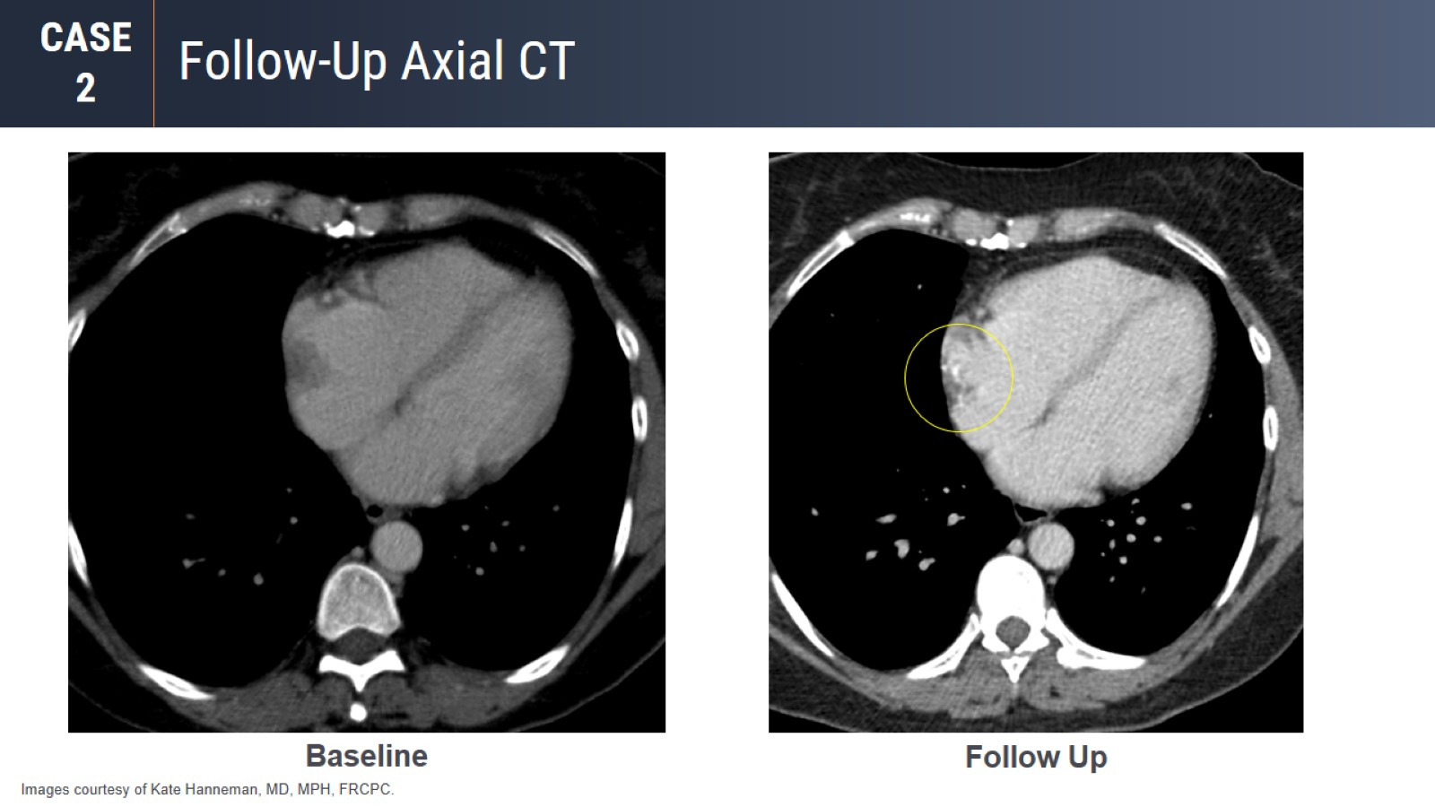
Follow-Up Axial CT

Slide 60
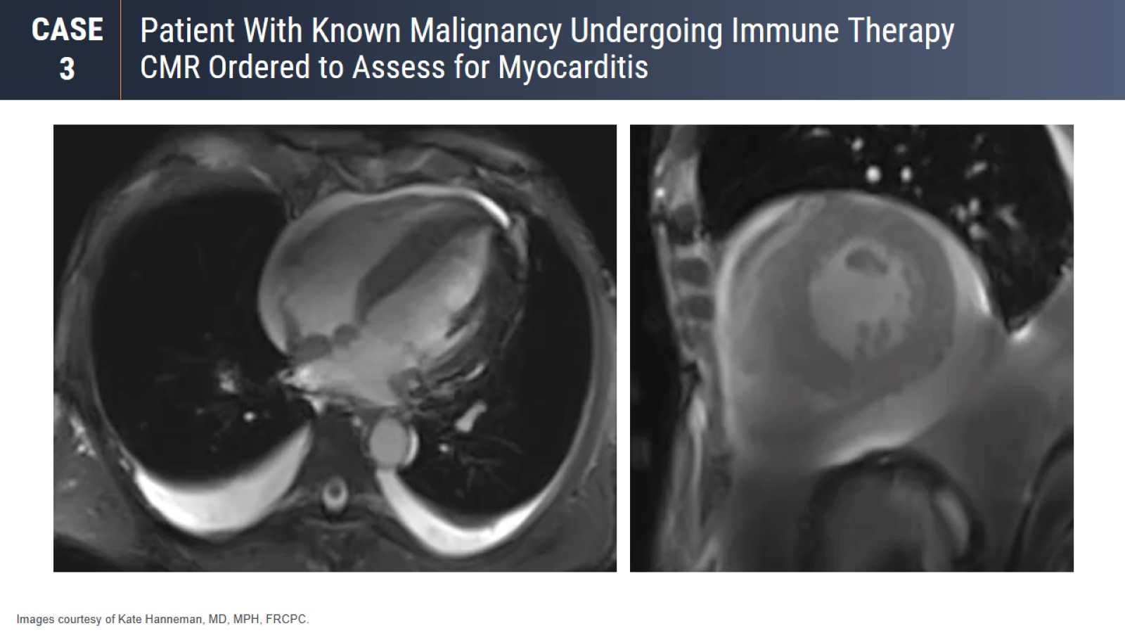
Patient With Known Malignancy Undergoing Immune Therapy CMR Ordered to Assess for Myocarditis

Slide 61
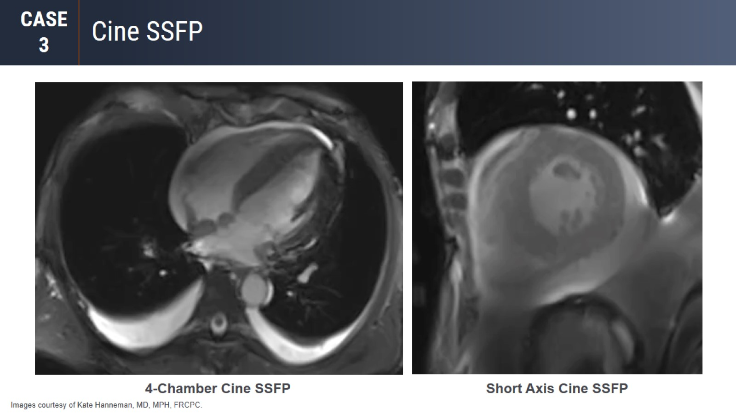
Cine SSFP

Slide 62
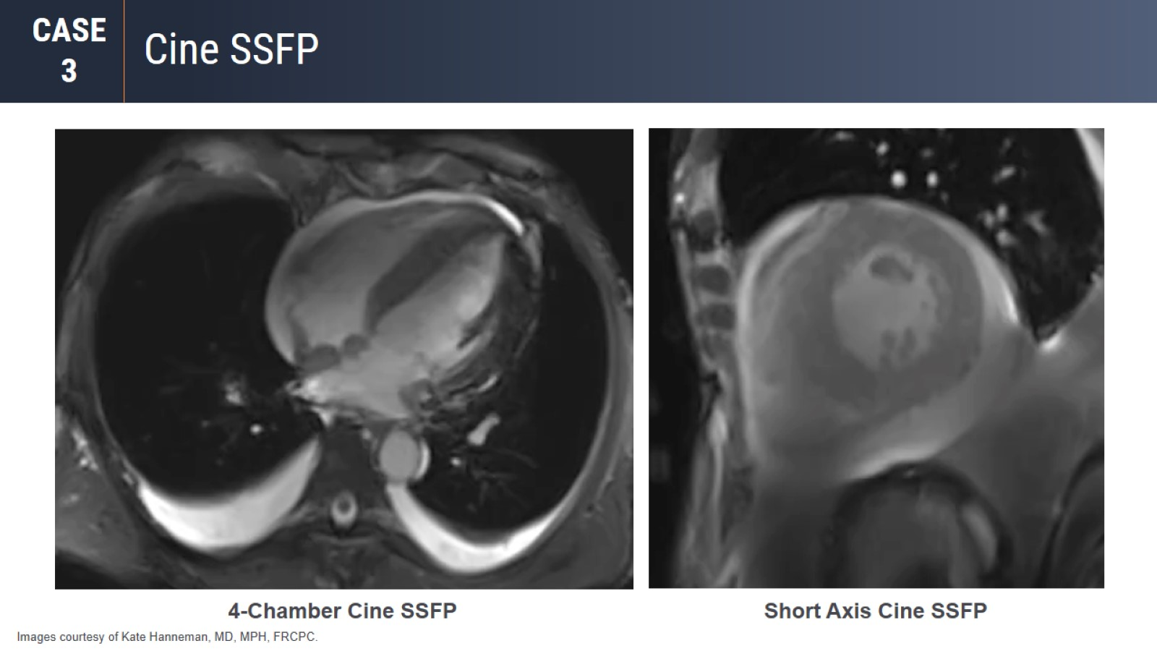
Cine SSFP

Slide 63
Tissue Characterization

Slide 64
Tissue Characterization

Slide 65
Native T1 and T2 Mapping

Slide 66
Diagnosis: Diffuse Infiltrative Melanoma

Slide 67
Key Points

Slide 68
Please continue to the next segment of this activity

Slide 70
Case History

Slide 71
CTA

Slide 72
CMR Stress Imaging

Slide 73
CMR Stress Imaging

Slide 74
Myocardial Structures and Fibrosis Confirmation

Slide 75
Myocardial Structures and Fibrosis Confirmation

Slide 76
LGE and ECV Mapping

Slide 77
LGE and ECV Mapping

Slide 78
Quantitative Stress CMR Perfusion

Slide 79
Quantitative Stress CMR Perfusion

Slide 80
Quantitative Stress CMR Perfusion

Slide 81
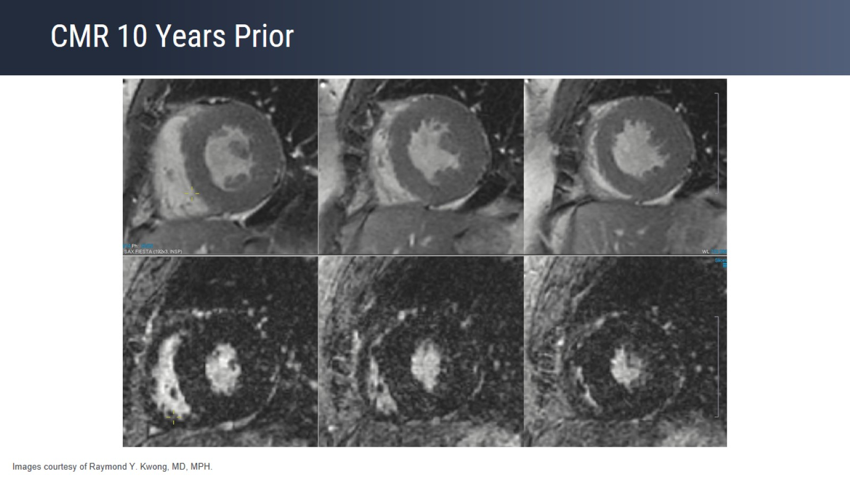
CMR 10 Years Prior

Slide 82
Case Summary

Slide 83
Case Summary

Slide 84
Case Summary

Slide 85
Please continue to the next segment of this activity

Slide 87
In Summary

Slide 88
In Summary

Slide 89
In Summary

Slide 90
In Summary

Slide 91
In Summary

