Slide 2
Disruption in the School and Social Environment

Slide 3
Depression Is Getting Worse Over Time

Slide 4
Q&A

Slide 5
Functional Connectivity

Slide 6
Positive Life Events Strengthen Amygdala-OFC Connectivity

Slide 7
Positive Life Events Expert Perspective

Slide 8
Resilience in Adolescent Females With Family Risk of MDD

Slide 9
Resilience in Adolescent Females With Family Risk of MDD

Slide 10
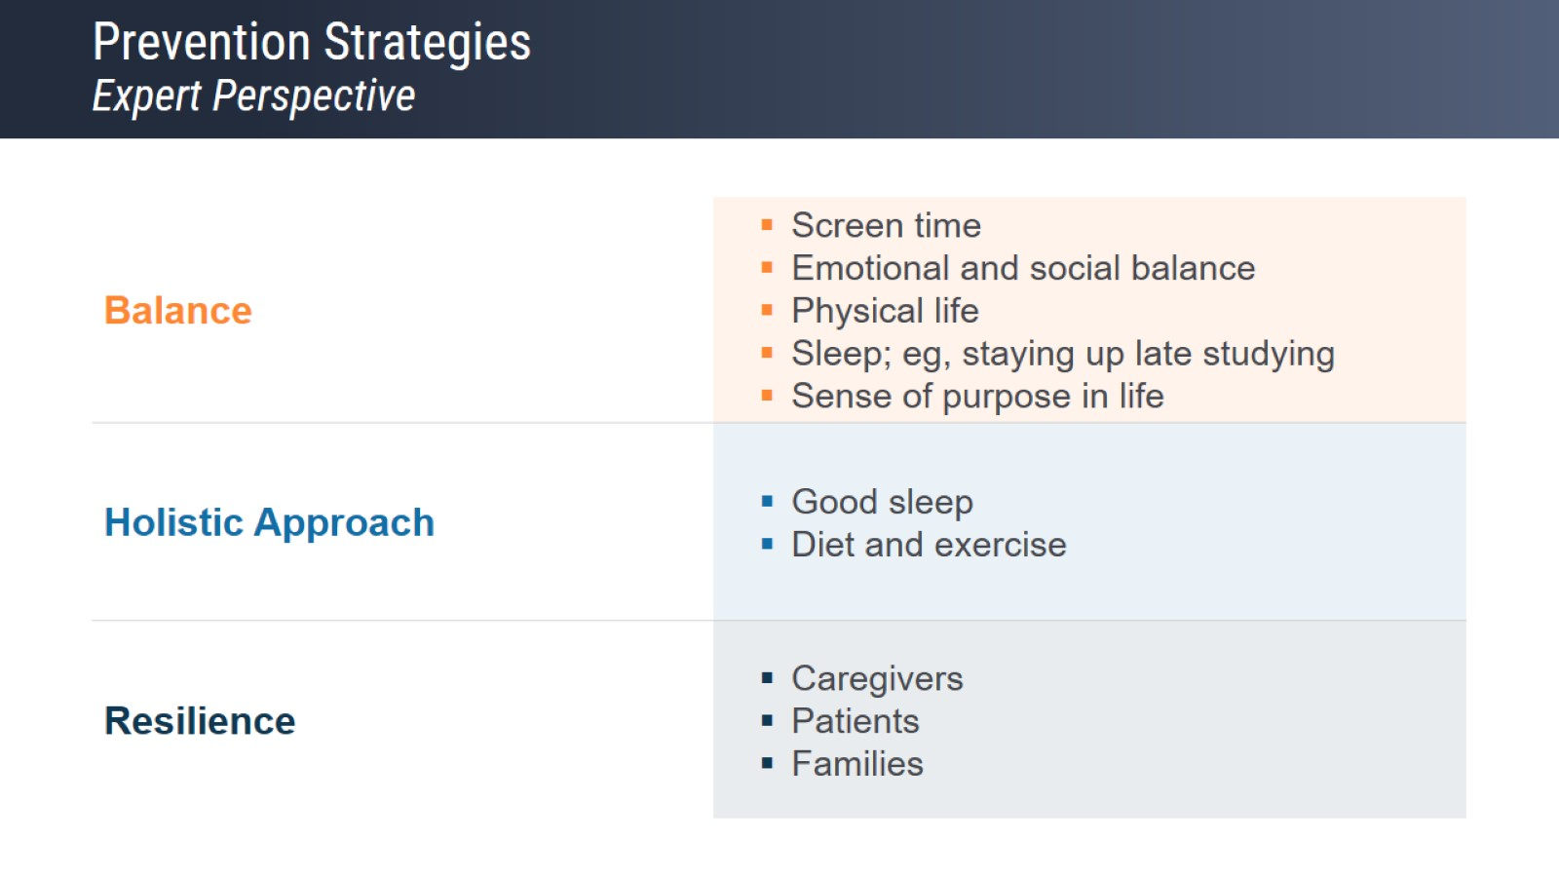
Prevention Strategies Expert Perspective

Slide 11
Resilience Underlying Mechanisms of Neurobiology and Psychosocial Factors

Slide 12
Kids Sleep Better With Parental Support

Slide 13
Signs and Symptoms: How to Manage Expert Perspective

Slide 14
Excessive Screen Time Worsens Cognition

Slide 15
Warning Signs Expert Perspective

Slide 16
Warning Signs Expert Perspective

Slide 17
Resilience Is Important for All Patients and Caregivers

