Slide 2
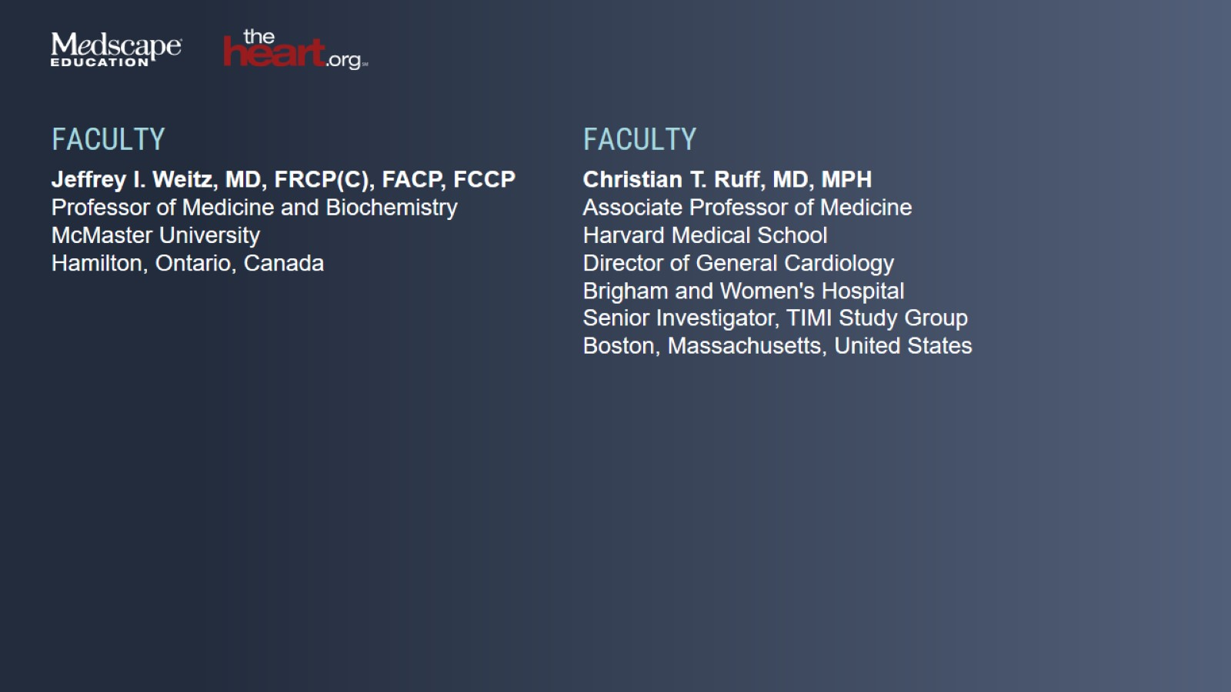

Slide 3
Atrial Fibrillation and Stroke Risk Are Underestimated

Slide 4
The Evolution of Anticoagulants

Slide 5
Stroke Prevention in AF DOACs vs Warfarin

Slide 6
DOACs Are Activated in the Gut

Slide 7
2019 AHA/ACC/HRS Recommendations on Anticoagulation Selection

Slide 8
Underuse and Inappropriate Use of DOACs for Stroke Prevention in AF

Slide 9
Fear of Bleeding Is a Major Driver of Undertreatment With Anticoagulation Faculty Insights

Slide 10
Targeting FXI Uncoupling Thrombosis From Hemostasis

Slide 11
Comparison of Anticoagulant Properties

Slide 12
Evidence Supporting Factor XI as a Target

Slide 13
Emerging Factor XI/XIa Inhibitors Mechanism of Action and Pharmacokinetics

Slide 14
Factor XIa vs XI Inhibition Expert Perspectives

Slide 15
Meta-Analysis of Phase 2 Studies Comparing Factor XI/XIa Inhibitors vs Enoxaparin in Total Knee Replacement Recipients

Slide 16
Factor Xa Inhibitors in VTE Systematic Meta-Analysis

Slide 17
PACIFIC Phase 2 Clinical Trial Program Evaluating Safety of Asundexian

Slide 18
PACIFIC Phase 2 Clinical Trial Program (cont)

Slide 19
PACIFIC Phase 2 Clinical Trial Program (cont)

Slide 20
Phase 2 Studies in Stroke Small-Molecule FXIa Inhibitors

Slide 21
PACIFIC Phase 2 Clinical Trial Program (cont)

Slide 22
Efficacy of Factor Xa Inhibition Post-ACS

Slide 23
AZALEA TIMI 71 Trial Design Evaluating Safety of Abelacimab

Slide 24
AZALEA TIMI 71 Factor XI Inhibition (%) with Abelacimab

Slide 25
AZALEA TIMI 71 Primary Endpoint: Safety

Slide 26
AZALEA TIMI 71 Bleeding Endpoints and Adverse Events

Slide 27
Phase 3 Clinical Trials With FXI/FXIa Inhibitors

Slide 28
Summary of Phase 2 Trials in FXI/FXIa Inhibition

Slide 29
Conclusion

