Slide 1


Slide 2

On Your Mark, Get Set, Go

Slide 3


Slide 4


Slide 5
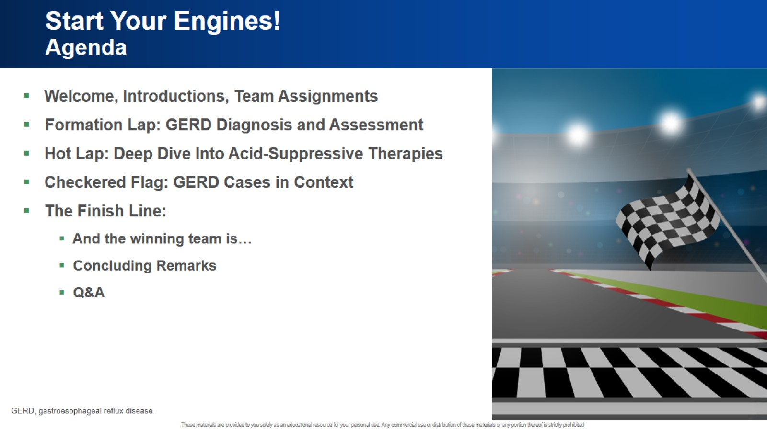
Start Your Engines! Agenda

Slide 6
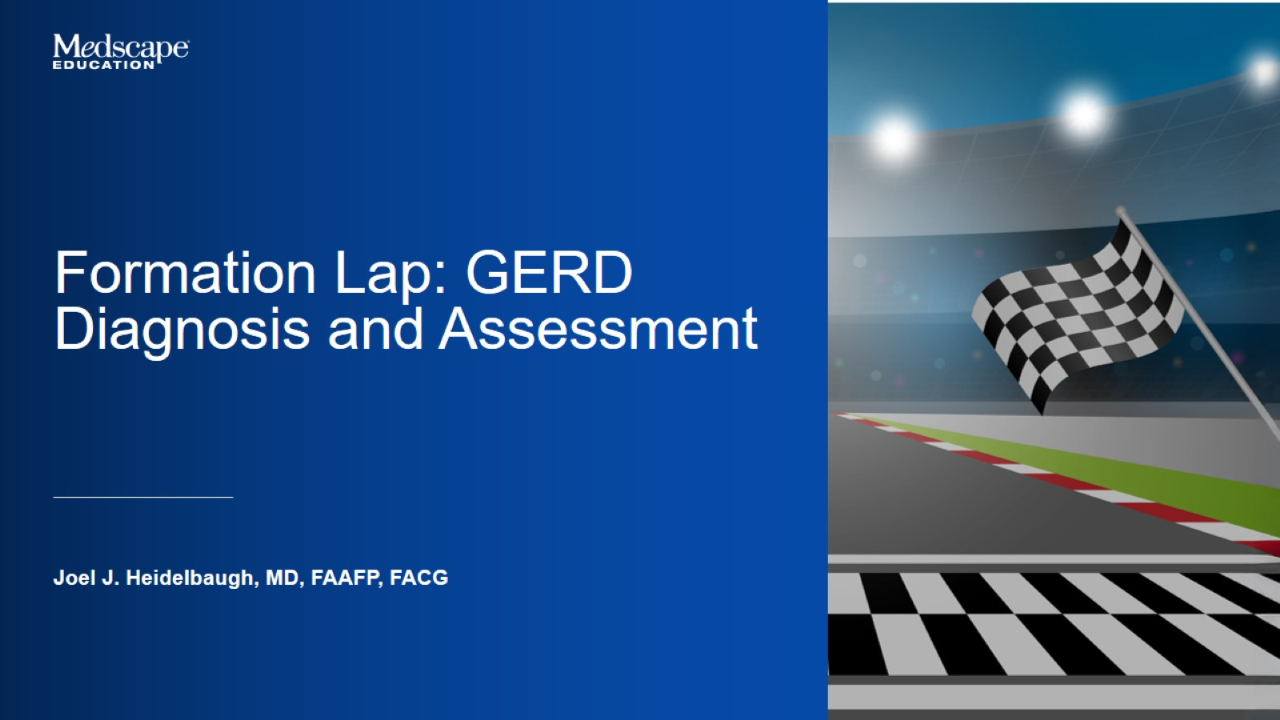

Slide 7
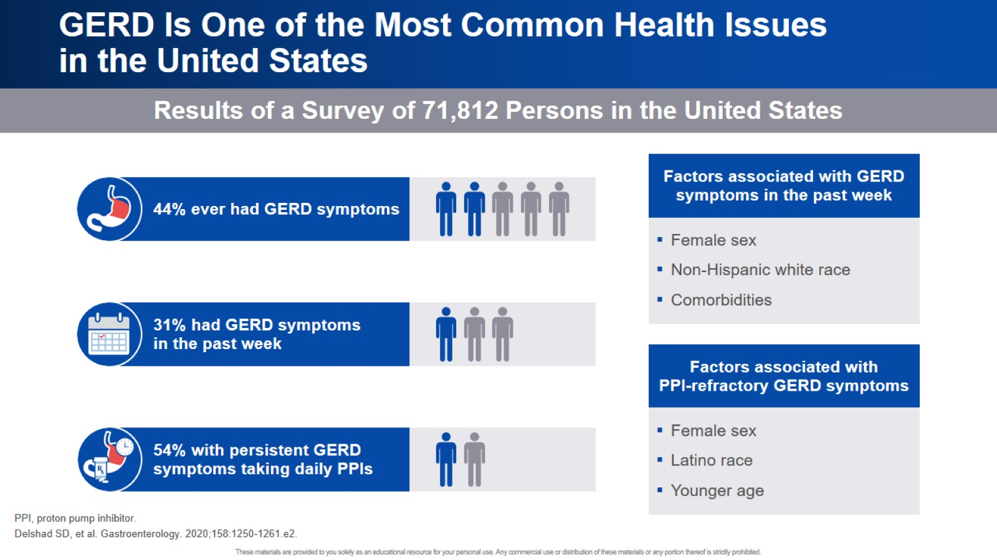
GERD Is One of the Most Common Health Issues in the United States

Slide 8
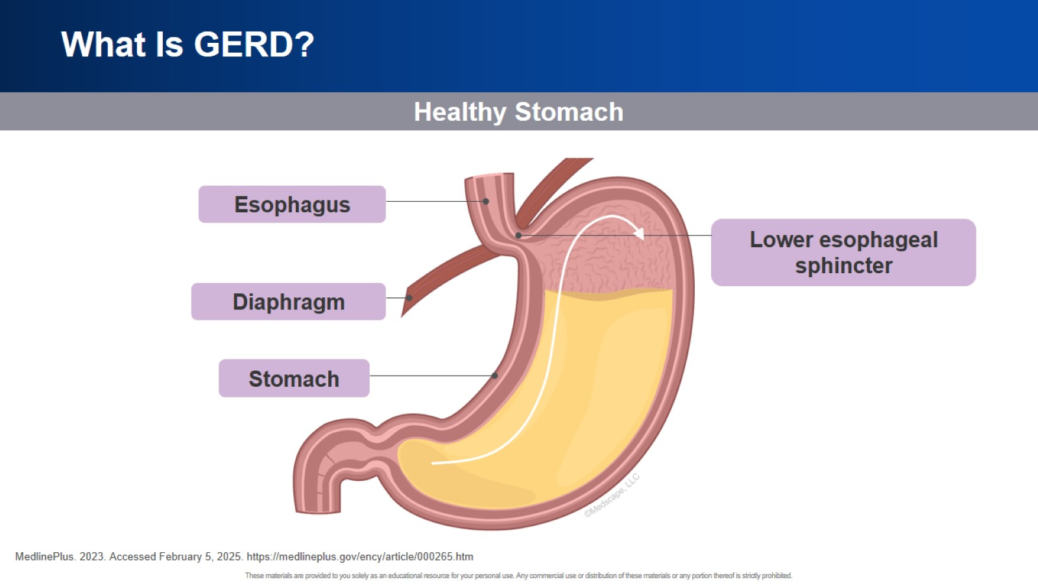
What Is GERD?

Slide 9
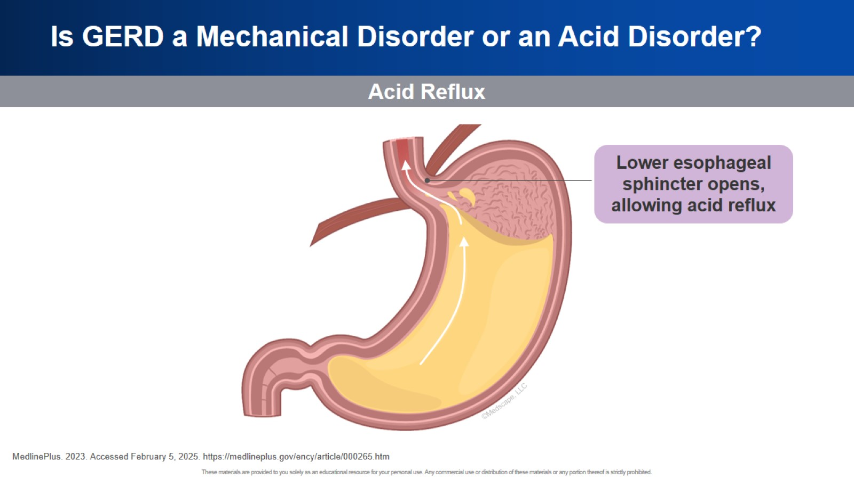
Is GERD a Mechanical Disorder or an Acid Disorder?

Slide 10
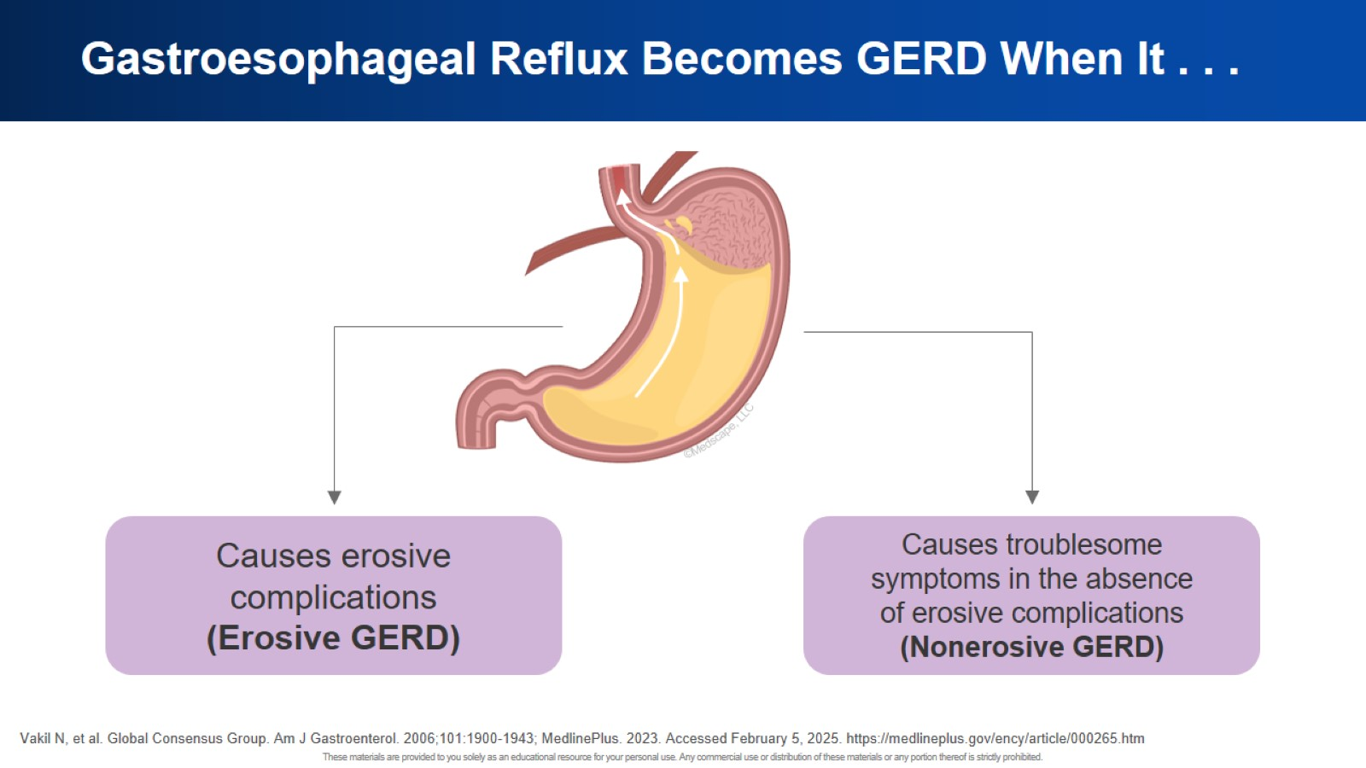
Gastroesophageal Reflux Becomes GERD When It . . .

Slide 11
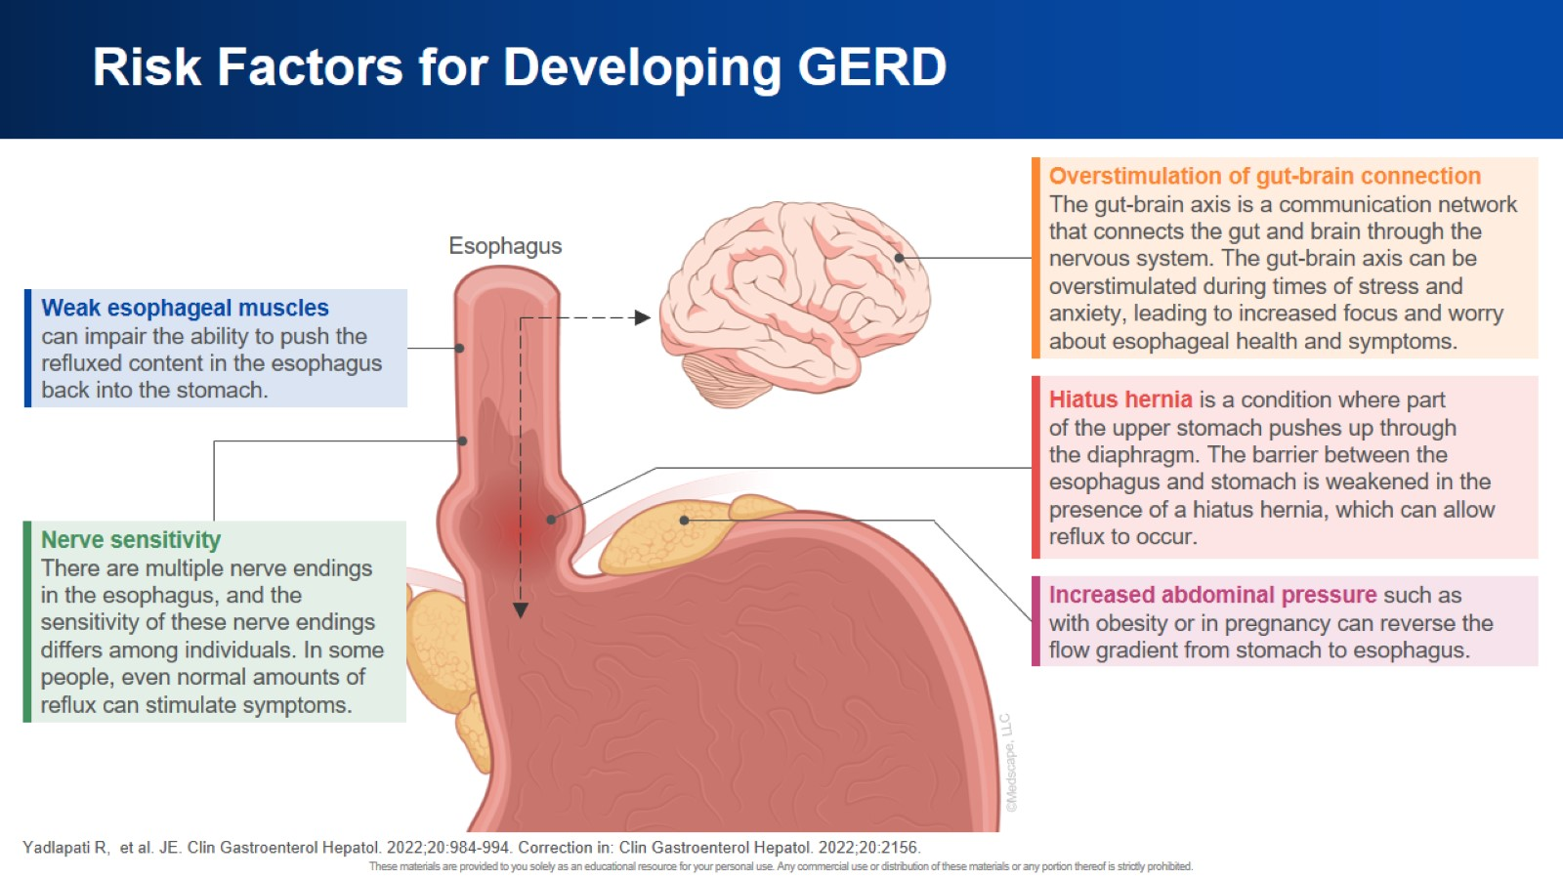
Risk Factors for Developing GERD

Slide 12
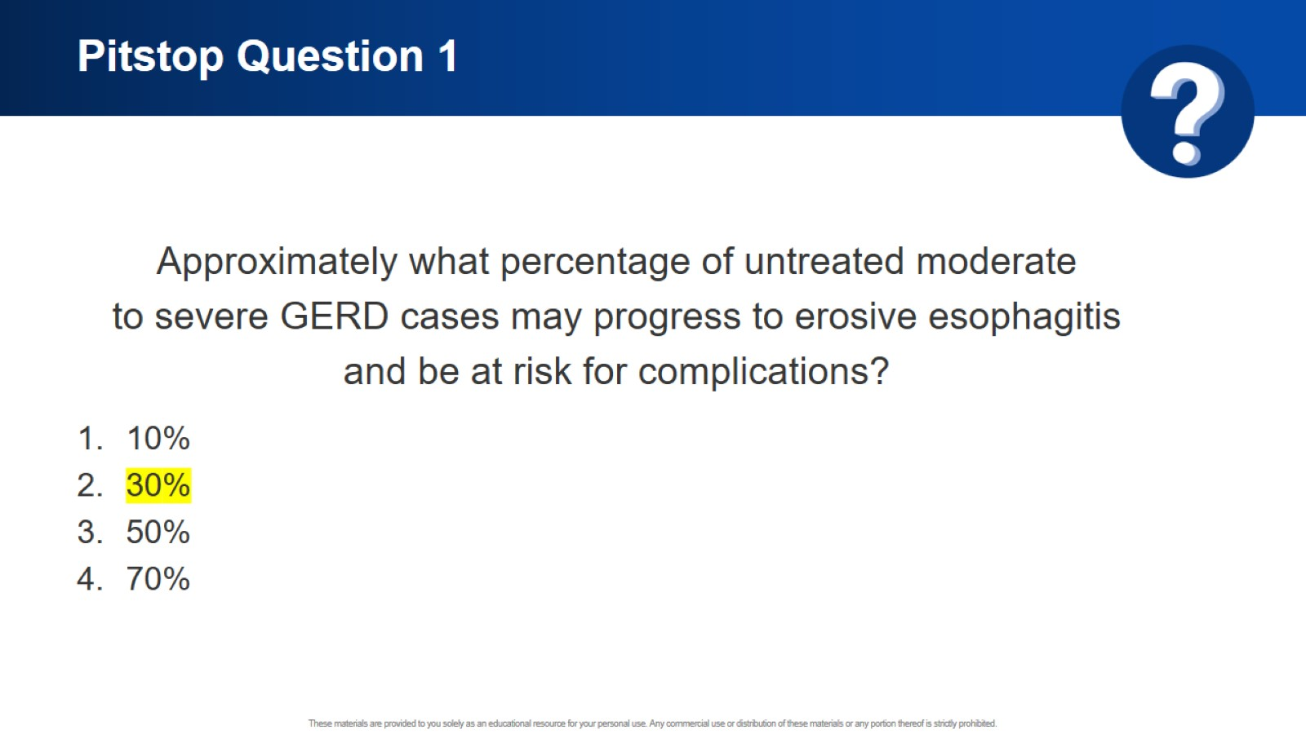
Pitstop Question 1

Slide 13
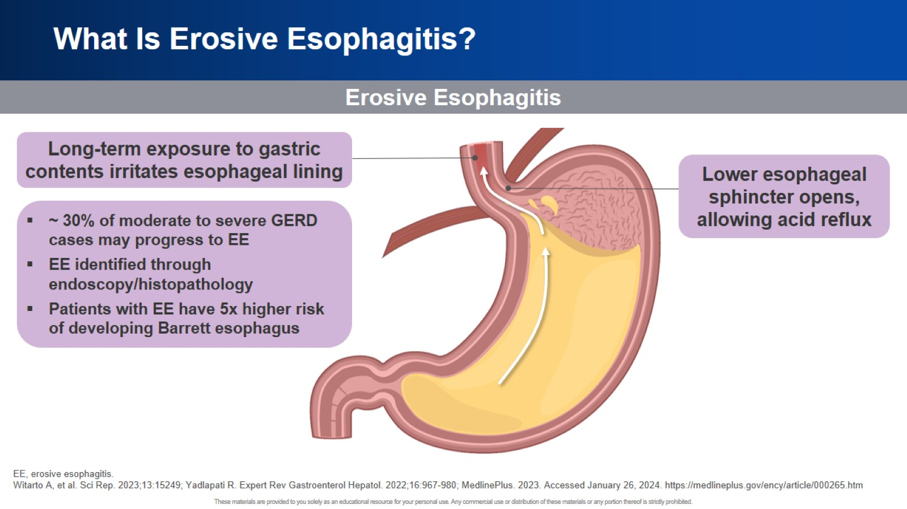
What Is Erosive Esophagitis?

Slide 14
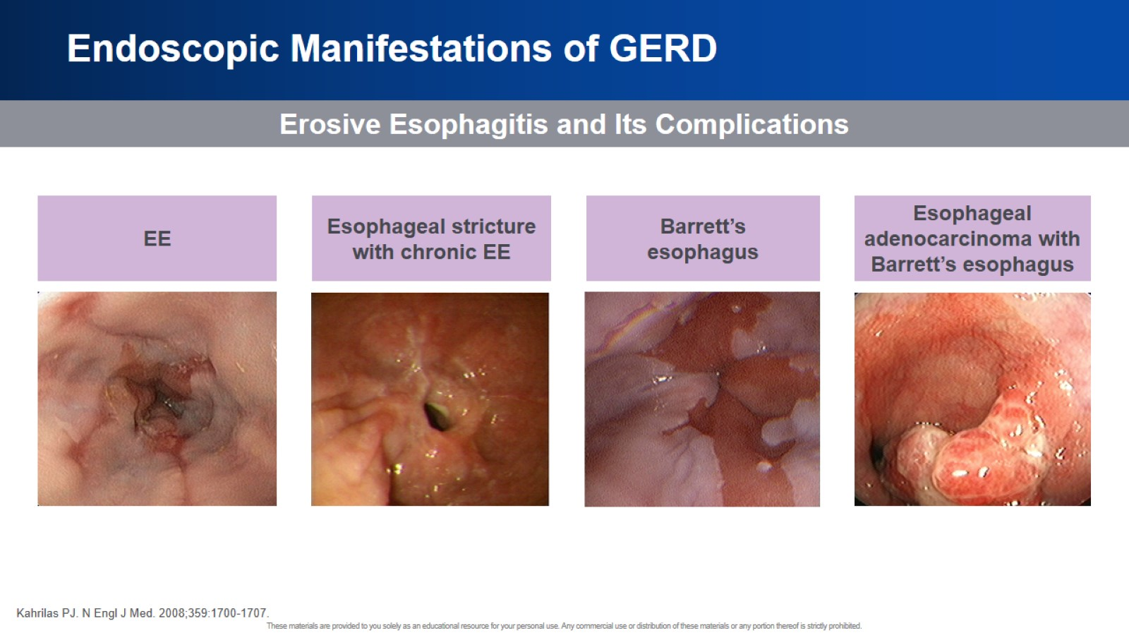
Endoscopic Manifestations of GERD

Slide 15
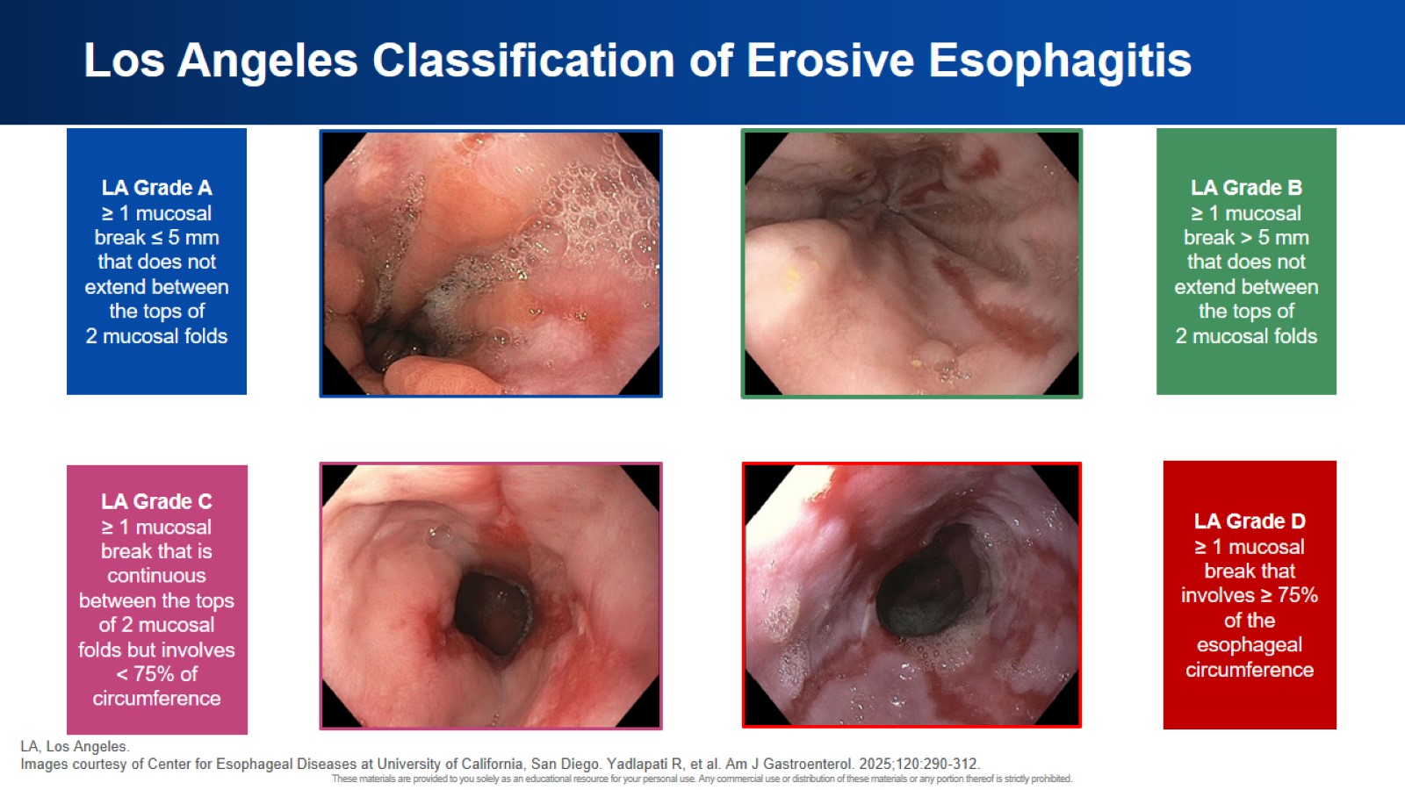
Los Angeles Classification of Erosive Esophagitis

Slide 16
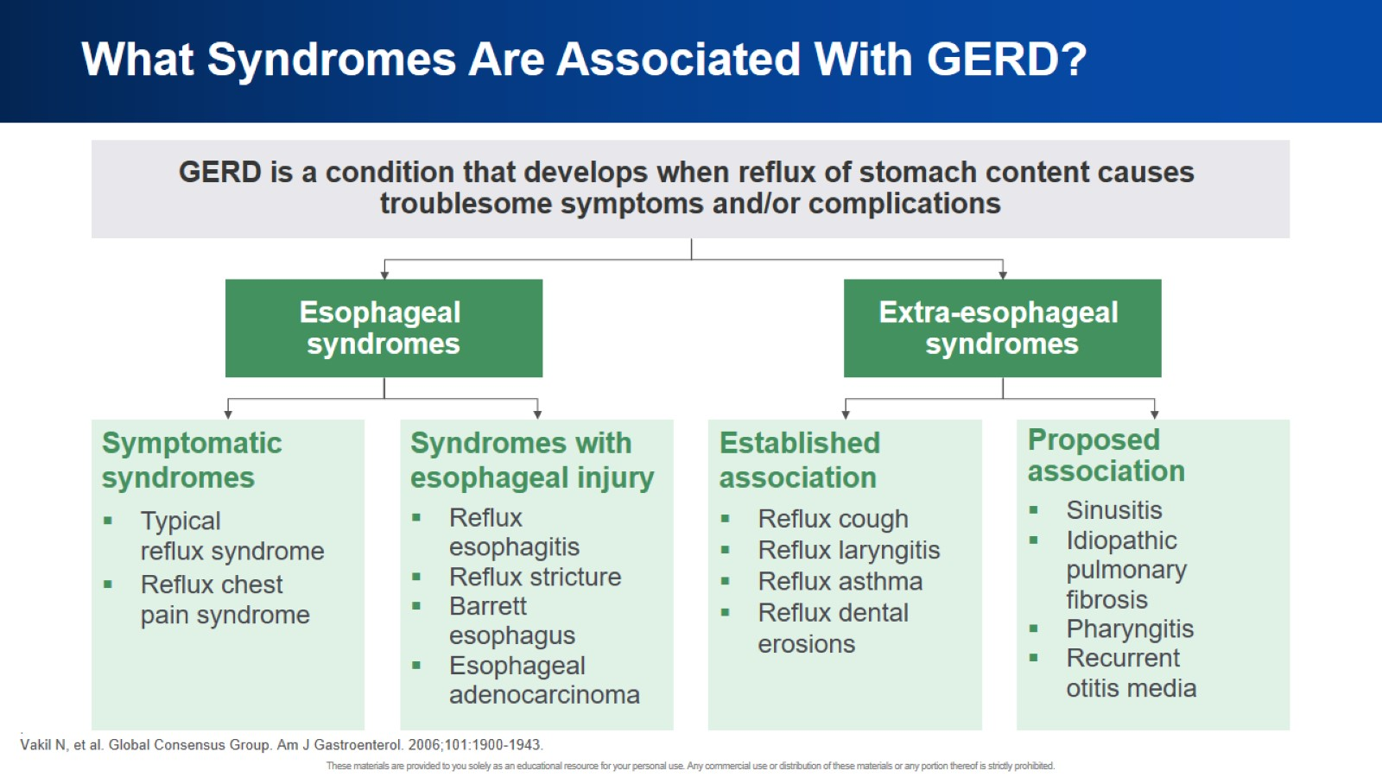
What Syndromes Are Associated With GERD?

Slide 17
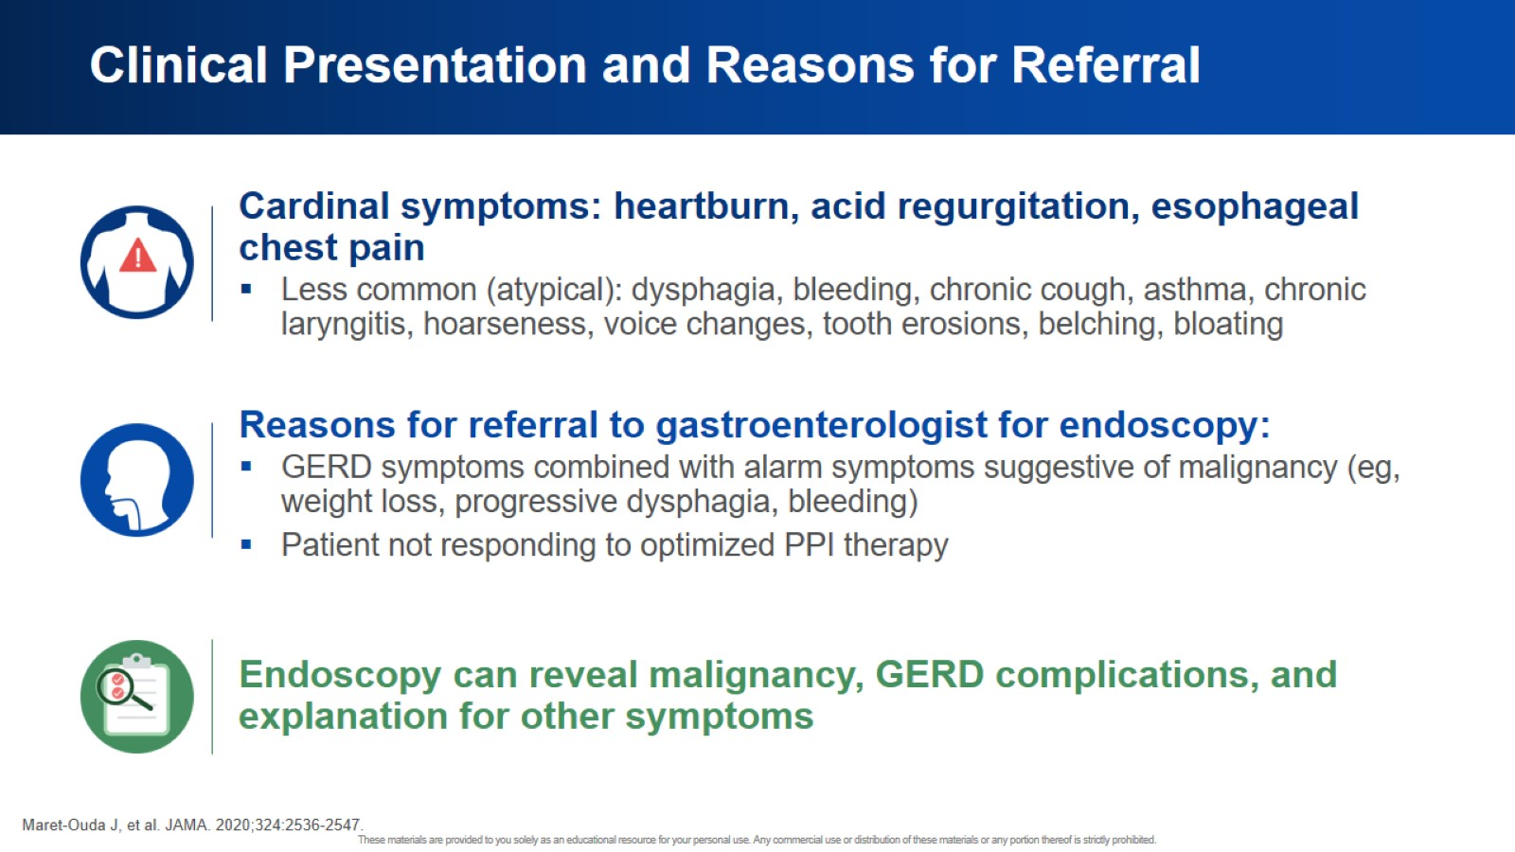
Clinical Presentation and Reasons for Referral

Slide 18
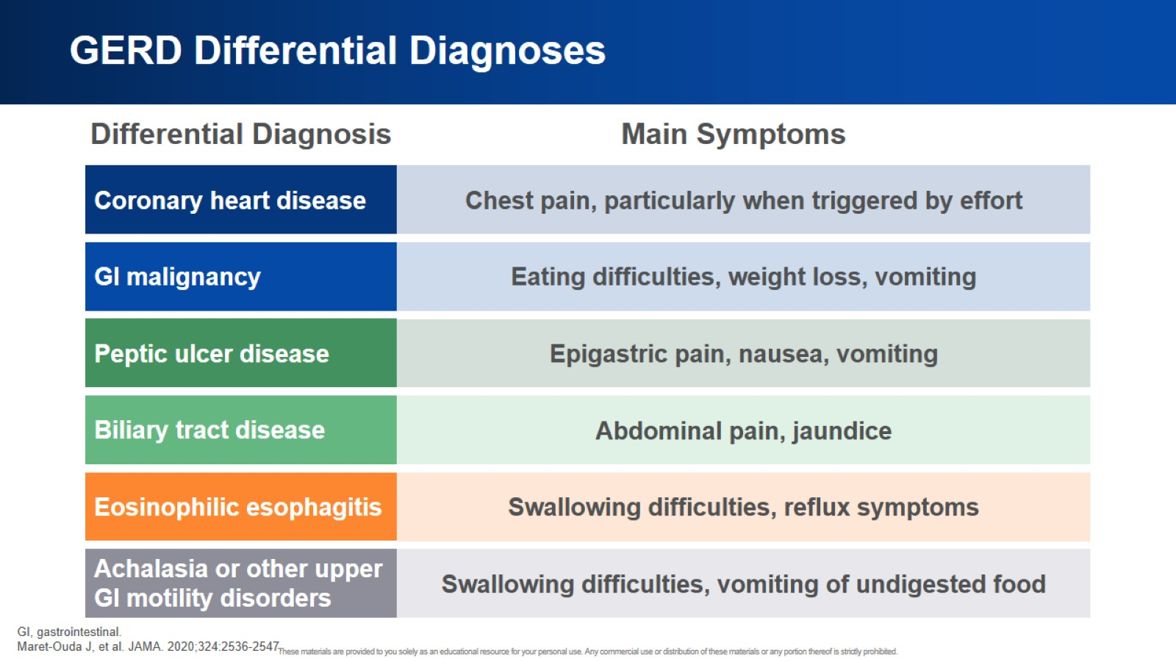
GERD Differential Diagnoses

Slide 19
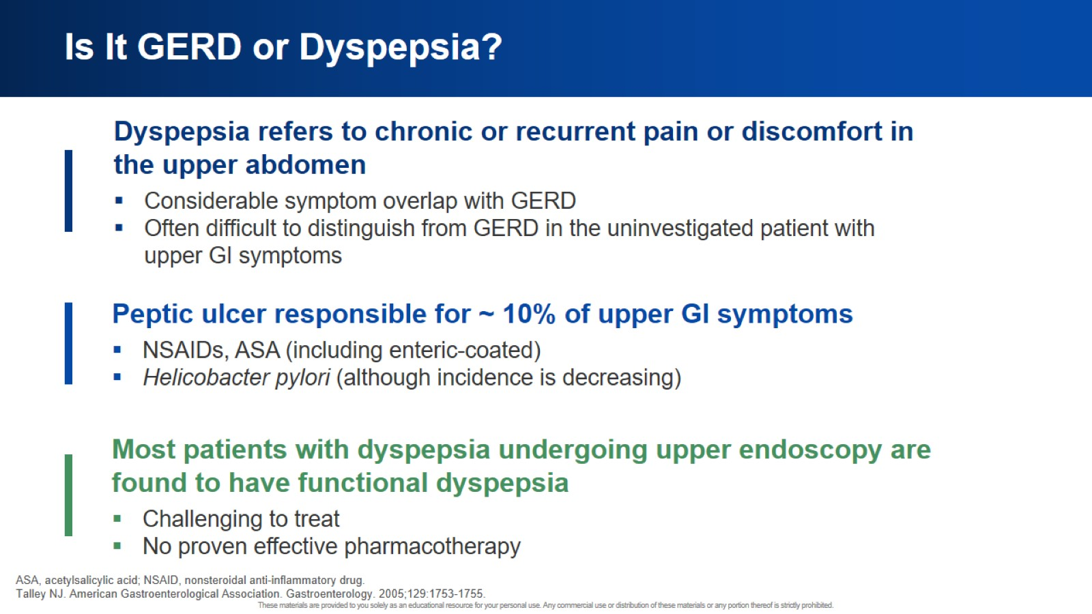
Is It GERD or Dyspepsia?

Slide 20
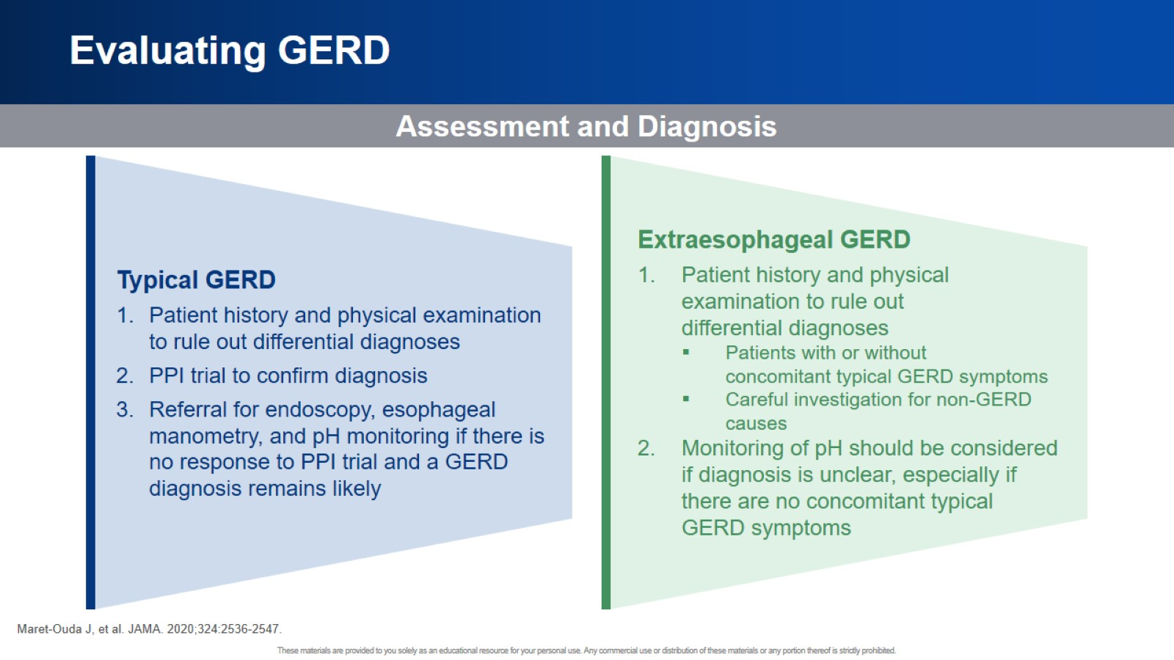
Evaluating GERD

Slide 21
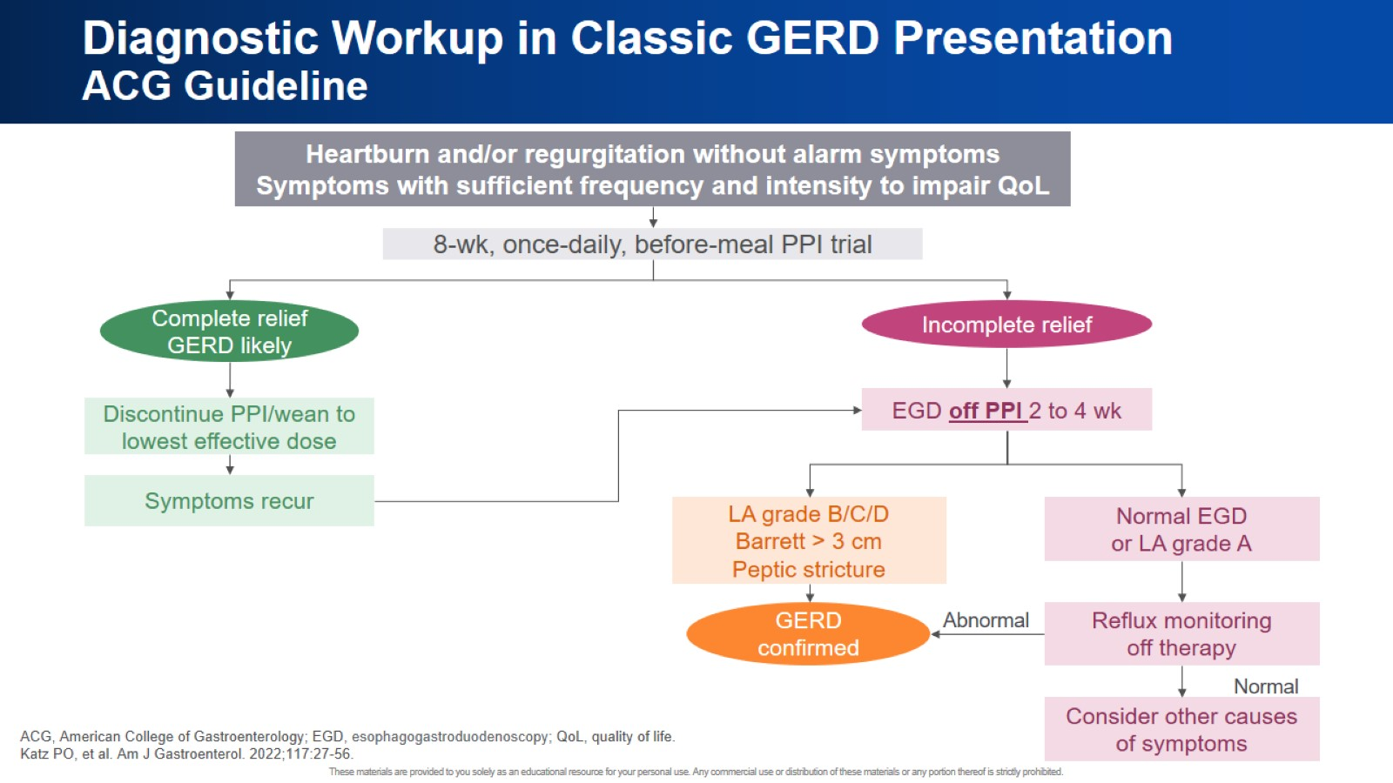
Diagnostic Workup in Classic GERD Presentation ACG Guideline

Slide 22
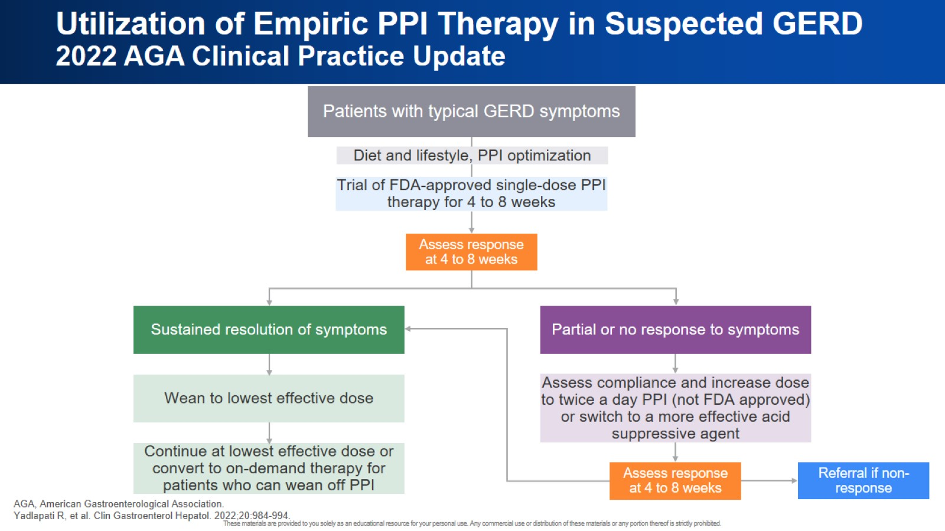
Utilization of Empiric PPI Therapy in Suspected GERD 2022 AGA Clinical Practice Update

Slide 23
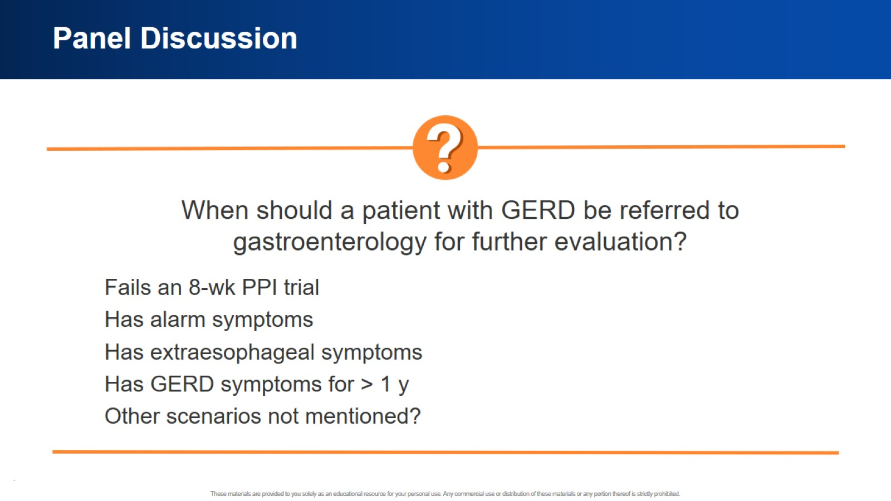
Panel Discussion

Slide 24


Slide 25
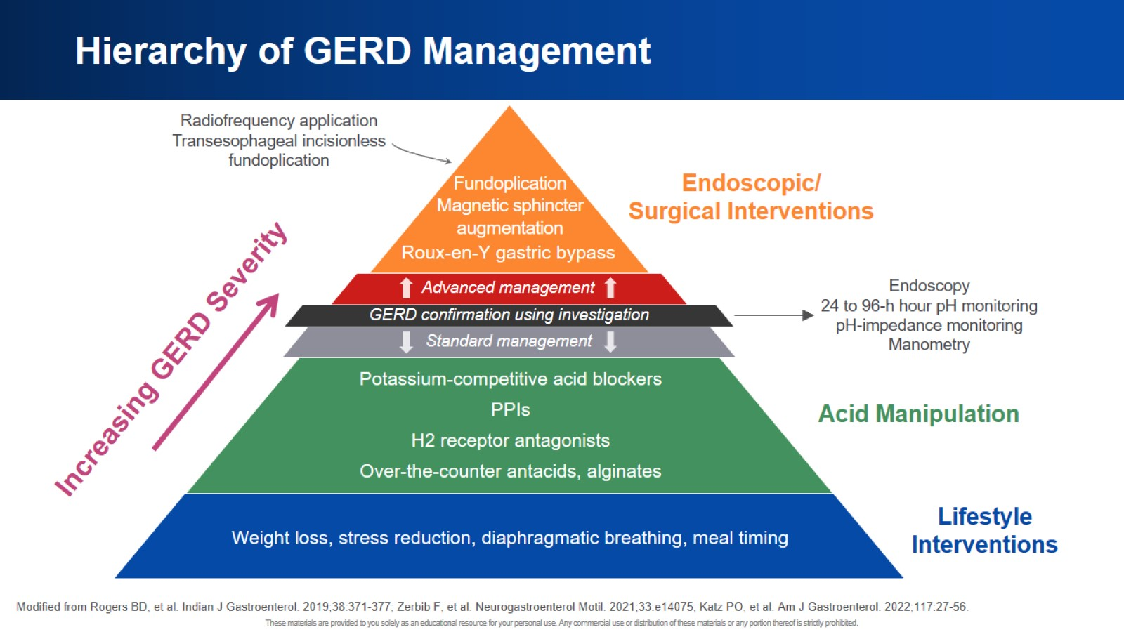
Hierarchy of GERD Management

Slide 26
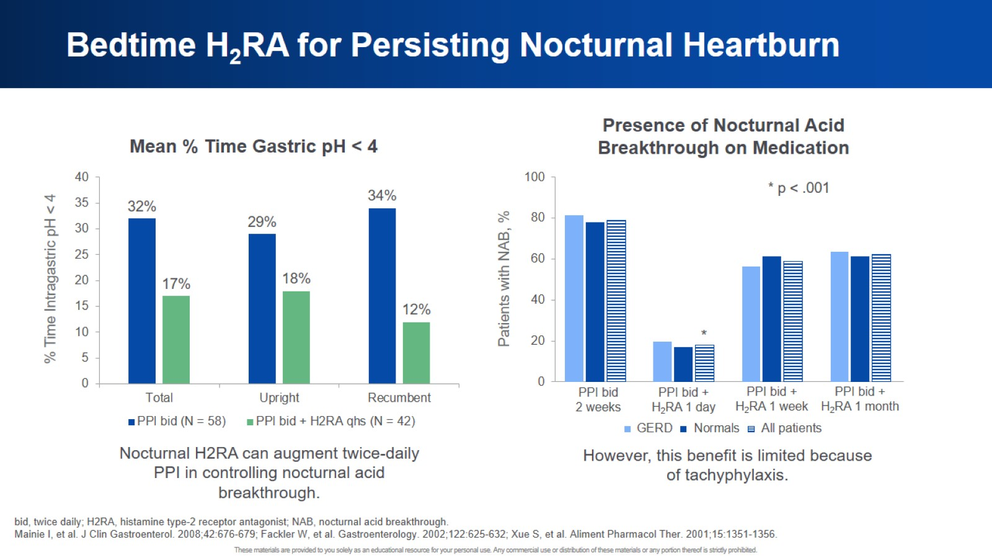
Bedtime H₂RA for Persisting Nocturnal Heartburn

Slide 27
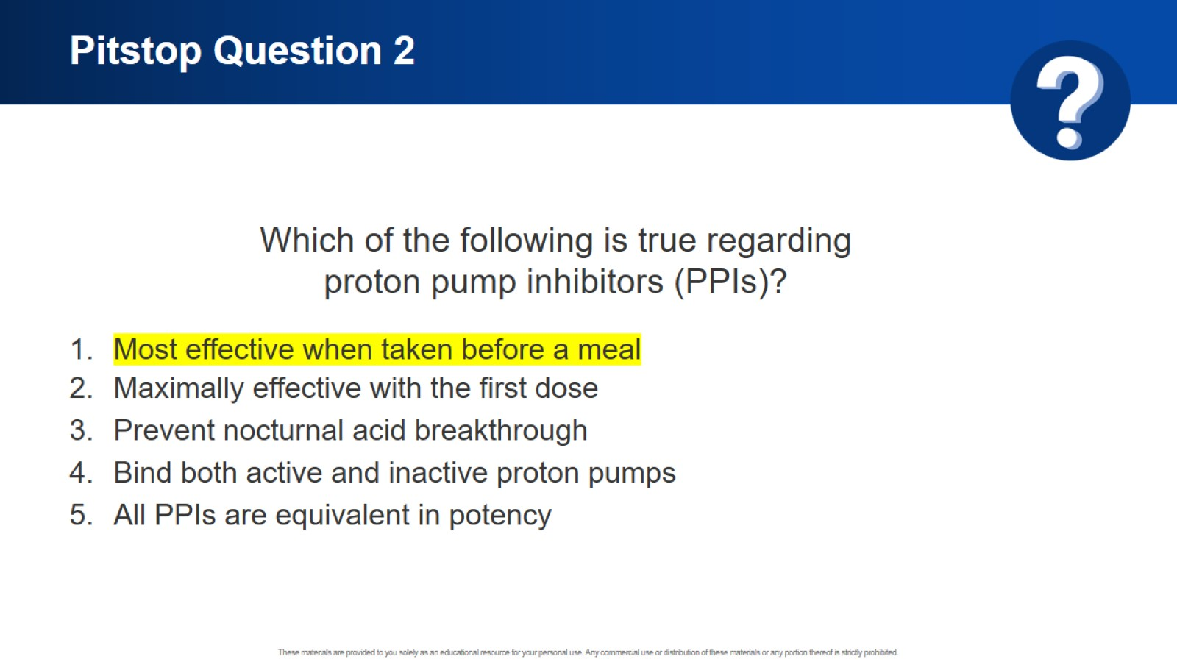
Pitstop Question 2

Slide 28
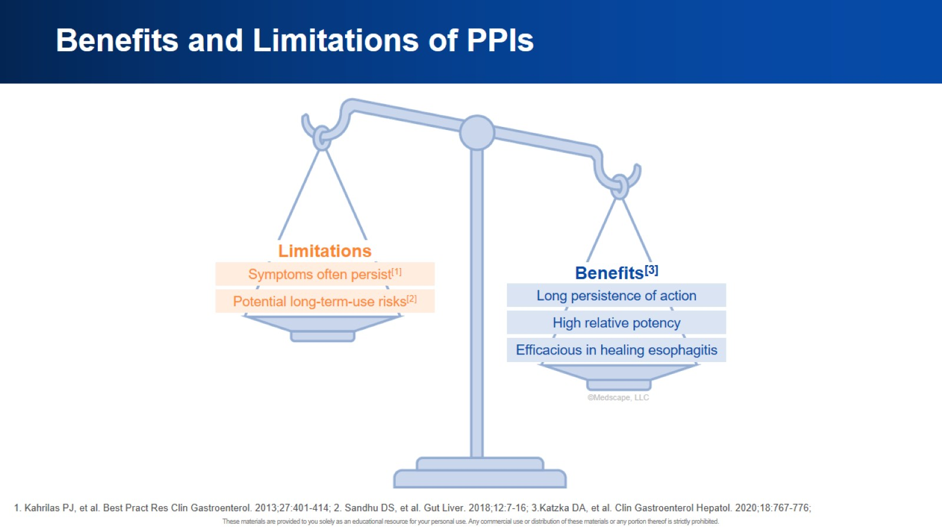
Benefits and Limitations of PPIs

Slide 29
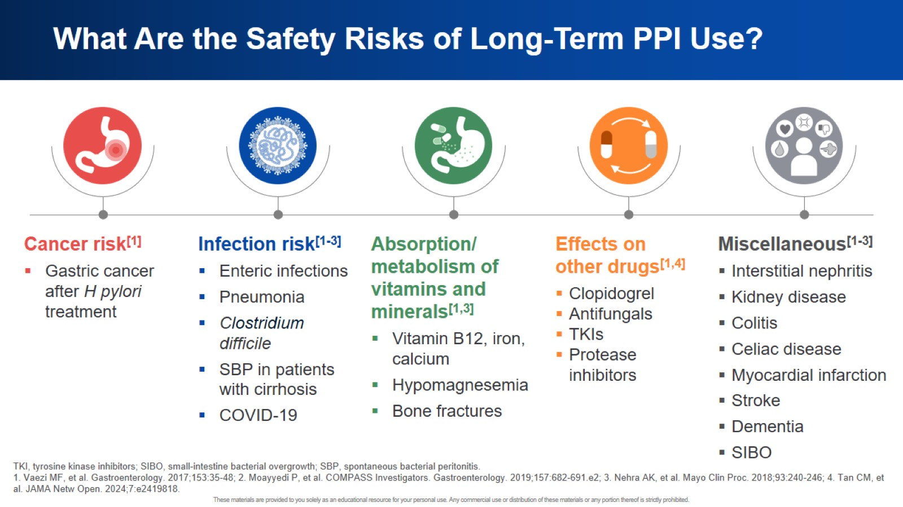
What Are the Safety Risks of Long-Term PPI Use?

Slide 30
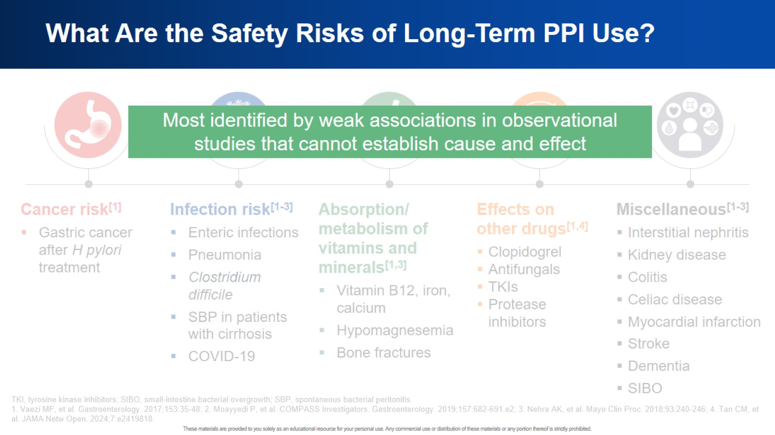
What Are the Safety Risks of Long-Term PPI Use?

Slide 31
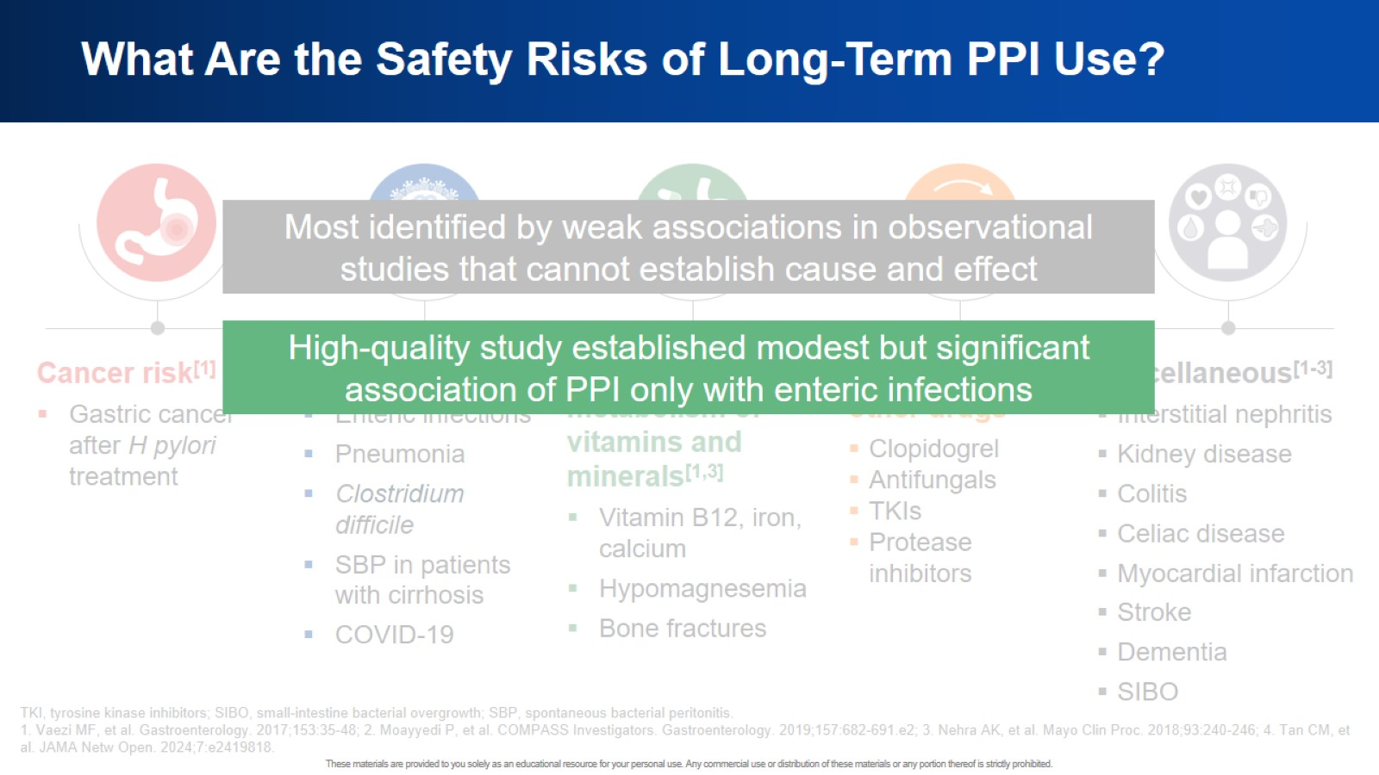
What Are the Safety Risks of Long-Term PPI Use?

Slide 32
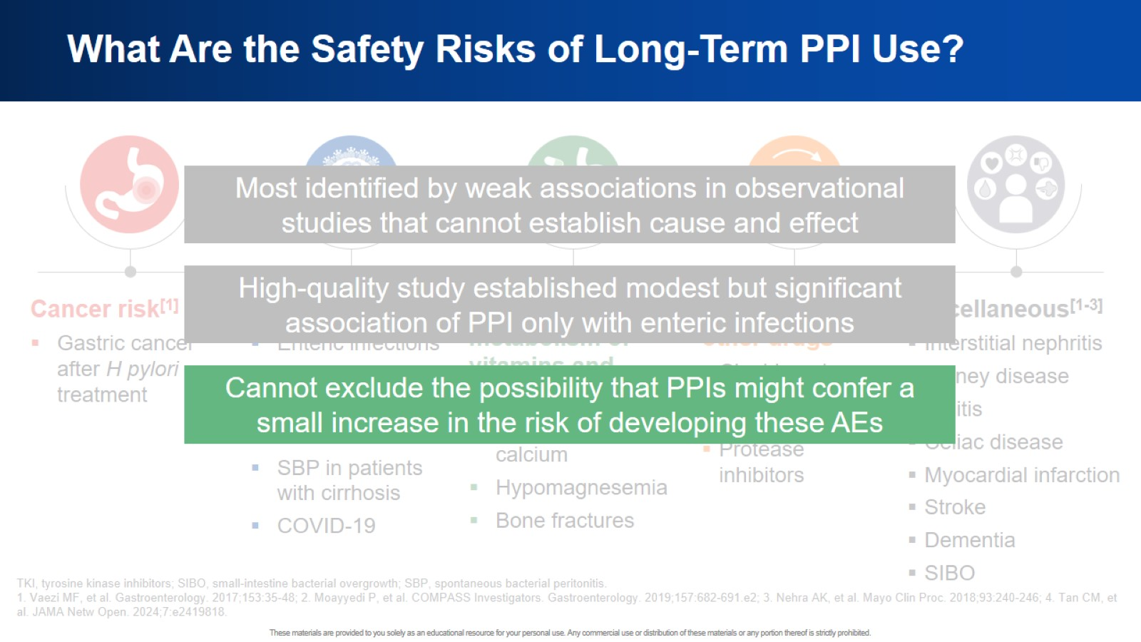
What Are the Safety Risks of Long-Term PPI Use?

Slide 33
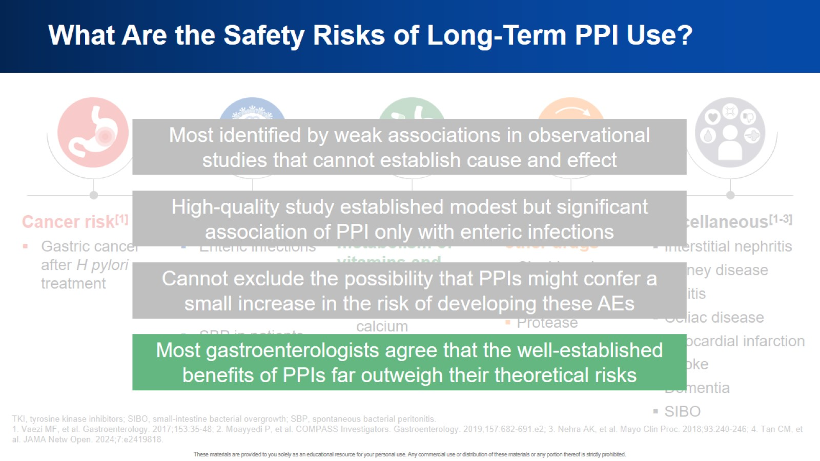
What Are the Safety Risks of Long-Term PPI Use?

Slide 34
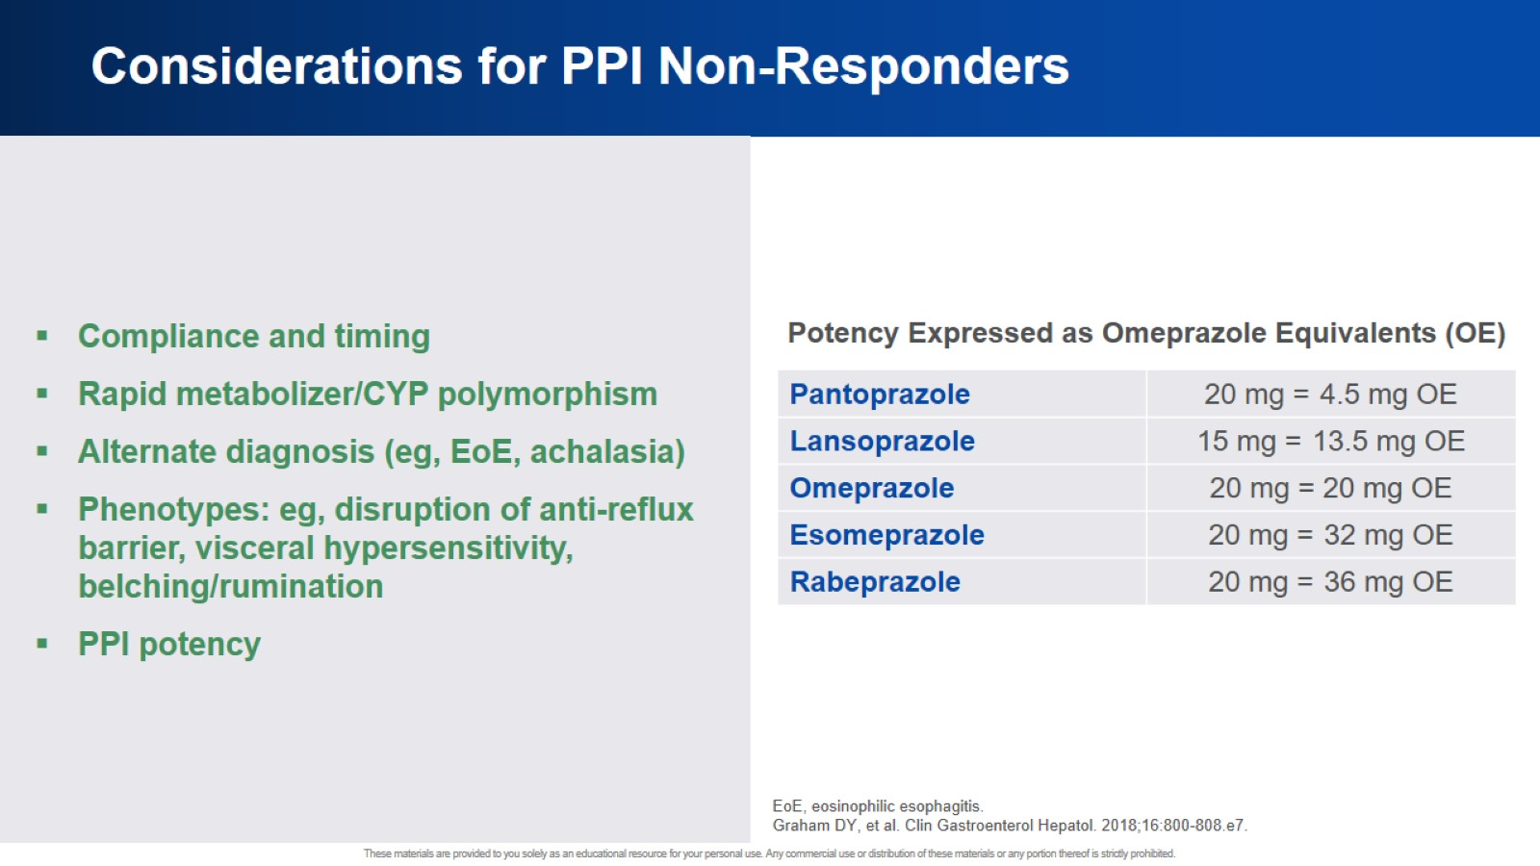
Considerations for PPI Non-Responders

Slide 35
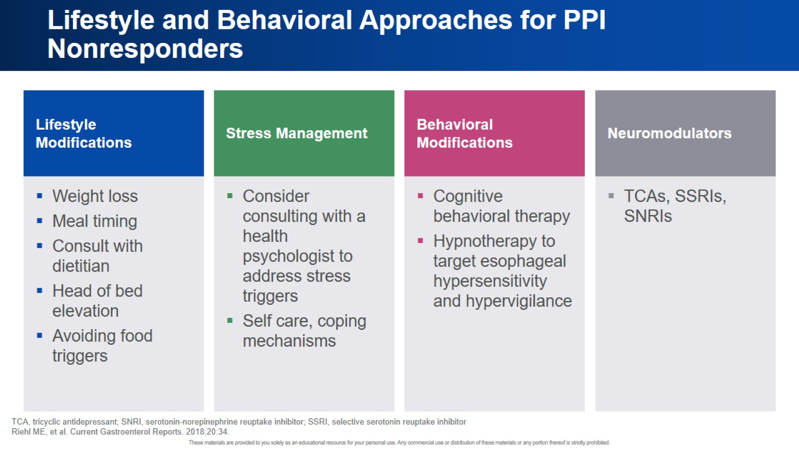
Lifestyle and Behavioral Approaches for PPI Nonresponders

Slide 36
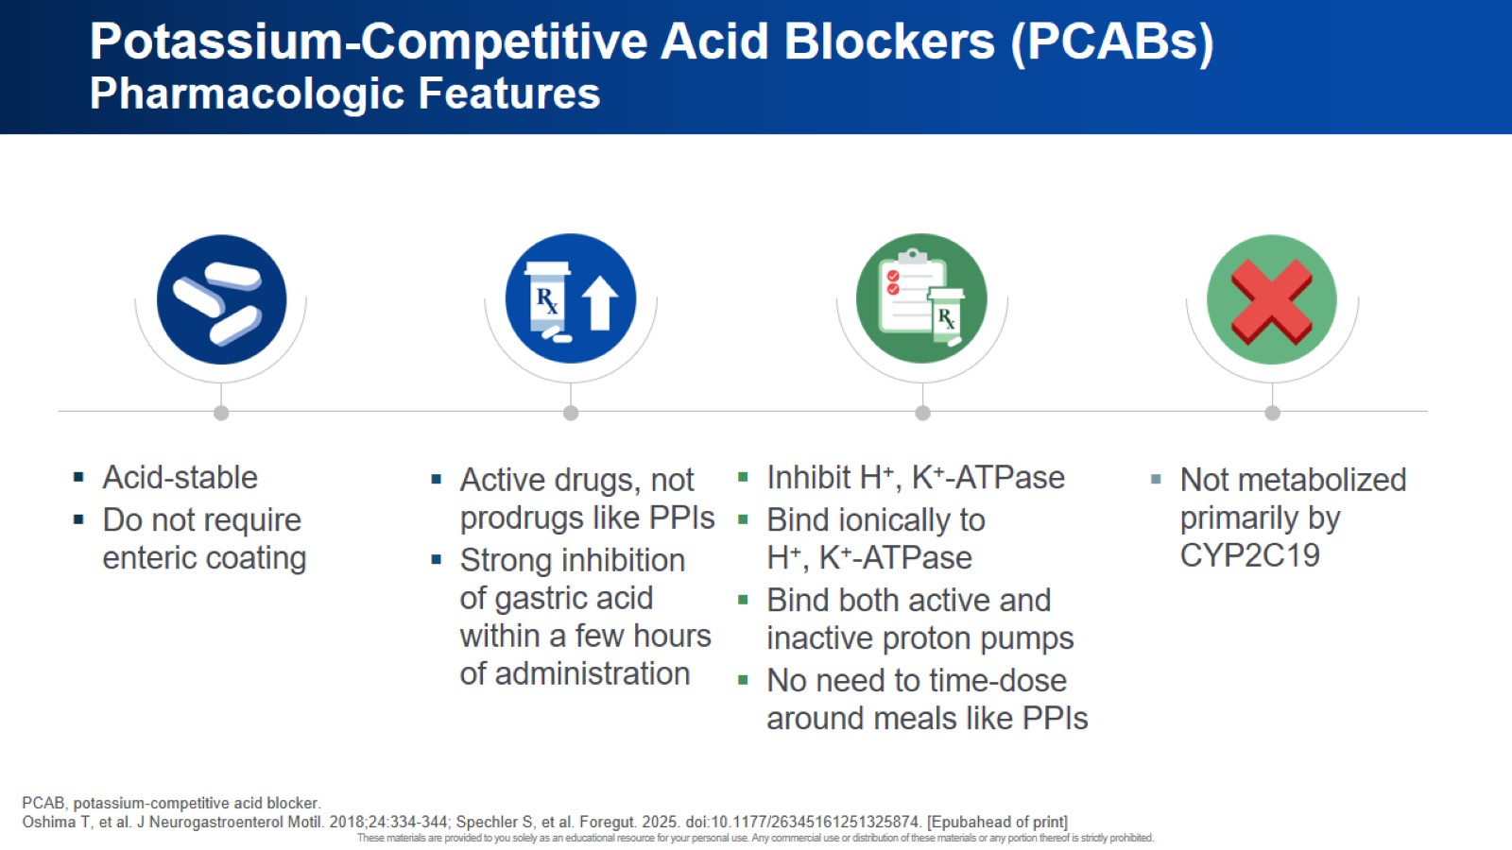
Potassium-Competitive Acid Blockers (PCABs) Pharmacologic Features

Slide 37
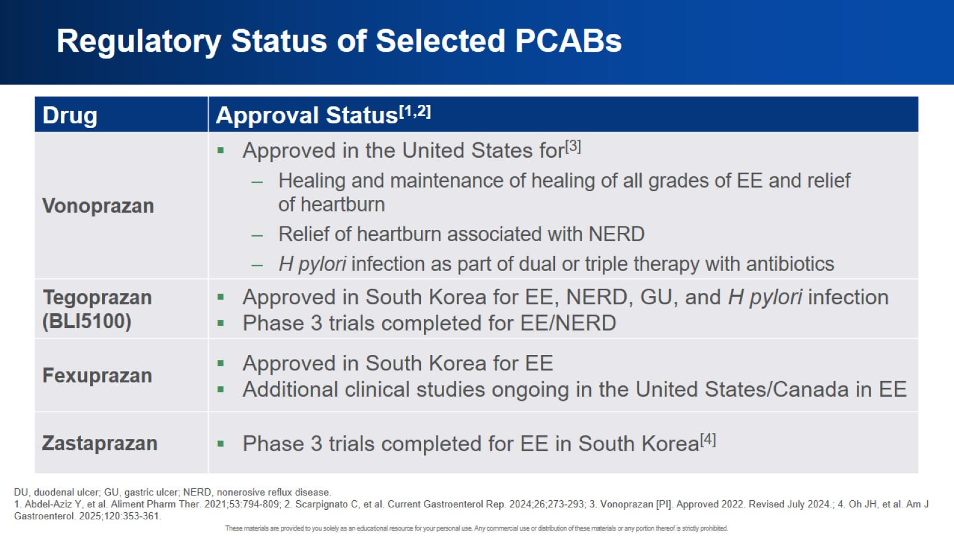
Regulatory Status of Selected PCABs

Slide 38
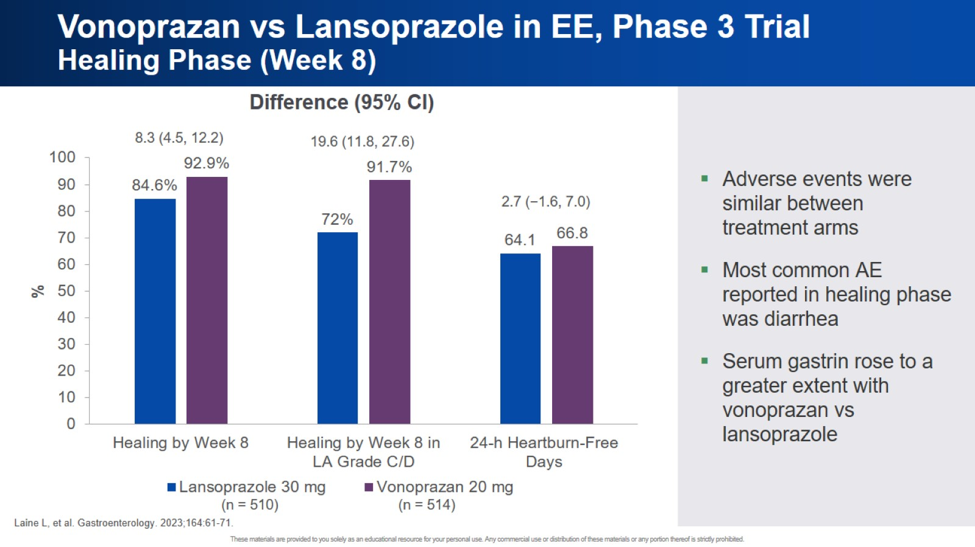
Vonoprazan vs Lansoprazole in EE, Phase 3 Trial Healing Phase (Week 8)

Slide 39
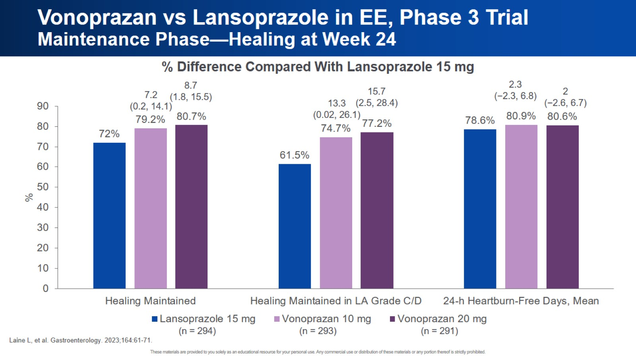
Vonoprazan vs Lansoprazole in EE, Phase 3 Trial Maintenance Phase—Healing at Week 24

Slide 40
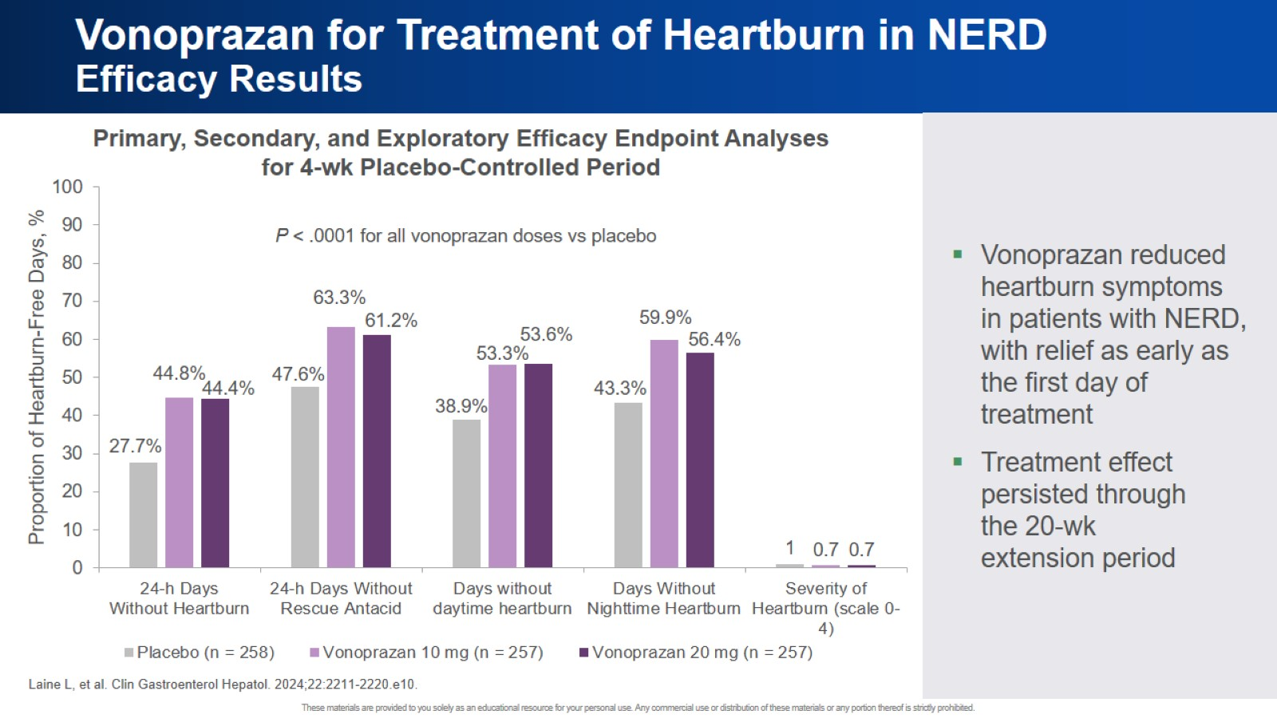
Vonoprazan for Treatment of Heartburn in NERD Efficacy Results

Slide 41
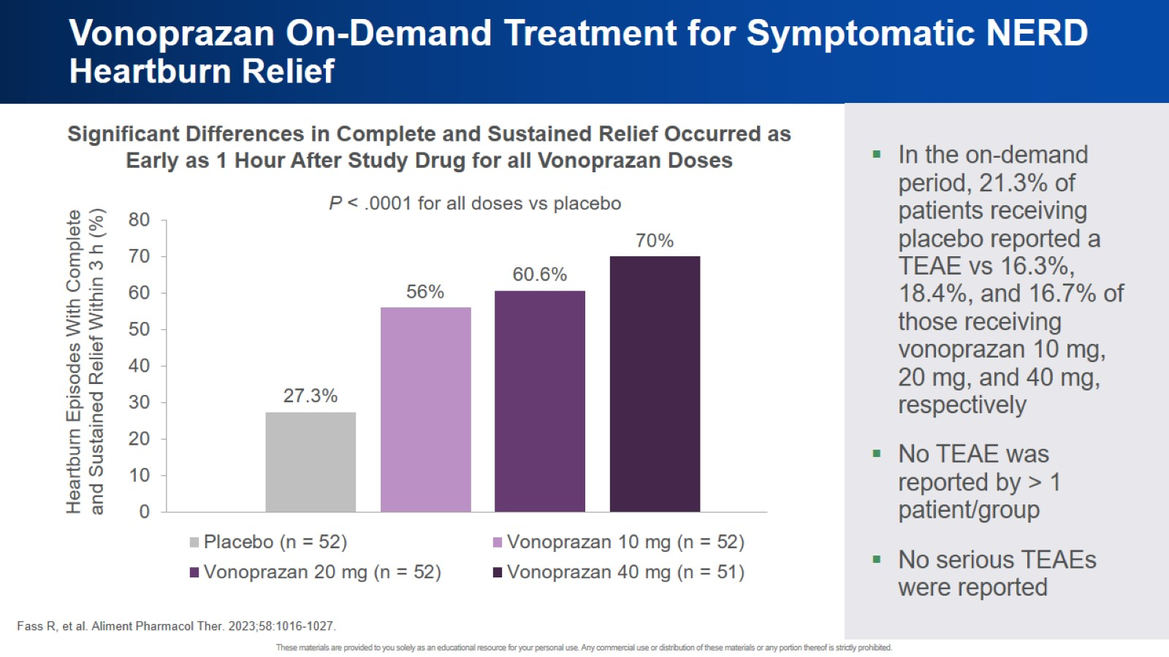
Vonoprazan On-Demand Treatment for Symptomatic NERD Heartburn Relief

Slide 42
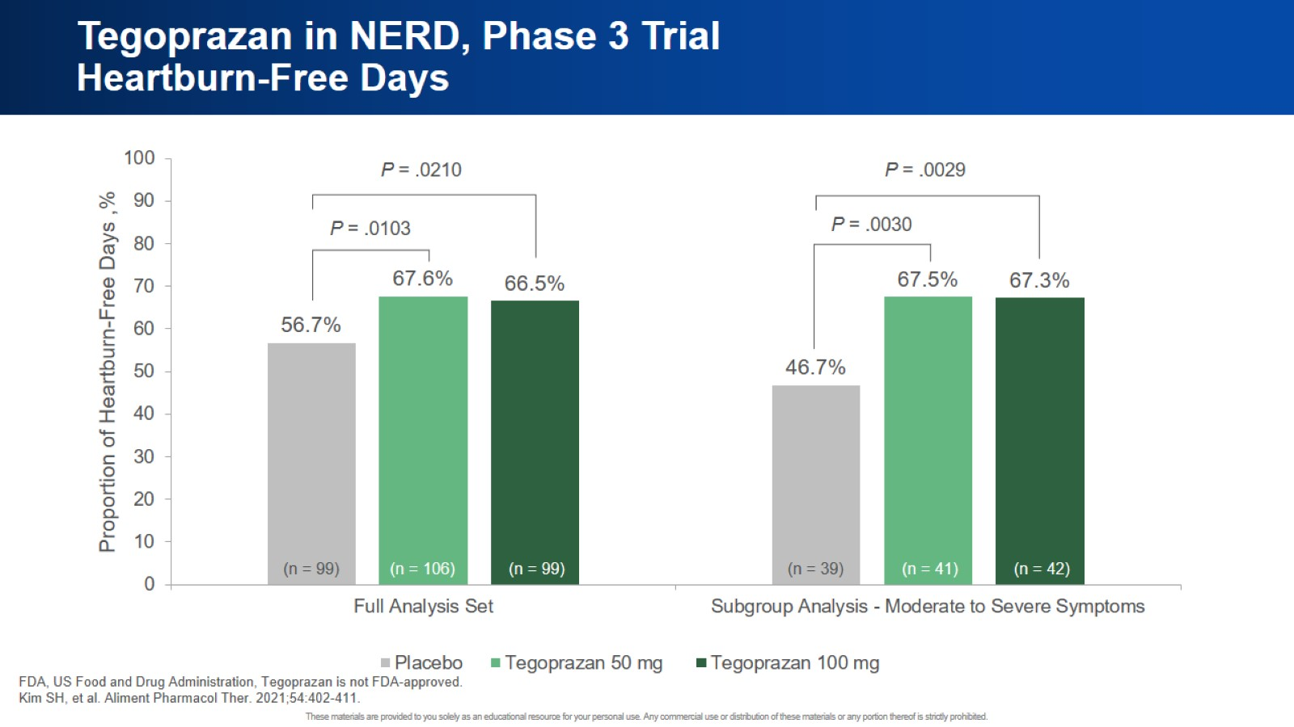
Tegoprazan in NERD, Phase 3 Trial Heartburn-Free Days

Slide 43
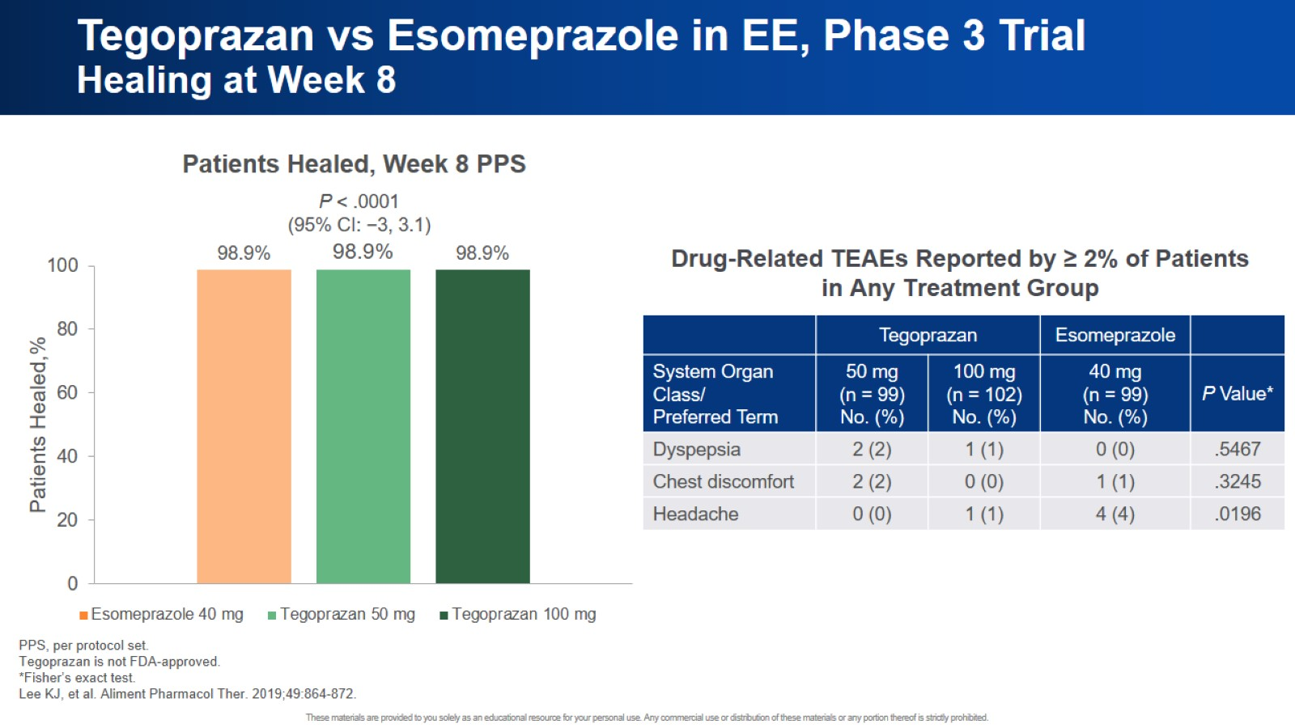
Tegoprazan vs Esomeprazole in EE, Phase 3 Trial Healing at Week 8

Slide 44
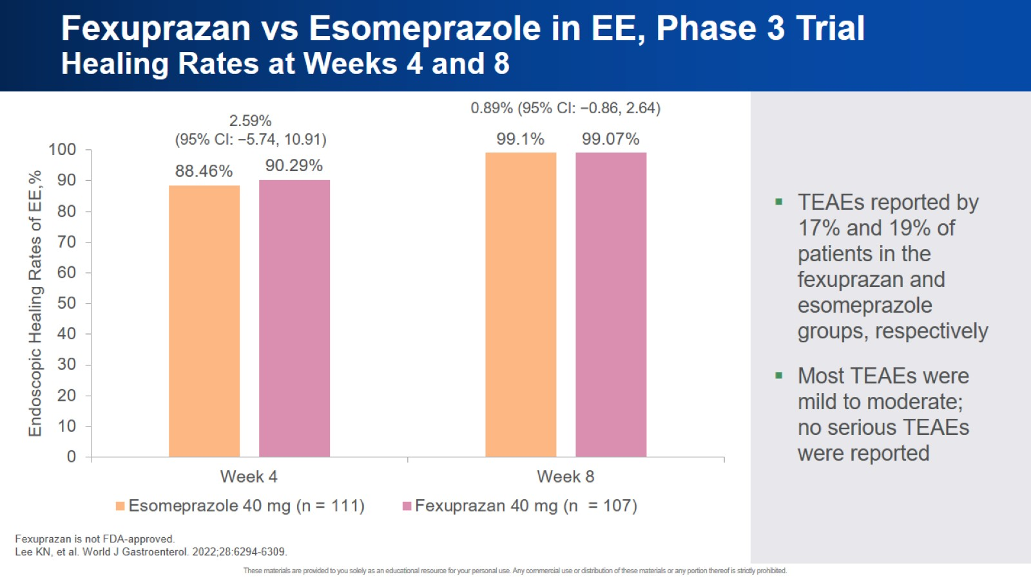
Fexuprazan vs Esomeprazole in EE, Phase 3 Trial Healing Rates at Weeks 4 and 8

Slide 45
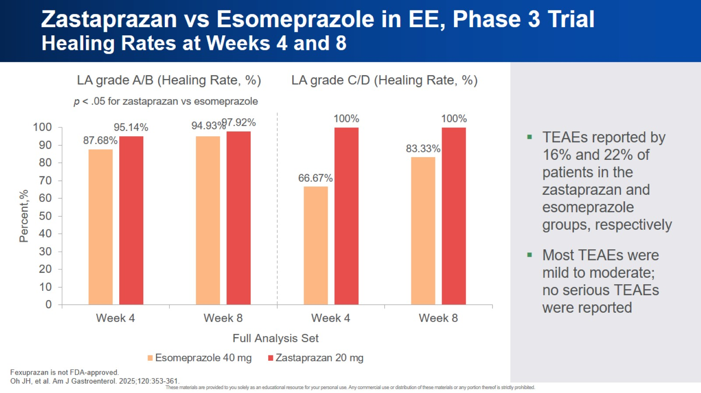
Zastaprazan vs Esomeprazole in EE, Phase 3 Trial Healing Rates at Weeks 4 and 8

Slide 46
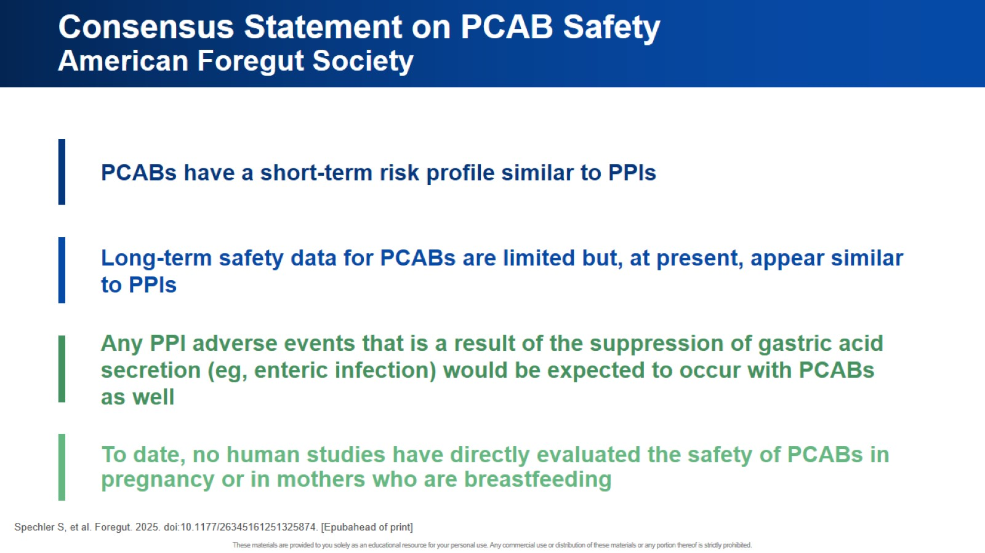
Consensus Statement on PCAB Safety American Foregut Society

Slide 47
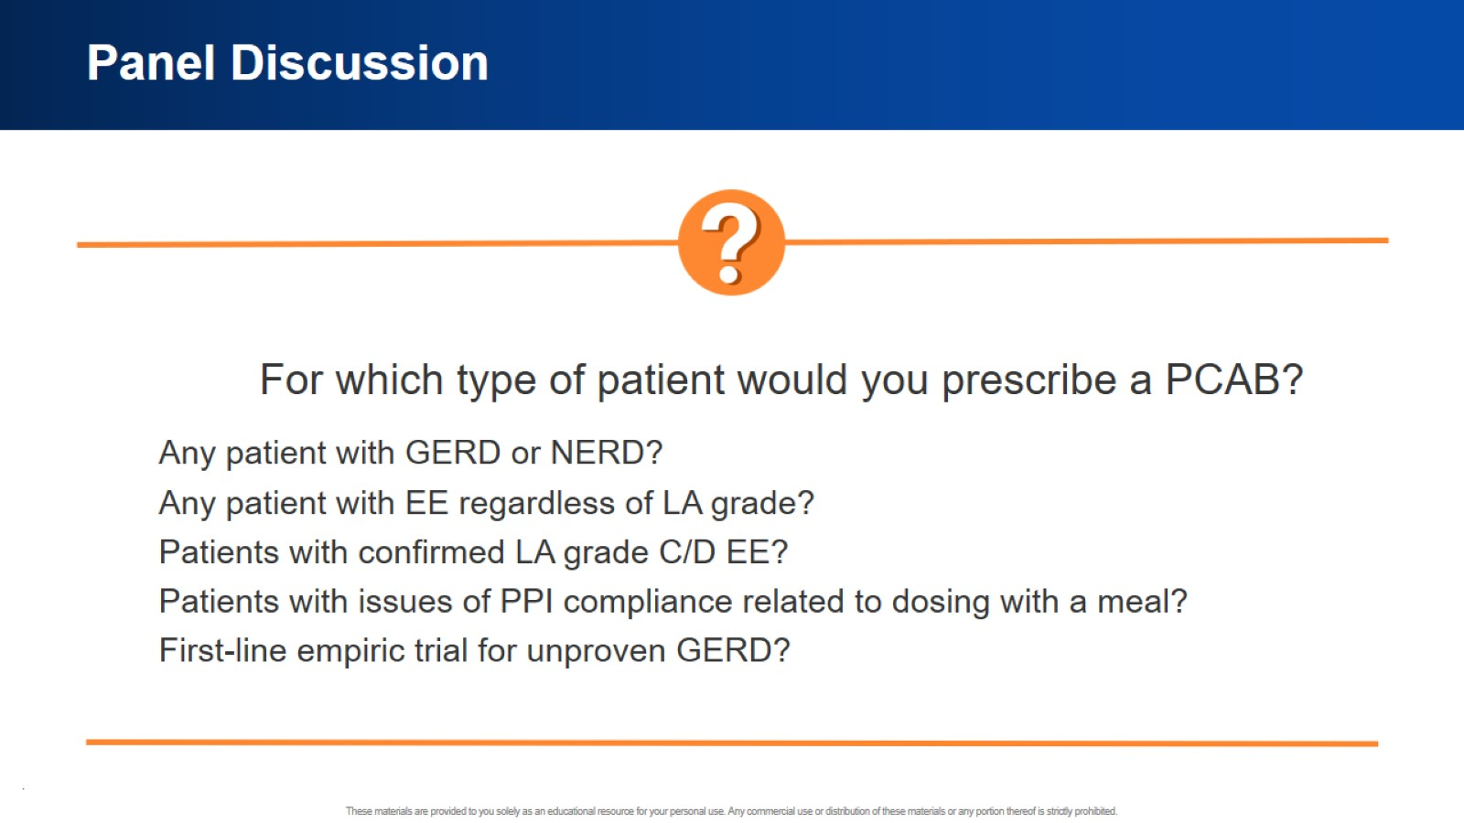
Panel Discussion

Slide 48


Slide 49
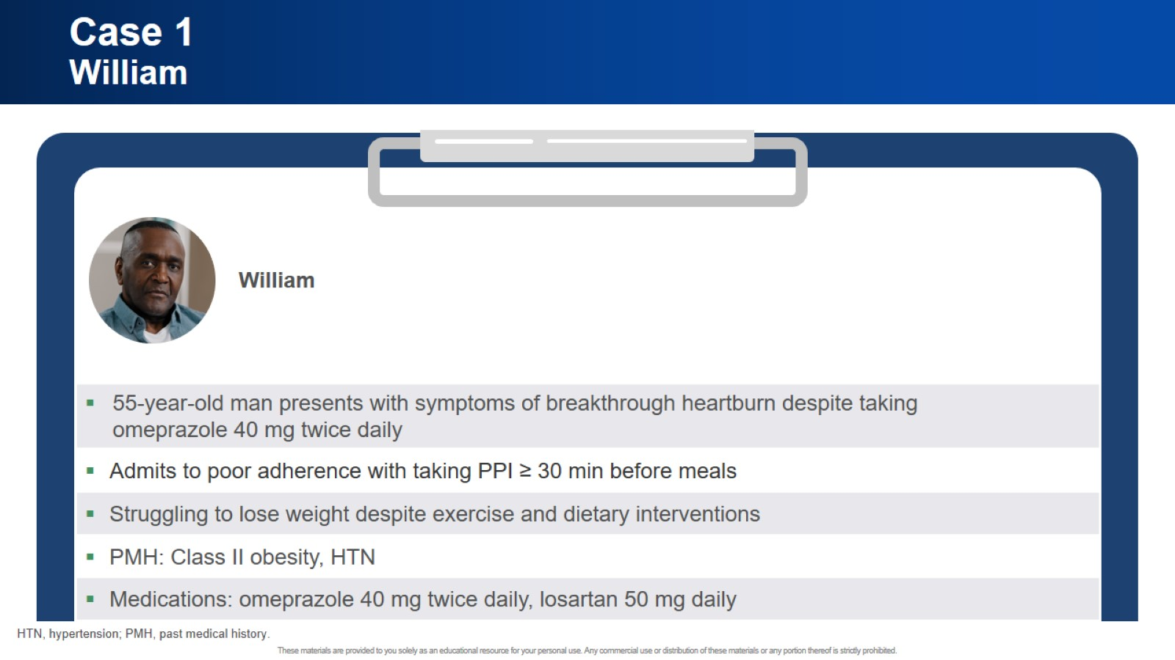
Case 1 William

Slide 50
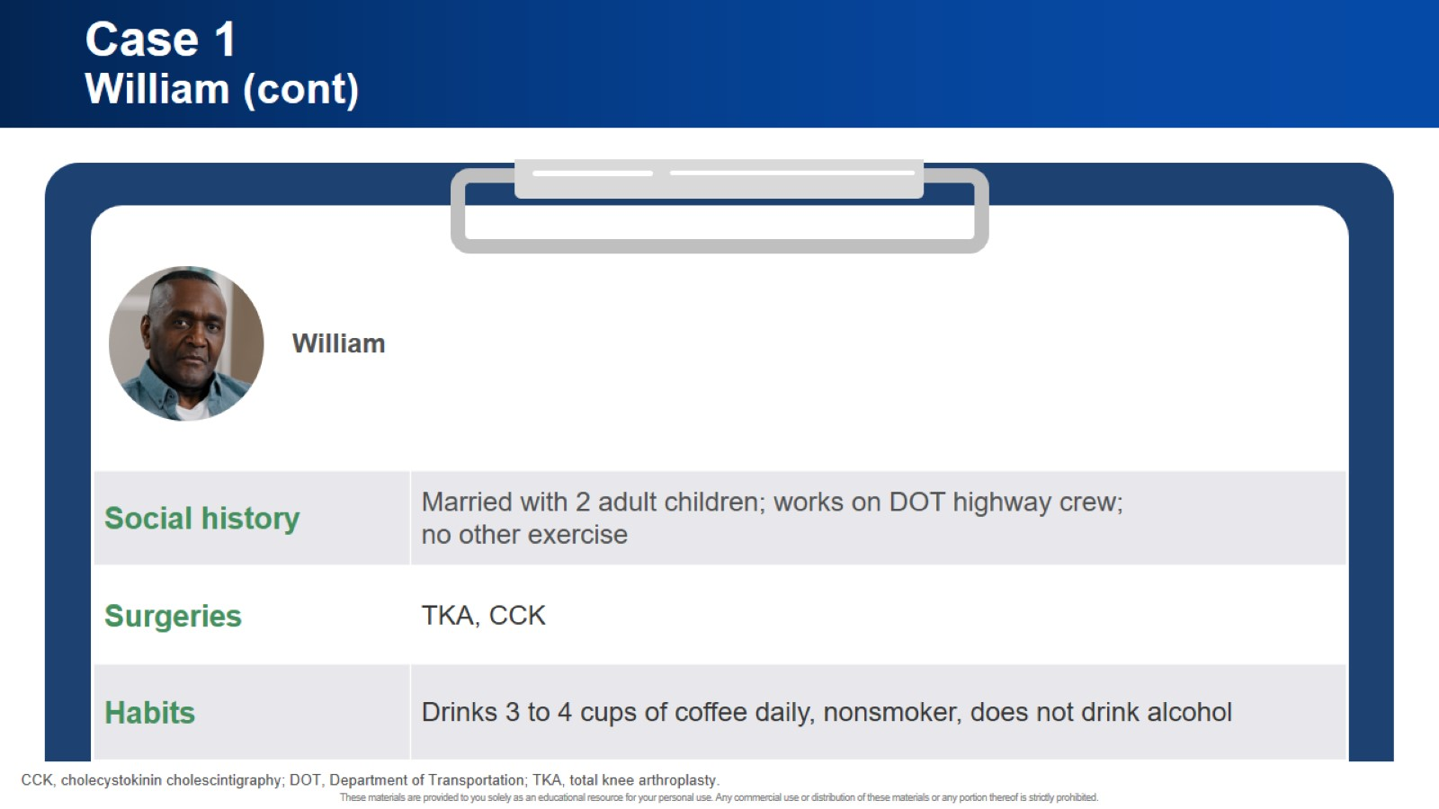
Case 1 William (cont)

Slide 51
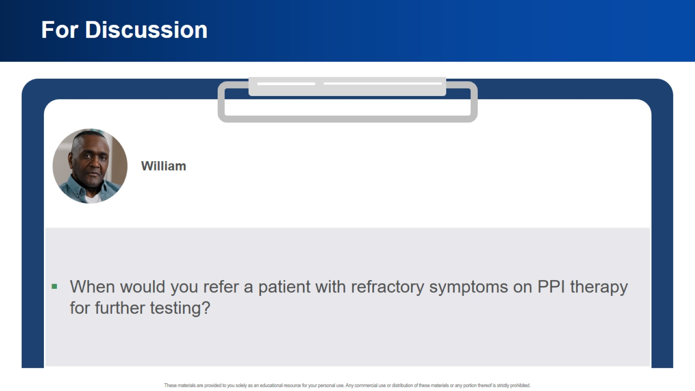
For Discussion

Slide 52
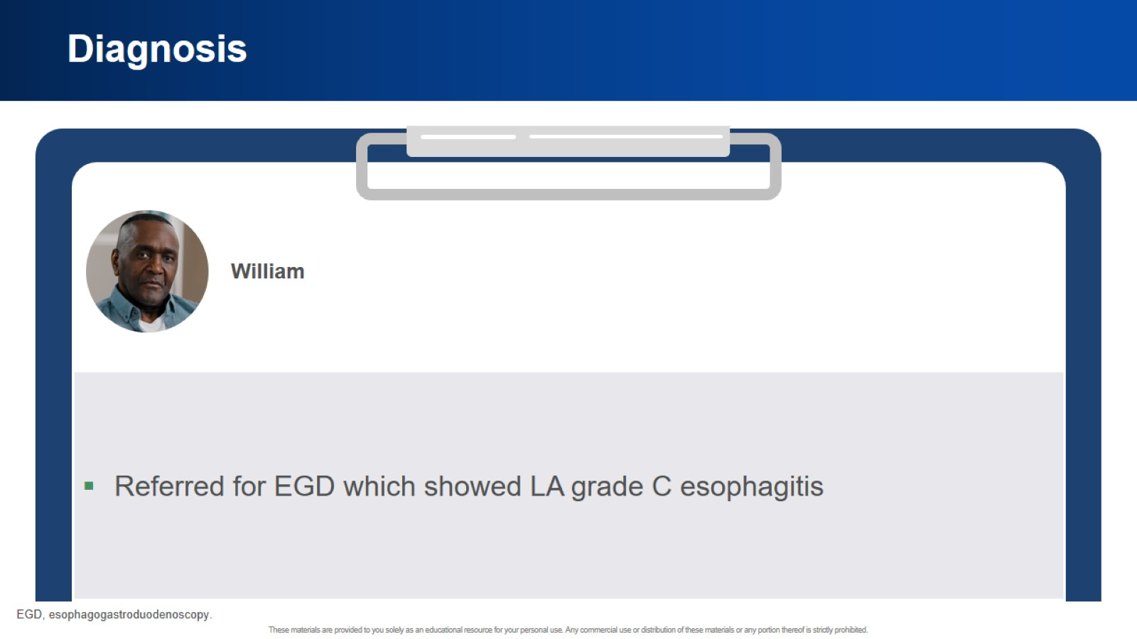
Diagnosis

Slide 53
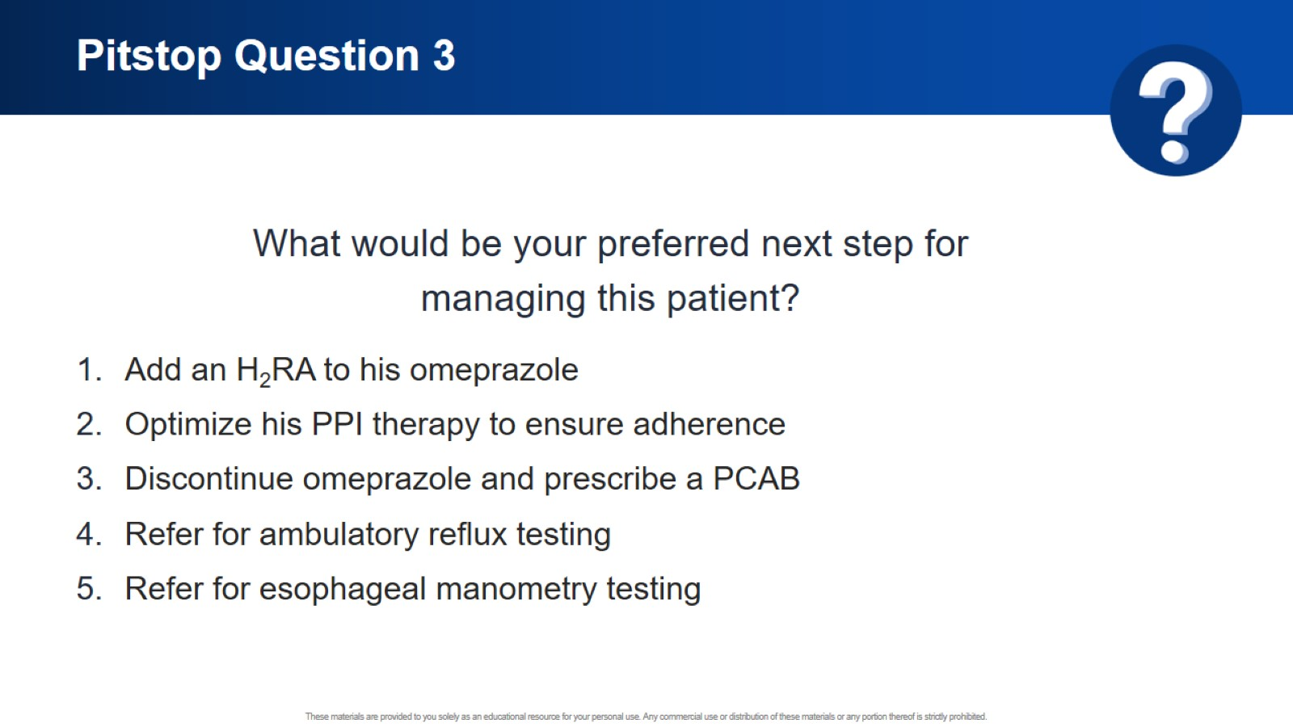
Pitstop Question 3

Slide 54
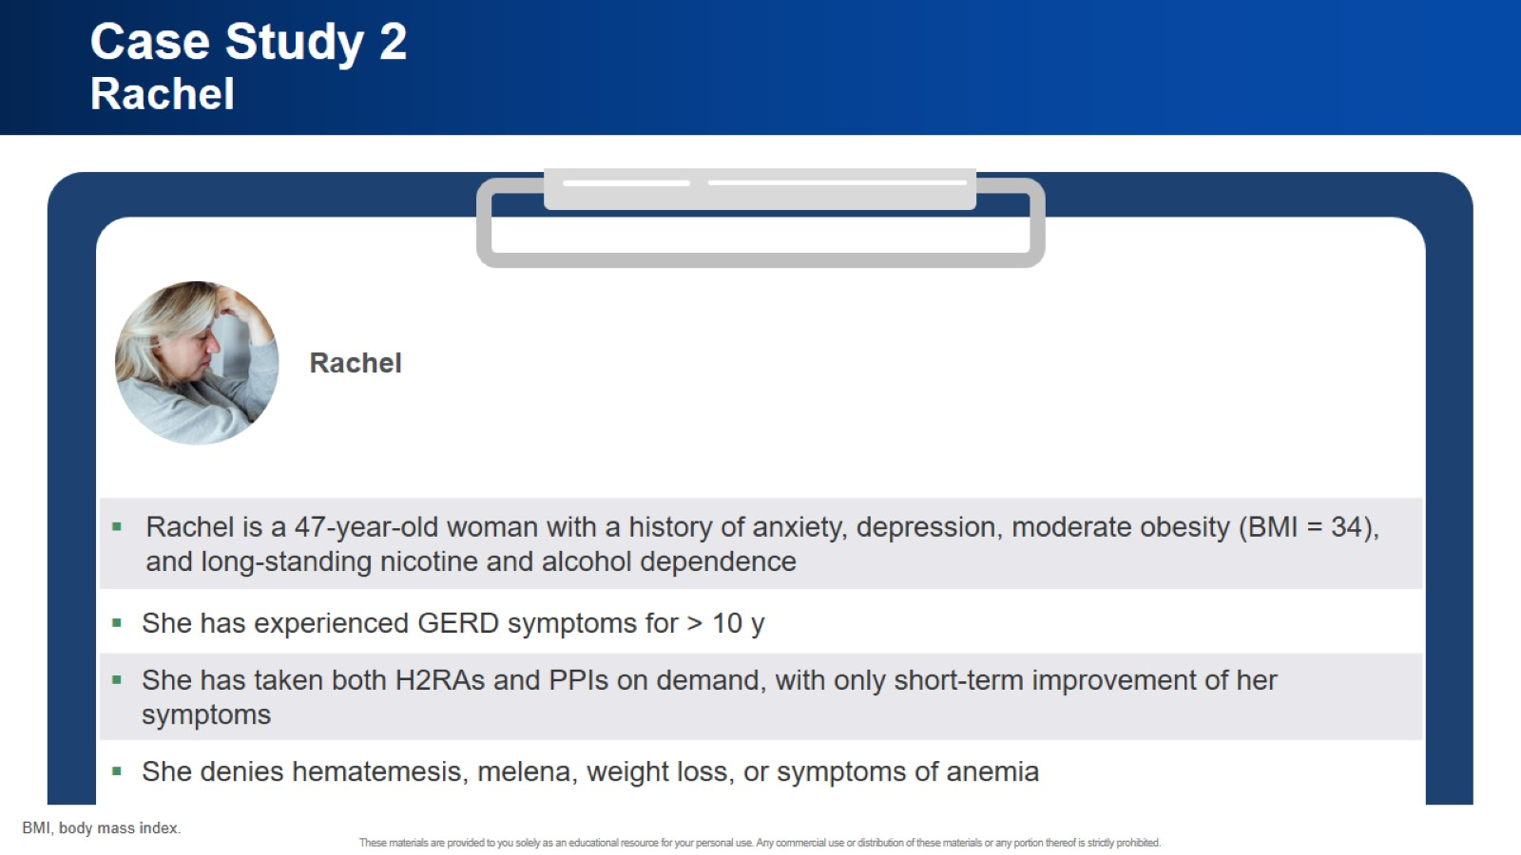
Case Study 2 Rachel

Slide 55
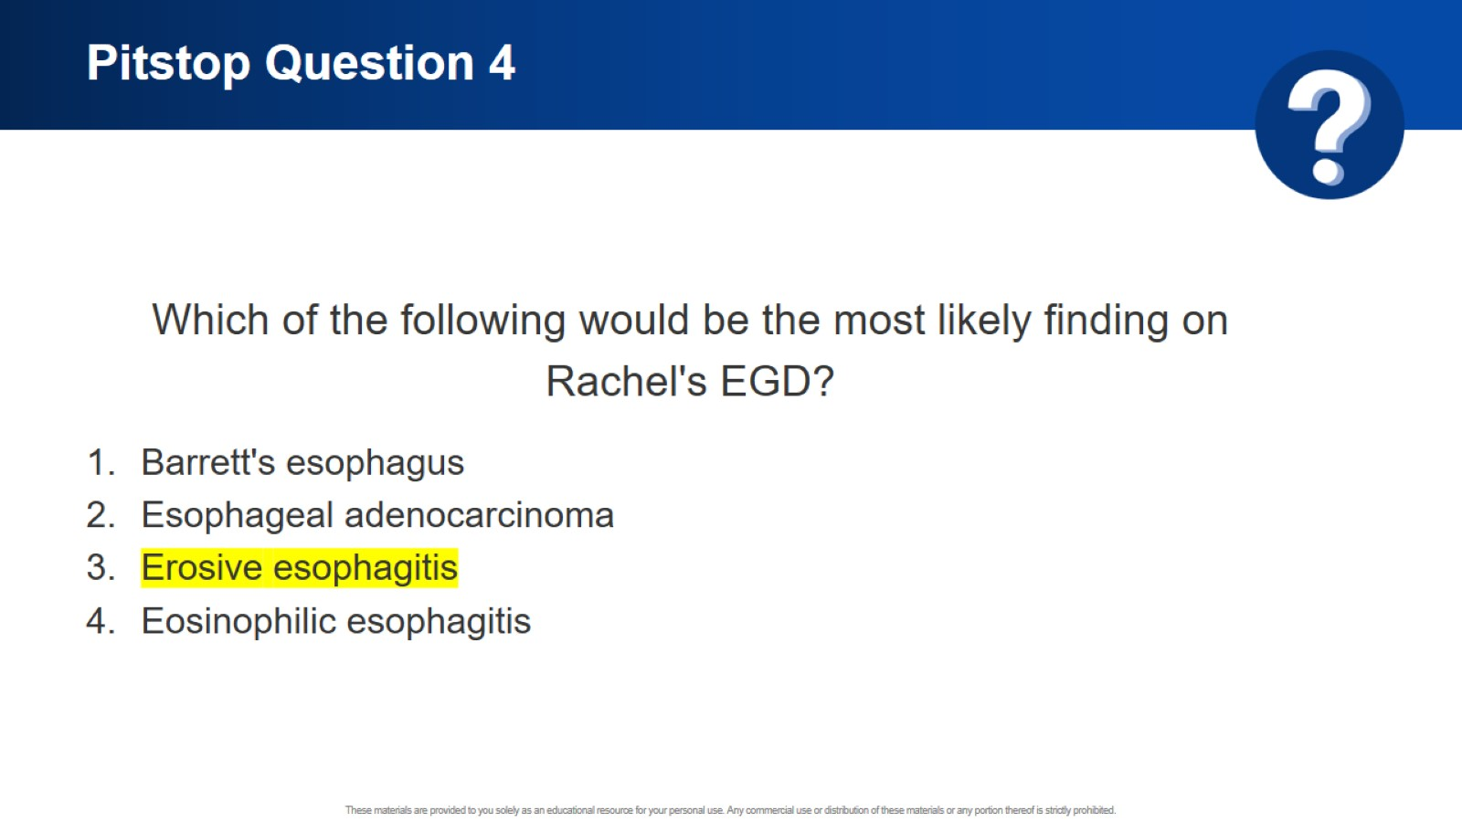
Pitstop Question 4

Slide 56
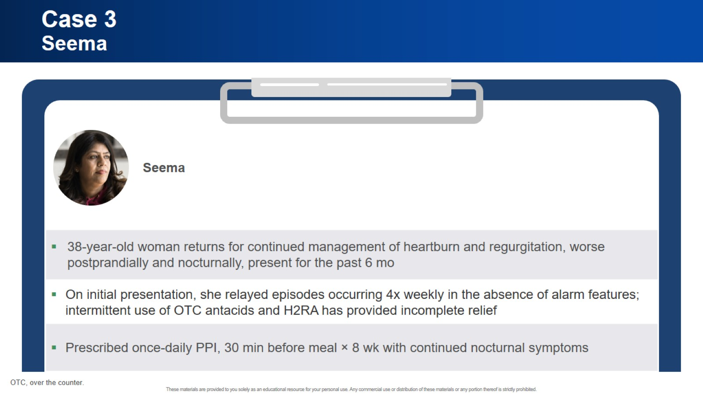
Case 3 Seema

Slide 57

Case 3 Seema (cont)

Slide 58

Pitstop Question 5

Slide 59

Summary of GERD Treatment

Slide 60

Patient-Centered Approach to Therapy

Slide 61

Concluding Remarks

Slide 62


Slide 63


Slide 64

Start Your Engines! Agenda

Slide 65


Slide 66

GERD Is One of the Most Common Health Issues in the United States

Slide 67

Angela’s Story

Slide 68

What Is GERD?

Slide 69

Is GERD a Mechanical Disorder or an Acid Disorder?

Slide 70

Gastroesophageal Reflux Becomes GERD When It . . .

Slide 71

Pitstop Question 1

Slide 72

What Is Erosive Esophagitis?

Slide 73

Endoscopic Manifestations of GERD

Slide 74

Los Angeles Classification of Erosive Esophagitis

Slide 75

Risk Factors for Developing GERD

Slide 76

What Syndromes Are Associated With GERD?

Slide 77

Clinical Presentation and Reasons for Referral

Slide 78

GERD Differential Diagnoses

Slide 79

Is It GERD or Dyspepsia?

Slide 80
Evaluating GERD

Slide 81

Diagnostic Workup in Classic GERD Presentation ACG Guideline

Slide 82
Panel Discussion

Slide 83


Slide 84

Hierarchy of GERD Management

Slide 85

Pitstop Question 2

Slide 86
Benefits and Limitations of PPIs

Slide 87

What Are the Safety Risks of Long-Term PPI Use?

Slide 88

What Are the Safety Risks of Long-Term PPI Use?

Slide 89

What Are the Safety Risks of Long-Term PPI Use?

Slide 90

What Are the Safety Risks of Long-Term PPI Use?

Slide 91

What Are the Safety Risks of Long-Term PPI Use?

Slide 92

Potassium-Competitive Acid Blockers (PCABs) Pharmacologic Features

Slide 93

Mechanism of Action of PCABs Compared With PPIs

Slide 94

Regulatory Status of Selected PCABs

Slide 95

Vonoprazan vs Lansoprazole in EE, Phase 3 Trial Healing Phase (Week 8)

Slide 96

Vonoprazan vs Lansoprazole in EE, Phase 3 Trial Maintenance Phase—Healing at Week 24

Slide 97

Vonoprazan for Treatment of Heartburn in NERD Efficacy Results

Slide 98

Vonoprazan for Treatment of Heartburn in NERD Heartburn-Free Days

Slide 99

Vonoprazan On-Demand Treatment for Symptomatic NERD Heartburn Relief

Slide 100

Tegoprazan vs Esomeprazole in EE, Phase 3 Trial Healing at Week 8

Slide 101

Tegoprazan in NERD, Phase 3 Trial Heartburn-Free Days

Slide 102

Fexuprazan vs Esomeprazole in EE, Phase 3 Trial Healing Rates at Weeks 4 and 8

Slide 103

Zastaprazan vs Esomeprazole in EE, Phase 3 Trial Healing Rates at Weeks 4 and 8

Slide 104

Consensus Statement on PCAB Safety American Foregut Society

Slide 105

Panel Discussion

Slide 106


Slide 107

Case Study No. 1 Miguel

Slide 108

Pitstop Question 3

Slide 109

Case Study No. 2 Rachel

Slide 110

Pitstop Question 4

Slide 111

Case Study No. 3 Elondra

Slide 112

Pitstop Question 5

Slide 113

Overview of GERD Treatment

Slide 114

Patient-Centered Approach to Therapy

Slide 115

Concluding Remarks

Slide 116


Slide 117


Slide 118

Who Is in the Waiting Room?

Slide 119


Slide 120

Case Study Susanna

Slide 121

Case Study Susanna

Slide 122

Case Study Susanna

Slide 123

2022 AGA Clinical Practice Update Utilization of Empiric PPI Therapy in GERD

Slide 124

Practical Tips to Guide Management in the Clinic

Slide 125

Diet and Lifestyle Modifications to Treat GERD

Slide 126

Weight Loss Is Effective

Slide 127

Nighttime Modifications

Slide 128

Diaphragmatic Breathing

Slide 129

2022 AGA Clinical Practice Update Utilization of Empiric PPI Therapy in GERD

Slide 130

Position Yourself for Success With PPIs

Slide 131

Evaluating for Erosive Esophagitis or Non-Erosive Reflux Disease

Slide 132

Audience Polling Question

Slide 133

LA Classification of Erosive Esophagitis

Slide 134

Los Angeles Grades B, C, and D Esophagitis Are Conclusive for GERD

Slide 135

Case Study (cont) Susanna

Slide 136

Upper GI Endoscopy and Ambulatory Reflux Monitoring

Slide 137

Prolonged Ambulatory Reflux Monitoring Predicts PPI Use

Slide 138

Case Study (cont) Susanna

Slide 139

Audience Polling Question

Slide 140

Utilization of Prolonged Reflux Monitoring off PPI to Characterize GERD Severity

Slide 141

Audience Polling Question

Slide 142

Utilization of Prolonged Reflux Monitoring Off PPI to Characterize GERD Severity

Slide 143

Potassium-Competitive Acid Blockers A New Acid Suppressive Option

Slide 144

Mechanism of Action of PCABs Compared With PPIs

Slide 145

Current Status of PCABs in the United States

Slide 146

Vonoprazan for Treatment of Heartburn in NERD Randomized Phase 3 Study

Slide 147

Vonoprazan for Treatment of Heartburn in NERD Randomized Phase 3 Study

Slide 148

Vonoprazan for Treatment of Heartburn in NERD Randomized Phase 3 Study

Slide 149

Vonoprazan for Treatment of Heartburn in NERD Safety

Slide 150

Vonoprazan On-Demand Treatment for Symptomatic NERD Randomized Phase 2 Study

Slide 151

Phase 3 Trial of Tegoprazan in NERD

Slide 152

Phase 3 Trial of Tegoprazan in NERD Safety

Slide 153

Case 1 Key Takeaways

Slide 154


Slide 155

Case Study Ray

Slide 156

Endoscopic GERD Phenotypes

Slide 157

Lyon 2.0

Slide 158

GERD Management

Slide 159

Gastric Acid Neutralization and Esophagitis Healing

Slide 160

Proton Pump Inhibitors Current Uses and Safety

Slide 161

Audience Polling Question

Slide 162

GERD Management

Slide 163

Case Study (cont) Ray

Slide 164

Case Study (cont) Ray

Slide 165

Bedtime H2RA for Persisting Nocturnal Heartburn

Slide 166

GERD Alternative Pharmacotherapy

Slide 167

GERD Management

Slide 168

Vonoprazan in Erosive Esophagitis

Slide 169

Phase 3 Trial of Vonoprazan vs Lansoprazole in EE Healing Phase (Week 8)

Slide 170

Phase 3 Trial of Tegoprazan vs Esomeprazole in EE

Slide 171

Phase 3 Trial of Fexuprazan vs Esomeprazole in EE Healing Rates at Weeks 4 and 8

Slide 172

Hierarchy of GERD Management

Slide 173

Case Study (cont) Ray

Slide 174

PCABs Are an Option for Refractory GERD Faculty Perspective

Slide 175

Case 2 Key Takeaways

Slide 176


Slide 177


Slide 178


Slide 179

Agenda

Slide 180


Slide 181

Definition of GERD

Slide 182

Classification and Risk

Slide 183

Clinical Presentation of GERD

Slide 184

LA Classification of EE

Slide 185

Etiology of GERD

Slide 186

Dyspepsia

Slide 187

Conclusion

Slide 188


Slide 189

Clinical Diagnosis Symptoms Suspicious for GERD

Slide 190

Updated Diagnosis of GERD Lyon Consensus 2.0

Slide 191

ACG Clinical GERD Guidelines 2022 Diagnosing GERD

Slide 192

Lyon Consensus 2.0 Conclusive Evidence for GERD

Slide 193

GERD Warning Signs

Slide 194

GERD Testing

Slide 195

Differential Diagnosis

Slide 196

Conclusion

Slide 197


Slide 198

Nonpharmacologic Management of GERD

Slide 199

Intermittent GERD

Slide 200

Chronic GERD: PPI Pharmacologic Features That Limit Speed of Onset and Acid-Inhibiting Efficacy

Slide 201

2022 AGA Clinical Practice Update Use of Empiric PPI Therapy in GERD

Slide 202

ACG 2022 GERD Diagnostic Algorithm

Slide 203

What Are the Safety Risks for Long-Term PPI Use?

Slide 204

What Are the Safety Risks for Long-Term PPI Use?

Slide 205

Conclusion

Slide 206


Slide 207

Agenda

Slide 208

History of PCABs

Slide 209

Overview of PCABs

Slide 210

MOAs of PPIs Compared With PCABs

Slide 211

Current Status of PCABs in the United States

Slide 212

Phase 3 Trial of Vonoprazan vs Lansoprazole in EE Healing Phase (Week 8)

Slide 213

Vonoprazan for Treatment of Heartburn PHALCON-NERD 301 Study

Slide 214

Vonoprazan On-Demand Treatment for Symptomatic NERD Randomized Phase 2 Study

Slide 215

Phase 3 Trial of Tegoprazan vs Esomeprazole in EE

Slide 216

Phase 3 Trial of Tegoprazan in NERD

Slide 217

Phase 3 Trial of Fexuprazan in EE Healing Rates at Weeks 4 and 8

Slide 218

Conclusion

Slide 219


Slide 220

Identifying Refractory GERD

Slide 221

Treatment for Atypical GERD

Slide 222

Treatment for Atypical GERD (cont)

Slide 223

Follow-Up and Surveillance

Slide 224

Follow-Up and Surveillance (cont)

Slide 225

Patient Case

Slide 226

Referral and Long-Term Management

Slide 227

Conclusion

Slide 228


