Slide 1
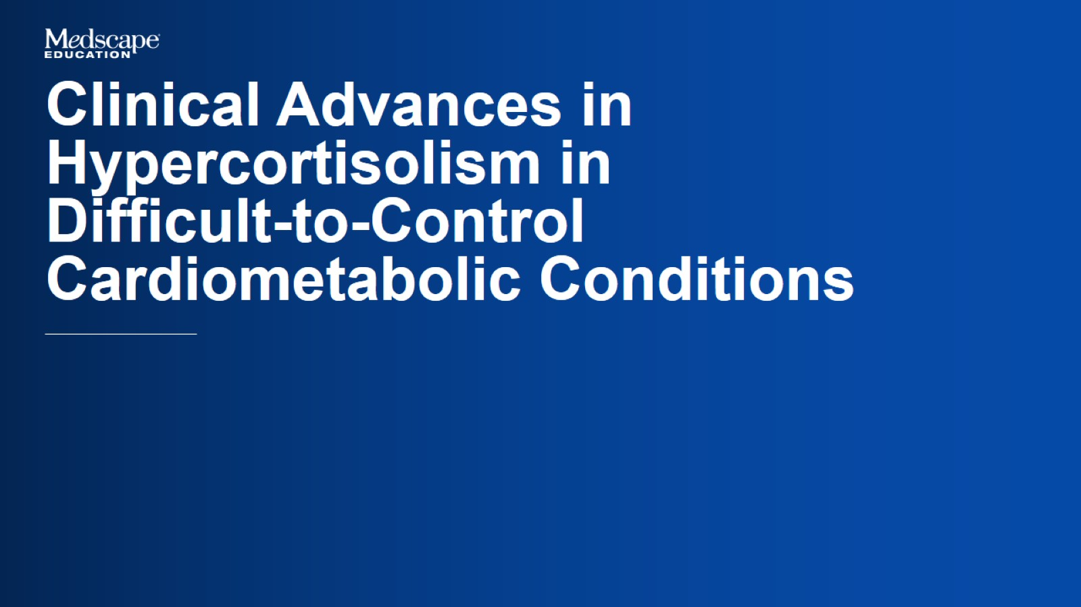

Slide 2
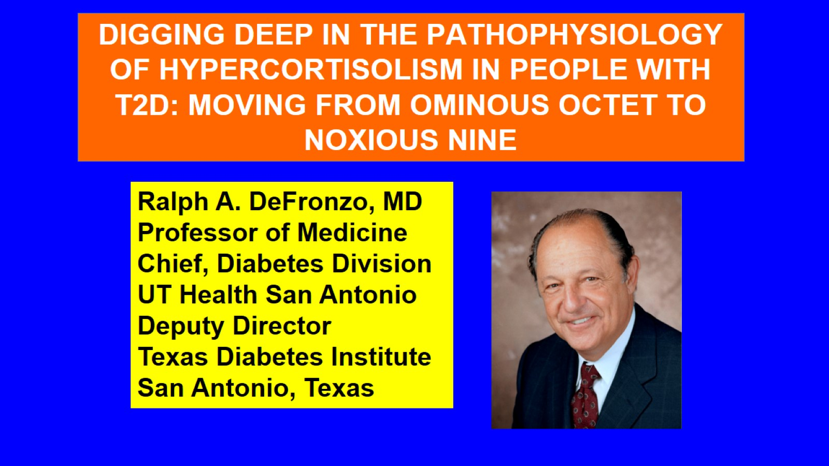

Slide 3
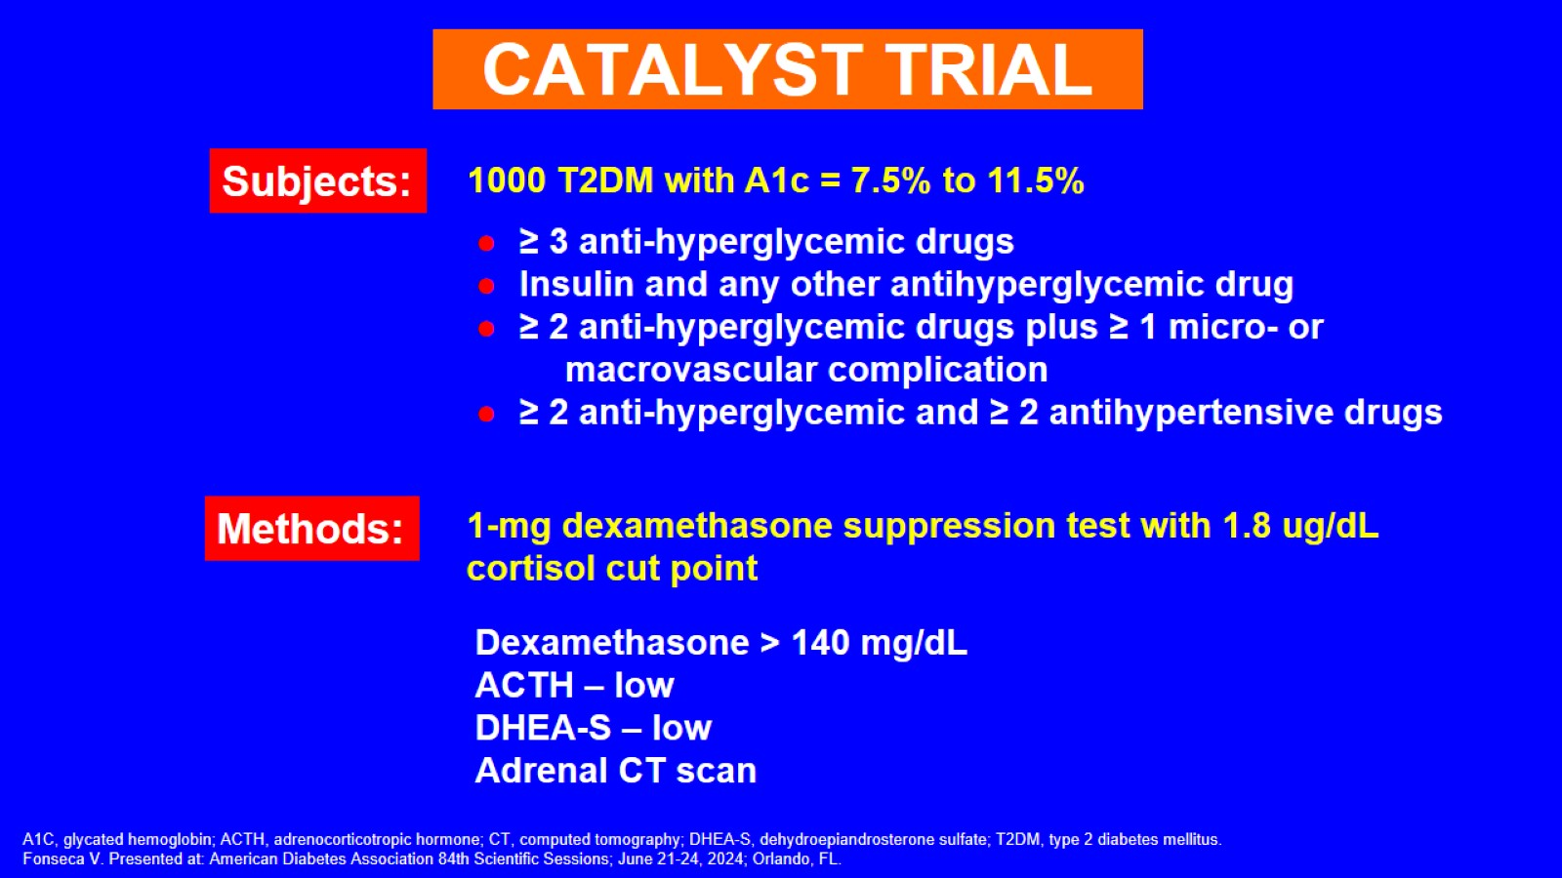

Slide 4
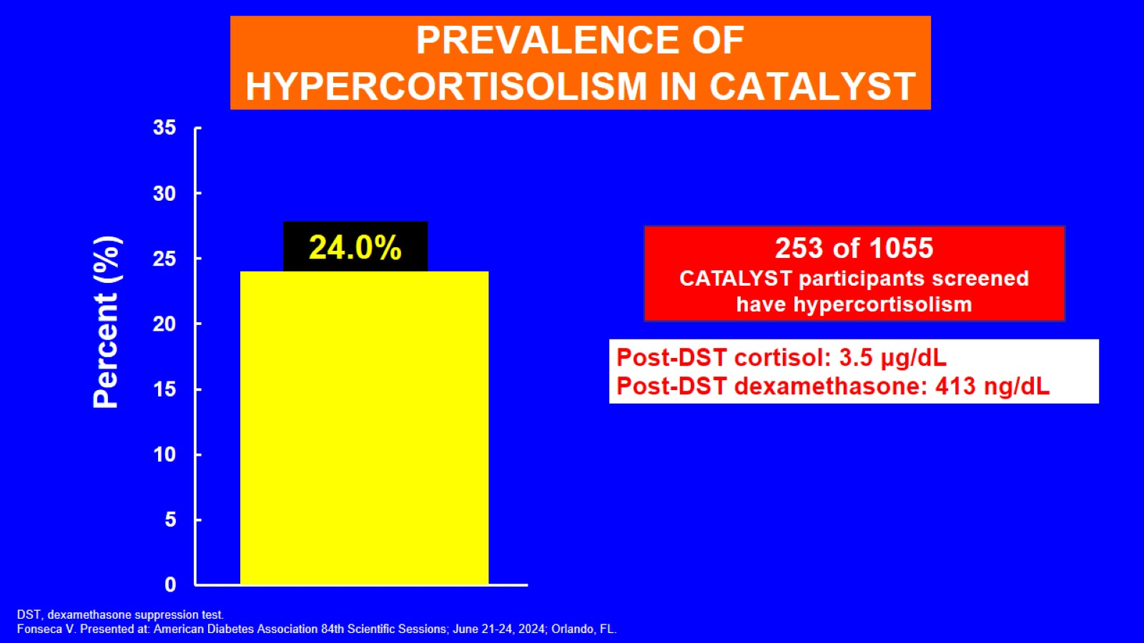
PREVALENCE OF HYPERCORTISOLISM IN CATALYST

Slide 5
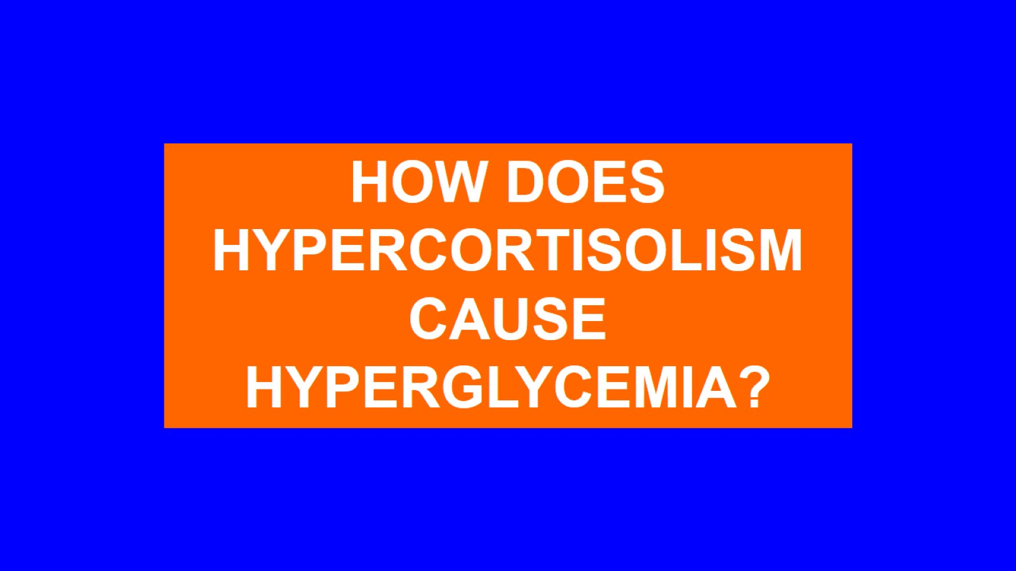

Slide 6
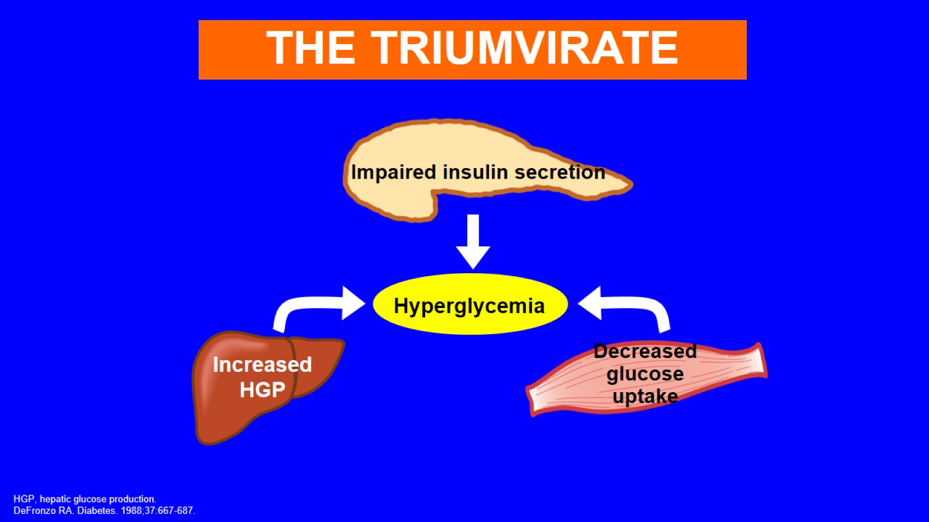

Slide 7
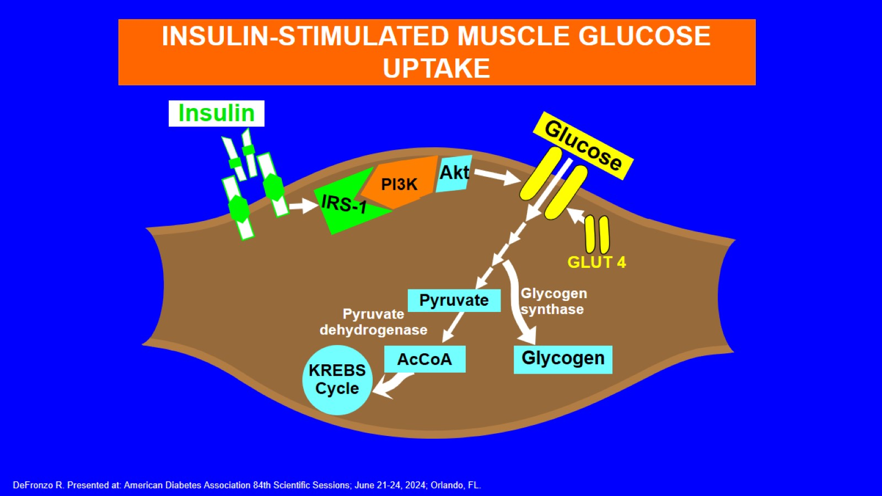

Slide 8
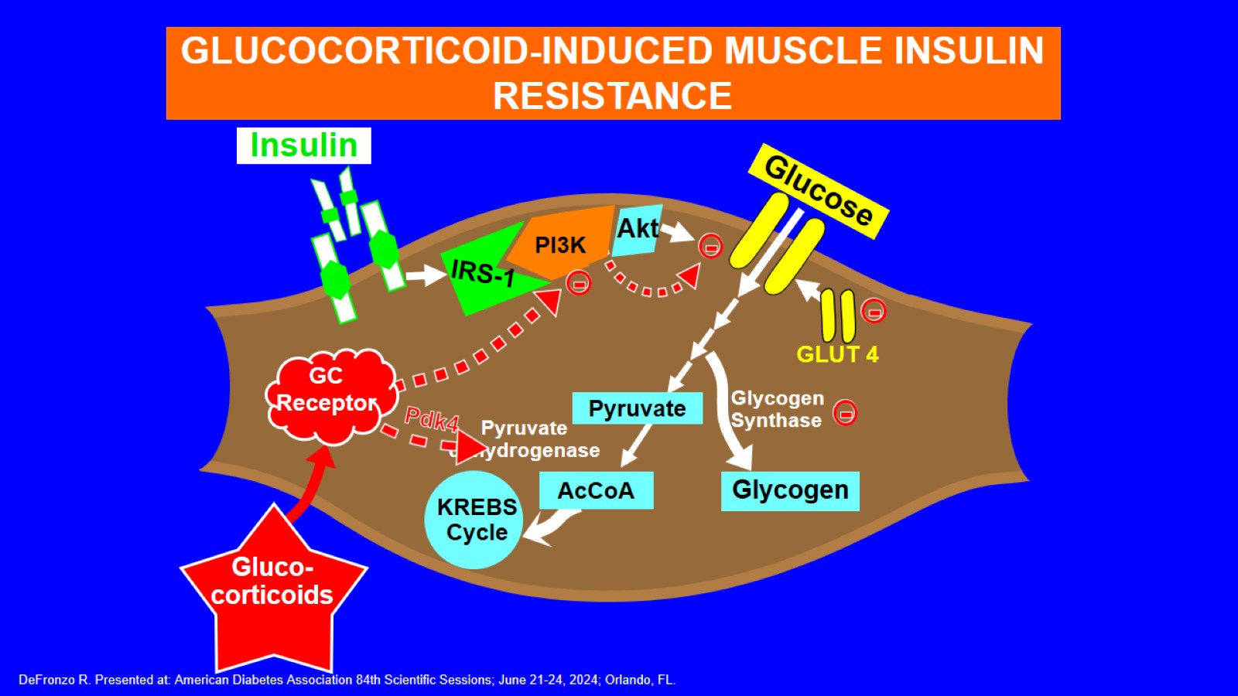

Slide 9
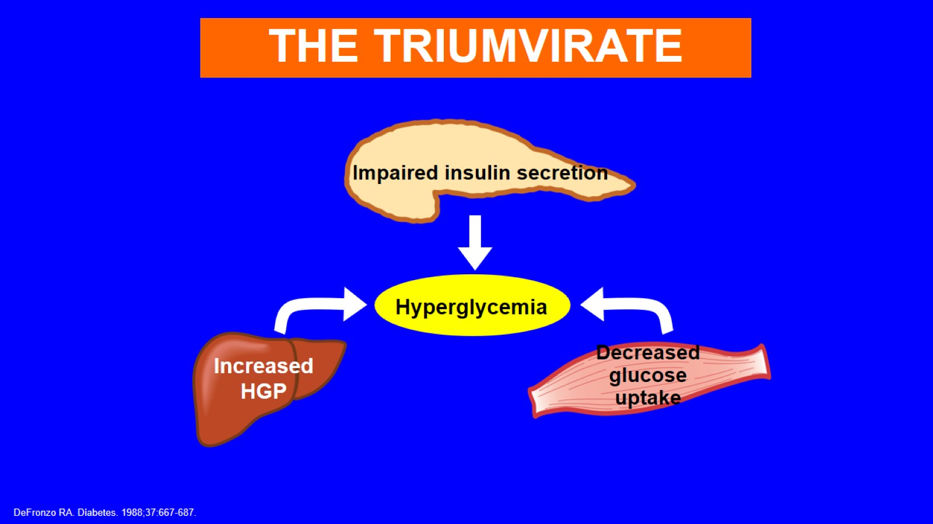

Slide 10
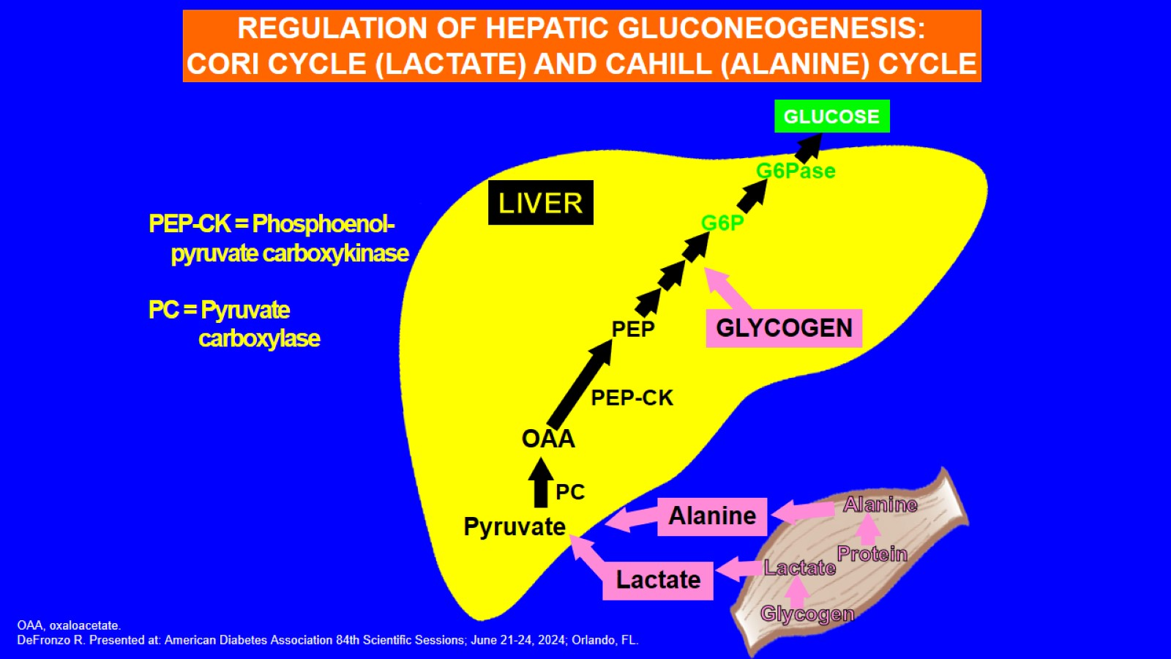

Slide 11
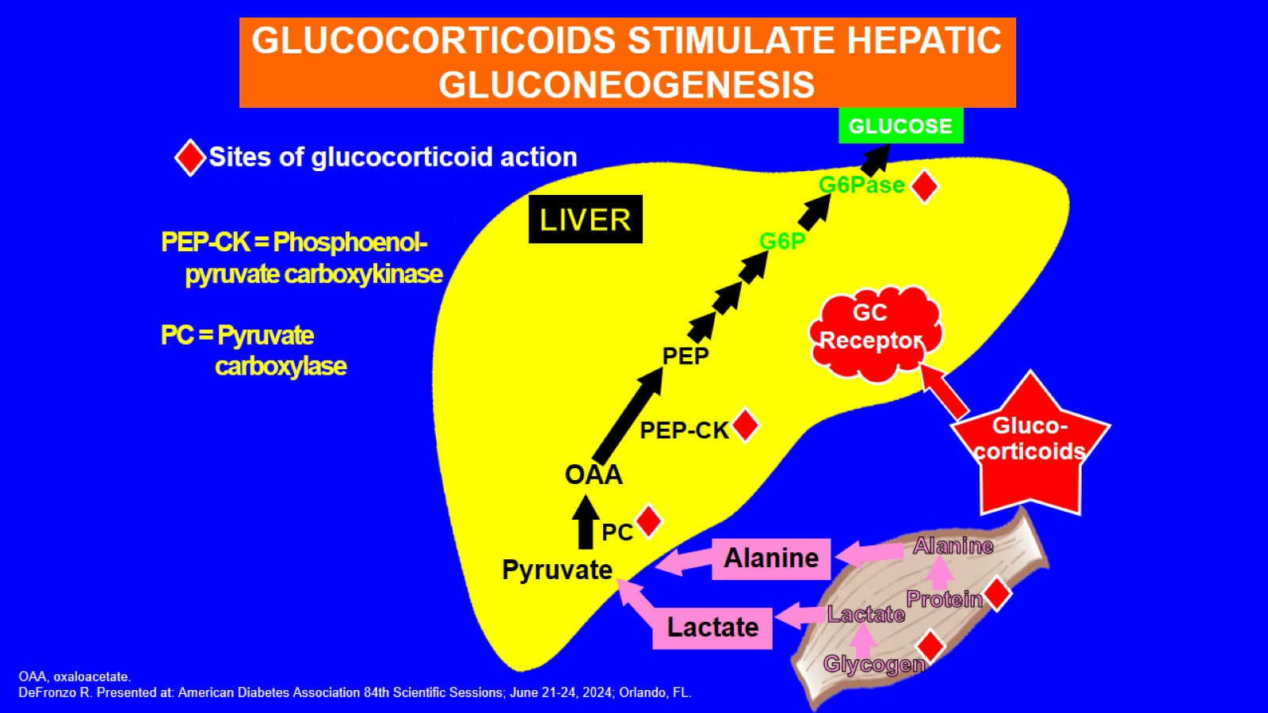

Slide 12
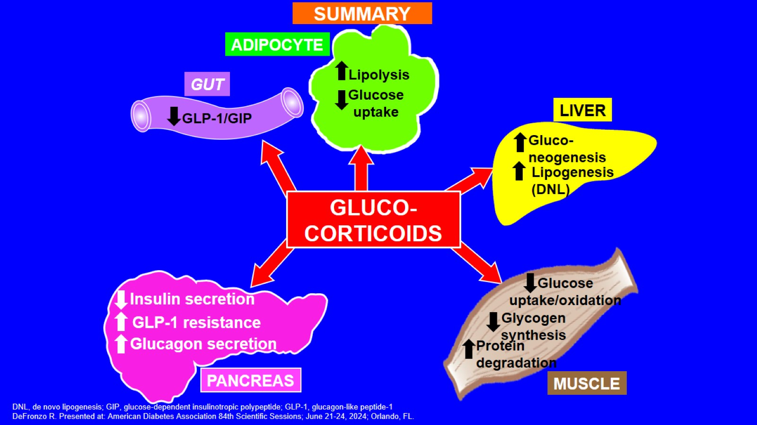

Slide 13
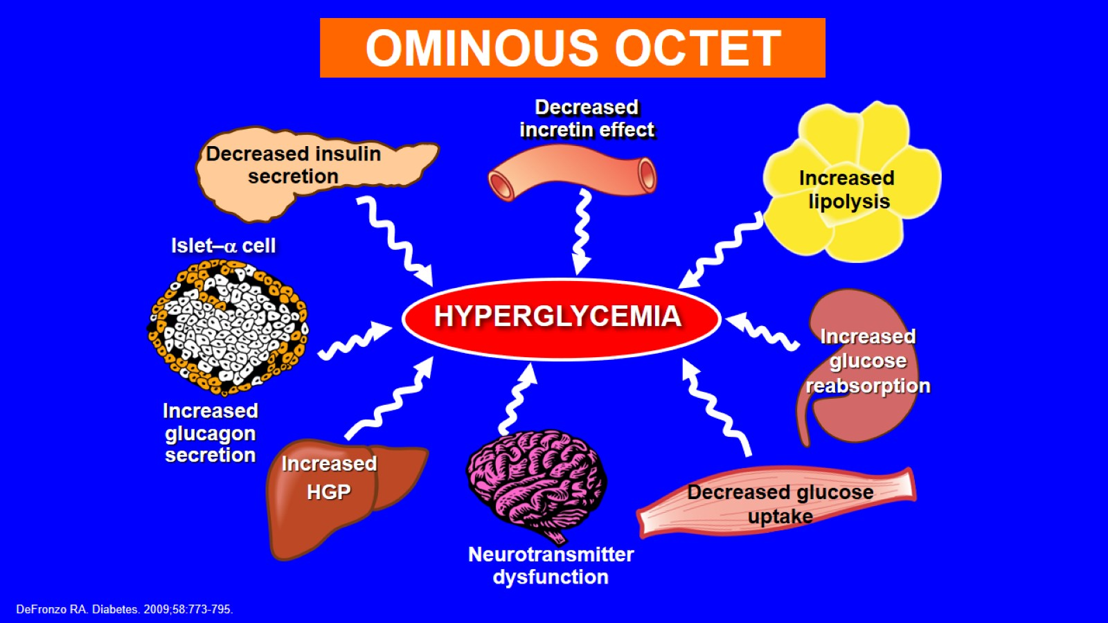

Slide 14
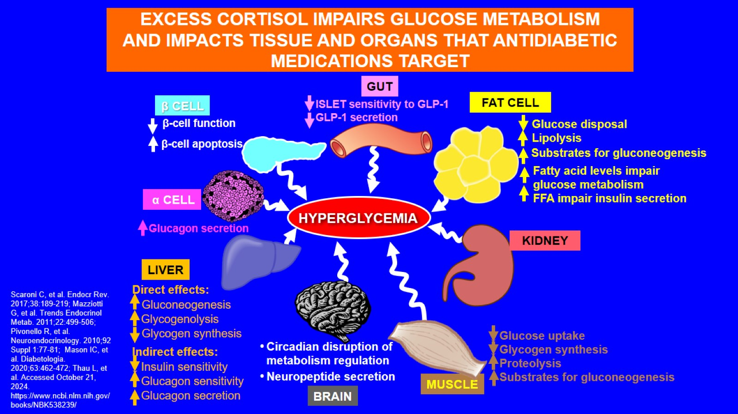

Slide 15
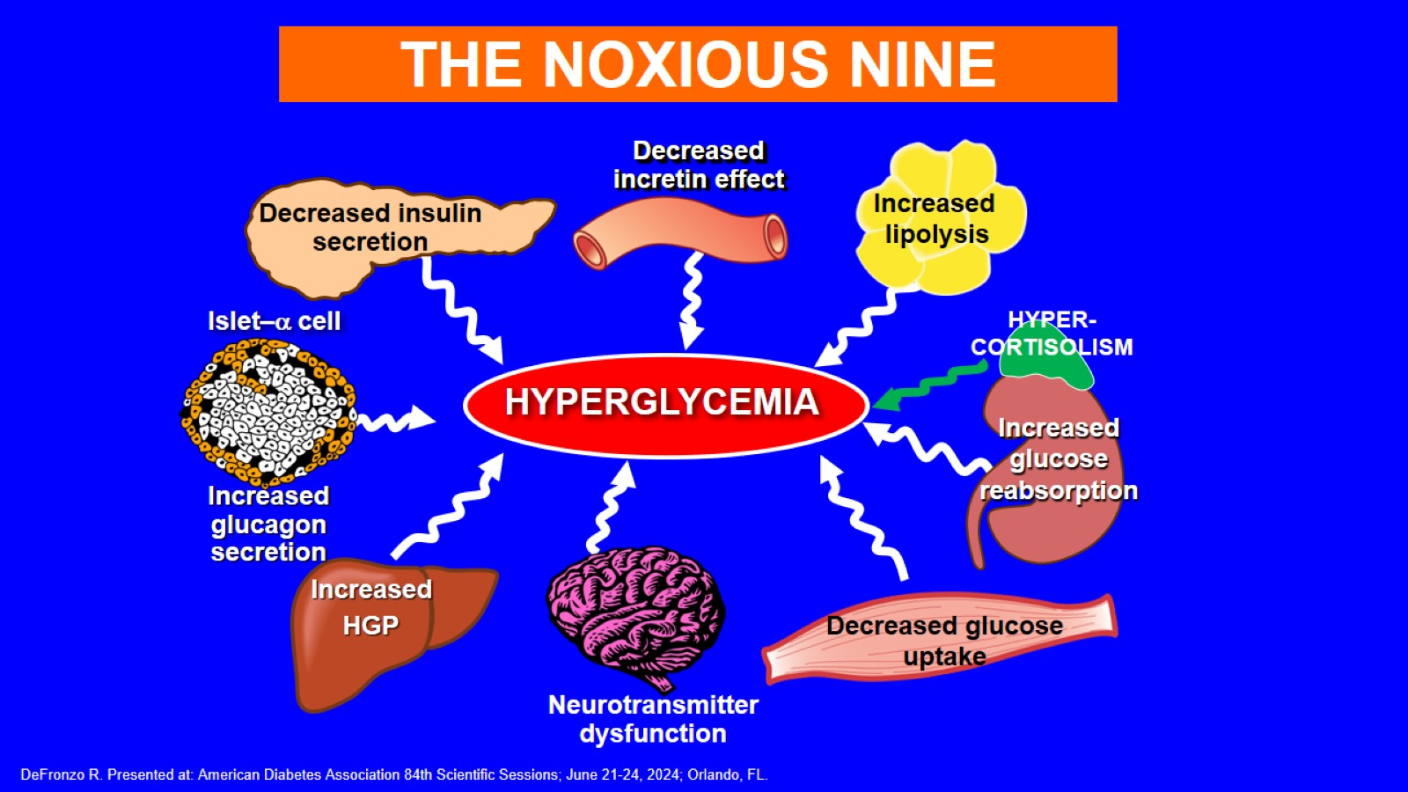

Slide 16
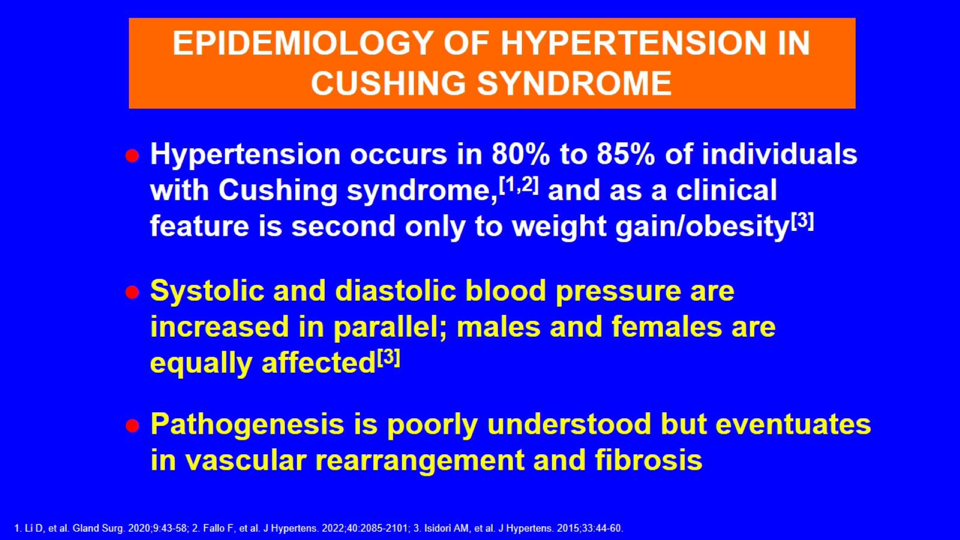

Slide 17
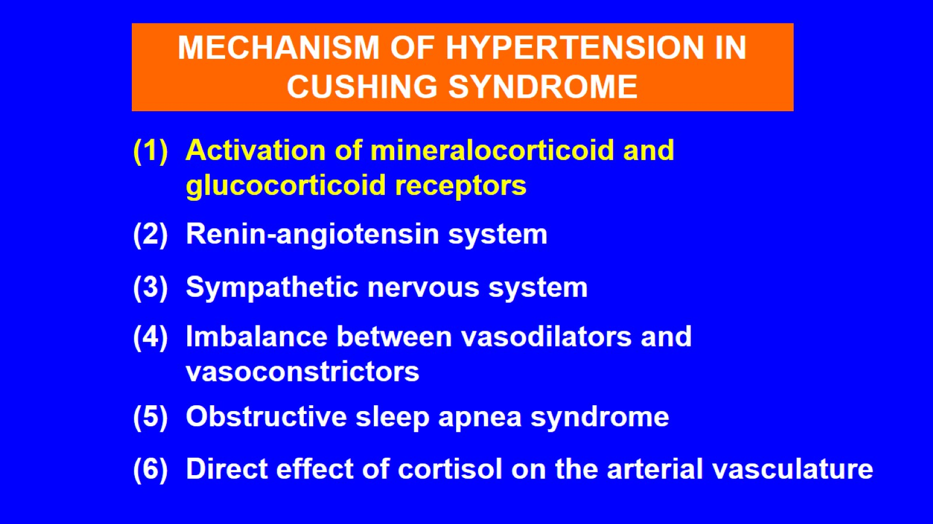

Slide 18
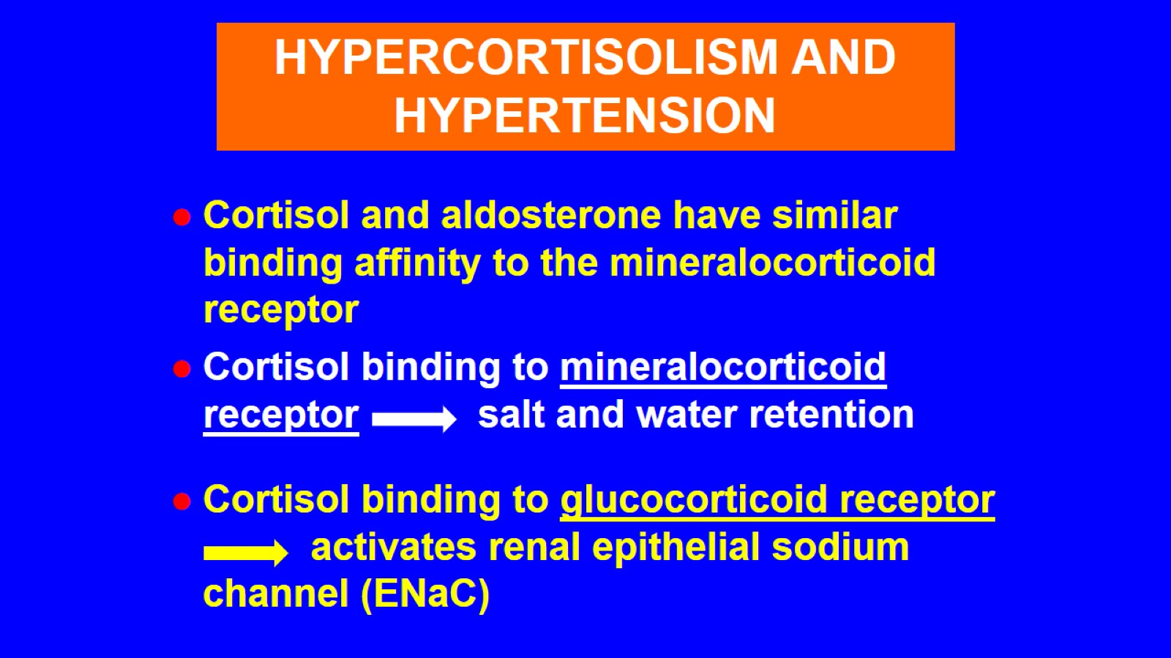

Slide 19
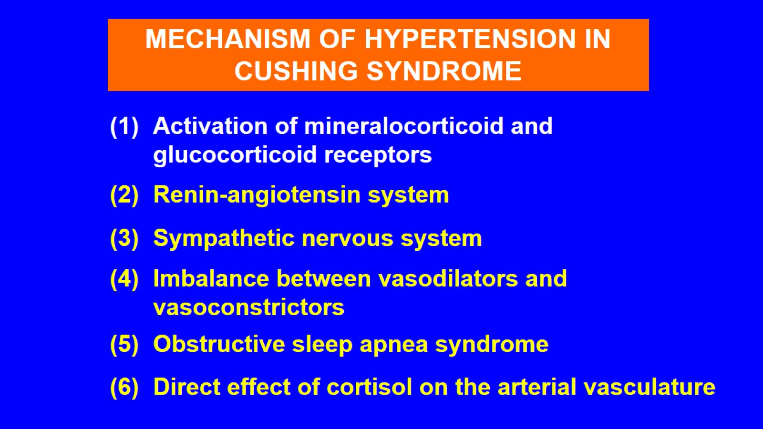

Slide 20
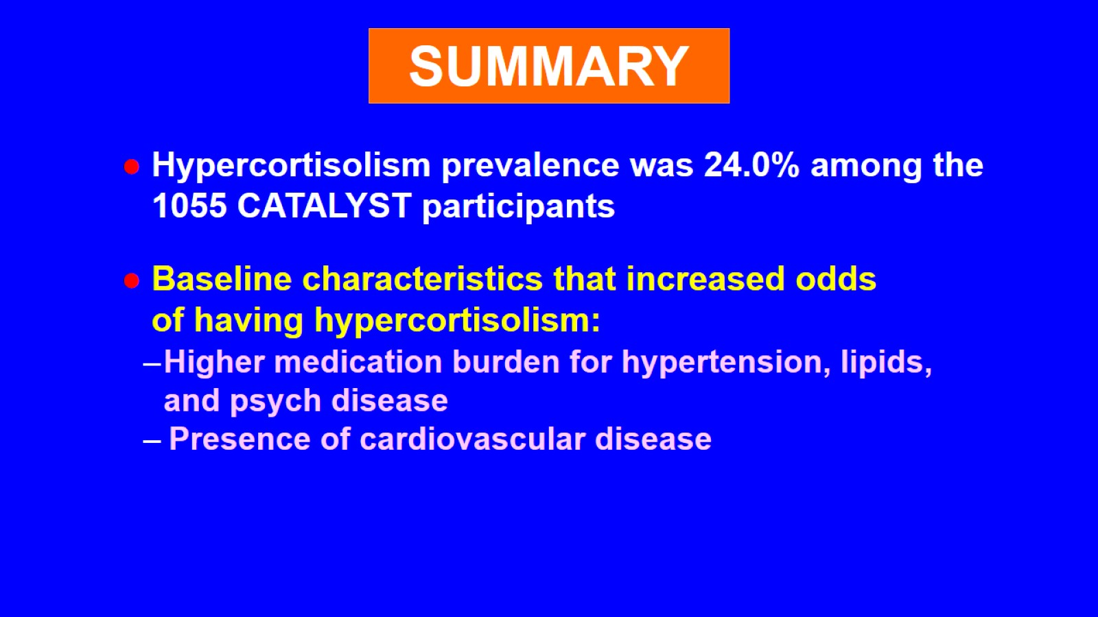

Slide 21
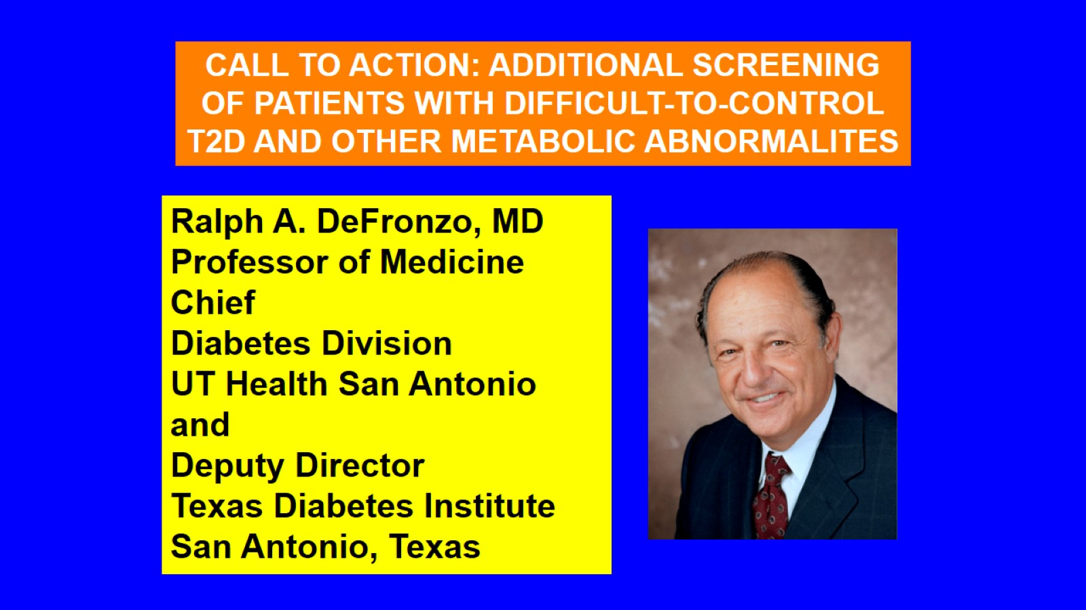

Slide 22
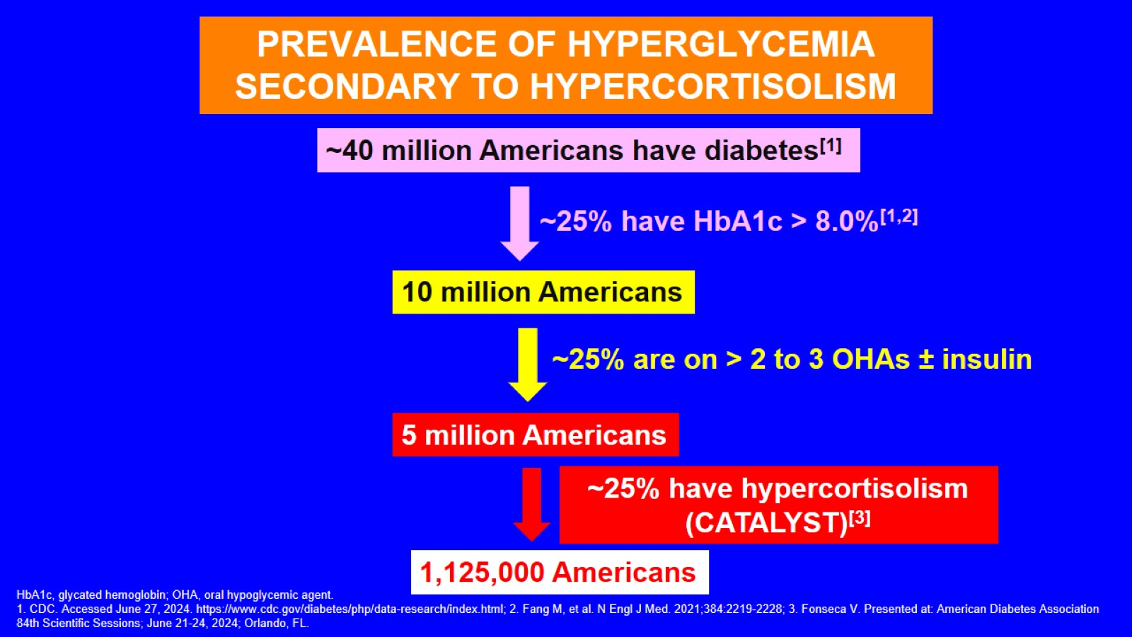
PREVALENCE OF HYPERGLYCEMIA SECONDARY TO HYPERCORTISOLISM

Slide 23
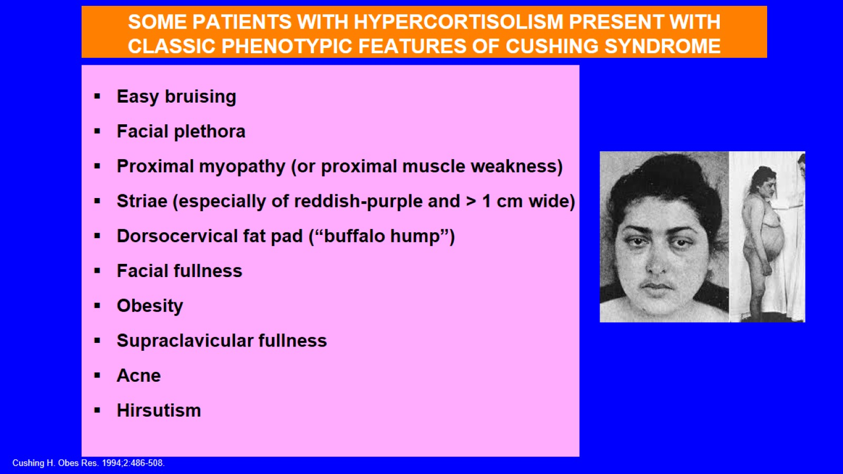

Slide 24
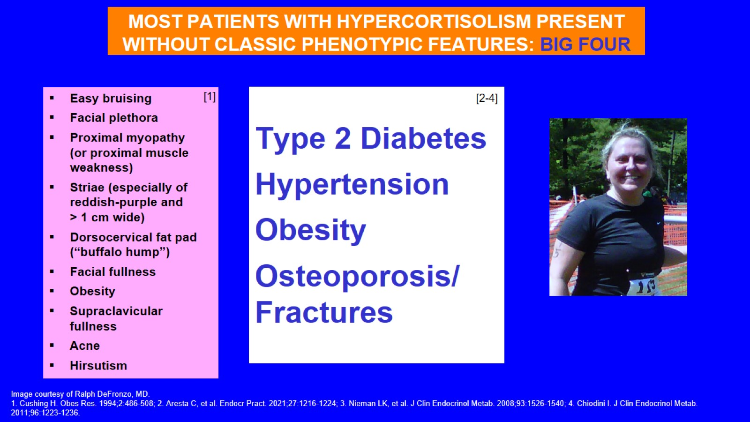

Slide 25
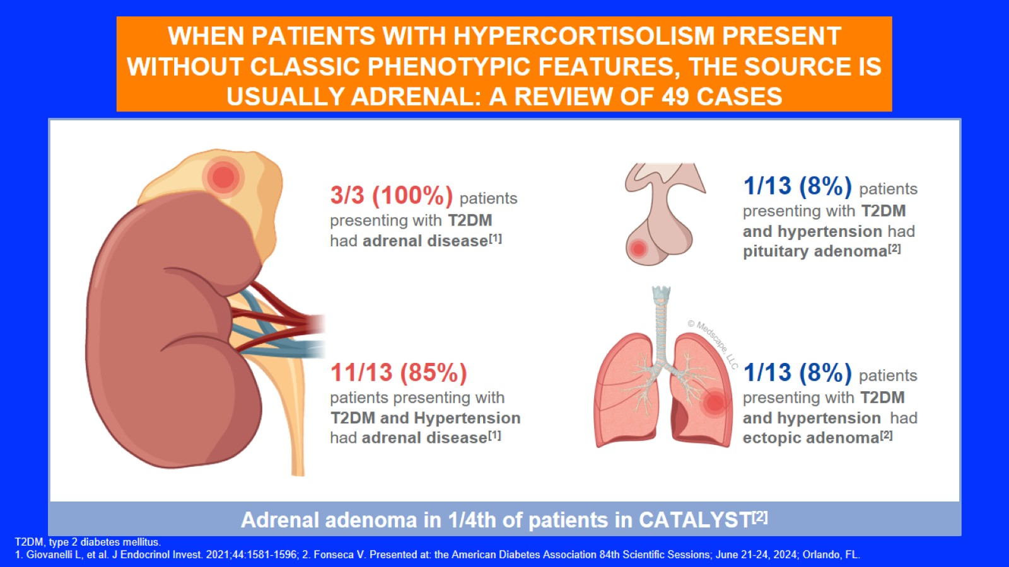
WHEN PATIENTS WITH HYPERCORTISOLISM PRESENT WITHOUT CLASSIC PHENOTYPIC FEATURES, THE SOURCE IS USUALLY ADRENAL: A REVIEW OF 49 CASES

Slide 26
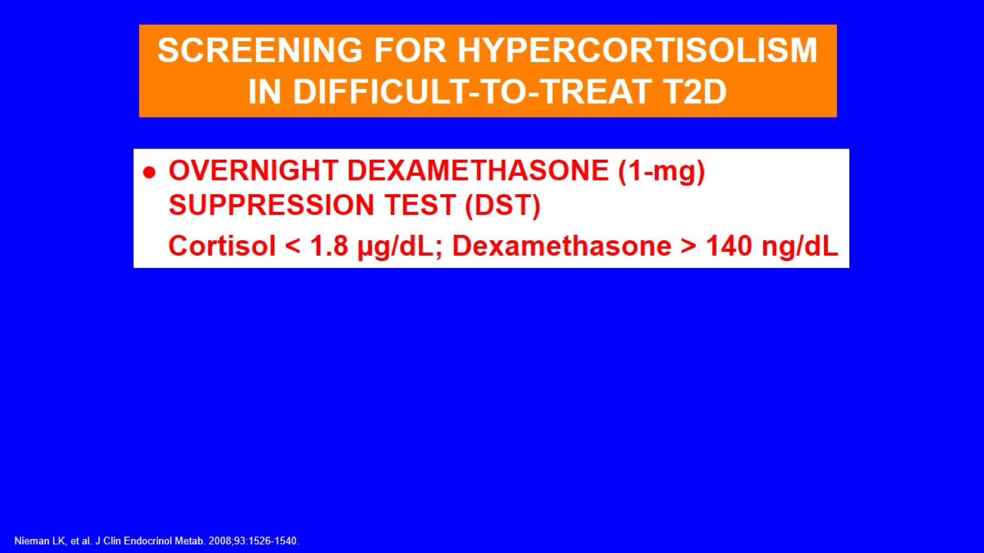

Slide 27
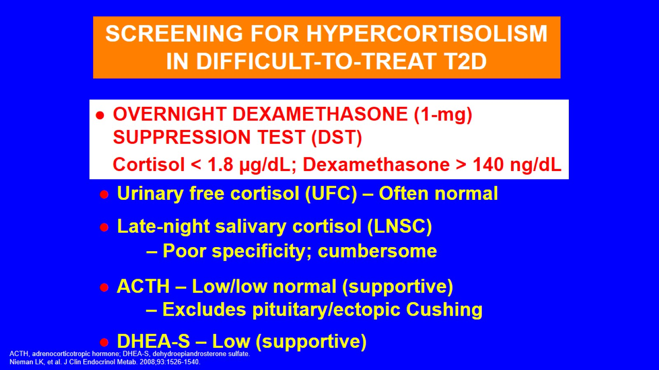

Slide 28
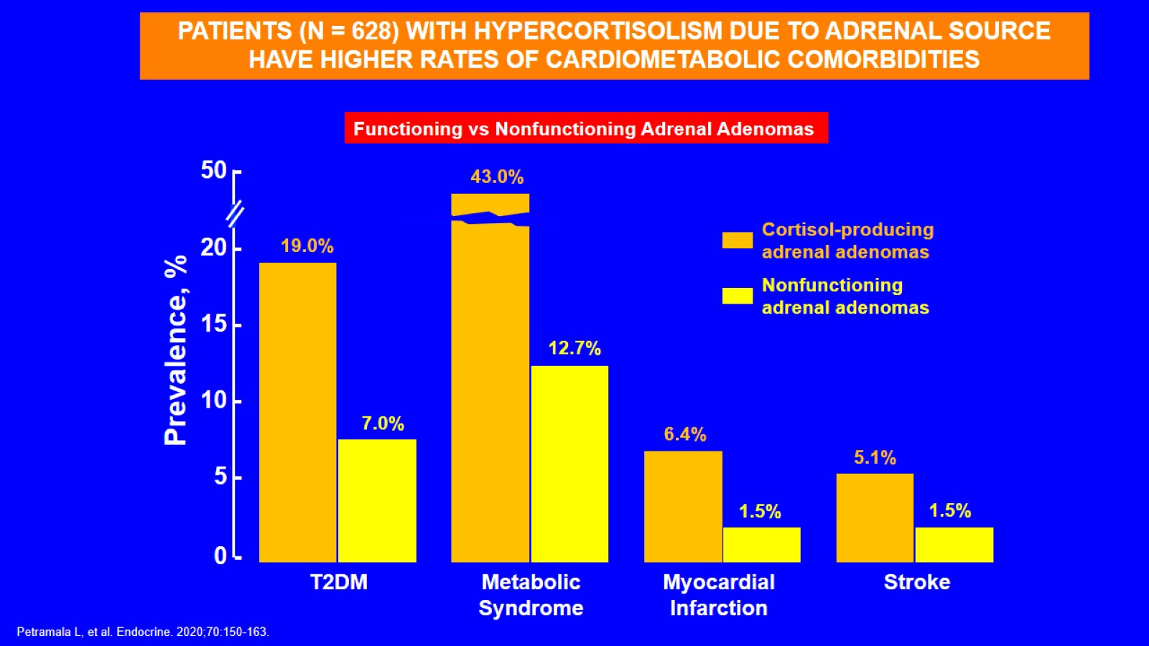

Slide 29
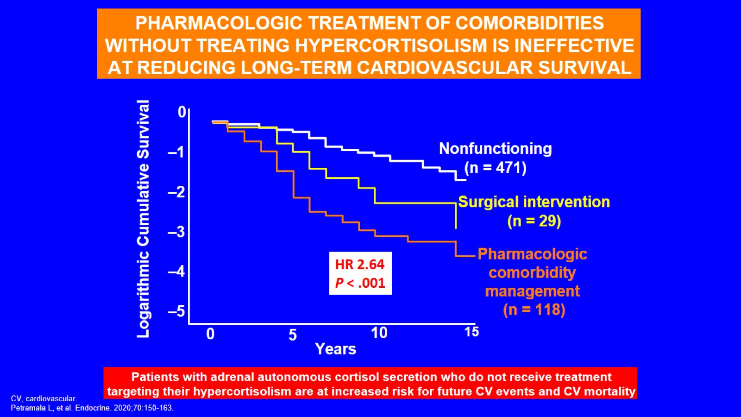
PHARMACOLOGIC TREATMENT OF COMORBIDITIES WITHOUT TREATING HYPERCORTISOLISM IS INEFFECTIVE AT REDUCING LONG-TERM CARDIOVASCULAR SURVIVAL

Slide 30
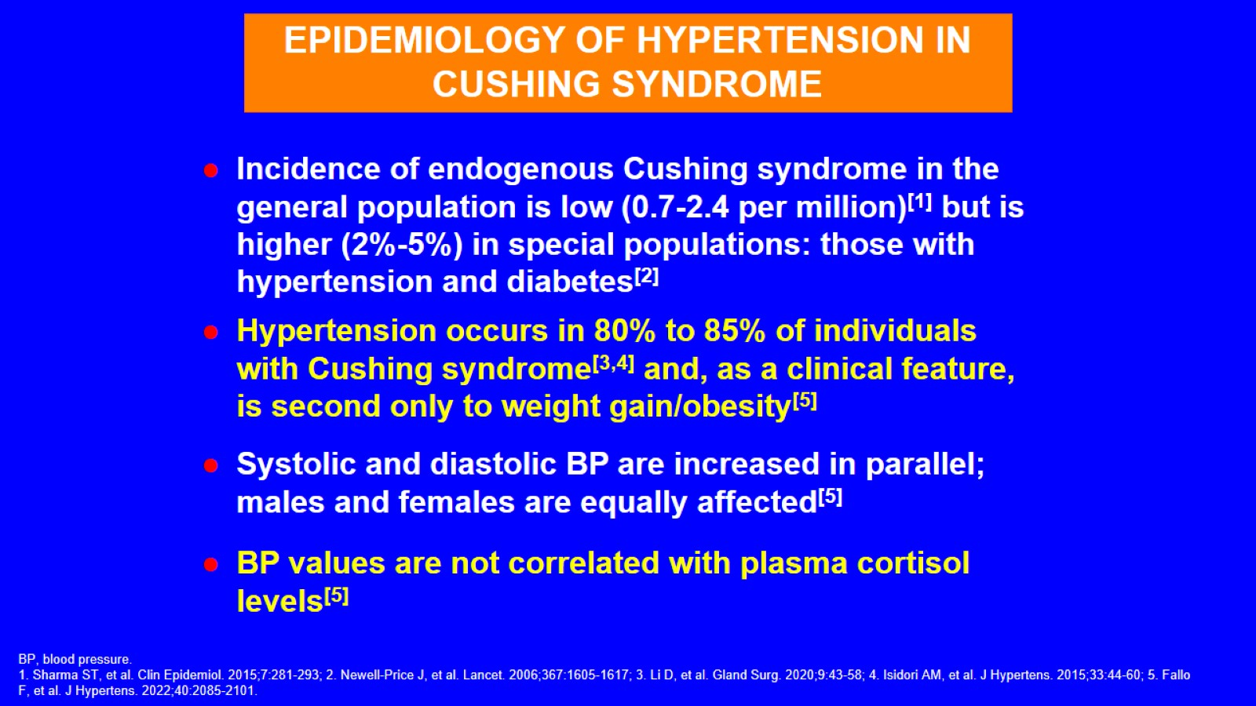

Slide 31
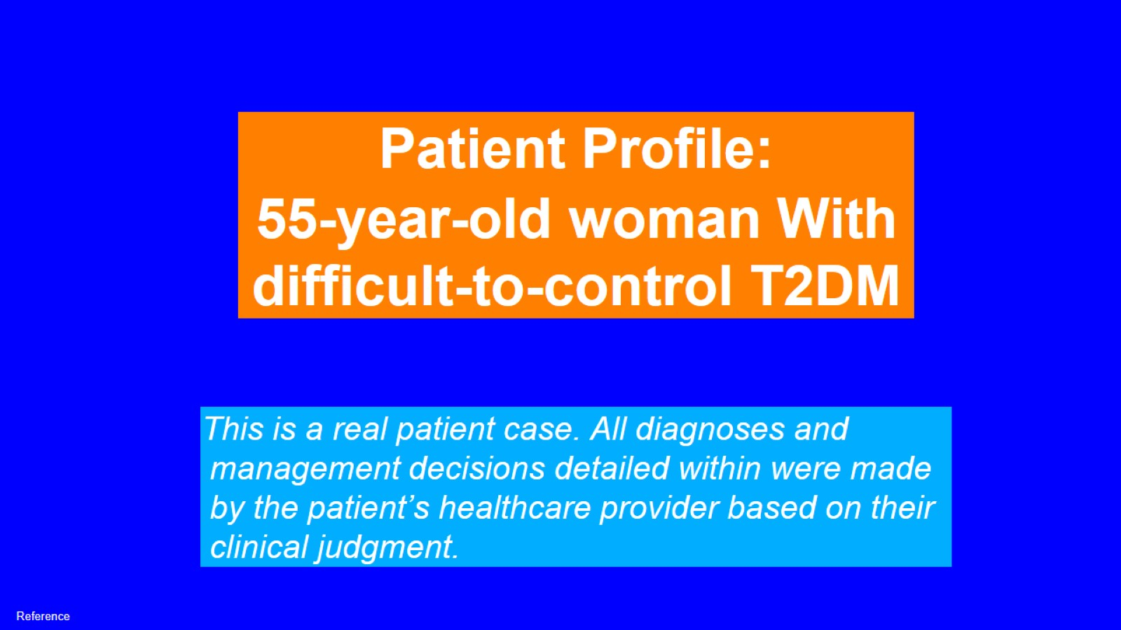

Slide 32
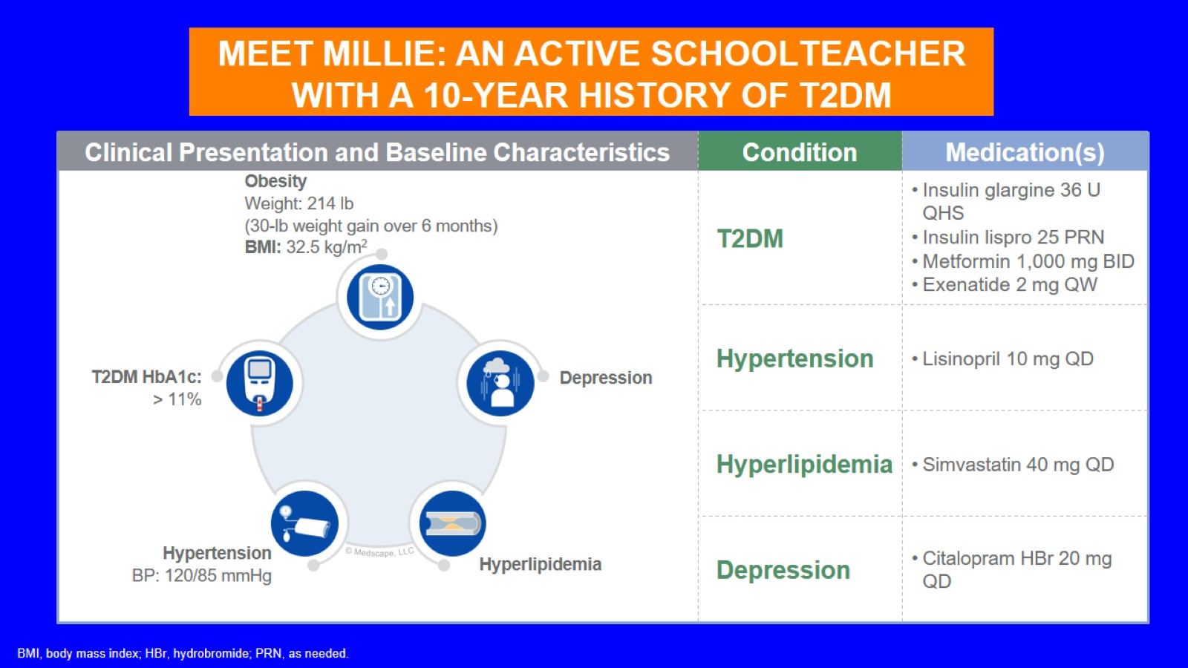
MEET MILLIE: AN ACTIVE SCHOOLTEACHER WITH A 10-YEAR HISTORY OF T2DM

Slide 33
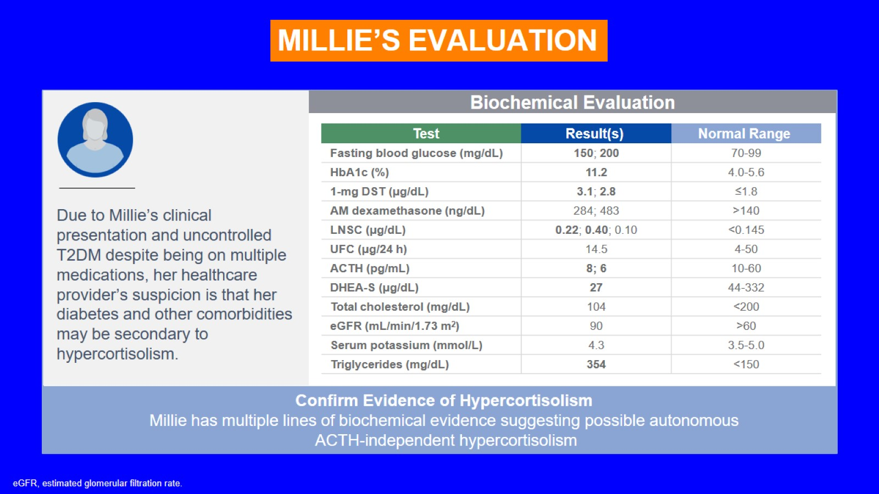

Slide 34
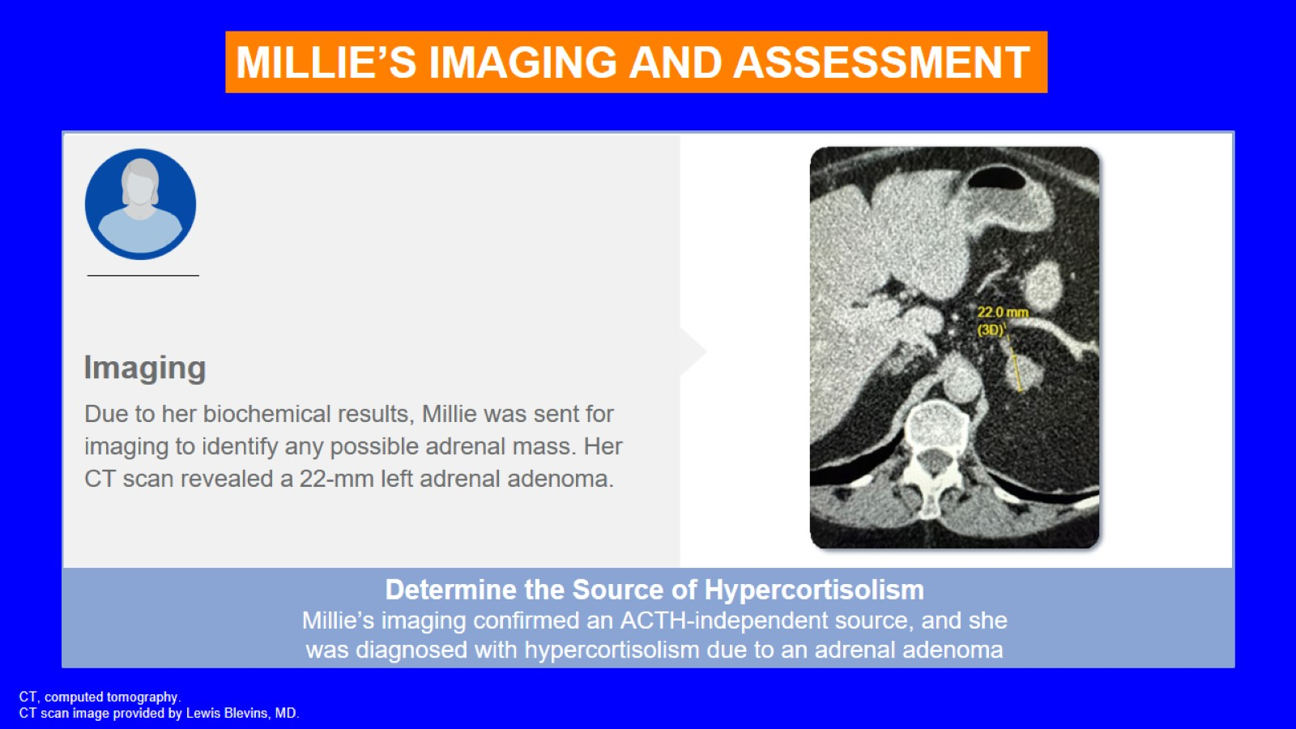

Slide 35
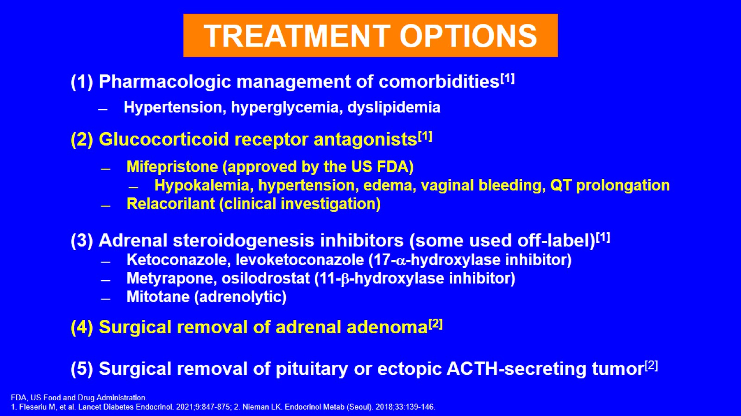

Slide 36
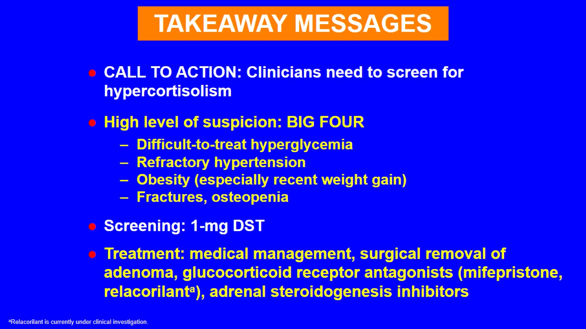

Slide 37
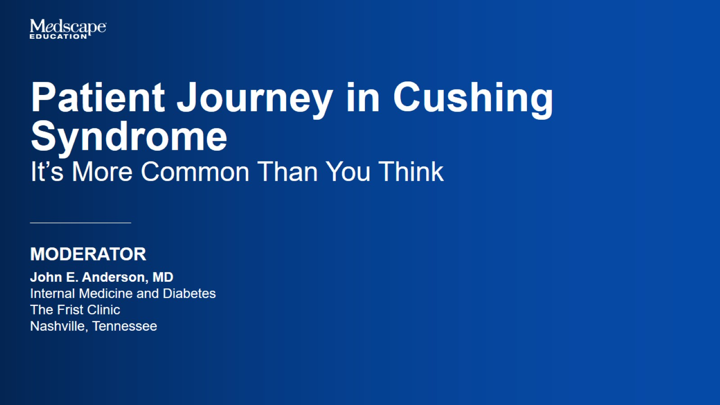

Slide 38
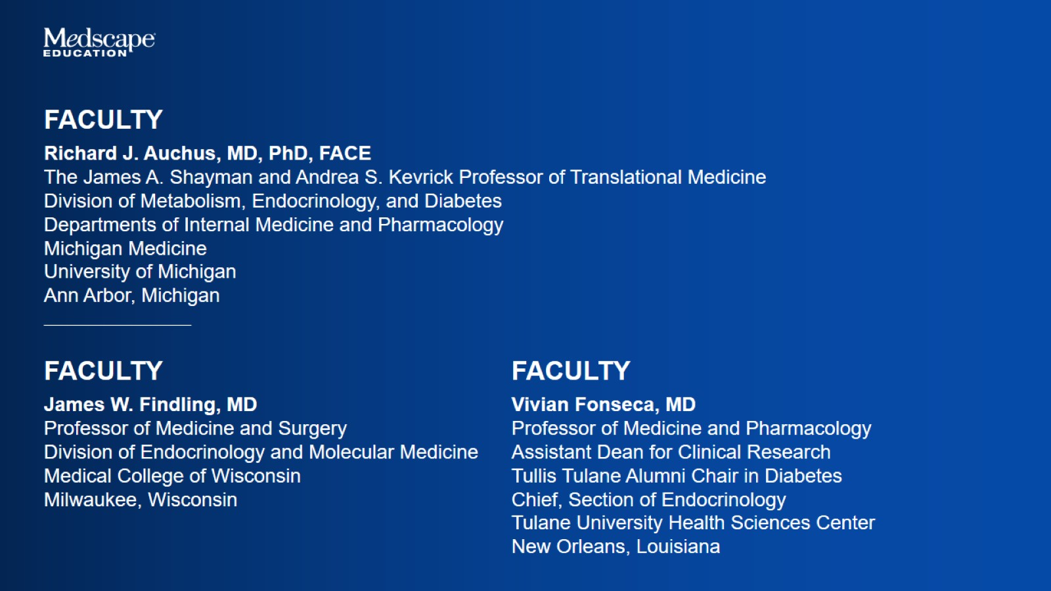

Slide 39


Slide 40
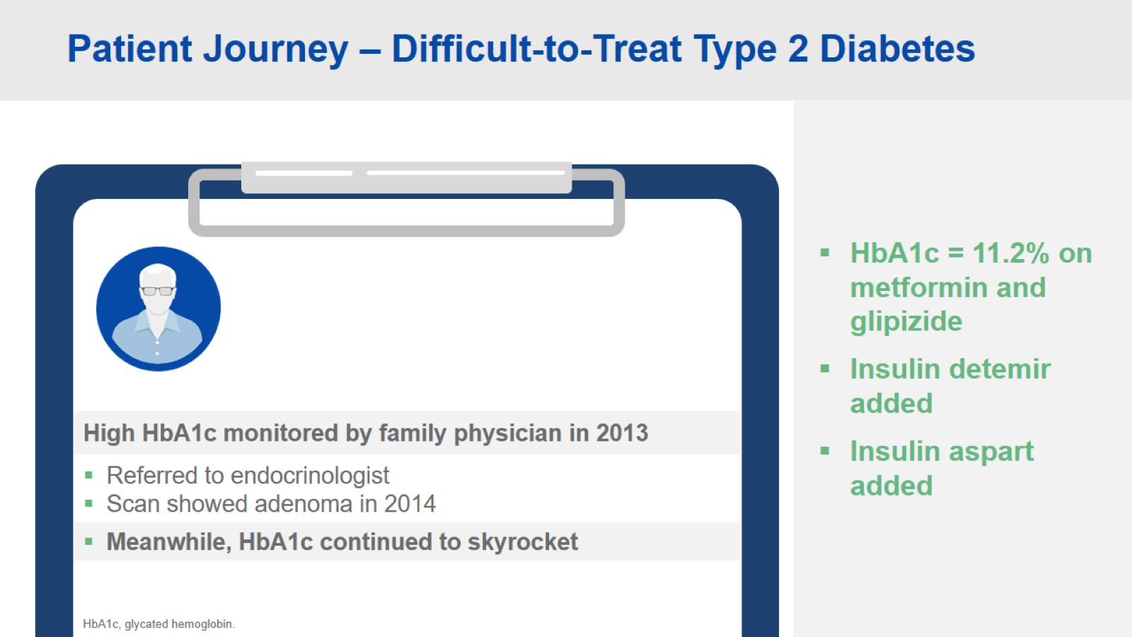
Patient Journey – Difficult-to-Treat Type 2 Diabetes

Slide 41
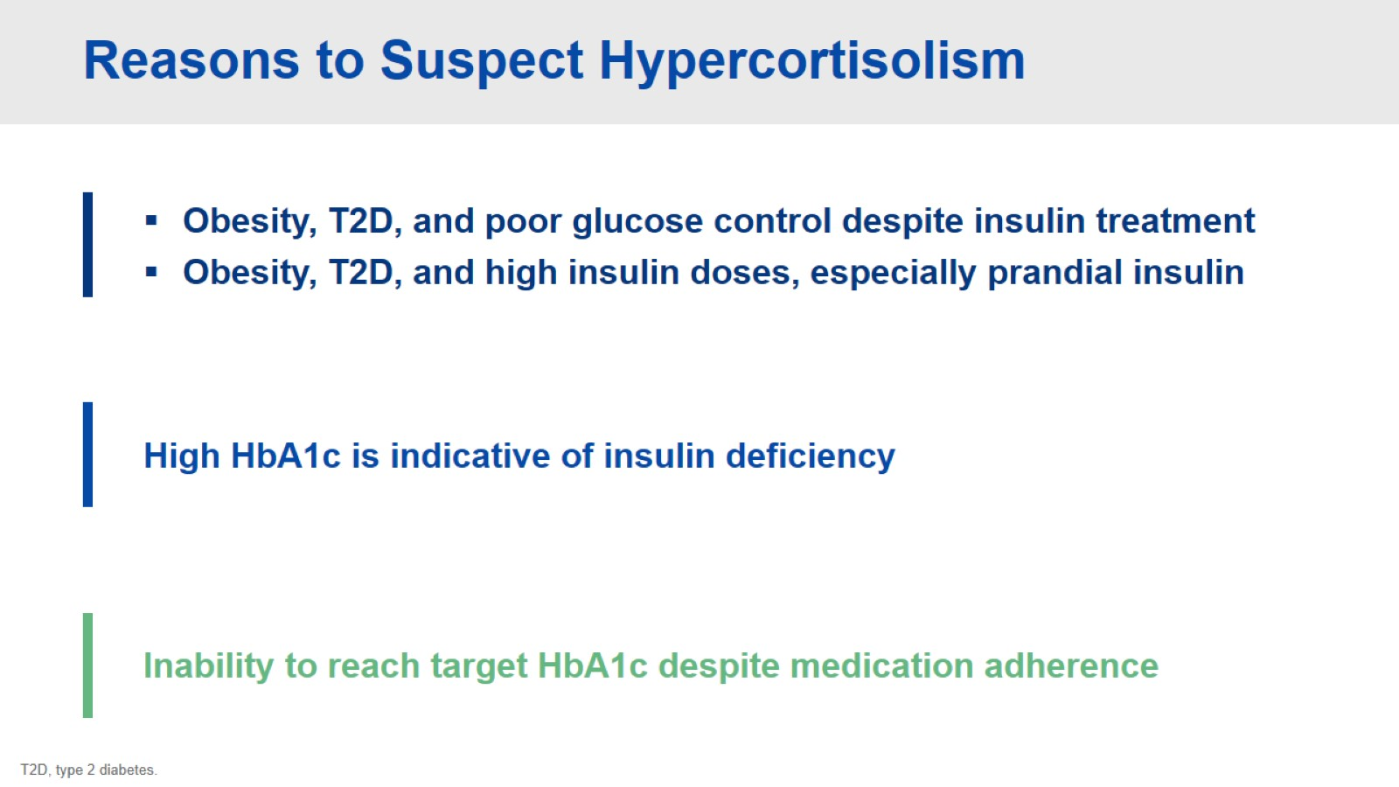
Reasons to Suspect Hypercortisolism

Slide 42
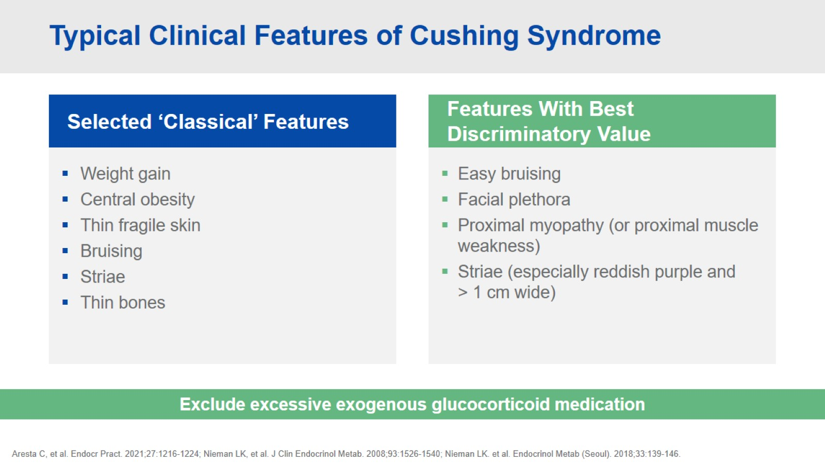
Typical Clinical Features of Cushing Syndrome

Slide 43
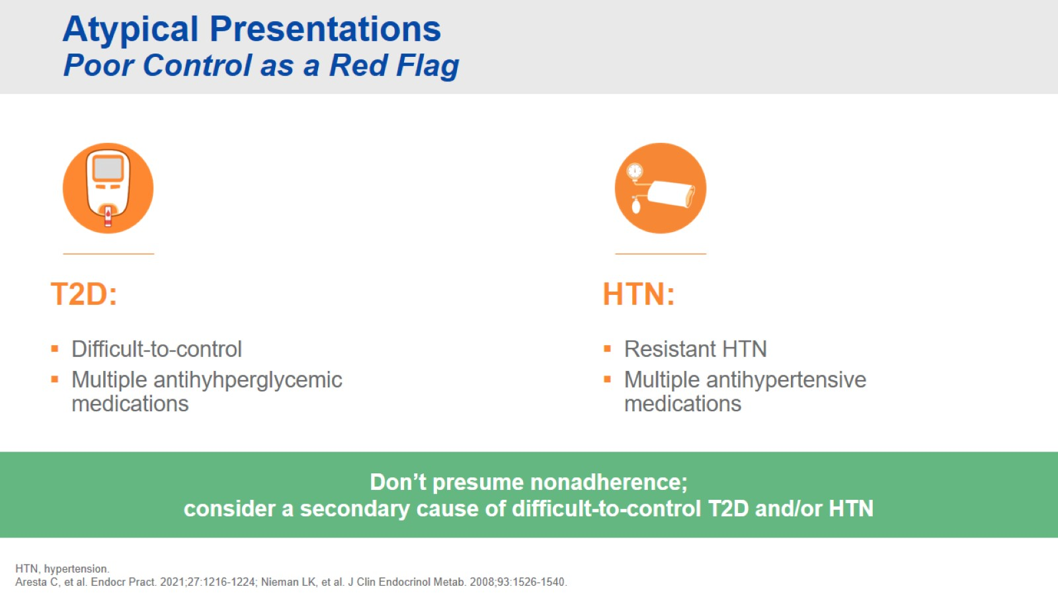
Atypical Presentations Poor Control as a Red Flag

Slide 44
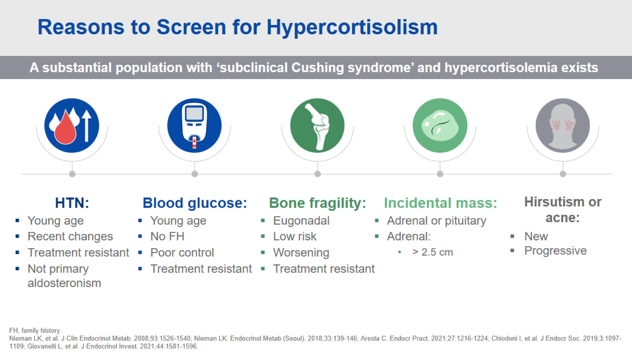
Reasons to Screen for Hypercortisolism

Slide 45
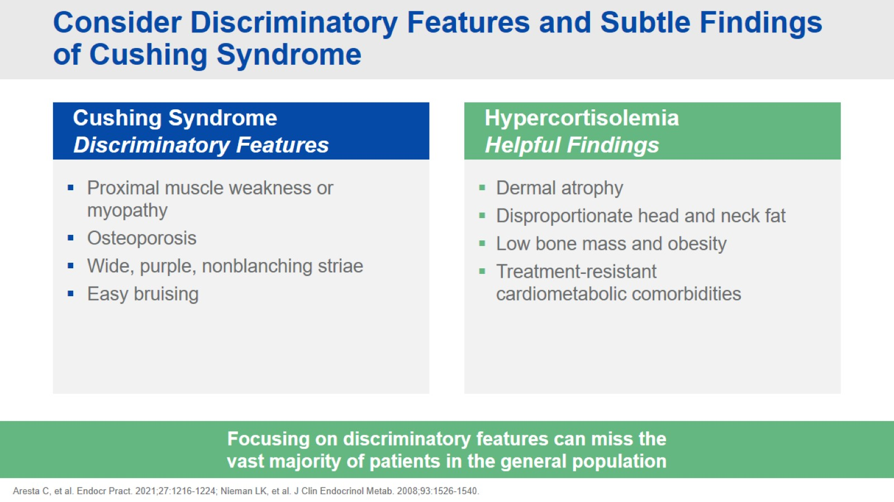
Consider Discriminatory Features and Subtle Findings of Cushing Syndrome

Slide 46
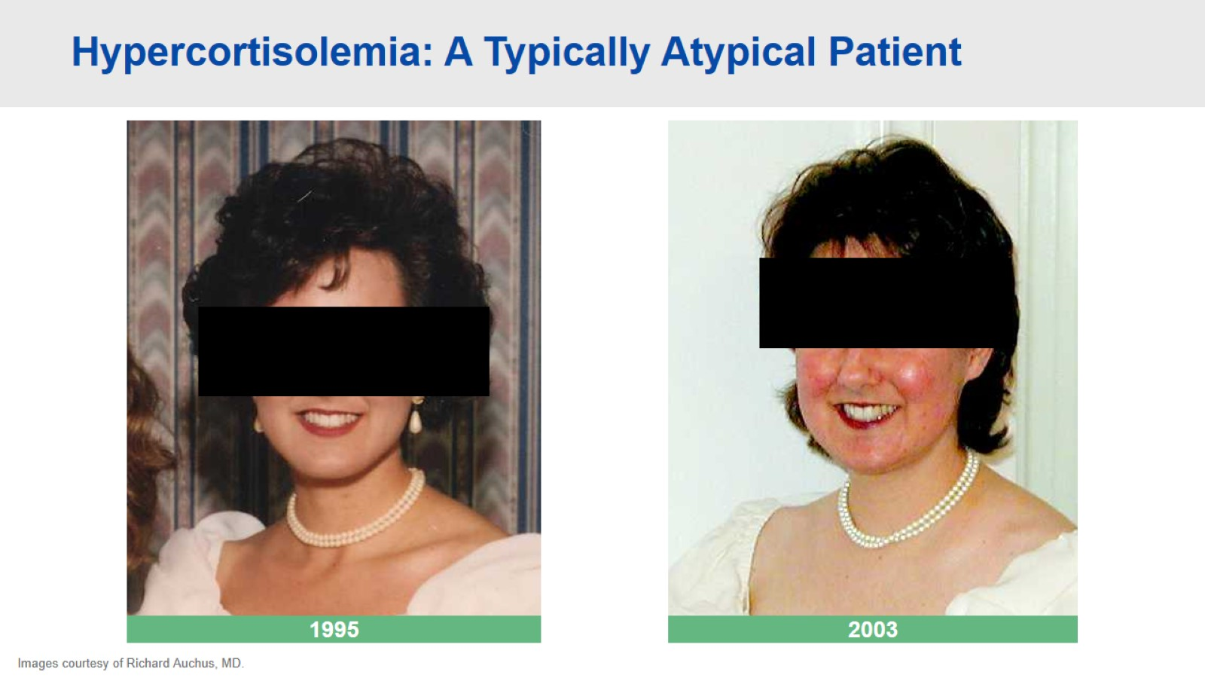
Hypercortisolemia: A Typically Atypical Patient

Slide 47
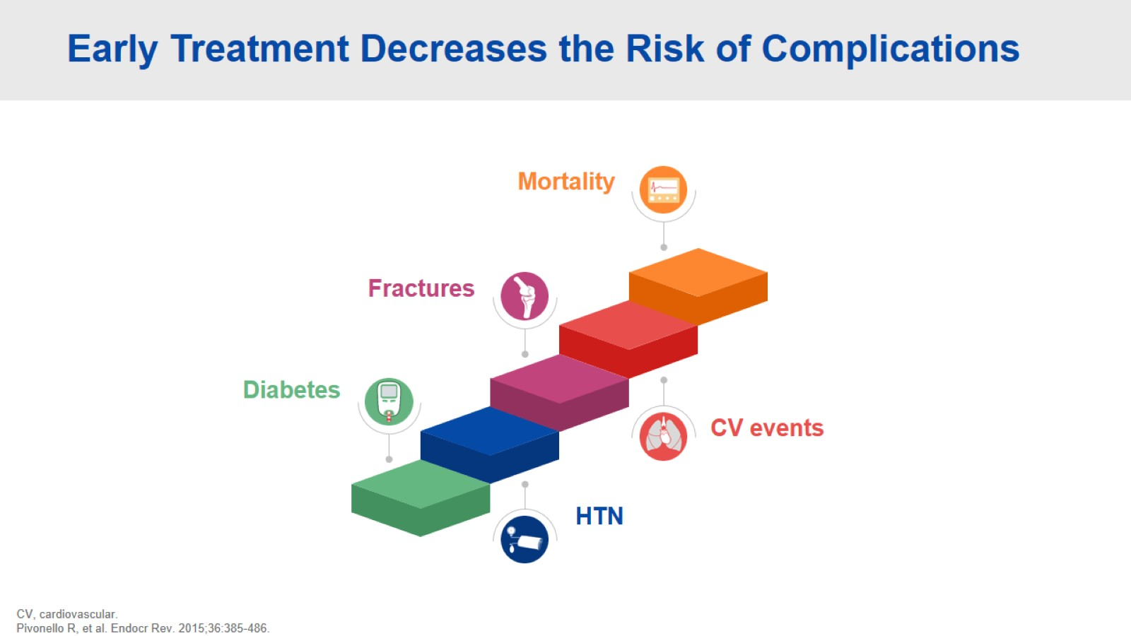
Early Treatment Decreases the Risk of Complications

Slide 48
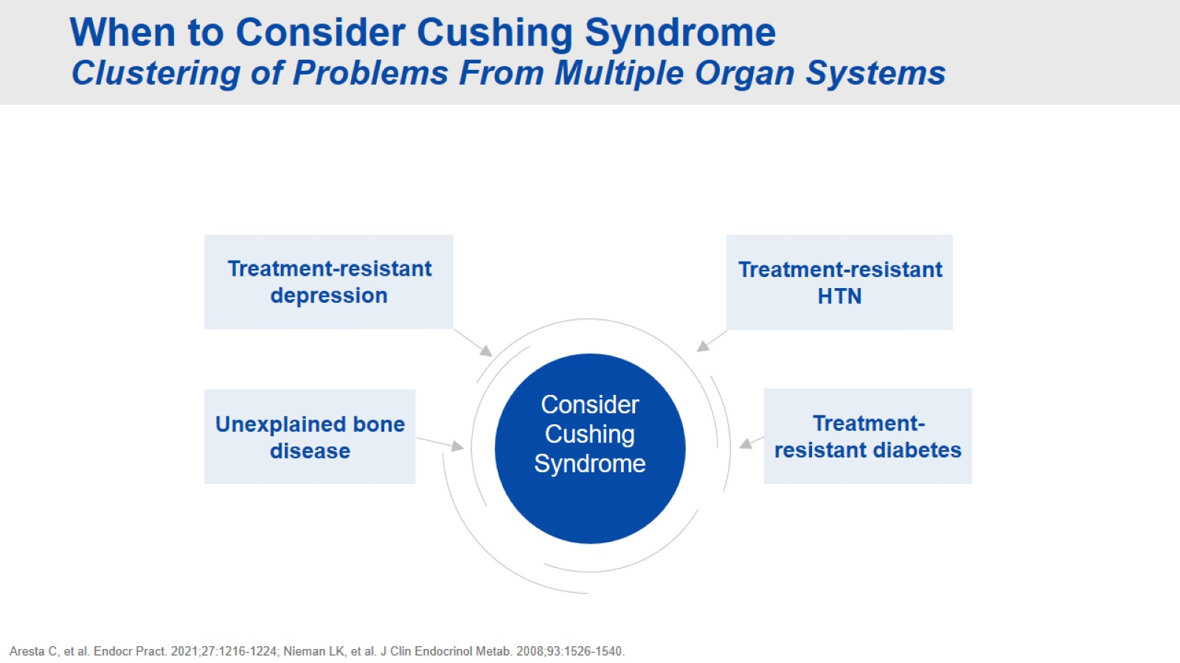
When to Consider Cushing Syndrome Clustering of Problems From Multiple Organ Systems

Slide 49
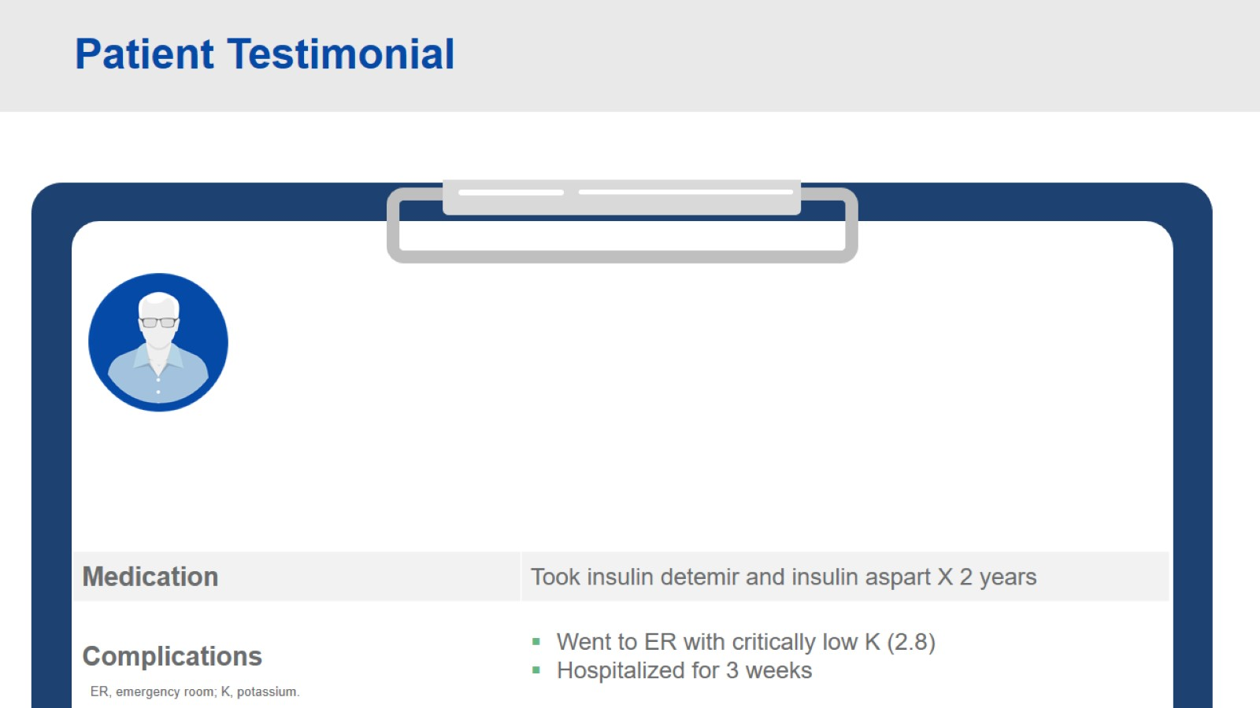
Patient Testimonial

Slide 50
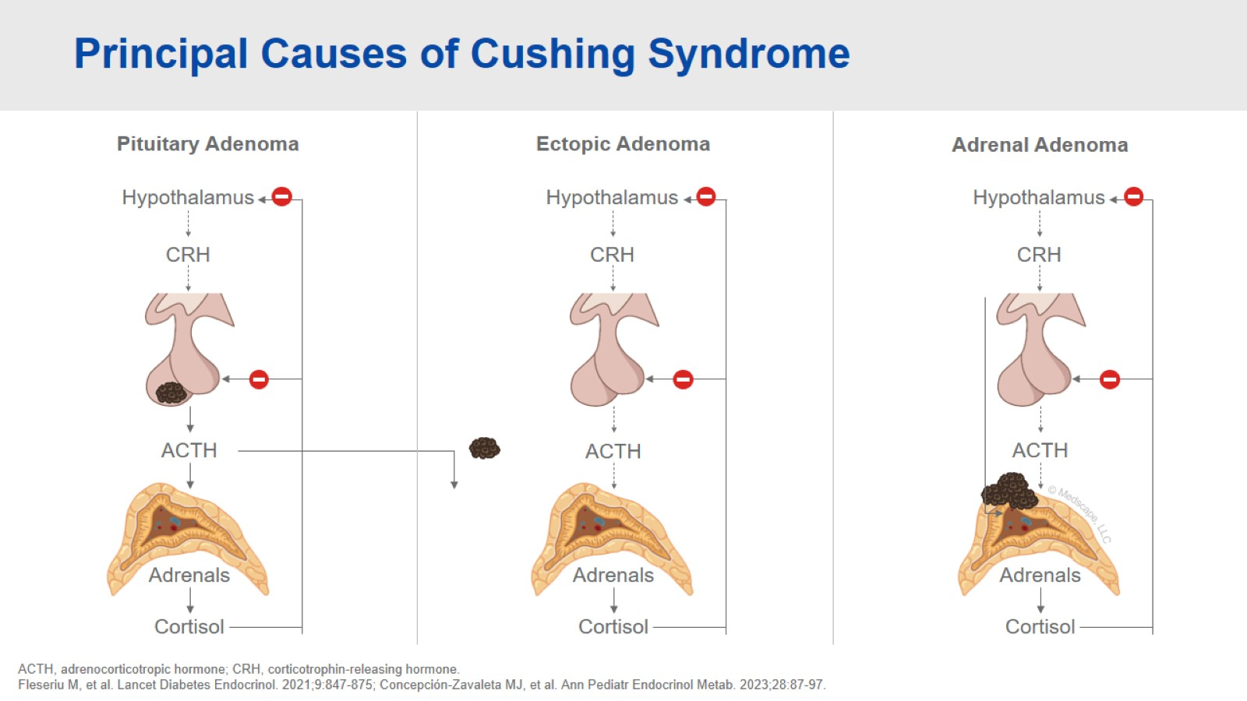
Principal Causes of Cushing Syndrome

Slide 51
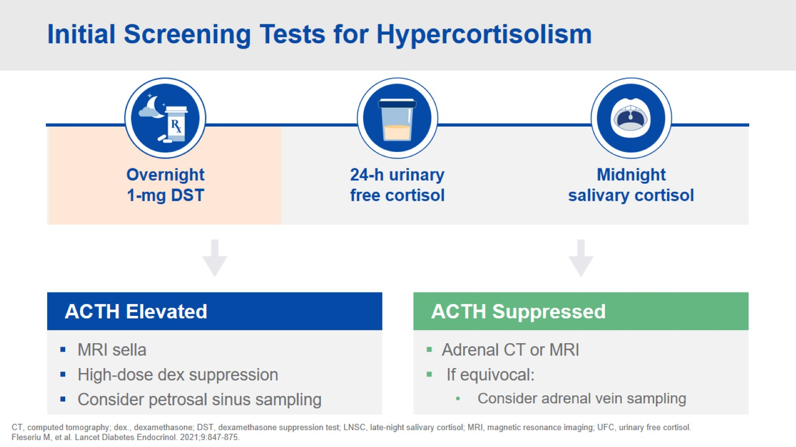
Initial Screening Tests for Hypercortisolism

Slide 52

Adrenal Mass on CT Scan

Slide 53

Interpreting the 1-mg Overnight DST

Slide 54

Further Testing to Differentiate the Tumor Source

Slide 55

Additional Considerations

Slide 56

Hypercortisolism in Difficult-to-Treat T2D Prevalence Data From the CATALYST Study

Slide 57

Hypercortisolism in Difficult-to-Treat T2D Prevalence Data From the CATALYST Population (cont)

Slide 58

Treatment for Hypercortisolemia

Slide 59

Patient Testimonial

Slide 60

Postoperative Patient Care Glucocorticoid Withdrawal Syndrome

Slide 61

Medical Therapy for Cushing Syndrome

Slide 62

Medical Therapy for Cushing Syndrome Additional Considerations

Slide 63

Patient Testimonial

Slide 64

Key Takeaways

Slide 65


