Slide 1
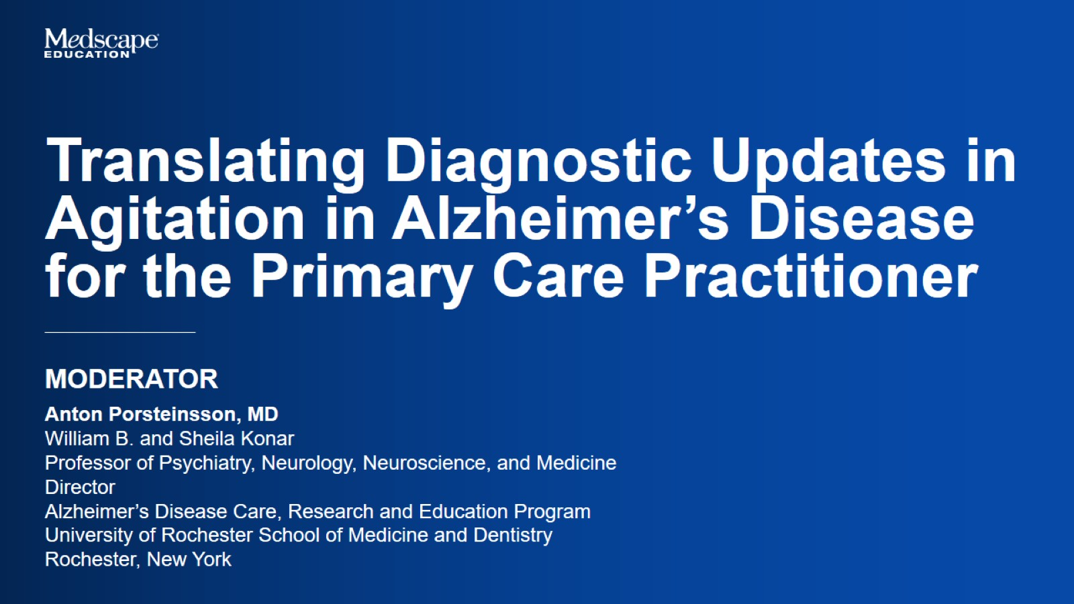

Slide 2
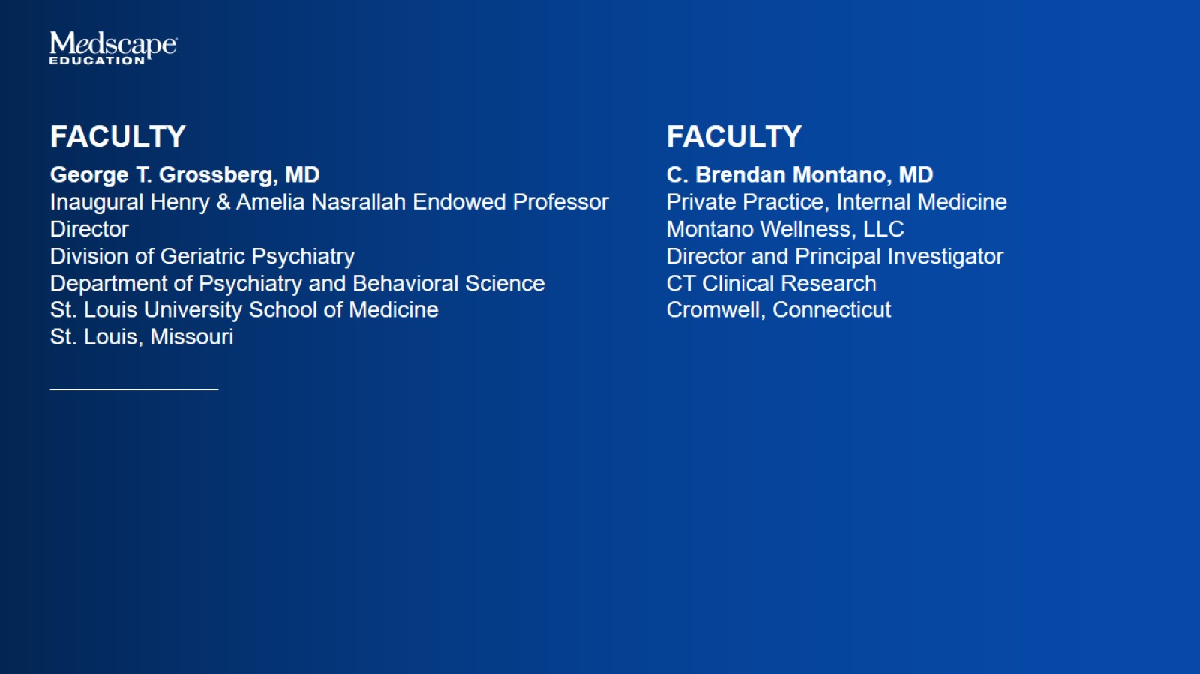

Slide 3
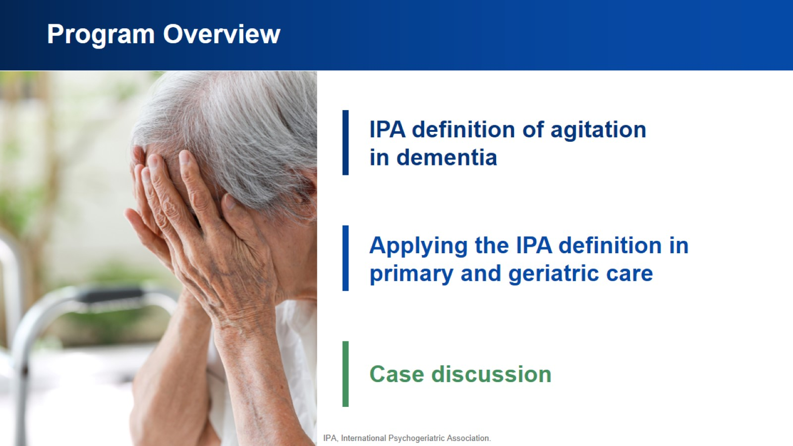
Program Overview

Slide 4
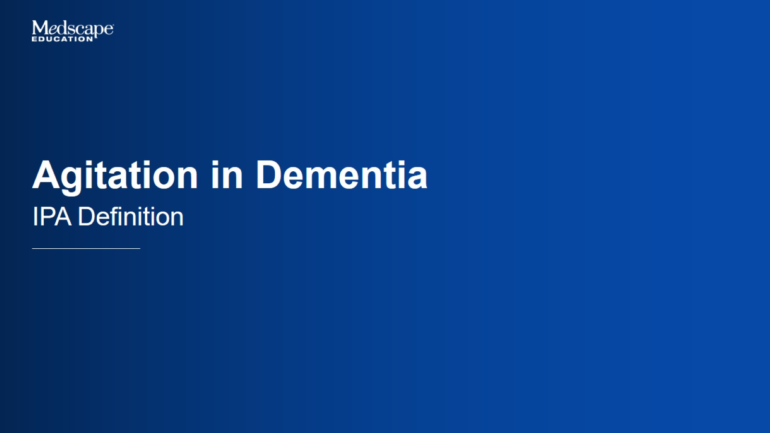
Agitation in Dementia

Slide 5
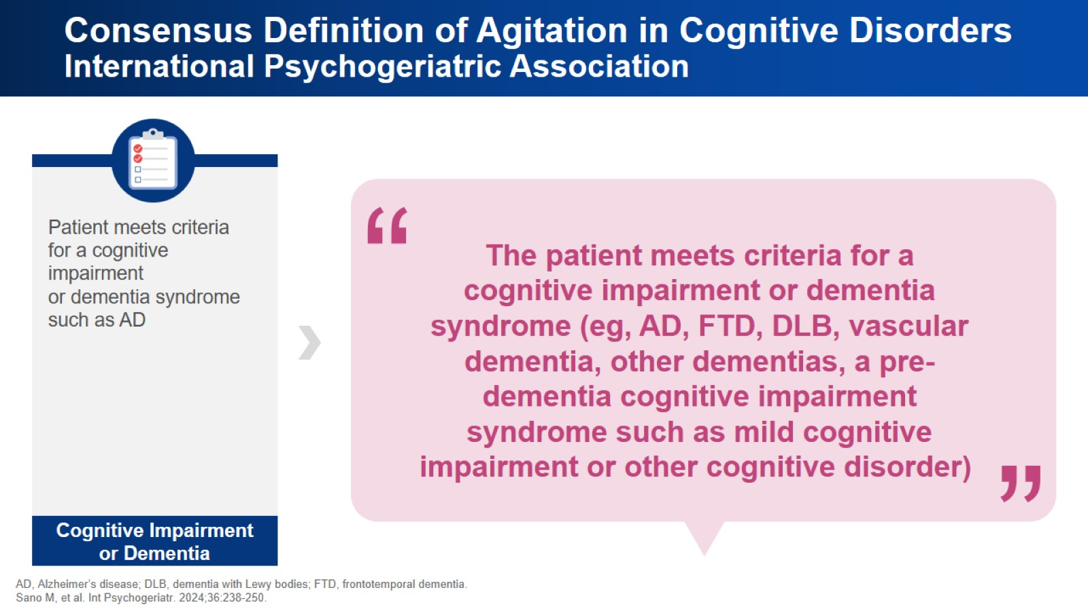
Consensus Definition of Agitation in Cognitive Disorders
International Psychogeriatric Association

Slide 6
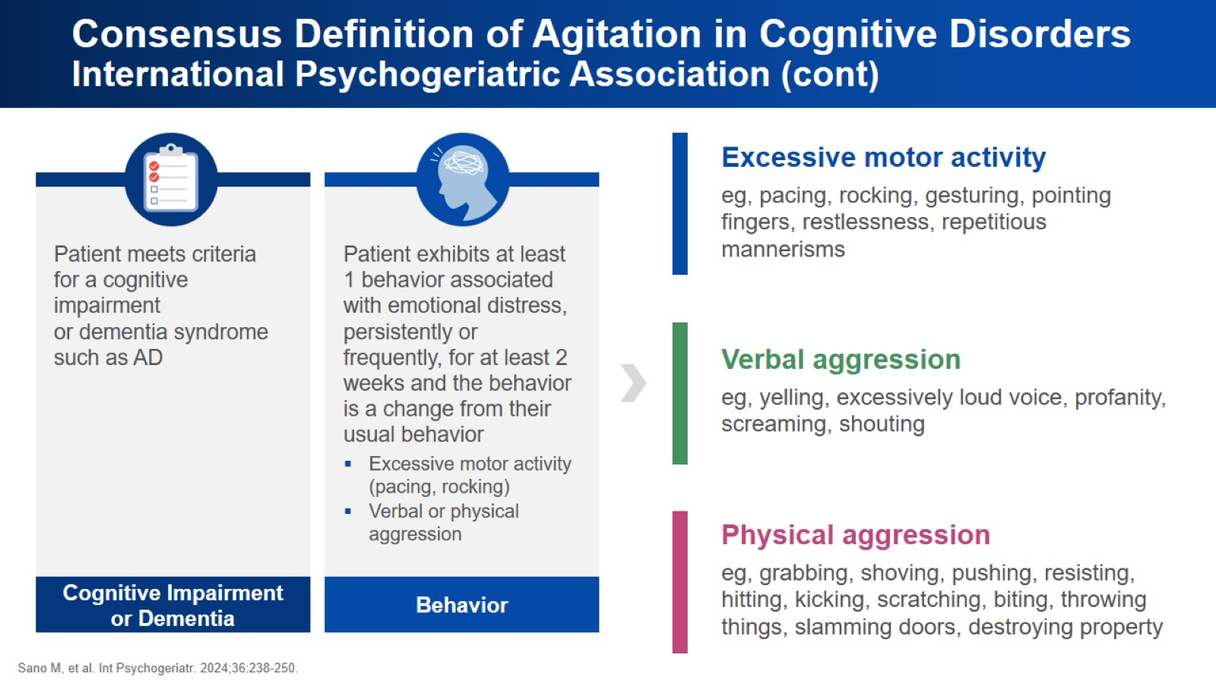
Consensus Definition of Agitation in Cognitive Disorders
International Psychogeriatric Association (cont)

Slide 7
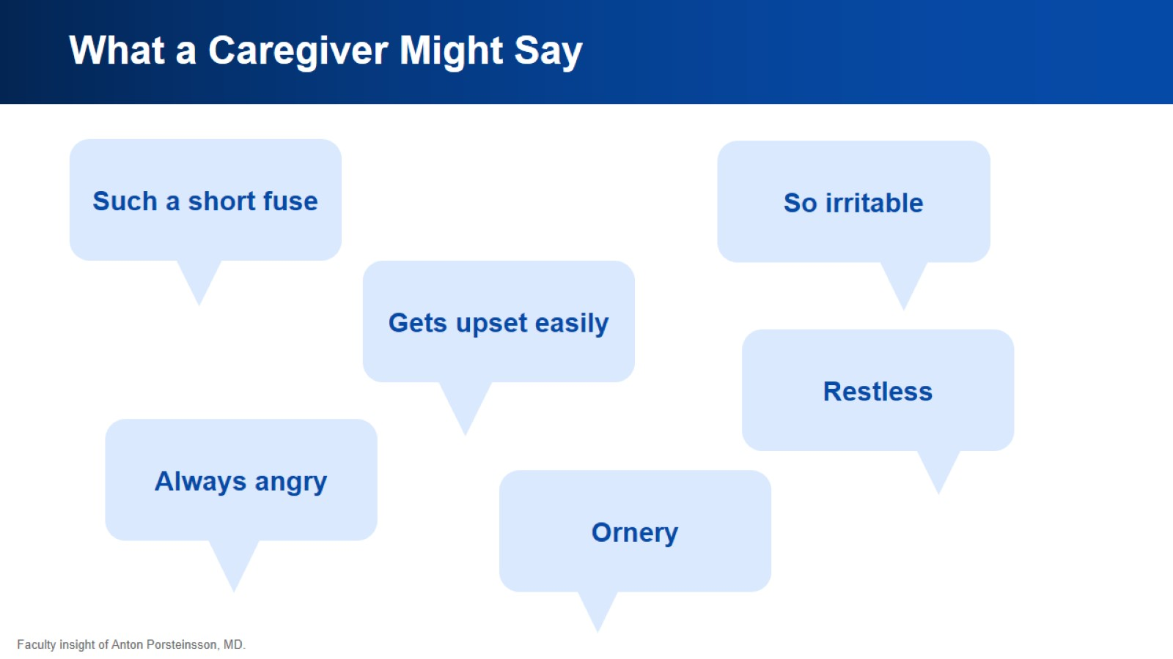
What a Caregiver Might Say

Slide 8
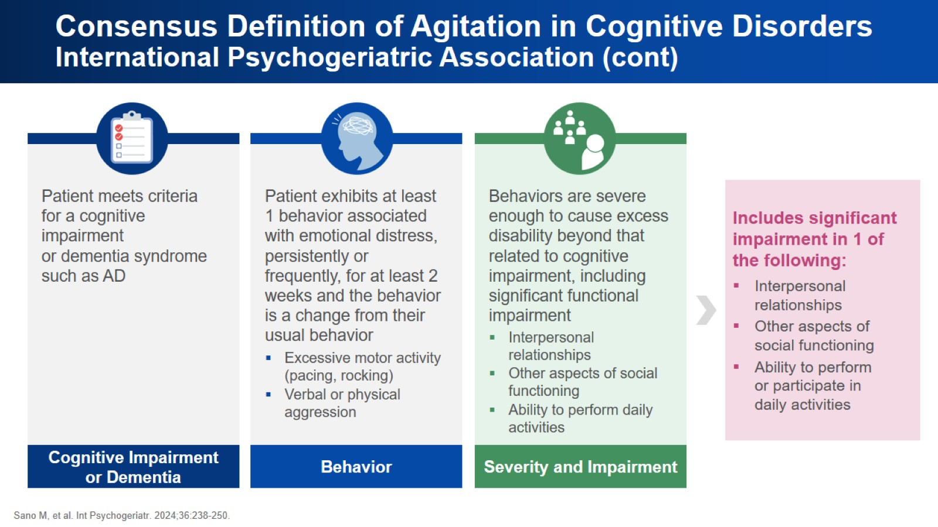
Consensus Definition of Agitation in Cognitive Disorders
International Psychogeriatric Association (cont)

Slide 9
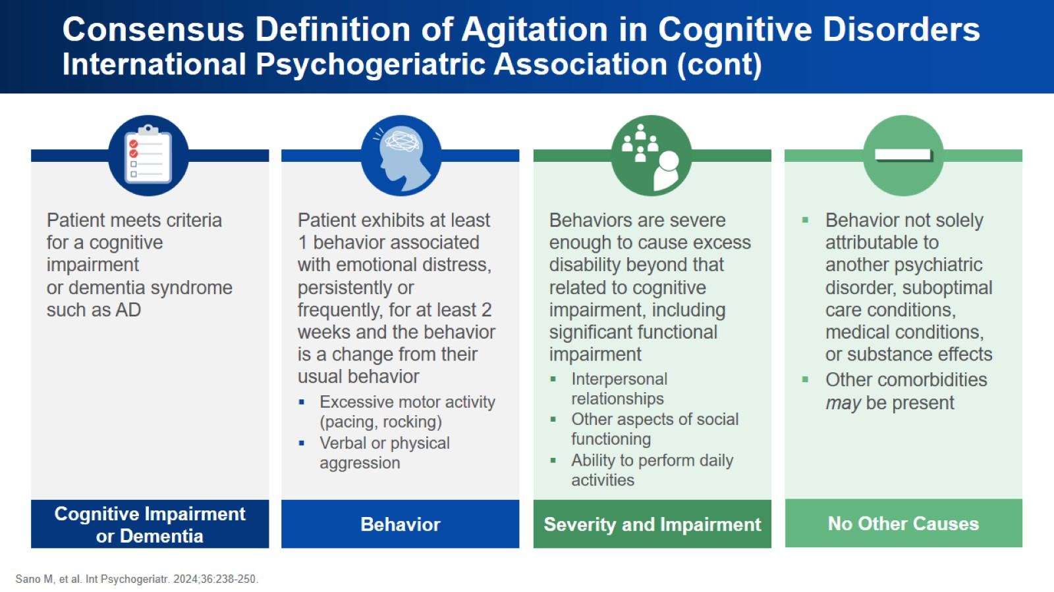
Consensus Definition of Agitation in Cognitive Disorders
International Psychogeriatric Association (cont)

Slide 10
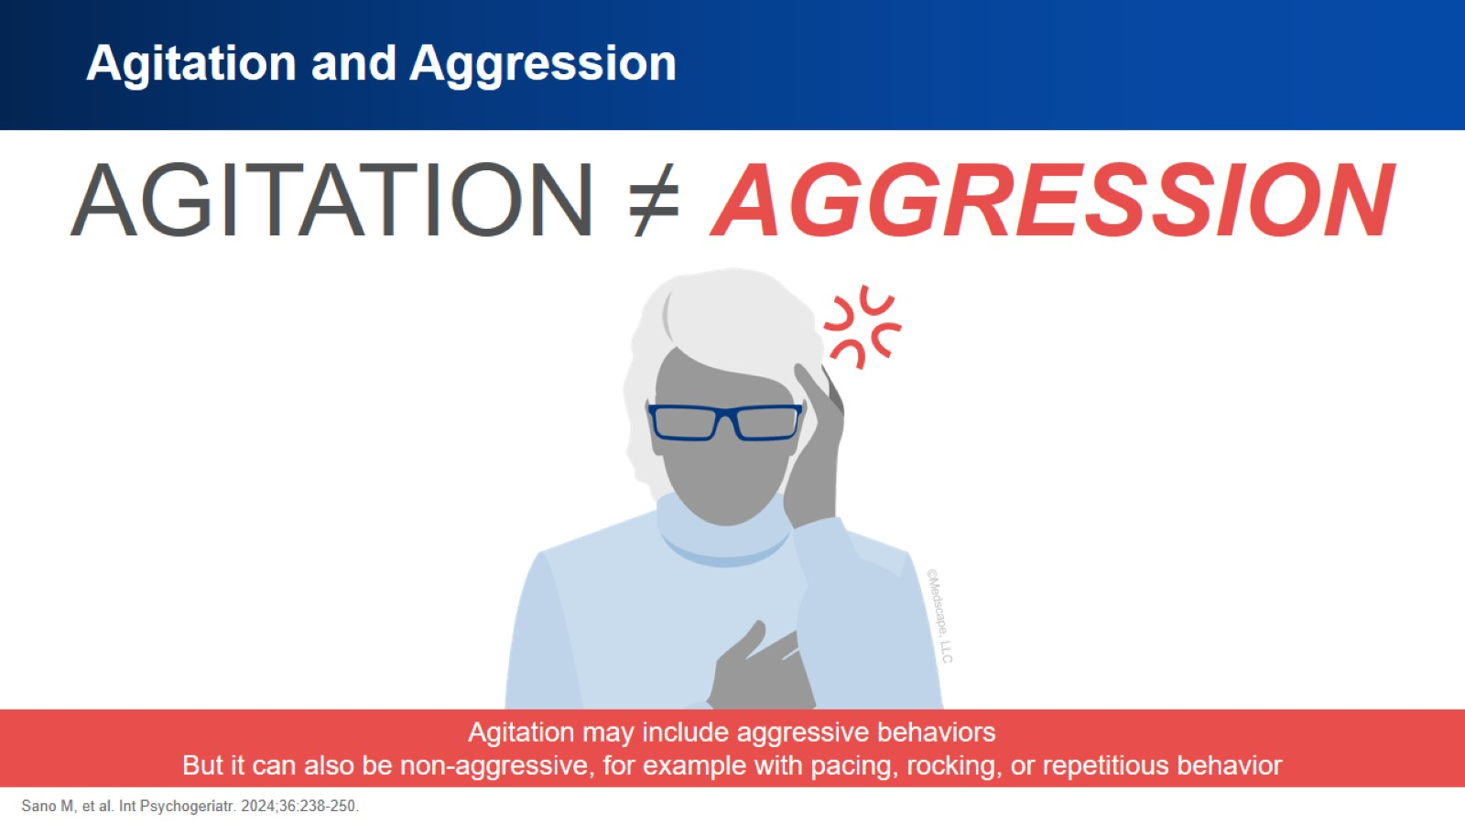
Agitation and Aggression

Slide 11
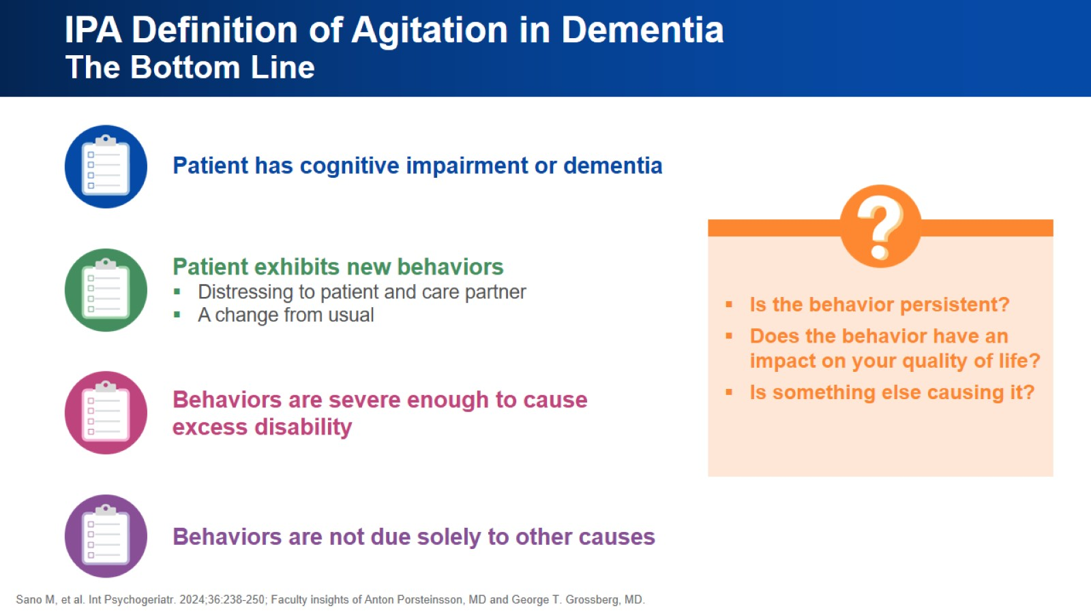
IPA Definition of Agitation in Dementia
The Bottom Line

Slide 12
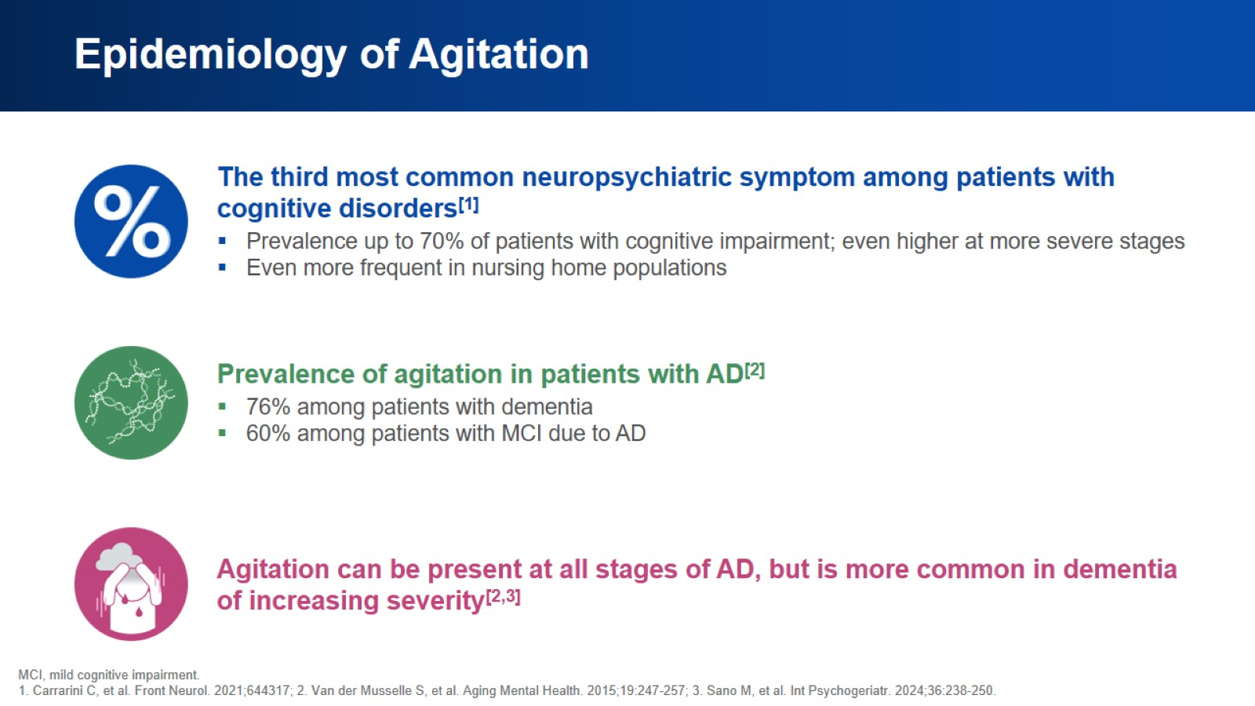
Epidemiology of Agitation

Slide 13
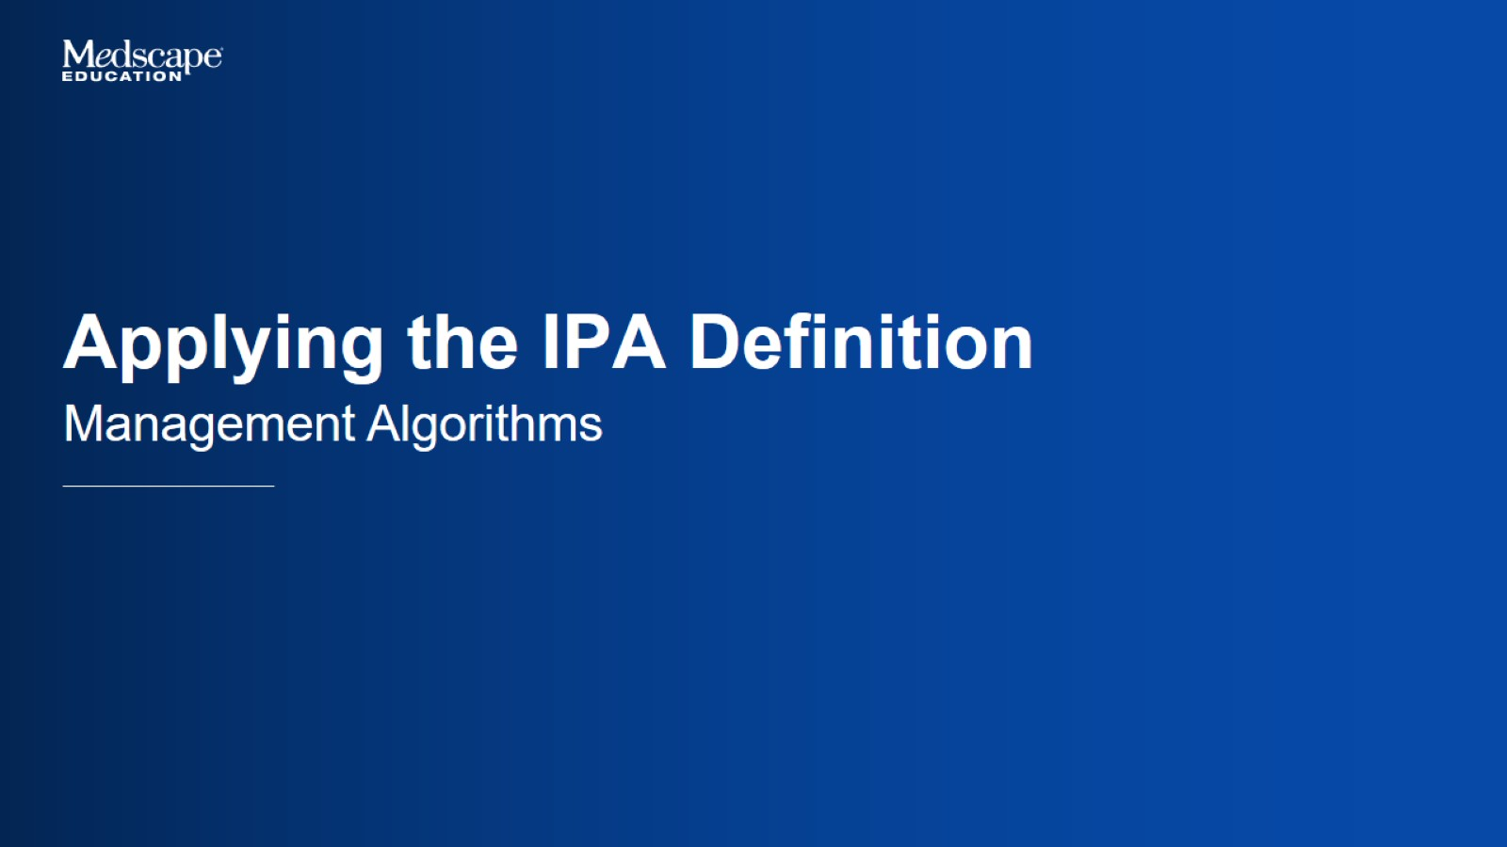
Applying the IPA Definition

Slide 14
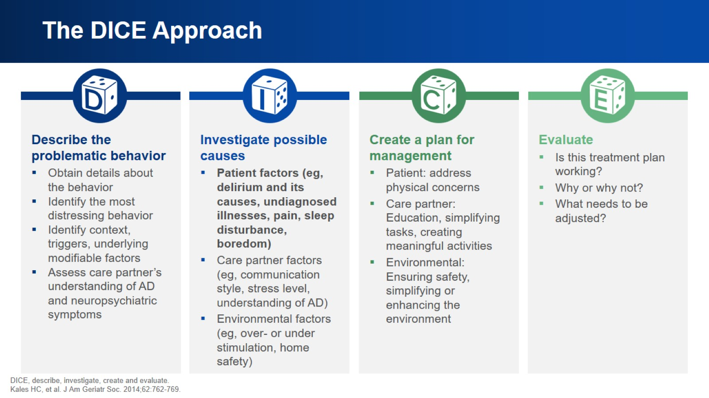
The DICE Approach

Slide 15
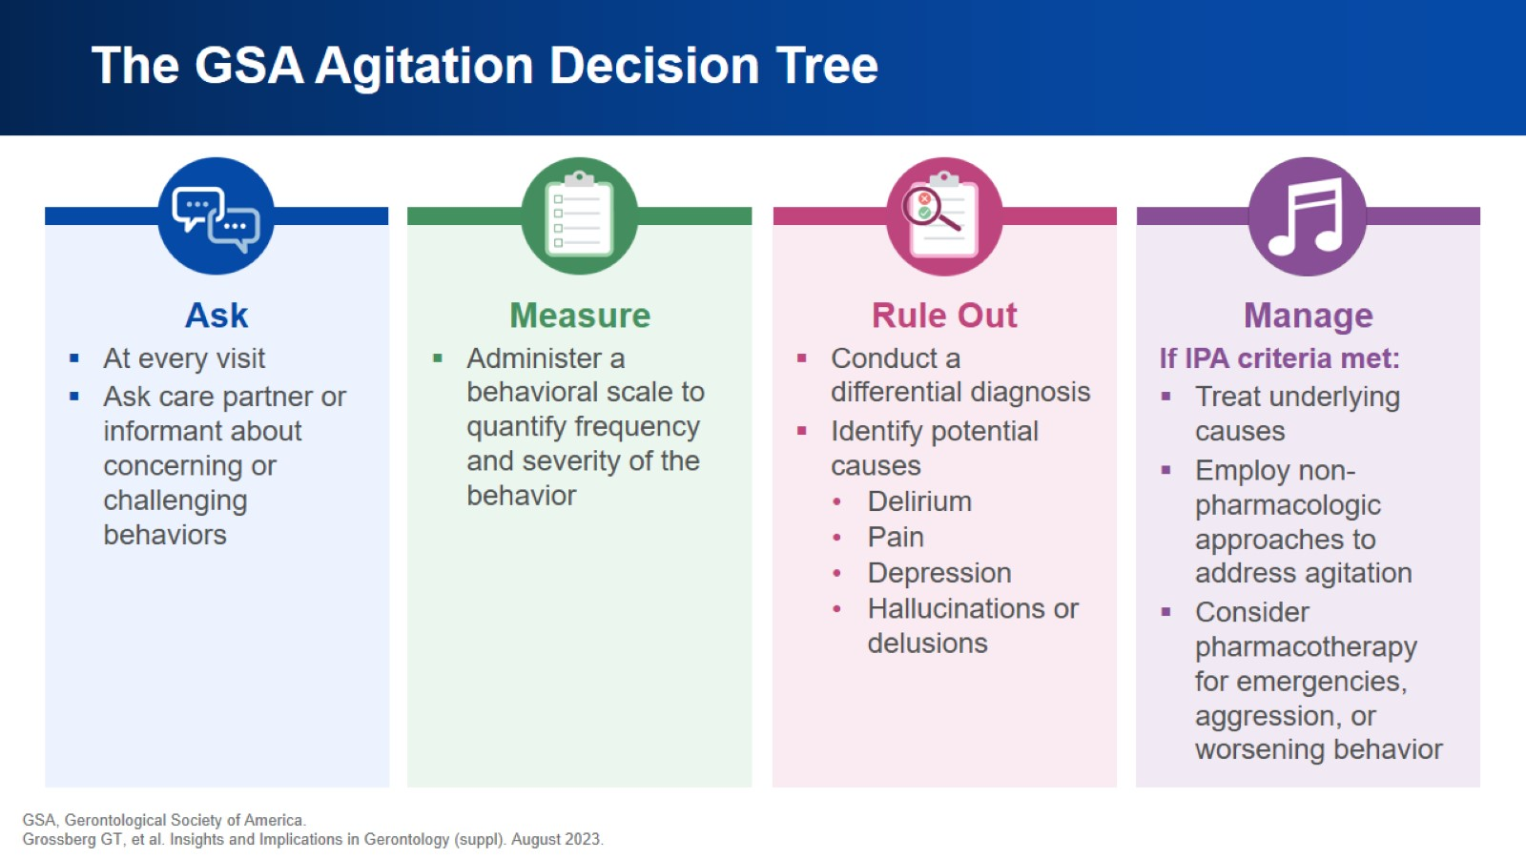
The GSA Agitation Decision Tree

Slide 16
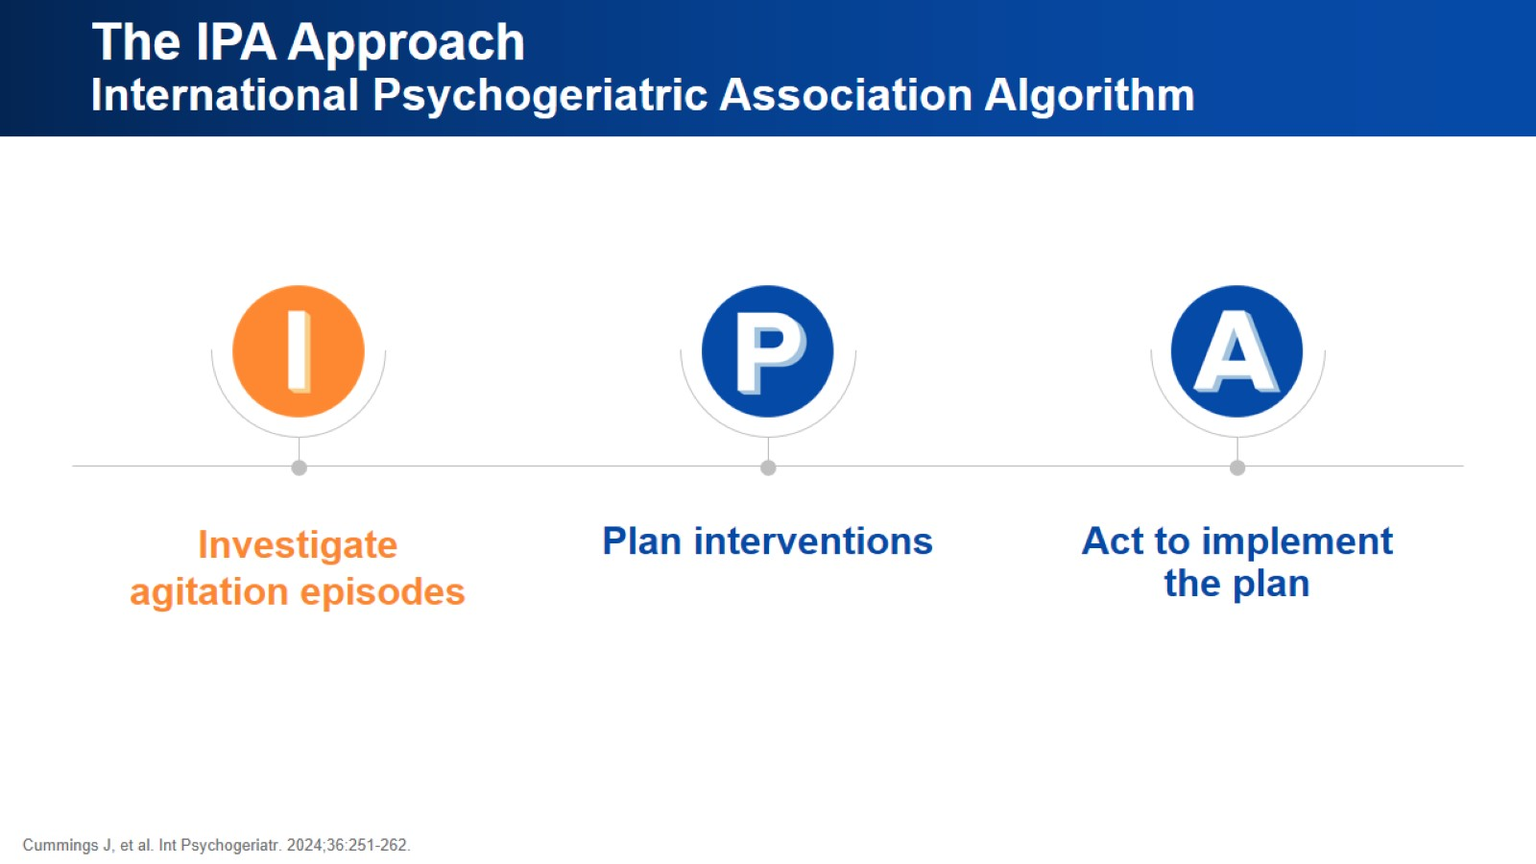
The IPA Approach
International Psychogeriatric Association Algorithm

Slide 17
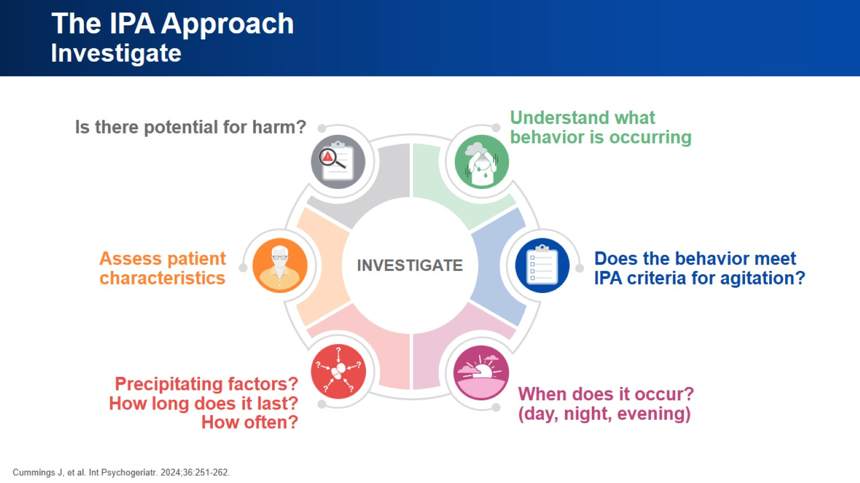
The IPA Approach
Investigate

Slide 18
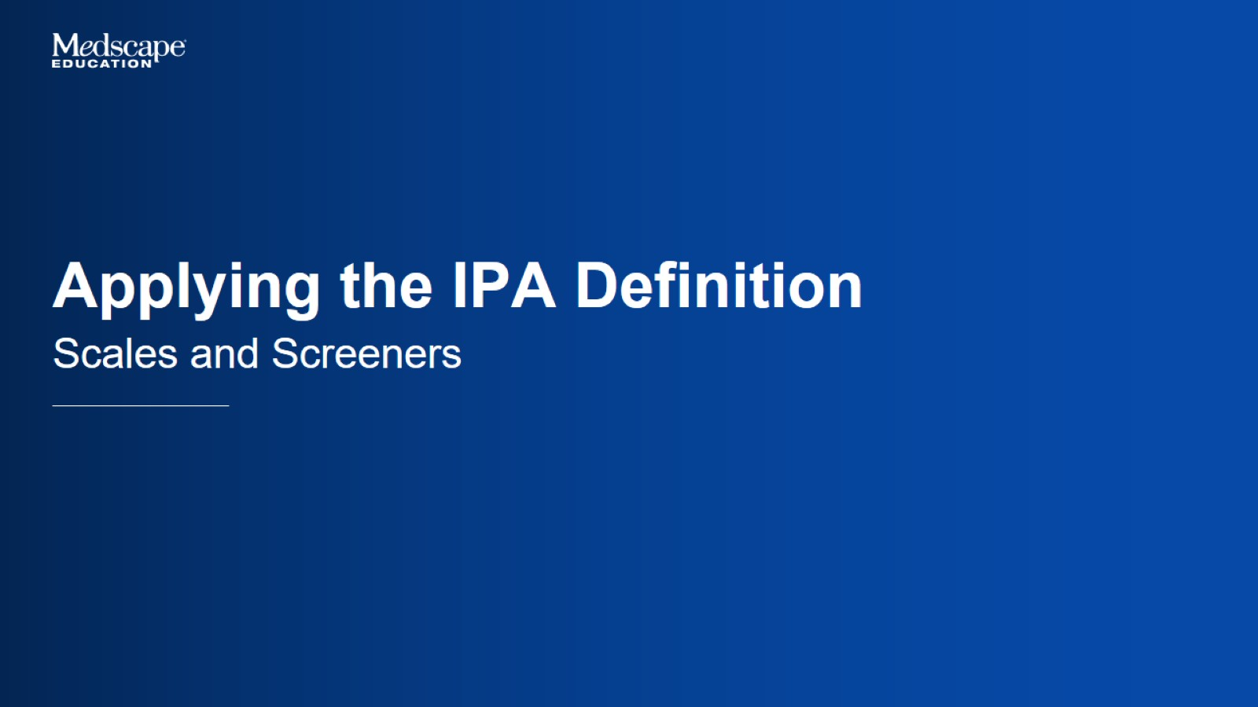
Applying the IPA Definition

Slide 19
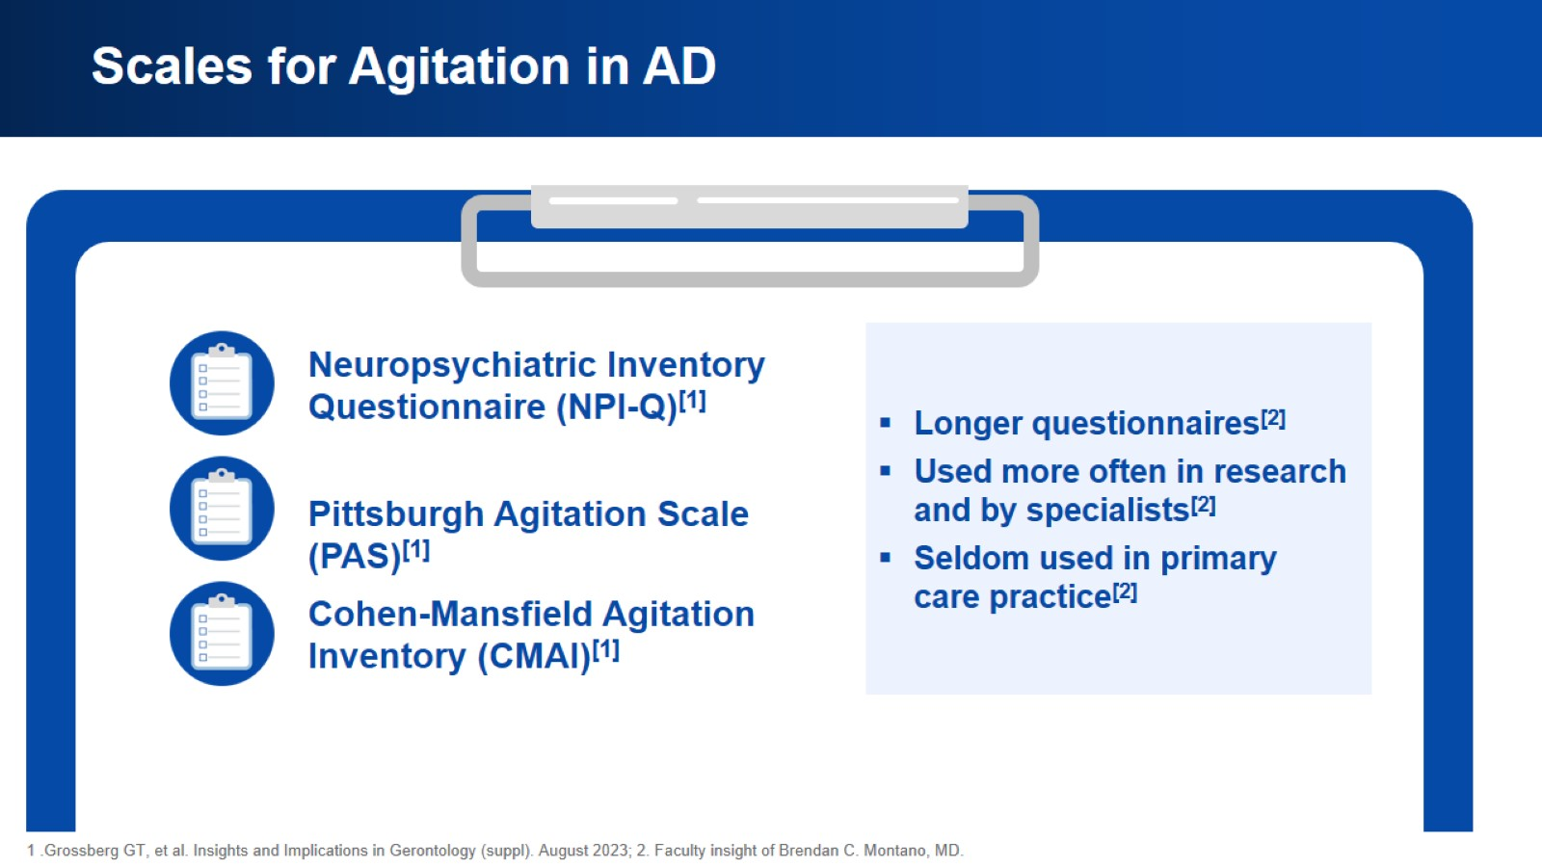
Scales for Agitation in AD

Slide 20
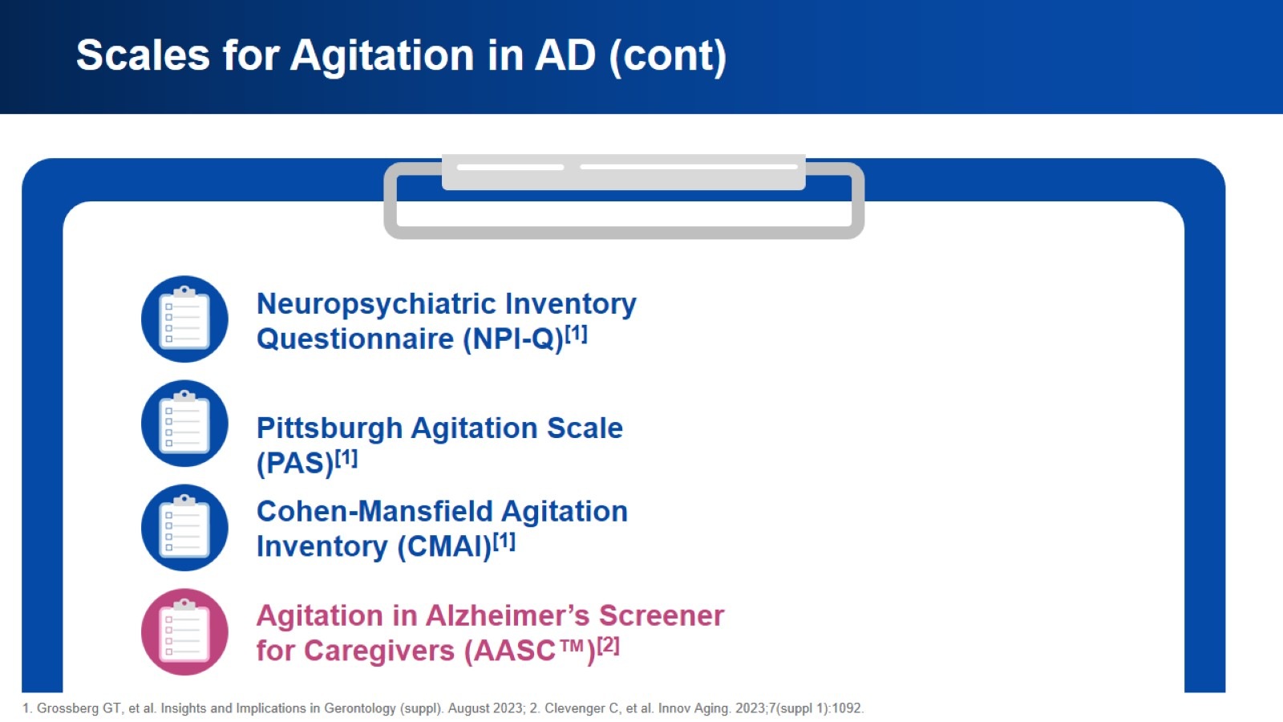
Scales for Agitation in AD (cont)

Slide 21
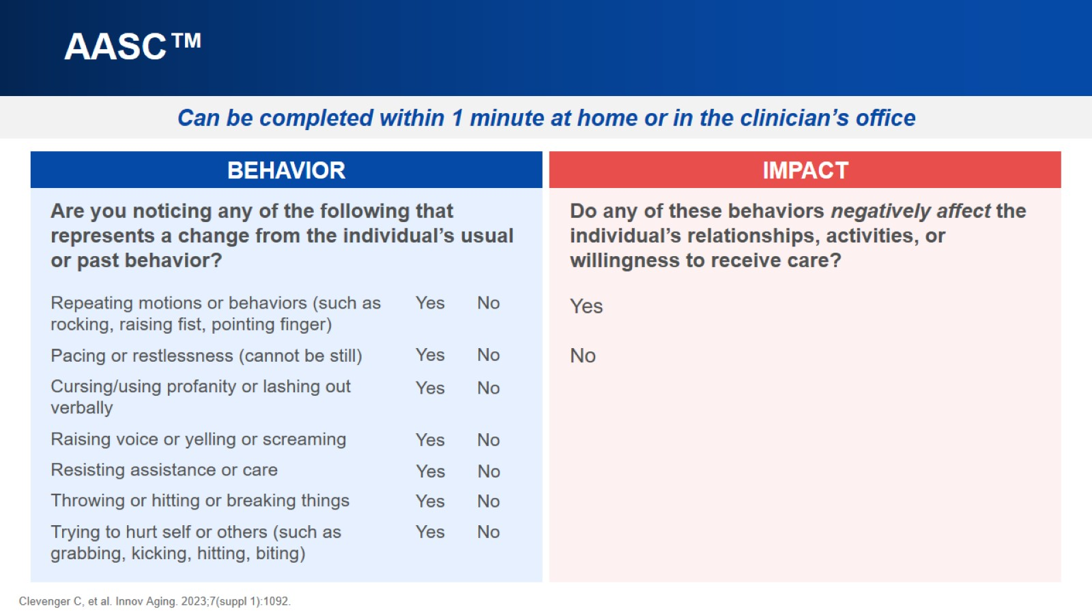
AASC™

Slide 22
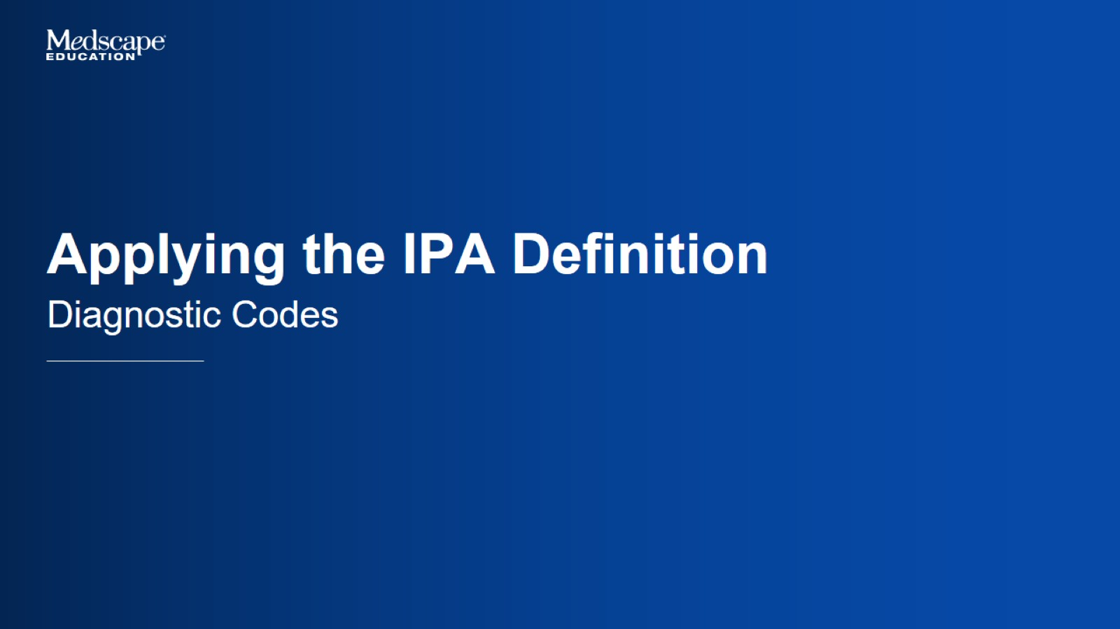
Applying the IPA Definition

Slide 23
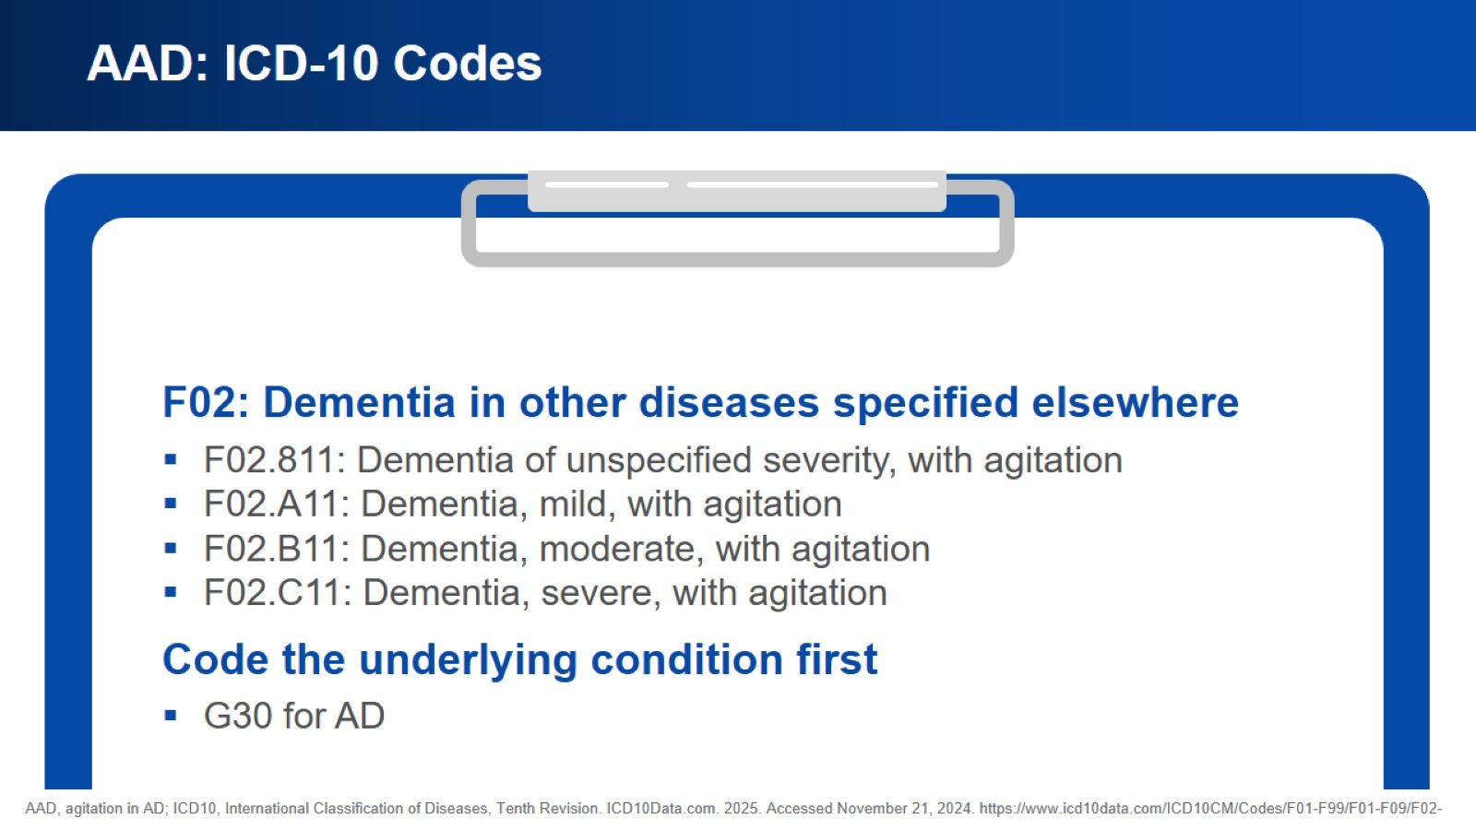
AAD: ICD-10 Codes

Slide 24

Case Discussions

Slide 25
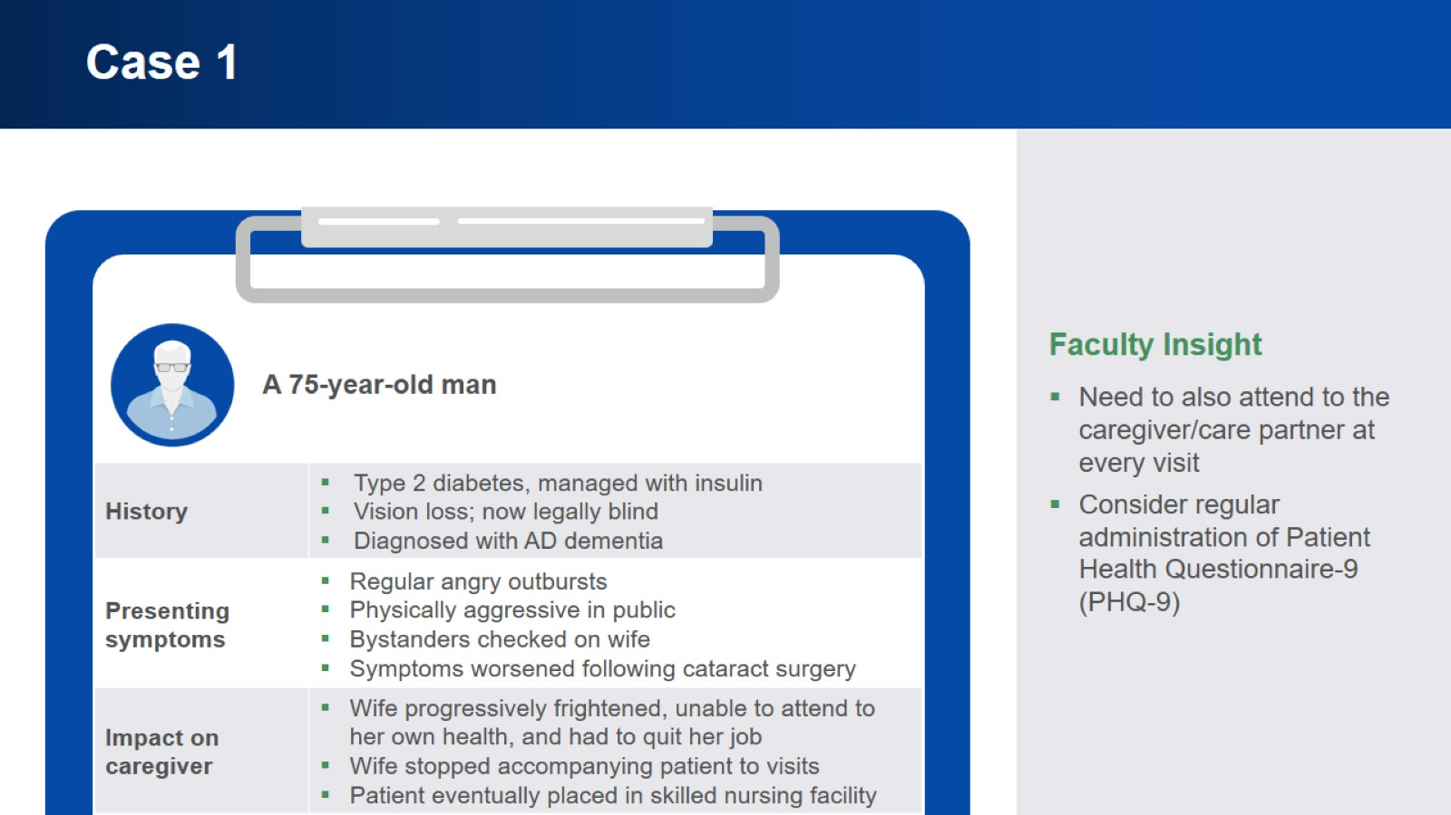
Case 1

Slide 26
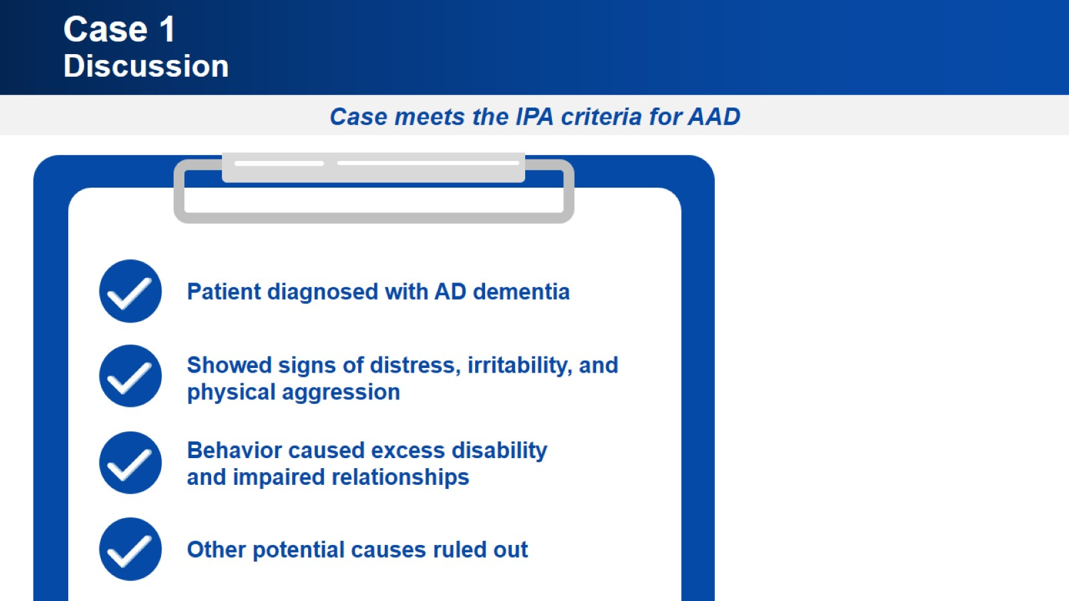
Case 1
Discussion

Slide 27
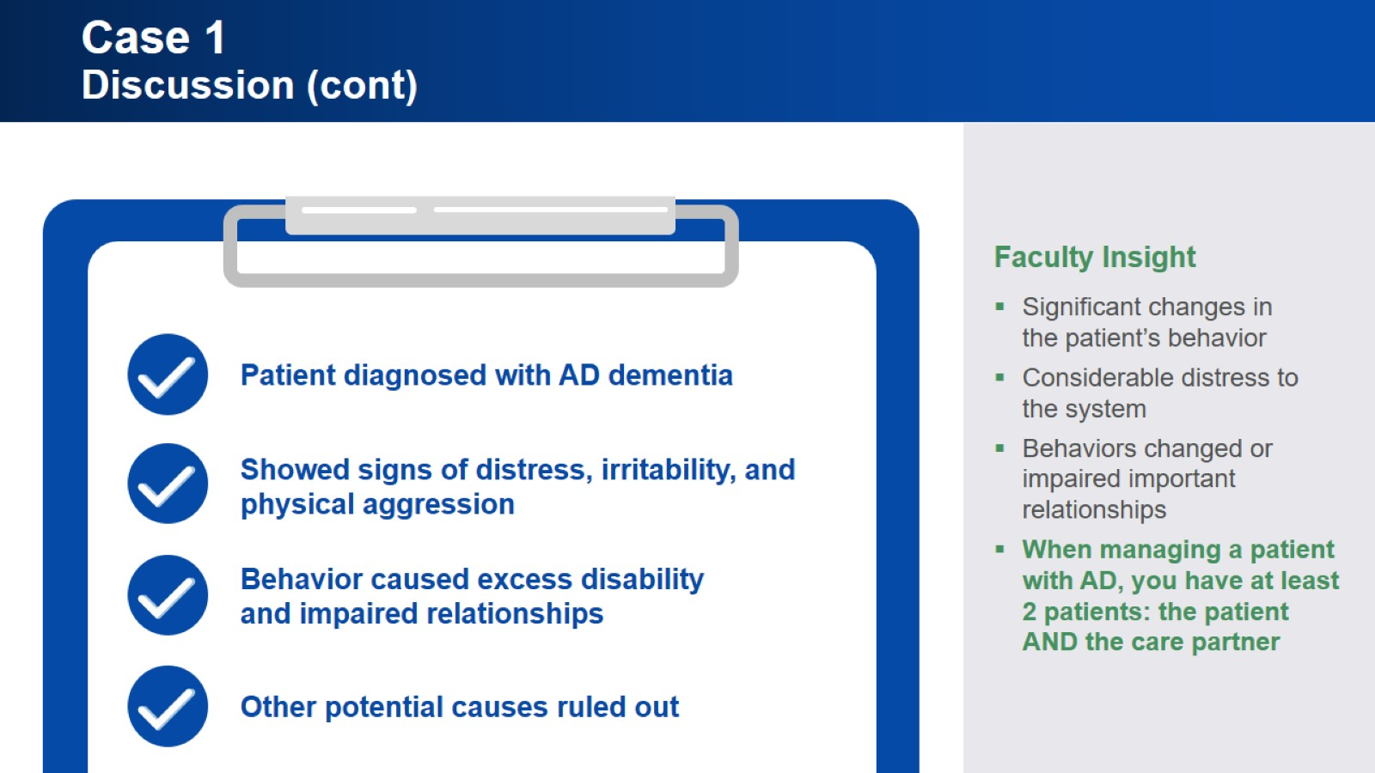
Case 1
Discussion (cont)

Slide 28
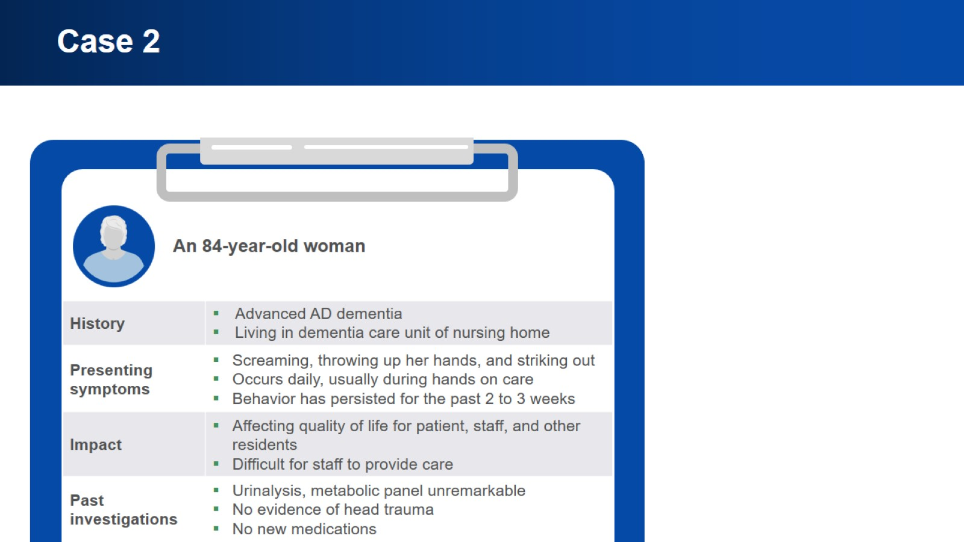
Case 2

Slide 29
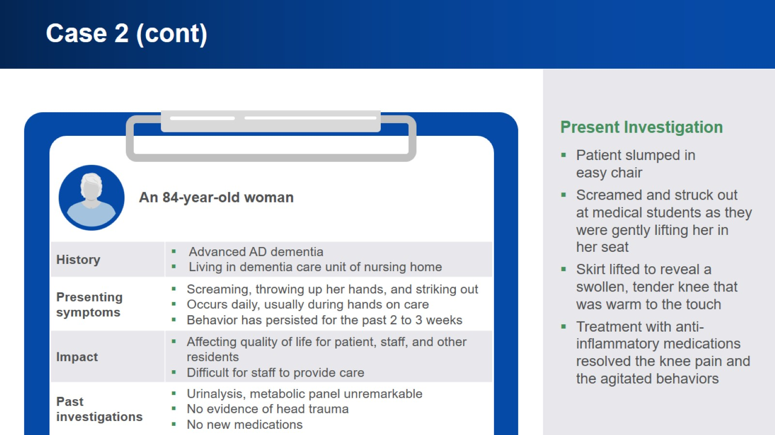
Case 2 (cont)

Slide 30
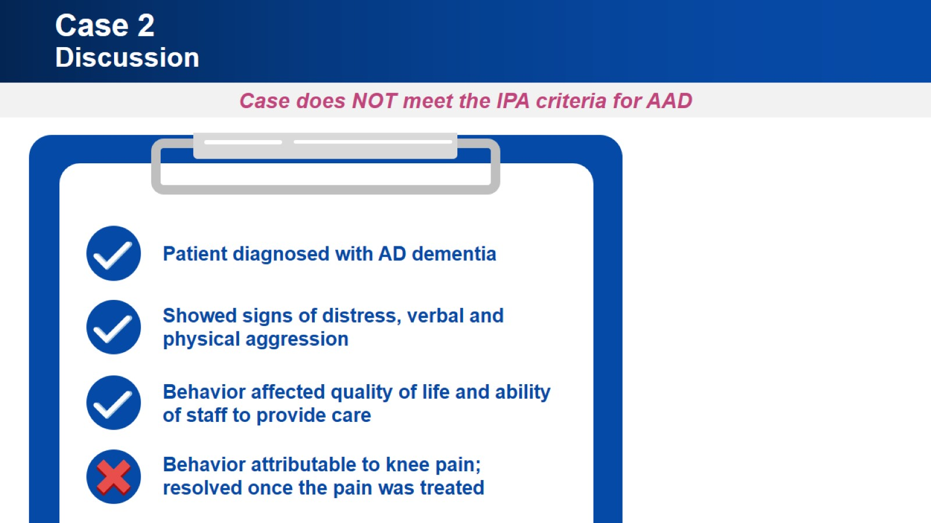
Case 2
Discussion

Slide 31
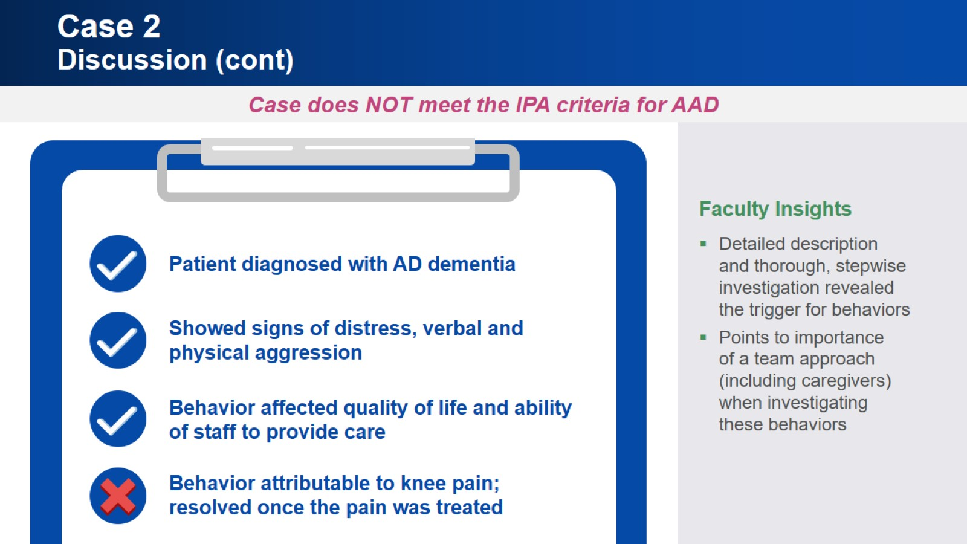
Case 2
Discussion (cont)

Slide 32
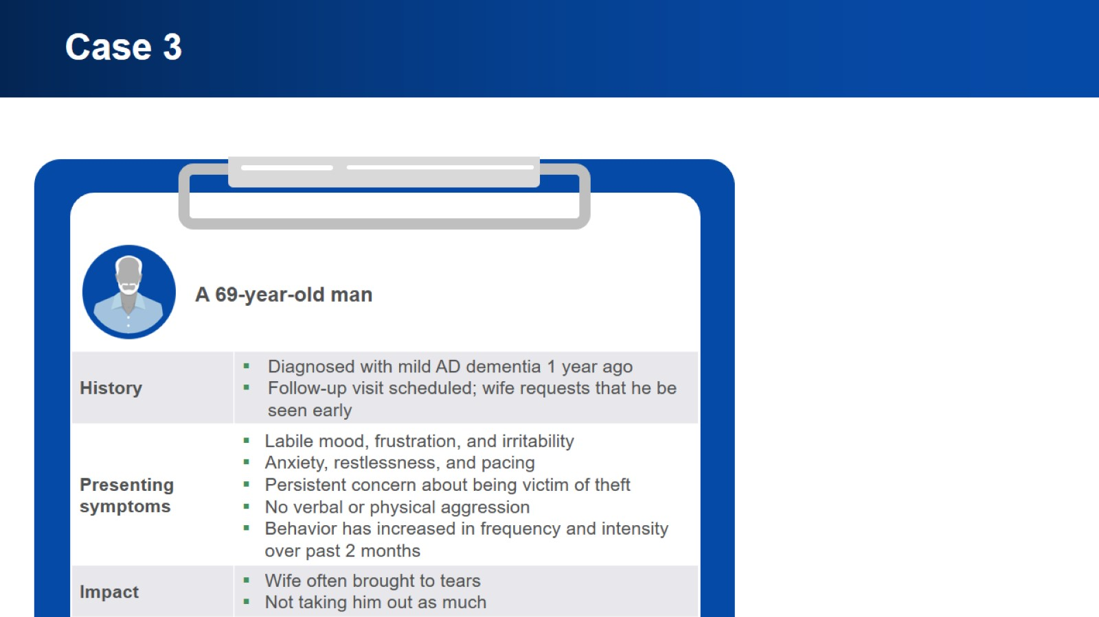
Case 3

Slide 33
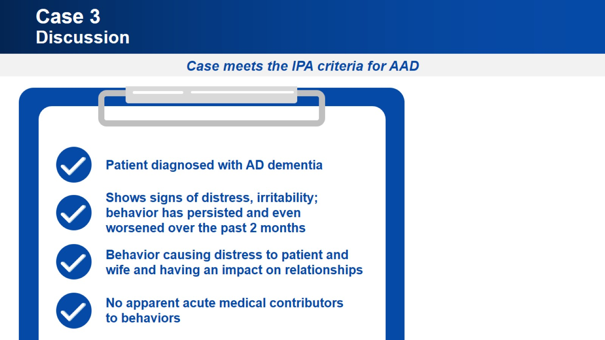
Case 3
Discussion

Slide 34
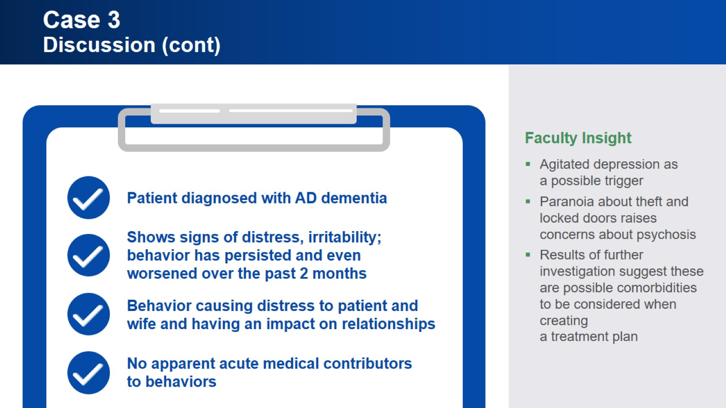
Case 3
Discussion (cont)

Slide 35

Summary

Slide 36
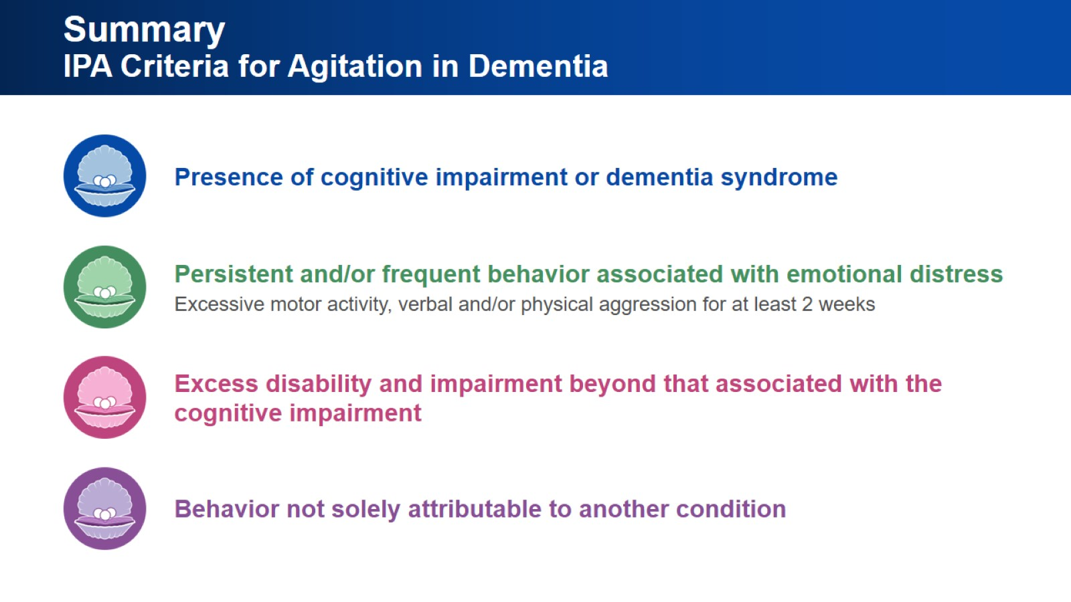
Summary
IPA Criteria for Agitation in Dementia

Slide 37
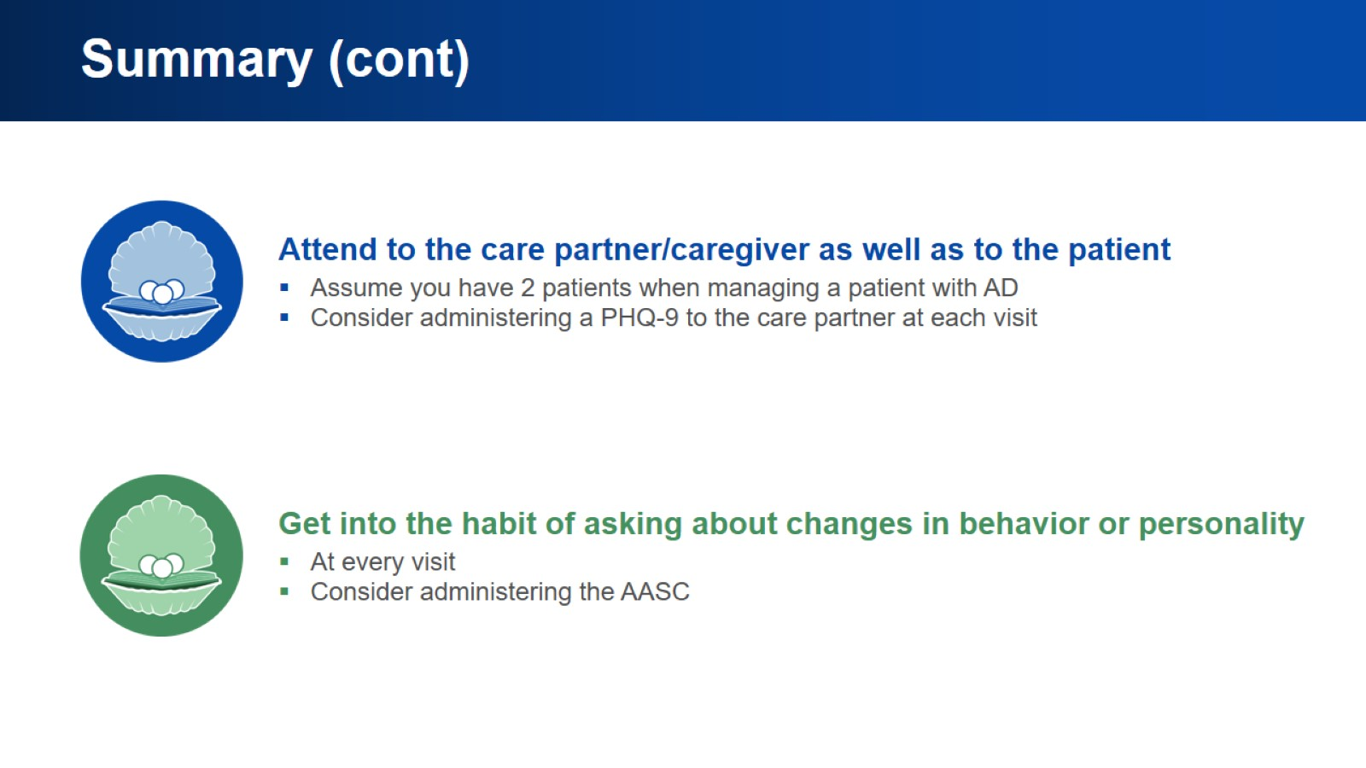
Summary (cont)

Slide 38


