Slide 1
Diagnosing Myocardial Infarction in the Era of Ultrasensitive Troponins
James L. Januzzi Jr, MD, FACC, FESC
Hutter Family Professor of Medicine, Harvard Medical School
Director GDMT Clinic, Massachusetts General Hospital
Chief Scientific Officer and Gibson Chair, Baim Institute for Clinical Research
Deputy Editor, Journal of the American College of Cardiology
Boston, Massachussetts
Notes:
Timecode:

Slide 2
Outline
Troponin biology
What exactly does “ultra-sensitive” mean?
Clinical uses
Caveats

Slide 3
Troponin Complex: A Road Map
Troponin I
20 kDA to 25 kDA, Inhibits actomyosin-ATPase
Troponin C
Calcium binding region, Ubiquitous
Troponin T
30 kDA to 34 kDA, Bridge to tropomyosin
Troponin C
Troponin I
Troponin T
26.50 nm^{[3]}
Head-to-tail overlap of Tropomyosin
© Medscape, LLC
Tropomyosin
Actin
Notes:
Marston S, Zamora JE. Troponin structure and function: a view of recent progress. J Muscle Res Cell Motil. 2020 Mar;41(1):71-89. doi: 10.1007/s10974-019-09513-1. Epub 2019 Apr 27. PMID: 31030382; PMCID: PMC7109197.
2. Wei B, Jin JP. Troponin T isoforms and posttranscriptional modifications: Evolution, regulation and function. Arch Biochem Biophys. 2011 Jan 15;505(2):144-54. doi: 10.1016/j.abb.2010.10.013. Epub 2010 Oct 18. PMID: 20965144; PMCID: PMC3018564.
Paul DM, Morris EP, Kensler RW, Squire JM. Structure and orientation of troponin in the thin filament. J Biol Chem. 2009 May 29;284(22):15007-15. doi: 10.1074/jbc.M808615200. Epub 2009 Mar 24. PMID: 19321455; PMCID: PMC2685683.
Shave R, Baggish A, George K, Wood M, Scharhag J, Whyte G, Gaze D, Thompson PD. Exercise-induced cardiac troponin elevation: evidence, mechanisms, and implications. J Am Coll Cardiol. 2010 Jul 13;56(3):169-76. doi: 10.1016/j.jacc.2010.03.037. PMID: 20620736.
Li MX, Hwang PM. Structure and function of cardiac troponin C (TNNC1): Implications for heart failure, cardiomyopathies, and troponin modulating drugs. Gene. 2015 Oct 25;571(2):153-66. doi: 10.1016/j.gene.2015.07.074. Epub 2015 Jul 29. PMID: 26232335; PMCID: PMC4567495.

Slide 4
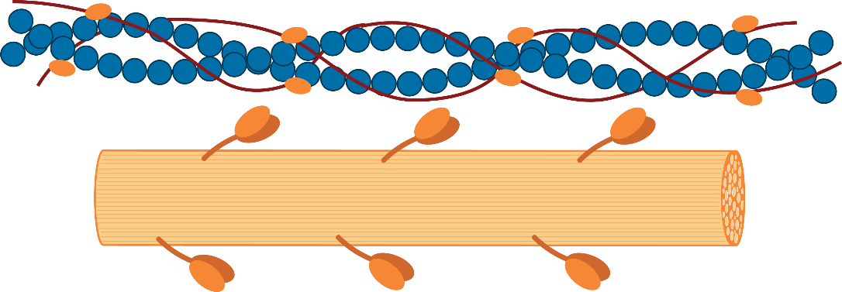
2-Compartment Troponin Biology
Myocardial Injury
Cytosolic troponin
Contractile apparatus
Cardiomyocite
© Medscape, LLC
Responsible for “early” troponin release
Responsible for “delayed/persistent” troponin release
Notes:
Sternberg M, Pasini E, Chen-Scarabelli C, Corsetti G, Patel H, Linardi D, Onorati F, Faggian G, Scarabelli T, Saravolatz L. Elevated Cardiac Troponin in Clinical Scenarios Beyond Obstructive Coronary Artery Disease. Med Sci Monit. 2019 Sep 22;25:7115-7125. doi: 10.12659/MSM.915830. PMID: 31542787; PMCID: PMC6774266.

Slide 5
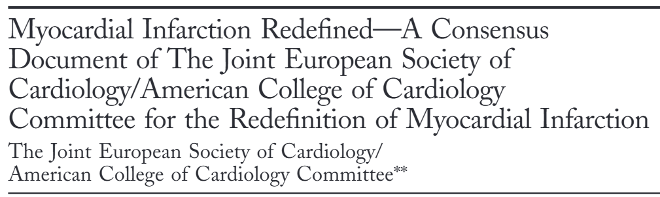
Diagnosis of MI
Biomarker indicators of MI
Troponin is preferred biomarker for diagnosis of MI
CK-MB only if troponin is not available
Alpert JS, et al. J Am Coll Cardiol. 2000;36:959-969.
Notes:
Alpert JS, Thygesen K, Antman E, Bassand JP. Myocardial infarction redefined--a consensus document of The Joint European Society of Cardiology/American College of Cardiology Committee for the redefinition of myocardial infarction. J Am Coll Cardiol. 2000 Sep;36(3):959-69. doi: 10.1016/s0735-1097(00)00804-4. Erratum in: J Am Coll Cardiol 2001 Mar 1;37(3):973. PMID: 10987628.

Slide 6
The Fourth Universal Definition of MI
Injury PLUS:
Symptoms
ECG changes
Loss of function
Thrombus at cath
Autopsy evidence
Thygesen K, et al. Circulation. 2018;138:1.

Slide 7
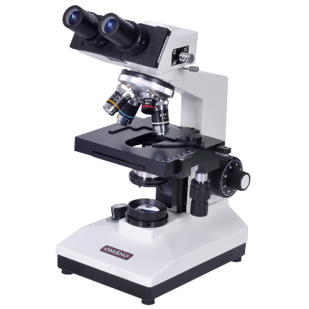
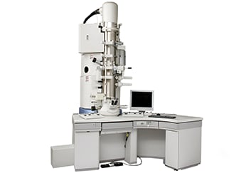
High-Sensitivity Troponin Assays
Assays for that have higher precision (ie, < 10% co-efficient of variation) at the 99th percentile for a normal patient population and detect concentrations of troponin in > 50% of a normal population
The term “ultrasensitive” should not be used!
Conventional assay
hs-cTn assay
Auberger N, et al. Pract Lab Med. 2024 Nov 29;42:e00441
Notes:
Auberger N, Coin I, Marillet L, Raymond F, Michel-Busseret S, Claret PG, Pease C. Assay precision, 99th percentile reference value and proportion of detected healthy european adults for VIDAS® high-sensitive troponin I. Pract Lab Med. 2024 Nov 29;42:e00441. doi: 10.1016/j.plabm.2024.e00441. PMID: 39717566; PMCID: PMC11665417.
Auberger N, et al. Pract Lab Med. 2024 Nov 29;42:e00441.

Slide 8
Contemporary cTn assay
High-sensitivity cTn assay
Measure cTn in < 50% of a ‘healthy’ cohort.
Measure cTn in ≥ 50% of ‘healthy’ men and women.
Analytical sensitivity
Lower analytical sensitivity
Higher analytical sensitivity
Acceptable CV ≤ 20% at 99th URL.
CV<10% at the 99th URL.
Measured value
Measured value
Imprecision
Higher imprecision
More ‘analytical noise‘
Lower imprecision
Less ‘analytical noise‘
CV
CV
© Medscape, LLC
Wu AHB et al. Clin Chem 2018; 64: 645-655; Apple FS et al. Clin Chem 2017; 63: 73-81.
Notes:
Wu AHB, Christenson RH, Greene DN, Jaffe AS, Kavsak PA, Ordonez-Llanos J, Apple FS. Clinical Laboratory Practice Recommendations for the Use of Cardiac Troponin in Acute Coronary Syndrome: Expert Opinion from the Academy of the American Association for Clinical Chemistry and the Task Force on Clinical Applications of Cardiac Bio-Markers of the International Federation of Clinical Chemistry and Laboratory Medicine. Clin Chem. 2018 Apr;64(4):645-655. doi: 10.1373/clinchem.2017.277186. Epub 2018 Jan 17. PMID: 29343532.
Apple FS, Sandoval Y, Jaffe AS, Ordonez-Llanos J; IFCC Task Force on Clinical Applications of Cardiac Bio-Markers. Cardiac Troponin Assays: Guide to Understanding Analytical Characteristics and Their Impact on Clinical Care. Clin Chem. 2017 Jan;63(1):73-81. doi: 10.1373/clinchem.2016.255109. Epub 2016 Oct 10. PMID: 28062612.

Slide 9
Population Measurements of hsTnT
Depending on the assay, up to 75% or more of ‘normals’ will have measurable Tn!
The term ‘troponin positive’ will become less useful!
300
Blood donors (n=1251)
Apparently healthy individuals (n=500)
250
200
99th percentile= 14 pg/mL
(imprecision 10%)
Old URL = 0.03 ng/mL
(imprecision 10%)
Frequency abs.
150
100
50
0
0
2
4
6
8
10
12
14
16
18
20
22
50
TnT [pg/mL]
Faculty data on file.

Slide 10
High-Sensitivity Troponin and Acute Myocardial Injury
What will clinicians notice when they convert?
More/most people will “have a number”
“Larger numbers” due to conversion to ng/L
Faster recognition of acute myocardial injury/necrosis—hs-cTn concentrations change much faster than prior assays
Detection of more patients with myocardial injury/necrosis—not all will have an MI

Slide 11
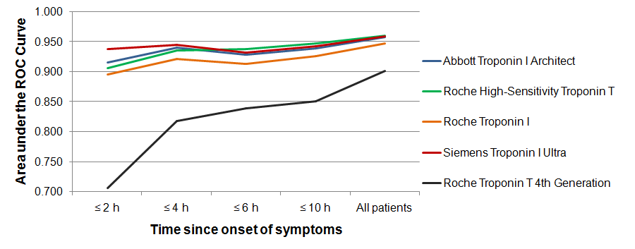
Speed to Diagnosis in Acute MI
Reichlin T, et al. New Engl J Medicine. 2009;361:858–867.
It is the policy of Medscape Education to avoid the mention of brand names or specific manufacturers in accredited educational activities. However, trade and manufacturer names related to heart failure are provided in this activity in an effort to provide clarity. The use of manufacturer names should not be viewed as an endorsement by Medscape of any specific product or manufacturer.
Notes:
11
Reichlin T, Hochholzer W, Bassetti S, Steuer S, Stelzig C, Hartwiger S, et al. Early Diagnosis of Myocardial Infarction with Sensitive Cardiac Troponin Assays. New Engl J Medicine. 2009;361(9):858–67.

Slide 12
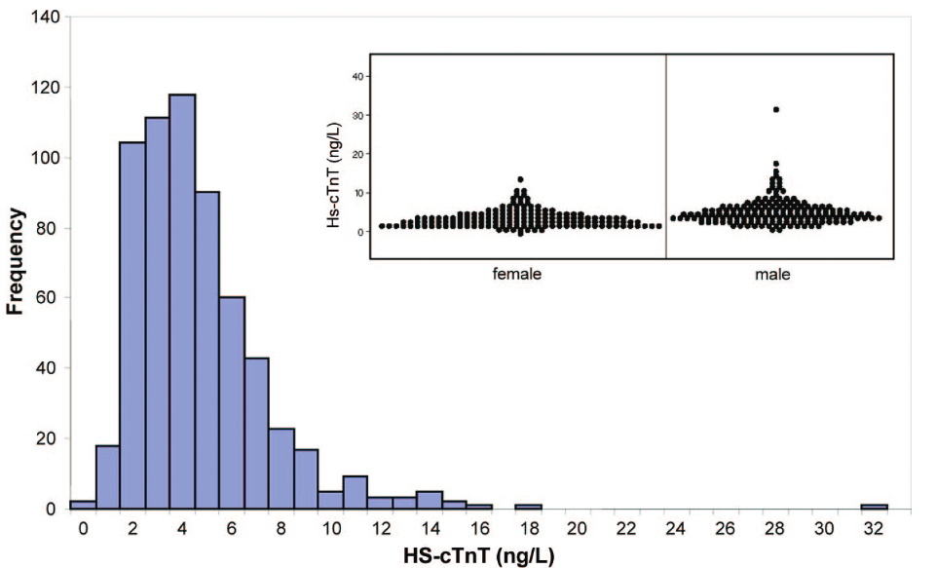
Sex-Based Differences in hsTn
Median hs-cTnT in women (14 ng/L) was lower than corresponding value in men (20 ng/L)
This has significant ramifications for use in evaluation of possible ACS
Giannitsis E, et al. Clin Chem. 2010;56:254-261.

Slide 13
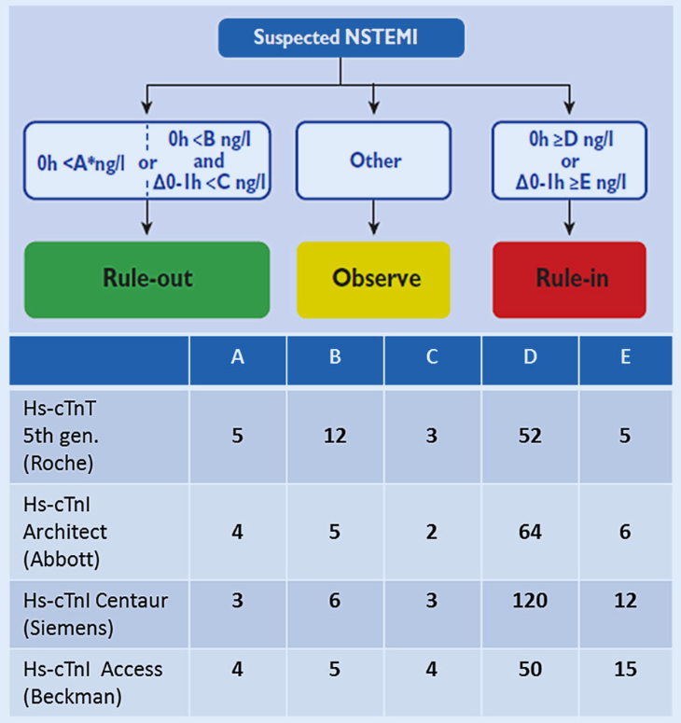
ESC Protocol: 0/1 or 0/3H
A value < limit of blank (essentially, 'undetectable') has high NPV
In other patients, a low value at presentation and little change a 1 or 3H → Rule-out zone
In those with elevated or rising values → Rule-in zone*
Those in between "Observation" zone
*Being in the "rule in zone" does NOT mean the patient has an acute Ml!
Giannitsis E, Gopi V. Herz. 2020;45:509-519.
Notes:
13
Giannitsis E, Gopi V. Biomarkers for infarct diagnosis and rapid rule-out/rule-in of acute myocardial infarction. Herz. 2020 Sep;45(6):509-519. English.
A value < limit of blank (essentially, 'undetectable') has high NPV
In other patients, a low value at presentation and little change a 1 or 3H → Rule out zone In those with elevated or rising values → Rule in zone* Those in between "Observation" zone *Being in the "rule in zone" does NOT mean the patient has an acute Ml!

Slide 14
Ischemia and Necrosis: Conventional Tn Assay
Non-coronary
cardiac necrosis
Ischemia
Necrosis
Unstable Angina
AMI
Christ M, et al. Am J Med. 2010;123:1134-42.
Notes:
Einthoven aus Holland
Nobelpreis für Physiologie und Medizin 1924
Byrne RA, Rossello X, Coughlan JJ, Barbato E, Berry C, Chieffo A, Claeys MJ, Dan GA, Dweck MR, Galbraith M, Gilard M, Hinterbuchner L, Jankowska EA, Jüni P, Kimura T, Kunadian V, Leosdottir M, Lorusso R, Pedretti RFE, Rigopoulos AG, Rubini Gimenez M, Thiele H, Vranckx P, Wassmann S, Wenger NK, Ibanez B; ESC Scientific Document Group. 2023 ESC Guidelines for the management of acute coronary syndromes. Eur Heart J. 2023 Oct 12;44(38):3720-3826. doi: 10.1093/eurheartj/ehad191. Erratum in: Eur Heart J. 2024 Apr 1;45(13):1145. doi: 10.1093/eurheartj/ehad870. PMID: 37622654.
Bluemke DA, Teague SD. In: Hodler J, Kubik-Huch RA, von Schulthess GK, editors. Diseases of the Chest, Breast, Heart and Vessels 2019-2022: Diagnostic and Interventional Imaging [Internet]. Cham (CH): Springer; 2019. Chapter 16. Available from: https://www.ncbi.nlm.nih.gov/books/NBK553869/ doi: 10.1007/978-3-030-11149-6_16

Slide 15
Ischemia and Necrosis: hs-cTn Assay
Increase 20% to 50%
Non-coronary
cardiac necrosis
Ischemia
Necrosis
Increase >200%
Unstable Angina
AMI
Christ M, et al. Am J Med. 2010;123:1134-1142.
Notes:
Einthoven aus Holland
Nobelpreis für Physiologie und Medizin 1924

Slide 16
The Golden Rules of Troponin Testing
When seeking an MI, pre-test probability rules the validity of a post-test result
→Stated another way…don’t test someone with zero likelihood for an ACS
Troponin is only one component to the diagnosis of acute MI
→With hs-cTn assays, injury is way more common than MI
Clinical judgment is the most important part of how these tests should be deployed
→ Think about why you are testing and what the results may mean!

Slide 17
The Fourth Universal Definition of MI
Injury PLUS:
Symptoms
ECG changes
Loss of function
Thrombus at cath
Autopsy evidence
Thygesen K, et al. Circulation. 2018;138:1.

Slide 18
Determinants of Higher hsTn Concentrations in Those Without MI
Age
Male sex
Black race
Kidney function - presence and severity
Diabetes mellitus - presence and severity
Hypertension - presence and severity
Prior CV disease - presence and severity
Irfan A, et al. Am J Med. 2012;125:491-498.e1; Rubin J, et al. Clin Biochem. 2016;49:657-662.
Notes:
1. Irfan A, Twerenbold R, Reiter M, Reichlin T, Stelzig C, Freese M, Haaf P, Hochholzer W, Steuer S, Bassetti S, Zellweger C, Freidank H, Peter F, Campodarve I, Meune C, Mueller C. Determinants of high-sensitivity troponin T among patients with a noncardiac cause of chest pain. Am J Med. 2012 May;125(5):491-498.e1. doi: 10.1016/j.amjmed.2011.10.031. PMID: 22482847.
2. Rubin J, Matsushita K, Lazo M, Ballantyne CM, Nambi V, Hoogeveen R, Sharrett AR, Blumenthal RS, Coresh J, Selvin E. Determinants of minimal elevation in high-sensitivity cardiac troponin T in the general population. Clin Biochem. 2016 Jun;49(9):657-662. doi: 10.1016/j.clinbiochem.2016.01.024. Epub 2016 Mar 11. PMID: 26975902; PMCID: PMC4889514.

Slide 19
Determinants of Higher hsTn Concentrations in Those Without MI
Age
Male sex
Black race
Kidney function - presence and severity
Diabetes mellitus - presence and severity
Hypertension - presence and severity
Prior CV disease - presence and severity
CAD
With or without prior MI
Heart muscle disease
LVH
HF
HCM
Valve disease
AF
Pulmonary pressure
Irfan A, et al. Am J Med. 2012;125:491-498.e1; Rubin J, et al. Clin Biochem. 2016;49:657-662.
Notes:
1. Irfan A, Twerenbold R, Reiter M, Reichlin T, Stelzig C, Freese M, Haaf P, Hochholzer W, Steuer S, Bassetti S, Zellweger C, Freidank H, Peter F, Campodarve I, Meune C, Mueller C. Determinants of high-sensitivity troponin T among patients with a noncardiac cause of chest pain. Am J Med. 2012 May;125(5):491-498.e1. doi: 10.1016/j.amjmed.2011.10.031. PMID: 22482847.
2. Rubin J, Matsushita K, Lazo M, Ballantyne CM, Nambi V, Hoogeveen R, Sharrett AR, Blumenthal RS, Coresh J, Selvin E. Determinants of minimal elevation in high-sensitivity cardiac troponin T in the general population. Clin Biochem. 2016 Jun;49(9):657-662. doi: 10.1016/j.clinbiochem.2016.01.024. Epub 2016 Mar 11. PMID: 26975902; PMCID: PMC4889514.

Slide 20
Differential Diagnosis of a Rising and/or Falling Troponin
“Troponin release identifies the presence of myocardial injury/necrosis, but not the mechanism”
Type I MI
Type II MI
Type IV MI
Type V MI
Heart failure
HTN emergency
AF with RVR
Apical ballooning
Myocarditis
Pericarditis
Pulmonary embolism
Critical illness
Renal failure
Trauma
Transplant rejection
Aortic dissection
Cardioversion
RF ablation
Myocardial abscess
Envenomation
Chemotherapy
Stimulant abuse
COVID19
And many more…

Slide 21
Understanding the Differential Diagnosis of an Abnormal hsTn
Januzzi JL Jr, et al. J Am Coll Cardiol. 2019;73:1059-1077.
Notes:
Januzzi JL Jr, Mahler SA, Christenson RH, Rymer J, Newby LK, Body R, Morrow DA, Jaffe AS. Recommendations for Institutions Transitioning to High-Sensitivity Troponin Testing: JACC Scientific Expert Panel. J Am Coll Cardiol. 2019 Mar 12;73(9):1059-1077. doi: 10.1016/j.jacc.2018.12.046. Epub 2019 Feb 21. PMID: 30798981.

Slide 22

A Predictable US Response to the Advent of hs-cTn
“The US is different than Europe!”
“Everyone will need a cardiology consult”
“We’re going to cath everyone!”
“Outcomes will be worsened”

Slide 23
ED Algorithm, Massachusetts General Hospital
Patient arrives with chest pain or anginal equivalent¹
Order troponin at presentation and 1hr later
TROPONIN
Neither Rule in/Rule out
Order 3hr troponin, if any criteria for Rule in Zone met, follow recommendation
ALL troponins <10 ng/L (female) or <12 ng/L (male) with Δ <3 ng/L if presenting >3hr after
symptom onset
ANY troponin 52 ng/L OR
Δ >5 ng/L
Observation zone
Rule Out Zone
Rule In Zone
Observation
Zone
RISK SCORE
HEART 7-10: High
probability
HEART 0-6: Low & Intermediate probability
HEART 7-10: High
probability
HEART 0-6: Low &
Intermediate probability
HEART 7-10: High
probability
HEART 0-6: Low &
Intermediate probability
Dispo
Admit to Cardiology
Admit to Medicine
ED Observation or further evaluation
Discharge Home
Slide courtesy of James L. Januzzi Jr, MD.

Slide 24
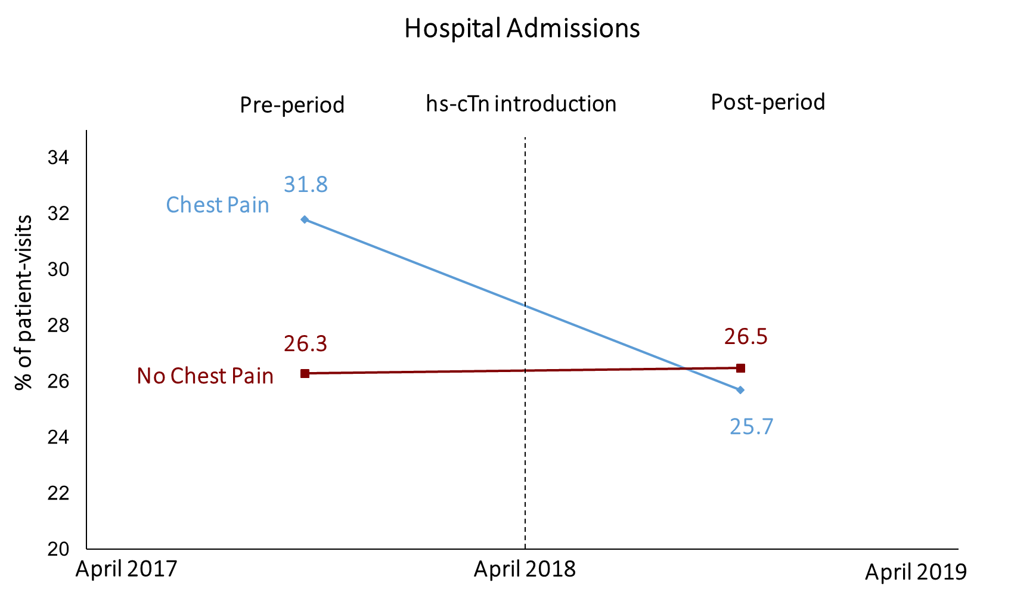
Troponin Testing During ED Visits: MGB
Chest pain patients received net fewer stress tests, cardiac catheterizations, cardiology evaluations, hospital admissions
Ganguli I, et al. J Am Coll Cardiol. 2021;77:3171-3179.
Notes:
But when we drilled down into specific cascade events, we found that they received net fewer stress tests, catheterizations, cardiology evaluations, and hospital admissions – in other words, the more costly or invasive cascade events, which suggests that the new assay may actually have net benefit in streamlining the cascades. This graph shows how hospital admissions dropped specifically for the chest pain patients, resulting in a net decrease Ganguli I, Cui J, Thakore N, Orav EJ, Januzzi JL, Baugh CW, Sequist TD, Wasfy JH. Downstream Cascades of Care Following High-Sensitivity Troponin Test Implementation. J Am Coll Cardiol. 2021 Jun 29;77(25):3171-3179. doi: 10.1016/j.jacc.2021.04.049. Epub 2021 May 3. PMID: 34167642; PMCID: PMC8091384.

Slide 25
The Transition to hs-cTn
PAST – CONTEMPORARY ASSAYS | PRESENT – HIGH-SENSITIVITY ASSAYS
Binary test: negative vs positive | Continuous biomarker: barometer of CV health
Delays in diagnosis due to prolonged sampling | Rapid diagnosis, most within 1-3 hours
More samples needed | Less samples needed
More analytical noise; more false positives. | Less analytical noise; less false positives.
More uncertainty about ‘low-risk’ which contributed to additional risk-stratification in ruled-out patients | Less uncertainty about ‘low-risk’ which reduces additional testing in ruled-out patients
No randomized trials | Multiple RCTs
Limited MI vs. no MI scope | Multiple applications, including emerging outpatient CV applications
Overall threshold, MI under-diagnosis in women | Sex-specific thresholds, improved diagnosis in women

Slide 26
Outline
Troponin biology
What exactly does “ultra-sensitive” mean?
Clinical uses
Caveats
Highly sensitive

Slide 27
Conclusions
Due in large part to refinements in assay technology, high sensitivity assays are now widely available globally
A standard “rule out” MI protocol may be performed using a single sample, or a 0-1H or 0-3H sampling approach.
Troponin testing should ALWAYS be done with the clinical picture kept fully in mind and used in the context of the Universal Definition of MI.
Myocardial injury is common, and should ALWAYS be contextualized: Is it an MI? Is it due to some other cause?

Slide 28
Diagnosing Myocardial Infarction in the Era of Ultrasensitive Troponins
James L. Januzzi Jr, MD, FACC, FESC
Hutter Family Professor of Medicine, Harvard Medical School
Director GDMT Clinic, Massachusetts General Hospital
Chief Scientific Officer and Gibson Chair, Baim Institute for Clinical Research
Deputy Editor, Journal of the American College of Cardiology
Boston, Massachussetts
Highly sensitive
Notes:
Timecode:

Slide 29
Exploring Chronic Coronary Artery Disease: Latest Guidelines and Implications
Marc P. Bonaca, MD, MPH
Director of Vascular Research
Professor of Medicine, Cardiovascular Division
University of Colorado School of Medicine
William R. Hiatt Endowed Chair in Cardiovascular Research
Executive Director
CPC Clinical Research and Community Health
Aurora, Colorado
Notes:
Timecode:

Slide 30
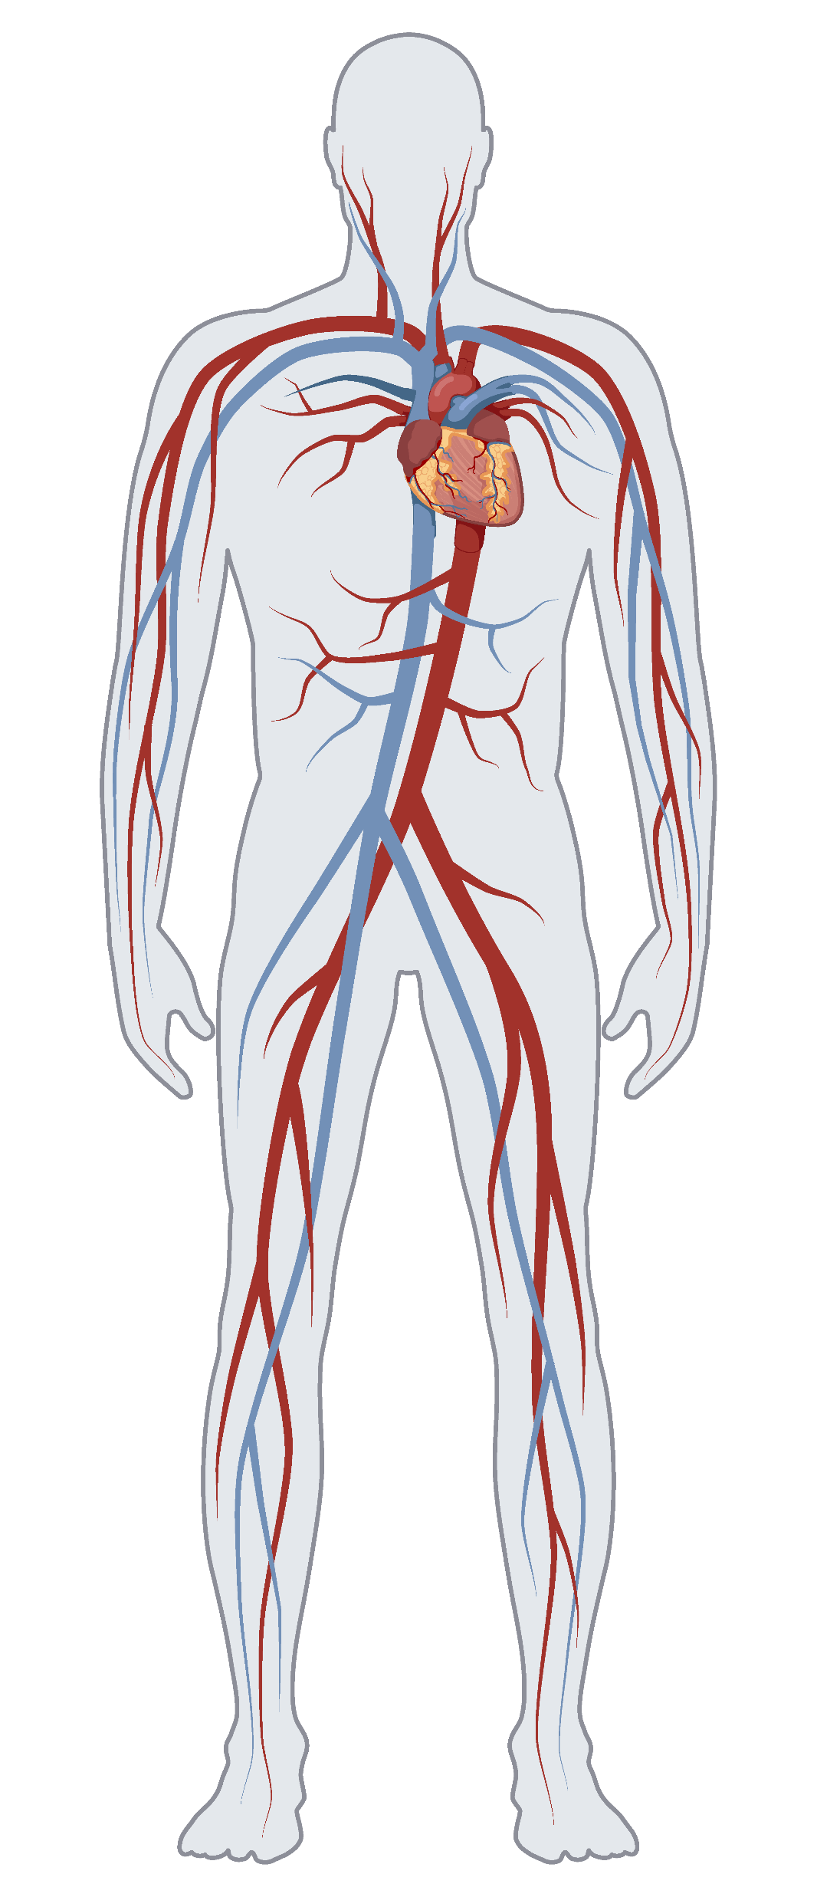



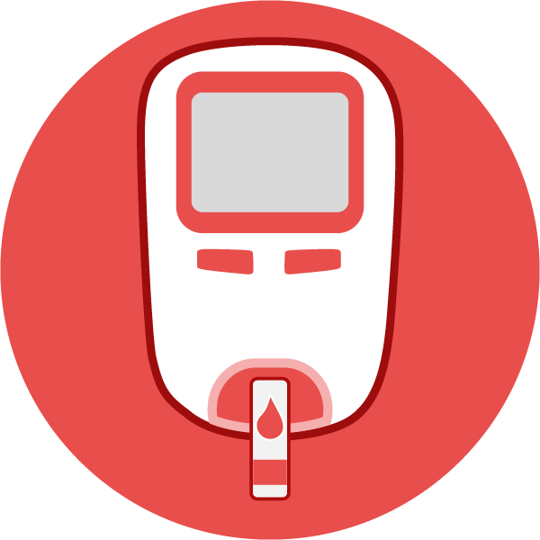



Axes of Risk and Treatment Targets in CAD
Foundational Components
Exercise, diet, weight loss, smoking cessation, annual flu shot, COVID-19 vaccination, pneumococcal (2a)
Lipid Risk
(LDL and Lpa)
High intensity statin +/- ezetimibe and PCSK9i, icosapent ethyl
Thrombosis
Antiplatelet therapy
Rivaroxaban
Blood Pressure
BP Target, β-blockers and ACEi/ARB for specific patients
Diabetes Risk (micro and macrovascular)
GLP1a/SGLTi
Glycemic targets per GL
Symptom Management
Nitrates
Ranolazine
© Medscape, LLC
Obesity Risk
GLP1a
Inflammatory Risk
Colchicine
ACEi, Angiotensin-converting enzyme inhibitor; ARB, angiotensin receptor blockers; BP, blood pressure; GLP1, glucagon-like peptide 1 agonists; Lpa, lipoprotein a; SGLT, sodium-glucose co-transporters.
Slide courtesy of Marc P. Bonaca, MD, MPH.

Slide 31
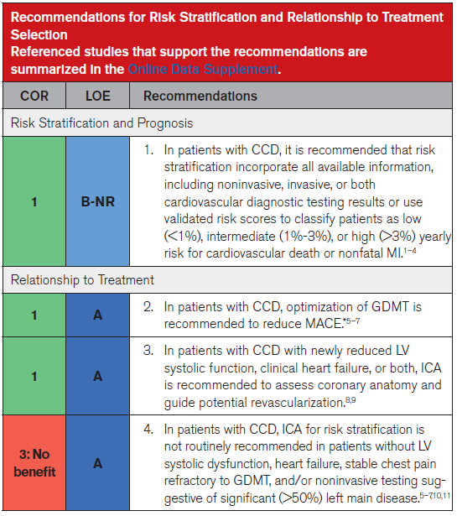
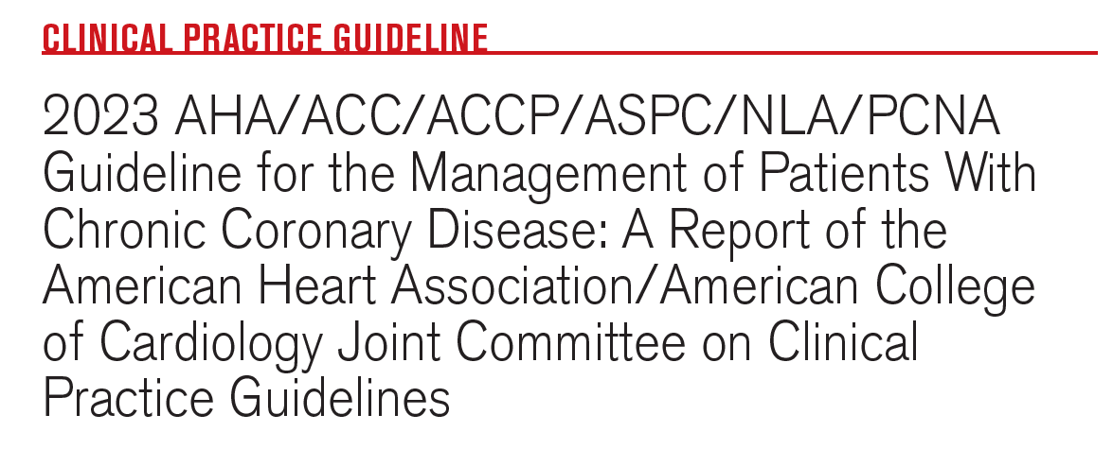
Guidelines
Social determinants, age, sex, comorbidities, advanced atherosclerosis, non-invasive testing, biomarkers
CCD, chronic coronary disease; GDMT, guideline-directed medical therapy;
ICA, Invasive coronary angiography.
Virani SS, et al. Circulation. 2023;148:e9-e119.
Notes:
3.2
Virani SS, Newby LK, Arnold SV, Bittner V, Brewer LC, Demeter SH, Dixon DL, Fearon WF, Hess B, Johnson HM, Kazi DS, Kolte D, Kumbhani DJ, LoFaso J, Mahtta D, Mark DB, Minissian M, Navar AM, Patel AR, Piano MR, Rodriguez F, Talbot AW, Taqueti VR, Thomas RJ, van Diepen S, Wiggins B, Williams MS. 2023 AHA/ACC/ACCP/ASPC/NLA/PCNA Guideline for the Management of Patients With Chronic Coronary Disease: A Report of the American Heart Association/American College of Cardiology Joint Committee on Clinical Practice Guidelines. Circulation. 2023 Aug 29;148(9):e9-e119. doi: 10.1161/CIR.0000000000001168. Epub 2023 Jul 20. Erratum in: Circulation. 2023 Sep 26;148(13):e148. Erratum in: Circulation. 2023 Dec 5;148(23):e186. PMID: 37471501.

Slide 32
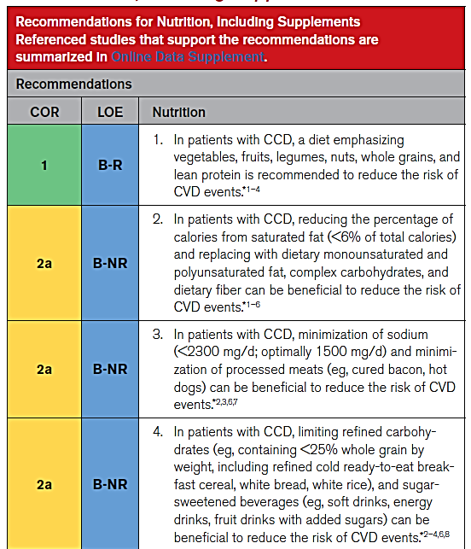
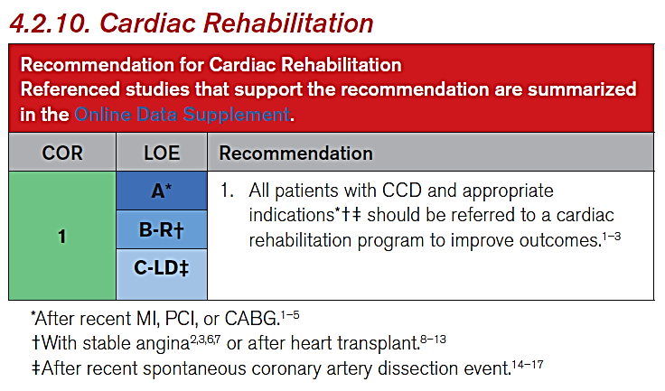
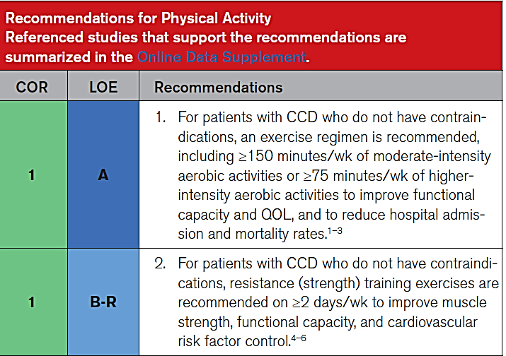
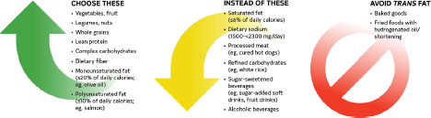
Nutrition and Exercise
ASCVD, atherosclerotic cardiovascular disease. Virani SS, et al. Circulation. 2023;148:e9-e119.

Slide 33
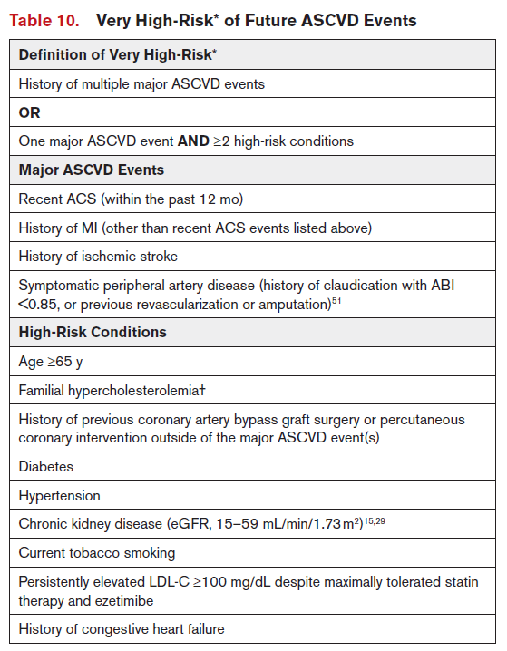
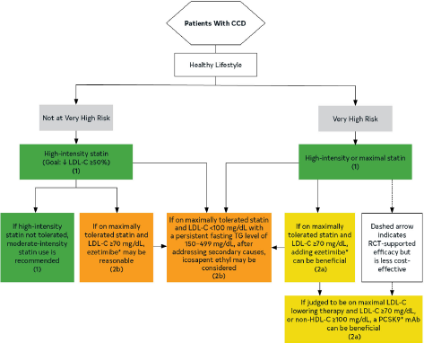
Cholesterol Management
ABI, ankle-brachial index; eGFR, estimated glomerular filtration rate.
Virani SS, et al. Circulation. 2023;148:e9-e119.

Slide 34
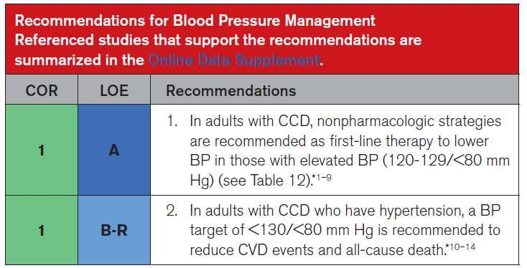
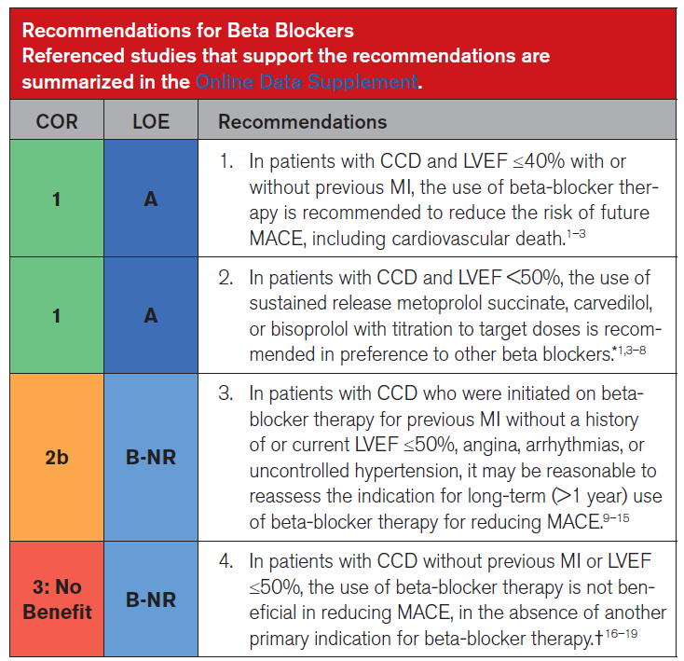
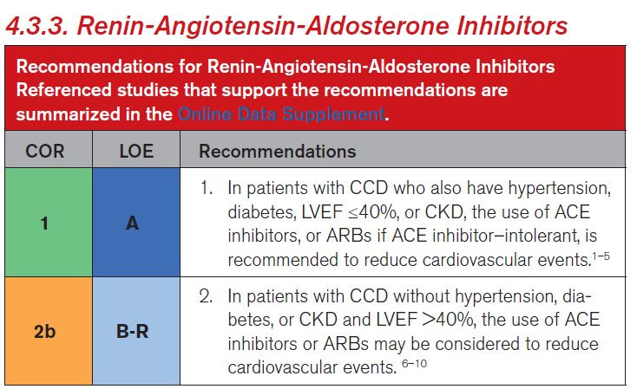
Blood Pressure Management
Virani SS, et al. Circulation. 2023;148:e9-e119.

Slide 35
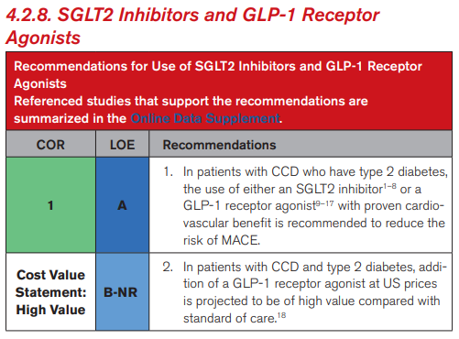
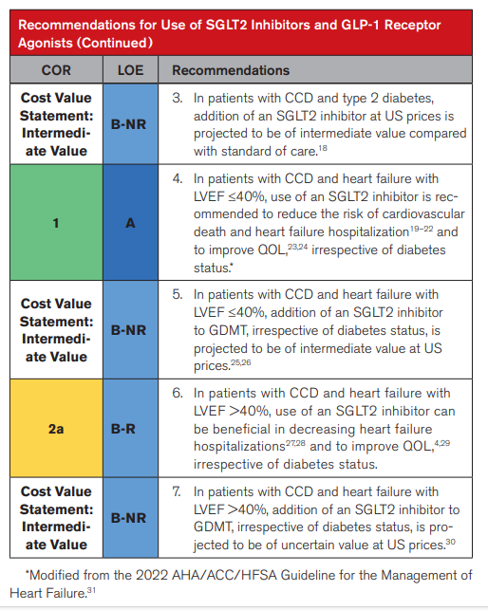
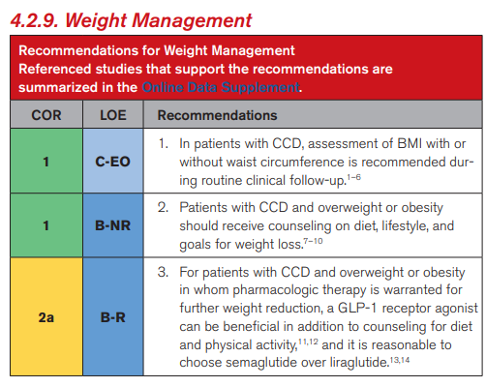
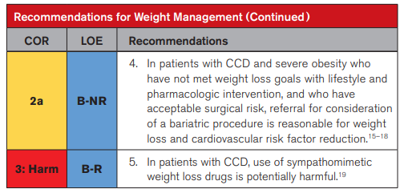
Role of SGLT2i and GLP-1RA in CCD
Virani SS, et al. Circulation. 2023;148:e9-e119.

Slide 36
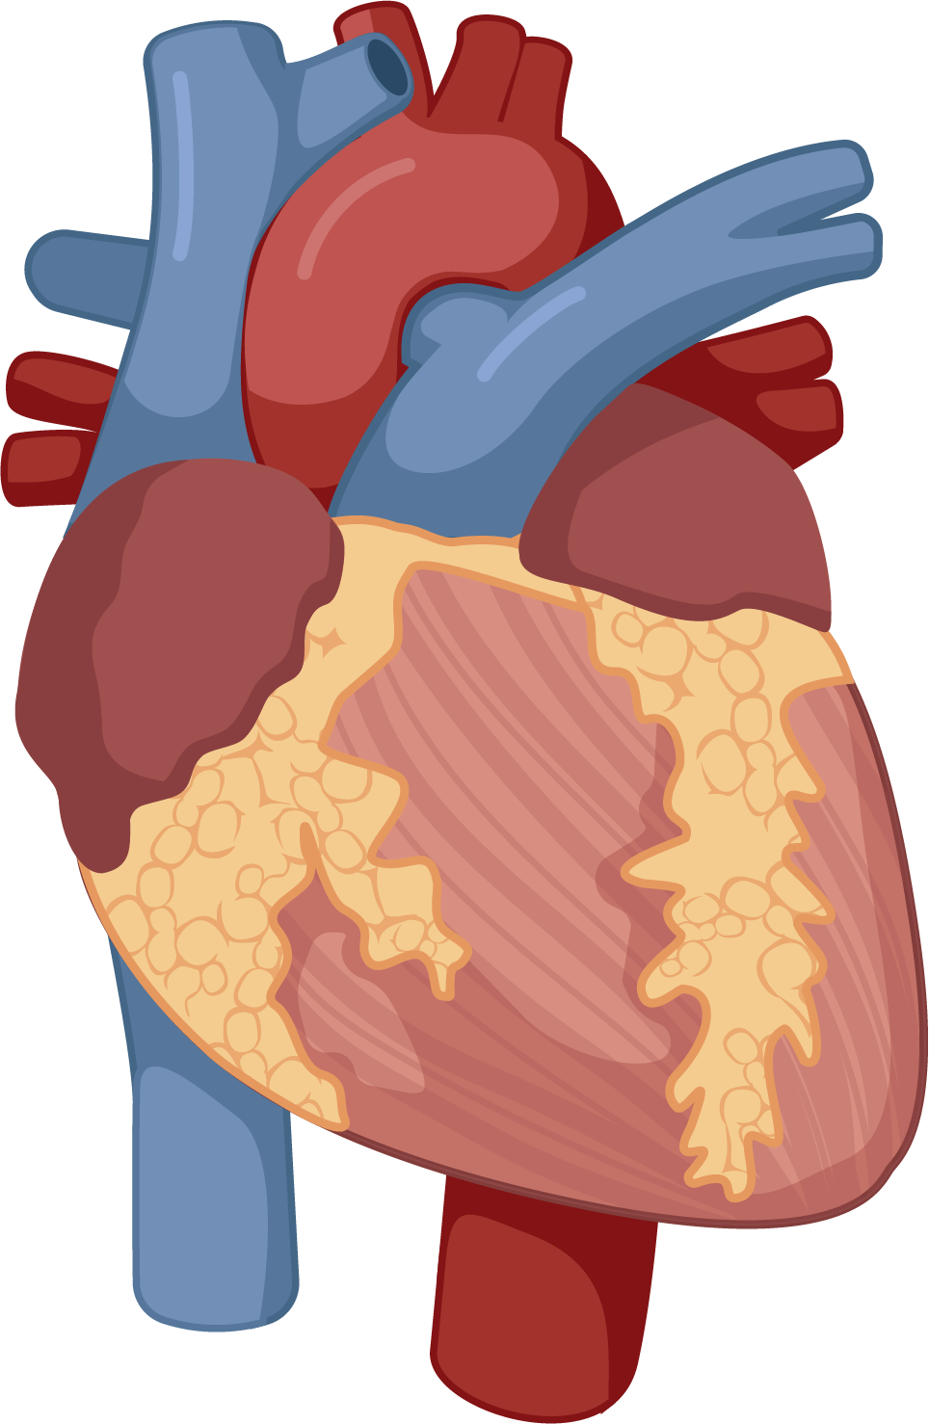

Role of Colchicine in CCD
Colchicine in patients with chronic coronary disease
Multicenter, double-blind, randomized, controlled trial
0.5 mg daily
[1]
Patients were not eligible if they had moderate-to-severe renal impairment, severe heart failure, severe valvular heart disease, or known side effects from colchicine.
© Medscape, LLC
5522
Patients with
chronic coronary disease
Colchicine (0.5 mg/day)
Placebo
N=2762
N=2760
Cardiovascular death,
Spontaneous MI,
Ischemic stroke, or
coronary revascularization
6.8%
9.6%
Recommendation for Colchicine
HR, 0.69; 95% CI, 0.57 to 0.83; P < 0.001
COR
LOE
Recommendation
Death from
noncardiovascular causes
0.7 events
Per 100 person-yr
0.5 events
Per 100 person-yr
2b
B-R
In patients with CCD, the addition of colchicine for secondary prevention may be considered to reduce recurrent ASCVD events
Lower risk of cardiovascular events for patients receiving colchicine
2023 AHA/ACC/ACCP/ASPC/NLA/PCNA Guideline for the Management of Patients With Chronic Coronary Disease: A Report of the American Heart Association/American College of Cardiology Joint Committee on Clinical Practice Guidelines
1. Nidorf SM, et al. N Engl J Med. 2020; 383:1838-1847; 2. Virani SS, et al. Circulation. 2023;148:e9-e119.
Notes:
Nidorf SM, Fiolet ATL, Mosterd A, Eikelboom JW, Schut A, Opstal TSJ, The SHK, Xu XF, Ireland MA, Lenderink T, Latchem D, Hoogslag P, Jerzewski A, Nierop P, Whelan A, Hendriks R, Swart H, Schaap J, Kuijper AFM, van Hessen MWJ, Saklani P, Tan I, Thompson AG, Morton A, Judkins C, Bax WA, Dirksen M, Alings M, Hankey GJ, Budgeon CA, Tijssen JGP, Cornel JH, Thompson PL; LoDoCo2 Trial Investigators. Colchicine in Patients with Chronic Coronary Disease. N Engl J Med. 2020 Nov 5;383(19):1838-1847. doi: 10.1056/NEJMoa2021372. Epub 2020 Aug 31. PMID: 32865380.

Slide 37
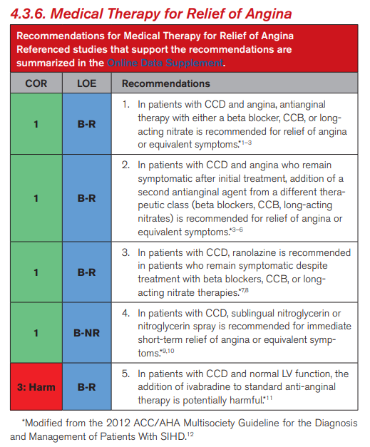

Anti-Anginal Therapy
Summary/Conclusions
ORBITA-2 proves that PCI relieves angina in symptomatic patients with chronic coronary disease and is safe
Results align with with our understanding of the biology and pathophysiology of angina
Patient/Provider Shared Decision-making
Minimal symptoms,
Tolerating antianginal therapies
Symptomatic, unable/unwilling to take antianginal therapies
PCI unlikely to make patients feel better
© Medscape, LLC
PCI can improve health status
Virani SS, et al. Circulation. 2023;148:e9-e119.

Slide 38
Recent Data and Controversies
LDL – How low should you go?
Does colchicine work after MI?
MRA after MI?
Beta-blockers after MI?
Cardiometabolic disease
SGLT2i after MI
GLP1ra in ASCVD without T2DM
Antithrombotic therapy – DAPT, DPI, or AP monotherapy
Notes:
Reference
American Heart Association. Heart Disease and Stroke Statistics—2006 Update. Dallas, Tex: American Heart Association; 2006.

Slide 39
Treatment Goals for LDL-C Across Categories of Total CVD Risk
ESC Prevention Guidelines 2019
Stage 2
CKD, chronic kidney disease; FH, familial hypercholesterolemia T1DM, type 1 diabetes mellitus; TC, total cholesterol.
Mach F, et al. Eur Heart J. 2020;41:111-188.
Notes:
Mach F, Baigent C, Catapano AL, Koskinas KC, Casula M, Badimon L, Chapman MJ, De Backer GG, Delgado V, Ference BA, Graham IM, Halliday A, Landmesser U, Mihaylova B, Pedersen TR, Riccardi G, Richter DJ, Sabatine MS, Taskinen MR, Tokgozoglu L, Wiklund O; ESC Scientific Document Group. 2019 ESC/EAS Guidelines for the management of dyslipidaemias: lipid modification to reduce cardiovascular risk. Eur Heart J. 2020 Jan 1;41(1):111-188. doi: 10.1093/eurheartj/ehz455. Erratum in: Eur Heart J. 2020 Nov 21;41(44):4255. PMID: 31504418.

Slide 40
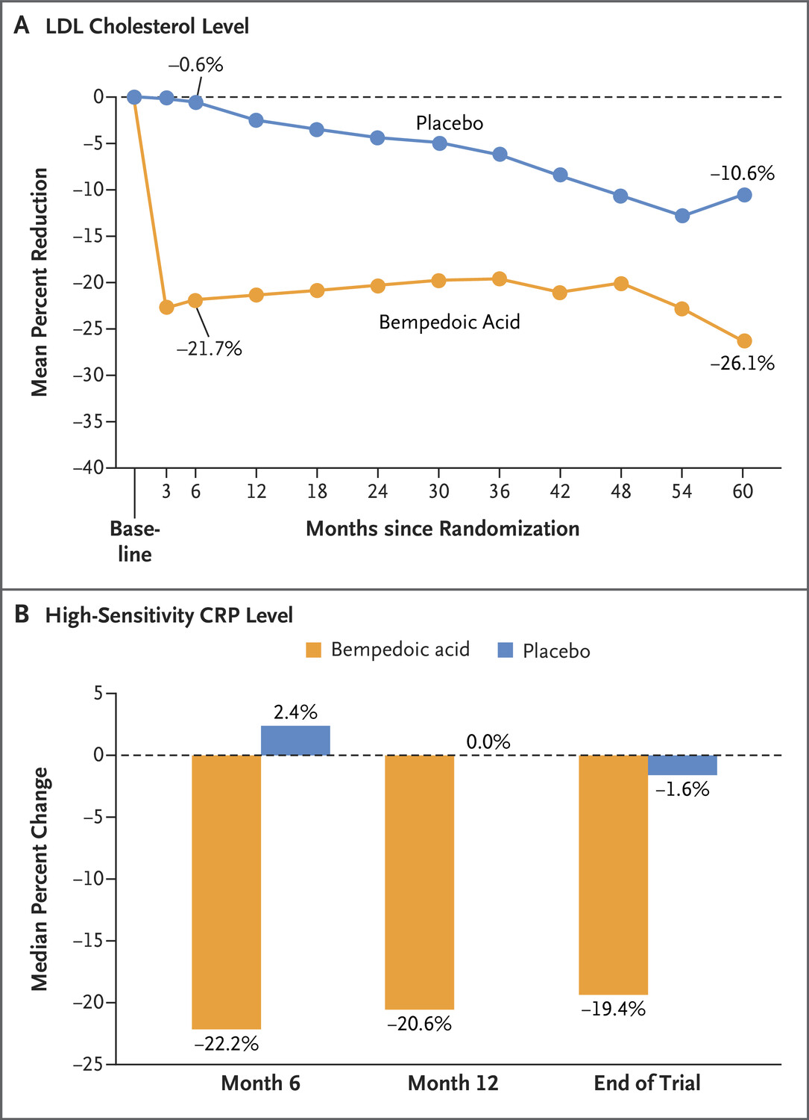
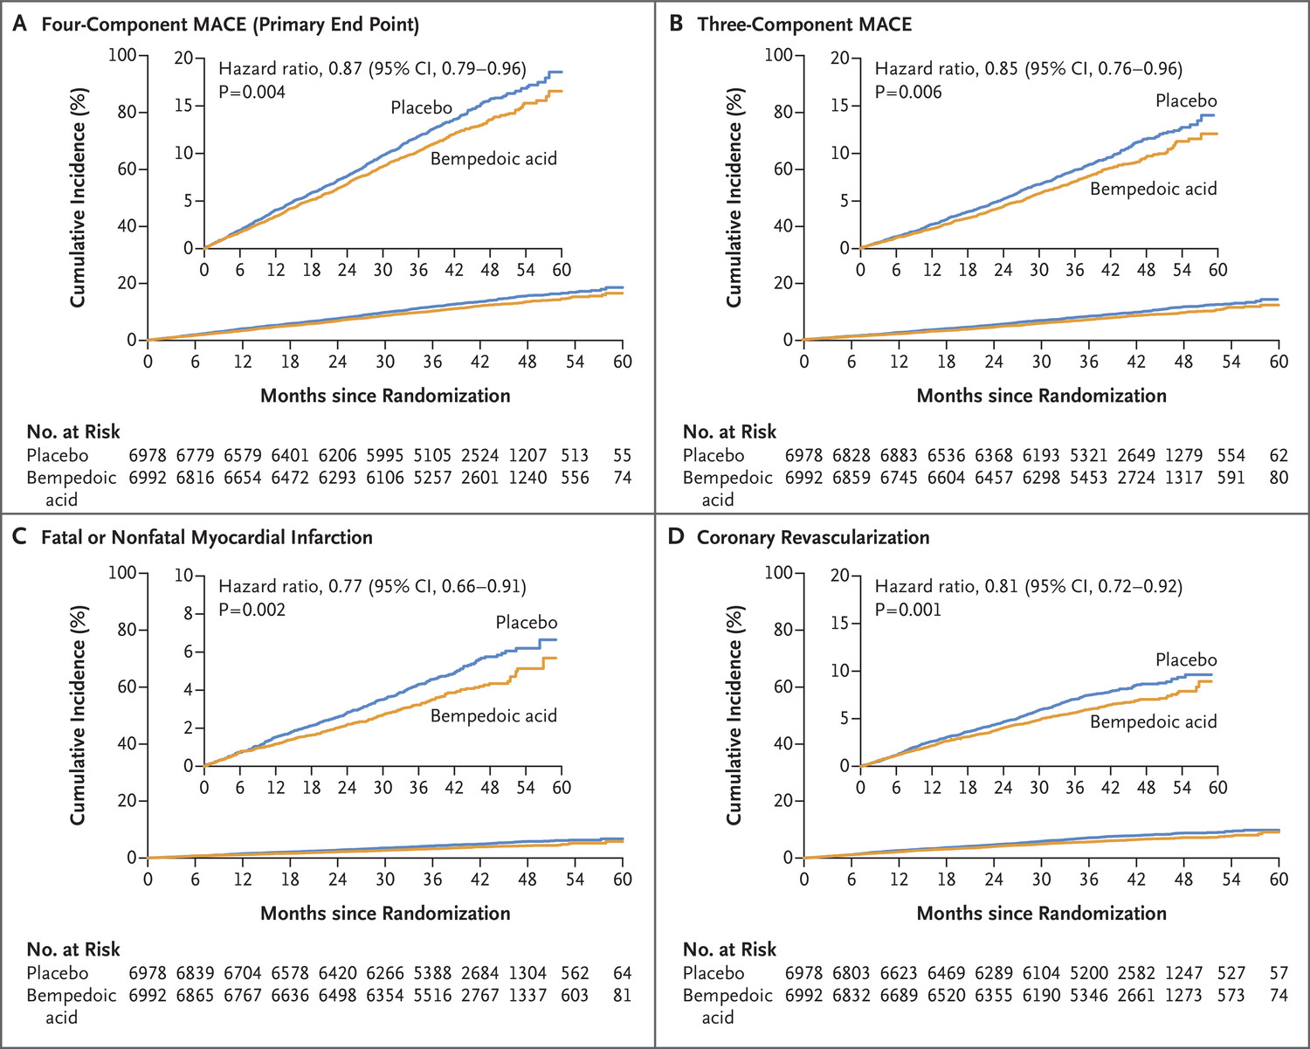
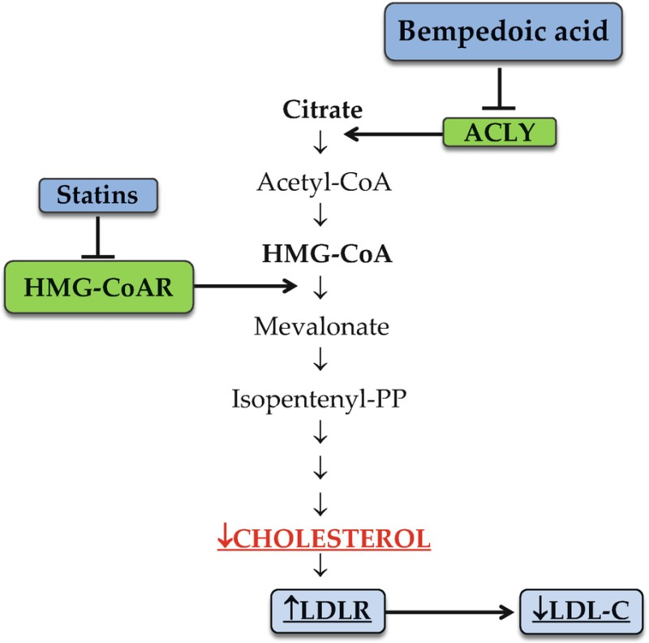
Clear Outcomes -- Bempedoic Acid
Event | Bempedoic Acid | Placebo
Serious Adverse Event | 25.2% | 24.9%
Hepatic | 4.5% | 3.0%
Renal | 11.5% | 8.6%
Myalgia | 5.6% | 6.8%
Gout | 3.1% | 2.1%
Oral – alone or in combination with ezetimibe and/or statins
Well tolerated & does not increase HbA1C or incidence of new onset T2DM
Pirillo A, et al. LDL-Cholesterol-Lowering Therapy. In: von Eckardstein A, et al. Springer; 2022. Accessed February 4, 2025. https://www.ncbi.nlm.nih.gov/books/NBK584301/ Nissen SE, et al. N Engl J Med. 2023;388:1353-1364.
Notes:
Pirillo A, Norata GD, Catapano AL. LDL-Cholesterol-Lowering Therapy. 2020 Apr 30. In: von Eckardstein A, Binder CJ, editors. Prevention and Treatment of Atherosclerosis: Improving State-of-the-Art Management and Search for Novel Targets [Internet]. Cham (CH): Springer; 2022
Nissen SE, Lincoff AM, Brennan D, Ray KK, Mason D, Kastelein JJP, Thompson PD, Libby P, Cho L, Plutzky J, Bays HE, Moriarty PM, Menon V, Grobbee DE, Louie MJ, Chen CF, Li N, Bloedon L, Robinson P, Horner M, Sasiela WJ, McCluskey J, Davey D, Fajardo-Campos P, Petrovic P, Fedacko J, Zmuda W, Lukyanov Y, Nicholls SJ; CLEAR Outcomes Investigators. Bempedoic Acid and Cardiovascular Outcomes in Statin-Intolerant Patients. N Engl J Med. 2023 Apr 13;388(15):1353-1364. doi: 10.1056/NEJMoa2215024. Epub 2023 Mar 4. PMID: 36876740.

Slide 41
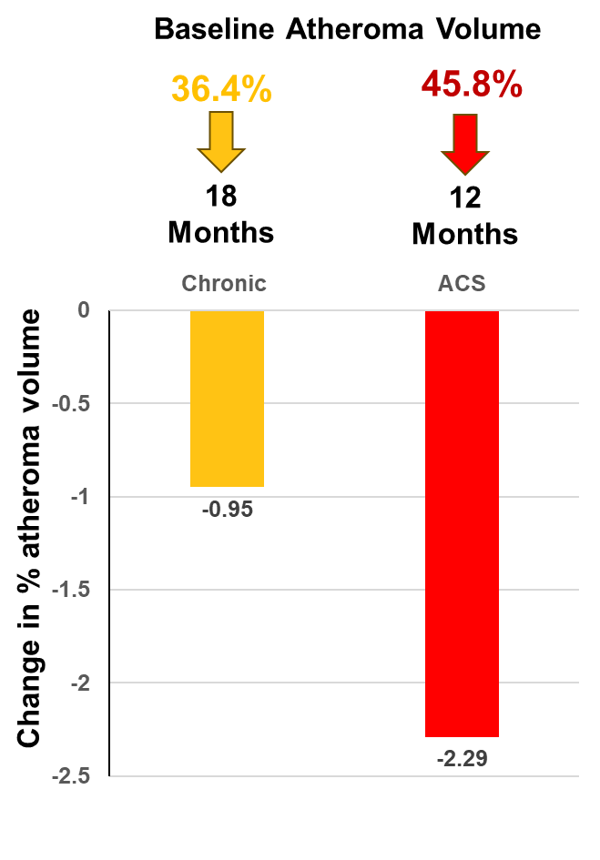
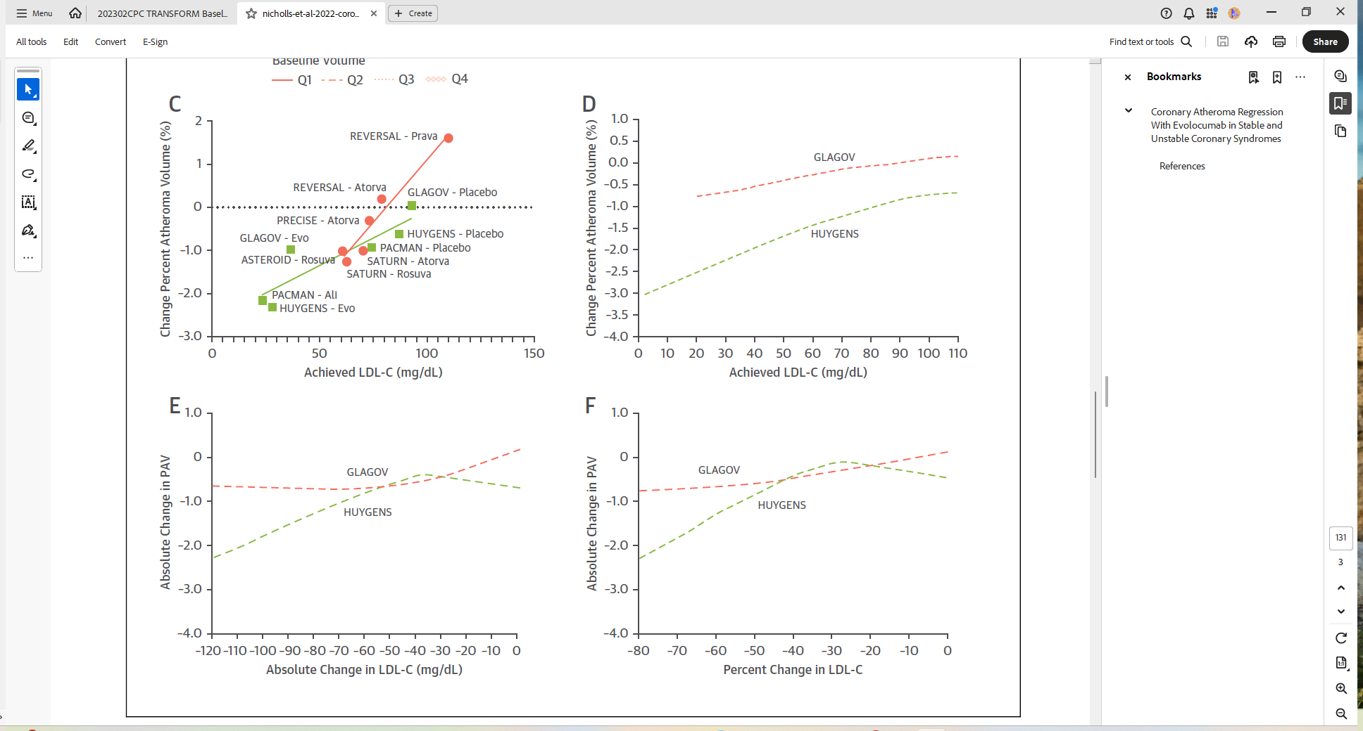
Are Plaque Changes With PCSK9 Inhibitors Different in the Chronic and ACS Settings?
“More biologically active form of disease may be more amenable to regression”
Nicholls SJ, et al. JACC Cardiovasc Imaging. 2023;16:130-132.
Notes:
Nicholls SJ, Kataoka Y, Nissen SE, Prati F, Windecker S, Puri R, Hucko T, Aradi D, Herrman JR, Hermanides RS, Wang B, Wang H, Butters J, Giovanni GD, Jones S, Pompili G, Wolski K, Psaltis PJ. Coronary Atheroma Regression With Evolocumab in Stable and Unstable Coronary Syndromes. JACC Cardiovasc Imaging. 2023 Jan;16(1):130-132. doi: 10.1016/j.jcmg.2022.07.020. Epub 2022 Nov 16. PMID: 36599559.

Slide 42
Plaque Optimization Prior to PCI?
Kataoka T, et al. Atherosclerosis. 2024;399:118581.
Notes:
Kataoka T, Morishita T, Uzui H, Sato Y, Shimizu T, Miyoshi M, Yamaguchi J, Shiomi Y, Ikeda H, Tama N, Hasegawa K, Ishida K, Tada H. Very short-term effects of a single dose of a proprotein convertase subtilisin/kexin 9 inhibitor before percutaneous coronary intervention: A single-arm study. Atherosclerosis. 2024 Dec;399:118581. doi: 10.1016/j.atherosclerosis.2024.118581. Epub 2024 Sep 2. PMID: 39277430.

Slide 43
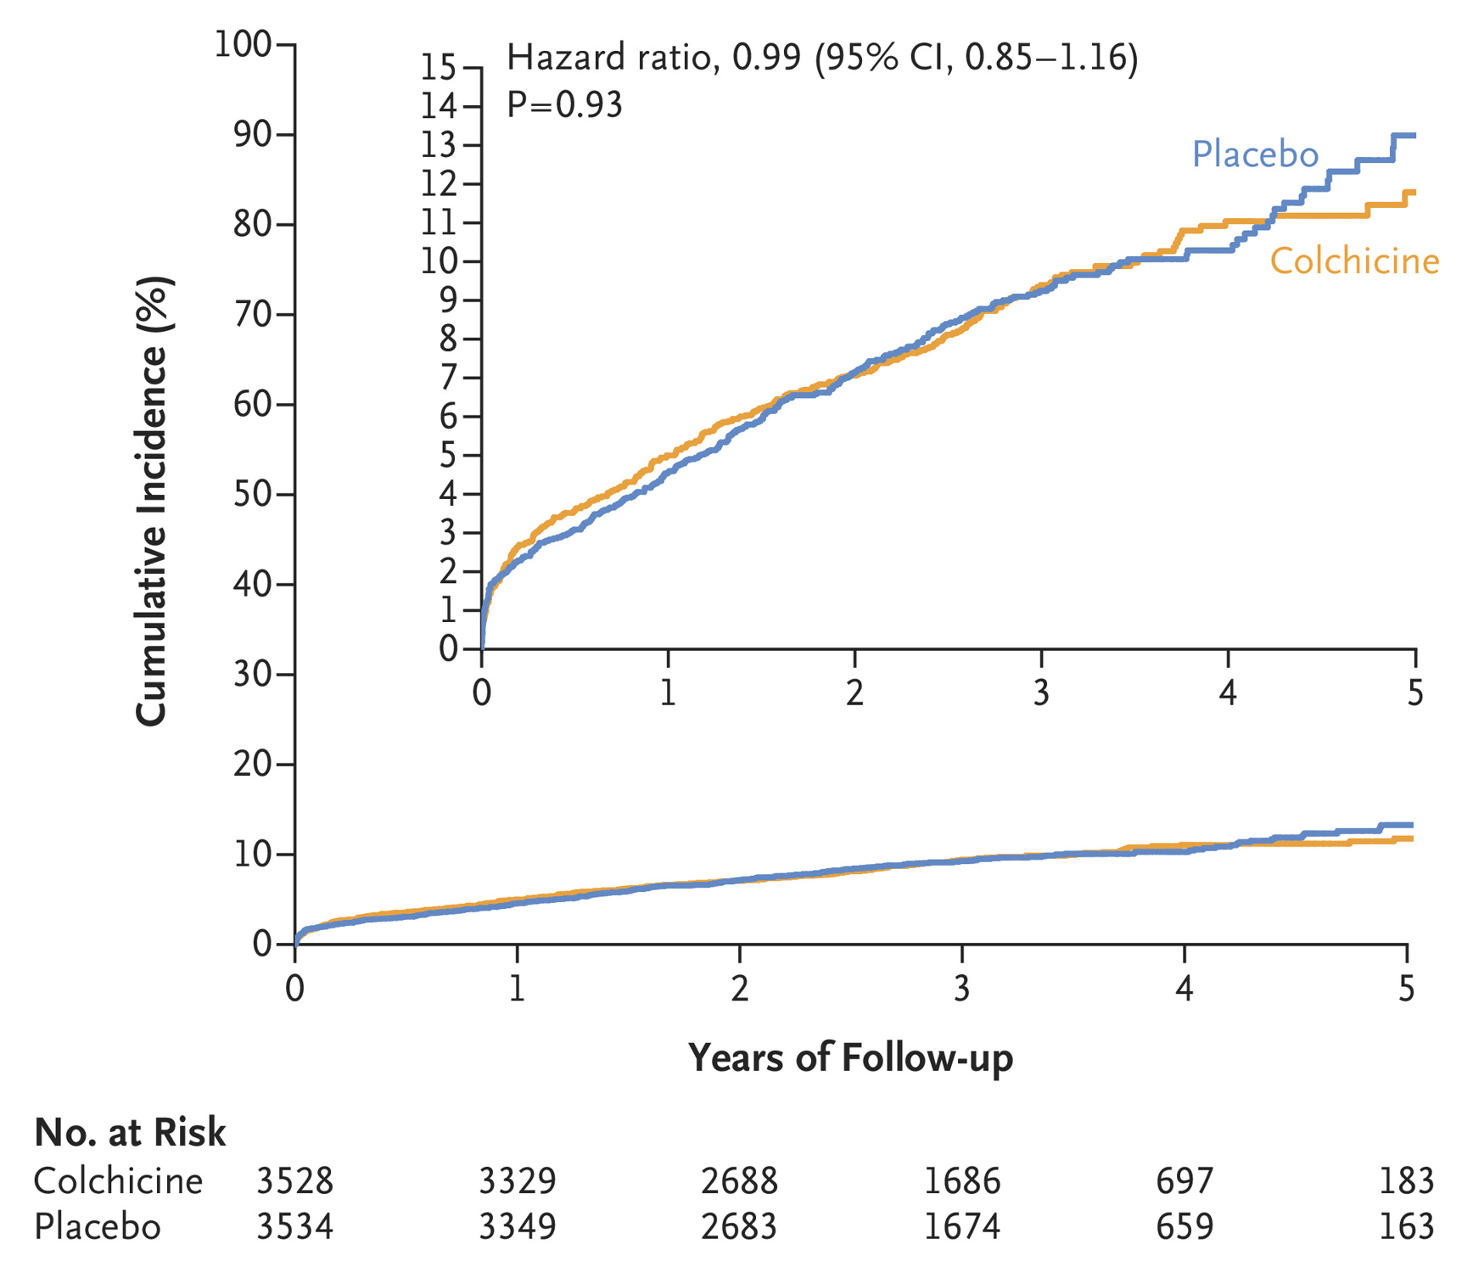
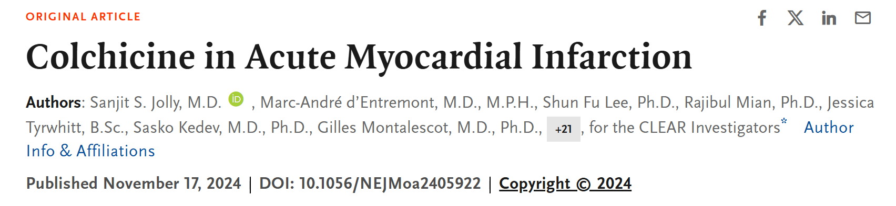
Clear Synergy -- Colchicine
7062 patients with AMI treated with primary PCI
Primary endpoint CVD, MI, stroke, unplanned ischemia driven revasc
2x2 factorial with colchicine and spironolactone
Median follow up 3 years
Change in hsCRP -1.28 mg/L (-1.81; -0.75)
43
Jolly SS, et al. N Engl J Med. 2024. doi: 10.1056/NEJMoa2405922. [Epub ahead of print.]
Notes:
Jolly SS, d'Entremont MA, Lee SF, Mian R, Tyrwhitt J, Kedev S, Montalescot G, Cornel JH, Stanković G, Moreno R, Storey RF, Henry TD, Mehta SR, Bossard M, Kala P, Layland J, Zafirovska B, Devereaux PJ, Eikelboom J, Cairns JA, Shah B, Sheth T, Sharma SK, Tarhuni W, Conen D, Tawadros S, Lavi S, Yusuf S; CLEAR Investigators. Colchicine in Acute Myocardial Infarction. N Engl J Med. 2024 Nov 17. doi: 10.1056/NEJMoa2405922. Epub ahead of print. PMID: 39555823.

Slide 44
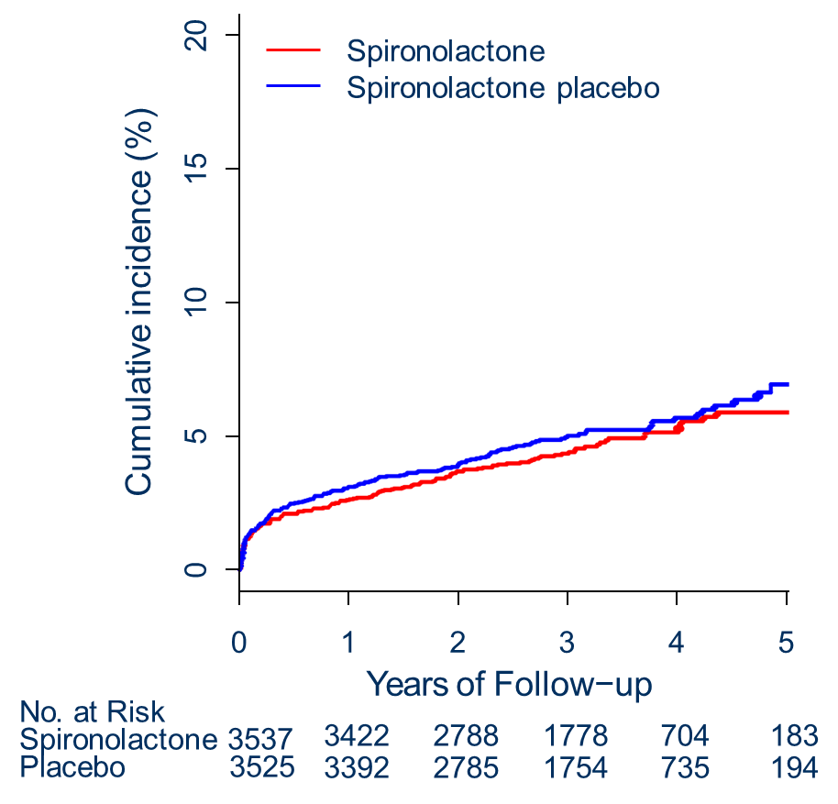
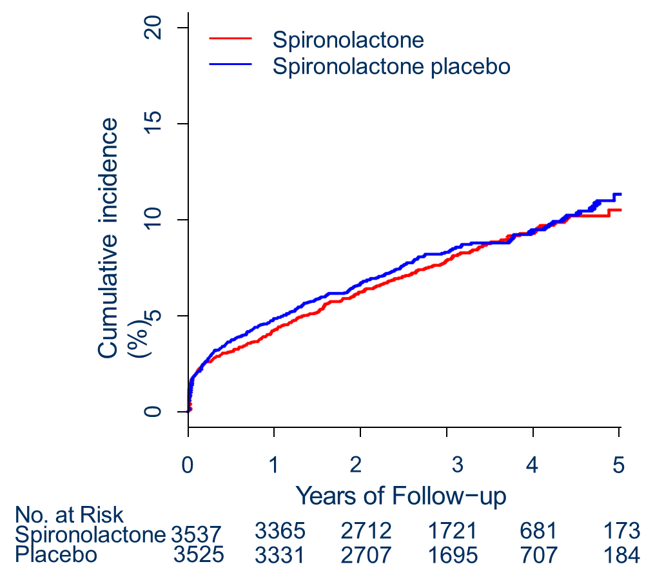
Clear Synergy -- Spironolactone
CV Death, MI, Stroke or New or Worsening Heart Failure
HR 0.95
95% CI 0.80, 1.12
P = .52
574 events
CV Death or New or Worsening Heart Failure
HR 0.89
95% CI 0.73, 1.08
P = .23
403 events
Spironolactone
Spironolactone placebo
Jolly SS, et al. N Engl J Med. 2024. doi: 10.1056/NEJMoa2405923. [Epub ahead of print.]
Notes:
Jolly SS, d'Entremont MA, Pitt B, Lee SF, Mian R, Tyrwhitt J, Kedev S, Montalescot G, Cornel JH, Stanković G, Moreno R, Storey RF, Henry TD, Mehta SR, Bossard M, Kala P, Bhindi R, Zafirovska B, Devereaux PJ, Eikelboom J, Cairns JA, Natarajan MK, Schwalm JD, Sharma SK, Tarhuni W, Conen D, Tawadros S, Lavi S, Asani V, Topic D, Cantor WJ, Bertrand OF, Pourdjabbar A, Yusuf S; CLEAR investigators. Routine Spironolactone in Acute Myocardial Infarction. N Engl J Med. 2024 Nov 17. doi: 10.1056/NEJMoa2405923. Epub ahead of print. PMID: 39555814.

Slide 45
Estimated Annualized Event Rate in AMI Trials: PLACEBO ARMS
EPHESUS
AMI with LV dysfunction & HF
45% Revascularized
Pitt et al. NEJM 2003^{[1]}
PARADISE MI
AMI with LV dysfunction & HF
89% Revascularized
Pfeffer et al. NEJM 2021^{[2]}
EMPACT MI
AMI with LV dysfunction or HF
89% Revascularized
Butler et al. NEJM 2024^{[3]}
CLEAR SYNERGY
Large NSTEMI or STEMI for primary PCI
Jolly et al. AHA 2024^{[4]}
Rate at 1 Year
1. Pitt B, et al. N Engl J Med. 2003 Apr 3;348(14):1309-21. Erratum in: N Engl J Med. 2003 May 29;348(22):2271. PMID: 12668699; 2. Pfeffer MA, et al. N Engl J Med. 2021;385:1845-1855. Erratum in: N Engl J Med. 2021 Dec 30;385(27):2592; 3. Butler J, et al. N Engl J Med. 2024;390:1455-1466; 4. Jolly SS, et al. Presented at: the American Heart Association Scientific Sessions, Chicago, IL, November 17, 2024. Presentation.
Notes:
Pitt B, Remme W, Zannad F, Neaton J, Martinez F, Roniker B, Bittman R, Hurley S, Kleiman J, Gatlin M; Eplerenone Post-Acute Myocardial Infarction Heart Failure Efficacy and Survival Study Investigators. Eplerenone, a selective aldosterone blocker, in patients with left ventricular dysfunction after myocardial infarction. N Engl J Med. 2003 Apr 3;348(14):1309-21. doi: 10.1056/NEJMoa030207. Epub 2003 Mar 31. Erratum in: N Engl J Med. 2003 May 29;348(22):2271. PMID: 12668699.
Pfeffer MA, Claggett B, Lewis EF, Granger CB, Køber L, Maggioni AP, Mann DL, McMurray JJV, Rouleau JL, Solomon SD, Steg PG, Berwanger O, Cikes M, De Pasquale CG, East C, Fernandez A, Jering K, Landmesser U, Mehran R, Merkely B, Vaghaiwalla Mody F, Petrie MC, Petrov I, Schou M, Senni M, Sim D, van der Meer P, Lefkowitz M, Zhou Y, Gong J, Braunwald E; PARADISE-MI Investigators and Committees. Angiotensin Receptor-Neprilysin Inhibition in Acute Myocardial Infarction. N Engl J Med. 2021 Nov 11;385(20):1845-1855. doi: 10.1056/NEJMoa2104508. Erratum in: N Engl J Med. 2021 Dec 30;385(27):2592. doi: 10.1056/NEJMx210024. PMID: 34758252.
Butler J, Jones WS, Udell JA, Anker SD, Petrie MC, Harrington J, Mattheus M, Zwiener I, Amir O, Bahit MC, Bauersachs J, Bayes-Genis A, Chen Y, Chopra VK, Figtree G, Ge J, Goodman SG, Gotcheva N, Goto S, Gasior T, Jamal W, Januzzi JL, Jeong MH, Lopatin Y, Lopes RD, Merkely B, Parikh PB, Parkhomenko A, Ponikowski P, Rossello X, Schou M, Simic D, Steg PG, Szachniewicz J, van der Meer P, Vinereanu D, Zieroth S, Brueckmann M, Sumin M, Bhatt DL, Hernandez AF. Empagliflozin after Acute Myocardial Infarction. N Engl J Med. 2024 Apr 25;390(16):1455-1466. doi: 10.1056/NEJMoa2314051. Epub 2024 Apr 6. PMID: 38587237.
Jolly SS, et al. Presented at: the American Heart Association Scientific Sessions, Chicago, IL, November 17, 2024. Presentation

Slide 46
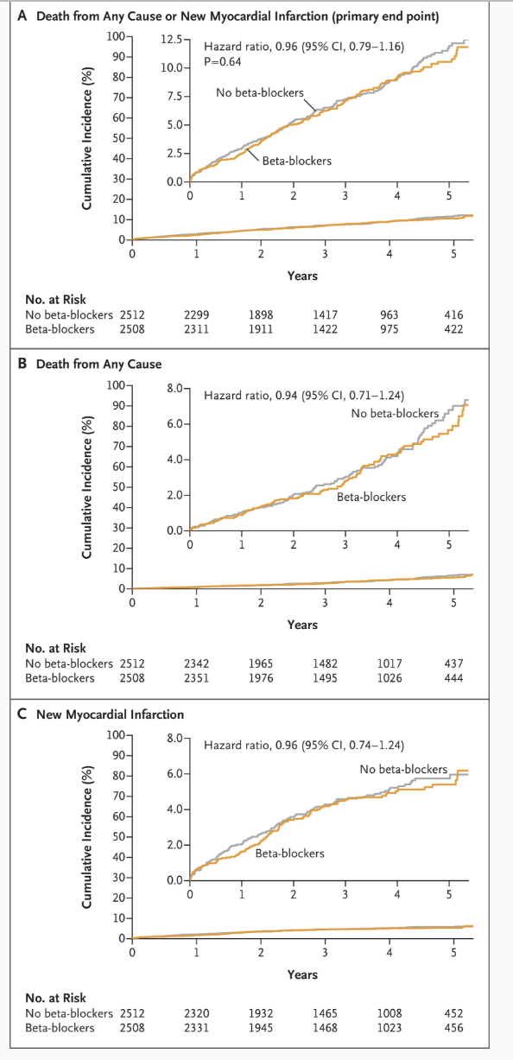
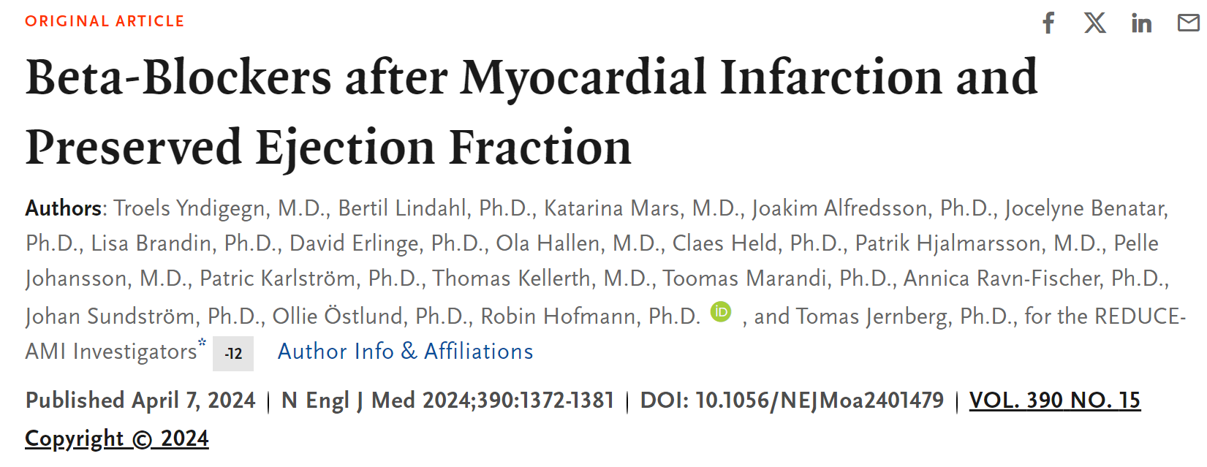
Beta-Blocker After MI
5020 patients with AMI and angiography/revascularization and EF ≥ 50%
Randomized at time of MI to BB vs no BB
Median follow up 3.5 years
No difference in mortality or recurrent MI
Yndigegn T, et al. N Engl J Med. 2024;390:1372-1381.
Notes:
Yndigegn T, Lindahl B, Mars K, Alfredsson J, Benatar J, Brandin L, Erlinge D, Hallen O, Held C, Hjalmarsson P, Johansson P, Karlström P, Kellerth T, Marandi T, Ravn-Fischer A, Sundström J, Östlund O, Hofmann R, Jernberg T; REDUCE-AMI Investigators. Beta-Blockers after Myocardial Infarction and Preserved Ejection Fraction. N Engl J Med. 2024 Apr 18;390(15):1372-1381. doi: 10.1056/NEJMoa2401479. Epub 2024 Apr 7. PMID: 38587241.

Slide 47
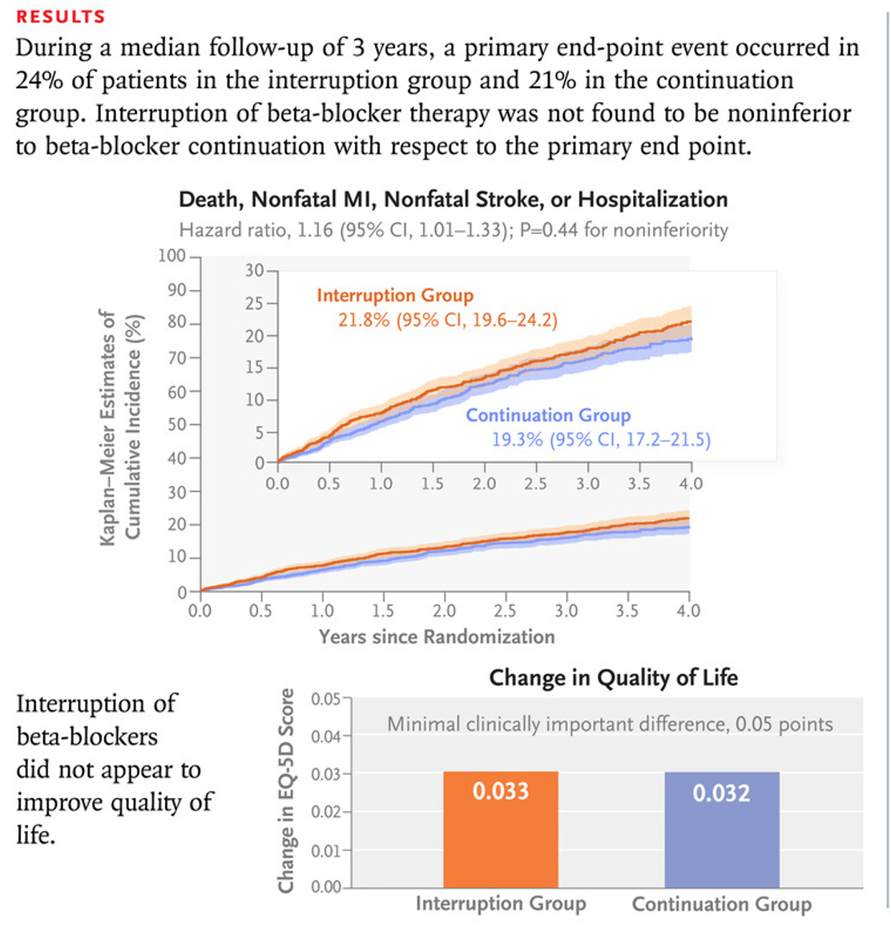
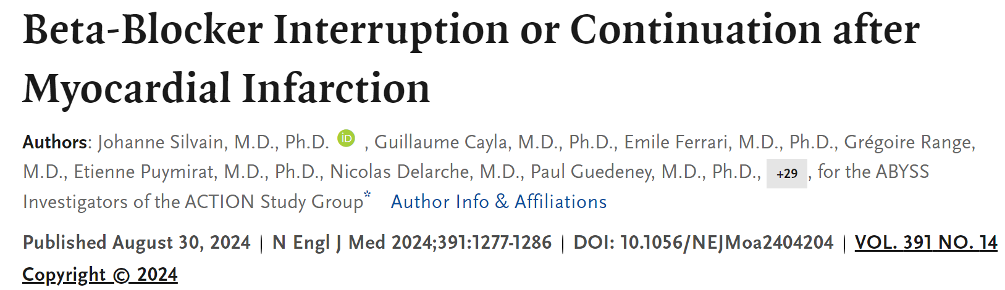
Beta-Blocker After MI… #2
3698 patients with EF ≥ 40% with history of MI (median 2.9 yrs ago)
Randomized to continuation vs withdrawal of beta-blocker
Not non-inferior for composite of death, nonfatal myocardial infarction, nonfatal stroke, or hospitalization for cardiovascular reasons
Silvain J, et al. N Engl J Med. 2024;391:1277-1286.
Notes:
Silvain J, Cayla G, Ferrari E, Range G, Puymirat E, Delarche N, Guedeney P, Cuisset T, Ivanes F, Lhermusier T, Petroni T, Lemesle G, Bresoles F, Labeque JN, Pommier T, Dillinger JG, Leclercq F, Boccara F, Lim P, Besseyre des Horts T, Fourme T, Jourda F, Furber A, Lattuca B, Redjimi N, Thuaire C, Deharo P, Procopi N, Dumaine R, Slama M, Payot L, El Kasty M, Aacha K, Diallo A, Vicaut E, Montalescot G; ABYSS Investigators of the ACTION Study Group. Beta-Blocker Interruption or Continuation after Myocardial Infarction. N Engl J Med. 2024 Oct 10;391(14):1277-1286. doi: 10.1056/NEJMoa2404204. Epub 2024 Aug 30. PMID: 39213187.

Slide 48
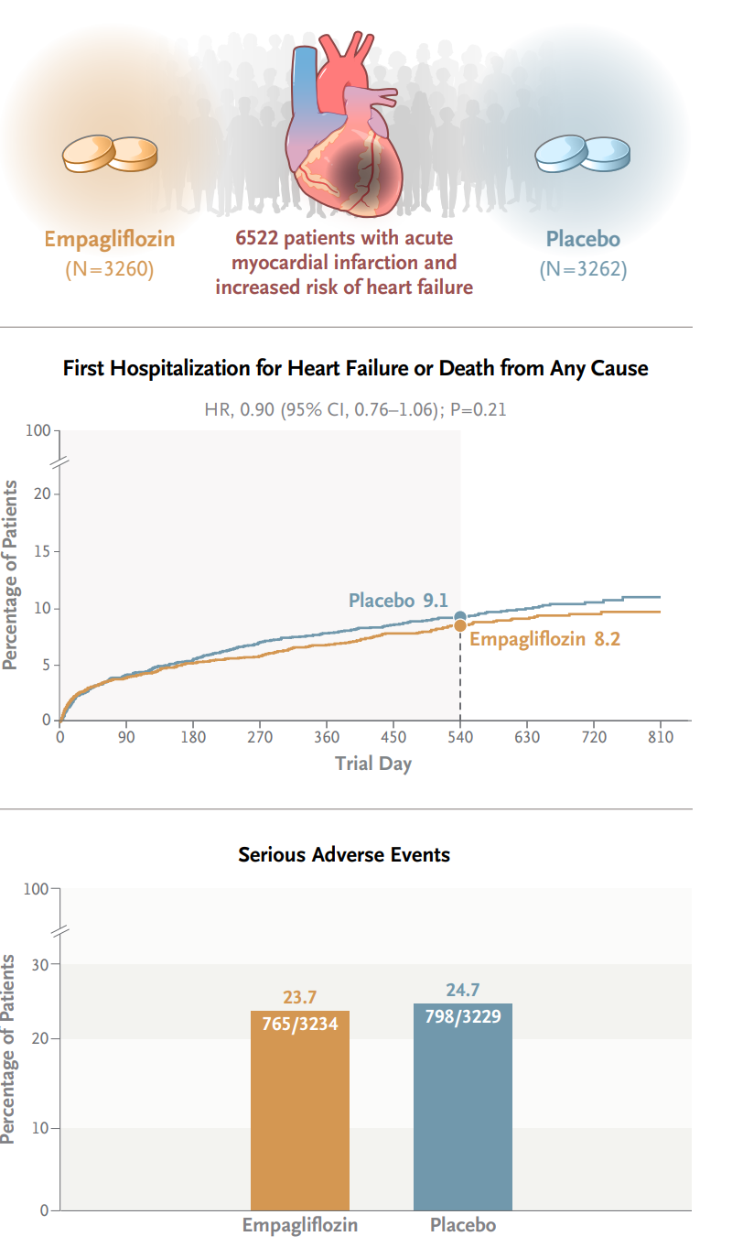
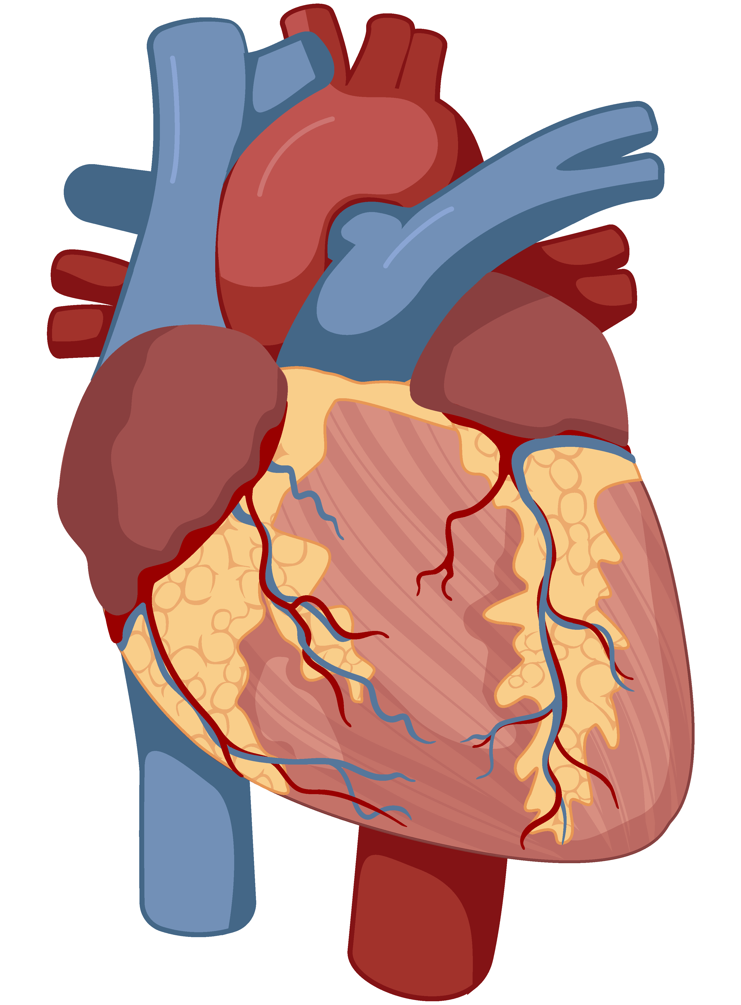

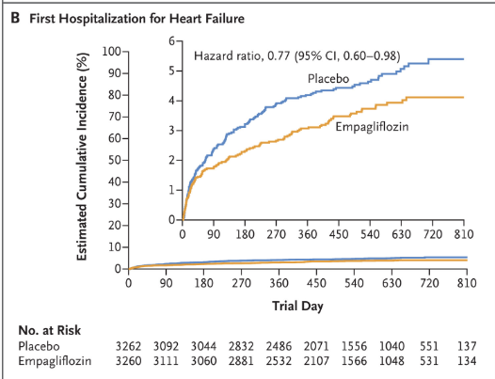
SGLT2i after Acute Myocardial Infarction
6522
Patients with acute MI
and increased risk of HF
Empagliflozin
N=3260
© Medscape, LLC
Placebo
N=3262
Butler J et al. DOI: 10.1056/NEJMoa2314051

Slide 49
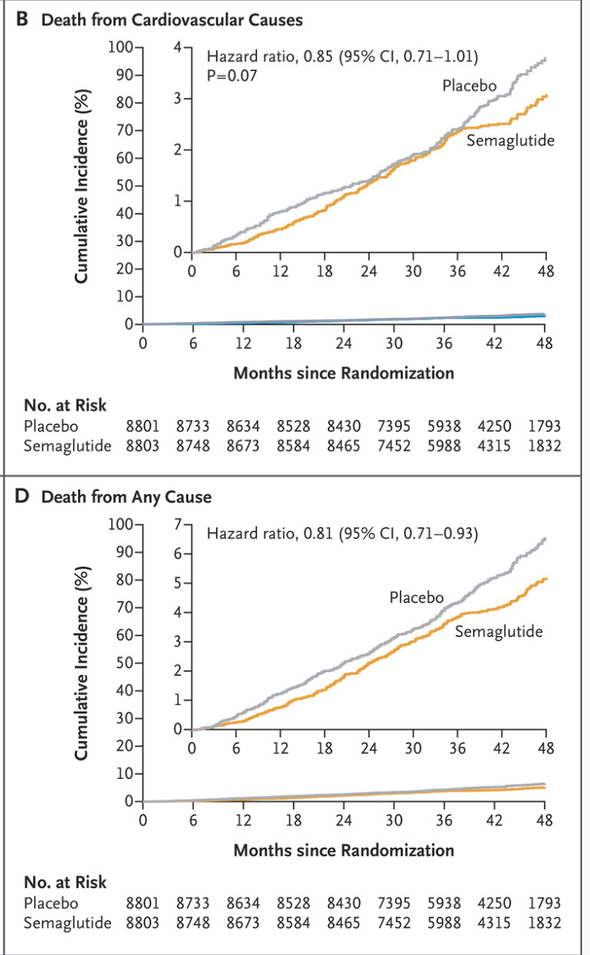
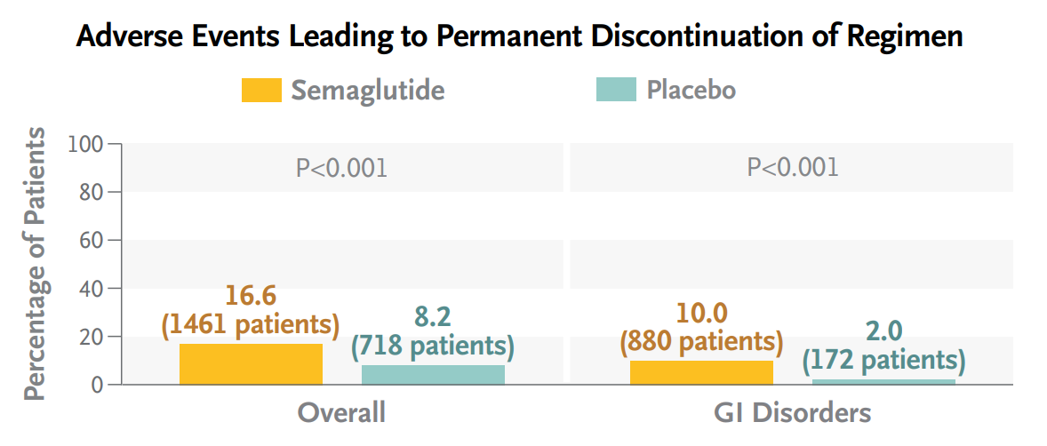


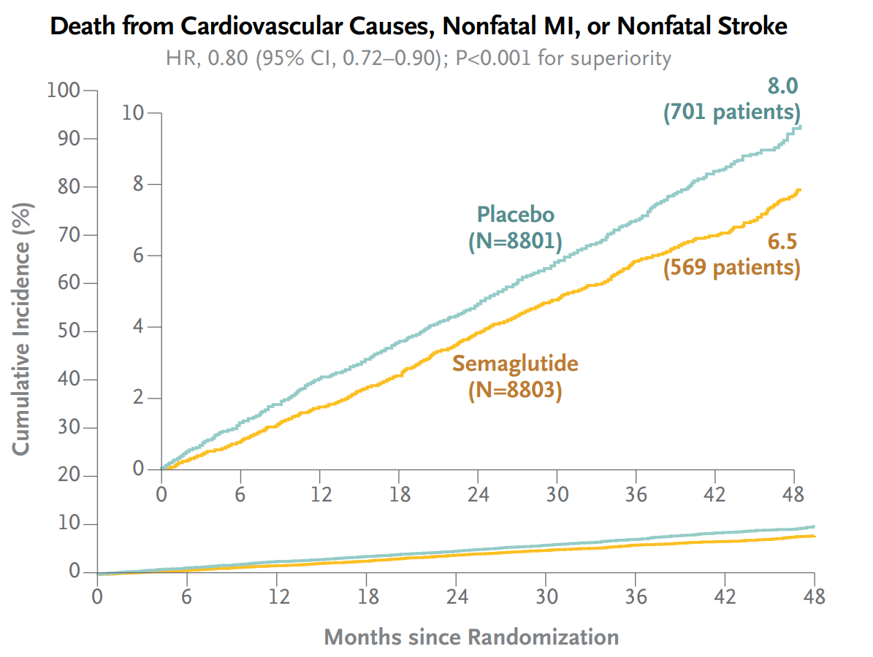
GLP1a in ASCVD
Semaglutide
N = 8803
Placebo
N = 8801
Patients with stable ASCVD, BMI ≥ 27, no T2DM
Mean follow-up 40 months
Lincoff AM et al. DOI: 10.1056/NEJMoa2307563

Slide 50

Antithrombotic Therapy Expert Perspectives
How Long after PCI?
How Long after MI?
CAD/PAD with no recent MI or PCI?
T2DM + CAD and no MI?
Bleeding Risk!
De-escalate by dropping P2Y₁₂ Inhibition?
De-escalate by dropping aspirin ?
If need chronic anticoagulation?
PCI, percutaneous coronary intervention.

Slide 51
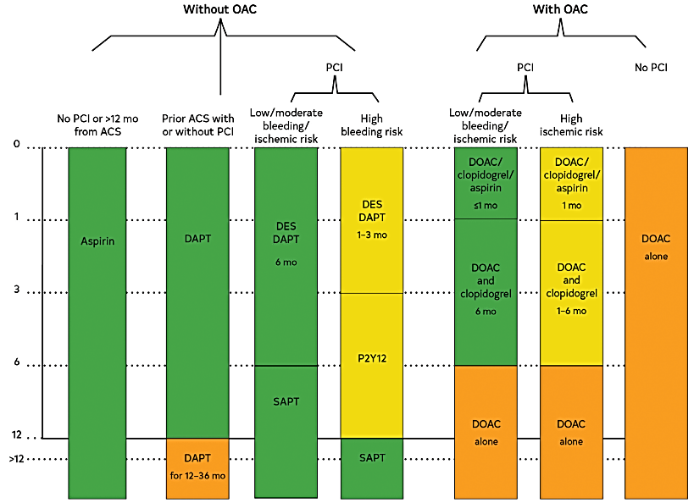
Recommended Duration of Antiplatelet Therapy
Colors correspond to Class of Recommendation:
green: Class I (strong) yellow: Class 2a (moderate) orange: Class 2b (weak)
This figure does not encompass all recommendations within this section. Virani SS, et al. Circulation. 2023;148:e9-e119.
Notes:
Virani SS, Newby LK, Arnold SV, Bittner V, Brewer LC, Demeter SH, Dixon DL, Fearon WF, Hess B, Johnson HM, Kazi DS, Kolte D, Kumbhani DJ, LoFaso J, Mahtta D, Mark DB, Minissian M, Navar AM, Patel AR, Piano MR, Rodriguez F, Talbot AW, Taqueti VR, Thomas RJ, van Diepen S, Wiggins B, Williams MS. 2023 AHA/ACC/ACCP/ASPC/NLA/PCNA Guideline for the Management of Patients With Chronic Coronary Disease: A Report of the American Heart Association/American College of Cardiology Joint Committee on Clinical Practice Guidelines. Circulation. 2023 Aug 29;148(9):e9-e119. doi: 10.1161/CIR.0000000000001168. Epub 2023 Jul 20. Erratum in: Circulation. 2023 Sep 26;148(13):e148. Erratum in: Circulation. 2023 Dec 5;148(23):e186. PMID: 37471501.

Slide 52
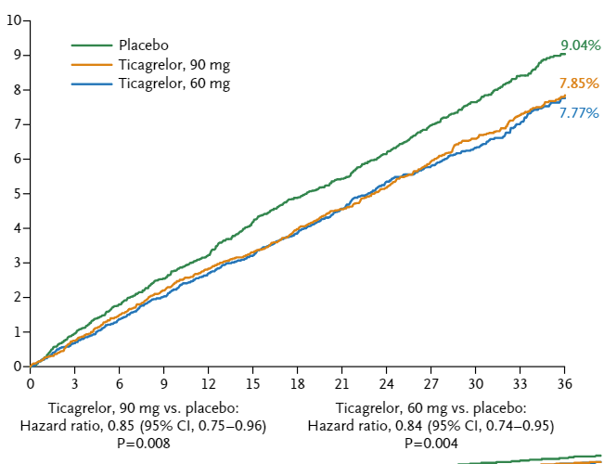
Antithrombotic Therapy
PEGASUS-TIMI 54: Long-Term Use of Ticagrelor in Patients with Prior Myocardial Infarction
Cardiovascular Death, MI, or Stroke
History of spontaneous MI 1-2 y prior and at least 1 additional risk factor
N = 21,162
Median follow-up: 33 mo
Event rate, %
Months since randomization
Bonaca MP, et al. N Engl J Med. 2015;372:1791-1800
Notes:
Bonaca MP, Bhatt DL, Cohen M, Steg PG, Storey RF, Jensen EC, Magnani G, Bansilal S, Fish MP, Im K, Bengtsson O, Oude Ophuis T, Budaj A, Theroux P, Ruda M, Hamm C, Goto S, Spinar J, Nicolau JC, Kiss RG, Murphy SA, Wiviott SD, Held P, Braunwald E, Sabatine MS; PEGASUS-TIMI 54 Steering Committee and Investigators. Long-term use of ticagrelor in patients with prior myocardial infarction. N Engl J Med. 2015 May 7;372(19):1791-800. doi: 10.1056/NEJMoa1500857. Epub 2015 Mar 14. PMID: 25773268.
Anand SS, Bosch J, Eikelboom JW, Connolly SJ, Diaz R, Widimsky P, Aboyans V, Alings M, Kakkar AK, Keltai K, Maggioni AP, Lewis BS, Störk S, Zhu J, Lopez-Jaramillo P, O'Donnell M, Commerford PJ, Vinereanu D, Pogosova N, Ryden L, Fox KAA, Bhatt DL, Misselwitz F, Varigos JD, Vanassche T, Avezum AA, Chen E, Branch K, Leong DP, Bangdiwala SI, Hart RG, Yusuf S; COMPASS Investigators. Rivaroxaban with or without aspirin in patients with stable peripheral or carotid artery disease: an international, randomised, double-blind, placebo-controlled trial. Lancet. 2018 Jan 20;391(10117):219-229. doi: 10.1016/S0140-6736(17)32409-1. Epub 2017 Nov 10. PMID: 29132880.

Slide 53
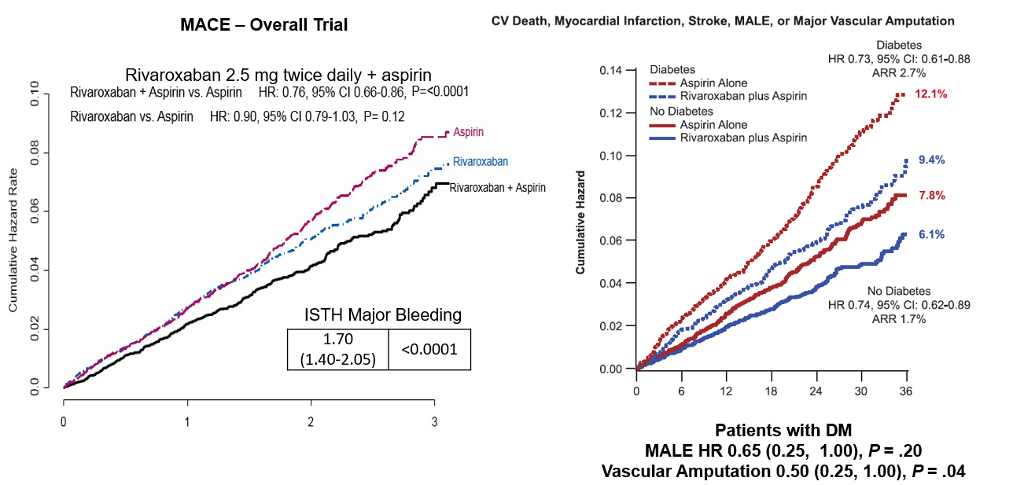
COMPASS Combination of Aspirin and Rivaroxaban Reduces Thrombosis
^{[1]}
^{[2]}
ISTH, International Society on Thrombosis and Haemostasis. 1. Eikelboom JW, et al. N Engl J Med. 2017;377:1319-1330; 2. Bhatt DL, et al. Circulation. 2020;141:1841-1854.
Notes:
Have explanation ready re: CV deaths
Eikelboom JW, Connolly SJ, Bosch J, Dagenais GR, Hart RG, Shestakovska O, Diaz R, Alings M, Lonn EM, Anand SS, Widimsky P, Hori M, Avezum A, Piegas LS, Branch KRH, Probstfield J, Bhatt DL, Zhu J, Liang Y, Maggioni AP, Lopez-Jaramillo P, O'Donnell M, Kakkar AK, Fox KAA, Parkhomenko AN, Ertl G, Störk S, Keltai M, Ryden L, Pogosova N, Dans AL, Lanas F, Commerford PJ, Torp-Pedersen C, Guzik TJ, Verhamme PB, Vinereanu D, Kim JH, Tonkin AM, Lewis BS, Felix C, Yusoff K, Steg PG, Metsarinne KP, Cook Bruns N, Misselwitz F, Chen E, Leong D, Yusuf S; COMPASS Investigators. Rivaroxaban with or without Aspirin in Stable Cardiovascular Disease. N Engl J Med. 2017 Oct 5;377(14):1319-1330. doi: 10.1056/NEJMoa1709118. Epub 2017 Aug 27. PMID: 28844192.
Bhatt DL, Eikelboom JW, Connolly SJ, Steg PG, Anand SS, Verma S, Branch KRH, Probstfield J, Bosch J, Shestakovska O, Szarek M, Maggioni AP, Widimský P, Avezum A, Diaz R, Lewis BS, Berkowitz SD, Fox KAA, Ryden L, Yusuf S; COMPASS Steering Committee and Investigators. Role of Combination Antiplatelet and Anticoagulation Therapy in Diabetes Mellitus and Cardiovascular Disease: Insights From the COMPASS Trial. Circulation. 2020 Jun 9;141(23):1841-1854. doi: 10.1161/CIRCULATIONAHA.120.046448. Epub 2020 Mar 28. PMID: 32223318; PMCID: PMC7314494.

Slide 54
No Clear Winner for More Intensive Options and Bleeding Risk
GUSTO Moderate or Severe
Annulized Rates
P < .001 for all comparisons at full follow up
^{[1]}
^{[2]}
^{[3]}
^{[4]}
Clopidogrel 75 mg daily vs Placebo
Clopidogrel 75 mg daily vs Placebo
Prior MI Subgroup
Ticagrelor 60 mg BID vs Placebo
Vorapaxar 2.5 mg daily vs Placebo
1. Berger PB, et al. Circulation. 2010;121:2575-2583; 2. Mauri L, et al. N Engl J Med. 2014;371:2155-2166; 3. Scirica BM, et al. Lancet. 2012;380:1317-1324; 4. Bonaca et al. N Engl J Med. 2015;372:1791-800.
Notes:
Berger PB, Bhatt DL, Fuster V, Steg PG, Fox KA, Shao M, Brennan DM, Hacke W, Montalescot G, Steinhubl SR, Topol EJ; CHARISMA Investigators. Bleeding complications with dual antiplatelet therapy among patients with stable vascular disease or risk factors for vascular disease: results from the Clopidogrel for High Atherothrombotic Risk and Ischemic Stabilization, Management, and Avoidance (CHARISMA) trial. Circulation. 2010 Jun 15;121(23):2575-83. doi: 10.1161/CIRCULATIONAHA.109.895342. Epub 2010 Jun 1. PMID: 20516378.
Mauri L, Kereiakes DJ, Yeh RW, Driscoll-Shempp P, Cutlip DE, Steg PG, Normand SL, Braunwald E, Wiviott SD, Cohen DJ, Holmes DR Jr, Krucoff MW, Hermiller J, Dauerman HL, Simon DI, Kandzari DE, Garratt KN, Lee DP, Pow TK, Ver Lee P, Rinaldi MJ, Massaro JM; DAPT Study Investigators. Twelve or 30 months of dual antiplatelet therapy after drug-eluting stents. N Engl J Med. 2014 Dec 4;371(23):2155-66. doi: 10.1056/NEJMoa1409312. Epub 2014 Nov 16. PMID: 25399658; PMCID: PMC4481318.
Scirica BM, Bonaca MP, Braunwald E, De Ferrari GM, Isaza D, Lewis BS, Mehrhof F, Merlini PA, Murphy SA, Sabatine MS, Tendera M, Van de Werf F, Wilcox R, Morrow DA; TRA 2°P-TIMI 50 Steering Committee Investigators. Vorapaxar for secondary prevention of thrombotic events for patients with previous myocardial infarction: a prespecified subgroup analysis of the TRA 2°P-TIMI 50 trial. Lancet. 2012 Oct 13;380(9850):1317-24. doi: 10.1016/S0140-6736(12)61269-0. Epub 2012 Aug 26. PMID: 22932716.
Bonaca MP, Bhatt DL, Cohen M, Steg PG, Storey RF, Jensen EC, Magnani G, Bansilal S, Fish MP, Im K, Bengtsson O, Oude Ophuis T, Budaj A, Theroux P, Ruda M, Hamm C, Goto S, Spinar J, Nicolau JC, Kiss RG, Murphy SA, Wiviott SD, Held P, Braunwald E, Sabatine MS; PEGASUS-TIMI 54 Steering Committee and Investigators. Long-term use of ticagrelor in patients with prior myocardial infarction. N Engl J Med. 2015 May 7;372(19):1791-800. doi: 10.1056/NEJMoa1500857. Epub 2015 Mar 14. PMID: 25773268.

Slide 55
Personalization Is Critical
van der Sangen NMR, et al. Eur Heart J. 2021;42:1038-1046.
Notes:
van der Sangen NMR, Rozemeijer R, Chan Pin Yin DRPP, Valgimigli M, Windecker S, James SK, Buccheri S, Ten Berg JM, Henriques JPS, Voskuil M, Kikkert WJ. Patient-tailored antithrombotic therapy following percutaneous coronary intervention. Eur Heart J. 2021 Mar 7;42(10):1038-1046. doi: 10.1093/eurheartj/ehaa1097. PMID: 33515031; PMCID: PMC8244639.

Slide 56
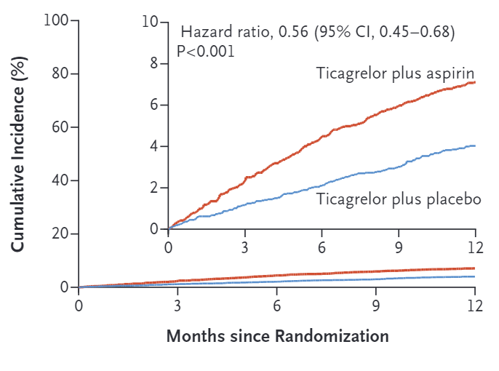


Ticagrelor Monotherapy TWILIGHT
Primary Endpoint: BARC Type 2, 3, or 5 Bleeding (Intention-to-Treat Population)
Secondary Endpoint: Death from Any Cause, Nonfatal MI, or Nonfatal Stroke (Per Protocol Population)
ARD = -0.06 (-0.97% to 0.84%)
P_{non-inferiority} < .001
7.1%
3.9%
4.0%
3.9%
Mehran R, et al. N Engl J Med. 2019;381:2032-2042.
Notes:
Mehran R, Baber U, Sharma SK, Cohen DJ, Angiolillo DJ, Briguori C, Cha JY, Collier T, Dangas G, Dudek D, Džavík V, Escaned J, Gil R, Gurbel P, Hamm CW, Henry T, Huber K, Kastrati A, Kaul U, Kornowski R, Krucoff M, Kunadian V, Marx SO, Mehta SR, Moliterno D, Ohman EM, Oldroyd K, Sardella G, Sartori S, Shlofmitz R, Steg PG, Weisz G, Witzenbichler B, Han YL, Pocock S, Gibson CM. Ticagrelor with or without Aspirin in High-Risk Patients after PCI. N Engl J Med. 2019 Nov 21;381(21):2032-2042. doi: 10.1056/NEJMoa1908419. Epub 2019 Sep 26. PMID: 31556978.

Slide 57


Choice of Monotherapy: Aspirin or P2Y₁₂ Inhibition? HOST-EXAM Extended Study
P2Y₁₂ monotherapy versus monotherapy after 6 to 18 months of DAPT for PCI?
P2Y₁₂ monotherapy was associated with lower rates of MACE and bleeding (no difference in mortality)
Kang J, et al. Circulation. 2023;147:108-117.
Notes:
Kang J, Park KW, Lee H, Hwang D, Yang HM, Rha SW, Bae JW, Lee NH, Hur SH, Han JK, Shin ES, Koo BK, Kim HS. Aspirin Versus Clopidogrel for Long-Term Maintenance Monotherapy After Percutaneous Coronary Intervention: The HOST-EXAM Extended Study. Circulation. 2023 Jan 10;147(2):108-117. doi: 10.1161/CIRCULATIONAHA.122.062770. Epub 2022 Nov 7. PMID: 36342475.
Kang J, Park KW, Lee H, Hwang D, Yang HM, Rha SW, Bae JW, Lee NH, Hur SH, Han JK, Shin ES, Koo BK, Kim HS. Aspirin Versus Clopidogrel for Long-Term Maintenance Monotherapy After Percutaneous Coronary Intervention: The HOST-EXAM Extended Study. Circulation. 2023 Jan 10;147(2):108-117. doi: 10.1161/CIRCULATIONAHA.122.062770. Epub 2022 Nov 7. PMID: 36342475.

Slide 58
Optimizing GDMT in Acute Coronary Syndrome Case-Based Guidance
Jennifer A. Rymer, MD
Assistant Professor of Medicine
Interventional Cardiology
John Bush Simpson Assistant Professor of Medicine
Duke University School of Medicine
Durham, North Carolina
Notes:
Timecode:

Slide 59
Agenda
Patient Case
Current GDMT in ACS
What’s on the Horizon

Slide 60
Patient Presentation
64 yo female with history of ESRD on dialysis, severe PAD s/p multiple interventions (amputation of multiple fingers/toes 2/2 ischemia), CAD s/p multiple PCIs, and AF with prior stroke, presents with several days of chest pain, elevated hs-troponin T
With previous P2Y12 inhibitor cessation has had stent thrombosis
Now on ticagrelor and apixaban chronically
Has failed multiple statins due to myalgias

Slide 61


Presenting Angiogram
Images courtesy of Dr Rymer

Slide 62
What’s Next?
Successful PCI is only the beginning of treating these patients
LLTs? - patient intolerance in the past cited, difficulties injecting because of finger amputations
ESRD – periodic hypotension/HTN, bleeding and ischemic risk
LVEF is now 35% - how to optimize?
Polypharmacy
How do you optimally reduce residual risk in patients with complex comorbidities?
What strategies can you implement to improve patient adherence to GDMT?

Slide 63
What’s Old in ACS GDMT
2013 ACCF/AHA/ Guideline for the Management of Patients with ST-Elevation Myocardial Infarction¹
2014 AHA/ACC Guideline for the Management of Patients with Non-ST-Elevation Acute Coronary Syndromes²
Class I Recommended discharge medications/classes (routinely used)
Aspirin
Oral P2Y12 inhibitor
Beta Blocker
ACE Inhibitor
MRA (Mineralocorticoid Receptor Antagonist)
High intensity Statin (+/- other LLTs)
1. O'Gara PT, et al; Circulation. 2013;127:e362-e425. Correction in: Circulation. 2013;128:e481. 2. Amsterdam EA, et al. J Am Coll Cardiol. 2014;64:e139-e228.

Slide 64
Trends in Prescribing GDMT at Discharge
Prescriptions for statins and P2Y12 inhibitors remain high at discharge (>95%)
Use of aldosterone antagonists in patients with LVEF <40% remains low (<15%)
Defect-free care hovers around 75% of discharged patients
Gandhi S, et al. Circ Cardiovasc Qual Outcomes. 2022;15:e008112.
Notes:
Table 4, Page 57

Slide 65


GDMT Nonadherence
Mathews R, et al. Circ Cardiovasc Qual Outcomes. 2015;8:347-356; Rymer JA, et al. J Am Heart Assoc. 2021;10:e016215.​
Notes:
Left-hand graph: Mathews, Figure 2, Page 14
Right-hand graph: Rymer, Figure1, Page 5

Slide 66


Antiplatelet Therapies
Parodi G, et al. J Am Coll Cardiol. ​2015;65:511-512.
Notes:
Left-hand algorithm: Figure 3, Page 4 https://www.acc.org/Latest-in-Cardiology/Articles/2022/01/25/13/57/Pretreatment-with-P2Y12-Inhibitor-in-Patients-with-ACS -- the figure there is used courtesy of Spirito A, Cao D, Mehran R.
Right-hand graph: Figure1, Page 512 Parodi G, et al. J Am Coll Cardiol. 2015;65:511-512.Results from Mojito study

Slide 67


Antiplatelet Therapies
Recommended duration of DAPT (months) with associated class and level of evidence
0
1
3
6
12
30
30+
No HBR
12 months or longer*
No high bleeding risk
(HBR)
BMS
I A
IIb A
HBR↑
6 months
US
DES
I BR
IIb A
Stable coronary artery disease
(SCAD)
BMS
DES
DCB
IIb A
EU
BRS
IIa C
Percutaneous coronary intervention
(PCI)
BMS
I A
Key
BMS: Bare metal stent
DES: Drug-eluting stent
DCB: Drug-coated balloon
BRS: Bioresorbable scaffold
US
DES
IIb C-LD
HBR
EU
IIa B
IIb C
No high bleeding risk
(HBR)
US
I BR
IIb A
Acute coronary artery disease
(ACS)
EU
I A
IIb B
© Medscape, LLC
US
HBR
IIb C-LD
EU
HBR, high-risk bleeding.
Capodanno, D. et al. J Am Coll Cardiol. 2018;72:2915-2931.
IIa B
Notes:
Page 2922, Central Illustration

Slide 68

De-Escalation of Antiplatelet Therapy in ACS
1363 ACS patients undergoing PCI enrolled during a 3-month period
Adverse Events at 1 Month FU
MACE, major adverse cardiovascular event; NACE, net adverse clinical event
De Luca L, et al. EuroIntervention. 2017;13:459-466.
Notes:
Figure1, Page 462

Slide 69
Shortening Duration of Antiplatelet in ACS
6-Month vs 12-Month Duration
Myocardial Infarction
BARC 2 to 5 bleeding
12-month or longer DAPT
6-month DAPT
12-month or longer DAPT
6-month DAPT
HR: 1.28 (95% CI 0.48, 3.45); P = .62
HR: 0.78 (95% CI 0.45, 1.37); P = .39
HR: 5.06 (95% CI: 1.46, 17.47); P = .01
HR: 0.57 (95% CI: 0.29, 1.12); P = .10
BARC, Bleeding Academic Research Consortium
Hahn JY, et al. Lancet. 2018;391:1274-1284.
Notes:
Figure3c & 3d, Page 1281

Slide 70
The EMMY Trial
476 patients with acute MI and large creatine kinase elevation (> 800 IU/L) randomized to empagliflozin 10mg or placebo within 72 hours of PCI
Primary outcome was the N-terminal pro-hormone of brain natriuretic peptide (NT-proBNP) change over 26 weeks
NT-proBNP reduction was significantly greater in the empa group, compared with placebo, (95% CI: −4.4%, −23.6%) after adjustment
Absolute left-ventricular ejection fraction improvement was significantly greater in the empagliflozin group (1.5% [95% CI: 0.2%, 2.9%]; P = 0.029) (secondary outcome)
empa, empagliflozin
von Lewinski D, et al. Eur Heart J. 2022;43:4421-4432.

Slide 71

SGLT2 Inhibition in AMI
Udell JA, et al. J Am Coll Cardiol. 2022;79:2058–2068.
Notes:
Central Illustration, Page 2064

Slide 72

DAPA-MI
7-component composite outcome “won” when comparing dapa to placebo
No difference in terms of MACE, death, HF/MI hospitalization
Dapa, dapagiflozin.
James S, et al. NEJM Evid. 2024;3:EVIDoa2300286.​
Notes:
Figure 1, Page 5

Slide 73


PCSK9 Inhibition in the Acute AMI Setting
Koskinas KC, et al. J Am Coll Cardiol. 2019;74:2452-2462.
Notes:
Left-hand graph: Central Illustration, Page 2458
Right-hand graph: Figure2B, Page 2457

Slide 74

PCSK9 Inhibition in the Acute AMI Setting
Early post-acute coronary syndrome (ACS) period
(Highest vulnerability)
Acute phase
(in-hospital)
8 weeks
Standard of care
Reperfusion/revascularization
Aspirin
Potent P2Y₁₂ inhibition
Achievement of LDL-C target
< 1.8 mmol/l
Current paradigm
© Medscape, LLC
Intensive statin and placebo subcutaneously
37.6%
?
Early clinical outcomes
Mortality
Recurrent ACS
Repeat revascularization
Experimental design
Intensive statin and Evolocumab
95.7%
?
Patients with elevated LDL-C at baseline
23.2 mmol/l on no statin
22.3 mmol/l on low-/moderate-intensity statin
≥ 1.8 mmol/l on high-intensity statin
Koskinas KC, et al. J Am Coll Cardiol. 2019;74:2452-2462.
Notes:
Left-hand graph: Central Illustration, Page 2458
Right-hand graph: Figure2B, Page 2457

Slide 75

Guidelines for LLT in ACS
Byrne RA, et al; ESC Scientific Document Group. Eur Heart J. 2023;44:3720-3826. Correction in: Eur Heart J. 2024;45:1145.
Notes:
Figure 18, Page 3785

Slide 76


Transfusion Strategies
Carson JL, et al. N Engl J Med. 2023;389:2446-2456.
Notes:
Left-hand figure: Figure2, Page 16
Right-hand graph: Figure 3A, Page 17

Slide 77


Cardiac Rehabilitation
Eijsvogels TMH, et al. JAMA Netw Open. 2020;3:e2011686; Doll JA, et al. JAMA Intern Med. 2015;175:1700-1702.
Notes:
Right-hand graph: Doll, Figure 2, Page 8

Slide 78
The SECURE Trial
2499 patients with MI in previous 6 months (median 8 days between MI and randomization) randomized to polypill (aspirin, ramipril, atorvastatin) or usual care
Primary outcome: CV death, nonfatal MI, nonfatal ischemic stroke, or urgent revascularization
Polypill (9.5%) vs usual care (12.7%); HR: 0.76 (95% CI: 0.60, 0.96)
Patient-reported medication adherence was higher in the polypill group
Castellano JM, et al. N Engl J Med. 2022;387:967-977.

Slide 79
Case Follow-up
Engaged patient’s primary caregiver/family member to come to clinic visits
Was able to assist with PCSK9i and helping the patient set up a system at home to organize daily medication routine
Discuss WHY each medication was important and wrote the reasoning for medications on the after visit summaries
When possible, examine the costs of medications before discharging from the hospital (assess feasibility)

Slide 80
What’s On the Horizon

Slide 81
SOS-AMI
Study to Evaluate the Efficacy and Safety of Self-administered Subcutaneous Selatogrel for Prevention of All-cause Death and Treatment of Acute Myocardial Infarction in Subjects With a Recent History of Acute Myocardial Infarction (SOS-AMI)
Participants with acute MI no longer than 4 weeks prior to randomization with either history of of prior MI in the last year or at least 2 other enrichment criteria
14,000 participants, estimated completion 8/2025
ClinicalTrials.gov. NCT04957719. Accessed January 16, 2025.

Slide 82

ARTEMIS Trial
ClinicalTrials.gov. NCT06118281. Accessed January 16, 2025.

Slide 83

CELEBRATE Trial
Rikken SA, et al; Am Heart J. 2023;258:119-128
Notes:
Figure from Rikken, Figure 1, Page 122
Figure 1, Page 122

Slide 84












Conclusions
Class I GDMT for ACS focuses on treating the post-ACS patient but also concomitant conditions (HF, PAD, etc)
There are many new potential drugs/therapies in the pipeline
Most importantly, we can prescribe GDMT but it has to be adhered to
Implementation science is critical in this space to improve adherence after discharge
Long term treatment after ACS
Discharge on cardio-protective medications, start lifestyle management and refer to cardiac rehab
Arrange OPD review to manage comorbidities and discuss patient goals and preferences
Treatment goals
1. Support healthy lifestyle choices
2. Continue optimal pharmacological and cardio-protective treatment
3. Reach and sustain risk factor treatment targets
Smoking cessation
Antithrombotic therapy
Systolic BP < 130 mmHg and diastolic BP < 80 mmHg (if tolerated)
Healthy diet
Lipid-lowering therapy
Regular exercise
Annual influenza vaccination
LDL-C < 1.4 mmol/L (< 55 mg/dL)
Healthy weight
Promote drug adherence and persistence +
other treatments as appropriate
Psychosocial management
HbAlc < 53 mmol/mol (< 7%)
© Medscape, LLC
Byrne RA, et al; Eur Heart J. 2023;44:3720-3826.
Class I GDMT for ACS focuses on treating the post-ACS patient but also concomitant conditions (HF, PAD, etc)
There are many new potential drugs/therapies in the pipeline
Most importantly, we can prescribe GDMT but it has to be adhered to
Implementation science is critical in this space to improve adherence after discharge

Slide 85
Modern Management of Cardiogenic Shock
Vanessa Blumer, MD
Advanced Heart Failure and Transplant Cardiology
Associate Director, Heart Failure Research
Medical Co-Director, Heart Failure Outreach
Inova Schar Heart and Vascular
Falls Church, Virginia
Notes:
Timecode:

Slide 86

Outline
Epidemiology
Definitions and classification
Cardiogenic shock teams
Management:
Risk stratification
Drugs
Devices
Take home points and future directions
~75%
These materials are provided to you solely as an educational resource for your personal use. Any commercial use or distribution of these materials or any portion thereof is strictly prohibited.

Slide 87






These materials are provided to you solely as an educational resource for your personal use. Any commercial use or distribution of these materials or any portion thereof is strictly prohibited.
Notes:
There really are no CS guidelines. Most of what we do is either based on Scientific Statements, Expert Consensus, or extrapolated from AMI guidelines.
van Diepen S, et al; American Heart Association Council on Clinical Cardiology; Council on Cardiovascular and Stroke Nursing; Council on Quality of Care and Outcomes Research; and Mission: Lifeline. Circulation. 2017;136:e232-e268; Blumer V, et al; American Heart Association Cardiovascular Disease in Older Populations Committee of the Council on Clinical Cardiology and Council on Cardiovascular and Stroke Nursing; Council on Quality of Care and Outcomes Research; and Council on Cardiovascular Surgery and Anesthesia. Circulation. 2024;149:e1051-e1065; Tehrani BN, et al. JACC Heart Fail. 2020;8:879-891; Baran DA, et al. Catheter Cardiovasc Interv. 2019;94:29-37; Naidu SS, et al. J Am Coll Cardiol. 2022;79:933-946; Rihal CS, et al; Society for Cardiovascular Angiography and Interventions (SCAI); Heart Failure Society of America (HFSA); Society of Thoracic Surgeons (STS); American Heart Association (AHA), and American College of Cardiology (ACC). J Am Coll Cardiol. 2015;65(19):e7-e26; Ibánez B, et al. Rev Esp Cardiol (Engl Ed). 2017;70:1082; O'Gara PT, et al; American College of Cardiology Foundation; American Heart Association Task Force on Practice Guidelines; American College of Emergency Physicians; Society for Cardiovascular Angiography and Interventions. Catheter Cardiovasc Interv. 2013;82:E1-E27.

Slide 88


ACC, American College of Cardiology; AHA, American Heart Association; HFSA, Heart Failure Society of America. Heidenreich PA, et al. Circulation. 2022;145:e895-e1032.Erratum in: Circulation. 2022 May 3;145(18):e1033. Erratum in: Circulation. 2022 Sep 27;146(13):e185. Erratum in: Circulation. 2023 Apr 4;147(14):e674.
Heidenreich et al. JACC 2022; 79(17): e263-421.
These materials are provided to you solely as an educational resource for your personal use. Any commercial use or distribution of these materials or any portion thereof is strictly prohibited.
Notes:
And if we look closer at the new HF guidelines, we recognize that our current best practices are based on Non-randomized data, observational studies or registry data copy.
Heidenreich PA, Bozkurt B, Aguilar D, Allen LA, Byun JJ, Colvin MM, Deswal A, Drazner MH, Dunlay SM, Evers LR, Fang JC, Fedson SE, Fonarow GC, Hayek SS, Hernandez AF, Khazanie P, Kittleson MM, Lee CS, Link MS, Milano CA, Nnacheta LC, Sandhu AT, Stevenson LW, Vardeny O, Vest AR, Yancy CW; ACC/AHA Joint Committee Members. 2022 AHA/ACC/HFSA Guideline for the Management of Heart Failure: A Report of the American College of Cardiology/American Heart Association Joint Committee on Clinical Practice Guidelines. Circulation. 2022 May 3;145(18):e895-e1032. doi: 10.1161/CIR.0000000000001063. Epub 2022 Apr 1. Erratum in: Circulation. 2022 May 3;145(18):e1033. doi: 10.1161/CIR.0000000000001073. Erratum in: Circulation. 2022 Sep 27;146(13):e185. doi: 10.1161/CIR.0000000000001097. Erratum in: Circulation. 2023 Apr 4;147(14):e674. doi: 10.1161/CIR.0000000000001142. PMID: 35363499.

Slide 89


Epidemiology
… management is also changing!
The landscape of CS is changing…
CS, cardiogenic shock; IABP, intra-aortic balloon counter-pulsation pump; pLVAD, percutaneous left ventricular assist device; VA-ECMO, veno-arterial extracorporeal membrane oxygenation therapy. Berg DD, et al. Circ Cardiovasc Qual Outcomes. 2019;12:e005618; Schrage B, et al. ESC Heart Fail. 2021;8:1295-1303.
These materials are provided to you solely as an educational resource for your personal use. Any commercial use or distribution of these materials or any portion thereof is strictly prohibited.
Notes:
Berg DD, Bohula EA, van Diepen S, Katz JN, Alviar CL, Baird-Zars VM, Barnett CF, Barsness GW, Burke JA, Cremer PC, Cruz J, Daniels LB, DeFilippis AP, Haleem A, Hollenberg SM, Horowitz JM, Keller N, Kontos MC, Lawler PR, Menon V, Metkus TS, Ng J, Orgel R, Overgaard CB, Park JG, Phreaner N, Roswell RO, Schulman SP, Jeffrey Snell R, Solomon MA, Ternus B, Tymchak W, Vikram F, Morrow DA. Epidemiology of Shock in Contemporary Cardiac Intensive Care Units. Circ Cardiovasc Qual Outcomes. 2019 Mar;12(3):e005618. doi: 10.1161/CIRCOUTCOMES.119.005618. PMID: 30879324; PMCID: PMC11032172.
Schrage B, Becher PM, Goßling A, Savarese G, Dabboura S, Yan I, Beer B, Söffker G, Seiffert M, Kluge S, Kirchhof P, Blankenberg S, Westermann D. Temporal trends in incidence, causes, use of mechanical circulatory support and mortality in cardiogenic shock. ESC Heart Fail. 2021 Apr;8(2):1295-1303. doi: 10.1002/ehf2.13202. Epub 2021 Feb 19. PMID: 33605565; PMCID: PMC8006704.

Slide 90

Definitions and Classification
CS definition has evolved in time…
1967
1976
1999
2012, 2017
2017
2022
Killip et al.^{[1]}
Diamond and Forrester^{[2]}
SHOCK Trial^{[3]}
IABP II and Culprit Shock^{[4]}
AHA Scientific Statement^{[5]}
VANQUISH Registry^{[6]}
Pulmonary edema with SBP < 90 mmHg
PCWP > 18mmHg + CI < 2.2 L/min/m²
SBP < 90 mmHg or HD support
AND
Hypoperfusion (cold/oliguric)
AND
PCWP > 18 mmHg + CI < 2.2 L/min/m²
SBP < 90 mmHg or catecholamines
AND
Pulmonary congestion
AND
Hypoperfusion (lactate > 2, cold, oliguric, confusion)
Ineffective cardiac output caused by a primary cardiac disorder resulting in both clinical and biochemical manifestations of inadequate tissue perfusion unresponsive to volume resuscitation
Shock team referral for CS
AND/OR
Clinical CS (hypoperfusion with SBP < 90 mmHg or vasoactives)
AND/OR
Hemodynamic CS (CI < 2.2 L/min/m² or CPO < 0.6 W or PAPi <1.0)
CPO, cardiac power output; PAPi, pulmonary artery pulsatility index; PCWP, pulmonary capillary wedge pressure
1. Killip T 3rd, et al. Am J Cardiol. 1967;20:457-64; 2. Forrester JS, et al. N Engl J Med. 1976;295:1356-62; 3. Hochman JS, et al. N Engl J Med. 1999;341:625-34; 4. Katz SD, et al. Circulation. 2019;139:404-406. Erratum in: Circulation. 2019 Jan 15;139(3):e9; 5. van Diepen S, et al. Circulation. 2017;136:e232-e268; 6. Tehrani BN, et al. Can J Cardiol. 2022;38:1286-1295.
These materials are provided to you solely as an educational resource for your personal use. Any commercial use or distribution of these materials or any portion thereof is strictly prohibited.
Notes:
Killip T 3rd, Kimball JT. Treatment of myocardial infarction in a coronary care unit. A two year experience with 250 patients. Am J Cardiol. 1967 Oct;20(4):457-64. doi: 10.1016/0002-9149(67)90023-9. PMID: 6059183.
Forrester JS, Diamond G, Chatterjee K, Swan HJ. Medical therapy of acute myocardial infarction by application of hemodynamic subsets (first of two parts). N Engl J Med. 1976 Dec 9;295(24):1356-62. doi: 10.1056/NEJM197612092952406. PMID: 790191.
Hochman JS, Sleeper LA, Webb JG, Sanborn TA, White HD, Talley JD, Buller CE, Jacobs AK, Slater JN, Col J, McKinlay SM, LeJemtel TH. Early revascularization in acute myocardial infarction complicated by cardiogenic shock. SHOCK Investigators. Should We Emergently Revascularize Occluded Coronaries for Cardiogenic Shock. N Engl J Med. 1999 Aug 26;341(9):625-34. doi: 10.1056/NEJM199908263410901. PMID: 10460813.
Katz SD, Smilowitz NR, Hochman JS. Another Nail in the Coffin for Intra-Aortic Balloon Counterpulsion in Acute Myocardial Infarction With Cardiogenic Shock. Circulation. 2019 Jan 15;139(3):404-406. doi: 10.1161/CIRCULATIONAHA.118.038279. Erratum in: Circulation. 2019 Jan 15;139(3):e9. doi: 10.1161/CIR.0000000000000653. PMID: 30586784; PMCID: PMC6331234.
van Diepen S, Katz JN, Albert NM, Henry TD, Jacobs AK, Kapur NK, Kilic A, Menon V, Ohman EM, Sweitzer NK, Thiele H, Washam JB, Cohen MG; American Heart Association Council on Clinical Cardiology; Council on Cardiovascular and Stroke Nursing; Council on Quality of Care and Outcomes Research; and Mission: Lifeline. Contemporary Management of Cardiogenic Shock: A Scientific Statement From the American Heart Association. Circulation. 2017 Oct 17;136(16):e232-e268. doi: 10.1161/CIR.0000000000000525. Epub 2017 Sep 18. PMID: 28923988.
Tehrani BN, Drakos SG, Billia F, Batchelor WB, Luk A, Stelling K, Tonna J, Rosner C, Hanff T, Rao V, Brozzi NA, Baran DA. The Multicenter Collaborative to Enhance Biologic Understanding, Quality, and Outcomes in Cardiogenic Shock (VANQUISH Shock): Rationale and Design. Can J Cardiol. 2022 Aug;38(8):1286-1295. doi: 10.1016/j.cjca.2022.03.005. Epub 2022 Mar 11. PMID: 35288292; PMCID: PMC10625804.

Slide 91



Definitions and Classification
Waksman R, et al. Circulation. 2023;148:1113-1126.
These materials are provided to you solely as an educational resource for your personal use. Any commercial use or distribution of these materials or any portion thereof is strictly prohibited.
Notes:
Waksman R, et al. Circulation. 2023;148:1113-1126.

Slide 92
Definitions and Classification
Waksman R, et al. Circulation. 2023;148:1113-1126.
These materials are provided to you solely as an educational resource for your personal use. Any commercial use or distribution of these materials or any portion thereof is strictly prohibited.
Notes:
Waksman R, et al. Circulation. 2023;148:1113-1126.

Slide 93


Definitions and Classification
SCAI SHOCK Stage Classification, a five-stage system intended to facilitate communication about the diagnosis, presentation, and evolving nature of CS...
1. Jentzer JC, et al. J Soc Cardiovasc Angiogr Interv. 2023;2:100586; 2. Kapur NK, et al. J AmColl Cardiol. 2022;80:185-198.
These materials are provided to you solely as an educational resource for your personal use. Any commercial use or distribution of these materials or any portion thereof is strictly prohibited.
Notes:
Jentzer JC, Naidu SS, Bhatt DL, Stone GW. Mechanical Circulatory Support Devices in Acute Myocardial Infarction-Cardiogenic Shock: Current Studies and Future Directions. J Soc Cardiovasc Angiogr Interv. 2023 Mar 27;2(2):100586. doi: 10.1016/j.jscai.2023.100586. PMID: 39129807; PMCID: PMC11307970.
Kapur NK, Kanwar M, Sinha SS, Thayer KL, Garan AR, Hernandez-Montfort J, Zhang Y, Li B, Baca P, Dieng F, Harwani NM, Abraham J, Hickey G, Nathan S, Wencker D, Hall S, Schwartzman A, Khalife W, Li S, Mahr C, Kim JH, Vorovich E, Whitehead EH, Blumer V, Burkhoff D. Criteria for Defining Stages of Cardiogenic Shock Severity. J Am Coll Cardiol. 2022 Jul 19;80(3):185-198. doi: 10.1016/j.jacc.2022.04.049. PMID: 35835491.

Slide 94





We classify several phenotypes under the same umbrella of CS…
ETIOLOGY
PATHOPHYSIOLOGY
CLINICAL PRESENTATION
SEVERITY
1. Sinha SS, et al. Circ Heart Fail. 2022;15:e009279; 2. Hernandez-Montfort J, et al. JACC Heart Fail. 2023;11:176-187; 3. Thayer KL, et al. Circ Heart Fail. 2020;13:e007099; 4. Jentzer JC, et al. J Am Coll Cardiol. 2019;74:2117-2128.
These materials are provided to you solely as an educational resource for your personal use. Any commercial use or distribution of these materials or any portion thereof is strictly prohibited.
Notes:
“clinical presentation” bar diagram is present in article: Bhatt, AS et al. 2021; 27:P1073-P1081. (this article is not accessible, only abstract availble).
Could not find the citation for “pathophysiology pichart diagram
Severity bar diagram image has been taken from “Jentzer, JC 2022; 1:100120.
Please remove the reference cited from which data has not been taken.
Sinha SS, Rosner CM, Tehrani BN, Maini A, Truesdell AG, Lee SB, Bagchi P, Cameron J, Damluji AA, Desai M, Desai SS, Epps KC, deFilippi C, Flanagan MC, Genovese L, Moukhachen H, Park JJ, Psotka MA, Raja A, Shah P, Sherwood MW, Singh R, Tang D, Young KD, Welch T, O'Connor CM, Batchelor WB. Cardiogenic Shock From Heart Failure Versus Acute Myocardial Infarction: Clinical Characteristics, Hospital Course, and 1-Year Outcomes. Circ Heart Fail. 2022 Jun;15(6):e009279. doi: 10.1161/CIRCHEARTFAILURE.121.009279. Epub 2022 May 5. PMID: 35510546; PMCID: PMC9286066.
Hernandez-Montfort J, Kanwar M, Sinha SS, Garan AR, Blumer V, Kataria R, Whitehead EH, Yin M, Li B, Zhang Y, Thayer KL, Baca P, Dieng F, Harwani NM, Guglin M, Abraham J, Hickey G, Nathan S, Wencker D, Hall S, Schwartzman A, Khalife W, Li S, Mahr C, Kim J, Vorovich E, Pahuja M, Burkhoff D, Kapur NK. Clinical Presentation and In-Hospital Trajectory of Heart Failure and Cardiogenic Shock. JACC Heart Fail. 2023 Feb;11(2):176-187. doi: 10.1016/j.jchf.2022.10.002. Epub 2022 Oct 31. PMID: 36342421.
Thayer KL, Zweck E, Ayouty M, Garan AR, Hernandez-Montfort J, Mahr C, Morine KJ, Newman S, Jorde L, Haywood JL, Harwani NM, Esposito ML, Davila CD, Wencker D, Sinha SS, Vorovich E, Abraham J, O'Neill W, Udelson J, Burkhoff D, Kapur NK. Invasive Hemodynamic Assessment and Classification of In-Hospital Mortality Risk Among Patients With Cardiogenic Shock. Circ Heart Fail. 2020 Sep;13(9):e007099. doi: 10.1161/CIRCHEARTFAILURE.120.007099. Epub 2020 Sep 9. PMID: 32900234; PMCID: PMC10243474.
Jentzer JC, van Diepen S, Barsness GW, Henry TD, Menon V, Rihal CS, Naidu SS, Baran DA. Cardiogenic Shock Classification to Predict Mortality in the Cardiac Intensive Care Unit. J Am Coll Cardiol. 2019 Oct 29;74(17):2117-2128. doi: 10.1016/j.jacc.2019.07.077. Epub 2019 Sep 20. PMID: 31548097.

Slide 95



Using machine learning, 3 distinct CS phenotypes, with specific and reproducible associations with mortality have been identified
Identified 3 distinct clinical phenotypes:
I – Noncongested Phenotype = lower HR, lower filling pressures, higher BP
II – Cardiorenal Shock = multiple comorbidities, lower HR, elevated filling pressures, lower GFR
III – Cardiometabolic Shock = elevated markers of end-organ dysfunction, elevated HR, elevated filling pressures, lower BP, lower CO/CI
** Mortality: III > II > I **
Zweck E, et al. J Am Heart Assoc. 2021;10:e020085.
These materials are provided to you solely as an educational resource for your personal use. Any commercial use or distribution of these materials or any portion thereof is strictly prohibited.
Notes:
This represents a relatively stable profile of a noncongested patient with CS. In contrast, the patients in the cardiorenal shock (II) group were older, with multiple comorbidities. They exhibited a lower heart rate, elevated pulmonary arterial and pulmonary capillary wedge pressures, as well as lower glomerular filtration rate, suggesting renal involvement from shock. Last, the patients in the cardiometabolic shock (III) group exhibited elevated lactate, alanine aminotransferase, heart rate, and right atrial pressure, along with low blood pressure, cardiac power output, and index. This suggested a multiorgan involvement, featured by transaminases and lactic acidosis in a patient with CS.
Zweck E, Thayer KL, Helgestad OKL, Kanwar M, Ayouty M, Garan AR, Hernandez-Montfort J, Mahr C, Wencker D, Sinha SS, Vorovich E, Abraham J, O'Neill W, Li S, Hickey GW, Josiassen J, Hassager C, Jensen LO, Holmvang L, Schmidt H, Ravn HB, Møller JE, Burkhoff D, Kapur NK. Phenotyping Cardiogenic Shock. J Am Heart Assoc. 2021 Jul 20;10(14):e020085. doi: 10.1161/JAHA.120.020085. Epub 2021 Jul 6. PMID: 34227396; PMCID: PMC8483502.

Slide 96


Machine learning–based CS phenotypes are compatible with the expert consensus–based SCAI CS classification, providing additional predictive value when used in combination
Zweck E, et al. JACC Heart Fail. 2023;S2213-177900239-1.
These materials are provided to you solely as an educational resource for your personal use. Any commercial use or distribution of these materials or any portion thereof is strictly prohibited.
Notes:
Zweck E, Kanwar M, …Shashank S, Blumer V, et al. JACC Heart Fail. 2023 Jun 6;S2213-1779(23)00239-1

Slide 97


Cardiogenic Shock Teams
What does the evidence say? Shock teams and systems of care
Tehrani BN, et al. J Am Coll Cardiol. 2019;73:1659-1669.
These materials are provided to you solely as an educational resource for your personal use. Any commercial use or distribution of these materials or any portion thereof is strictly prohibited.
Notes:
The graph has been taken from Tehrani et al JACC 2019. Is some data from 2nd reference Tehrani et al. JACC HF 2020 cited here?
Tehrani BN, Truesdell AG, Sherwood MW, Desai S, Tran HA, Epps KC, Singh R, Psotka M, Shah P, Cooper LB, Rosner C, Raja A, Barnett SD, Saulino P, deFilippi CR, Gurbel PA, Murphy CE, O'Connor CM. Standardized Team-Based Care for Cardiogenic Shock. J Am Coll Cardiol. 2019 Apr 9;73(13):1659-1669. doi: 10.1016/j.jacc.2018.12.084. Erratum in: J Am Coll Cardiol. 2019 Jul 23;74(3):481. doi: 10.1016/j.jacc.2019.06.010. PMID: 30947919.

Slide 98

Cardiogenic Shock Teams
INOVA Standardized Treatment for Cardiogenic Shock
Utah Cardiac Recovery Shock Team
University of Ottawa
Code Shock Team
1. Tehrani BN, et al. JACC Heart Fail. 2019;7:477-480; 2. Taleb I, et al. Circulation. 2019;140:98-100; 3. Lee F, et al. CJC Open. 2020;2:249-257.
These materials are provided to you solely as an educational resource for your personal use. Any commercial use or distribution of these materials or any portion thereof is strictly prohibited.
Notes:
Tehrani BN, Rosner C, Sinha SS. Not All Shock Is Created Equal: Developing a Standardized Treatment Approach for Cardiogenic Shock. JACC Heart Fail. 2019 Jun;7(6):477-480. doi: 10.1016/j.jchf.2019.01.014. Epub 2019 May 8. PMID: 31078478.
Taleb I, Koliopoulou AG, Tandar A, McKellar SH, Tonna JE, Nativi-Nicolau J, Alvarez Villela M, Welt F, Stehlik J, Gilbert EM, Wever-Pinzon O, Morshedzadeh JH, Dranow E, Selzman CH, Fang JC, Drakos SG. Shock Team Approach in Refractory Cardiogenic Shock Requiring Short-Term Mechanical Circulatory Support: A Proof of Concept. Circulation. 2019 Jul 2;140(1):98-100. doi: 10.1161/CIRCULATIONAHA.119.040654. Epub 2019 Jul 1. PMID: 31549877; PMCID: PMC6872455.
Lee F, Hutson JH, Boodhwani M, McDonald B, So D, De Roock S, Rubens F, Stadnick E, Ruel M, Le May M, Labinaz M, Chien K, Garuba HA, Mielniczuk LM, Chih S. Multidisciplinary Code Shock Team in Cardiogenic Shock: A Canadian Centre Experience. CJC Open. 2020 Mar 27;2(4):249-257. doi: 10.1016/j.cjco.2020.03.009. PMID: 32695976; PMCID: PMC7365831.

Slide 99

Cardiogenic Shock Teams
Creative Commons Attribution License 4.0. Mehta A, et al. Front Cardiovasc Med. 2024:11:1354158.
These materials are provided to you solely as an educational resource for your personal use. Any commercial use or distribution of these materials or any portion thereof is strictly prohibited.
Notes:
Right device for the right patient at the right time
As soon as the device is about to go in, you must be thinking about your exit strategy and de-escalation mechanisms
Utilize your multidisciplinary team, in the absence of societal guidelines

Slide 100
Cardiogenic Shock Teams
Criteria met for CS?
Contraindications to escalation of care?
Resources to support pt’s needs?
Stable for transfer?
Creative Commons Attribution License 4.0. Mehta A, et al. Front Cardiovasc Med. 2024:11:1354158.
These materials are provided to you solely as an educational resource for your personal use. Any commercial use or distribution of these materials or any portion thereof is strictly prohibited.
Notes:
Right device for the right patient at the right time.
Cite the reference: Heidenreich PA, et al. ACC/AHA Joint Committee Members. Correction in: Circulation. 2022;145:e1033; Correction in: Circulation. 2022;146:e185; Correction in: Circulation. 2023;147:e674. Circulation. 2022;145:e895-e1032.
As soon as the device is about to go in, you must be thinking about your exit strategy and de-escalation mechanisms
Utilize your multidisciplinary team, in the absence of societal guidelines

Slide 101
Management: Risk Stratification
Tools for Severity Assessment
Contemporary MCS
Primary PCI Era
Medical Management of STEMI
*SCAI
Prior to 1980
1985
1990
1995
2000
2005
2010
2015
2020
Killip
APACHE II
APACHE III
SAPS II
GUSTO 1
SOFA
APACHE IV
MINAP
TRIUMPH
Hasdai et al., TIMI-NSTEMI, TMI-STEMI
APEX-AMI
Elebute-Stoner
Morrow et al.
ACC-NCDR, Klein et al., CADILLAC
SHOCK trial,
IABP-SHOCK II
CARD-SHOCK, SAVE
CRASH, ENCOURAGE
PREDICT-VA ECMO
GRACE, Zwolle, PAMI
Modified Shock Index
INOVA
ICU and ED Shock Related Scores
Include non-AMI CS patients
Kalra S, et al. J Card Fail. 2021;27:1099-1110.
These materials are provided to you solely as an educational resource for your personal use. Any commercial use or distribution of these materials or any portion thereof is strictly prohibited.

Slide 102




Management: Risk Stratification
LACTATE CLEARANCE
Surrogate for Mortality
Marbach JA, et al. J Am Heart Assoc. 2022;11:e023322; Iborra-Egea O, et al. Eur Heart J. 2020;41:3839-3848.
These materials are provided to you solely as an educational resource for your personal use. Any commercial use or distribution of these materials or any portion thereof is strictly prohibited.

Slide 103

Management: Risk Stratification
Narang N, et al. JACC Heart Fail. 2023;11:845-851.
.
These materials are provided to you solely as an educational resource for your personal use. Any commercial use or distribution of these materials or any portion thereof is strictly prohibited.

Slide 104



Management: Risk Stratification
VS.
2b or not 2b?
Kanwar M, et al. J Card Fail. 2023;29:1234-1244.
.
These materials are provided to you solely as an educational resource for your personal use. Any commercial use or distribution of these materials or any portion thereof is strictly prohibited.
Notes:
This observational study supports PAC use, because it was associated with decreased in-hospital mortality in HF-CS, especially if performed within 6 hours of hospital admission.
Kanwar M, Blumer V, et al. J Card Fail. 2023 Sep;29(9):1234-1244.

Slide 105


Management: Pharmacological Therapy
Blumer V, et al. Curr Opin Cardiol. 2022;37:250-260.
These materials are provided to you solely as an educational resource for your personal use. Any commercial use or distribution of these materials or any portion thereof is strictly prohibited.

Slide 106


Management: Device Therapy
How Do We Match the Right Patient to the Right Device at the Right Time?
Basir MB, et al. Accessed January 22, 2025. https://assets.bmctoday.net/citoday/pdfs/cit0120_SF4_O'Neill.pdf
These materials are provided to you solely as an educational resource for your personal use. Any commercial use or distribution of these materials or any portion thereof is strictly prohibited.
Notes:
The image is not present in the cited reference rather it is present in another article: https://assets.bmctoday.net/citoday/pdfs/cit0120_SF4_O'Neill.pdf

Slide 107

Management: Device Therapy
How Do We Match the Right Patient to the Right Device at the Right Time?
Blumer V, et al. Circulation. 2024;149:e1051-e1065.
These materials are provided to you solely as an educational resource for your personal use. Any commercial use or distribution of these materials or any portion thereof is strictly prohibited.

Slide 108

Management: Device Therapy
How Do We Match the Right Patient to the Right Device at the Right Time?
Atkinson TM, et al. JACC Cardiovasc Interv. 2016;9:871-83.
These materials are provided to you solely as an educational resource for your personal use. Any commercial use or distribution of these materials or any portion thereof is strictly prohibited.
Notes:
Atkinson TM, Ohman EM, O'Neill WW, Rab T, Cigarroa JE; Interventional Scientific Council of the American College of Cardiology. A Practical Approach to Mechanical Circulatory Support in Patients Undergoing Percutaneous Coronary Intervention: An Interventional Perspective. JACC Cardiovasc Interv. 2016 May 9;9(9):871-83. doi: 10.1016/j.jcin.2016.02.046. PMID: 27151604.

Slide 109

Management: Device Therapy
How Do We Match the Right Patient to the Right Device at the Right Time?
Atkinson TM, et al. JACC Cardiovasc Interv. 2016;9:871-83.
These materials are provided to you solely as an educational resource for your personal use. Any commercial use or distribution of these materials or any portion thereof is strictly prohibited.
Notes:
Could not find the citation of image

Slide 110




Management: Device Therapy
How Do We Match the Right Patient to the Right Device at the Right Time?
Table 1.3, Page e6
<75min >4hr
Basir MB, et al. Am J Cardiol. 2017;119:845-851.
These materials are provided to you solely as an educational resource for your personal use. Any commercial use or distribution of these materials or any portion thereof is strictly prohibited.
Notes:
delayed deployment of temporary MCS after established end-organ failure (ie, hemometabolic shock) may fail to improve survival despite successful hemodynamic stabilization.
Historically and currently, inotropes and vasopressors are first-line therapies for hemodynamic instability and CS. These agents lack data showing benefit and have potential harm with coronary and peripheral vasoconstriction. Early initiation of acute MCS can mitigate the consequences of systemic hypoperfusion, worsening ischemia, and declining cardiac function by relieving ischemic burden, augmenting CO and minimizing medications with high cardiac oxygen demands.43 Although data for this strategy exist in AMI-CS, more data are needed in non-AMI CS.4
Basir MB, Schreiber TL, Grines CL, Dixon SR, Moses JW, Maini BS, Khandelwal AK, Ohman EM, O'Neill WW. Effect of Early Initiation of Mechanical Circulatory Support on Survival in Cardiogenic Shock. Am J Cardiol. 2017 Mar 15;119(6):845-851. doi: 10.1016/j.amjcard.2016.11.037. Epub 2016 Dec 18. PMID: 28040188.

Slide 111

Management
Table courtesy of Vanessa Blumer, MD (publication in progress).
These materials are provided to you solely as an educational resource for your personal use. Any commercial use or distribution of these materials or any portion thereof is strictly prohibited.
Notes:
Could not find the citation of the image

Slide 112


Future Directions
1. Bhardwaj A, et al. JACC Adv. 2023;2:100708; 2. Jentzer JC, et al. J Soc Cardiovasc Angiogr Interv. 2023;2:100586.
These materials are provided to you solely as an educational resource for your personal use. Any commercial use or distribution of these materials or any portion thereof is strictly prohibited.
Notes:
Bhardwaj A, Khan S, Sinha SS, Pirlamarla P, Sankaranarayanan R, Hajduczok A, Thiele H, Kapur NK. Clinical Trials in Cardiogenic Shock: Challenges and Solutions for the Future. JACC Adv. 2023 Nov 9;2(10):100708. doi: 10.1016/j.jacadv.2023.100708. PMID: 38938490; PMCID: PMC11198470.
Jentzer JC, Naidu SS, Bhatt DL, Stone GW. Mechanical Circulatory Support Devices in Acute Myocardial Infarction-Cardiogenic Shock: Current Studies and Future Directions. J Soc Cardiovasc Angiogr Interv. 2023 Mar 27;2(2):100586. doi: 10.1016/j.jscai.2023.100586. PMID: 39129807; PMCID: PMC11307970.

Slide 113
Future Directions
TRADITIONAL MEDICINE:
Focused on syndromes
PRECISION MEDICINE:
Focused on a patient
DISEASE
Diagnostic and clinical criteria met
PHENOTYPE
Observable clusters of features: etiology, pathophysiology, severity, etc.
ENDOTYPE
Distinct molecular mechanisms that are biologically linked to clinical features
These materials are provided to you solely as an educational resource for your personal use. Any commercial use or distribution of these materials or any portion thereof is strictly prohibited.
Notes:
Pathway from tra

Slide 114


How is this relevant to clinical trials?
ENRICHMENT
Patients with low mortality risk
Scientific treatment for biological mechanism 1
Heterogenous cohort of patients with sepsis
Standard care
Prognostic
enrichment
Predicative enrichment
Patients with high mortality risk
Scientific treatment for biological mechanism 2
The U.S. Food and drug administration (FDA) defines predictive enrichment in clinical research as the prospective selection of a study population in which detection of a treatment effect is more likely than it would be in an unselected population. The aim here is to increase the efficiency of a treatment and support a more precision medicine in heterogeneous populations.
Cheng C, et al. Springer. Accessed January 22, 2025. https://link.springer.com/chapter/10.1007/978-3-030-77211-6_26;
US FDA. Accessed January 22, 2025. https://www.fda.gov/regulatory-information/search-fda-guidance-documents/enrichment-strategies-clinical-trials-support-approval-human-drugs-and-biological-products
These materials are provided to you solely as an educational resource for your personal use. Any commercial use or distribution of these materials or any portion thereof is strictly prohibited.
Notes:
Cheng, C., Kennedy, J., Seymour, C., Weiss, J.C. (2021). Disentangled Hyperspherical Clustering for Sepsis Phenotyping. In: Tucker, A., Henriques Abreu, P., Cardoso, J., Pereira Rodrigues, P., Riaño, D. (eds) Artificial Intelligence in Medicine. AIME 2021. Lecture Notes in Computer Science(), vol 12721. Springer, Cham. https://doi.org/10.1007/978-3-030-77211-6_26
https://www.fda.gov/regulatory-information/search-fda-guidance-documents/enrichment-strategies-clinical-trials-support-approval-human-drugs-and-biological-products

Slide 115
Take-Home Points
Cardiogenic shock management is rapidly advancing with new definitions, classifications, and phenotypic insights.
Multidisciplinary shock teams can improve coordination, decision-making, and outcomes in CS care.
PA catheter monitoring can guide timely interventions and prognostication.
Matching the right patient to the right pharmacological and mechanical support device is critical for optimizing outcomes.
Integrating phenotypes, endotypes, and predictive enrichment into clinical trials can pave the way for personalized CS management.
Patient-centric strategies, enriched trial designs, and innovative technologies are essential for improving outcomes and advancing the field.
These materials are provided to you solely as an educational resource for your personal use. Any commercial use or distribution of these materials or any portion thereof is strictly prohibited.

Slide 116
Key Updates About Peripheral Artery Disease
Marc P. Bonaca, MD, MPH
Professor of Medicine
Director of Vascular Research
Department of Cardiology
University of Colorado
Executive Director, CPC Clinical Research
Denver, Colorado, United States
Notes:
Timecode:

Slide 117
2024 ACC/AHA/AACVPR/APMA/ABC/SCAI/SVM/SVN/SVS/SIR/VESS Guideline for the Management of Lower Extremity Peripheral Artery Disease
A Report of the American College of Cardiology/American Heart Association Joint Committee on Clinical Practice Guidelines
Developed in Collaboration With and Endorsed by the American Association of Cardiovascular and Pulmonary Rehabilitation, American Podiatric Medical Association, Association of Black Cardiologists, Society for Cardiovascular Angiography and Interventions, Society for Vascular Medicine, Society for Vascular Nursing, Society for Vascular Surgery, Society of Interventional Radiology, and Vascular & Endovascular Surgery Society

Slide 118
Top 10 Take-Home Messages
Peripheral artery disease (PAD) is a common cardiovascular disease associated with increased risk of amputation, myocardial infarction, stroke, and death, as well as impaired quality of life, walking performance, and functional status.
This guideline defines 4 clinical subsets of PAD:
Asymptomatic PAD (may have functional impairment)
Chronic symptomatic PAD (including claudication),
Chronic limb-threatening ischemia, and
Acute limb ischemia.
Detection of PAD in most patients is accomplished through the history, examination, and the resting ankle-brachial index.
Health disparities in PAD are associated with poor limb and cardiovascular outcomes and must be addressed at the individual patient and population levels, with interventions coordinated between multiple stakeholders across the cardiovascular community and public health infrastructure.
Effective medical therapies for patients with PAD should be prescribed to prevent major adverse cardiovascular events and major adverse limb events for patients with PAD, including antiplatelet (generally single antiplatelet) and antithrombotic therapy, lipid-lowering (ie, high-intensity statin) and antihypertensive therapy, management of diabetes, and smoking cessation. Rivaroxaban (2.5 mg twice daily) combined with low-dose aspirin (81 mg daily) is effective to prevent major adverse cardiovascular events and major adverse limb events in patients with PAD who are not at increased risk of bleeding.
Structured exercise is a core component of care for patients with PAD. It includes supervised exercise therapy and community-based (including structured home-based) programs.

Slide 119
Top 10 Take-Home Messages
Revascularization (endovascular, surgical, or hybrid) should be used to prevent limb loss in those with chronic limb-threatening ischemia and can be used to improve quality of life and functional status in patients with claudication not responsive to medical therapy and structured exercise.
Care for patients with PAD, and especially those with chronic limb-threatening ischemia, is optimized when delivered by a multispecialty care team.
Foot care is crucial for patients with PAD across all clinical subsets and ranges from preventive care and patient education to advanced care in the setting of chronic limb-threatening ischemia. Podiatrists and other specialists with expertise in foot care, wound-healing therapies, and foot surgery are important members of the multispecialty care team.
The PAD National Action Plan outlines 6 strategic goals to improve awareness, detection, and treatment of PAD nationwide. Implementation of this action plan is recognized as a top advocacy priority by the writing committee.

Slide 120











Health Disparities and PAD-Related Risk Amplifiers Increase Risk of MACE and MALE
Contributors to Health Disparities
PAD-Related Risk Amplifiers
Race and Ethnicity
(especially black, Hispanic, American Indian individuals)
Older age (eg, > 75 y) and geriatric syndromes
(eg, frailty, mobility impairment
Diabetes
Geography
(eg, rural locations with less access to health care)
Ongoing smoking and other tobacco use
Structural Racism and Implicit Bias
Chronic kidney disease and end-stage kidney disease
Social Determinants of Health
Polyvascular disease
(ie, coexisting atherosclerotic heart-brain-leg cardiovascular disease)
Chronic stress
Lower quality education and poor health literacy
Lower income and less access to quality housing
Limited access to quality food and exercise
Inadequate health insurance
Poor access to health care (preventative care, diagnosis, treatment, revascularization)
Impact of health on jobs/workplace
Microvascular disease
(retinopathy, neuropathy, nephropathy)
©Medscape, LLC
Depression
MACE indicates major adverse cardiovascular events; MALE, major adverse limb events; and PAD, peripheral artery disease.
Notes:
Haas JD, Brownlie T 4th. Iron deficiency and reduced work capacity: a critical review of the research to determine a causal relationship. J Nutr. 2001 Feb;131(2S-2):676S-688S; discussion 688S-690S. doi: 10.1093/jn/131.2.676S. PMID: 11160598.
120

Slide 121

Figure 4. Medical Therapy and Foot Care for PAD.

Slide 122






Components of Care for CLTI
Multispecialty care team
Revascularization (endovascular, surgical, hybrid)
Wound care and management of infection
Pressure offloading
Selective amputation
(most distal level possible)
Antiplatelet and antithrombotic therapy and cardiovascular risk reduction
©Medscape, LLC
CLTI indicates chronic limb-threatening ischemia.
Notes:
Haas JD, Brownlie T 4th. Iron deficiency and reduced work capacity: a critical review of the research to determine a causal relationship. J Nutr. 2001 Feb;131(2S-2):676S-688S; discussion 688S-690S. doi: 10.1093/jn/131.2.676S. PMID: 11160598.
122

Slide 123
Health Equity
Function and Quality of Life
Risk of Major Adverse Limb Events
Lifestyle, Function, Smoking Cessation, Foot care, Influenza, and COVID vaccination (exercise, diet, cilostazol)
Rx for Diabetes
Blood Pressure
2016
Glycemic targets
2016
Antihypertensive therapy for MACE/ HF risk reduction
Risk amplifiers
Polyvascular disease
Age
Diabetes mellitus
Smoking
CKD
Prior revascularization
GLP1 agnoists, SGLT inhibitors for MACE/HF/CKD
Glycemic targets for microvascular disease
2016 Goal < 130/< 80 mmHg with ACEi
Risk of MACE and MALE
Antithrombotics
Lipid Lowering
2016
Aspirin or Clopidogrel for MACE Reduction
2016
Statin therapy
©Medscape, LLC
Anti-platelet Therapy for MACE Reduction
Low dose aspirin and rivaroxaban 2.5 mg twice daily to reduce MACE and MALE
High intensity statin therapy
If LDL-C ≥ 70mg/dL on maximally tolerated statin reasonable to add PCSK9i (Class 2a)
Comprehensive team approach and revascularization for CLTI
No PAD
Functional Impairment
(called asymptomatic PAD in GL)
Post Revascularization /
Chronic PAD
Chronic limb-threatening ischemia
Acute limb
ischemia
Notes:
Haas JD, Brownlie T 4th. Iron deficiency and reduced work capacity: a critical review of the research to determine a causal relationship. J Nutr. 2001 Feb;131(2S-2):676S-688S; discussion 688S-690S. doi: 10.1093/jn/131.2.676S. PMID: 11160598.
123

Slide 124
Key Updates
Guideline differences – ACC/AHA and ESC
Lipid lowering – treatments and targets
Implementation Science
Revascularization in CLTI and outcomes
Therapies for Function
Dhatariya et al. Diabetes Care 2018
Notes:
124
This is the Bulleted List slide.
To create this particular slide, click the NEW SLIDE button on your toolbar and choose the BULLETED LIST format. (Top row, second from left)
The Sub-Heading and footnote will not appear when you insert a new slide. If you need either one, copy and paste it from the sample slide.
If you choose not to use a Sub-Heading, let us know when you hand in your presentation for clean-up and we’ll adjust where the bullets begin on your master page.
Also, be sure to insert the presentation title onto the BULLETED LIST MASTER as follows:
Choose View / Master / Slide Master from your menu.
Select the text at the bottom of the slide and type in a short version of your presentation title.
Click the SLIDE VIEW button in the lower left hand part of your screen to return to the slide show. (Small white rectangle)

Slide 125

Differences in Guidelines
Ezetimibe Class 2a in ACC/AHA and Class I in ESC
PCSK9i Class 2a in ACC/AHA and Class I in ESC
Rivaroxaban Class I in ACC/AHA and Class 2a I ESC
Dhatariya et al. Diabetes Care 2018
Notes:
125
This is the Bulleted List slide.
To create this particular slide, click the NEW SLIDE button on your toolbar and choose the BULLETED LIST format. (Top row, second from left)
The Sub-Heading and footnote will not appear when you insert a new slide. If you need either one, copy and paste it from the sample slide.
If you choose not to use a Sub-Heading, let us know when you hand in your presentation for clean-up and we’ll adjust where the bullets begin on your master page.
Also, be sure to insert the presentation title onto the BULLETED LIST MASTER as follows:
Choose View / Master / Slide Master from your menu.
Select the text at the bottom of the slide and type in a short version of your presentation title.
Click the SLIDE VIEW button in the lower left hand part of your screen to return to the slide show. (Small white rectangle)

Slide 126


2024 American College of Cardiology Foundation

Slide 127


Dual Pathway Inhibition in Fragile Patients
Mario Enrico Canonico et al. JACC 2024; 84:801-811.
Dhatariya et al. Diabetes Care 2018
Notes:
127
This is the Bulleted List slide.
To create this particular slide, click the NEW SLIDE button on your toolbar and choose the BULLETED LIST format. (Top row, second from left)
The Sub-Heading and footnote will not appear when you insert a new slide. If you need either one, copy and paste it from the sample slide.
If you choose not to use a Sub-Heading, let us know when you hand in your presentation for clean-up and we’ll adjust where the bullets begin on your master page.
Also, be sure to insert the presentation title onto the BULLETED LIST MASTER as follows:
Choose View / Master / Slide Master from your menu.
Select the text at the bottom of the slide and type in a short version of your presentation title.
Click the SLIDE VIEW button in the lower left hand part of your screen to return to the slide show. (Small white rectangle)

Slide 128




PCSK9i Reduce both MACE and Major Adverse Limb Events (MALE)
FOURIER, Bonaca et al. Circ 2018
ODYSSEY, Jukema et al. Circ 2019; Schwartz et al. Circ 2020
MACE
MALE

Slide 129

Achieved LDL-C and Major Adverse Limb Events
P=0.026 for beta coefficient
adjusted for significant (p<0.05) predictors of LDL-C cholesterol at 1 month after randomization including age, BMI, LDL-C at baseline, male sex, race, randomized in North America, current smoker, high intensity statin.
Bonaca et al Circulation 2024

Slide 130

Limb Outcomes with Ezetimibe in IMPROVE IT
All Patients 18,144
14.6%
11.5%
N=1,005
Bonaca et al. ESC 2023

Slide 131

Results – risk of male in patients with pad
36% relative risk reduction in MALE
2.5% absolute risk reduction in MALE
Placebo
8.3%
Cumulative Incidence of
Major Adverse Limb Events (MALE)
Bempedoic
Acid
5.8%
HR 0.64
(0.44 – 0.93)
P=0.018
Bonaca et al. AHA 2024

Slide 132



Implementation Science to Improve LDL-C Lowering
Change in LDL-C from Baseline
OPTIMIZE PAD-1 Study Design
Temporal Trend in LDL-C
Hess et al. JACC 2024;83:2658-2670

Slide 133





Liporotein(a) and PAD Risk
Copenhagen General Population Study (108,146 Individuals)
Relative Risk (95% Cl) of Peripheral Artery Disease, Abdominal Aortic Aneurysms, and Major Adverse Limb Events
Lp(a)
≥ 99th percentile
≥ 143 mg/dL
≥ 307 nmol/L
versus
< 50th percentile
≤ 9 mg/dL
≤ 17 nmol/L
2.99 (2.09 to 4.30)
Peripheral artery disease
2.22 (1.21 to 4.07)
Abdominal aortic aneurysm
3.04 (1.55 to 5.98)
Major adverse limb event
Absolute 10-Year Risk of Peripheral Artery Disease
Lp(a)
≥ 143 mg/dL
≥ 307 nmol/L
29%
21%
Age 70-79
Smoking
Lp(a)
≤ 9 mg/dL
≤ 17 nmol/L
11%
8%
Thomas et al. JACC 2023;82:2265-2276.
Notes:
Haas JD, Brownlie T 4th. Iron deficiency and reduced work capacity: a critical review of the research to determine a causal relationship. J Nutr. 2001 Feb;131(2S-2):676S-688S; discussion 688S-690S. doi: 10.1093/jn/131.2.676S. PMID: 11160598.
133

Slide 134

Reduction in risk of MALE with alirocumab is associated with baseline and change in Lp(a)
Baseline
Lp(a)
quartile
Median change with alirocumab (mg/dl)
LDL-C_{corrected}* Lp(a)
-53.3 0
-52.7 - 5.0
-51.0 - 9.7
-47.5 -20.4
LDL-C_{corrected} = LDL-C – 0.3⸱Lp(a)
Schwartz GG, et al. Circulation 2020; 141:1608–1617

Slide 135


Role for Fibrates for DFU and Amputation?
PROMINENT neutral for cardiovascular event reduction in Type 2 DM
Exploratory analysis of PROMINENT
Blinded adjudication of lower extremity ischemic ulceration or gangrene
Over median 3.4 yr follow-up, 35 incident events in pemafibrate arm vs 56 in placebo
Marinho et al. JACC 2024;84:408-410

Slide 136


Fibrate Therapy and Diabetic Foot Disease: Consistent Findings from Randomized Trials
FIELD: Minor (Small Vessel) Amputations
PROMINENT: Lower Extremity Ulcer or Gangrene
Rajamani et al, Lancet 2009;373:1780-1788
Marinho et al. Circulation 2024

Slide 137

Outcomes after Revascularization
94,690 pts undergoing lower limb revascularization 2013-2020 in England
Risk for amputation and mortality higher for non-elective than elective procedures
Major Amputation after Revascularization
5-Year Mortality after Revascularization
Amputation rate (%)
Mortality rate (%)
Li et al. Circulation 2024;150:261-271

Slide 138



Causes of Death after Revascularization for CLTI
Bradbury et al. Eur J Vasc Endovasc Surg 2024
Butala et al. JSCAI 2023 2:101036

Slide 139


Novel Technologies for Below Knee Disease & CLTI
Primary Efficacy Endpoint
261 patients w/ CLTI and infrapopliteal disease
2:1 randomization to everolimus-eluting resorbable scaffold vs angioplasty
Primary endpoint
Efficacy: 1-year freedom from index limb major amputation, target vessel occlusion, clinically-driven target lesion revasc, target lesion binary restenosis
Safety: 6-month freedom from MALE and periop death
1-year: 74% vs 44%, p<0.001 for superiority
Safety: p<0.001 for noninferiority
Varcoe et al. NEJM 2024;84:408-410

Slide 140



Home Based Exercise and Maximal Walking Distance
Dhatariya et al. Diabetes Care 2018
Notes:
140
This is the Bulleted List slide.
To create this particular slide, click the NEW SLIDE button on your toolbar and choose the BULLETED LIST format. (Top row, second from left)
The Sub-Heading and footnote will not appear when you insert a new slide. If you need either one, copy and paste it from the sample slide.
If you choose not to use a Sub-Heading, let us know when you hand in your presentation for clean-up and we’ll adjust where the bullets begin on your master page.
Also, be sure to insert the presentation title onto the BULLETED LIST MASTER as follows:
Choose View / Master / Slide Master from your menu.
Select the text at the bottom of the slide and type in a short version of your presentation title.
Click the SLIDE VIEW button in the lower left hand part of your screen to return to the slide show. (Small white rectangle)

Slide 141

Challenges Finding Therapies for Function
Neutral effect for 6 MWD at 6 months
Hypothesis generating observations in T2DM
Dhatariya et al. Diabetes Care 2018
Notes:
141
This is the Bulleted List slide.
To create this particular slide, click the NEW SLIDE button on your toolbar and choose the BULLETED LIST format. (Top row, second from left)
The Sub-Heading and footnote will not appear when you insert a new slide. If you need either one, copy and paste it from the sample slide.
If you choose not to use a Sub-Heading, let us know when you hand in your presentation for clean-up and we’ll adjust where the bullets begin on your master page.
Also, be sure to insert the presentation title onto the BULLETED LIST MASTER as follows:
Choose View / Master / Slide Master from your menu.
Select the text at the bottom of the slide and type in a short version of your presentation title.
Click the SLIDE VIEW button in the lower left hand part of your screen to return to the slide show. (Small white rectangle)

Slide 142
A Novel Therapy for Function in PAD: STRIDE?
Once-weekly s.c. semaglutide + SOC
R
1:1
Placebo + SOC
792 participants
20 countries
Treatment duration 52 weeks
0.25 mg
0.5 mg
1 mg
Week -2
Week 0
Week 4
Week 8
Week 52
Week 57
Screening (2 weeks)
Dose escalation (8 weeks)
Treatment maintenance (44 weeks)
Follow-up (5 weeks)
Flow Trial
MALE HR: 0.56 (0.30 to 1.02)
Perkovic NEJM 2024;. Dhatariya et al. Diabetes Care 2018; 3. Bonaca et al. EHJ CV Pharmacotherapy 2024
Notes:
Haas JD, Brownlie T 4th. Iron deficiency and reduced work capacity: a critical review of the research to determine a causal relationship. J Nutr. 2001 Feb;131(2S-2):676S-688S; discussion 688S-690S. doi: 10.1093/jn/131.2.676S. PMID: 11160598.
142

Slide 143
Advancing VTE Management Tips for the General Practitioner
Geoffrey Barnes, MD, MSc
Associate Professor
Cardiovascular and Vascular Medicine
Frankel Cardiovascular Center
University of Michigan
Ann Arbor, Michigan
Notes:
Timecode:

Slide 144

Clinical Case 1
72-year-old woman
Presents to the ED with 2 days of progressive shortness of breath
Recently recovered from viral pneumonia
PMH: HTN, uterine fibroids, obesity (BMI 32), CKD stage 3
HR: 82: RR: 22; BP: 136/84; SpO2: 96% RA
Speaking in full sentences; moderate dyspnea with ambulation
D-dimer is elevated; hsTrop: 11; BNP: 68; Hg: 11.2; Plt: 220; Cr 1.2 (CrCl 52)
PECT – R-sided lobar, segmental acute PE. RV/LV 1.1
Does this patient require hospital admission?
ED, emergency department; PECT, positron emission computed tomography; Plts, platelets; PMH, past medical history

Slide 145

PE Risk Stratification
CHF, congestive heart failure; PE, pulmonary embolism;
1. Aujesky D, et al. Am J Respir Crit Care Med. 2005;172:1041-1046; 2. Jimenez D, et al. Arch Intern Med. 2010;170:1383-1389.
Notes:
Aujesky D, Obrosky DS, Stone RA, Auble TE, Perrier A, Cornuz J, Roy PM, Fine MJ. Derivation and validation of a prognostic model for pulmonary embolism. Am J Respir Crit Care Med. 2005 Oct 15;172(8):1041-6. doi: 10.1164/rccm.200506-862OC. Epub 2005 Jul 14. PMID: 16020800; PMCID: PMC2718410.

Slide 146
PE Risk Stratification
How healthy are your heart and lungs prior to PE?
- Age, CHF, Chronic Lung Disease
How well are you handling the PE?
- HR, SBP, RR, SpO2, Mental Status
Do you have other “bad” factors?
- Cancer
CHF, congestive heart failure; PE, pulmonary embolism;
1. Aujesky D, et al. Am J Respir Crit Care Med. 2005;172:1041-1046; 2. Jimenez D, et al. Arch Intern Med. 2010;170:1383-1389.
Notes:
Aujesky D, Obrosky DS, Stone RA, Auble TE, Perrier A, Cornuz J, Roy PM, Fine MJ. Derivation and validation of a prognostic model for pulmonary embolism. Am J Respir Crit Care Med. 2005 Oct 15;172(8):1041-6. doi: 10.1164/rccm.200506-862OC. Epub 2005 Jul 14. PMID: 16020800; PMCID: PMC2718410.

Slide 147



PESI Score
2005
[1]
PESI
score
Low risk
High risk
1. Aujesky D, et al. Am J Respir Crit Care Med. 2005;172:1041-1046; 2. MD CALC. Accessed January 15, 2025. https://www.mdcalc.com/calc/1304/pulmonary-embolism-severity-index-pesi

Slide 148


Hestia Criteria
The “common sense” criteria
– Jeff Kline, MD
Active bleeding or high risk thereof
Supplemental O₂
Persistent pain
Other reason for admission
Zondag W, et al. J Thromb Haemost. 2011;9:1500-1507.
Notes:
Zondag W, Mos IC, Creemers-Schild D, Hoogerbrugge AD, Dekkers OM, Dolsma J, Eijsvogel M, Faber LM, Hofstee HM, Hovens MM, Jonkers GJ, van Kralingen KW, Kruip MJ, Vlasveld T, de Vreede MJ, Huisman MV; Hestia Study Investigators. Outpatient treatment in patients with acute pulmonary embolism: the Hestia Study. J Thromb Haemost. 2011 Aug;9(8):1500-7. doi: 10.1111/j.1538-7836.2011.04388.x. PMID: 21645235.
Zondag W, et al. J Thromb Haemost. 2011;9:1500-1507.

Slide 149
Supportive Evidence of Outpatient Treatment: Systematic Review
Study Type:
RCTs – 4
Prospective, non-randomized – 8
Patient Selection:
Hestia Criteria – 5
PESI or sPESI – 4
No formal score - 2
All-Cause Mortality (high-quality studies):
30-day: 0.3%
90-day: ≤ 1.0%
Recurrent VTE (median):
30-day: 0%
90-day: 0.3%
Major Bleeding (median):
30-day: 0%
90-day: 0.3%
Major Adverse Events:
VKA: 2.8%
DOAC: 1.5%
sPESI, simplified PESI
Maughan BC, et al. Acad Emerg Med. 2021;28:226-239.
Notes:
Maughan BC, et al. Acad Emerg Med. 2021;28:226-239.

Slide 150


What About RV Dysfunction?
Acute PE
(n = 817)
PESI
Low Risk
(n = 331)
High Risk
(n = 486)
Concerning CT Features
None
(n = 180)
Yes
(n = 151)
CT, computed tomography; RV, right ventricle.
O'Hare C, et al. JAMA Netw Open. 2023;6:e2311455. Erratum in: JAMA Netw Open. 2024 Oct 1;7(10):e2443500.
Notes:
O'Hare C, Grace KA, Schaeffer WJ, Hyder SN, Stover M, Liles AL, Khaja MS, Cranford JA, Kocher KE, Barnes GD, Greineder CF. Adverse Clinical Outcomes Among Patients With Acute Low-risk Pulmonary Embolism and Concerning Computed Tomography Imaging Findings. JAMA Netw Open. 2023 May 1;6(5):e2311455. doi: 10.1001/jamanetworkopen.2023.11455. Erratum in: JAMA Netw Open. 2024 Oct 1;7(10):e2443500. doi: 10.1001/jamanetworkopen.2024.43500. PMID: 37256624; PMCID: PMC10233419.

Slide 151

What About RV Dysfunction?
O'Hare C, et al. JAMA Netw Open. 2023;6:e2311455. Erratum in: JAMA Netw Open. 2024 Oct 1;7(10):e2443500.

Slide 152
RV Dysfunction and PE Risk → Not Really Dichotomous
1596 Patients With Acute PE
Predict 30-Day All-Cause Mortality
 | OR
RV/LV > 1.0 (CI) | 4.08 (1.67, 9.96)
RV/LV for each 0.1 increase | 1.20 (1.06, 1.36)
Cai B, et al. J Thorac Imag 2013;28:196-201.
Notes:
Cai B, Bedayat A, George E, Hunsaker AR, Dill KE, Rybicki FJ, Kumamaru KK. Malignancy and acute pulmonary embolism: risk stratification including the right to left ventricle diameter ratio in 1596 subjects. J Thorac Imaging. 2013 May;28(3):196-201. doi: 10.1097/RTI.0b013e3182870bf9. PMID: 23478511.

Slide 153
Return to Case 1
72-year-old woman with acute PE, PESI score of 72, mild RV enlargement
Does she require hospital admission?
Probably not!
Low-risk by PESI, no HESTIA criteria
RV only mildly enlarged; all other risk elements are “negative”
Ensure rapid follow-up, access to medications

Slide 154

Clinical Case 1
78-year-old man
Prior DVT; presents to ED with 3 days of chest pain and shortness of breath
PMH: COPD, HTN, DM2, CKD stage 2, obesity (BMI: 31)
HR: 105; BP: 108/62; RR: 28; SpO2: 86%; RA → 94% 3L
Hg: 11.4; Plt: 189; Cr: 1.3 (CrCl 65); hsTrop: 32
PECT: Acute saddle PE, RV/LV 1.3
What is best anticoagulant for this patient?
.

Slide 155


Early Heparin Reduces Mortality
400 Patients With Acute PE in ED → IV UFH
When Is Heparin Initiated?
When Is First Therapeutic aPTT?
P = .009
P < .001
P = .091
P = .037
aPTT, activated partial thromboplastin time
Smith SB, et al. Chest. 2010;137:1382-1390.
Notes:
Smith SB, et al. Chest. 2010;137:1382-1390.

Slide 156
Heparin Failure: Penn Medicine
56 Patients With PE Admitted to HUP Using Heparin 2018
 | Percent Therapeutic
First PTT > 62 entire cohort | 52%
First PTT > 62 received bolus | 69%
2 consecutive PTTs > 62 within 24 h (All received bolus) | 47%
Patients with 2 consecutive PTTs 62 to 80 within 24 hours: 11%
HUP, Hospital of University of Pennsylvania
Slide courtesy of Jay Giri, MD.

Slide 157

LMWH vs UFH
All-Cause Mortality: OR 0.71 (P = .02) in favor of LMWH
Gould MK, et al. Ann Intern Med. 1999;130:800-809.
Notes:
Gould MK, Dembitzer AD, Doyle RL, Hastie TJ, Garber AM. Low-molecular-weight heparins compared with unfractionated heparin for treatment of acute deep venous thrombosis. A meta-analysis of randomized, controlled trials. Ann Intern Med. 1999 May 18;130(10):800-9. doi: 10.7326/0003-4819-130-10-199905180-00003. PMID: 10366369.

Slide 158

LMWH vs UFH – HIT Risk
Favors LMWH
Favors UFH
HIT, heparin-induced thrombocytopenia.
Martel N, et al. Blood. 2005;106:2710-2715.

Slide 159
UFH vs LMWH and CDT
None of the comparisons reached statistical significance
CDT, catheter-directed thrombolysis.
Graif A, et al. J Vasc Interv Radiol. 2020;31:2052-2059.
Notes:
Note: Bleeding rates are similar to published trials (SEATTLE II) and registries (PERFECT)
Graif A, Patel KD, Wimmer NJ, Kimbiris G, Grilli CJ, Upparapalli D, Kaneria AR, Leung DA. Large-Bore Aspiration Thrombectomy versus Catheter-Directed Thrombolysis for Acute Pulmonary Embolism: A Propensity Score-Matched Comparison. J Vasc Interv Radiol. 2020 Dec;31(12):2052-2059. doi: 10.1016/j.jvir.2020.08.028. Epub 2020 Nov 9. PMID: 33183975.
Graif A, et al. J Vasc Interv Radiol. 2020;31:2052-2059.

Slide 160
Return to Case 1
78-year-old man with acute intermediate-high risk PE
What is best anticoagulant for this patient?
Fast, reliable heparin → LMWH
Okay for LMWH even if considering catheter-based therapies

Slide 161
Evolving Anticoagulation Strategies
Geoffrey Barnes, MD, MSc
Associate Professor of Medicine
University of Michigan
Frankel Cardiovascular Center
Ann Arbor, Michigan​
Notes:
Timecode:

Slide 162
Clinical Case 1
68 y/o woman presents to the ED with palpitations
PMH: HTN, DM2, obesity (BMI 44, 136 kg)
HR 82, RR 16, BP 136 / 84, SpO2 96% RA
ECG with AFib
Hg 11.4, Plts 180, Cr 1.2 (CrCl 96)
What is the best anticoagulant for stroke prevention?
Plts, platelets; PMH, past medical history

Slide 163

Anticoagulation and Obesity
2017
Recommendation:
Normal dosing for BMI < 40 and Wgt < 120 kg
Avoid DOAC if BMI > 40 or Wgt > 120kg
If using DOAC, check peak and trough levels
Only half of phase 3 RCTs included weight/BMI-based safety analysis
PK/PD data: ↓ peak drug concentration with ↑ weight
Martin K, et al. J Thromb Haemost. 2016;14:1308-1313.

Slide 164

Anticoagulation and Obesity
2017
2021
Apixaban Use in VTE
4 Large Claims Databases
Morbid Obesity: BMI > 40
CRNM, clinically relevant non-major
Cohen A, et al. J Clin Med. 2021;10:200.

Slide 165

Anticoagulation and Obesity
2017
2021
VTE Recurrence Risk
Rivaroxaban Use in VTE
Optum EHR Data
Costa OS, et al. J Thromb Thrombolysis. 2021;51:349-358.

Slide 166

Anticoagulation and Obesity
2017
2021
Recommendation:
Normal dosing for BMI < 40 and Wgt < 120 kg
Use apix or riva for VTE treatment regardless of weight/BMI
Recommend AGAINST peak/trough drug levels
Note: No comment on DOAC use in AFib
.
Martin KA, et al. J Thromb Haemost. 2021;19:1874-1882.

Slide 167

Anticoagulation and Obesity
2017
2021
aHR 0.75
0.65-0.88
Single-Center EHR Analysis
OAC Use for AFib
aHR 0.75
0.64-0.87
BMI 30-39.9
BMI > 40
Barakat AF, et al. JACC Clin Electrophysiol. 2021;7:649-658.

Slide 168

Anticoagulation and Obesity
2017
2021
2024
Risk of Stroke, Embolism, VTE
Multi-Center Registry
AFib and VTE
BMI ≥ 50 or Wgt ≥ 150 kg
Warf vs FXa-I
BMI
Dobry P, et al. J Thromb Haemost. 2024;22:3500-3509.

Slide 169
Return to Clinical Case 1
68 y/o woman presents to the ED with palpitations, new AFib diagnosis
PMH: HTN, DM2, obesity (BMI 44, 136 kg)
What is the best anticoagulant for stroke prevention?
Any DOAC is reasonable
Most data with apixaban and rivaroxaban

Slide 170
Clinical Case 2
66 yo man with paroxysmal AFib, HTN, DM2, and progressive CKD is hospitalized → progressed to ESRD, starts dialysis
Currently using rivaroxaban 15 mg daily for stroke prevention
What is the best stroke-prevention strategy for this patient?

Slide 171


AFib and ESRD – OAC Needed?
US Renal Data System – 2012-2015
Mavrakanas TA, et al. Clin J Am Soc Nephrol. 2020;15:1146-1154.

Slide 172


AFib and ESRD – OAC Needed?
US Renal Data System – 2012-2015
Mavrakanas TA, et al. Clin J Am Soc Nephrol. 2020;15:1146-1154.

Slide 173

AFib and ESRD – Which DOAC and Dose?
Apixaban Dose Reduce:
Age > 80
Weight < 60 kg
Cr > 1.5 (or dialysis)
Joglar JA, et al. J Am Coll Cardiol. 2024;83:109-279.

Slide 174

AFib and CKD
CKD Stage 3
CKD Stage 4
ESRD
or Dialysis
Joglar JA, et al. J Am Coll Cardiol. 2024;83:109-279.

Slide 175


OPTION Trial
AFib
2+ non-sex CHA₂DS₂-VASc risks factors
Non-procedure Bleeding (Major + CRNM)
Ablation Therapy
R
LAAO
OAC
Death, Stroke, Embolism
OAC + ASA 3 mo
ASA thereafter
ESRD NOT an exclusion, # not reported
Wazni OM, et al; OPTION Trial Investigators. N Engl J Med.doi: 10.1056/NEJMoa2408308 [Epub ahead of print].

Slide 176
Return to Clinical Case 2
66 yo man with paroxysmal AFib, HTN, DM2, and progressive CKD is hospitalized → progressed to ESRD, starts dialysis
Currently using rivaroxaban 15 mg daily for stroke prevention
What is the best stroke-prevention strategy for this patient?
UNKNOWN!!
Use shared decision-making with patient

Slide 177
THANK YOU
for participating in this conference

