Slide 1
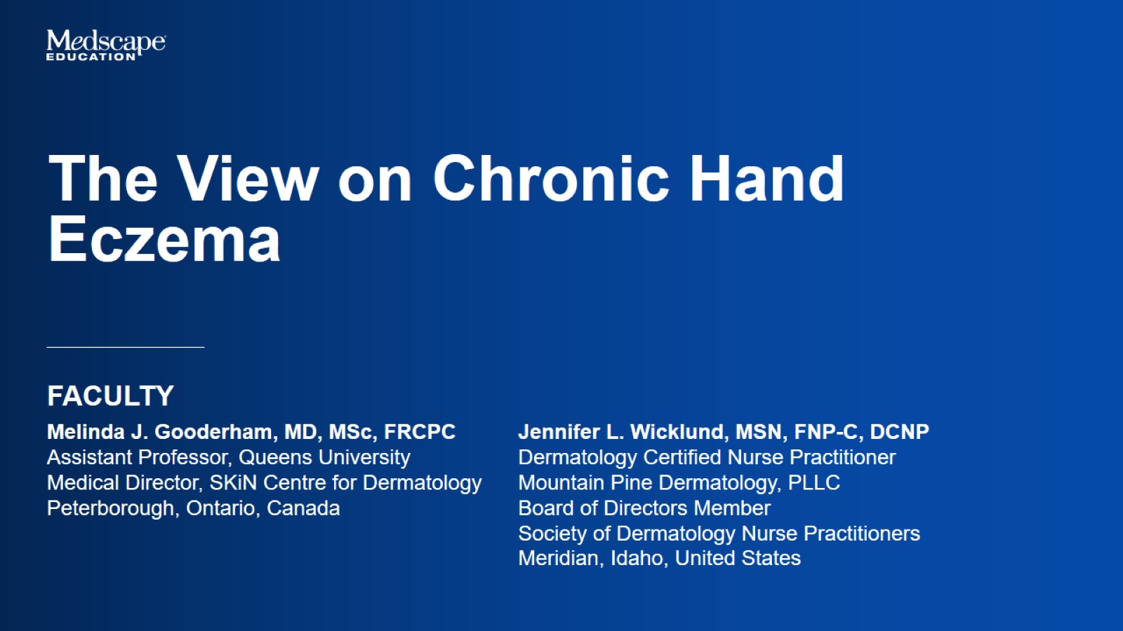

Slide 2
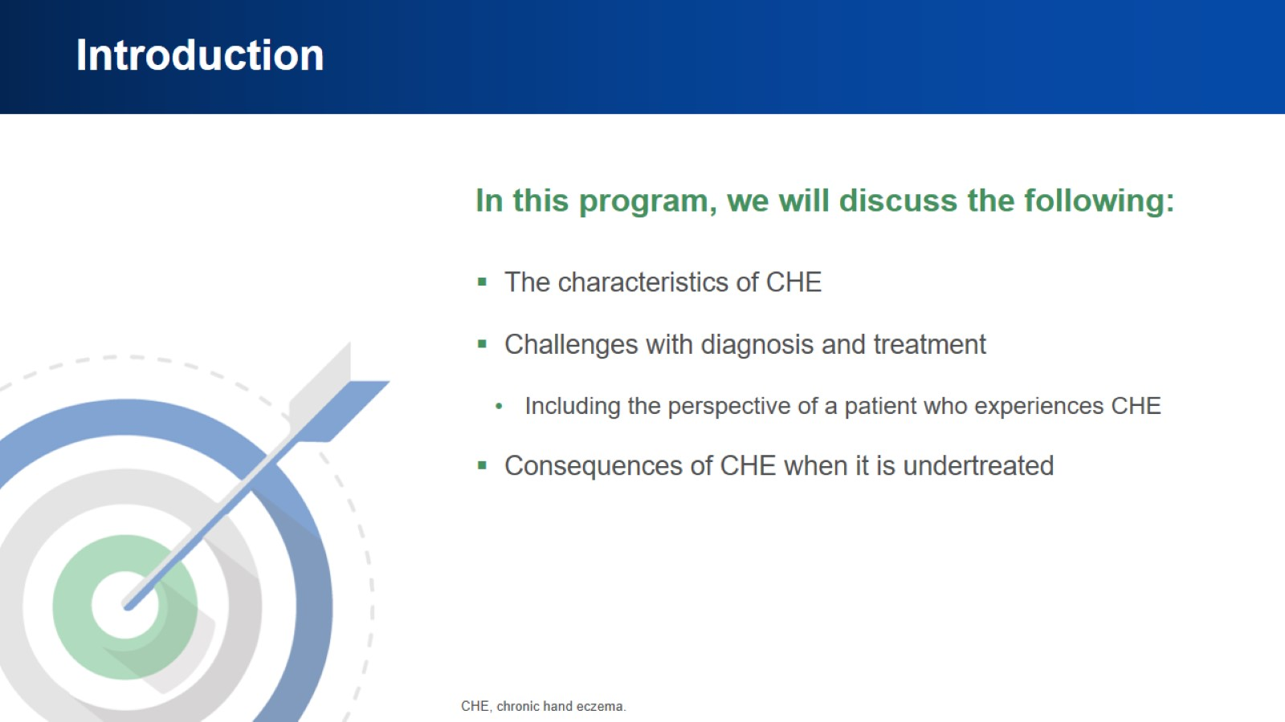
Introduction

Slide 3
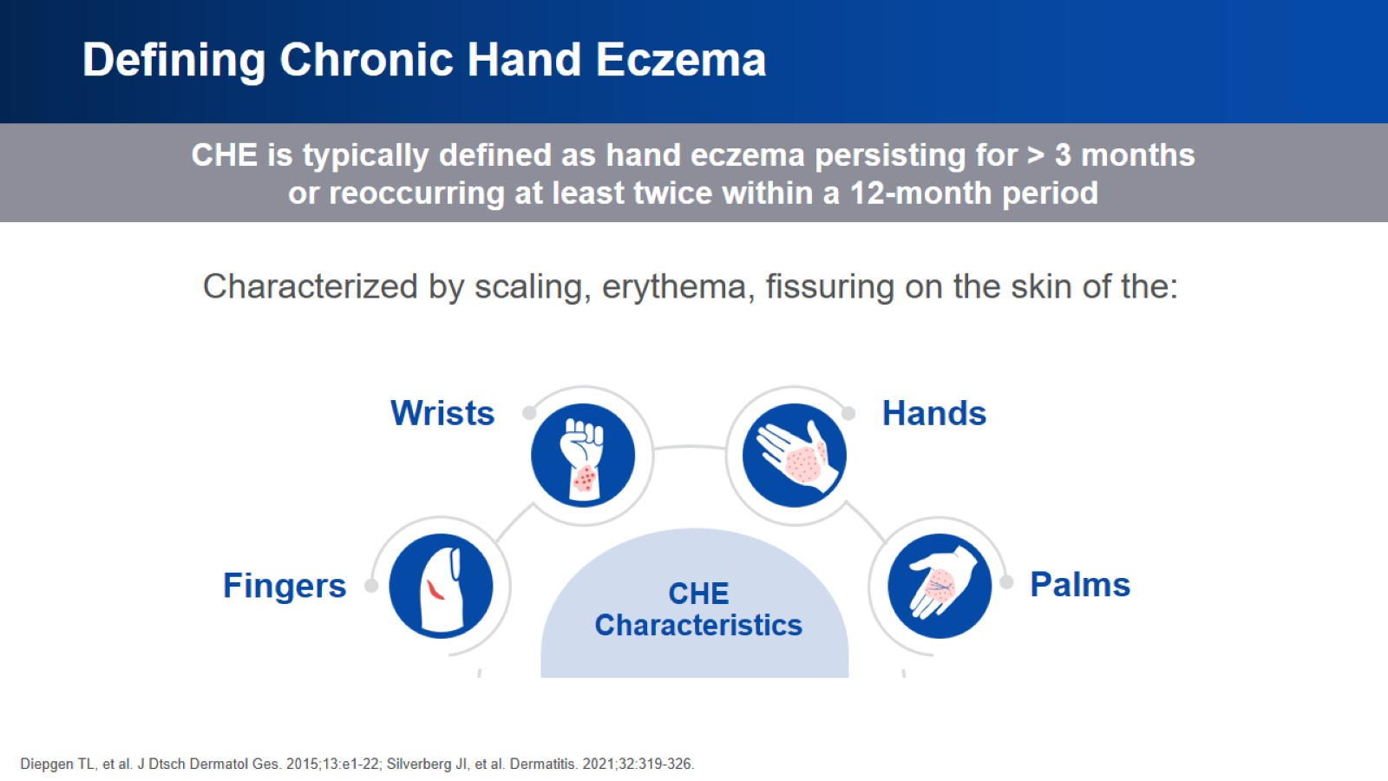
Defining Chronic Hand Eczema

Slide 4
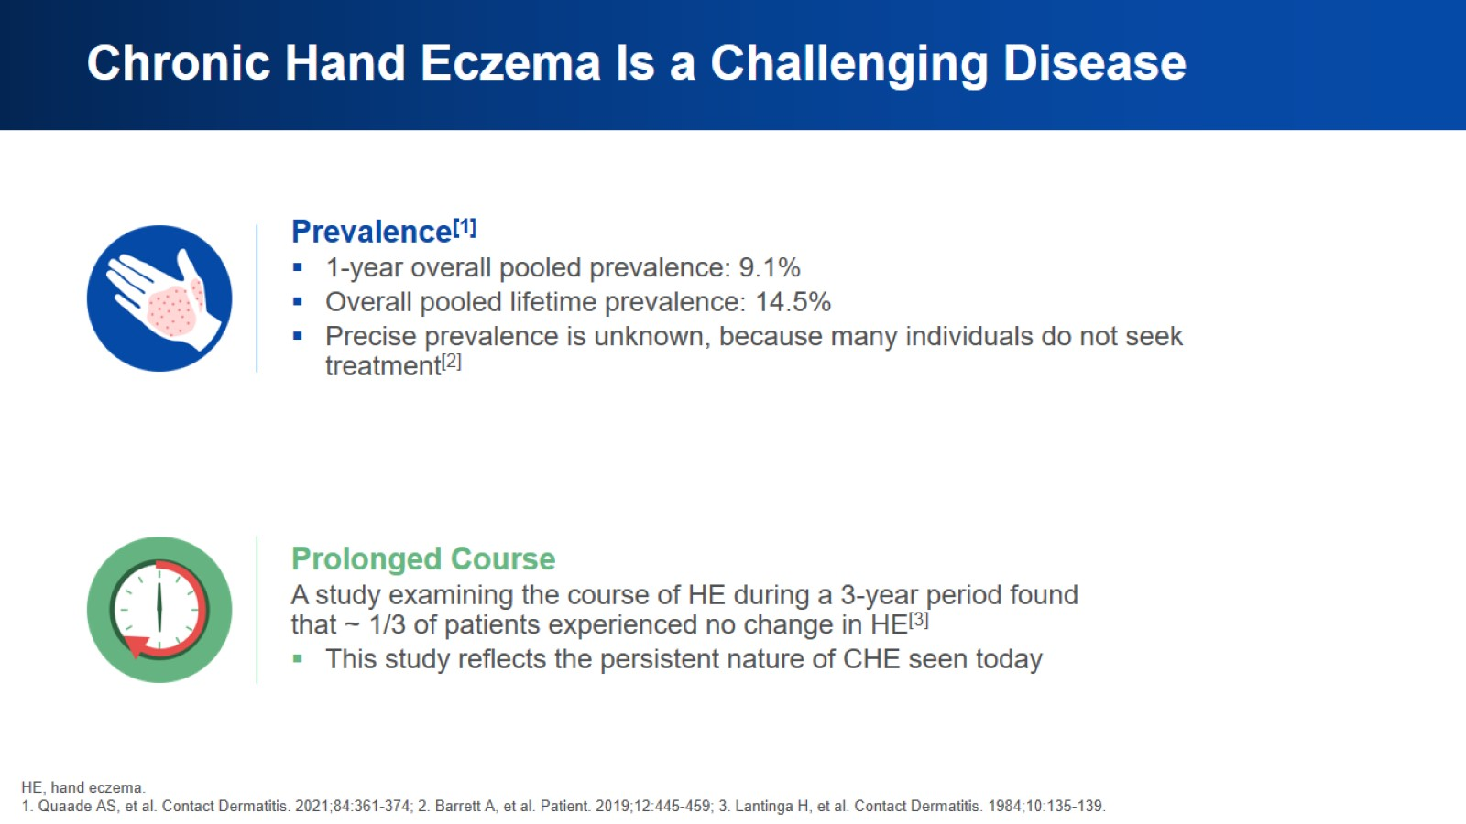
Chronic Hand Eczema Is a Challenging Disease

Slide 5
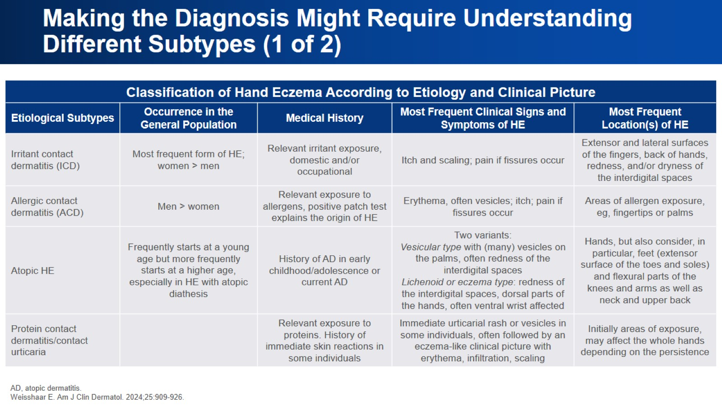
Making the Diagnosis Might Require Understanding Different Subtypes (1 of 2)

Slide 6
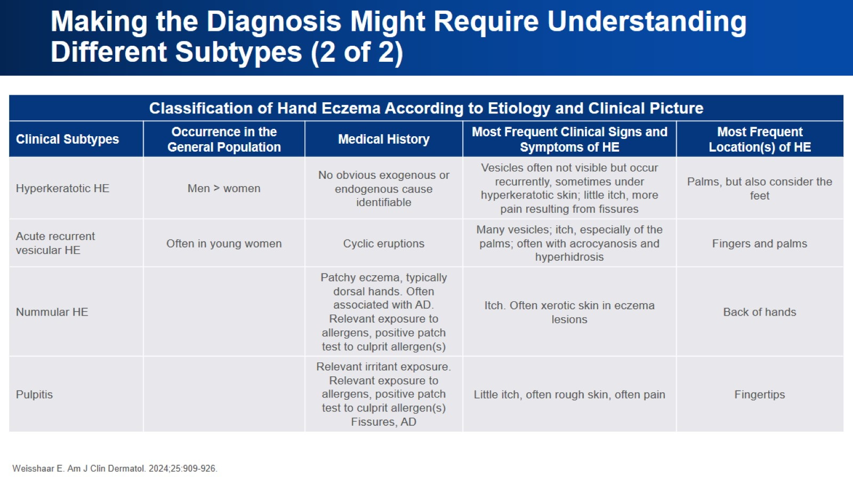
Making the Diagnosis Might Require Understanding Different Subtypes (2 of 2)

Slide 7
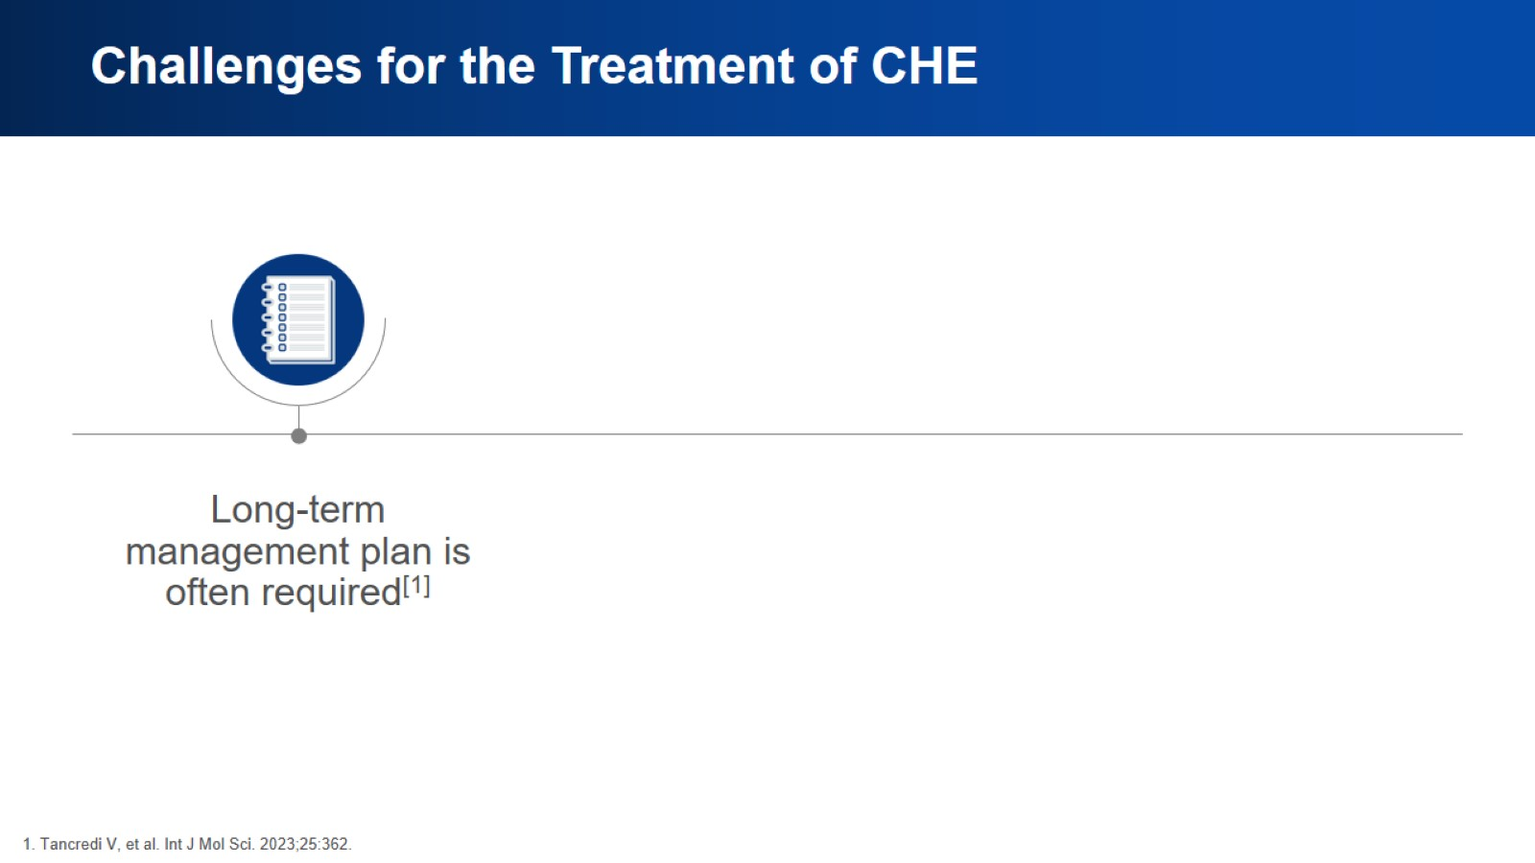
Challenges for the Treatment of CHE

Slide 8
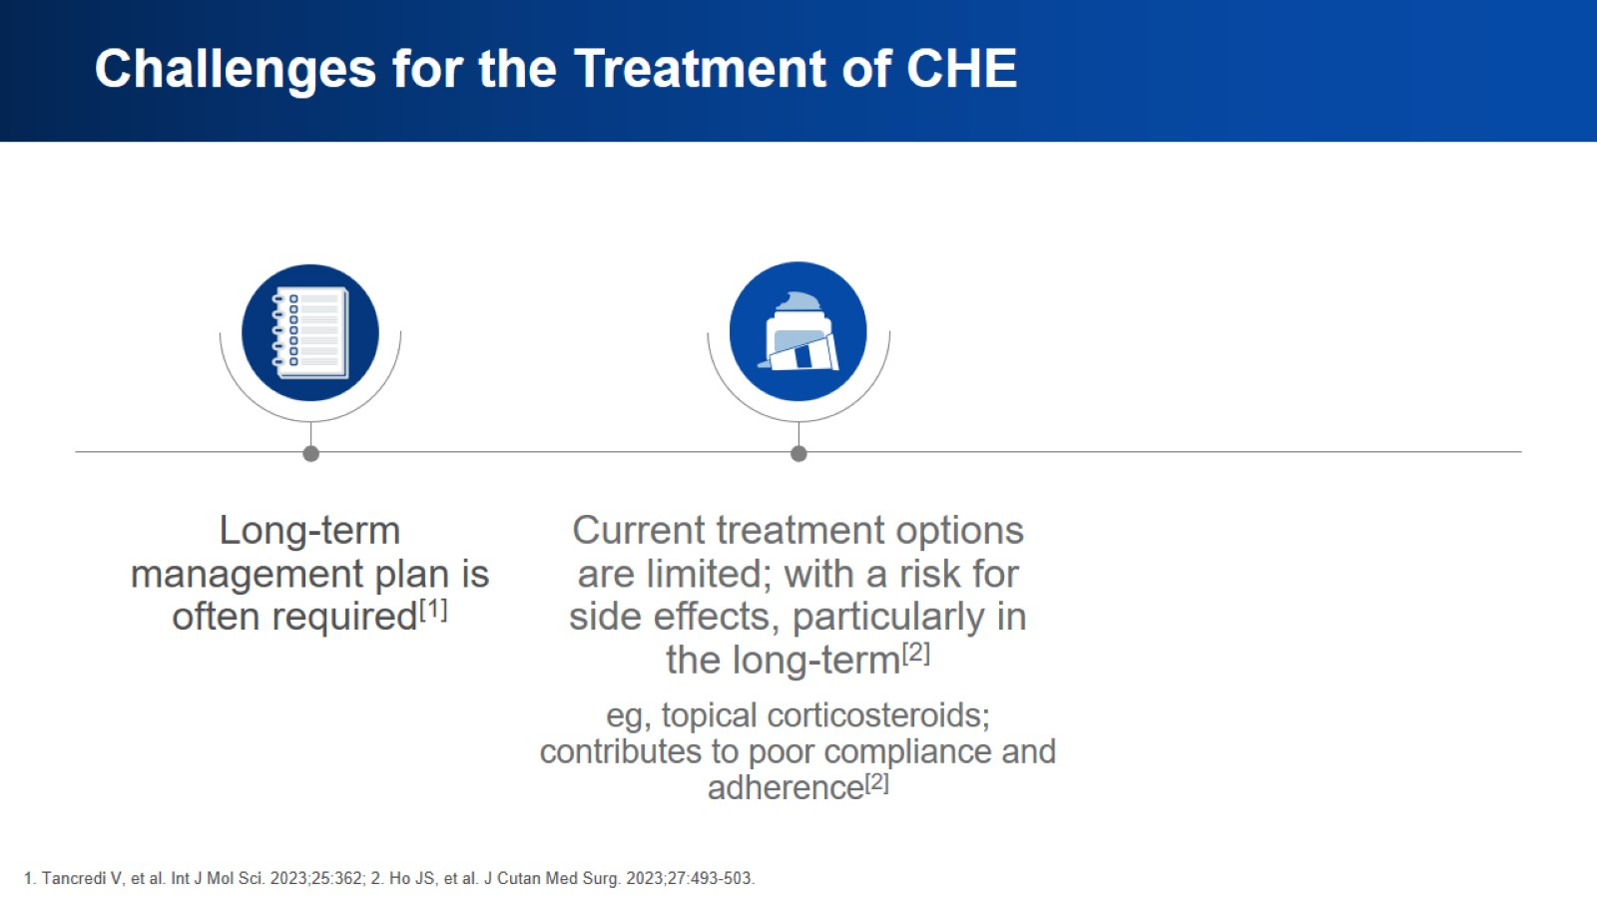
Challenges for the Treatment of CHE

Slide 9
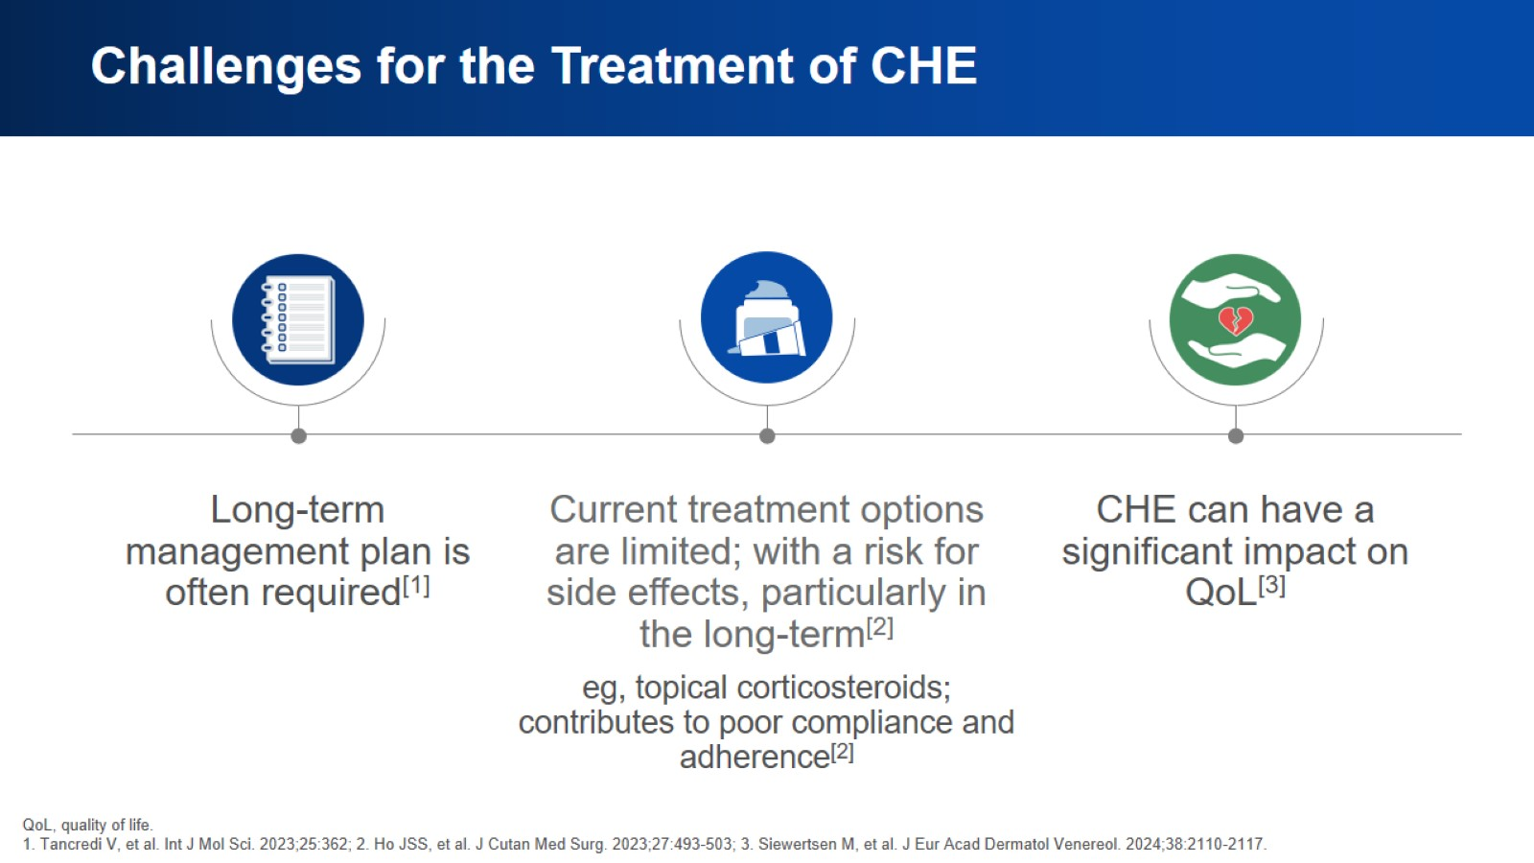
Challenges for the Treatment of CHE

Slide 10
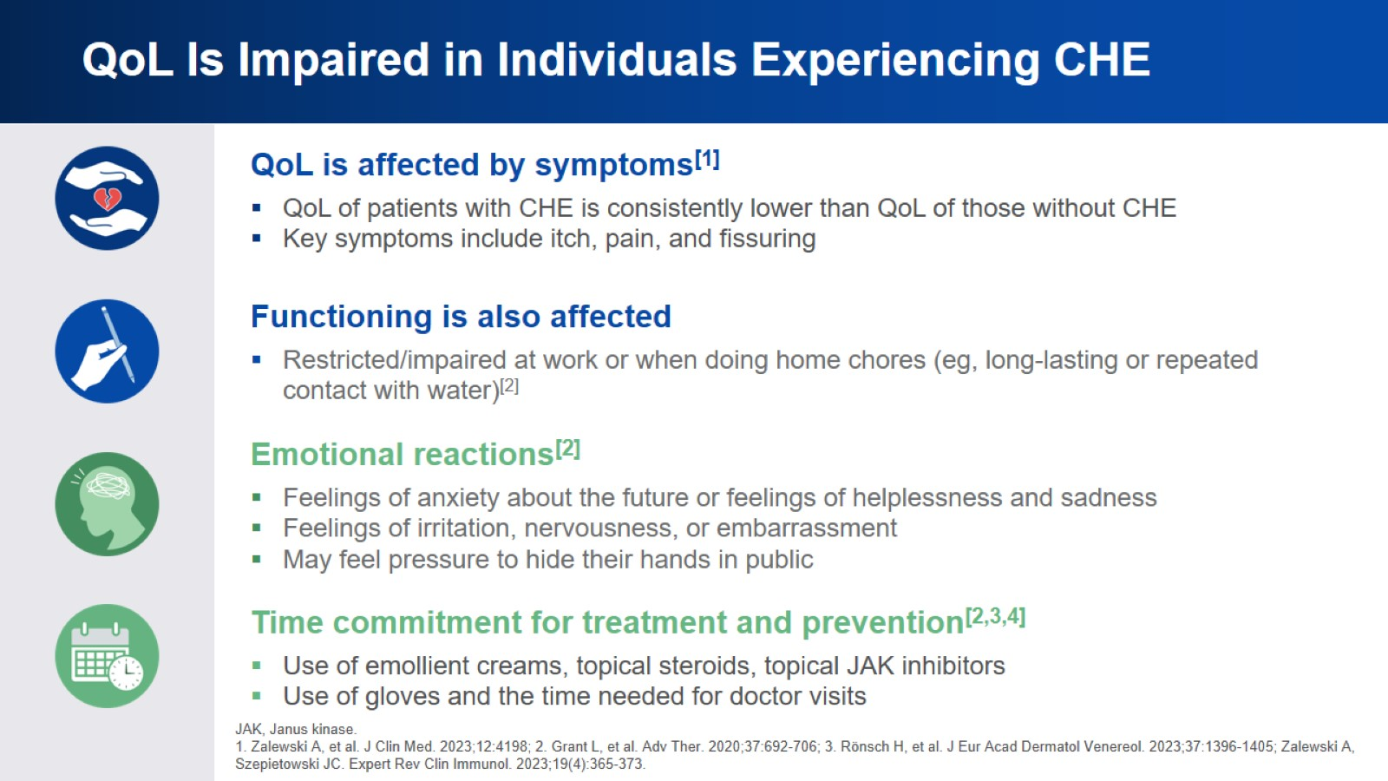
QoL Is Impaired in Individuals Experiencing CHE

Slide 11
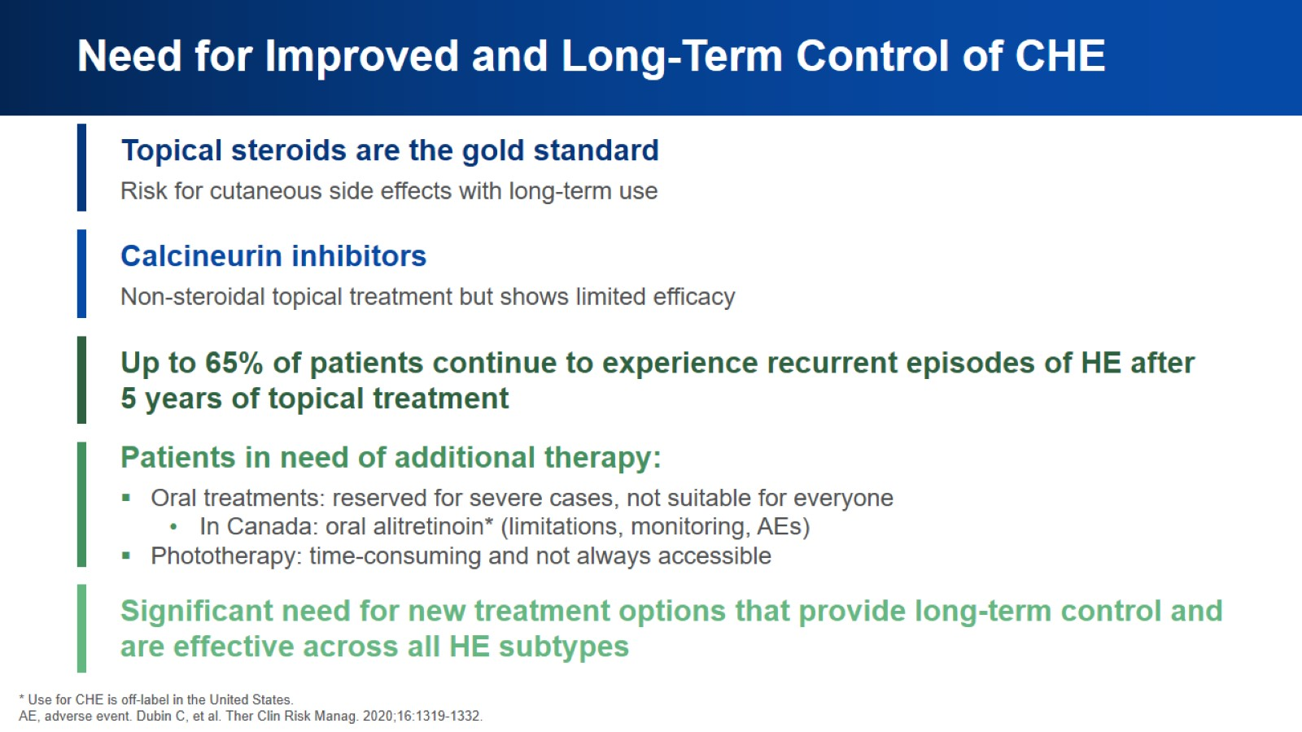
Need for Improved and Long-Term Control of CHE

Slide 12
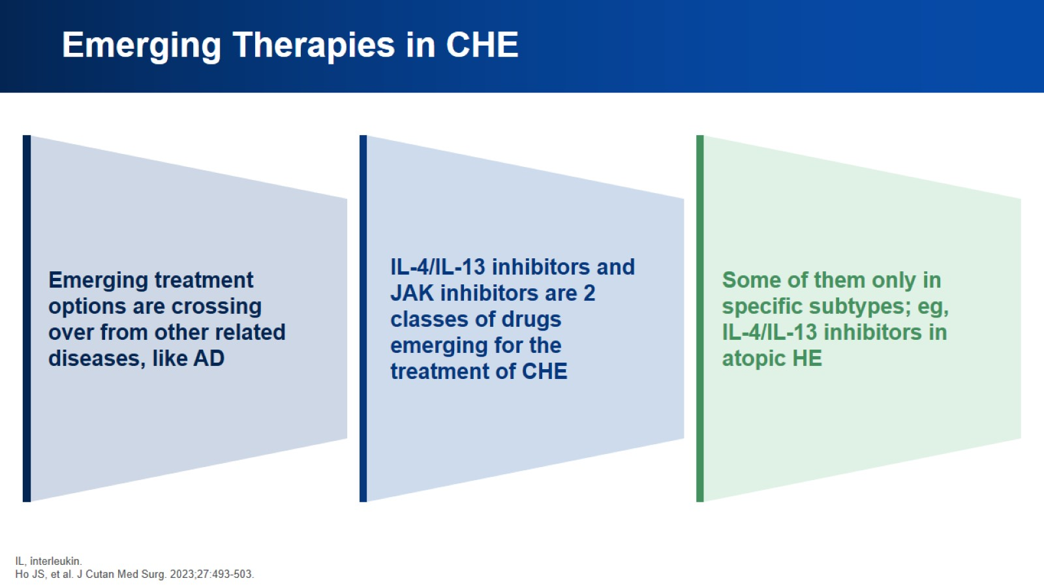
Emerging Therapies in CHE

Slide 13
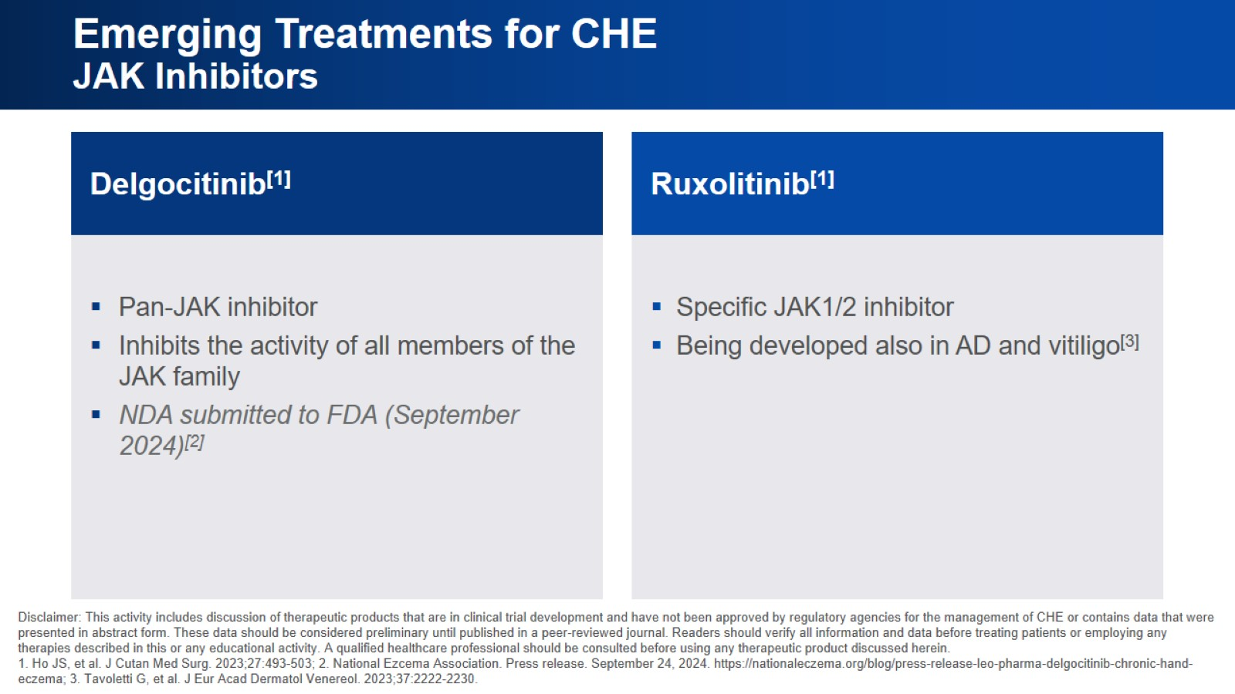
Emerging Treatments for CHE
JAK Inhibitors

Slide 14
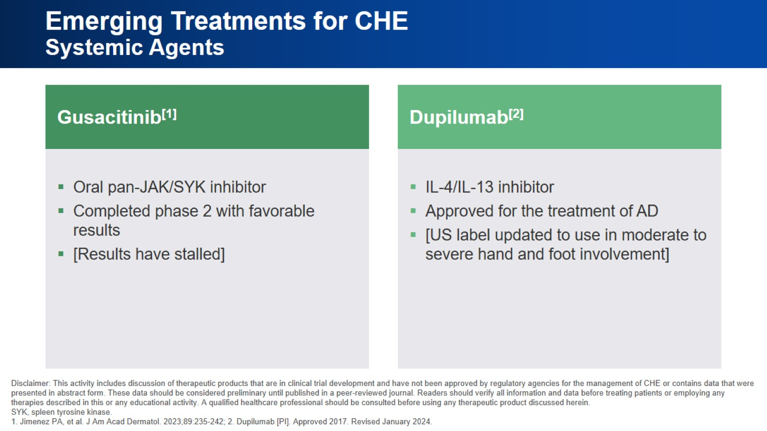
Emerging Treatments for CHE
Systemic Agents

Slide 15
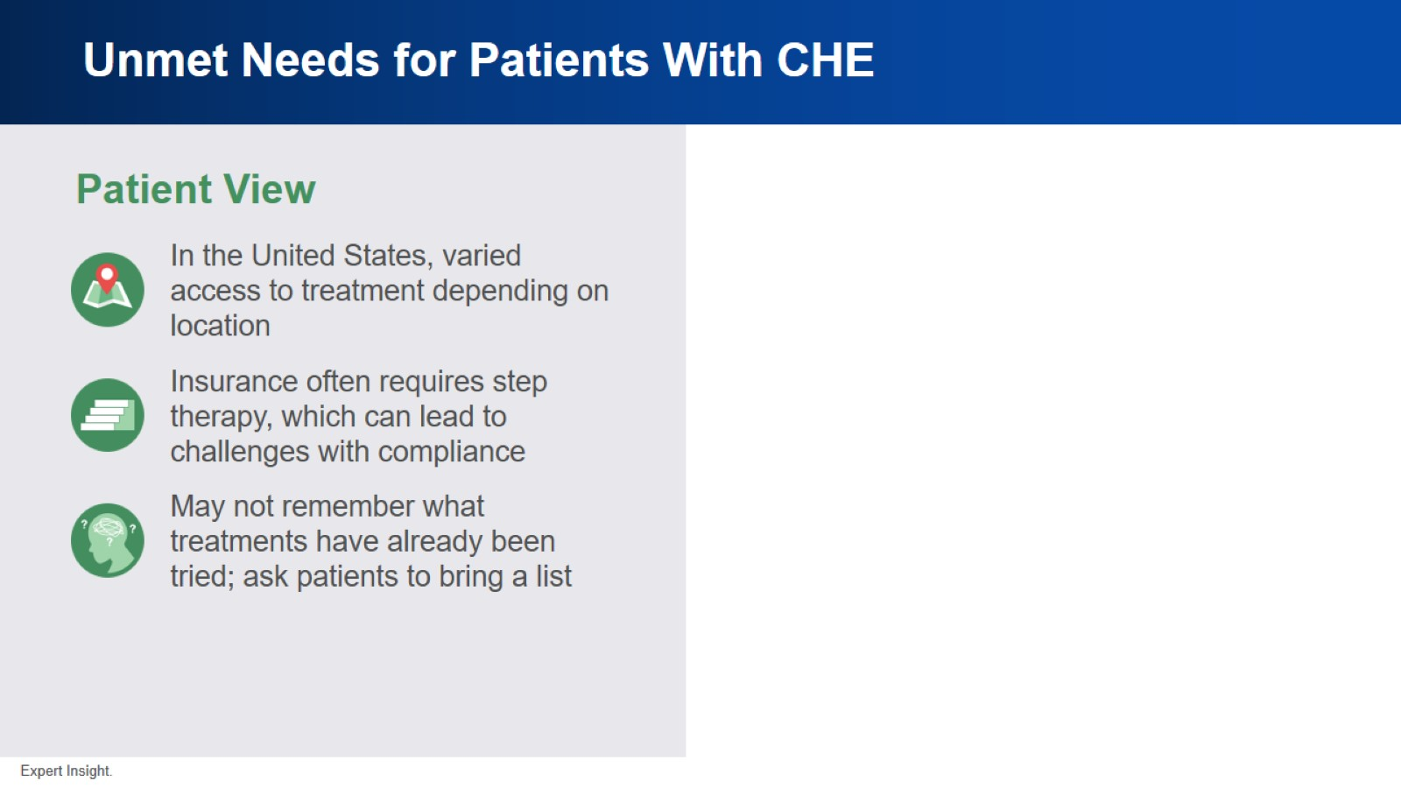
Unmet Needs for Patients With CHE

Slide 16
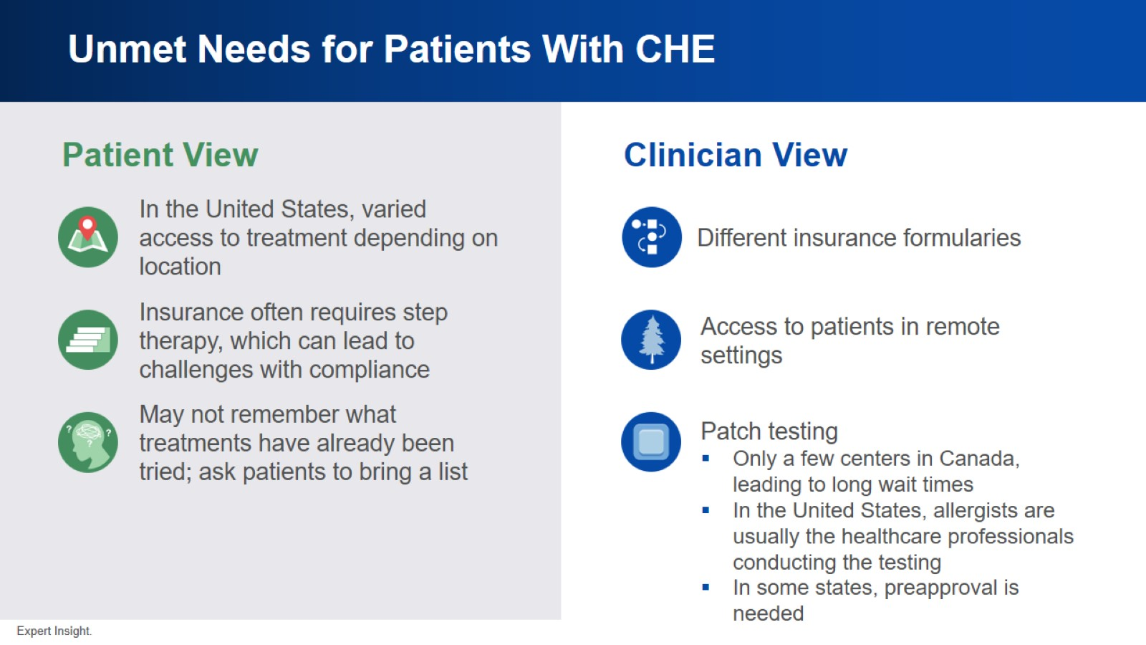
Unmet Needs for Patients With CHE

Slide 17
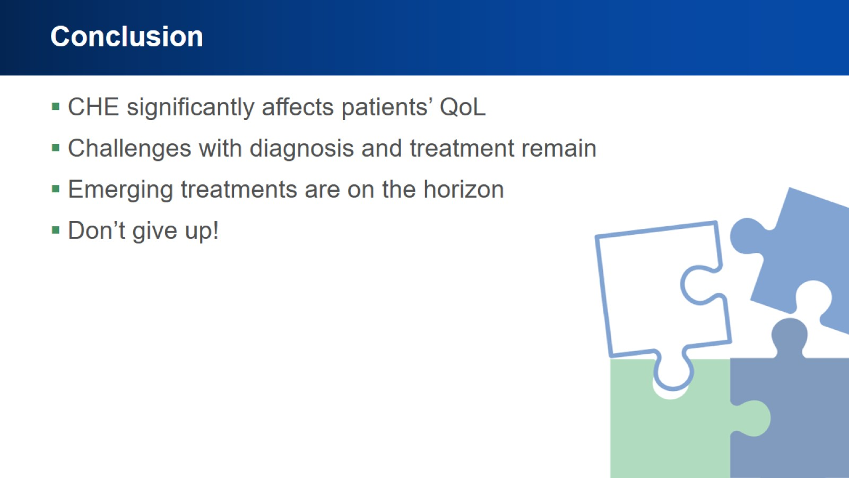
Conclusion

Slide 18


