Slide 1
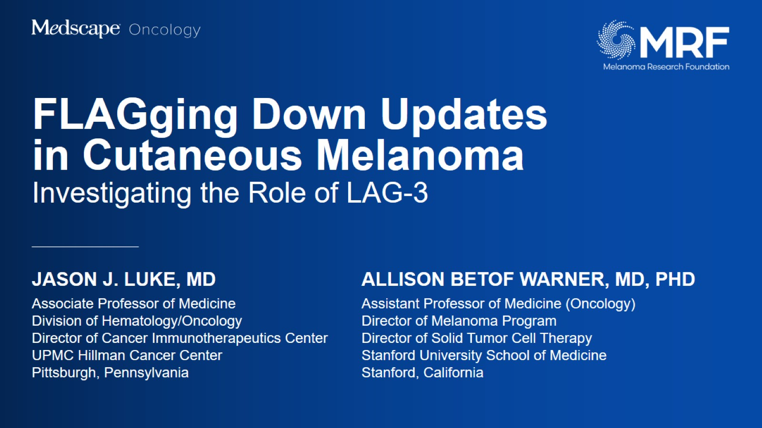

Slide 2
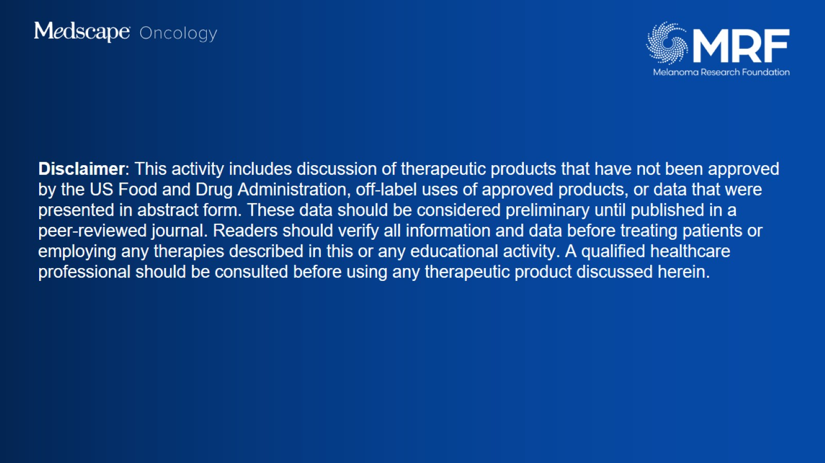
Disclaimer: This activity includes discussion of therapeutic products that have not been approved by the US Food and Drug Administration, off-label uses of approved products, or data that were presented in abstract form. These data should be considered preliminary until published in a peer-reviewed journal. Readers should verify all information and data before treating patients or employing any therapies described in this or any educational activity. A qualified healthcare professional should be consulted before using any therapeutic product discussed herein.​

Slide 3
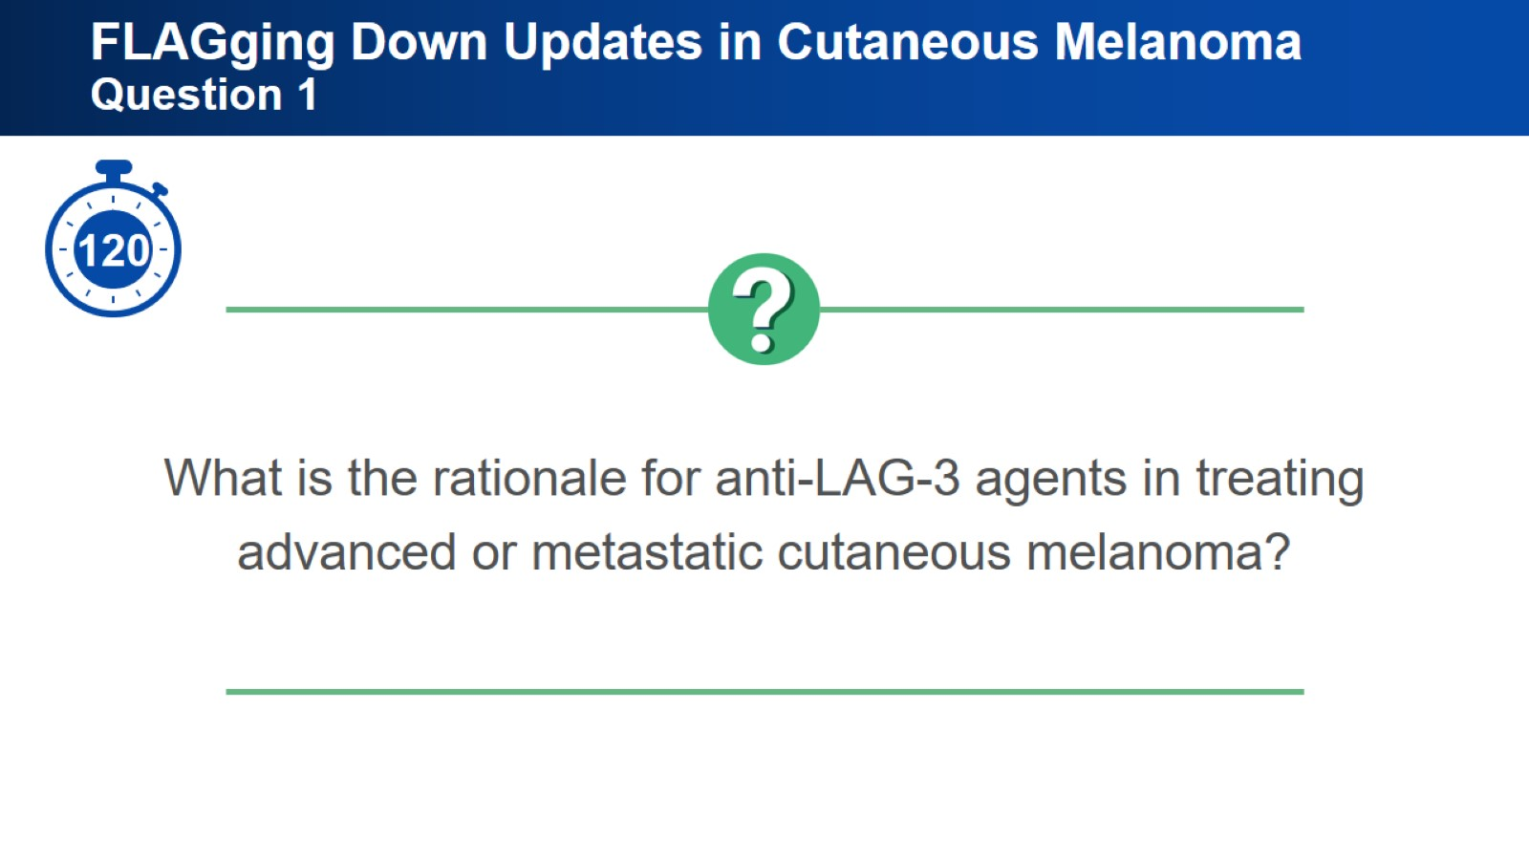
FLAGging Down Updates in Cutaneous Melanoma Question 1

Slide 4
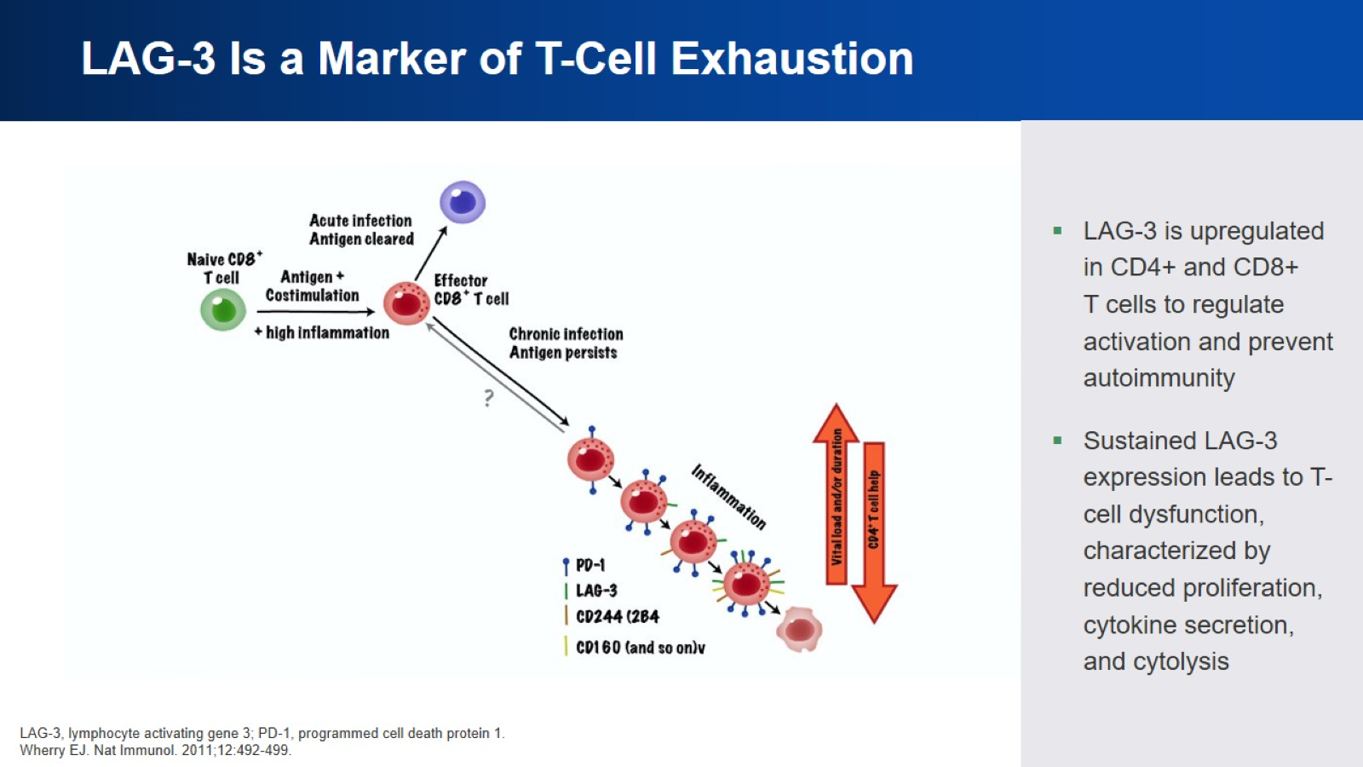
LAG-3 Is a Marker of T-Cell Exhaustion

Slide 5
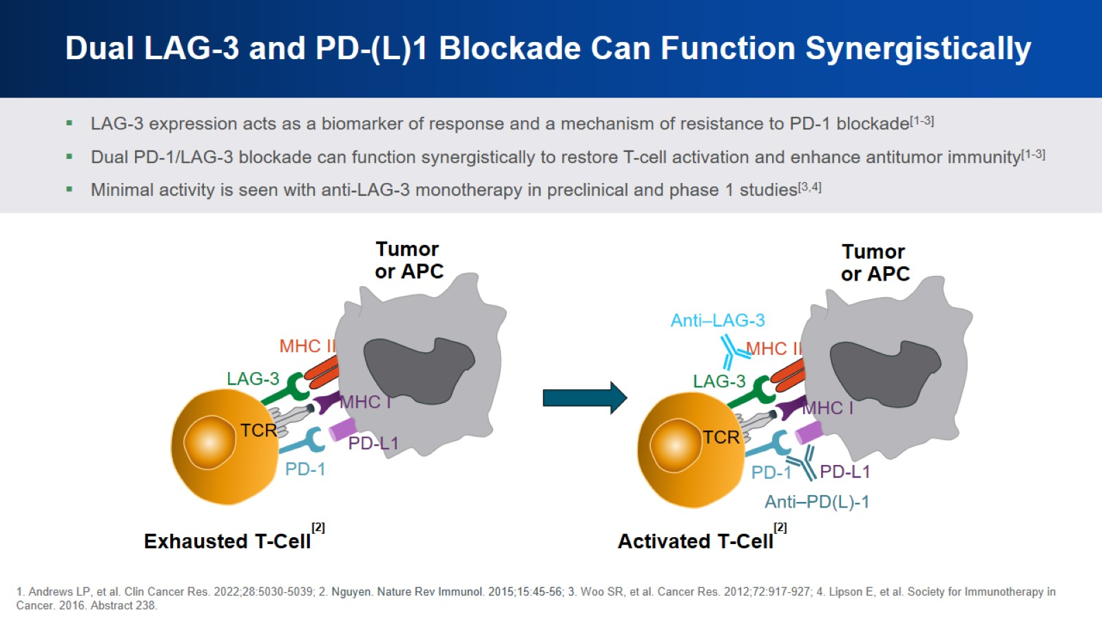
Dual LAG-3 and PD-(L)1 Blockade Can Function Synergistically

Slide 6
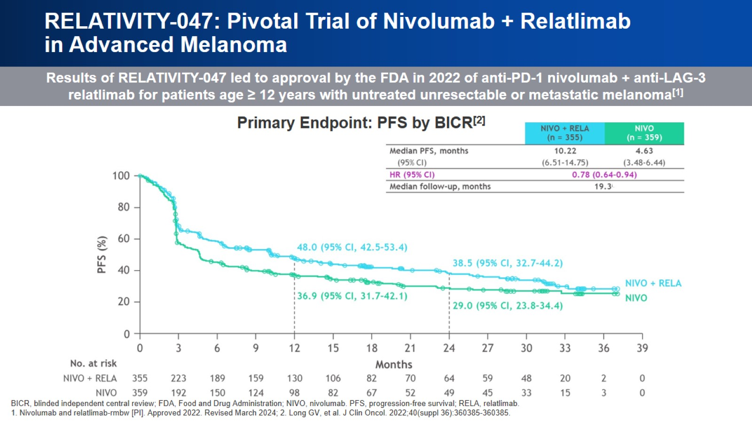
RELATIVITY-047: Pivotal Trial of Nivolumab + Relatlimab in Advanced Melanoma

Slide 7

FLAGging Down Updates in Cutaneous Melanoma Question 2

Slide 8
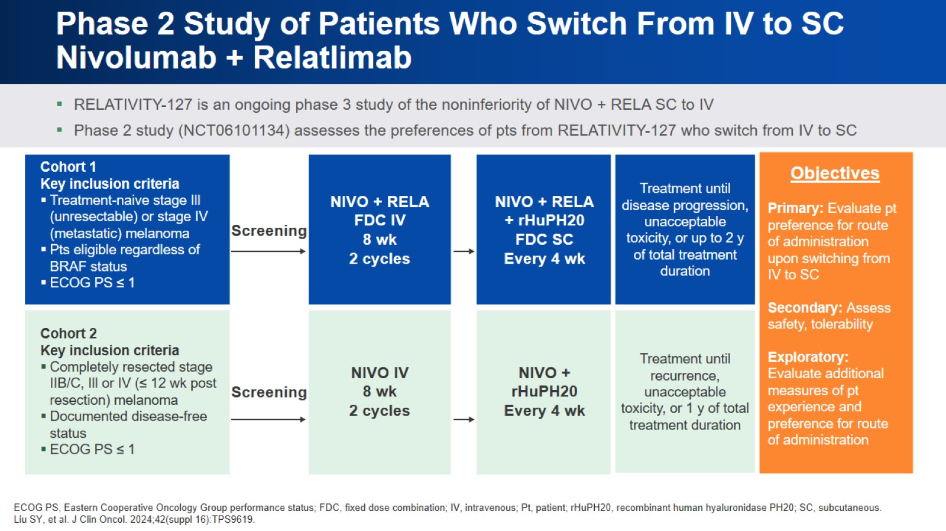
Phase 2 Study of Patients Who Switch From IV to SC Nivolumab + Relatlimab

Slide 9
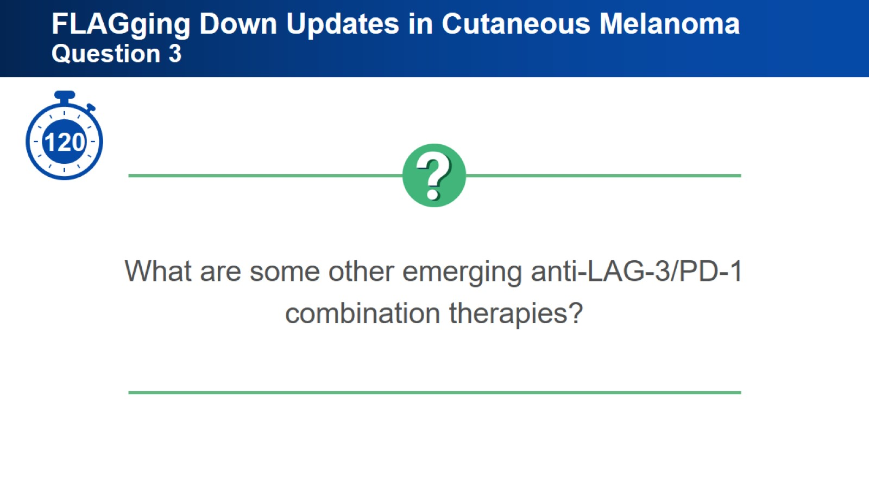
FLAGging Down Updates in Cutaneous Melanoma Question 3

Slide 10
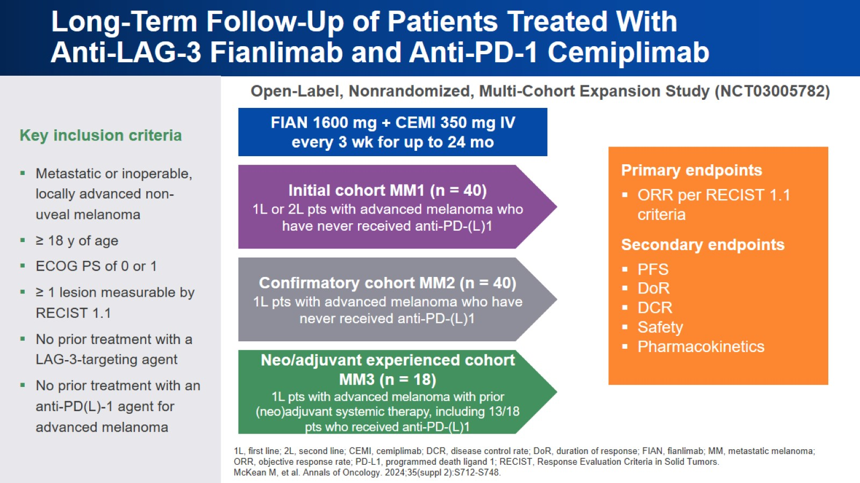
Long-Term Follow-Up of Patients Treated With Anti-LAG-3 Fianlimab and Anti-PD-1 Cemiplimab

Slide 11
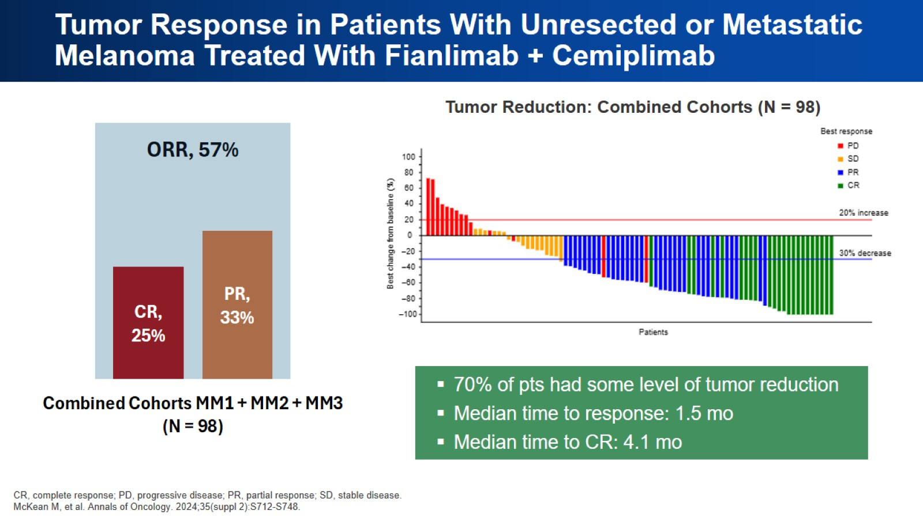
Tumor Response in Patients With Unresected or Metastatic Melanoma Treated With Fianlimab + Cemiplimab

Slide 12
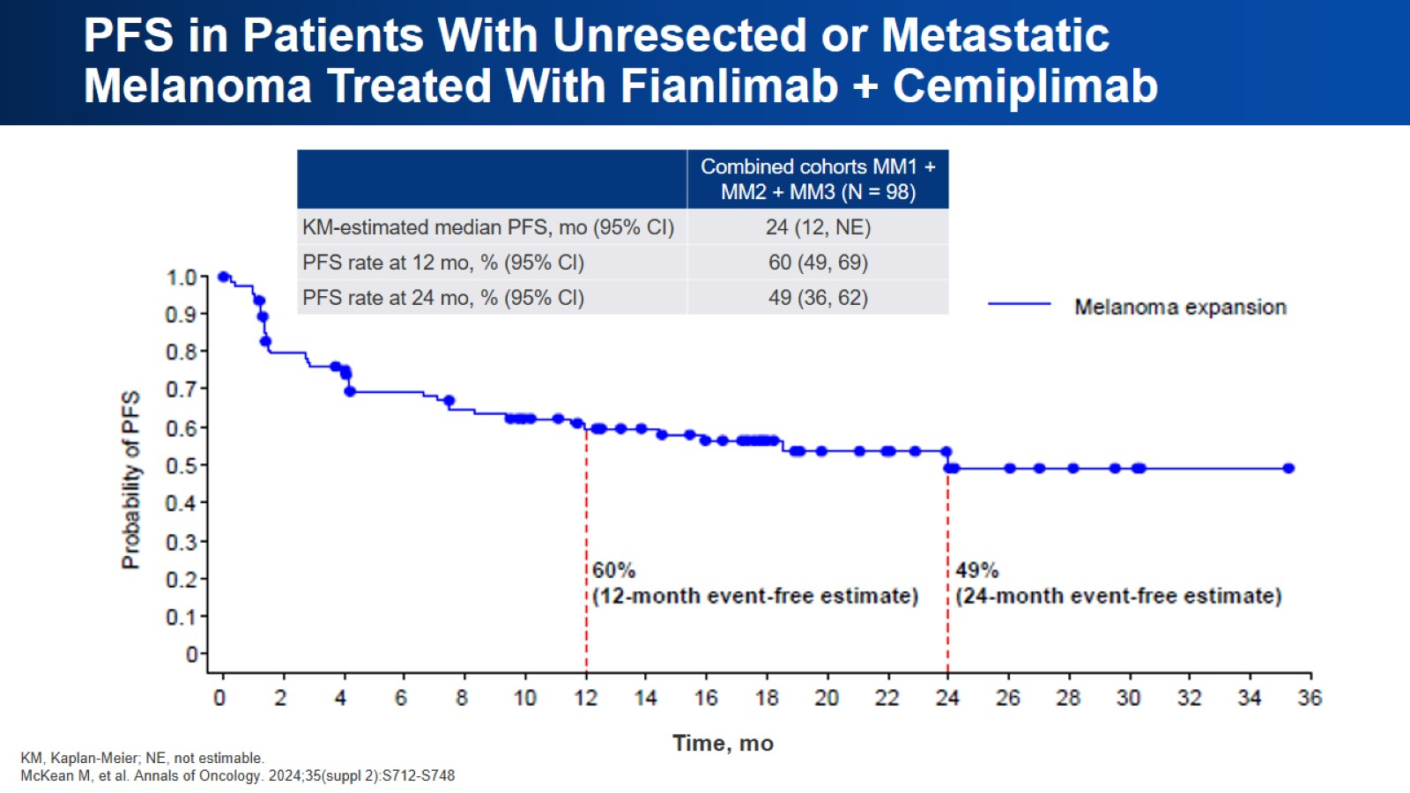
PFS in Patients With Unresected or Metastatic Melanoma Treated With Fianlimab + Cemiplimab

Slide 13

FLAGging Down Updates in Cutaneous Melanoma Question 4

Slide 14
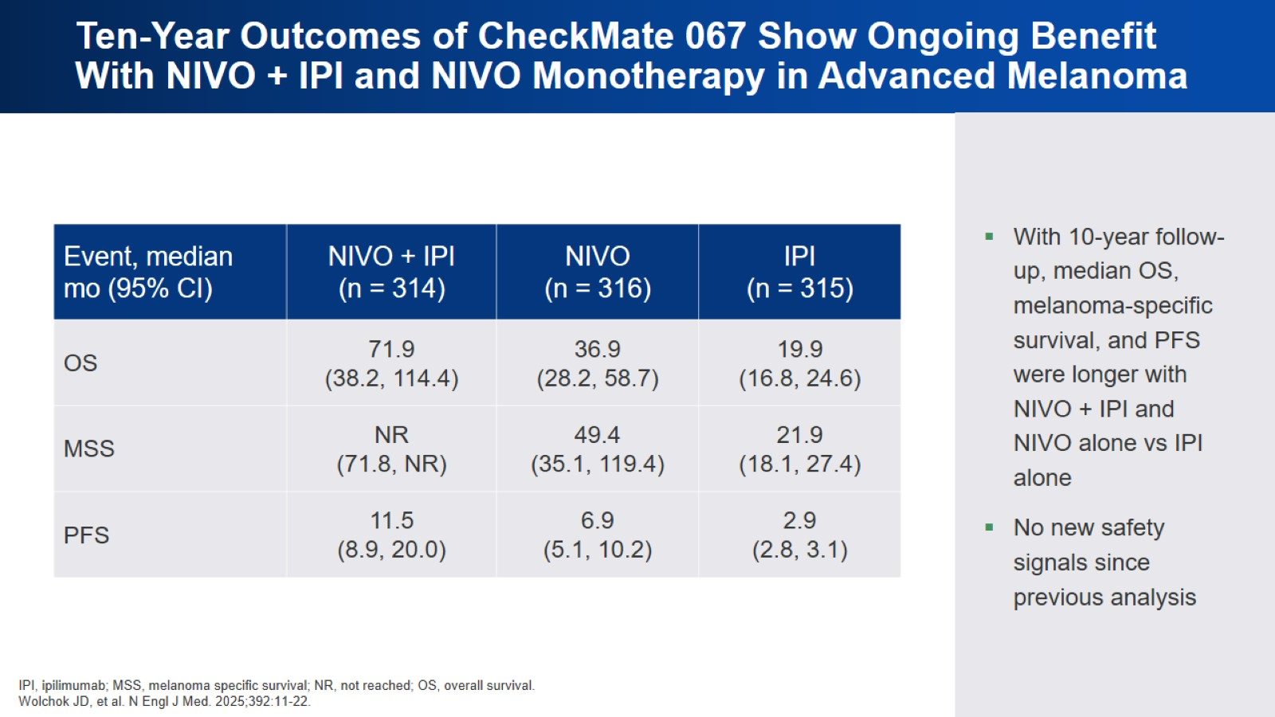
Ten-Year Outcomes of CheckMate 067 Show Ongoing Benefit With NIVO + IPI and NIVO Monotherapy in Advanced Melanoma

Slide 15
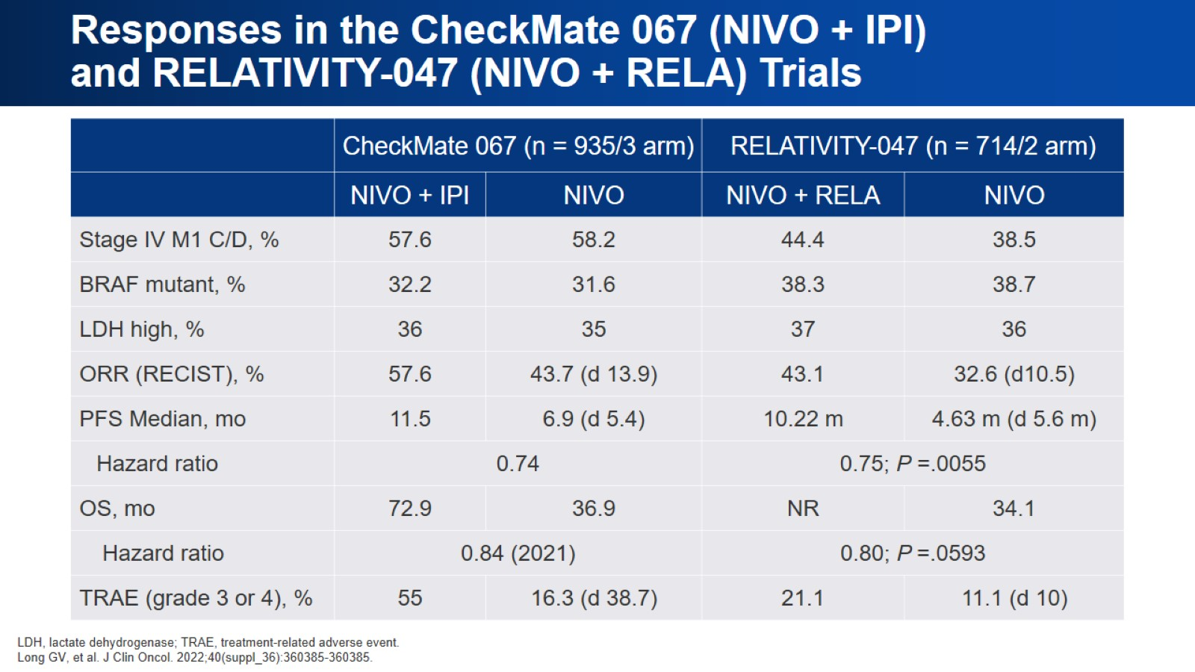
Responses in the CheckMate 067 (NIVO + IPI) and RELATIVITY-047 (NIVO + RELA) Trials

Slide 16
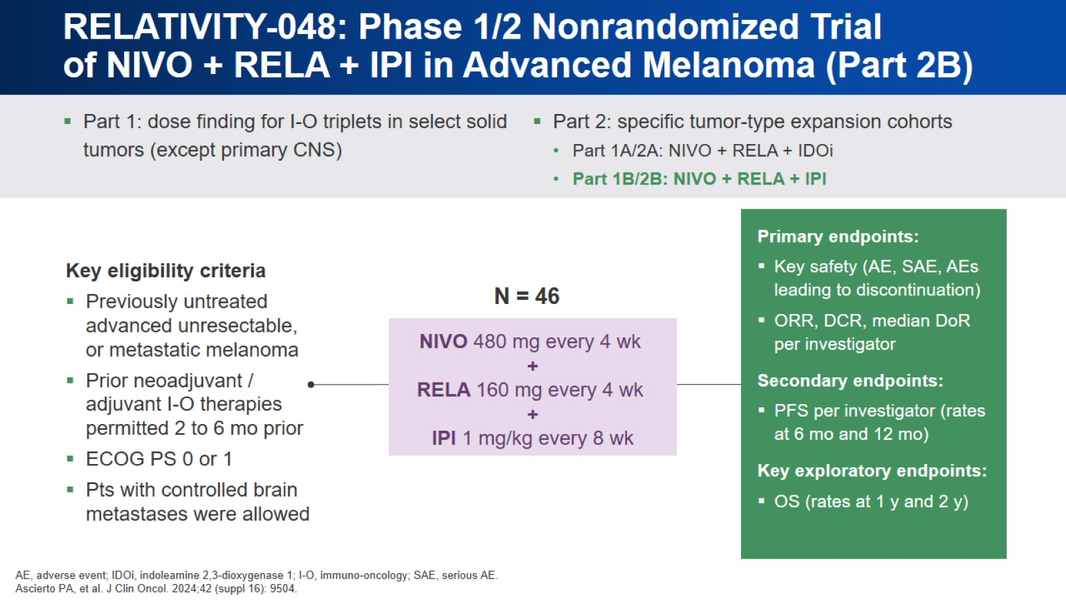
RELATIVITY-048: Phase 1/2 Nonrandomized Trial of NIVO + RELA + IPI in Advanced Melanoma (Part 2B)

Slide 17
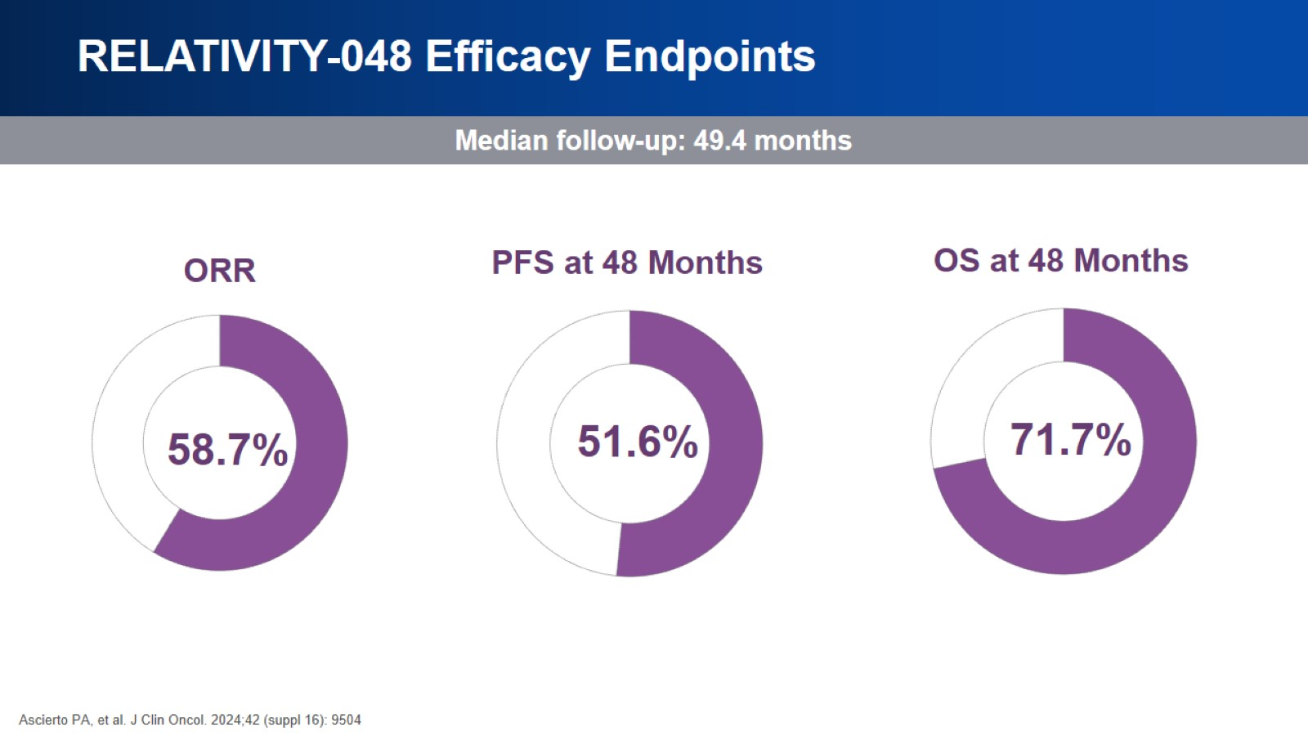
RELATIVITY-048 Efficacy Endpoints

Slide 18
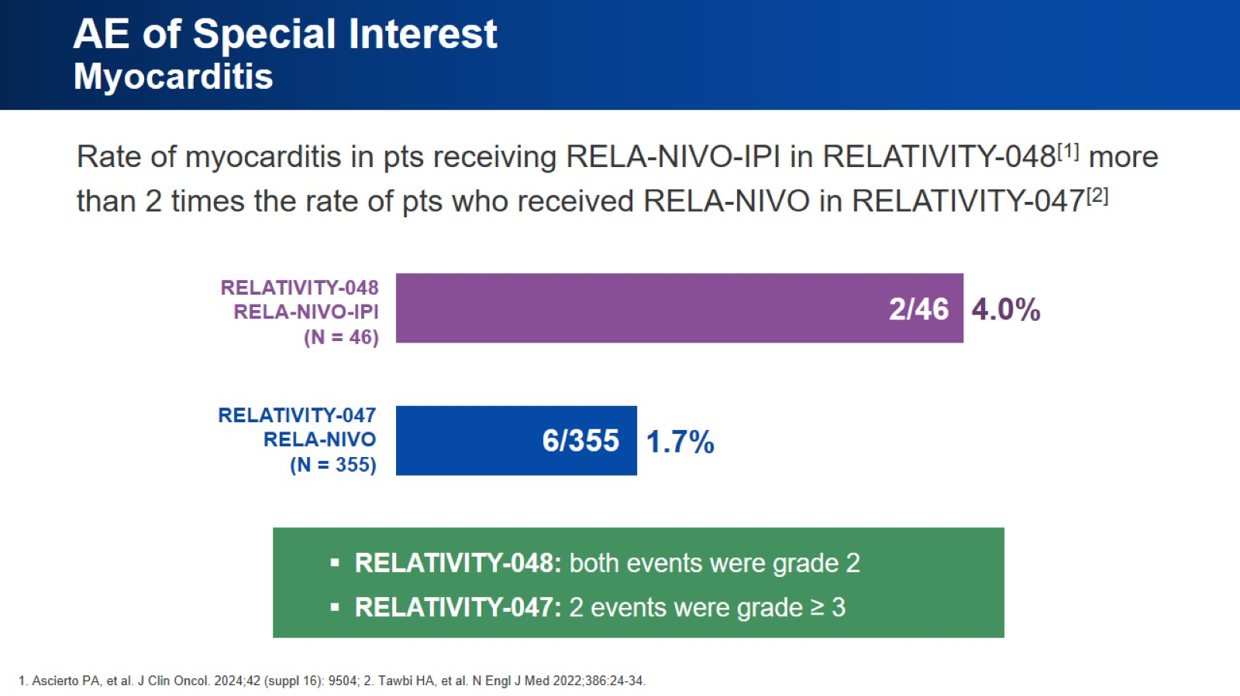
AE of Special Interest Myocarditis

Slide 19

FLAGging Down Updates in Cutaneous Melanoma Question 5

Slide 20
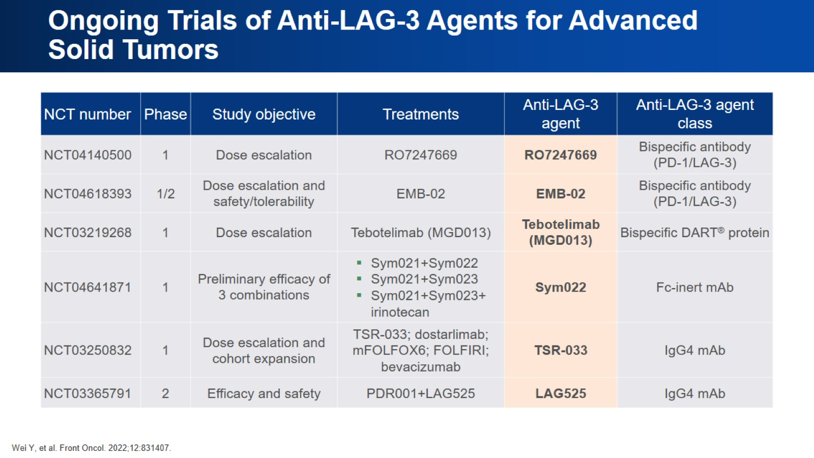
Ongoing Trials of Anti-LAG-3 Agents for Advanced Solid Tumors

Slide 21
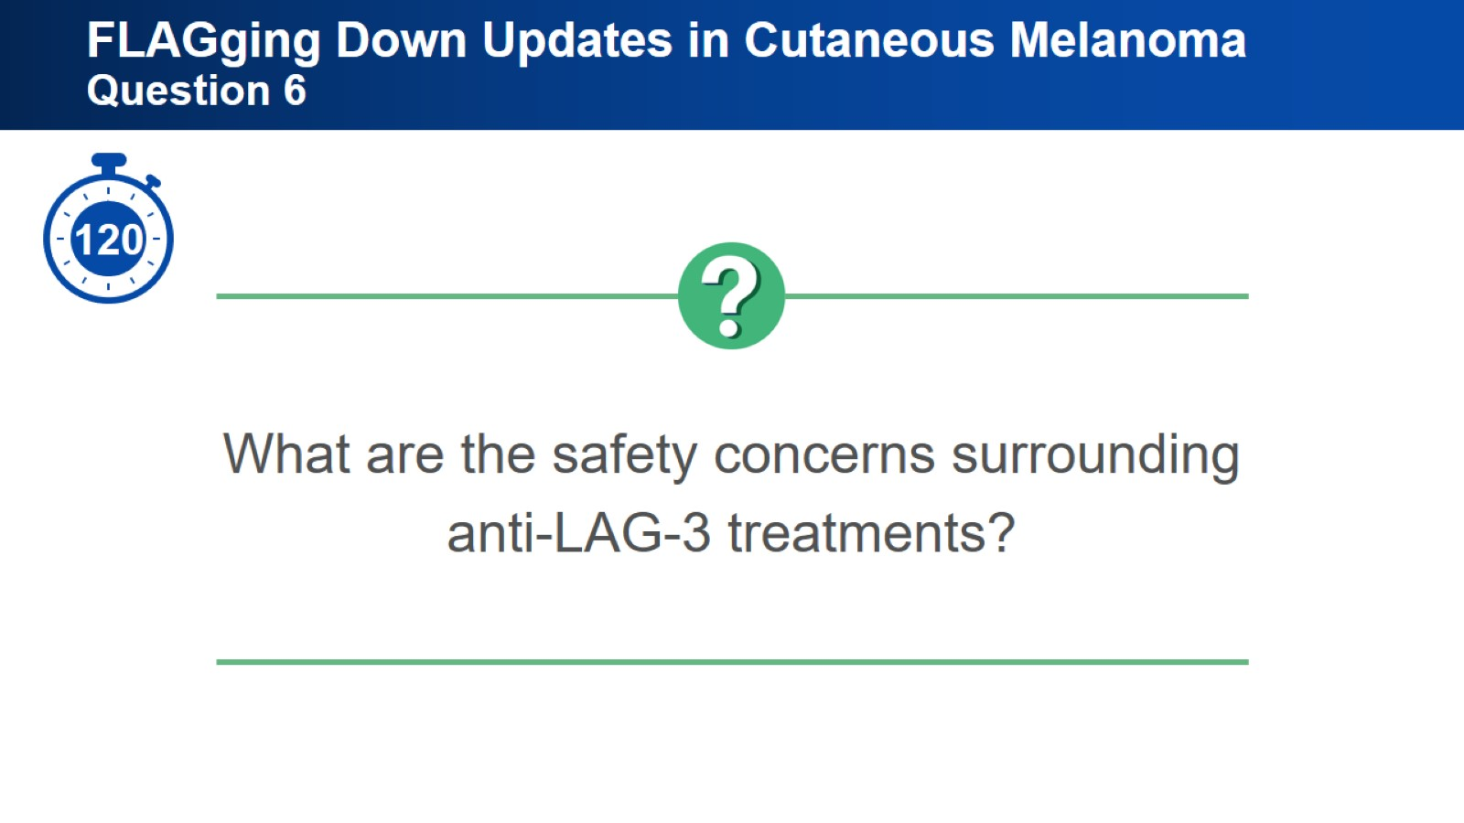
FLAGging Down Updates in Cutaneous Melanoma Question 6

Slide 22
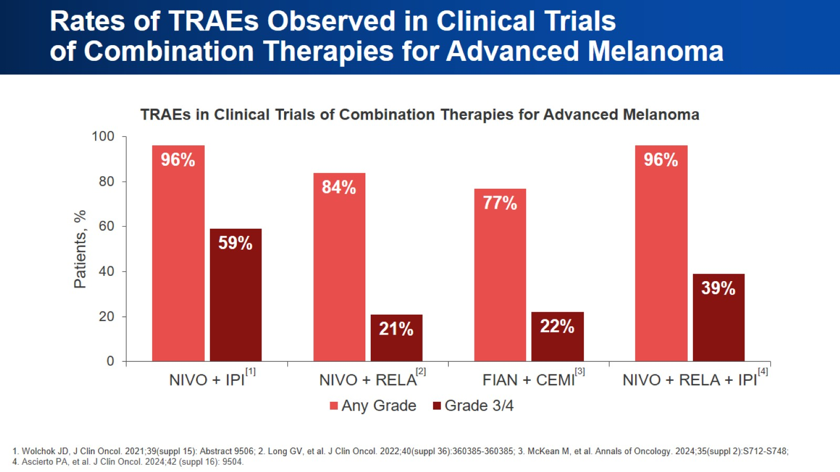
Rates of TRAEs Observed in Clinical Trials of Combination Therapies for Advanced Melanoma

Slide 23
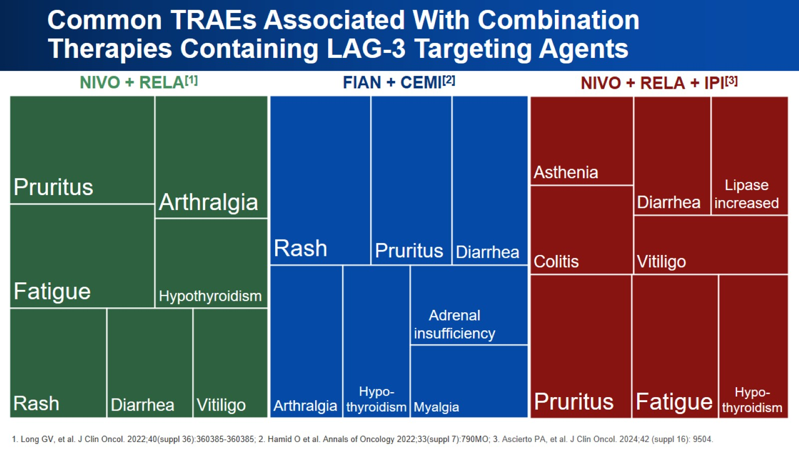
Common TRAEs Associated With Combination Therapies Containing LAG-3 Targeting Agents

Slide 24
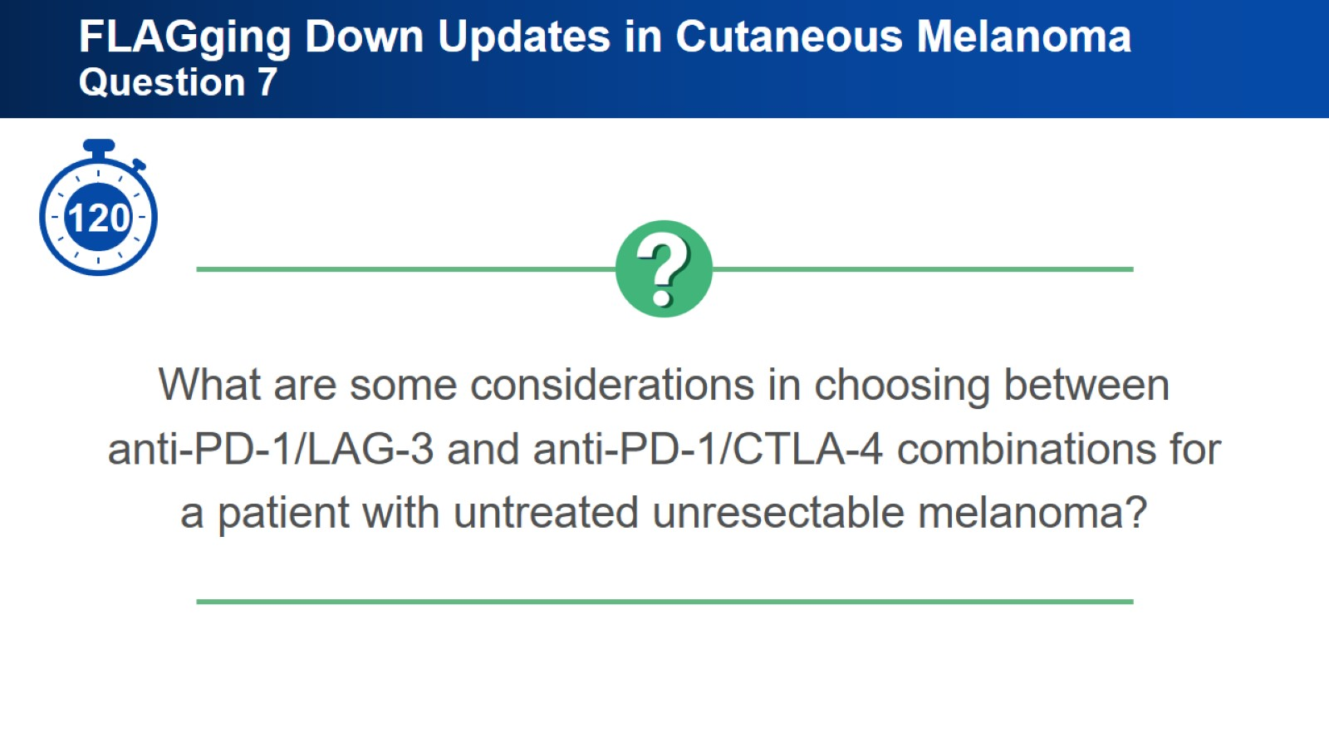
FLAGging Down Updates in Cutaneous Melanoma Question 7

Slide 25
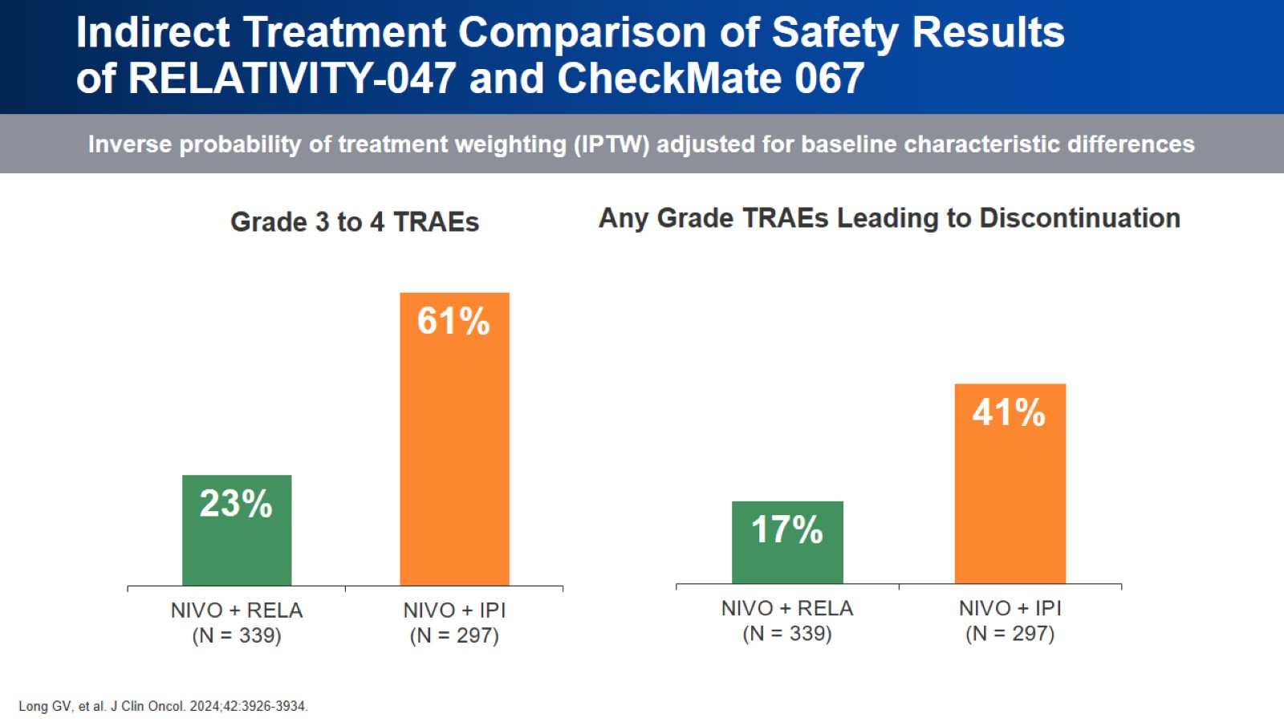
Indirect Treatment Comparison of Safety Results of RELATIVITY-047 and CheckMate 067

Slide 26
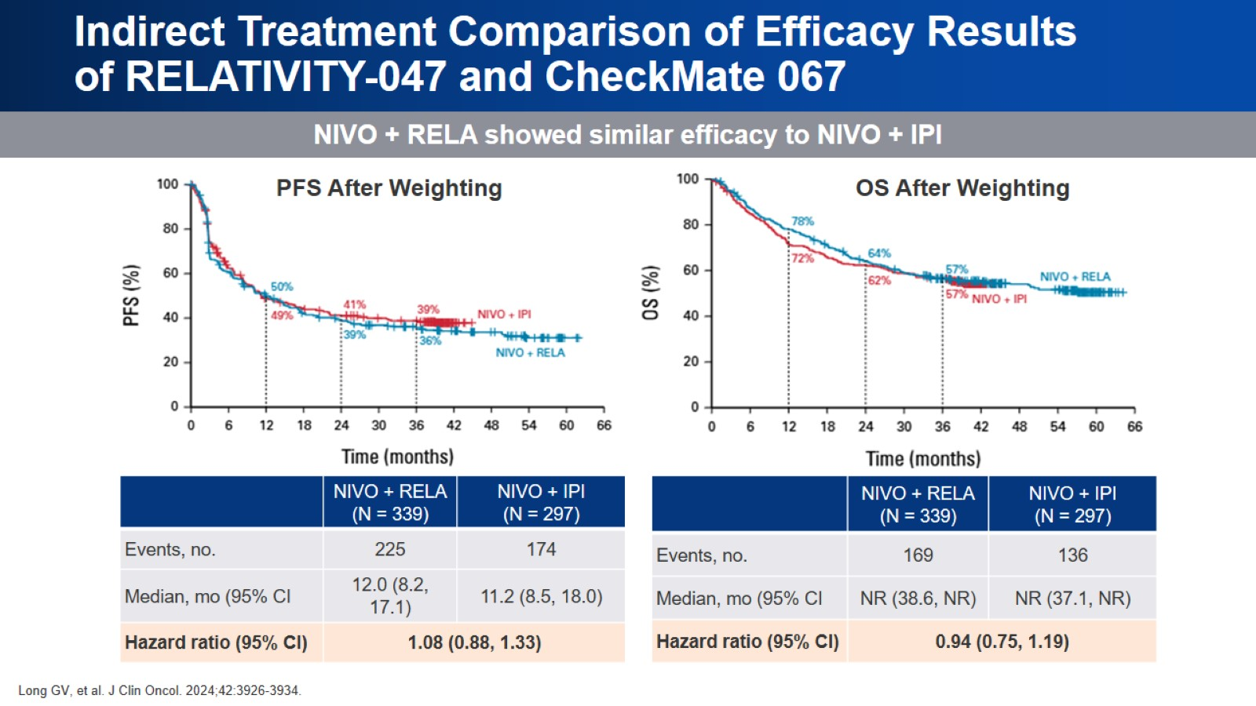
Indirect Treatment Comparison of Efficacy Results of RELATIVITY-047 and CheckMate 067

Slide 27
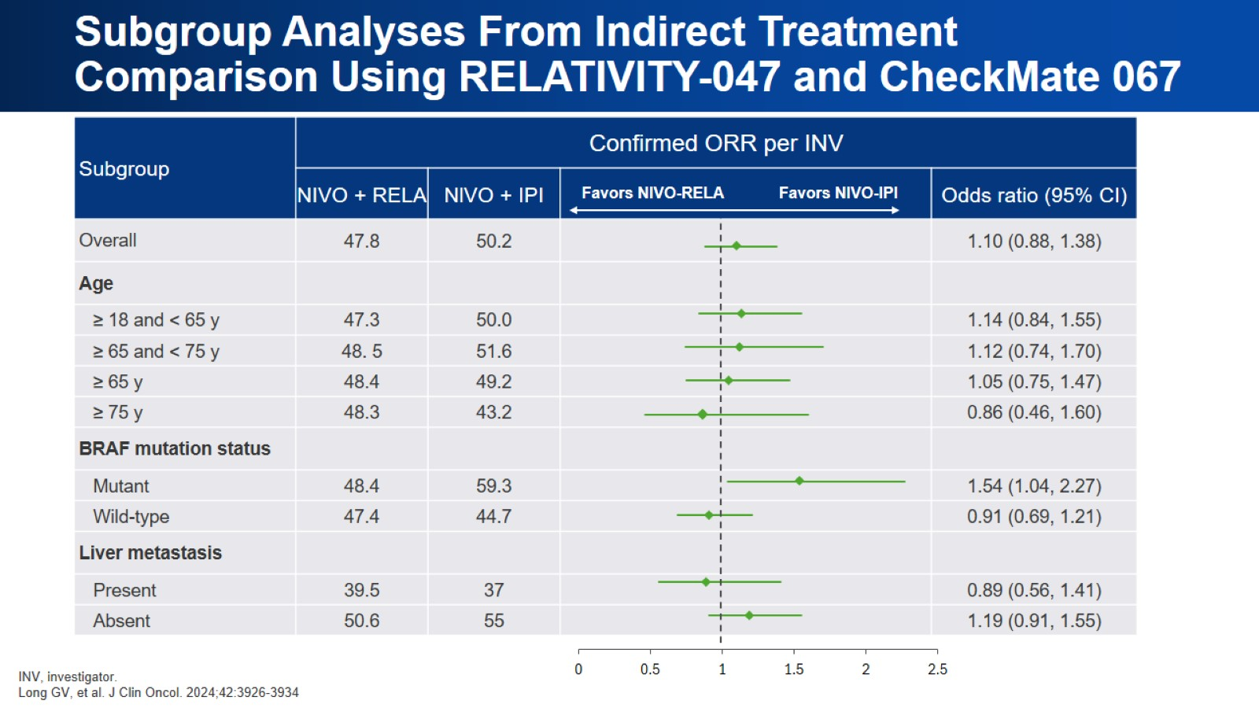
Subgroup Analyses From Indirect Treatment Comparison Using RELATIVITY-047 and CheckMate 067

Slide 28
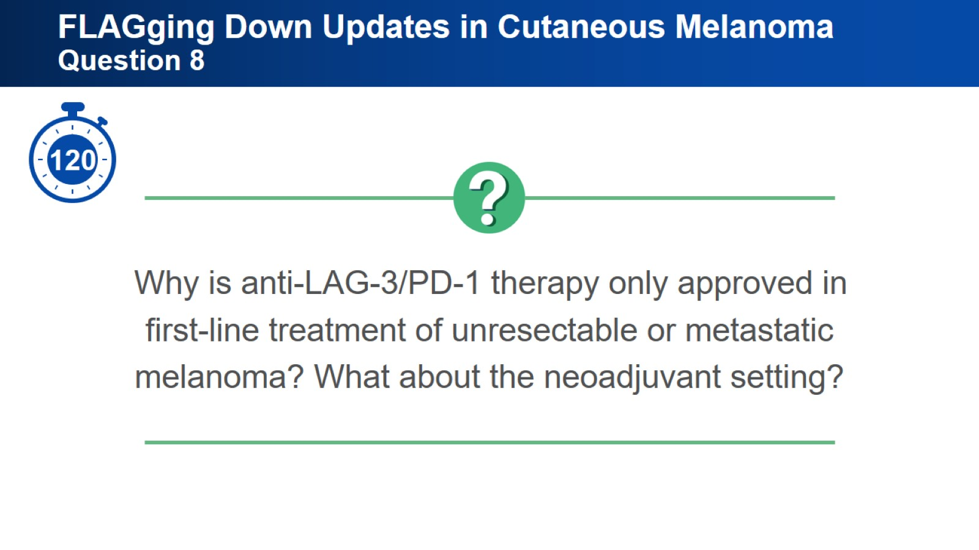
FLAGging Down Updates in Cutaneous Melanoma Question 8

Slide 29
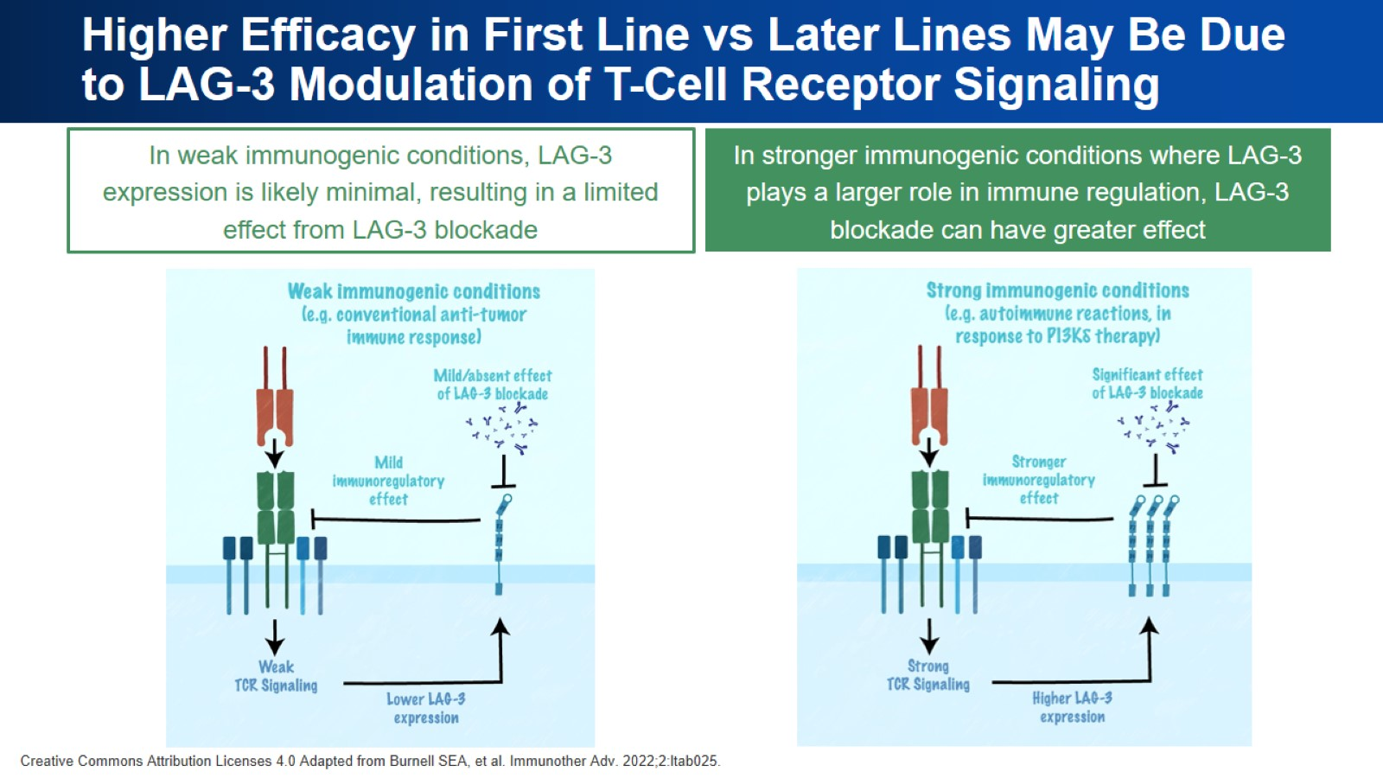
Higher Efficacy in First Line vs Later Lines May Be Due to LAG-3 Modulation of T-Cell Receptor Signaling

Slide 30
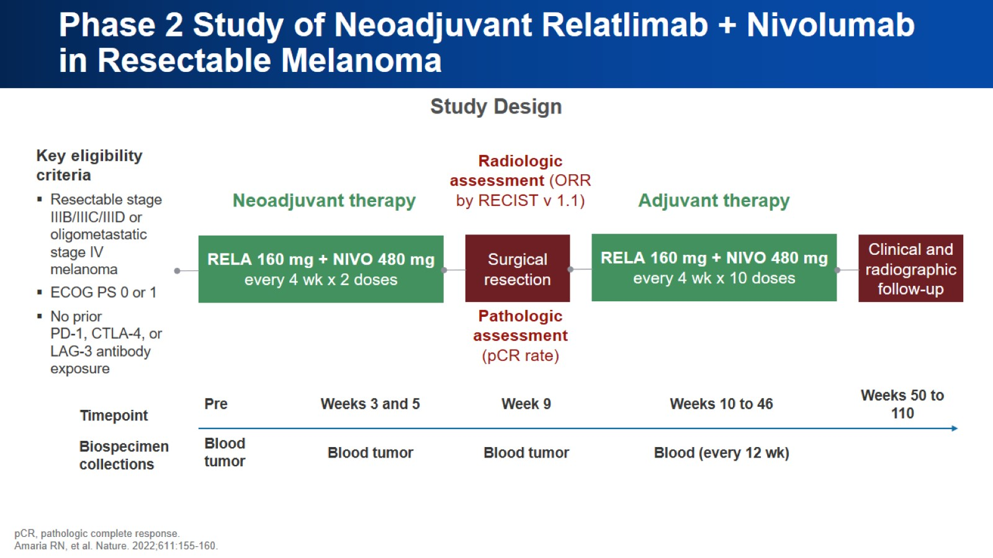
Phase 2 Study of Neoadjuvant Relatlimab + Nivolumab in Resectable Melanoma

Slide 31
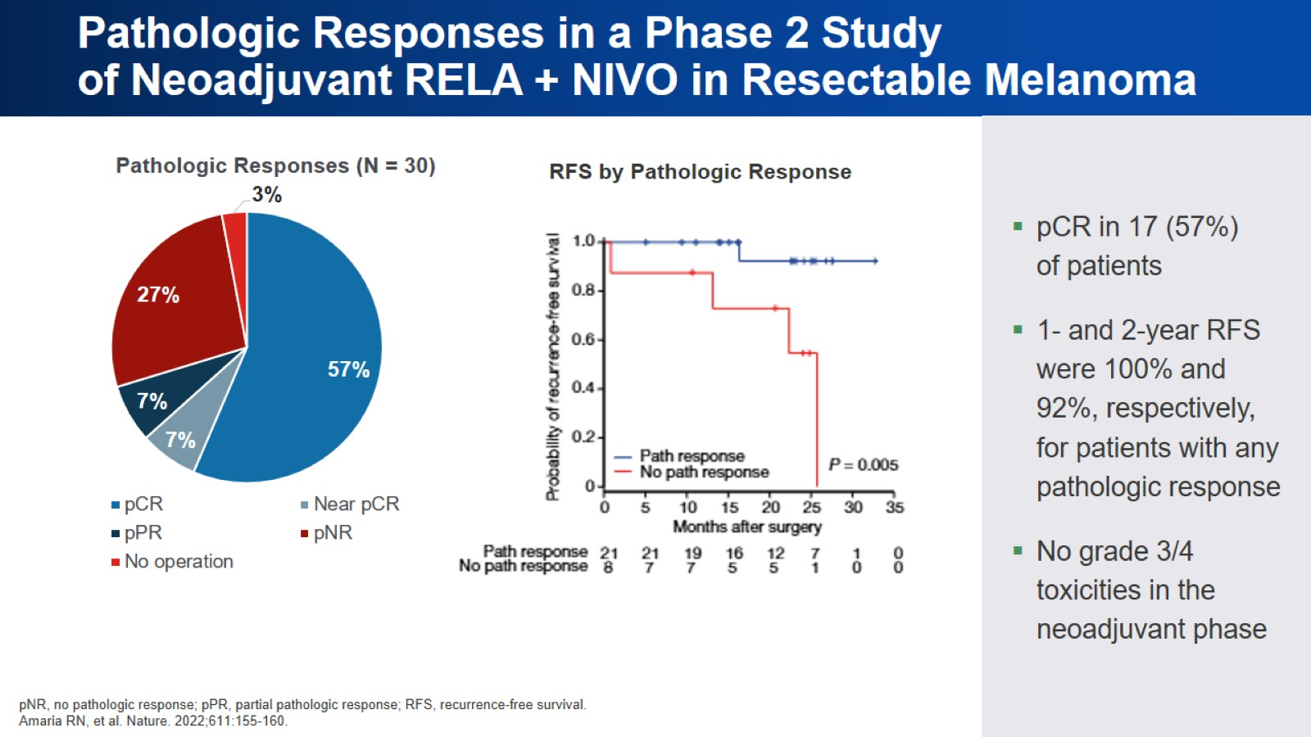
Pathologic Responses in a Phase 2 Study of Neoadjuvant RELA + NIVO in Resectable Melanoma

Slide 32


