Slide 1
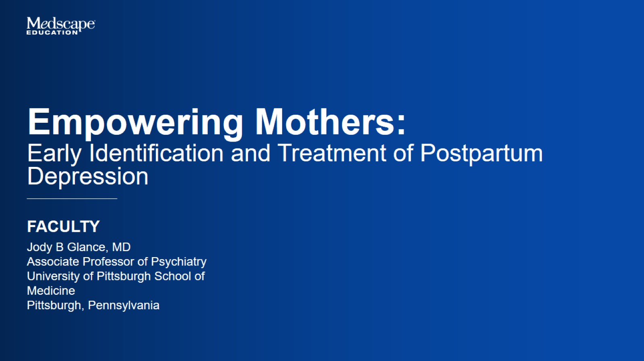

Slide 2
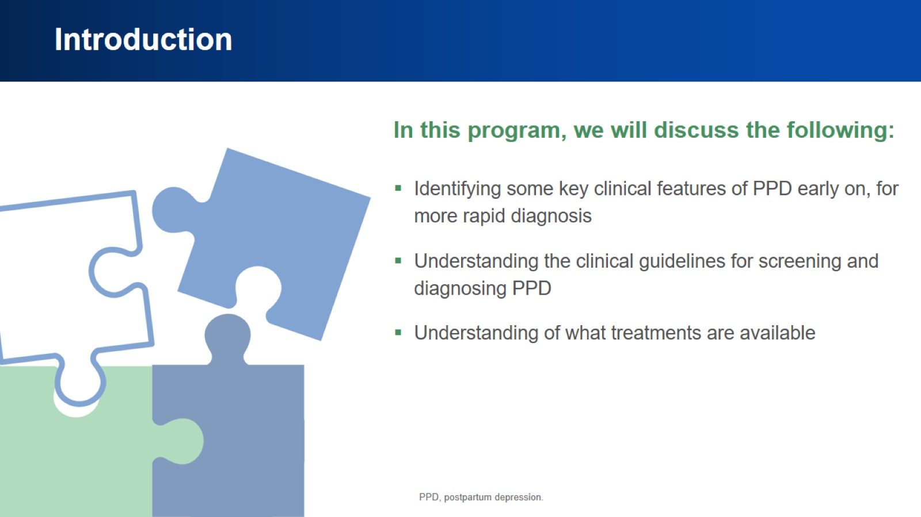
Introduction

Slide 3
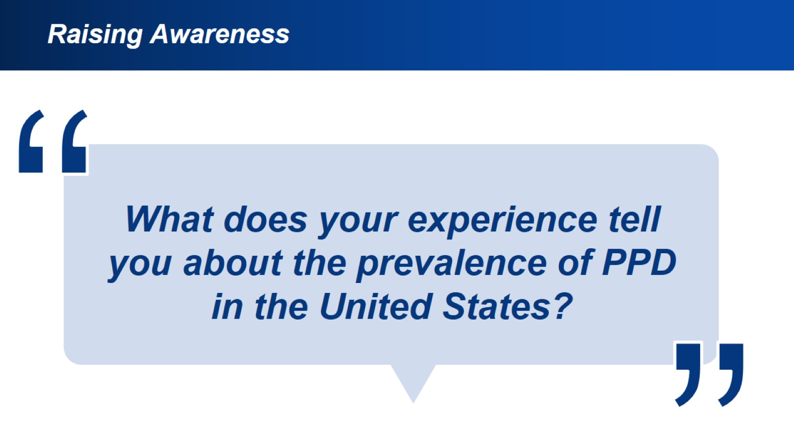
Raising Awareness

Slide 4
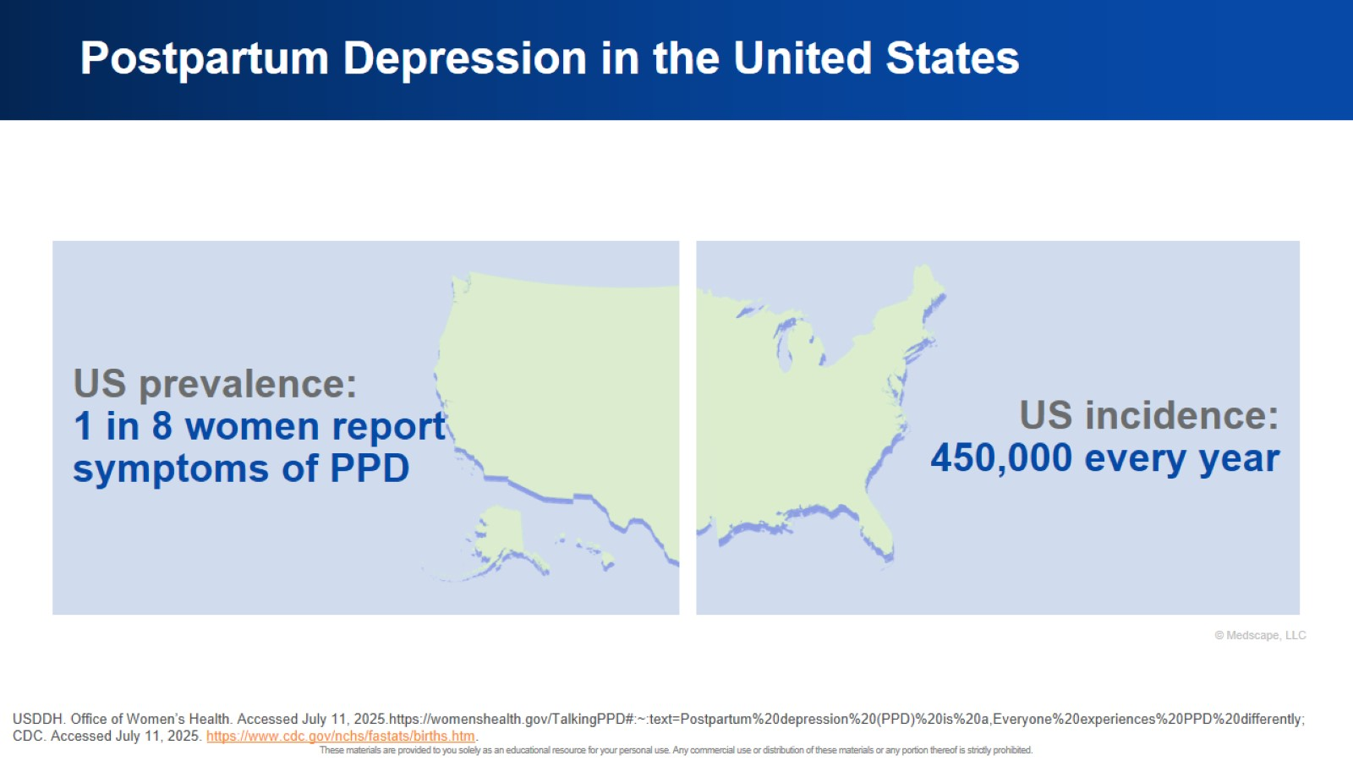
Postpartum Depression in the United States

Slide 5
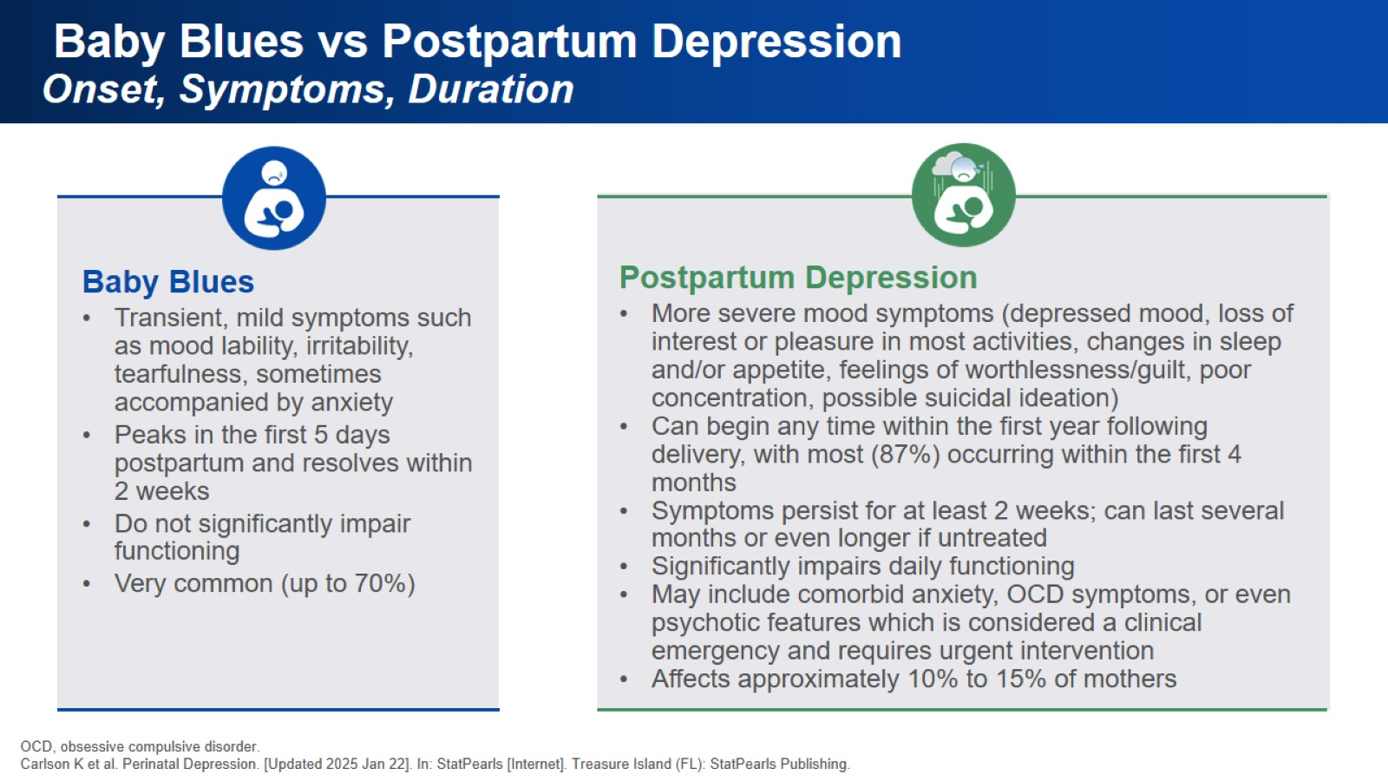
Baby Blues vs Postpartum Depression
Onset, Symptoms, Duration

Slide 6
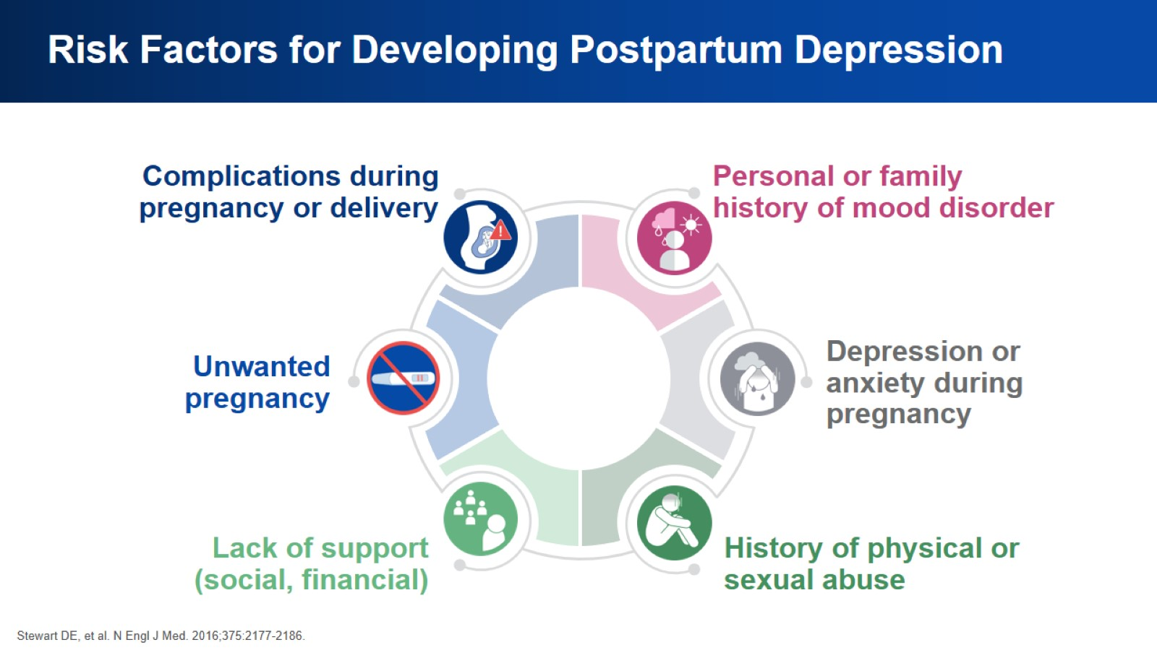
Risk Factors for Developing Postpartum Depression

Slide 7
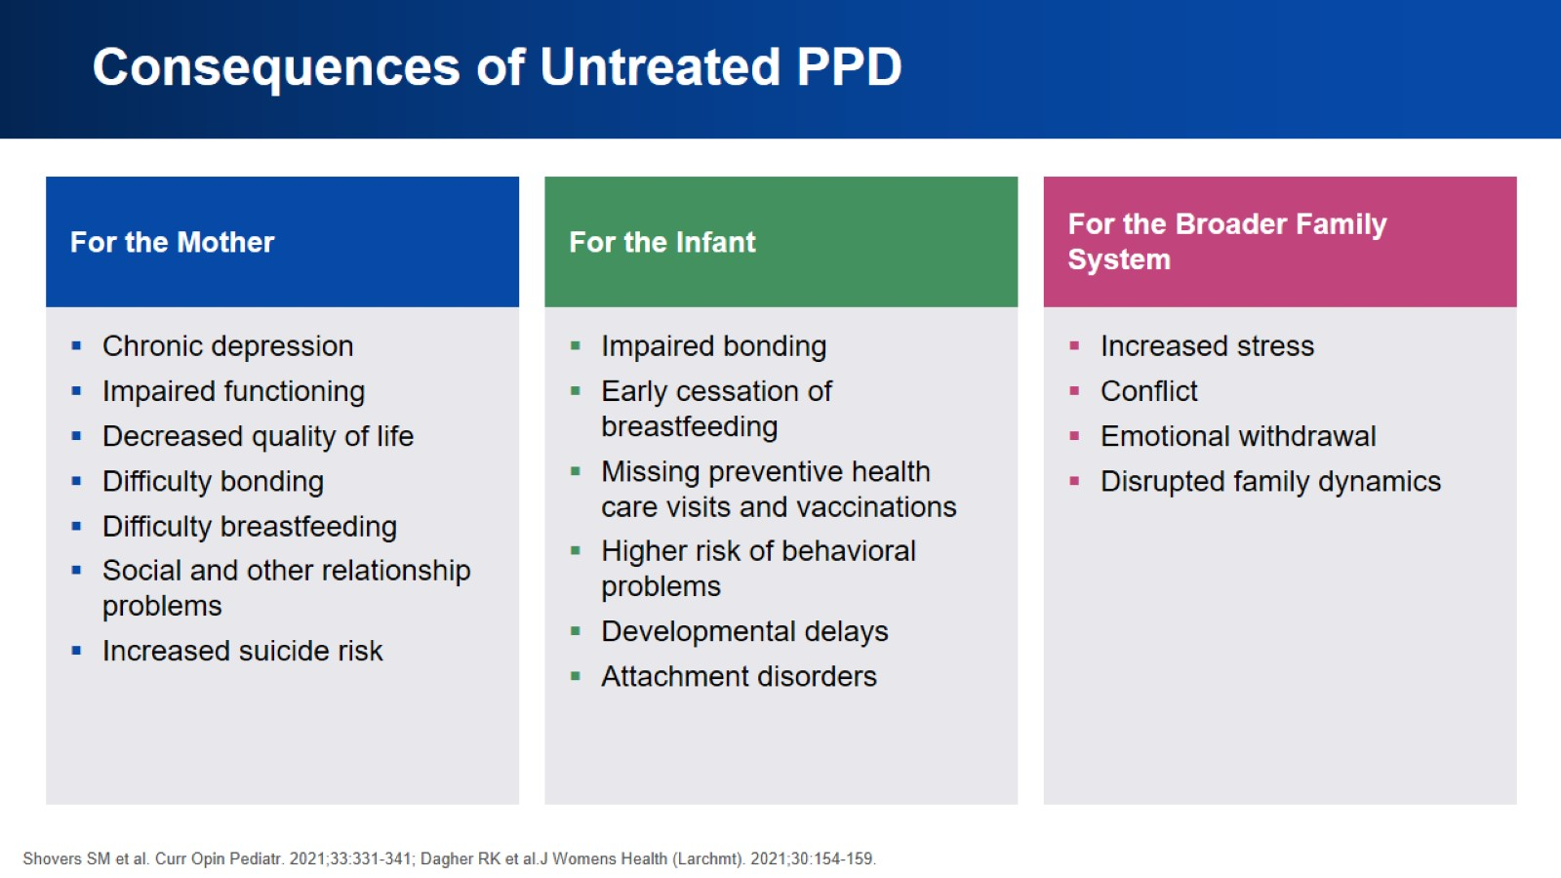
Consequences of Untreated PPD

Slide 8
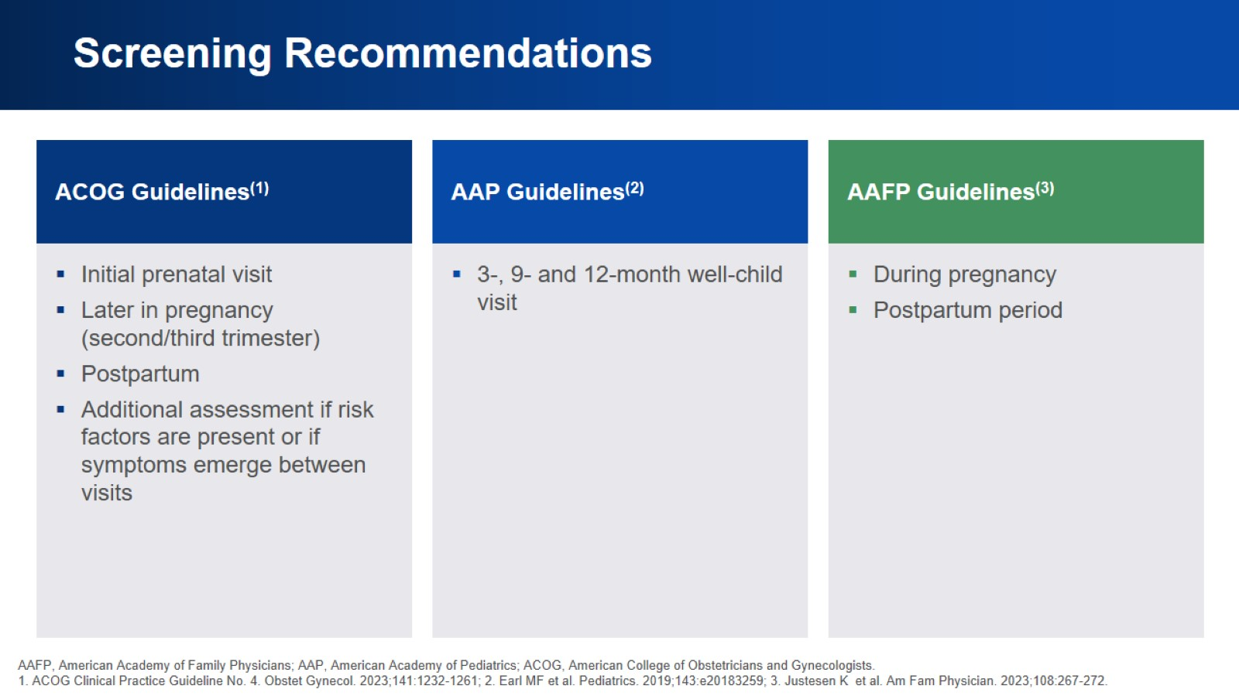
Screening Recommendations

Slide 9
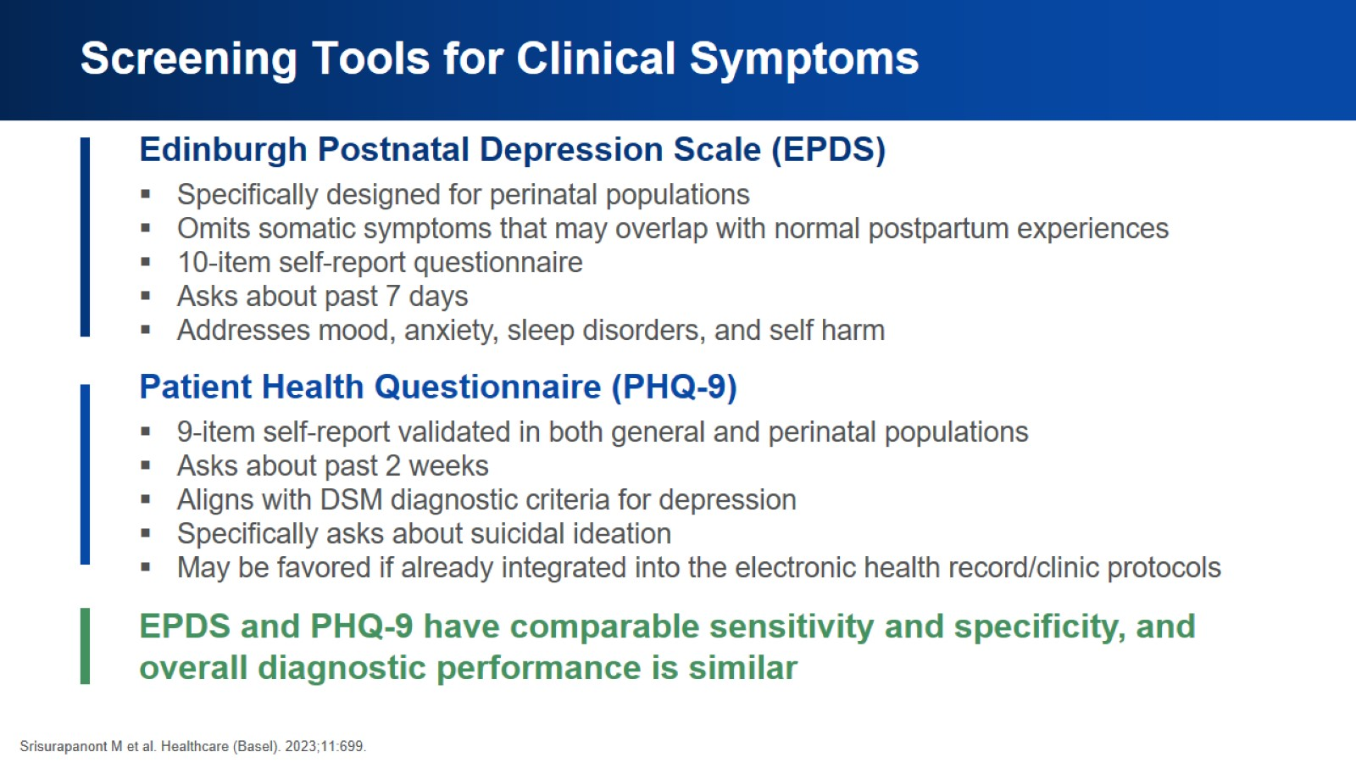
Screening Tools for Clinical Symptoms

Slide 10
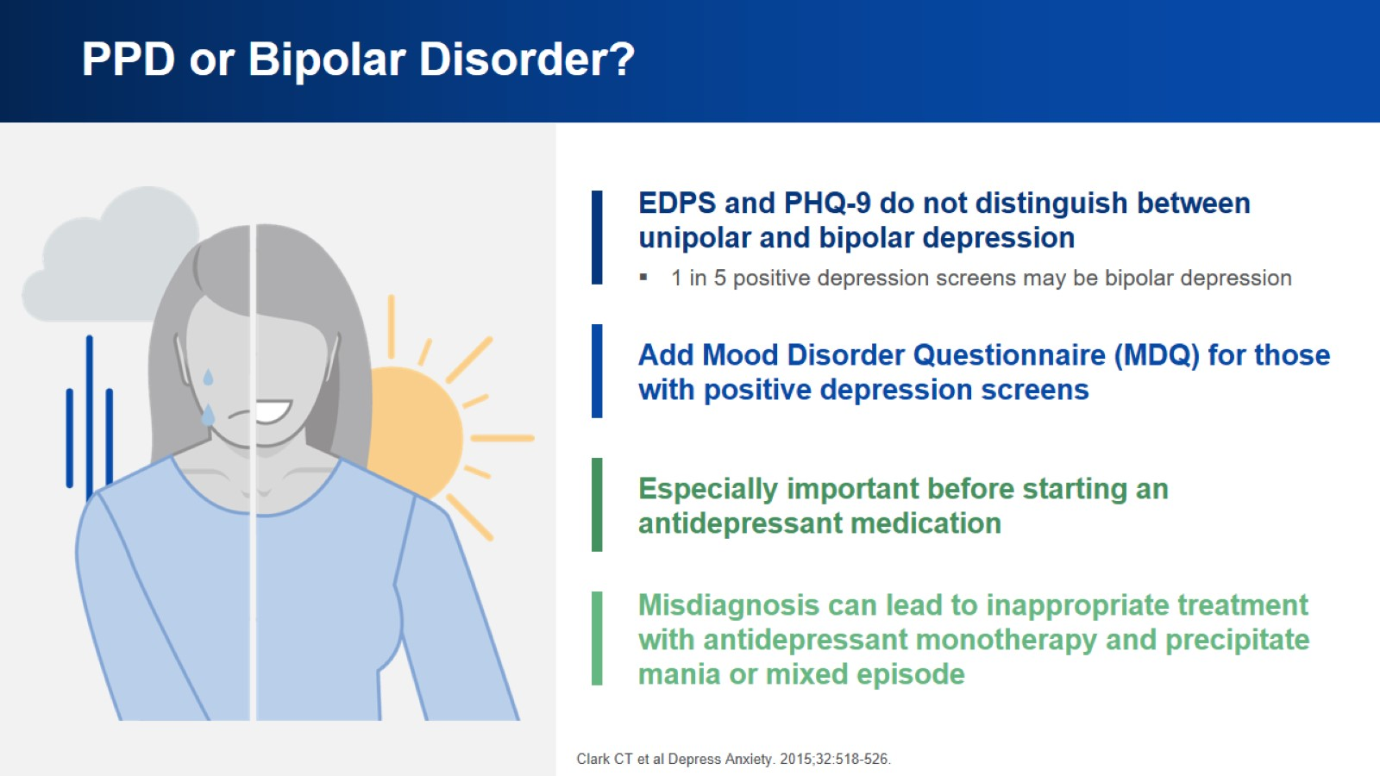
PPD or Bipolar Disorder?

Slide 11
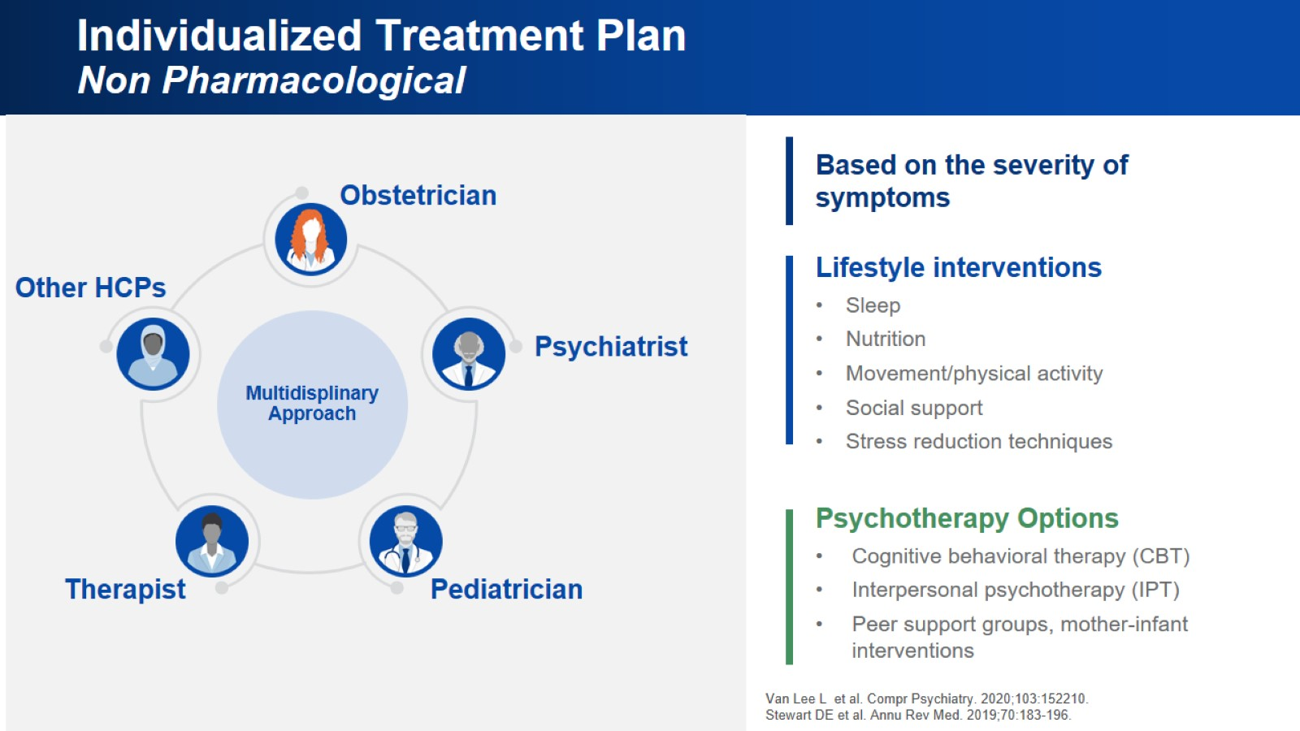
Individualized Treatment Plan
Non Pharmacological

Slide 12
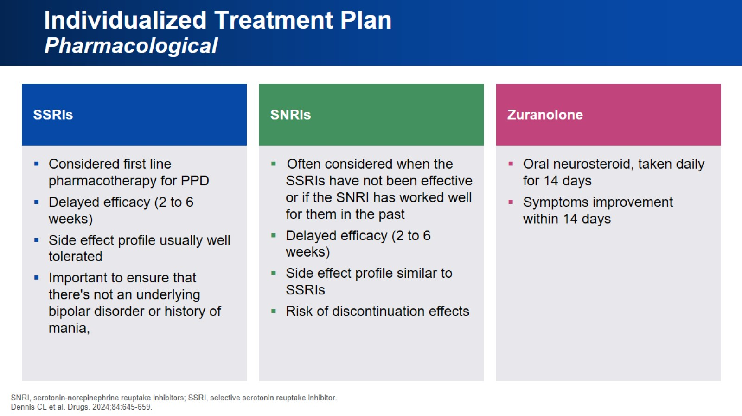
Individualized Treatment Plan
Pharmacological

Slide 13
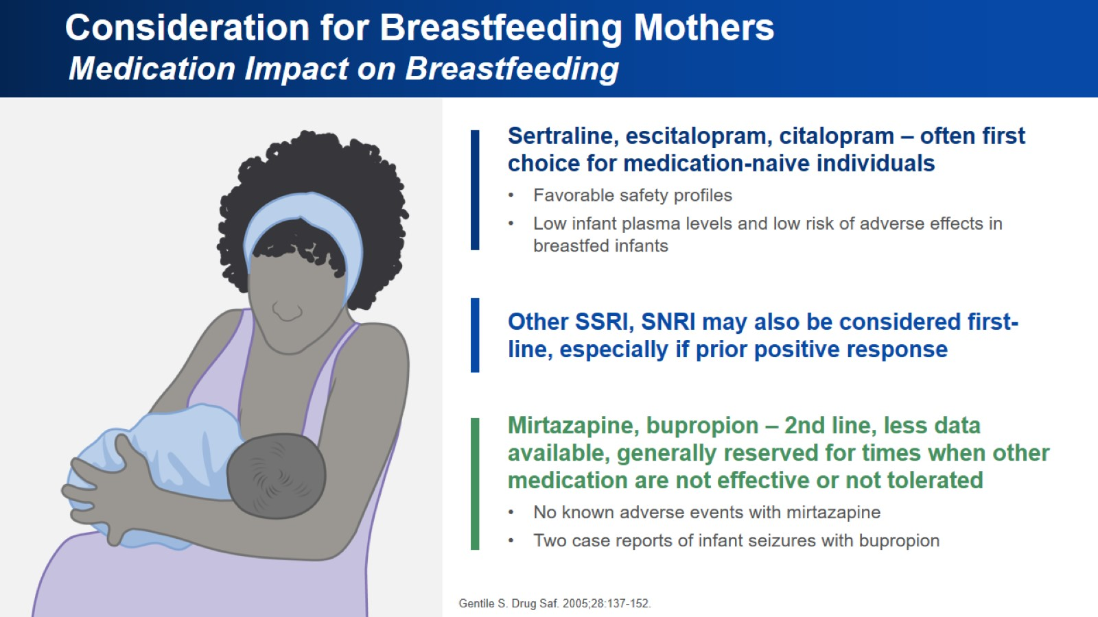
Consideration for Breastfeeding Mothers
Medication Impact on Breastfeeding

Slide 14
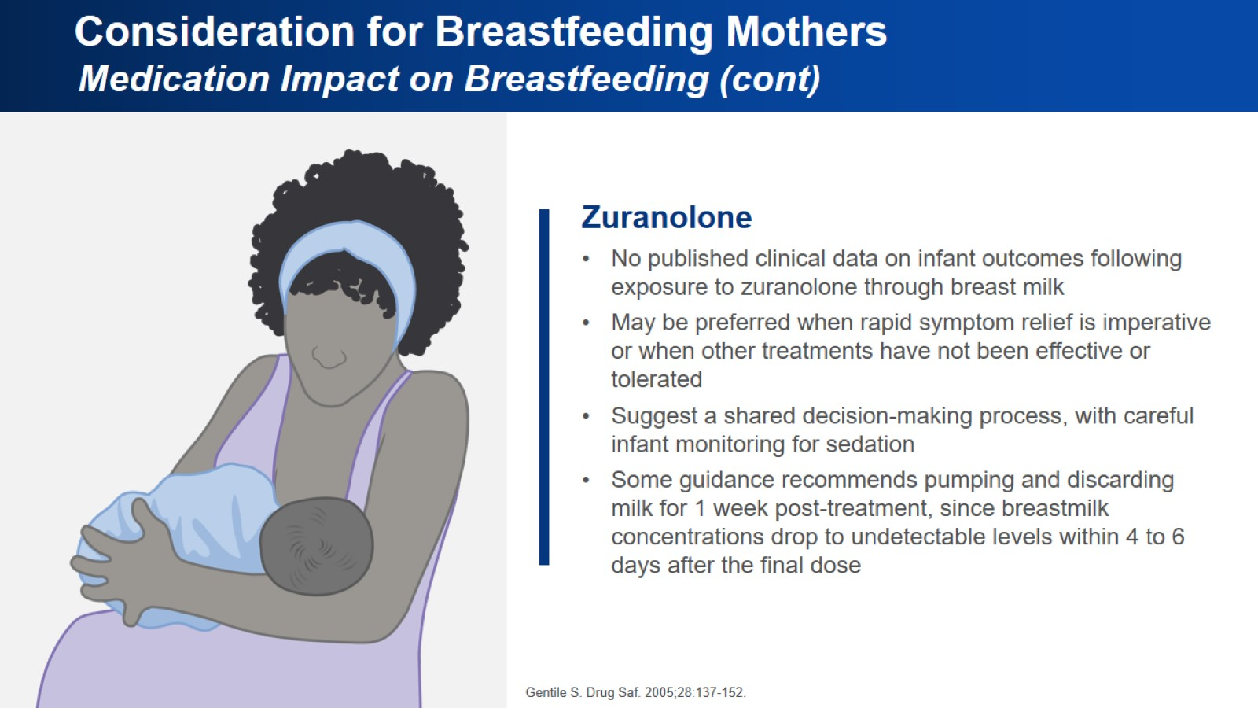
Consideration for Breastfeeding Mothers
Medication Impact on Breastfeeding (cont)

Slide 15
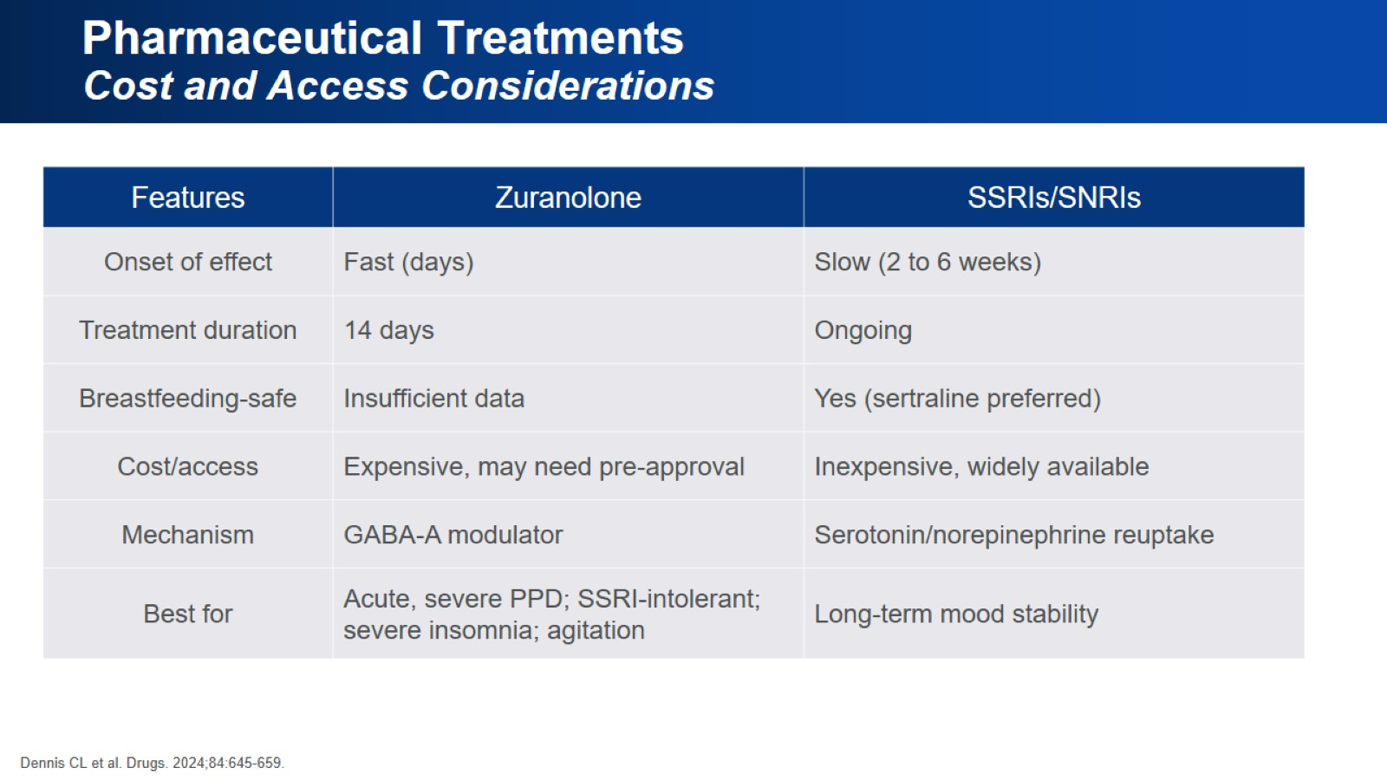
Pharmaceutical Treatments
Cost and Access Considerations

Slide 16
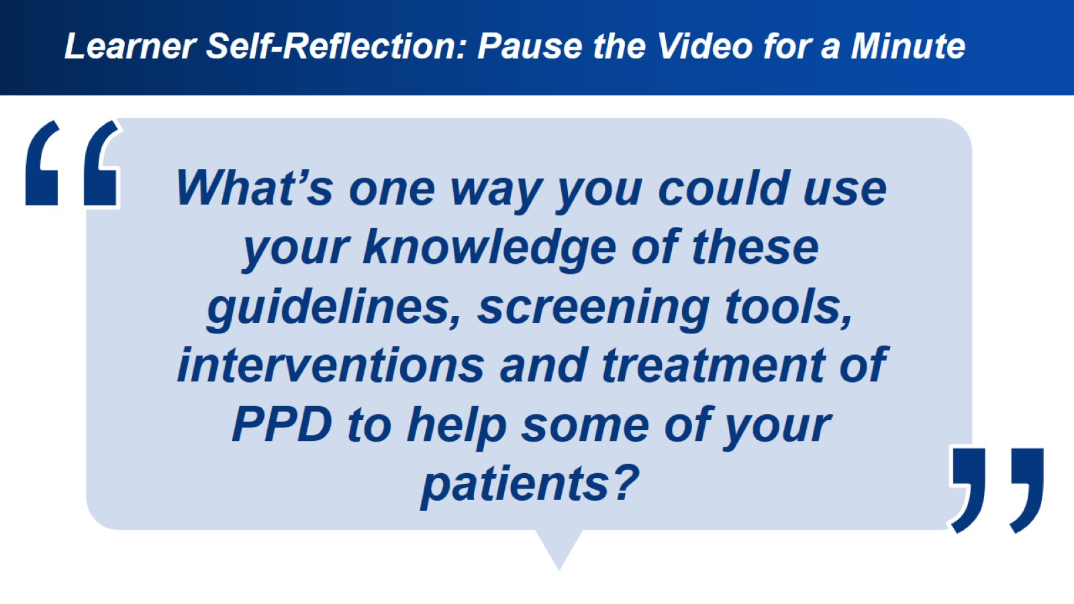
Learner Self-Reflection: Pause the Video for a Minute

Slide 17
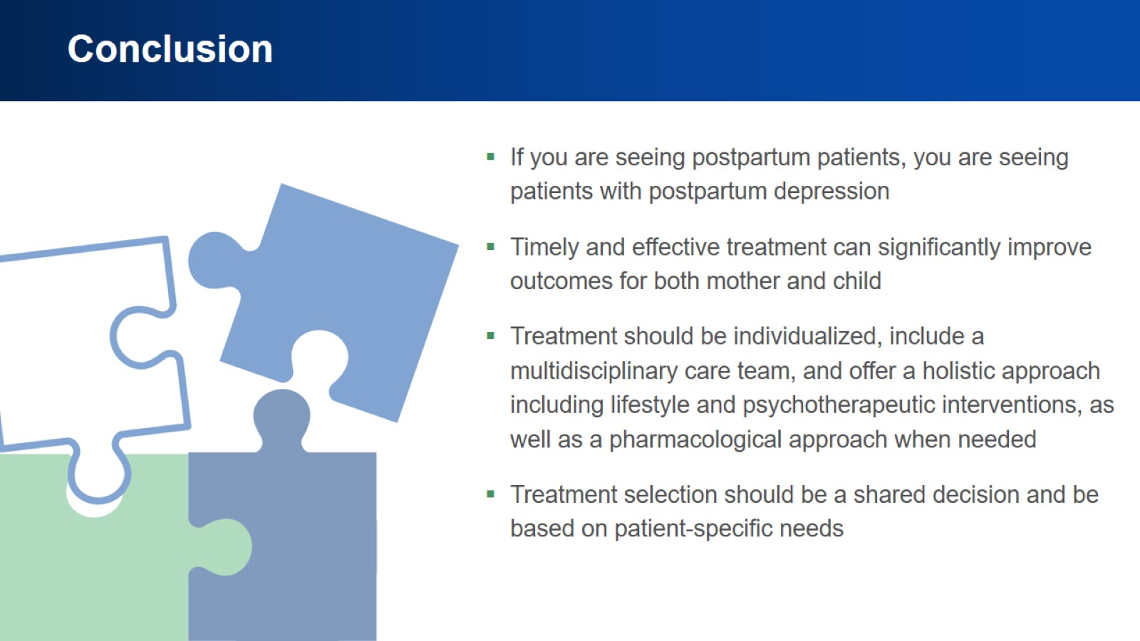
Conclusion

Slide 18
