Slide 1


Slide 2


Slide 3

Case 1: Paul

Slide 4
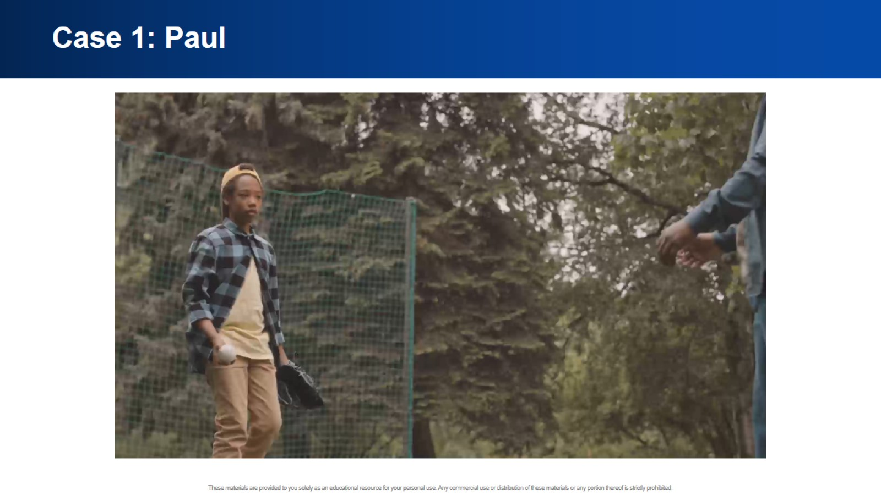
Case 1: Paul

Slide 5
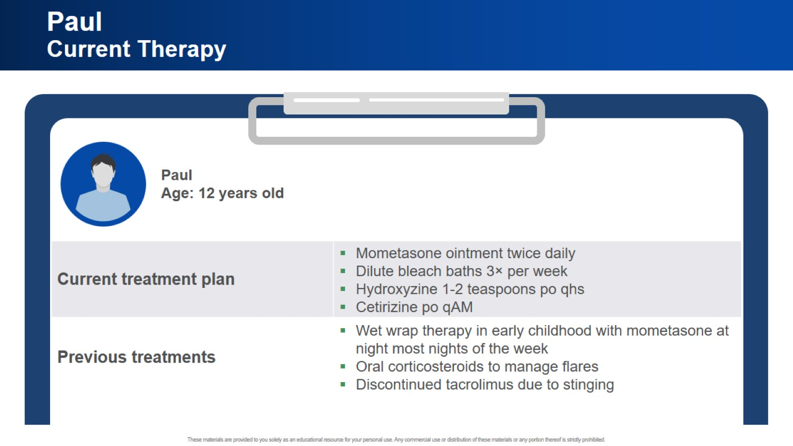
Paul Current Therapy

Slide 6
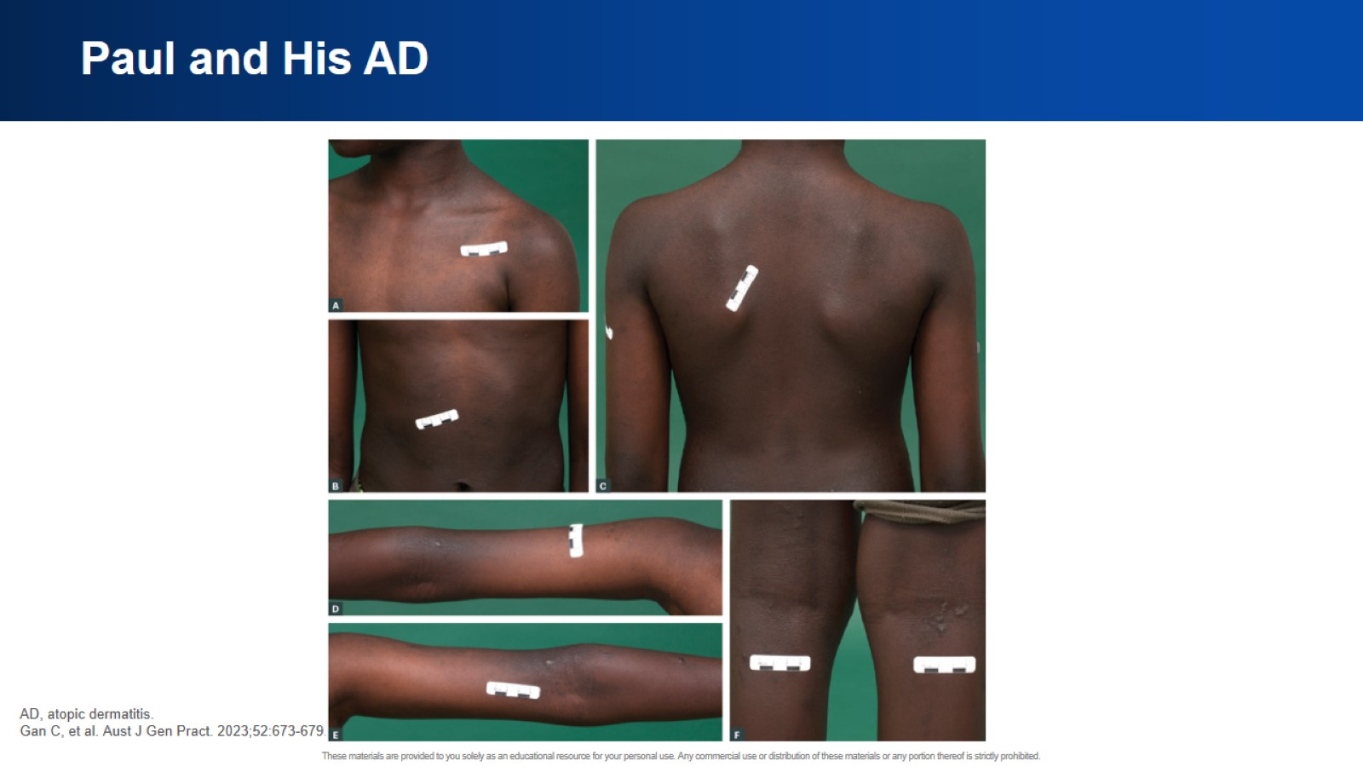
Paul and His AD

Slide 7
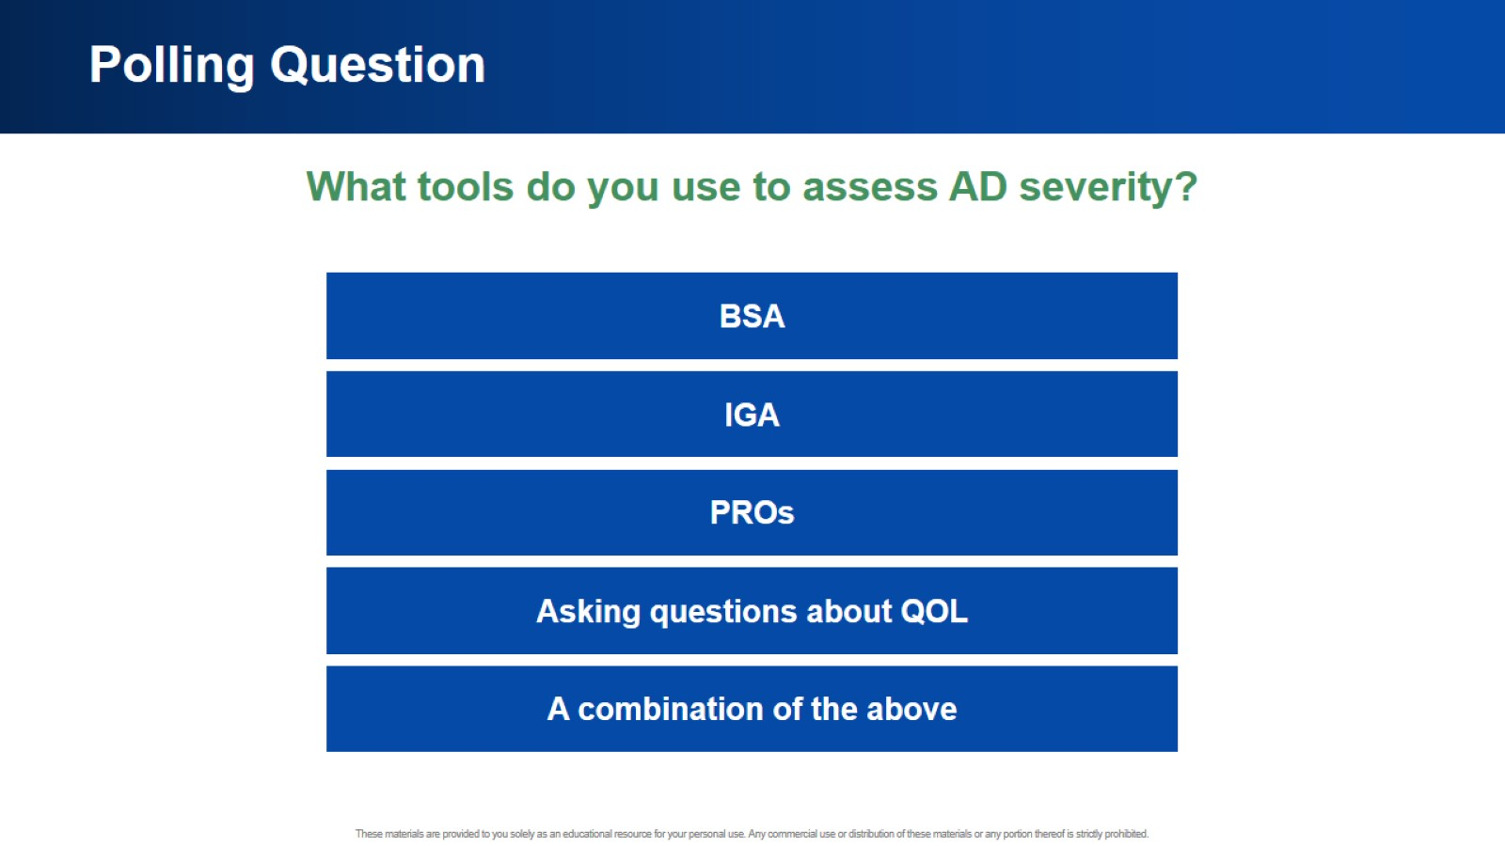
Polling Question

Slide 8
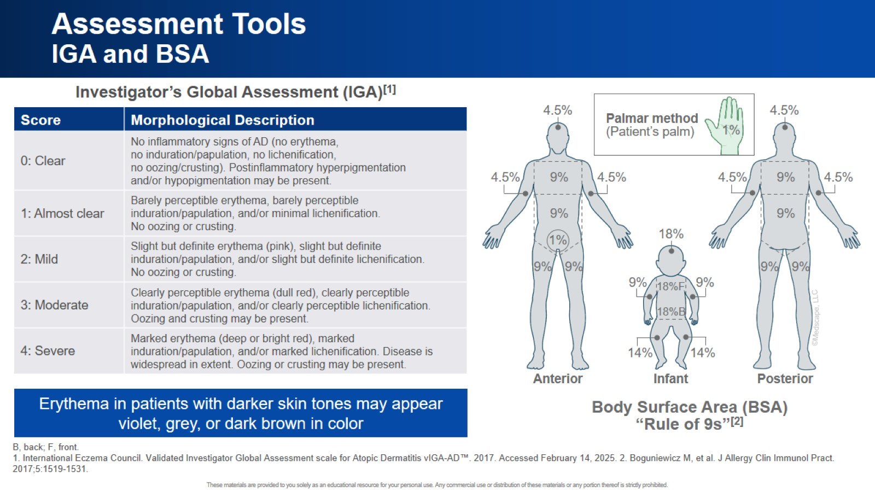
Assessment Tools IGA and BSA

Slide 9
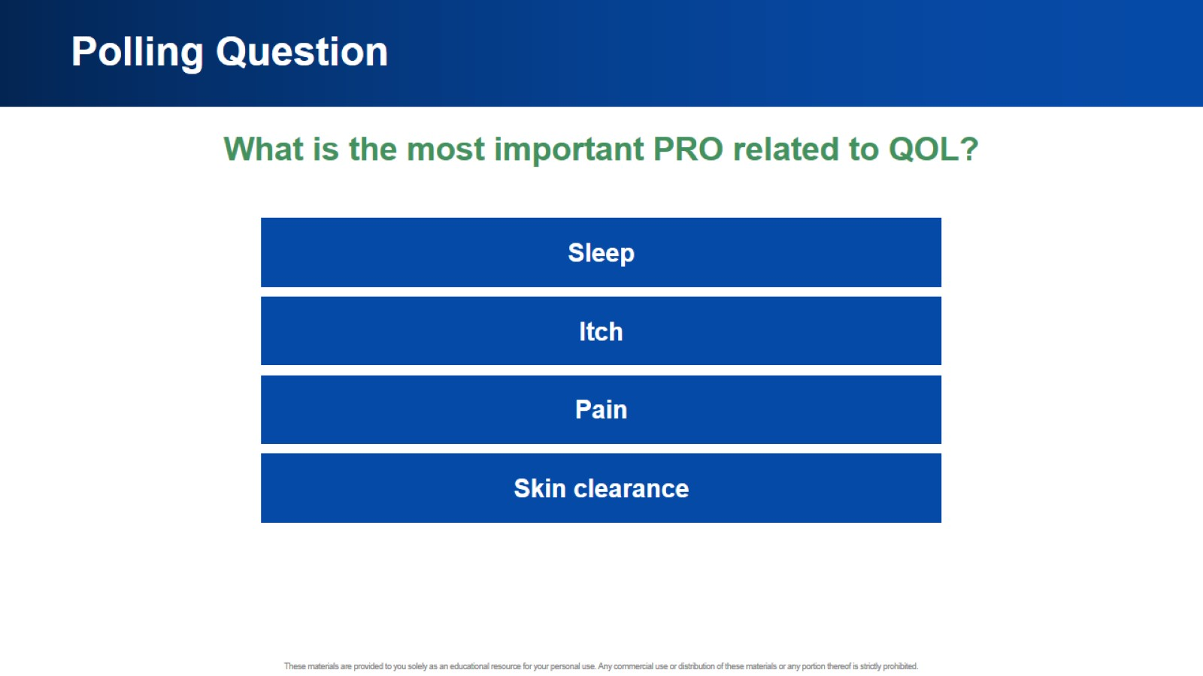
Polling Question

Slide 10
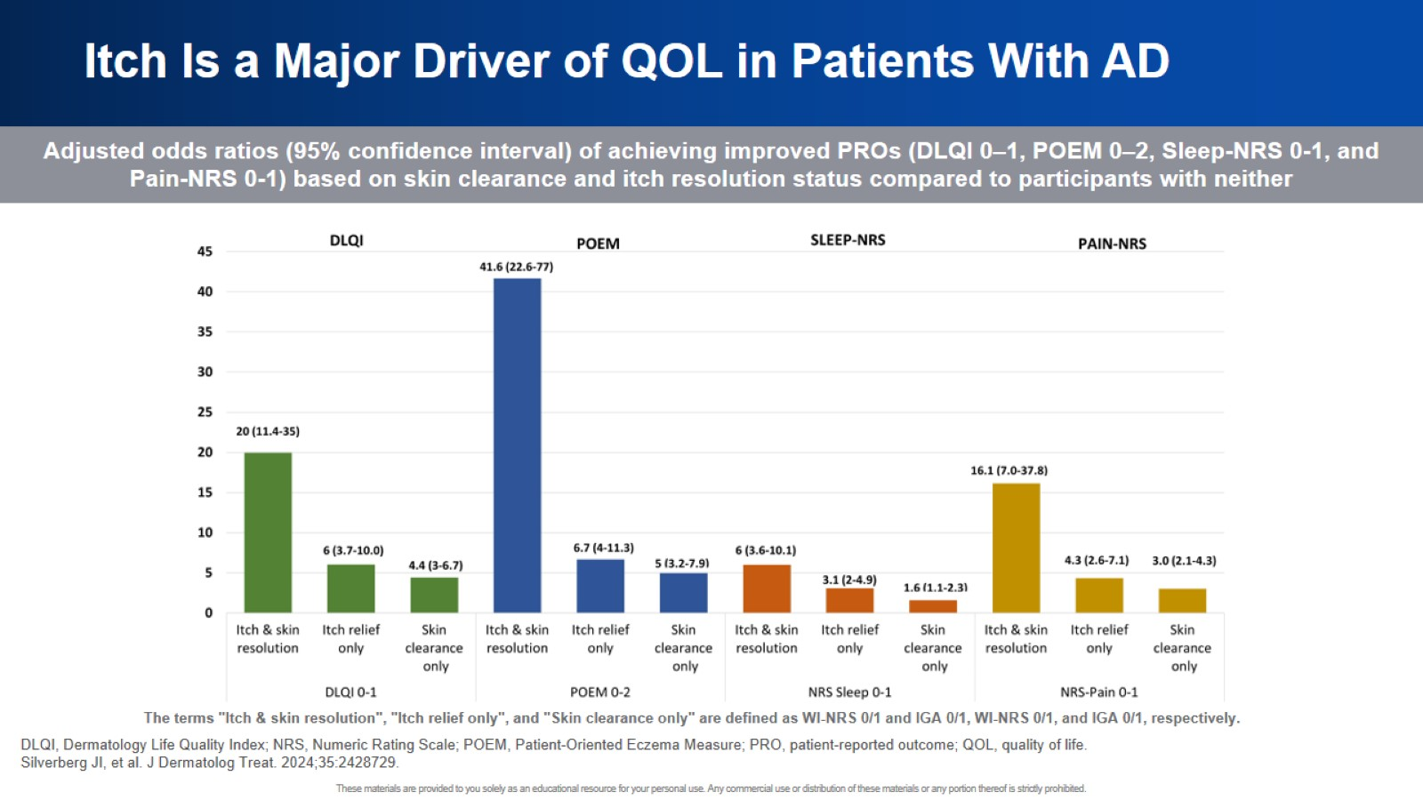
Itch Is a Major Driver of QOL in Patients With AD

Slide 11
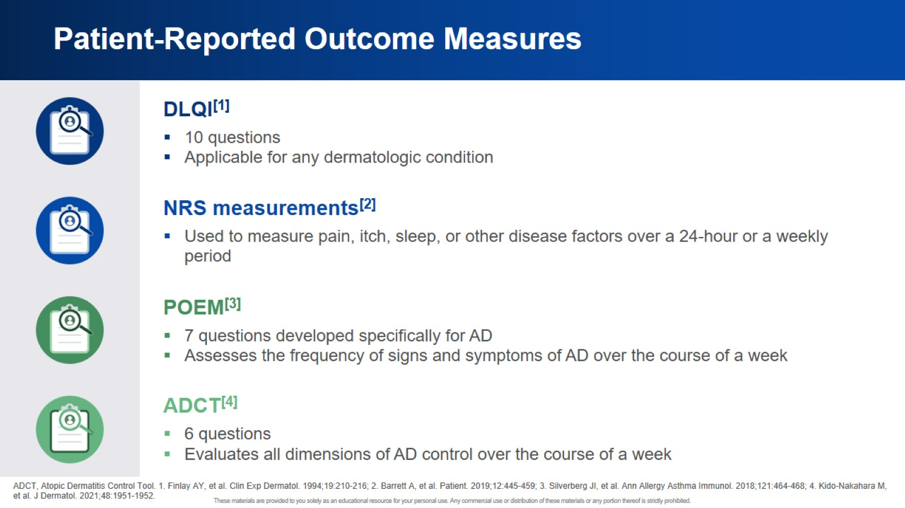
Patient-Reported Outcome Measures

Slide 12
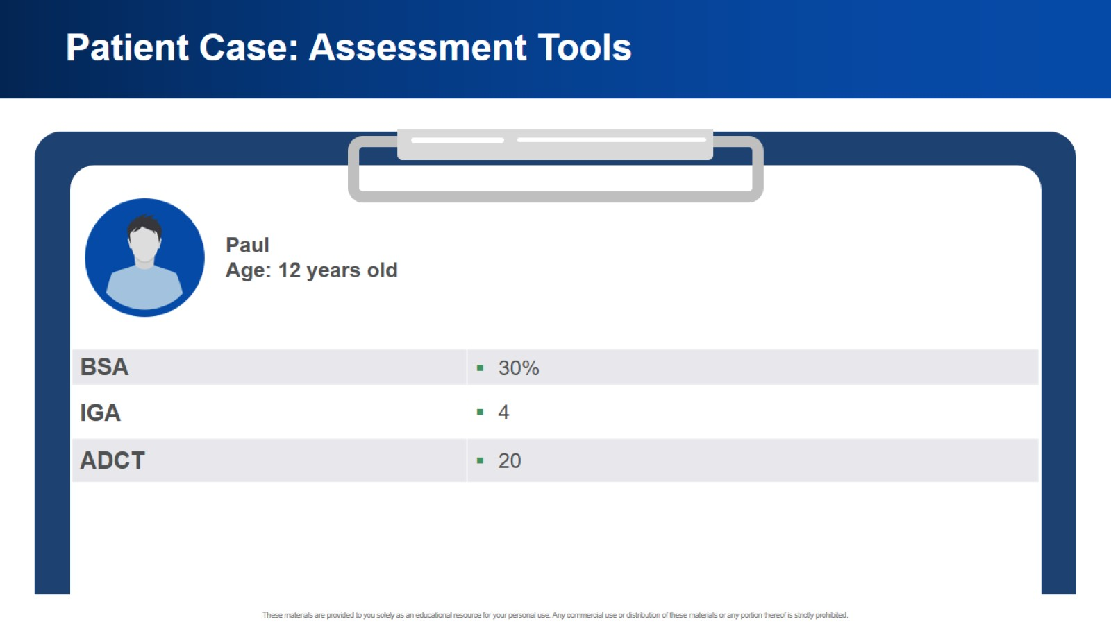
Patient Case: Assessment Tools

Slide 13
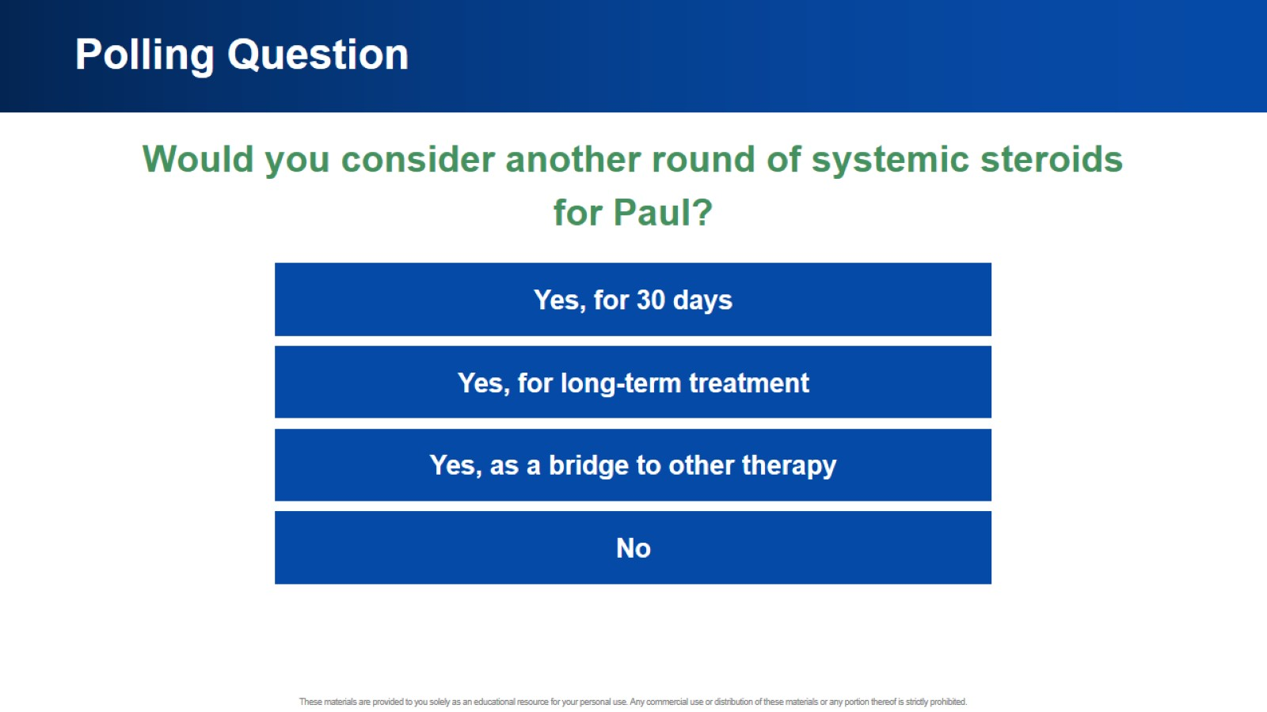
Polling Question

Slide 14
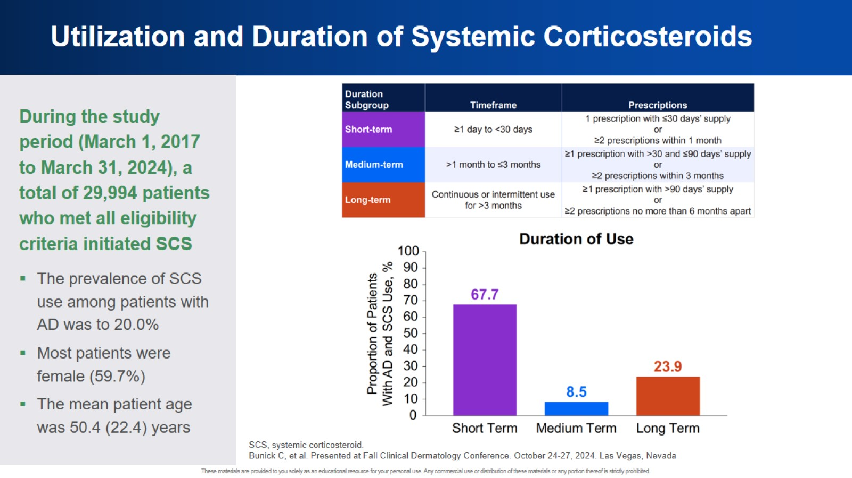
Utilization and Duration of Systemic Corticosteroids

Slide 15
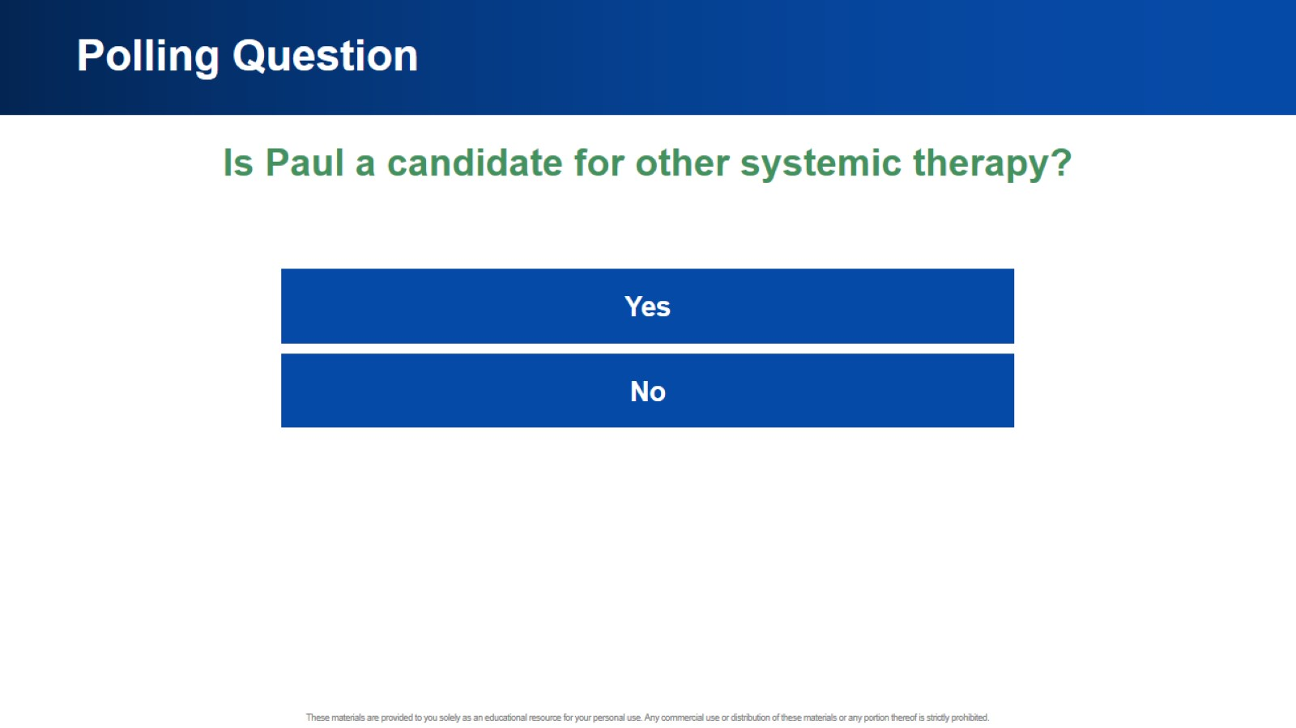
Polling Question

Slide 16
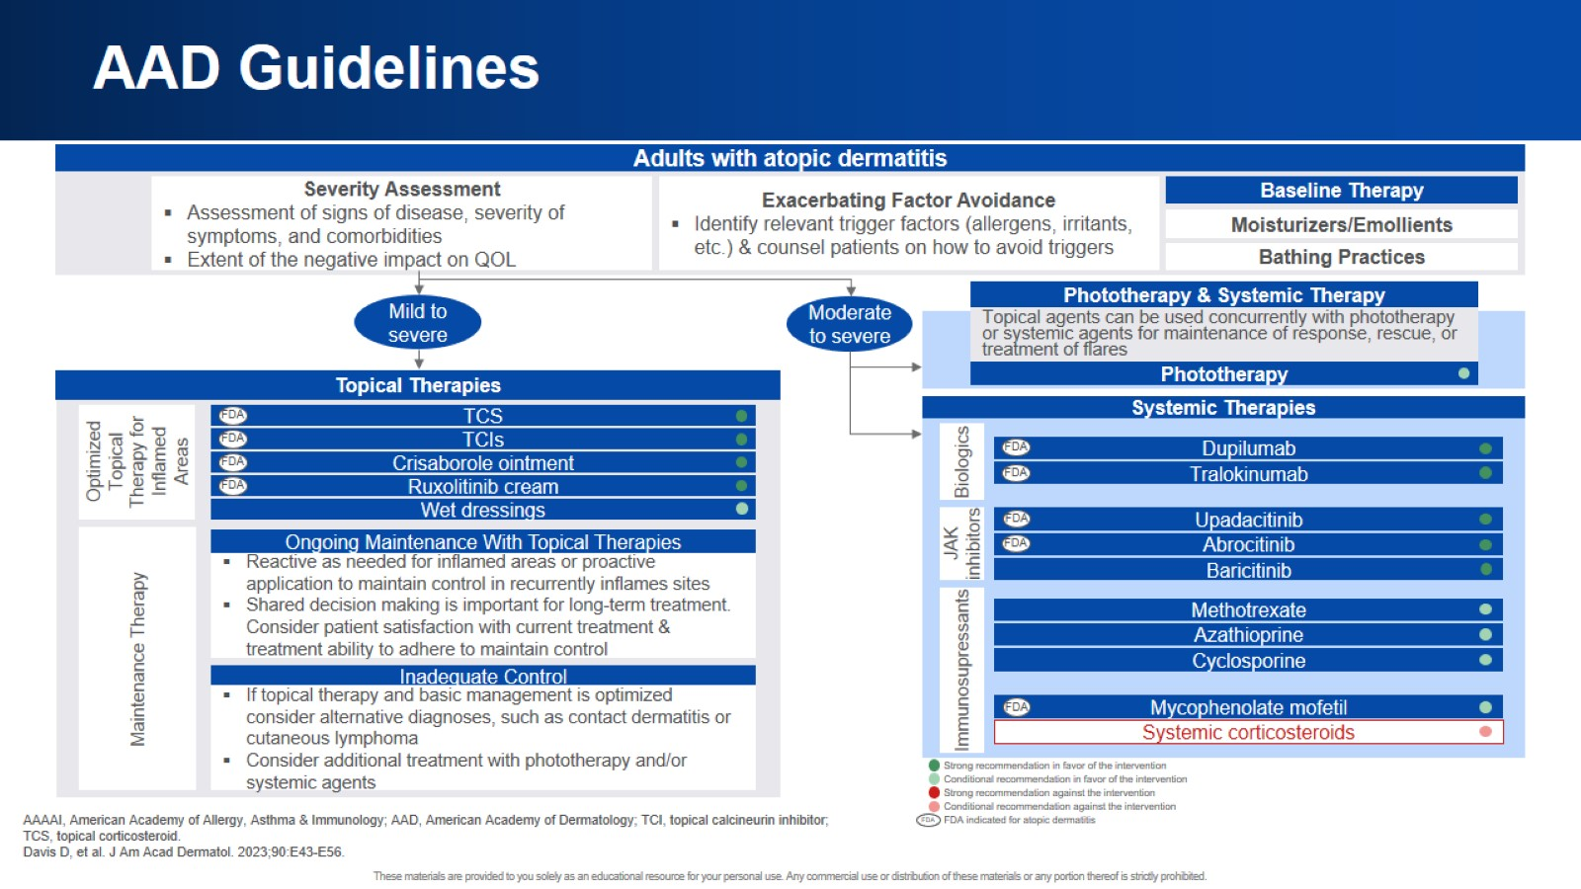
AAD Guidelines

Slide 17
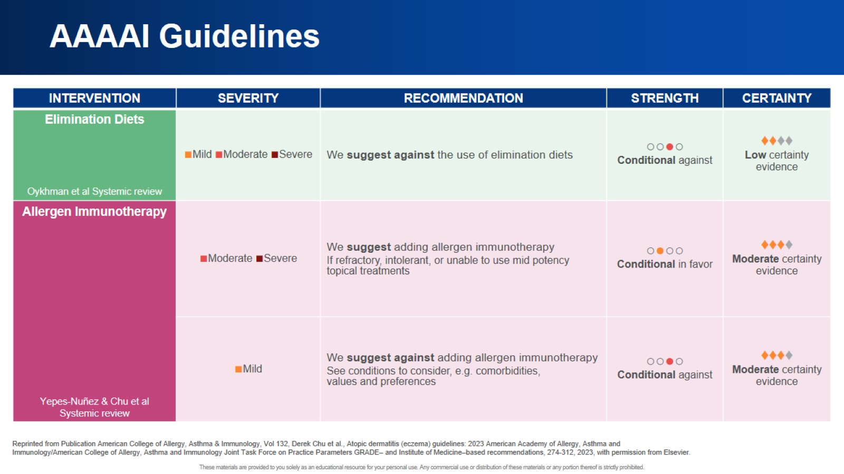
AAAAI Guidelines

Slide 18
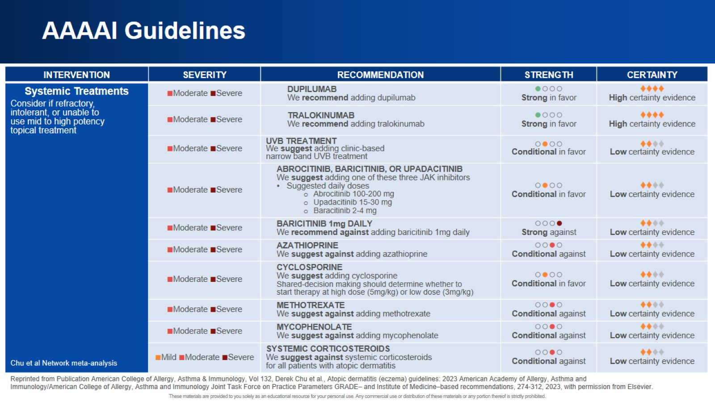
AAAAI Guidelines

Slide 19
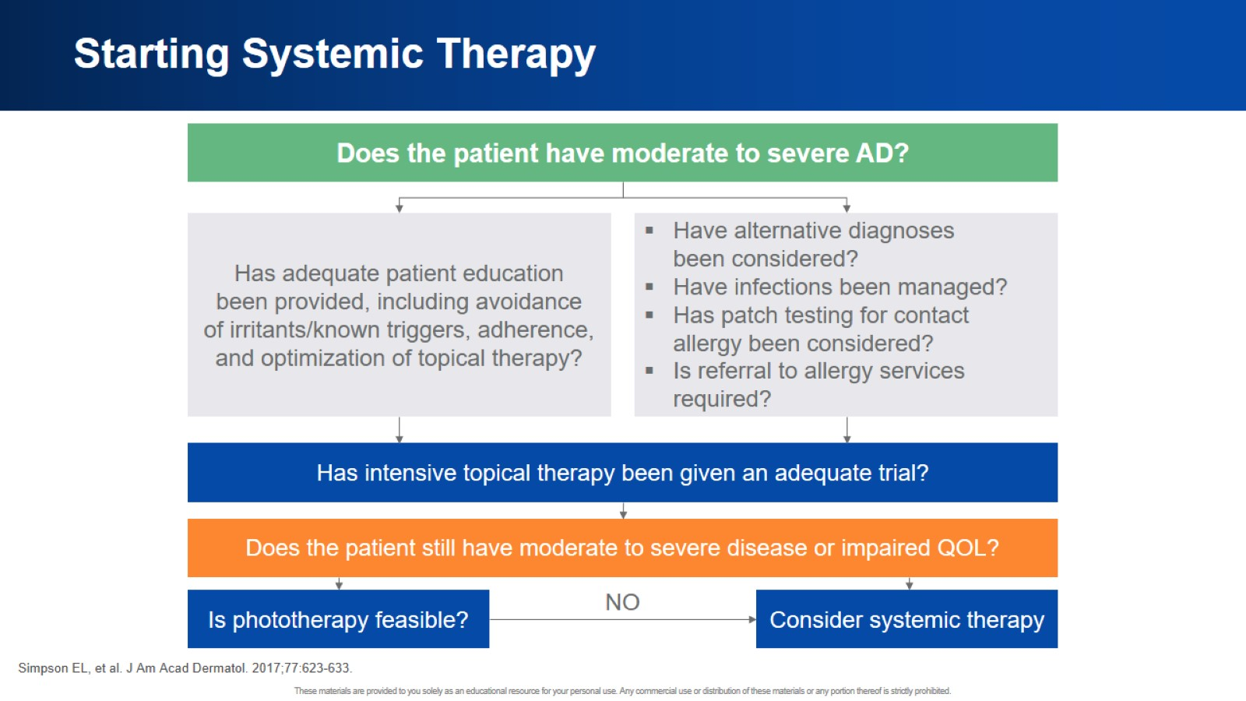
Starting Systemic Therapy

Slide 20
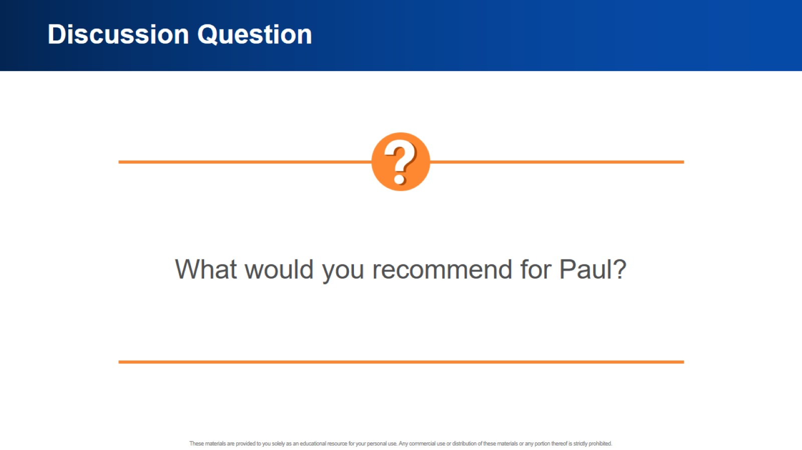
Discussion Question

Slide 21

Case 2: Tessa

Slide 22

Case 2: Tessa

Slide 23
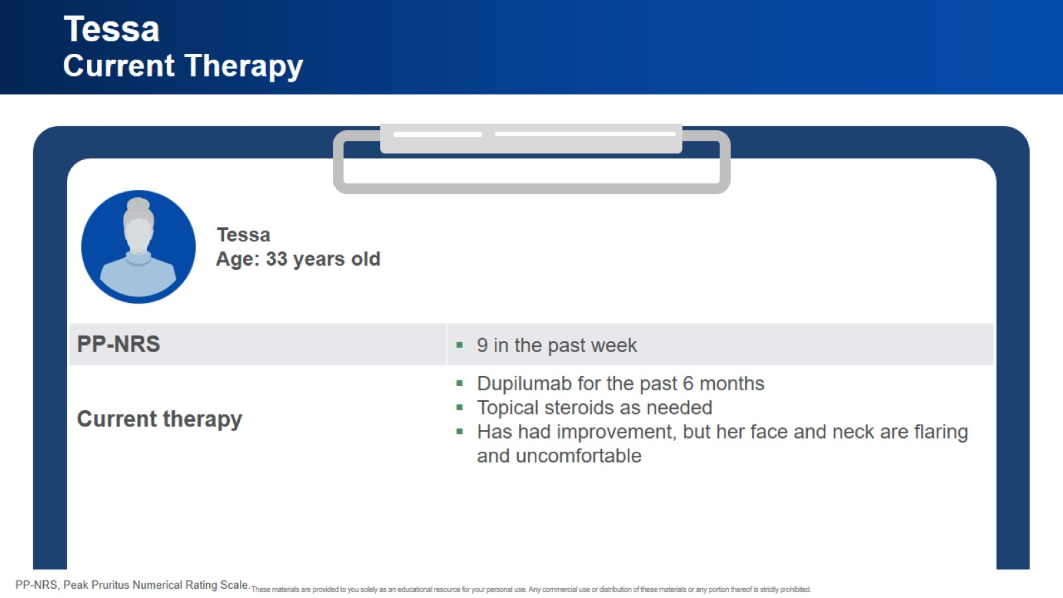
Tessa Current Therapy

Slide 24
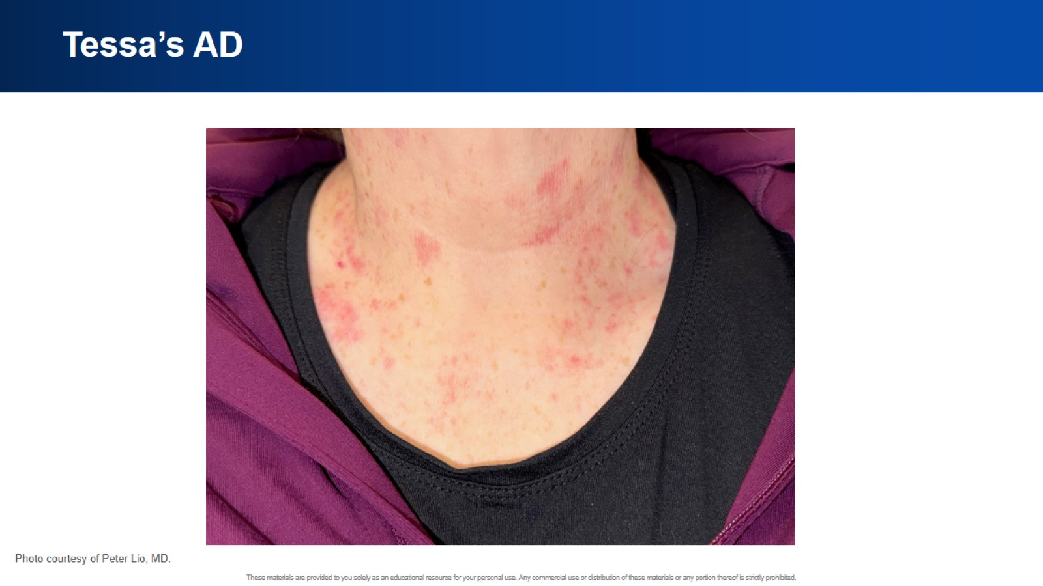
Tessa’s AD

Slide 25

Polling Question

Slide 26
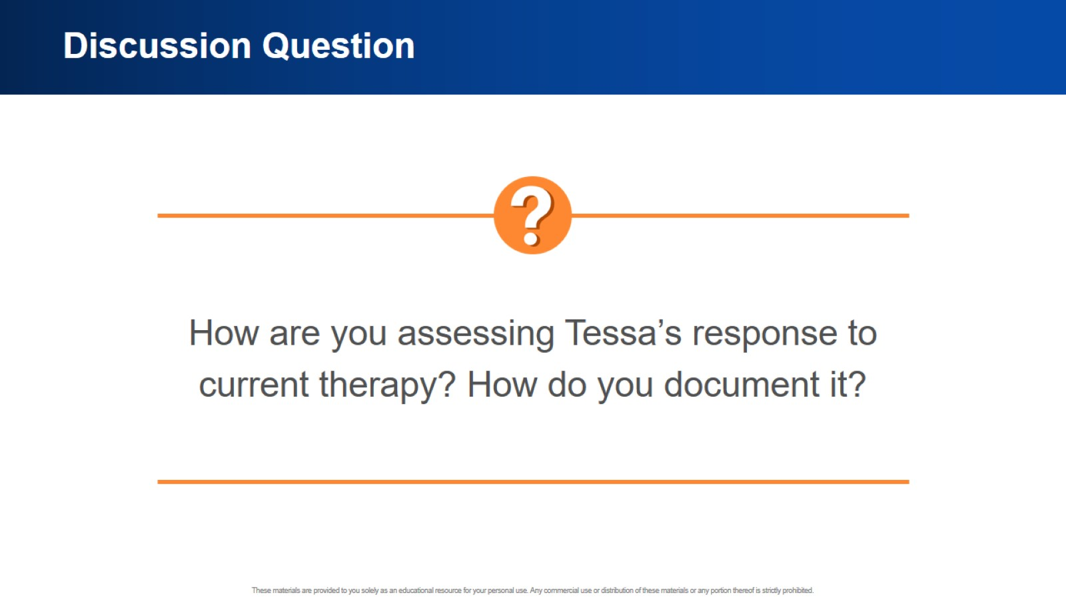
Discussion Question

Slide 27
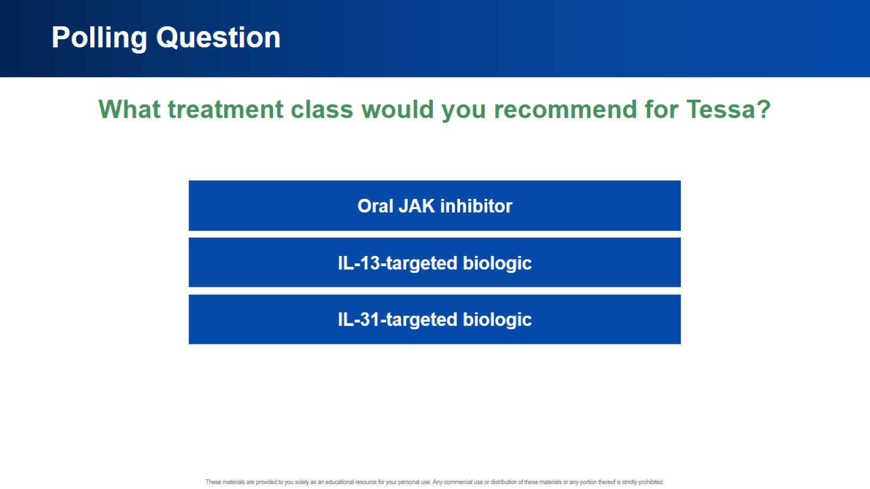
Polling Question

Slide 28
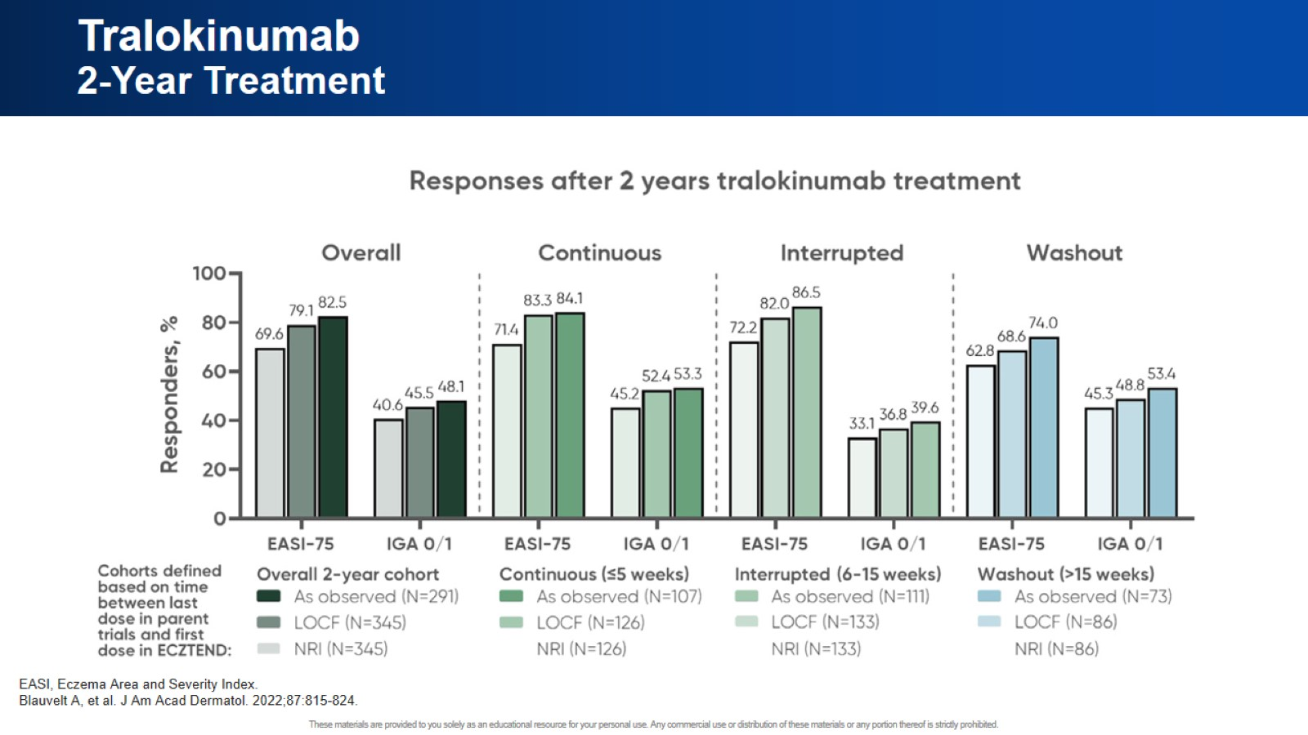
Tralokinumab 2-Year Treatment

Slide 29
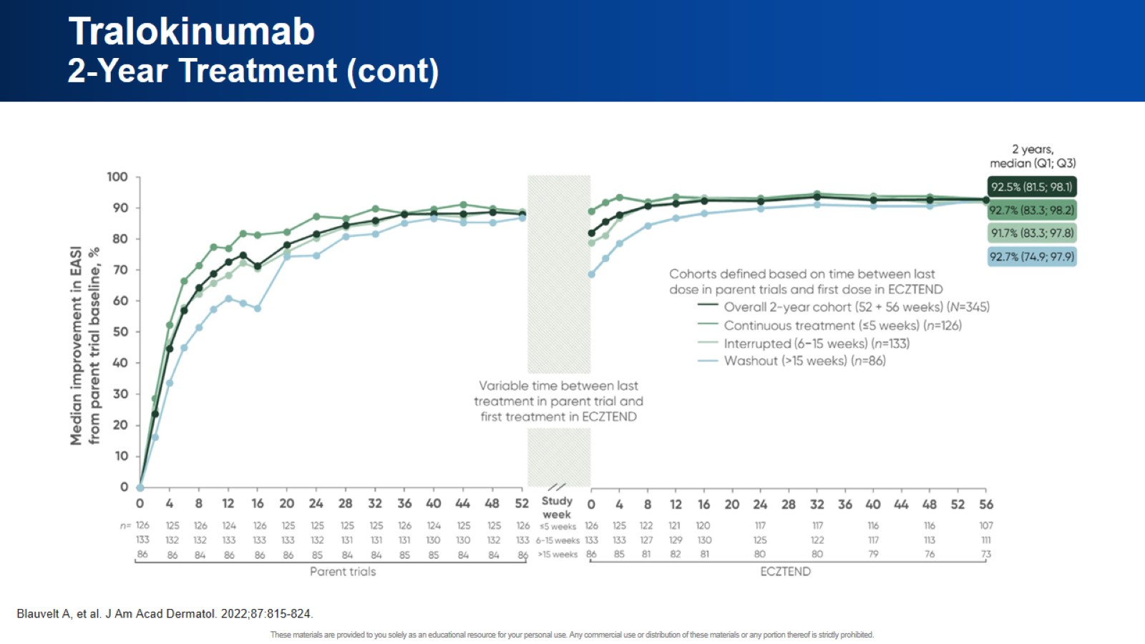
Tralokinumab 2-Year Treatment (cont)

Slide 30
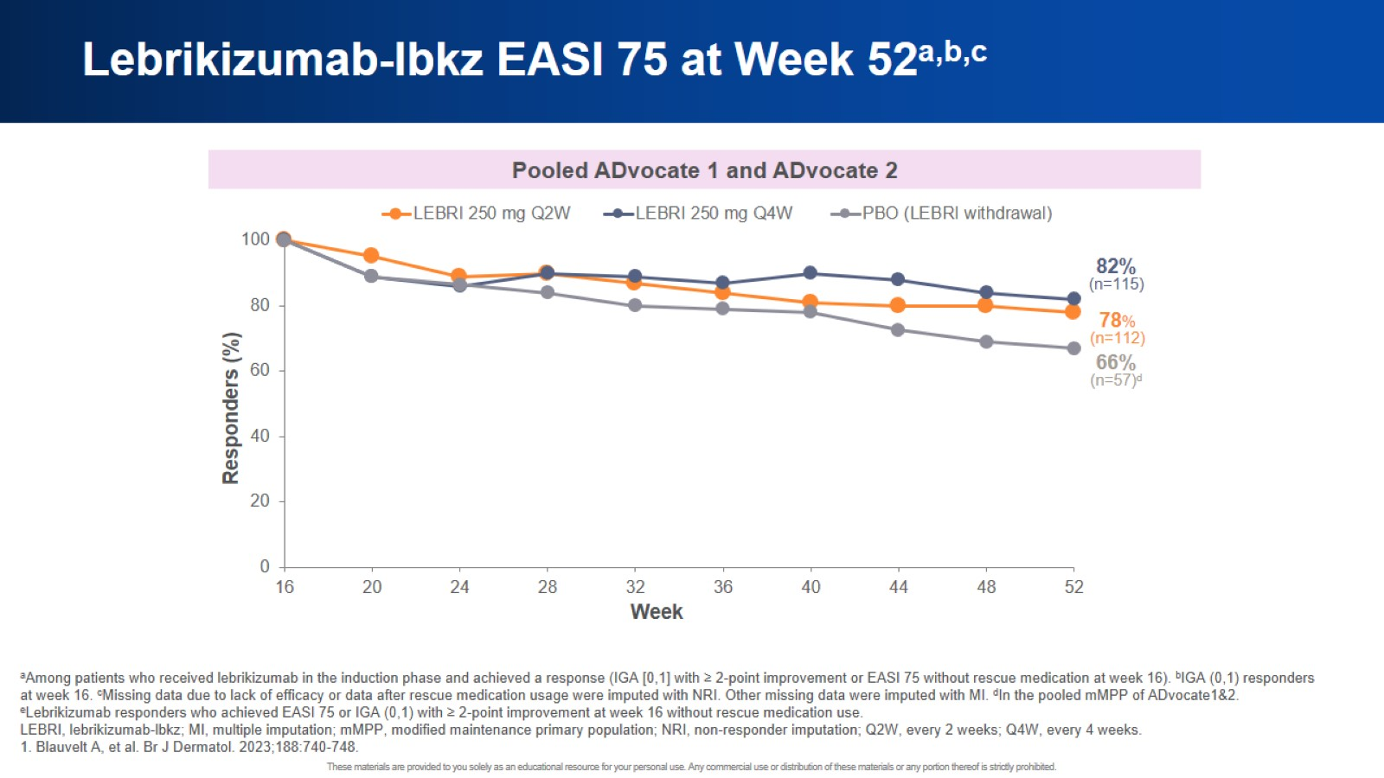
Lebrikizumab-lbkz EASI 75 at Week 52^{a,b,c}

Slide 31
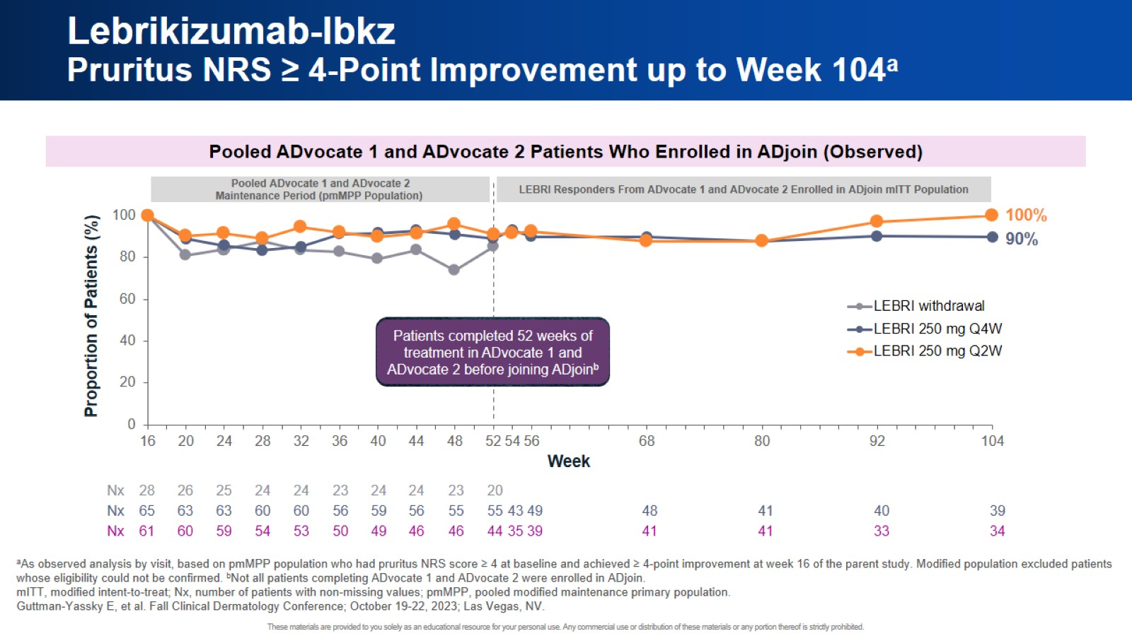
Lebrikizumab-lbkz Pruritus NRS ≥ 4-Point Improvement up to Week 104ª

Slide 32
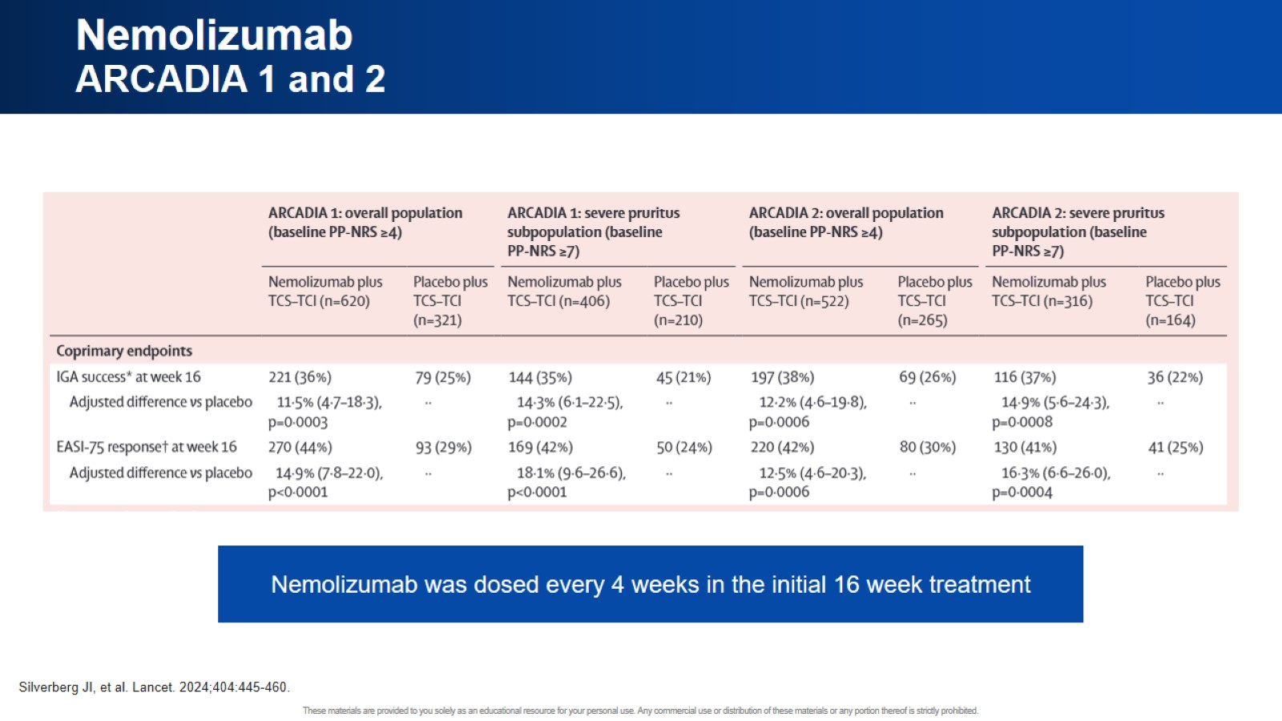
Nemolizumab ARCADIA 1 and 2

Slide 33
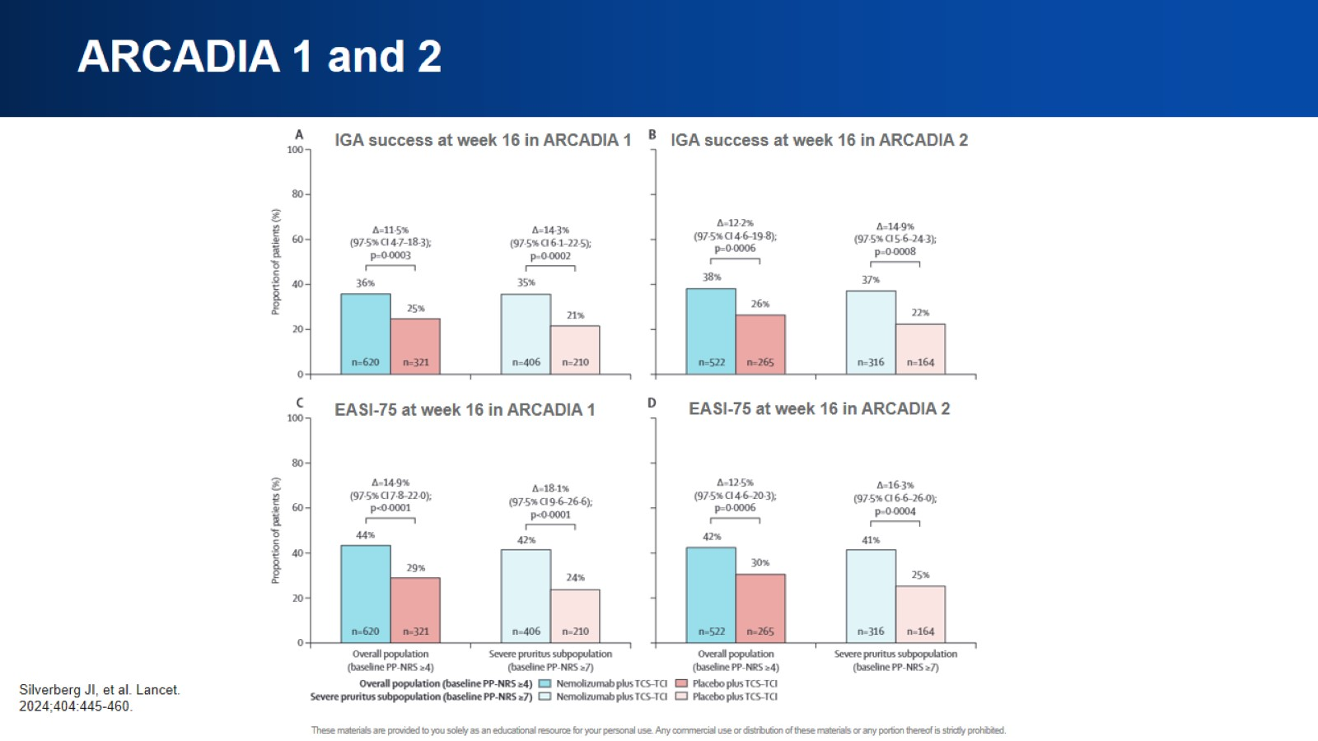
ARCADIA 1 and 2

Slide 34
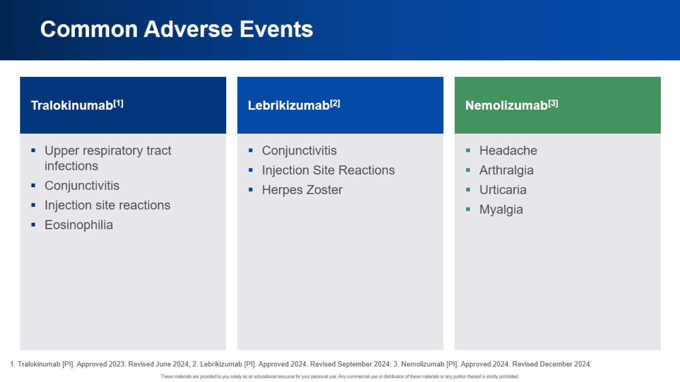
Common Adverse Events

Slide 35
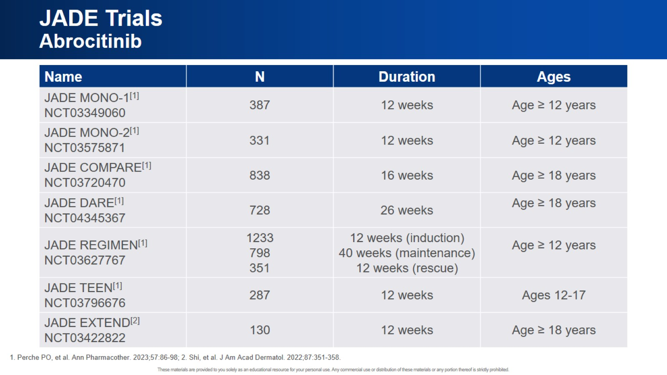
JADE Trials Abrocitinib

Slide 36
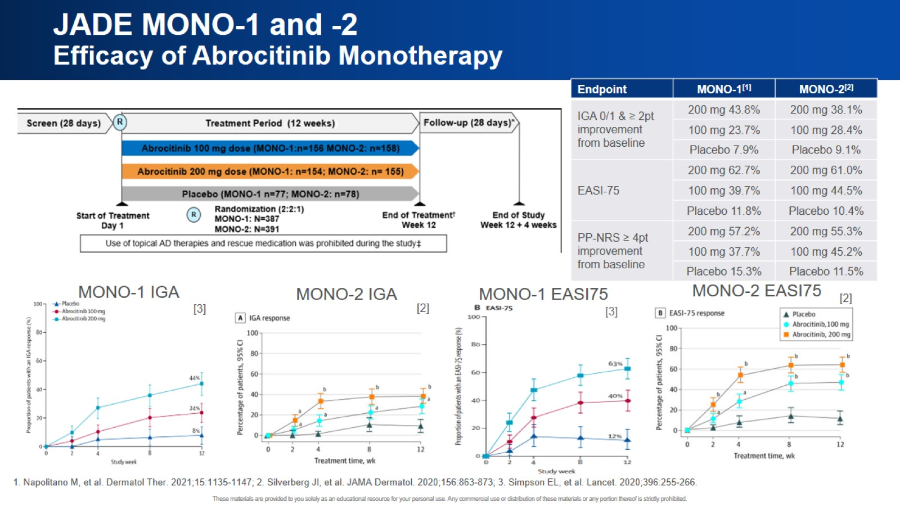
JADE MONO-1 and -2 Efficacy of Abrocitinib Monotherapy

Slide 37
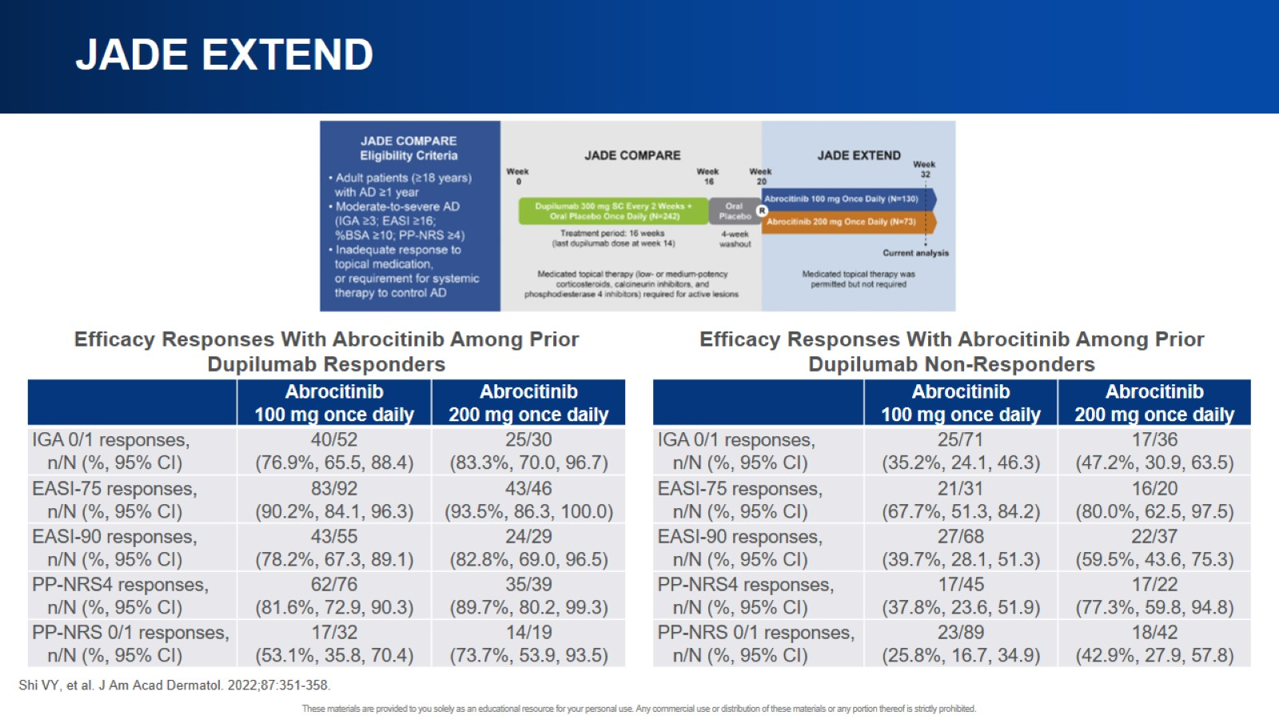
JADE EXTEND

Slide 38
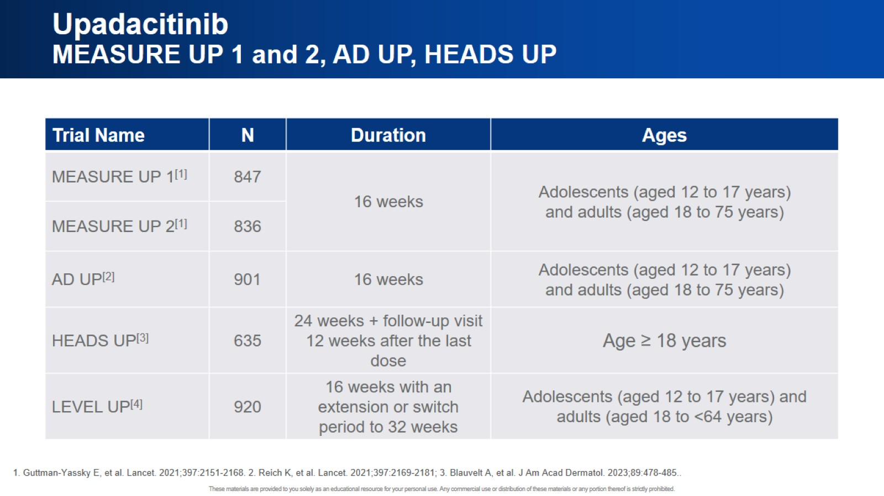
Upadacitinib MEASURE UP 1 and 2, AD UP, HEADS UP

Slide 39
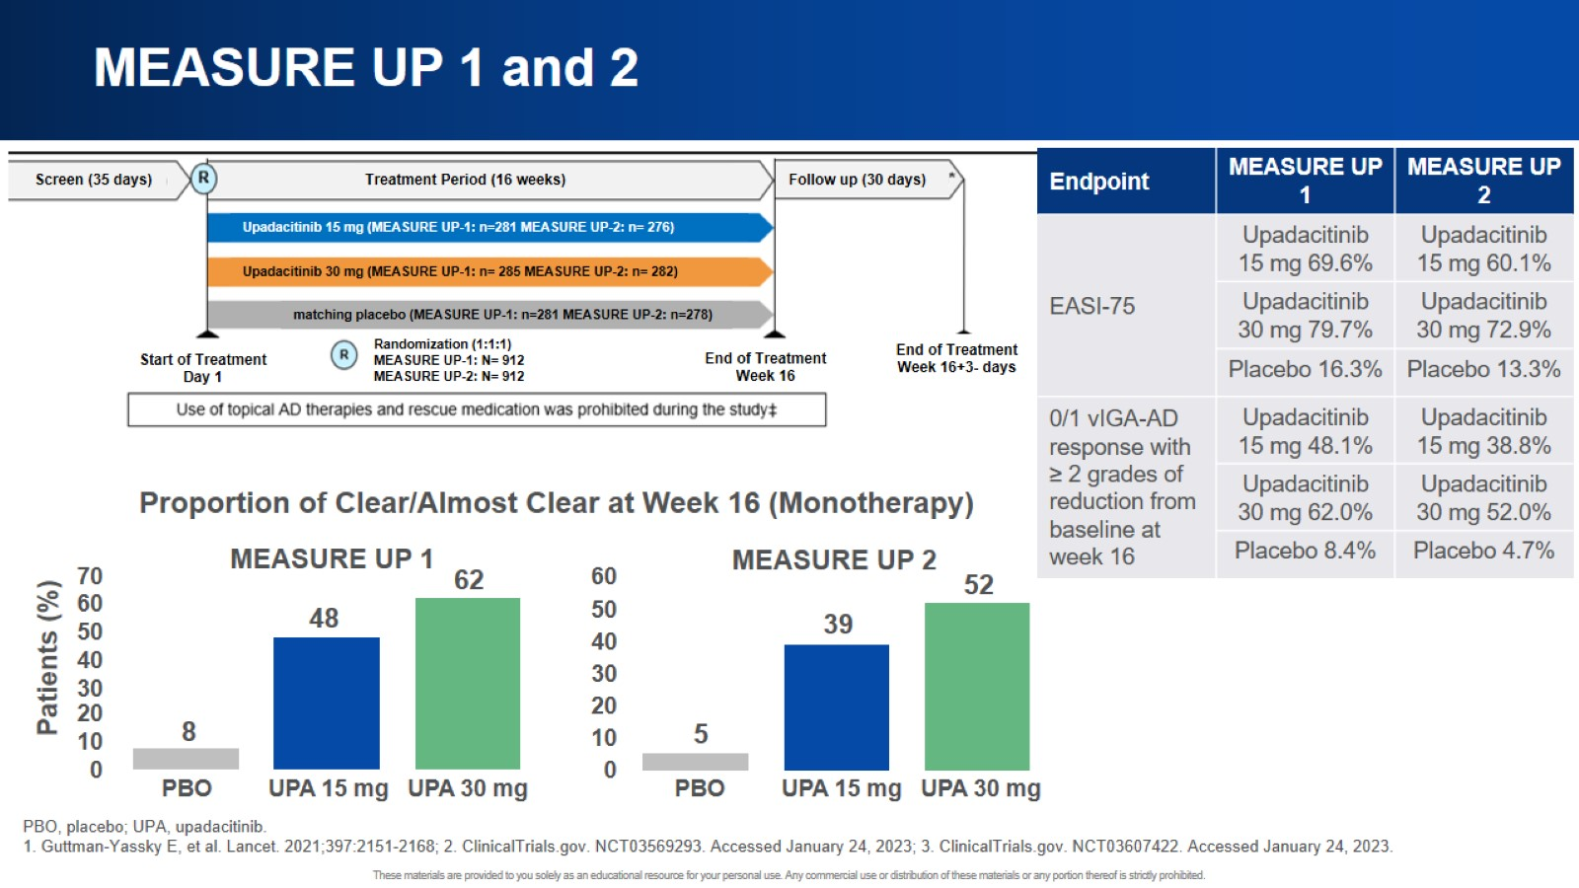
MEASURE UP 1 and 2

Slide 40
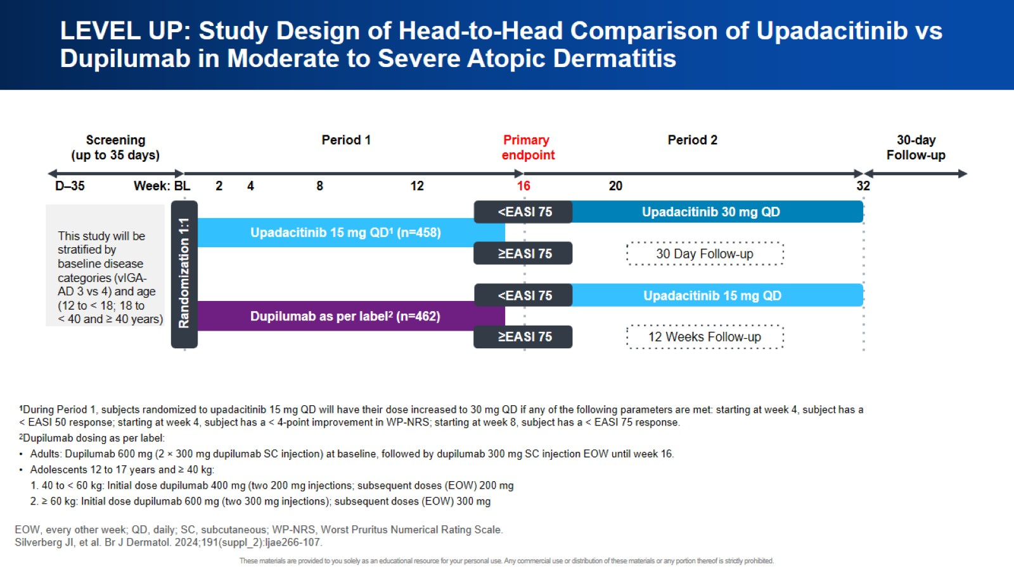
LEVEL UP: Study Design of Head-to-Head Comparison of Upadacitinib vs Dupilumab in Moderate to Severe Atopic Dermatitis

Slide 41
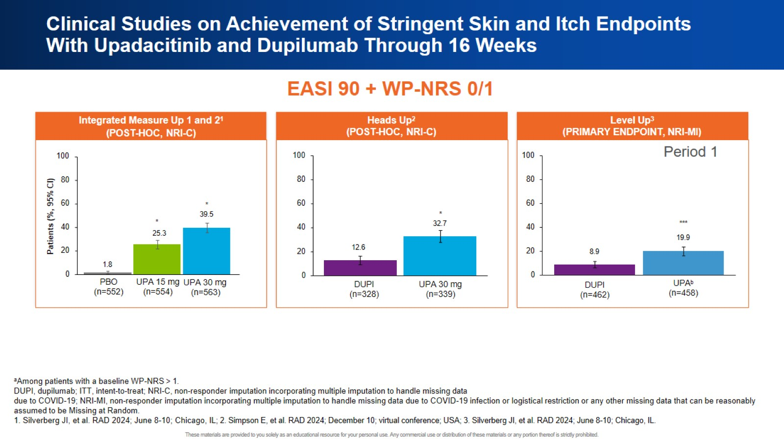
Clinical Studies on Achievement of Stringent Skin and Itch Endpoints With Upadacitinib and Dupilumab Through 16 Weeks

Slide 42
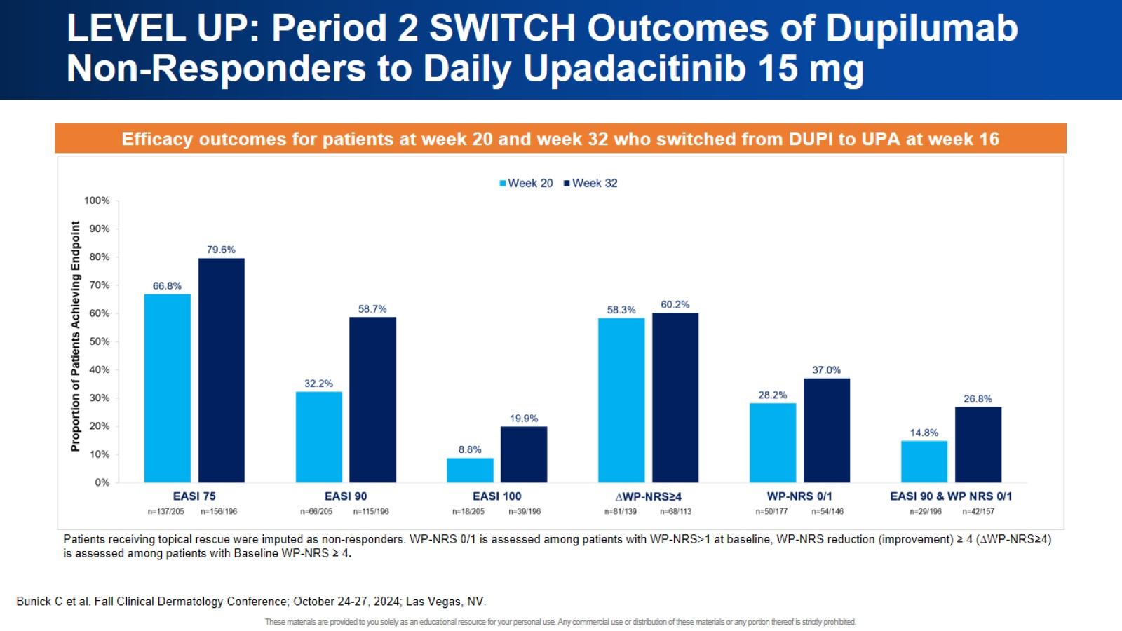
LEVEL UP: Period 2 SWITCH Outcomes of Dupilumab Non-Responders to Daily Upadacitinib 15 mg

Slide 43
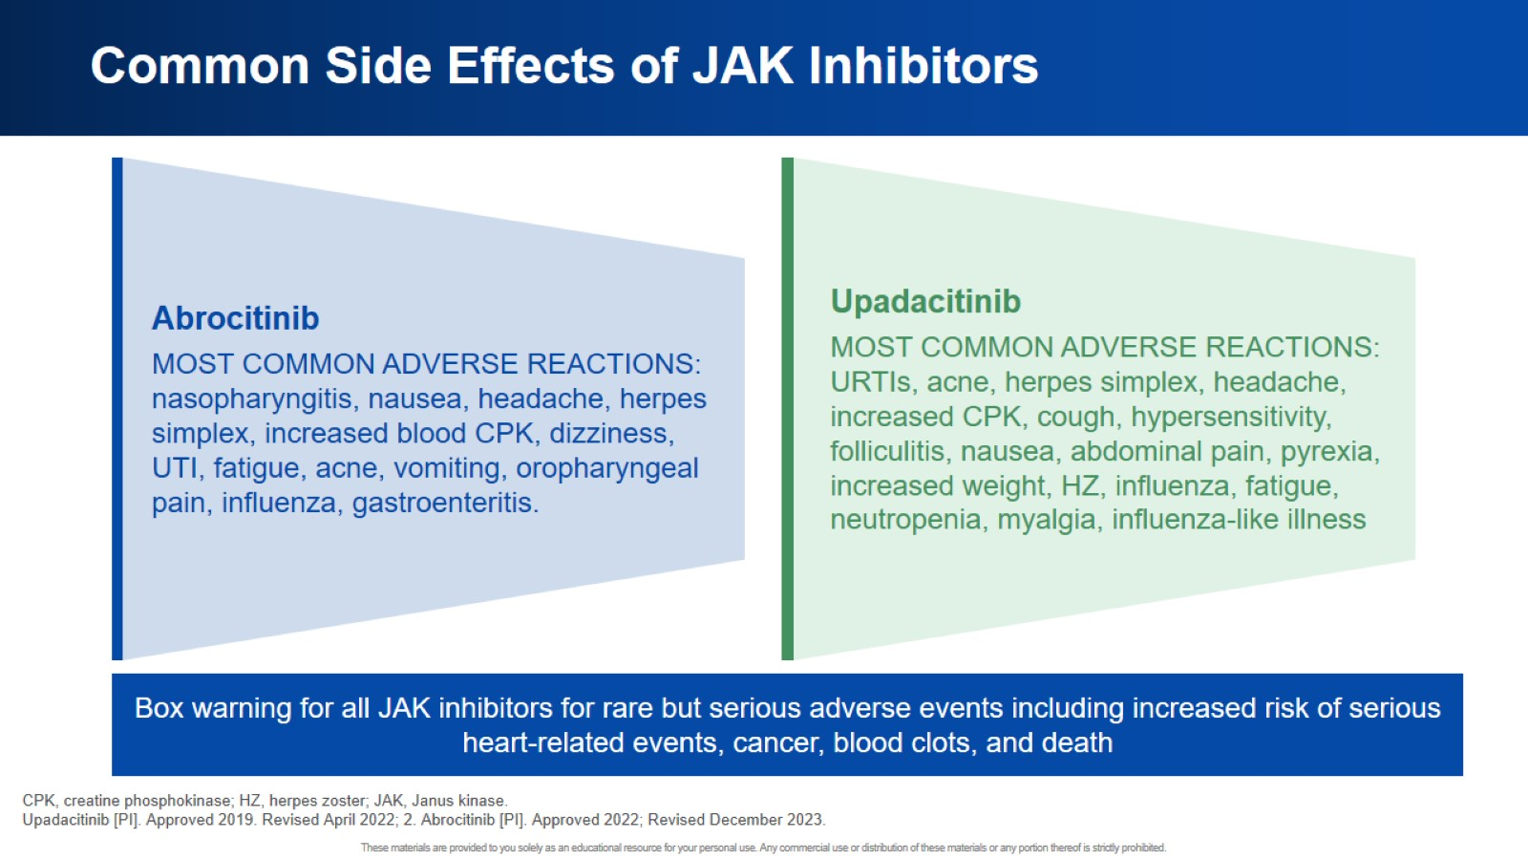
Common Side Effects of JAK Inhibitors

Slide 44
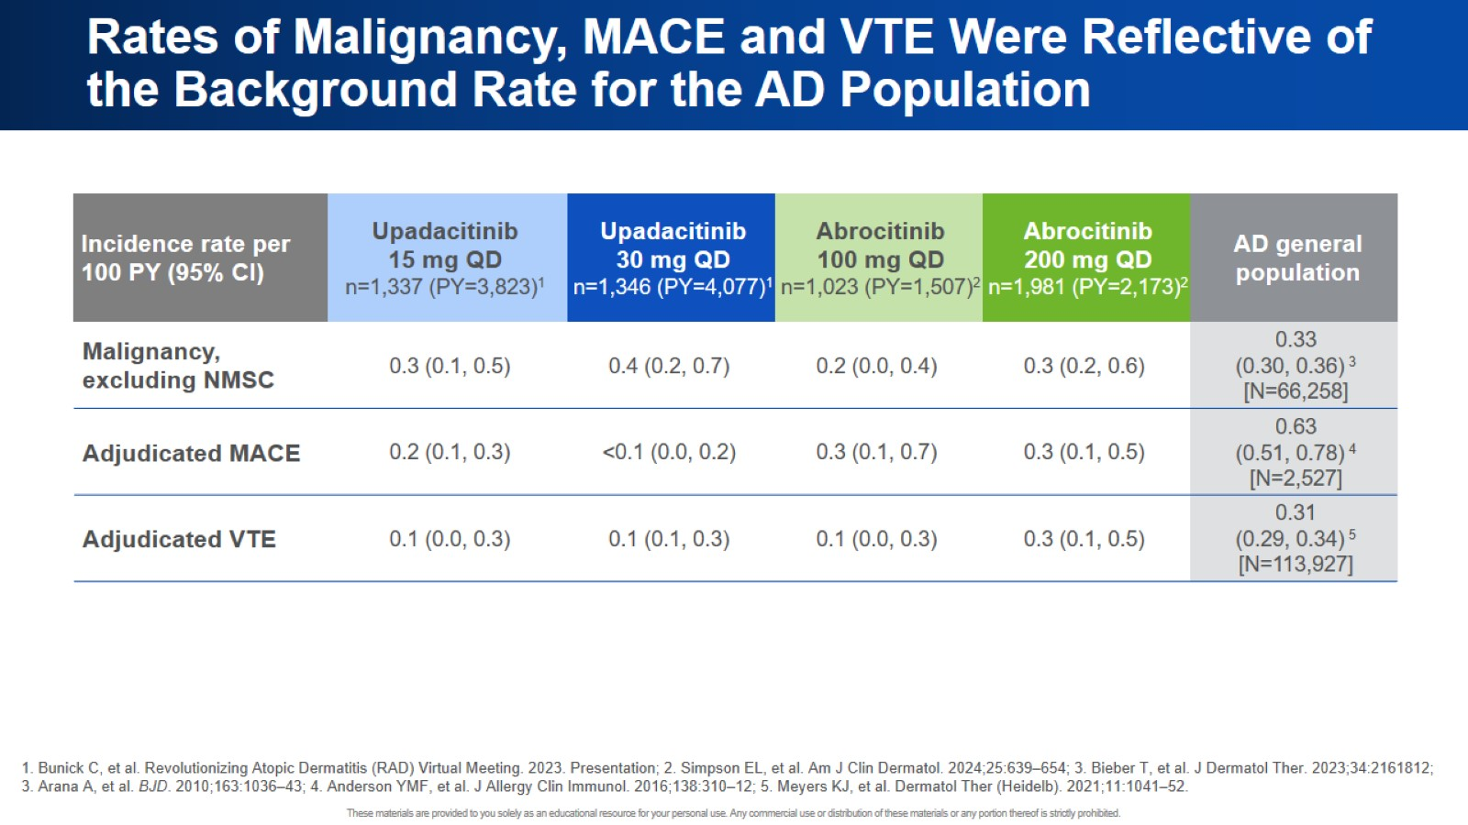
Rates of Malignancy, MACE and VTE Were Reflective of the Background Rate for the AD Population

Slide 45
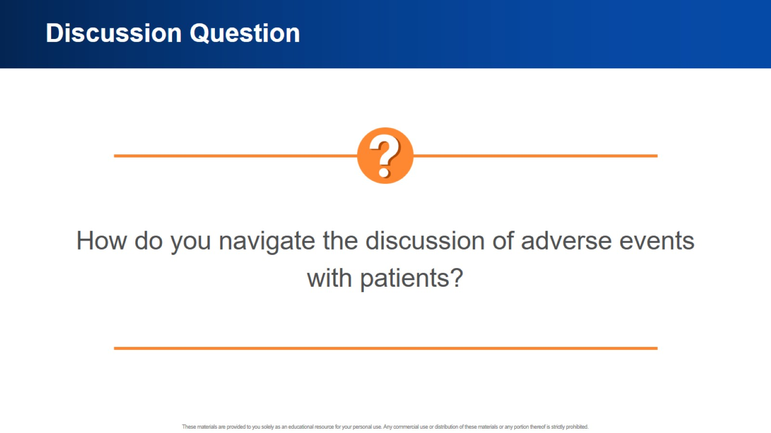
Discussion Question

Slide 46
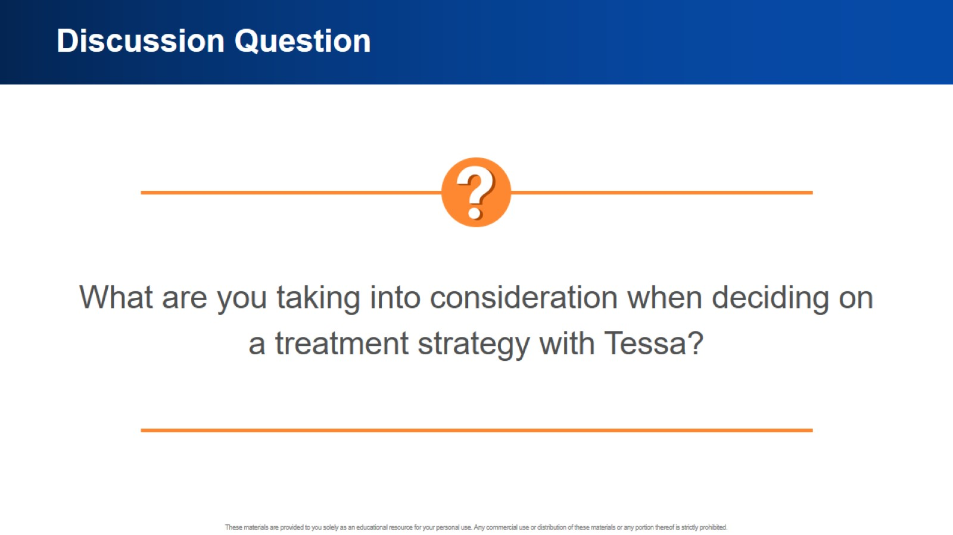
Discussion Question

Slide 47
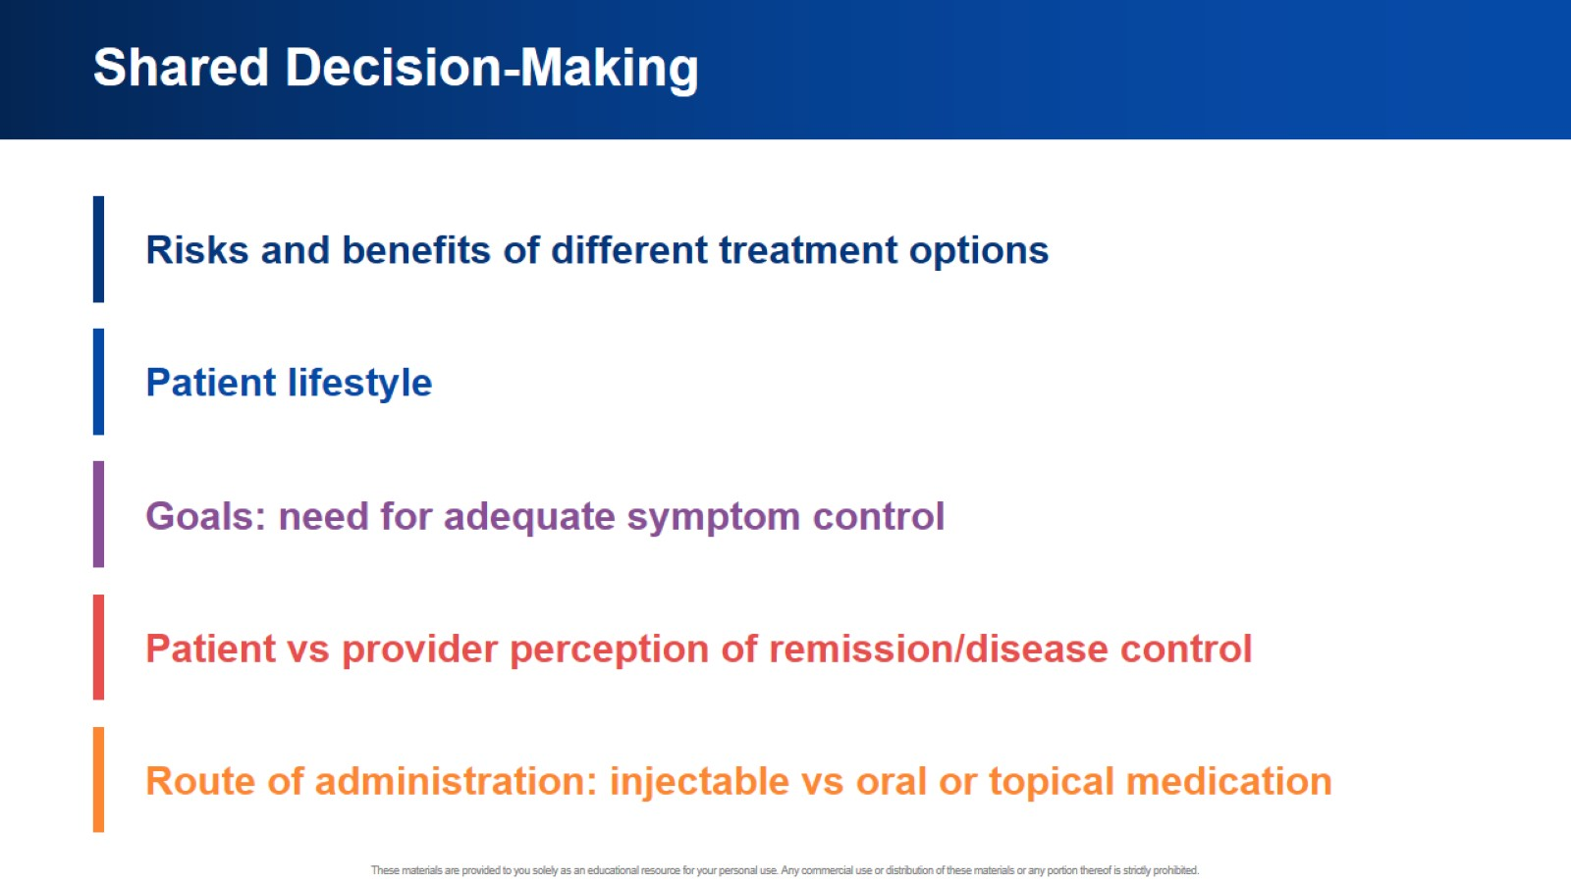
Shared Decision-Making

Slide 48
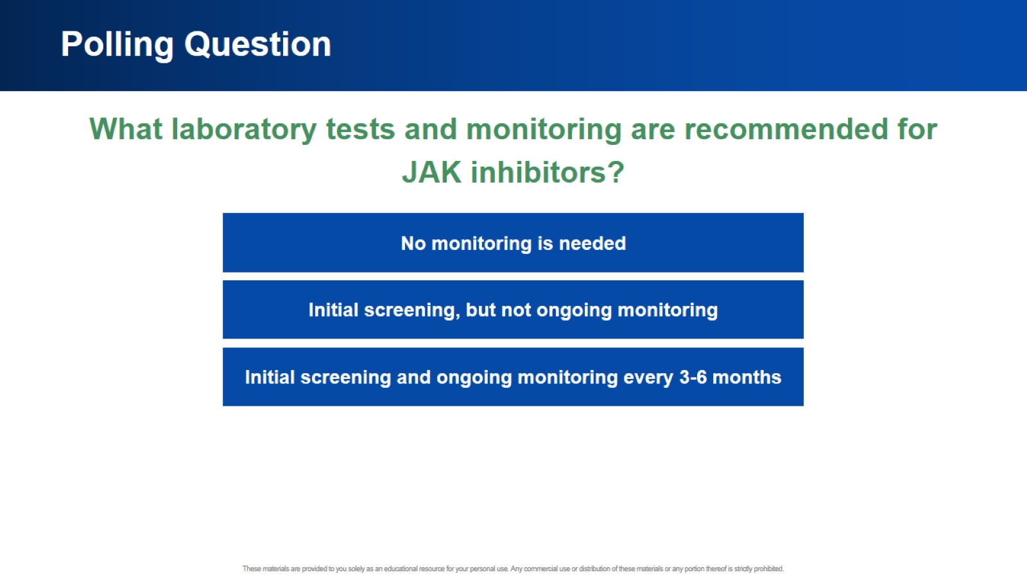
Polling Question

Slide 49
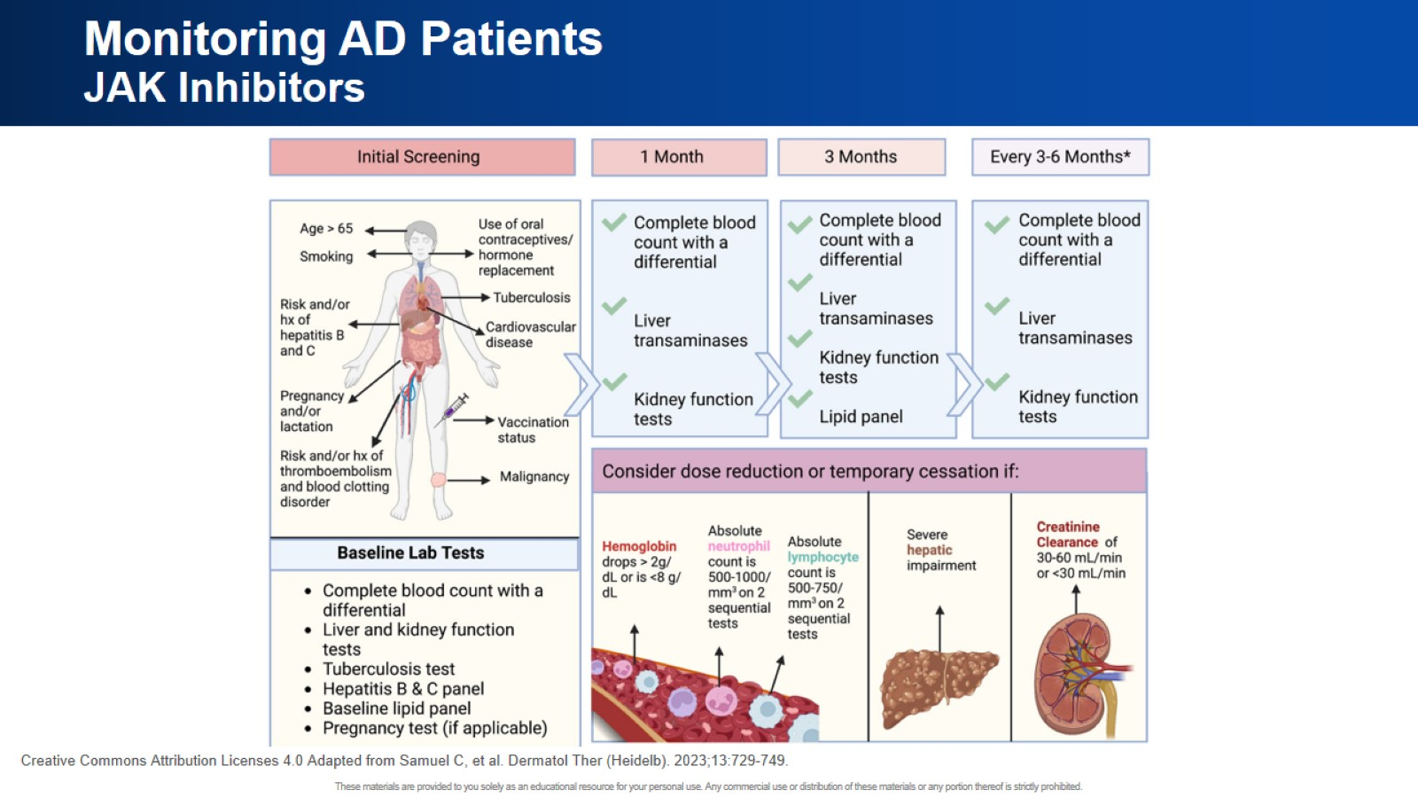
Monitoring AD Patients JAK Inhibitors

Slide 50
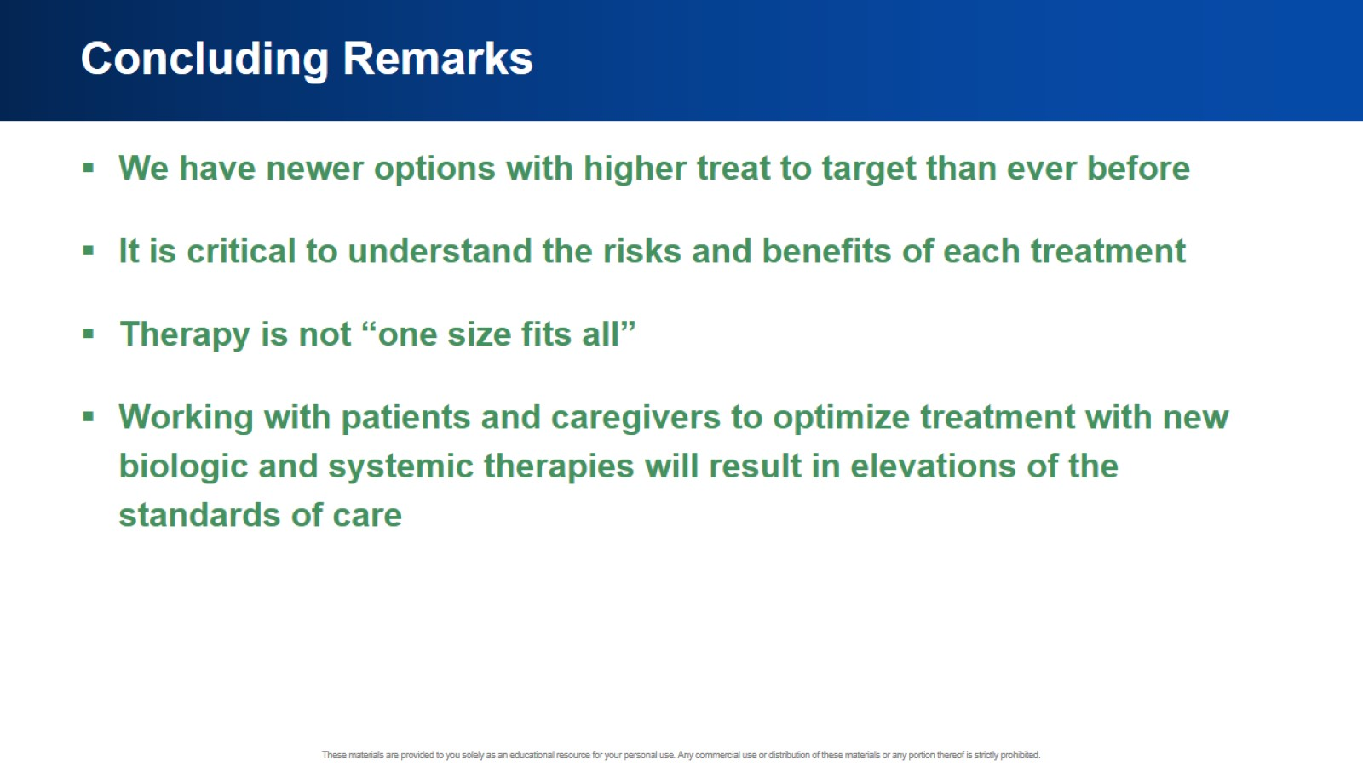
Concluding Remarks

Slide 51


