Slide 1
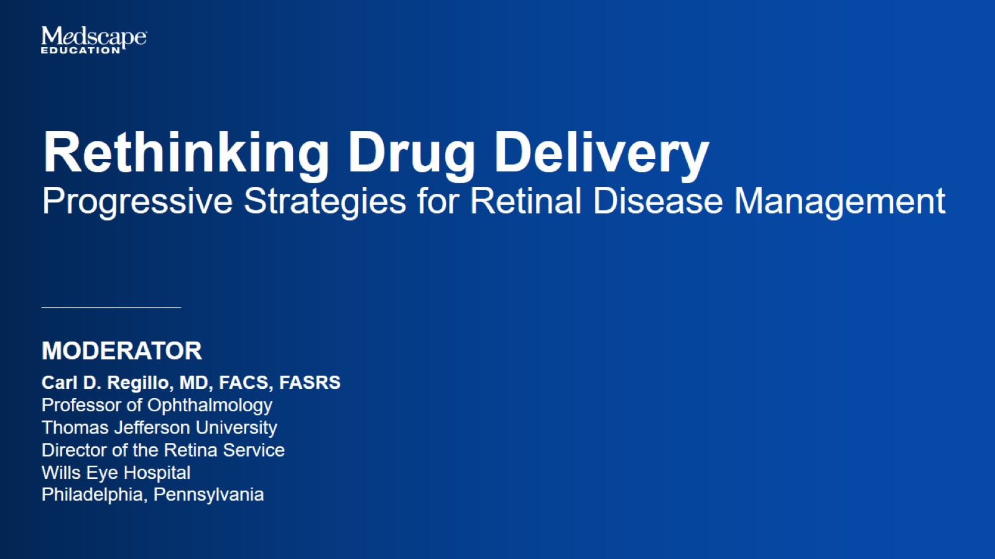

Slide 2
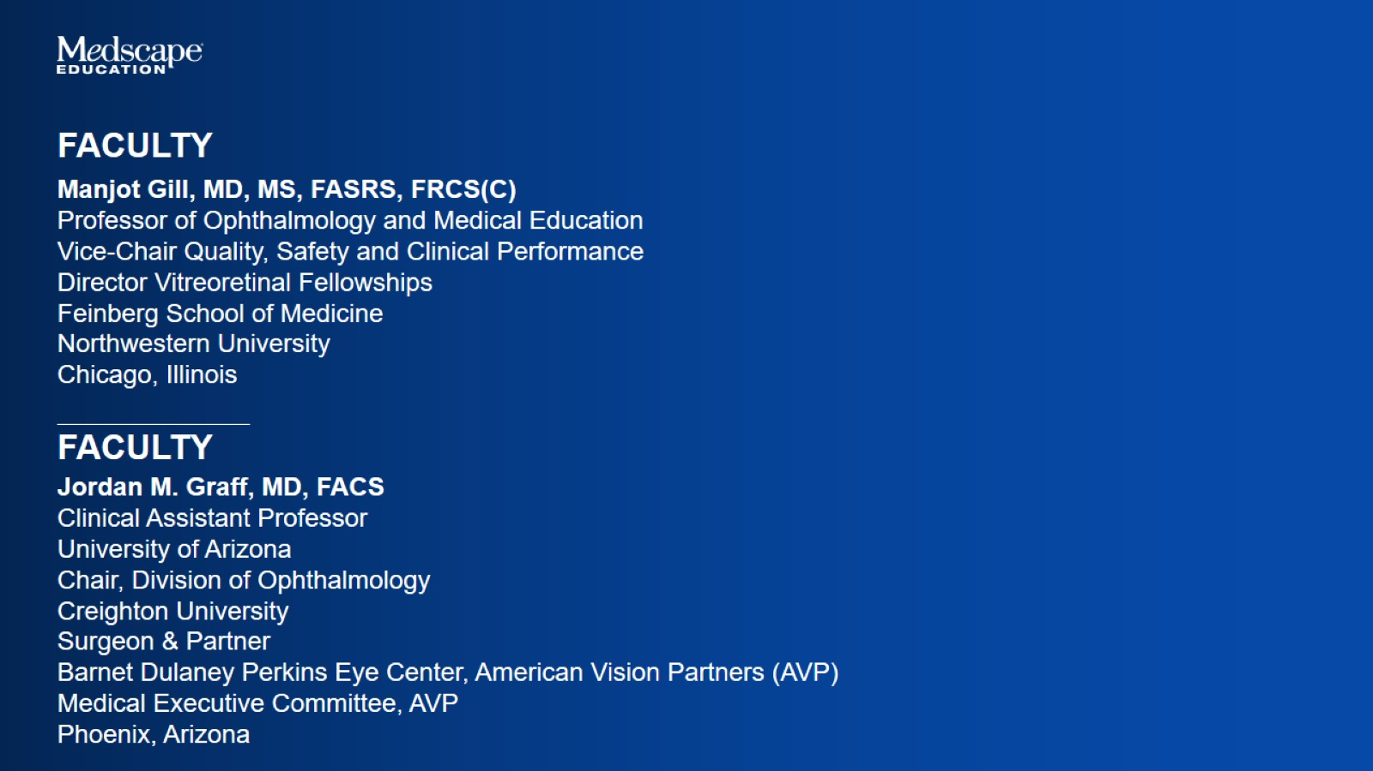

Slide 3
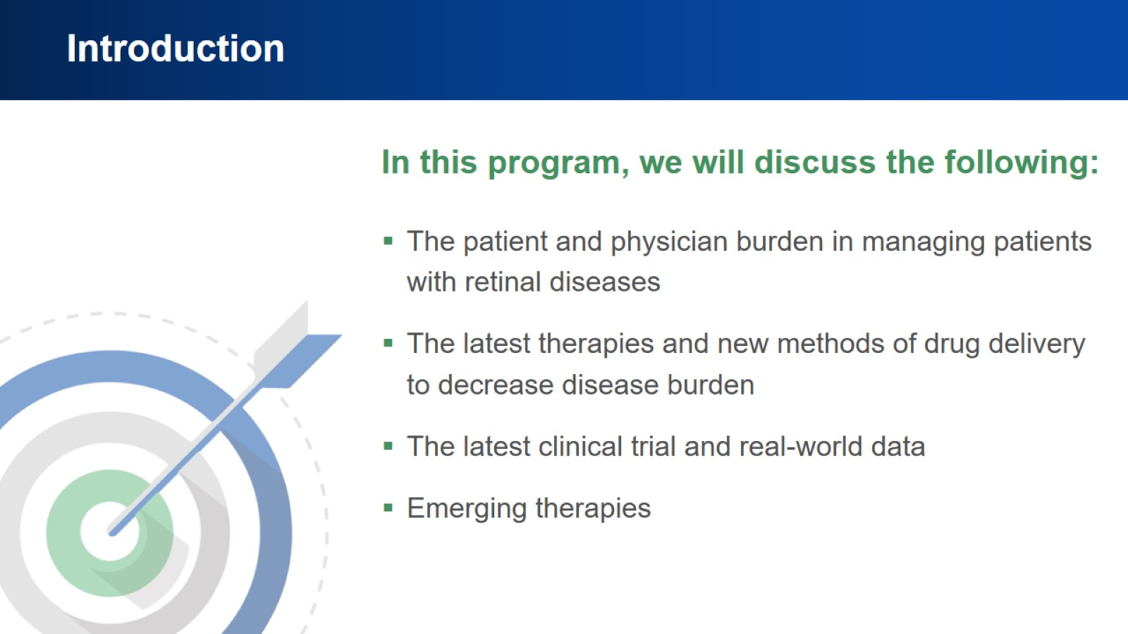
Introduction

Slide 4
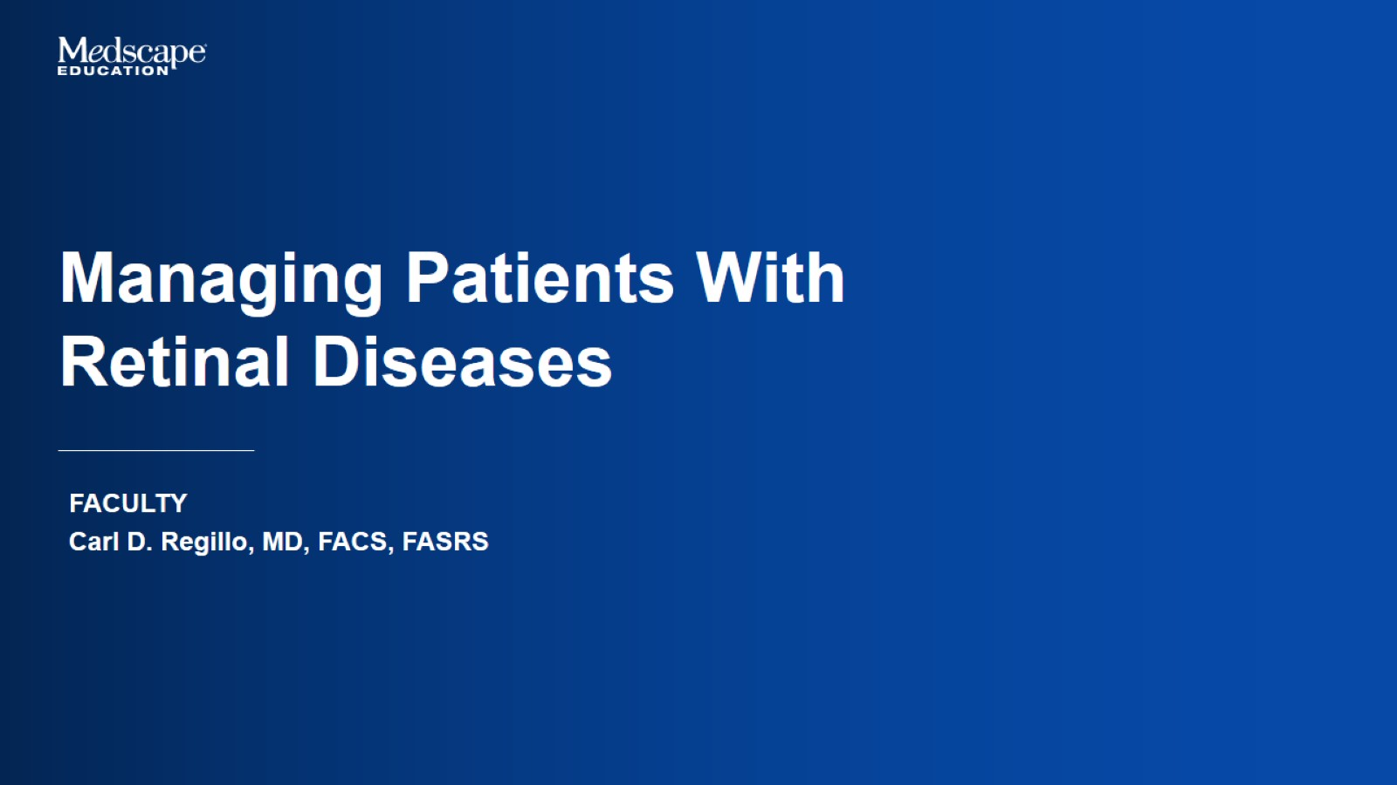
Managing Patients With
Retinal Diseases

Slide 5
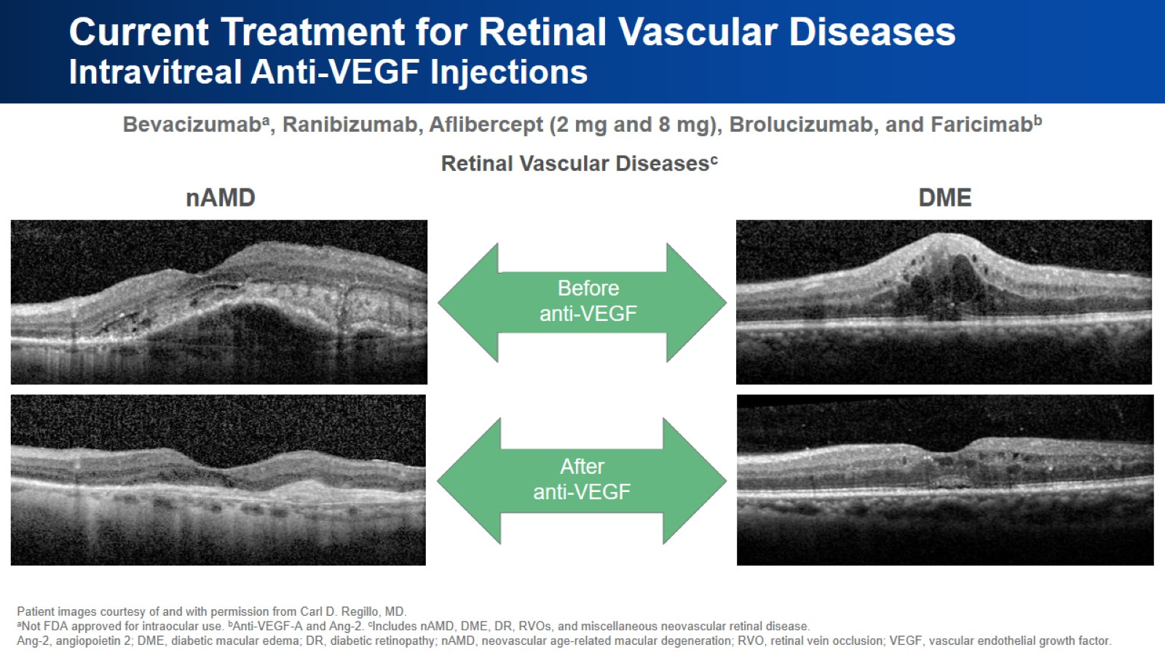
Current Treatment for Retinal Vascular Diseases
Intravitreal Anti-VEGF Injections

Slide 6
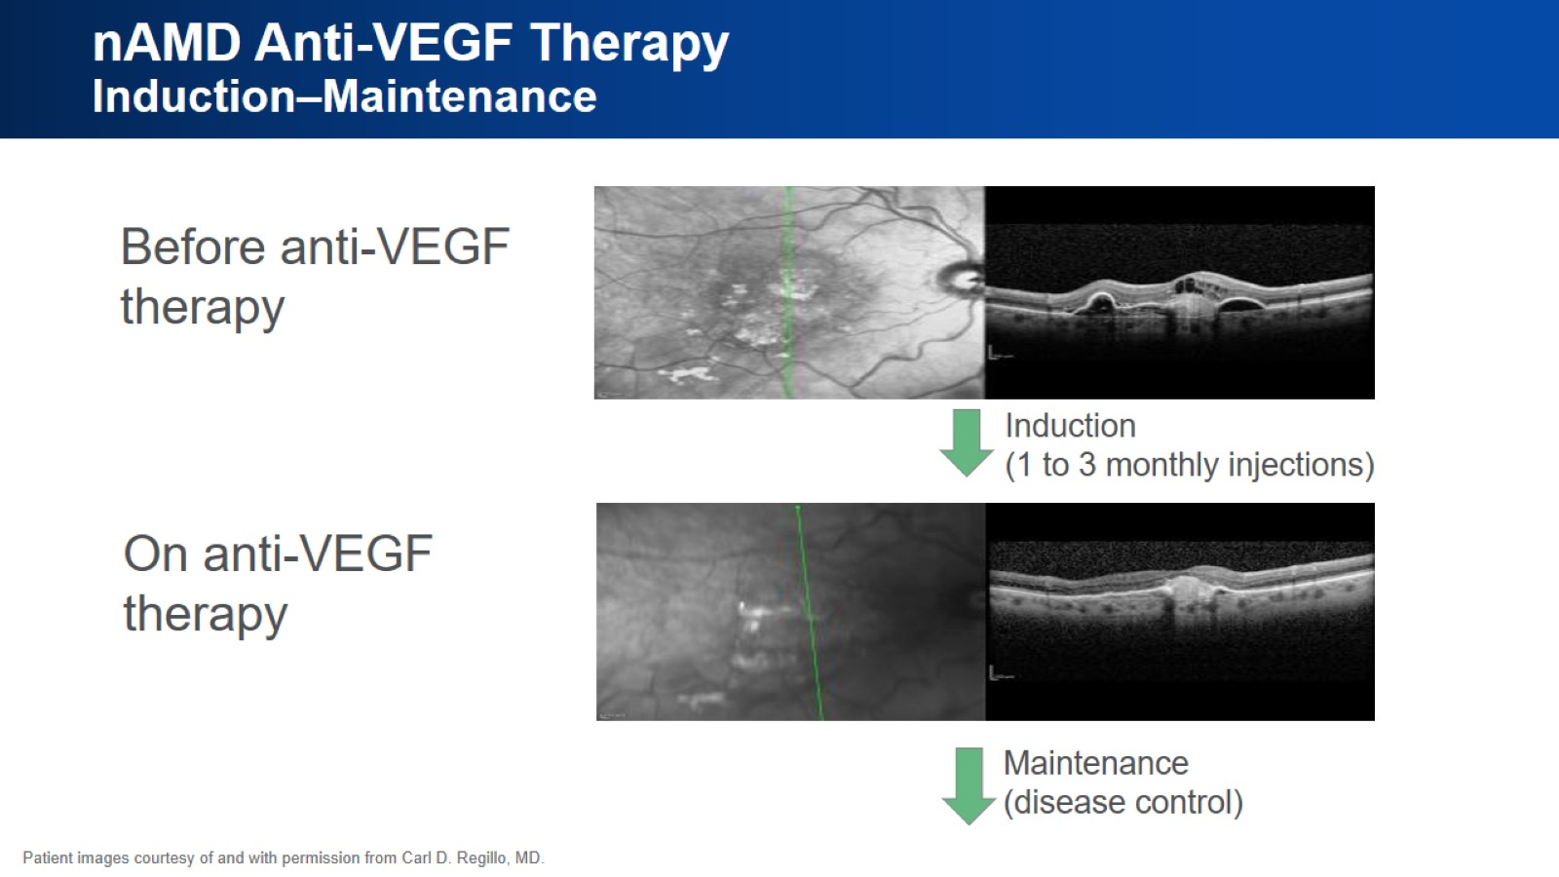
nAMD Anti-VEGF Therapy
Induction–Maintenance

Slide 7
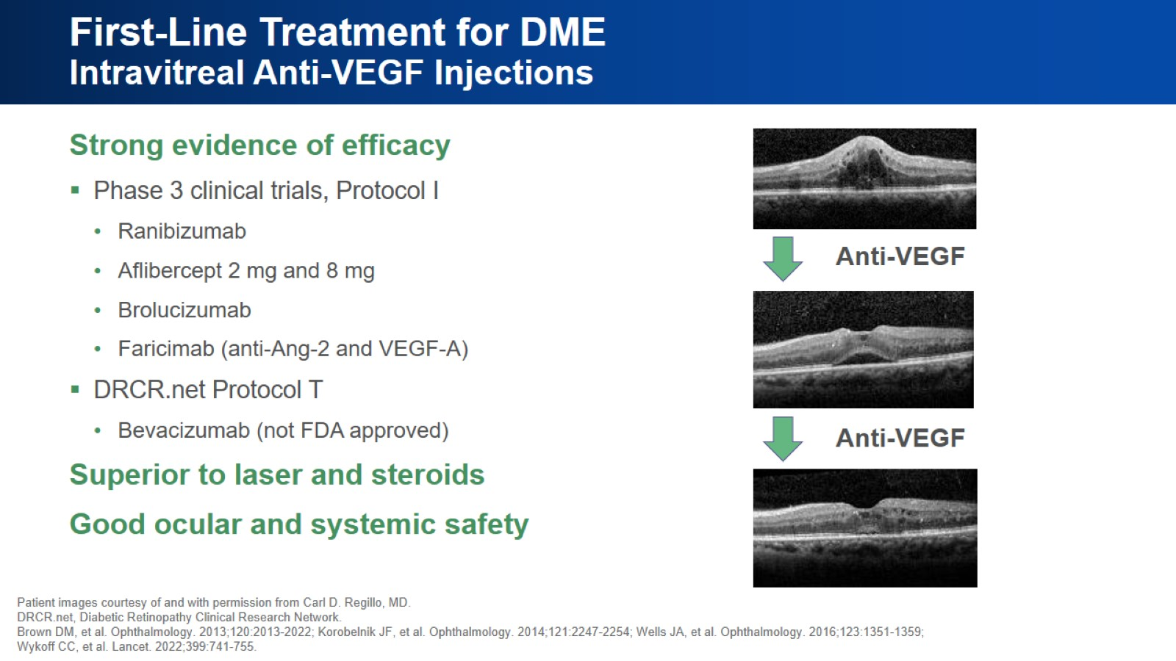
First-Line Treatment for DME
Intravitreal Anti-VEGF Injections

Slide 8
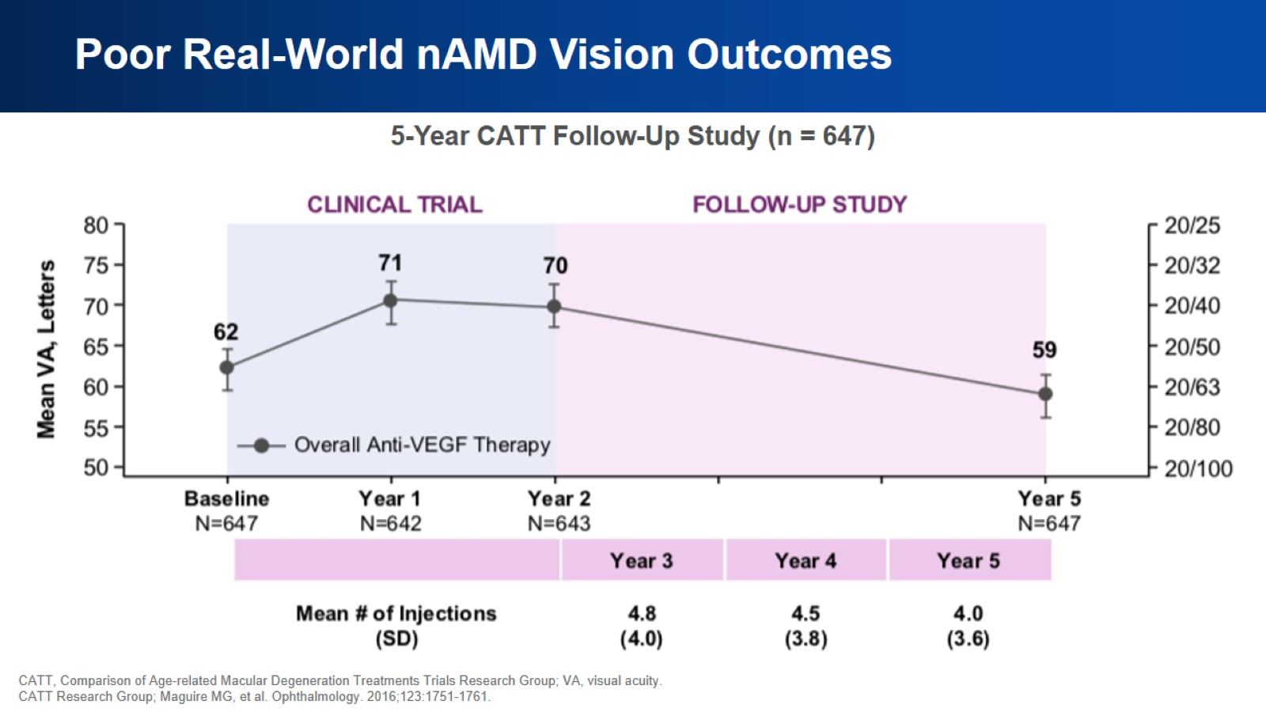
Poor Real-World nAMD Vision Outcomes

Slide 9
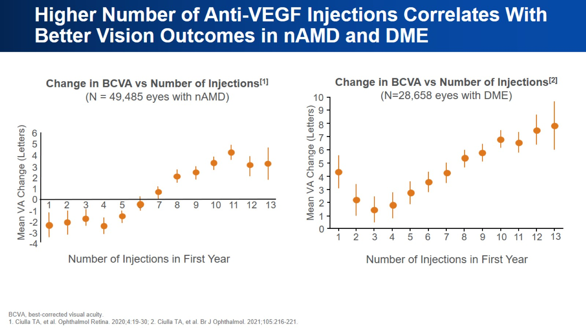
Higher Number of Anti-VEGF Injections Correlates With Better Vision Outcomes in nAMD and DME

Slide 10
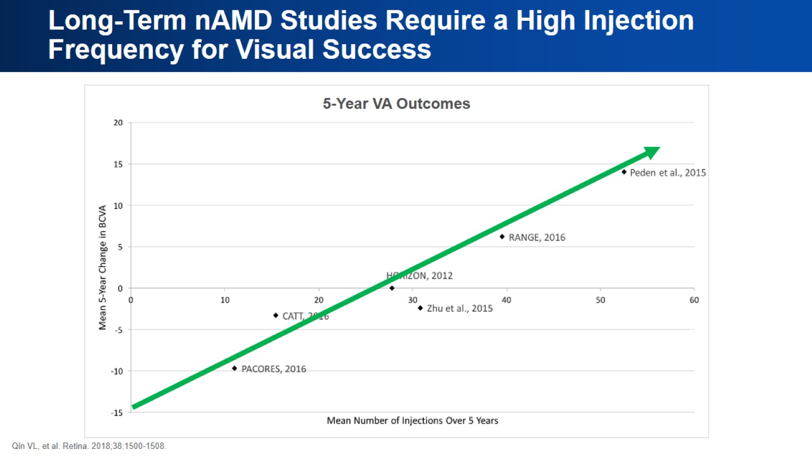
Long-Term nAMD Studies Require a High Injection Frequency for Visual Success

Slide 11
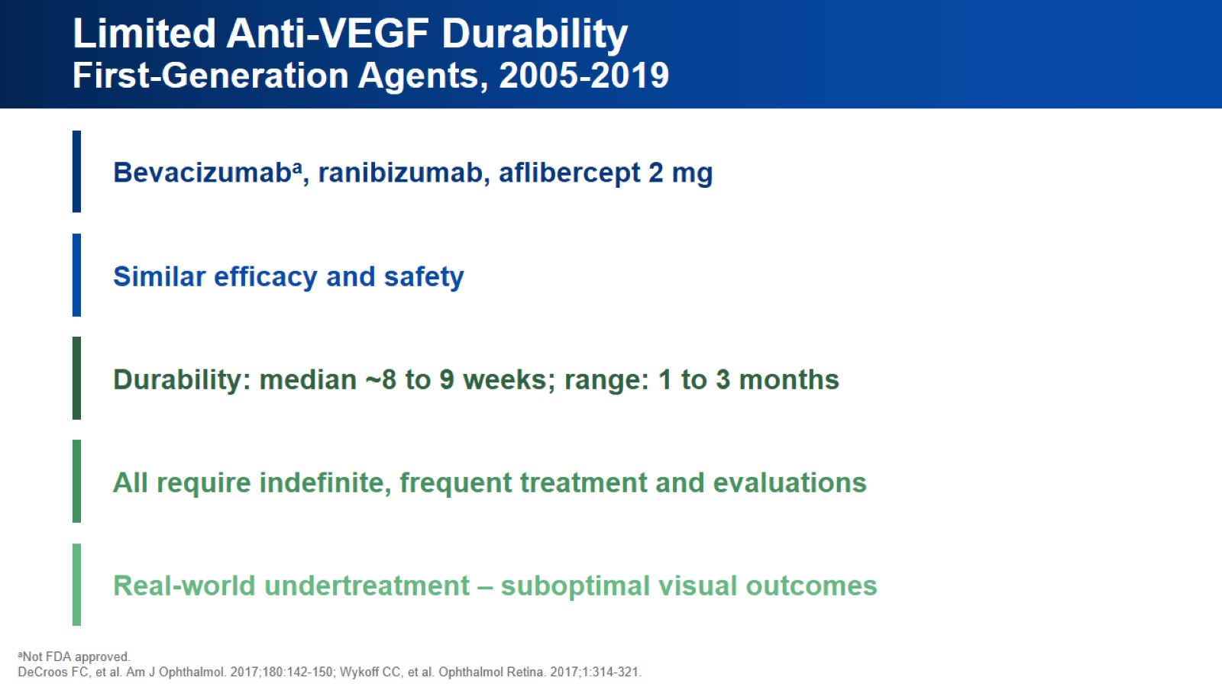
Limited Anti-VEGF Durability
First-Generation Agents, 2005-2019

Slide 12
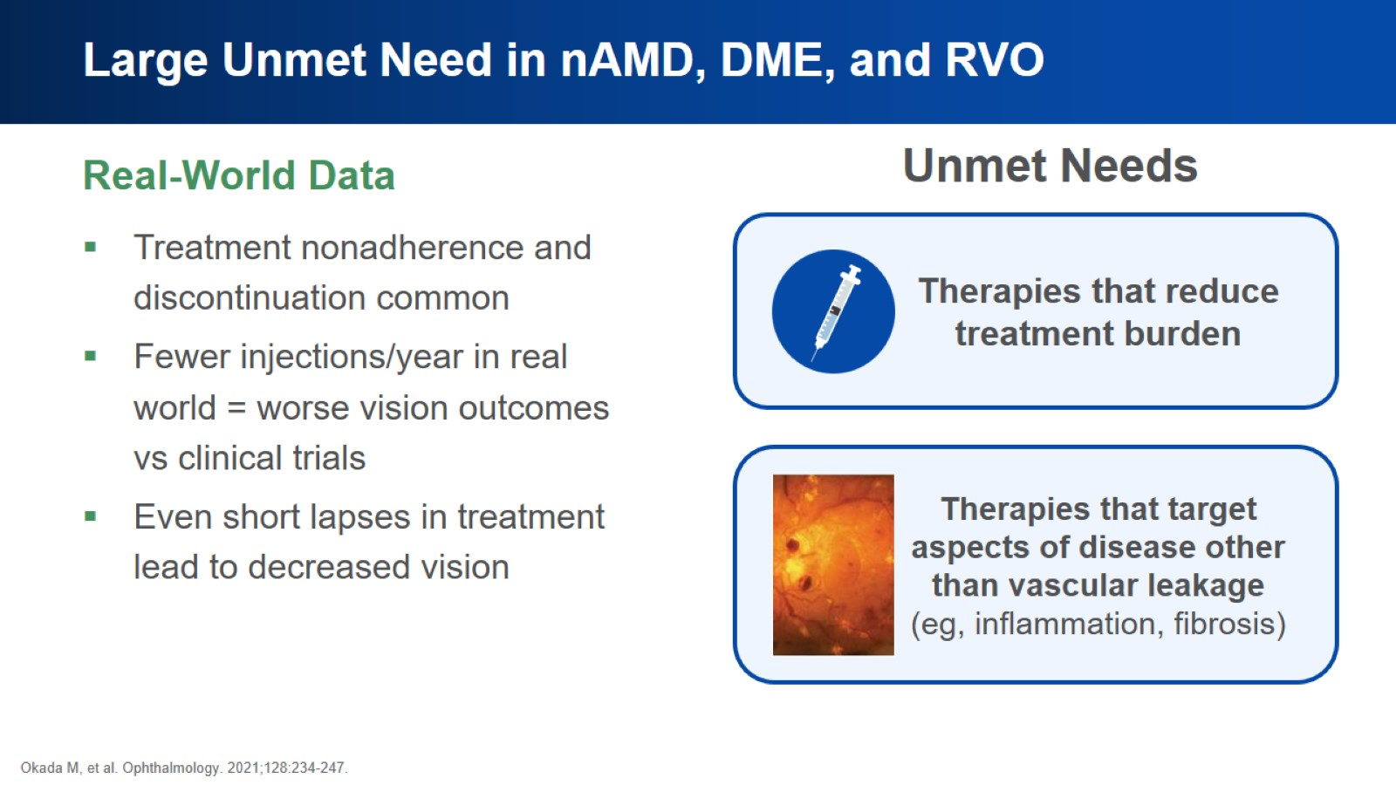
Large Unmet Need in nAMD, DME, and RVO

Slide 13

The Current Treatment Landscape

Slide 14
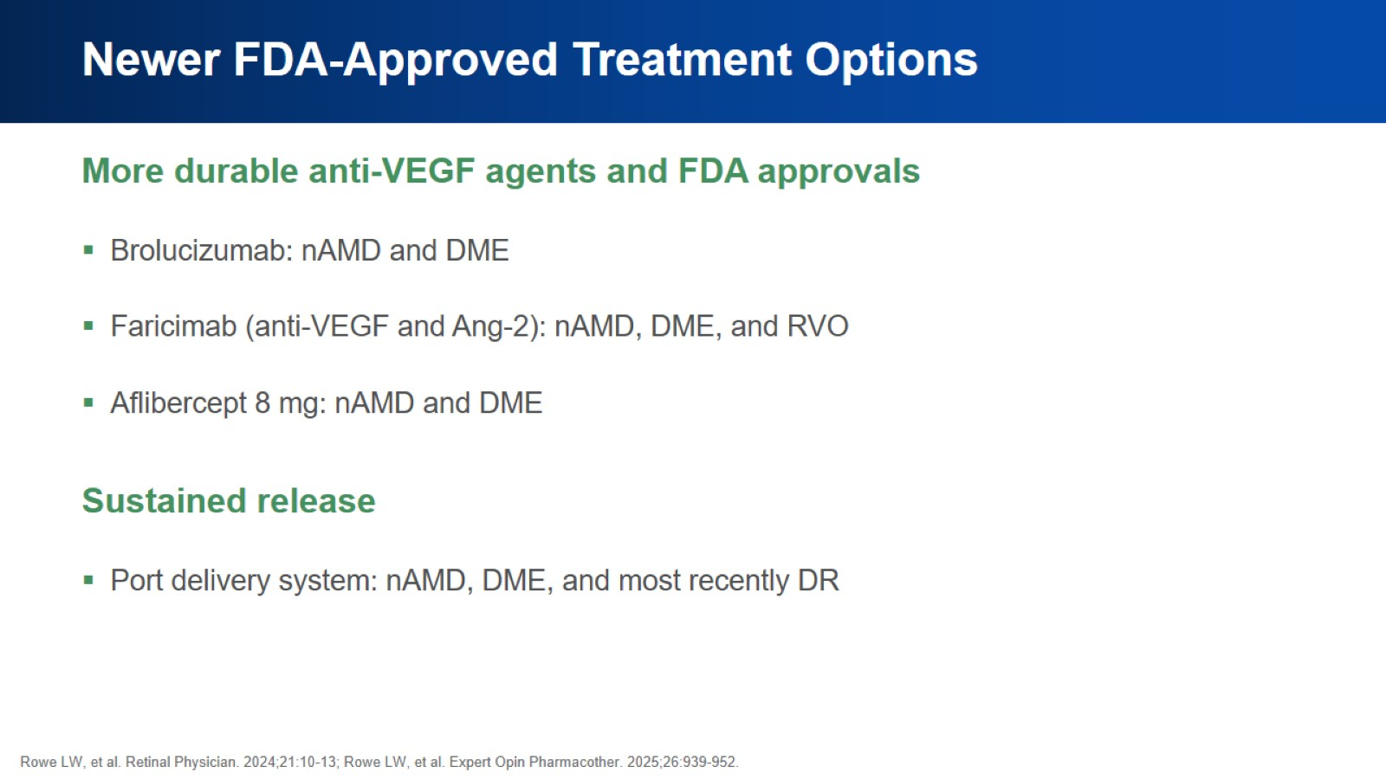
Newer FDA-Approved Treatment Options

Slide 15
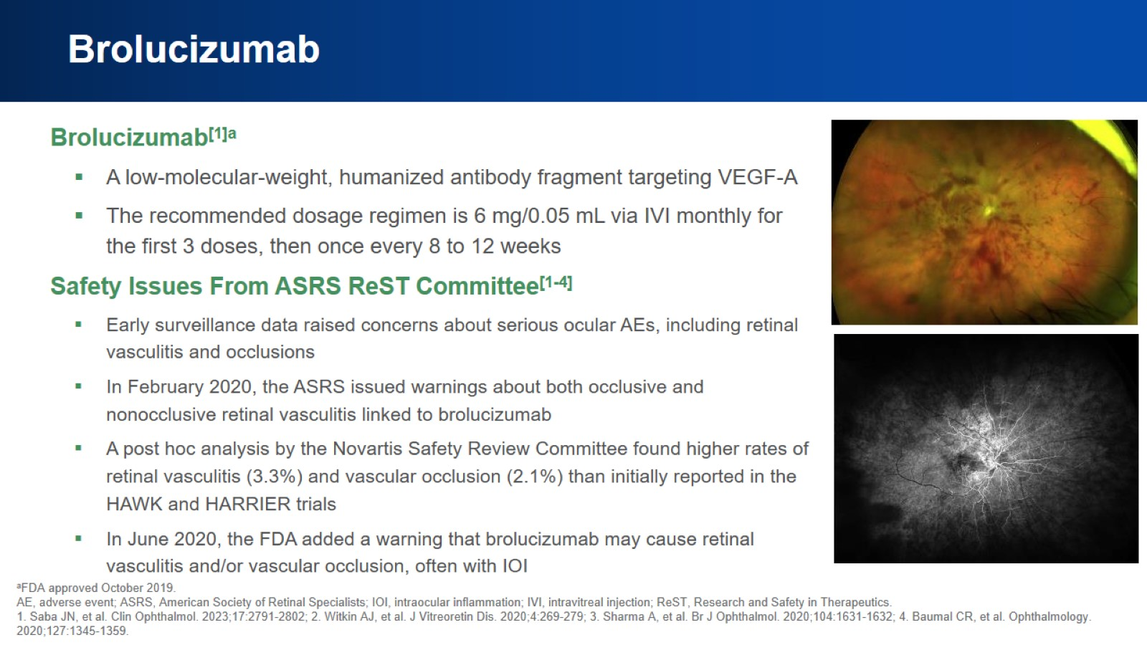
Brolucizumab

Slide 16
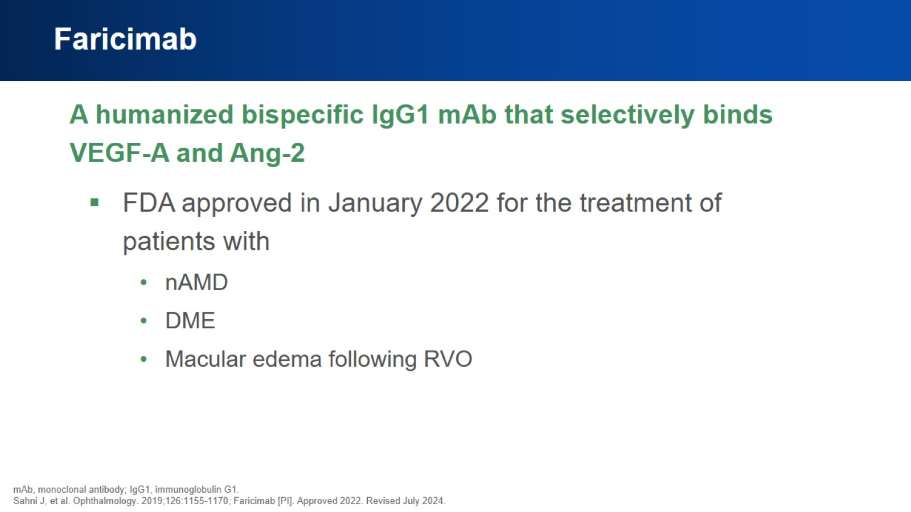
Faricimab

Slide 17
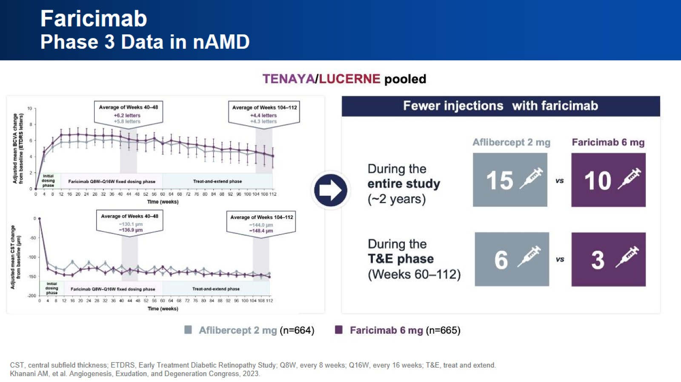
Faricimab
Phase 3 Data in nAMD

Slide 18
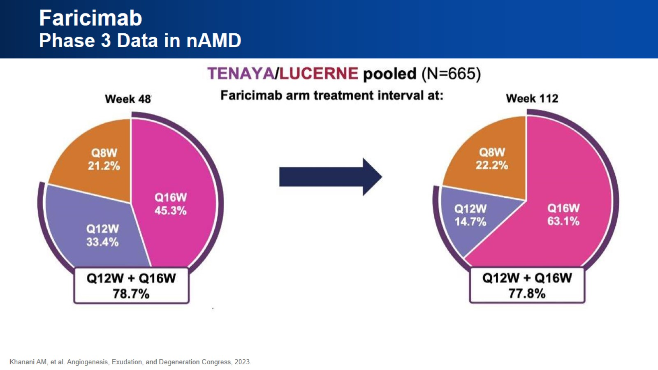
Faricimab
Phase 3 Data in nAMD

Slide 19
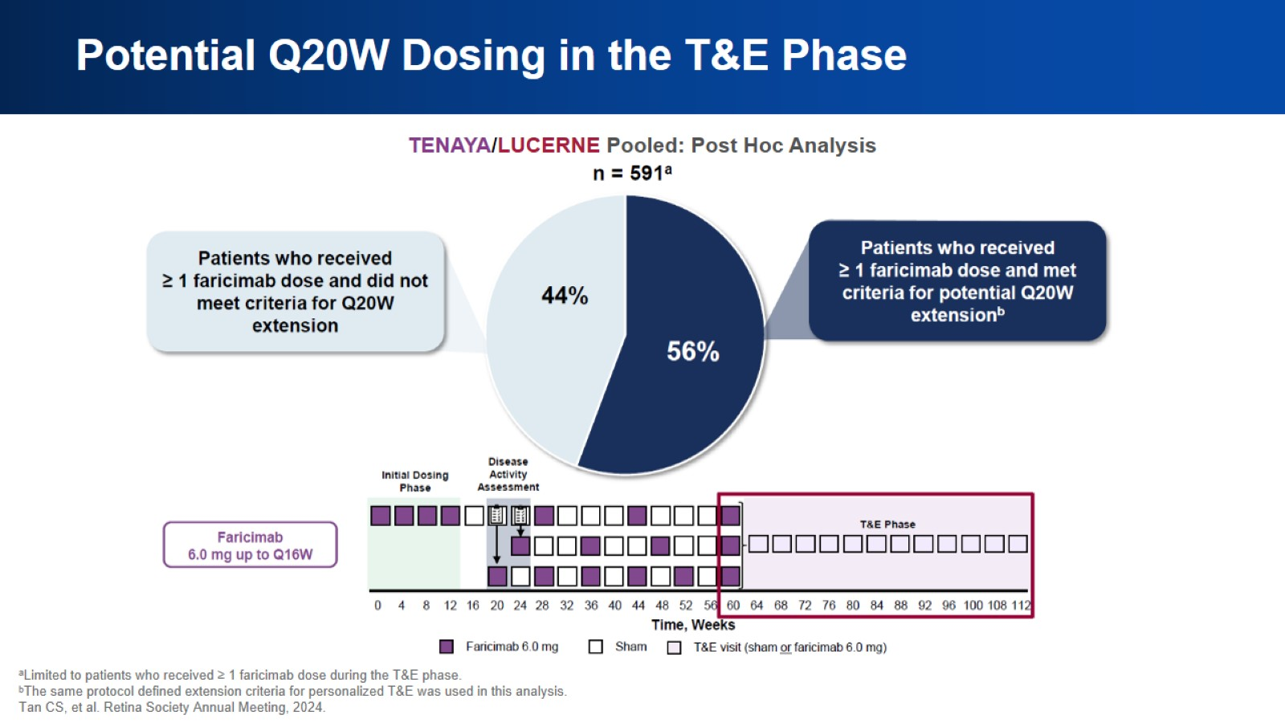
Potential Q20W Dosing in the T&E Phase

Slide 20
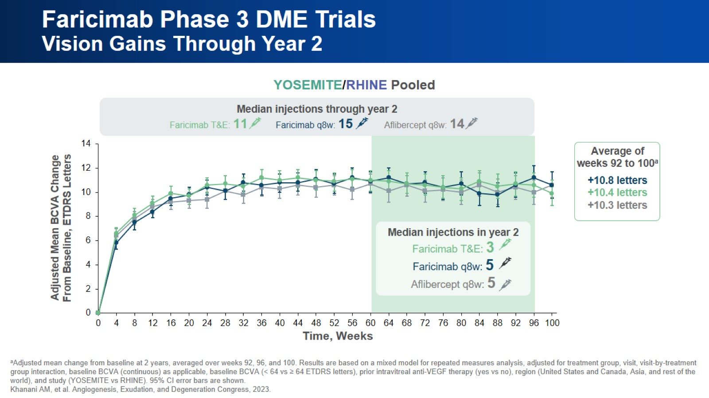
Faricimab Phase 3 DME Trials
Vision Gains Through Year 2

Slide 21
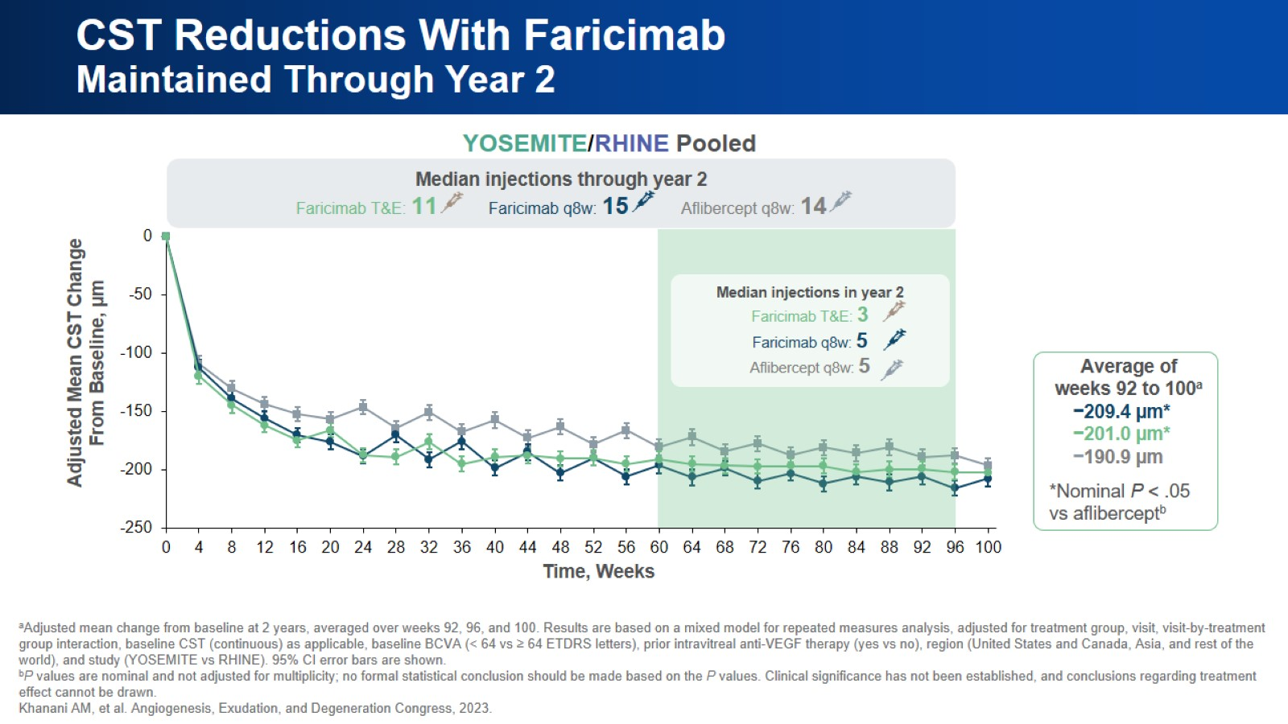
CST Reductions With Faricimab
Maintained Through Year 2

Slide 22
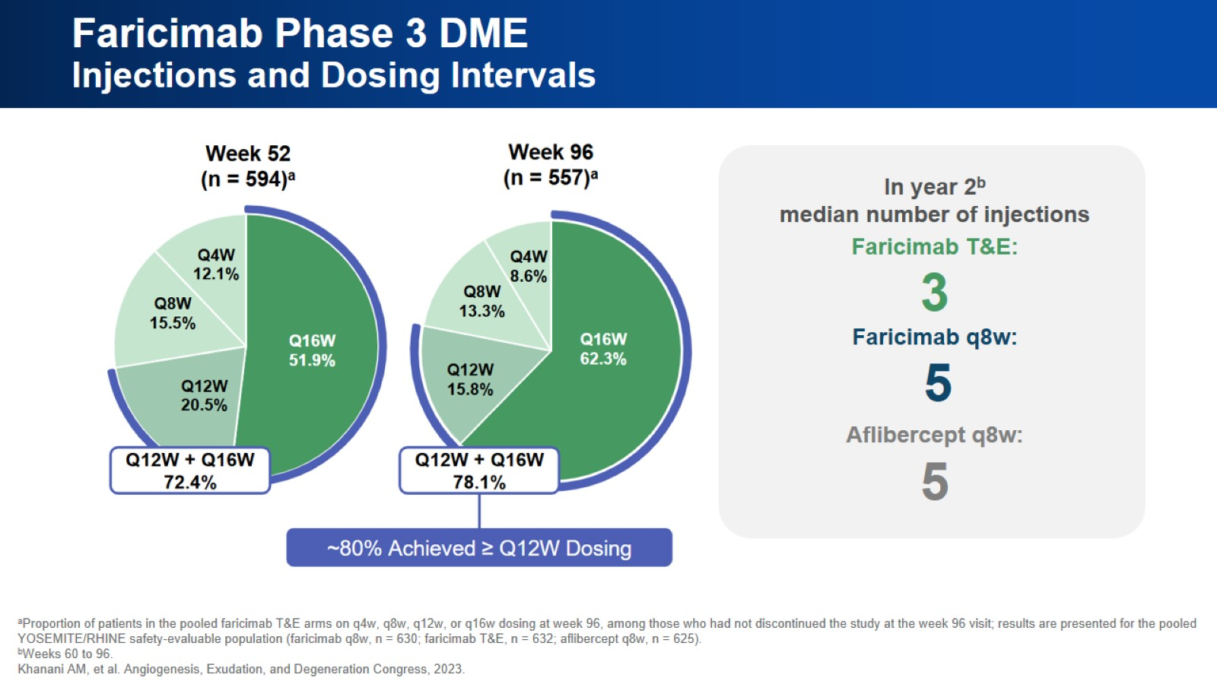
Faricimab Phase 3 DME
Injections and Dosing Intervals

Slide 23
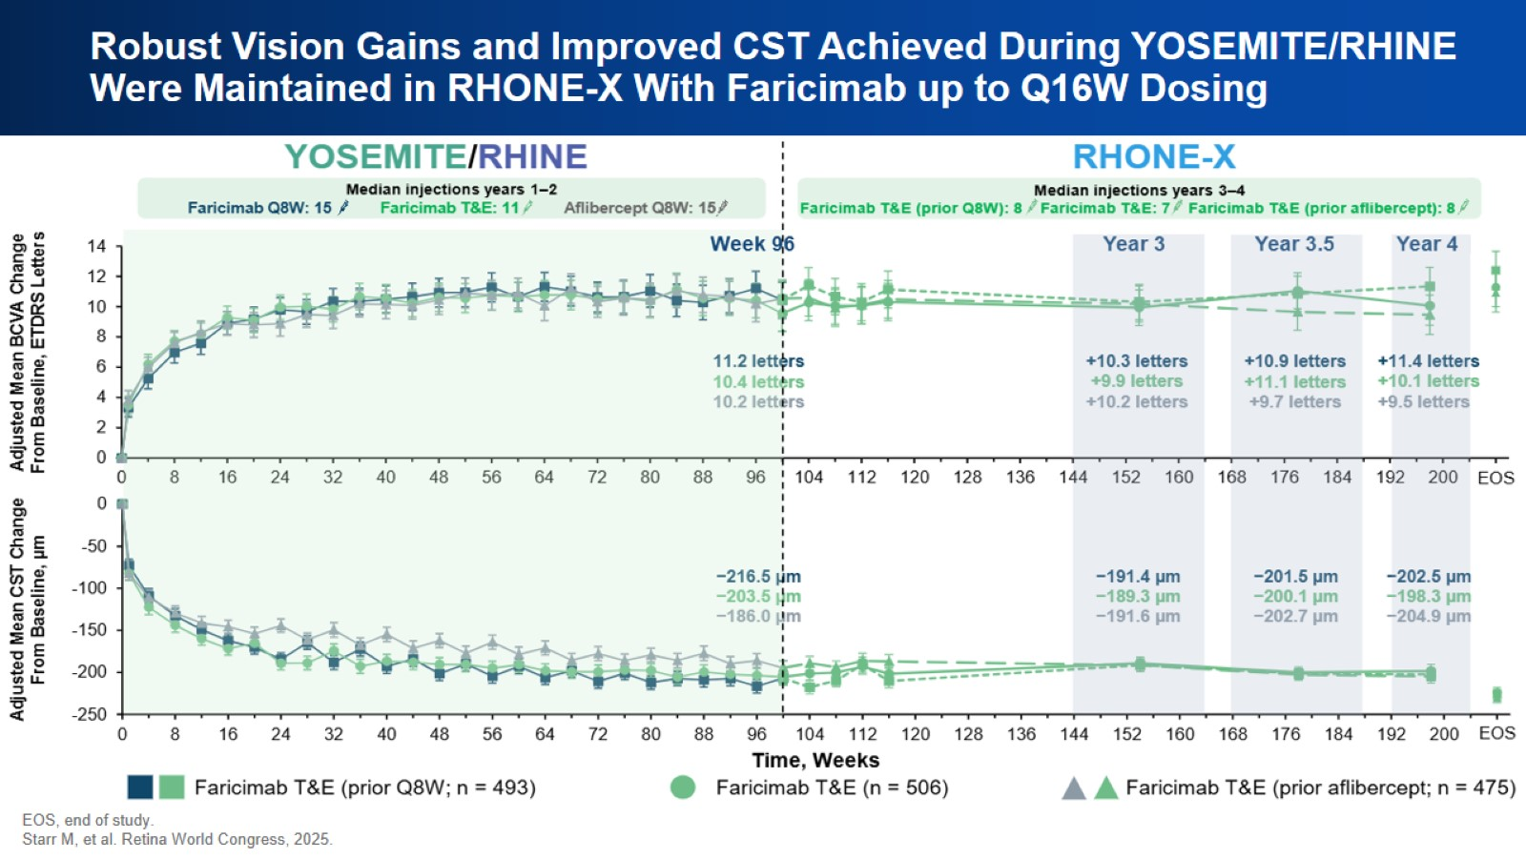
Robust Vision Gains and Improved CST Achieved During YOSEMITE/RHINE Were Maintained in RHONE-X With Faricimab up to Q16W Dosing

Slide 24
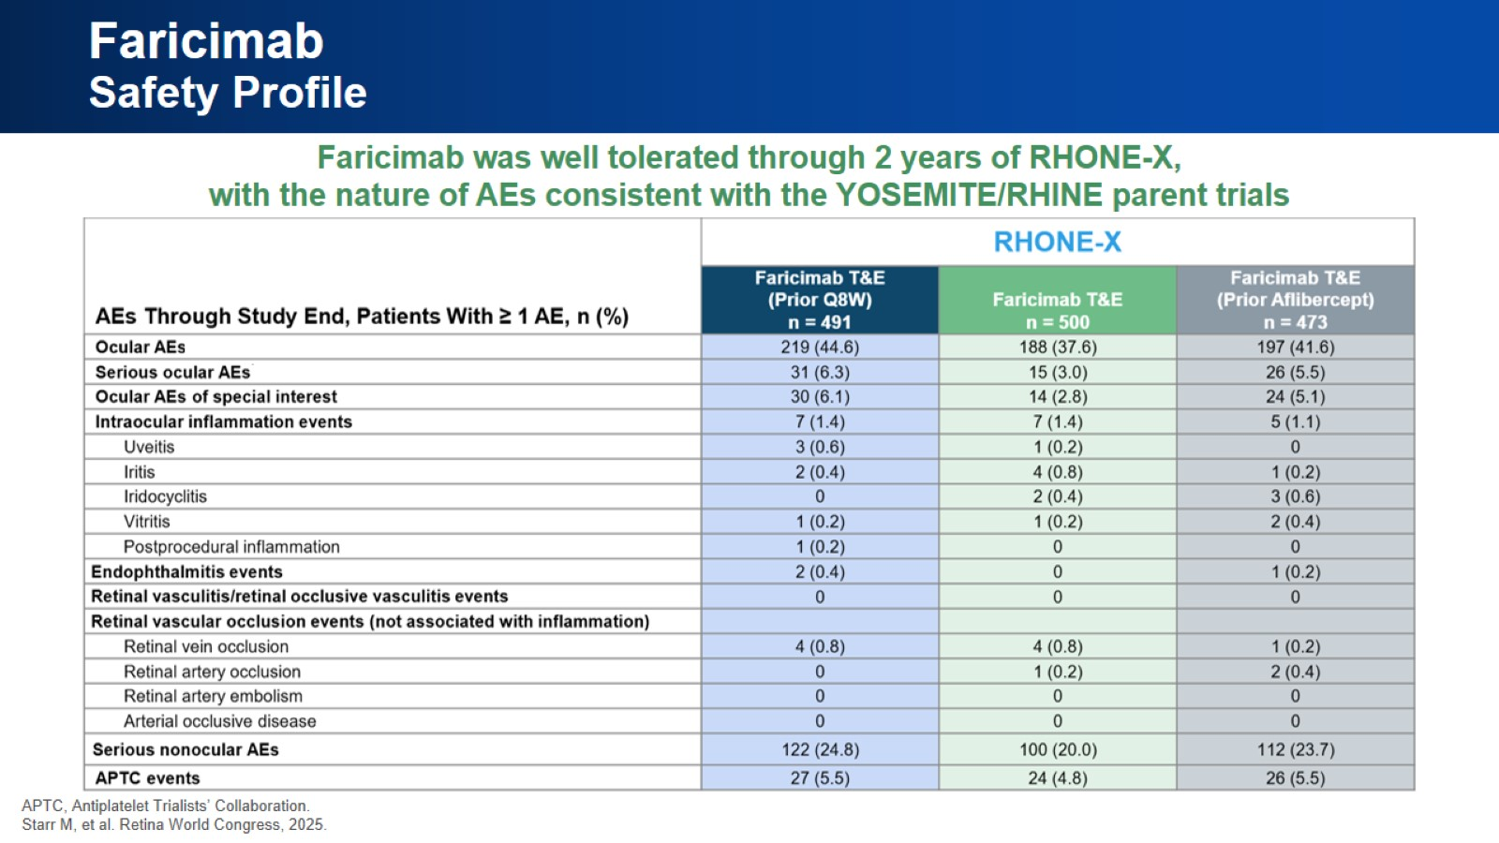
Faricimab
Safety Profile

Slide 25

Real-World Data

Slide 26
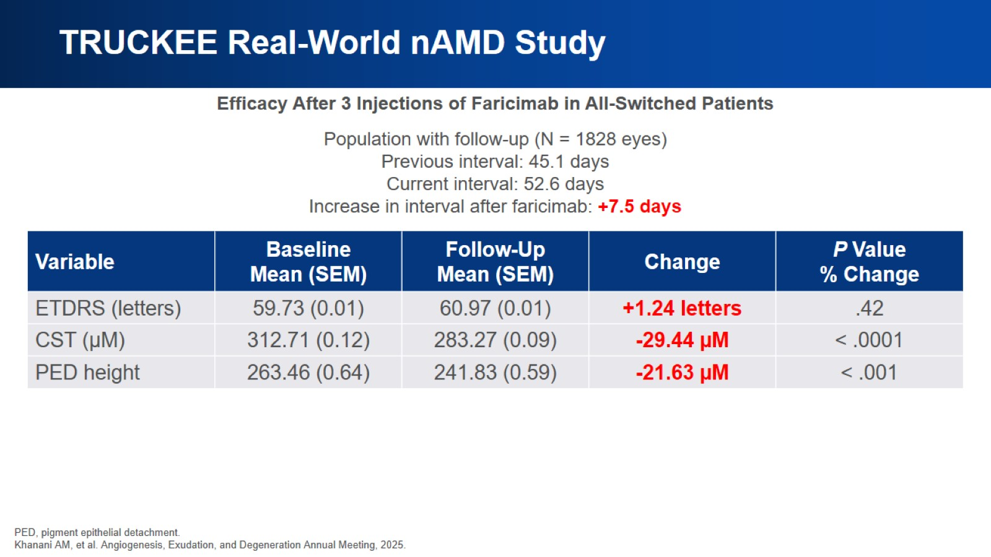
TRUCKEE Real-World nAMD Study

Slide 27
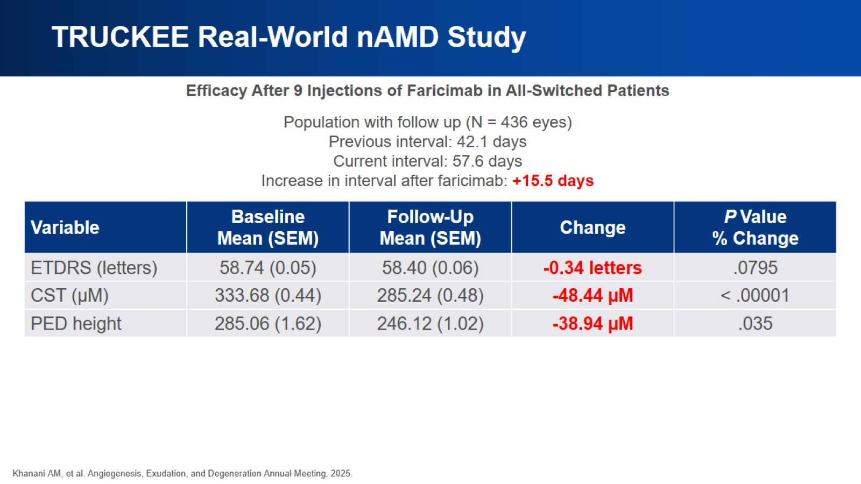
TRUCKEE Real-World nAMD Study

Slide 28
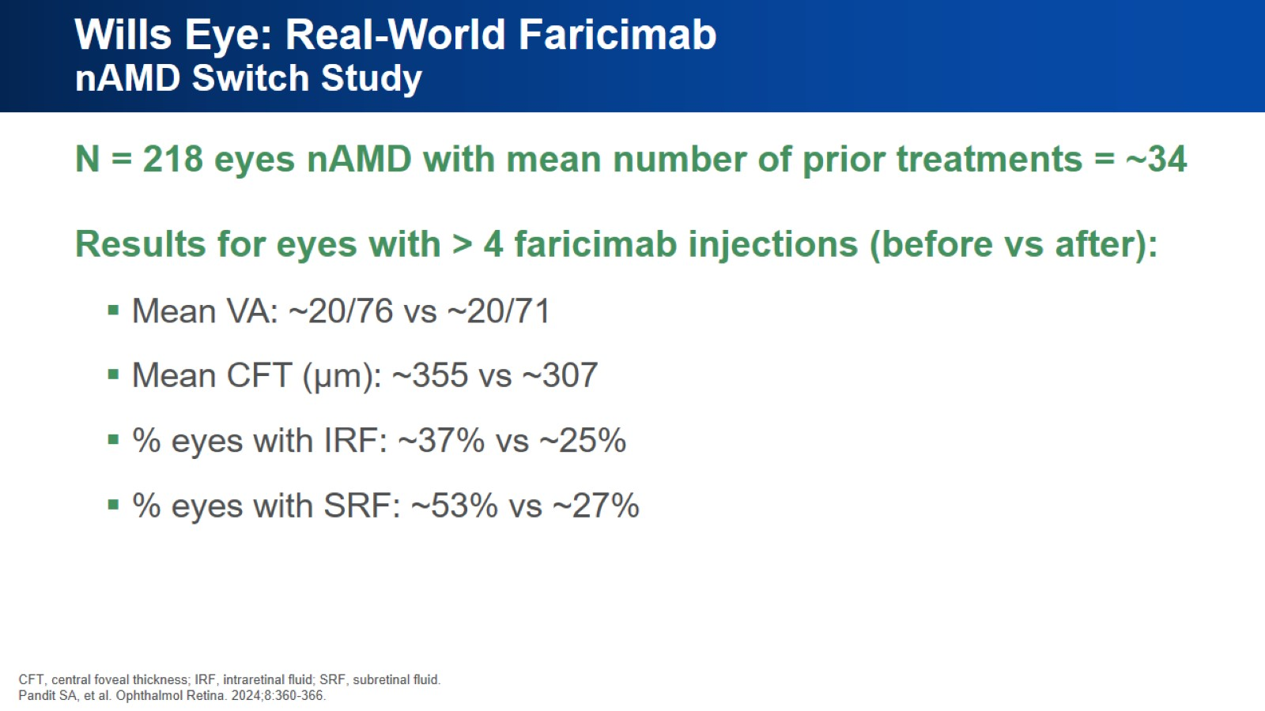
Wills Eye: Real-World Faricimab nAMD Switch Study

Slide 29
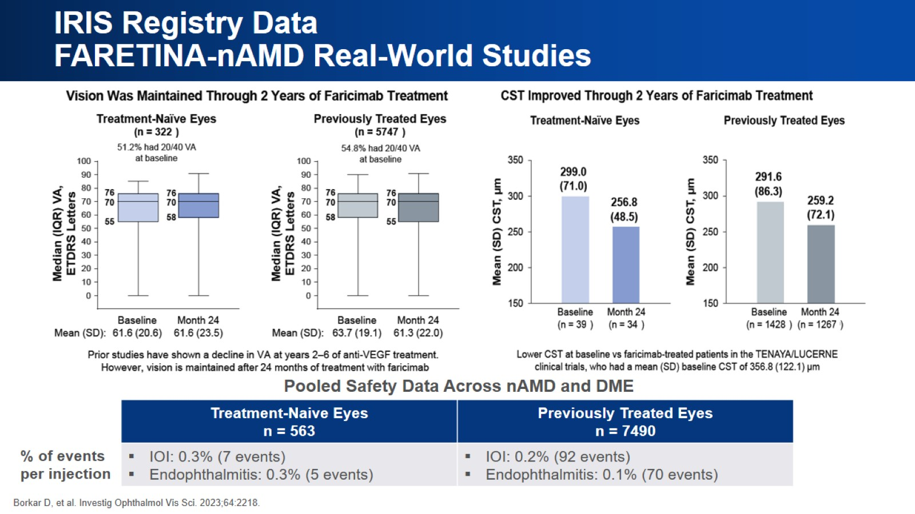
IRIS Registry Data
FARETINA-nAMD Real-World Studies

Slide 30
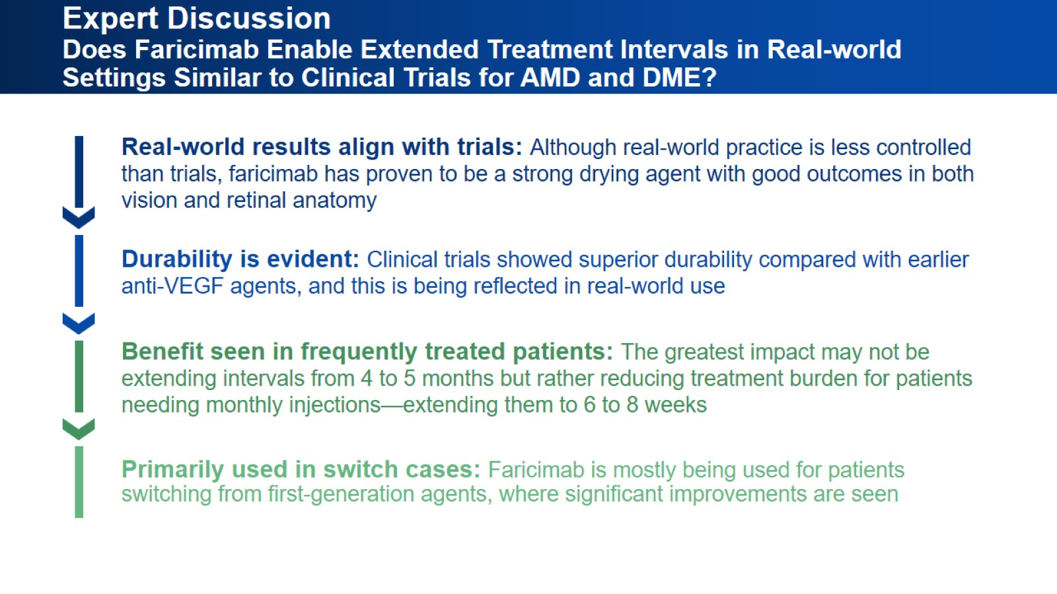
Expert Discussion
Does Faricimab Enable Extended Treatment Intervals in Real-world Settings Similar to Clinical Trials for AMD and DME?

Slide 31
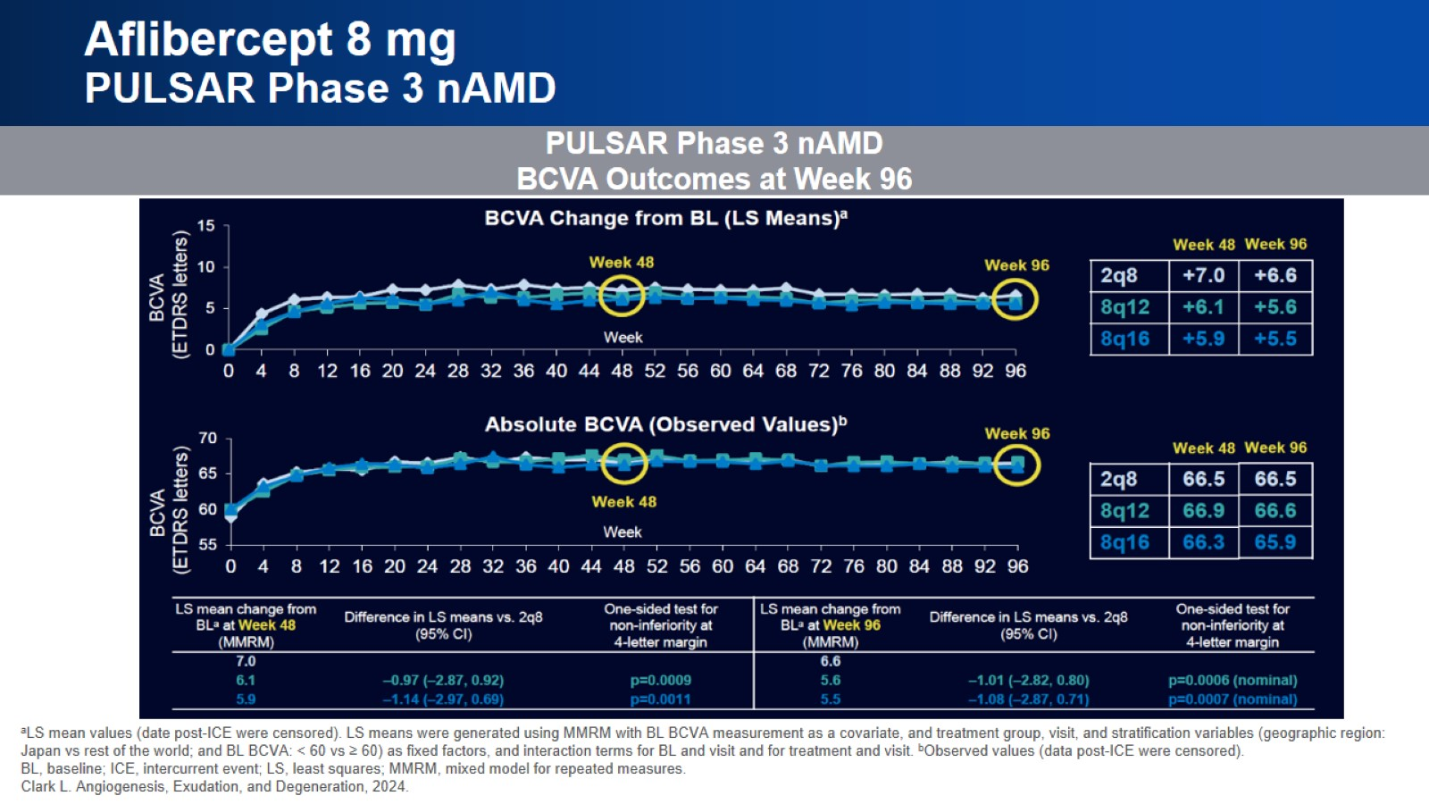
Aflibercept 8 mg
PULSAR Phase 3 nAMD

Slide 32
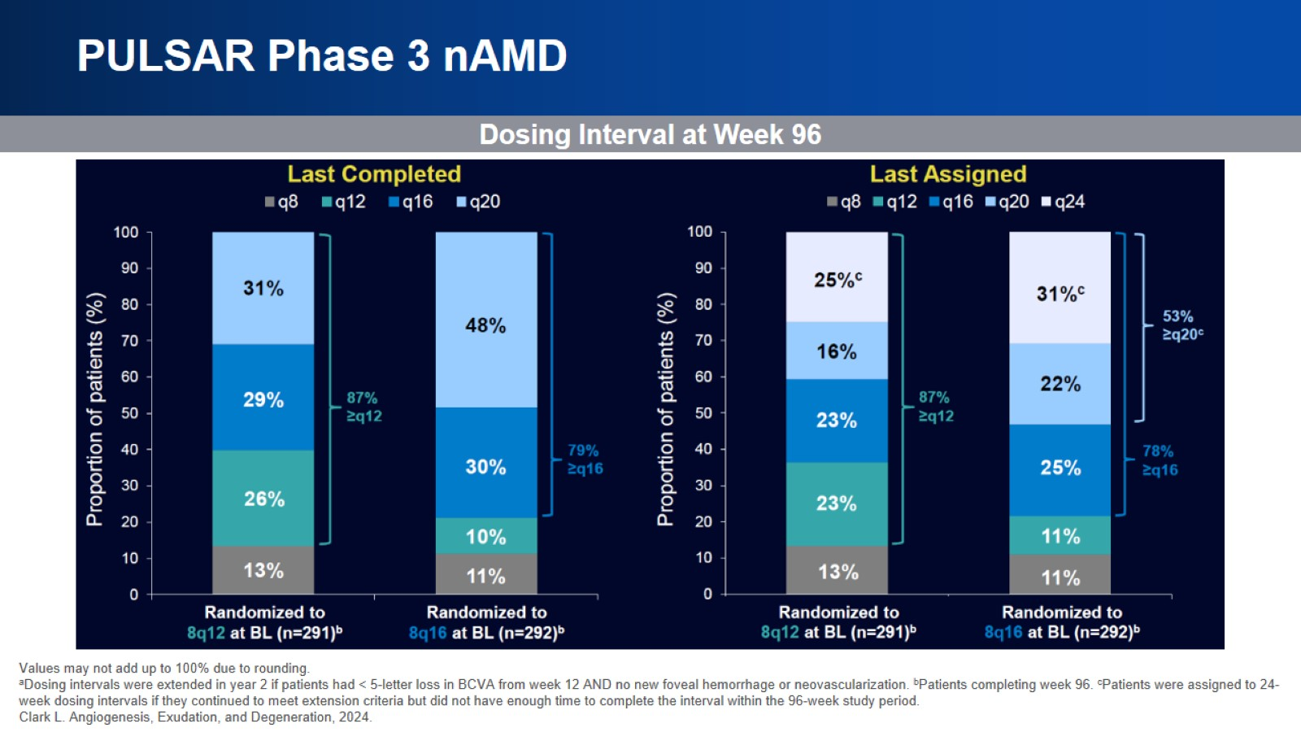
PULSAR Phase 3 nAMD

Slide 33
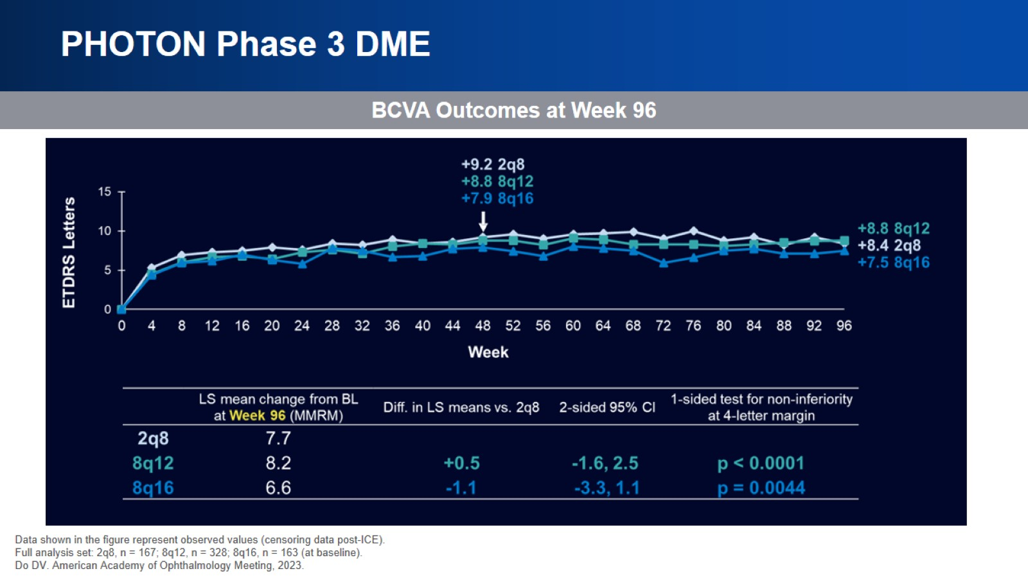
PHOTON Phase 3 DME

Slide 34
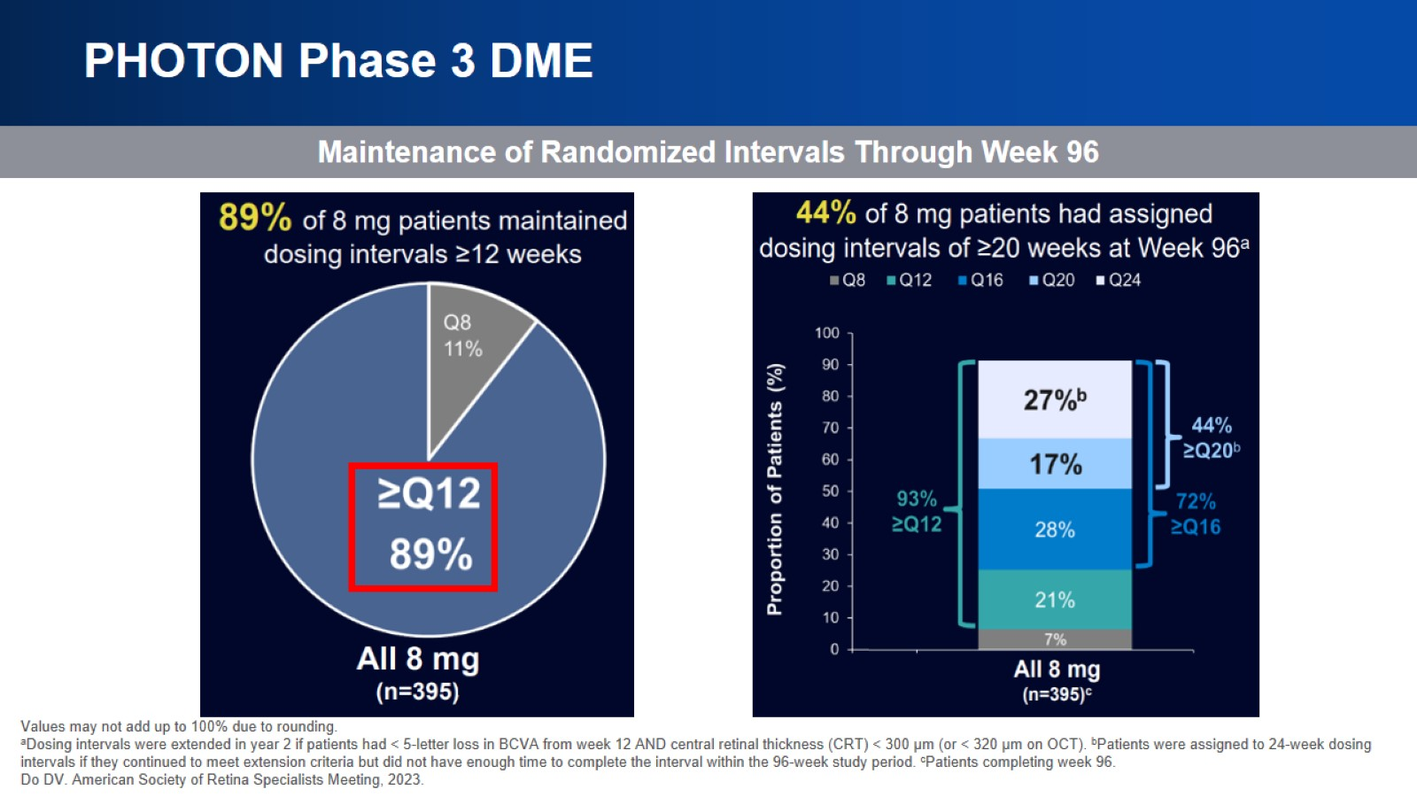
PHOTON Phase 3 DME

Slide 35
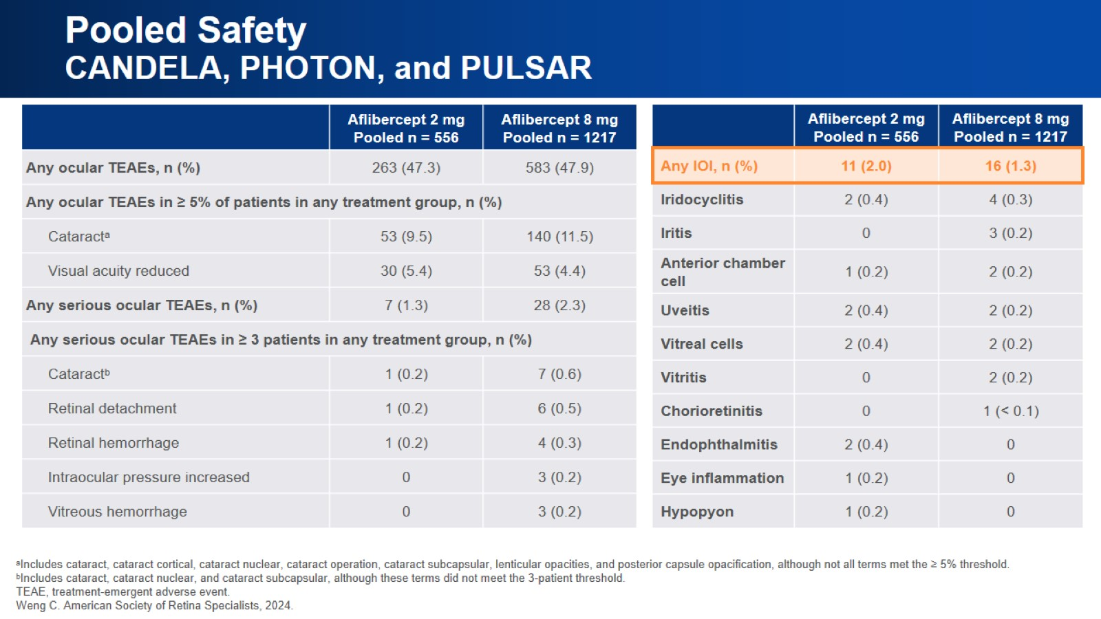
Pooled Safety
CANDELA, PHOTON, and PULSAR

Slide 36

Biosimilars

Slide 37
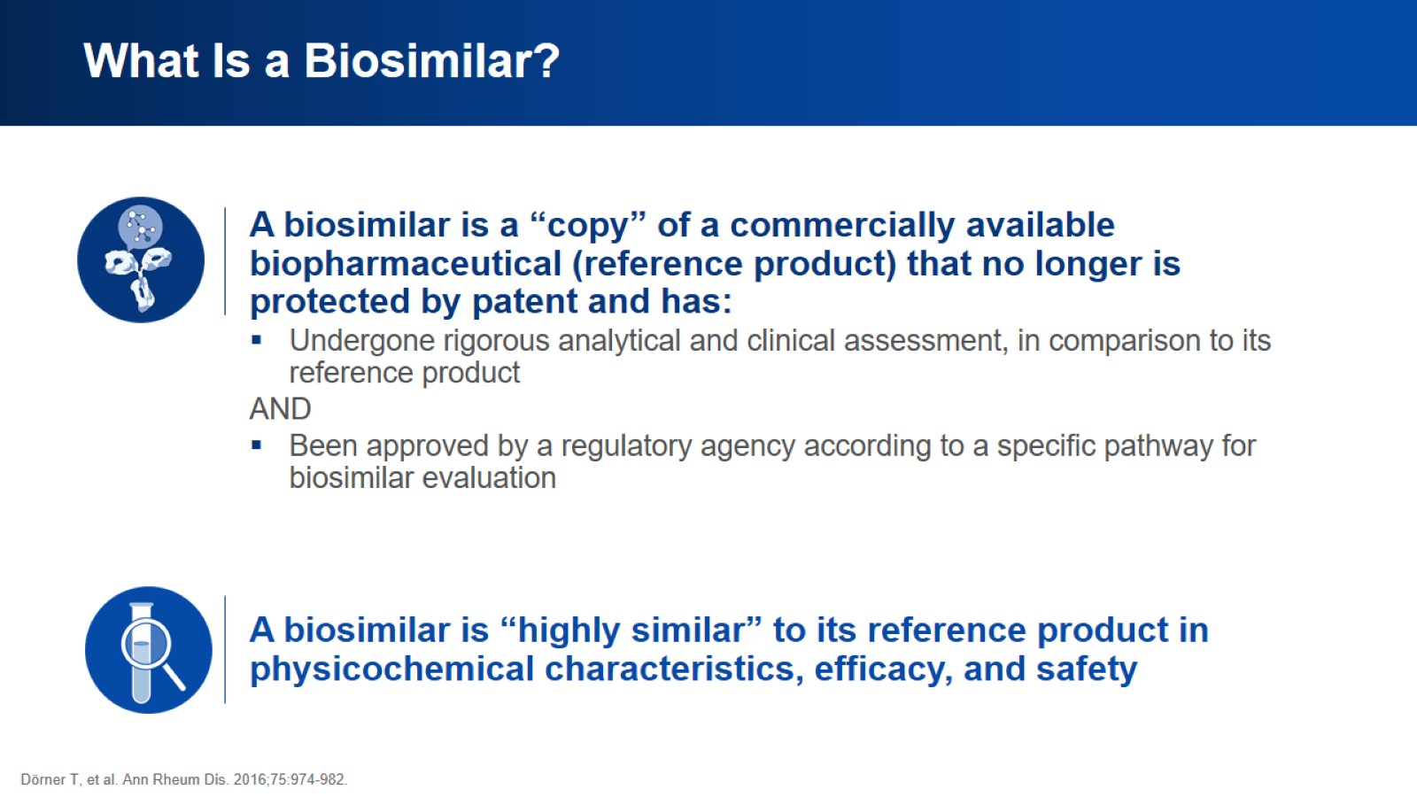
What Is a Biosimilar?

Slide 38
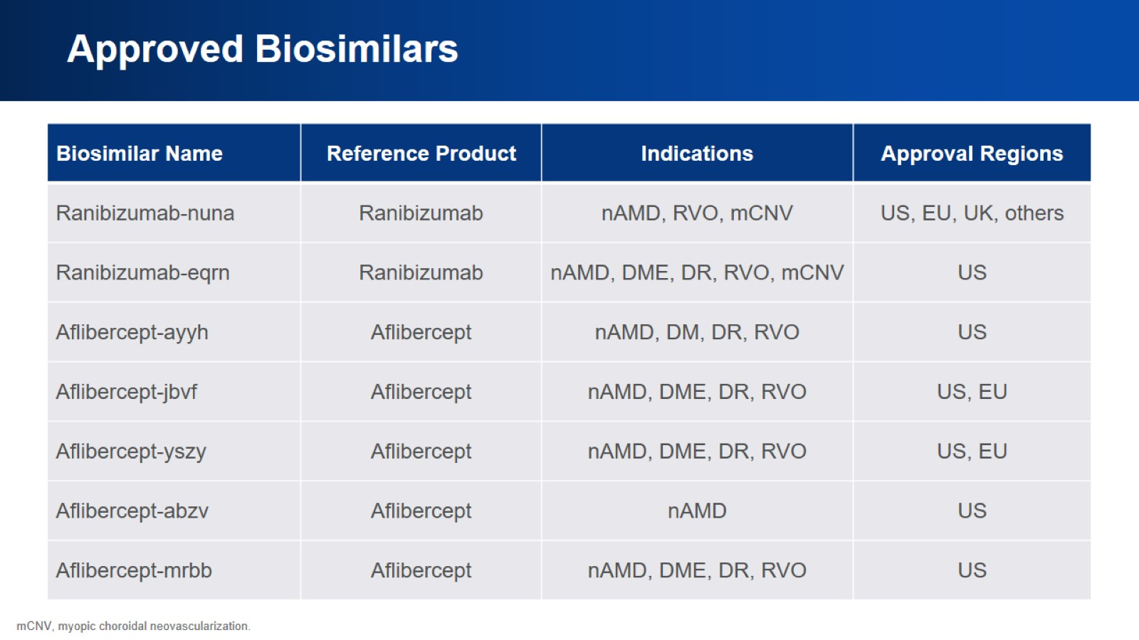
Approved Biosimilars

Slide 39
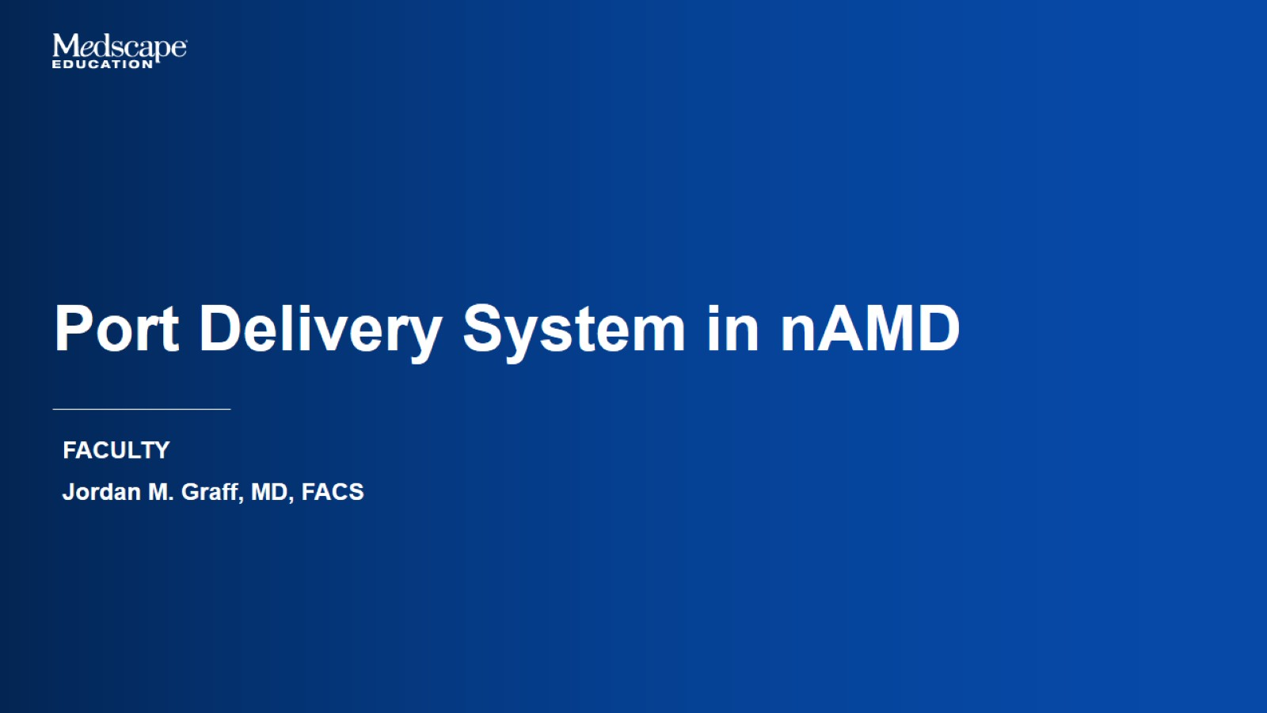
Port Delivery System in nAMD

Slide 40
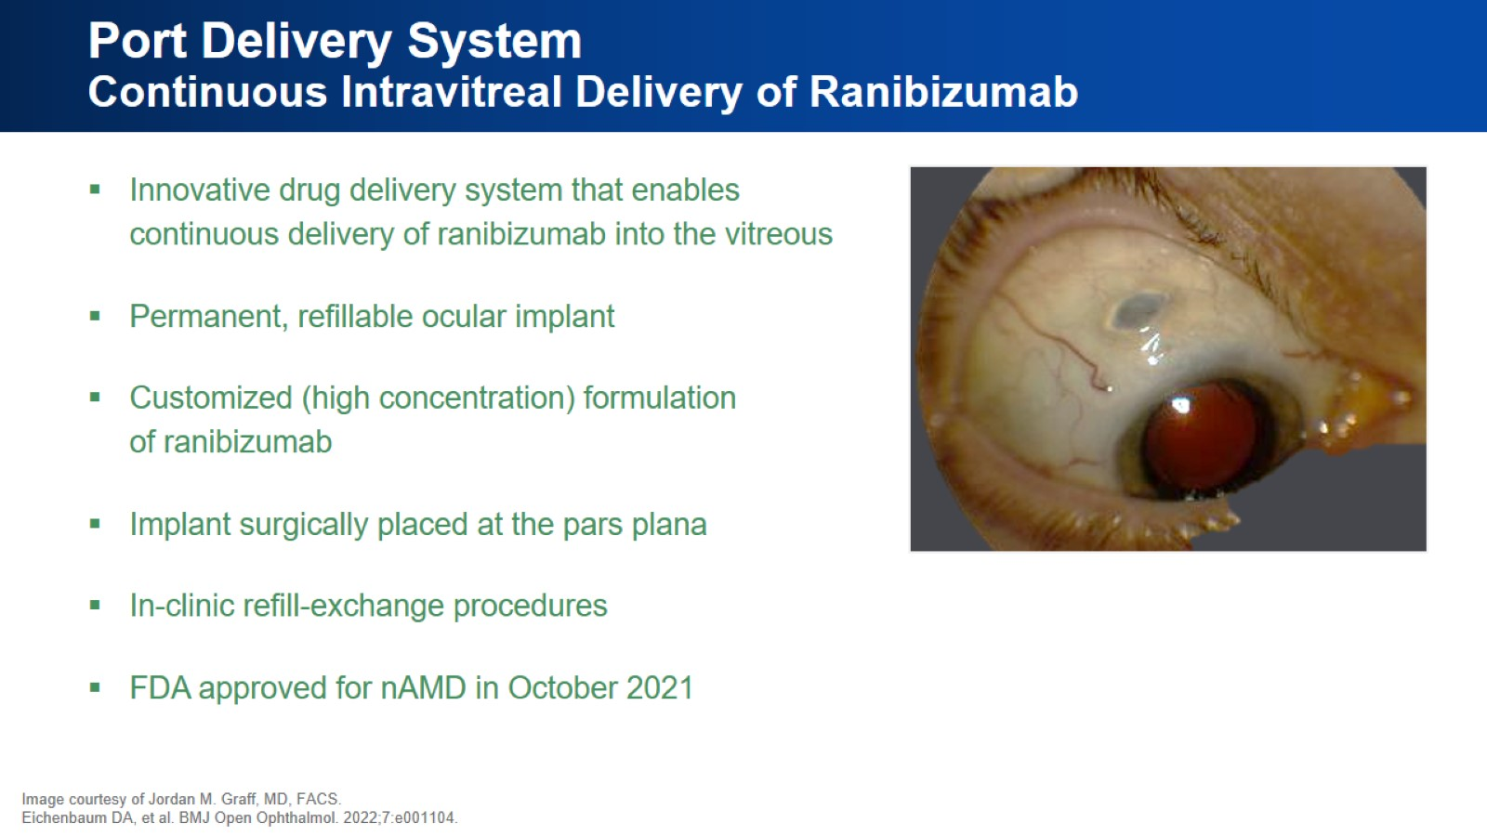
Port Delivery System
Continuous Intravitreal Delivery of Ranibizumab

Slide 41
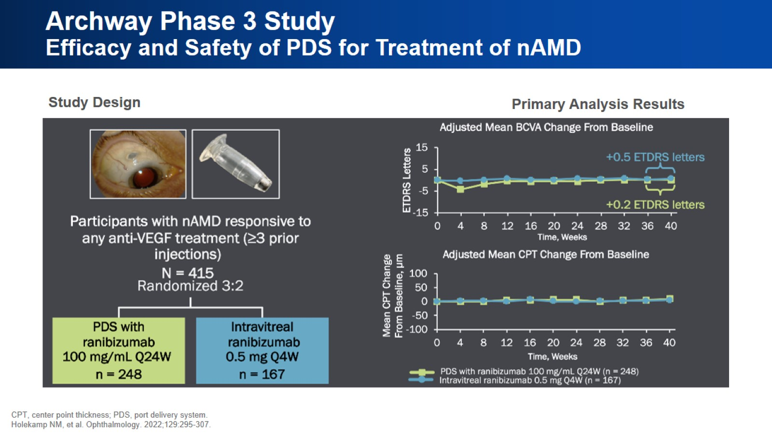
Archway Phase 3 Study
Efficacy and Safety of PDS for Treatment of nAMD

Slide 42
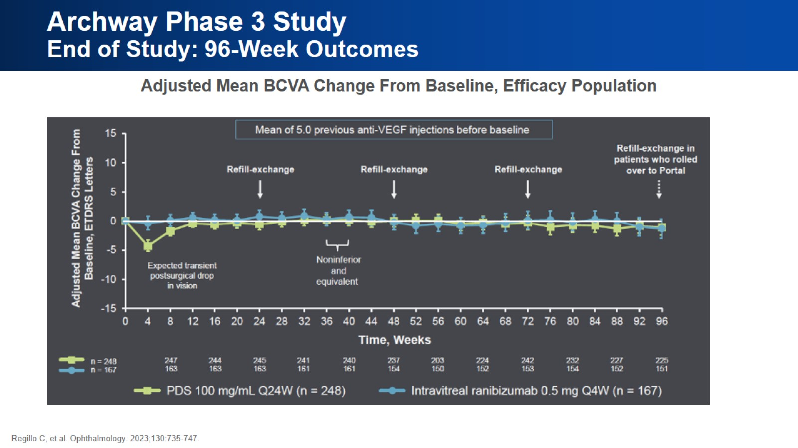
Archway Phase 3 Study
End of Study: 96-Week Outcomes

Slide 43
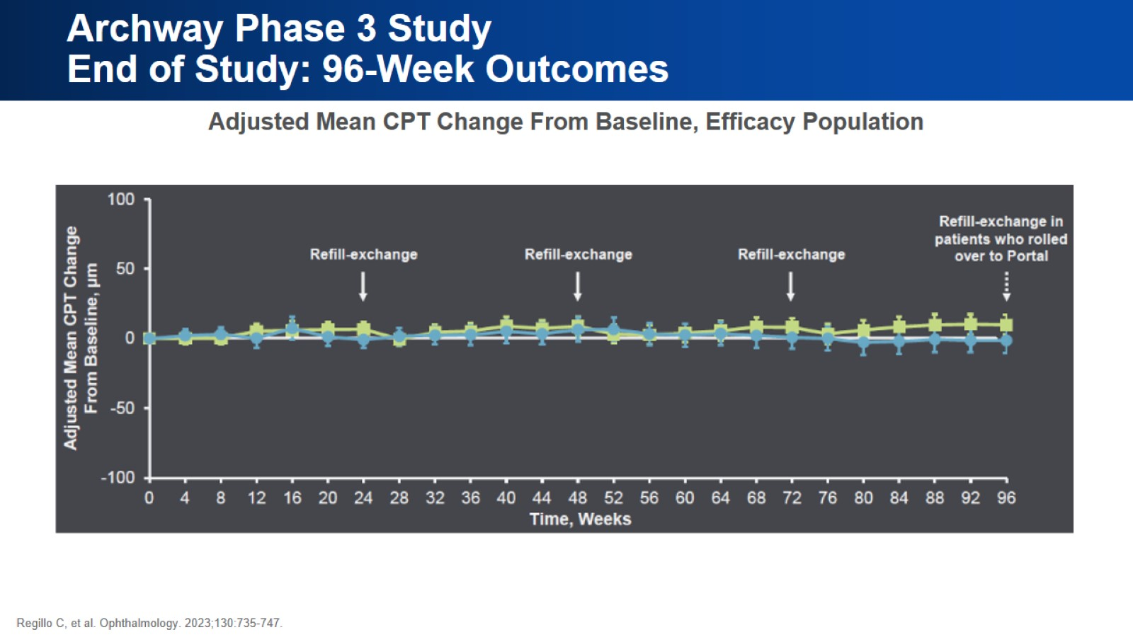
Archway Phase 3 Study
End of Study: 96-Week Outcomes

Slide 44
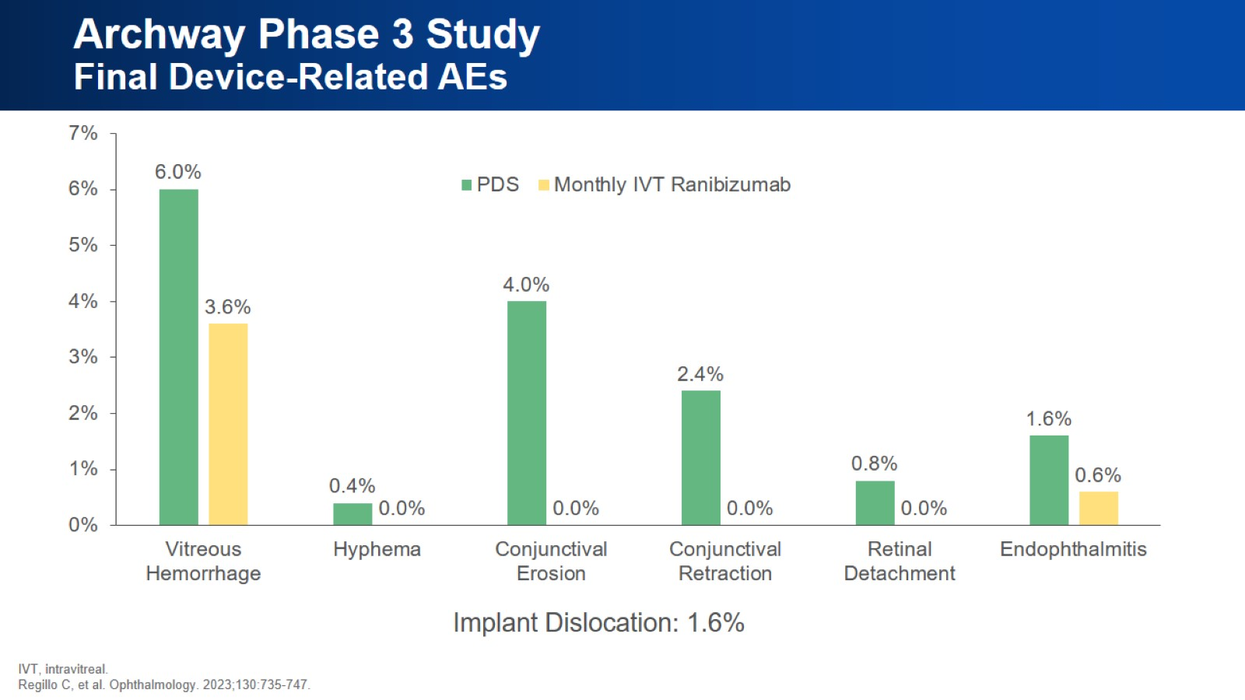
Archway Phase 3 Study
Final Device-Related AEs

Slide 45
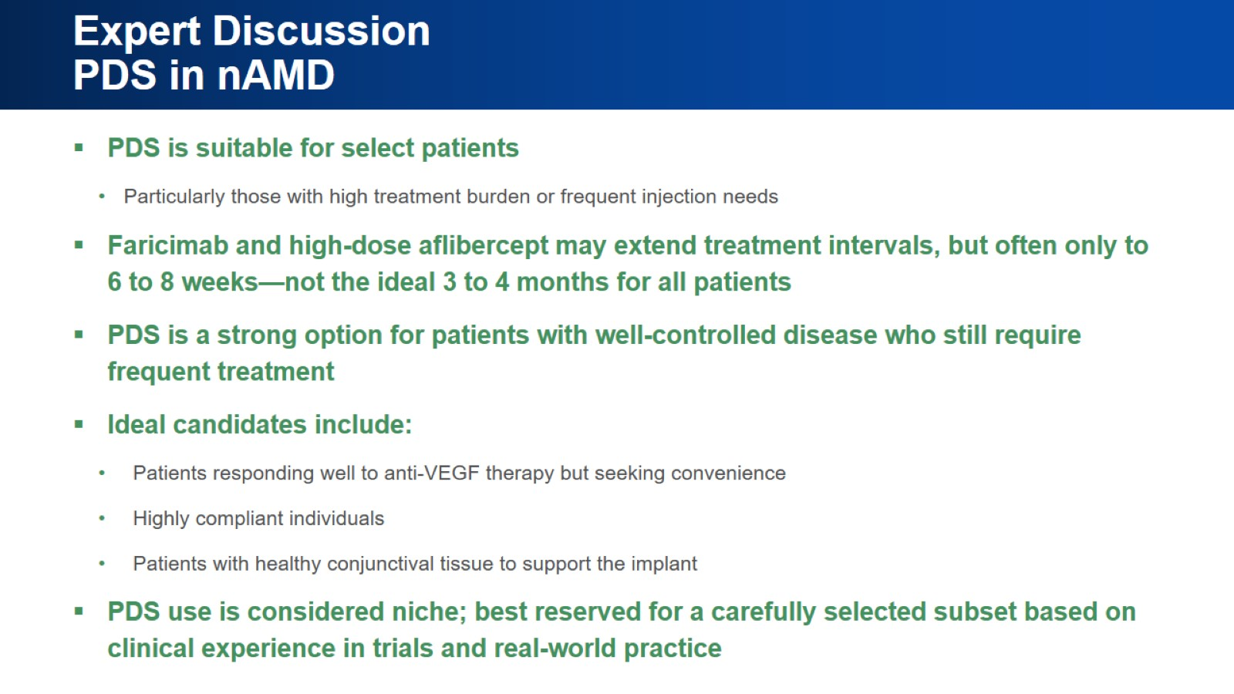
Expert Discussion
PDS in nAMD

Slide 46
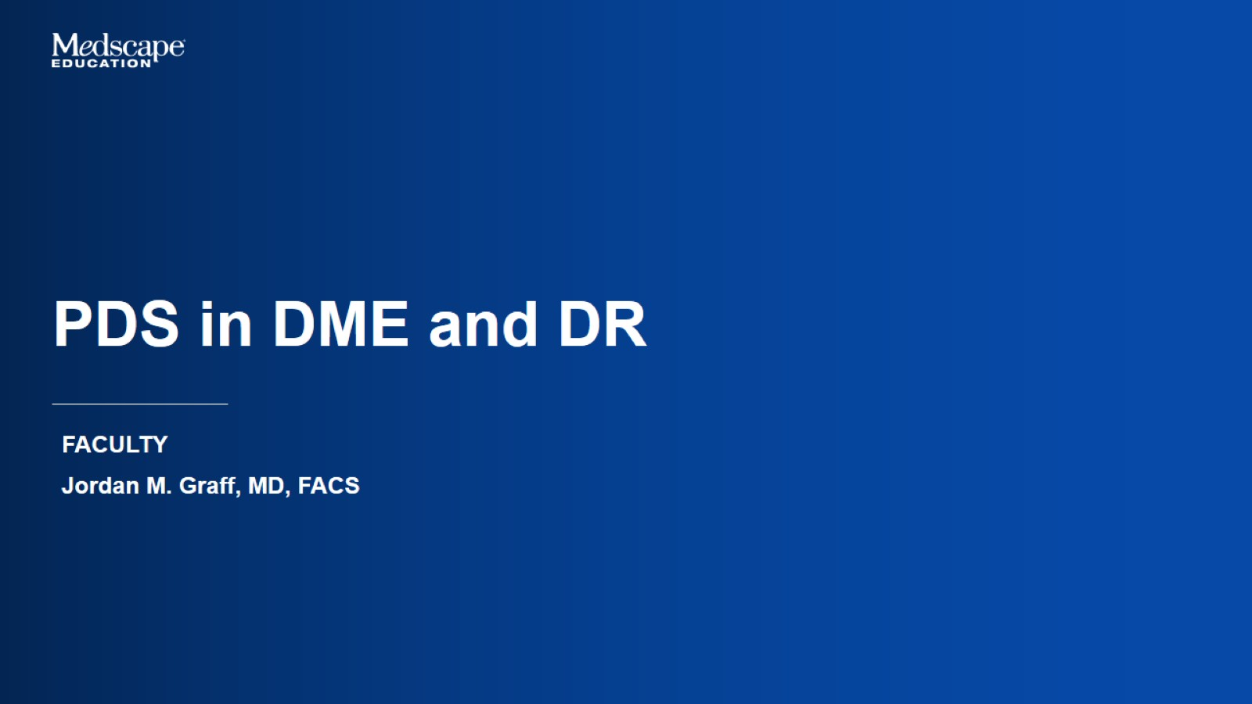
PDS in DME and DR

Slide 47
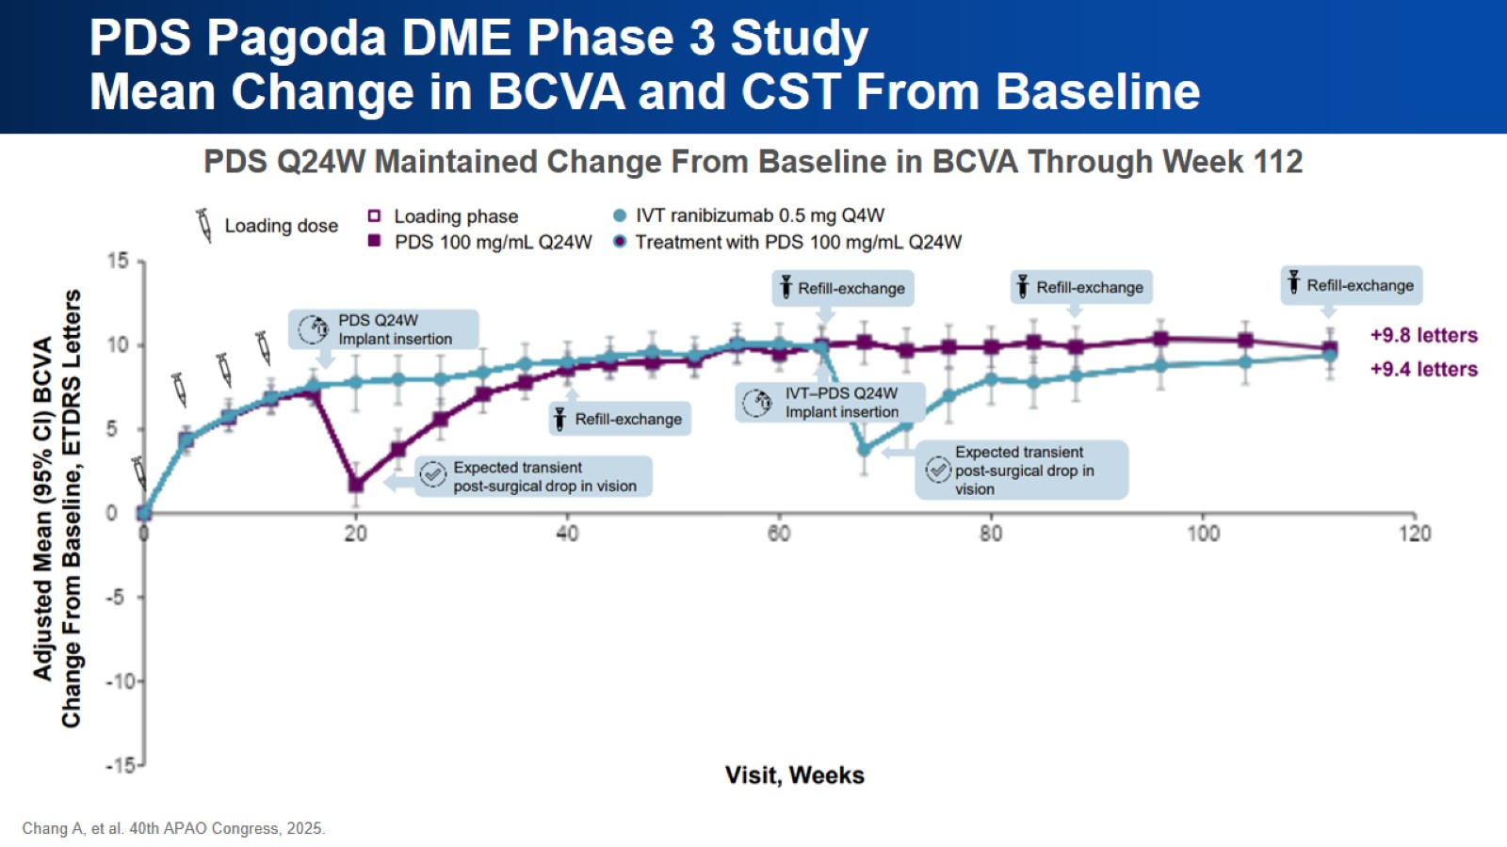
PDS Pagoda DME Phase 3 Study
Mean Change in BCVA and CST From Baseline

Slide 48
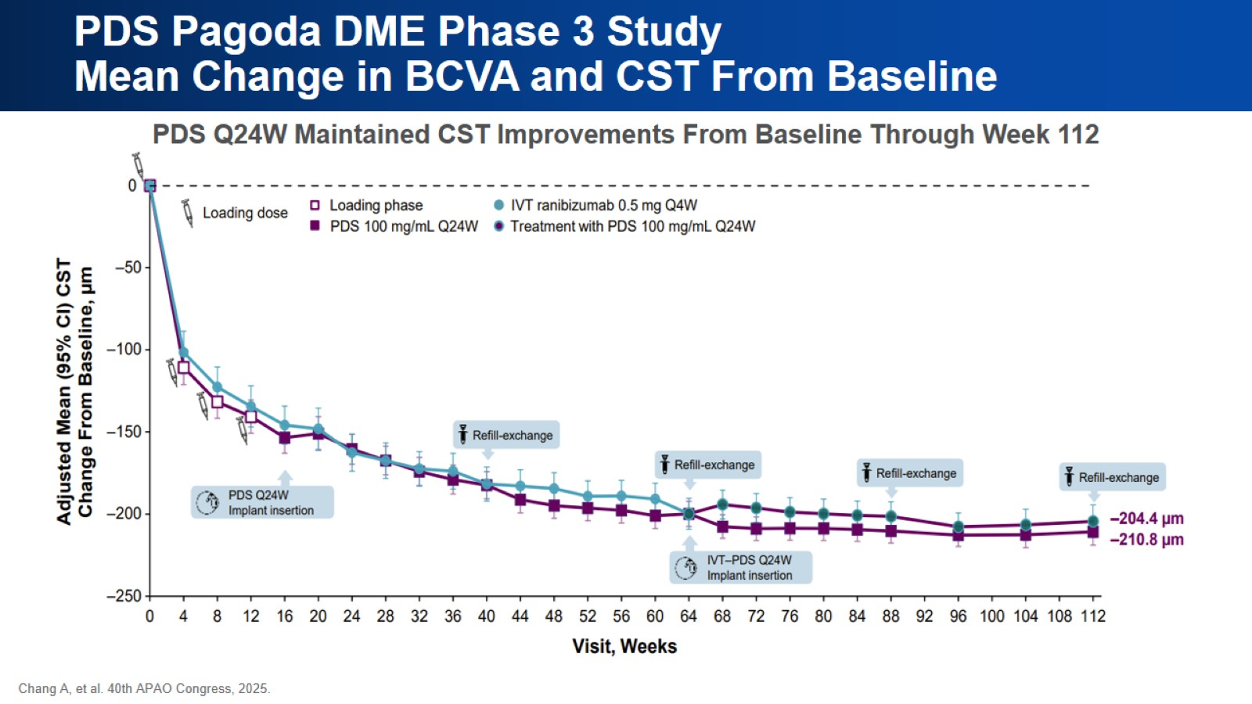
PDS Pagoda DME Phase 3 Study
Mean Change in BCVA and CST From Baseline

Slide 49
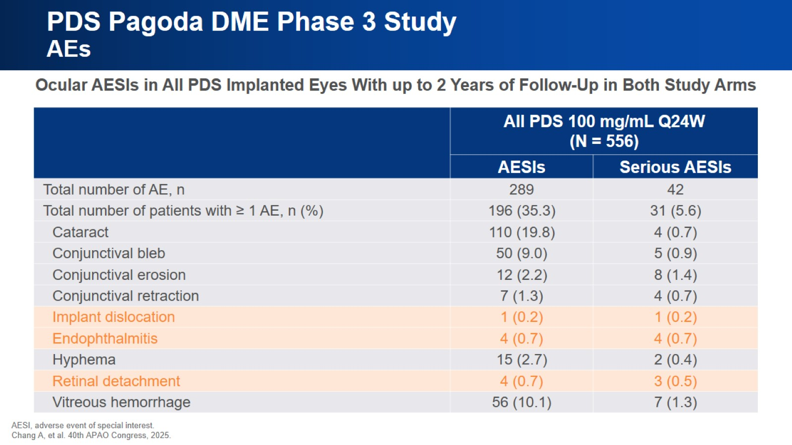
PDS Pagoda DME Phase 3 Study
AEs

Slide 50
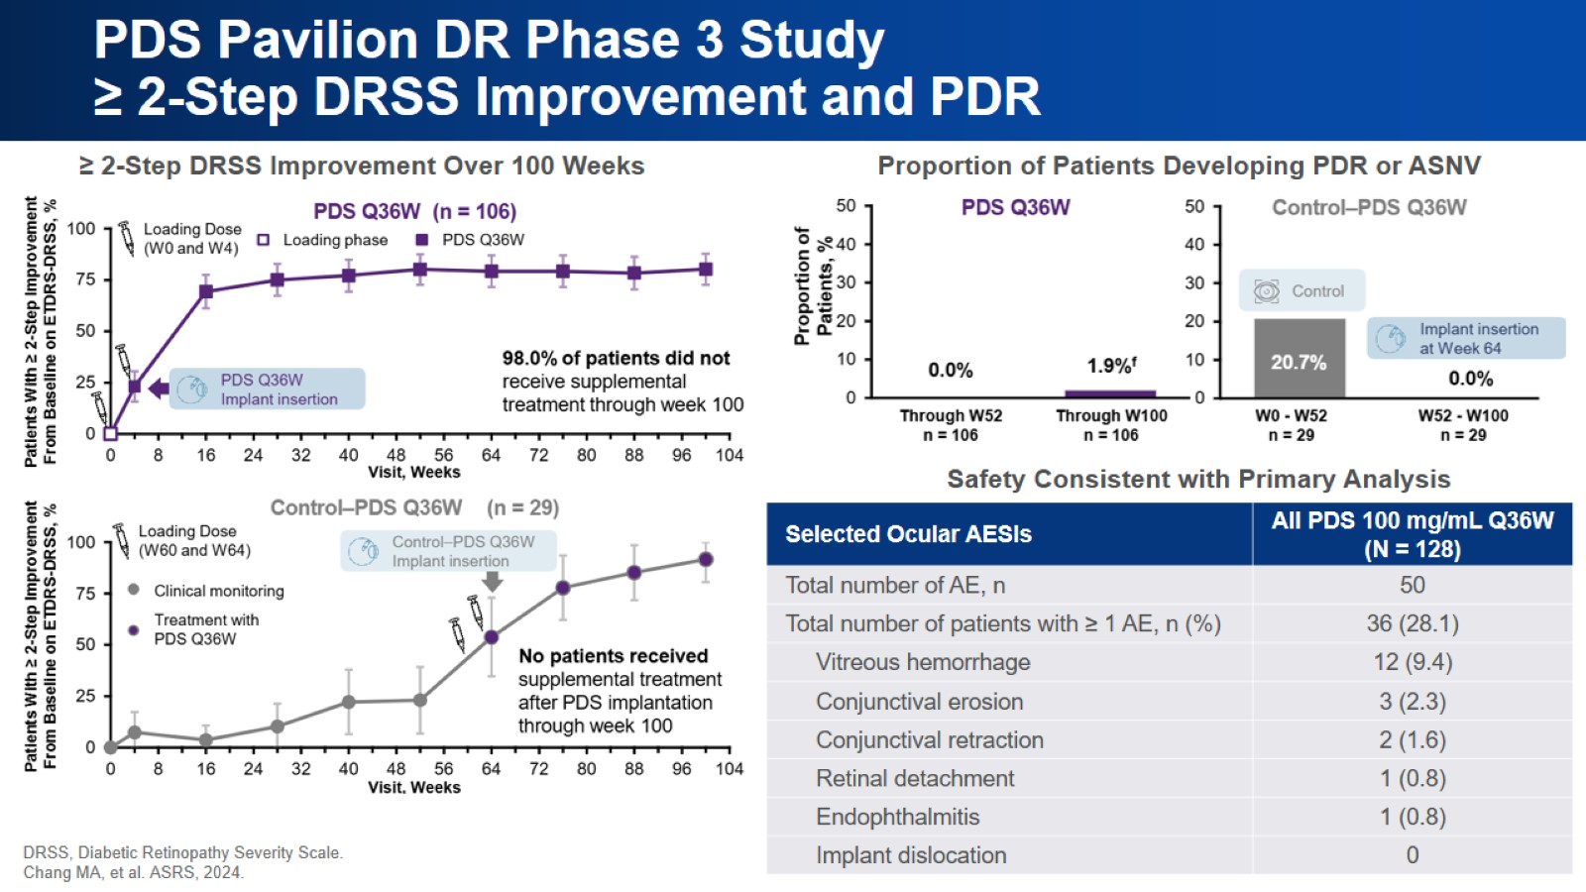
PDS Pavilion DR Phase 3 Study
≥ 2-Step DRSS Improvement and PDR

Slide 51
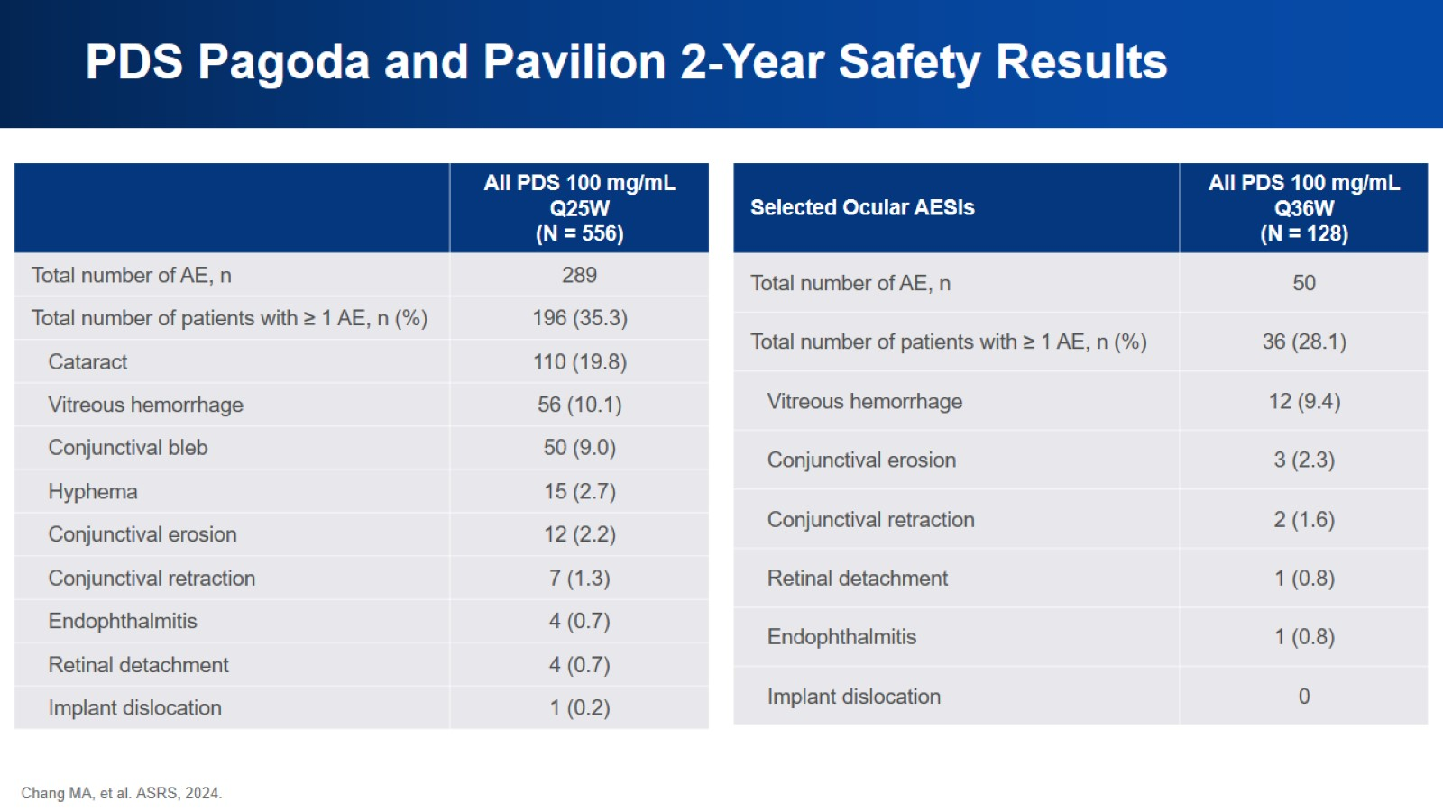
PDS Pagoda and Pavilion 2-Year Safety Results

Slide 52
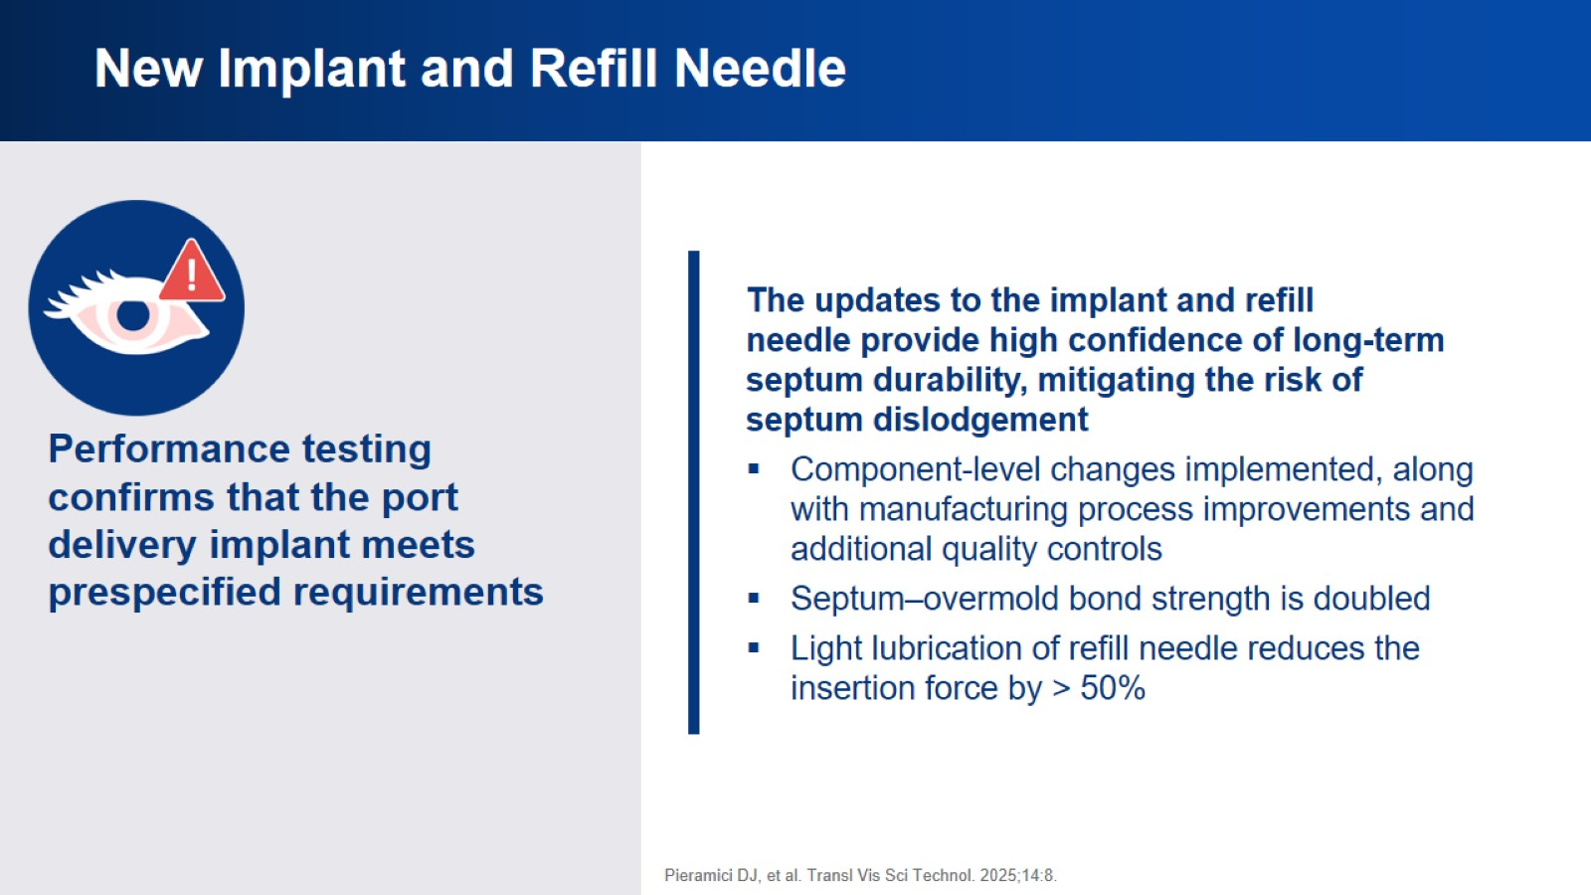
New Implant and Refill Needle

Slide 53
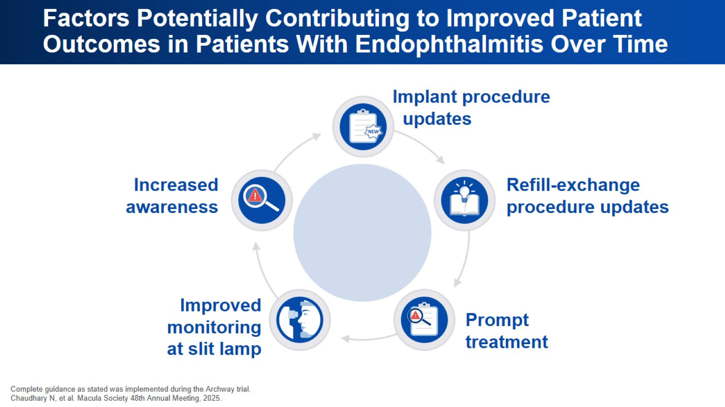
Factors Potentially Contributing to Improved Patient Outcomes in Patients With Endophthalmitis Over Time

Slide 54

Emerging Therapies

Slide 55

Biodegradable Implants and Microparticles

Slide 56

Current Gene Therapy Programs

Slide 57

Concluding Remarks

Slide 58


