Slide 1
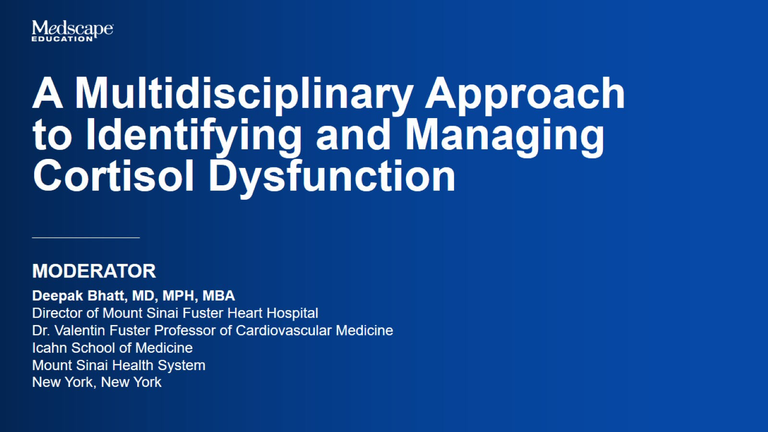

Slide 2


Slide 3
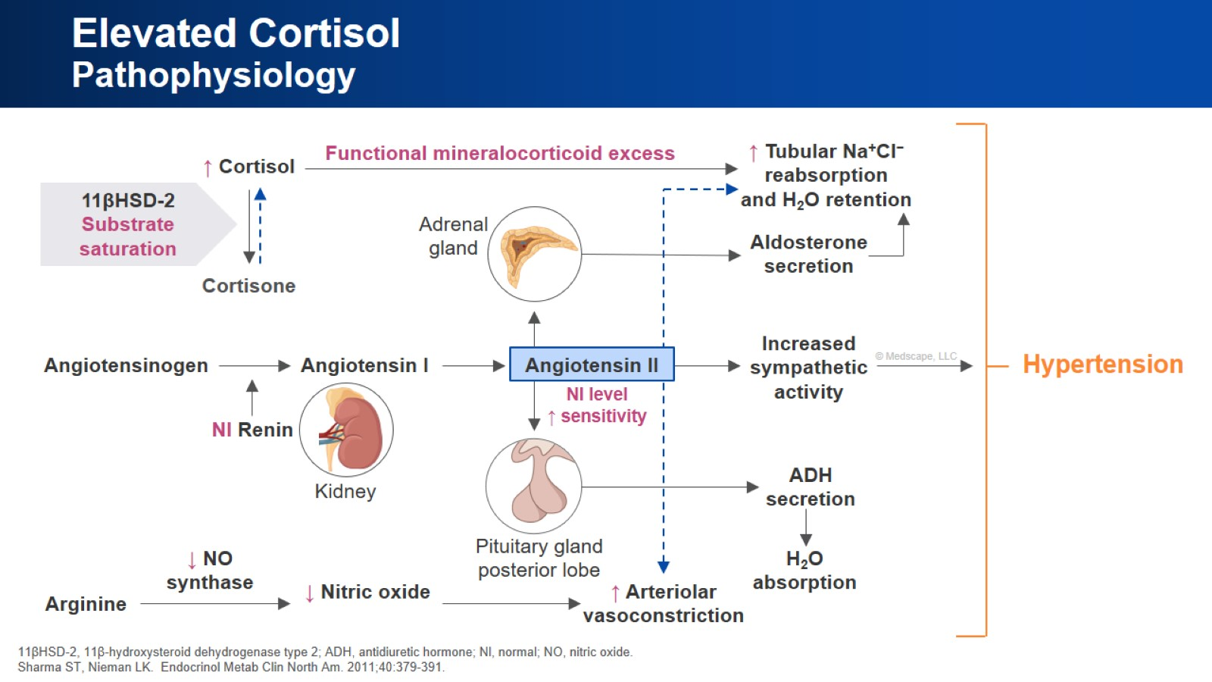
Elevated Cortisol Pathophysiology

Slide 4
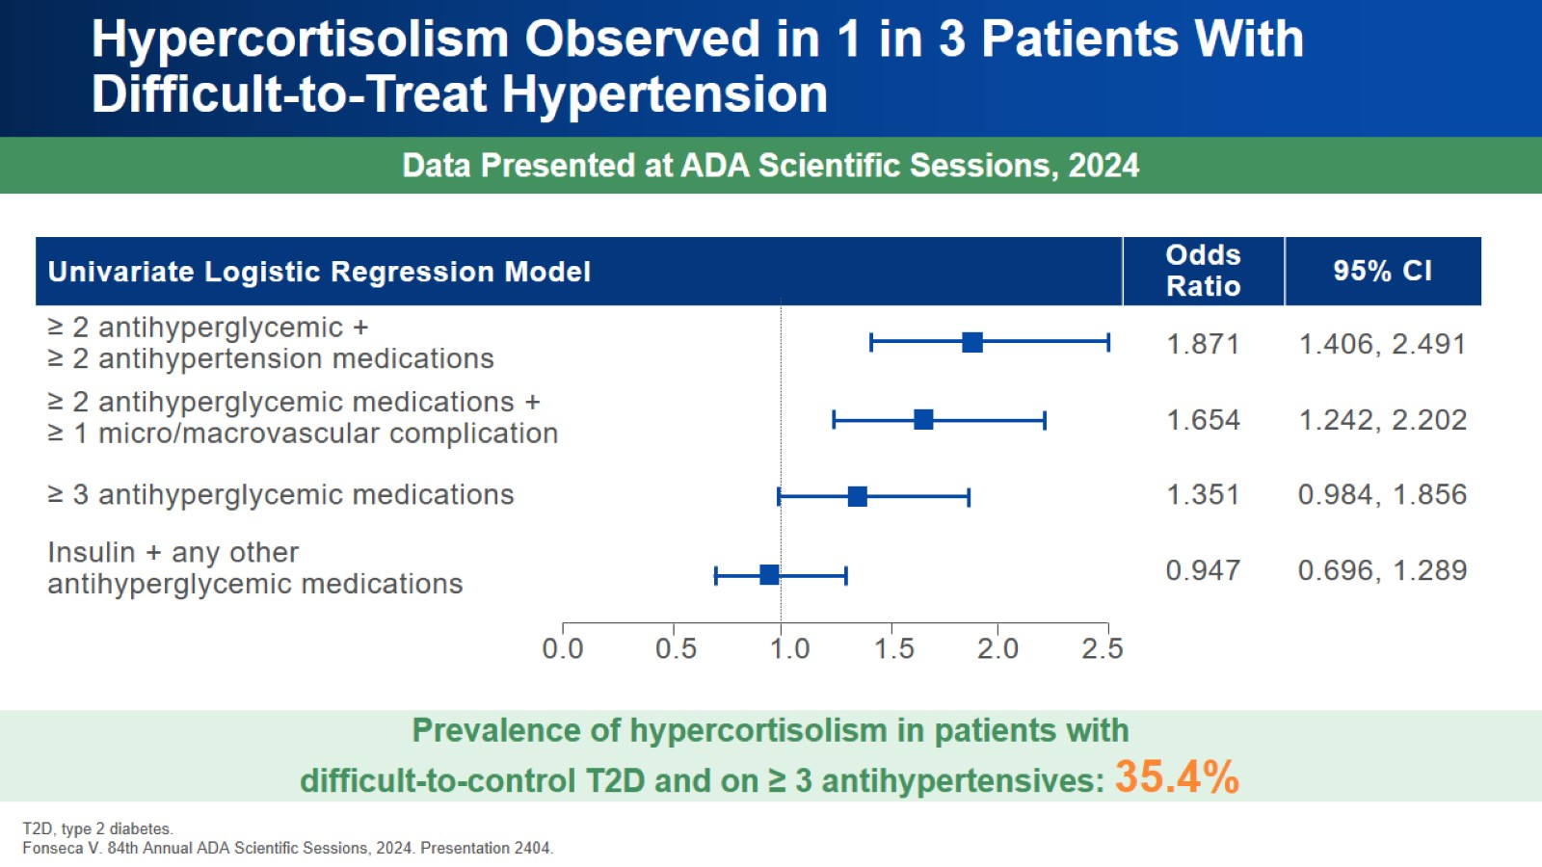
Hypercortisolism Observed in 1 in 3 Patients With Difficult-to-Treat Hypertension

Slide 5
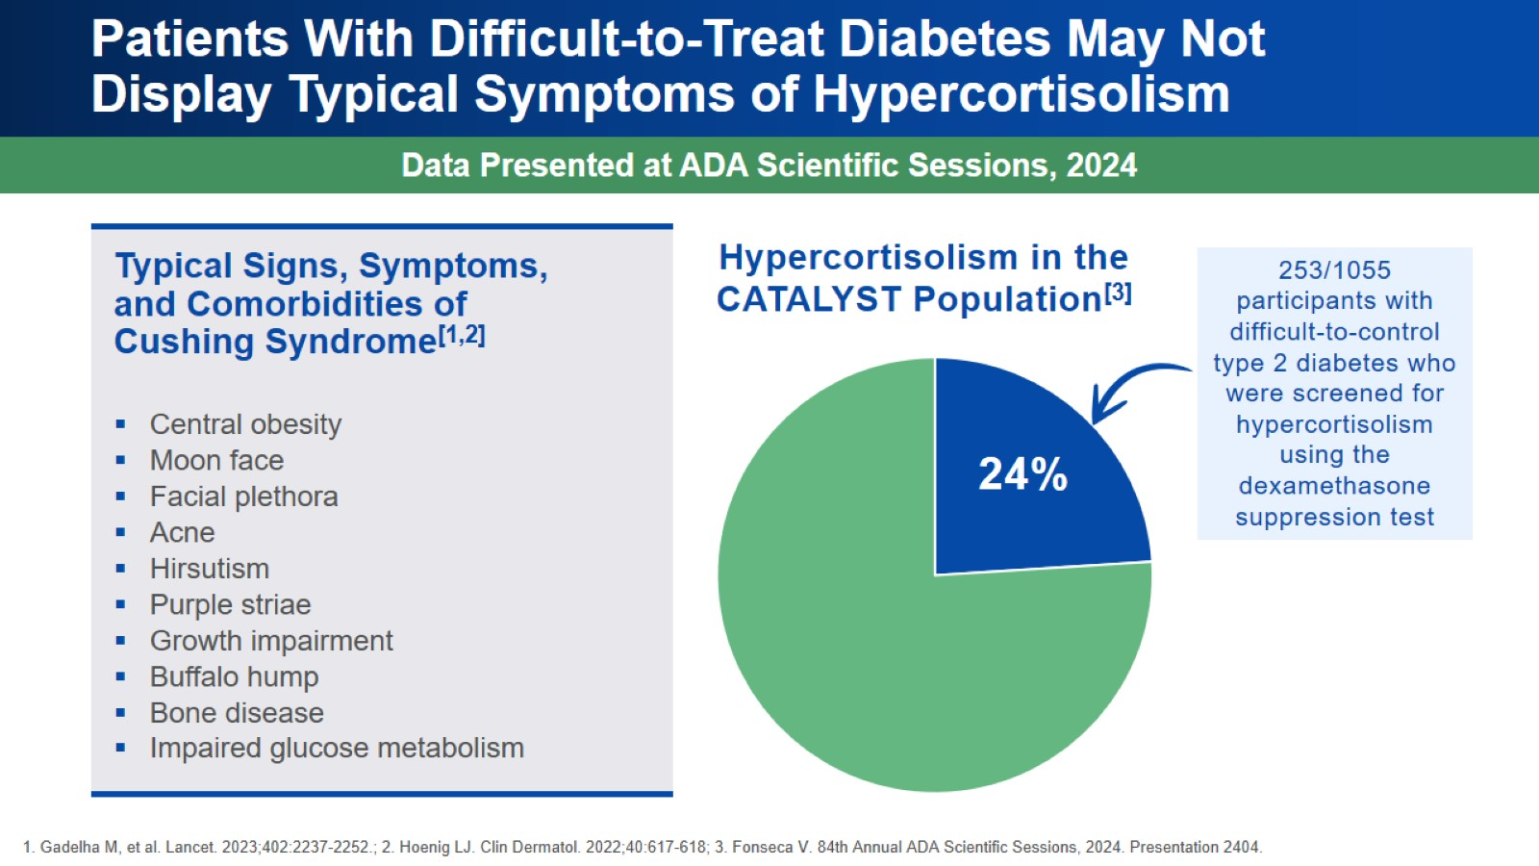
Patients With Difficult-to-Treat Diabetes May Not Display Typical Symptoms of Hypercortisolism

Slide 6
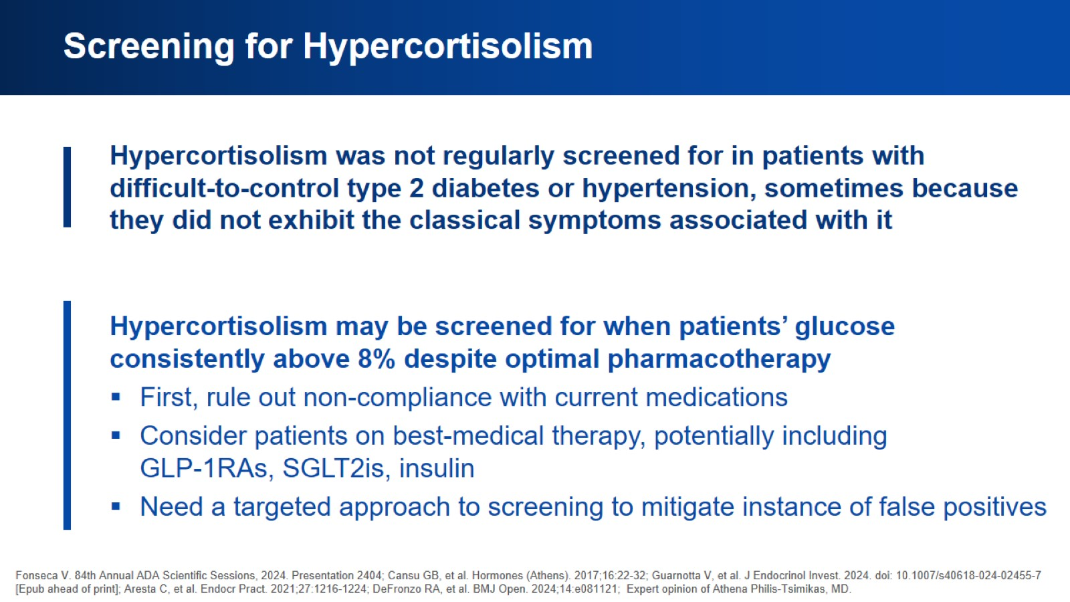
Screening for Hypercortisolism

Slide 7
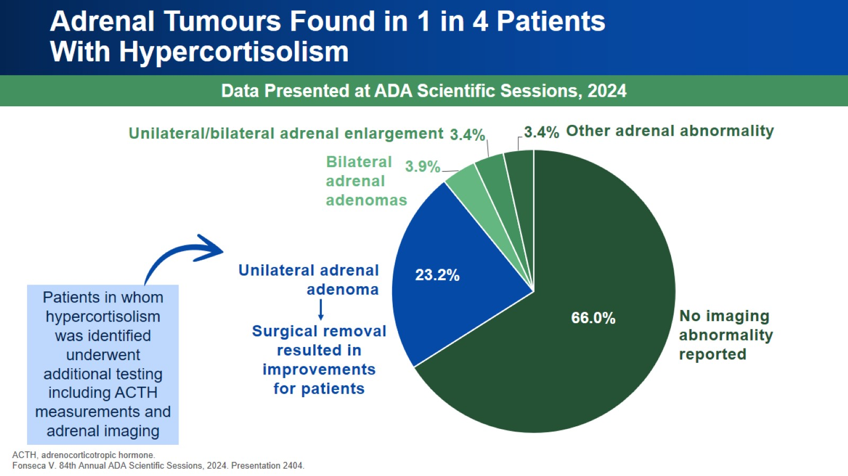
Adrenal Tumours Found in 1 in 4 Patients With Hypercortisolism

Slide 8
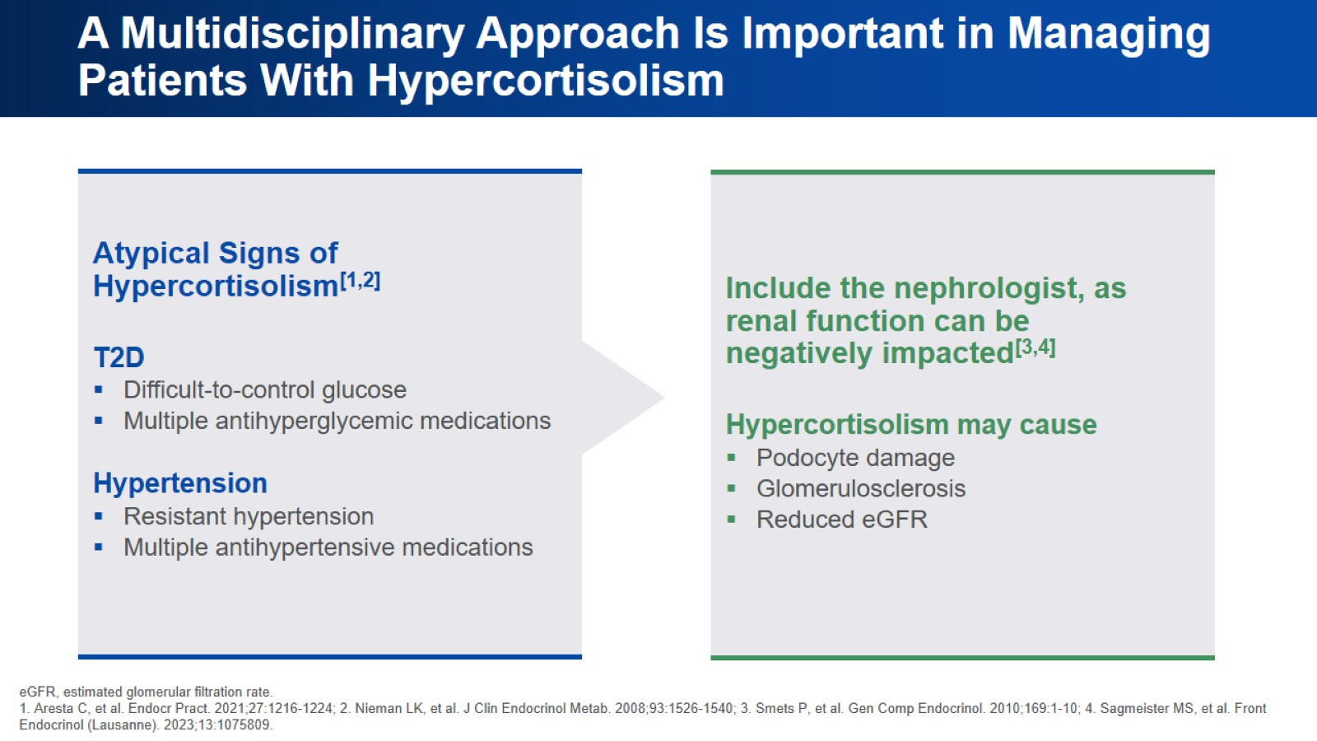
A Multidisciplinary Approach Is Important in Managing Patients With Hypercortisolism

Slide 9
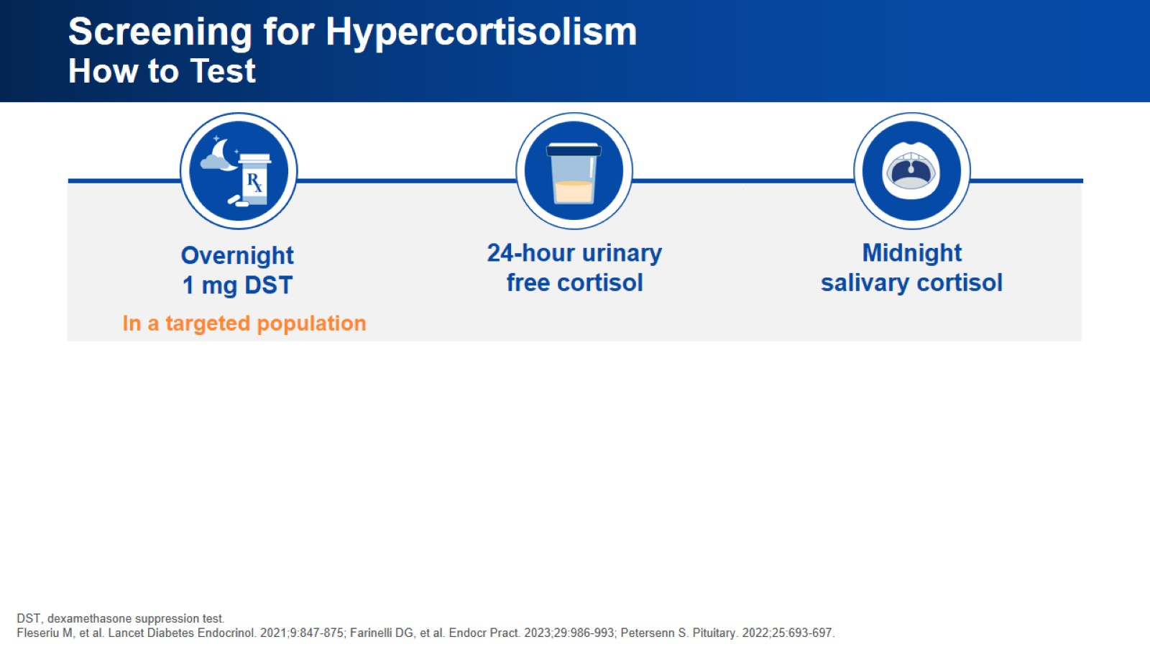
Screening for Hypercortisolism How to Test

Slide 10
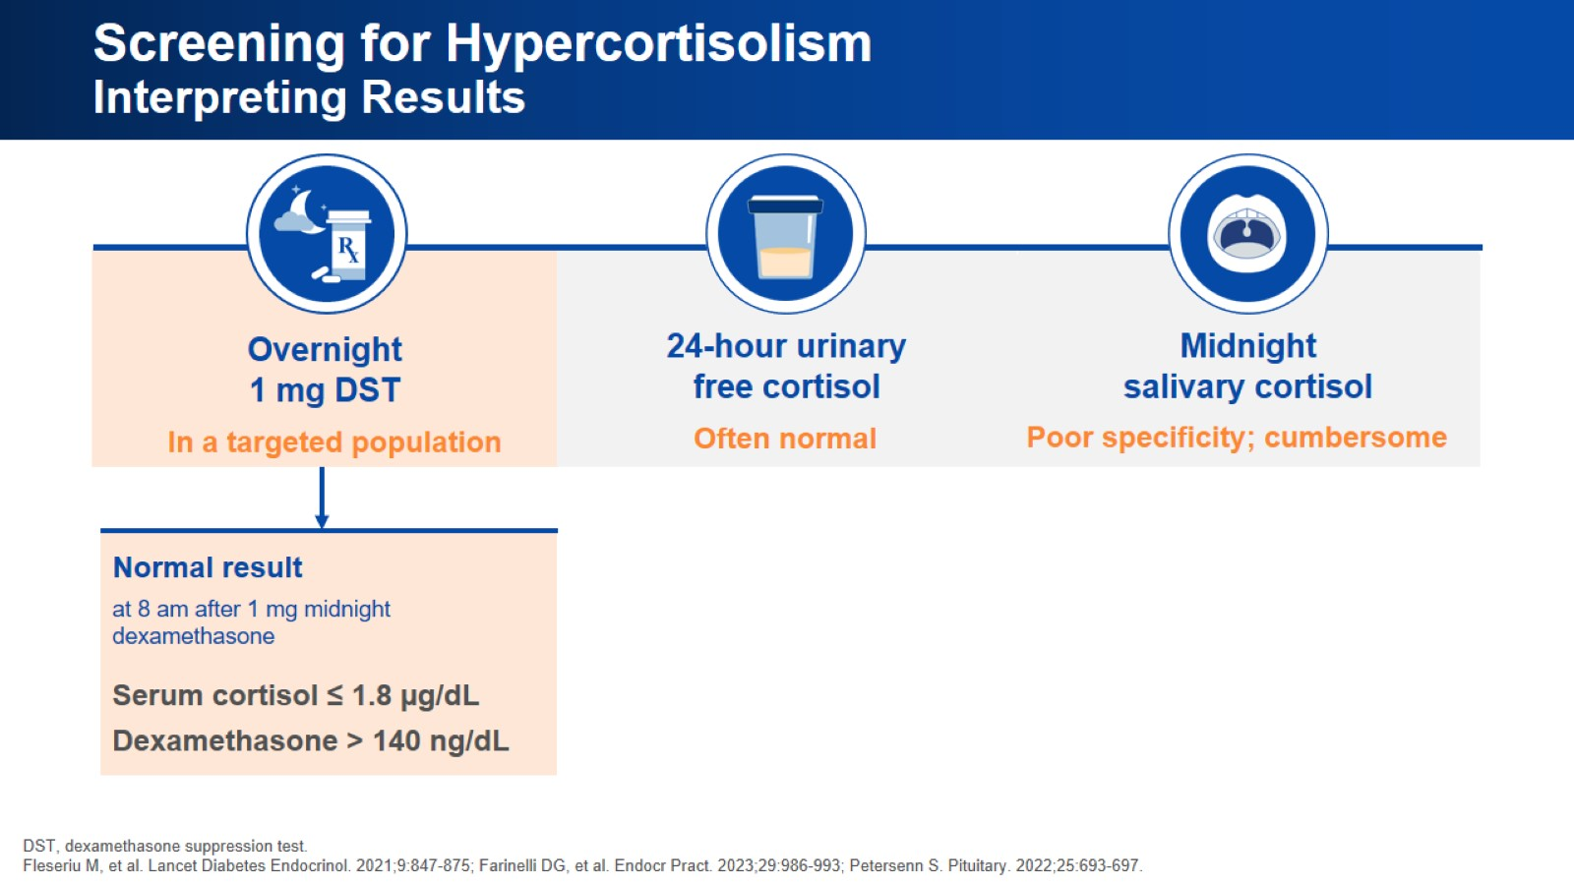
Screening for Hypercortisolism Interpreting Results

Slide 11
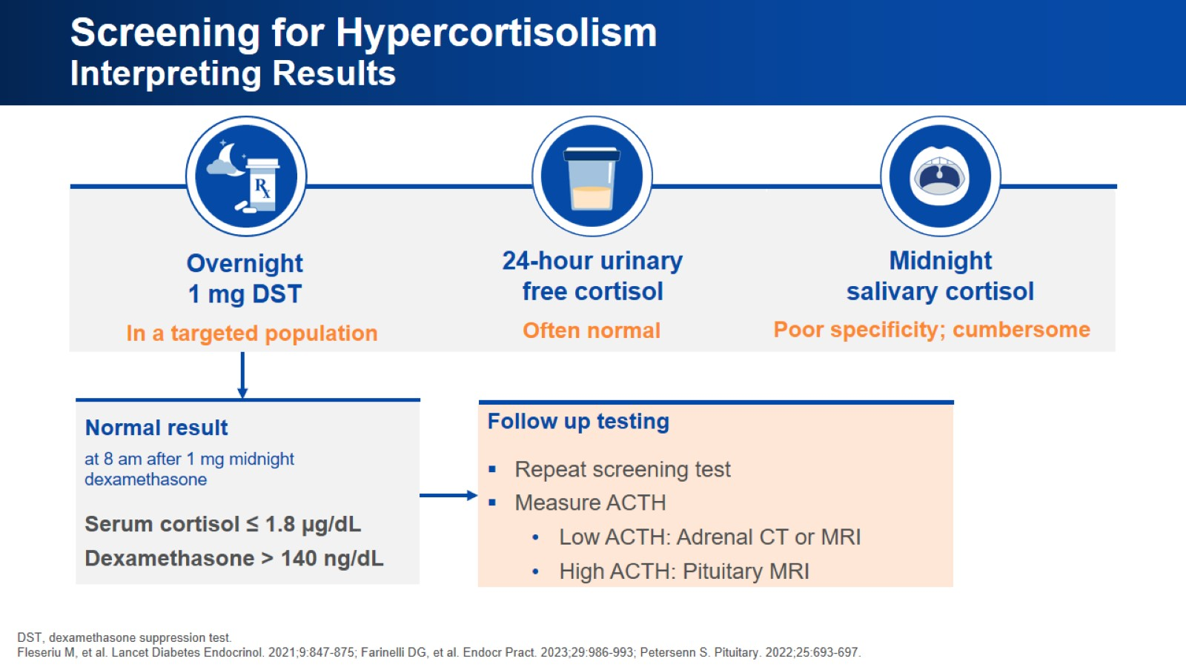
Screening for Hypercortisolism Interpreting Results

Slide 12
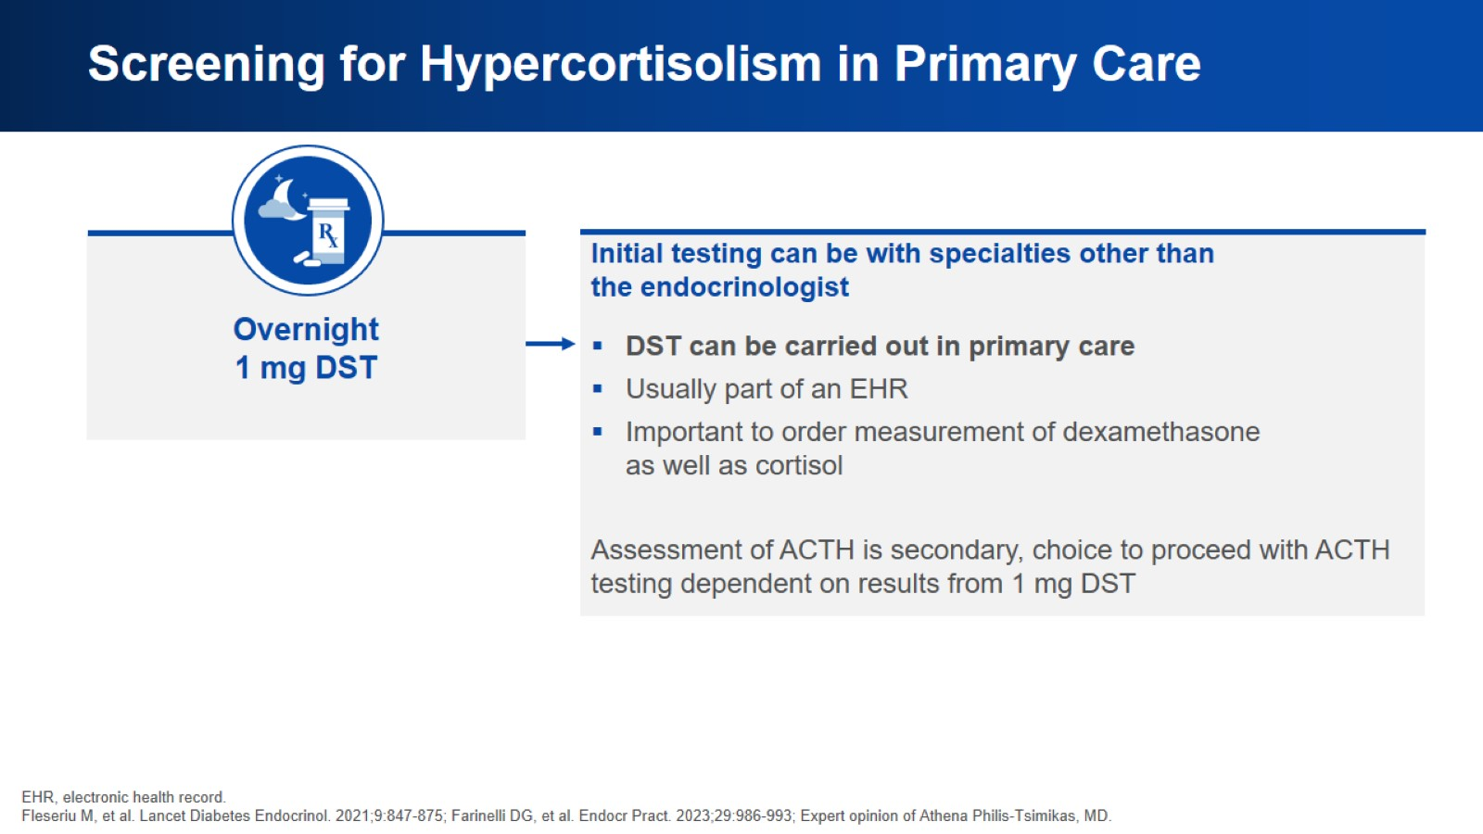
Screening for Hypercortisolism in Primary Care

Slide 13
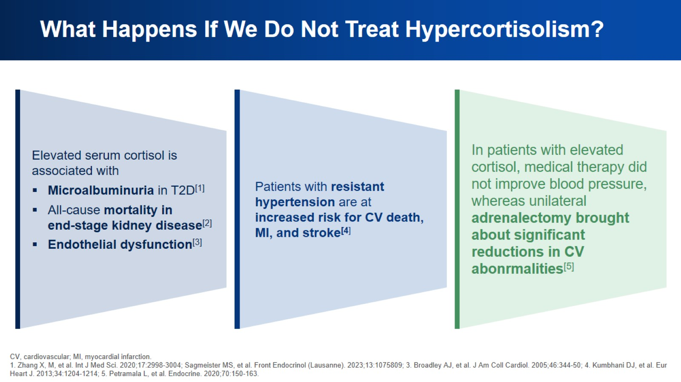
What Happens If We Do Not Treat Hypercortisolism?

Slide 14
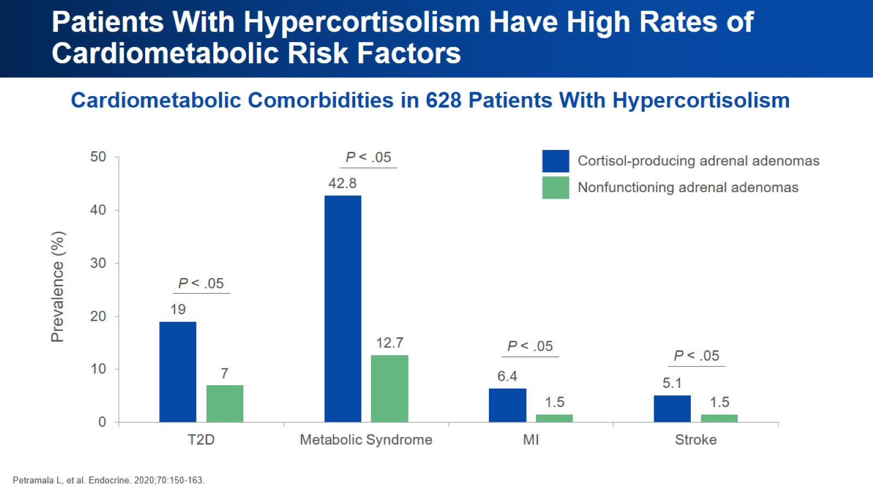
Patients With Hypercortisolism Have High Rates of Cardiometabolic Risk Factors

Slide 15
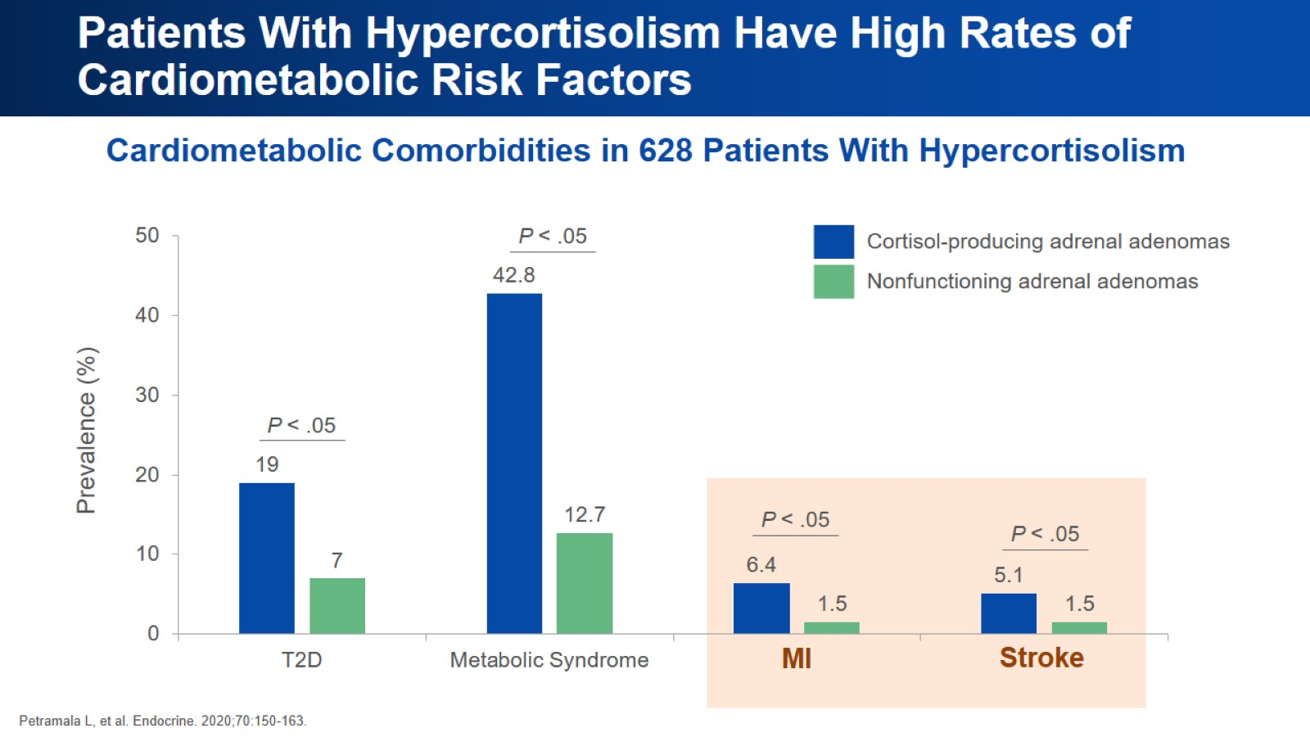
Patients With Hypercortisolism Have High Rates of Cardiometabolic Risk Factors

Slide 16
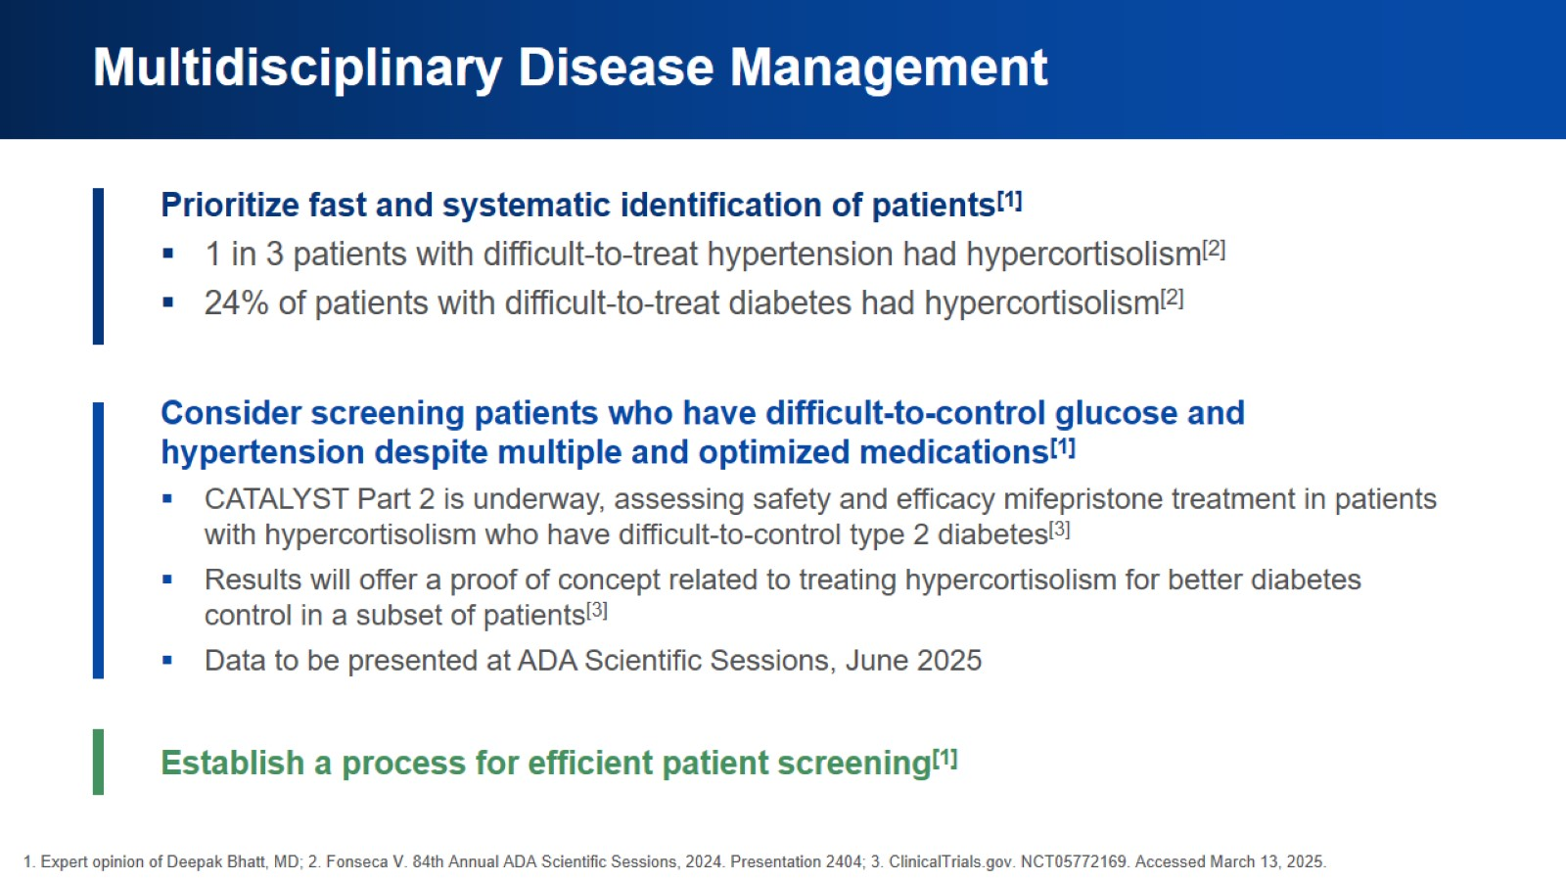
Multidisciplinary Disease Management

Slide 17
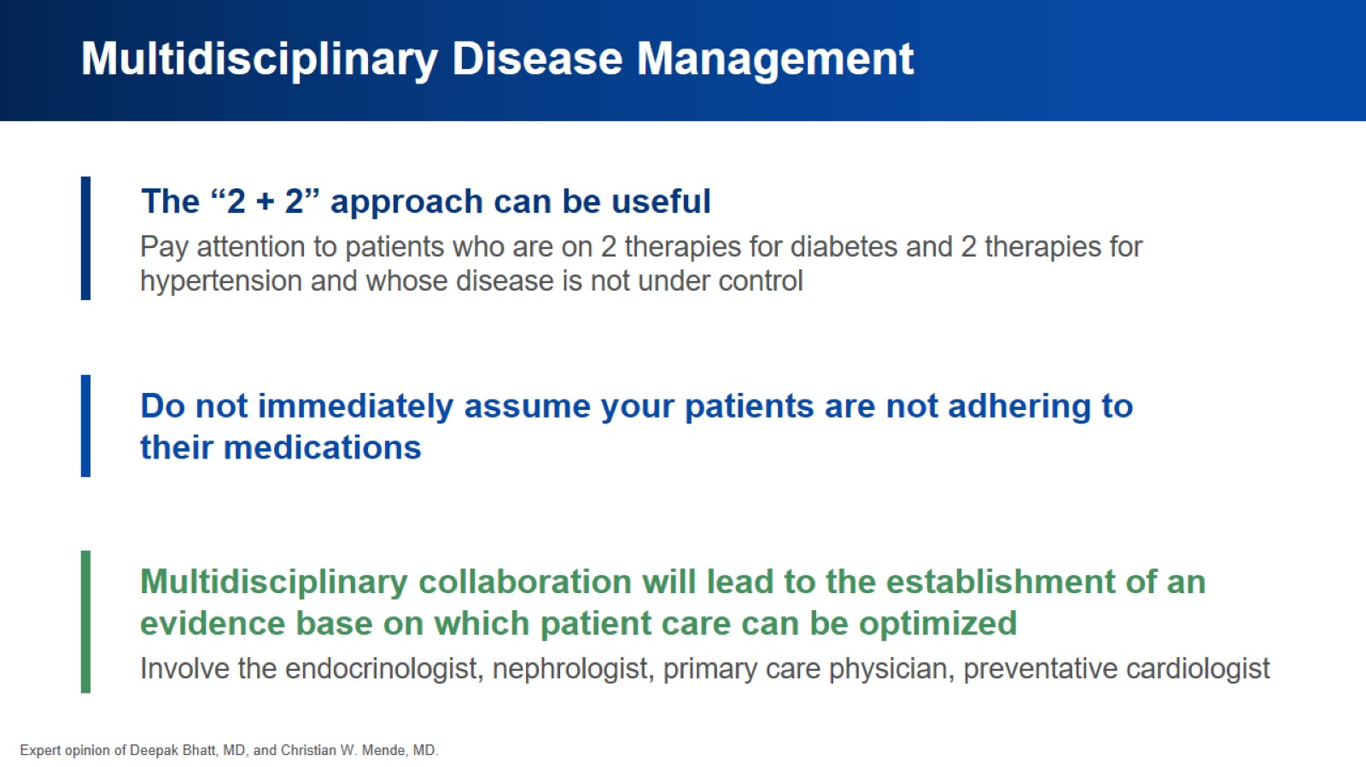
Multidisciplinary Disease Management

Slide 18
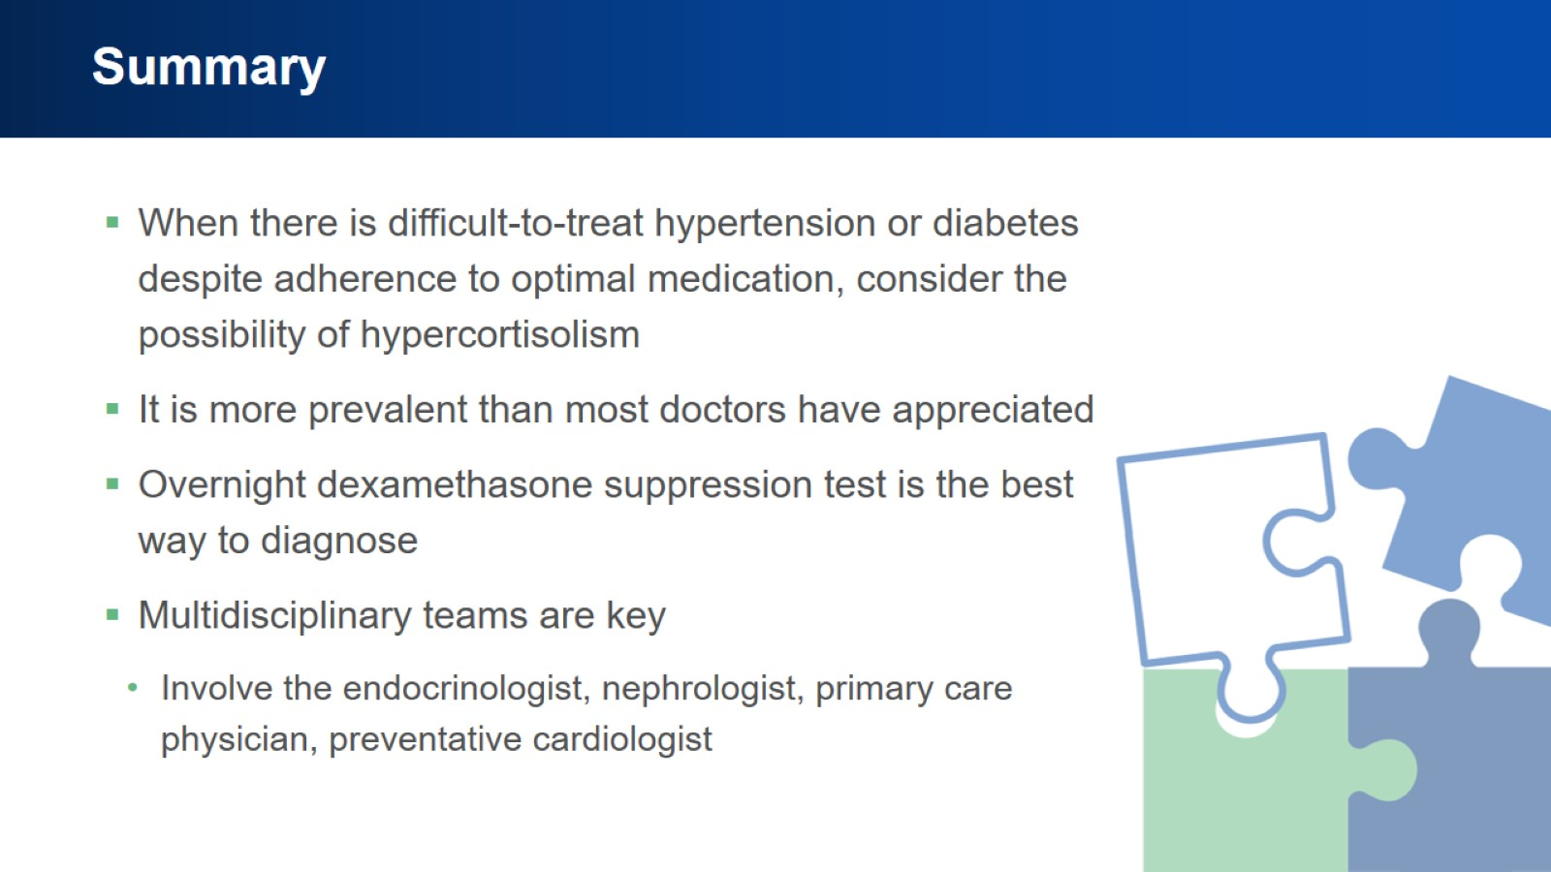
Summary

Slide 19


