Slide 1

Beyond Left Ventricular Hypertrophy in Hypertrophic Cardiomyopathy

Slide 2


Slide 3
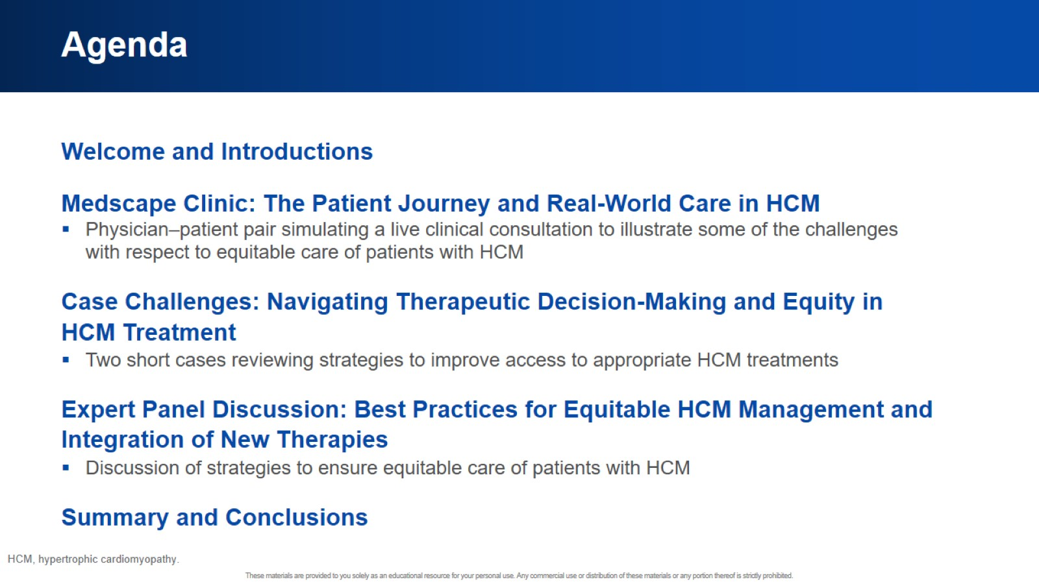
Agenda

Slide 4


Slide 5
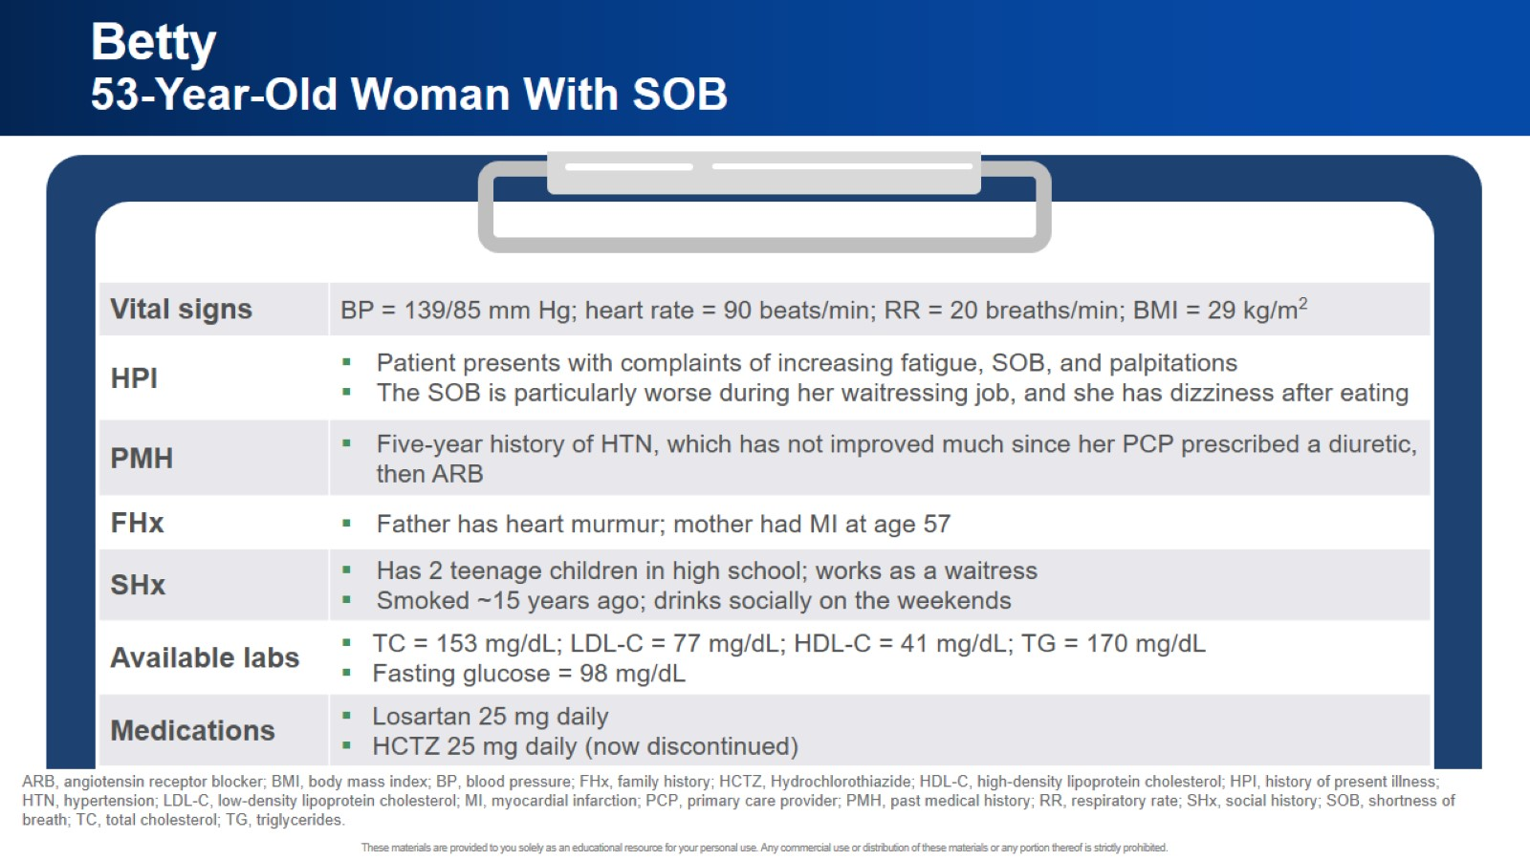
Betty 53-Year-Old Woman With SOB

Slide 6


Slide 7


Slide 8
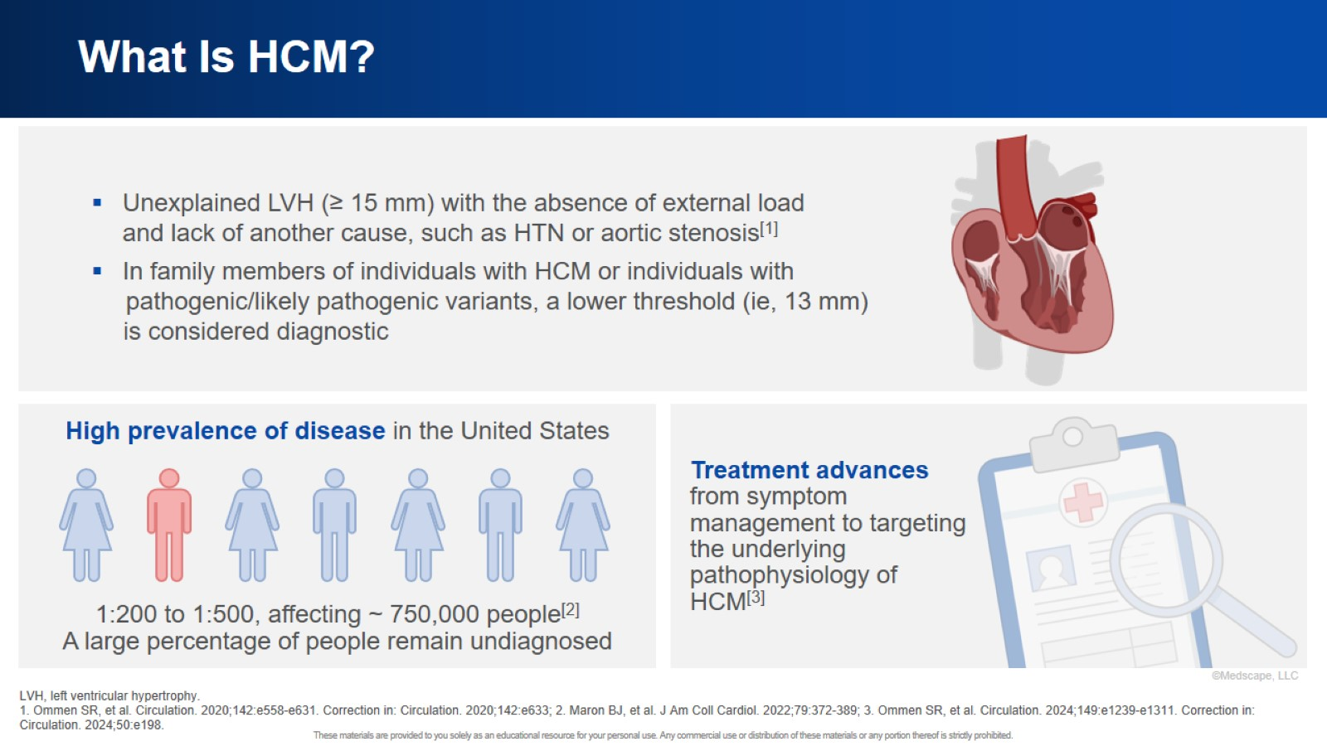
What Is HCM?

Slide 9
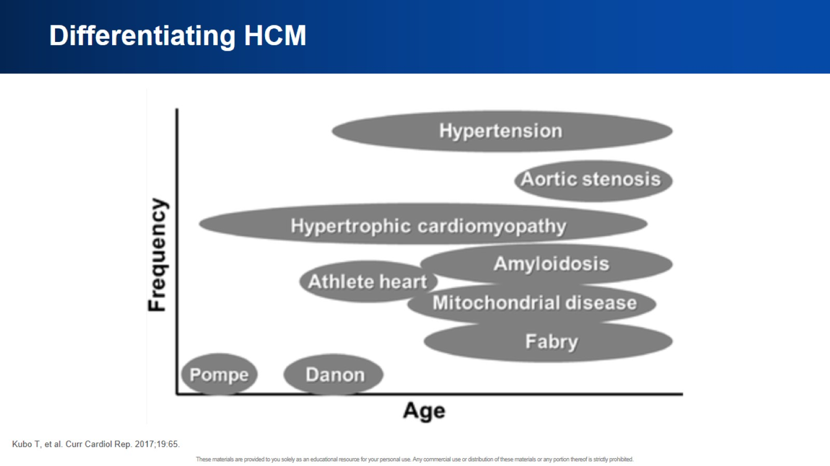
Differentiating HCM

Slide 10
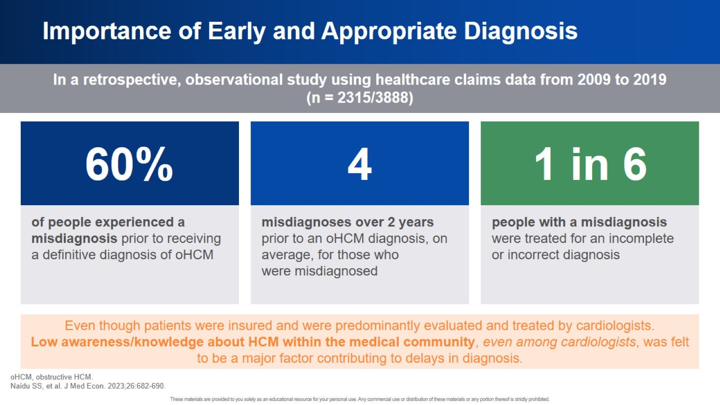
Importance of Early and Appropriate Diagnosis

Slide 11
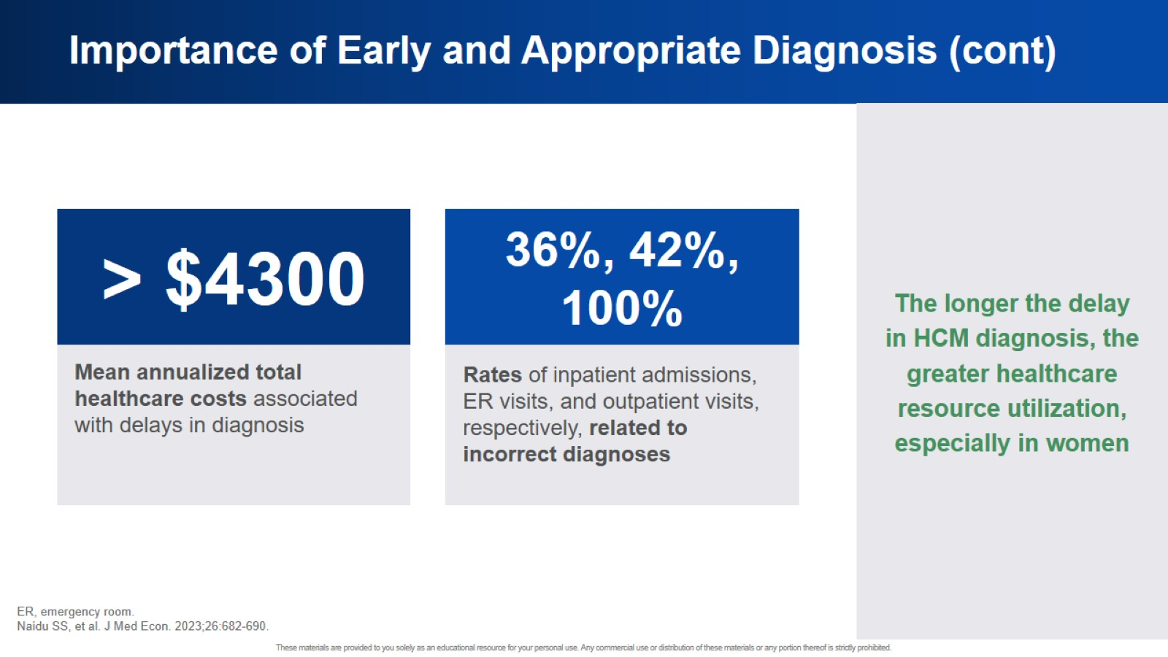
Importance of Early and Appropriate Diagnosis (cont)

Slide 12
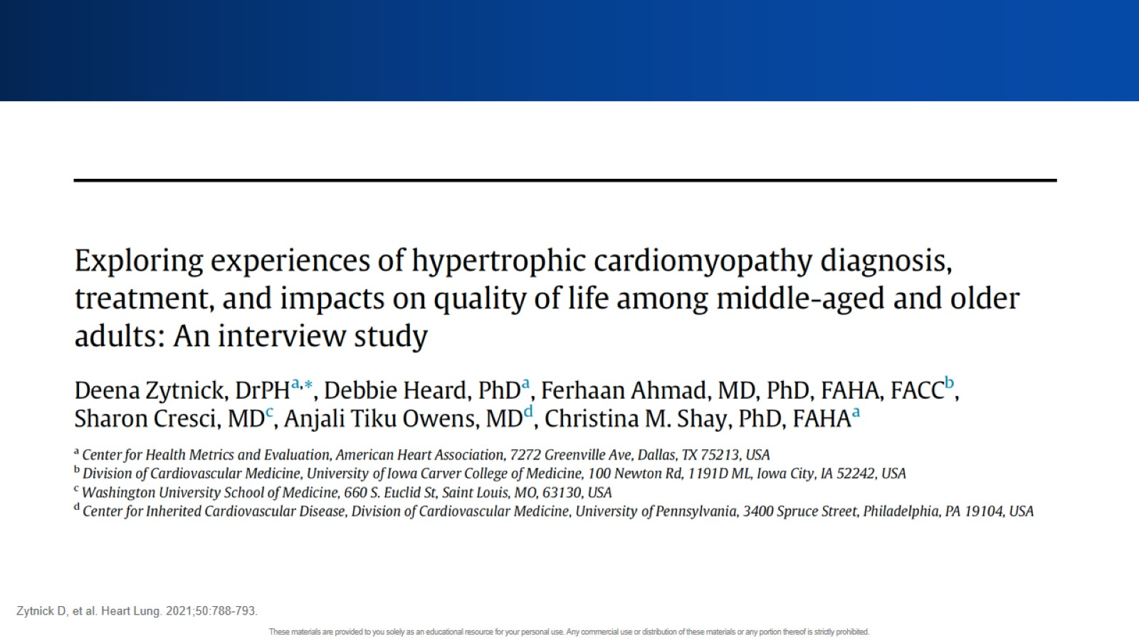

Slide 13
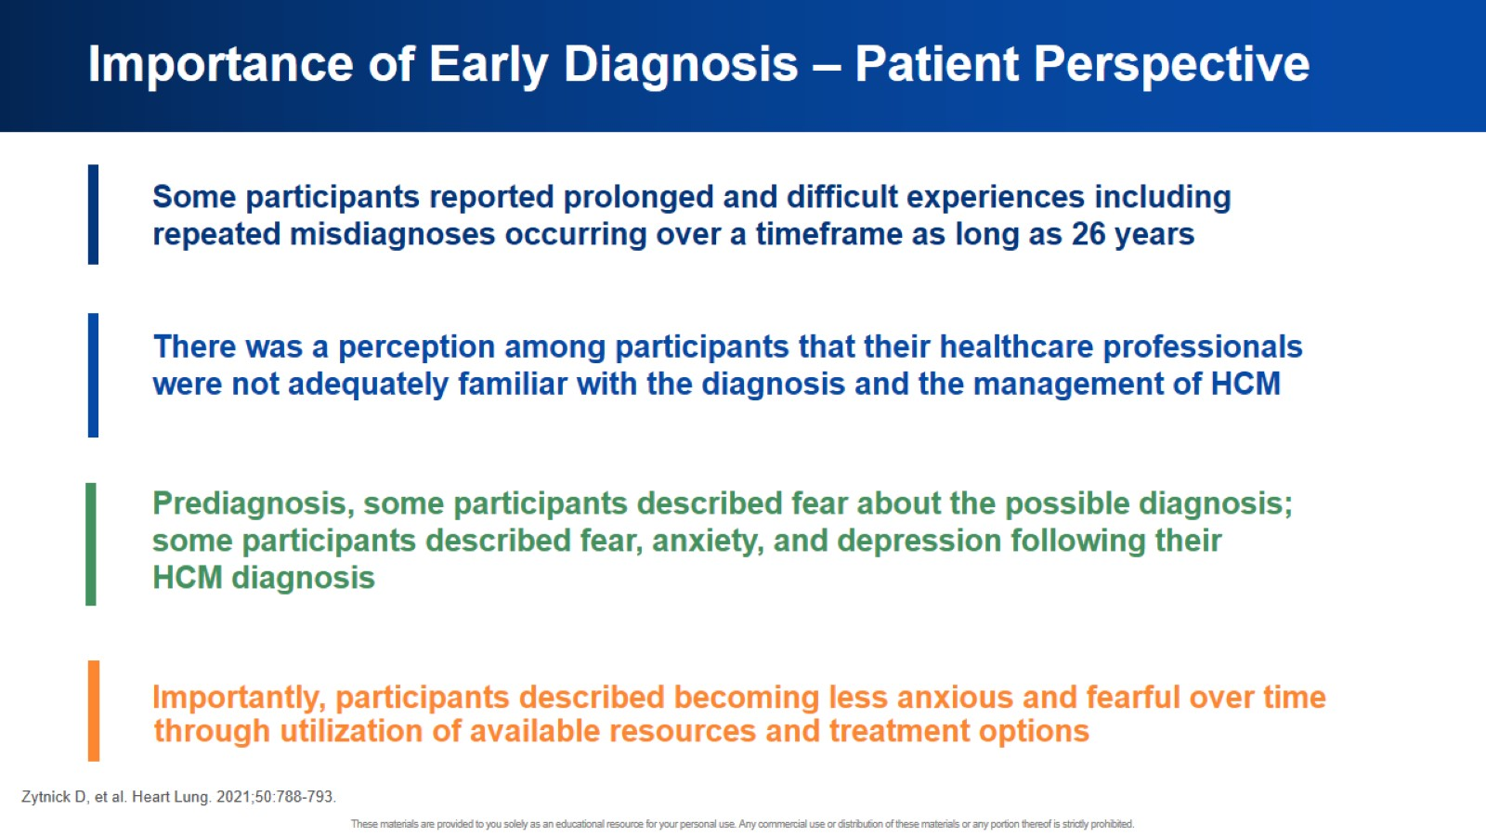
Importance of Early Diagnosis – Patient Perspective

Slide 14
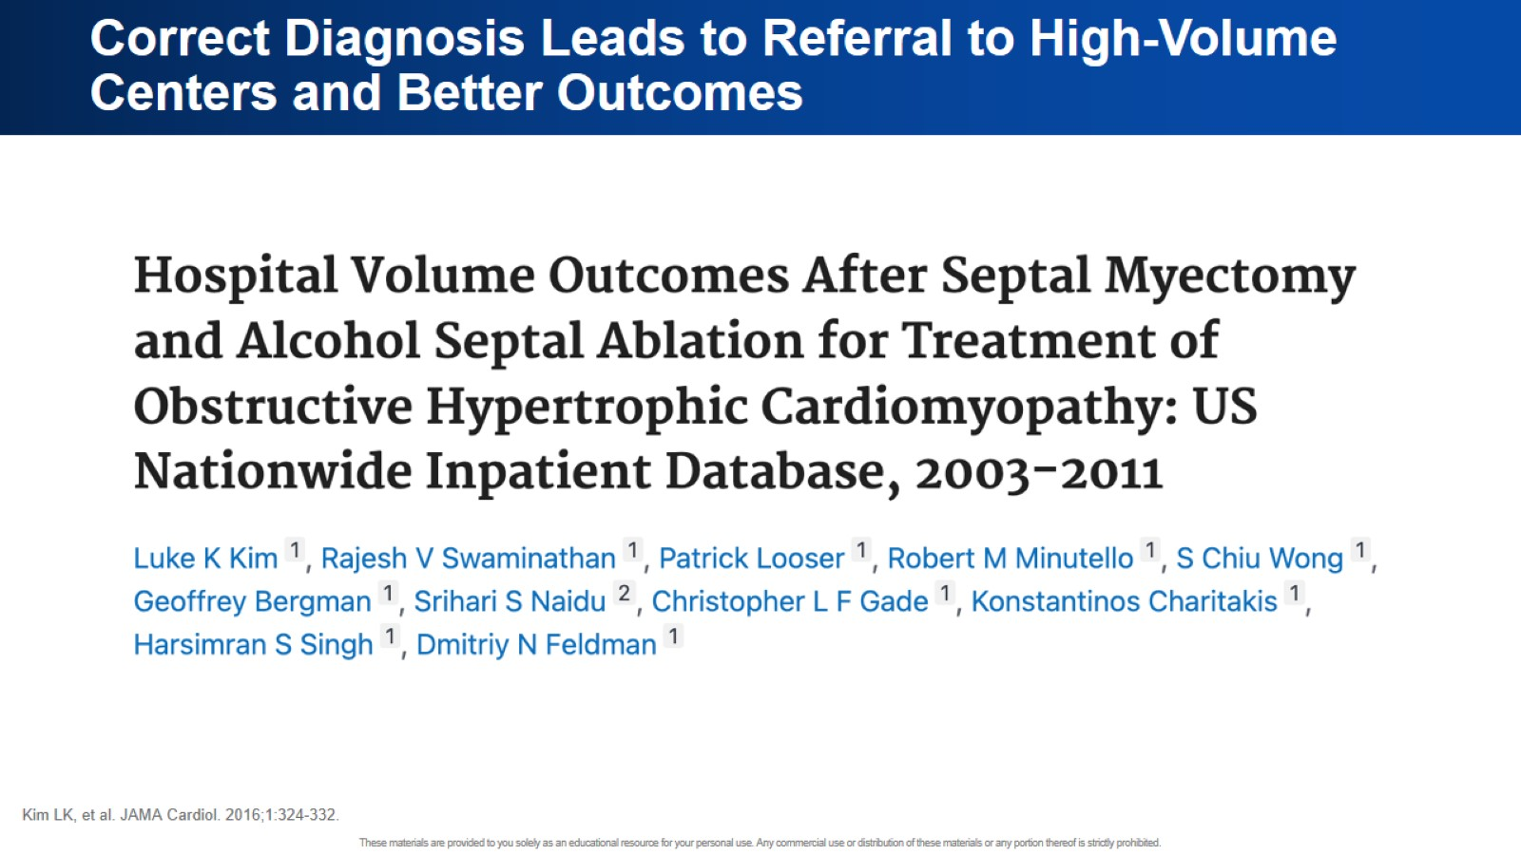
Correct Diagnosis Leads to Referral to High-Volume Centers and Better Outcomes

Slide 15
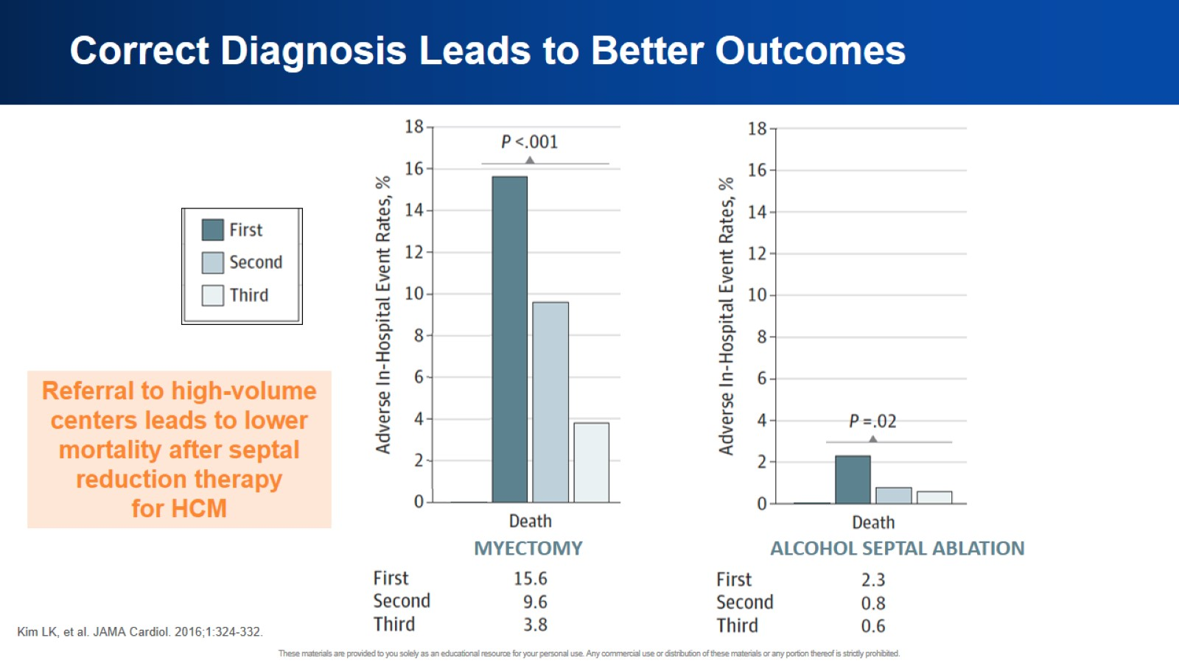
Correct Diagnosis Leads to Better Outcomes

Slide 16
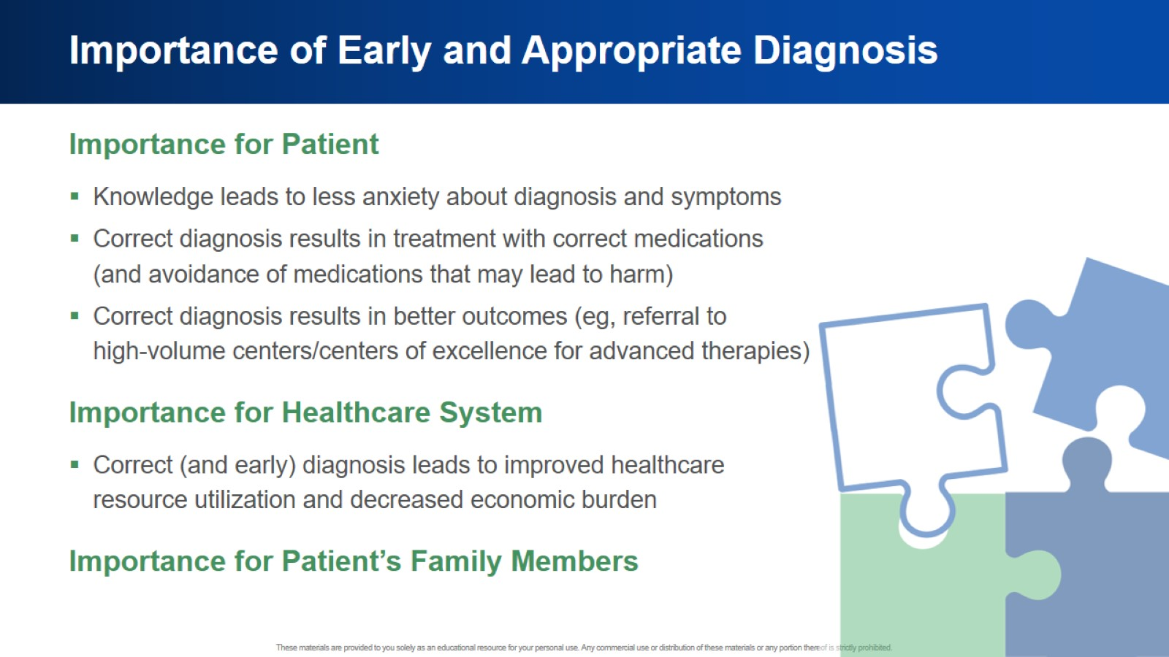
Importance of Early and Appropriate Diagnosis

Slide 17
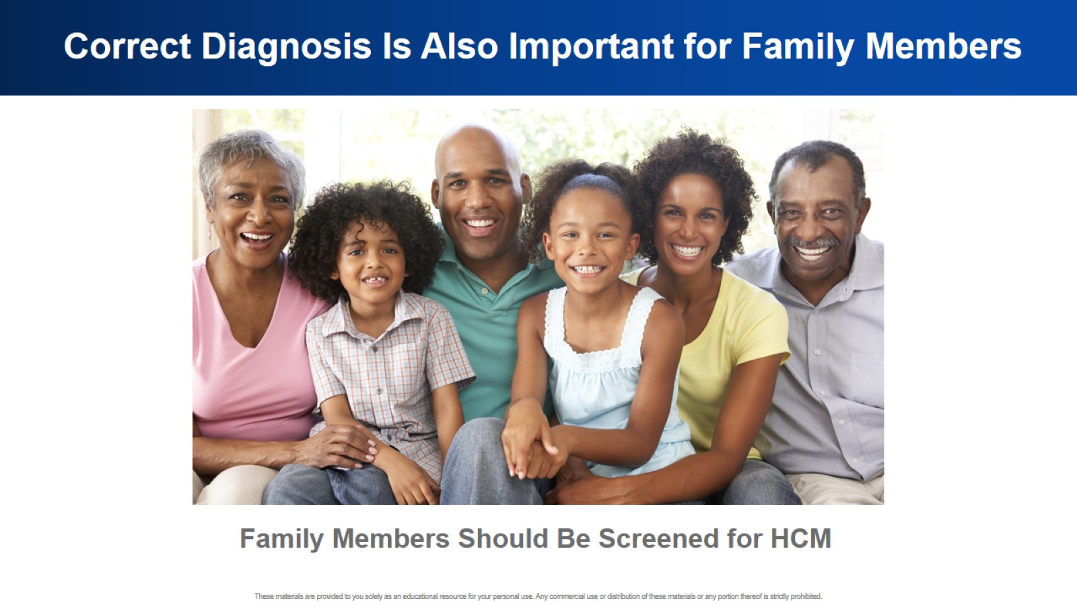
Correct Diagnosis Is Also Important for Family Members

Slide 18
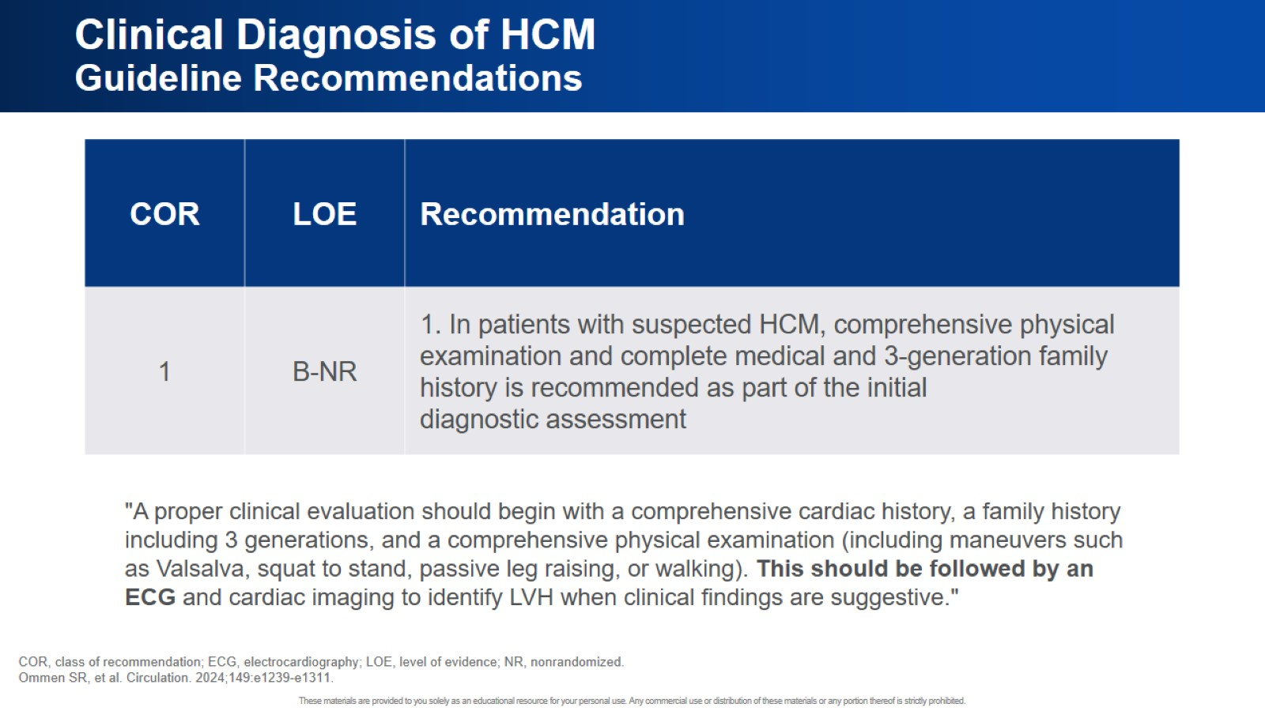
Clinical Diagnosis of HCM Guideline Recommendations

Slide 19
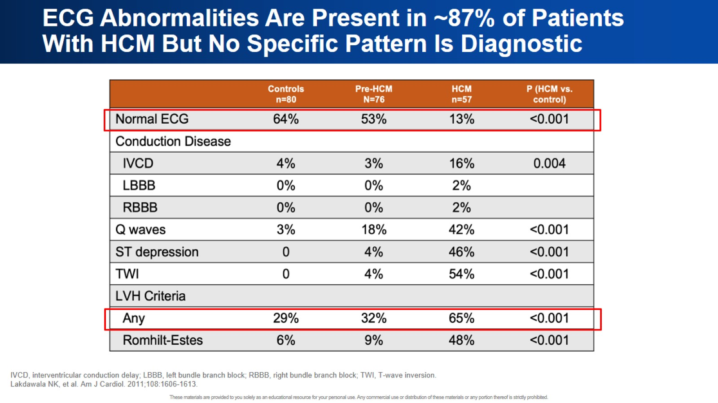
ECG Abnormalities Are Present in ~87% of Patients With HCM But No Specific Pattern Is Diagnostic

Slide 20
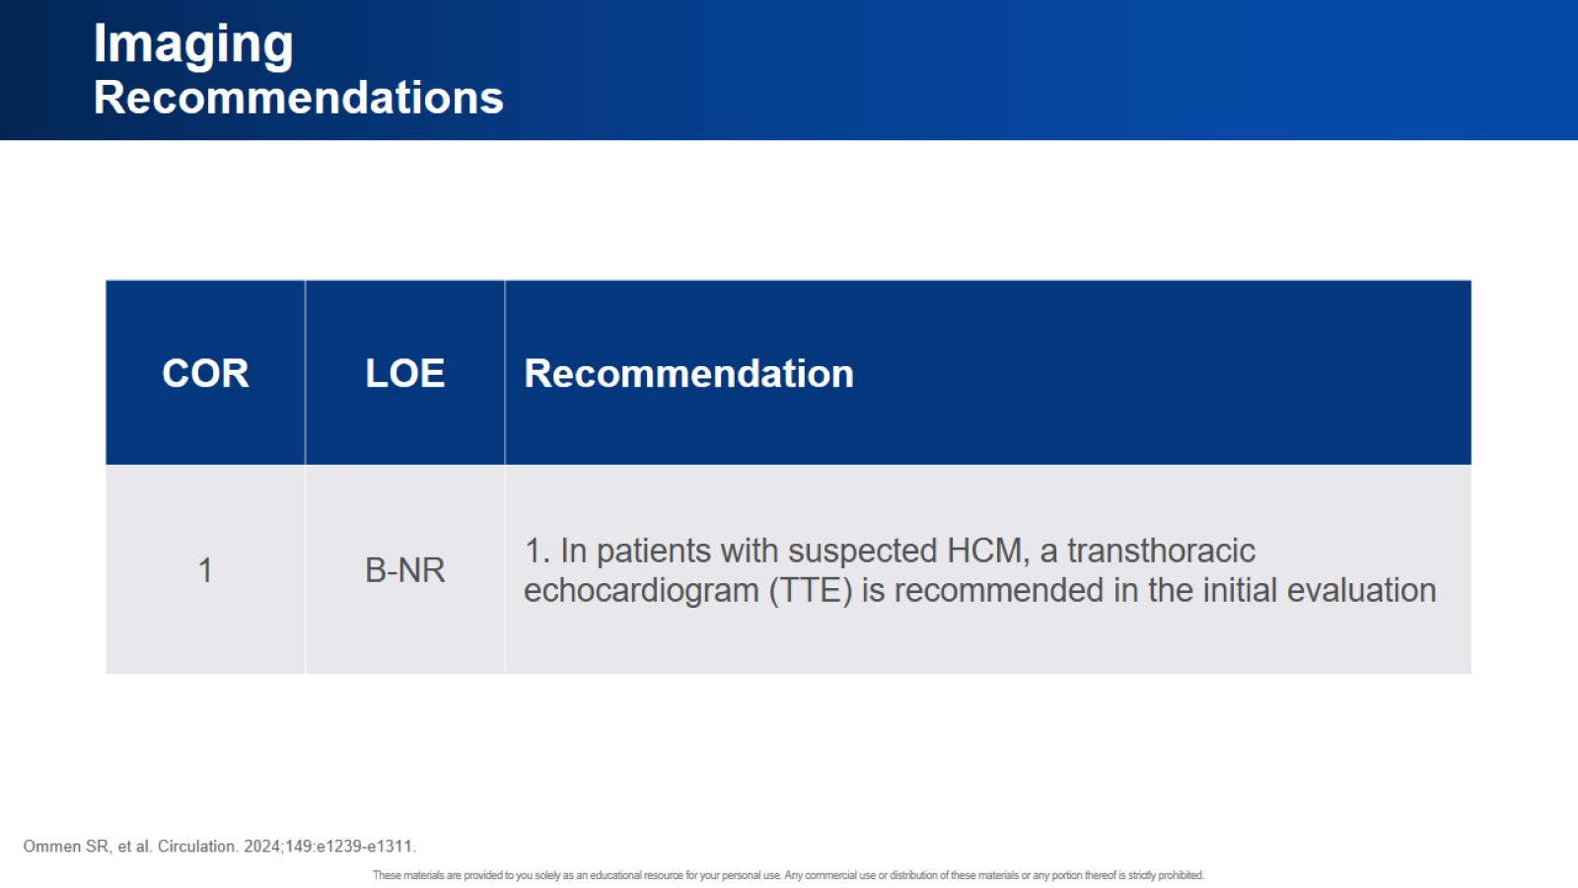
Imaging Recommendations

Slide 21
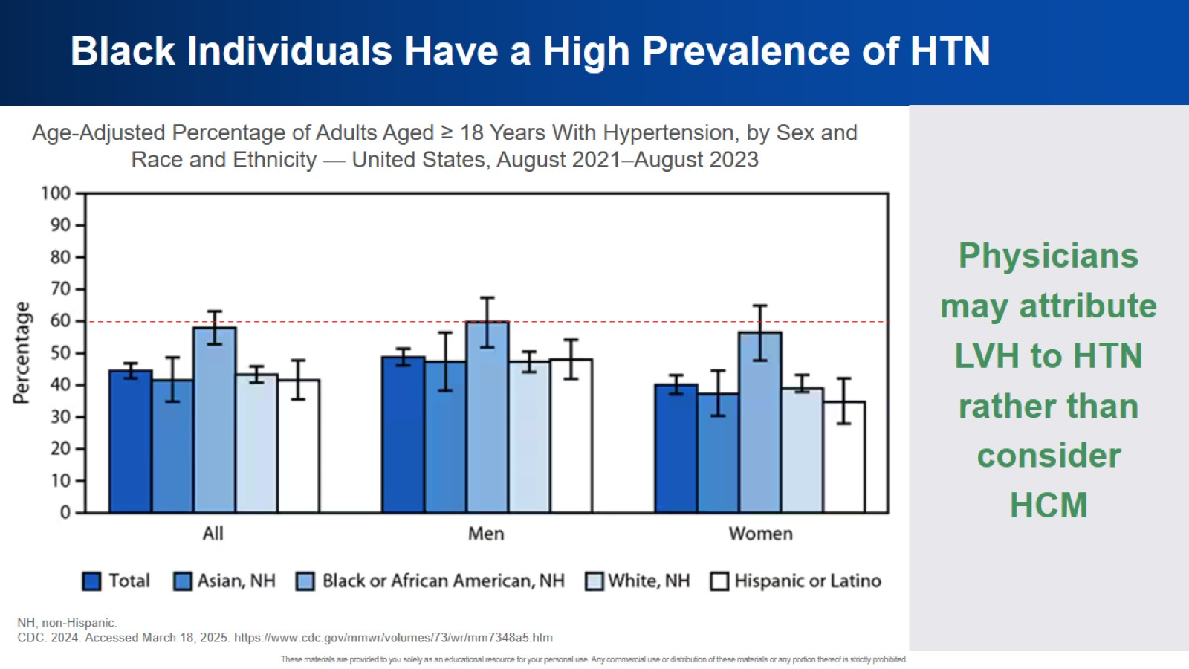
Black Individuals Have a High Prevalence of HTN

Slide 22
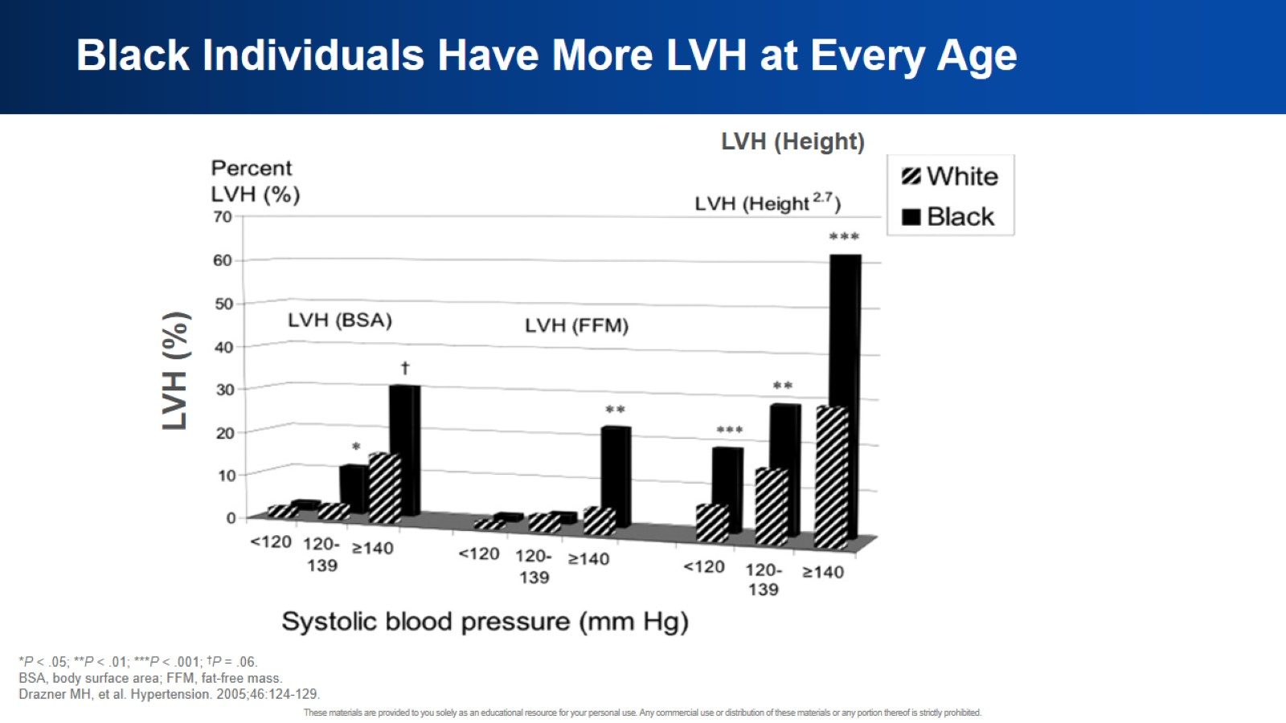
Black Individuals Have More LVH at Every Age

Slide 23
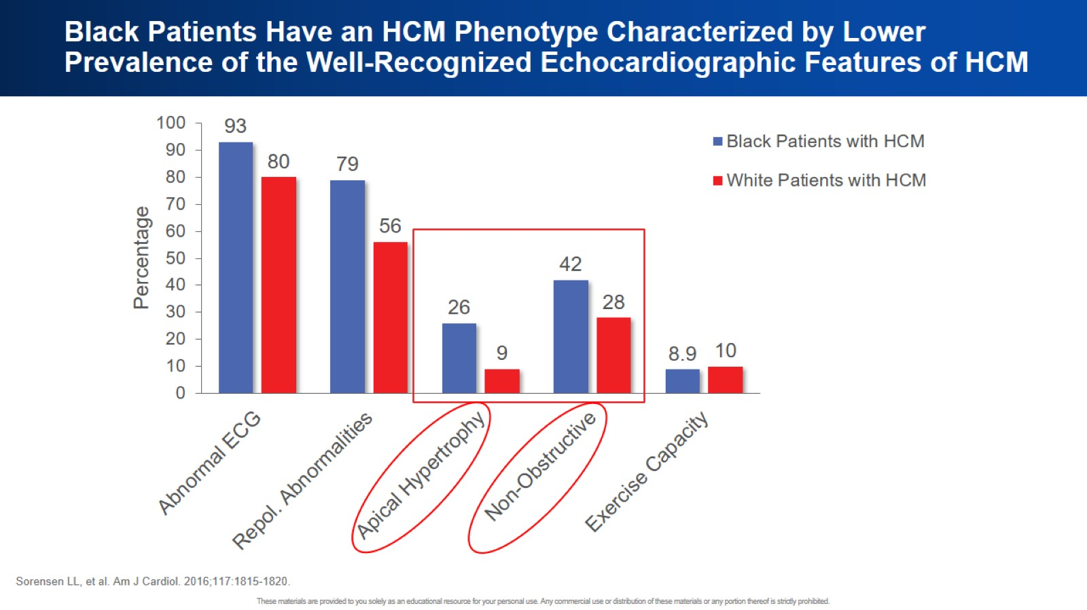
Black Patients Have an HCM Phenotype Characterized by Lower Prevalence of the Well-Recognized Echocardiographic Features of HCM

Slide 24
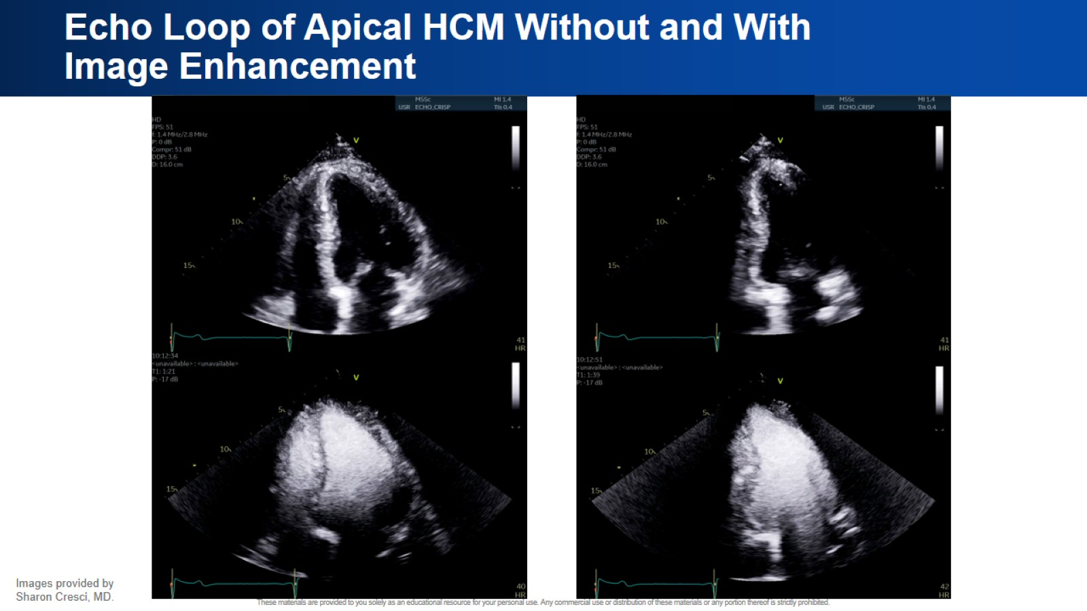
Echo Loop of Apical HCM Without and With Image Enhancement

Slide 25
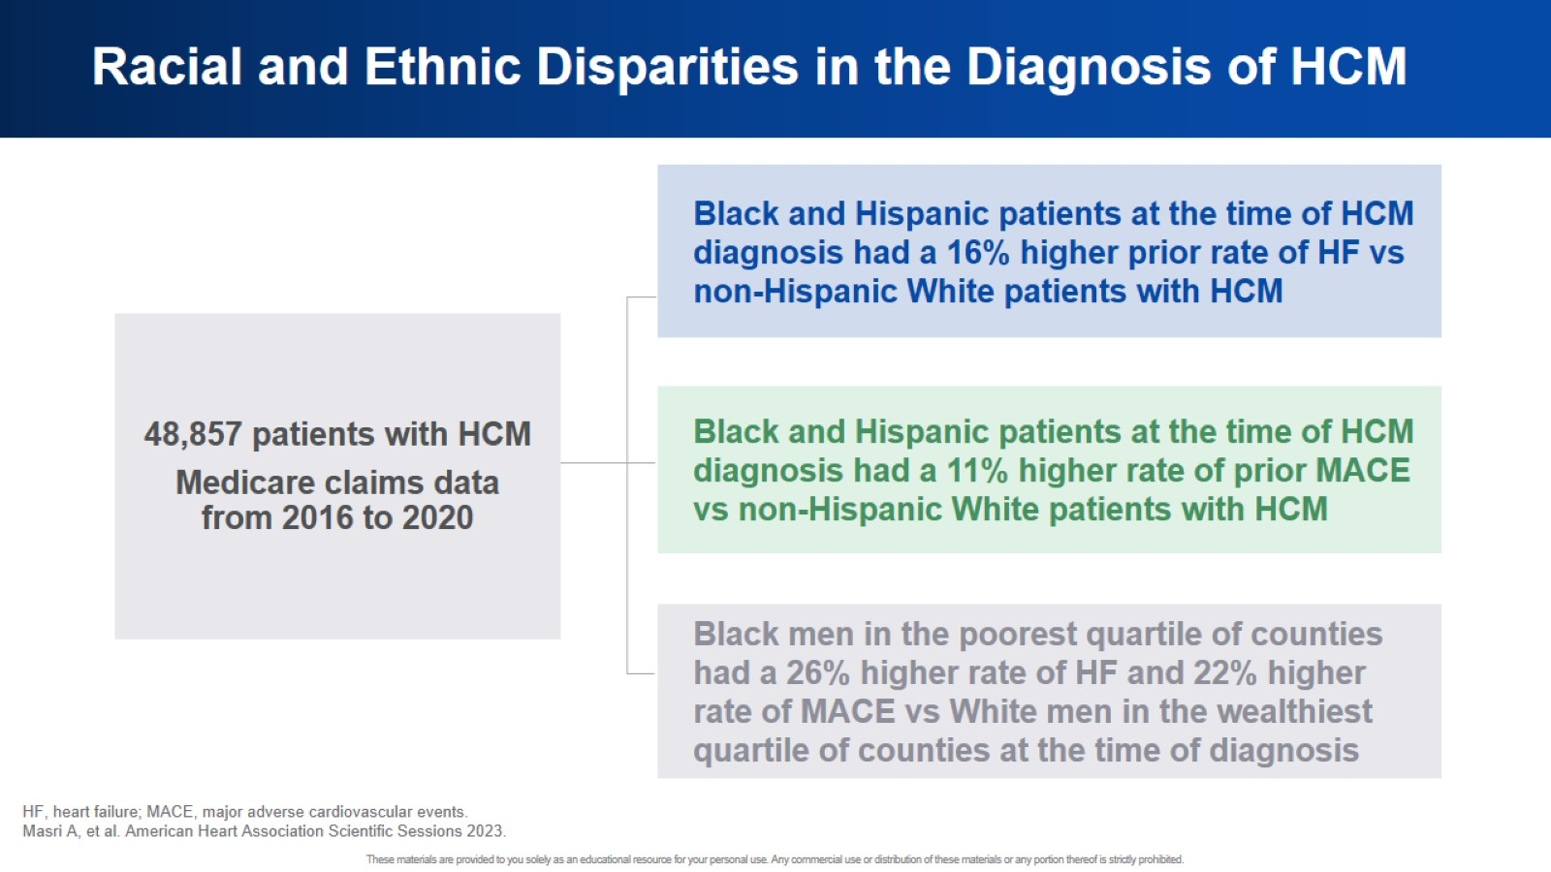
Racial and Ethnic Disparities in the Diagnosis of HCM

Slide 26
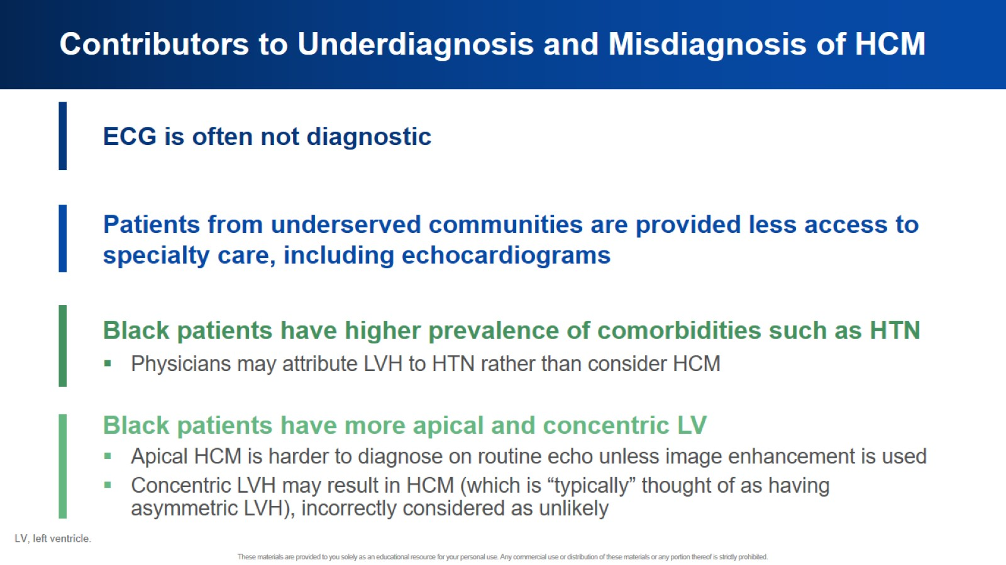
Contributors to Underdiagnosis and Misdiagnosis of HCM

Slide 27
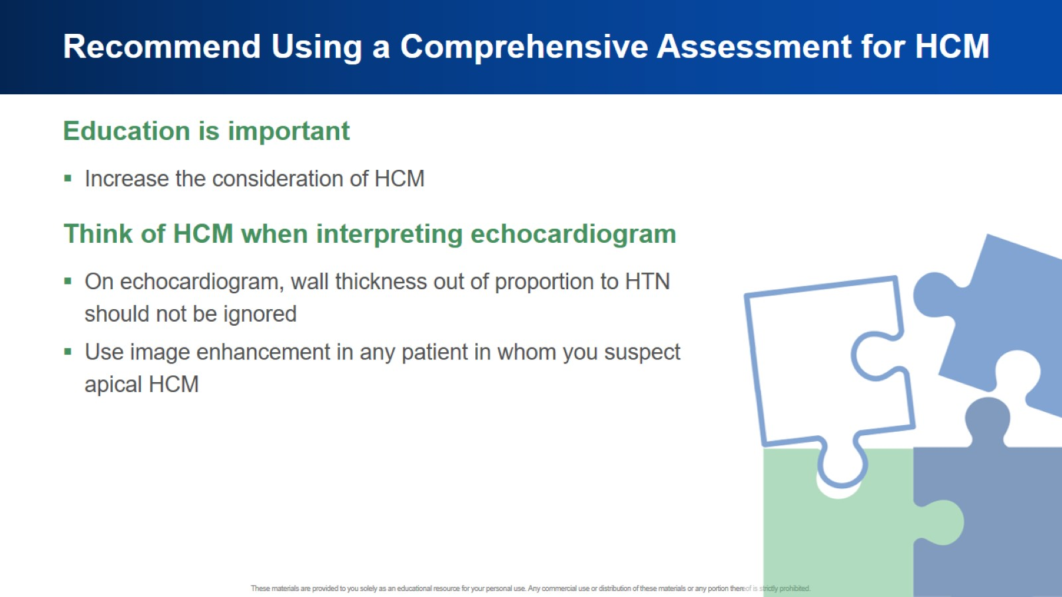
Recommend Using a Comprehensive Assessment for HCM

Slide 28
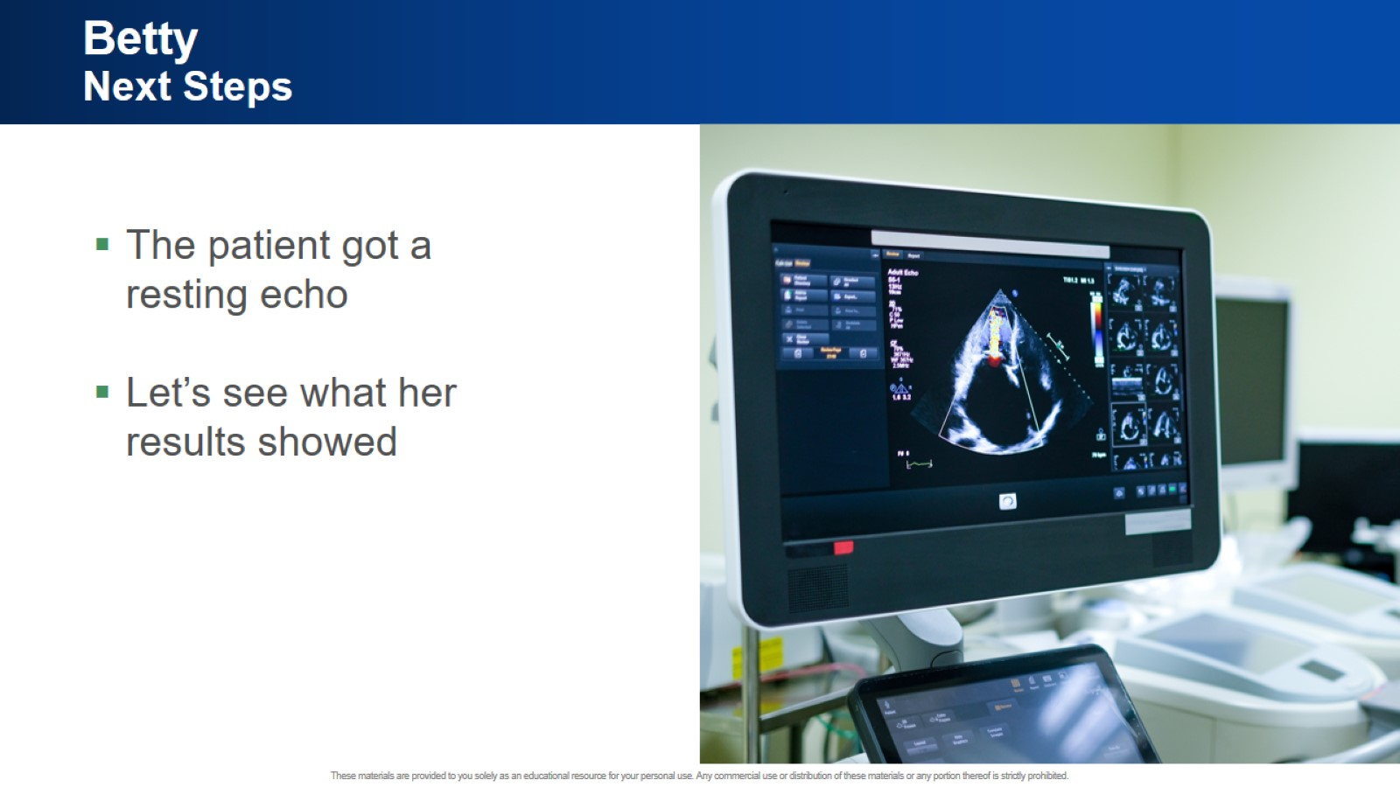
Betty Next Steps

Slide 29


Slide 30


Slide 31
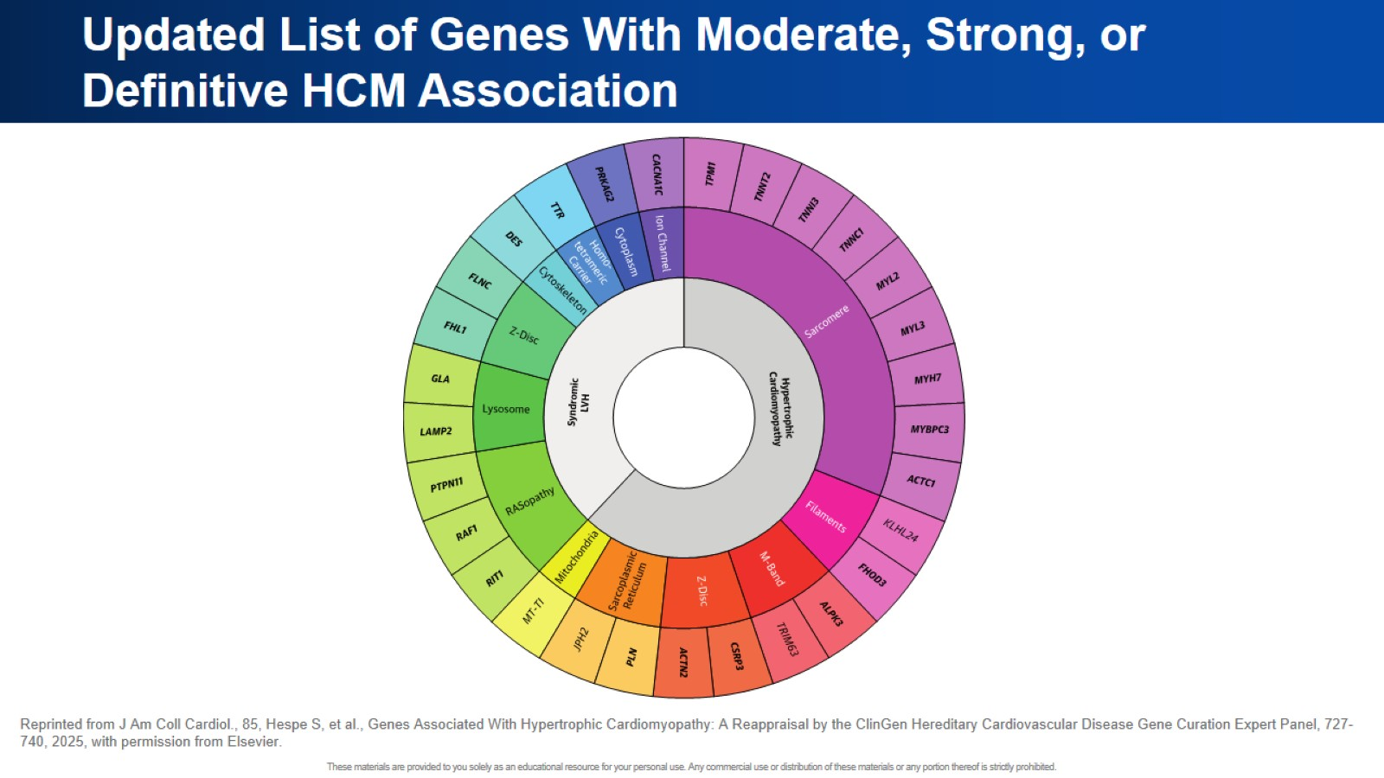
Updated List of Genes With Moderate, Strong, or Definitive HCM Association

Slide 32
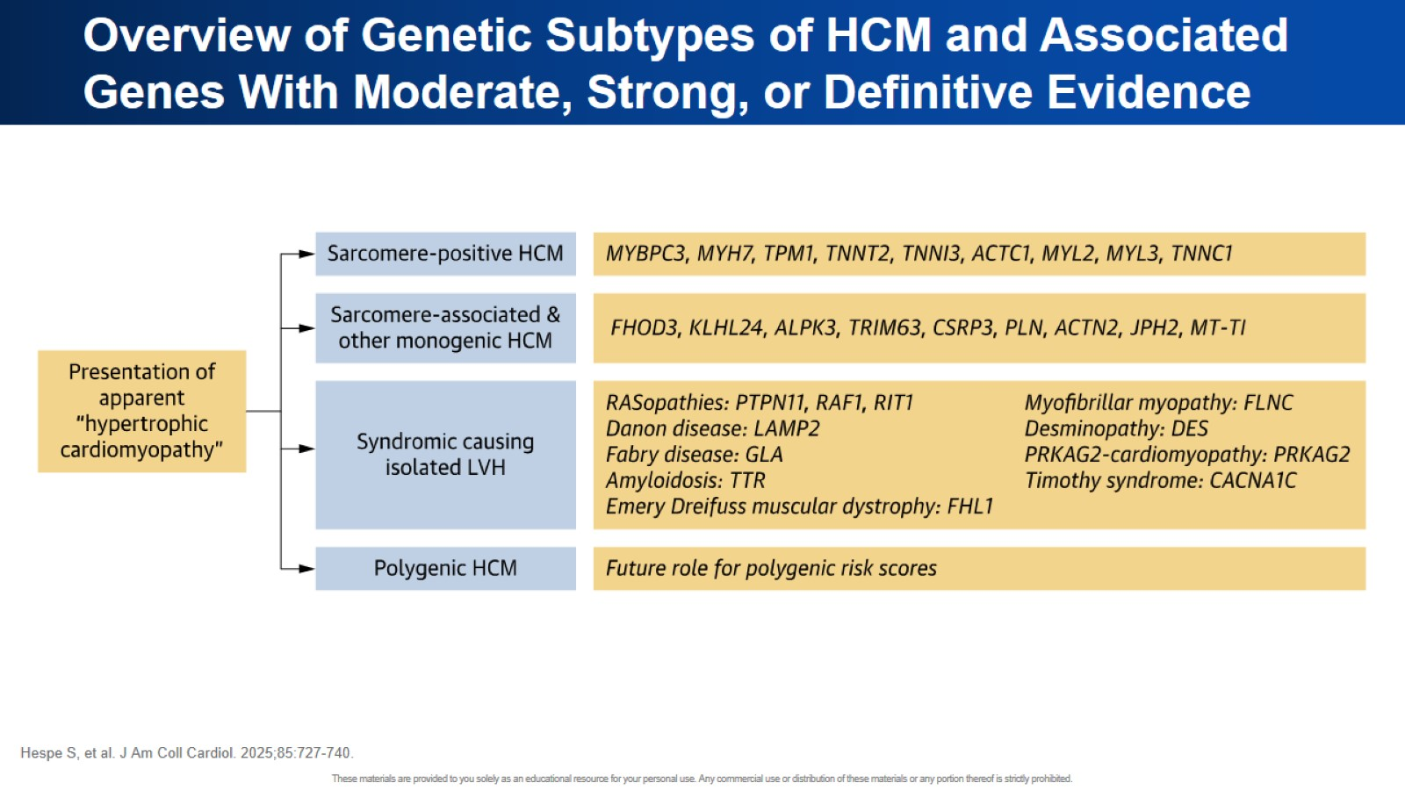
Overview of Genetic Subtypes of HCM and Associated Genes With Moderate, Strong, or Definitive Evidence

Slide 33
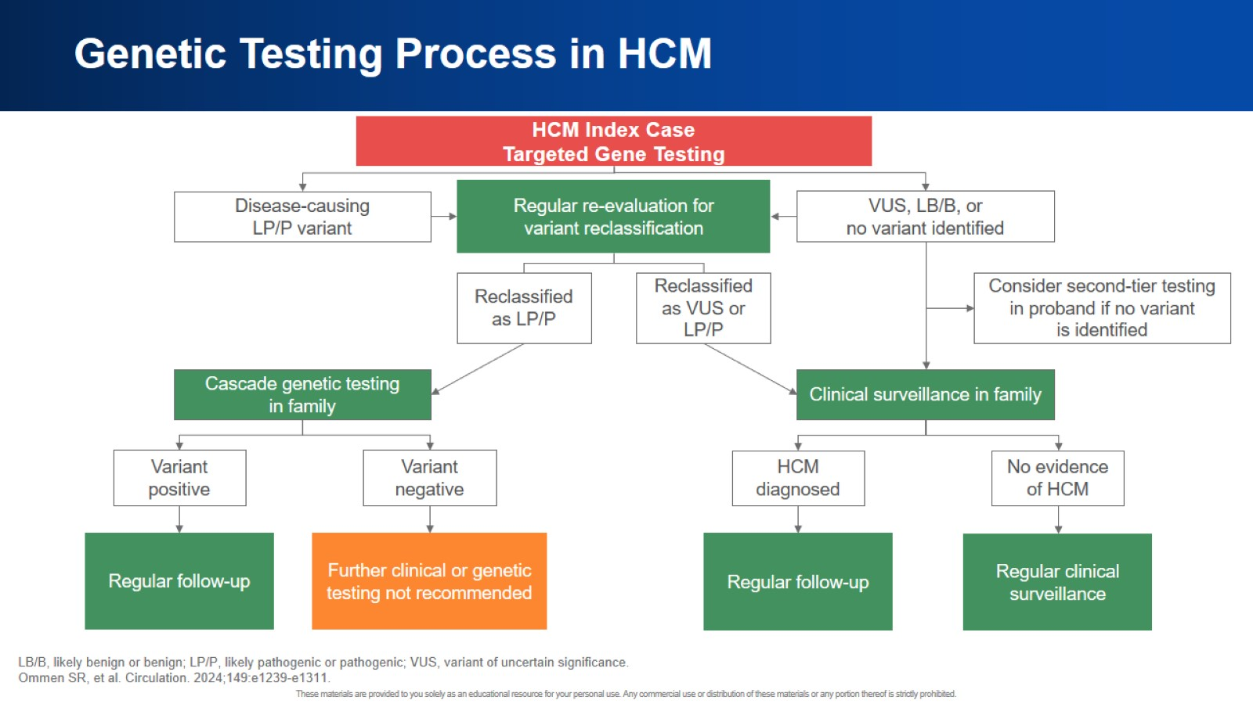
Genetic Testing Process in HCM

Slide 34
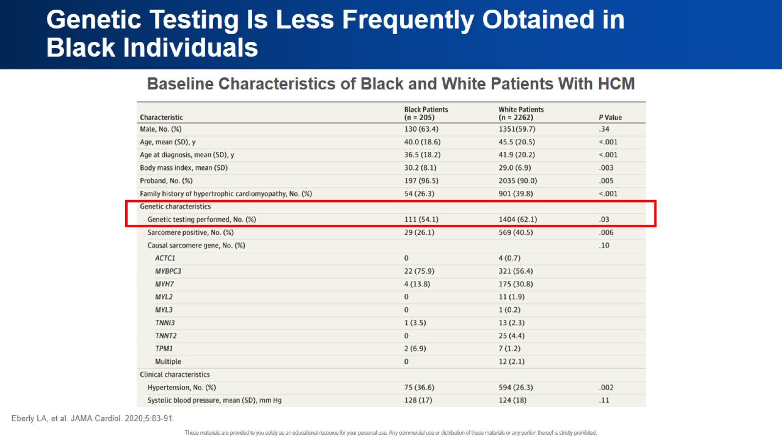
Genetic Testing Is Less Frequently Obtained in Black Individuals

Slide 35
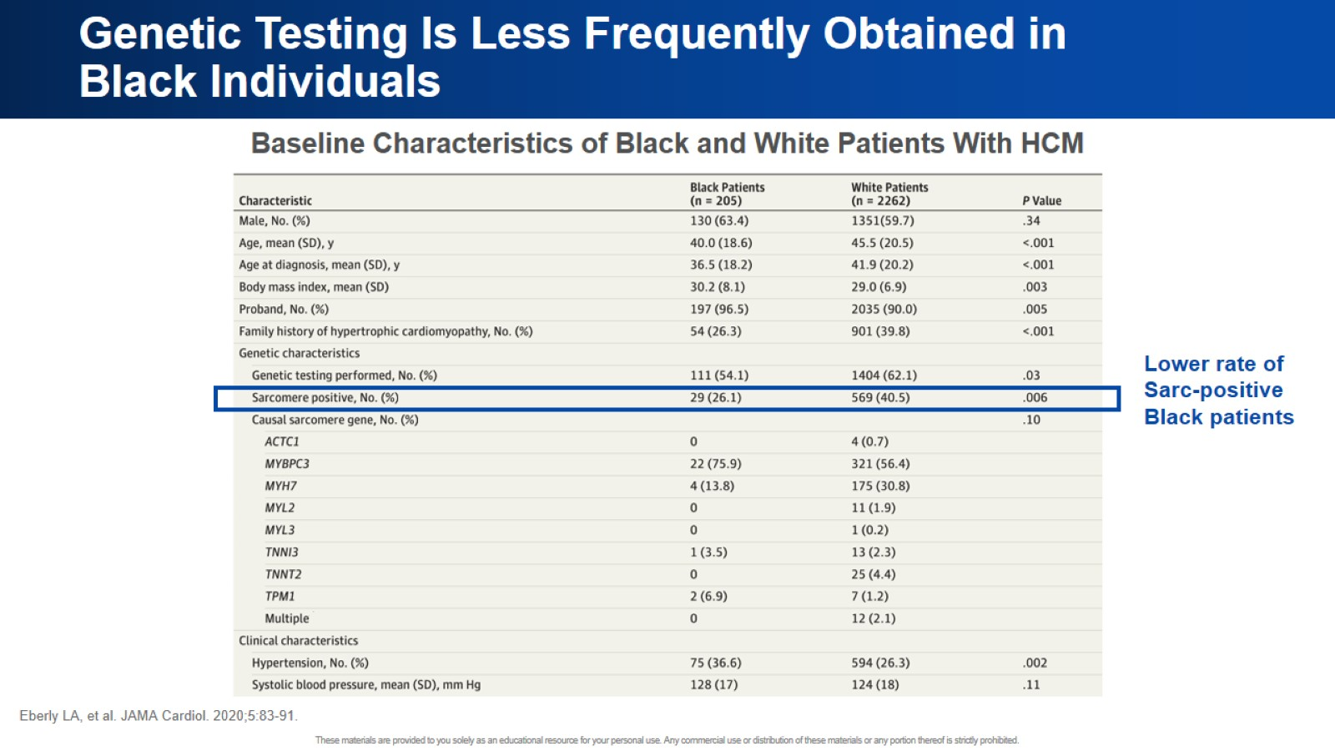
Genetic Testing Is Less Frequently Obtained in Black Individuals

Slide 36
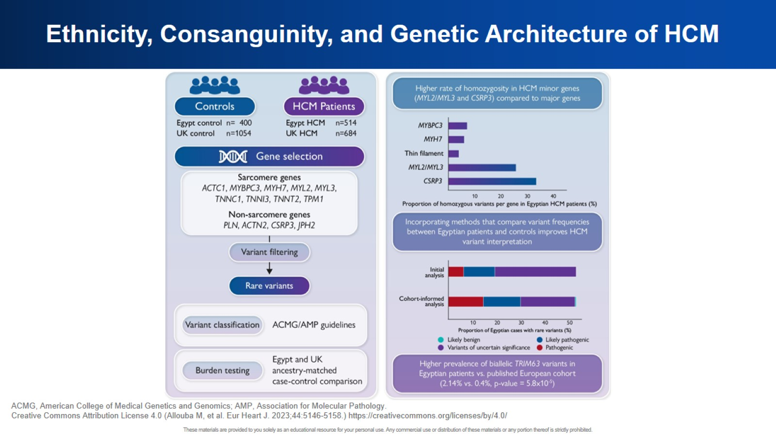
Ethnicity, Consanguinity, and Genetic Architecture of HCM

Slide 37
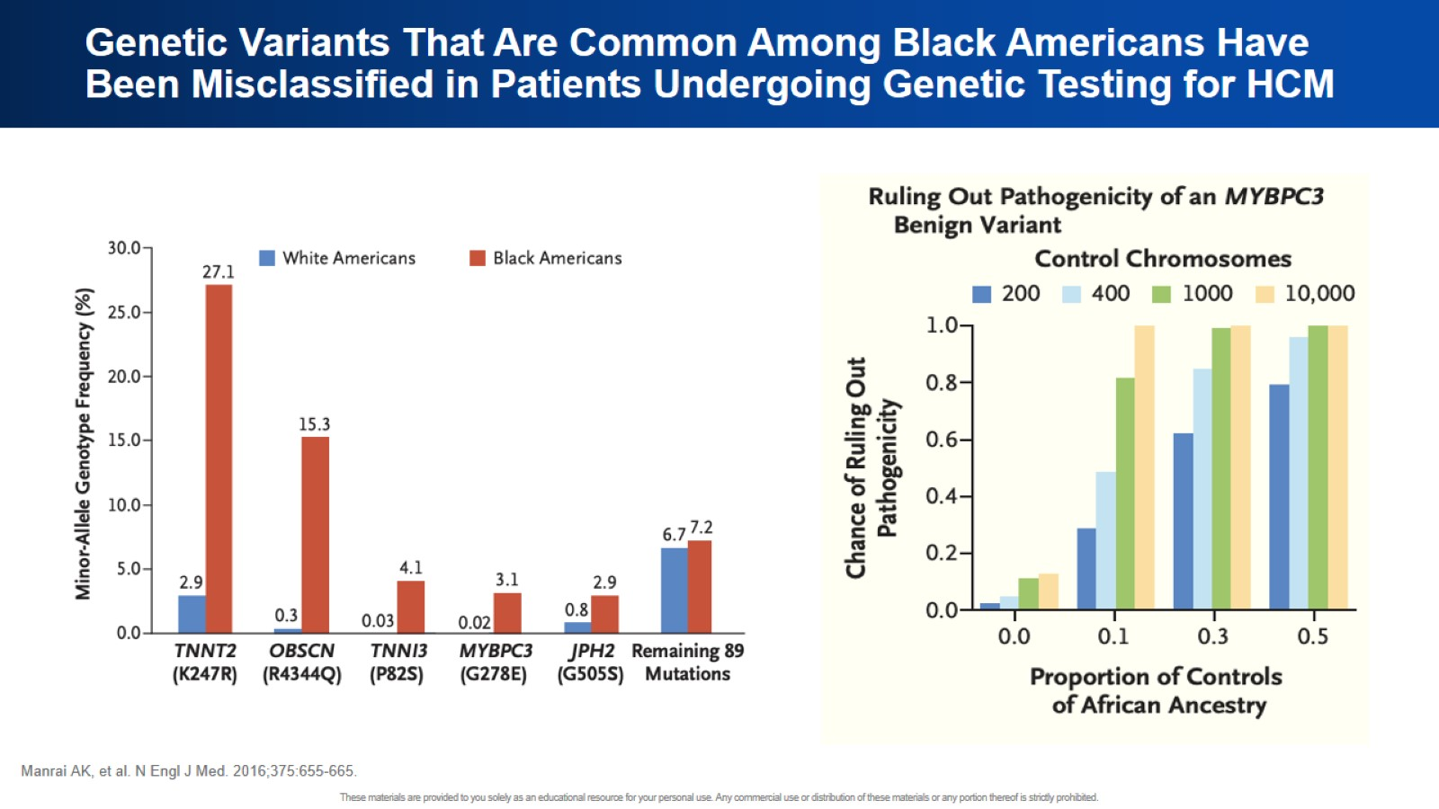
Genetic Variants That Are Common Among Black Americans Have Been Misclassified in Patients Undergoing Genetic Testing for HCM

Slide 38
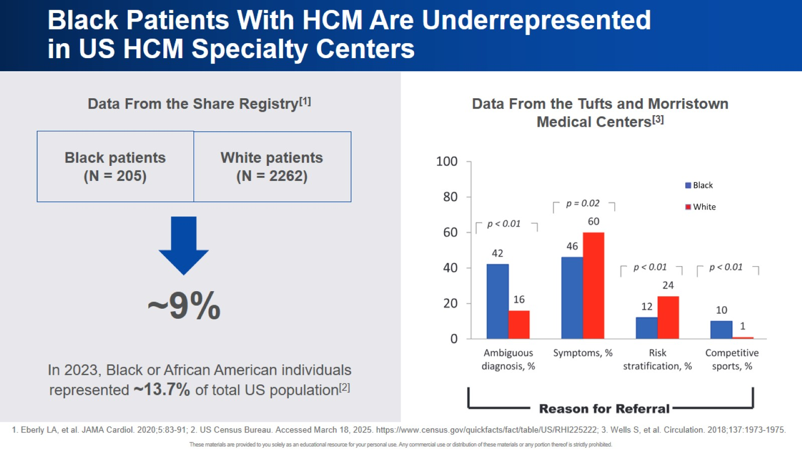
Black Patients With HCM Are Underrepresented in US HCM Specialty Centers

Slide 39
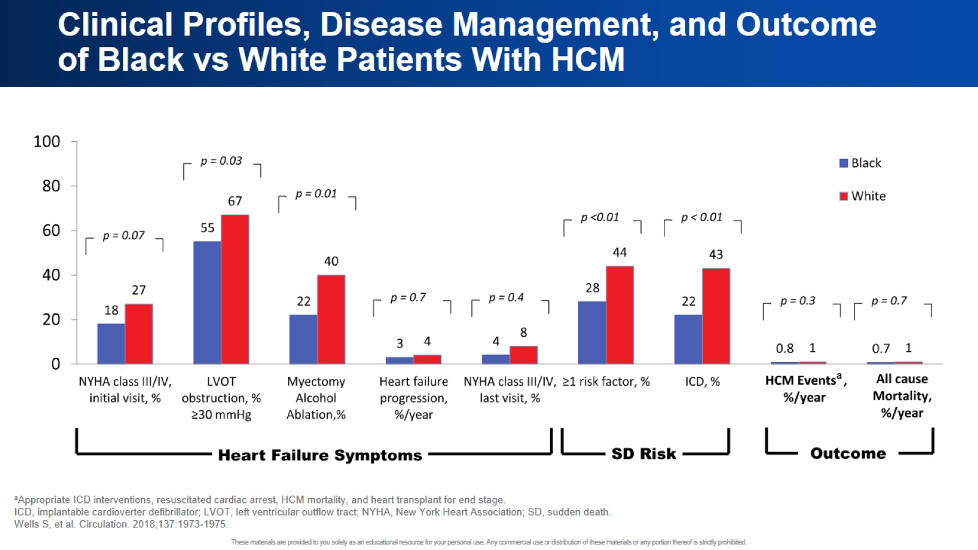
Clinical Profiles, Disease Management, and Outcome of Black vs White Patients With HCM

Slide 40
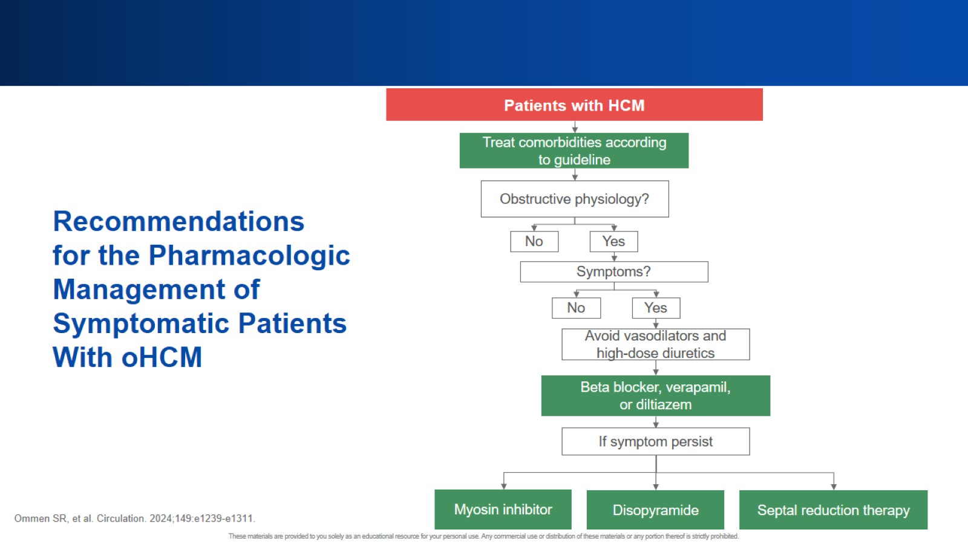

Slide 41
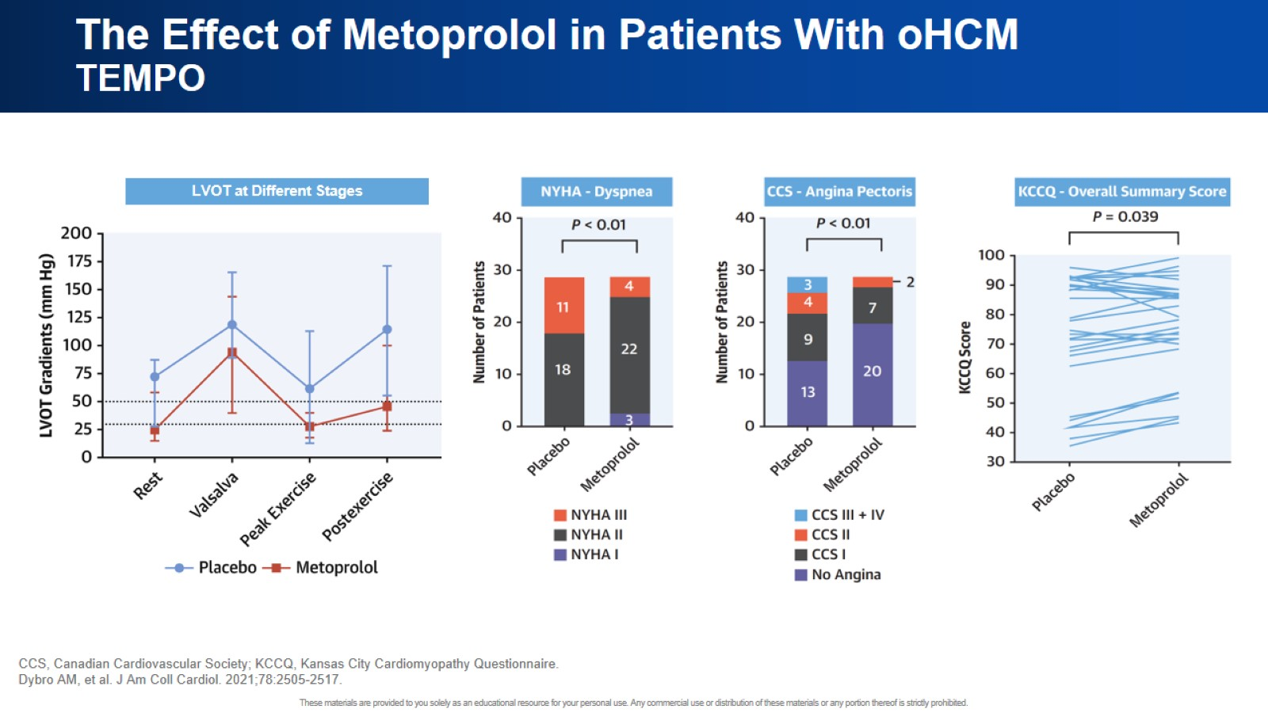
The Effect of Metoprolol in Patients With oHCM TEMPO

Slide 42
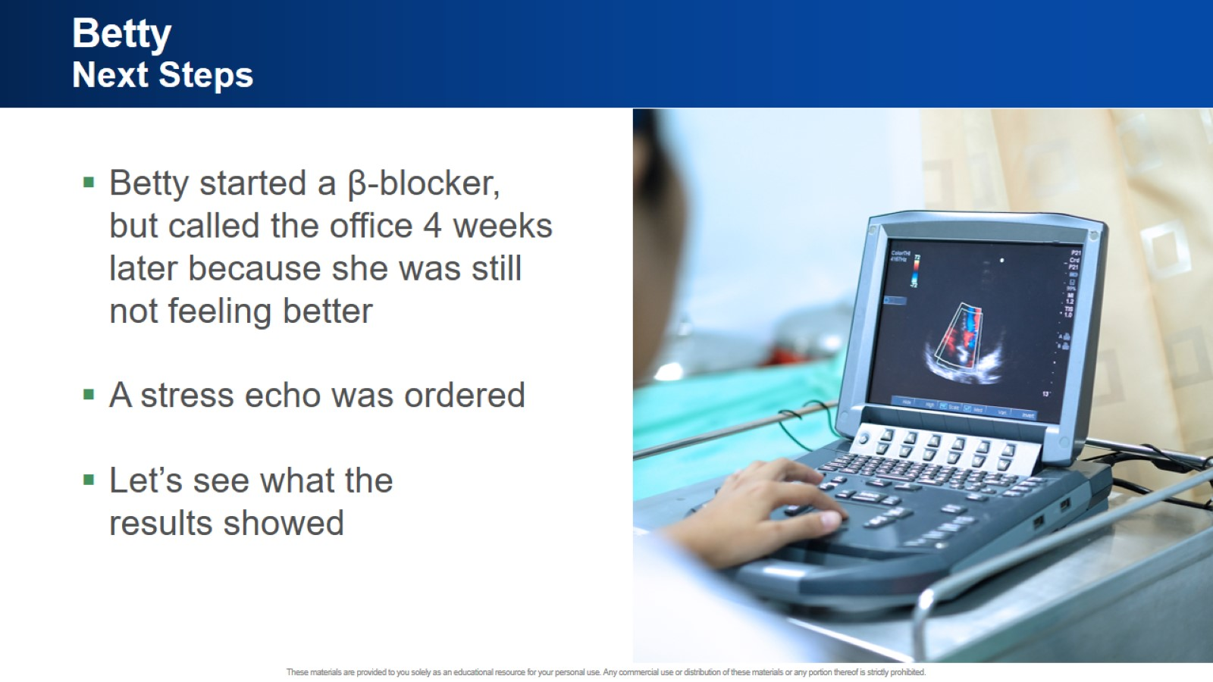
Betty Next Steps

Slide 43


Slide 44


Slide 45
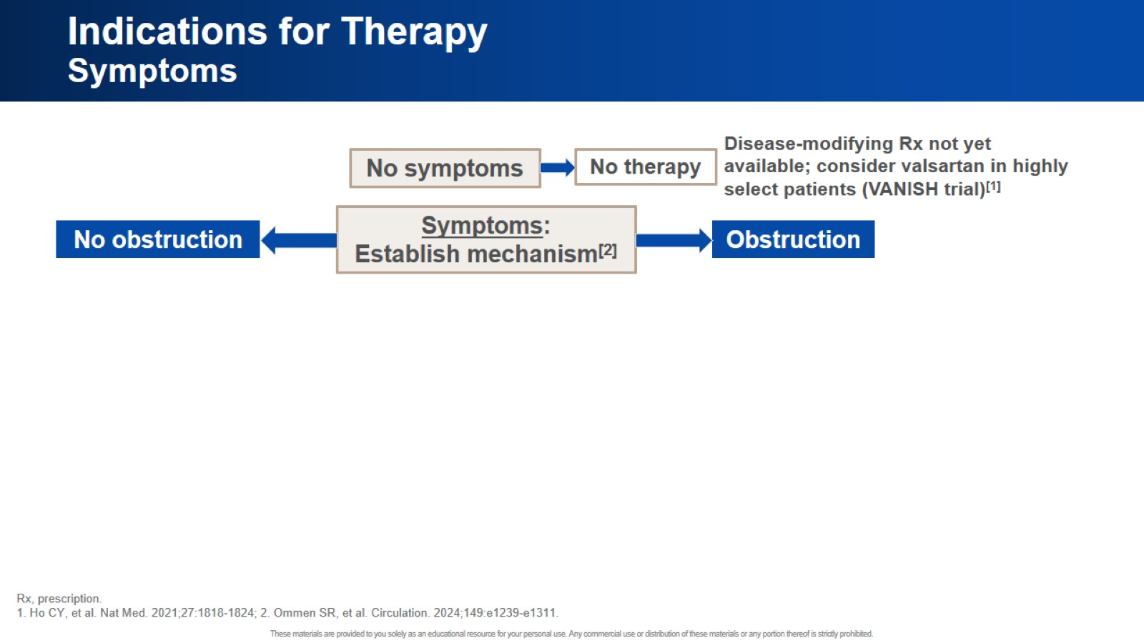
Indications for Therapy Symptoms

Slide 46
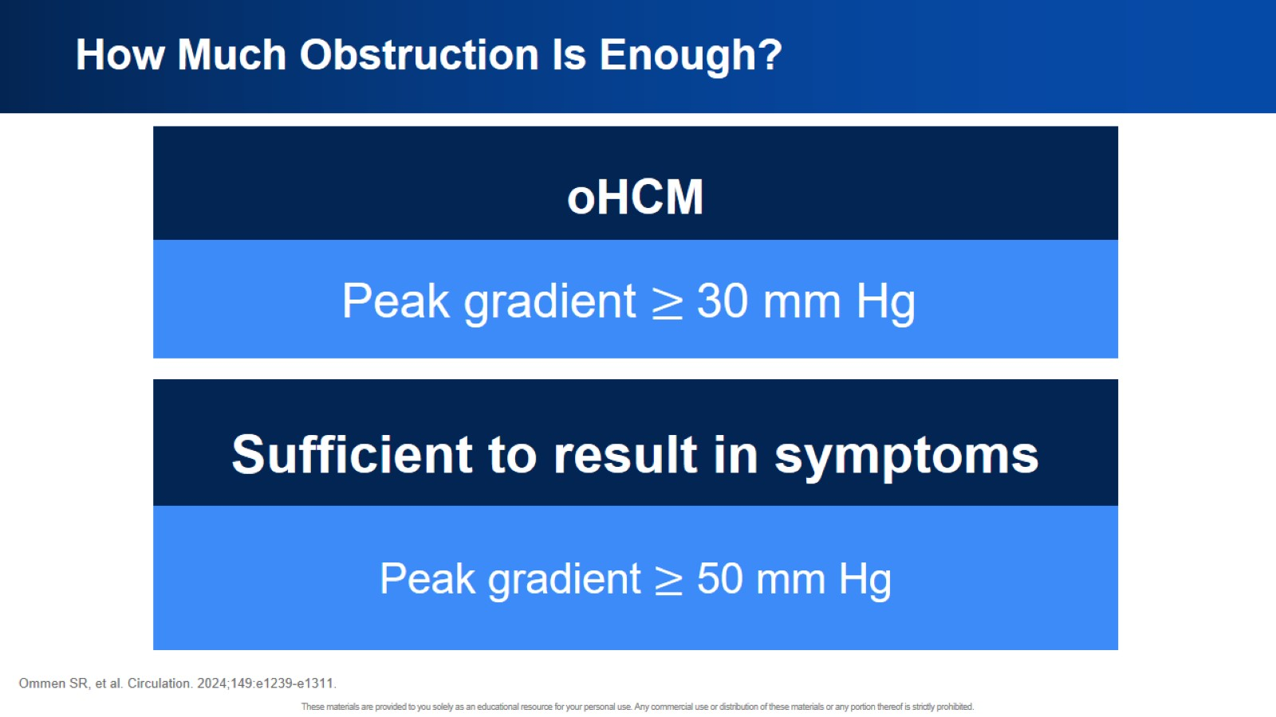
How Much Obstruction Is Enough?

Slide 47
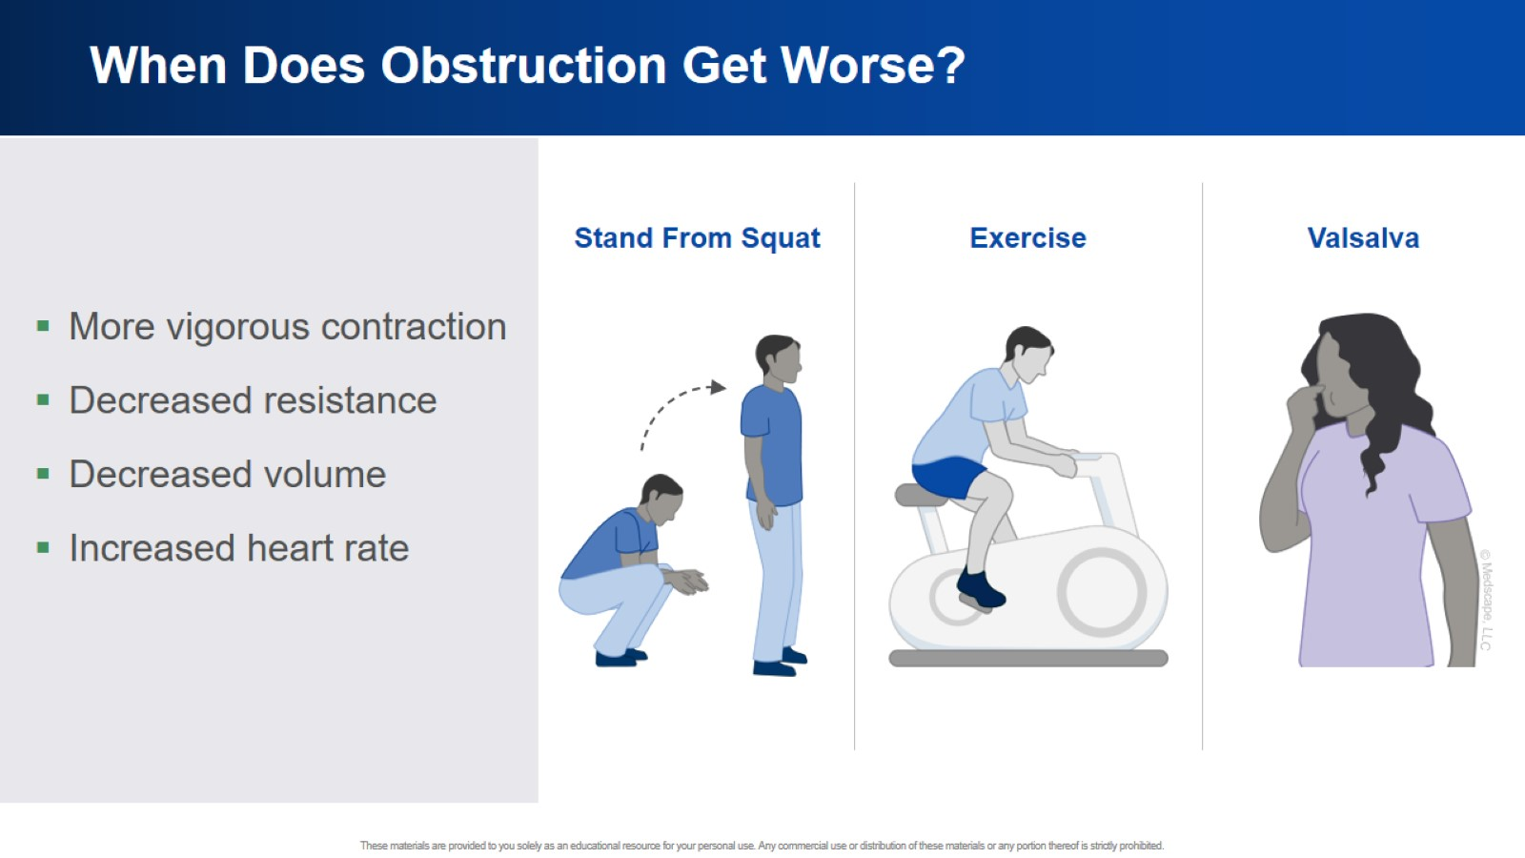
When Does Obstruction Get Worse?

Slide 48
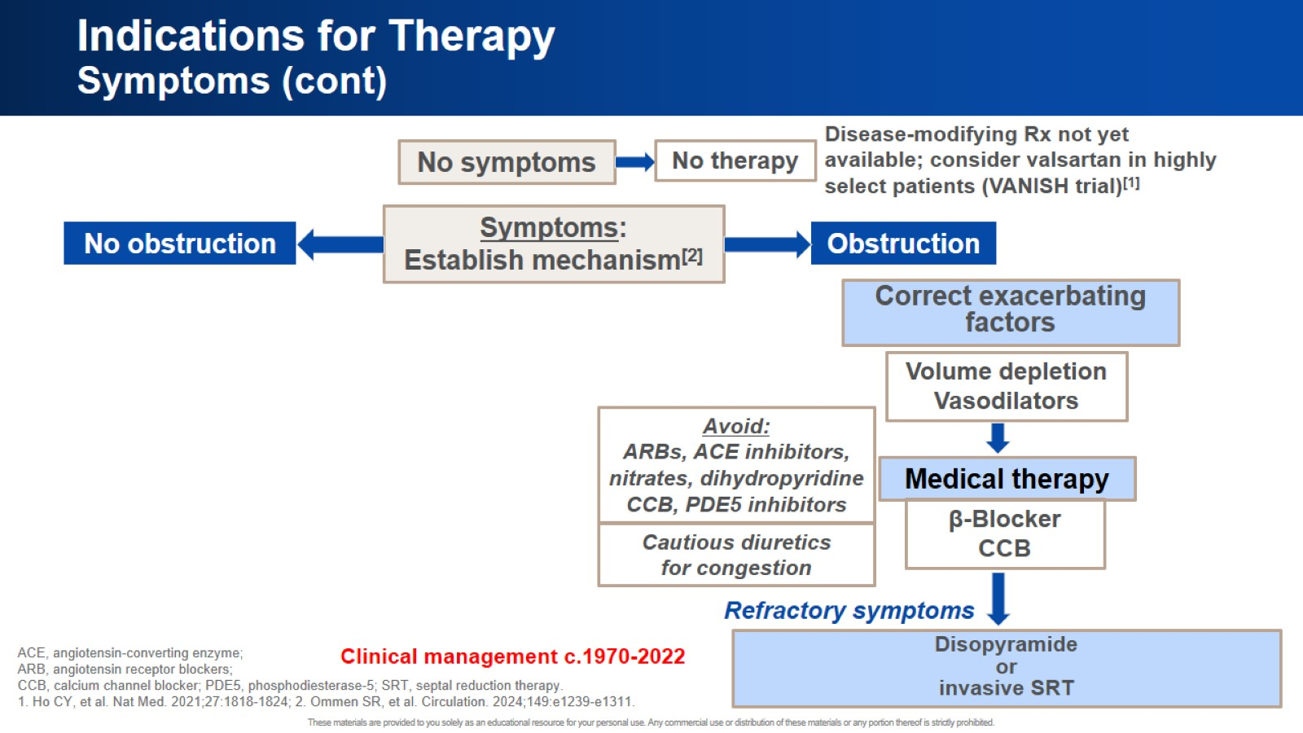
Indications for Therapy Symptoms (cont)

Slide 49

What Have We Learned About Disease Mechanism?

Slide 50
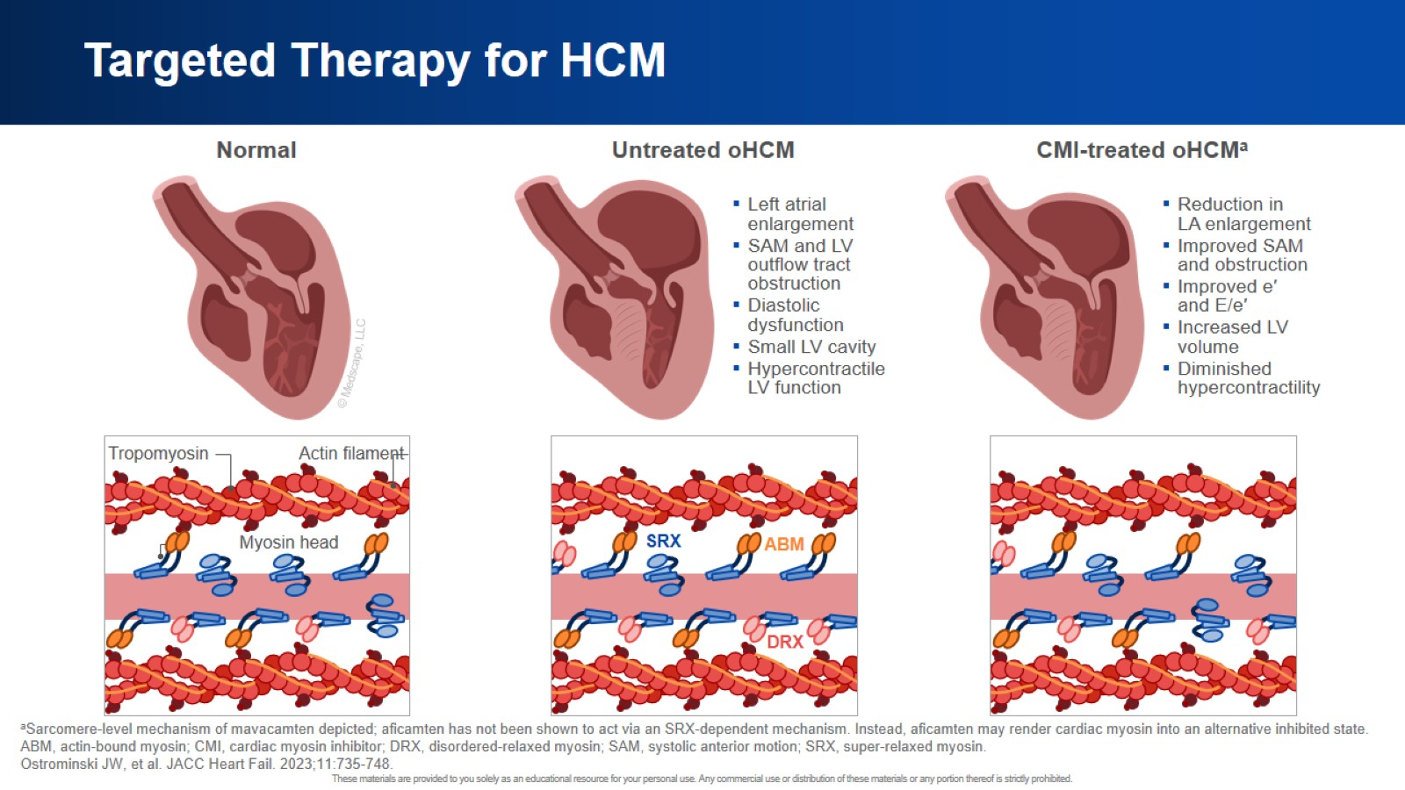
Targeted Therapy for HCM

Slide 51
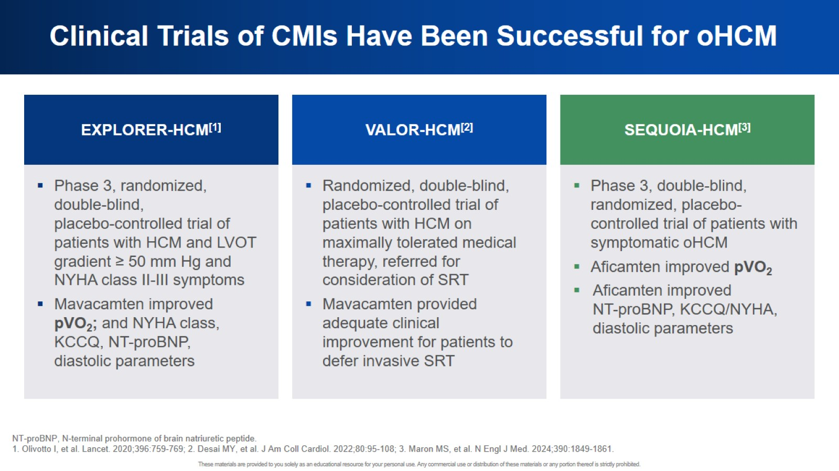
Clinical Trials of CMIs Have Been Successful for oHCM

Slide 52
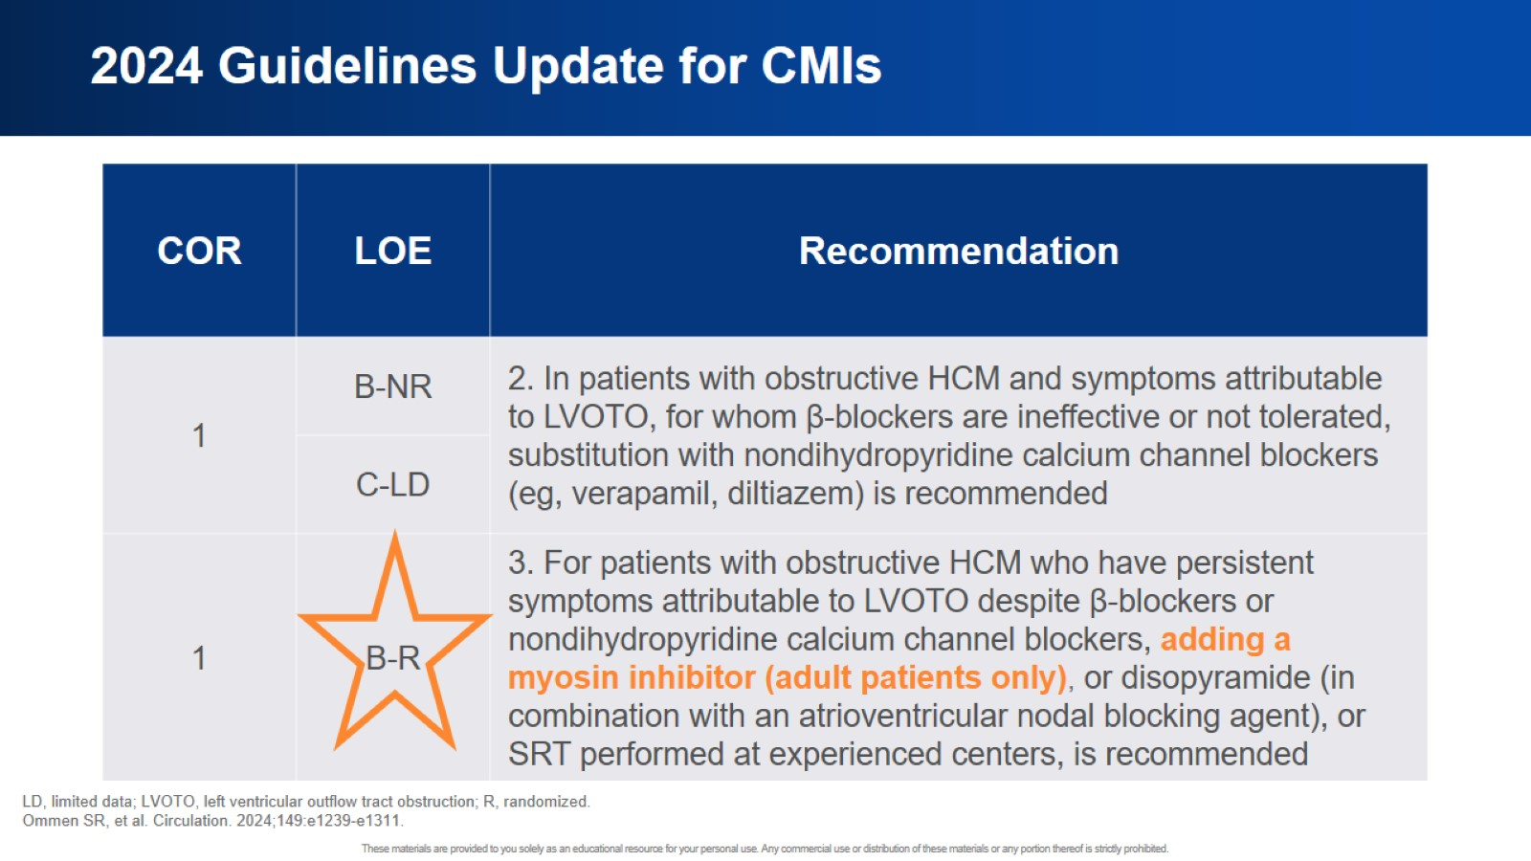
2024 Guidelines Update for CMIs

Slide 53
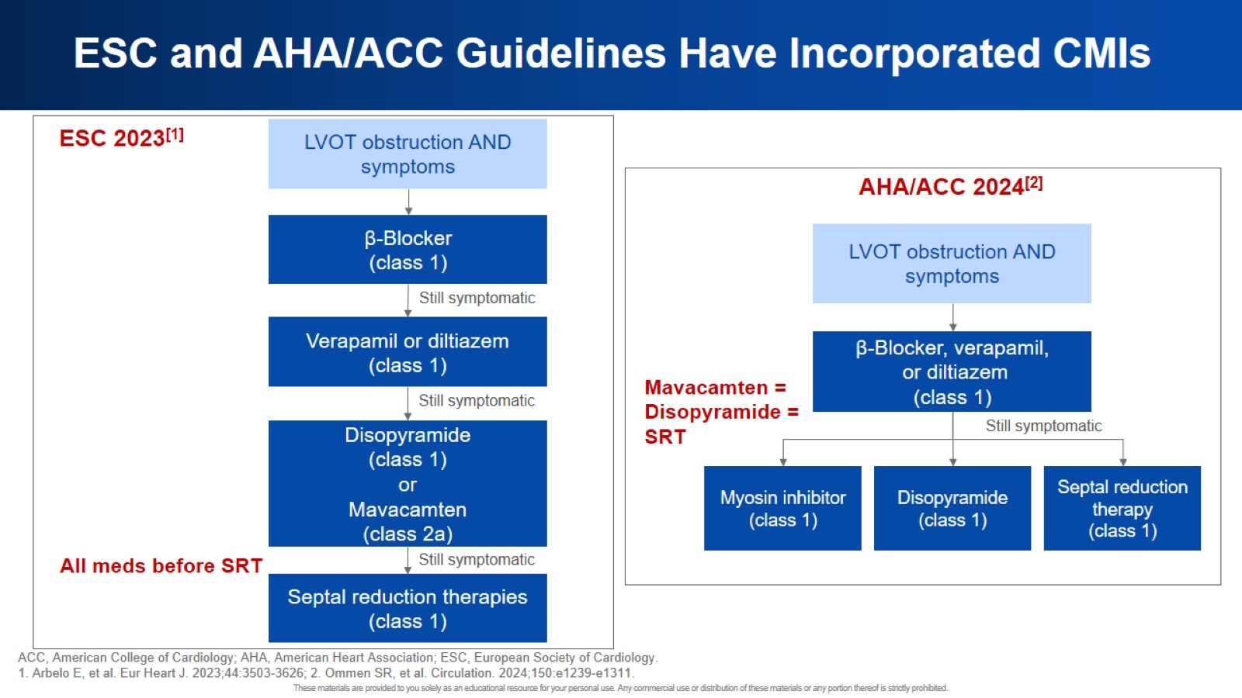
ESC and AHA/ACC Guidelines Have Incorporated CMIs

Slide 54
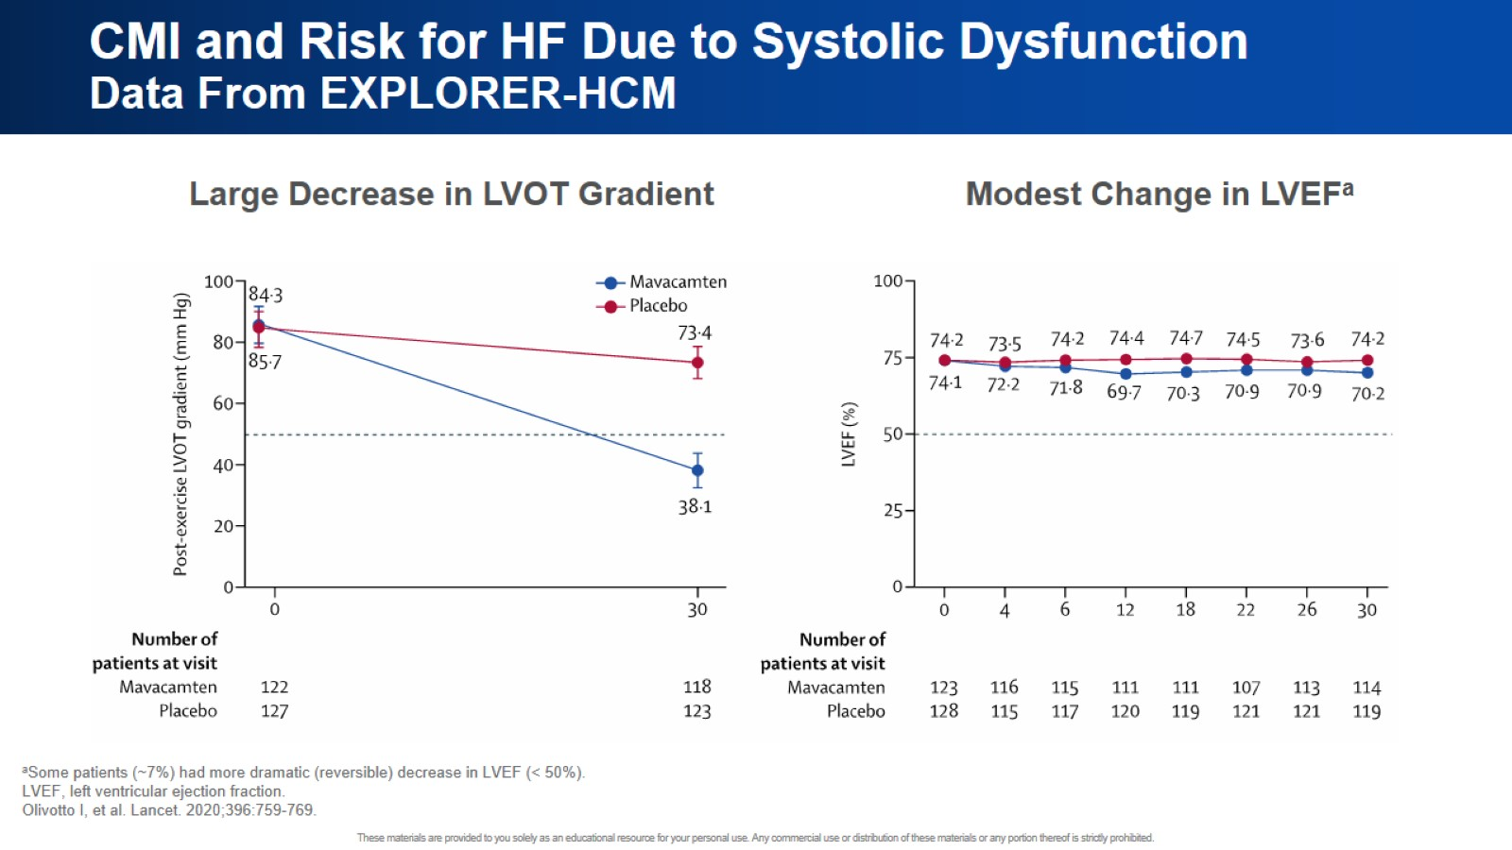
CMI and Risk for HF Due to Systolic Dysfunction Data From EXPLORER-HCM

Slide 55
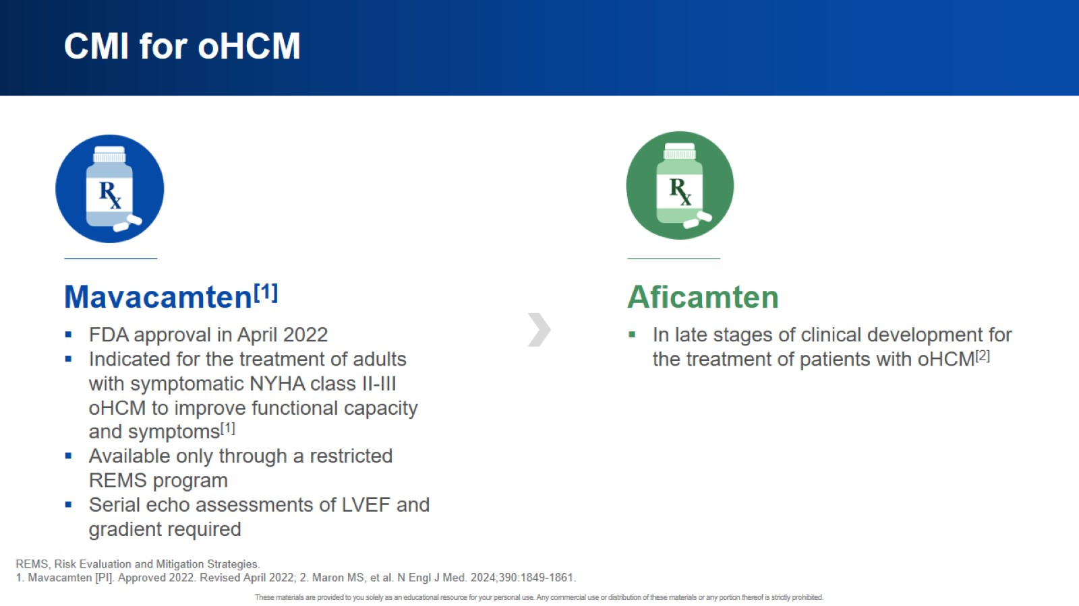
CMI for oHCM

Slide 56
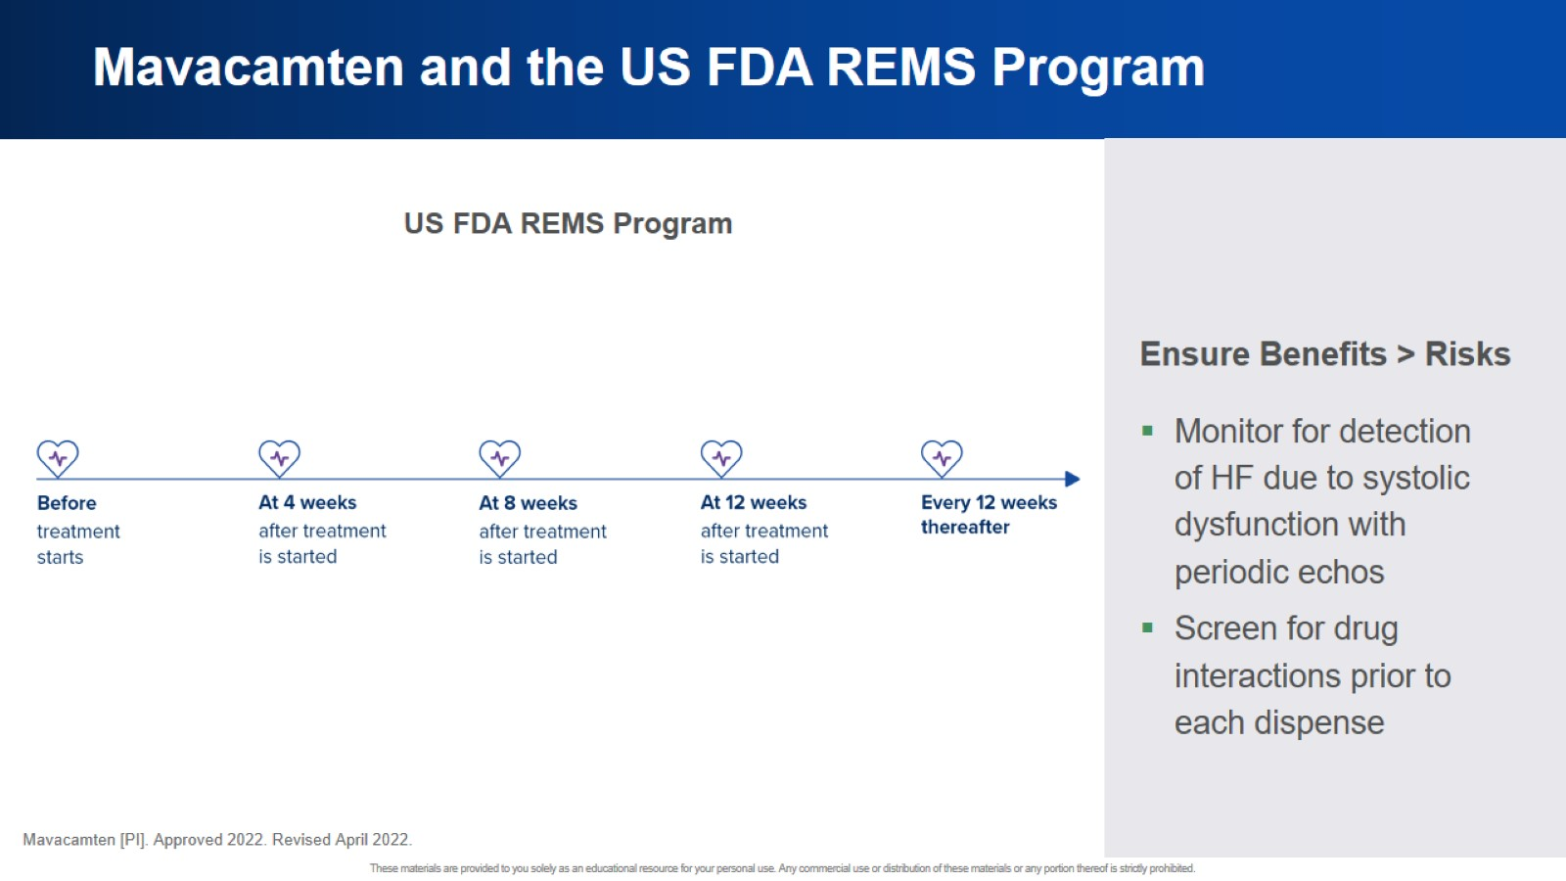
Mavacamten and the US FDA REMS Program

Slide 57
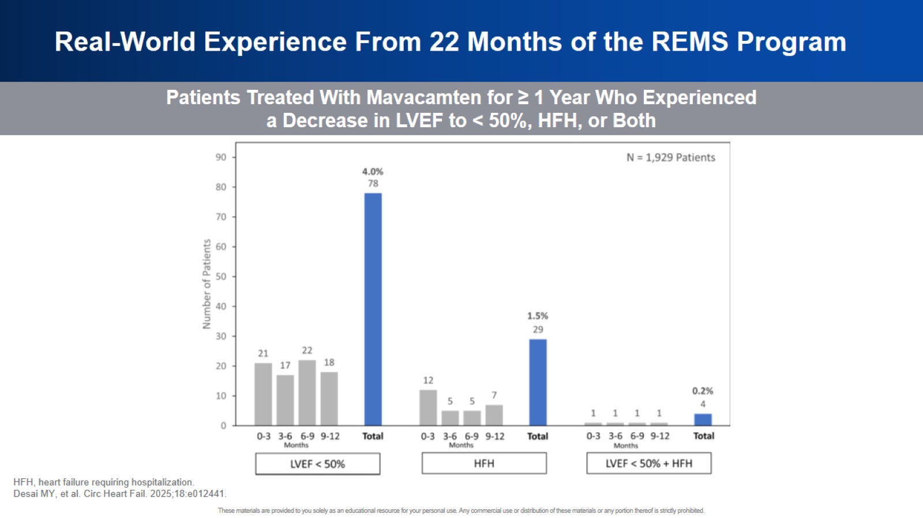
Real-World Experience From 22 Months of the REMS Program

Slide 58
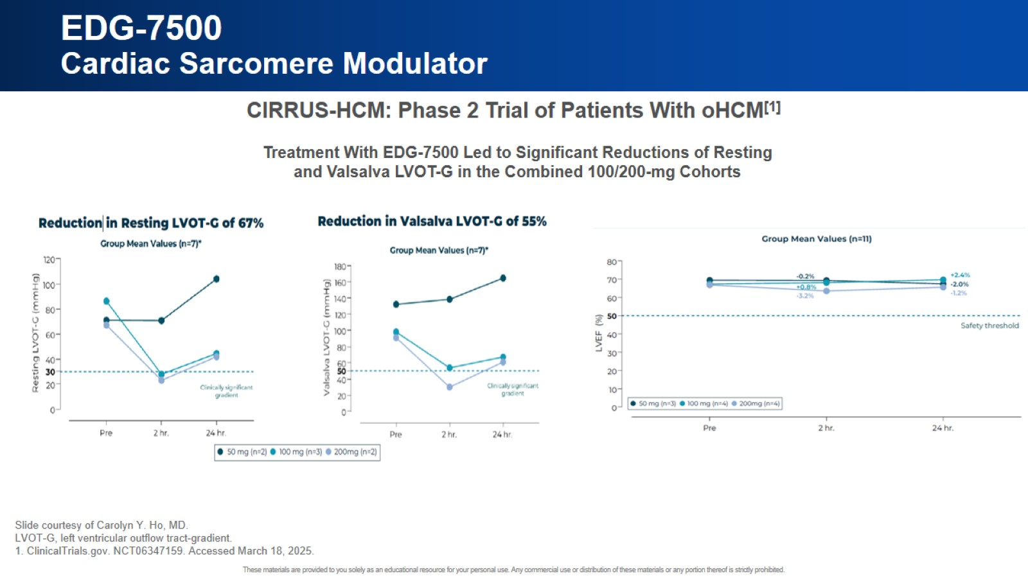
EDG-7500 Cardiac Sarcomere Modulator

Slide 59
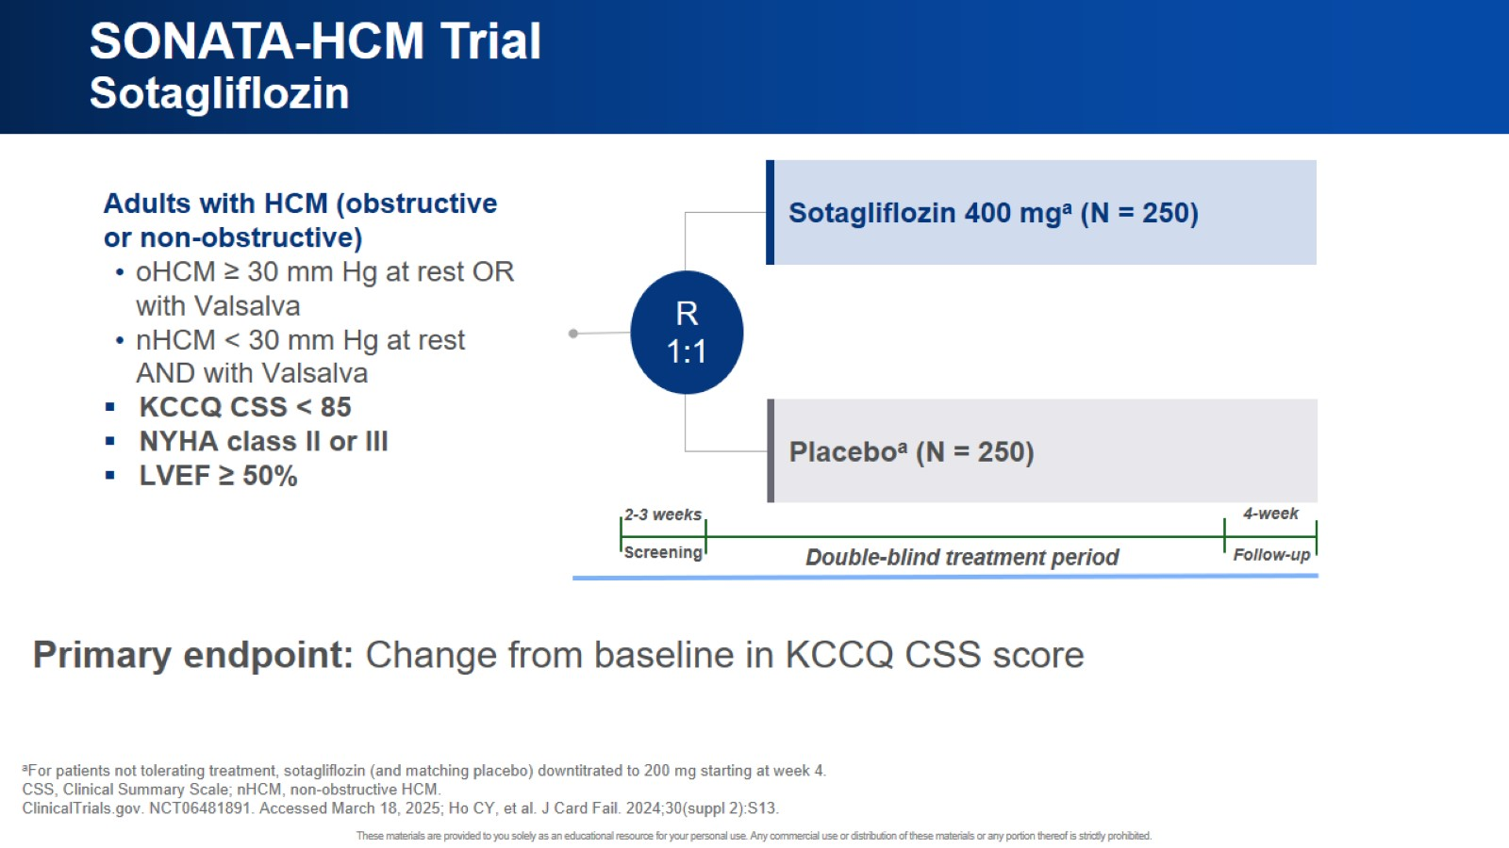
SONATA-HCM Trial Sotagliflozin

Slide 60

Challenges to Equitable Care and Access Resources

Slide 61
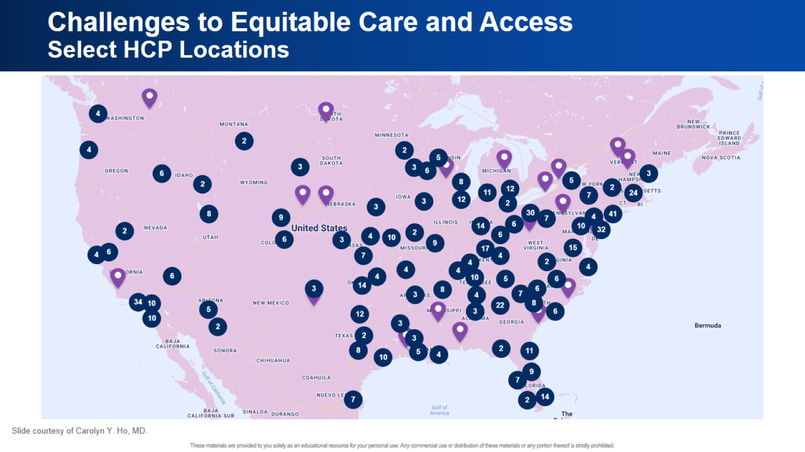
Challenges to Equitable Care and Access Select HCP Locations

Slide 62

Potential Strategies to Improve Equitability

Slide 63


Slide 64


Slide 65

Jennifer

Slide 66

Jennifer

Slide 67

Shared Decision-Making in HCM

Slide 68

Management of oHCM

Slide 69

Discussion With Jennifer

Slide 70


Slide 71

Black Patients With HCM and Those on Medicaid Have Lower Referral Rates for SRTs

Slide 72


Slide 73

George

Slide 74

George History of Present Illness

Slide 75

George Echo

Slide 76

George Genetic Testing Results

Slide 77

Few Therapeutic Options for nHCM

Slide 78

MAVERICK-HCM Trial Phase 2 Study With Mavacamten in nHCM

Slide 79

REDWOOD-HCM Trial, Cohort 4 Phase 2 Study in Patients With nHCM

Slide 80

New Data at ACC!

Slide 81

Ongoing Phase 3 Studies With CMIs in Patients With nHCM

Slide 82


Slide 83


Slide 84

Overcoming Barriers to Equitable Care

Slide 85

Shared Decision-Making for Individuals Experiencing Disadvantage

Slide 86


Slide 87

Overcoming Barriers to Equitable Care

Slide 88


Slide 89

Shared Care With Colleagues

Slide 90

Patients Are More Satisfied When Physicians Work Together

Slide 91


Slide 92

Supporting Access to CMI

Slide 93


