Slide 1


Slide 2
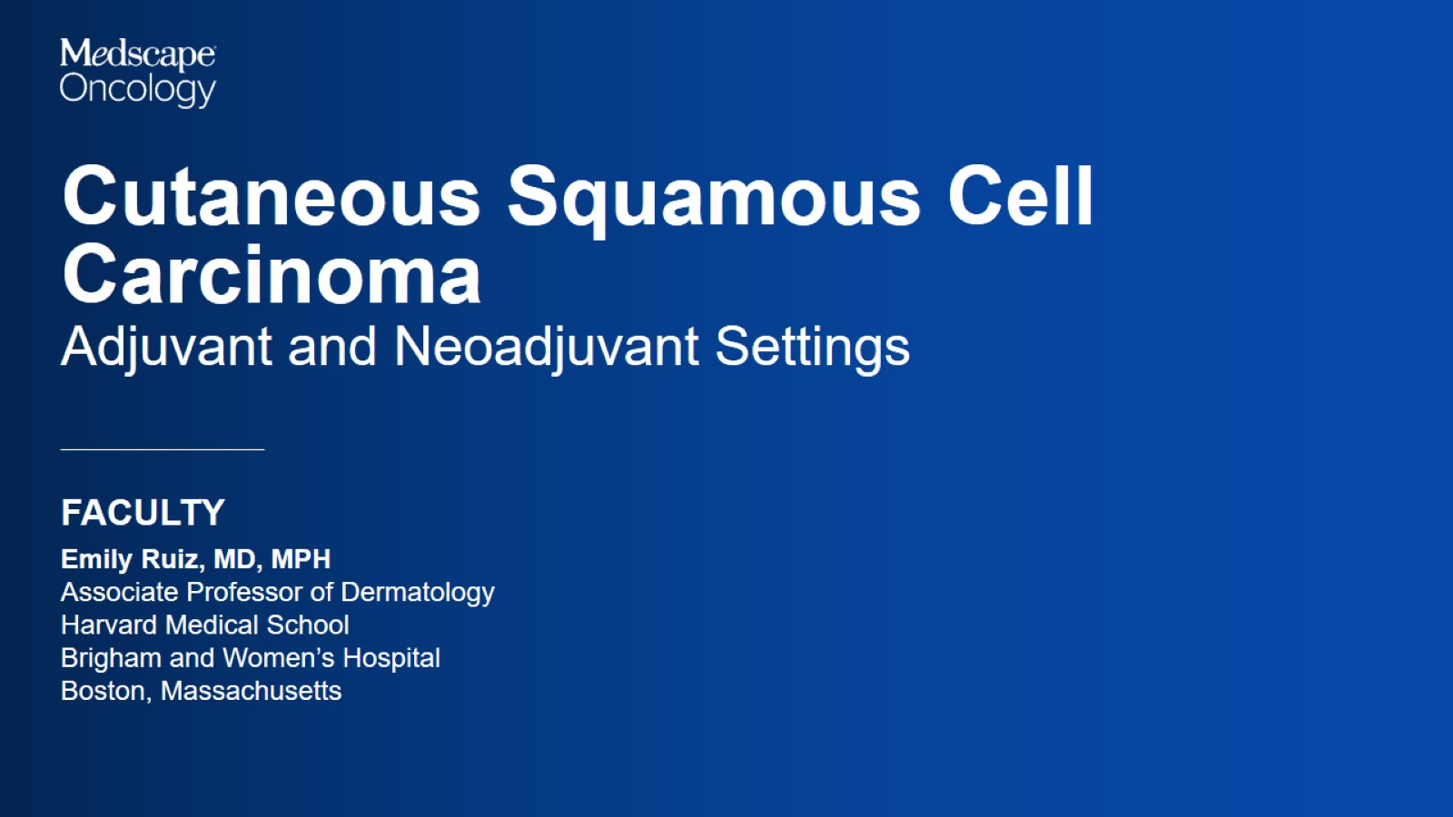

Slide 3
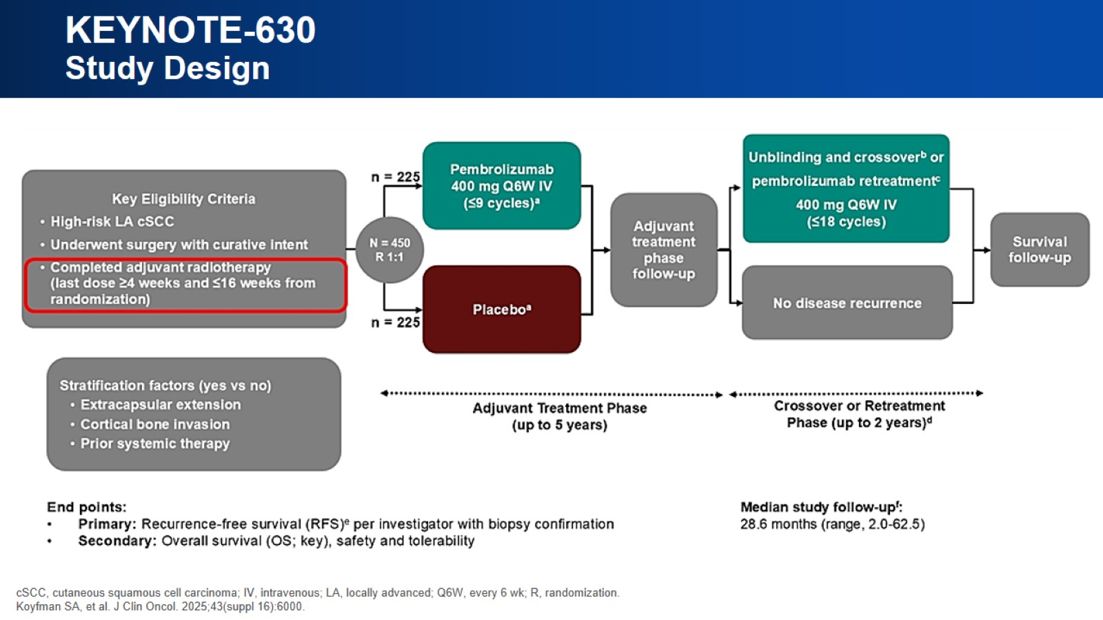
KEYNOTE-630 Study Design

Slide 4
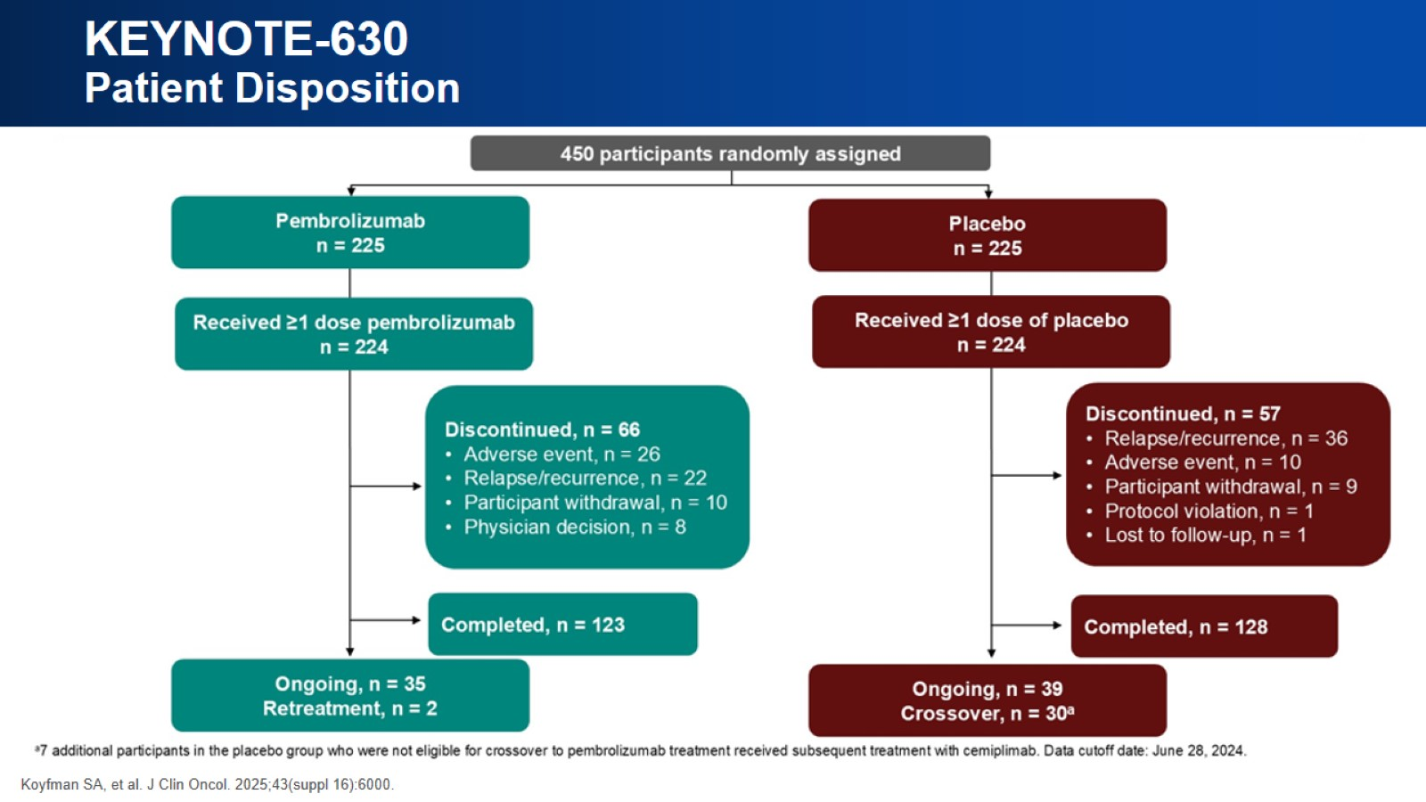
KEYNOTE-630 Patient Disposition

Slide 5
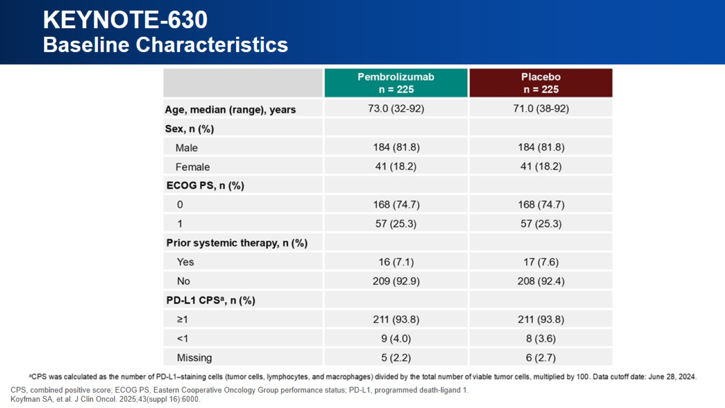
KEYNOTE-630 Baseline Characteristics

Slide 6
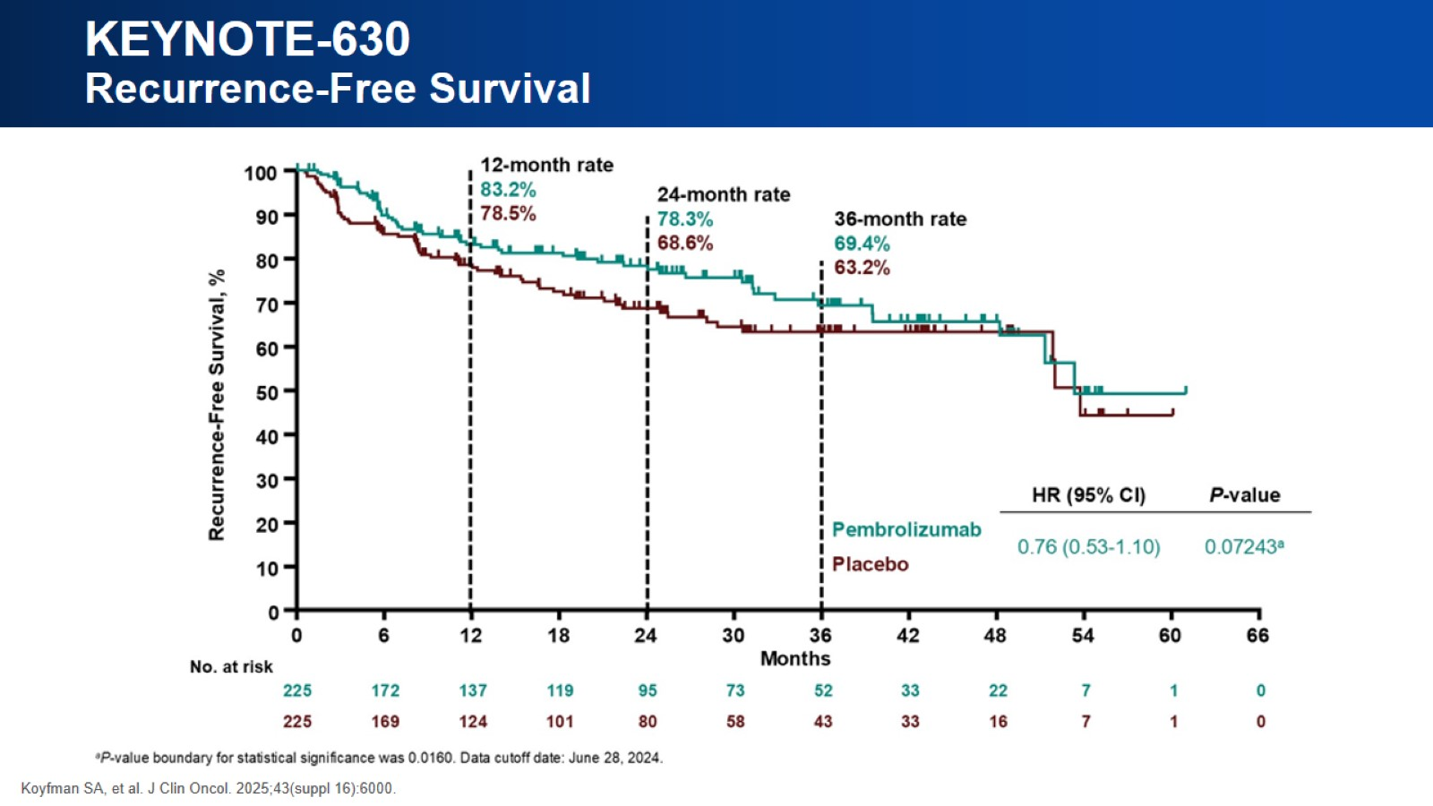
KEYNOTE-630 Recurrence-Free Survival

Slide 7
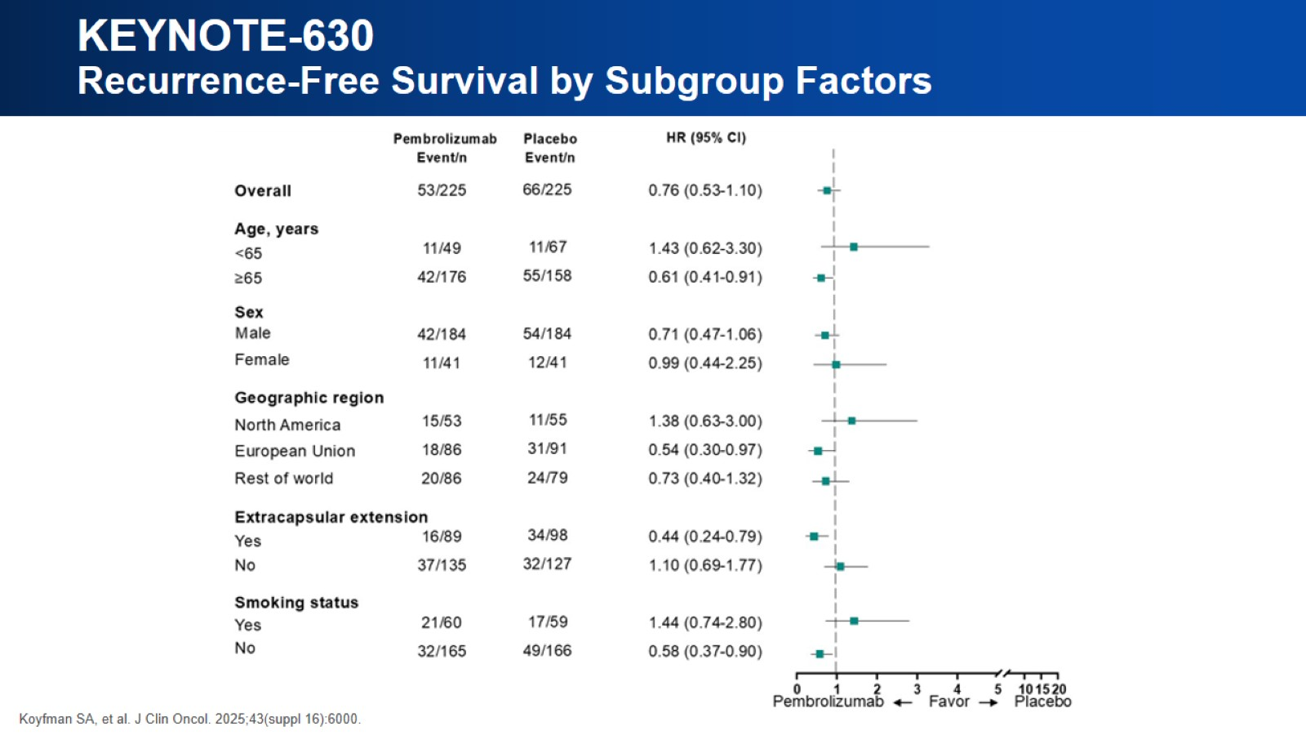
KEYNOTE-630 Recurrence-Free Survival by Subgroup Factors

Slide 8
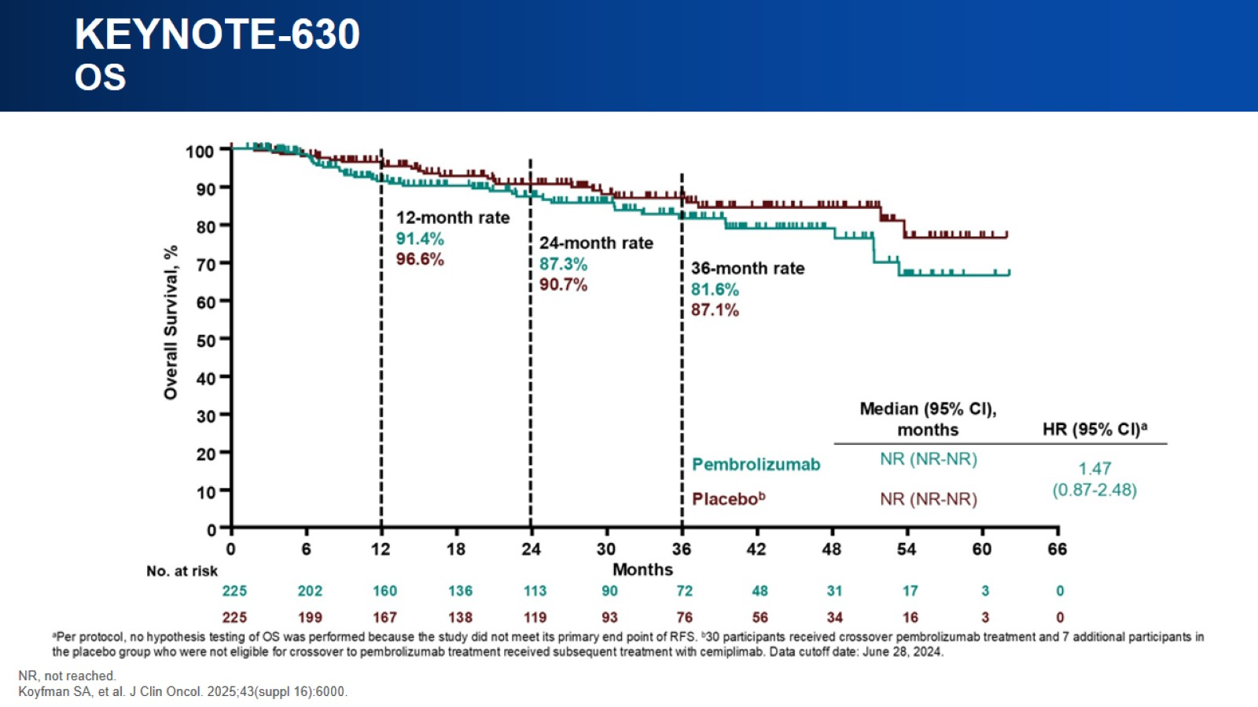
KEYNOTE-630 OS

Slide 9
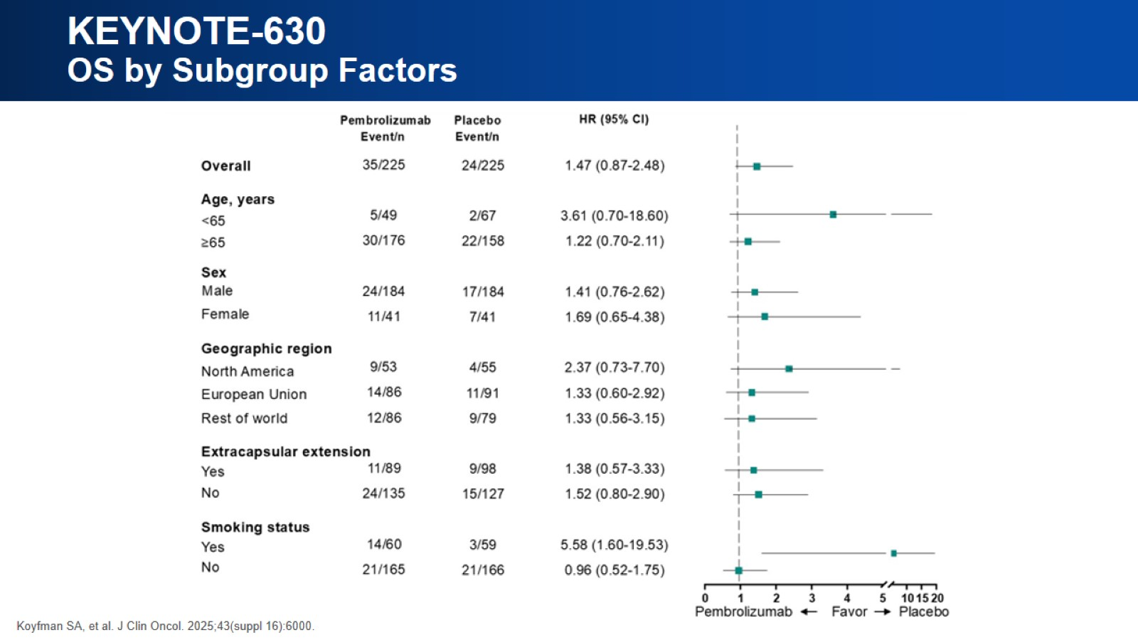
KEYNOTE-630 OS by Subgroup Factors

Slide 10
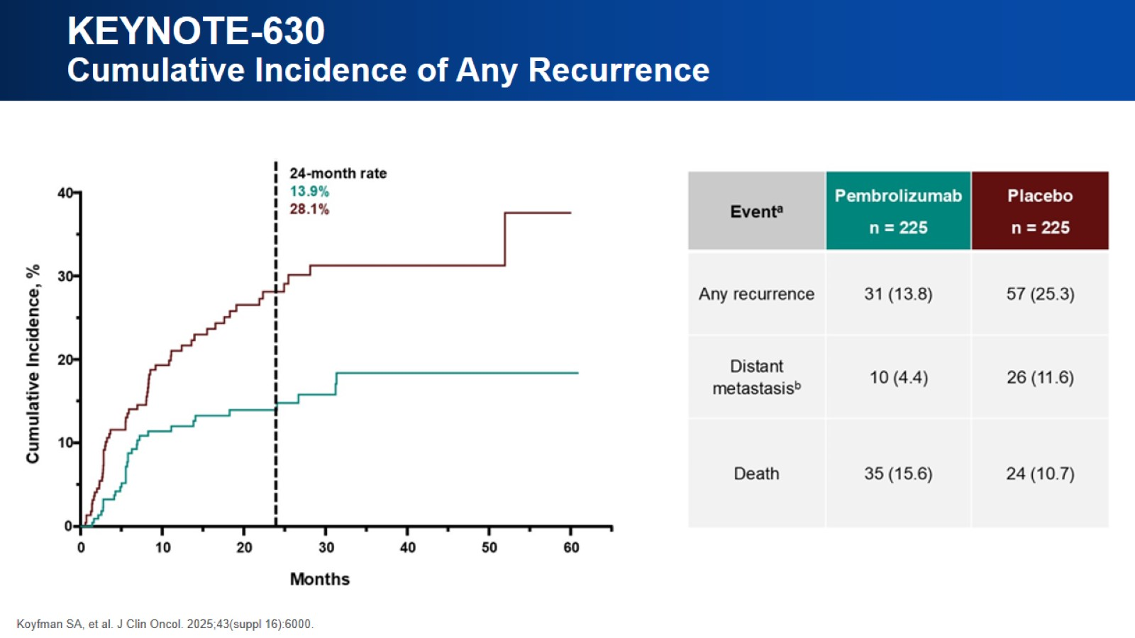
KEYNOTE-630 Cumulative Incidence of Any Recurrence

Slide 11
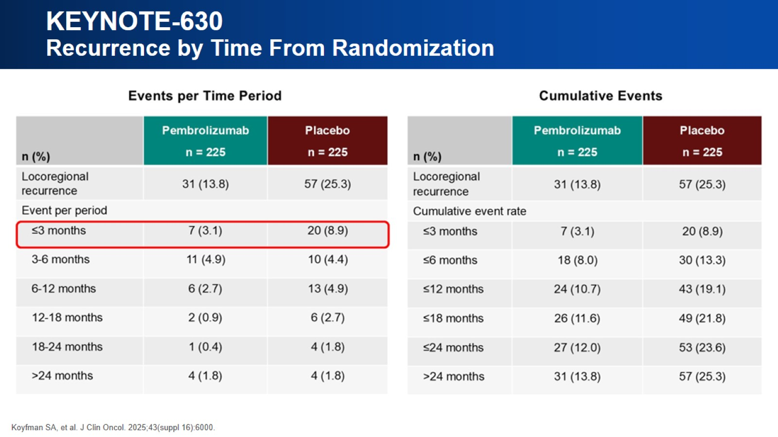
KEYNOTE-630 Recurrence by Time From Randomization

Slide 12
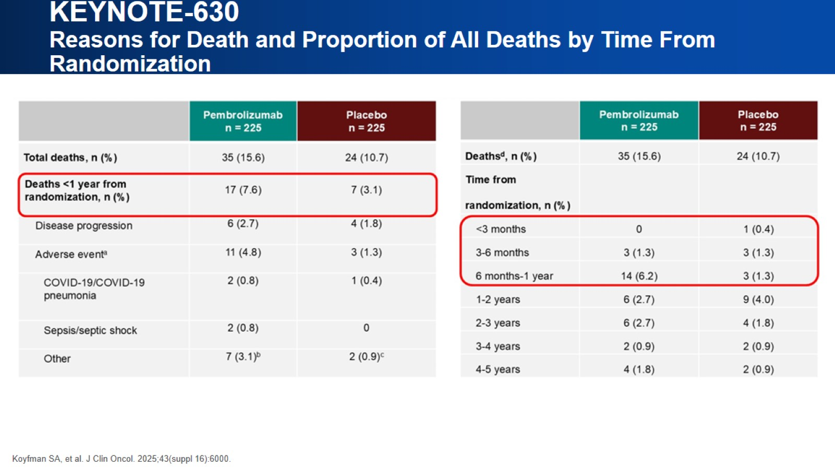
KEYNOTE-630 Reasons for Death and Proportion of All Deaths by Time From Randomization

Slide 13
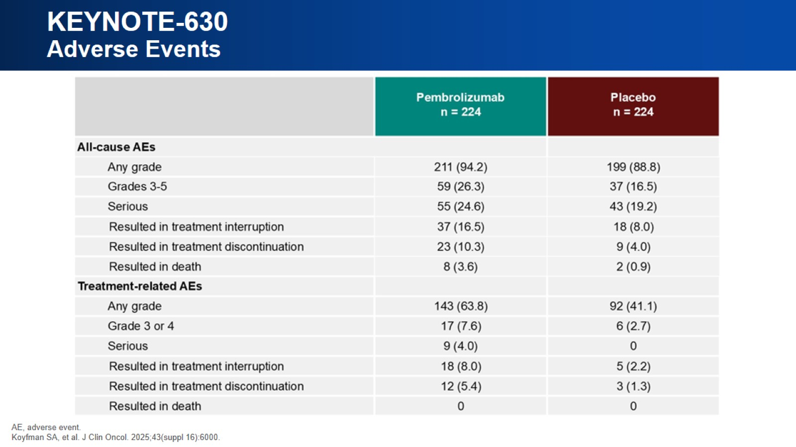
KEYNOTE-630 Adverse Events

Slide 14
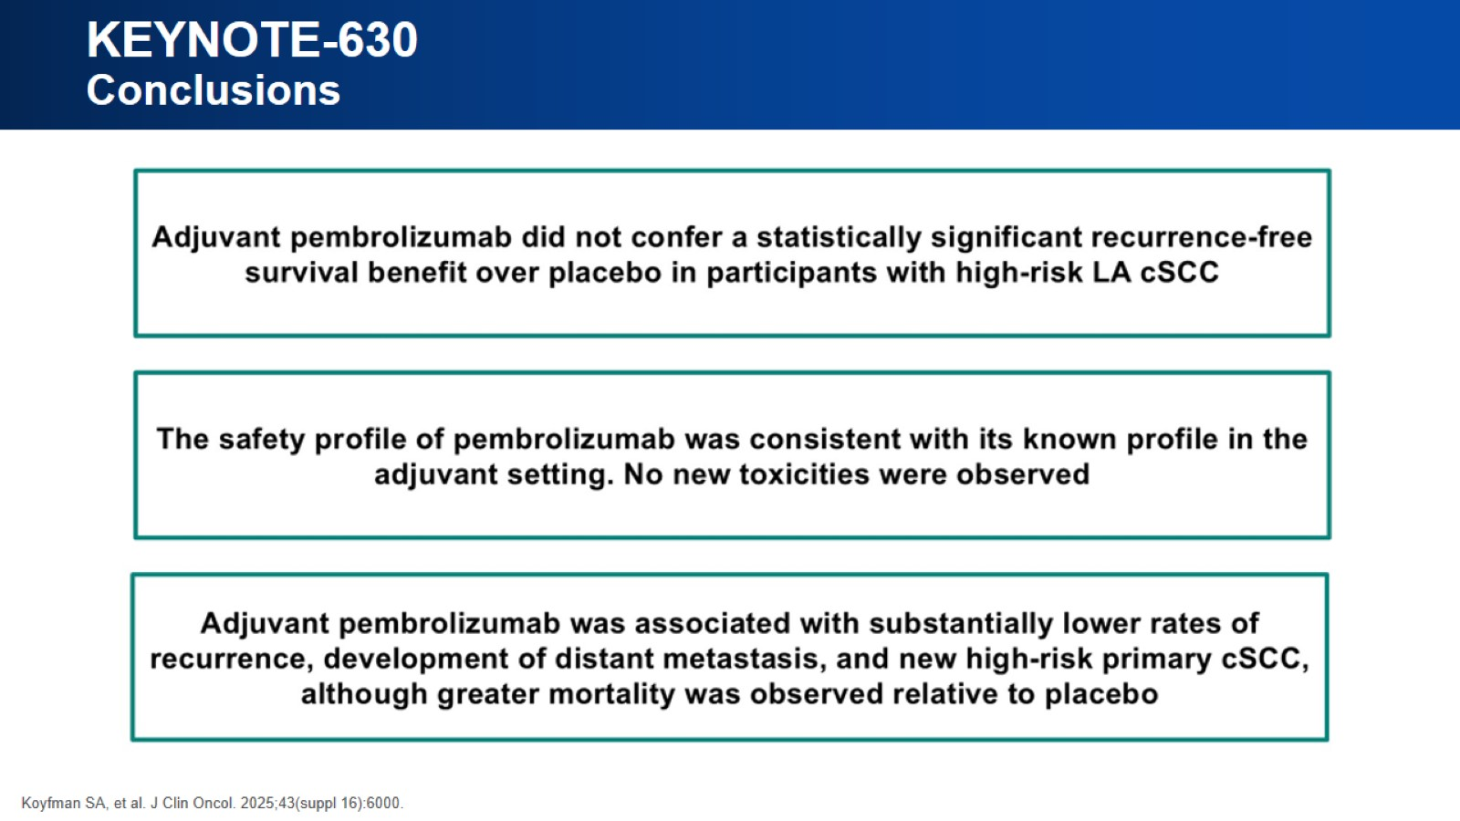
KEYNOTE-630 Conclusions

Slide 15
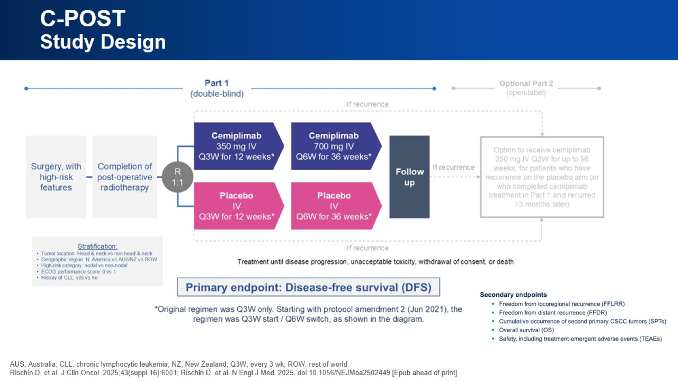
C-POST Study Design

Slide 16
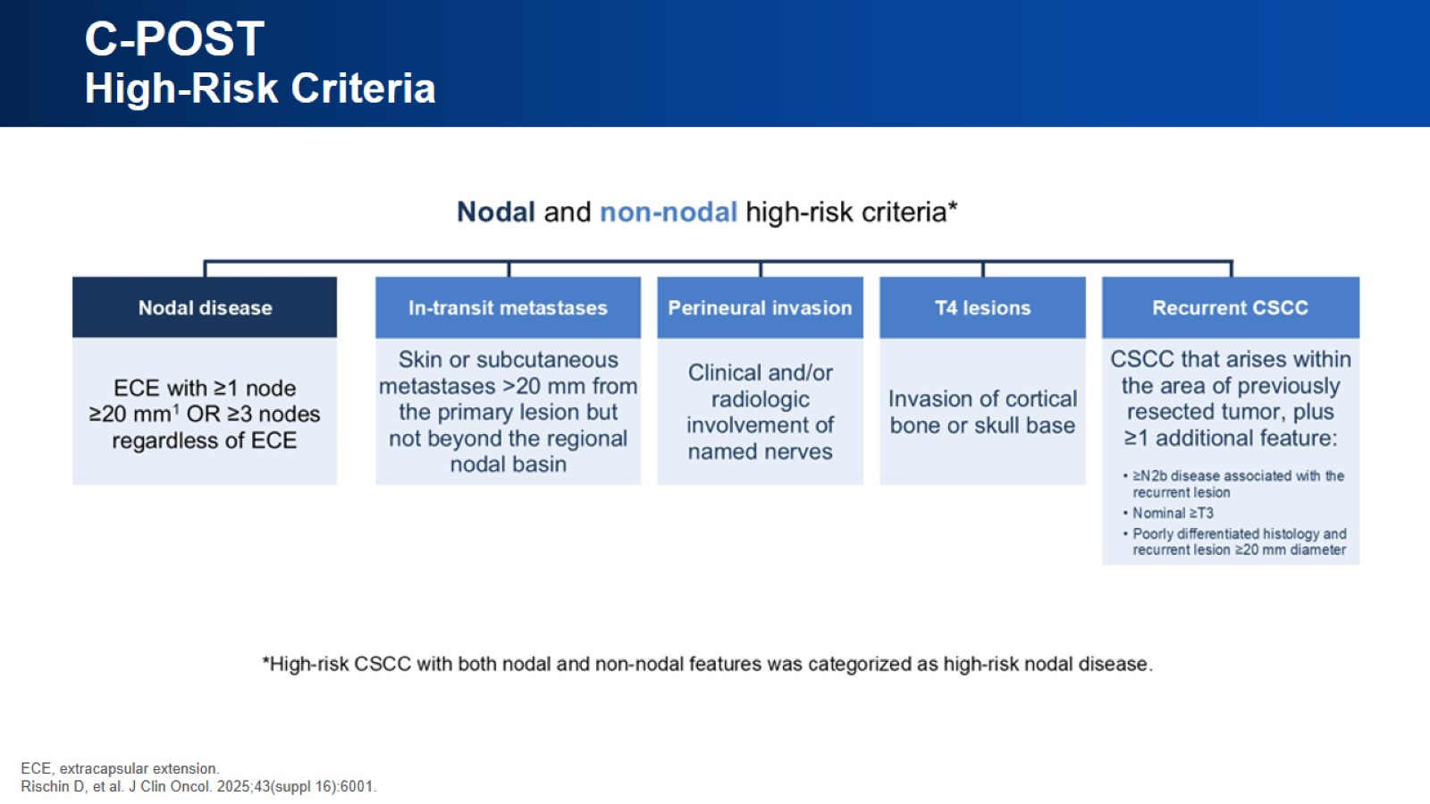
C-POST High-Risk Criteria

Slide 17
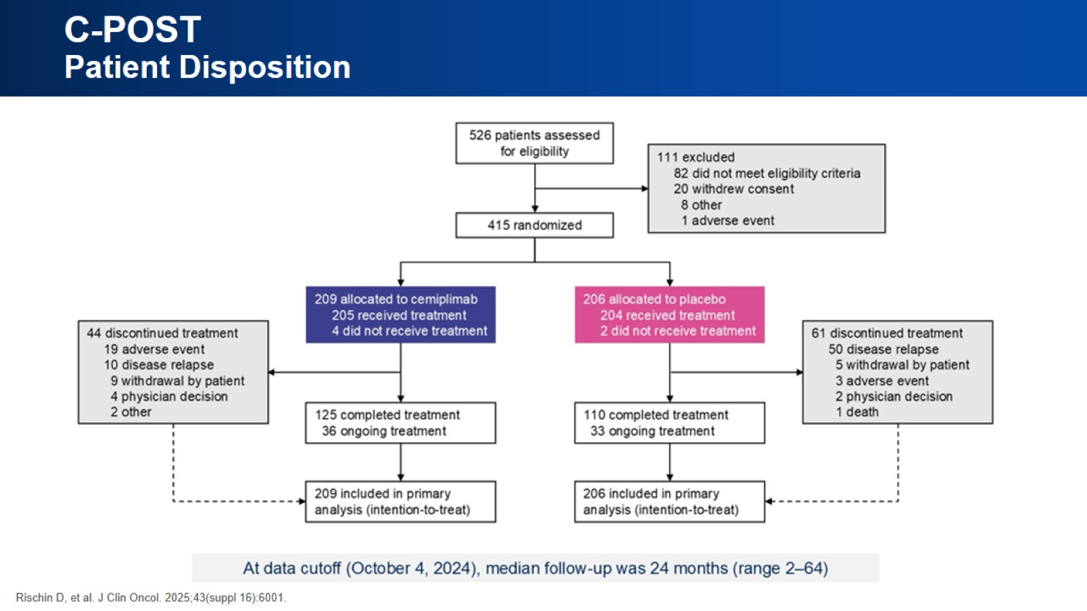
C-POST Patient Disposition

Slide 18
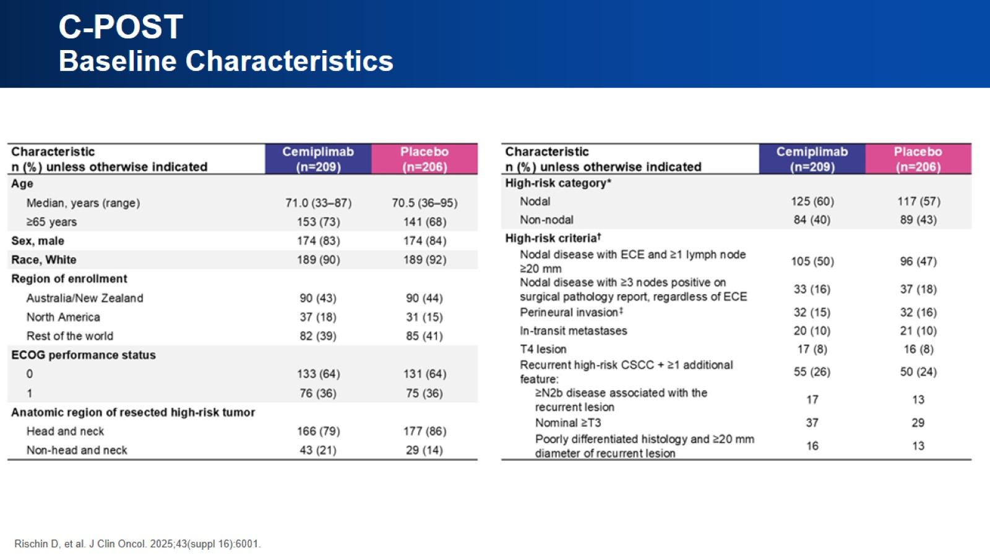
C-POST Baseline Characteristics

Slide 19
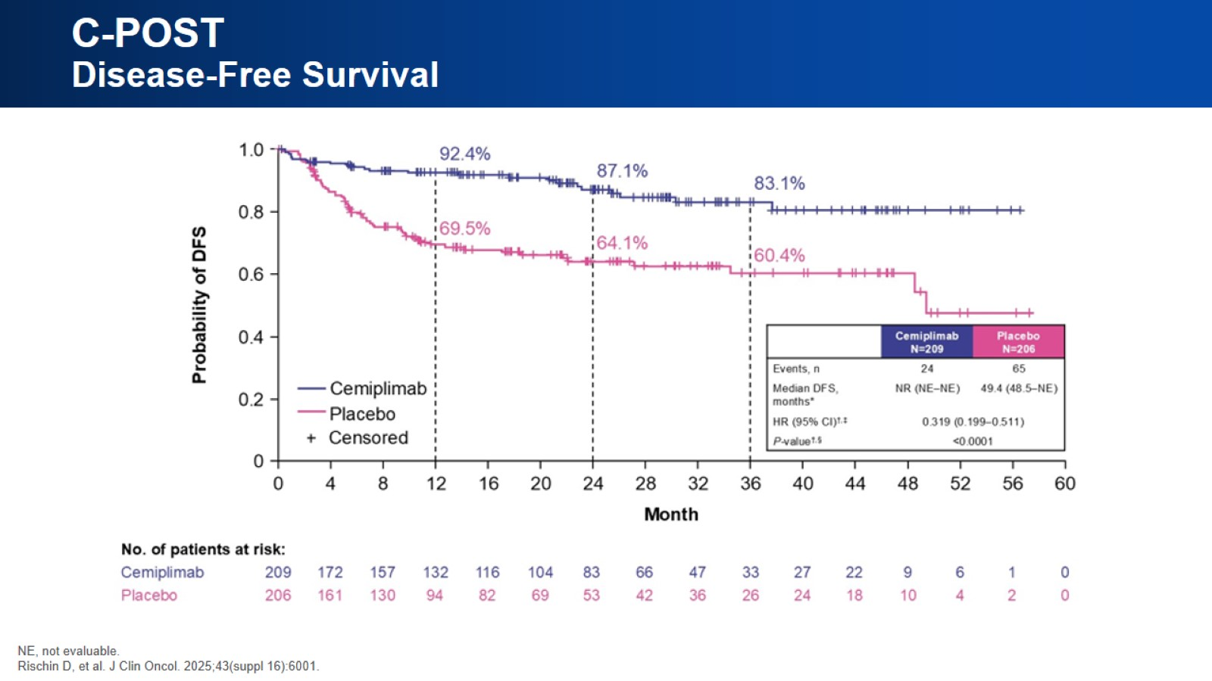
C-POST Disease-Free Survival

Slide 20
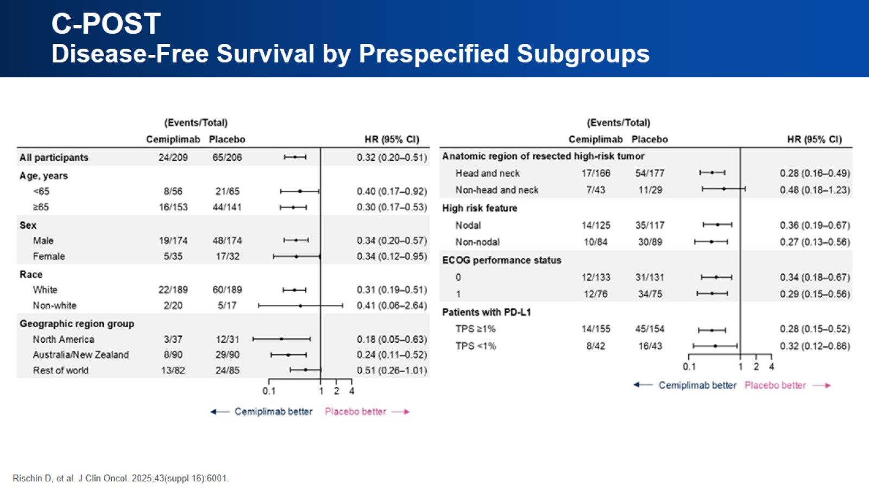
C-POST Disease-Free Survival by Prespecified Subgroups

Slide 21
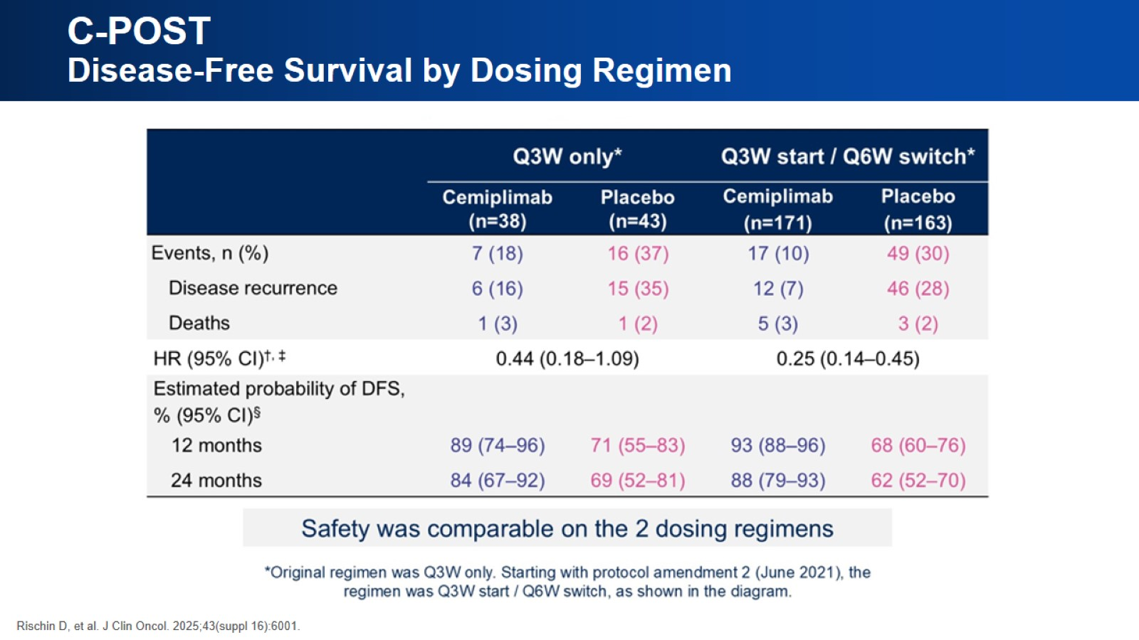
C-POST Disease-Free Survival by Dosing Regimen

Slide 22
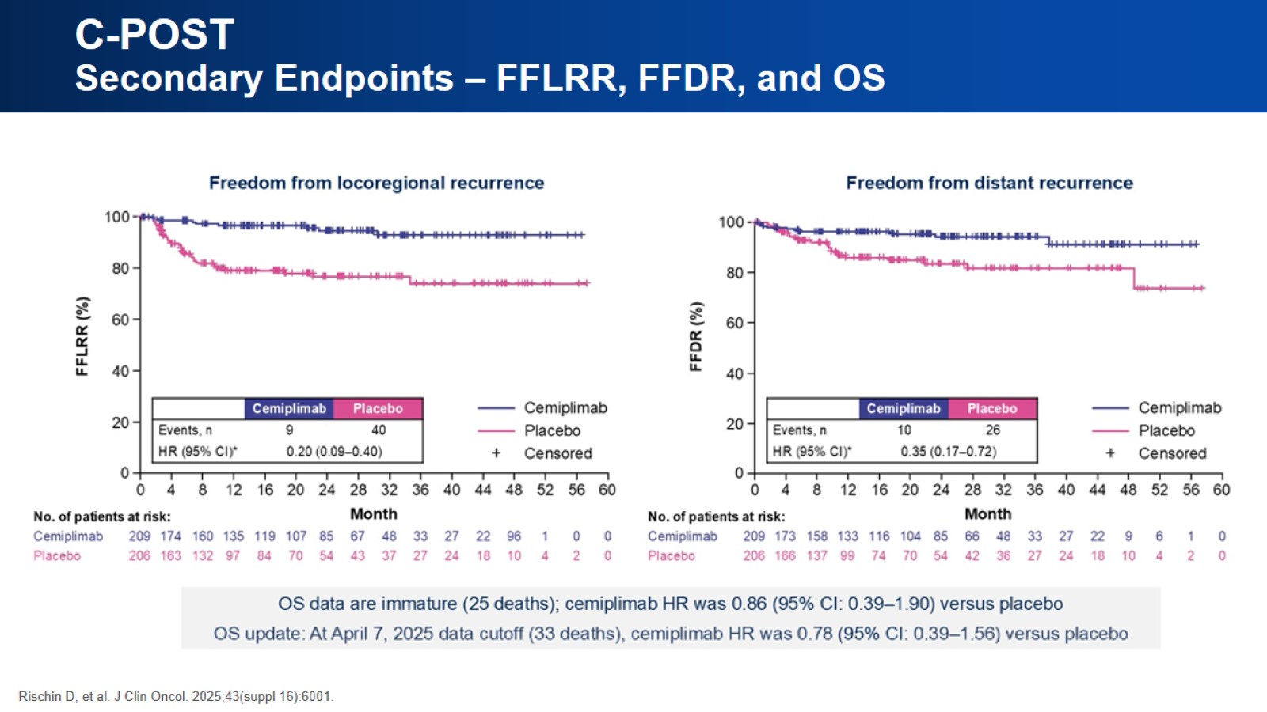
C-POST Secondary Endpoints – FFLRR, FFDR, and OS

Slide 23
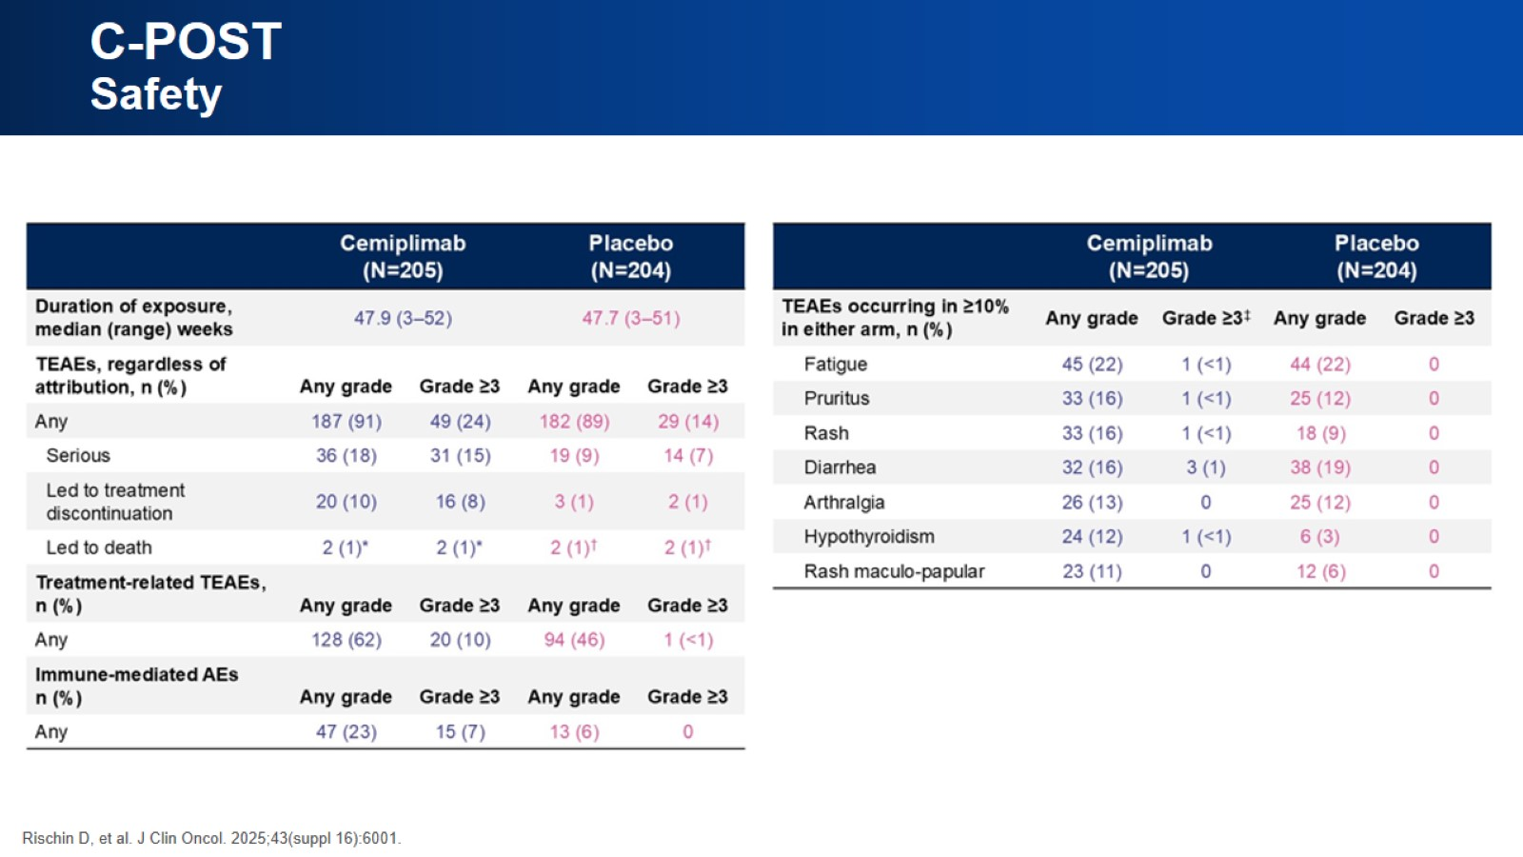
C-POST Safety

Slide 24
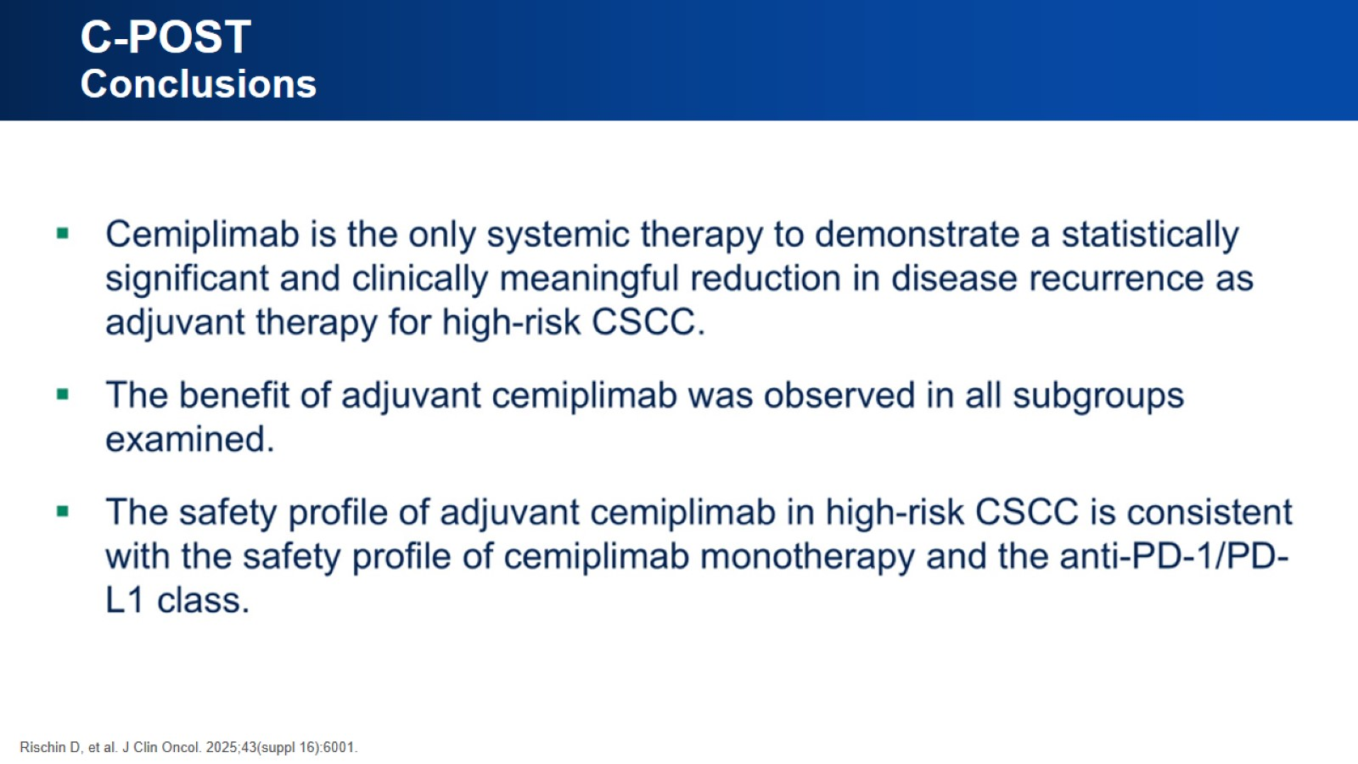
C-POST Conclusions

Slide 25
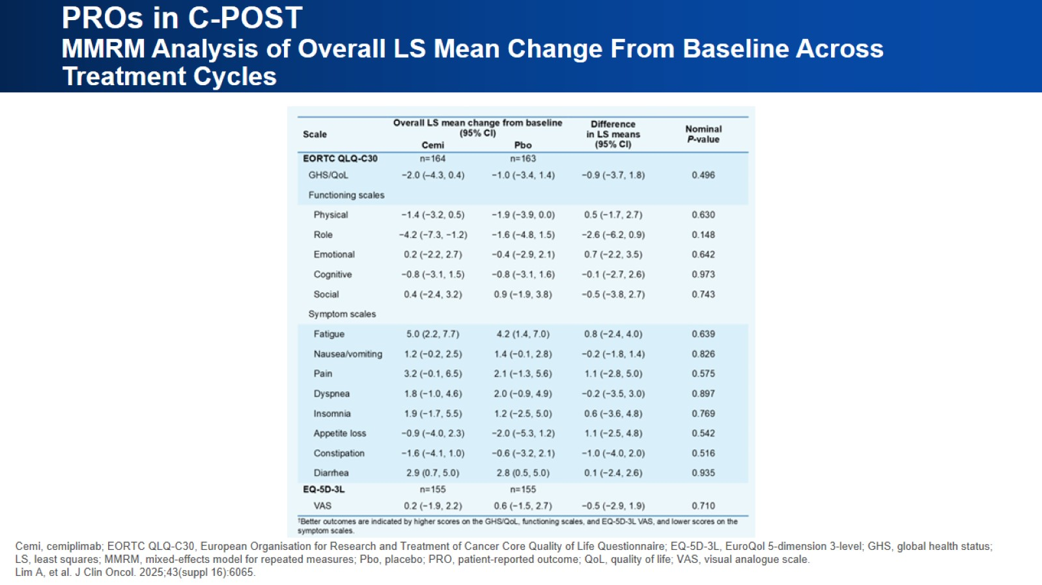
PROs in C-POST MMRM Analysis of Overall LS Mean Change From Baseline Across Treatment Cycles

Slide 26
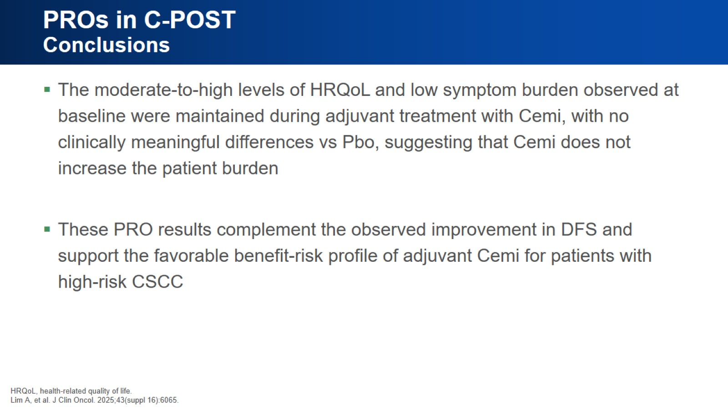
PROs in C-POST Conclusions

Slide 27
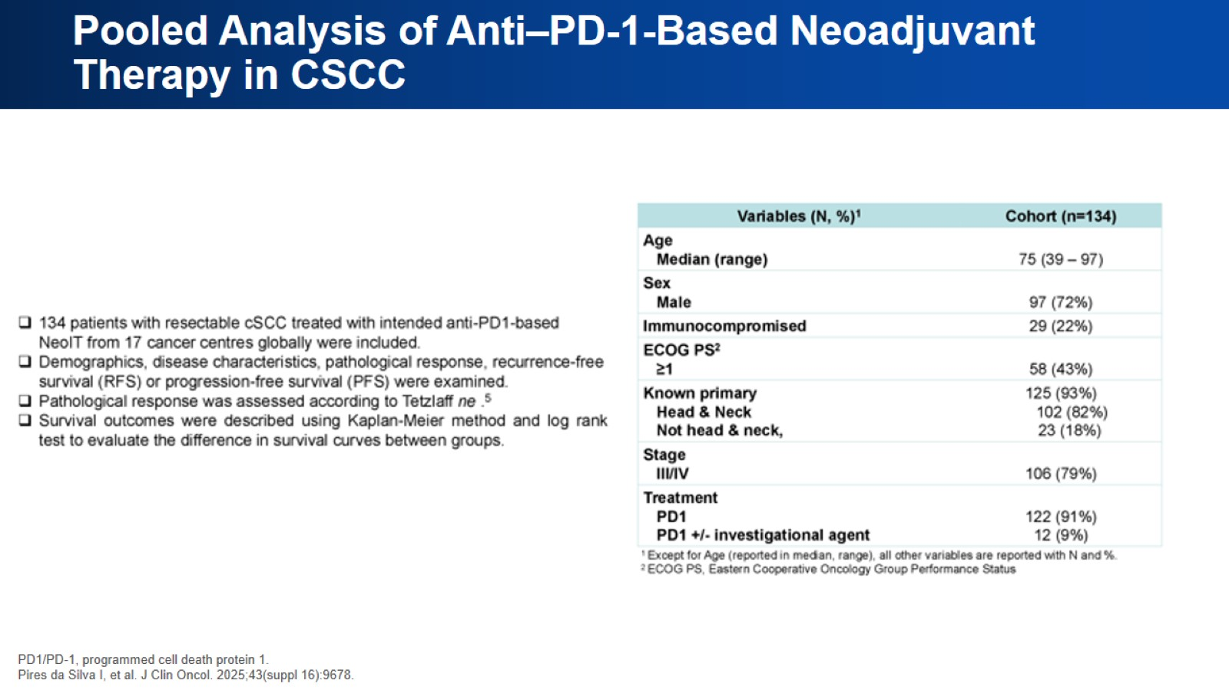
Pooled Analysis of Anti–PD-1-Based Neoadjuvant Therapy in CSCC

Slide 28
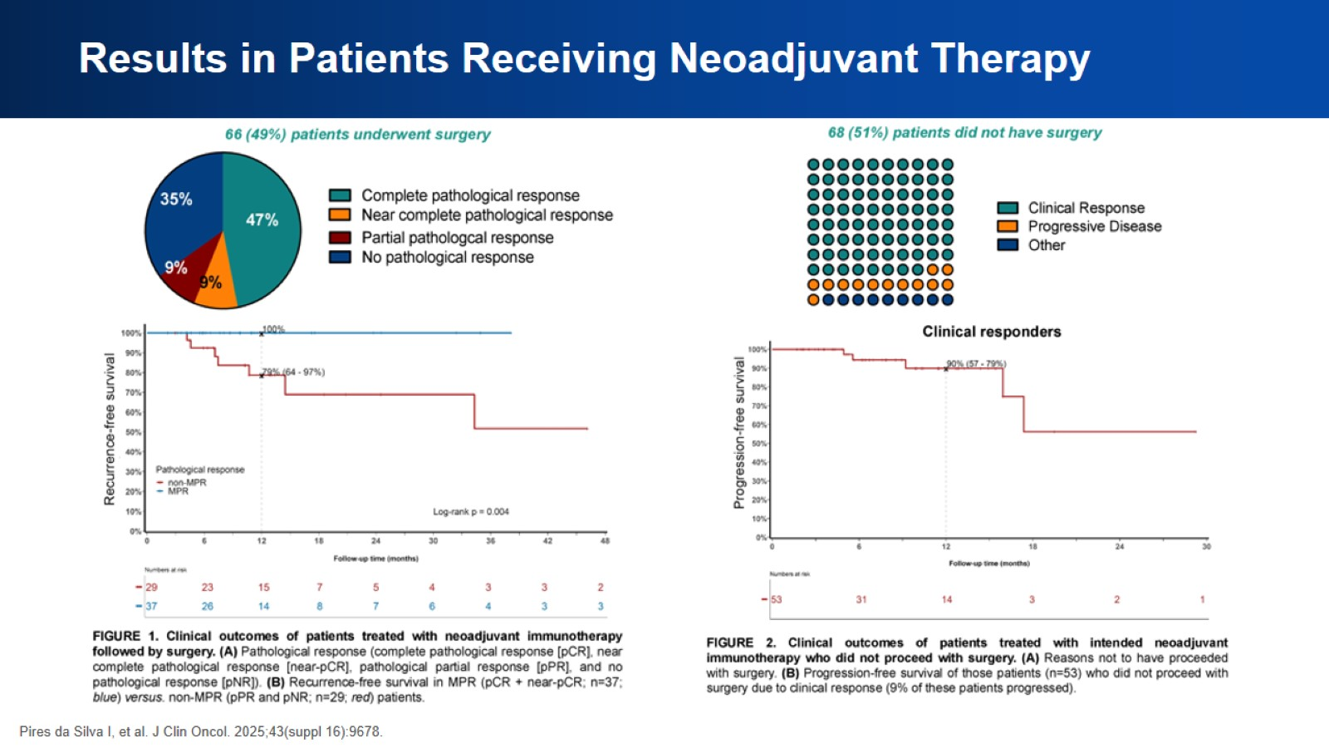
Results in Patients Receiving Neoadjuvant Therapy

Slide 29
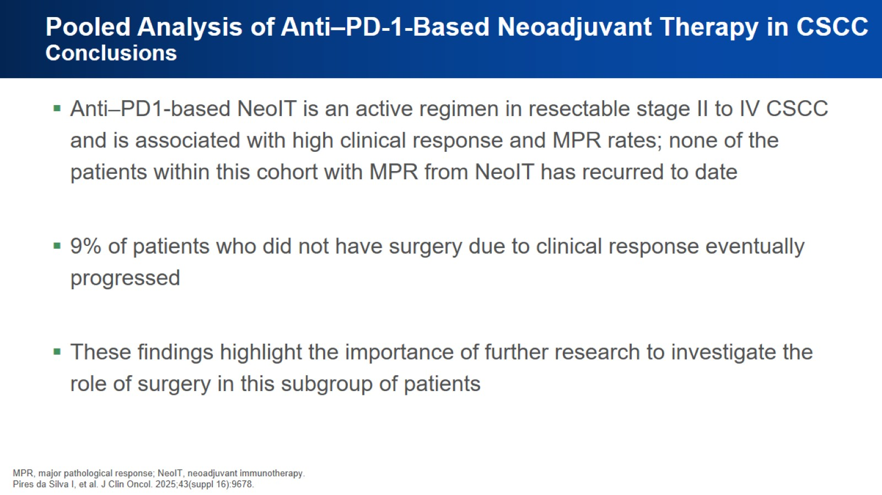
Pooled Analysis of Anti–PD-1-Based Neoadjuvant Therapy in CSCC Conclusions

Slide 30

Application to Practice

Slide 31

Please Continue to the Next Segment

Slide 32
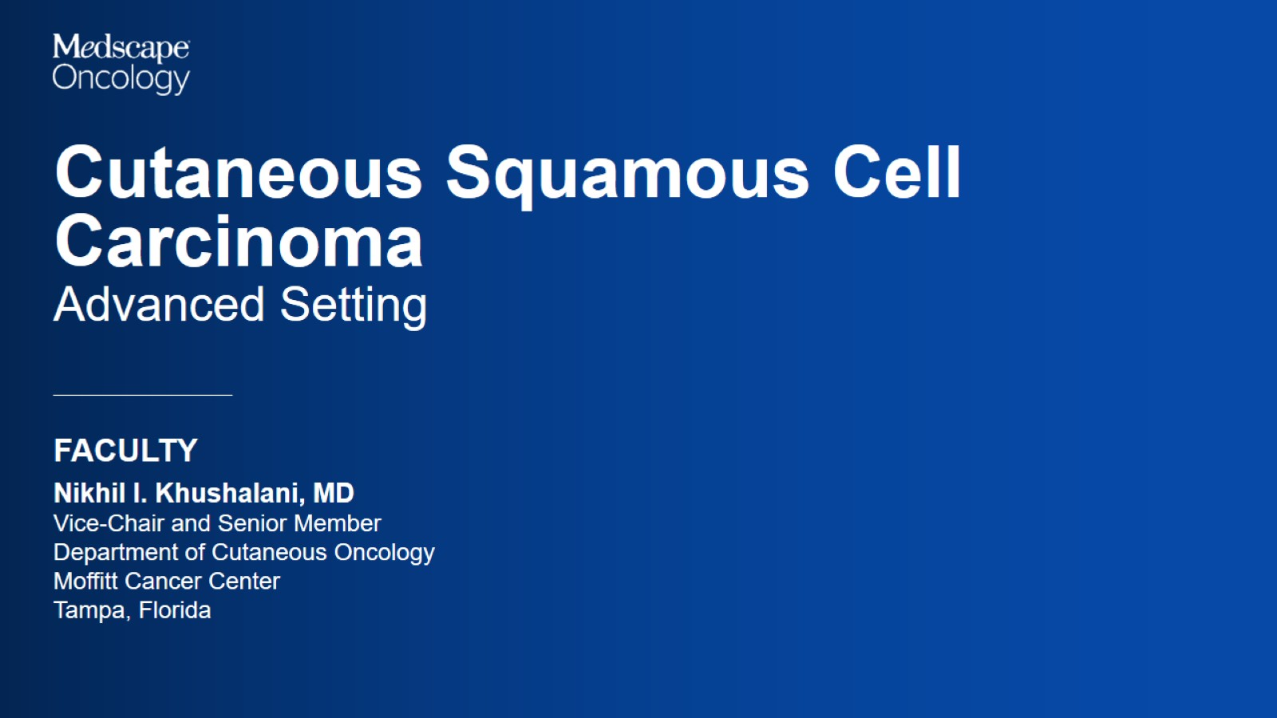

Slide 33
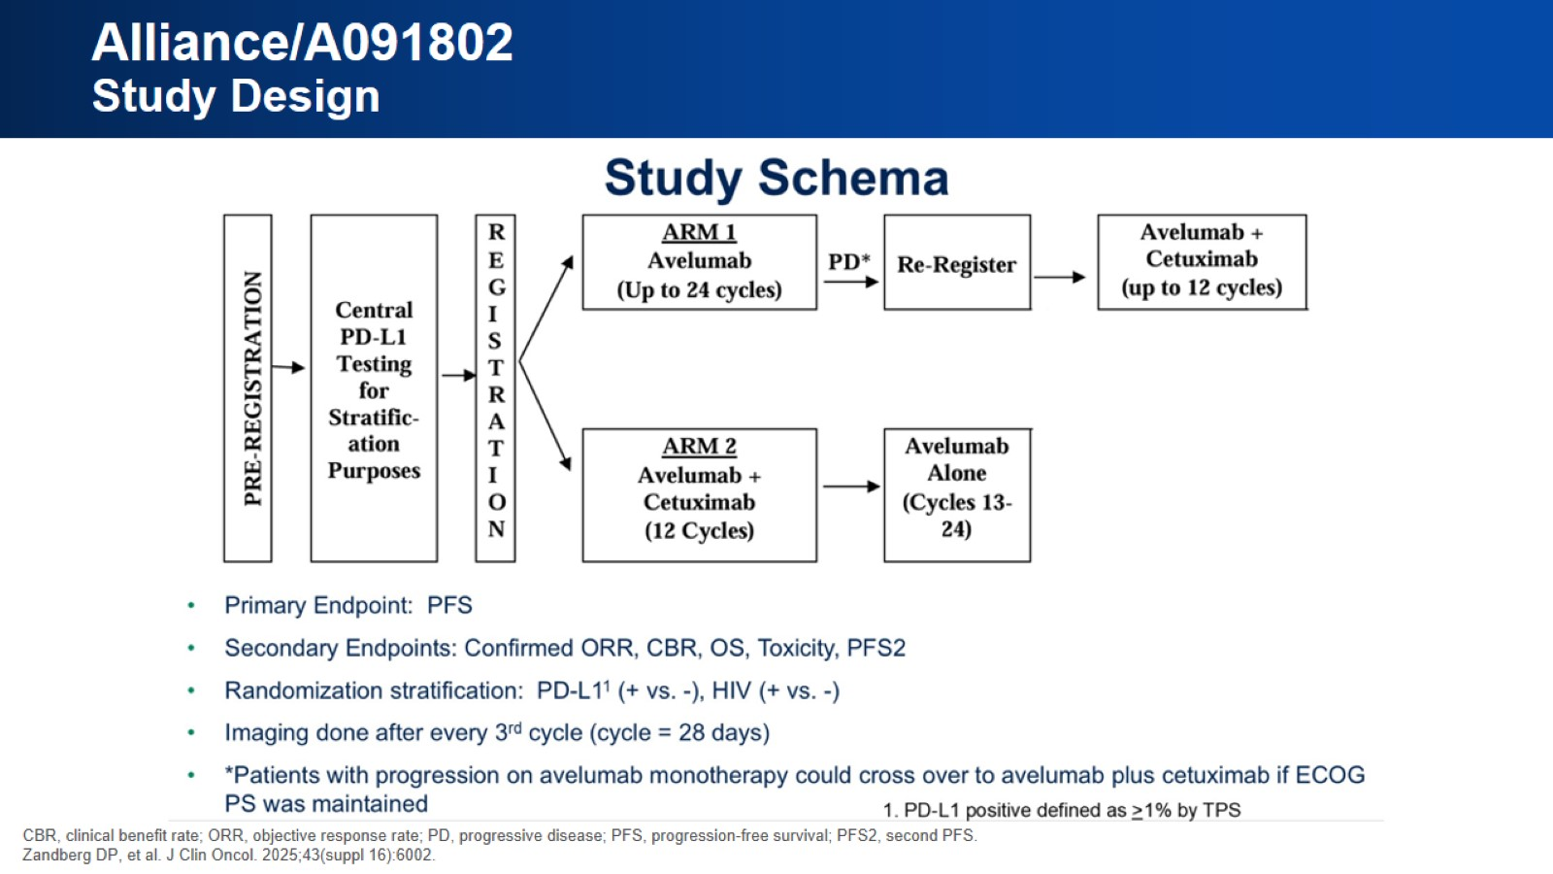
Alliance/A091802 Study Design

Slide 34
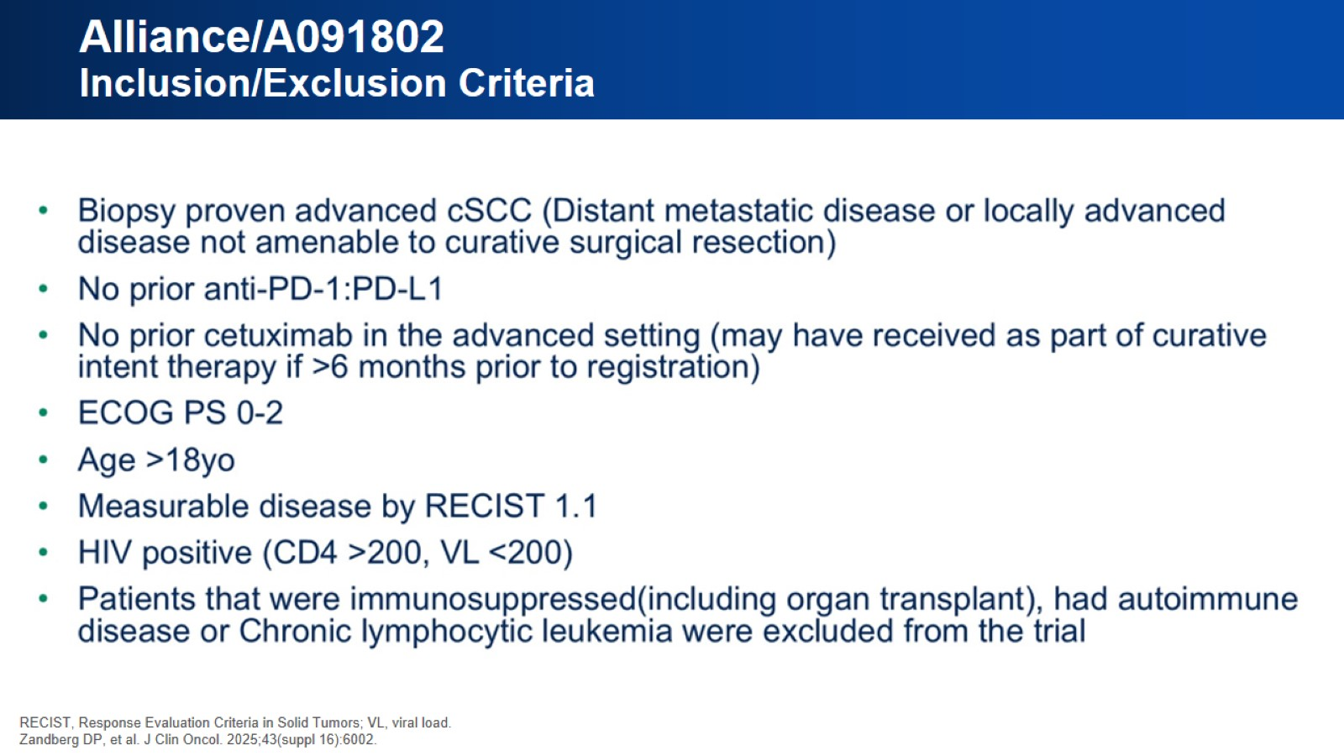
Alliance/A091802 Inclusion/Exclusion Criteria

Slide 35
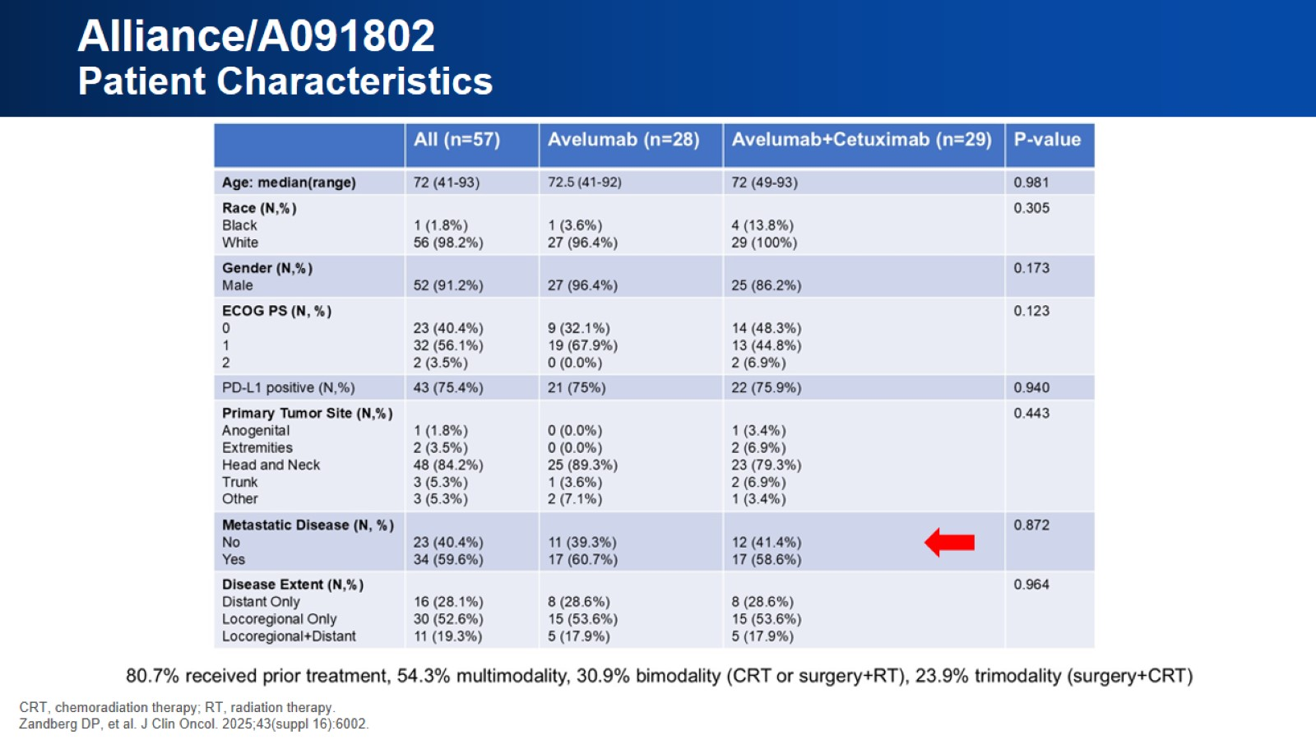
Alliance/A091802 Patient Characteristics

Slide 36
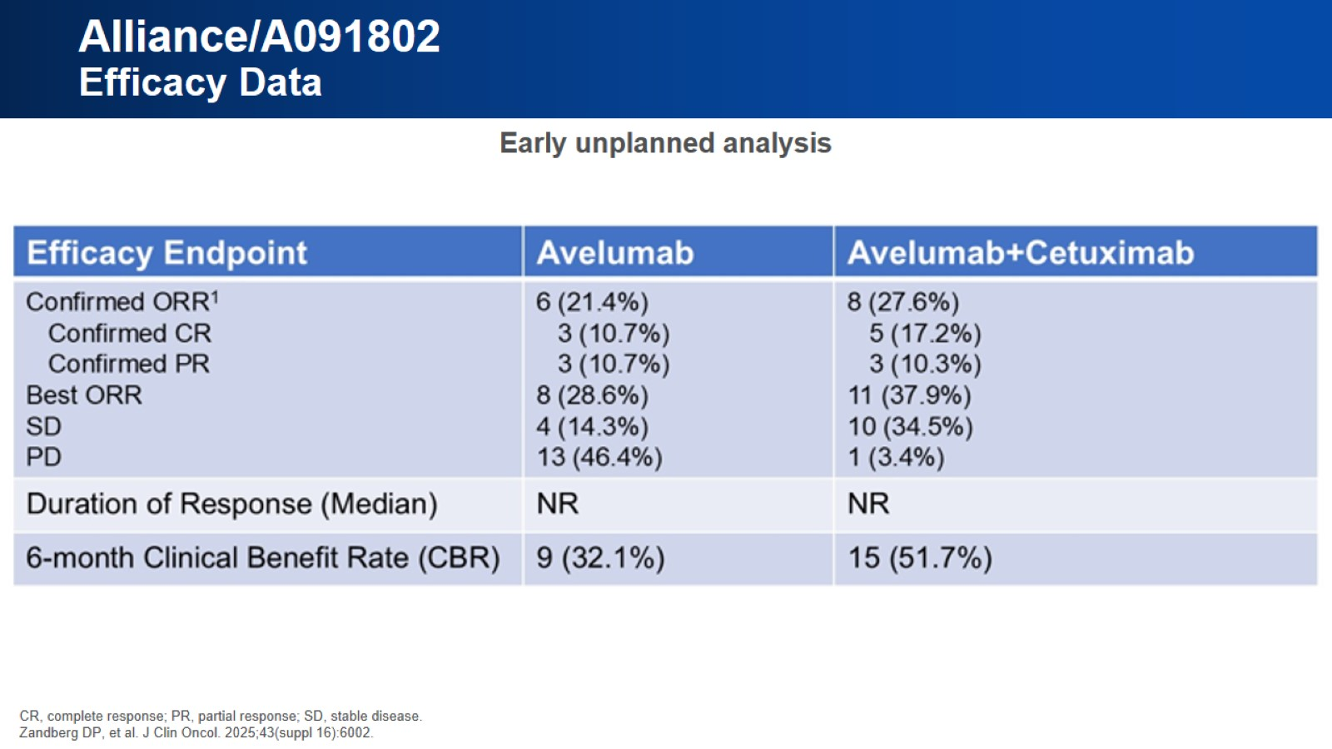
Alliance/A091802 Efficacy Data

Slide 37
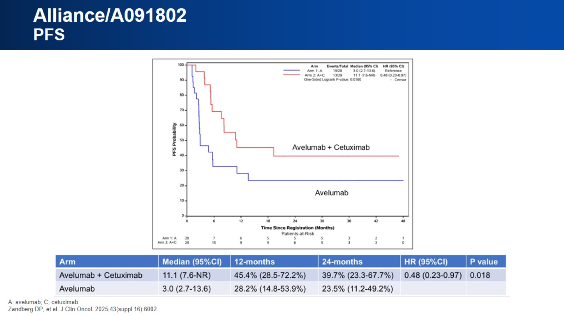
Alliance/A091802 PFS

Slide 38
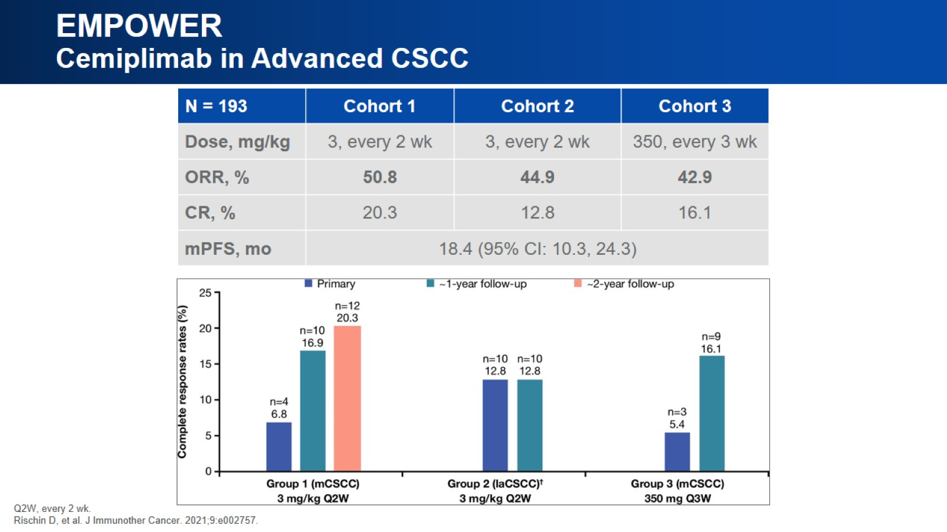
EMPOWER Cemiplimab in Advanced CSCC

Slide 39
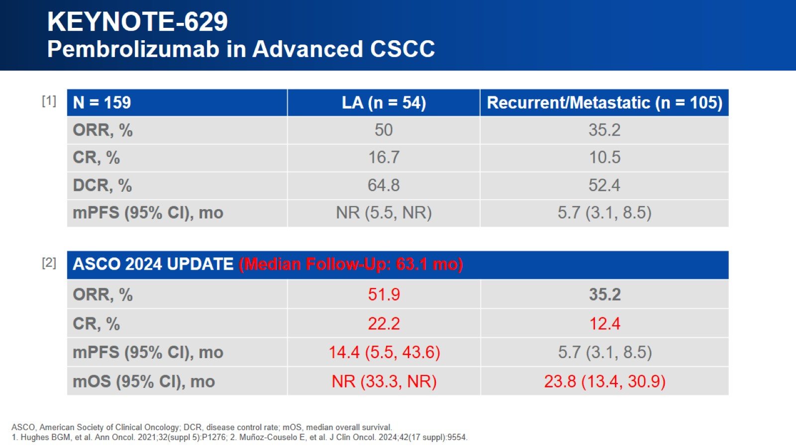
KEYNOTE-629 Pembrolizumab in Advanced CSCC

Slide 40
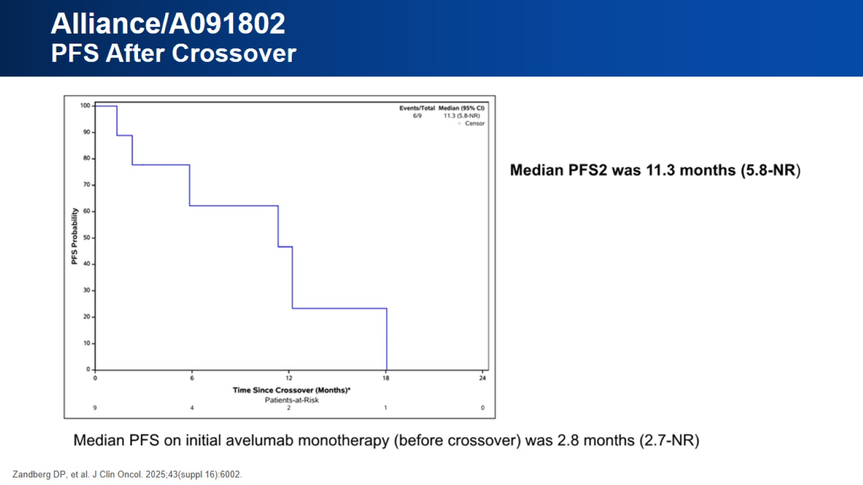
Alliance/A091802 PFS After Crossover

Slide 41
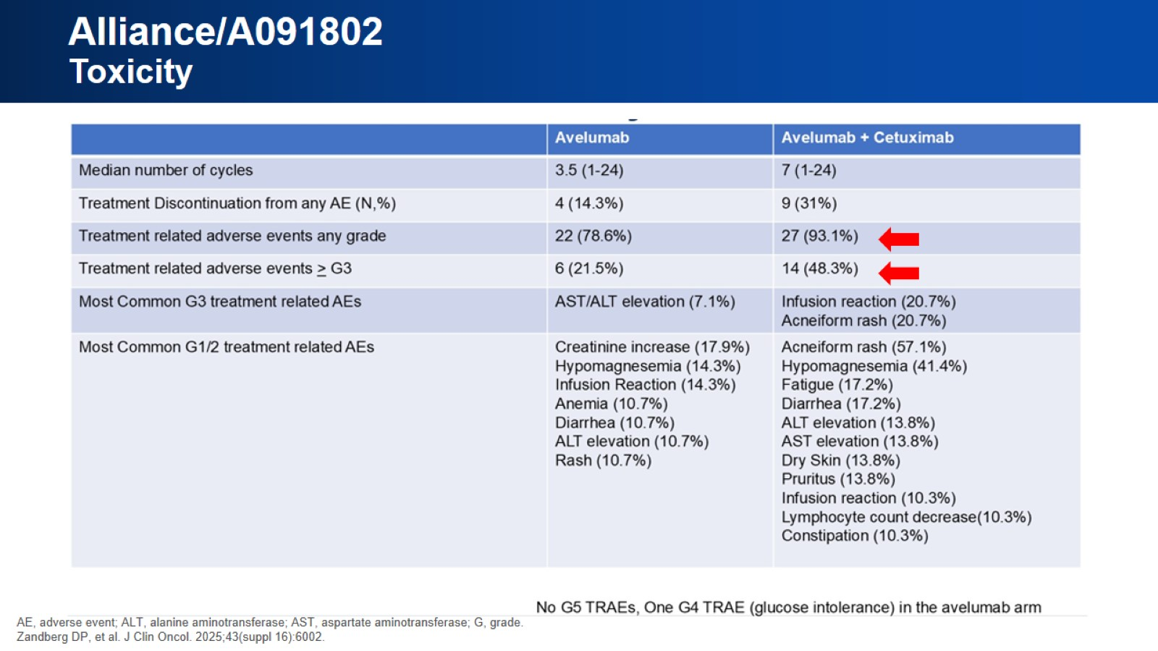
Alliance/A091802 Toxicity

Slide 42
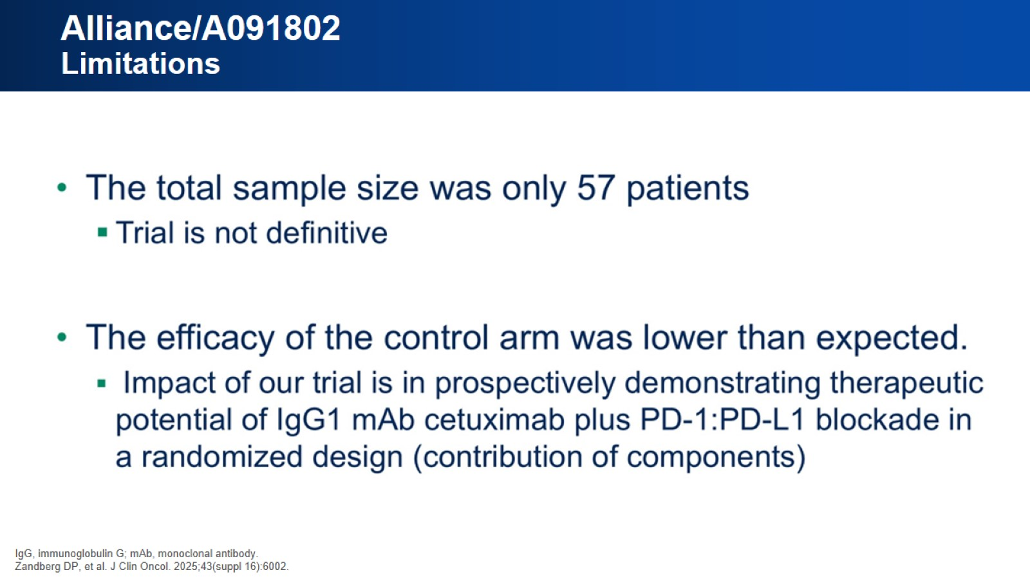
Alliance/A091802 Limitations

Slide 43
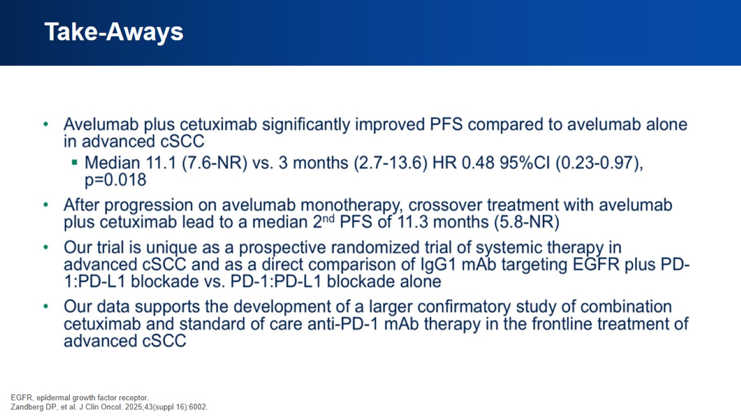
Take-Aways

Slide 44
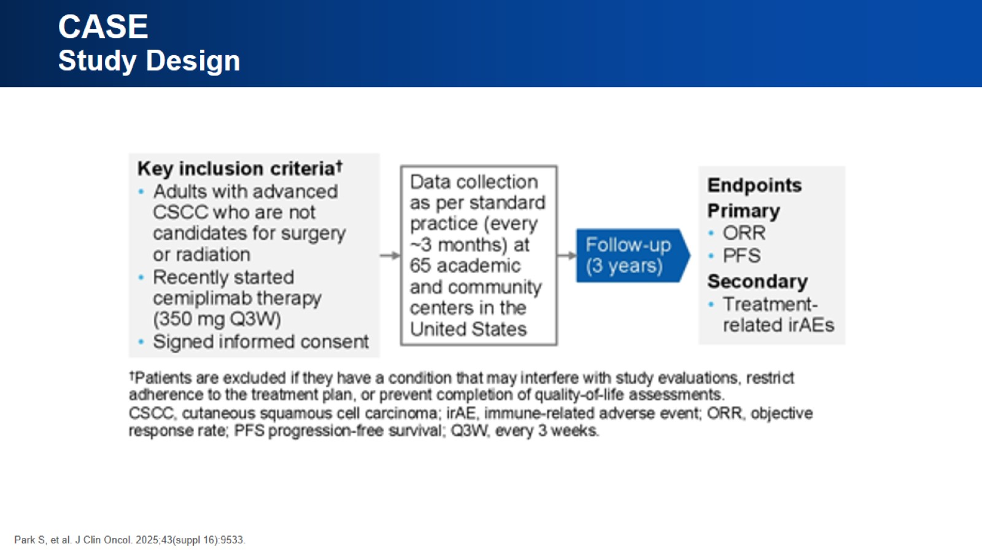
CASE Study Design

Slide 45
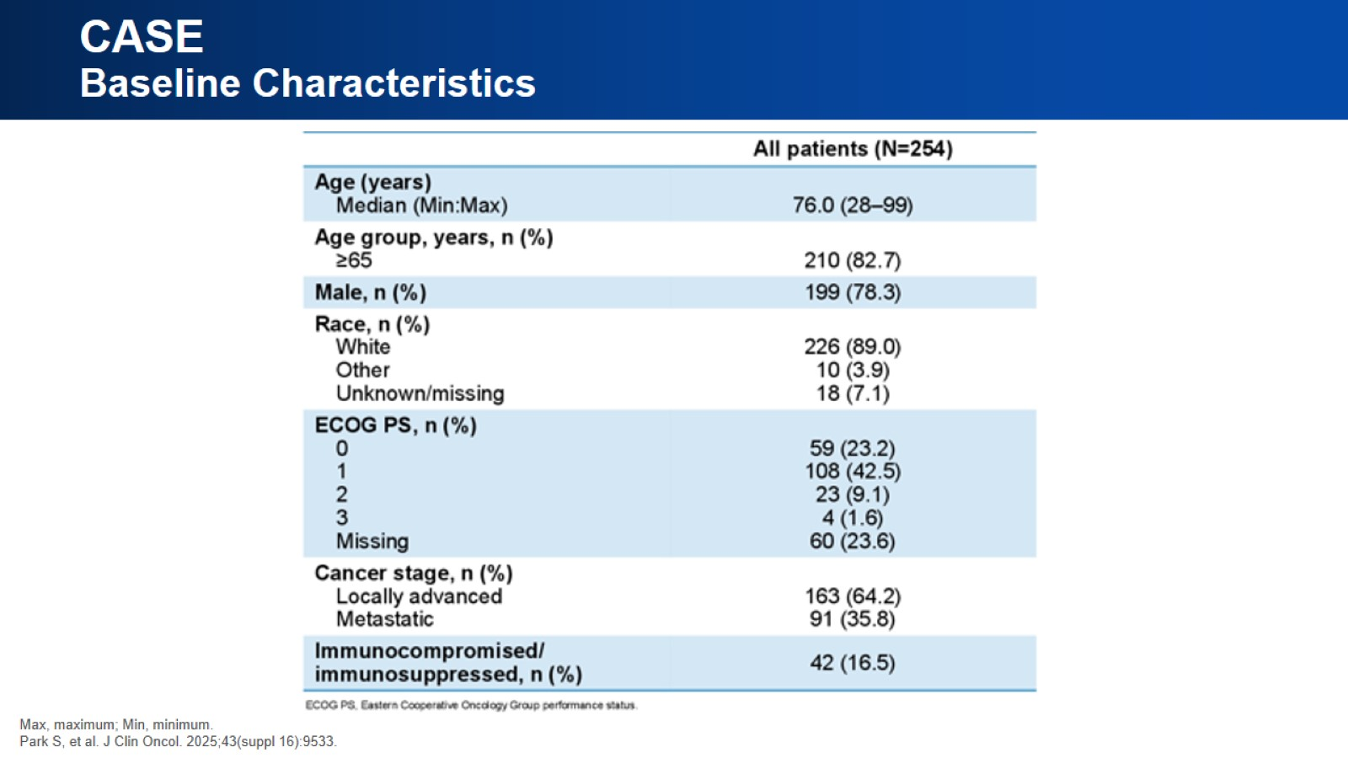
CASE Baseline Characteristics

Slide 46
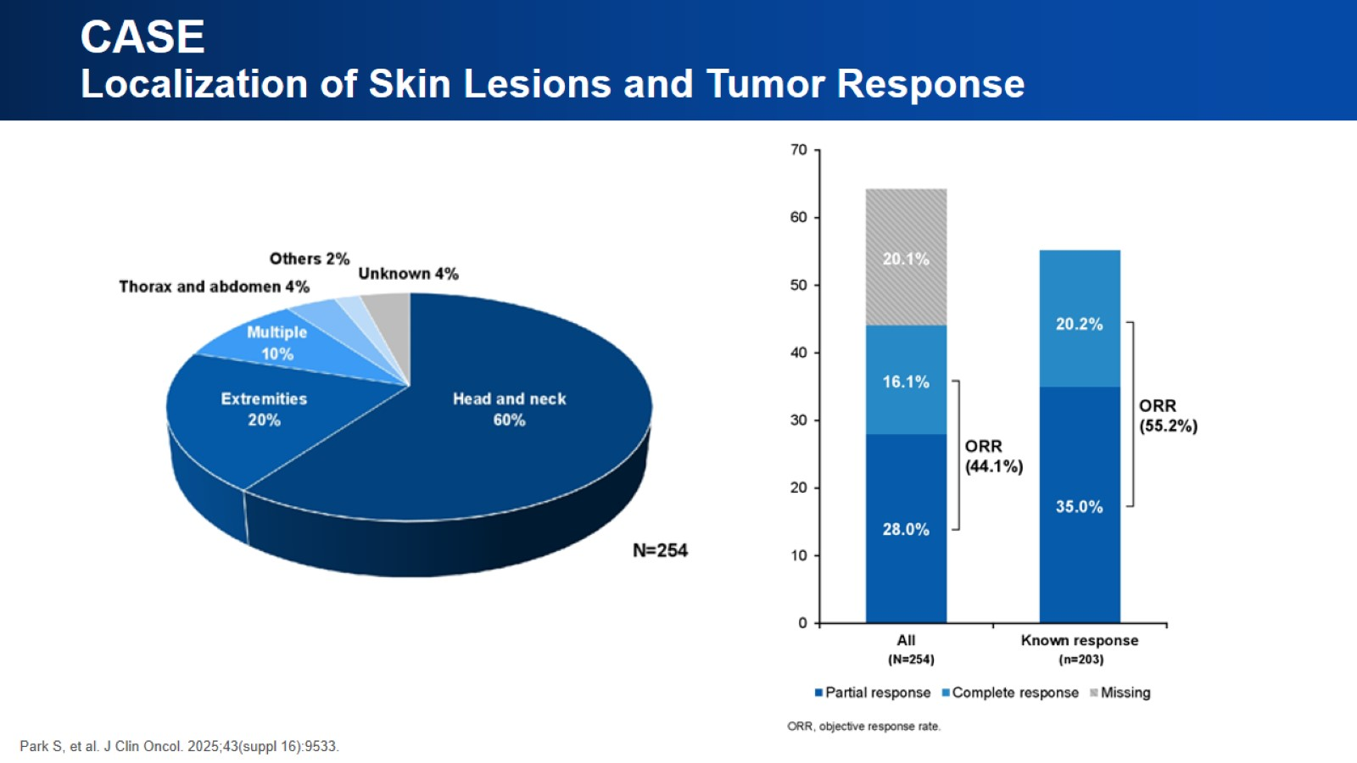
CASE Localization of Skin Lesions and Tumor Response

Slide 47
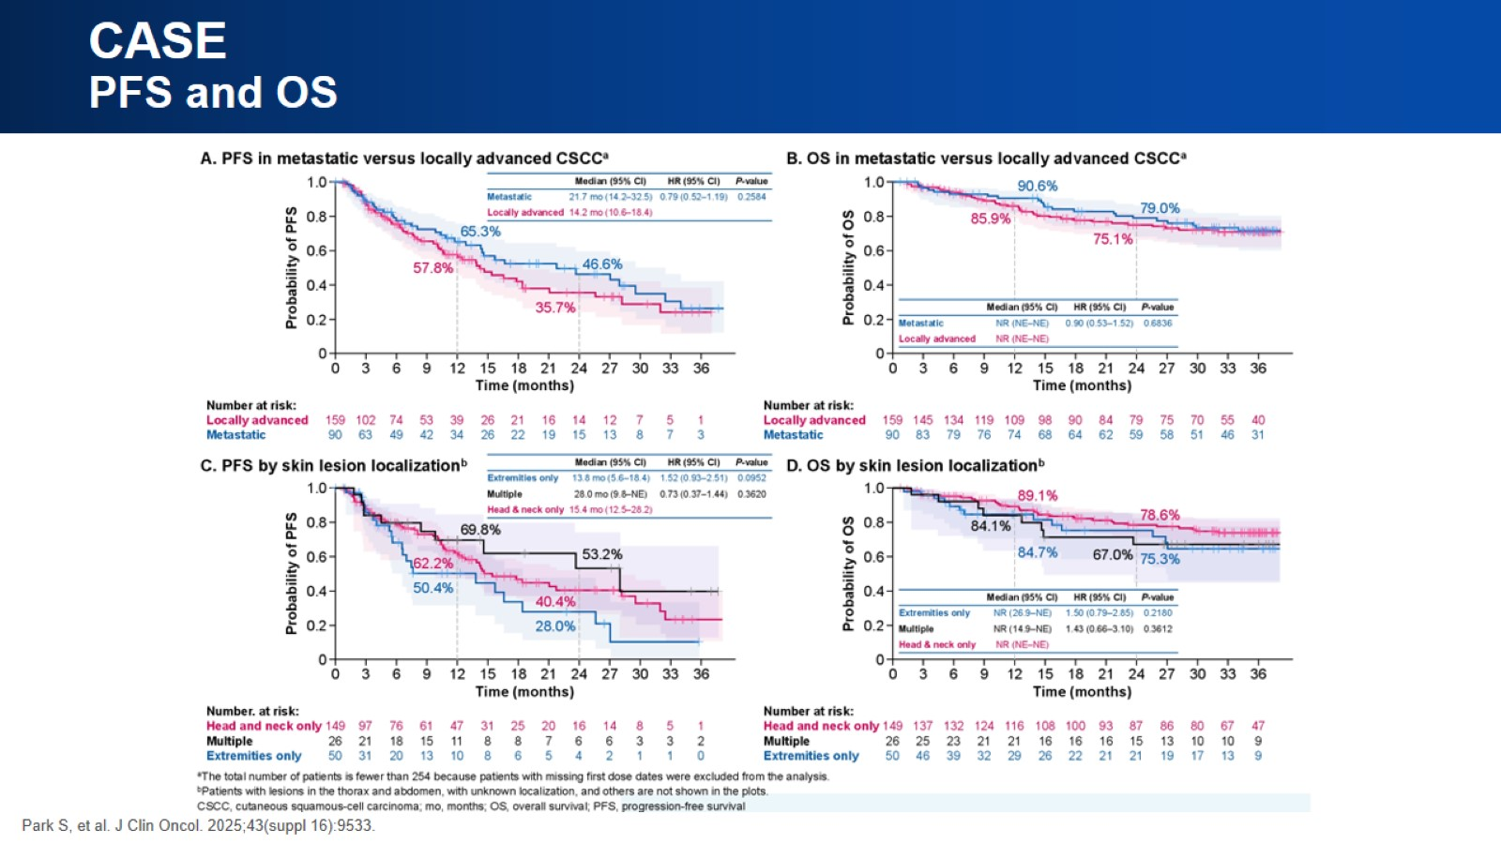
CASE PFS and OS

Slide 48
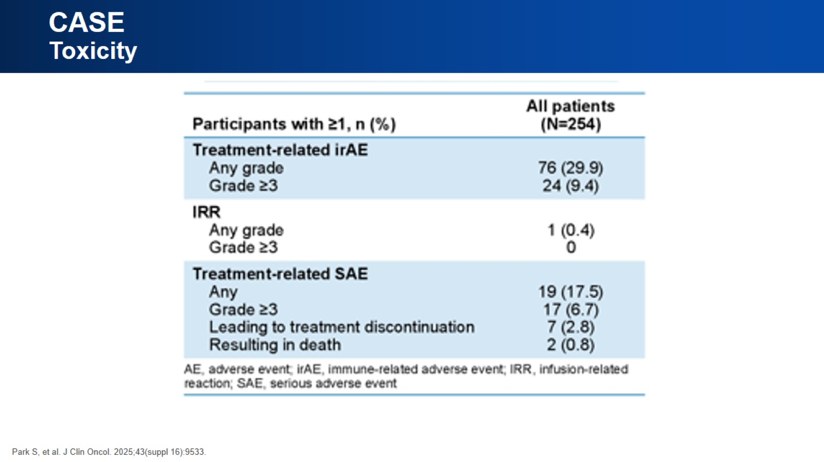
CASE Toxicity

Slide 49
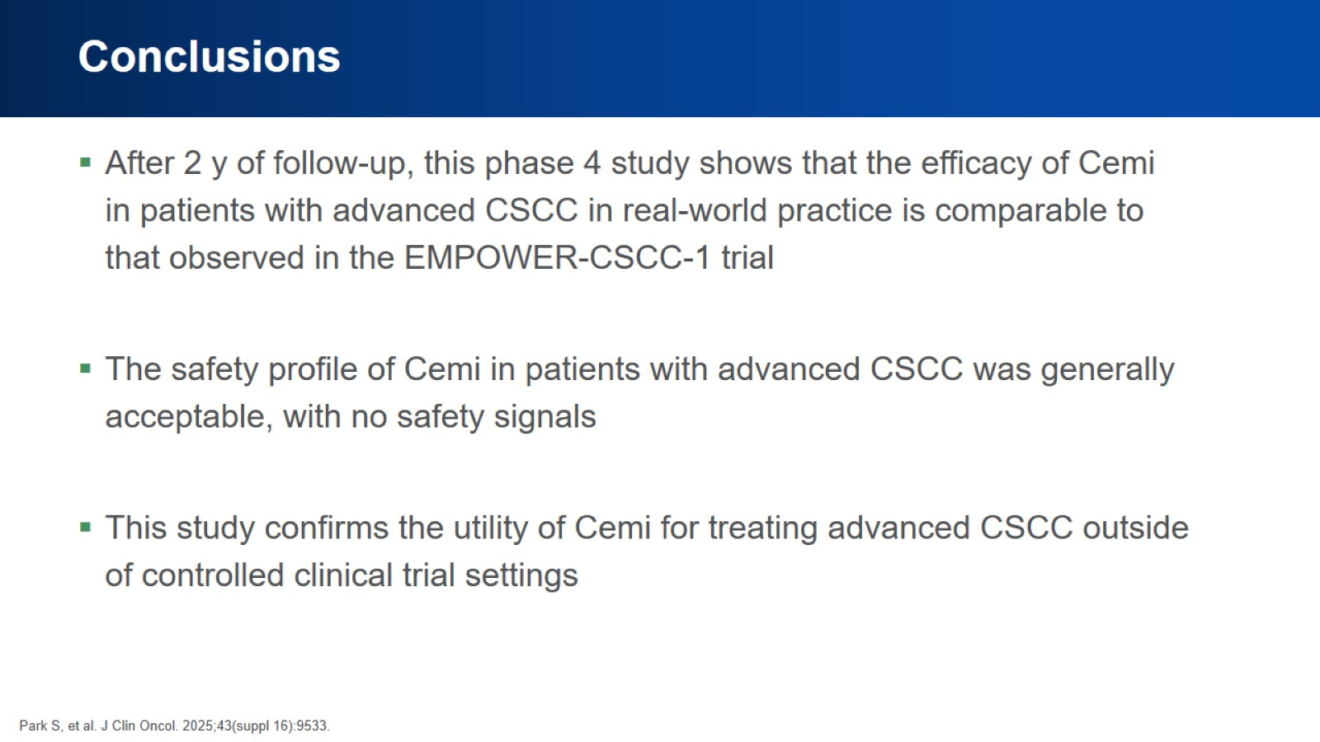
Conclusions

Slide 50
Please Continue to the Next Segment

Slide 51


Slide 52
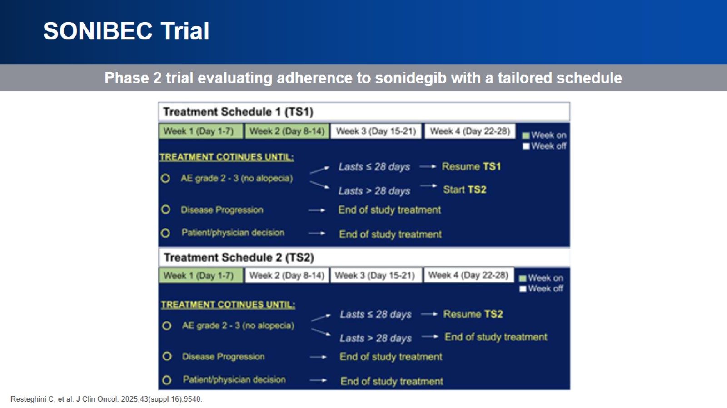
SONIBEC Trial

Slide 53
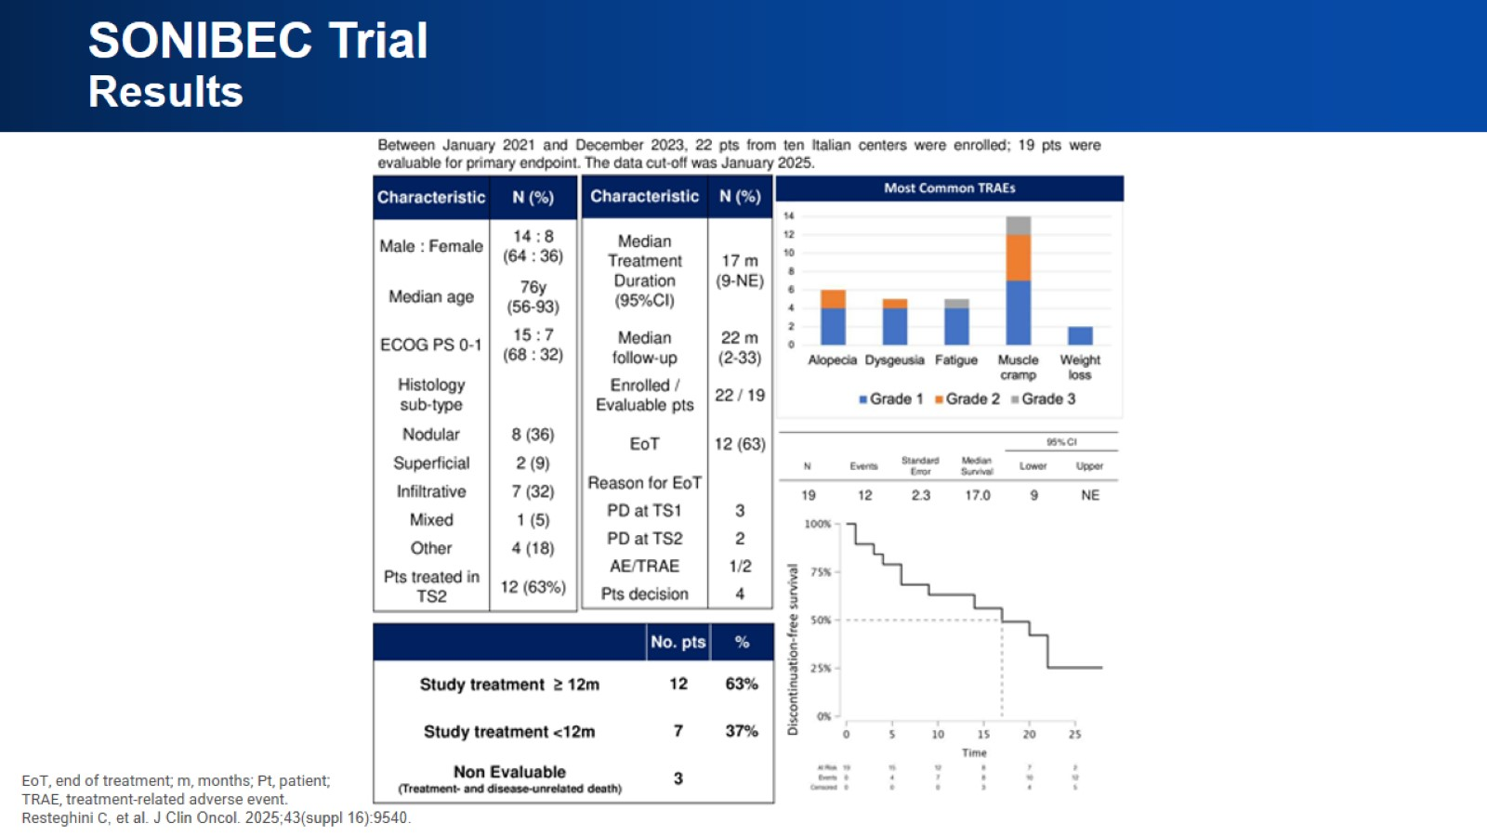
SONIBEC Trial Results

Slide 54
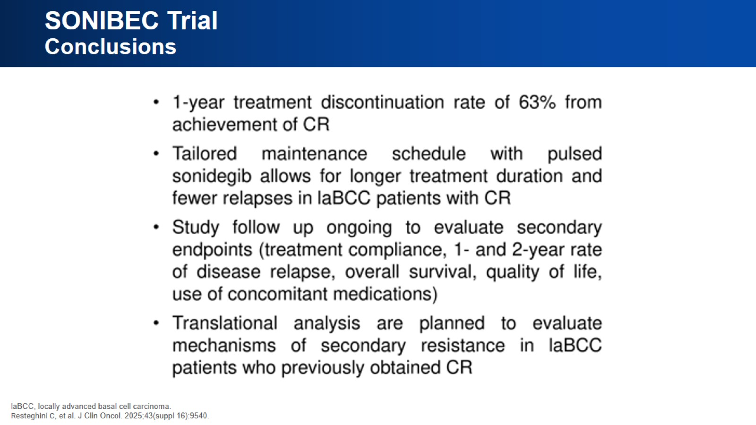
SONIBEC Trial Conclusions

Slide 55
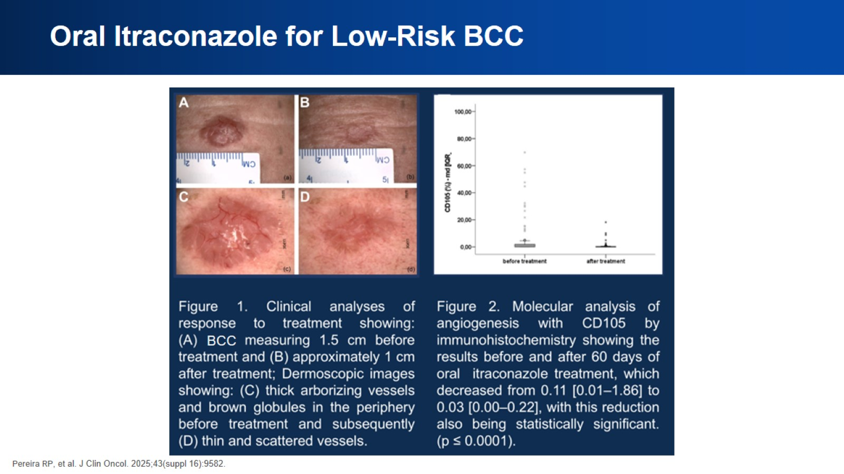
Oral Itraconazole for Low-Risk BCC

Slide 56

Oral Itraconazole in BCC Conclusions

Slide 57

CARADERM Database

Slide 58

CARADERM Database Results

Slide 59

Real-World HHI Comparison Conclusions

Slide 60


