Slide 1


Slide 2
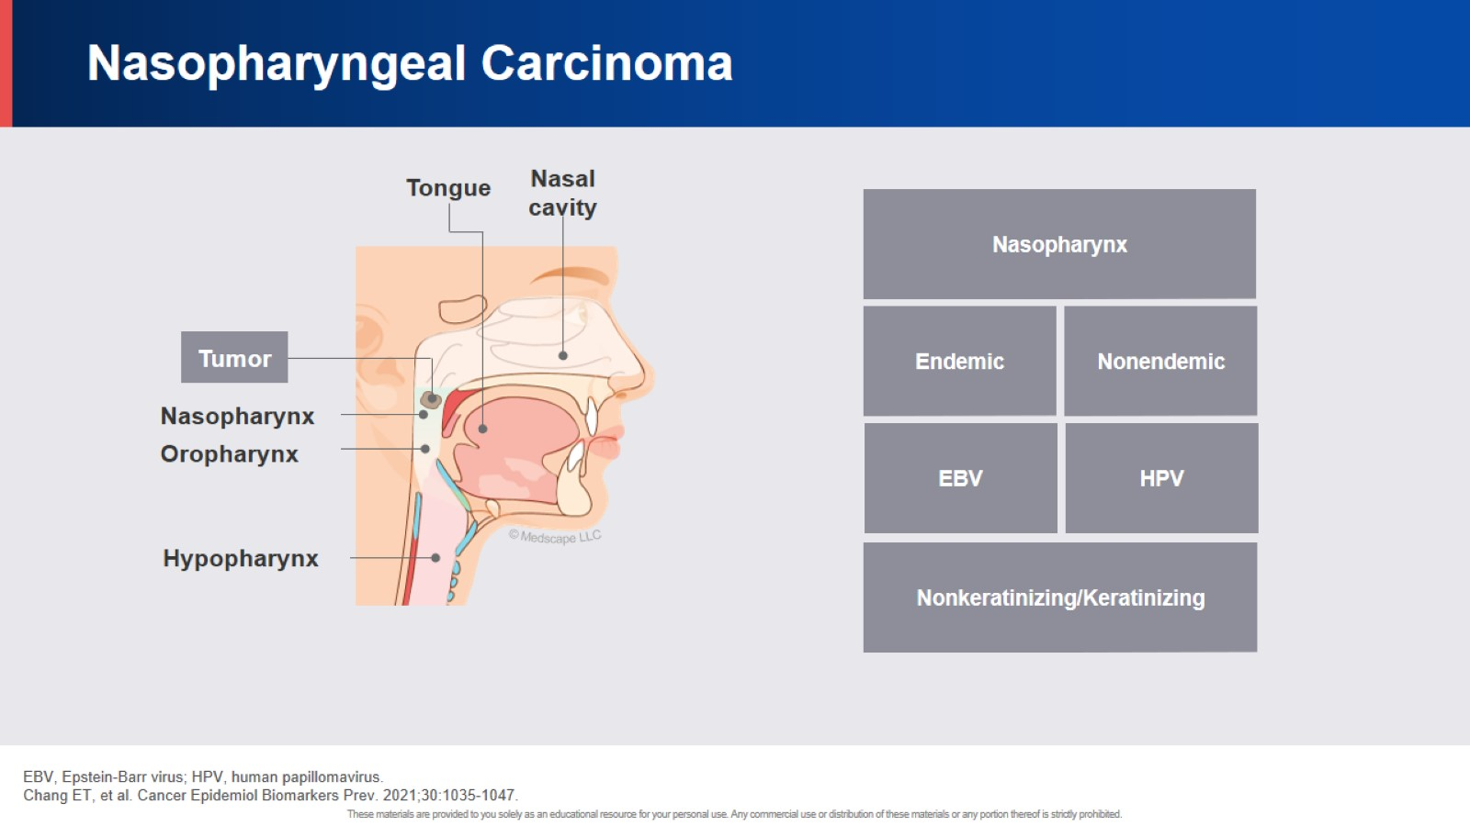
Nasopharyngeal Carcinoma

Slide 3
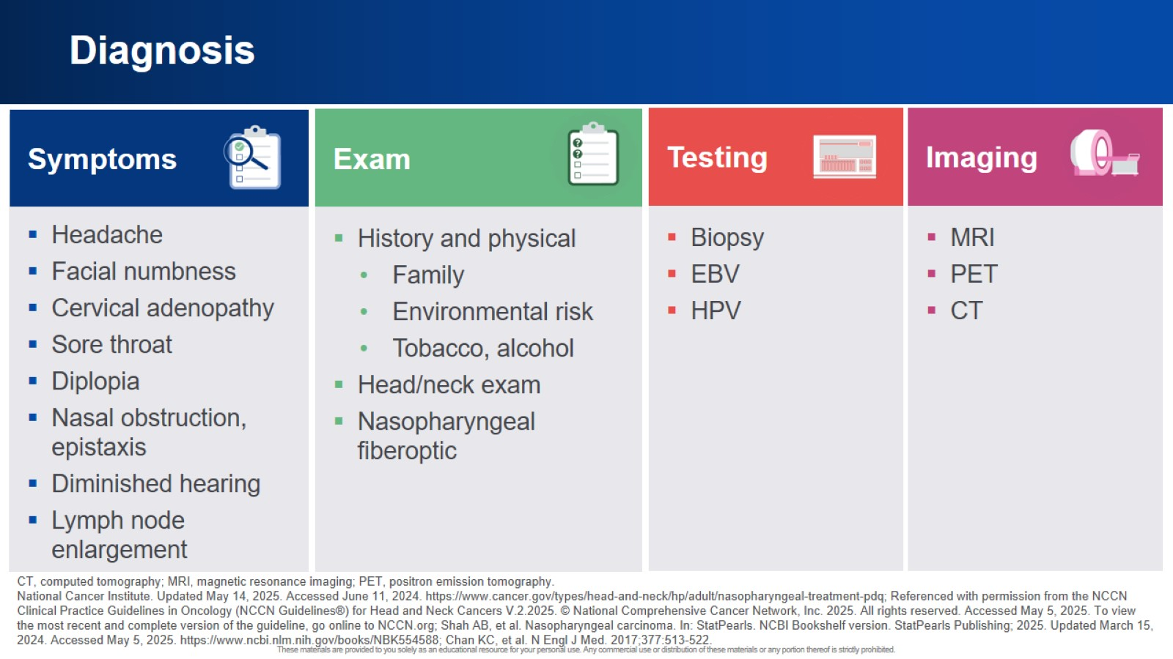
Diagnosis

Slide 4

Patient Case 1

Slide 5
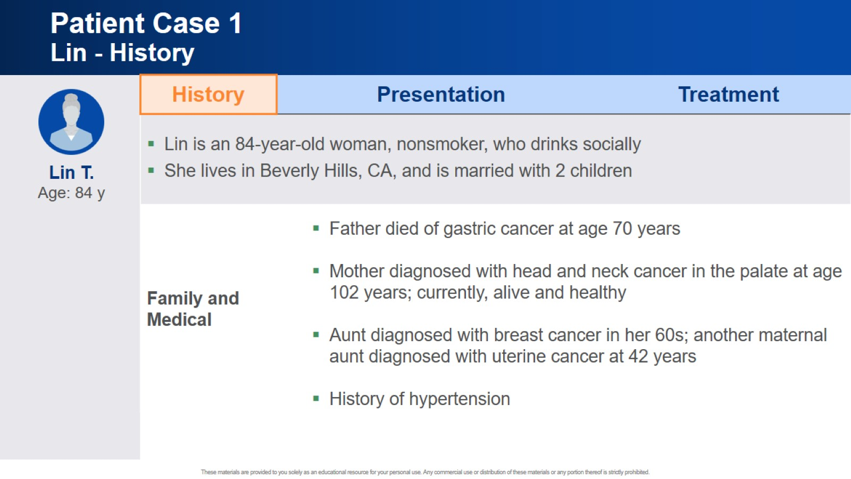
Patient Case 1 Lin - History

Slide 6
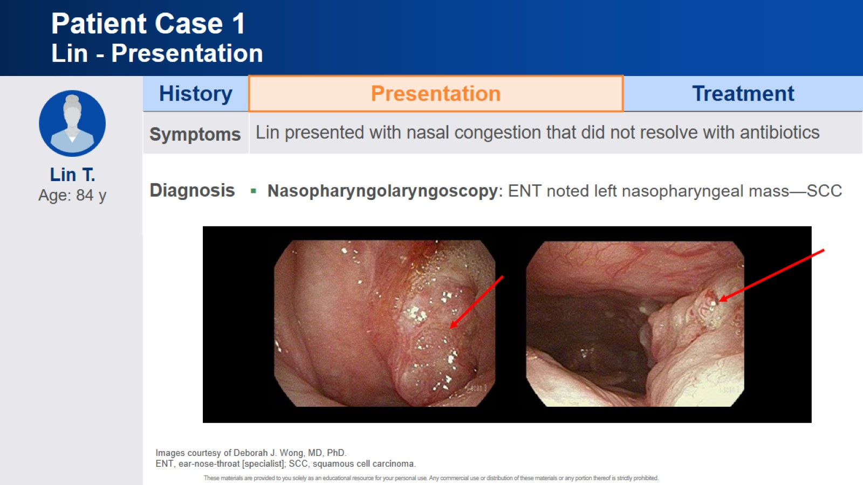
Patient Case 1 Lin - Presentation

Slide 7
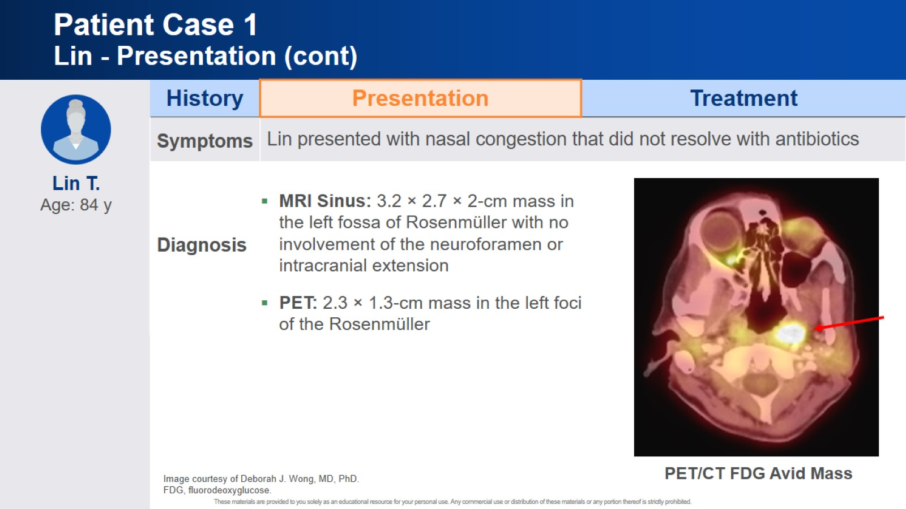
Patient Case 1 Lin - Presentation (cont)

Slide 8
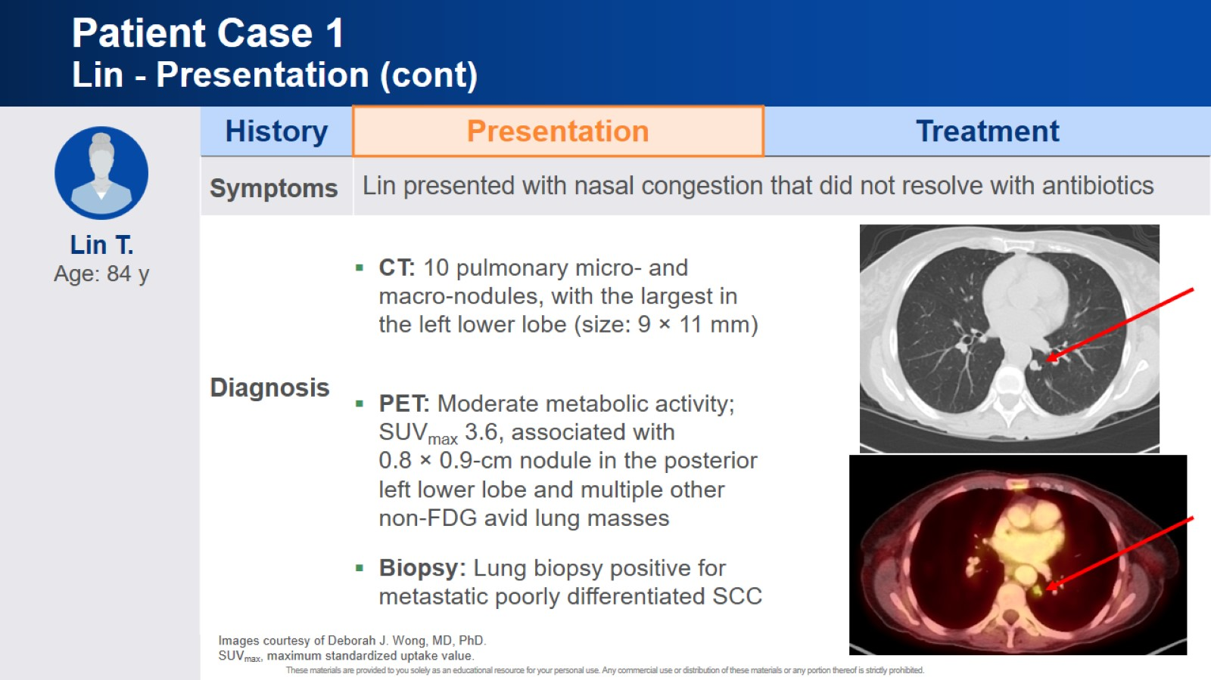
Patient Case 1 Lin - Presentation (cont)

Slide 9
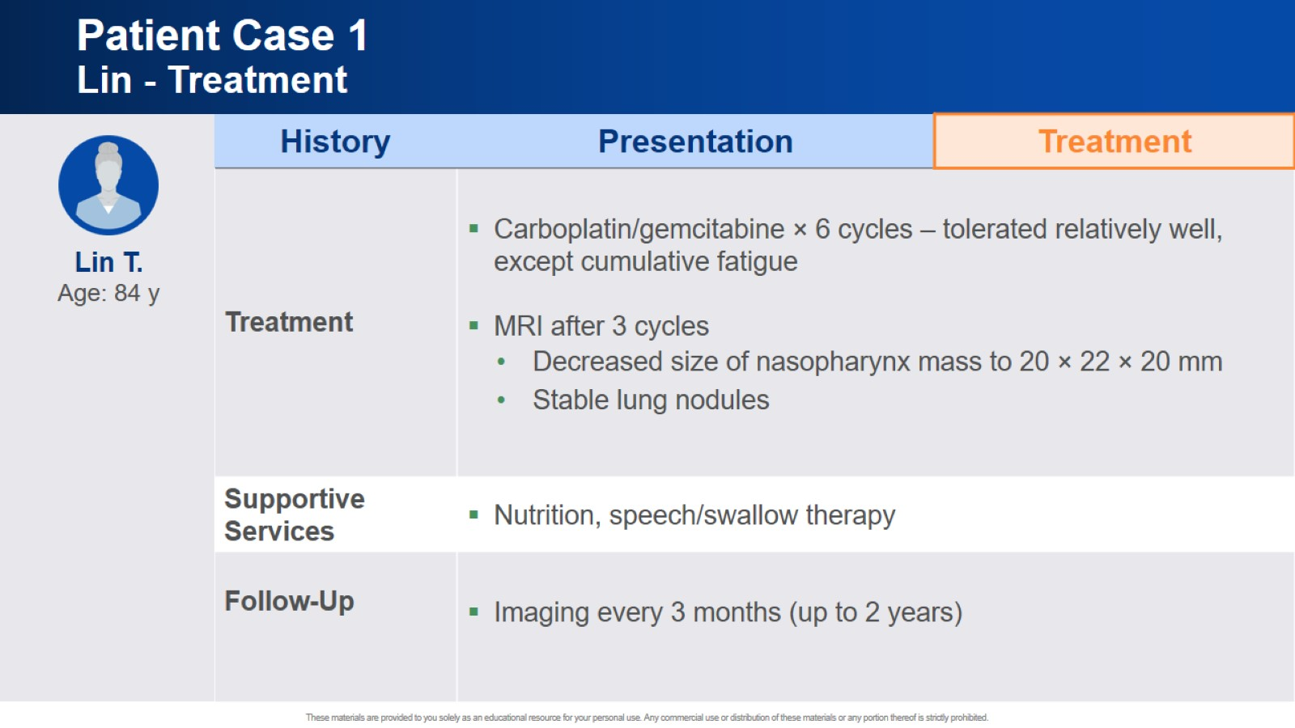
Patient Case 1 Lin - Treatment

Slide 10
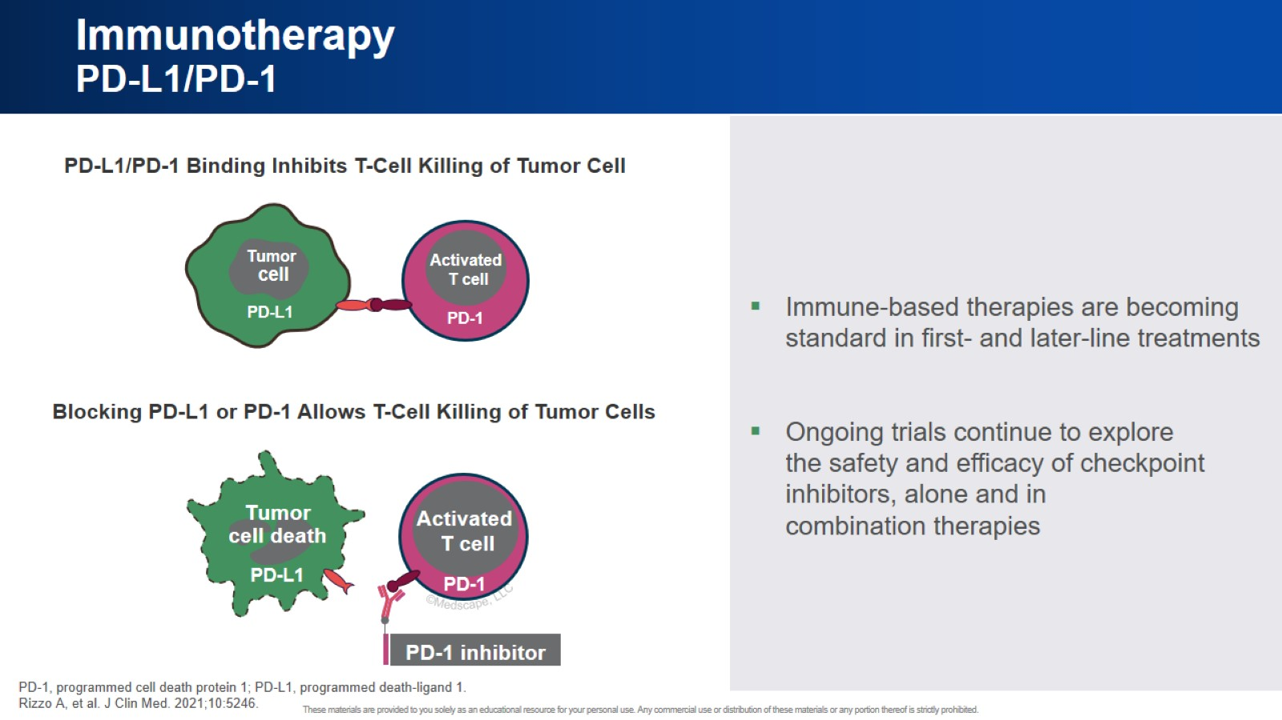
Immunotherapy PD-L1/PD-1

Slide 11
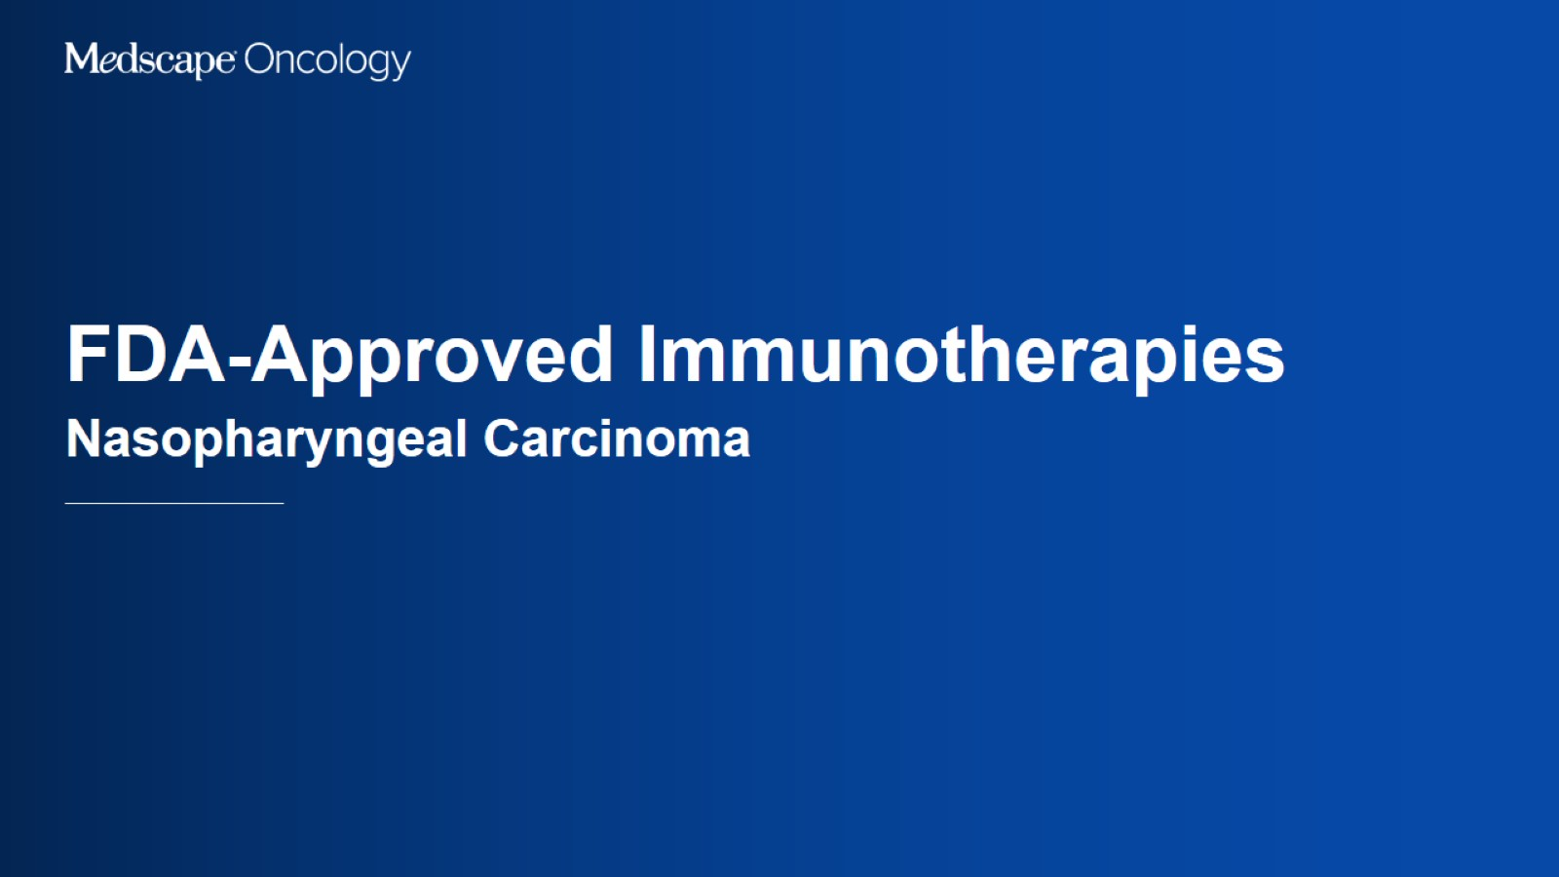
FDA-Approved Immunotherapies

Slide 12
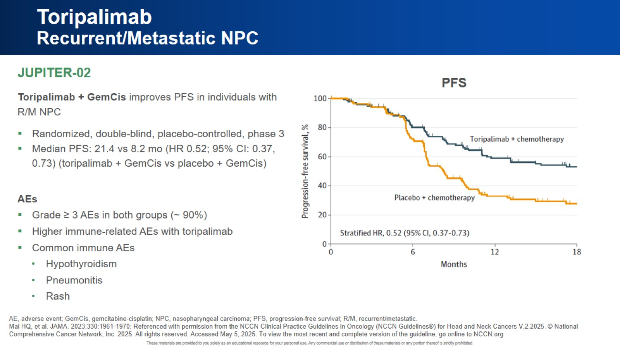
Toripalimab Recurrent/Metastatic NPC

Slide 13
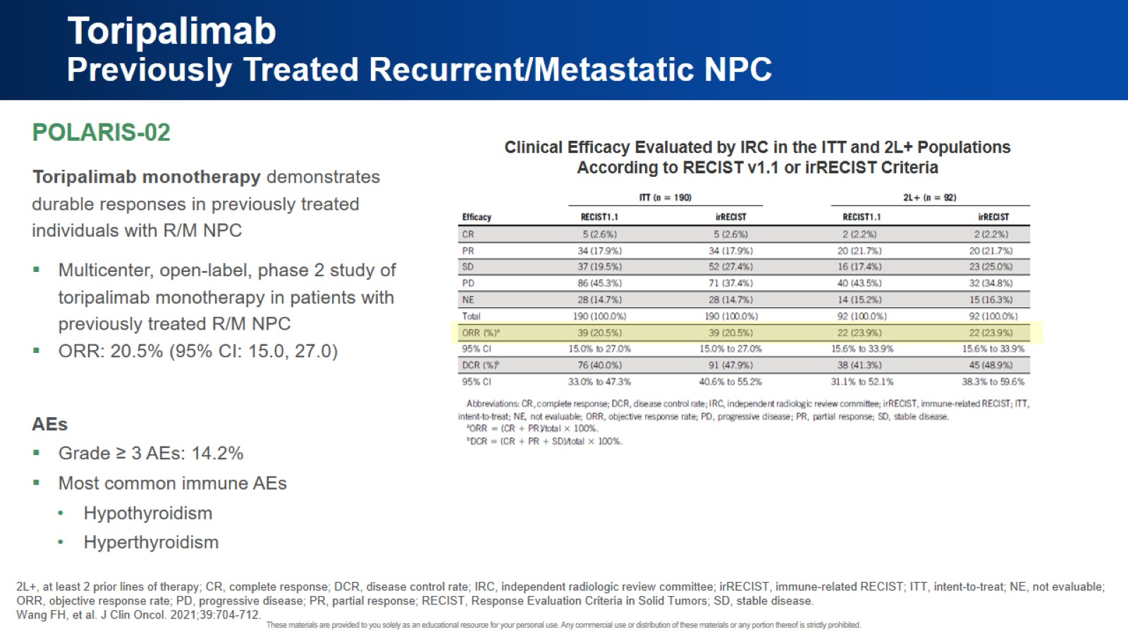
Toripalimab Previously Treated Recurrent/Metastatic NPC

Slide 14
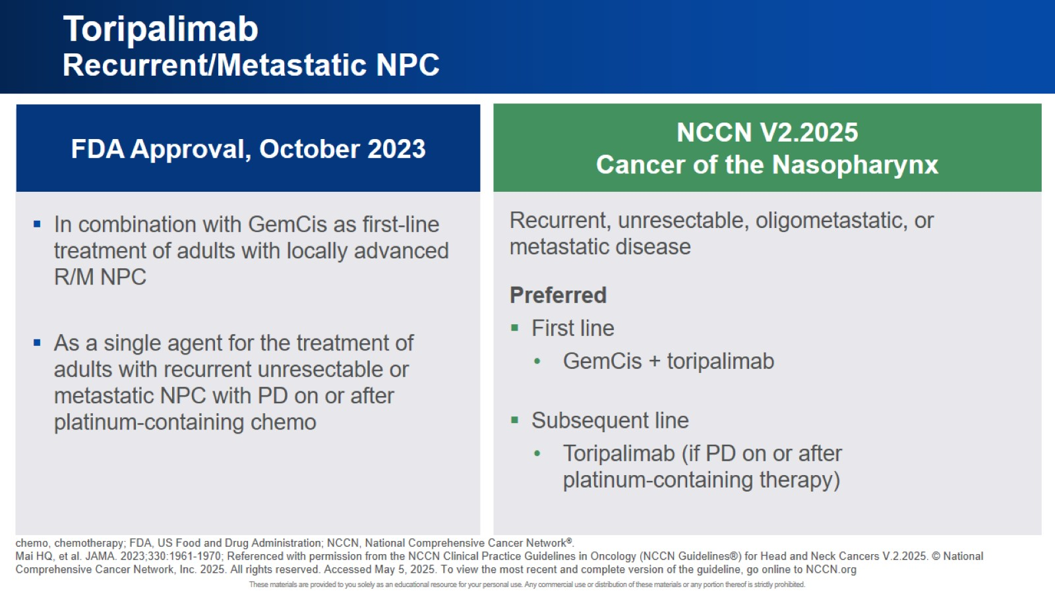
Toripalimab Recurrent/Metastatic NPC

Slide 15
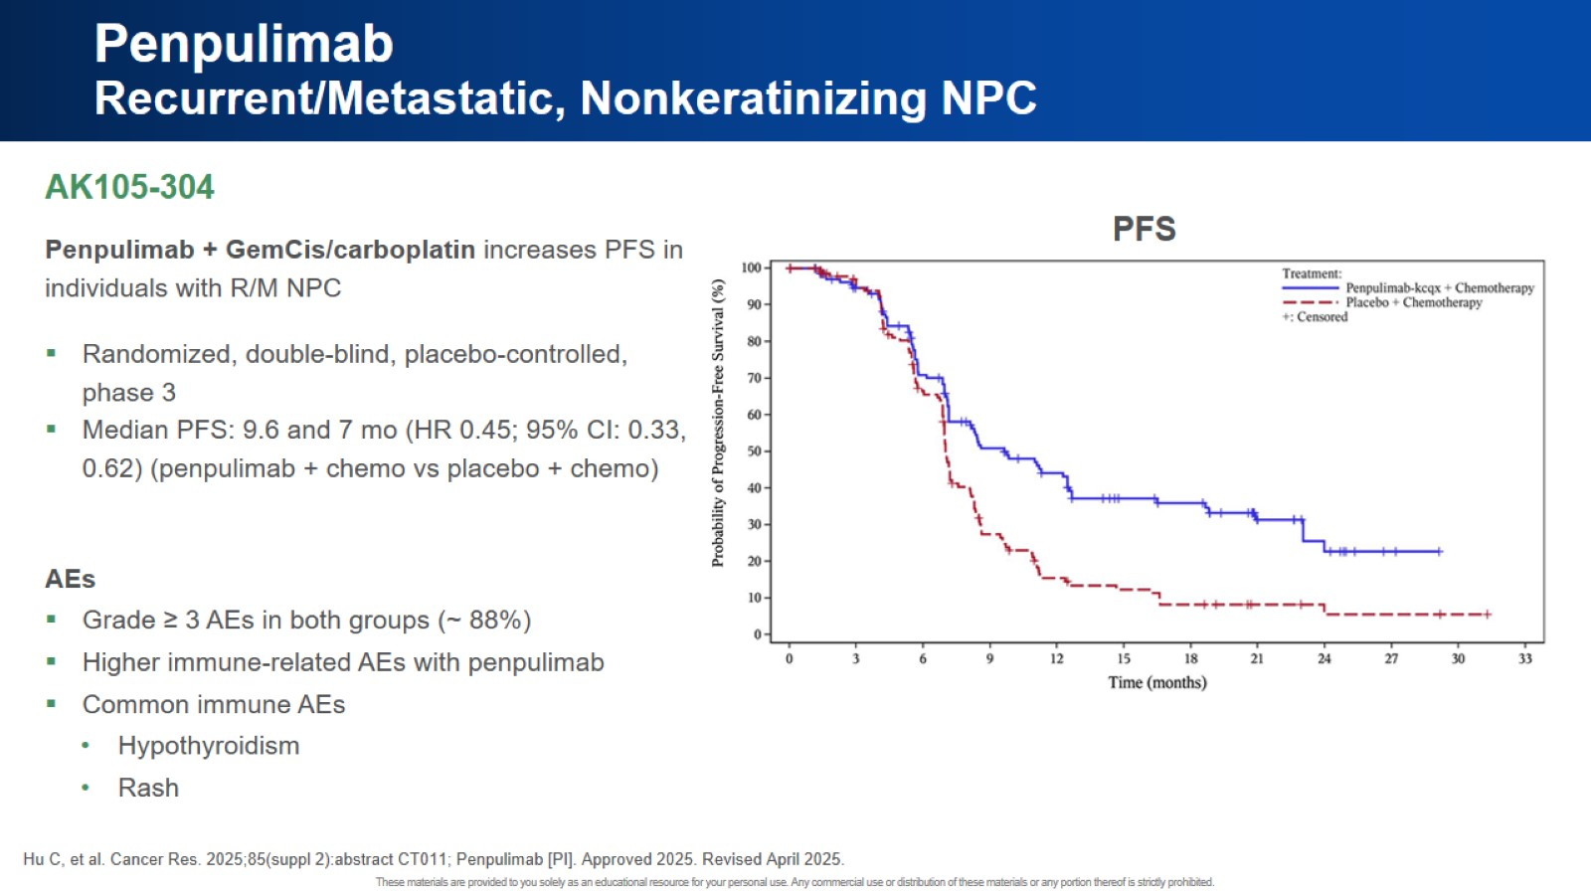
Penpulimab Recurrent/Metastatic, Nonkeratinizing NPC

Slide 16
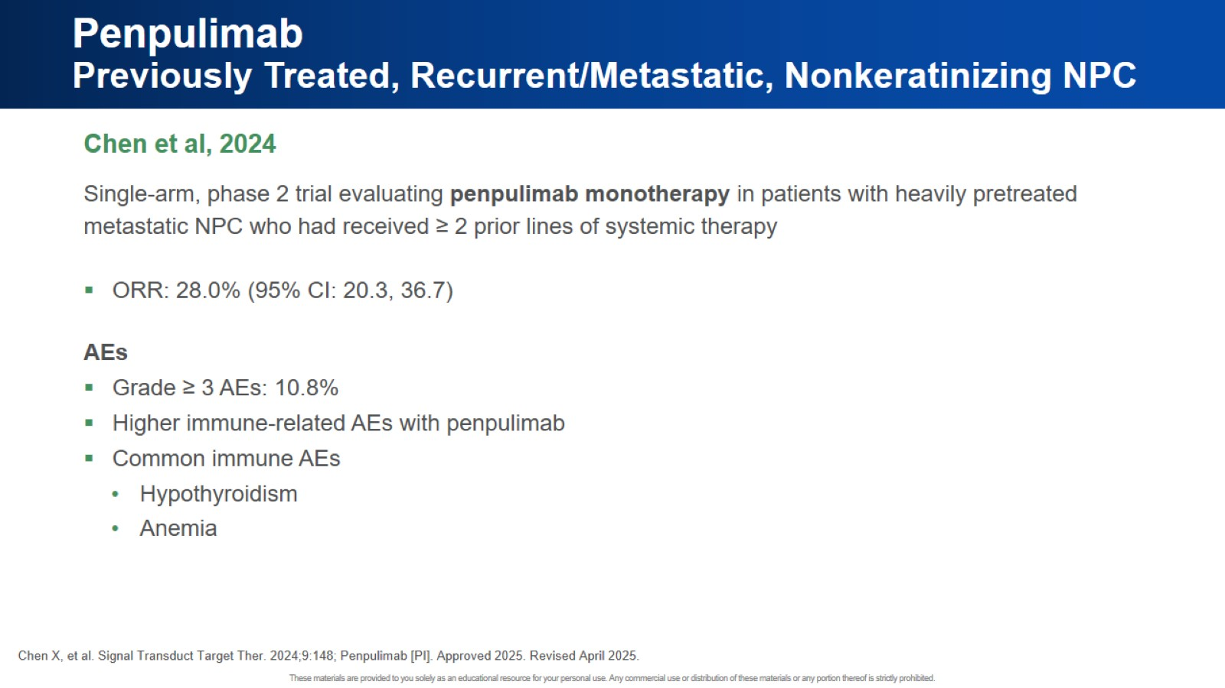
Penpulimab Previously Treated, Recurrent/Metastatic, Nonkeratinizing NPC

Slide 17
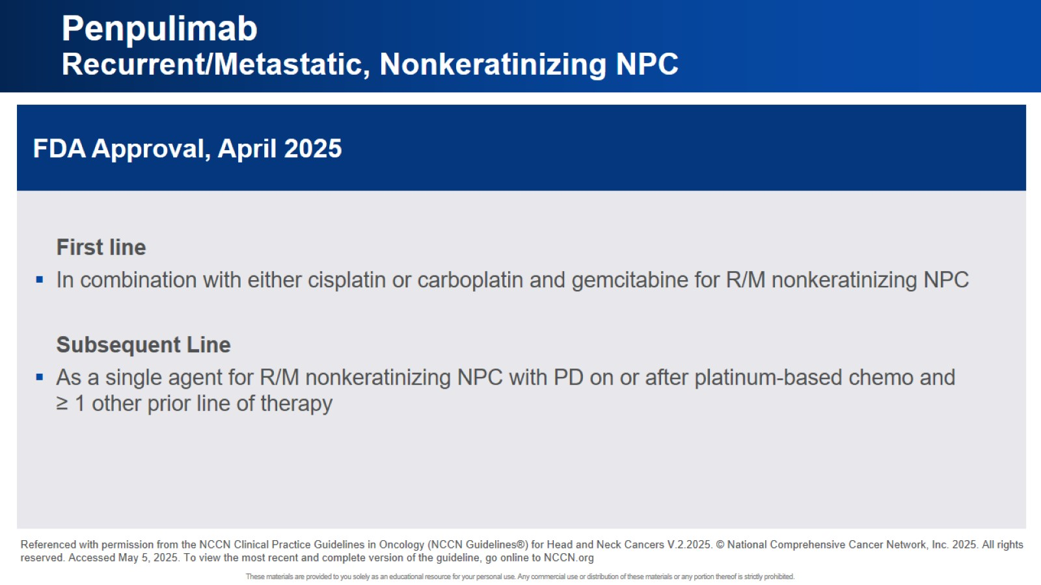
Penpulimab Recurrent/Metastatic, Nonkeratinizing NPC

Slide 18
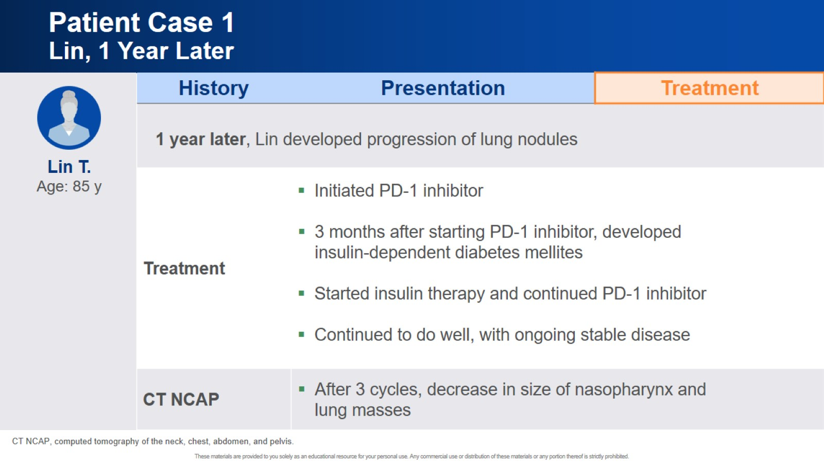
Patient Case 1 Lin, 1 Year Later

Slide 19

Patient Case 2

Slide 20
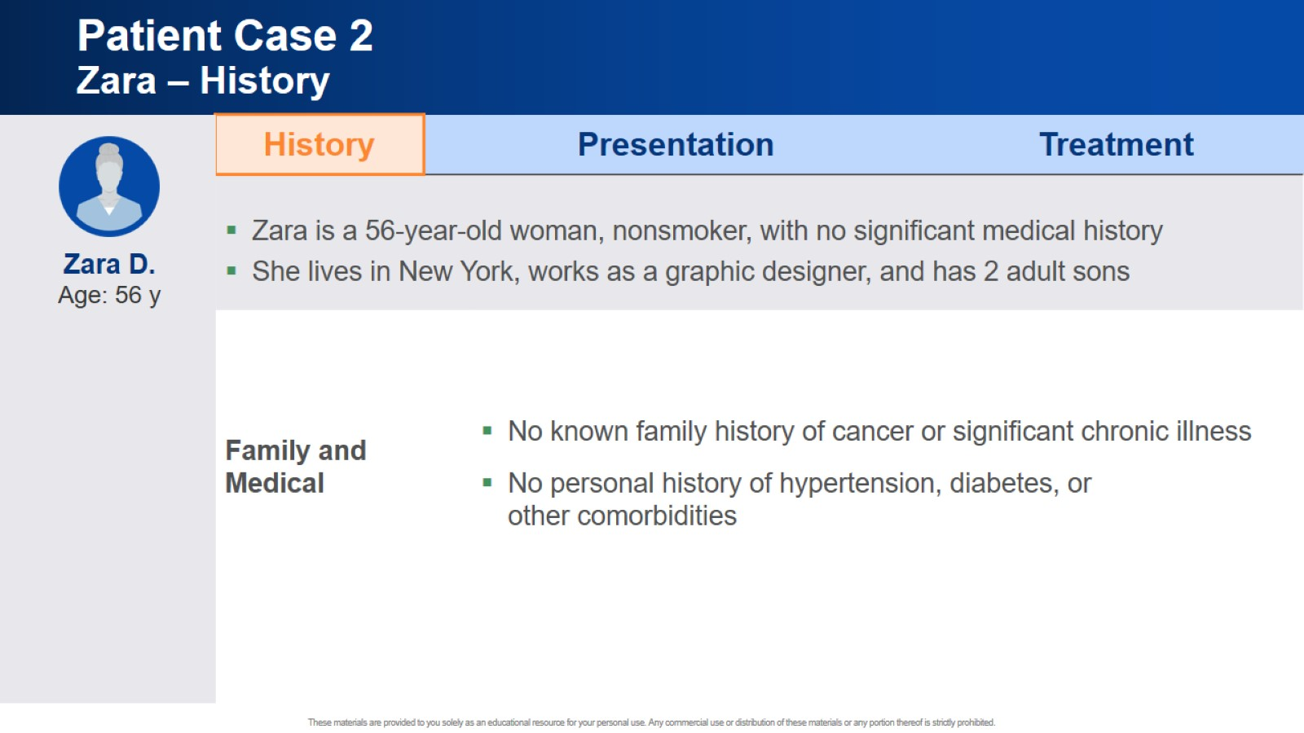
Patient Case 2 Zara – History

Slide 21
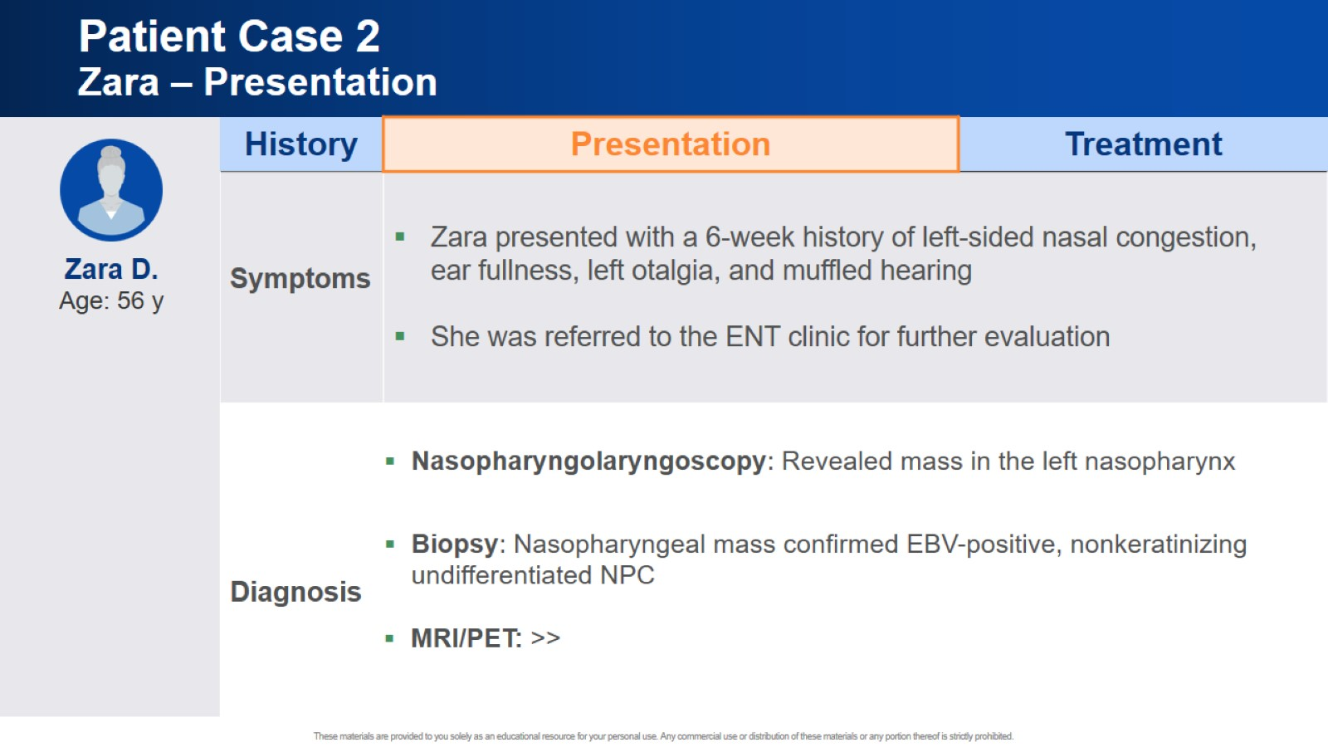
Patient Case 2 Zara – Presentation

Slide 22
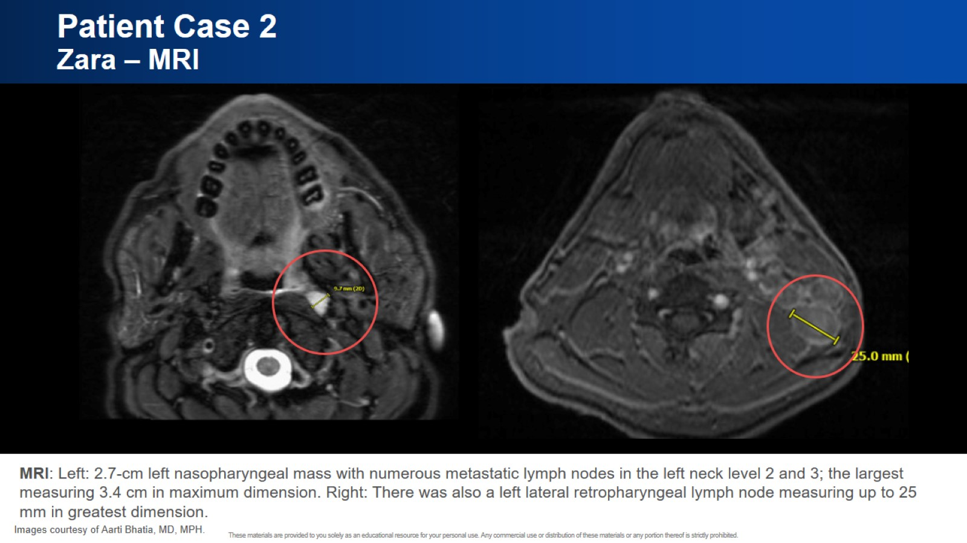
Patient Case 2 Zara – MRI

Slide 23
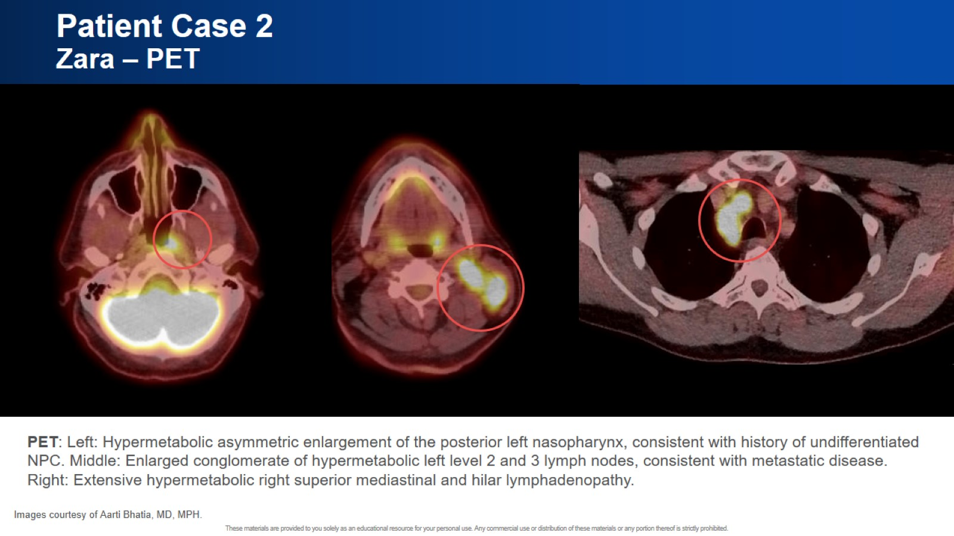
Patient Case 2 Zara – PET

Slide 24
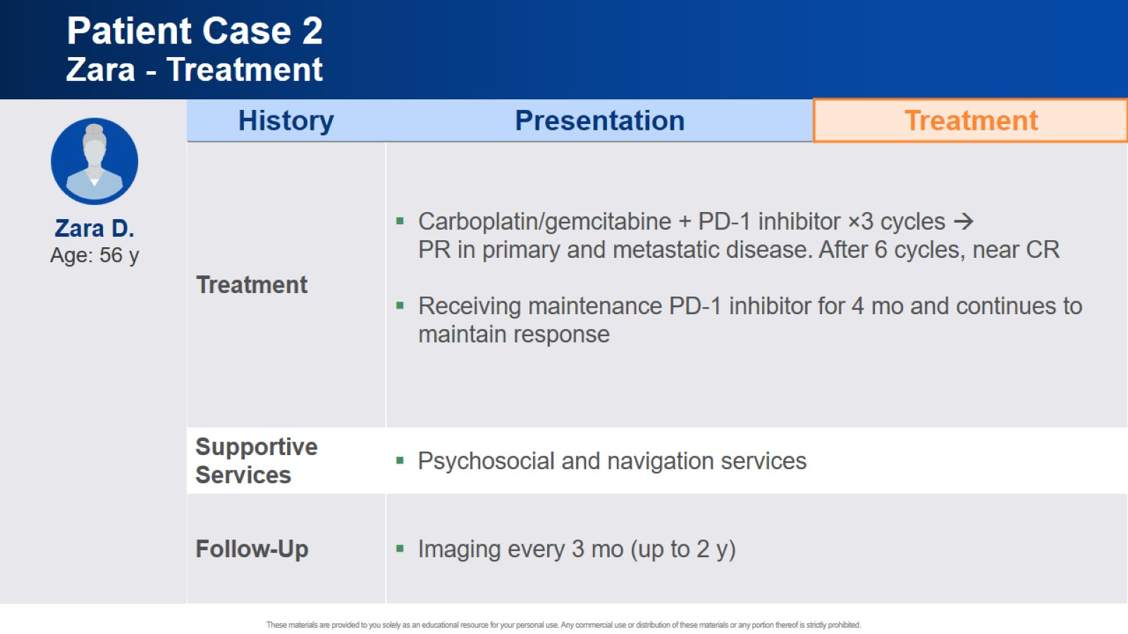
Patient Case 2 Zara - Treatment

Slide 25

Managing Potential Immune-Related Adverse Events

Slide 26
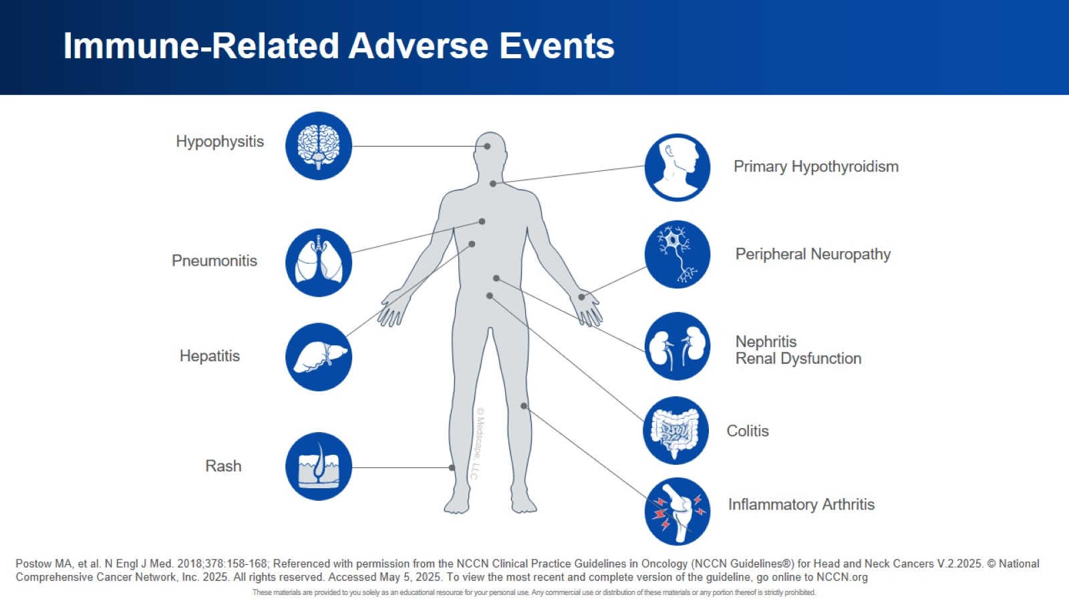
Immune-Related Adverse Events

Slide 27

Future Directions/Ongoing Research

Slide 28
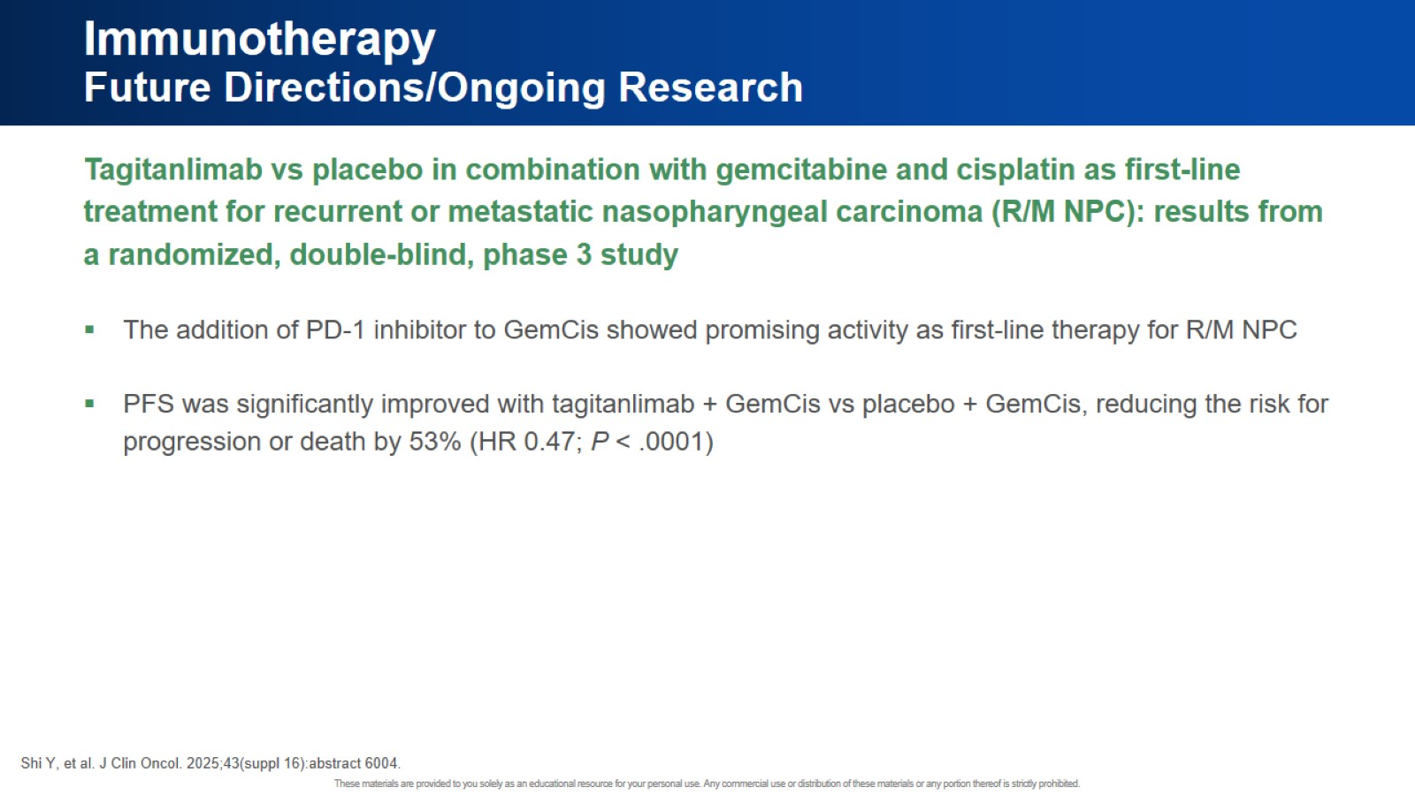
Immunotherapy Future Directions/Ongoing Research

Slide 29
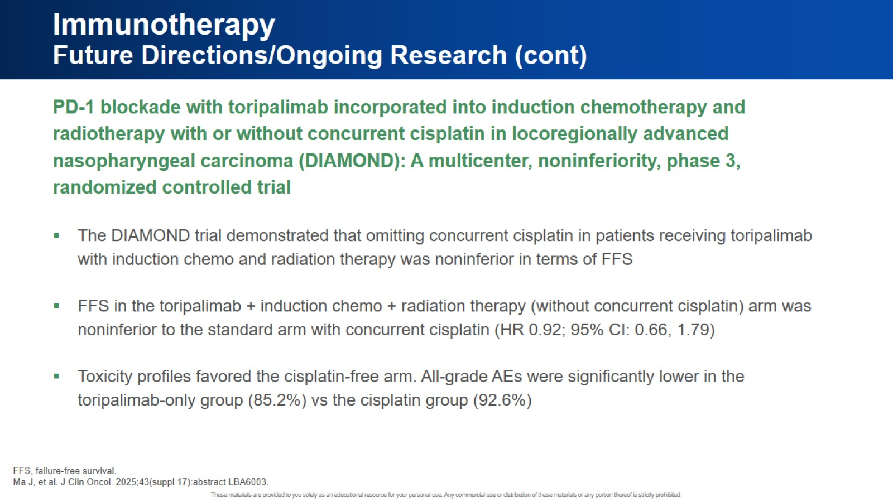
Immunotherapy Future Directions/Ongoing Research (cont)

Slide 30
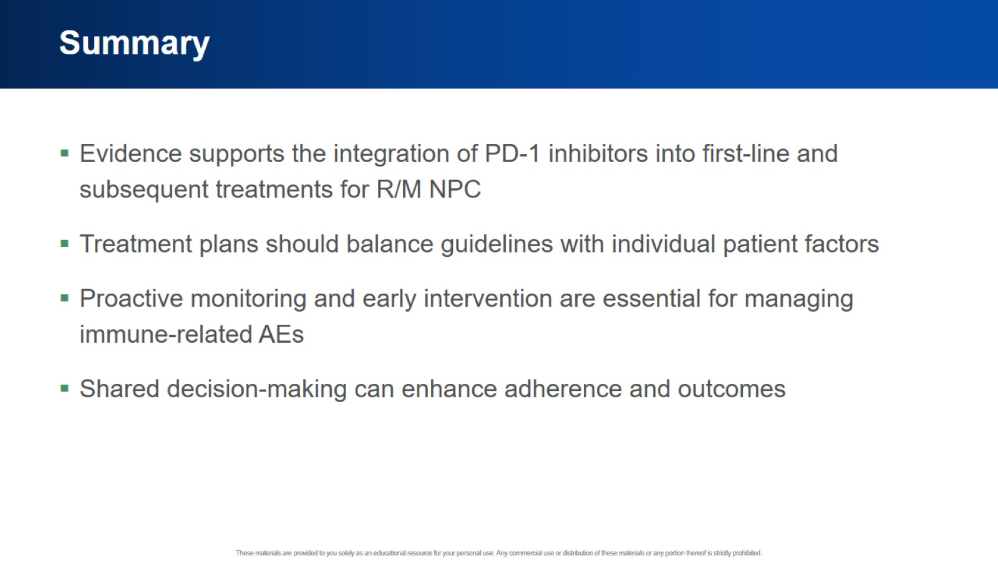
Summary

Slide 31

What is 1 actionable step you will take in your practice based on today’s session?

Slide 32


