Slide 1
Framing the Future of Topical Therapies for Atopic Dermatitis
Moderator
Lawrence F. Eichenfield, MD
Distinguished Professor of Dermatology and Pediatrics
Vice Chair, Department of Dermatology
University of California, San Diego
Chief, Pediatric and Adolescent Dermatology
Rady Children’s Hospital, San Diego
San Diego, California
Notes:
Timecode:

Slide 2
Faculty
FAcUlty
Nanette Silverberg, MD
Clinical Professor of Dermatology and Pediatrics
Icahn School of Medicine at Mount Sinai
Chief, Pediatric Dermatology
Mount Sinai Health Systems
New York, New York
Shanna Miranti, MPAS, PA-C ​
Riverchase Dermatology
Naples, Florida
Notes:
Timecode:

Slide 3

Agenda
In this program, we will discuss the following:
New systemic and topical treatment options in atopic dermatitis
The data behind these new medicines
Optimal use of new treatments in pediatric population
AD, atopic dermatitis.
Notes:
Timecode:
Abbreviations
References

Slide 4

Case 1
Reggie, male, age 4 years
History | AD diagnosed at 18 months
Presentation | 9% to 10% body surface area AD spreading on arms and legs and some on neck and eyelids Intermittent discomfort
Treatment | 2 corticosteroids Low potency for face Higher potency for body
BSA, body surface area.
Notes:
Timecode:
Abbreviations
References

Slide 5

Question
What nonsteroidal options are available for this patient?

Slide 6
Treatment Options
Pimecrolimus^{[1]}
Age 2 years or older
Mild to moderate AD
TCI
Tacrolimus^{[2]}
Age 2 years or older: 0.03%
Age 16 years or older: 0.1%
TCI
Crisaborole^{[3]}
Age 3 months or older
Topical PDE-4 inhibitor
Side effects: burning and stinging
Tapinarof^{[4]}
Age 2 years or older
Topical aryl hydrocarbon receptor agonist
Can be applied anywhere on body
Editor’s note: This program was developed prior to the expanded indication for ruxolitinib on September 19, 2025 to include patients down to 2 years of age and the expanded indication of roflumilast on October 6, 2025 to include patients down to 2 years of age. With those updated indications, ruxolitinib and roflumilast could also be appropriate options for this patient.
PDE-4, phosphodiesterase 4; TCI, topical calcineurin inhibitor.
1. Pimecrolimus [PI]. Approved 2001. Revised March 2014; 2. Tacrolimus [PI]. Approved 1994. Revised December 2020; 3. Crisaborole [PI]. Approved 2016. Revised March 2020; 4. Tapinarof [PI]. Approved 2022. Revised May 2022.
Notes:
Timecode:
Abbreviations
References

Slide 7
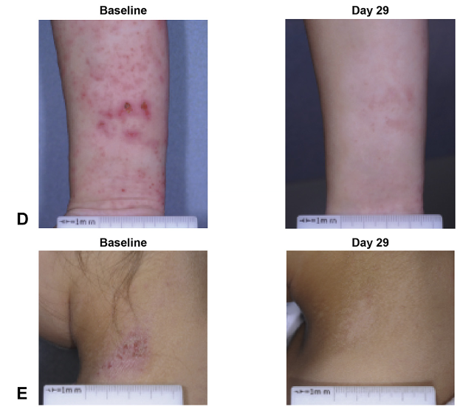
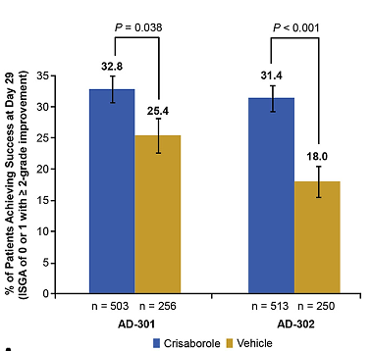
Crisaborole
ISGA, Investigator’s Static Global Assessment.
Paller AS, et al. J Am Acad Dermatol. 2016;75:494-503.e6.
Notes:
Paller AS, Tom WL, Lebwohl MG, Blumenthal RL, Boguniewicz M, Call RS, Eichenfield LF, Forsha DW, Rees WC, Simpson EL, Spellman MC, Stein Gold LF, Zaenglein AL, Hughes MH, Zane LT, Hebert AA. Efficacy and safety of crisaborole ointment, a novel, nonsteroidal phosphodiesterase 4 (PDE4) inhibitor for the topical treatment of atopic dermatitis (AD) in children and adults. J Am Acad Dermatol. 2016 Sep;75(3):494-503.e6. doi: 10.1016/j.jaad.2016.05.046. Epub 2016 Jul 11. Erratum in: J Am Acad Dermatol. 2017 Apr;76(4):777. doi: 10.1016/j.jaad.2017.01.026. PMID: 27417017.

Slide 8
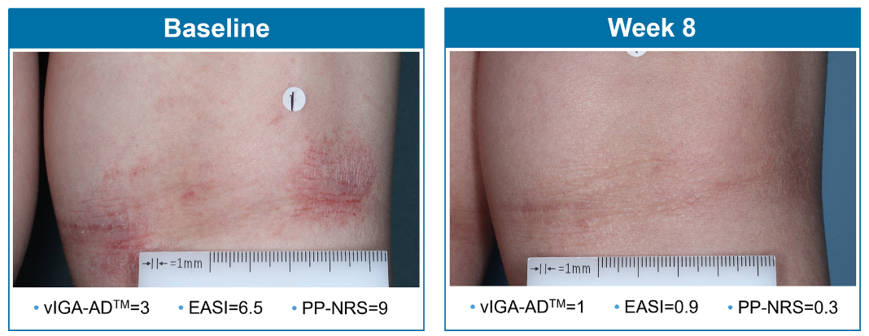
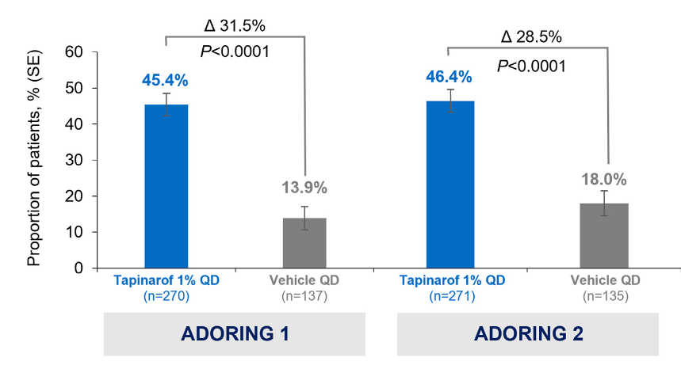
Tapinarof
vIGA-AD Response* at Week 8
EASI, Eczema Area and Severity Index; PP-NRS, Peak Pruritis Numerical Rating Scale; QD, once daily; vIGA-AD, Validated Investigator Global Assessment for Atopic Dermatitis.
Silverberg JI, et al. J Am Acad Dermatol. 2024;91:457-465.
Notes:
Silverberg JI, Eichenfield LF, Hebert AA, Simpson EL, Stein Gold L, Bissonnette R, Papp KA, Browning J, Kwong P, Korman NJ, Brown PM, Rubenstein DS, Piscitelli SC, Somerville MC, Tallman AM, Kircik L. Tapinarof cream 1% once daily: Significant efficacy in the treatment of moderate to severe atopic dermatitis in adults and children down to 2 years of age in the pivotal phase 3 ADORING trials. J Am Acad Dermatol. 2024 Sep;91(3):457-465. doi: 10.1016/j.jaad.2024.05.023. Epub 2024 May 20. PMID: 38777187.

Slide 9




Key Considerations for Selecting a Topical Nonsteroidal
Patient preferences
Patient age
Location of atopic dermatitis
Ease of application
Expert insight.
Notes:
Timecode:
Abbreviations
References

Slide 10

Recommendation for Case 1 Tapinarof
Once-daily application
Can go anywhere on the body
Simplicity
Nonsteroidal
Notes:
Timecode:
Abbreviations
References

Slide 11

Case 2
Samantha, female, age 15 years
History | Moderate AD during childhood
Presentation | AD currently inadequately controlled Eczema on inner thighs, face, and hands Experiencing self image issues
Treatment | Managing with a combination of TCI and TCS
TCS, topical corticosteroid.
Notes:
Timecode:
Abbreviations
References

Slide 12
Case 2
Considerations
Samantha wants an effective, uncomplicated regimen.
She has seen some worrying things about TCS on social media.
Samantha, female, age 15 years
History | Moderate AD during childhood
Presentation | AD currently inadequately controlled Eczema on inner thighs, face, and hands Experiencing self image issues
Treatment | Managing with a combination of TCI and TCS
Notes:
Timecode:
Abbreviations
References

Slide 13





Itch Is a Hallmark Symptom of AD
Can also be experienced as pain
Can peak at night, disturb sleep, impacting quality of life and long-term poor sleep habits
Can lead to absenteeism from or presenteeism at school
Has impact on family well-being/social life/activities
Vicho-de-la-Fuente N, et al. J Adv Nurs. 2025;81:4360-4387.
Notes:
Timecode:
Abbreviations
References

Slide 14



Treatment Options for Samantha
Roflumilast^{[1]}
Topical PDE-4 inhibitor
0.15%
Age 6 years or older
Tapinarof^{[2]}
Age 2 years or older
Topical aryl hydrocarbon receptor agonist
Nonsteroidal
Can be applied anywhere on body
Most recently approved
Ruxolitinib^{[3]}
Topical JAK inhibitor
Age 12 years or older
Maximum BSA 20%
JAK, Janus kinase.
1. FDA. Roflumilast PI. 2018; 2. FDA. Tapinarof PI. 2022; 3. FDA. Ruxolitinib PI. 2018.
Notes:
Timecode:
Abbreviations
References

Slide 15
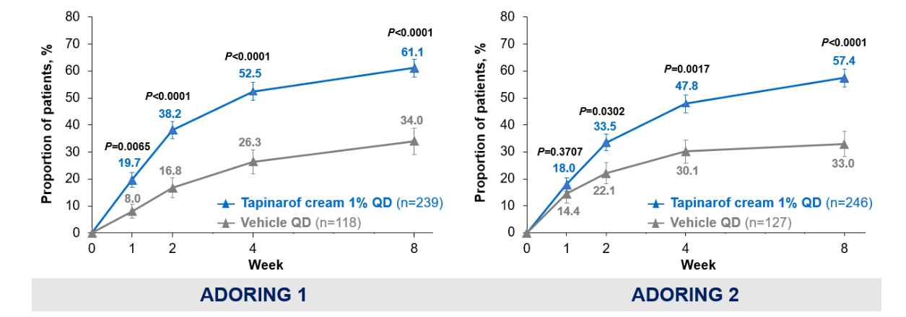
Itch Improvement Tapinarof
Early and statistically significant achievement of a minimum 4-point improvement in PP-NRS from baseline through week 8 with tapinarof cream 1% once daily in ADORING trials 1 and 2.
Simpson EL, et al. J Drugs Dermatol. 2025;24:600-607.
Notes:
Simpson EL, Silverberg JI, Bissonnette R, Stein Gold L, Armstrong A, Hebert AA, Serrao RT, Jakus JR, Brown PM, Rubenstein DS, Piscitelli SC, Tallman AM, Eichenfield LF. Rapid Onset of Itch Relief With Tapinarof in Two Phase 3 Trials in Atopic Dermatitis. J Drugs Dermatol. 2025 Jun 1;24(6):600-607. doi: 10.36849/JDD.8860. PMID: 40465504.

Slide 16
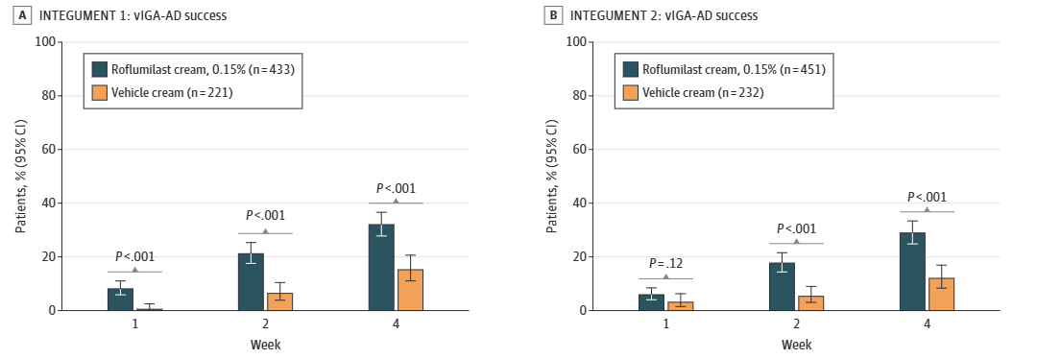
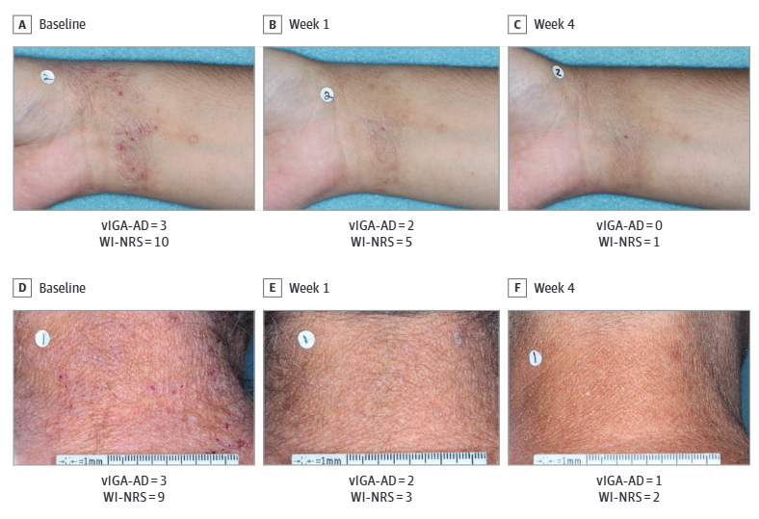
IGA Improvement Roflumilast
WI-NRS, Worst Itch Numeric Rating Scale.
Simpson EL, et al. JAMA Dermatol. 2024;160:1161-1170.

Slide 17
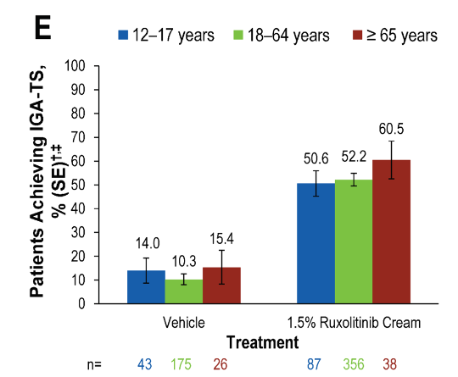
IGA Improvement Ruxolitinib
IGA-TS, Investigator’s Global Assessment treatment success.
Eichenfield LF, et al. Am J Clin Dermatol. 2024;25:669-683.
Notes:
Eichenfield LF, Simpson EL, Papp K, Szepietowski JC, Blauvelt A, Kircik L, Silverberg JI, Siegfried EC, Kuligowski ME, Venturanza ME, Kallender H, Ren H, Paller AS. Efficacy, Safety, and Long-Term Disease Control of Ruxolitinib Cream Among Adolescents with Atopic Dermatitis: Pooled Results from Two Randomized Phase 3 Studies. Am J Clin Dermatol. 2024 Jul;25(4):669-683. doi: 10.1007/s40257-024-00855-2. Epub 2024 May 2. PMID: 38698175; PMCID: PMC11193693.

Slide 18
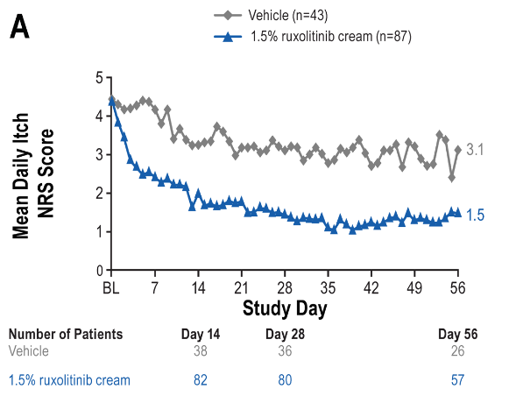
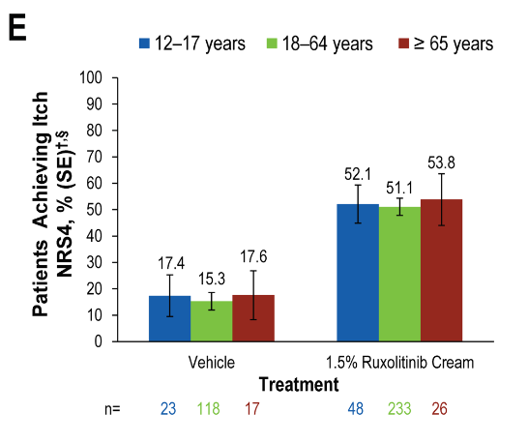
Itch Improvement Ruxolitinb
NRS4, Itch Numerical Rating Scale 4.
Eichenfield LF, et al. Am J Clin Dermatol. 2024;25:669-683.
Notes:
Eichenfield LF, Simpson EL, Papp K, Szepietowski JC, Blauvelt A, Kircik L, Silverberg JI, Siegfried EC, Kuligowski ME, Venturanza ME, Kallender H, Ren H, Paller AS. Efficacy, Safety, and Long-Term Disease Control of Ruxolitinib Cream Among Adolescents with Atopic Dermatitis: Pooled Results from Two Randomized Phase 3 Studies. Am J Clin Dermatol. 2024 Jul;25(4):669-683. doi: 10.1007/s40257-024-00855-2. Epub 2024 May 2. PMID: 38698175; PMCID: PMC11193693.

Slide 19
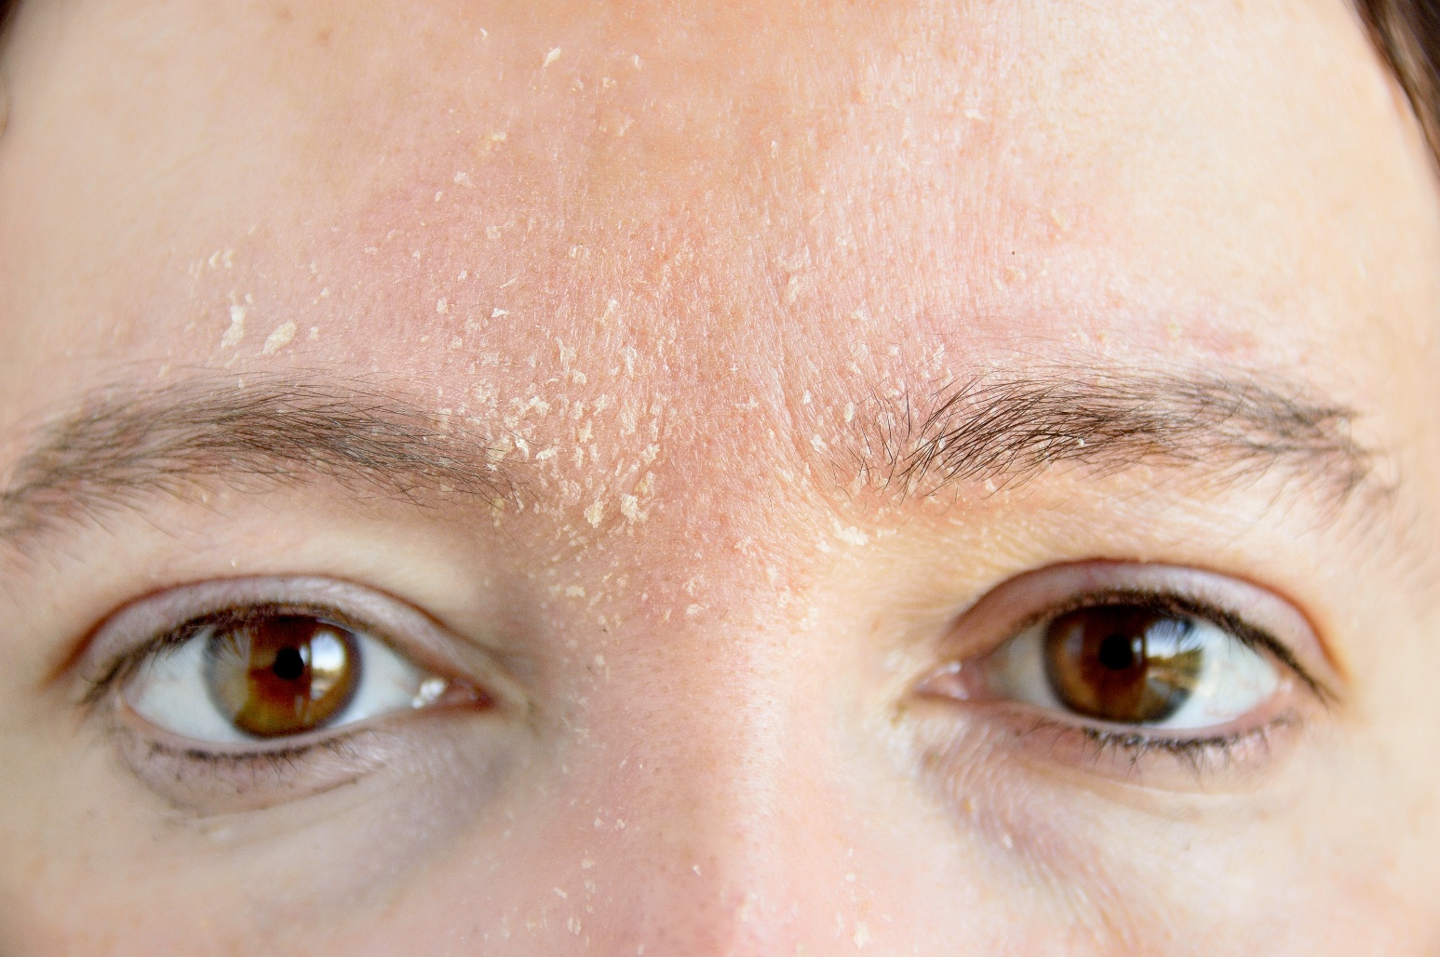
Key Considerations for Selecting a Topical Nonsteroidal in This Case
Patient concerns
Location of AD
Sensitive or troublesome areas
Impact on self image
Ease of application/use
Access
Topical corticosteroid stewardship
Expert opinion.
Notes:
Timecode:
Abbreviations
References

Slide 20

Key Points
New treatments are now available for younger pediatric AD patients
These options require discussion and planning with families and patients
Promising for patients who have been insufficiently managed due to concerns about traditional topical steroids
Notes:
Timecode:
Abbreviations
References

