Slide 1
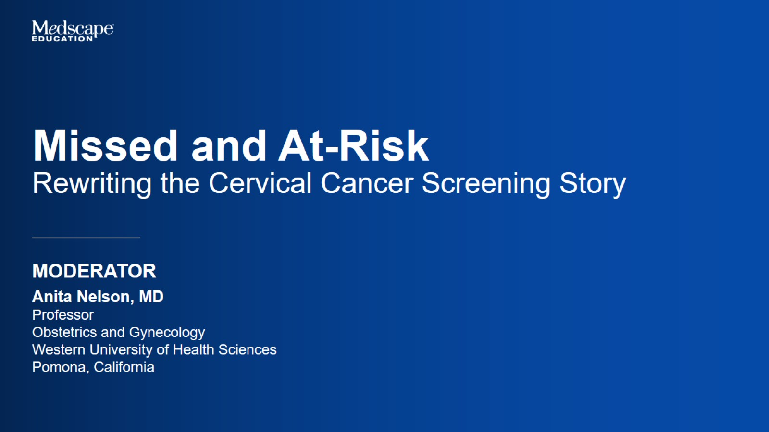

Slide 2


Slide 3
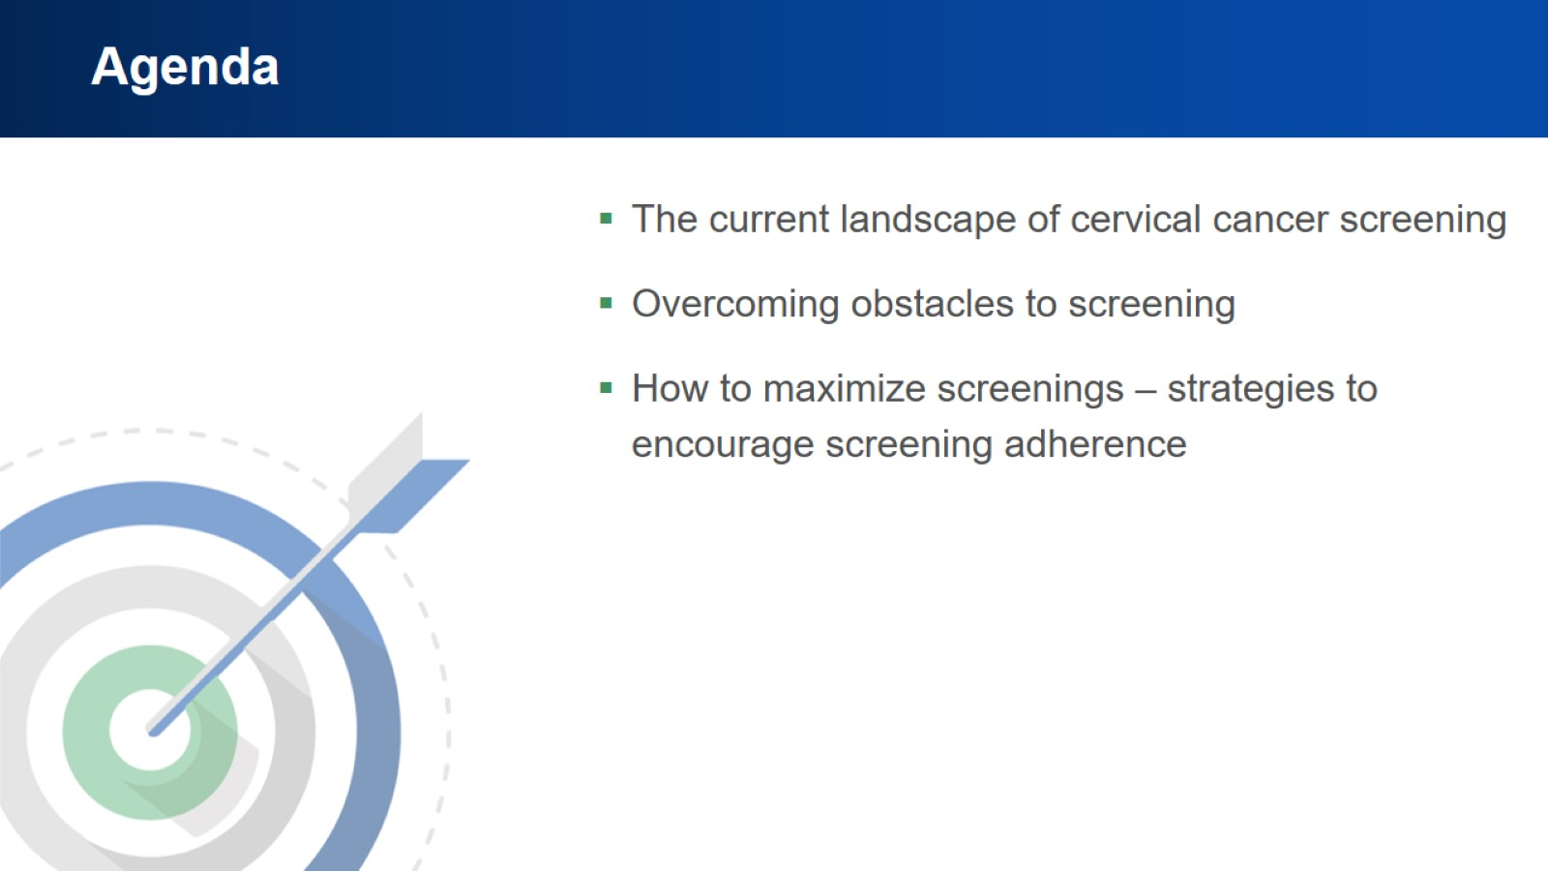
Agenda

Slide 4

Introduction

Slide 5
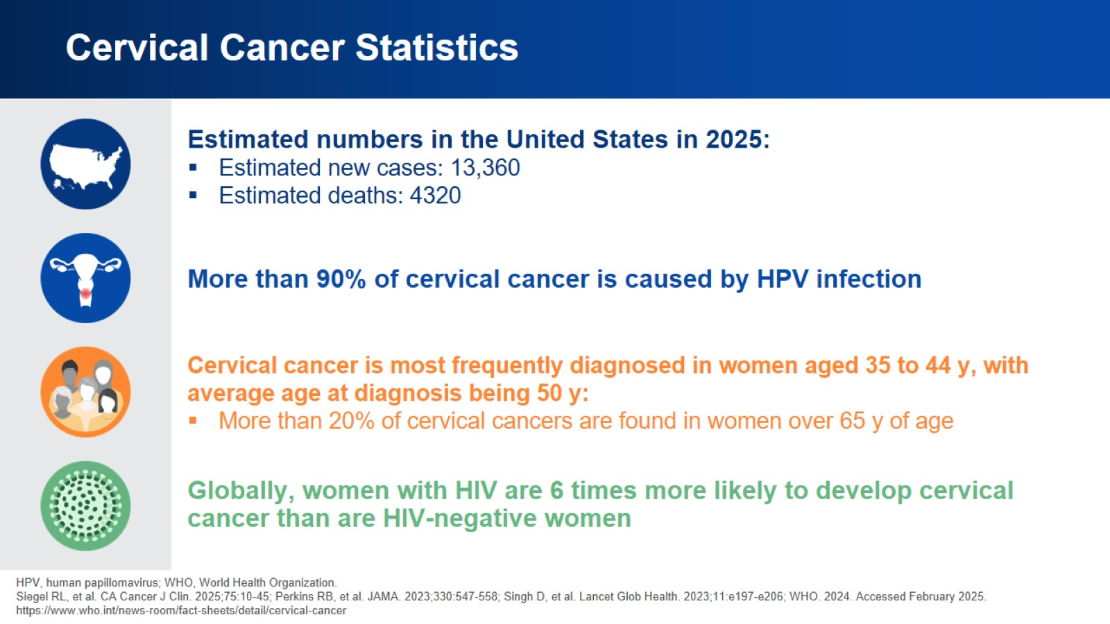
Cervical Cancer Statistics

Slide 6
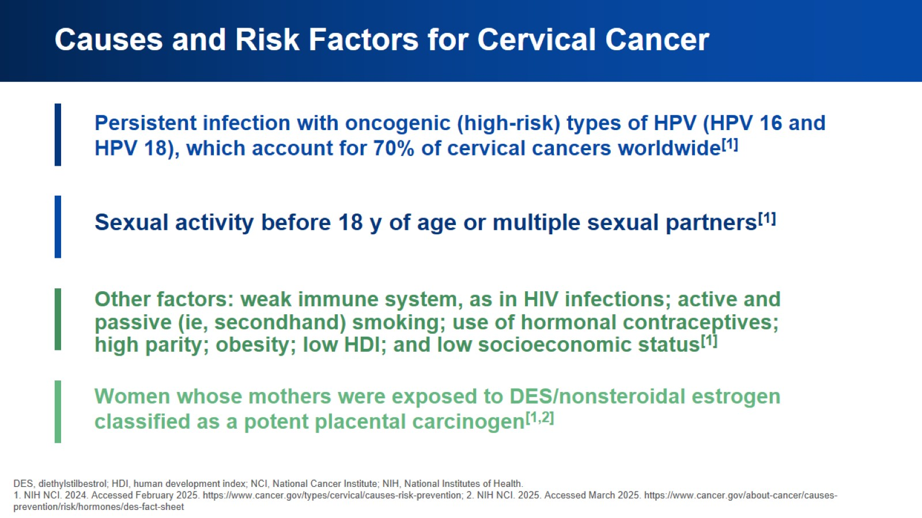
Causes and Risk Factors for Cervical Cancer

Slide 7
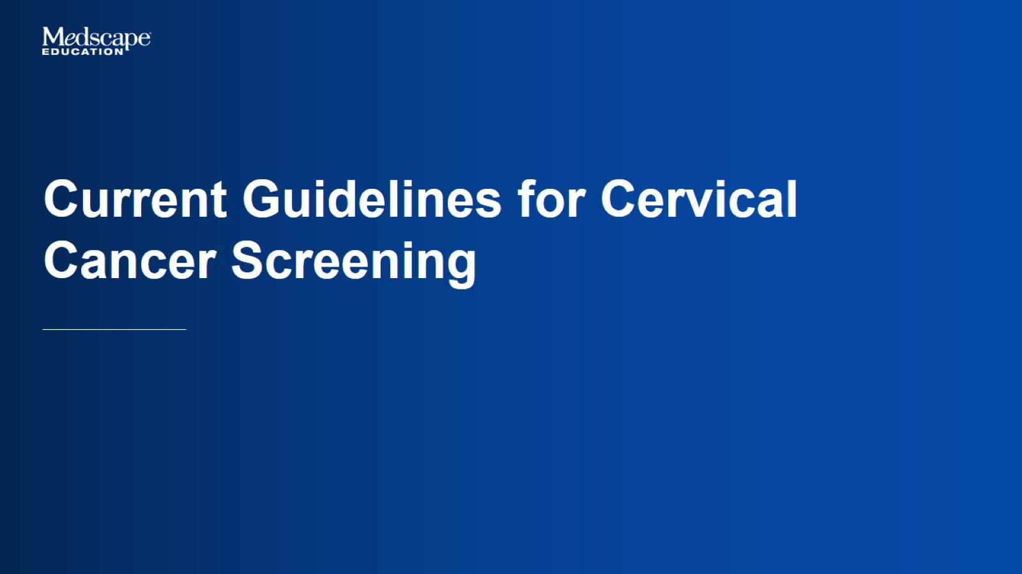
Current Guidelines for Cervical Cancer Screening

Slide 8
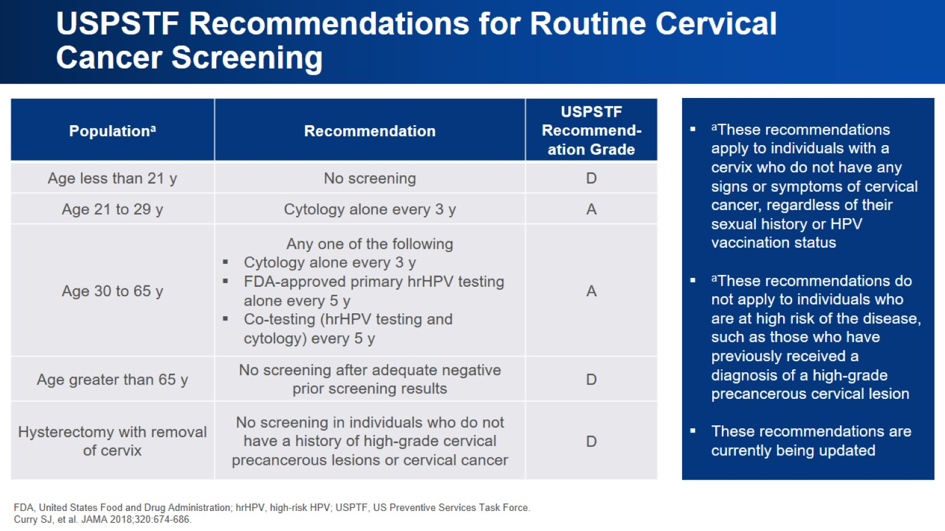
USPSTF Recommendations for Routine Cervical Cancer Screening

Slide 9
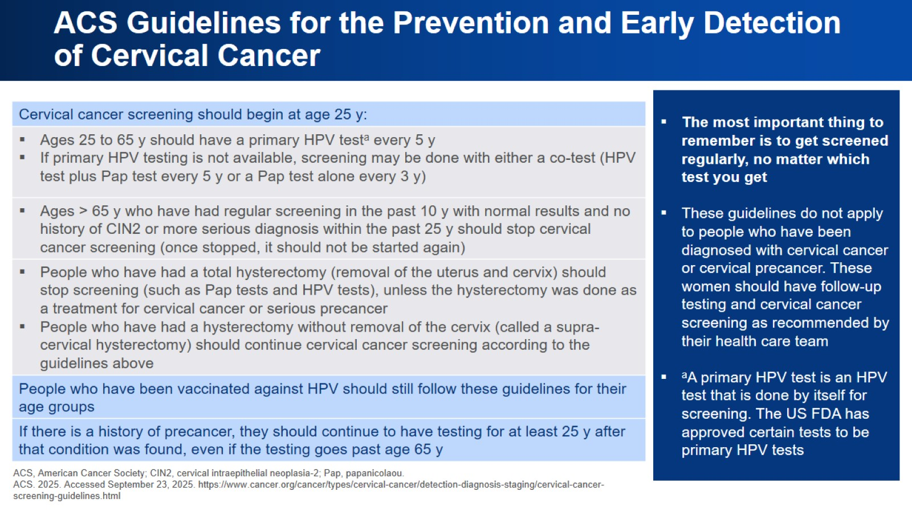
ACS Guidelines for the Prevention and Early Detection of Cervical Cancer

Slide 10
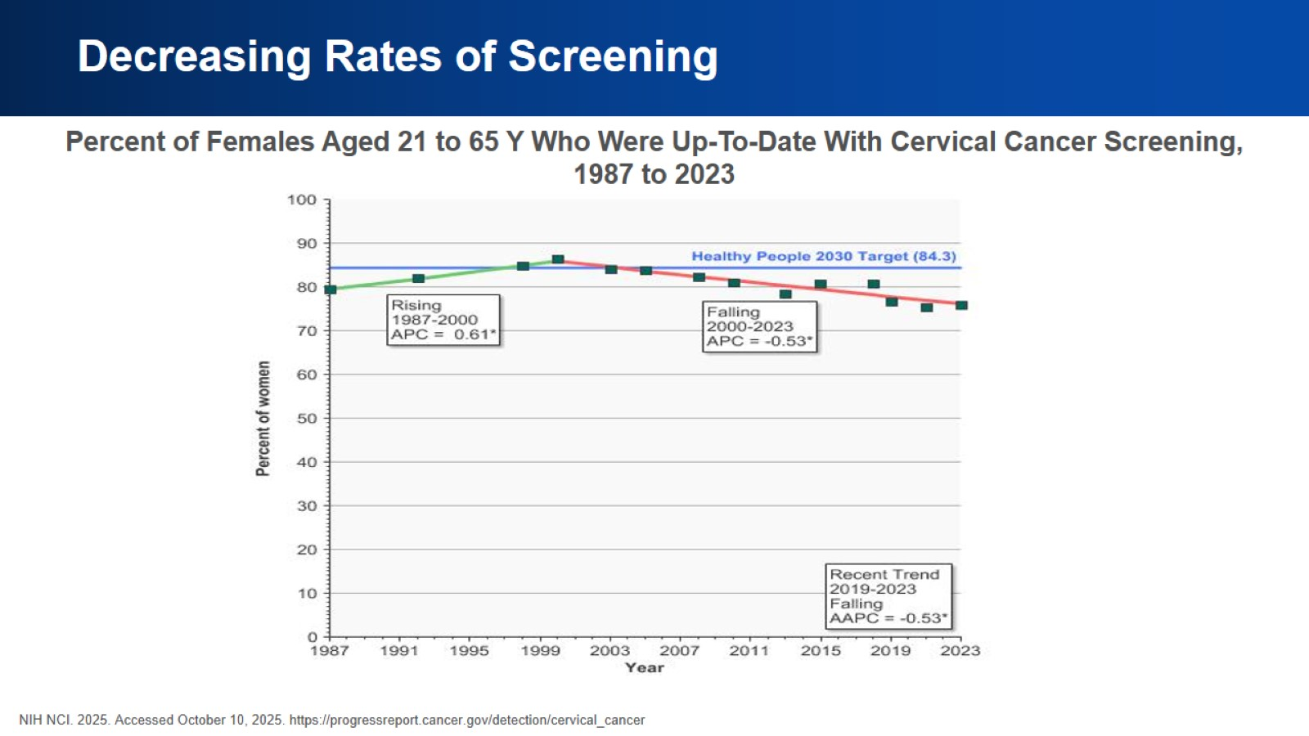
Decreasing Rates of Screening

Slide 11
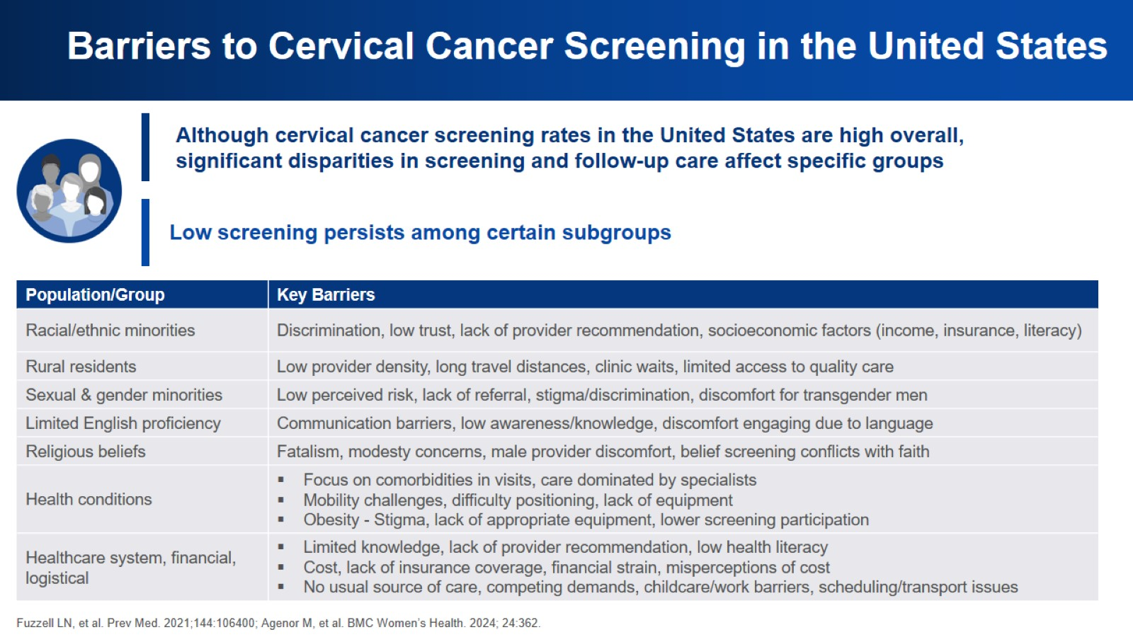
Barriers to Cervical Cancer Screening in the United States

Slide 12

Overcoming Obstacles to Screening

Slide 13
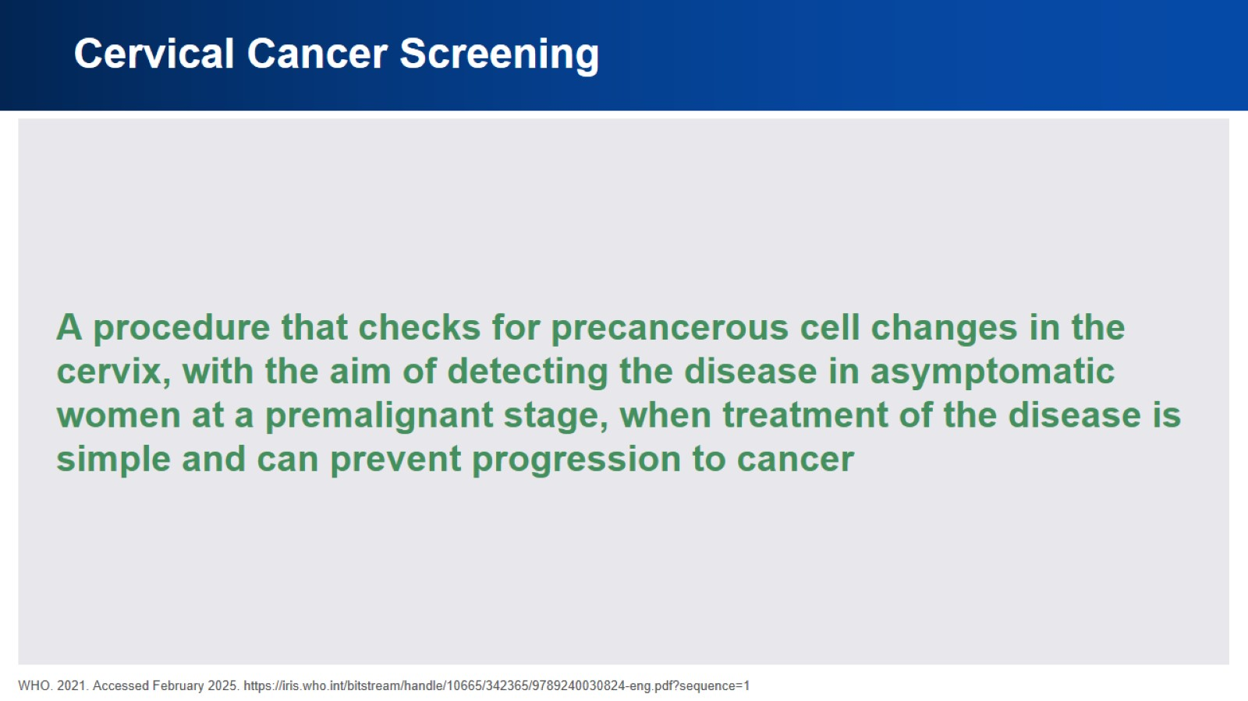
Cervical Cancer Screening

Slide 14
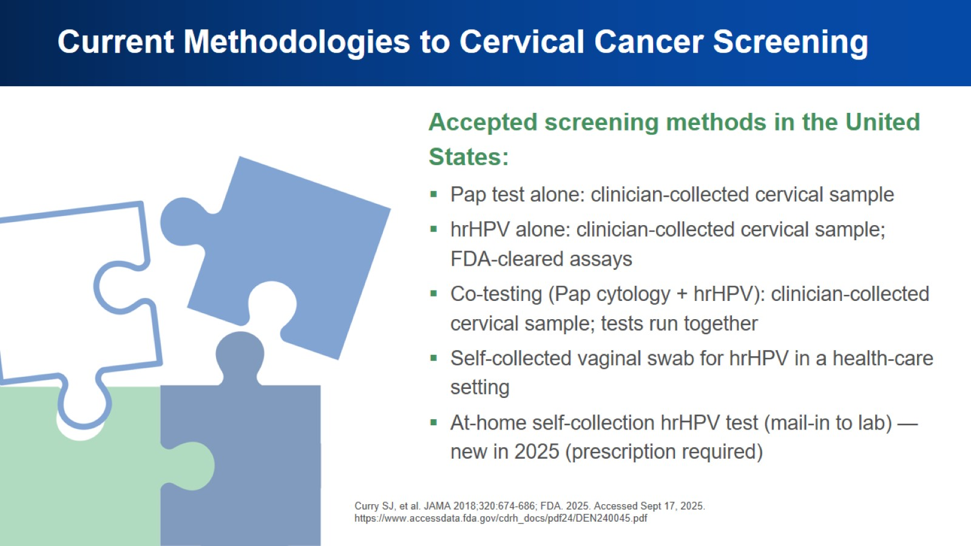
Current Methodologies to Cervical Cancer Screening

Slide 15
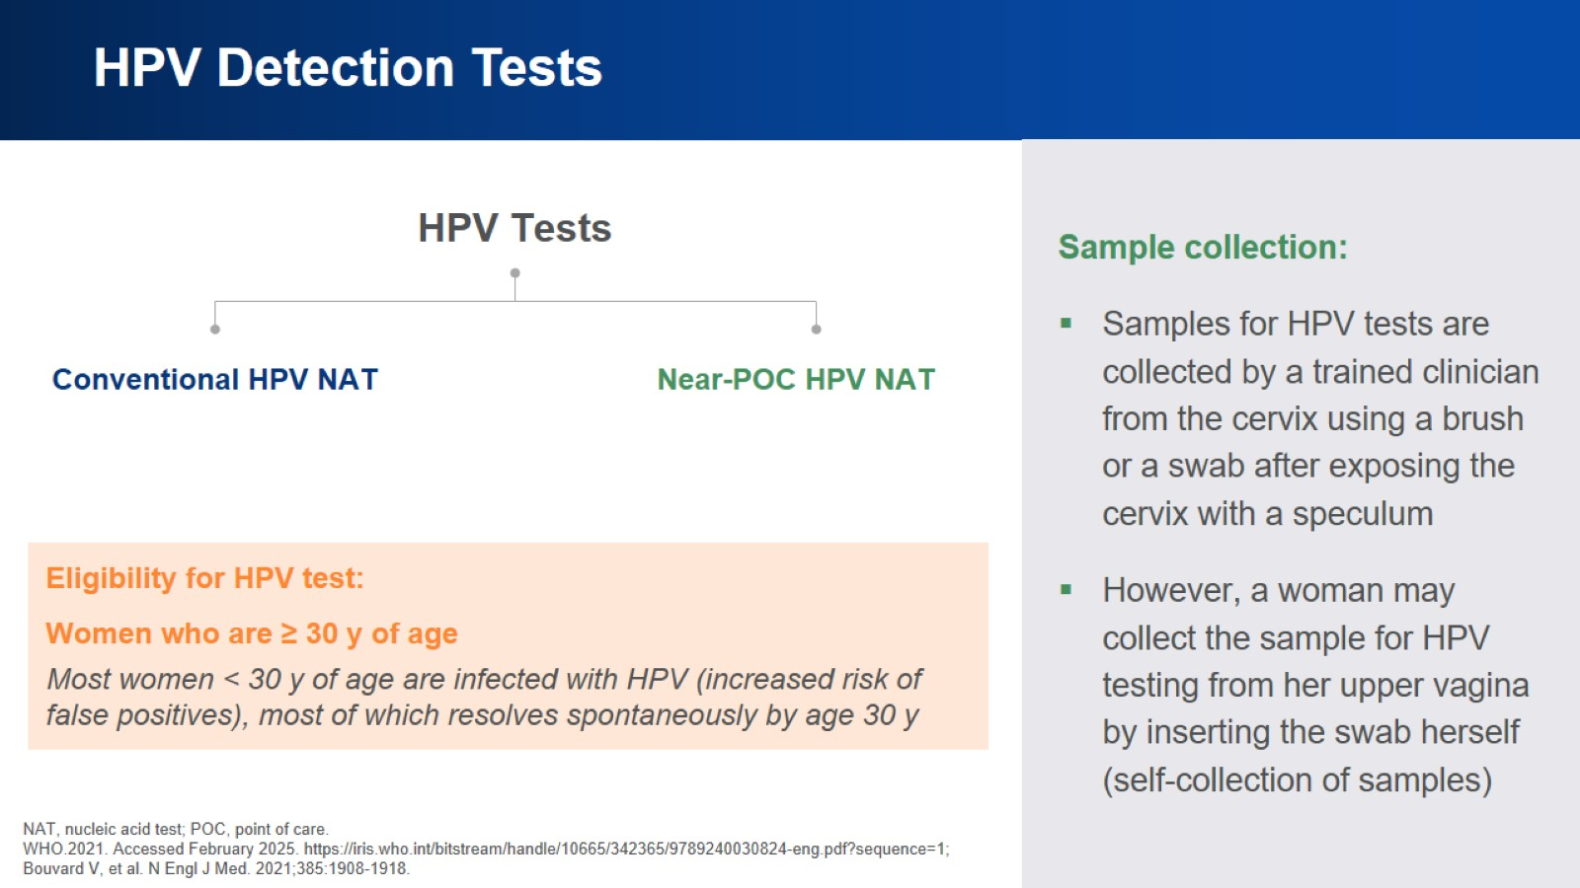
HPV Detection Tests

Slide 16
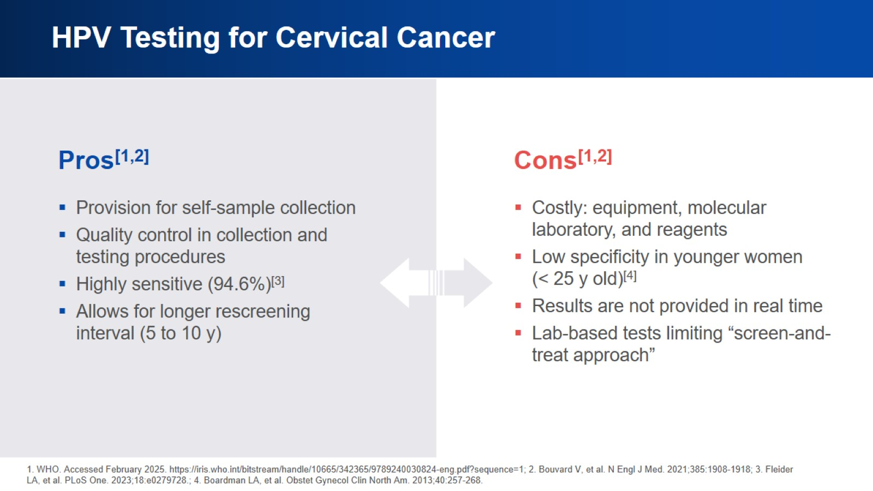
HPV Testing for Cervical Cancer

Slide 17
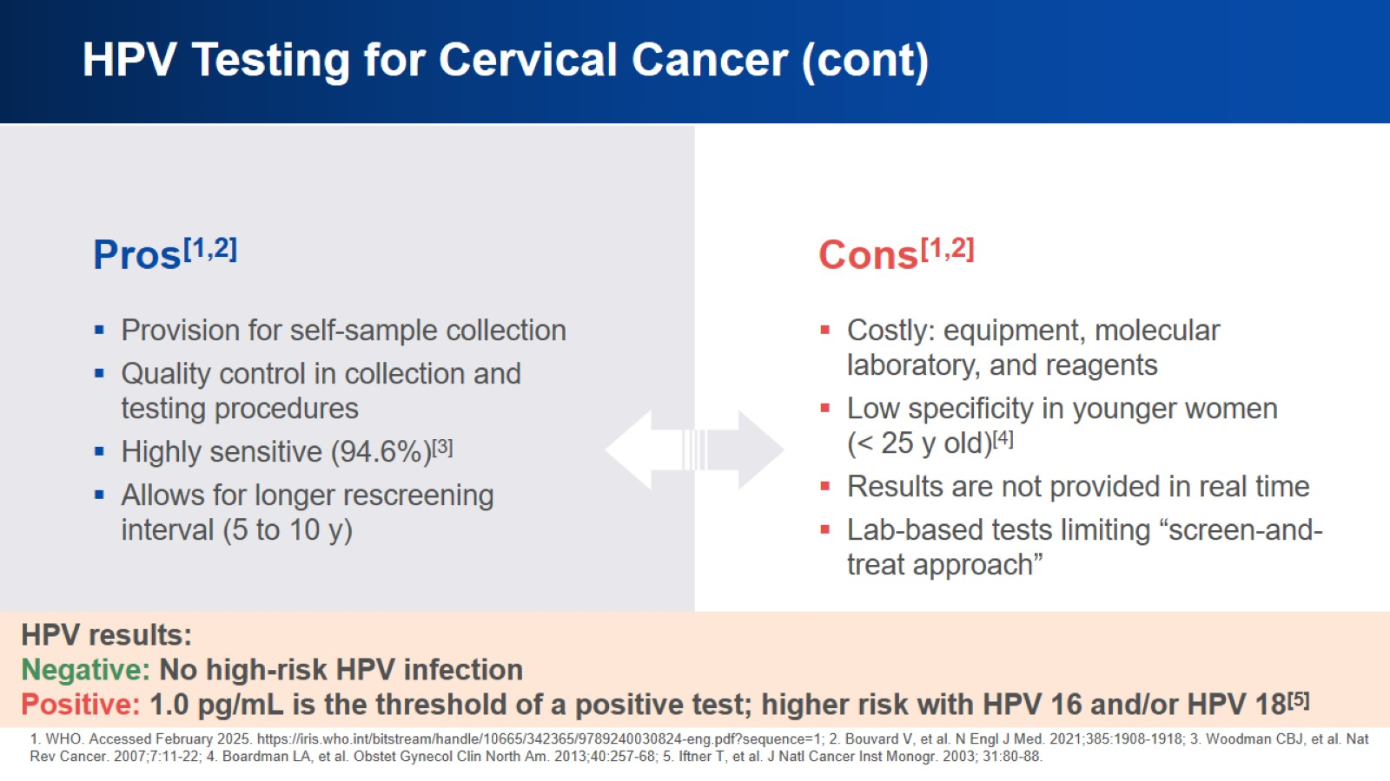
HPV Testing for Cervical Cancer (cont)

Slide 18
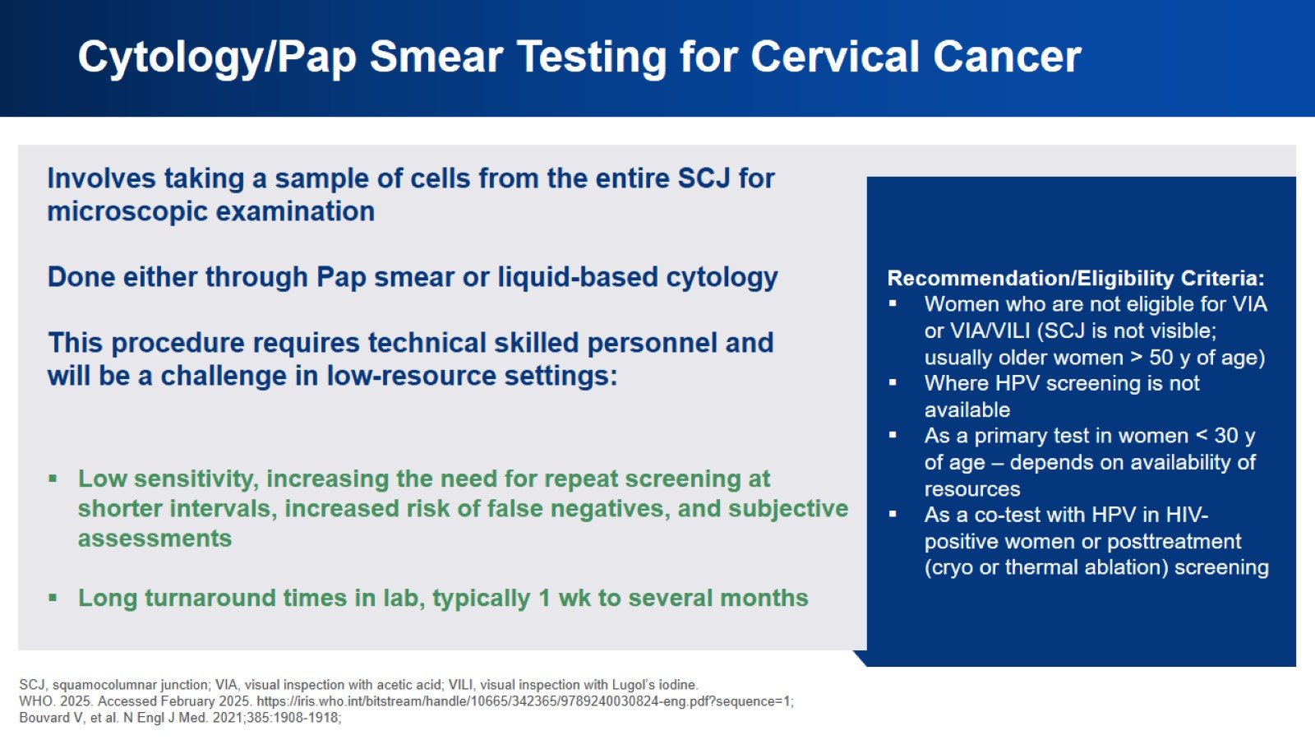
Cytology/Pap Smear Testing for Cervical Cancer

Slide 19
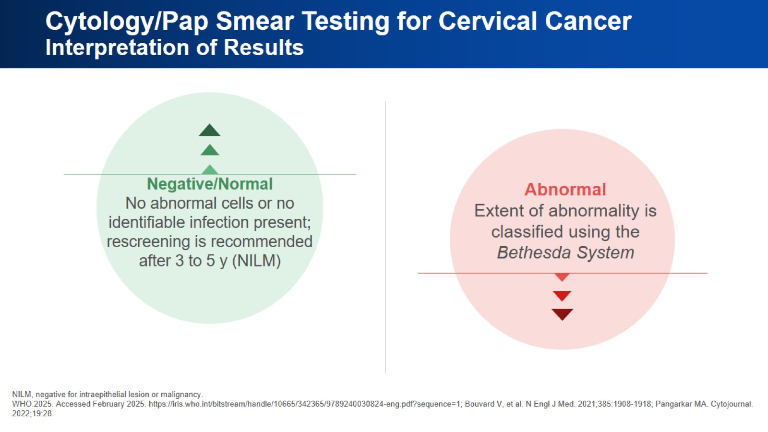
Cytology/Pap Smear Testing for Cervical Cancer
Interpretation of Results

Slide 20
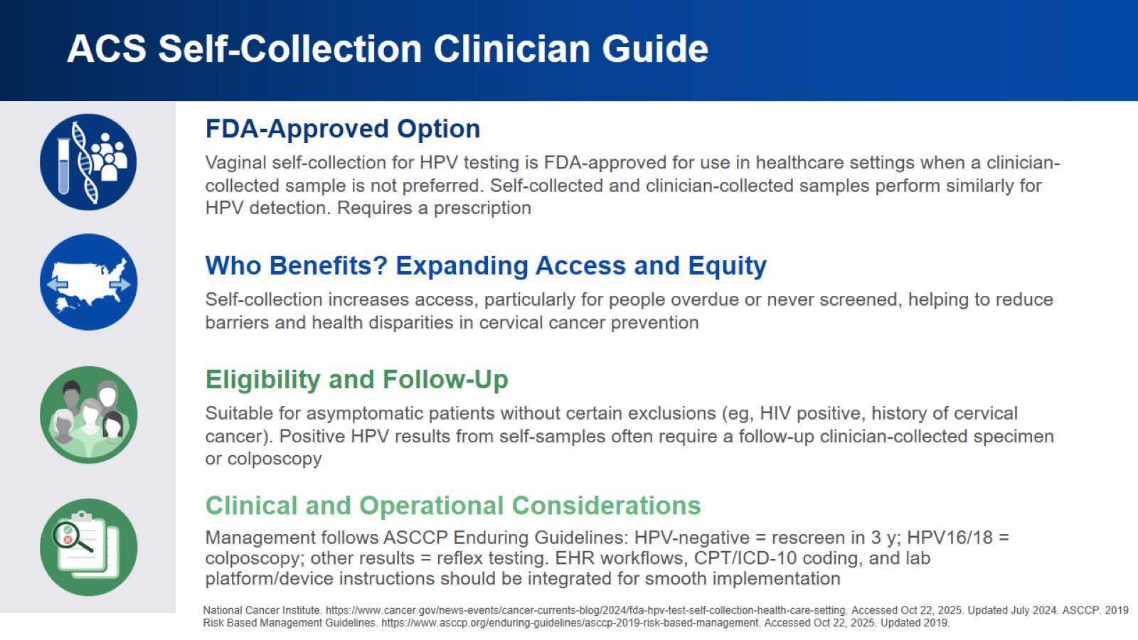
ACS Self-Collection Clinician Guide

Slide 21

Meaningful Conversations to Maximize Screening

Slide 22
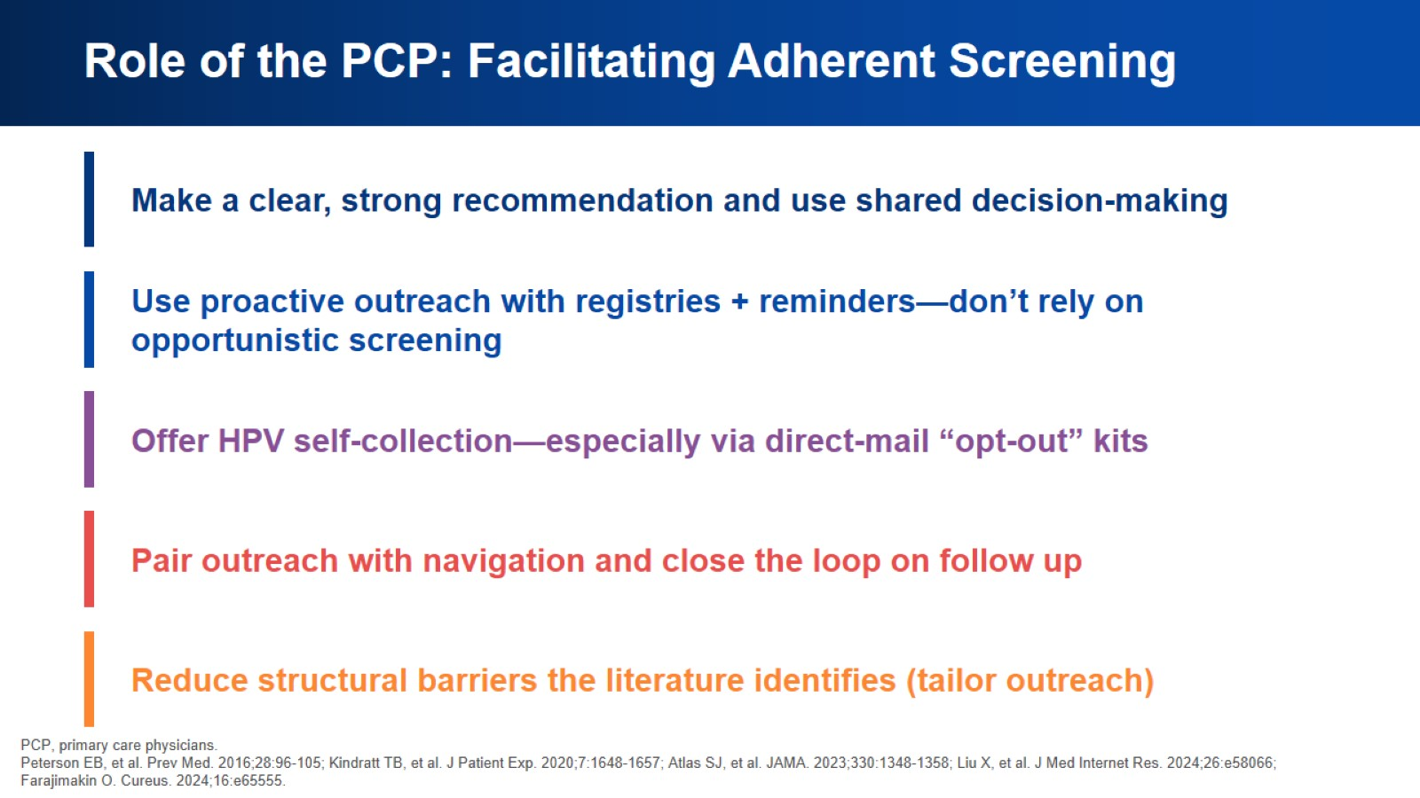
Role of the PCP: Facilitating Adherent Screening

Slide 23
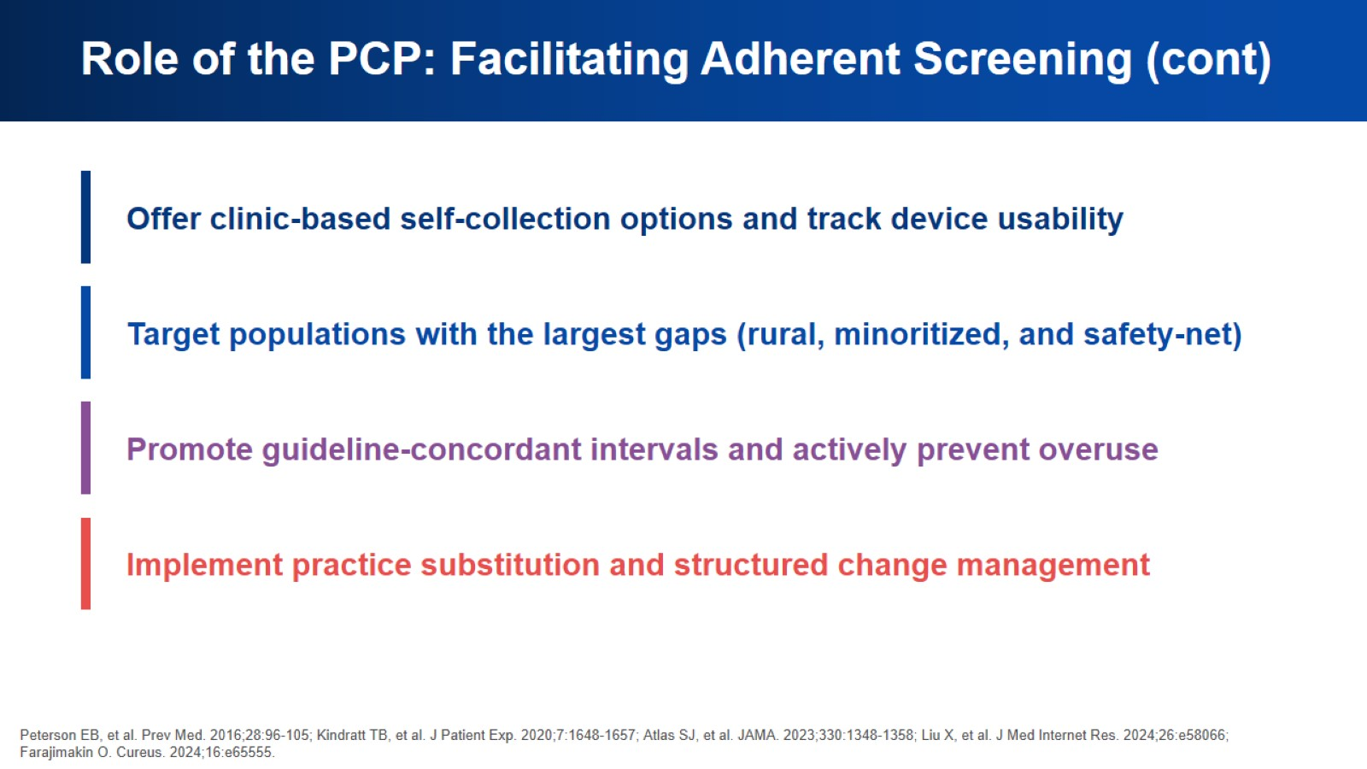
Role of the PCP: Facilitating Adherent Screening (cont)

Slide 24
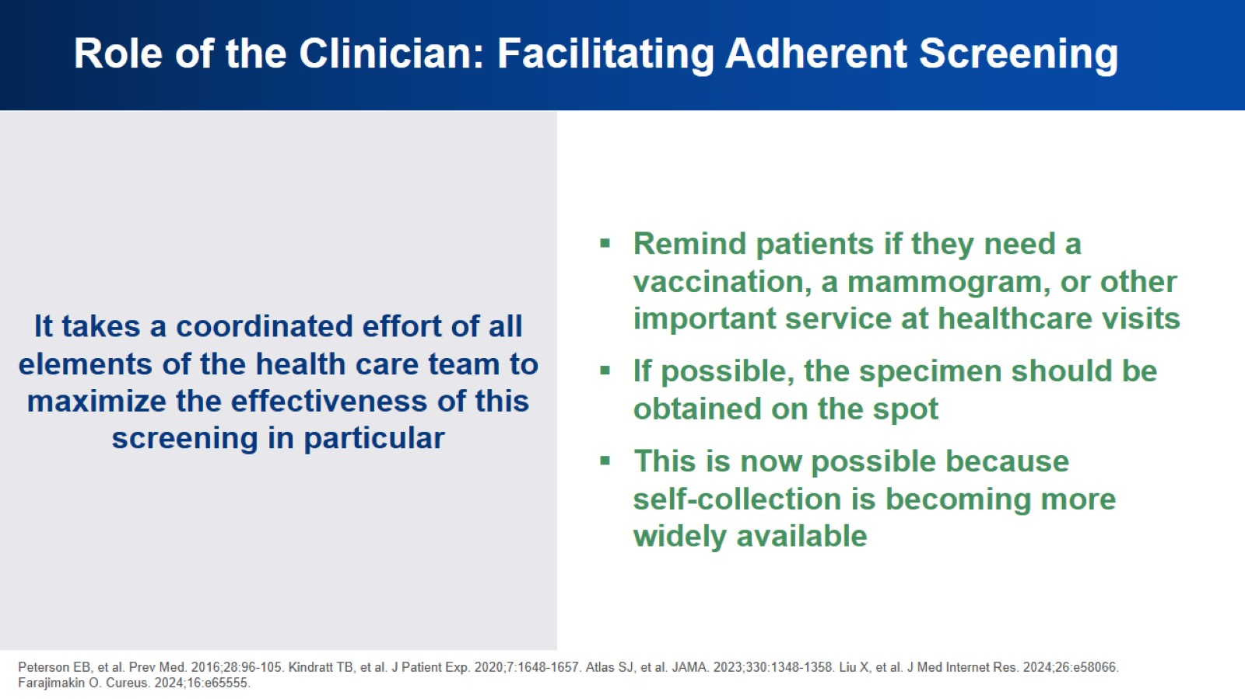
Role of the Clinician: Facilitating Adherent Screening

Slide 25
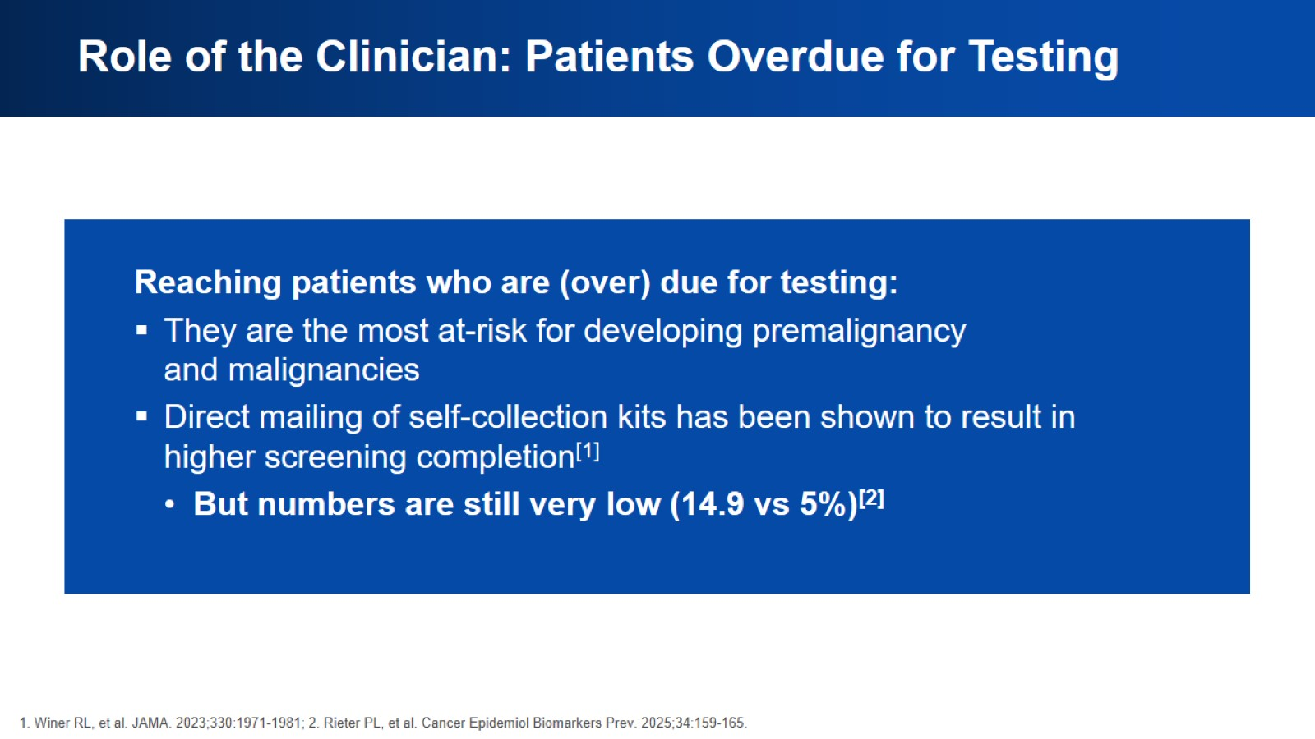
Role of the Clinician: Patients Overdue for Testing

Slide 26
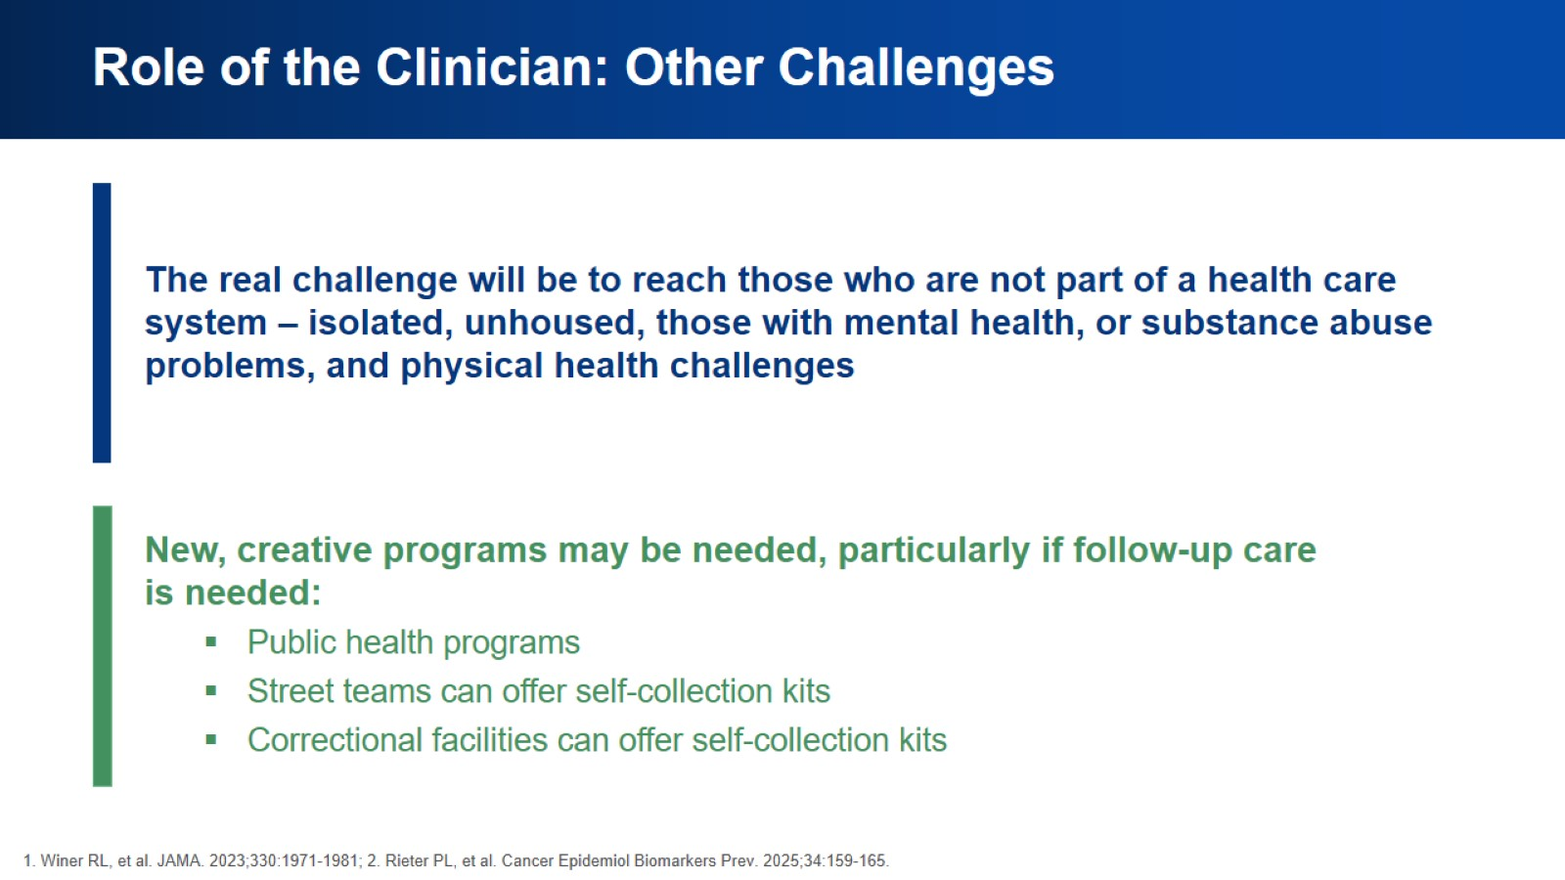
Role of the Clinician: Other Challenges

Slide 27
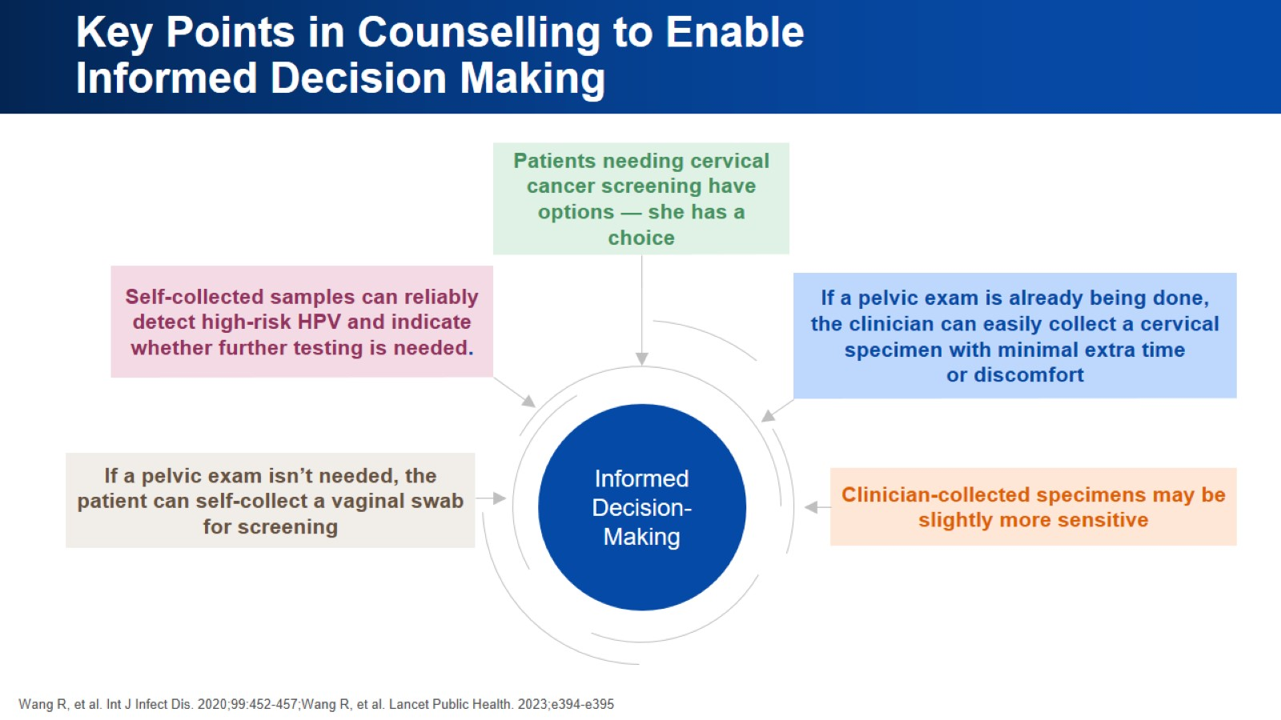
Key Points in Counselling to Enable
Informed Decision Making

Slide 28
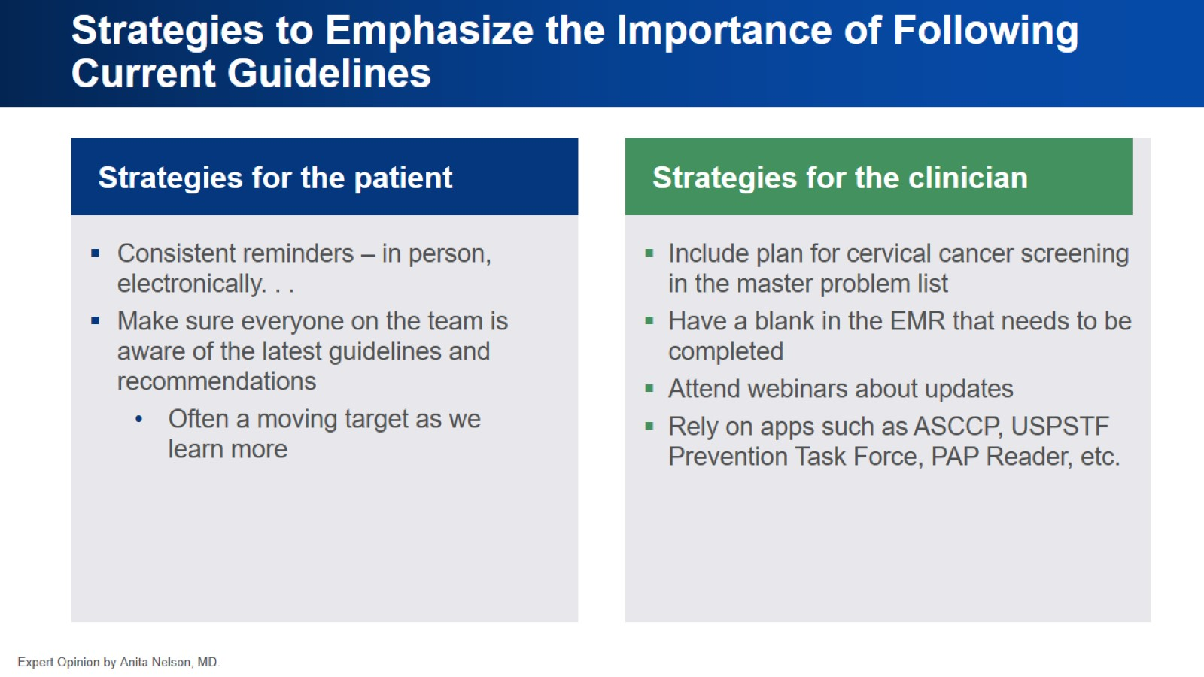
Strategies to Emphasize the Importance of Following Current Guidelines

Slide 29
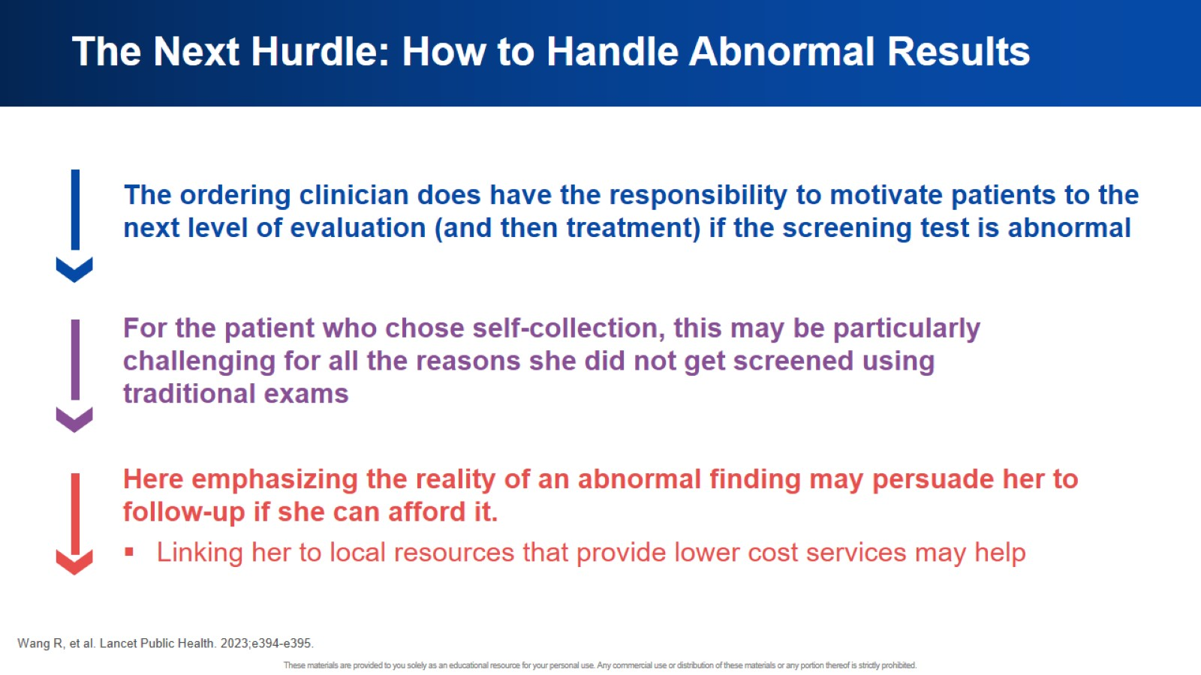
The Next Hurdle: How to Handle Abnormal Results

Slide 30
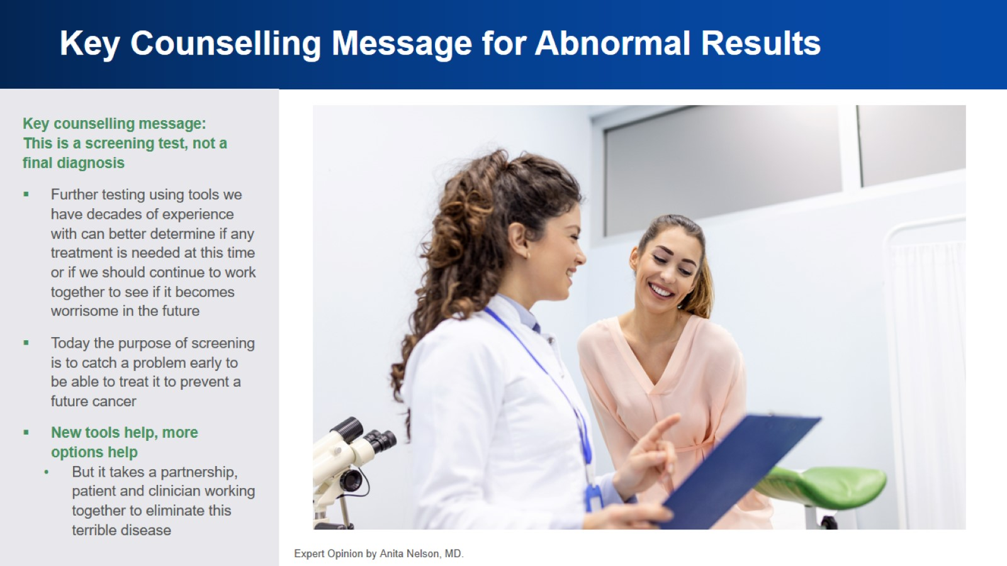
Key Counselling Message for Abnormal Results

Slide 31
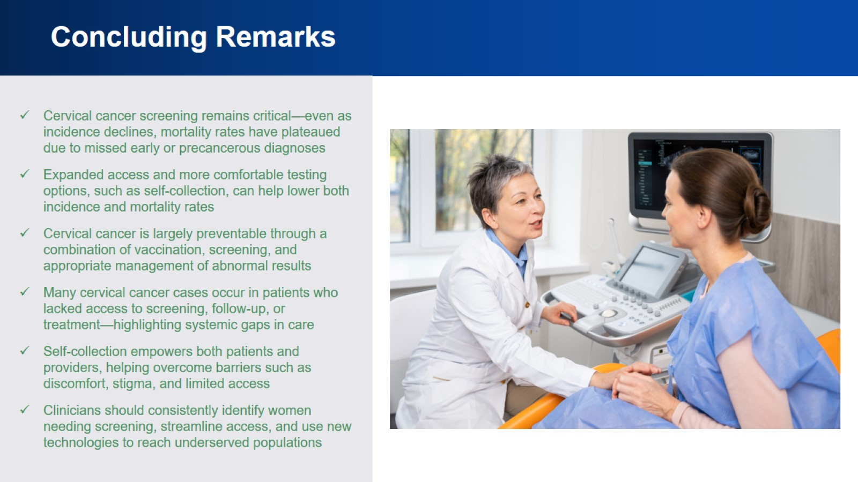
Concluding Remarks

Slide 32


