Slide 1
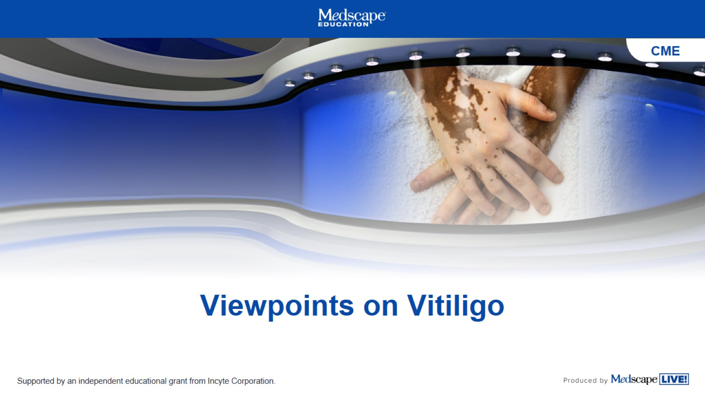
Viewpoints on Vitiligo

Slide 2
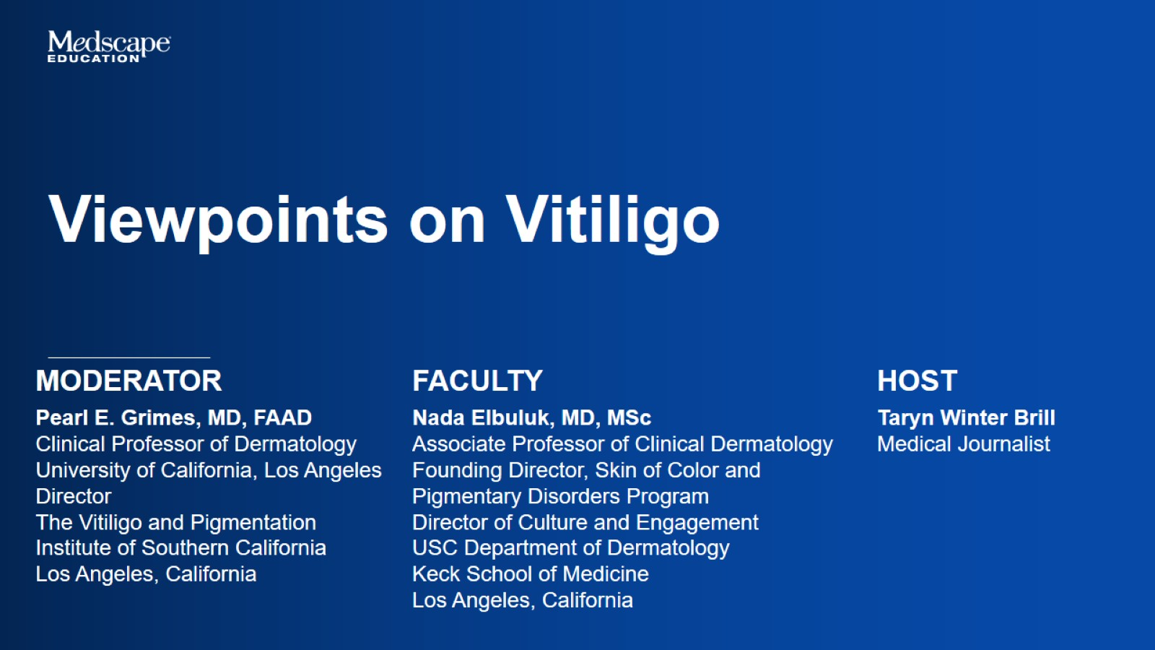

Slide 3


Slide 4
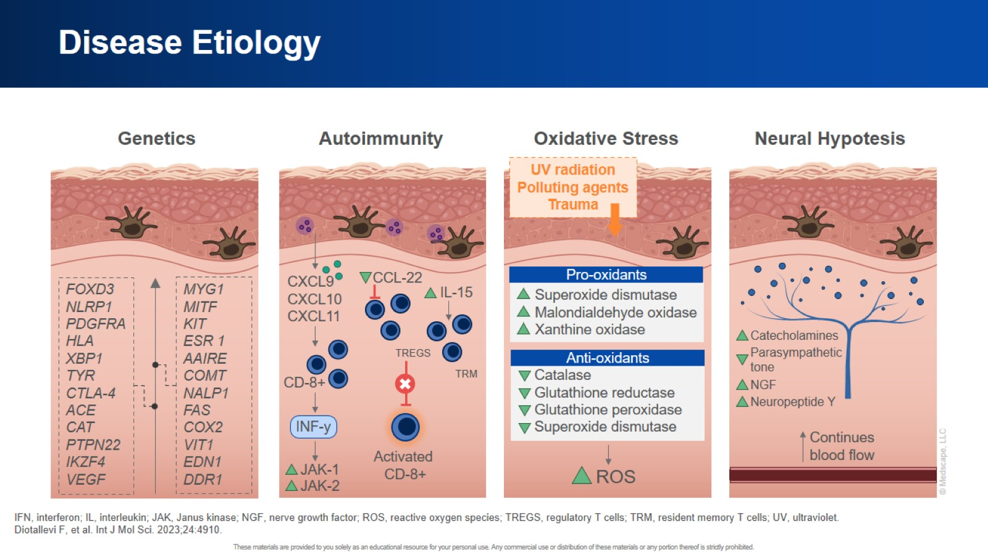
Disease Etiology

Slide 5
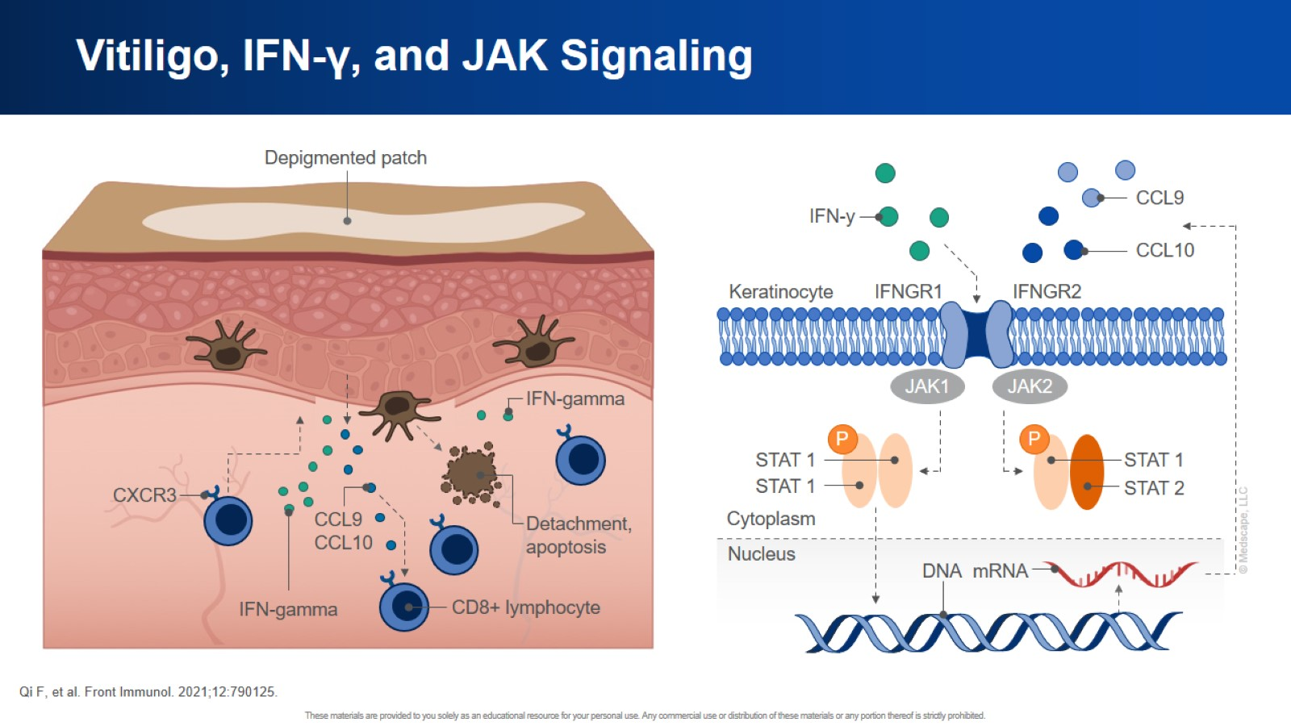
Vitiligo, IFN-γ, and JAK Signaling

Slide 6
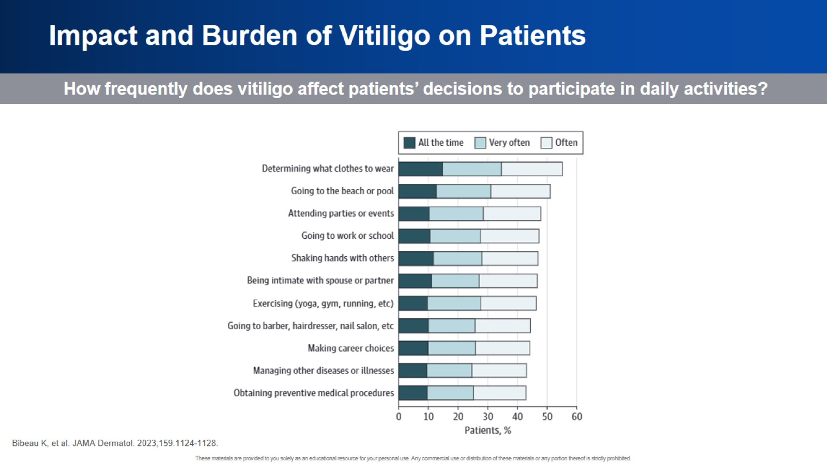
Impact and Burden of Vitiligo on Patients

Slide 7
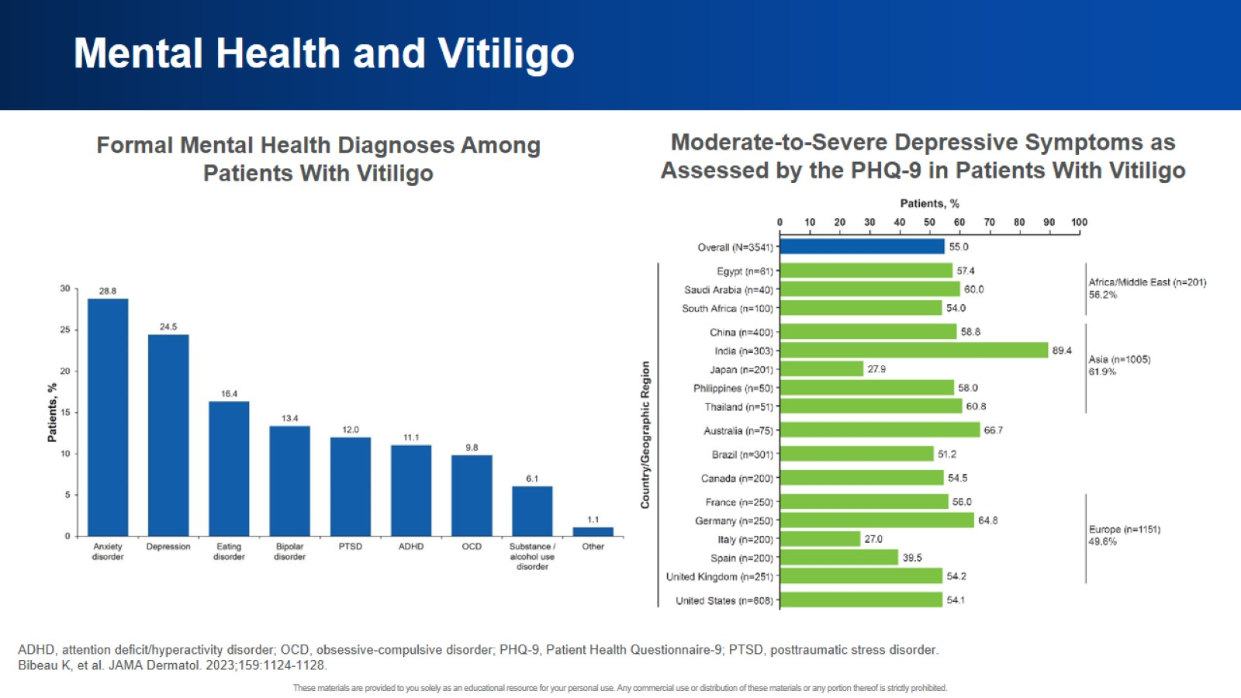
Mental Health and Vitiligo

Slide 8
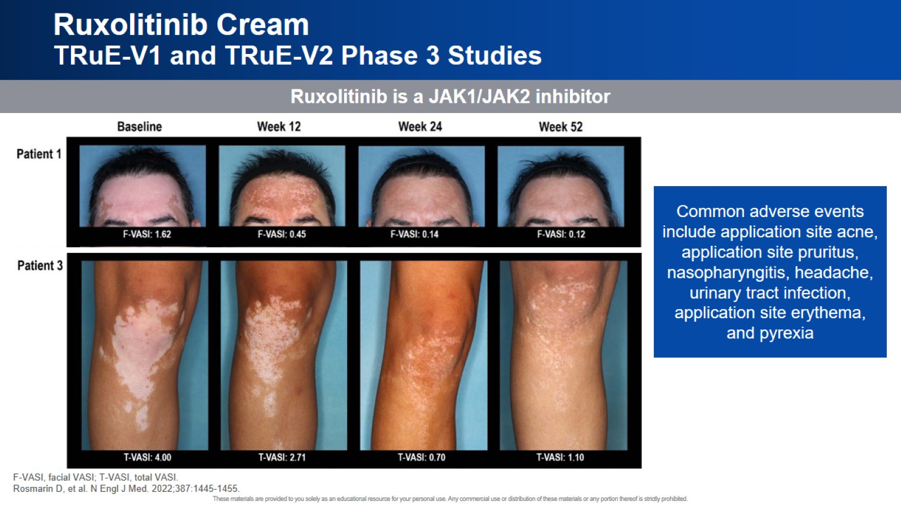
Ruxolitinib Cream
TRuE-V1 and TRuE-V2 Phase 3 Studies

Slide 9
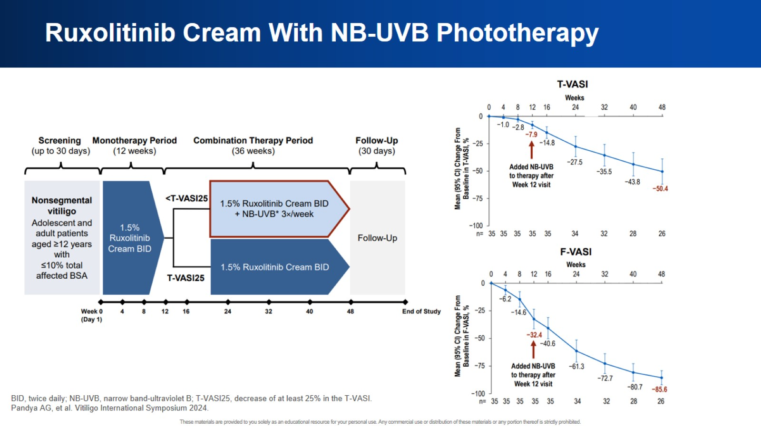
Ruxolitinib Cream With NB-UVB Phototherapy

Slide 10
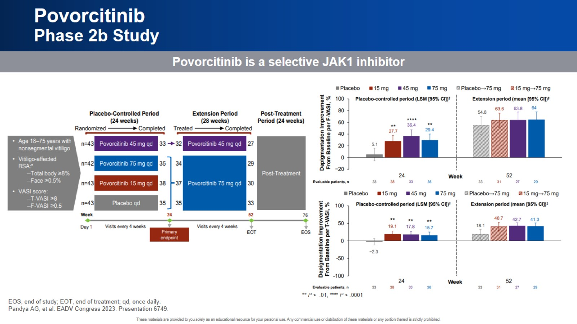
Povorcitinib
Phase 2b Study

Slide 11
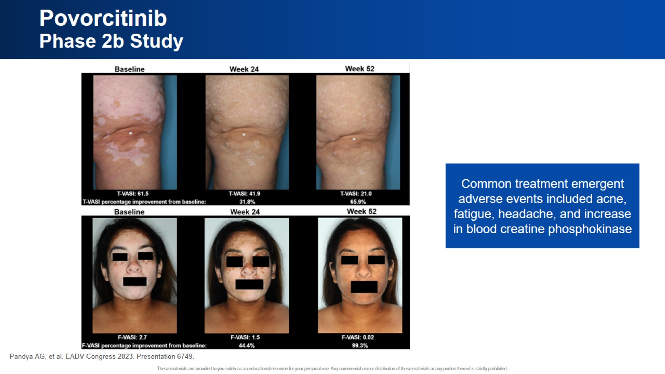
Povorcitinib
Phase 2b Study

Slide 12
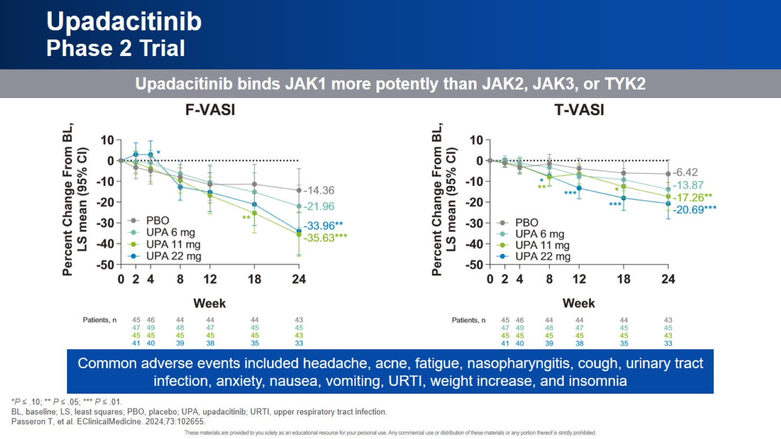
Upadacitinib
Phase 2 Trial

Slide 13
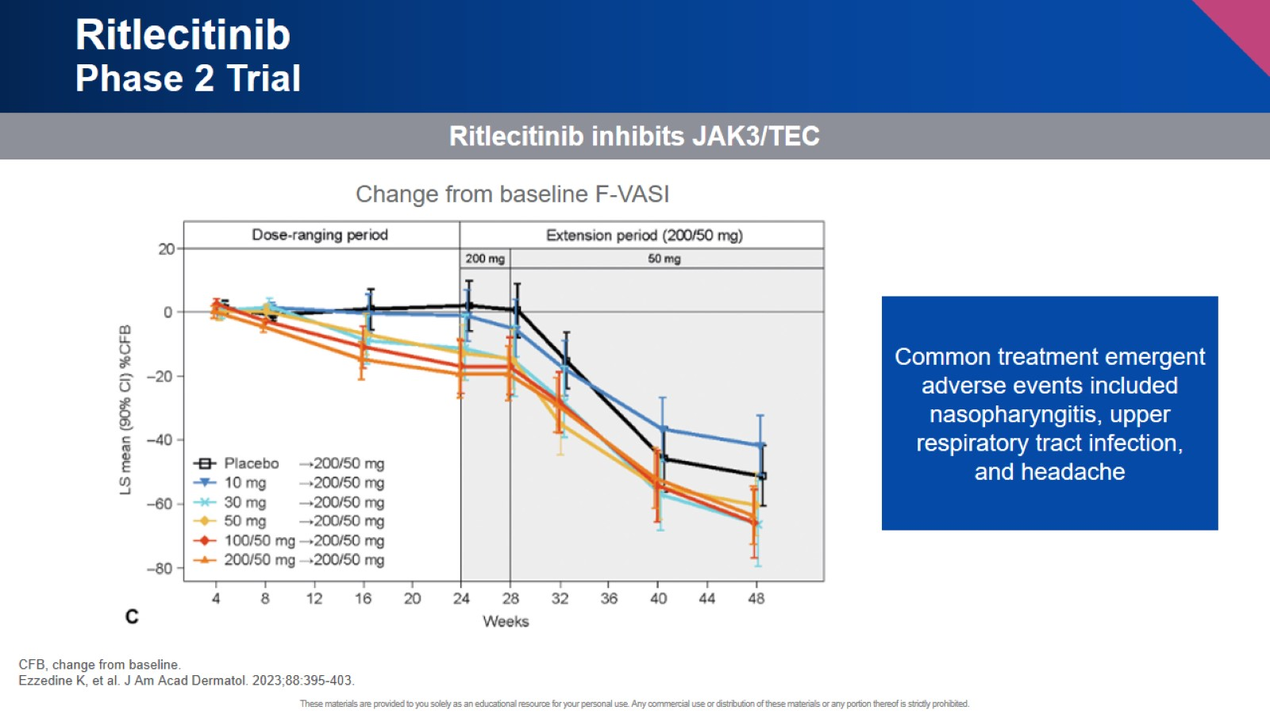
Ritlecitinib
Phase 2 Trial

Slide 14
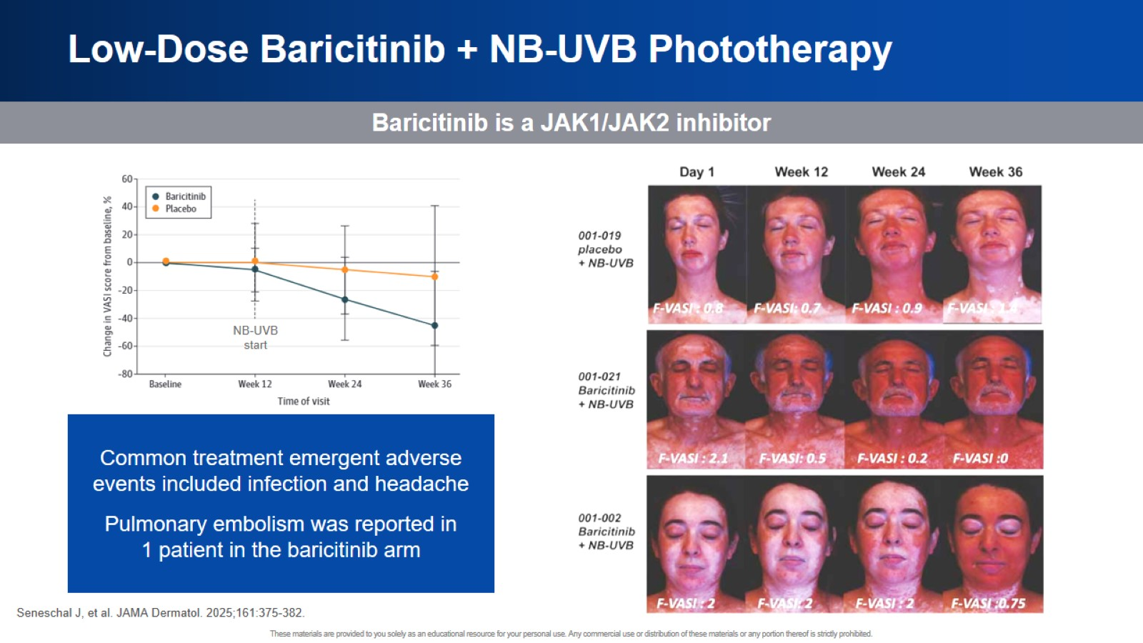
Low-Dose Baricitinib + NB-UVB Phototherapy

Slide 15
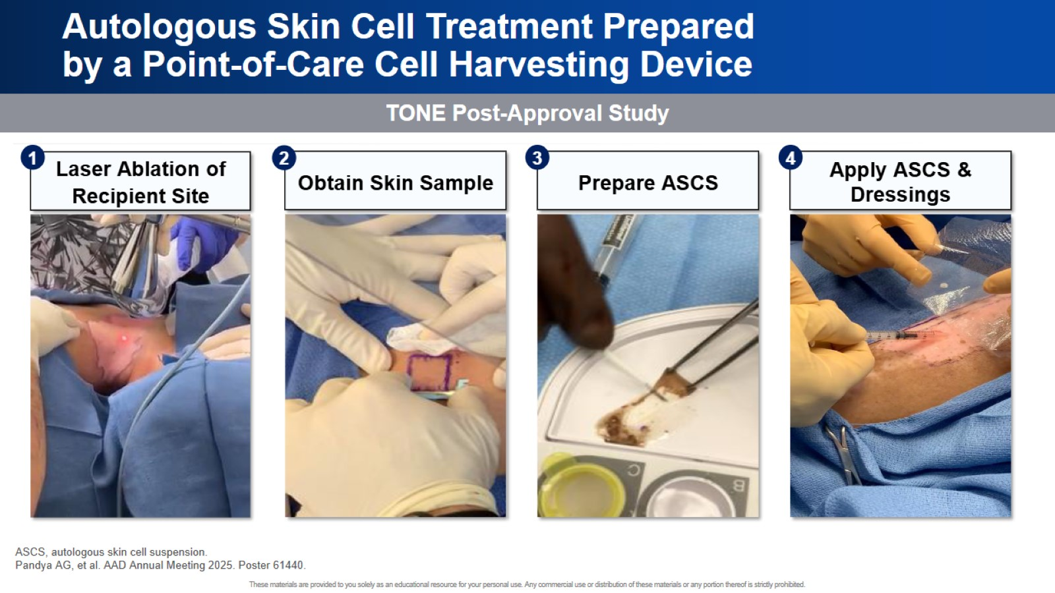
Autologous Skin Cell Treatment Prepared by a Point-of-Care Cell Harvesting Device

Slide 16
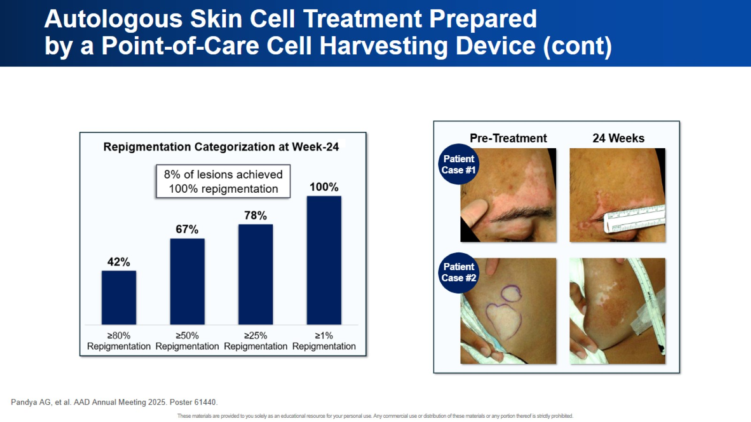
Autologous Skin Cell Treatment Prepared by a Point-of-Care Cell Harvesting Device (cont)

Slide 17
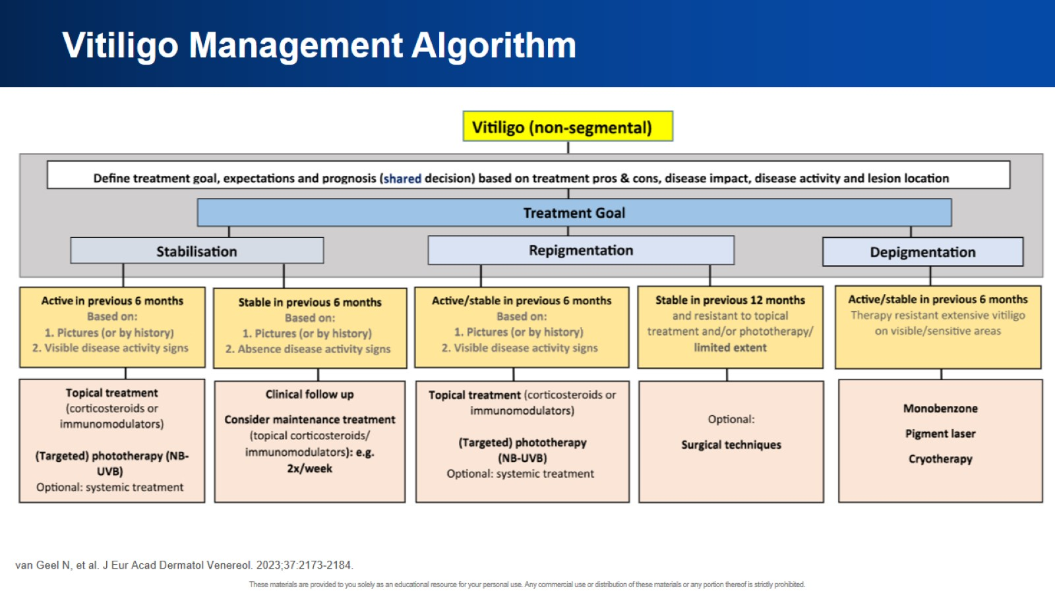
Vitiligo Management Algorithm

Slide 18


Slide 19
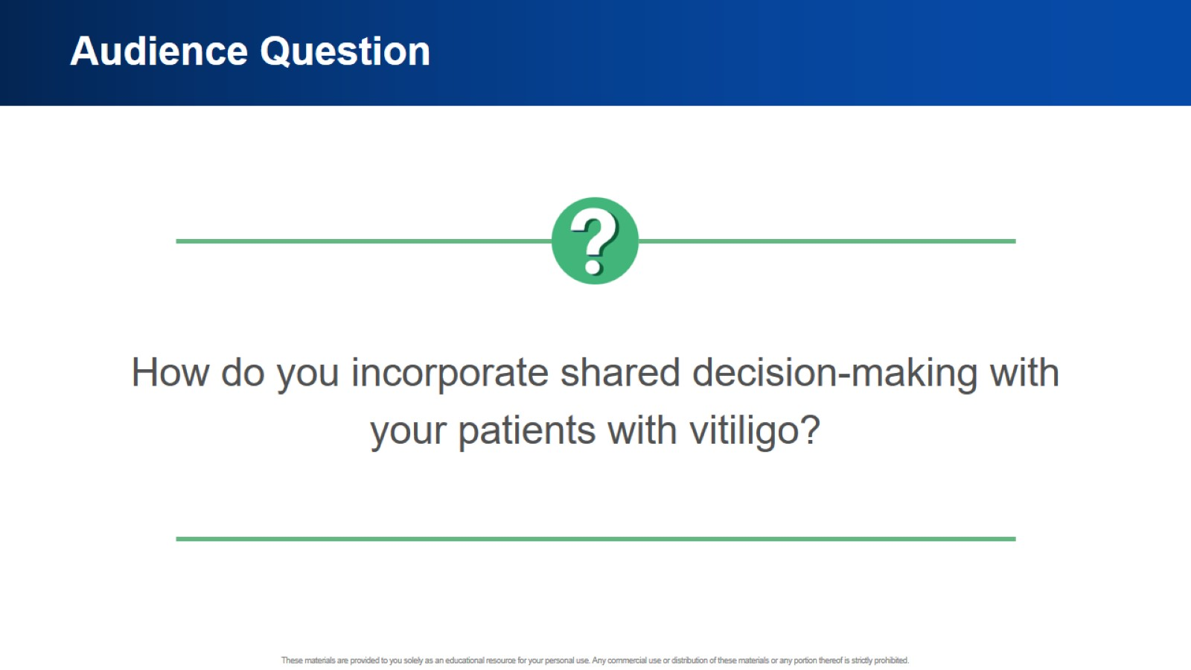
Audience Question

Slide 20
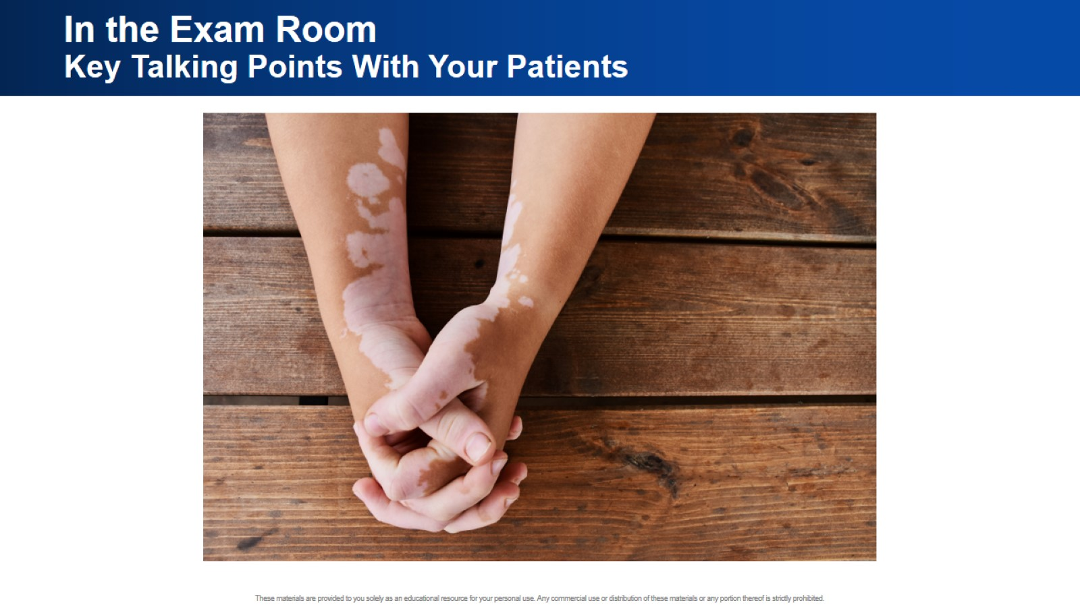
In the Exam Room
Key Talking Points With Your Patients

Slide 21
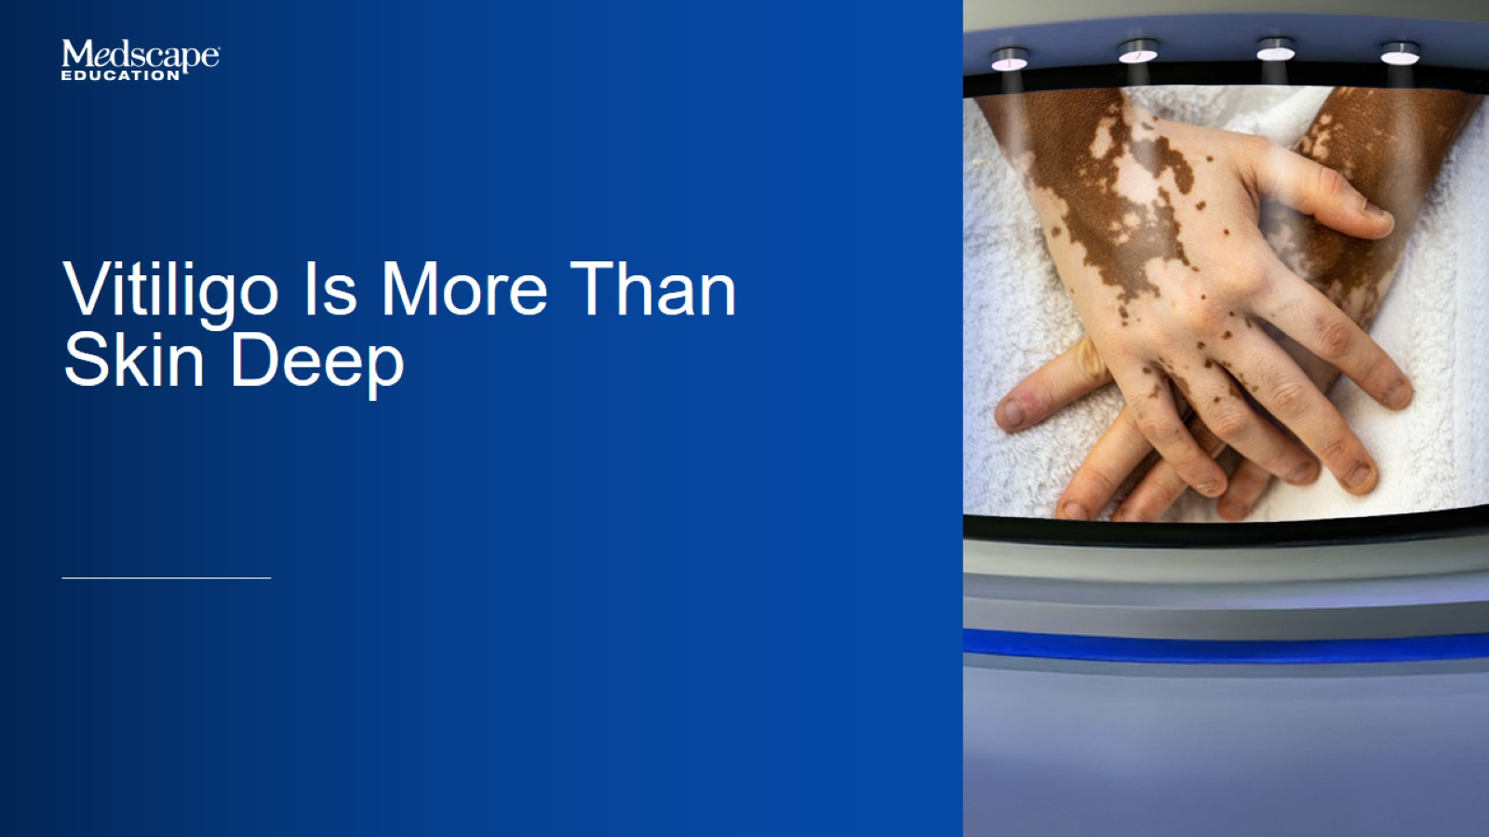

Slide 22
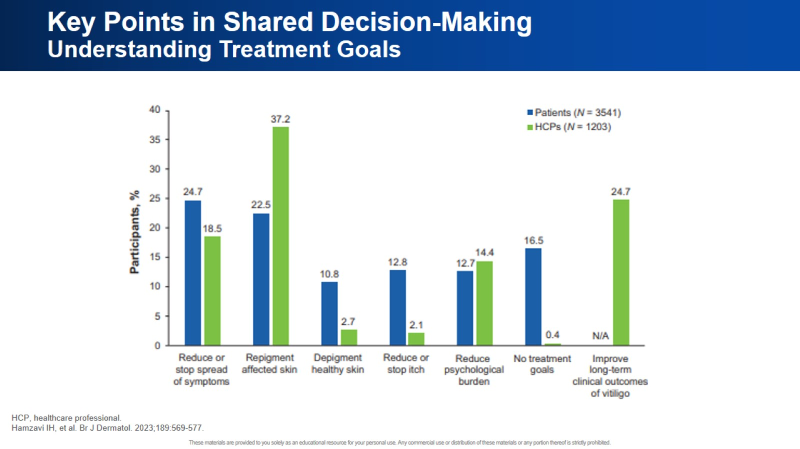
Key Points in Shared Decision-Making
Understanding Treatment Goals

Slide 23


Slide 24


