Slide 1
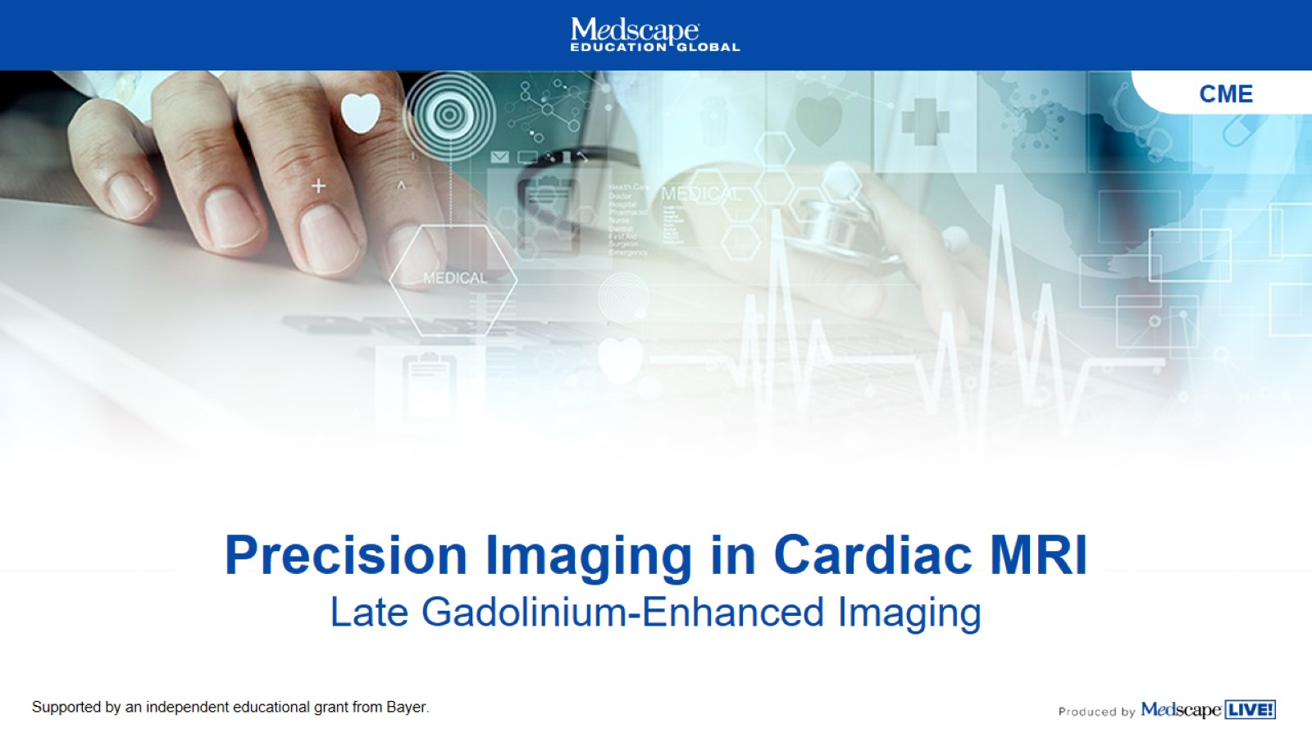
Precision Imaging in Cardiac MRI
Late Gadolinium-Enhanced Imaging

Slide 2
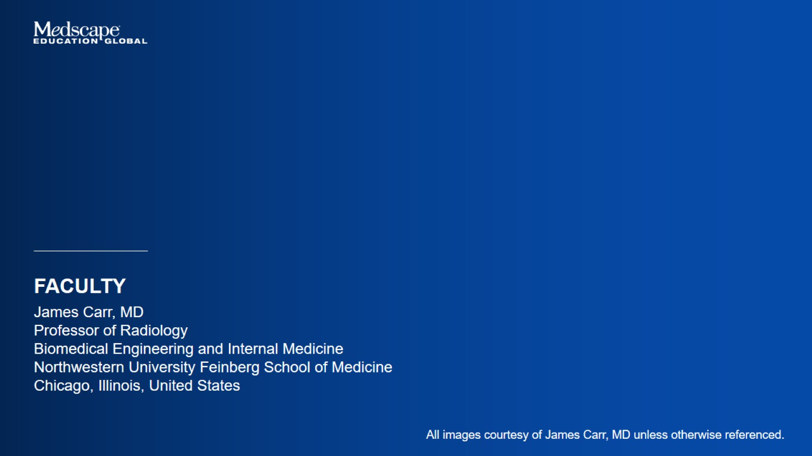

Slide 3
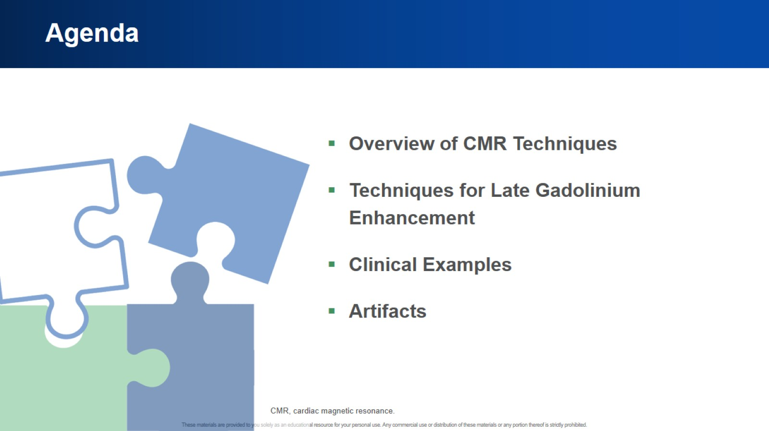
Agenda

Slide 4
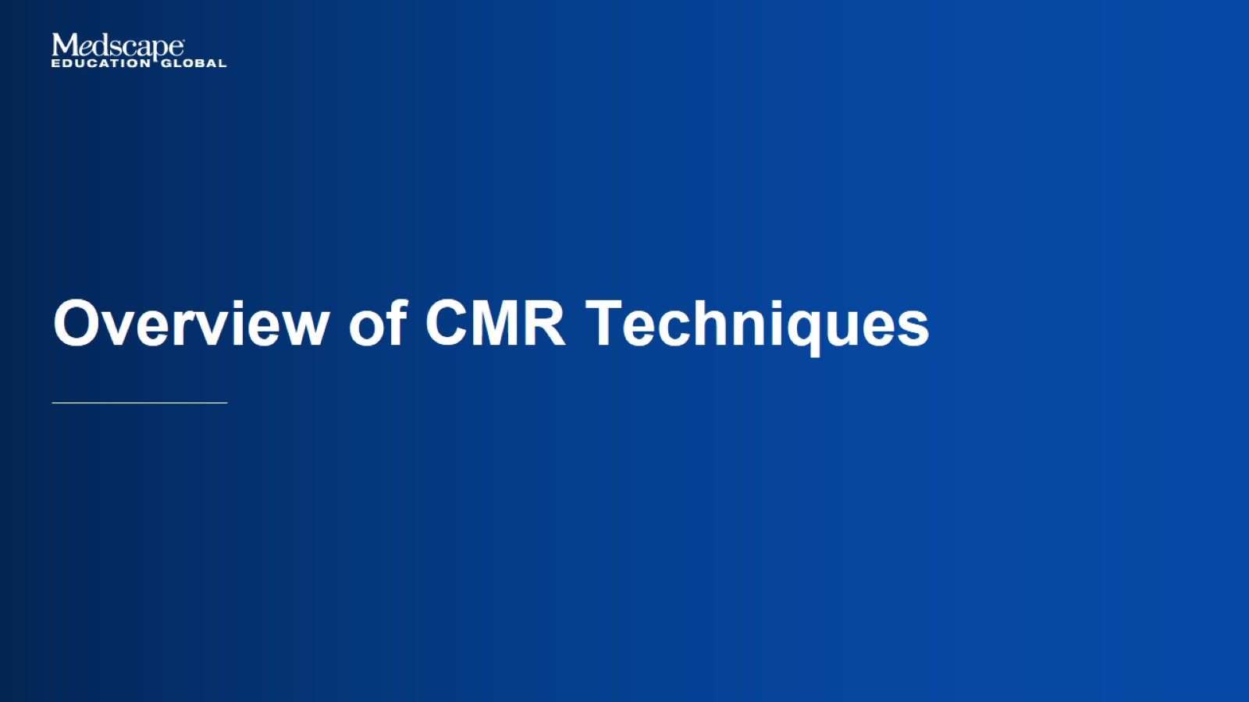
Overview of CMR Techniques

Slide 5
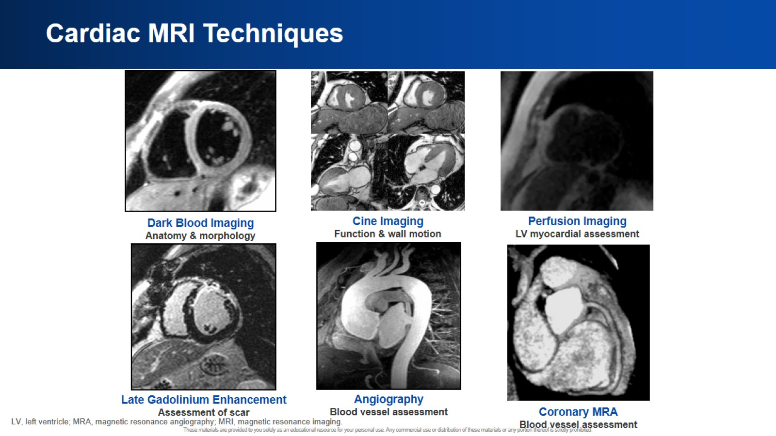
Cardiac MRI Techniques

Slide 6
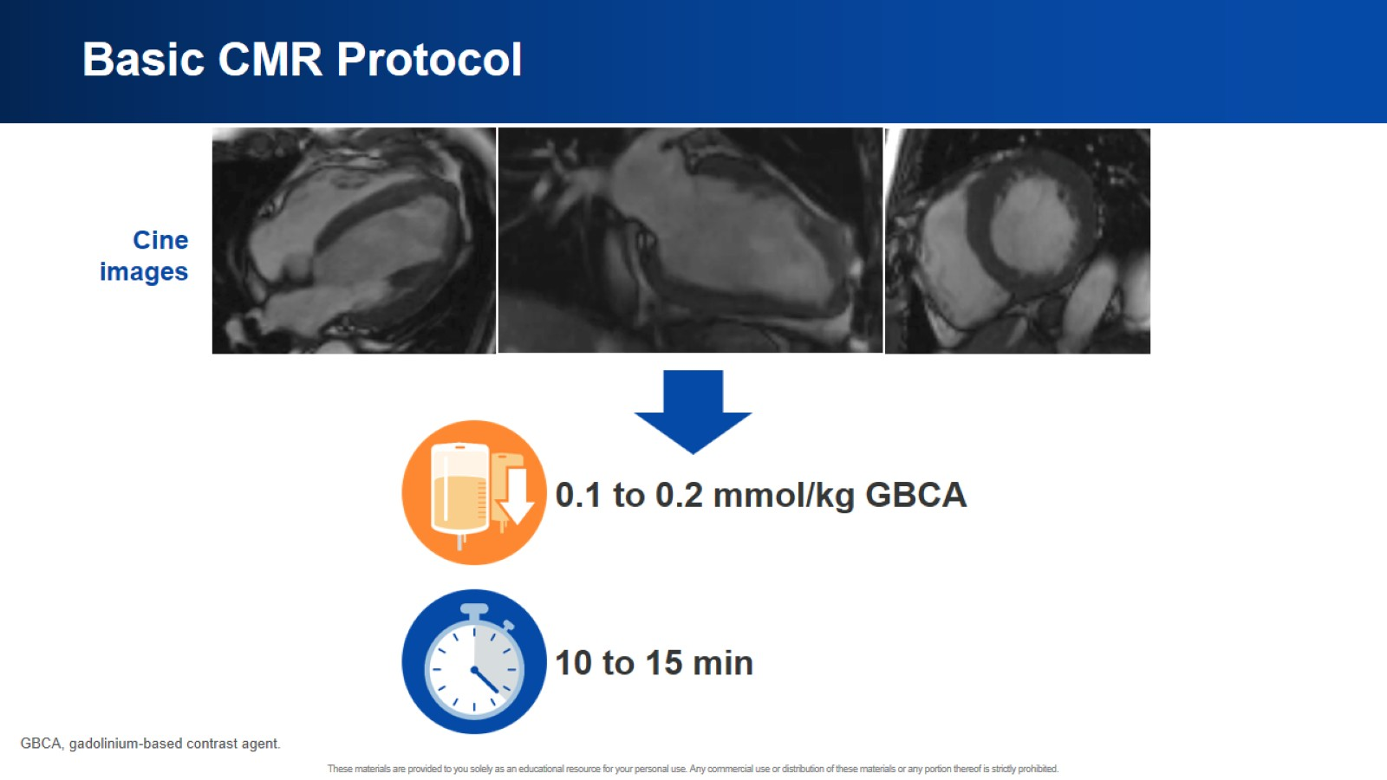
Basic CMR Protocol

Slide 7
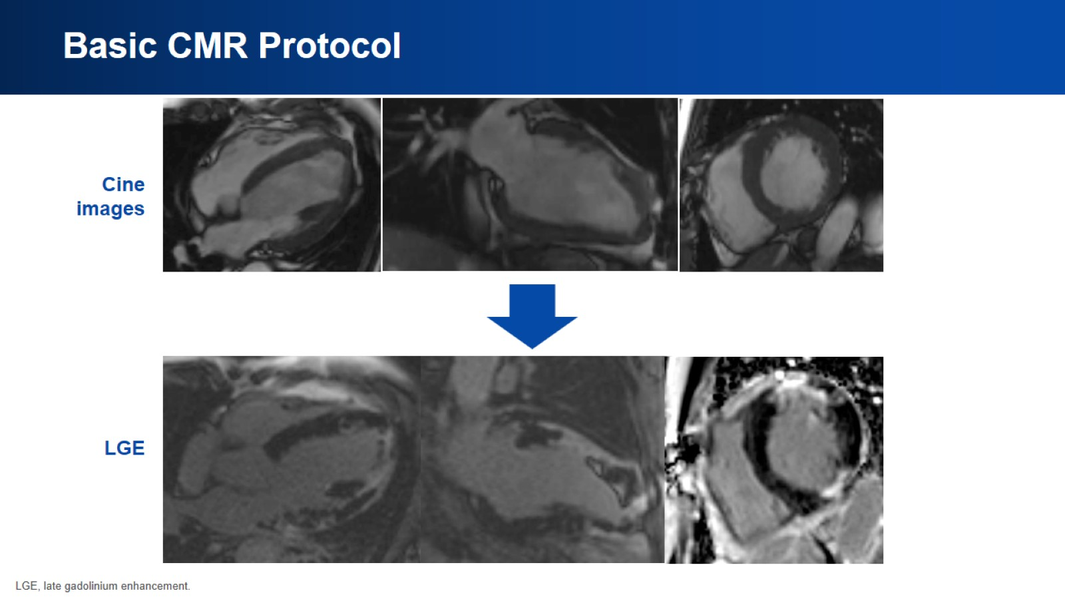
Basic CMR Protocol

Slide 8
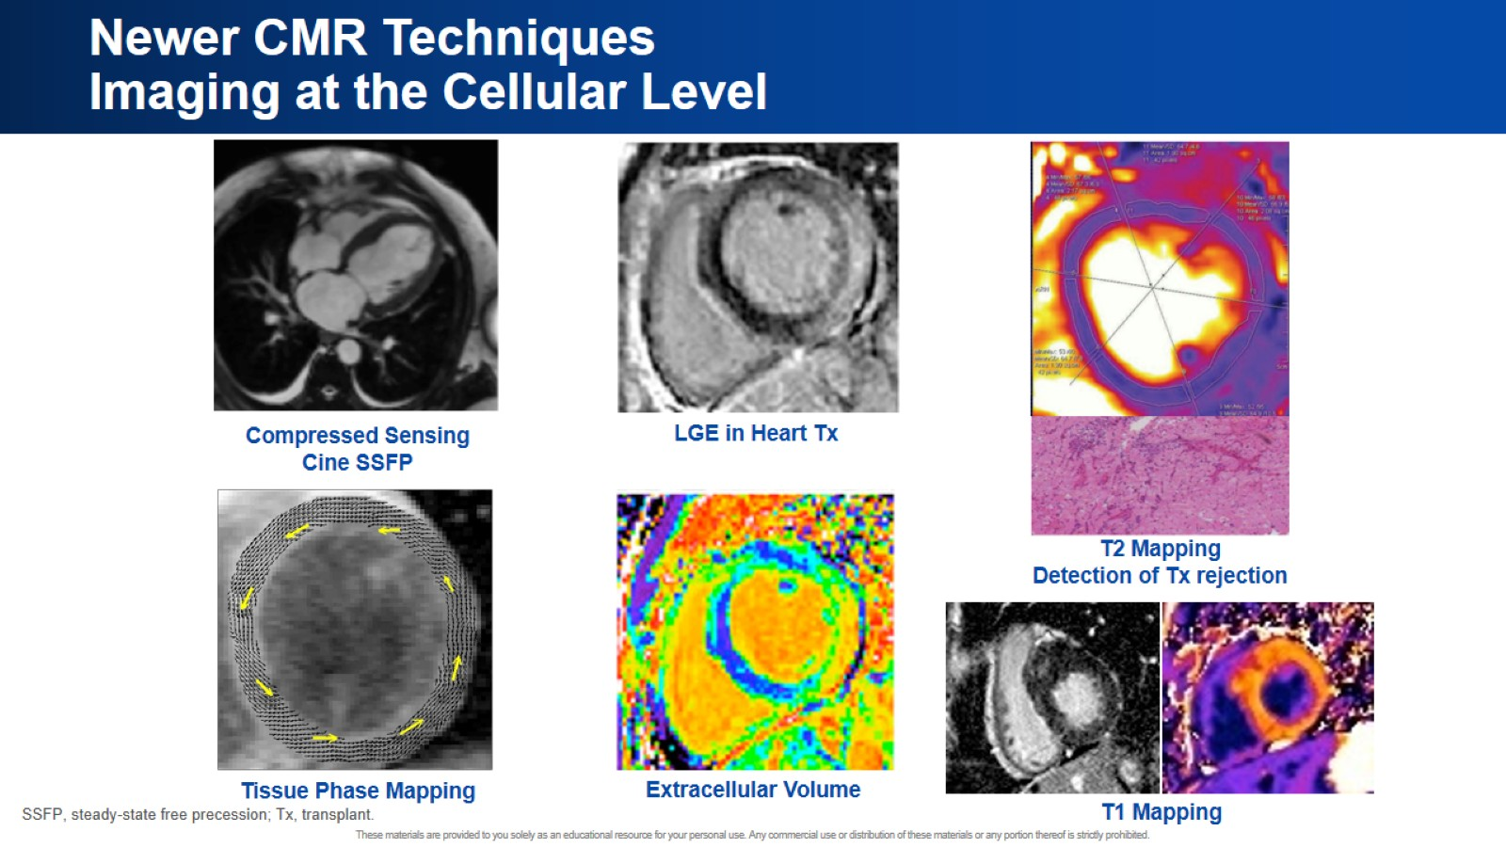
Newer CMR Techniques
Imaging at the Cellular Level

Slide 9
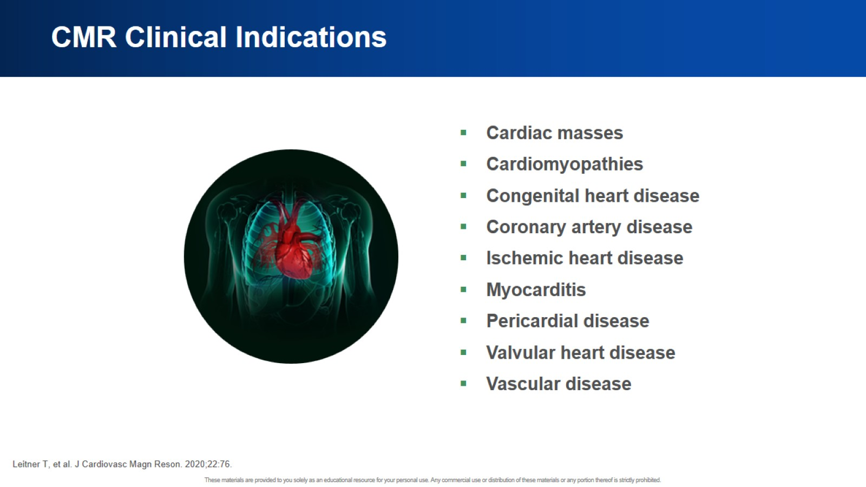
CMR Clinical Indications

Slide 10
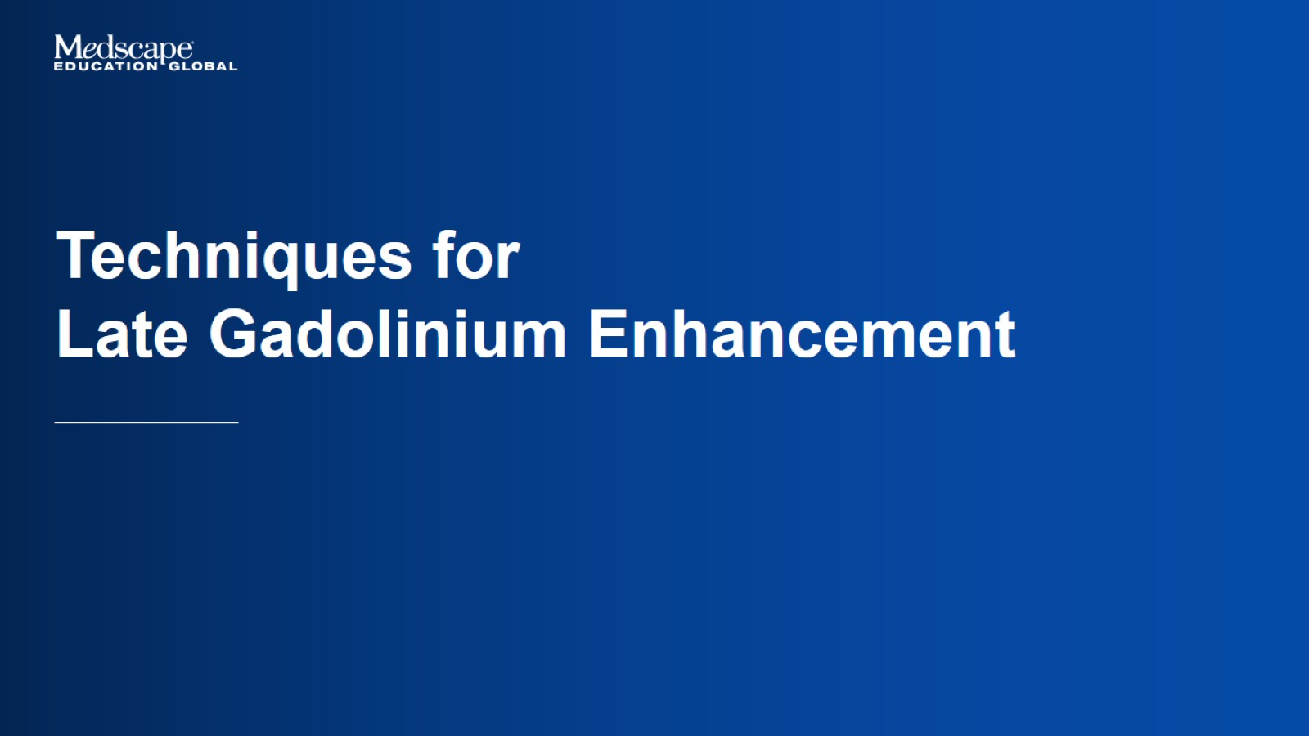
Techniques for
Late Gadolinium Enhancement

Slide 11
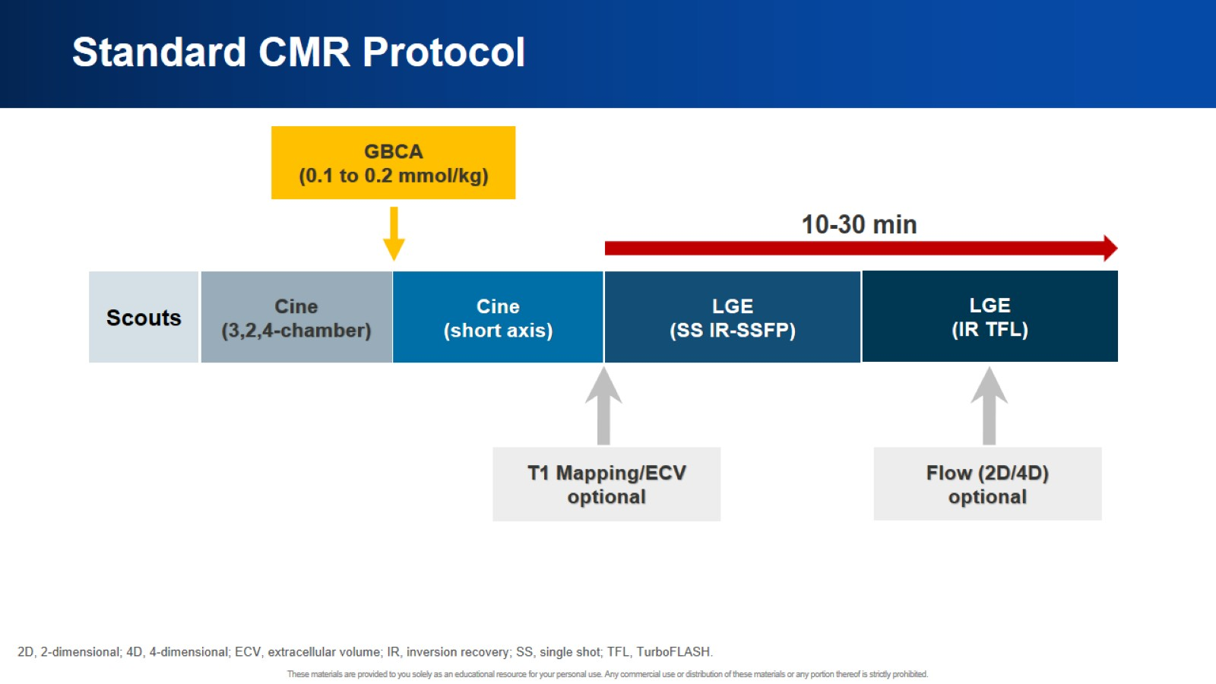
Standard CMR Protocol

Slide 12
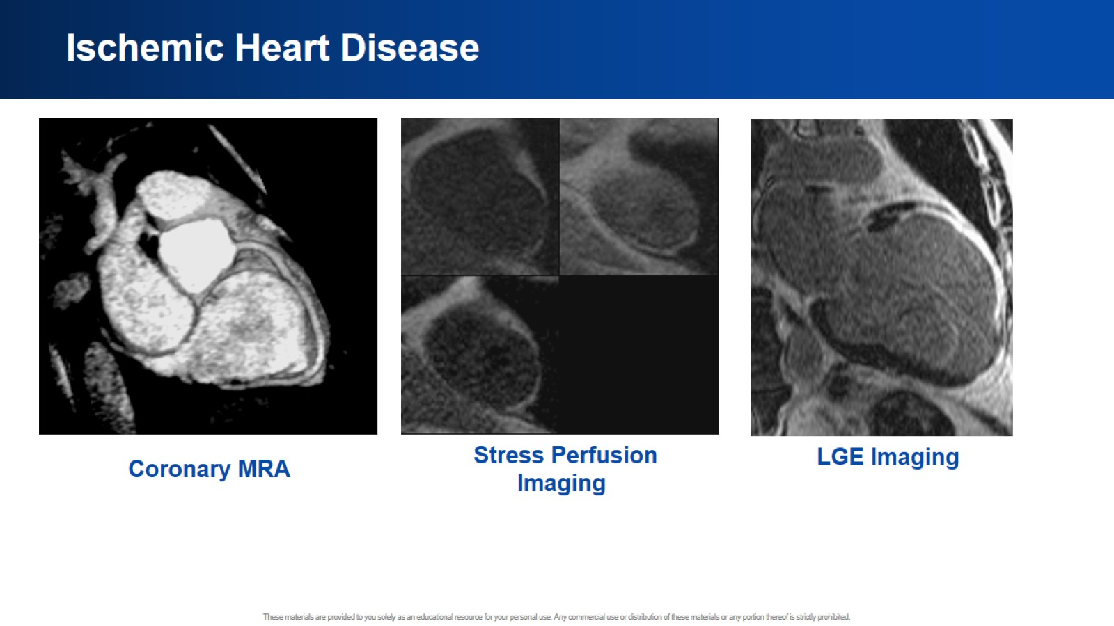
Ischemic Heart Disease

Slide 13
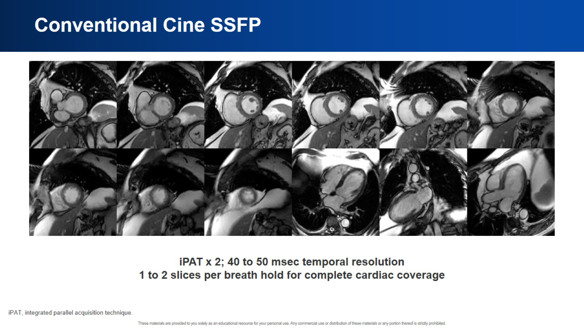
Conventional Cine SSFP

Slide 14
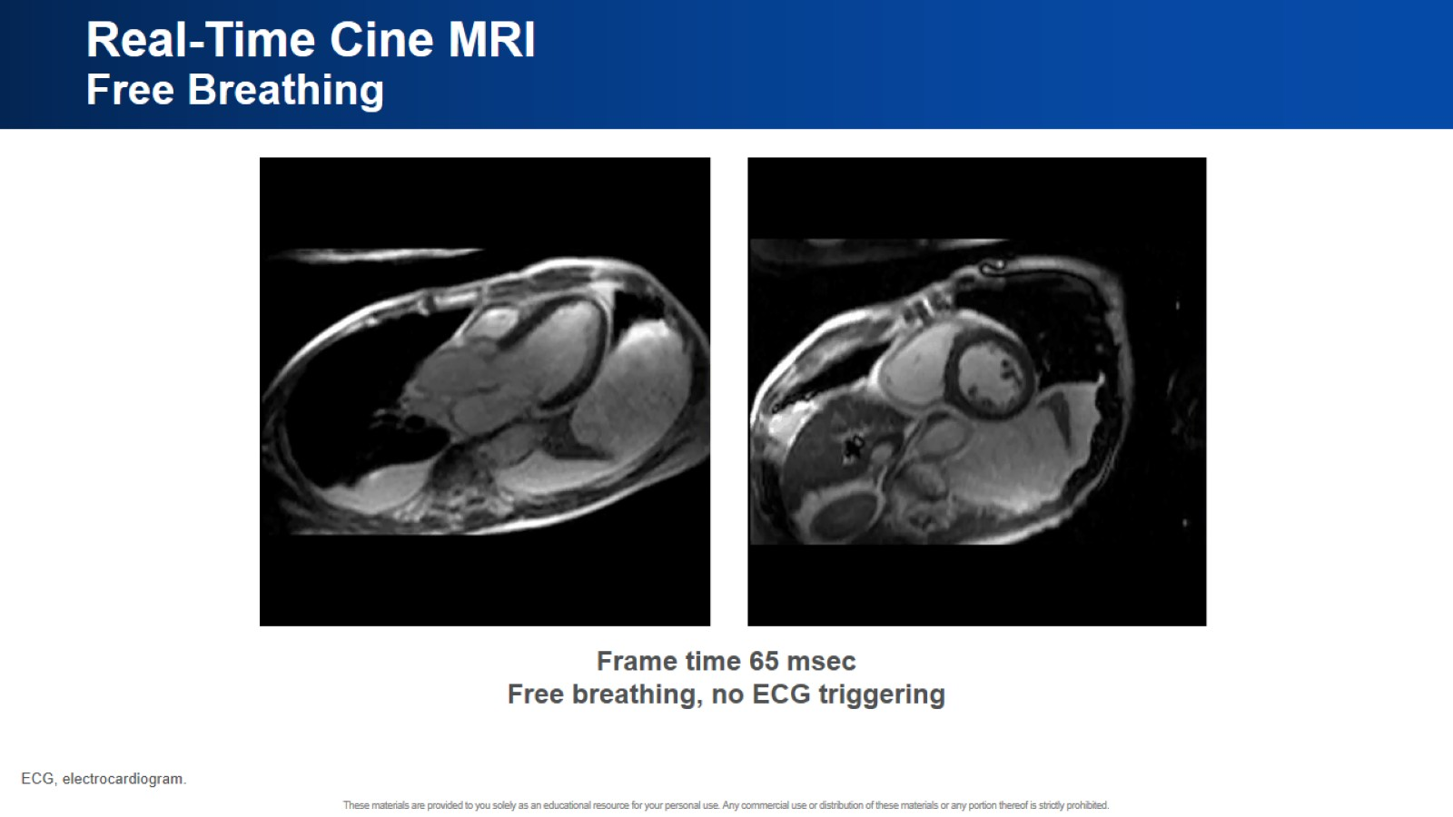
Real-Time Cine MRI
Free Breathing

Slide 15
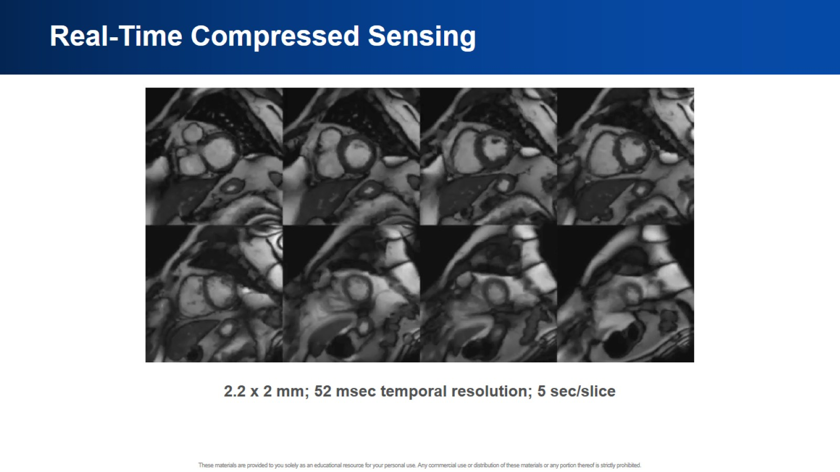
Real-Time Compressed Sensing

Slide 16
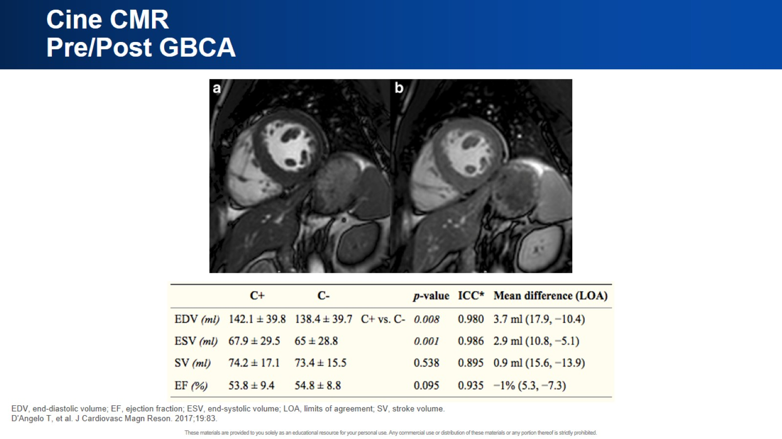
Cine CMR
Pre/Post GBCA

Slide 17
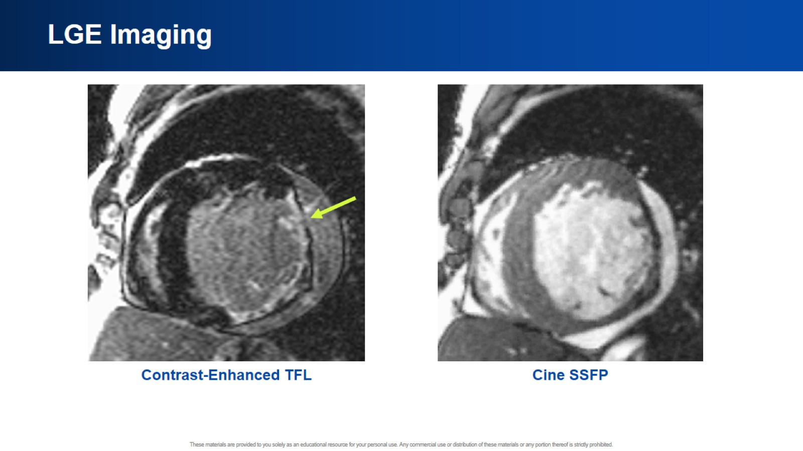
LGE Imaging

Slide 18
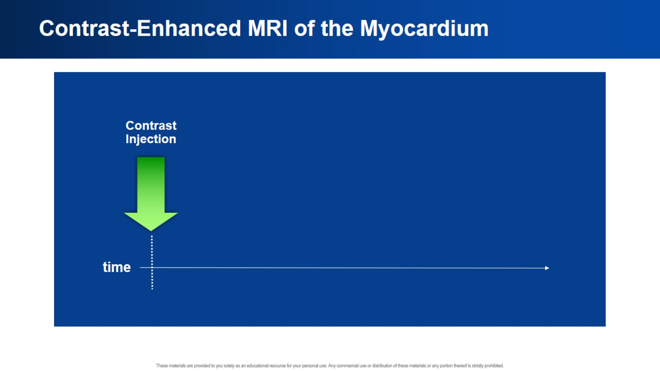
Contrast-Enhanced MRI of the Myocardium

Slide 19
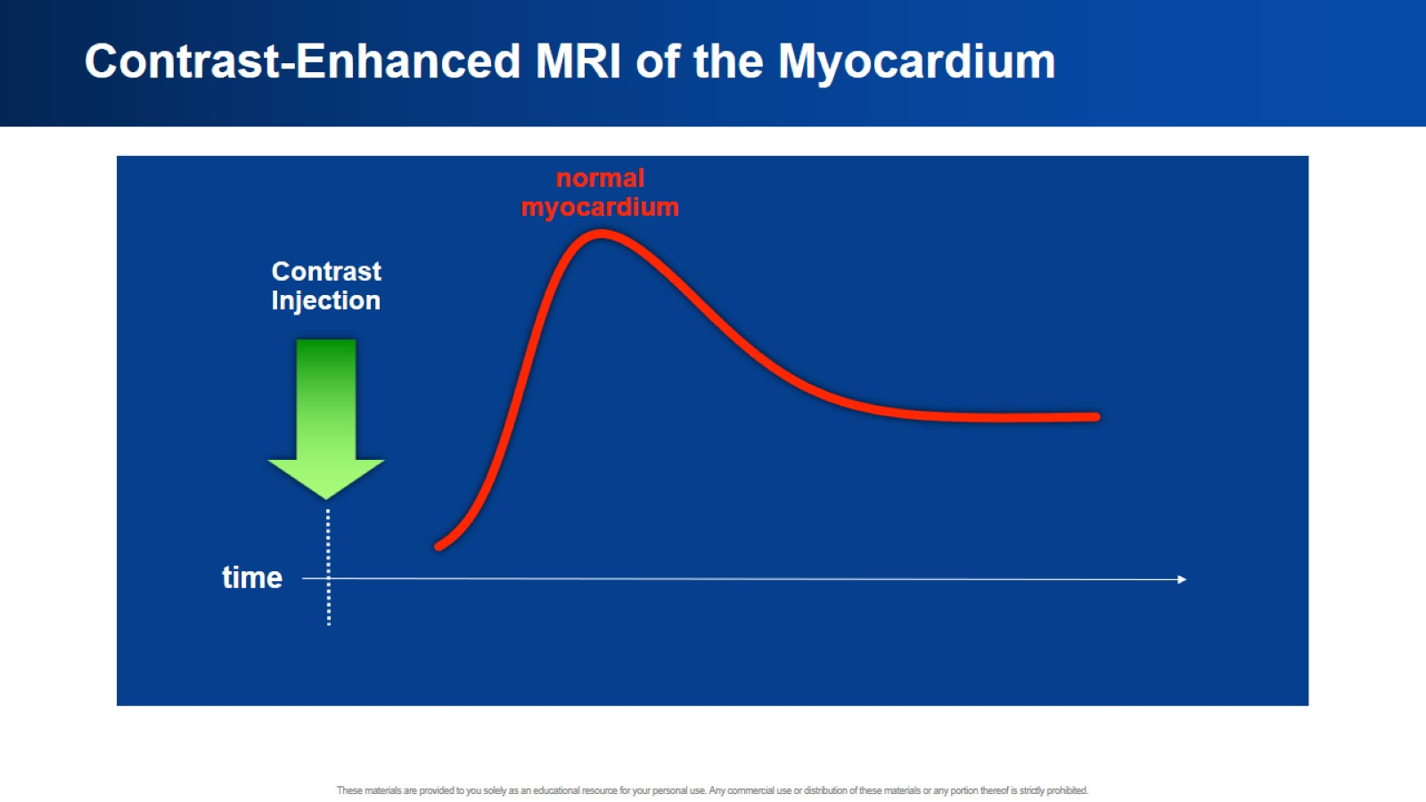
Contrast-Enhanced MRI of the Myocardium

Slide 20
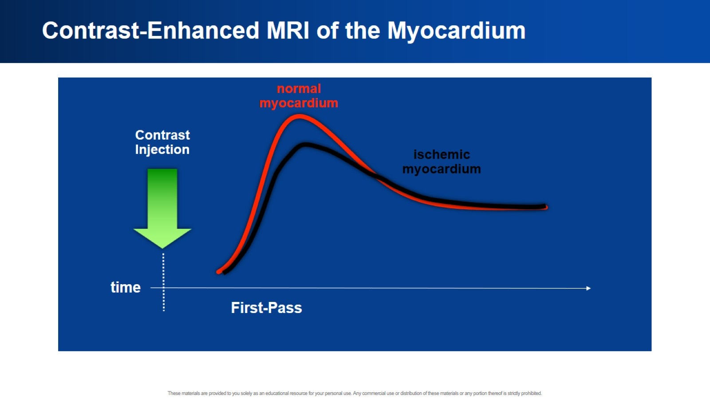
Contrast-Enhanced MRI of the Myocardium

Slide 21
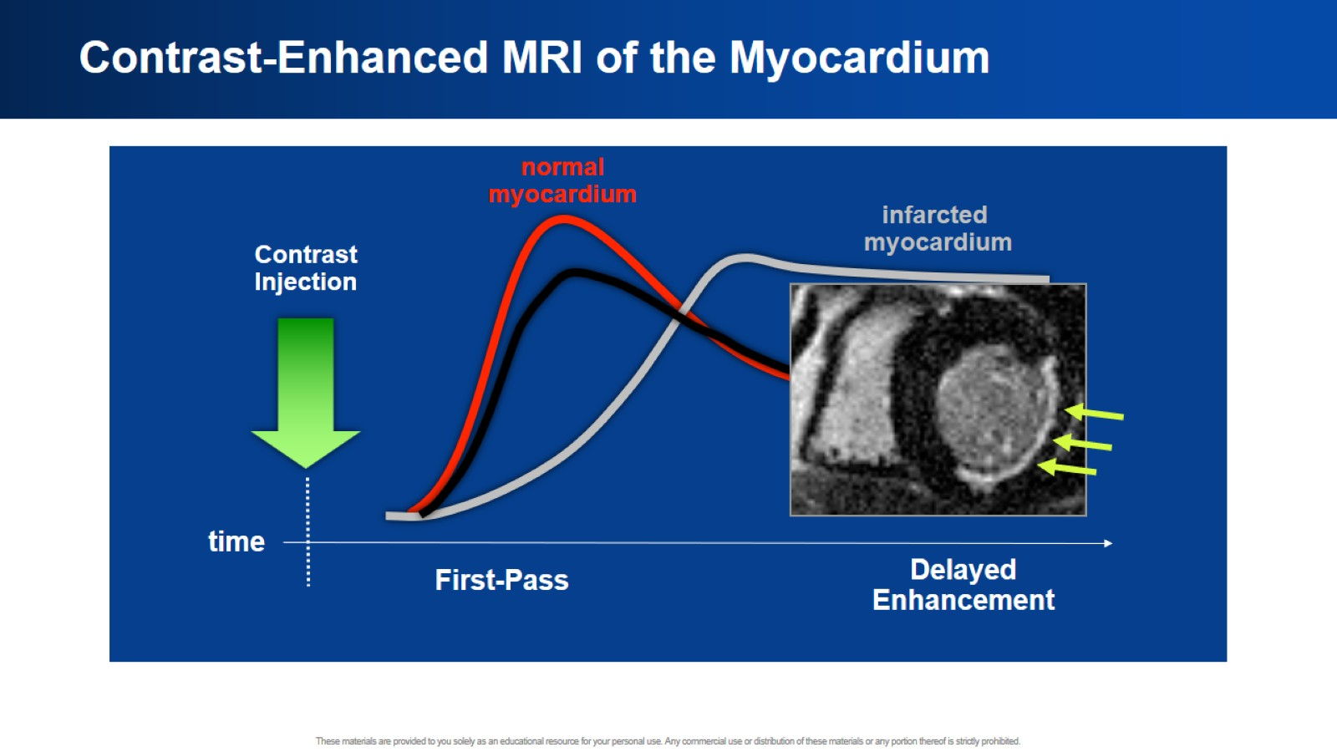
Contrast-Enhanced MRI of the Myocardium

Slide 22
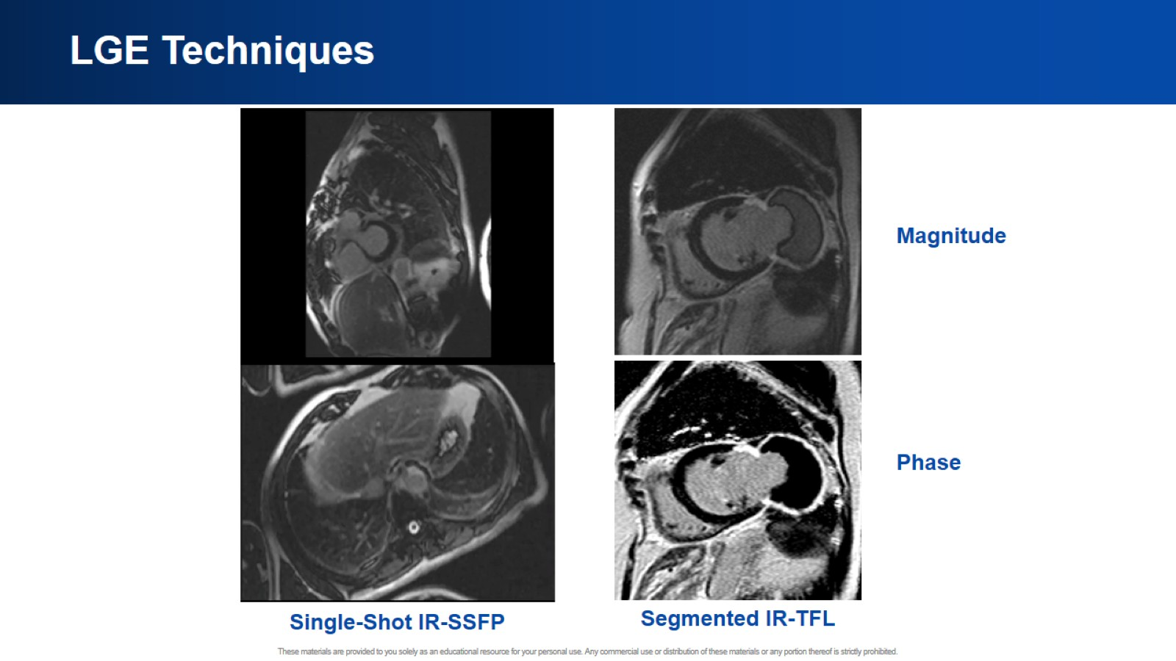
LGE Techniques

Slide 23
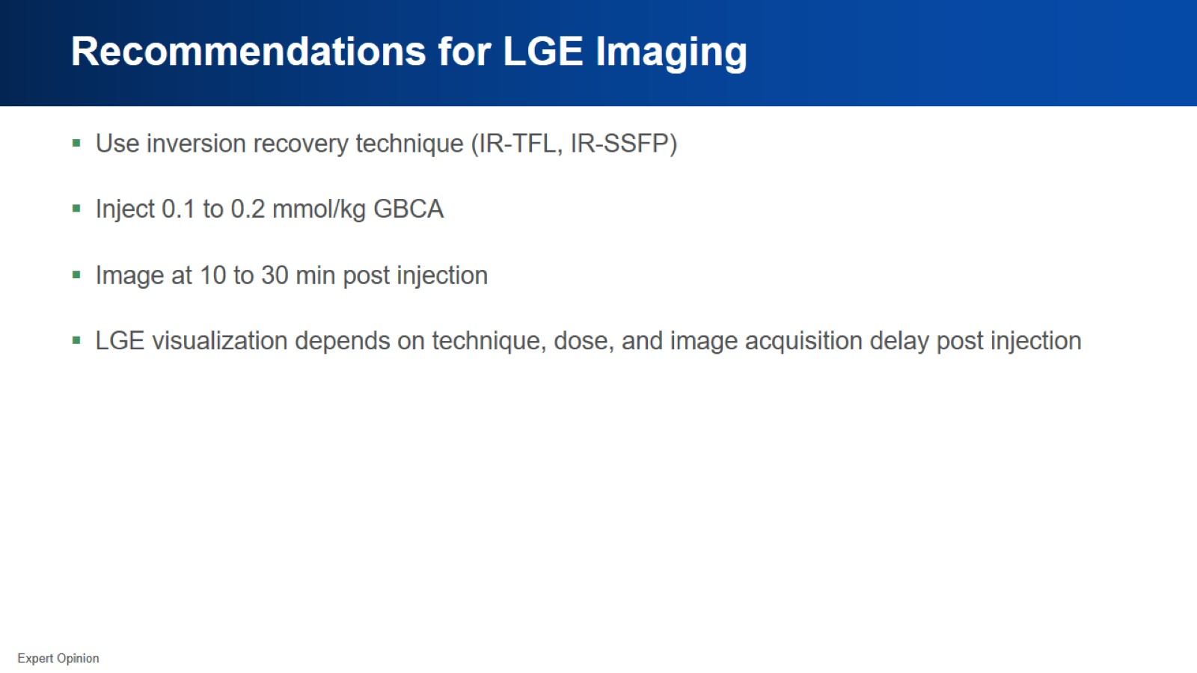
Recommendations for LGE Imaging

Slide 24
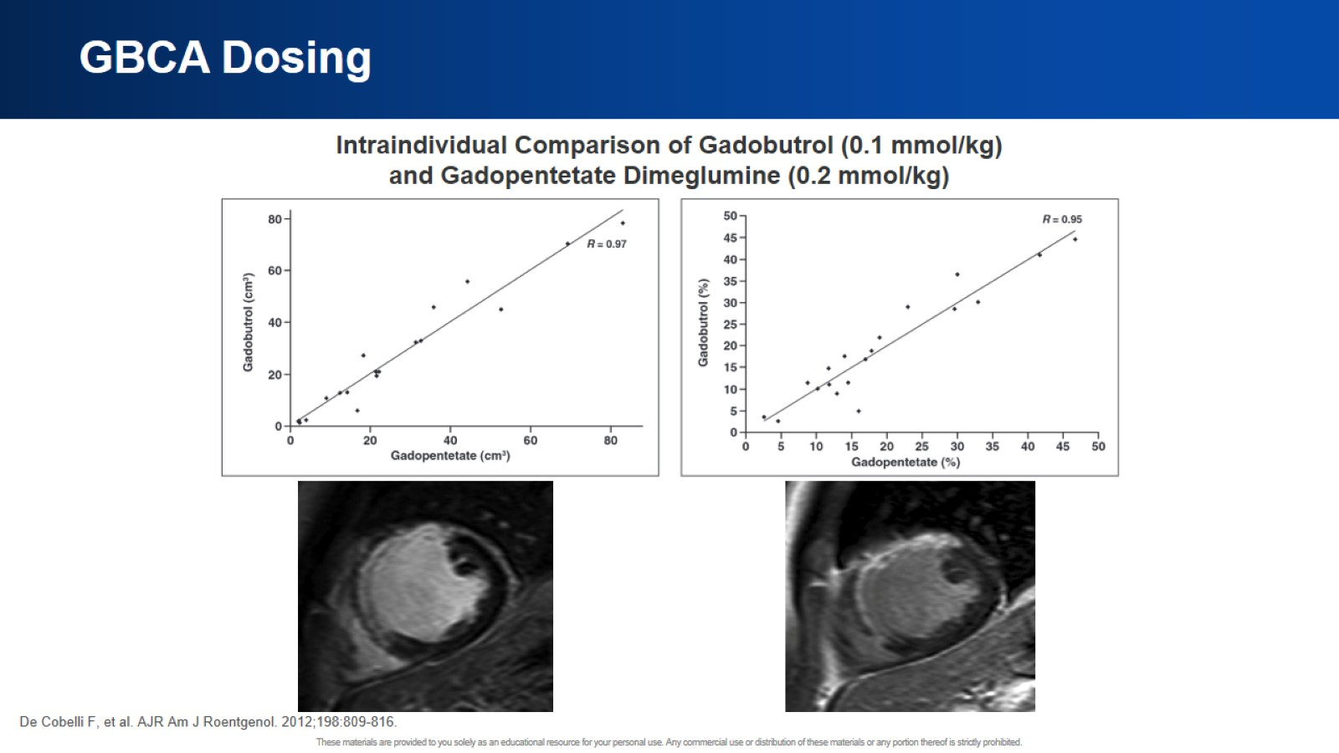
GBCA Dosing

Slide 25
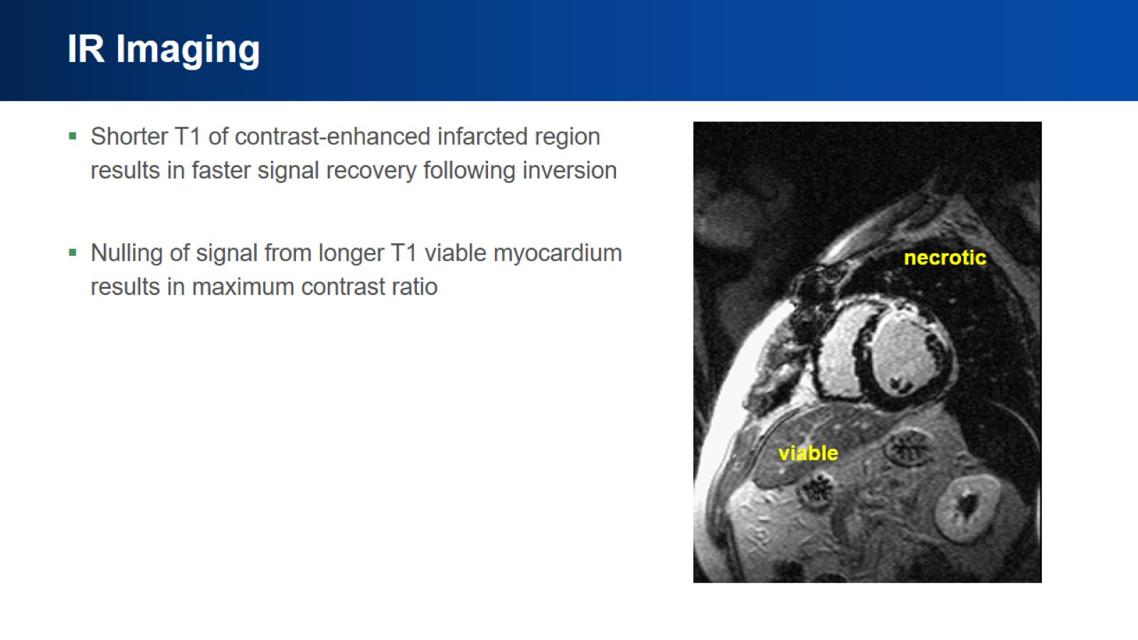
IR Imaging

Slide 26
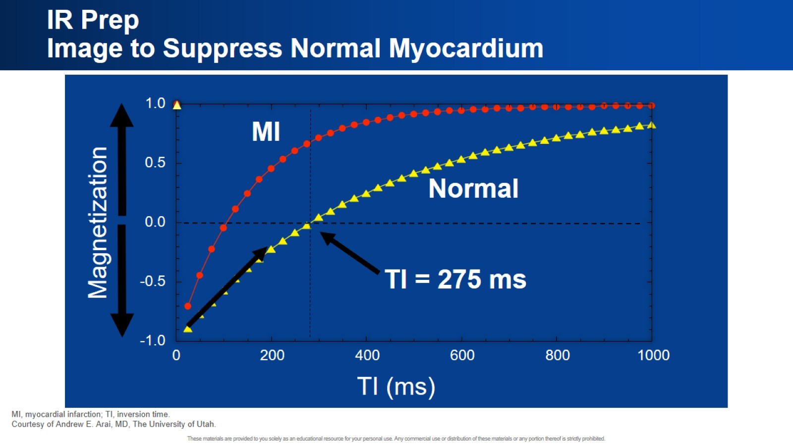
IR Prep
Image to Suppress Normal Myocardium

Slide 27
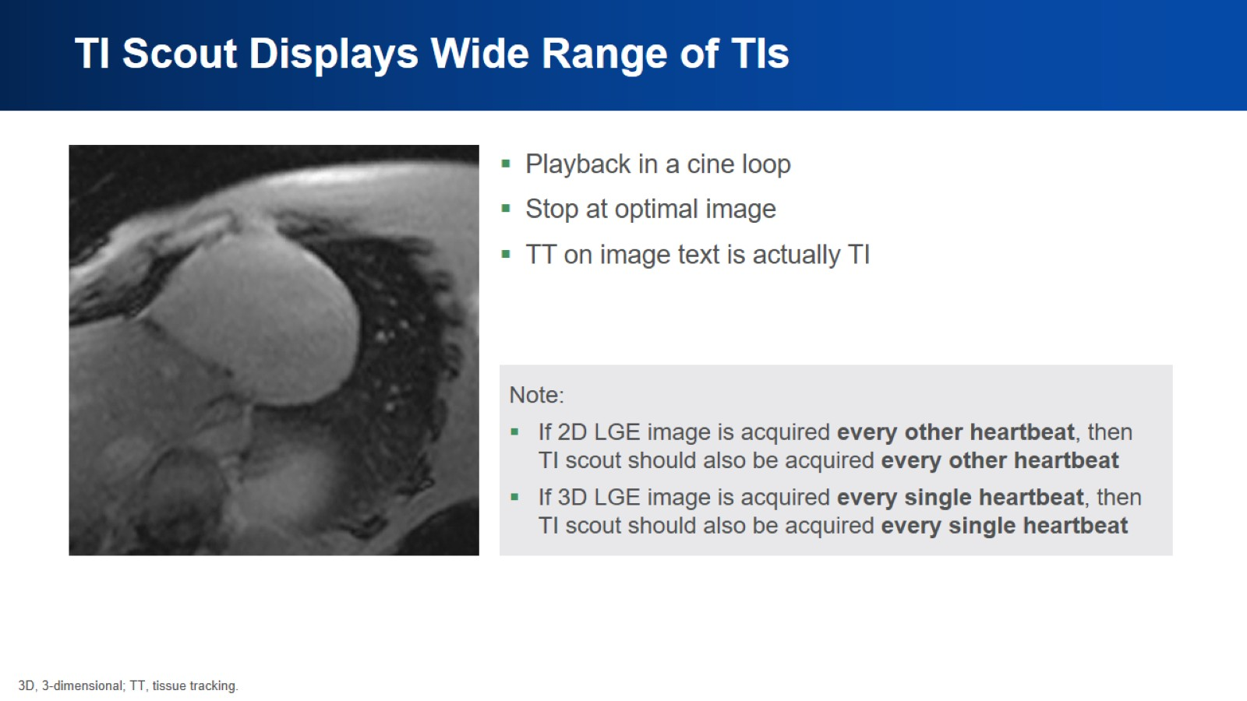
TI Scout Displays Wide Range of TIs

Slide 28
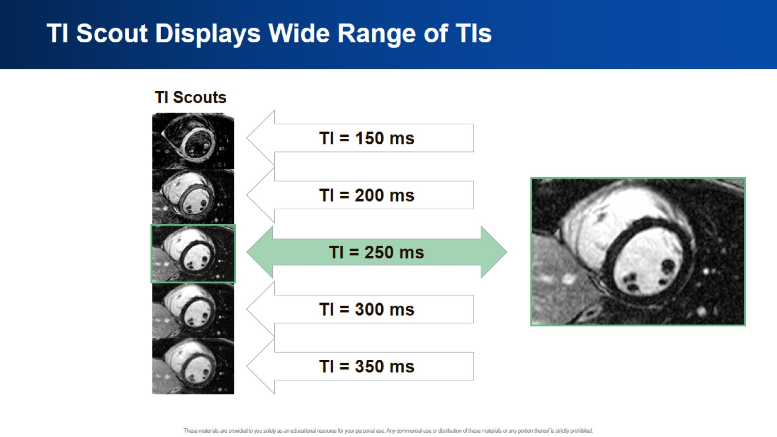
TI Scout Displays Wide Range of TIs

Slide 29
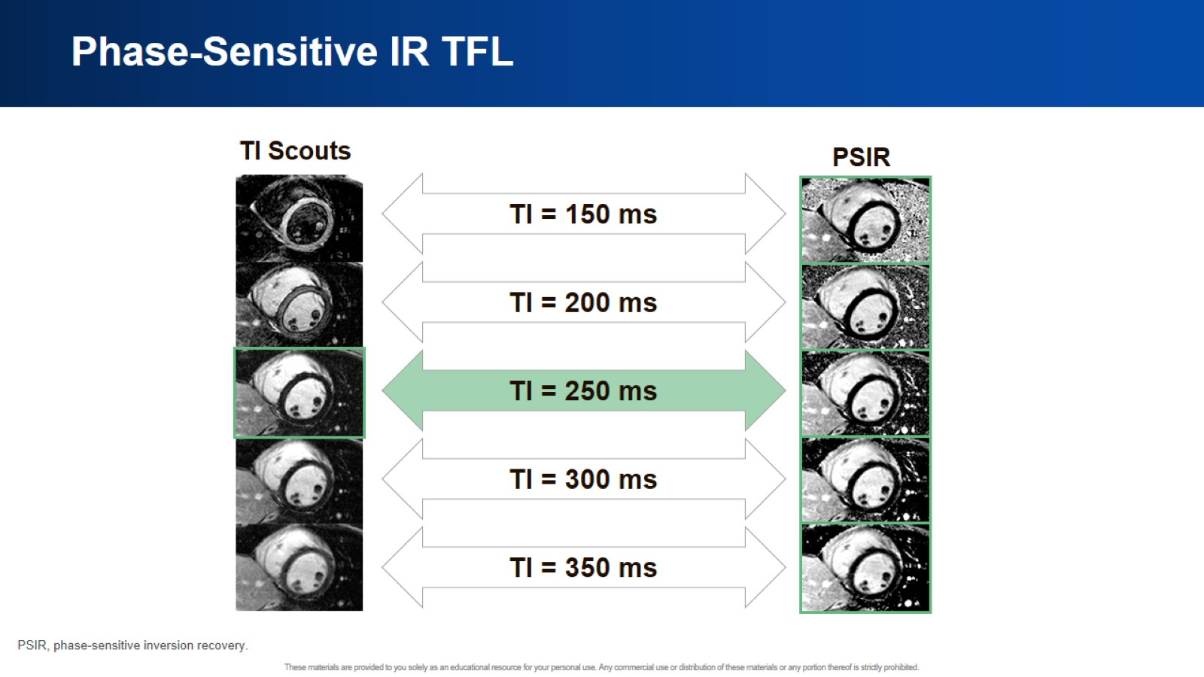
Phase-Sensitive IR TFL

Slide 30
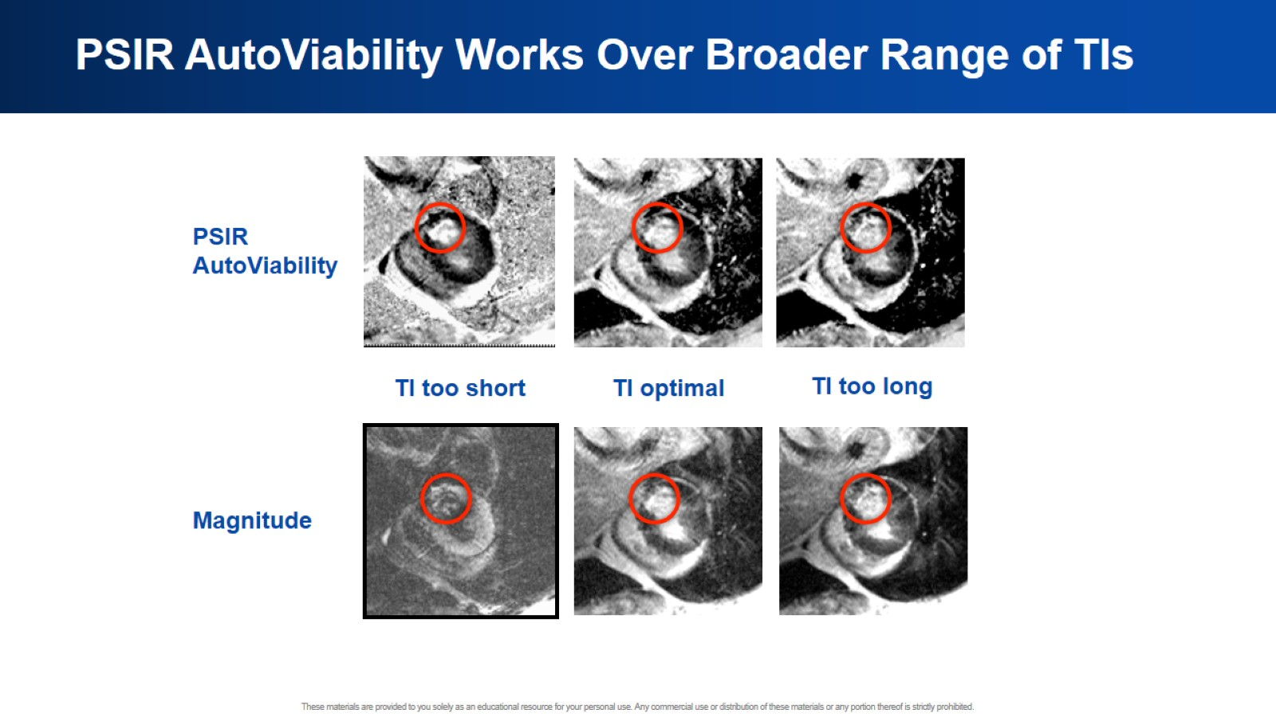
PSIR AutoViability Works Over Broader Range of TIs

Slide 31
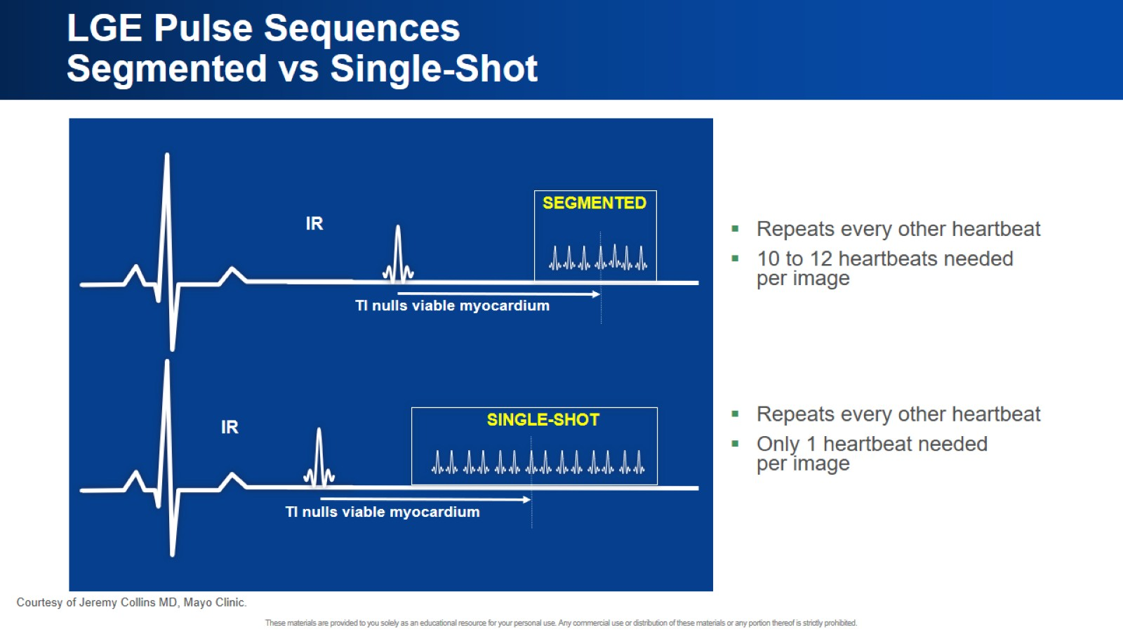
LGE Pulse Sequences
Segmented vs Single-Shot

Slide 32
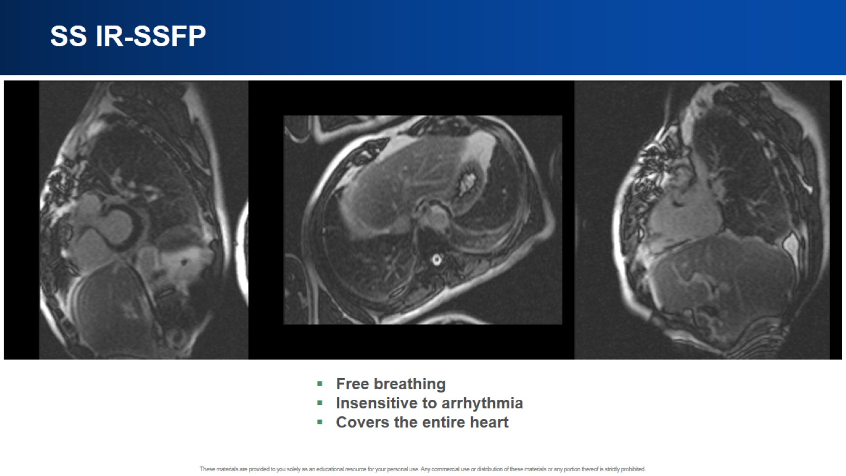
SS IR-SSFP

Slide 33
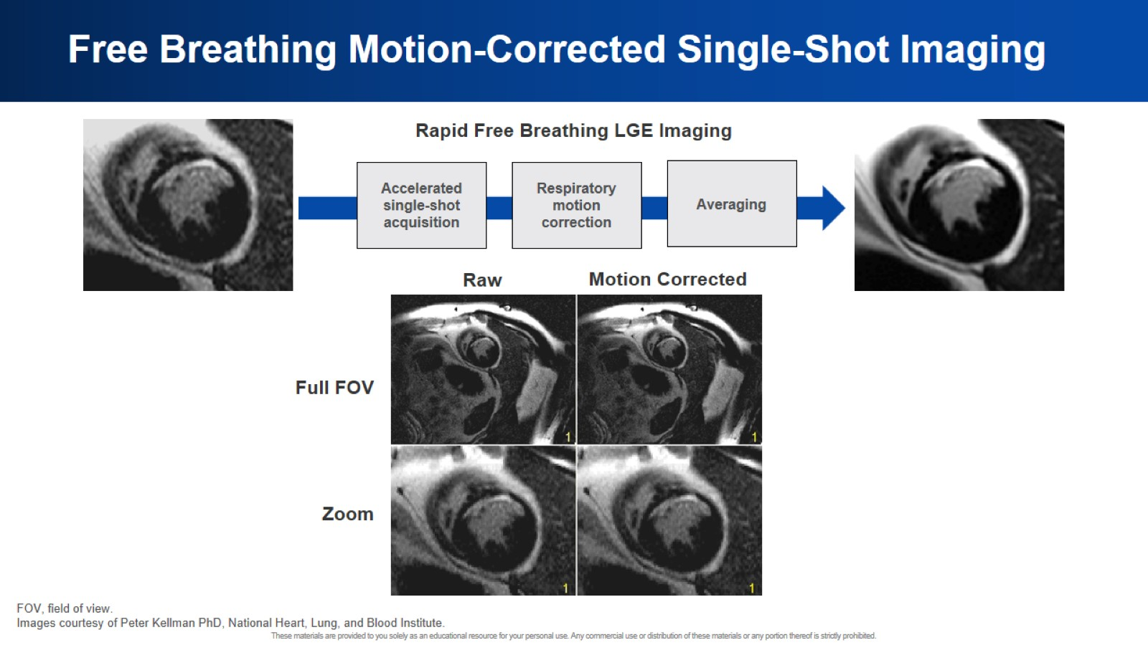
Free Breathing Motion-Corrected Single-Shot Imaging

Slide 34
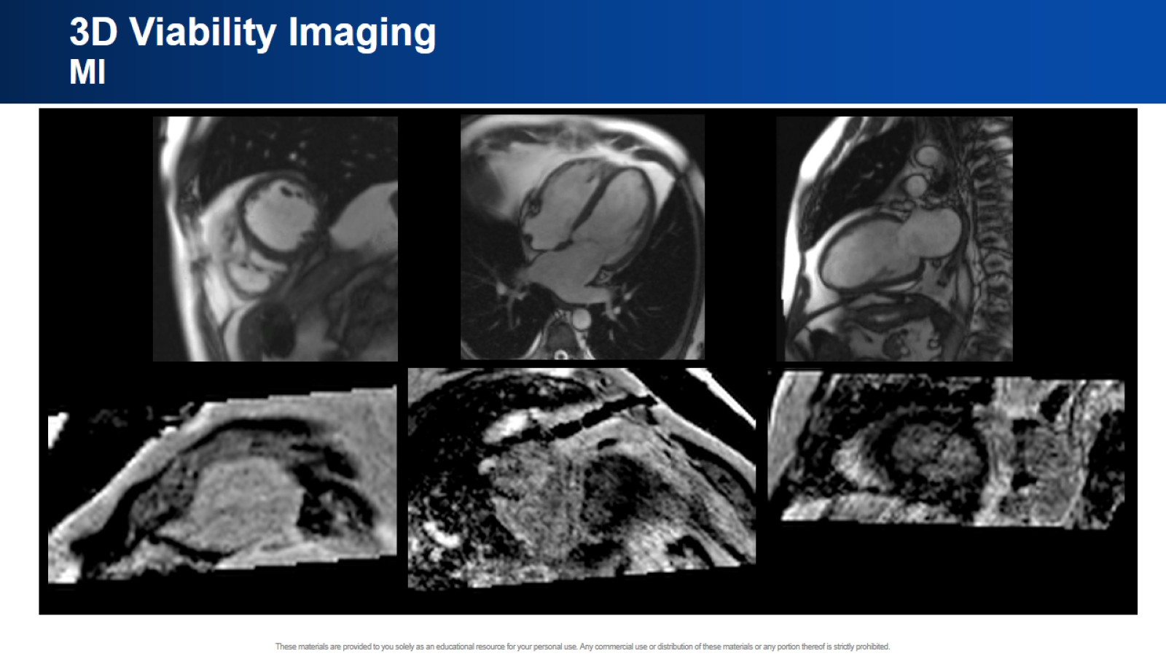
3D Viability Imaging
MI

Slide 35
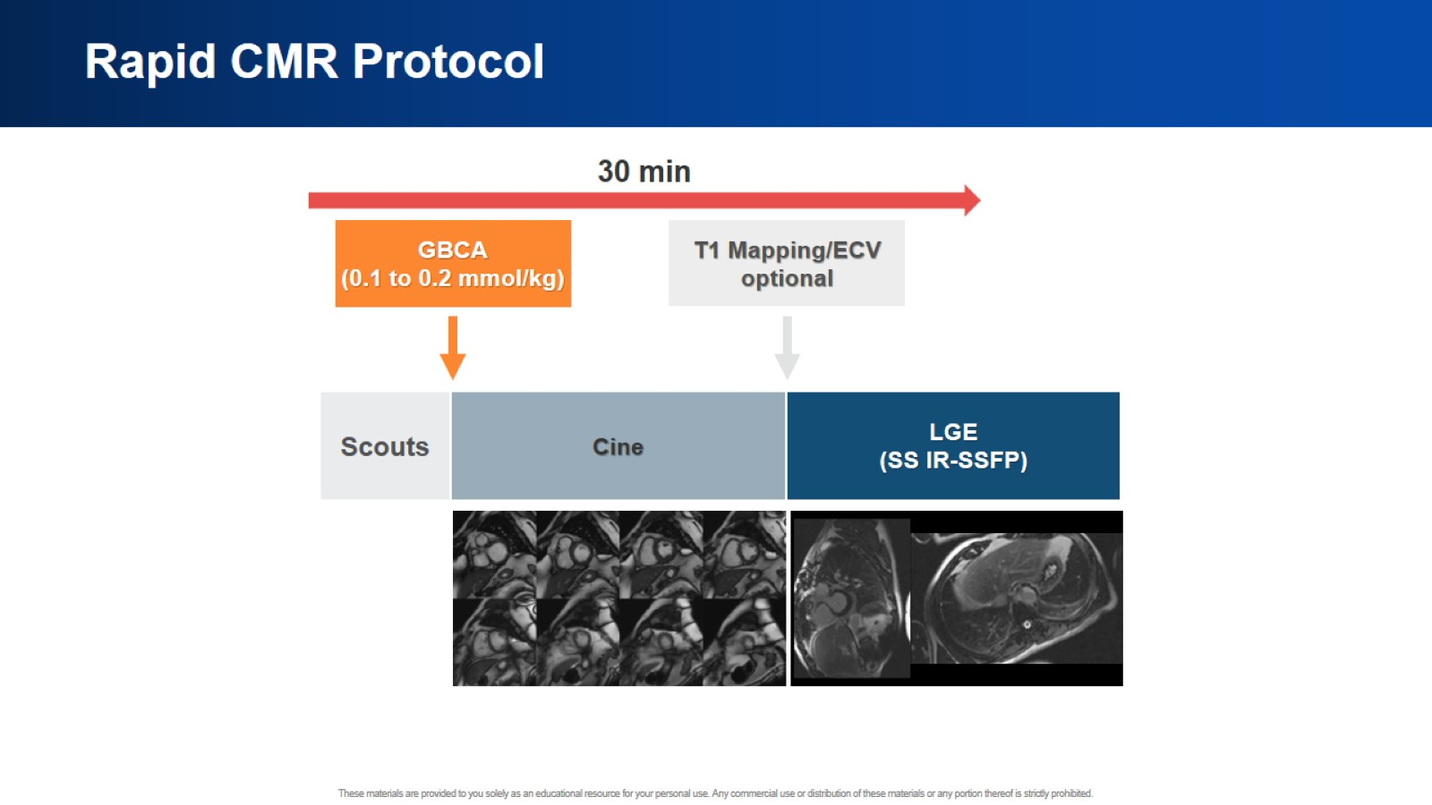
Rapid CMR Protocol

Slide 36
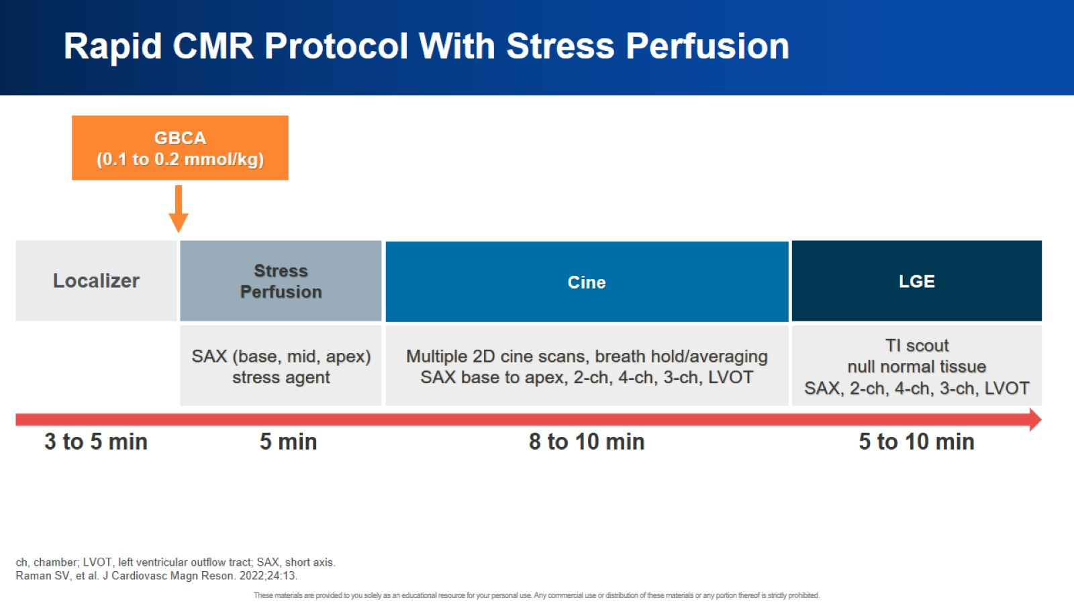
Rapid CMR Protocol With Stress Perfusion

Slide 37
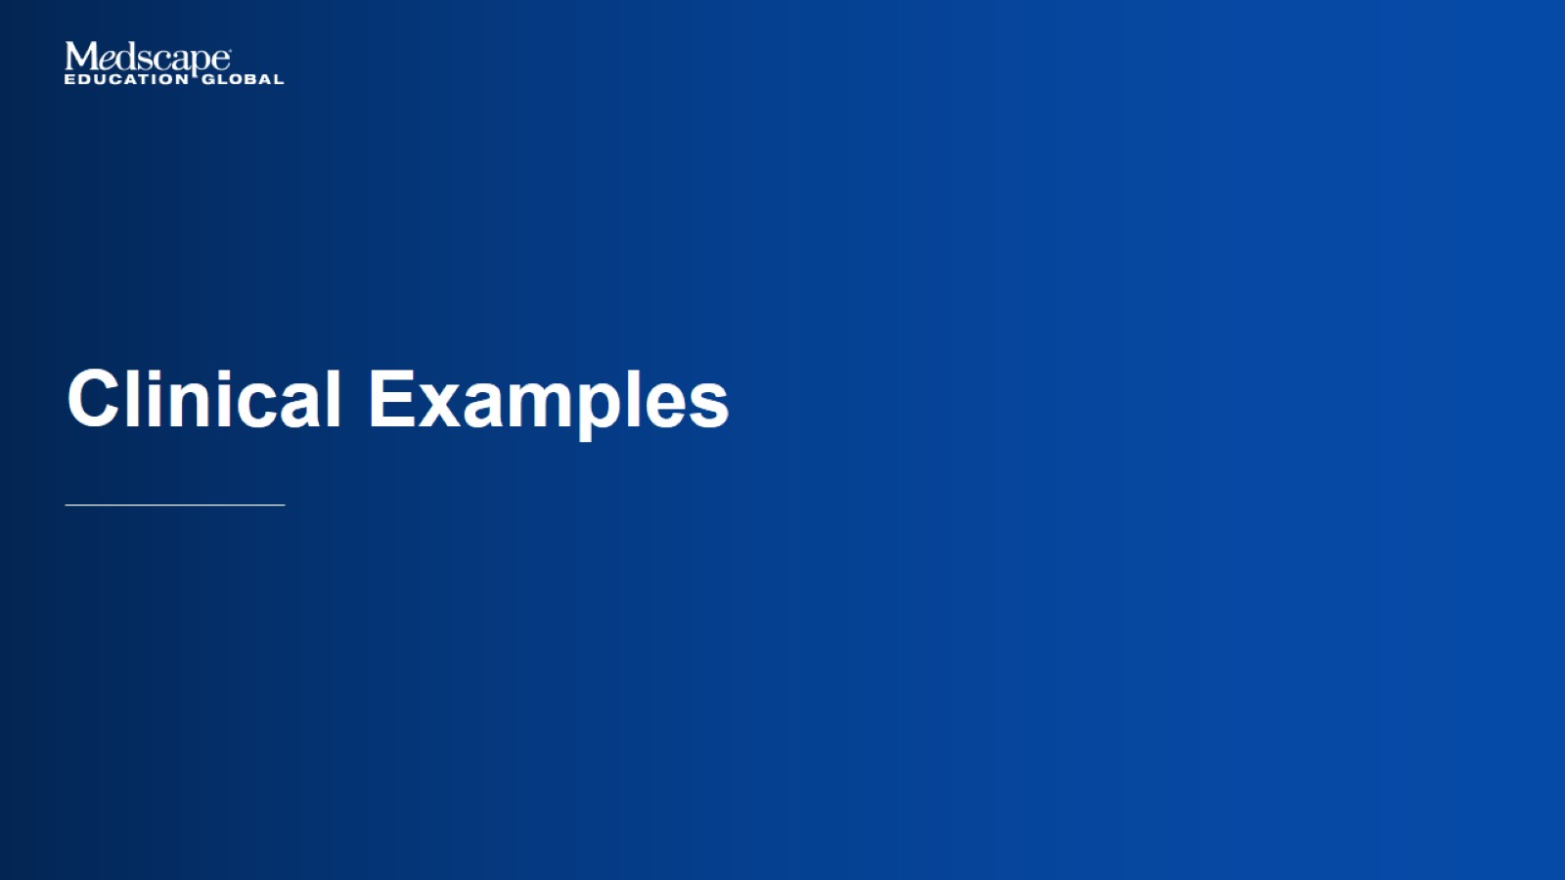
Clinical Examples

Slide 38
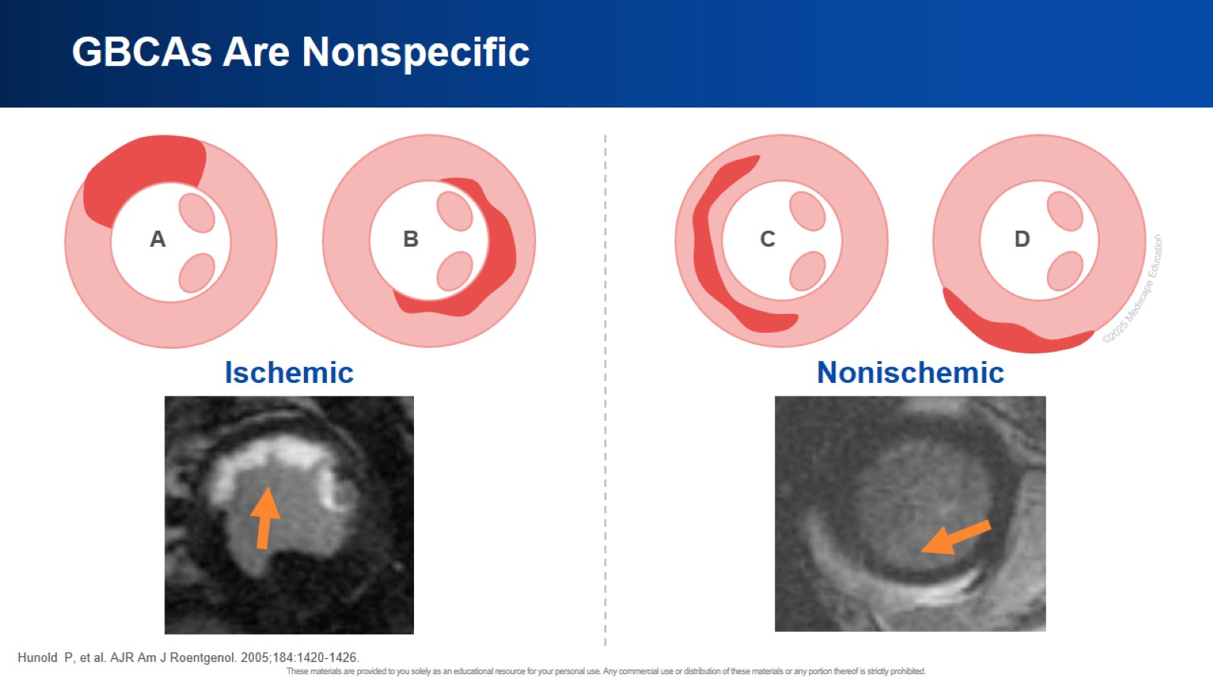
GBCAs Are Nonspecific

Slide 39
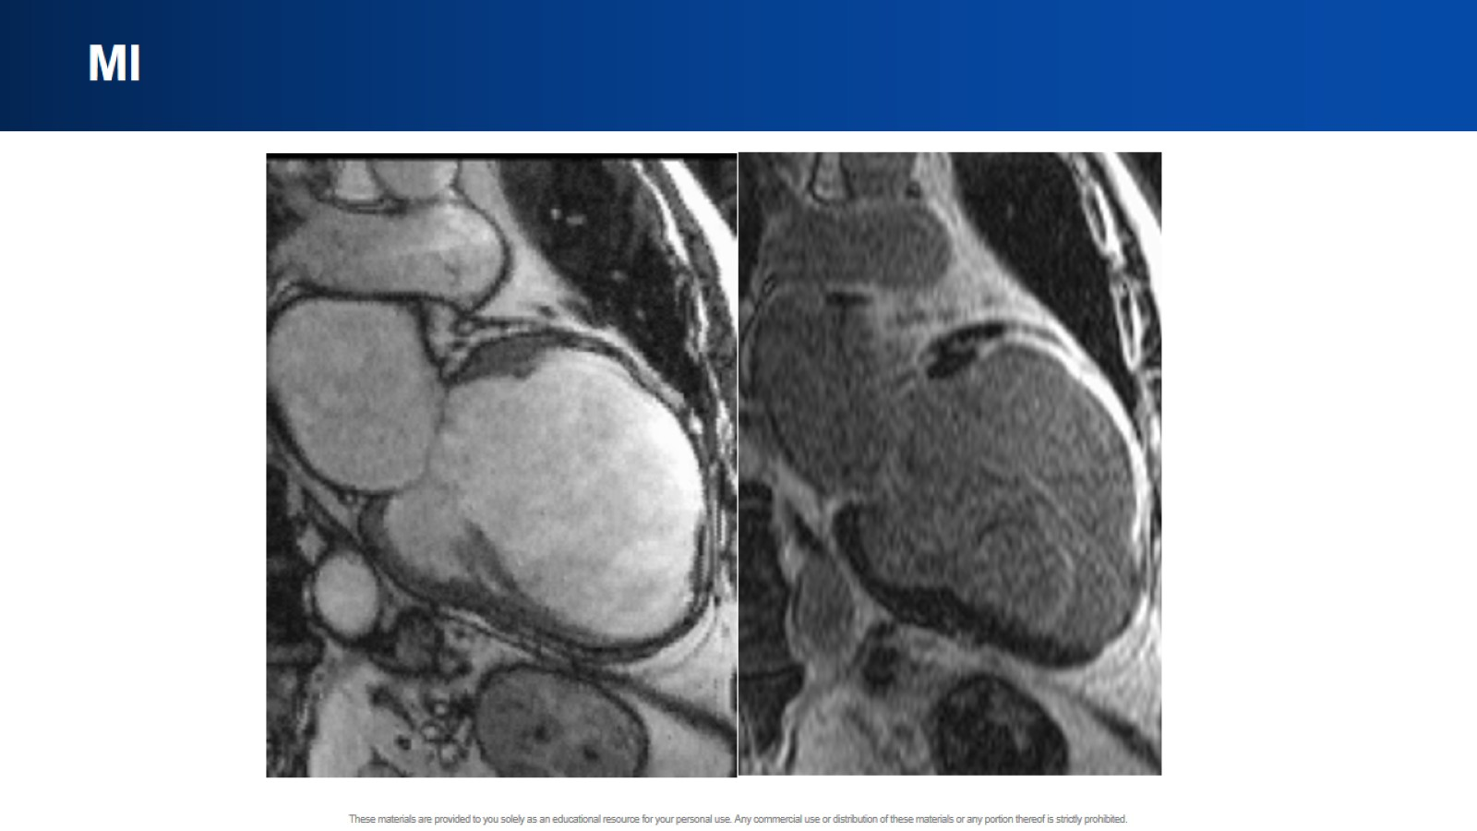
MI

Slide 40
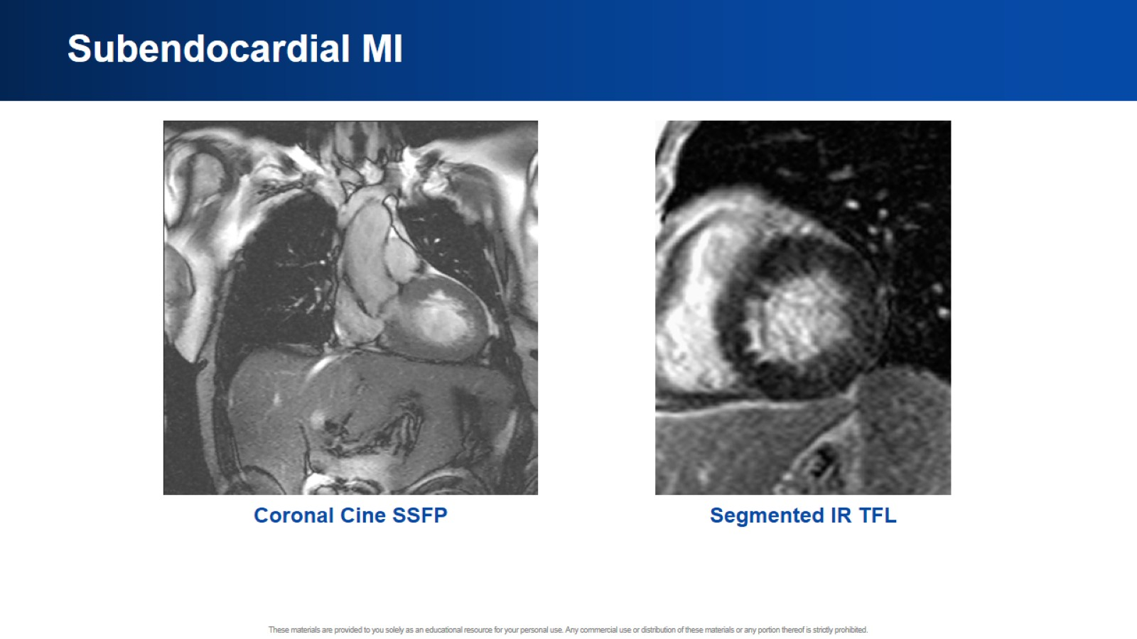
Subendocardial MI

Slide 41
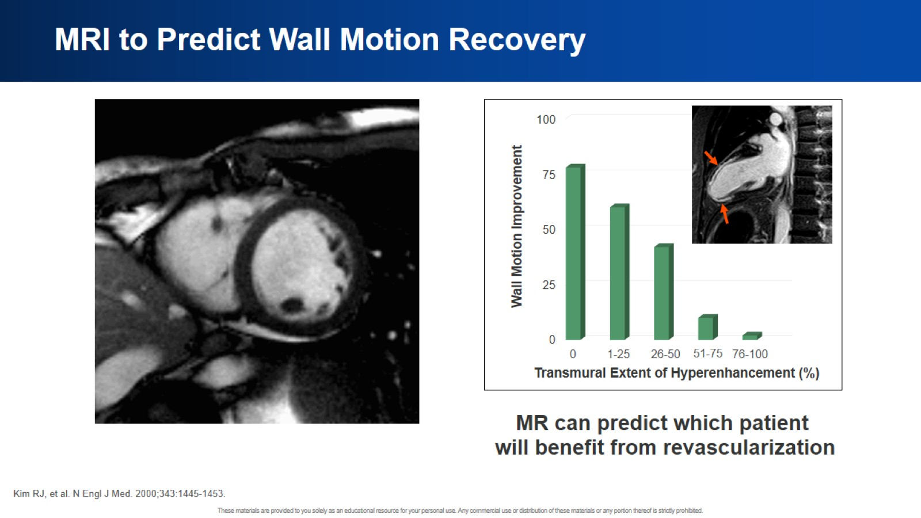
MRI to Predict Wall Motion Recovery

Slide 42
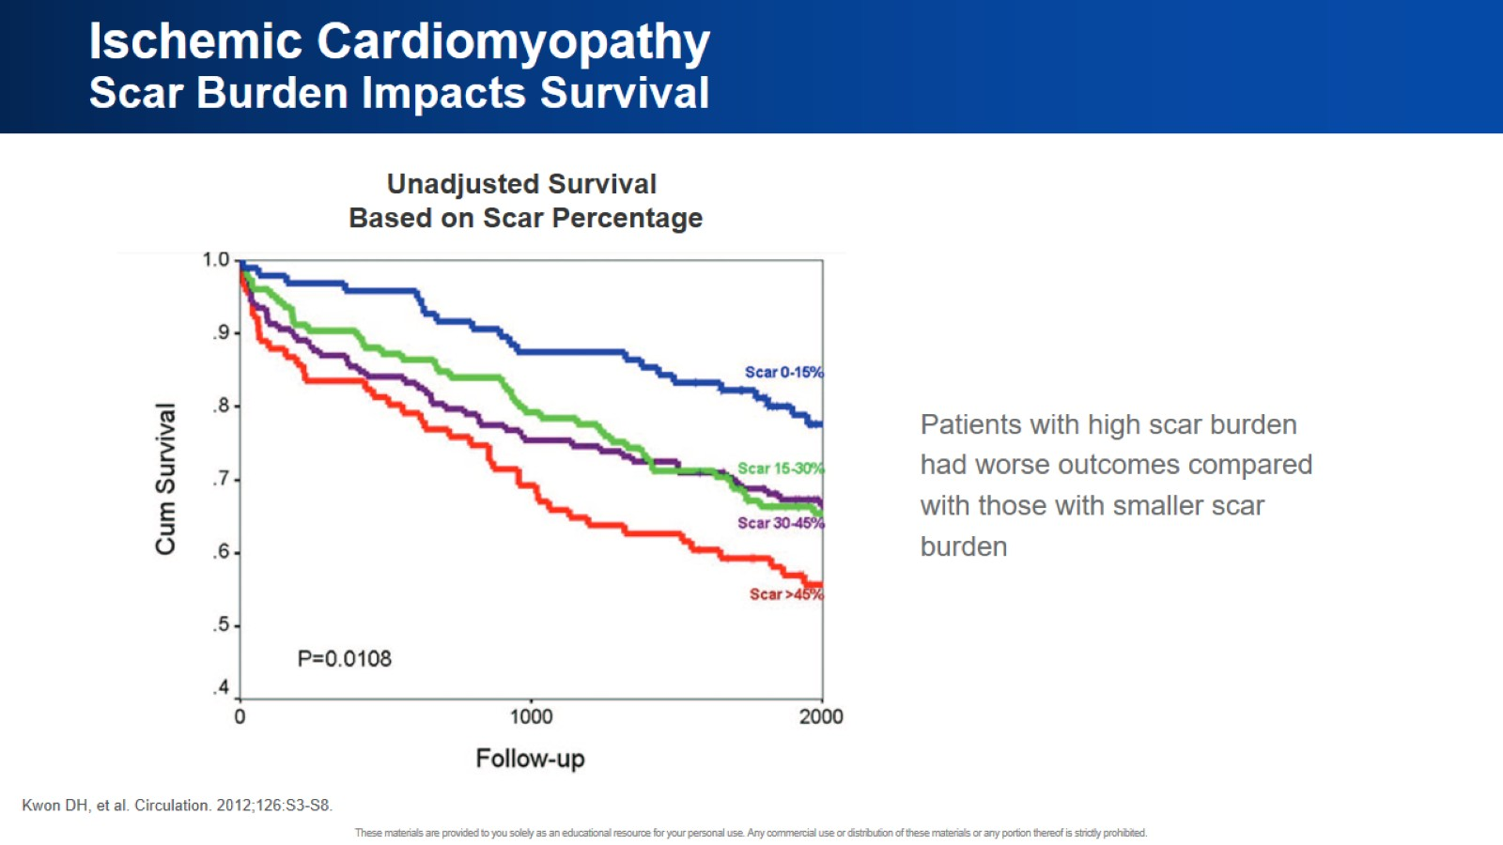
Ischemic Cardiomyopathy
Scar Burden Impacts Survival

Slide 43
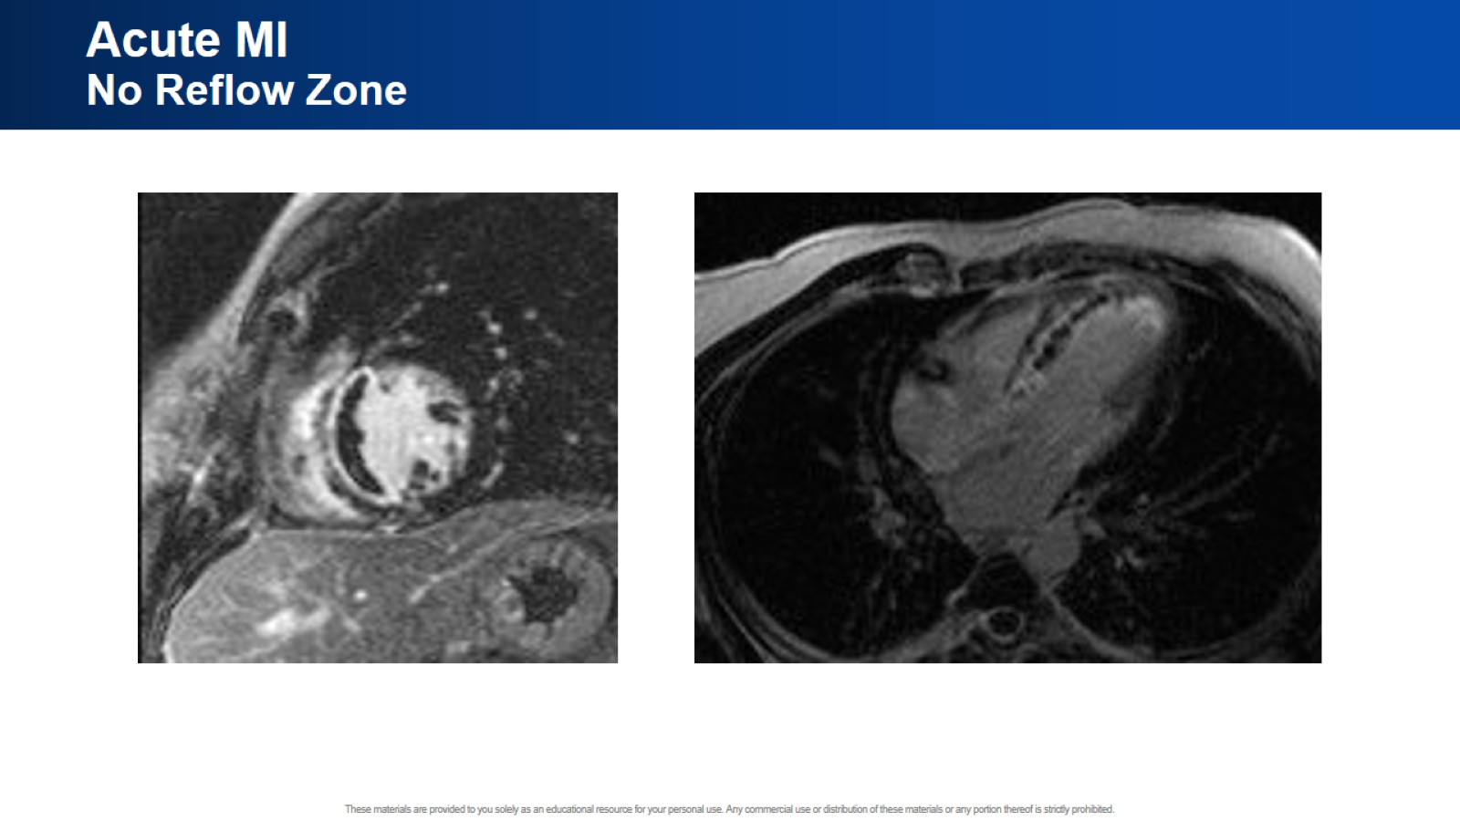
Acute MI
No Reflow Zone

Slide 44
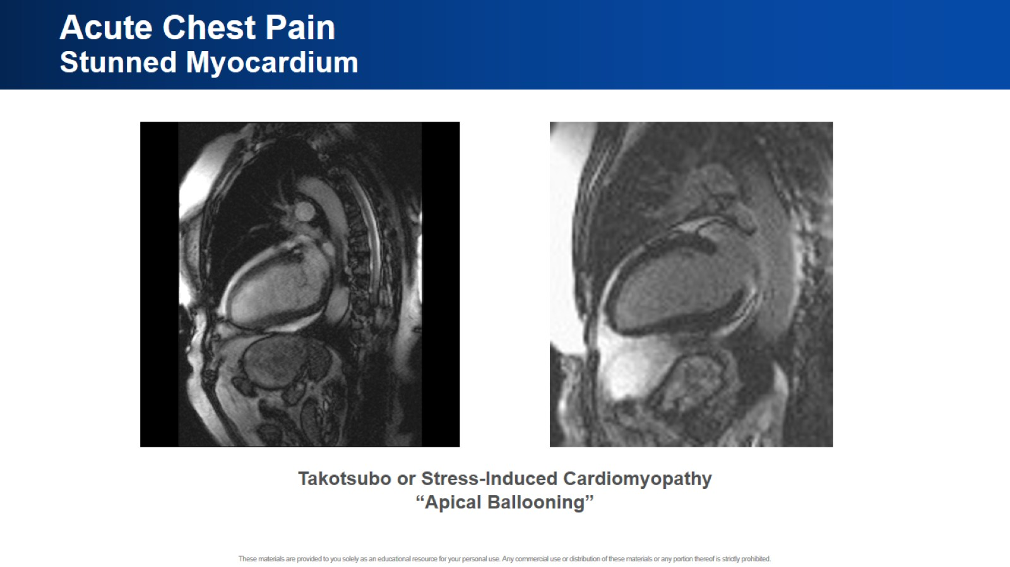
Acute Chest Pain
Stunned Myocardium

Slide 45
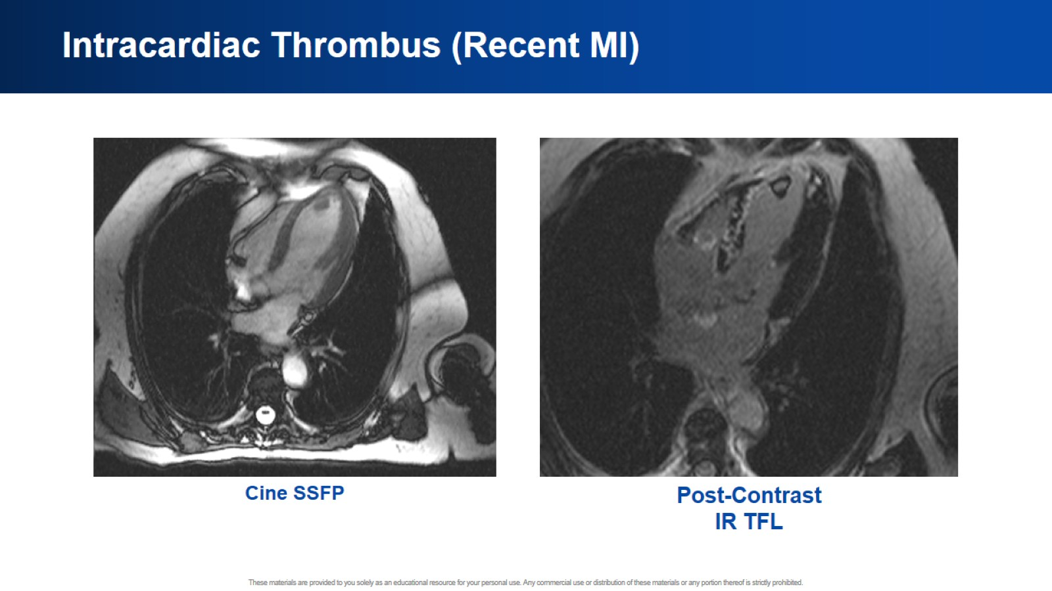
Intracardiac Thrombus (Recent MI)

Slide 46
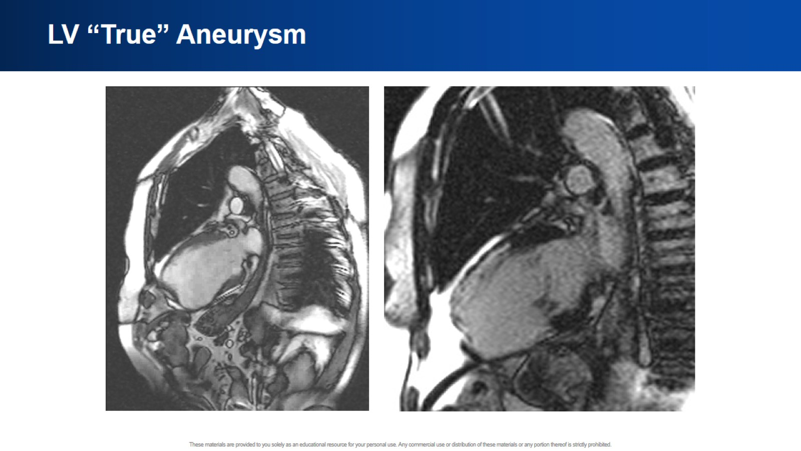
LV “True” Aneurysm

Slide 47
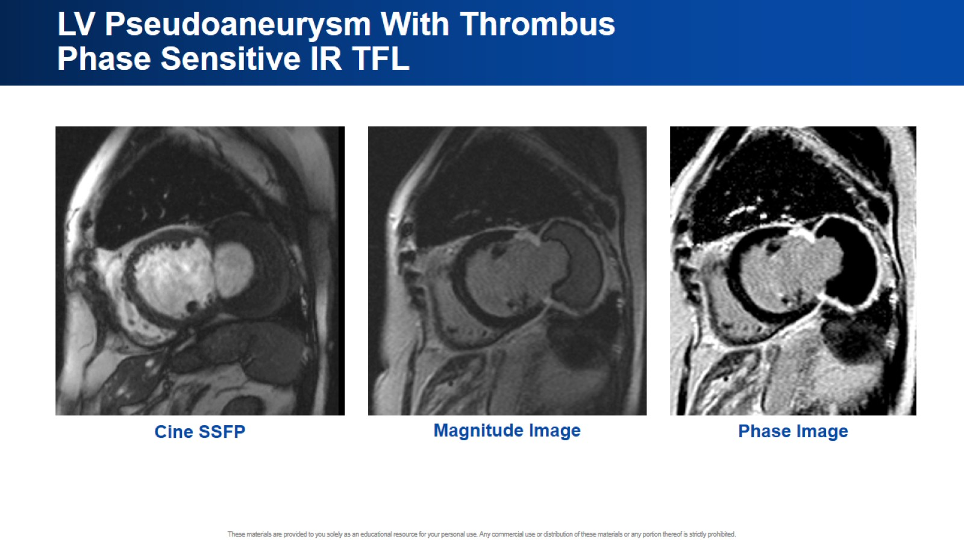
LV Pseudoaneurysm With Thrombus
Phase Sensitive IR TFL

Slide 48
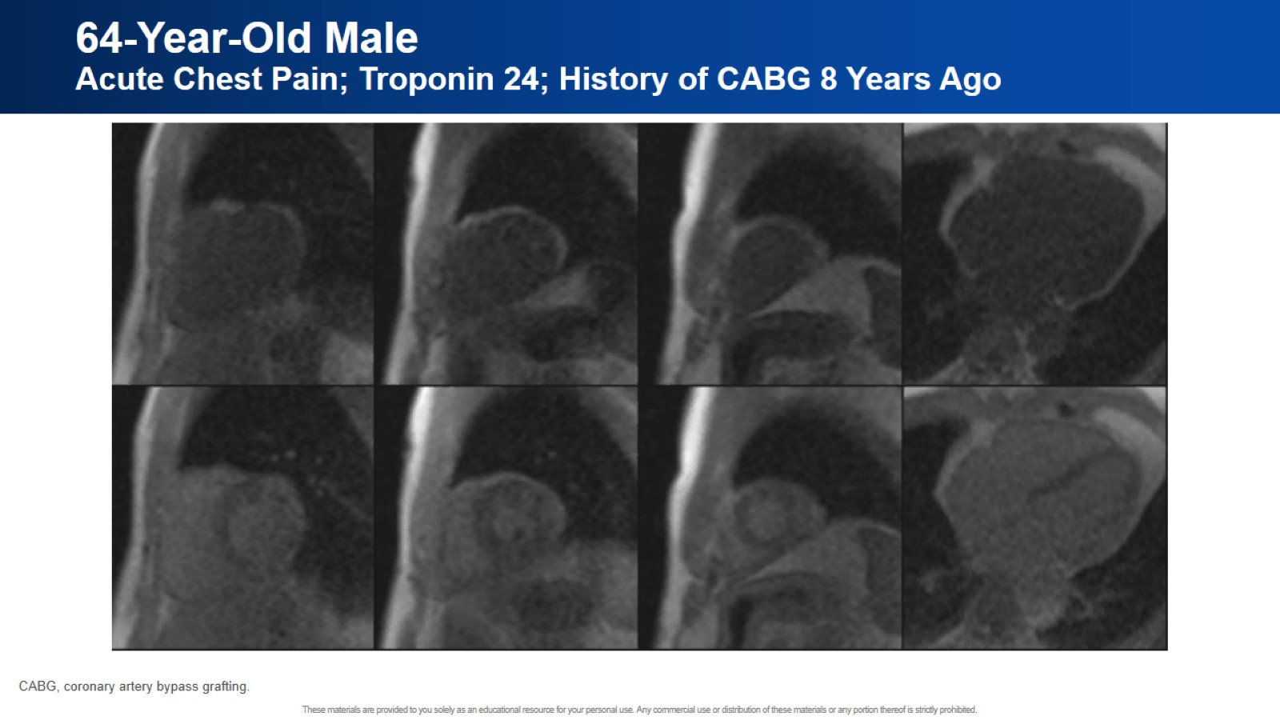
64-Year-Old Male
Acute Chest Pain; Troponin 24; History of CABG 8 Years Ago

Slide 49
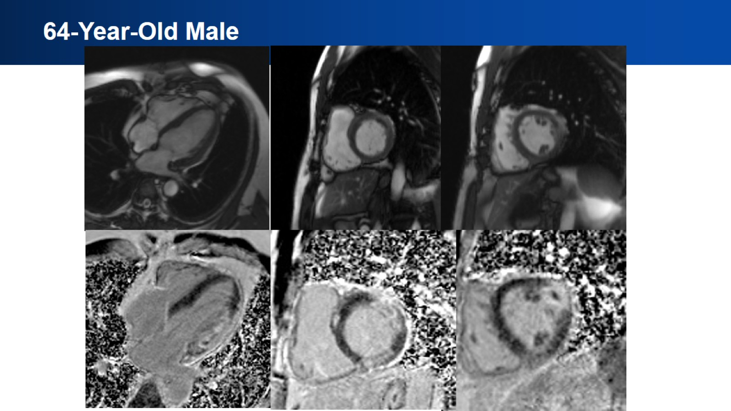
64-Year-Old Male

Slide 50
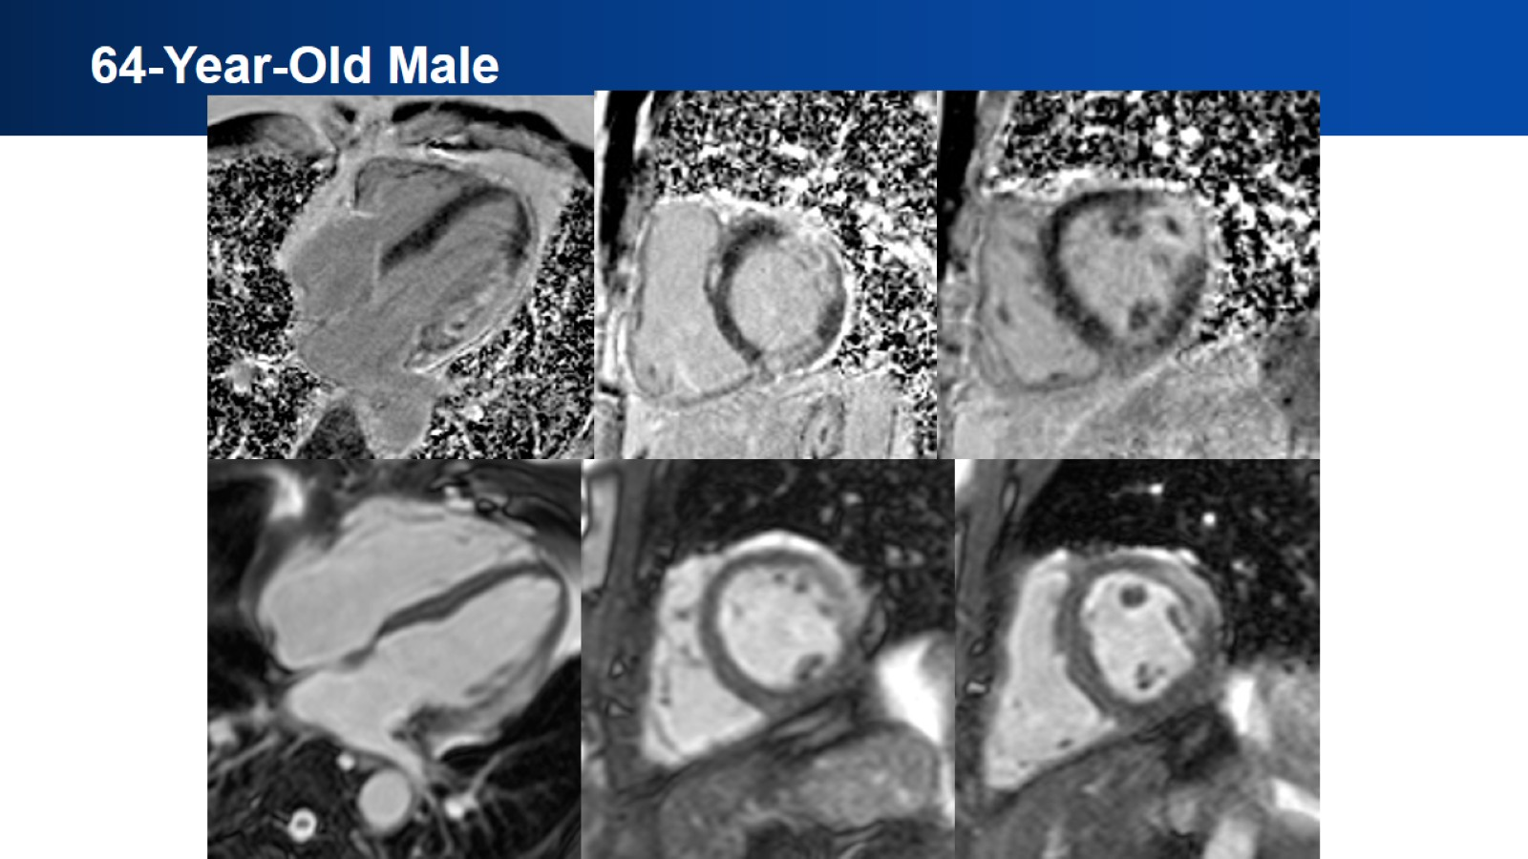
64-Year-Old Male

Slide 51

64-Year-Old Male

Slide 52

T1/ECV in Clinical Practice

Slide 53

Native T1 Mapping in IHD

Slide 54

Tissue Characterization Post MI

Slide 55

Traditional and Novel CMR Tissue Characterization Techniques After Acute Myocardial Injury

Slide 56

Artifacts

Slide 57

Balanced SSFP Artifact

Slide 58

Real-Time vs Segmented Cine
Arrhythmia

Slide 59

MI
Patient Unable to Breathhold

Slide 60

Incomplete Nulling of Myocardium on LGE

Slide 61

Successful MRI of Patients With ICD

Slide 62

Key Points

Slide 63


