Slide 1


Slide 2
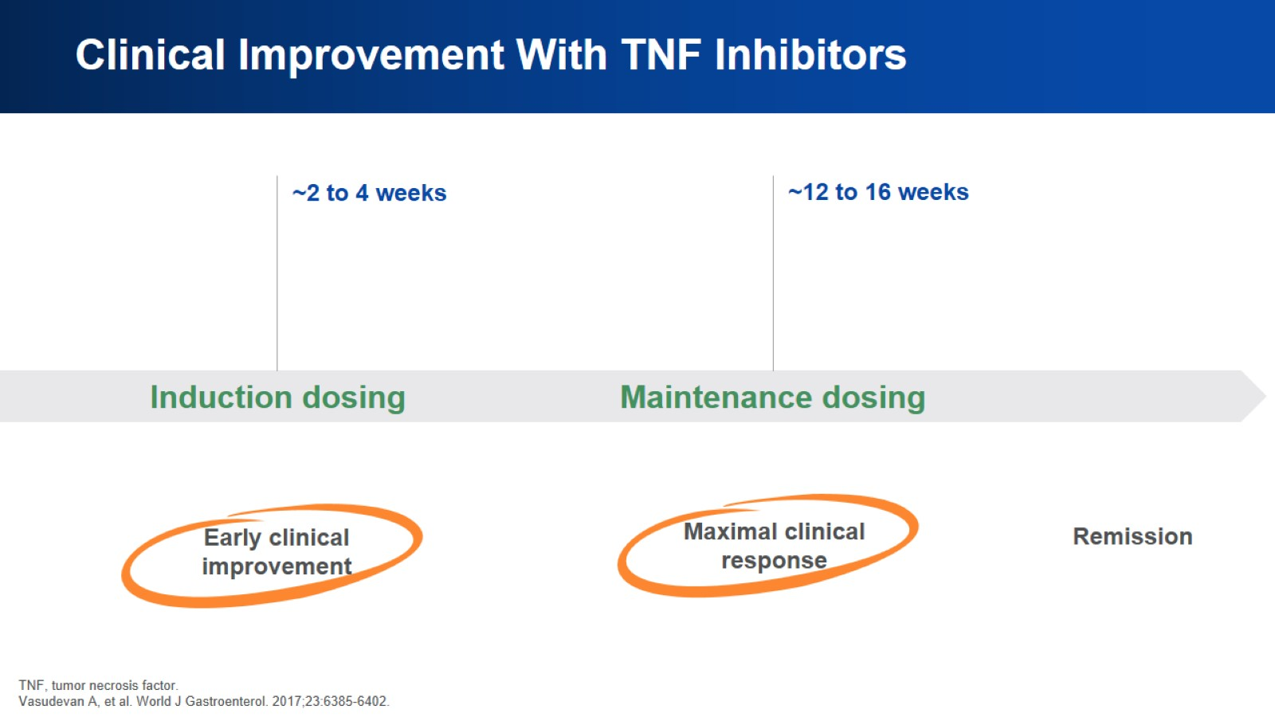
Clinical Improvement With TNF Inhibitors

Slide 3
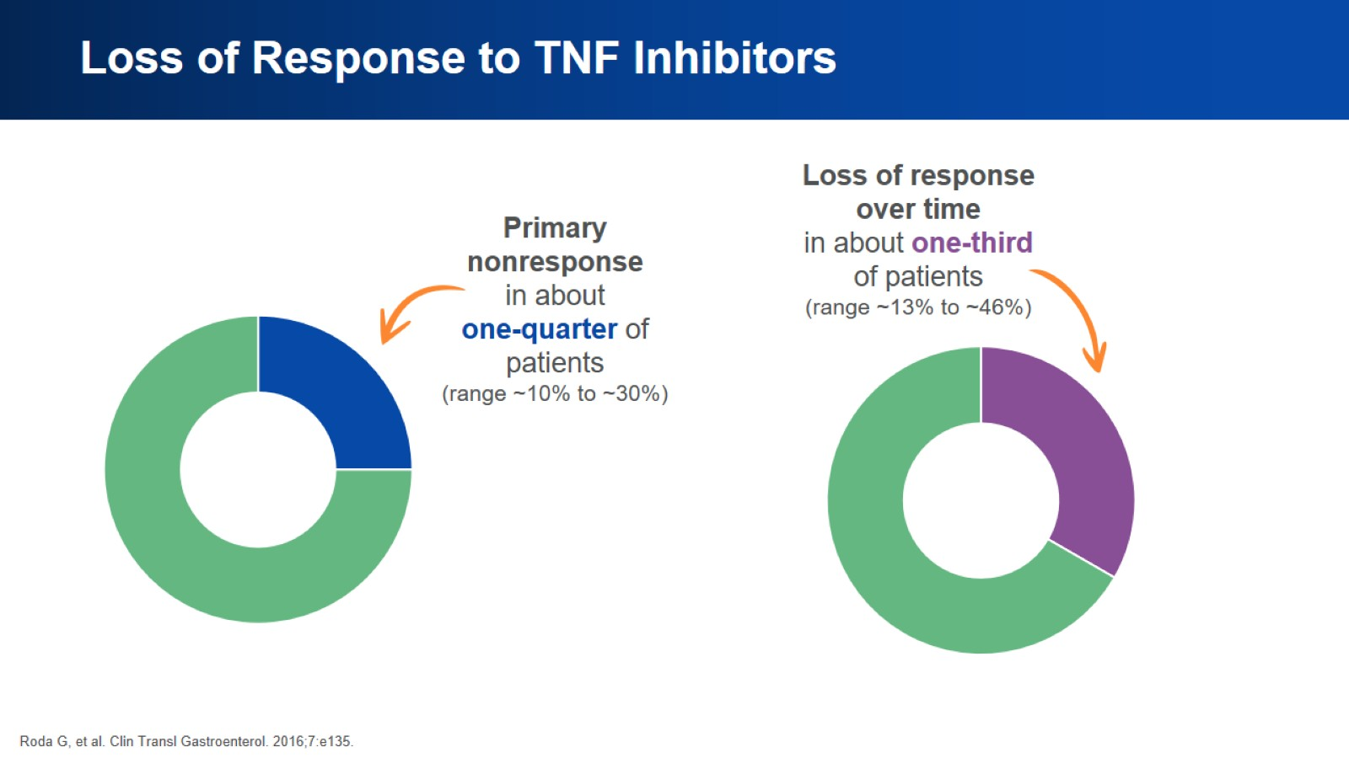
Loss of Response to TNF Inhibitors

Slide 4
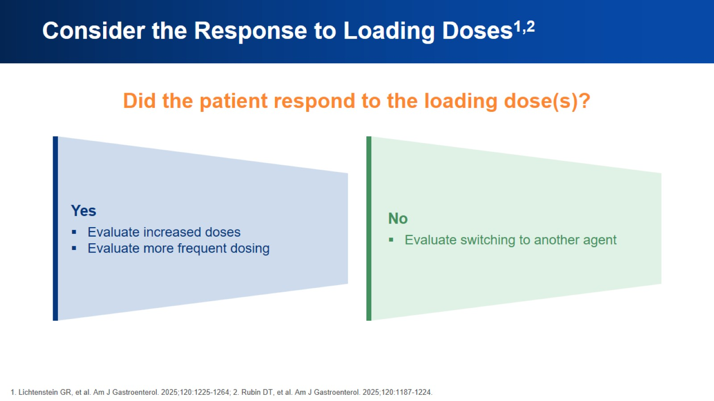
Consider the Response to Loading Doses^{1,2}

Slide 5
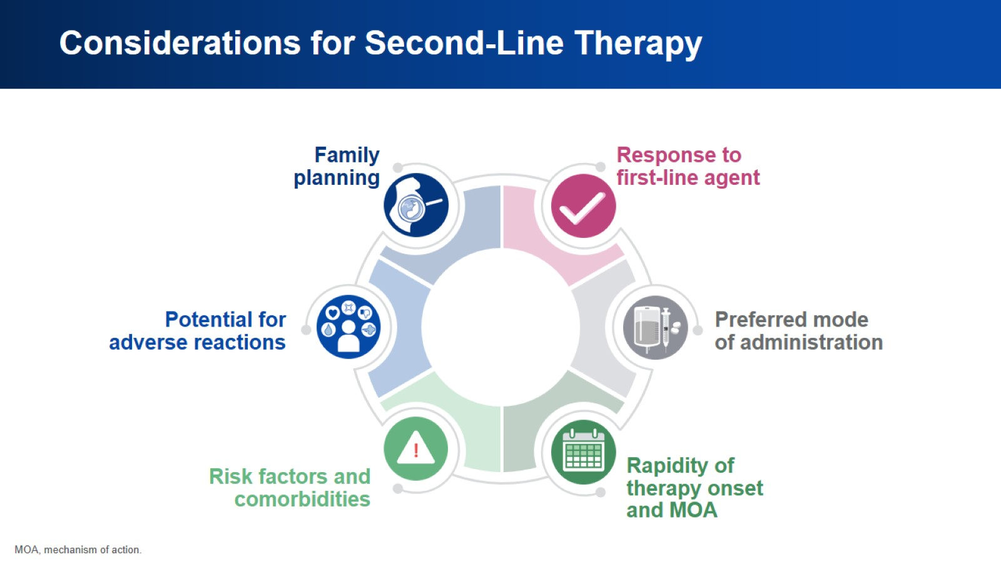
Considerations for Second-Line Therapy

Slide 6
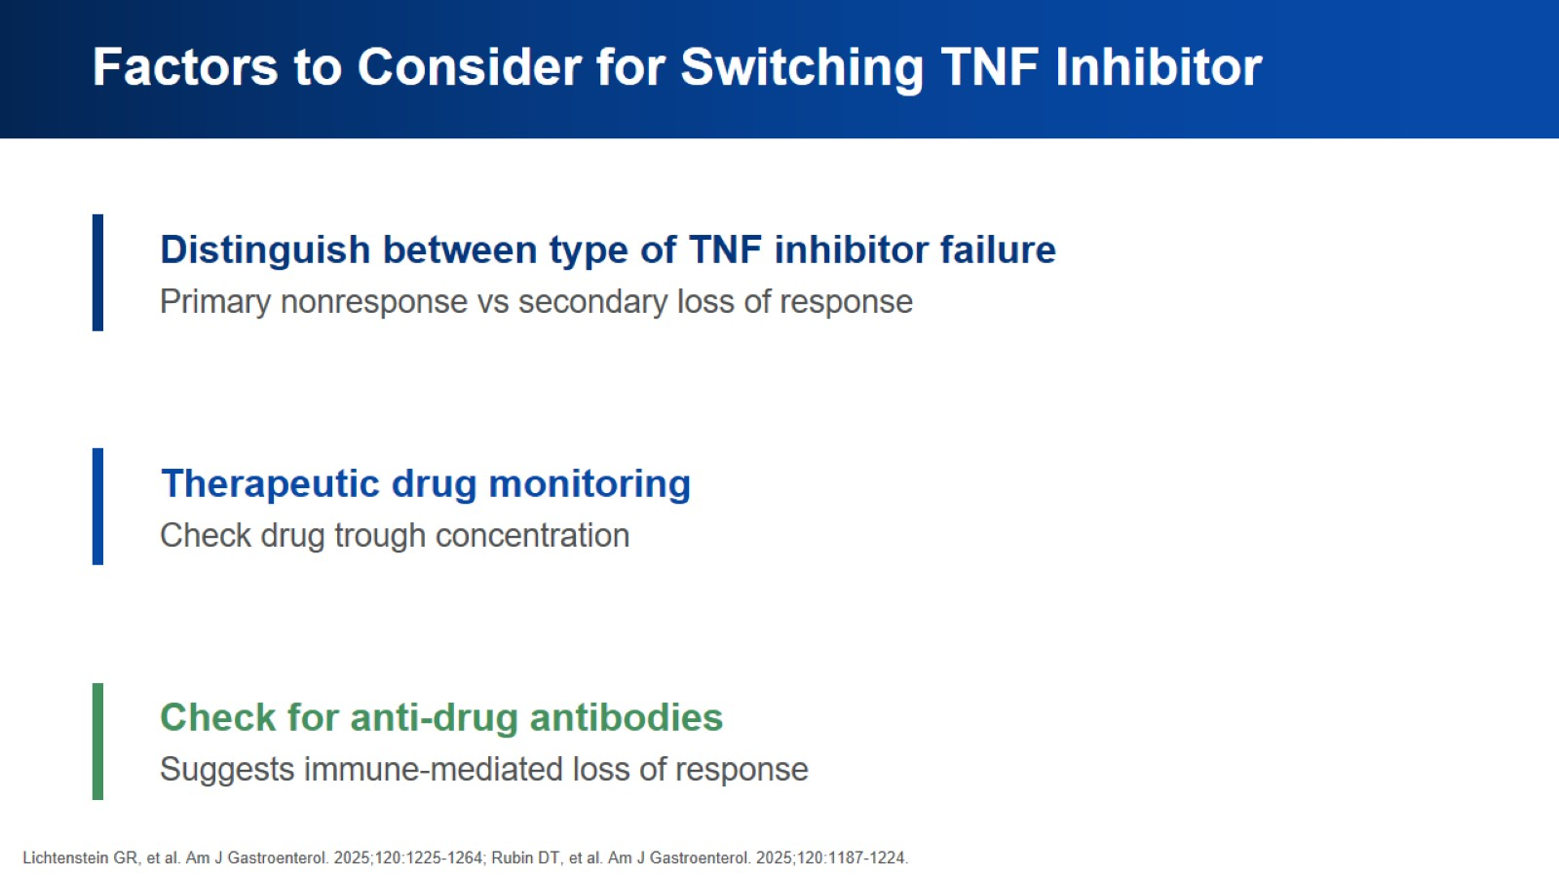
Factors to Consider for Switching TNF Inhibitor

Slide 7
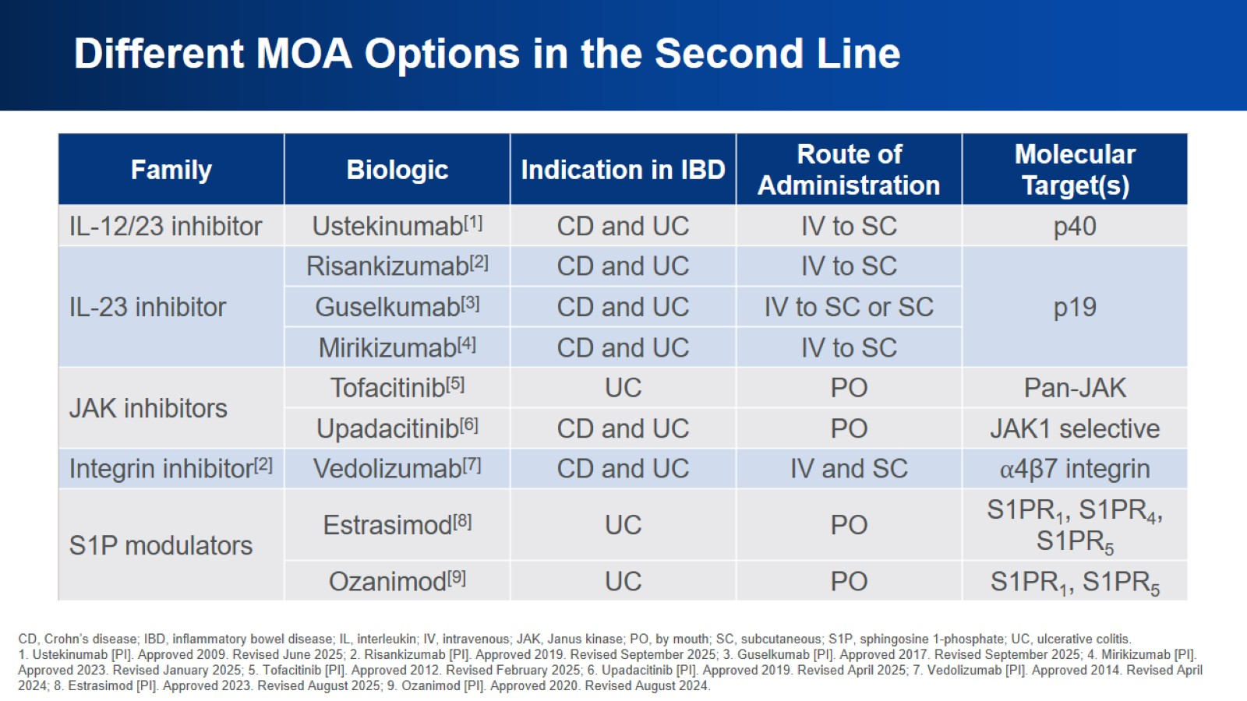
Different MOA Options in the Second Line

Slide 8
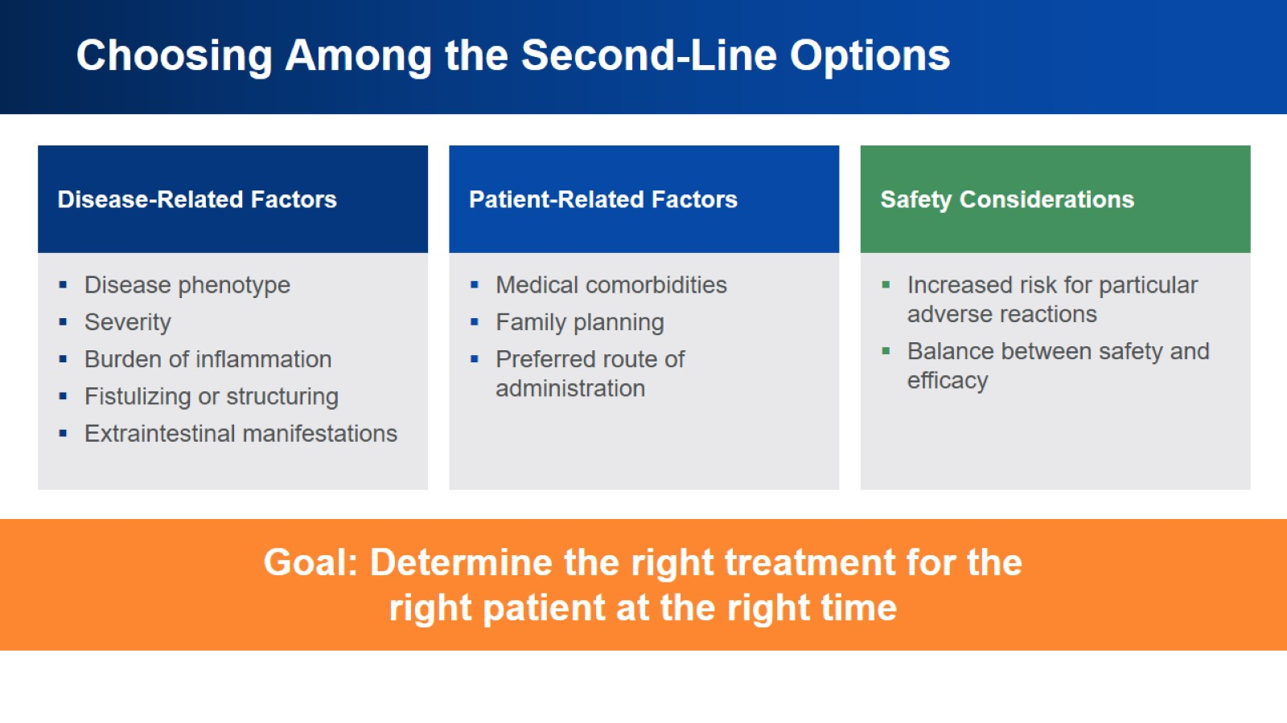
Choosing Among the Second-Line Options

Slide 9
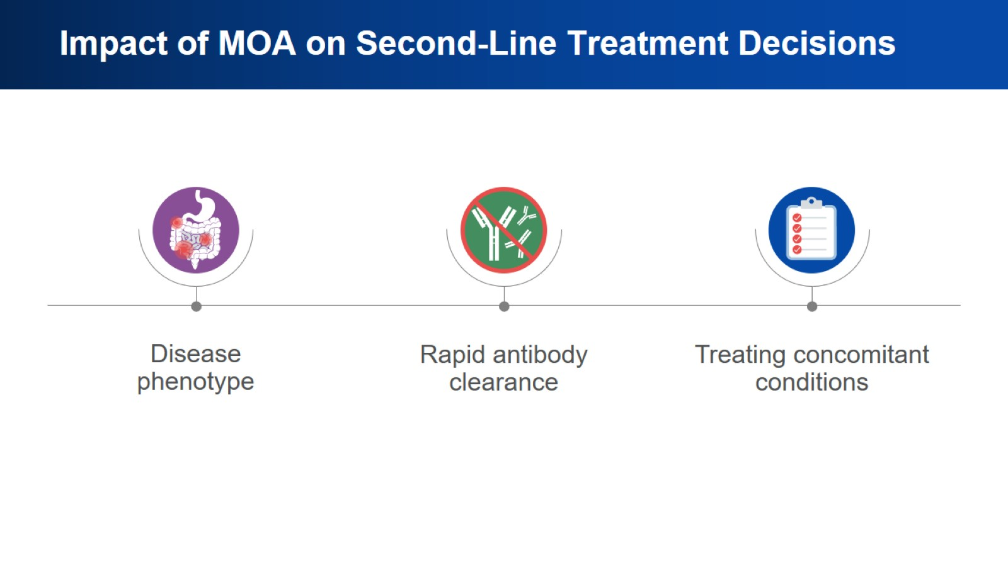
Impact of MOA on Second-Line Treatment Decisions

Slide 10
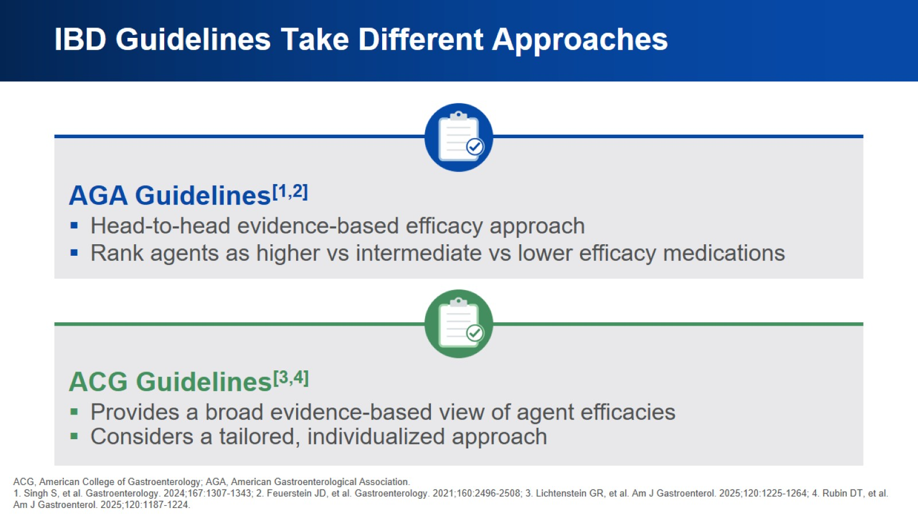
IBD Guidelines Take Different Approaches

Slide 11
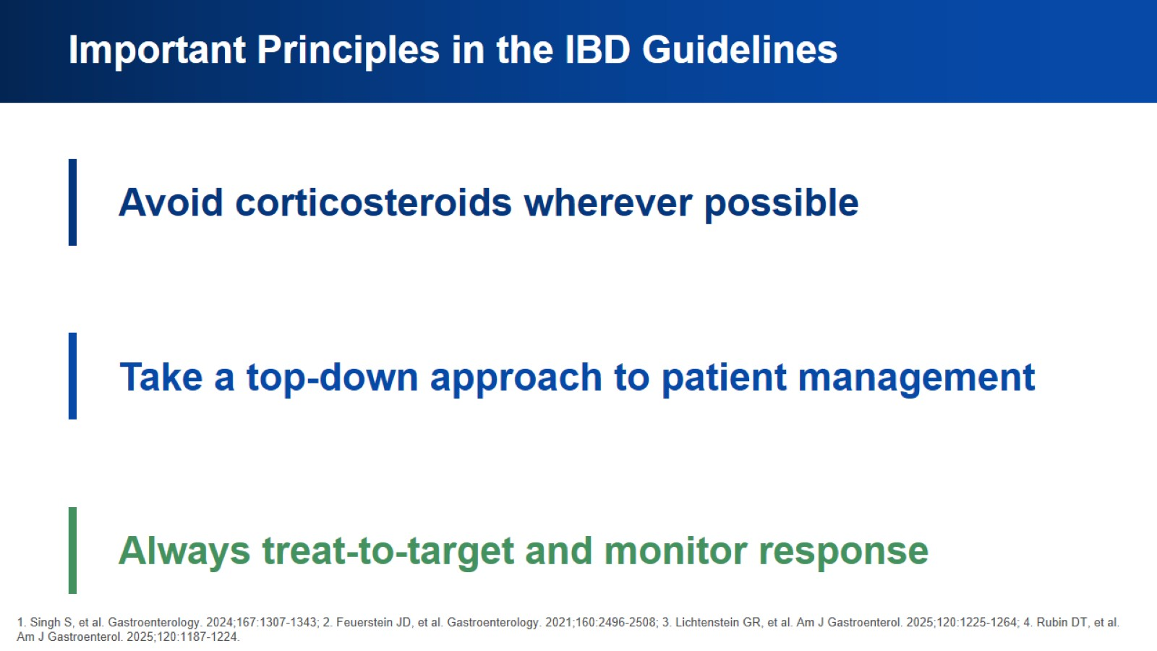
Important Principles in the IBD Guidelines

Slide 12
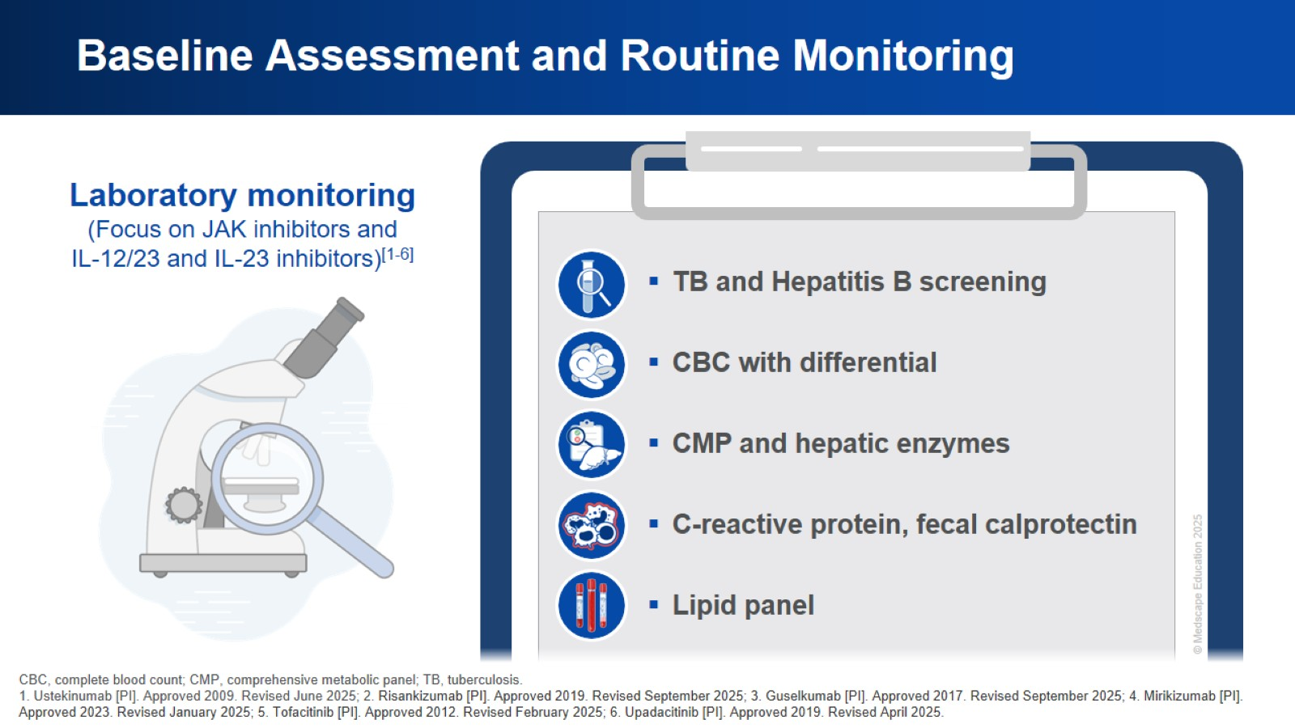
Baseline Assessment and Routine Monitoring

Slide 13
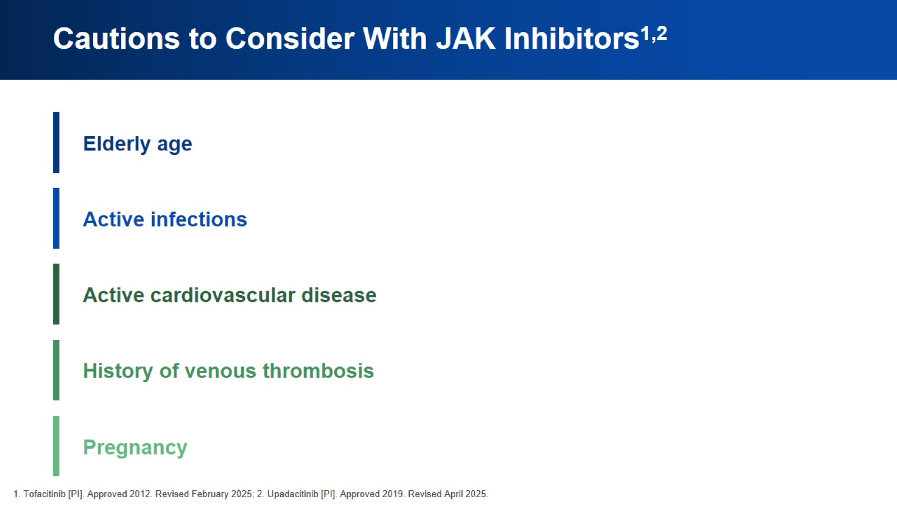
Cautions to Consider With JAK Inhibitors^{1,2}

Slide 14
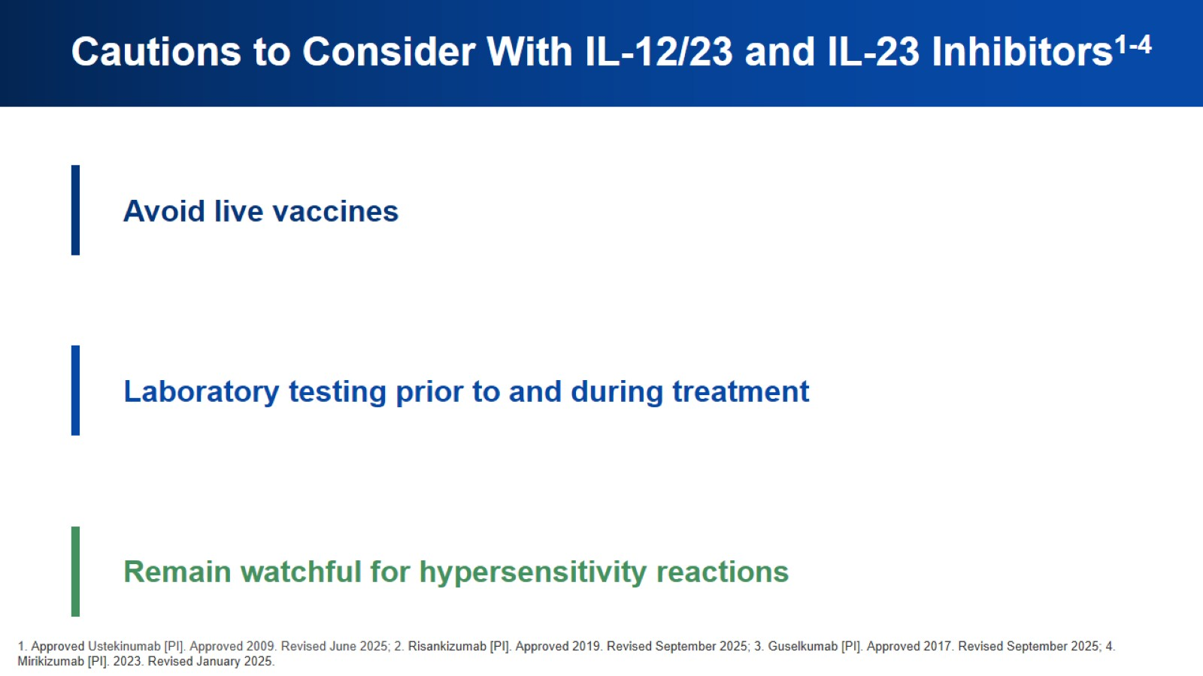
Cautions to Consider With IL-12/23 and IL-23 Inhibitors¹⁻⁴

Slide 15


