Slide 1

Hereditary Angioedema Headlines

Slide 2


Slide 3


Slide 4
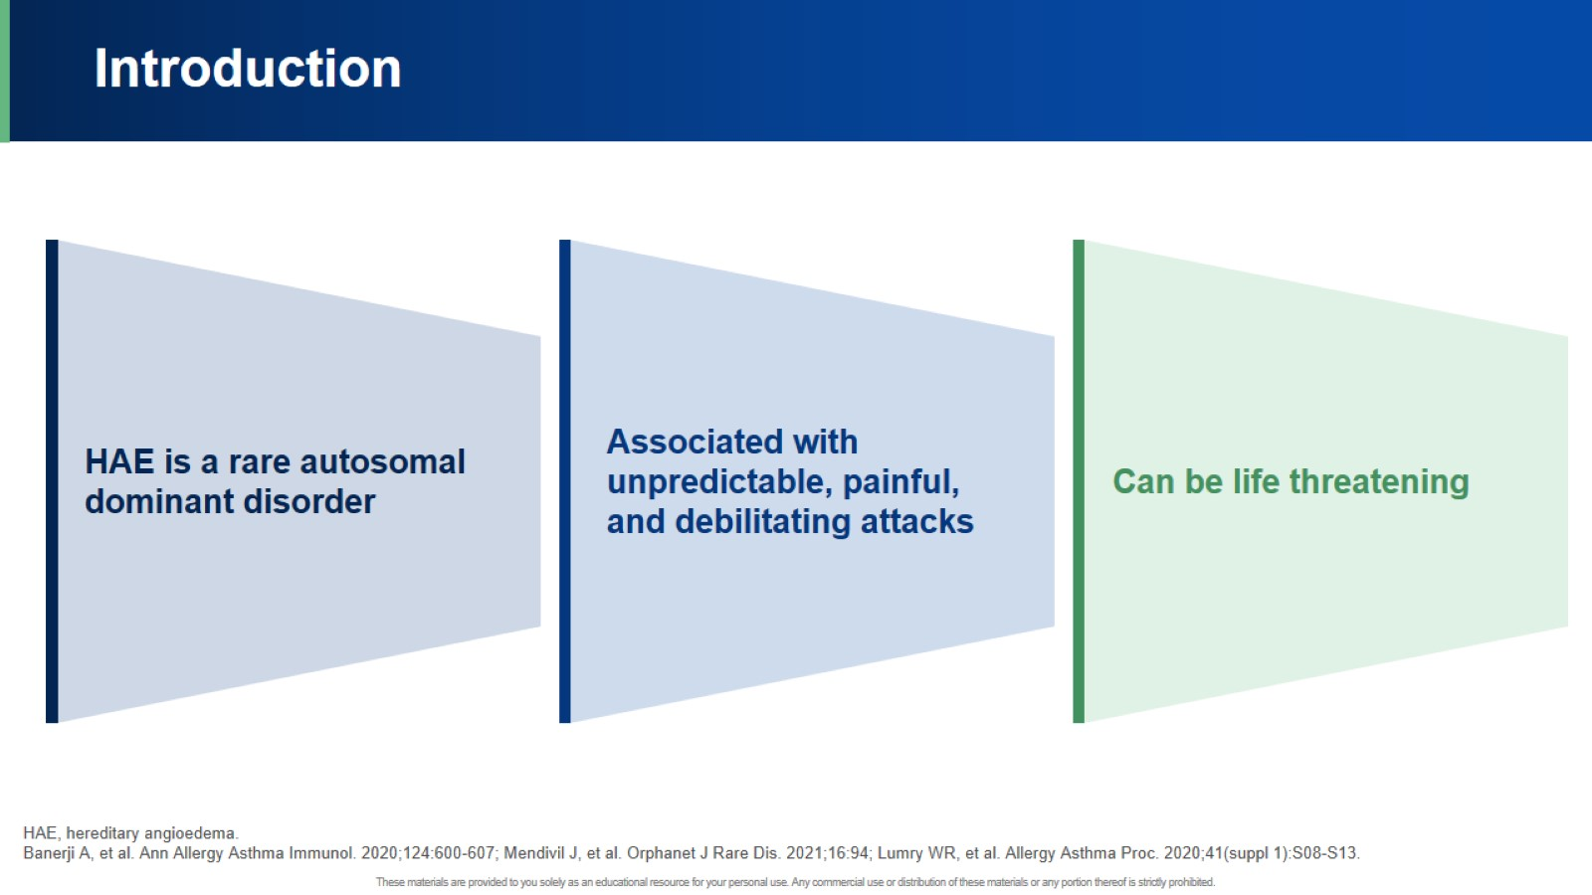
Introduction

Slide 5
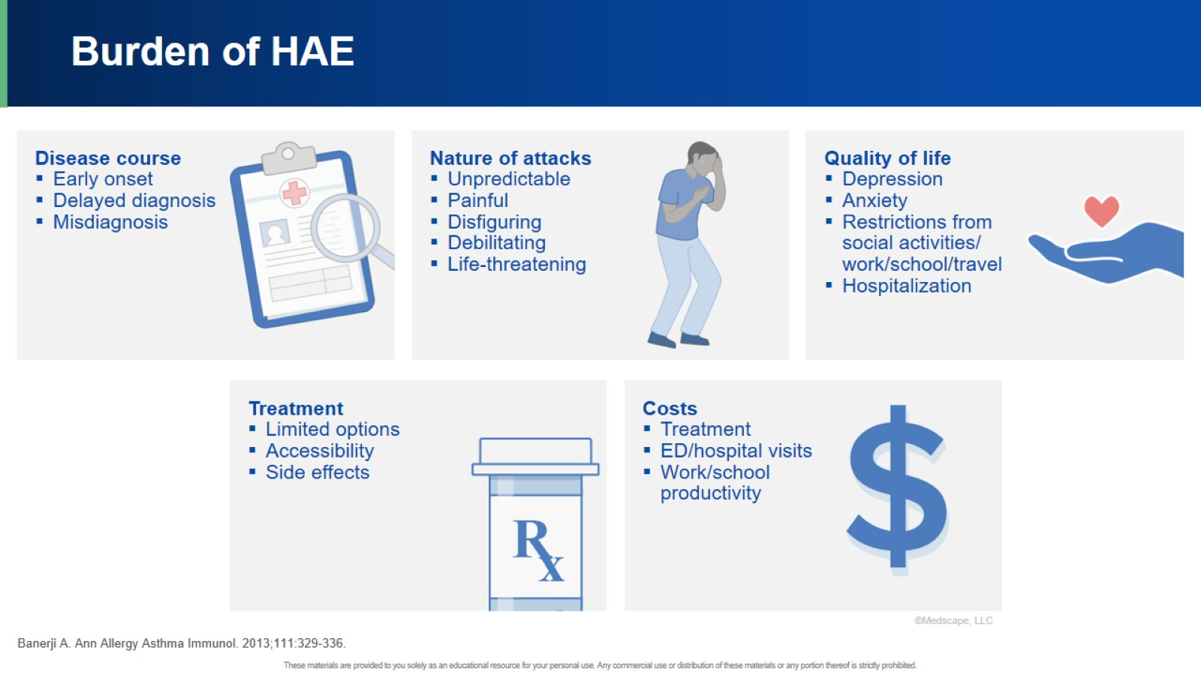
Burden of HAE

Slide 6


Slide 7
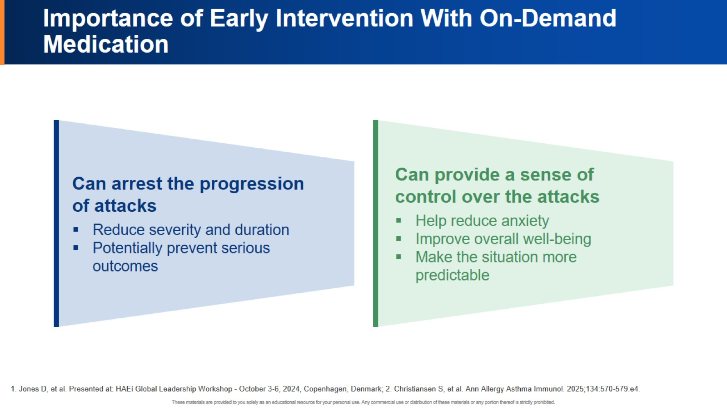
Importance of Early Intervention With On-Demand Medication

Slide 8
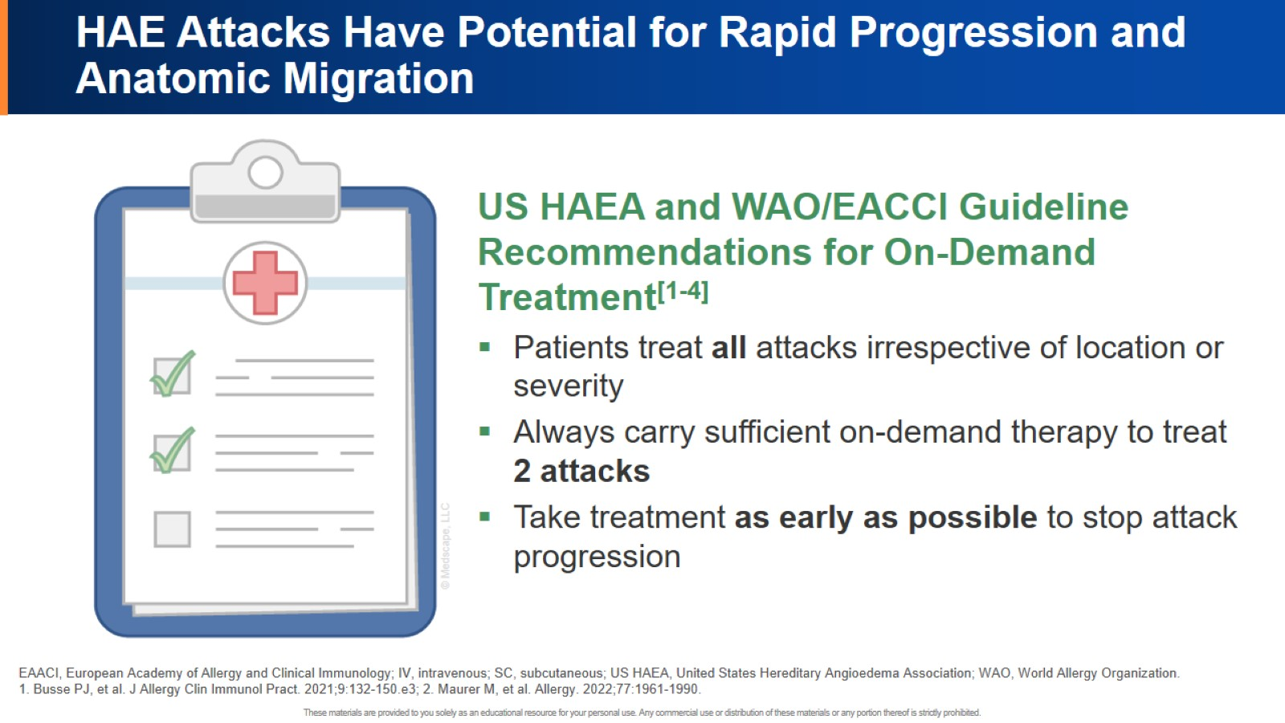
HAE Attacks Have Potential for Rapid Progression and Anatomic Migration

Slide 9
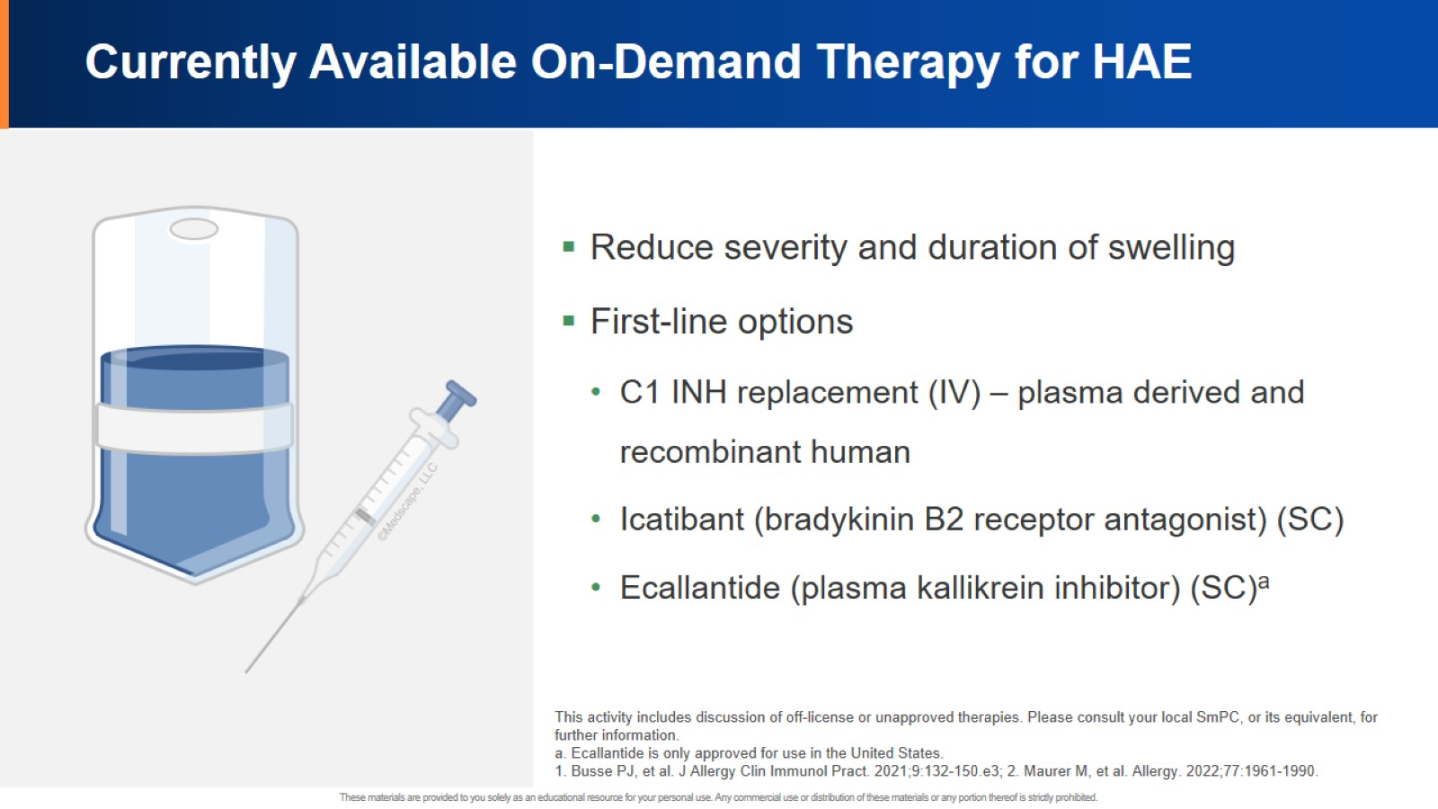
Currently Available On-Demand Therapy for HAE

Slide 10
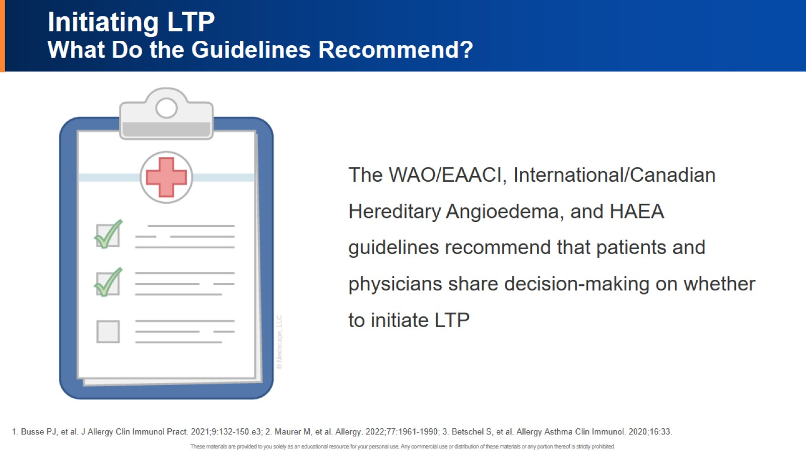
Initiating LTP What Do the Guidelines Recommend?

Slide 11
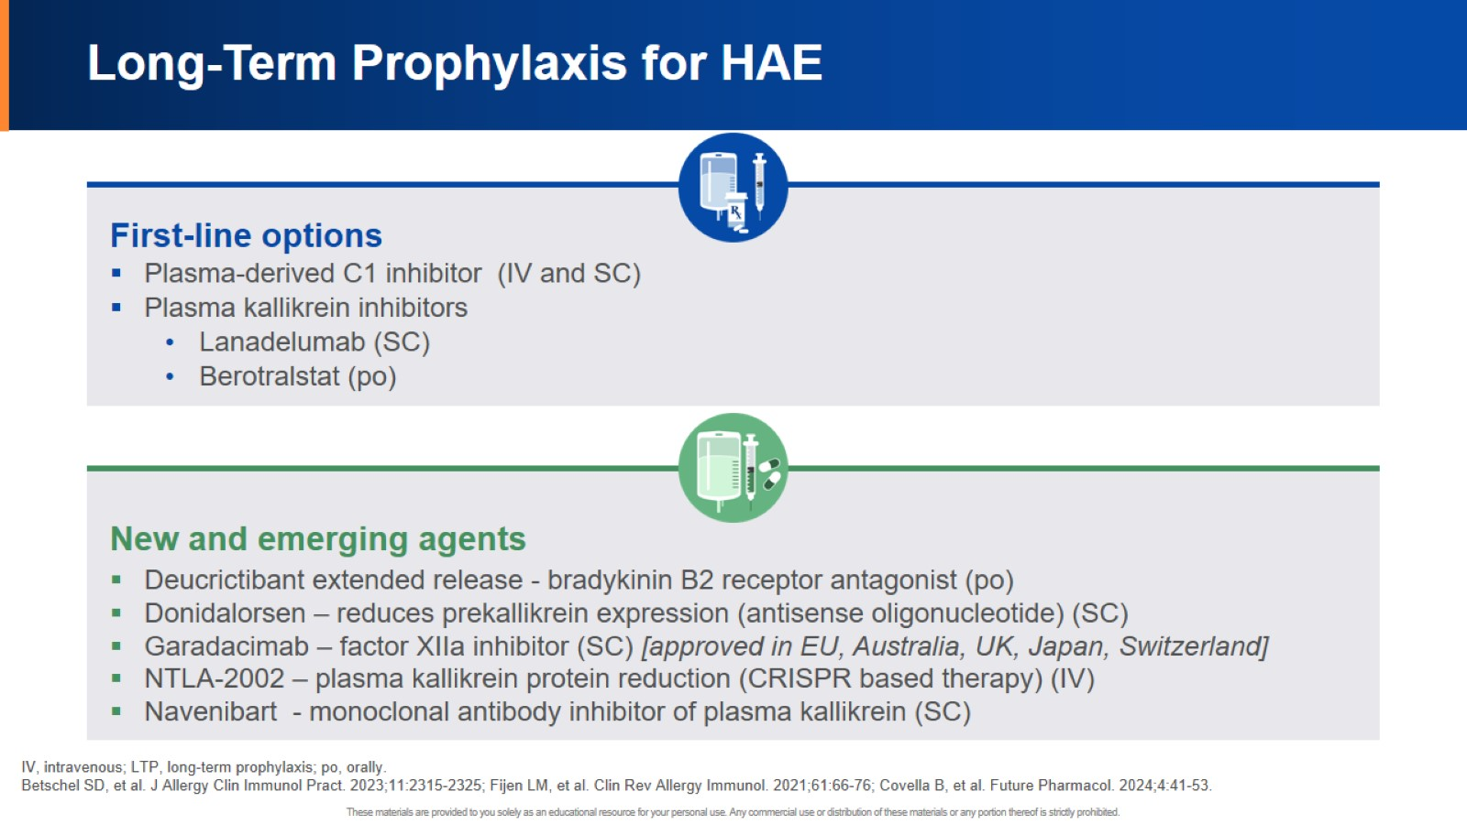
Long-Term Prophylaxis for HAE

Slide 12


Slide 13


Slide 14
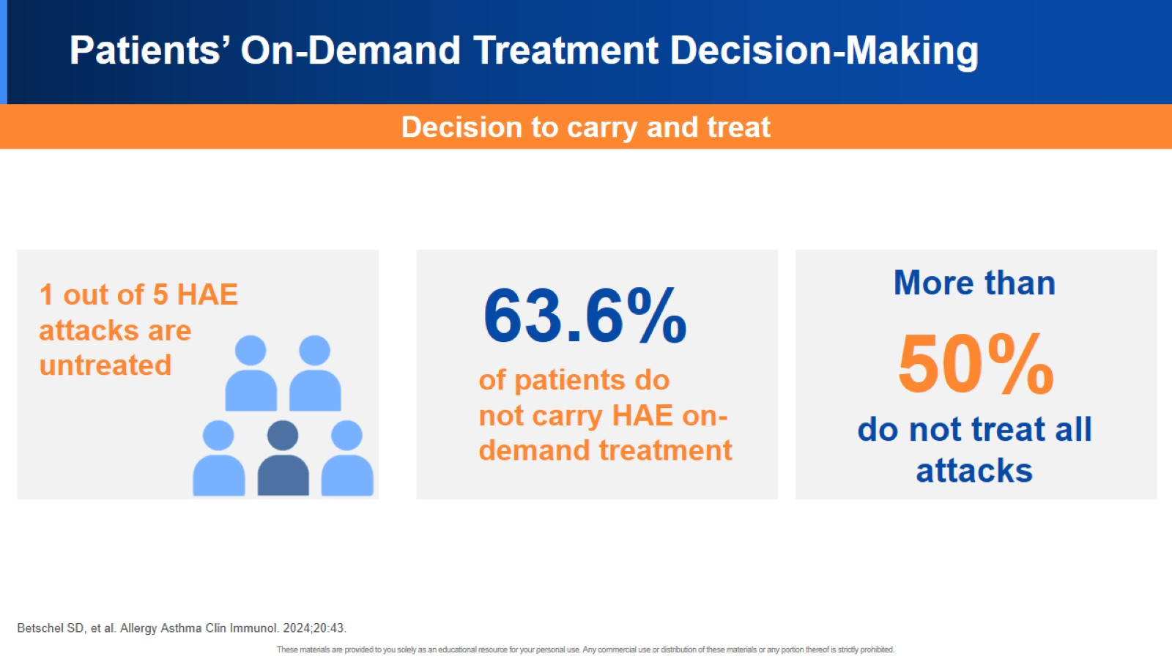
Patients’ On-Demand Treatment Decision-Making

Slide 15
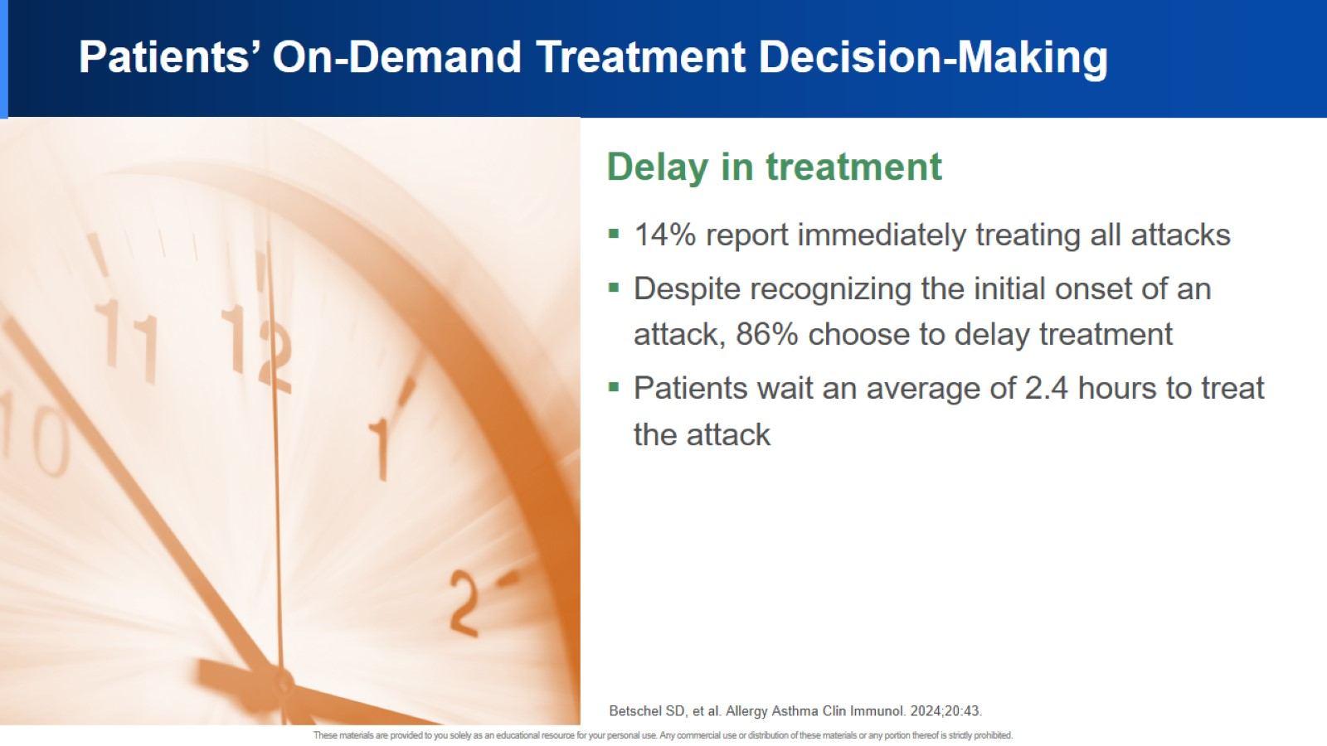
Patients’ On-Demand Treatment Decision-Making

Slide 16
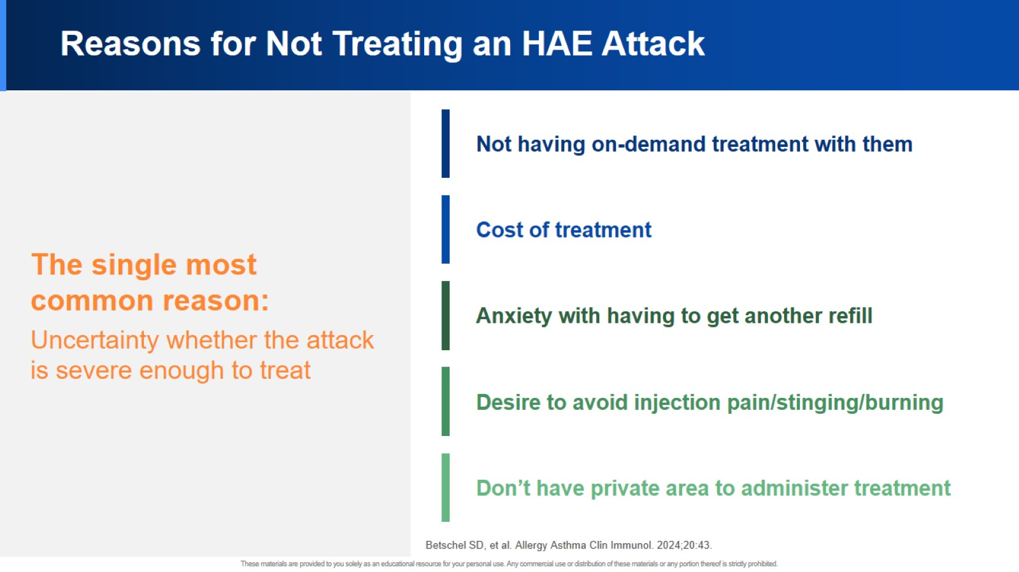
Reasons for Not Treating an HAE Attack

Slide 17
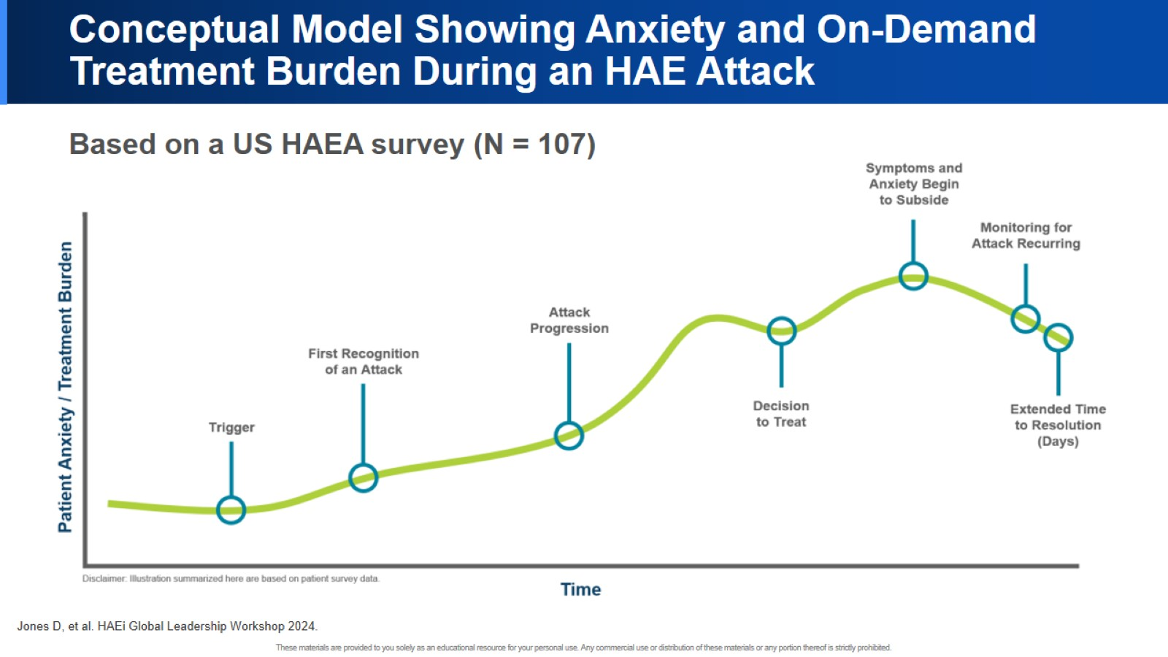
Conceptual Model Showing Anxiety and On-Demand Treatment Burden During an HAE Attack

Slide 18


Slide 19
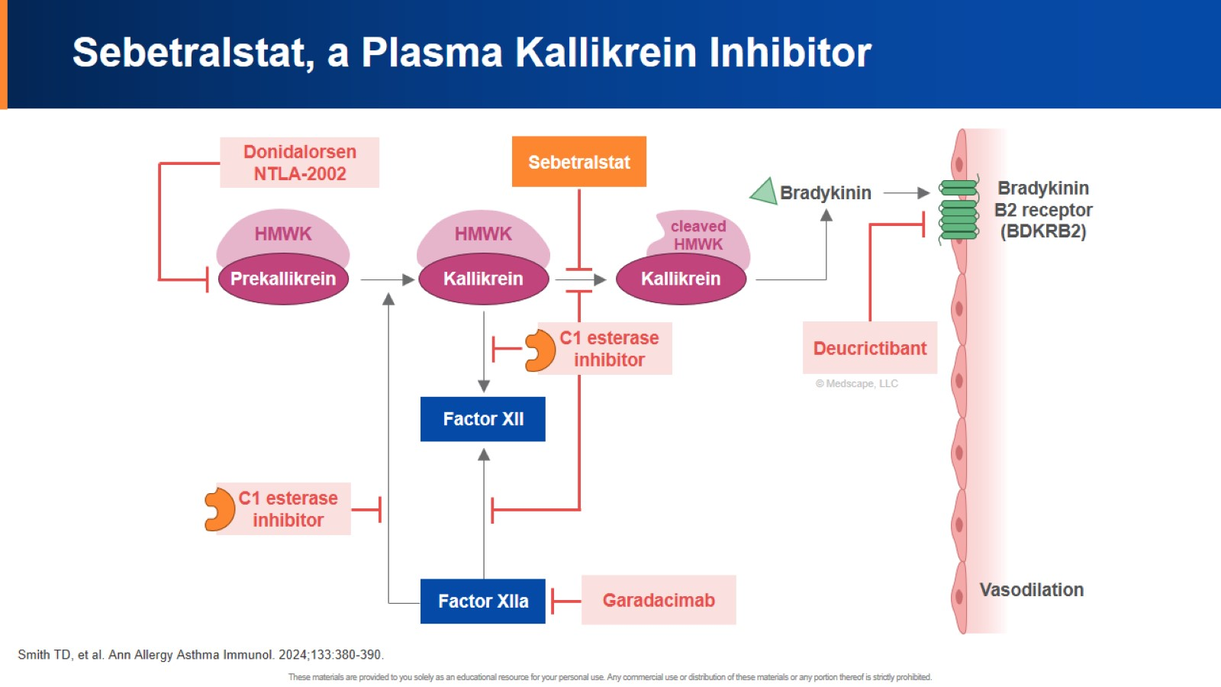
Sebetralstat, a Plasma Kallikrein Inhibitor

Slide 20
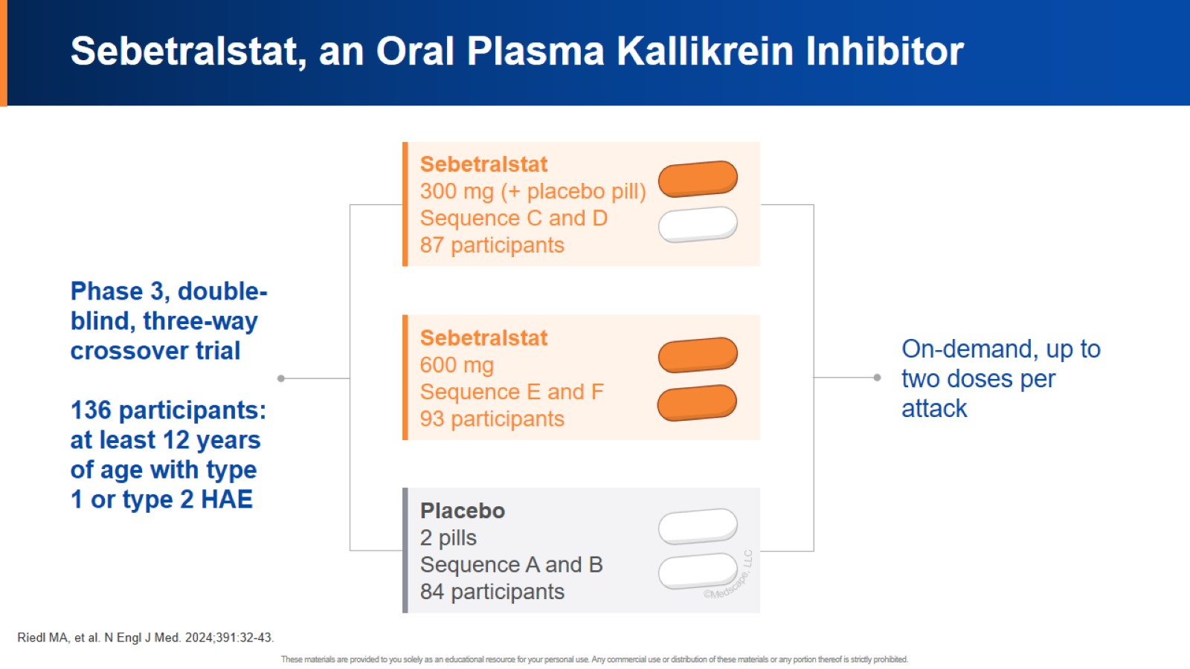
Sebetralstat, an Oral Plasma Kallikrein Inhibitor

Slide 21
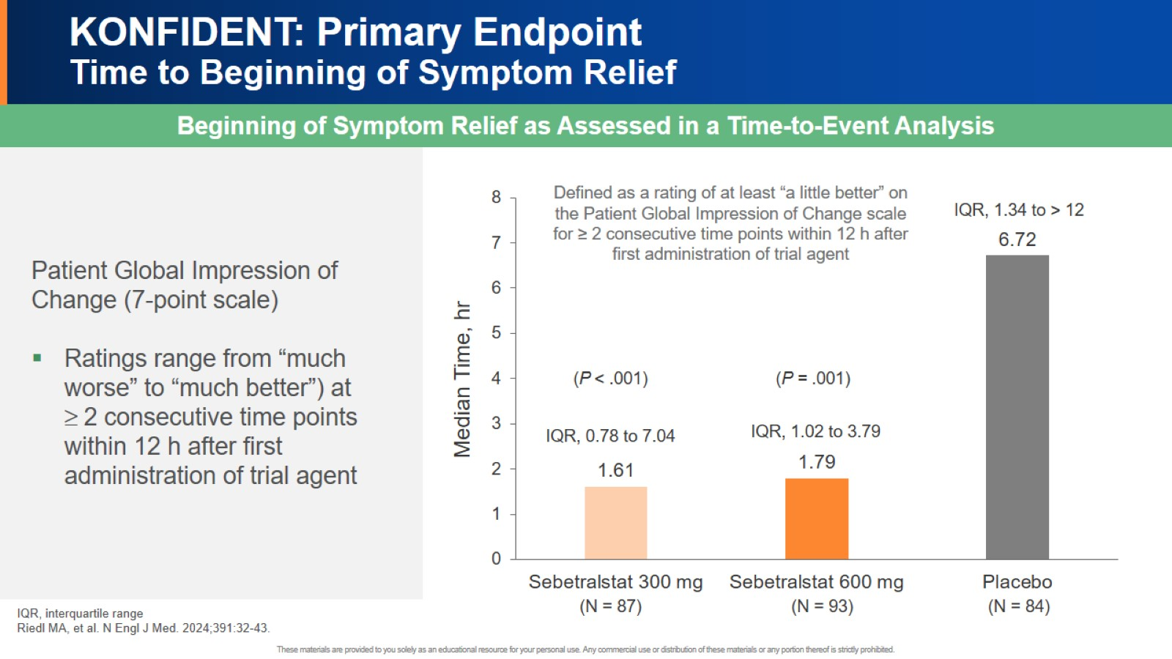
KONFIDENT: Primary Endpoint Time to Beginning of Symptom Relief

Slide 22
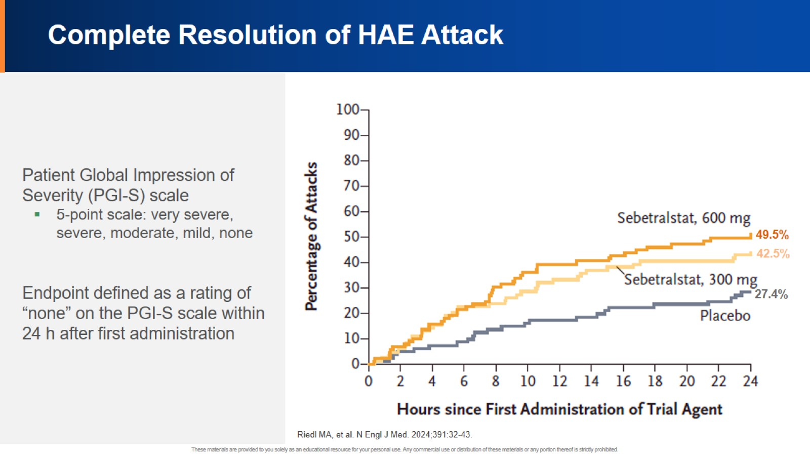
Complete Resolution of HAE Attack

Slide 23
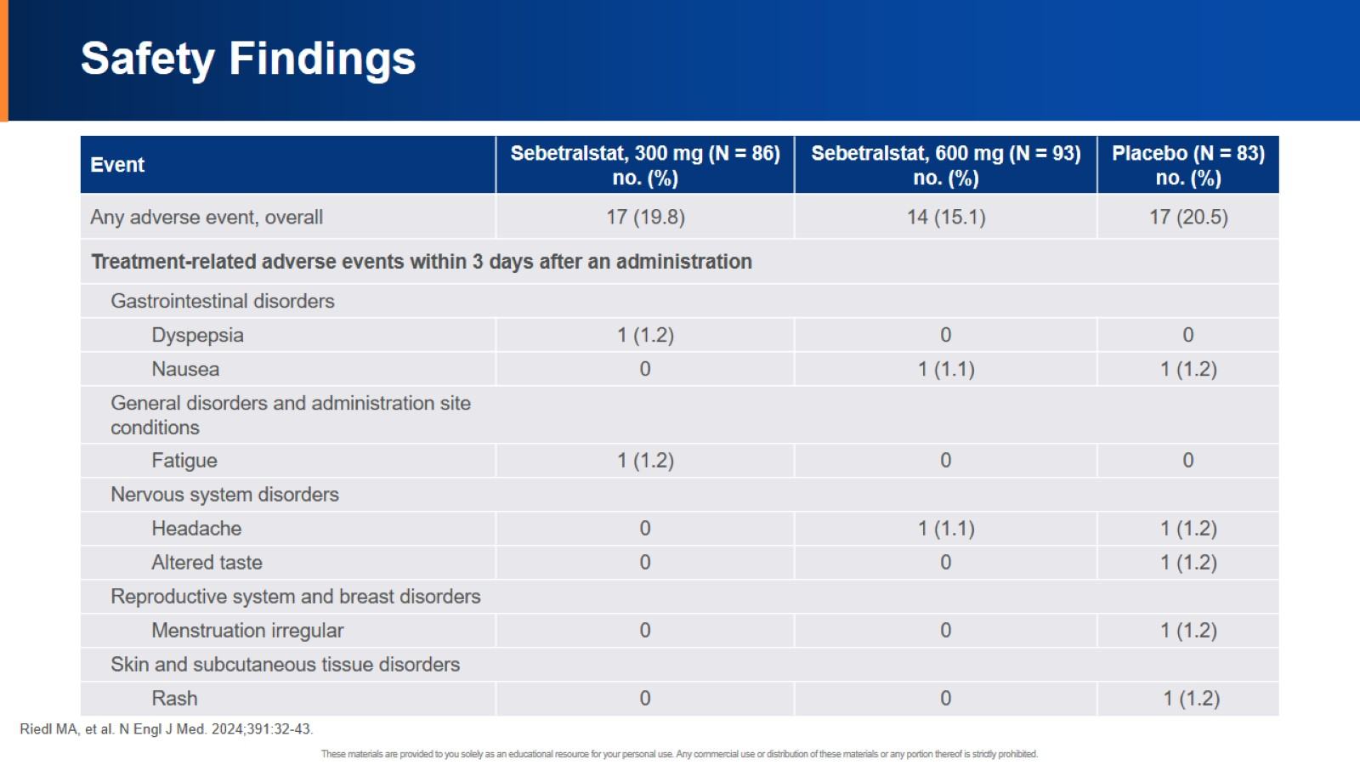
Safety Findings

Slide 24
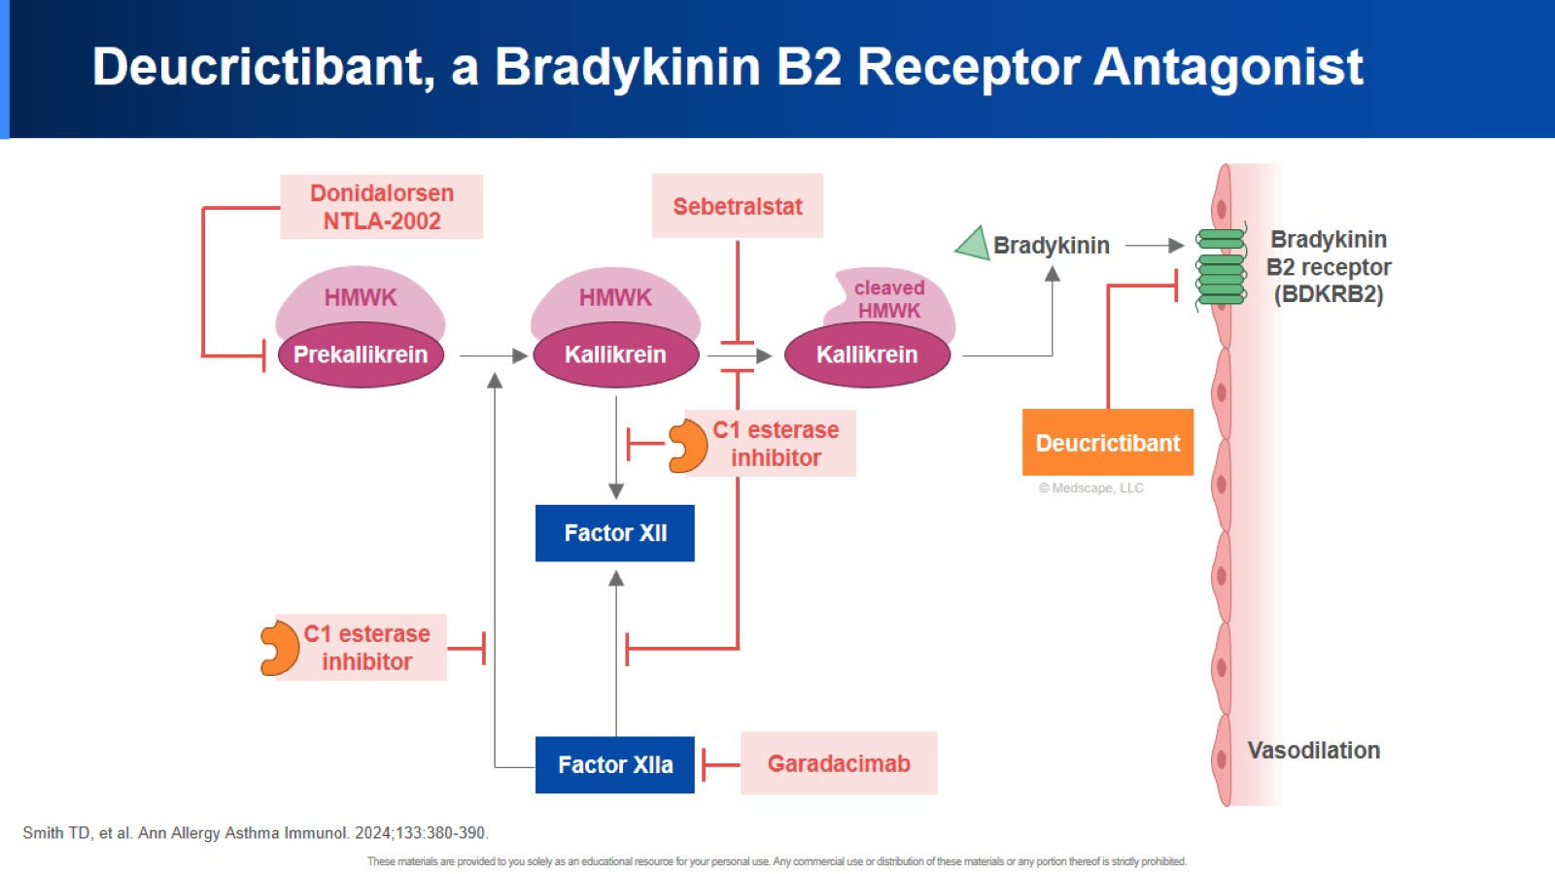
Deucrictibant, a Bradykinin B2 Receptor Antagonist

Slide 25
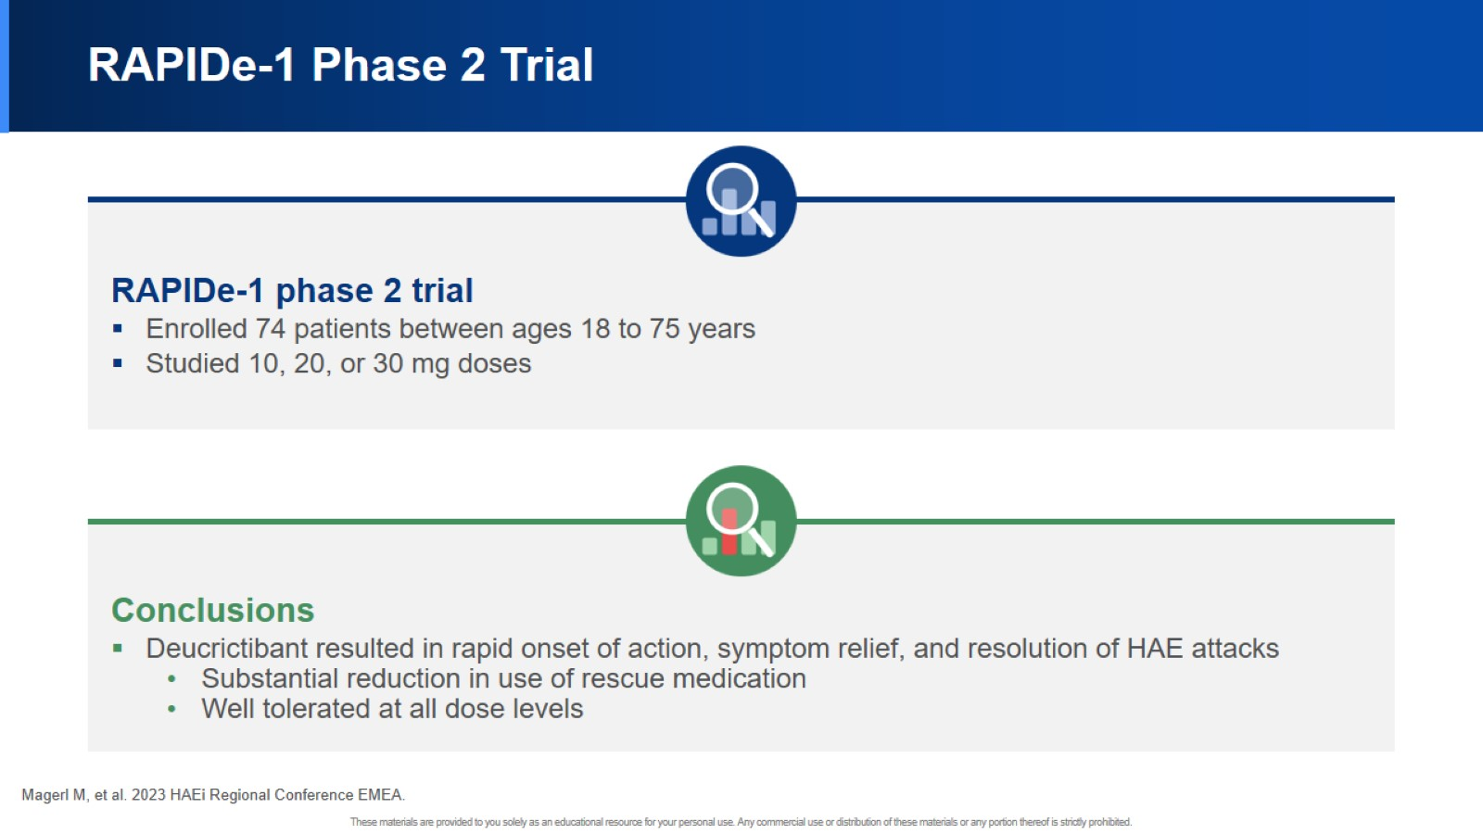
RAPIDe-1 Phase 2 Trial

Slide 26
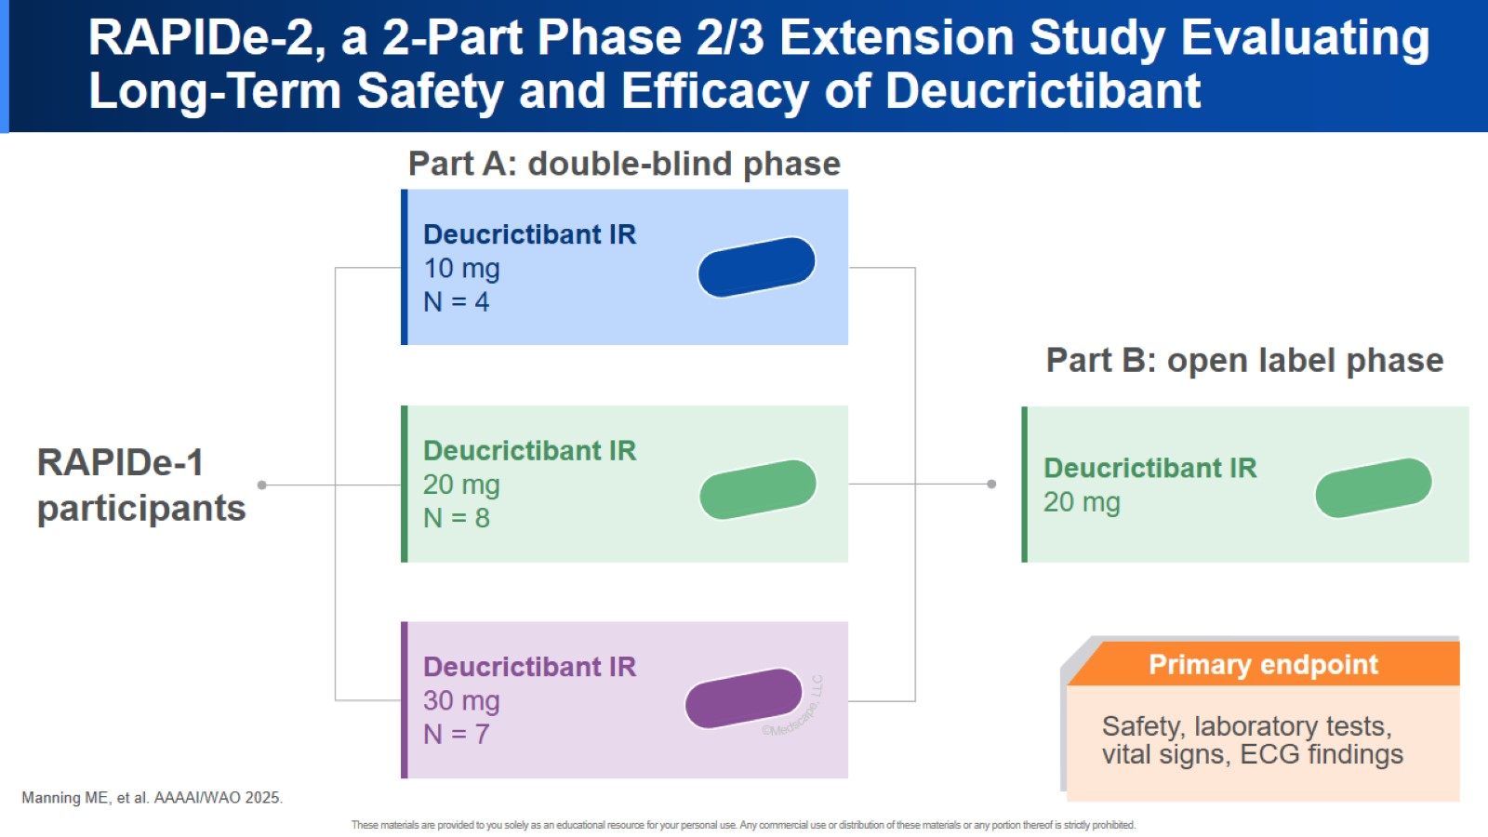
RAPIDe-2, a 2-Part Phase 2/3 Extension Study Evaluating Long-Term Safety and Efficacy of Deucrictibant

Slide 27
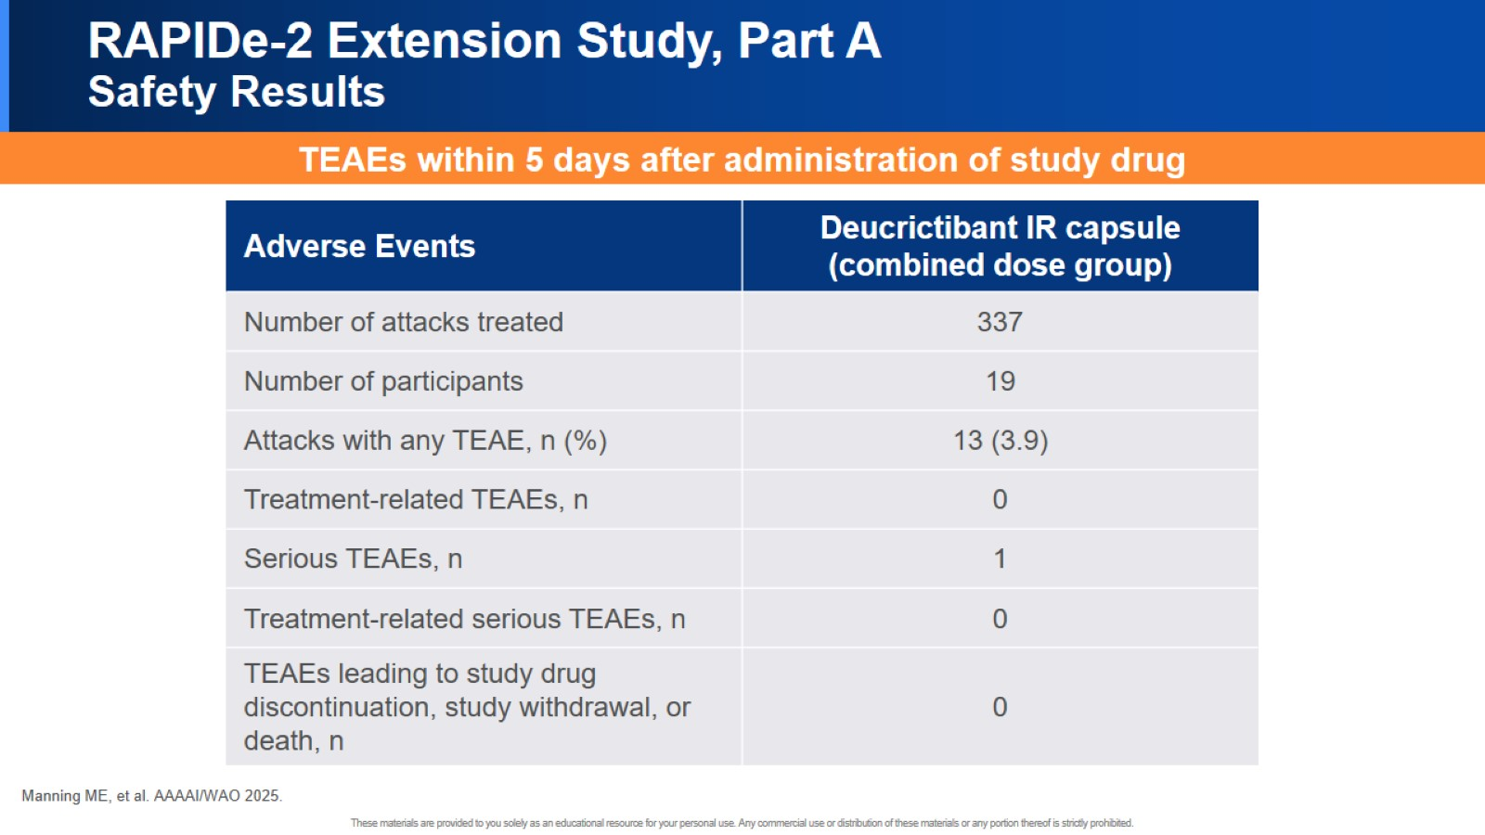
RAPIDe-2 Extension Study, Part A Safety Results

Slide 28
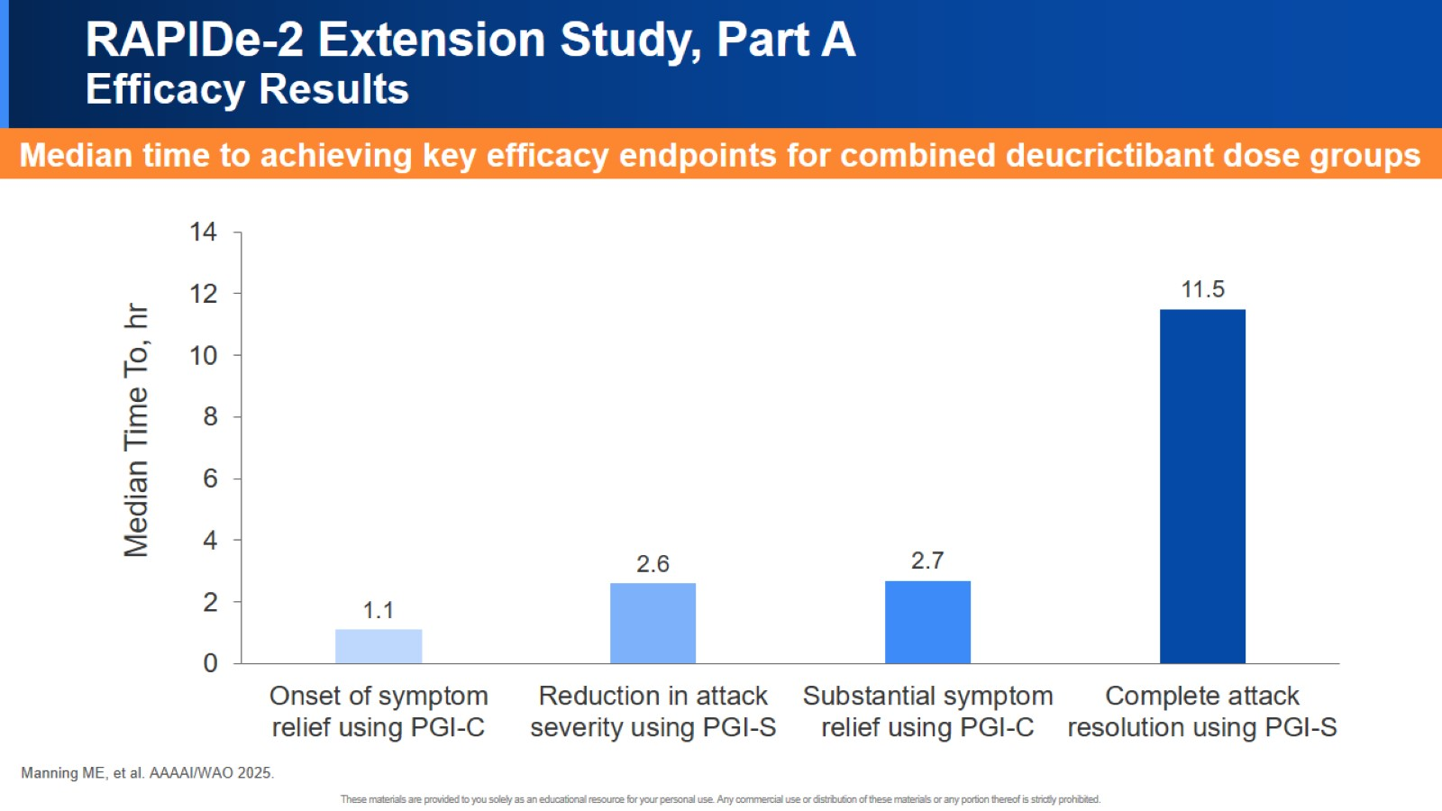
RAPIDe-2 Extension Study, Part A Efficacy Results

Slide 29


Slide 30
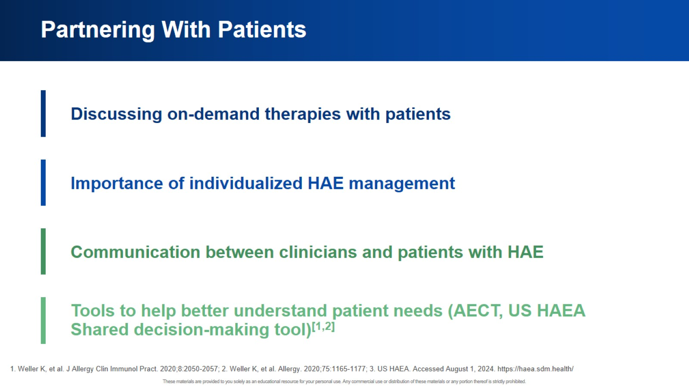
Partnering With Patients

Slide 31


Slide 32


