Slide 1
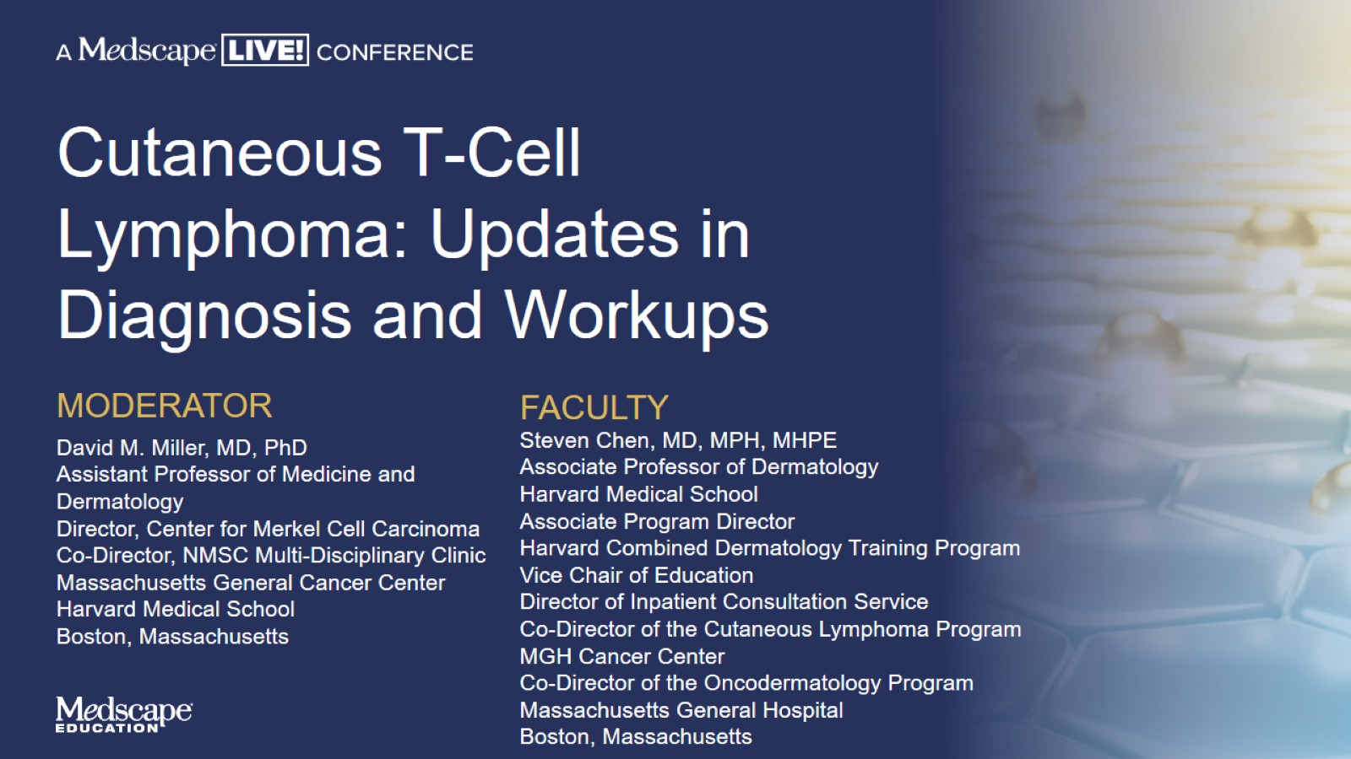
Cutaneous T-Cell Lymphoma: Updates in Diagnosis and Workups

Slide 2
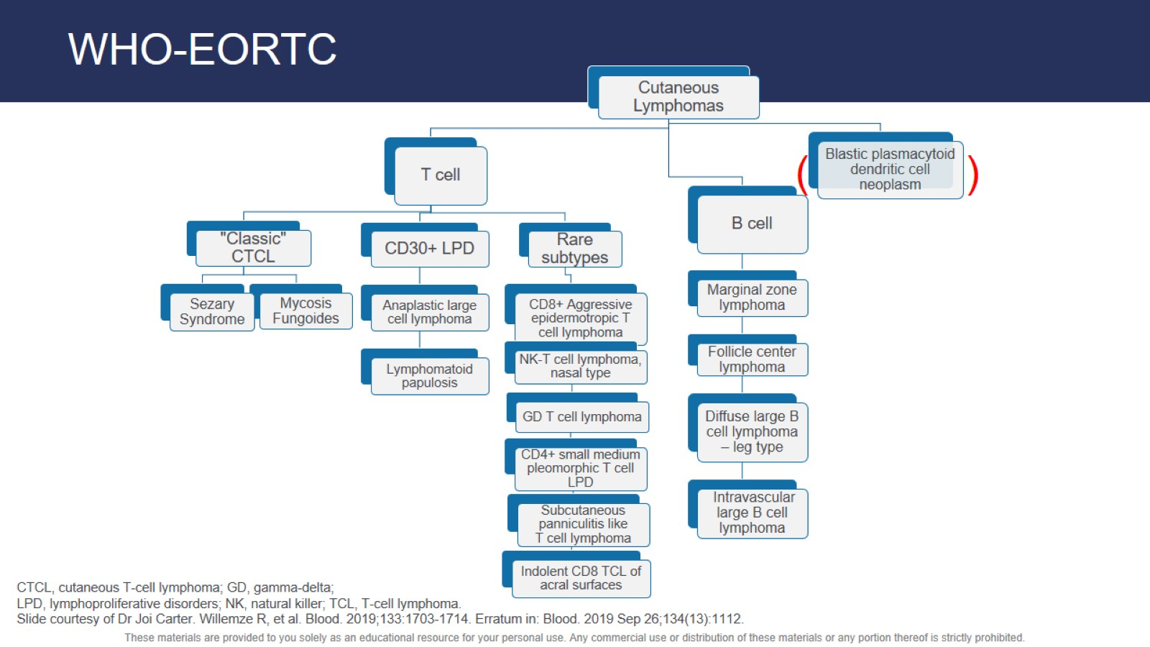
WHO-EORTC

Slide 3
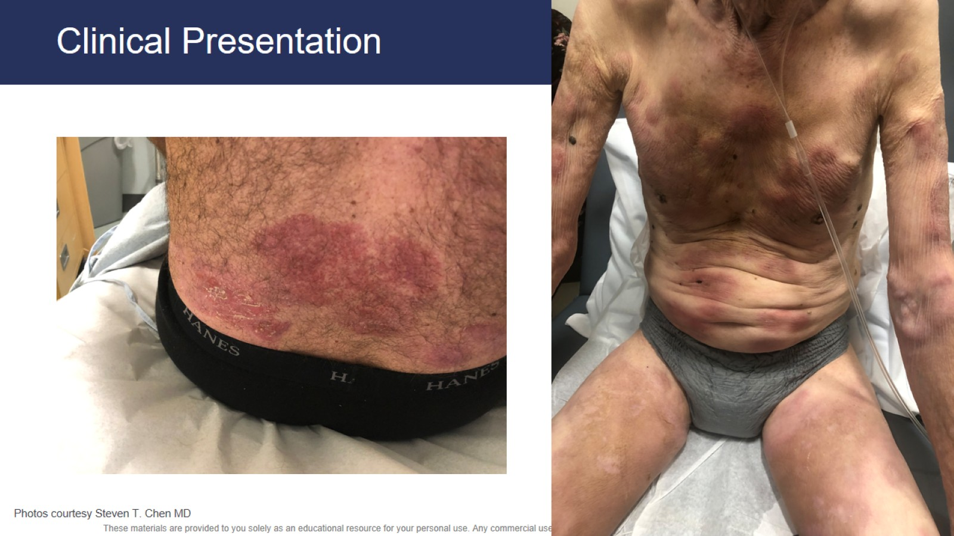
Clinical Presentation

Slide 4
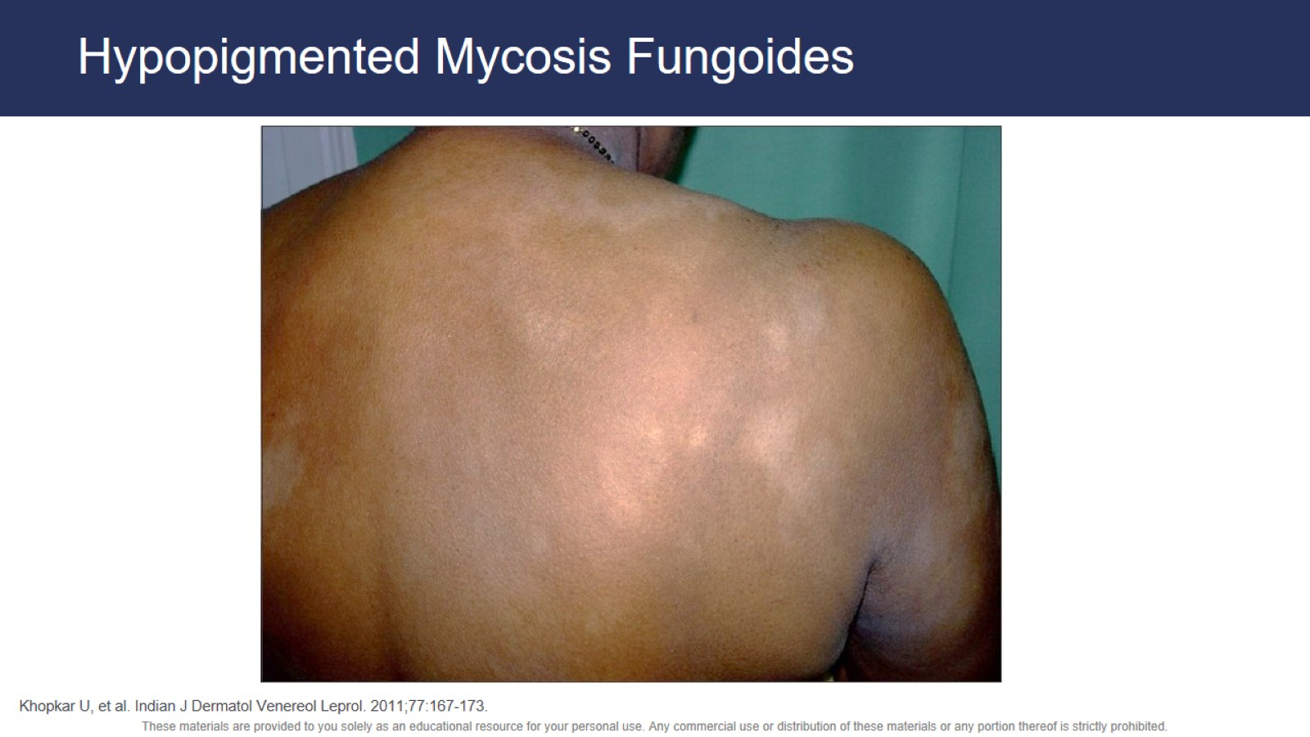
Hypopigmented Mycosis Fungoides

Slide 5
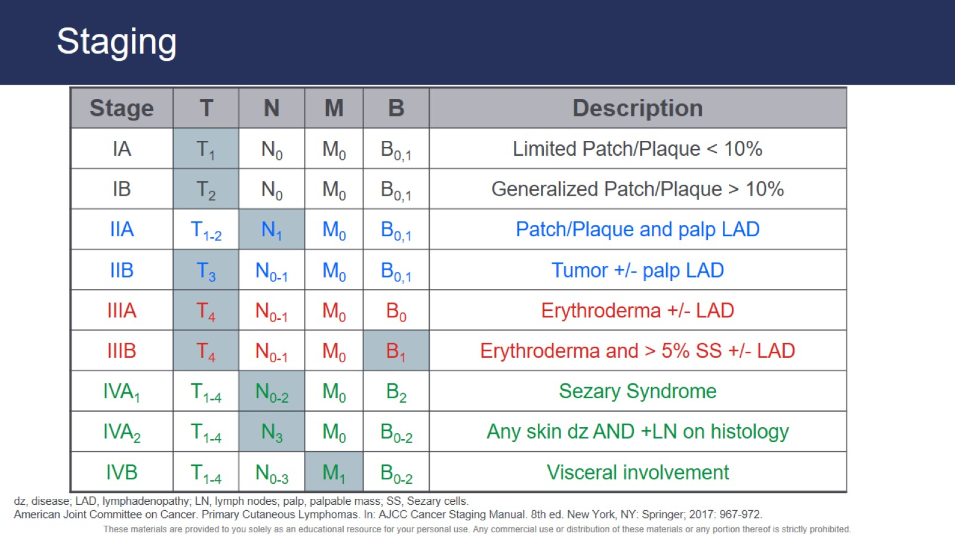
Staging

Slide 6
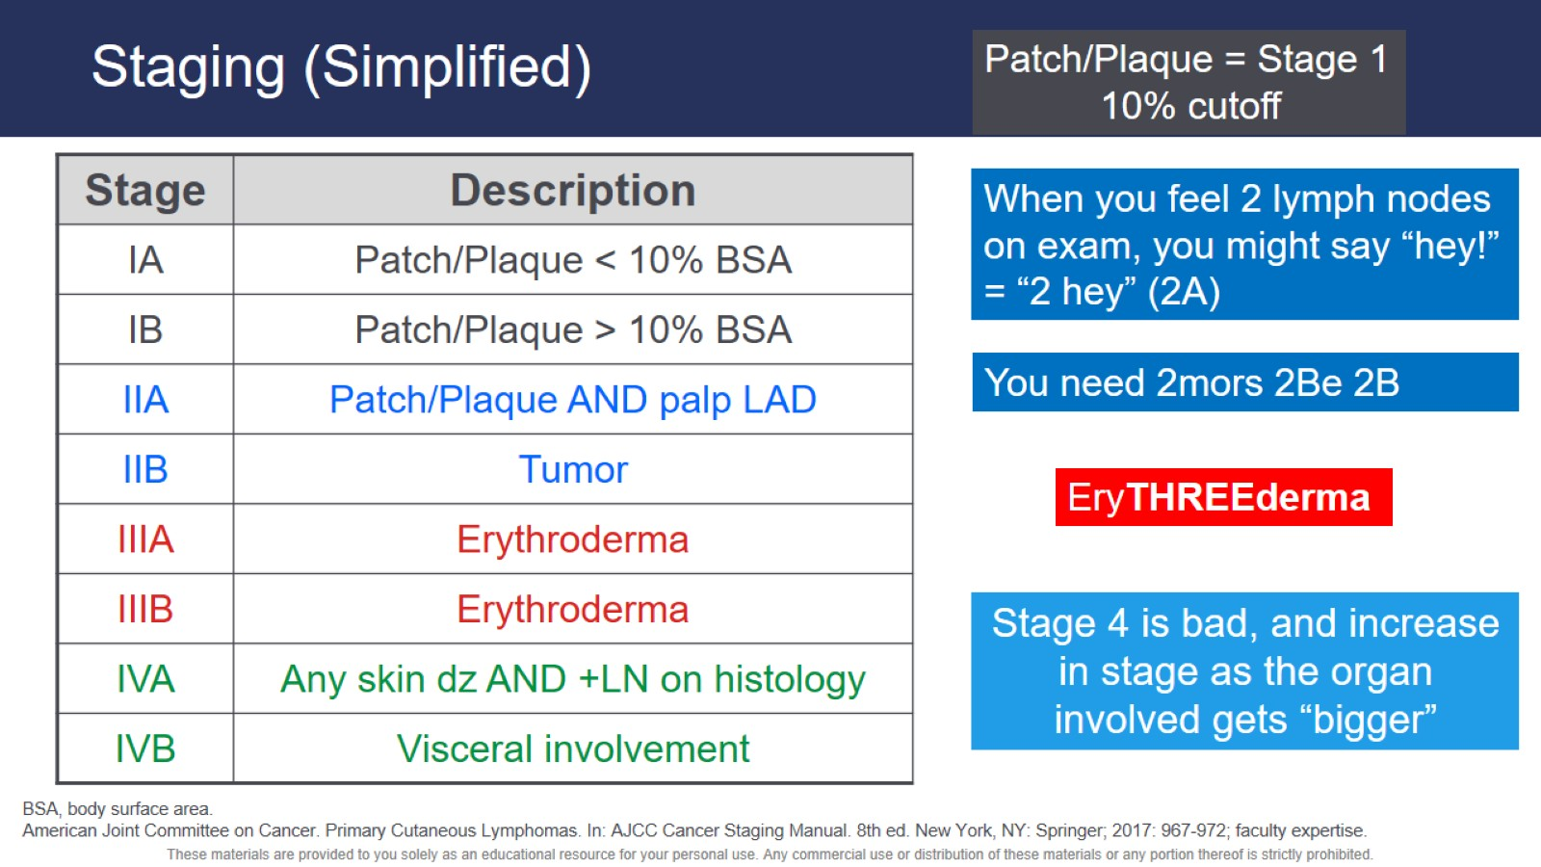
Staging (Simplified)

Slide 7
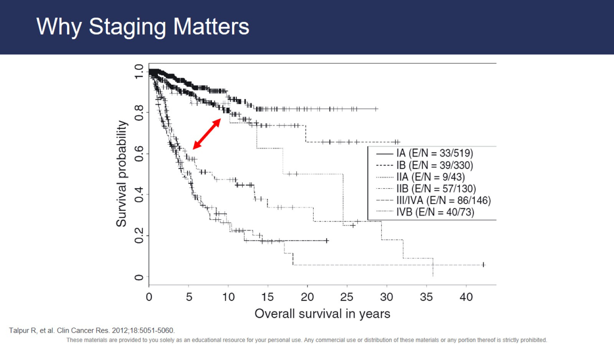
Why Staging Matters

Slide 8
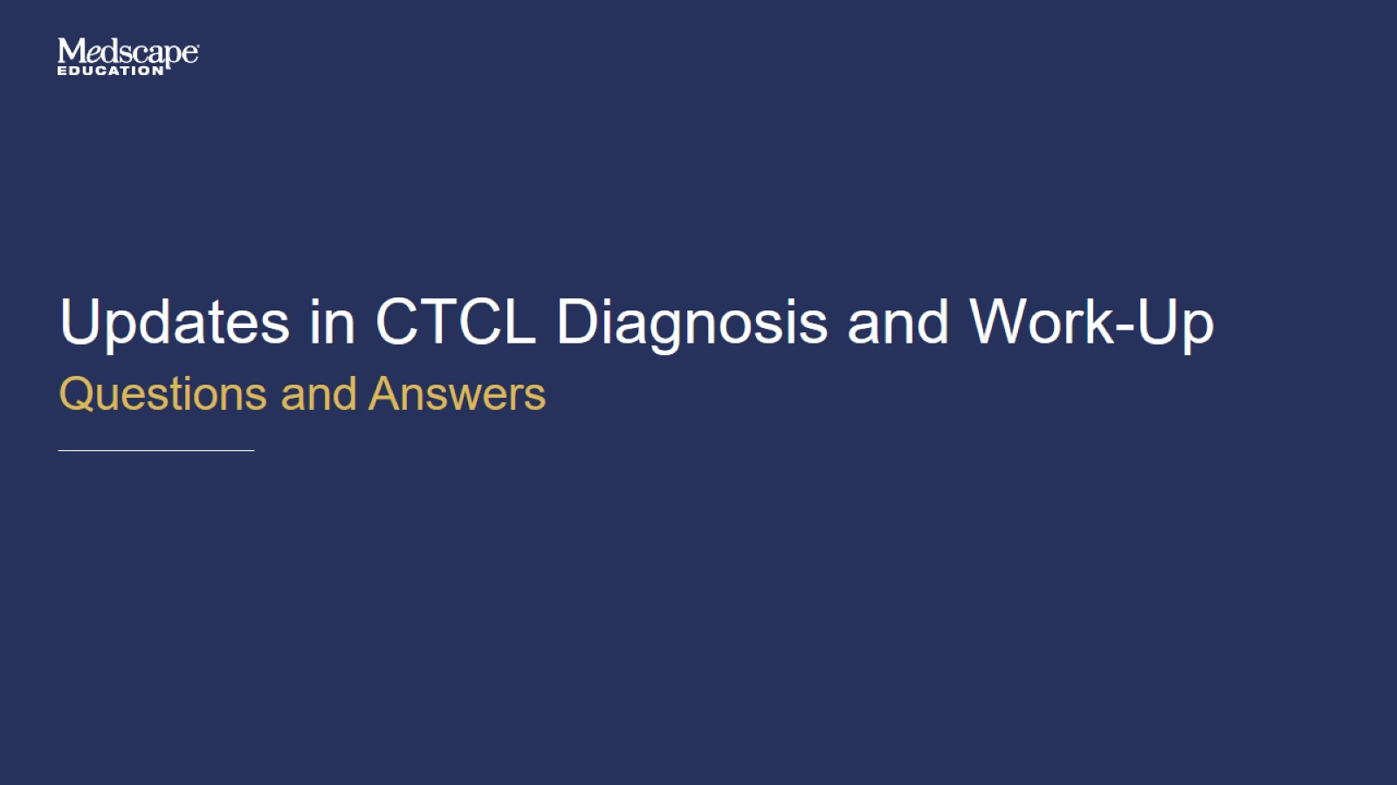
Updates in CTCL Diagnosis and Work-Up

Slide 9
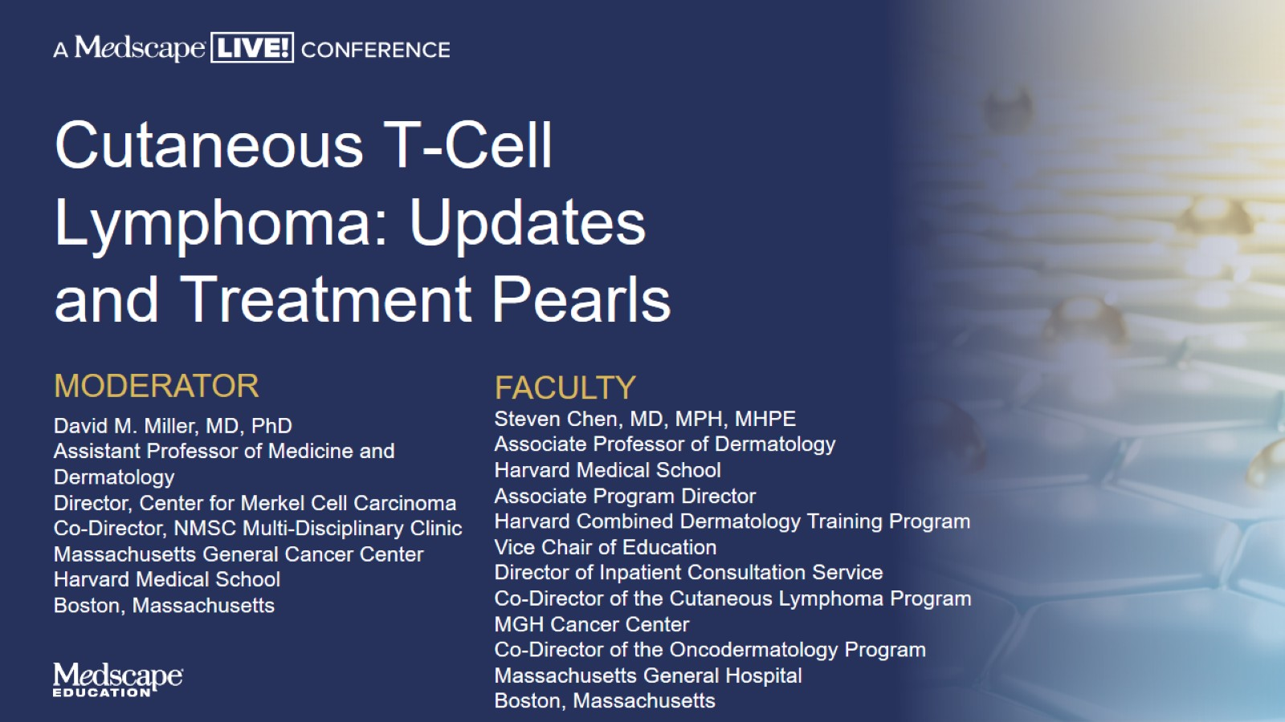
Cutaneous T-Cell Lymphoma: Updates and Treatment Pearls

Slide 10
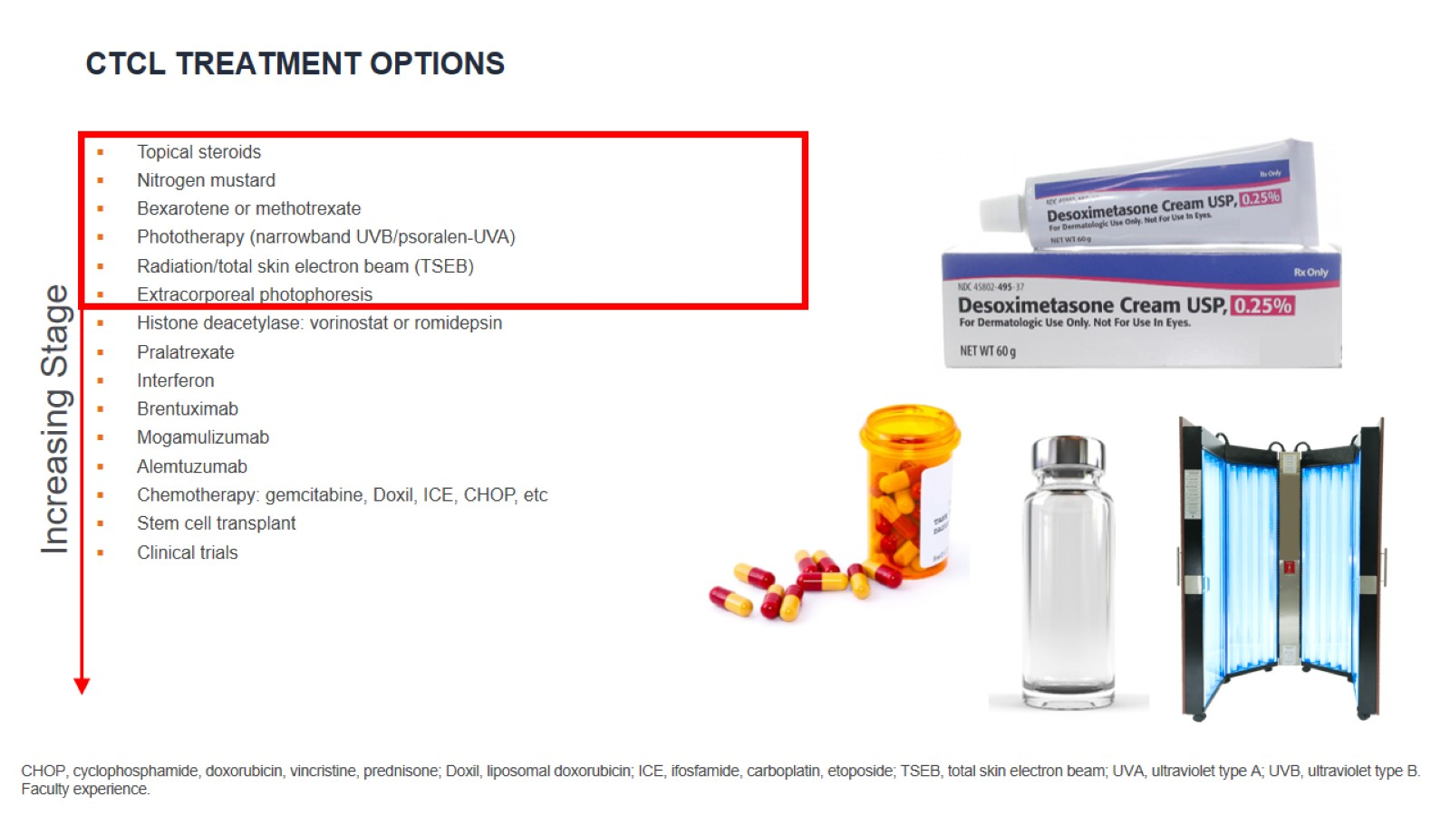
CTCL Treatment Options

Slide 11
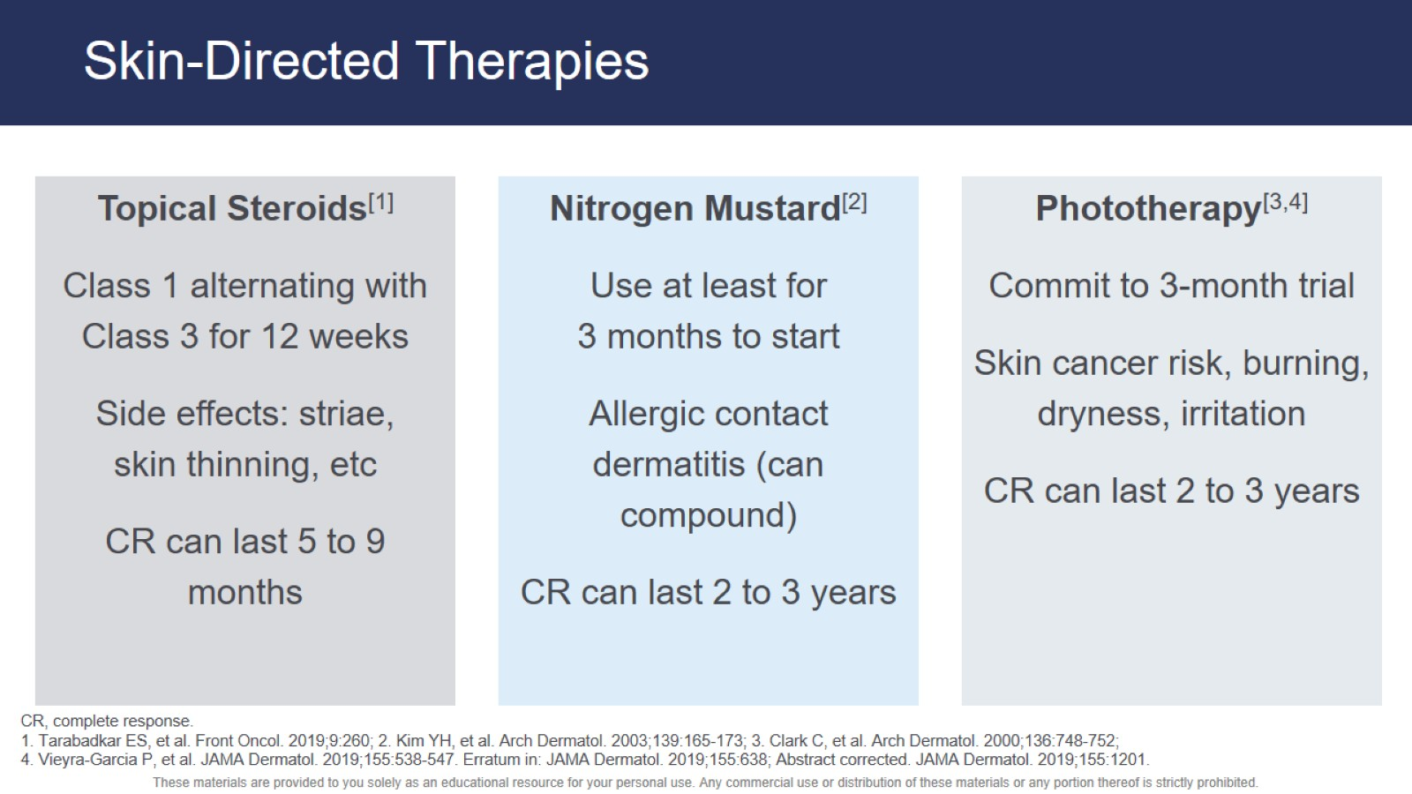
Skin-Directed Therapies

Slide 12
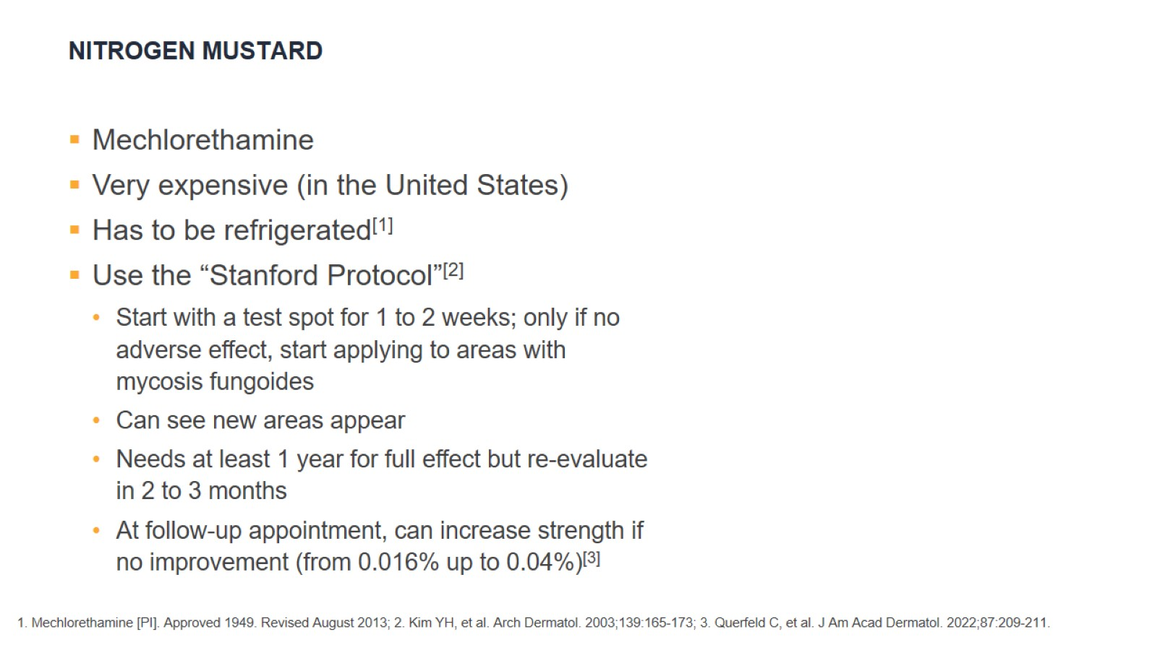
Nitrogen Mustard

Slide 13
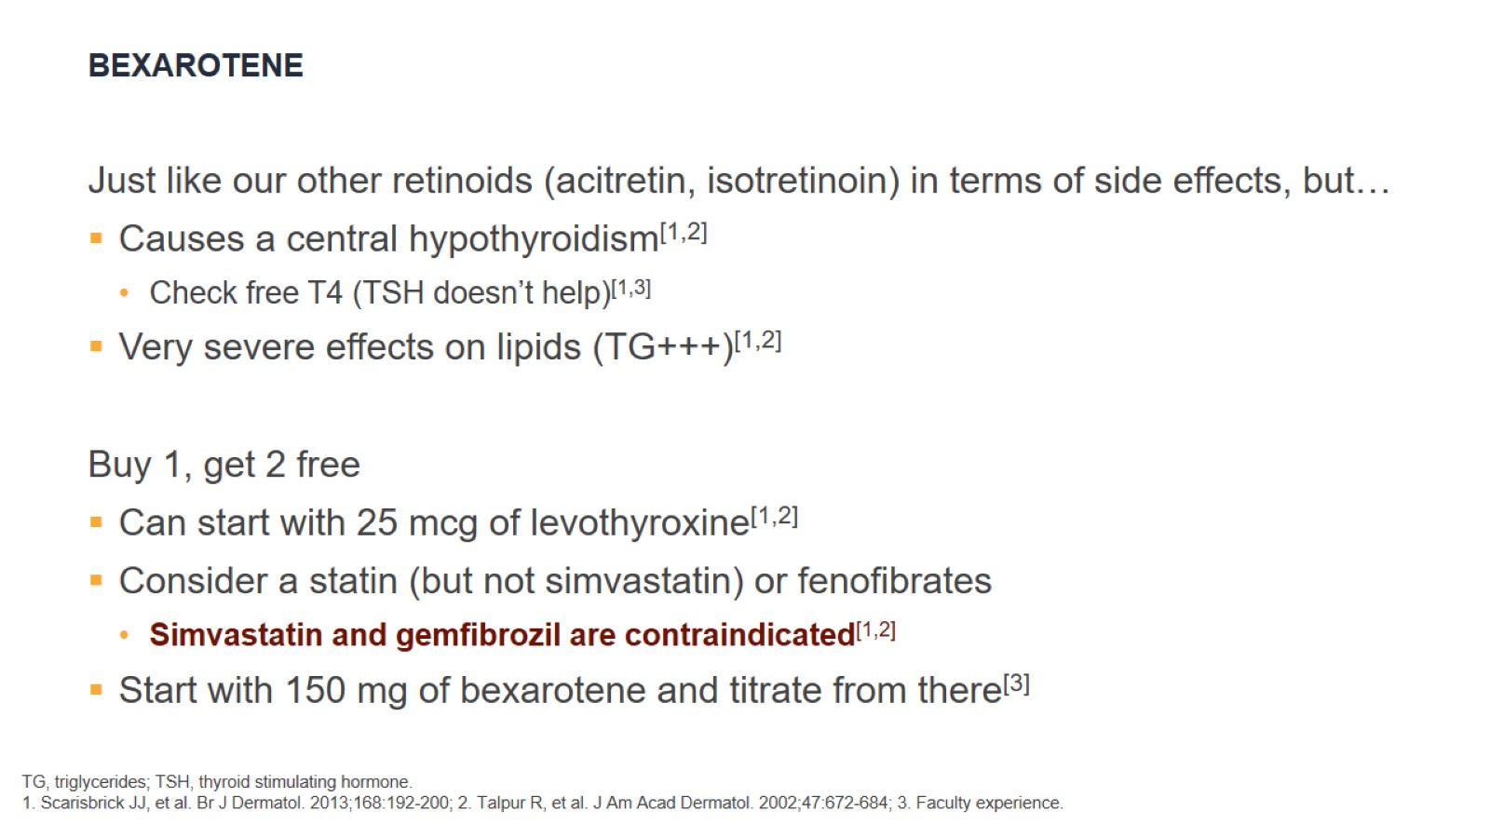
Bexarotene

Slide 14
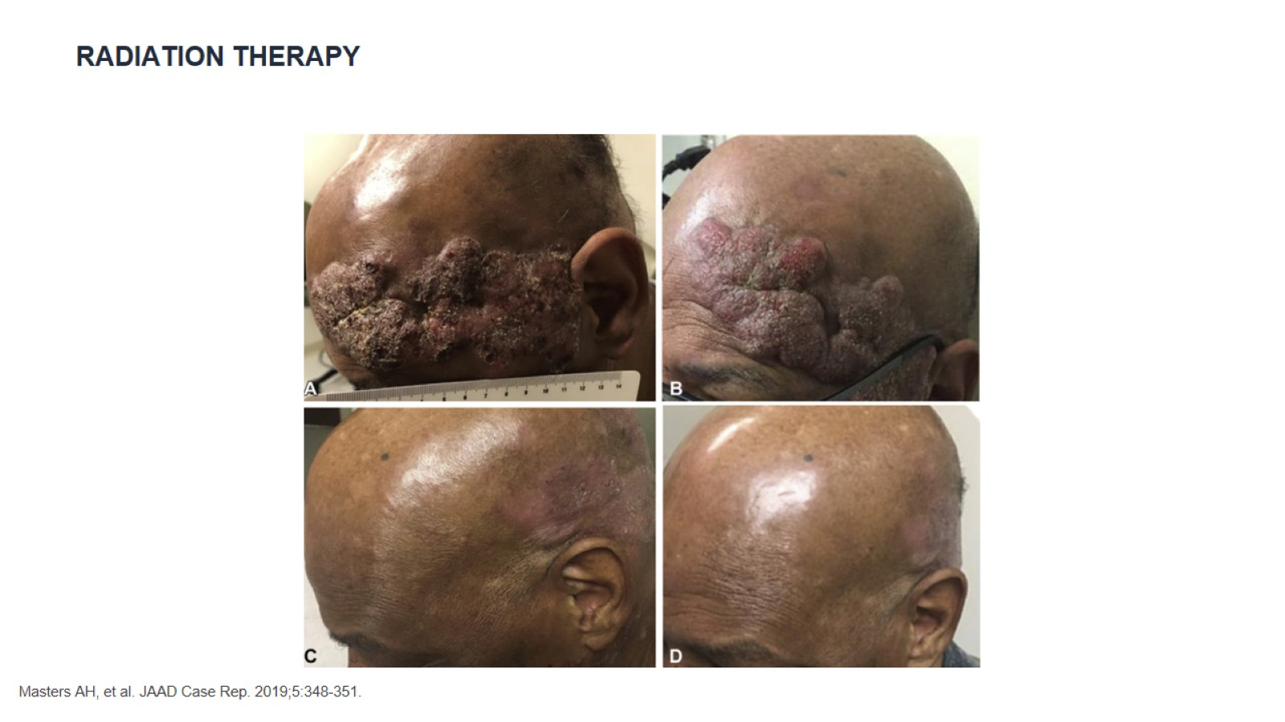
Radiation Therapy

Slide 15
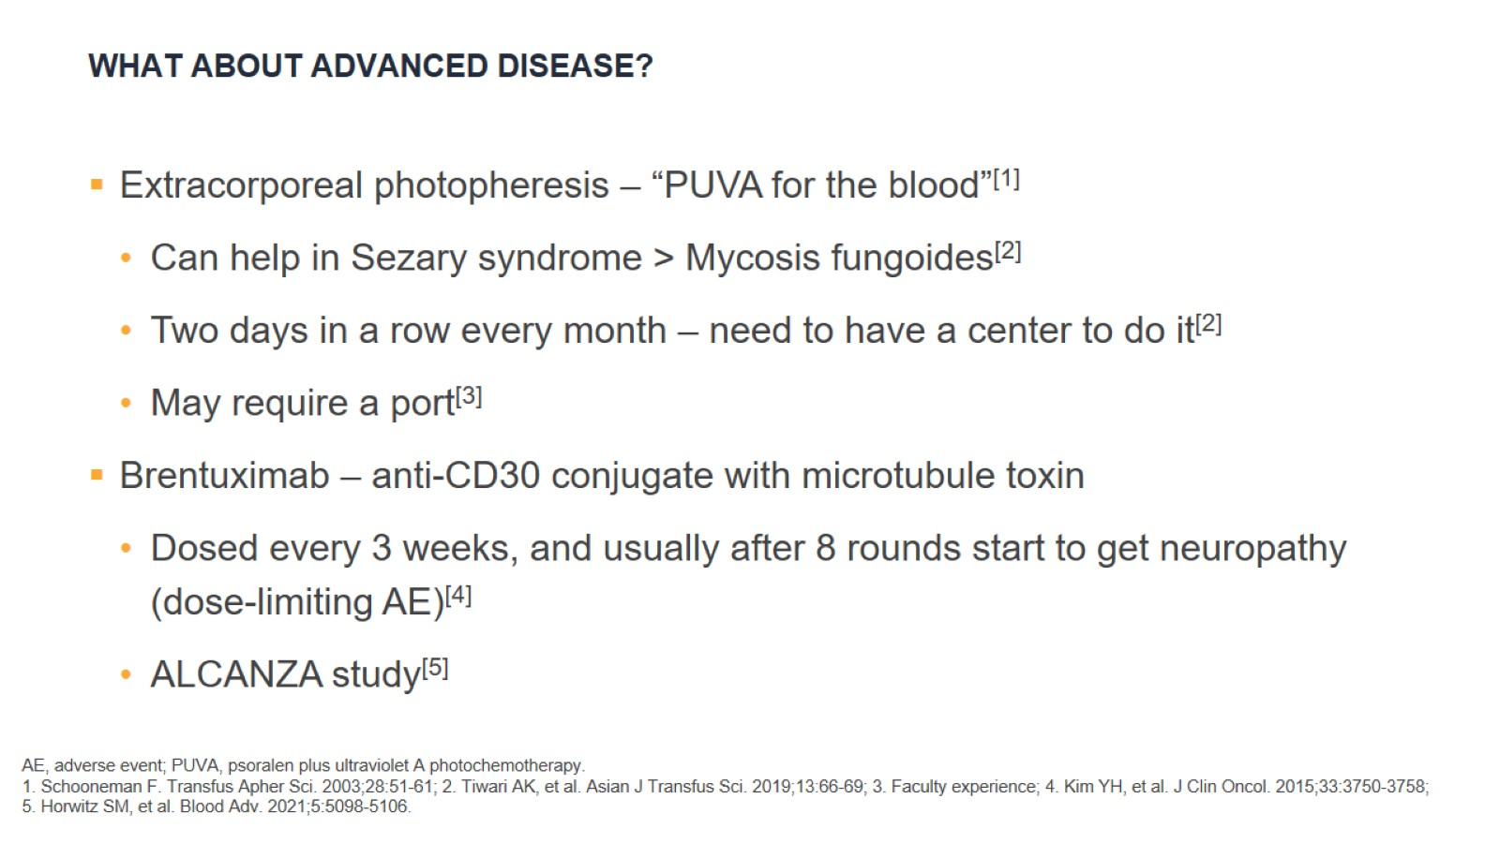
What About Advanced Disease?

Slide 16
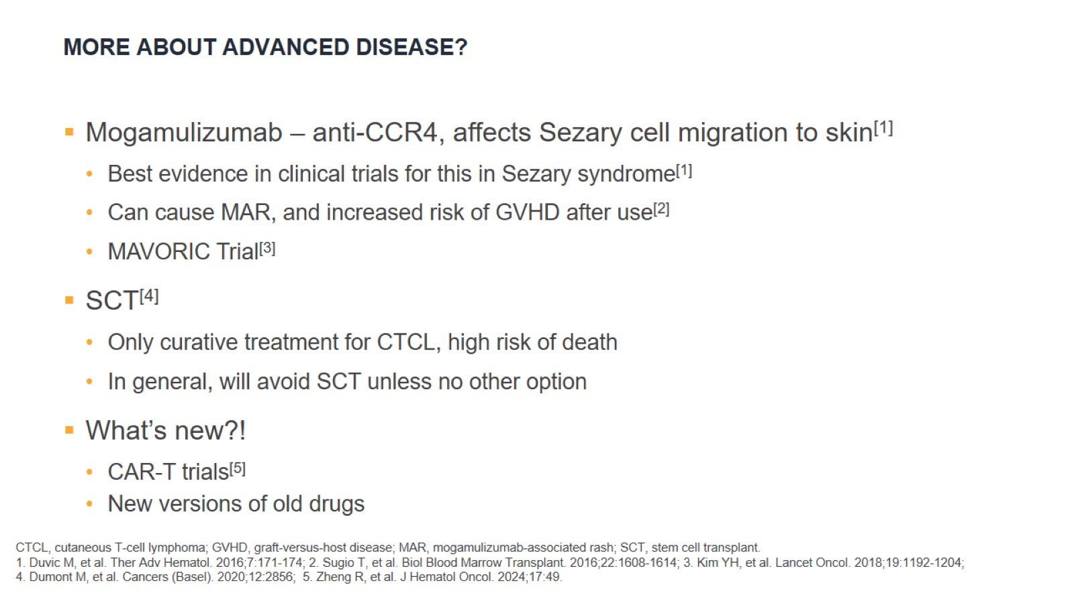
More About Advanced Disease?

Slide 17
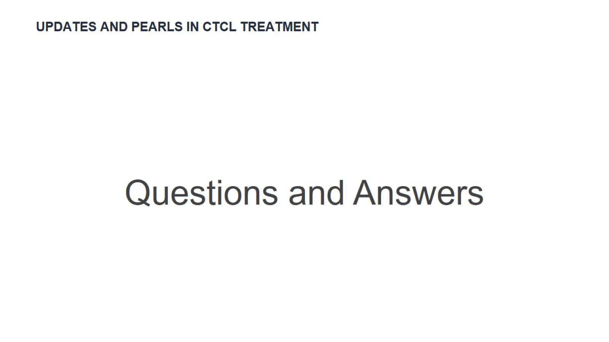
Updates and Pearls in CTCL Treatment

Slide 18


Slide 19

Melanoma Diagnosis and Risk Stratification

Slide 20
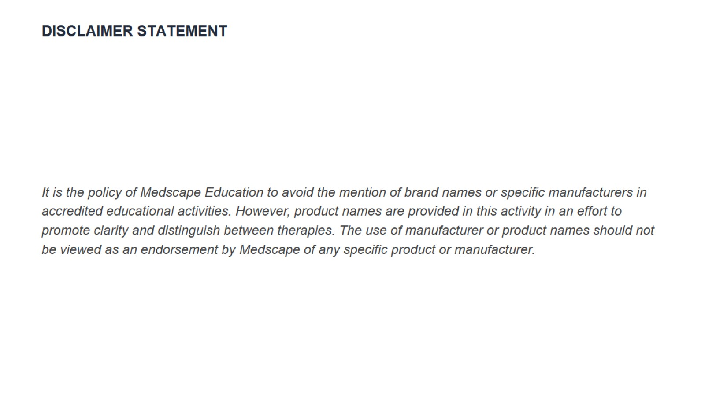
Disclaimer Statement

Slide 21
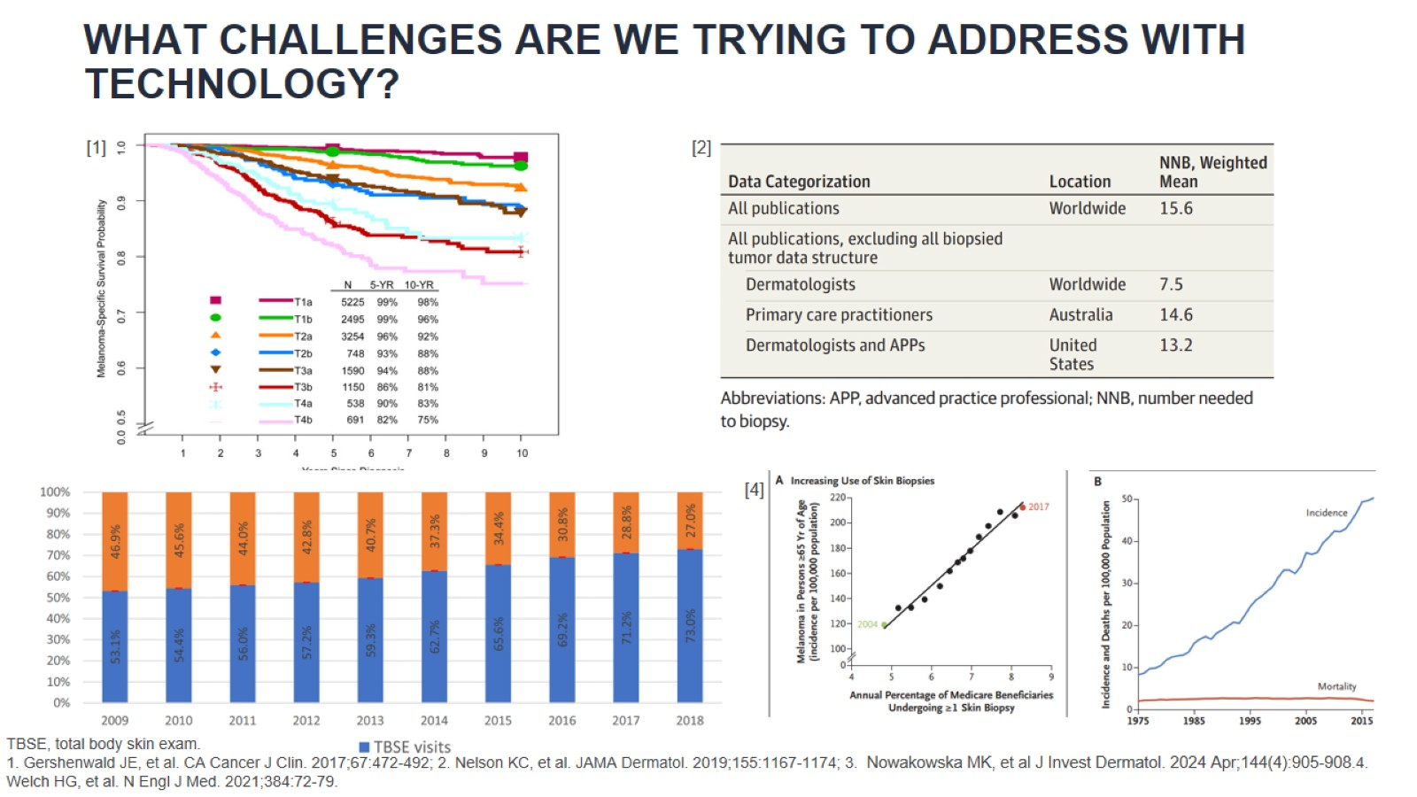
What Challenges Are We Trying to Address With Technology?

Slide 22
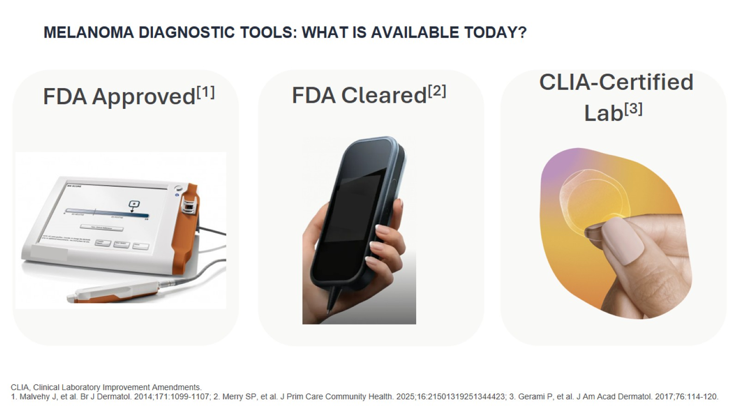
Melanoma Diagnostic Tools: What Is Available Today?

Slide 23
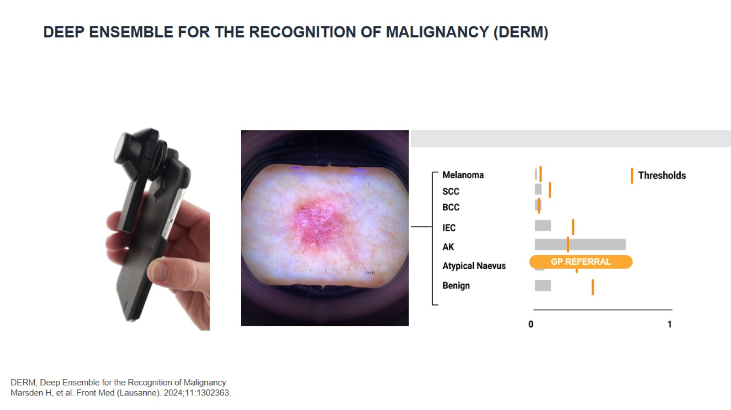
Deep Ensemble for the Recognition of Malignancy (DERM)

Slide 24
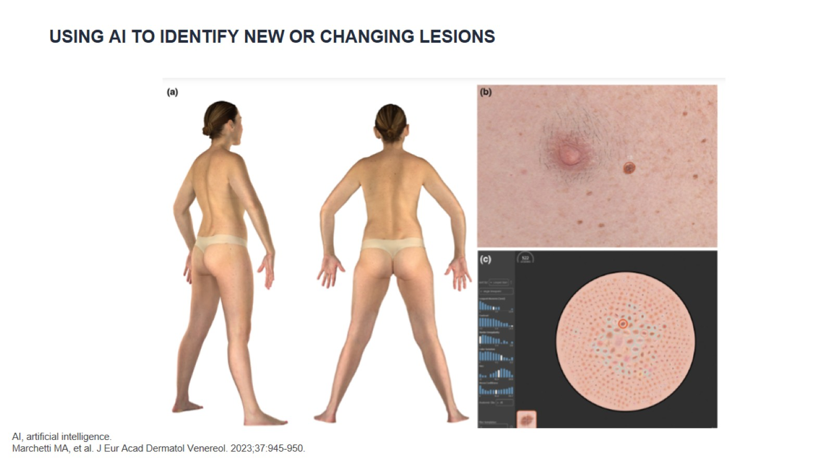
Using AI to Identify New or Changing Lesions

Slide 25
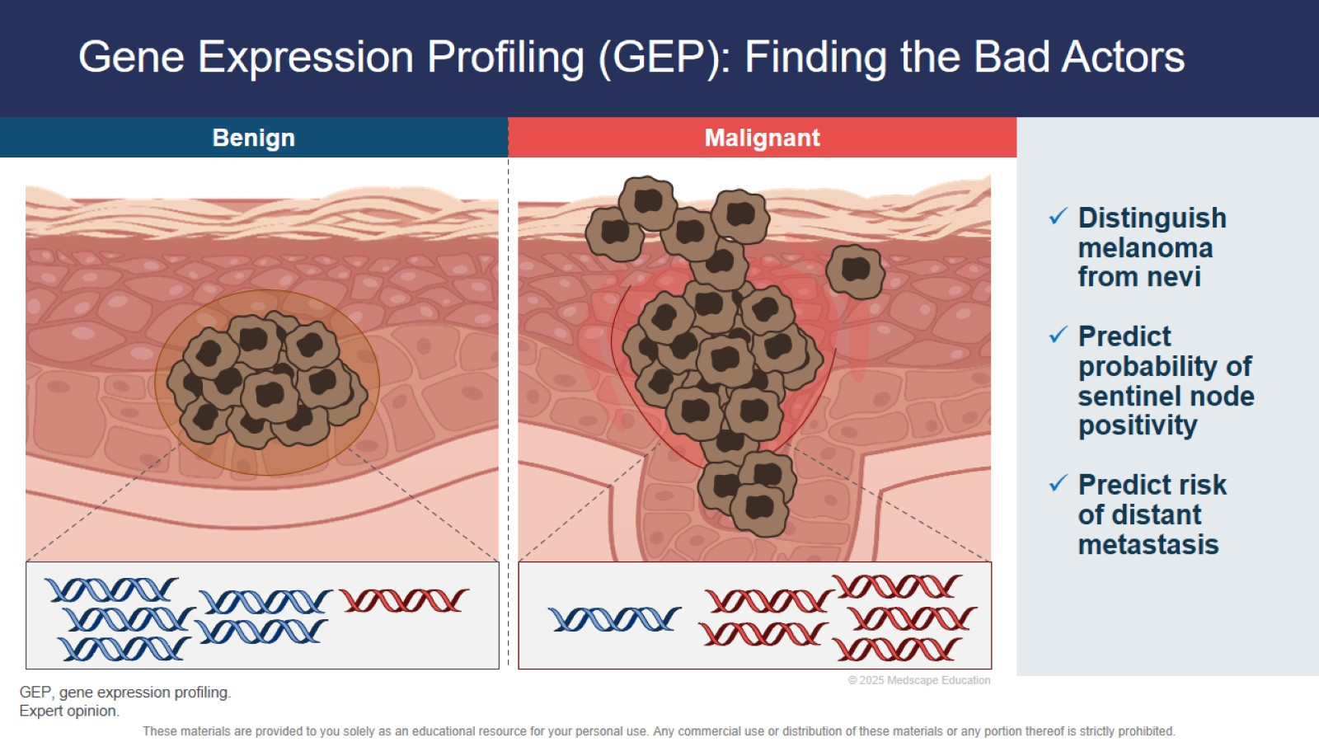
Gene Expression Profiling (GEP): Finding the Bad Actors

Slide 26
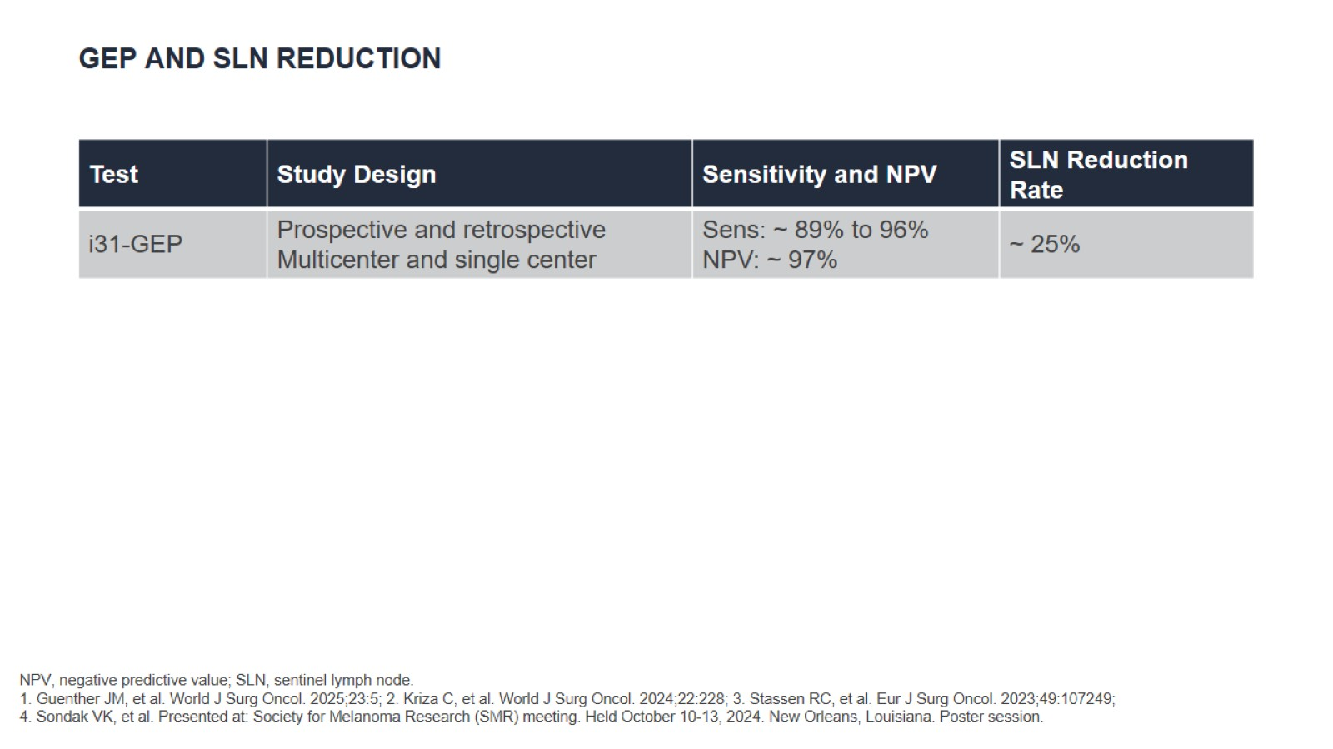
GEP and SLN Reduction

Slide 27
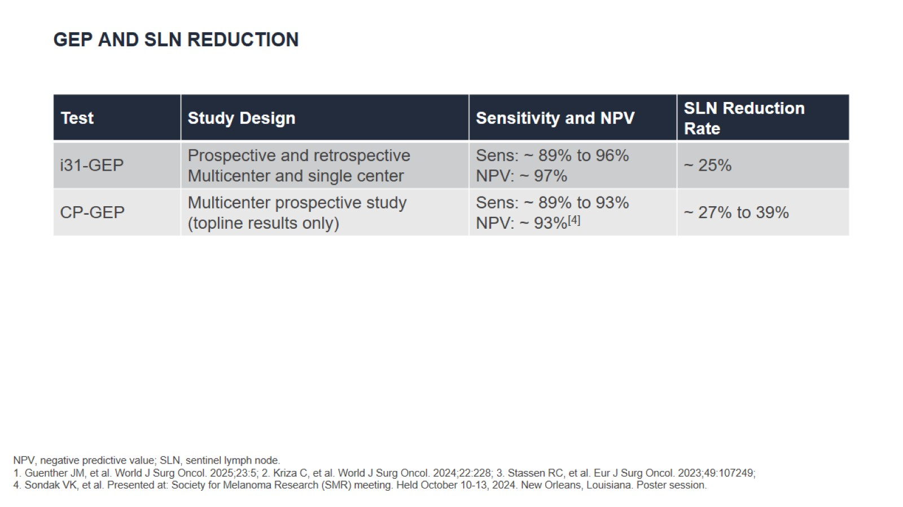
GEP and SLN Reduction

Slide 28
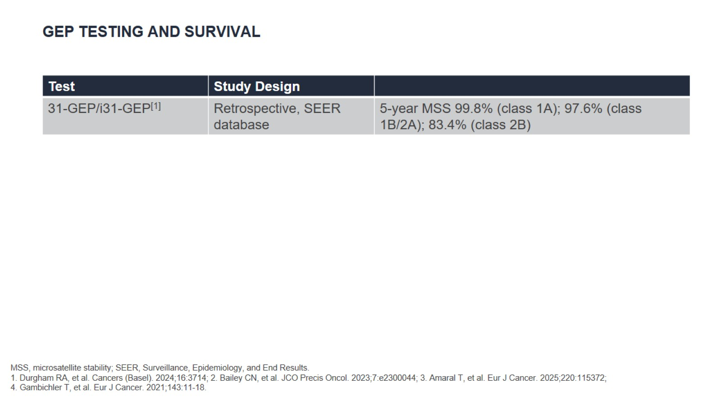
GEP Testing and Survival

Slide 29
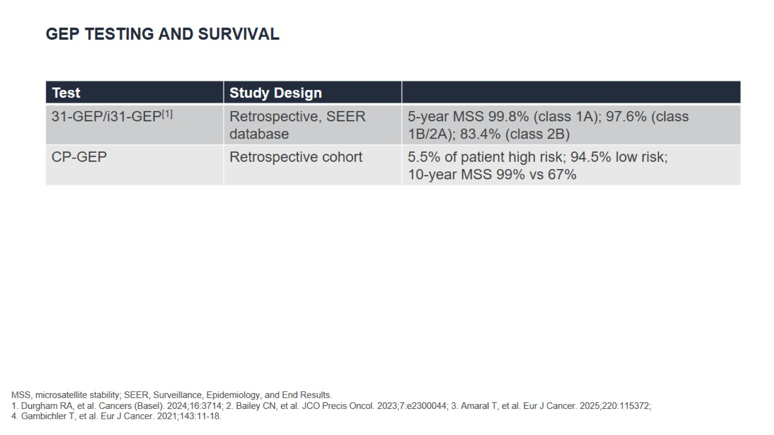
GEP Testing and Survival

Slide 30
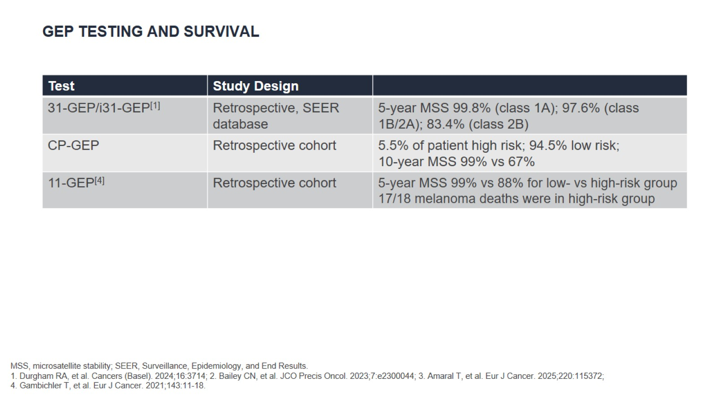
GEP Testing and Survival

Slide 32

Perioperative Management in Melanoma

Slide 33
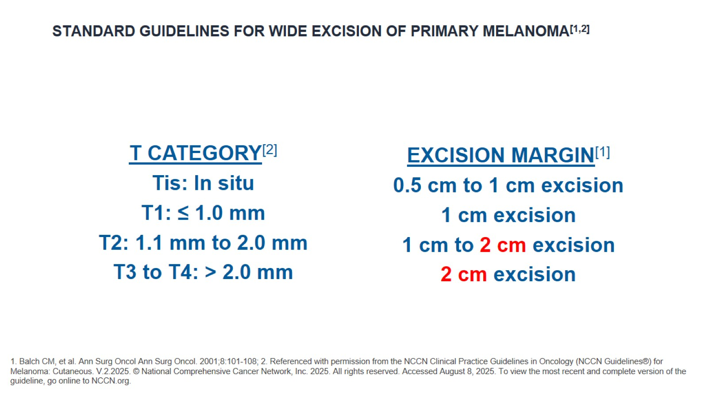
Standard Guidelines for Wide Excision of Primary Melanoma^{[1,2]}

Slide 34
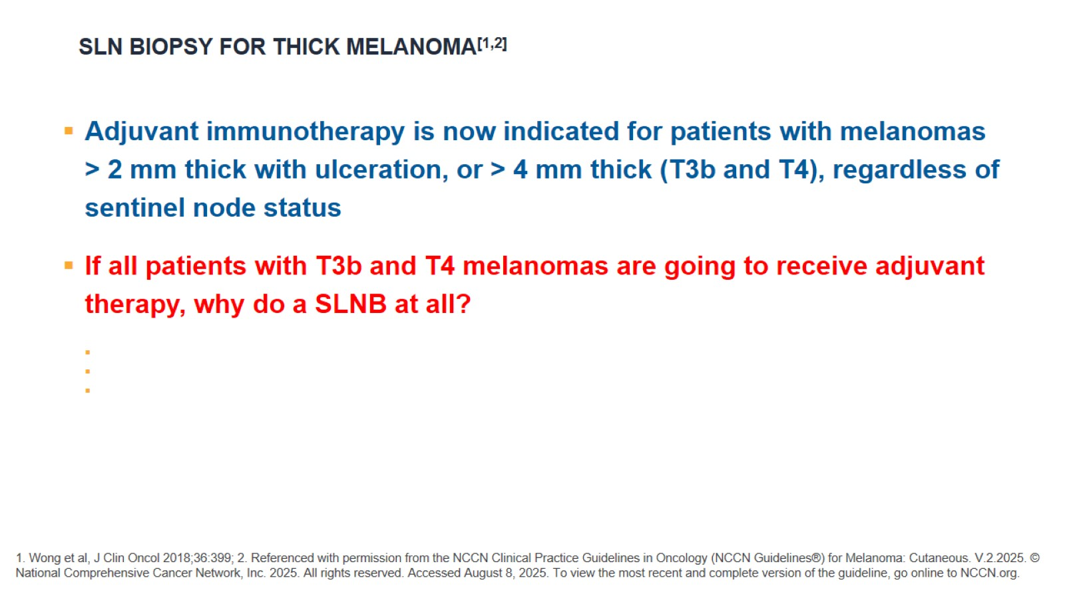
SLN Biopsy for Thick Melanoma^{[1,2]}

Slide 35
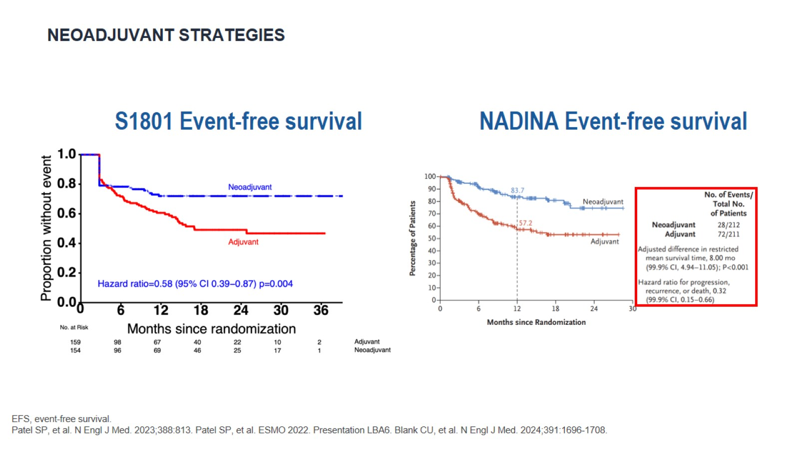
Neoadjuvant Strategies

Slide 36


