Slide 1


Slide 2


Slide 3
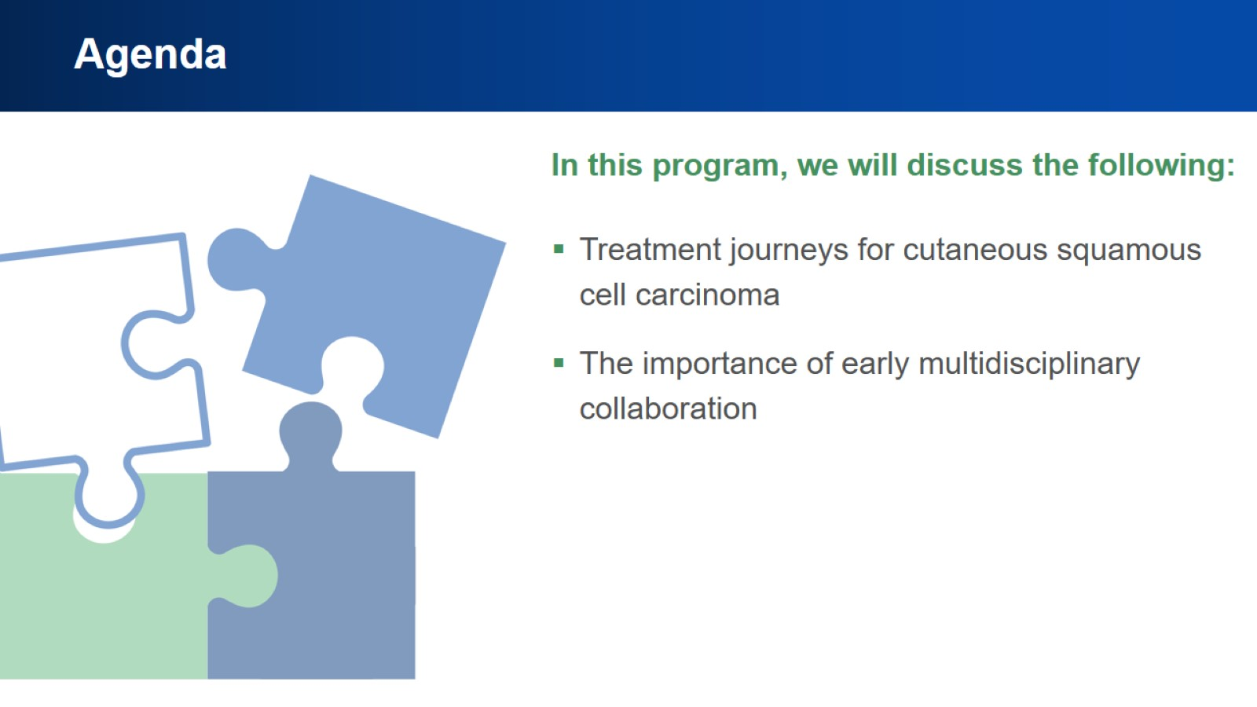
Agenda

Slide 4
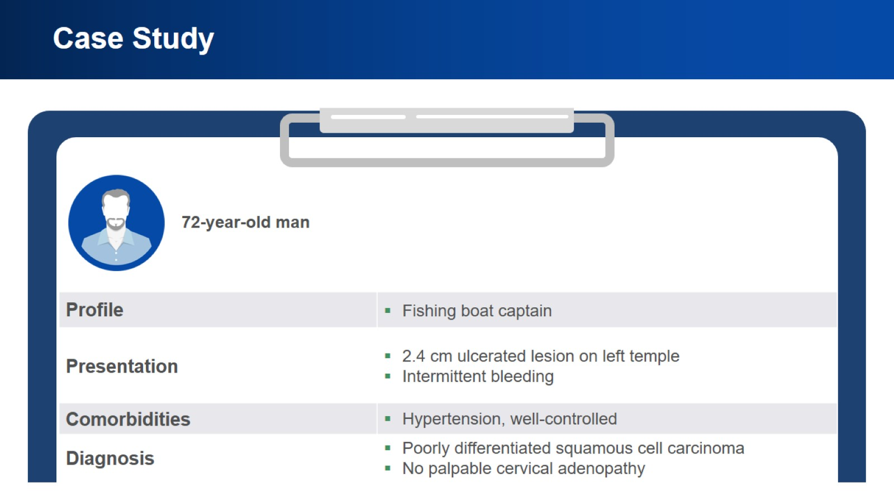
Case Study

Slide 5
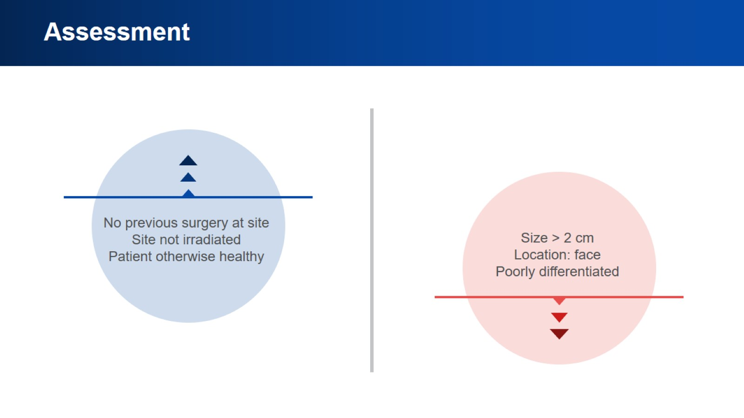
Assessment

Slide 6
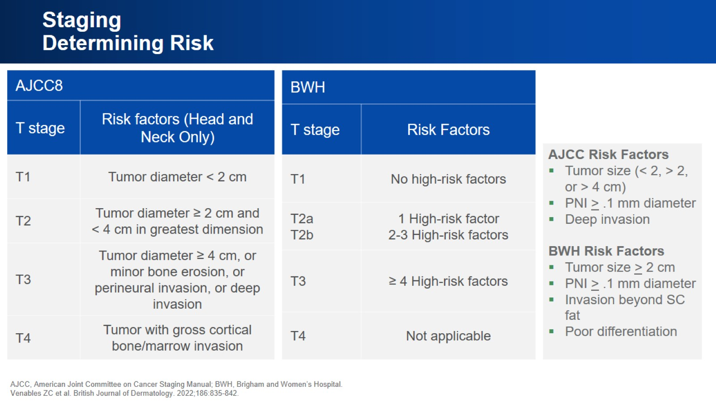
Staging Determining Risk

Slide 7
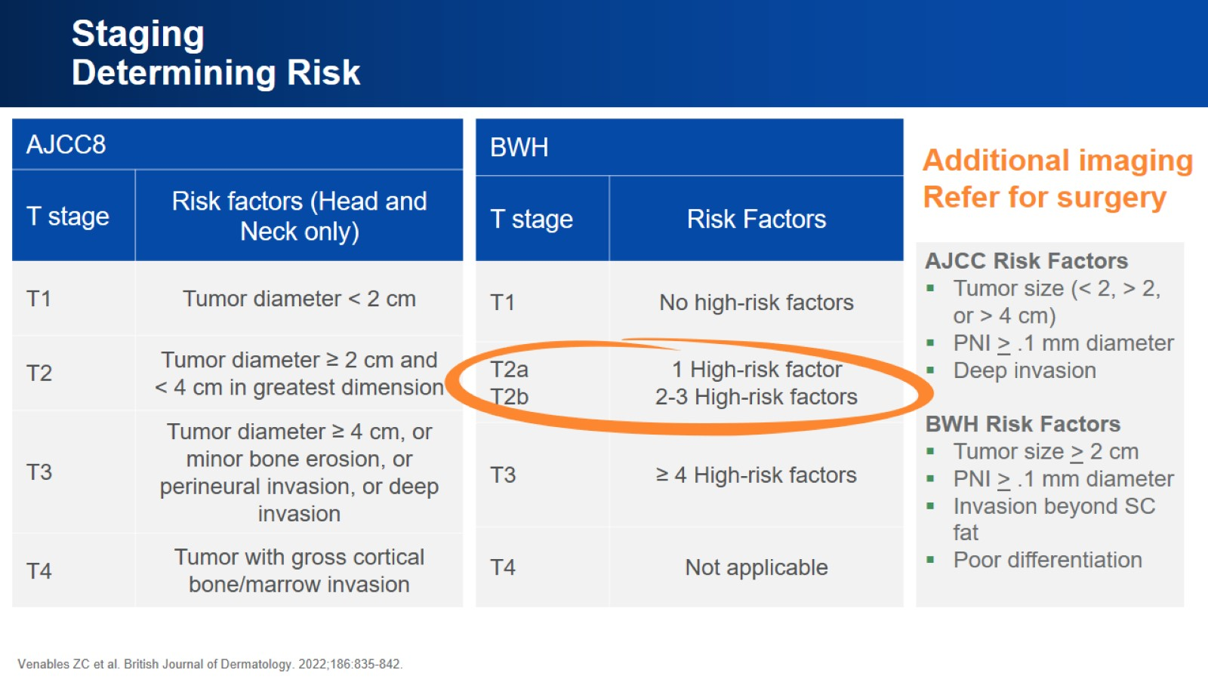
Staging Determining Risk

Slide 8
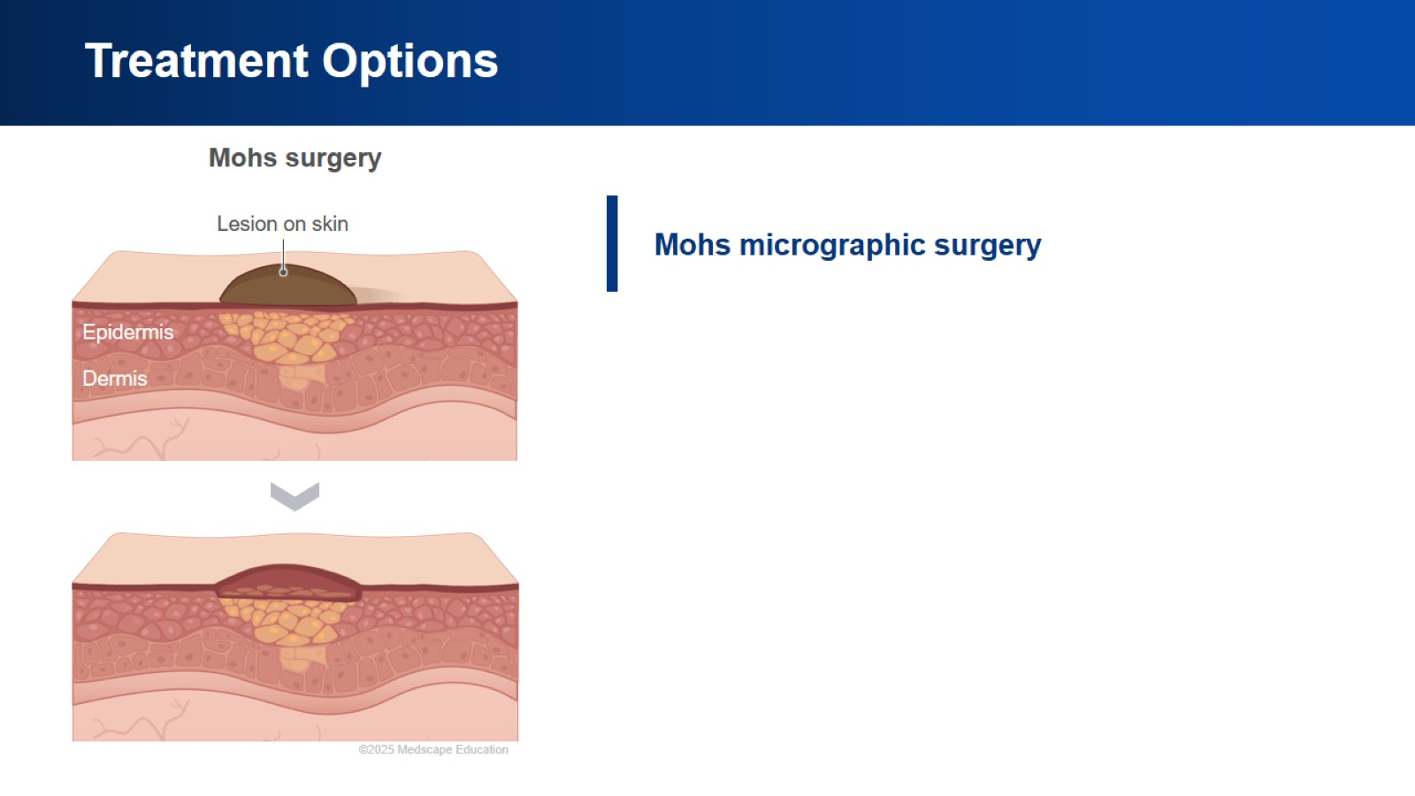
Treatment Options

Slide 9
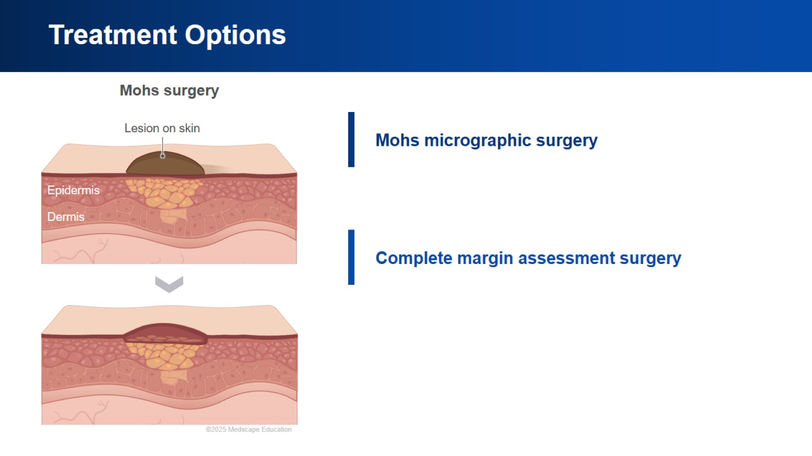
Treatment Options

Slide 10
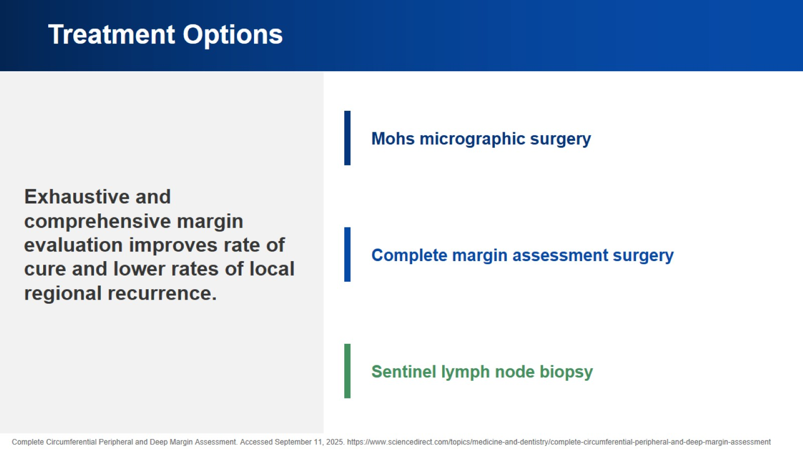
Treatment Options

Slide 11
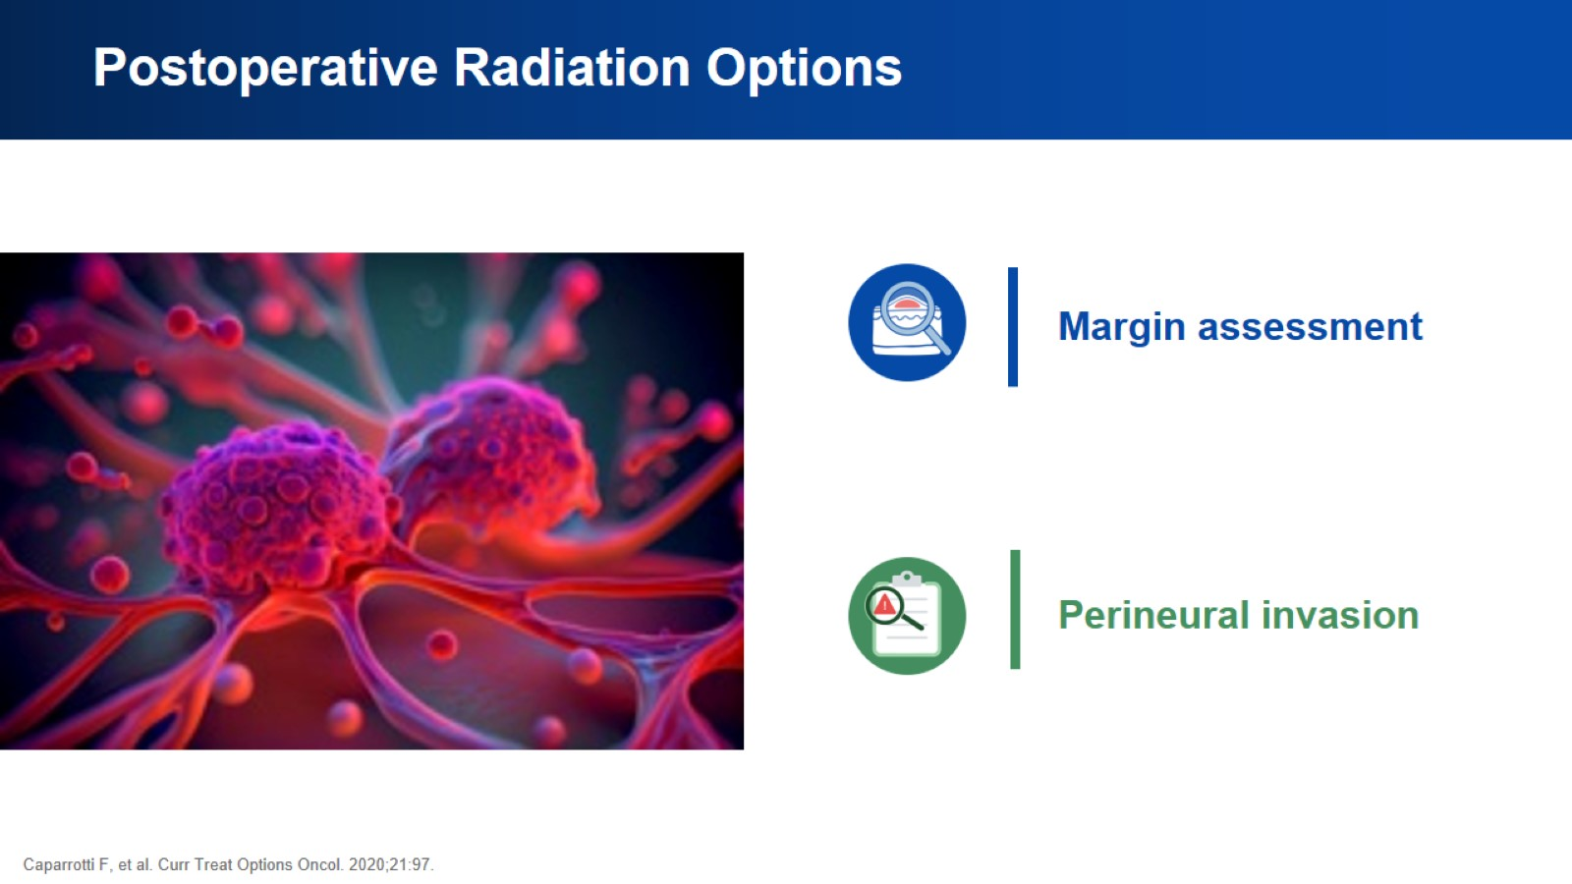
Postoperative Radiation Options

Slide 12
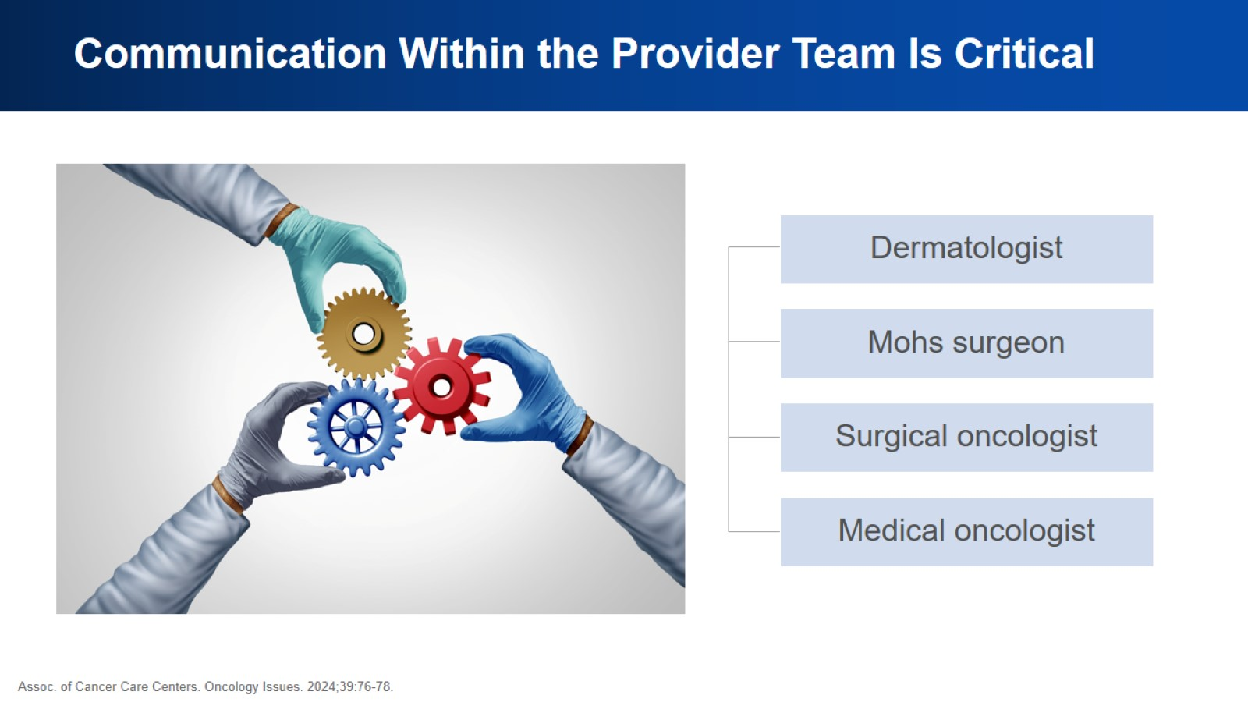
Communication Within the Provider Team Is Critical

Slide 13
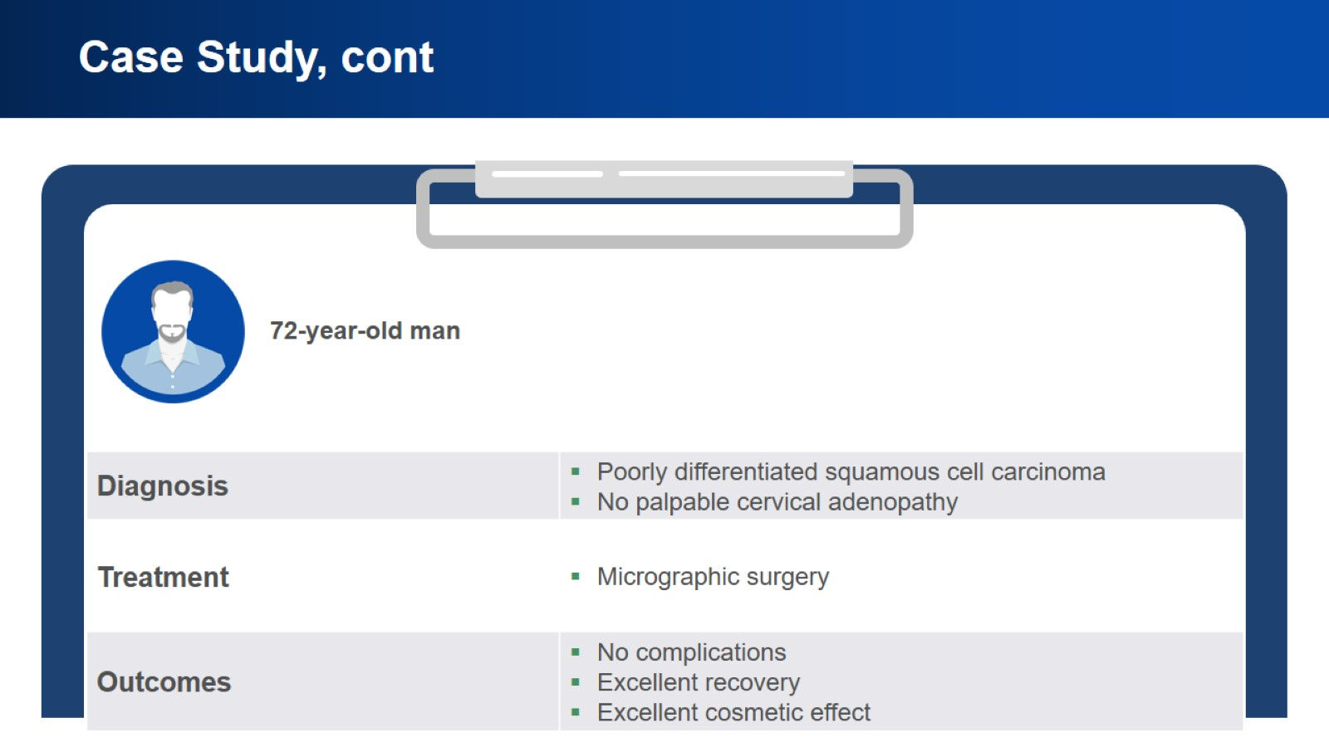
Case Study, cont

Slide 14
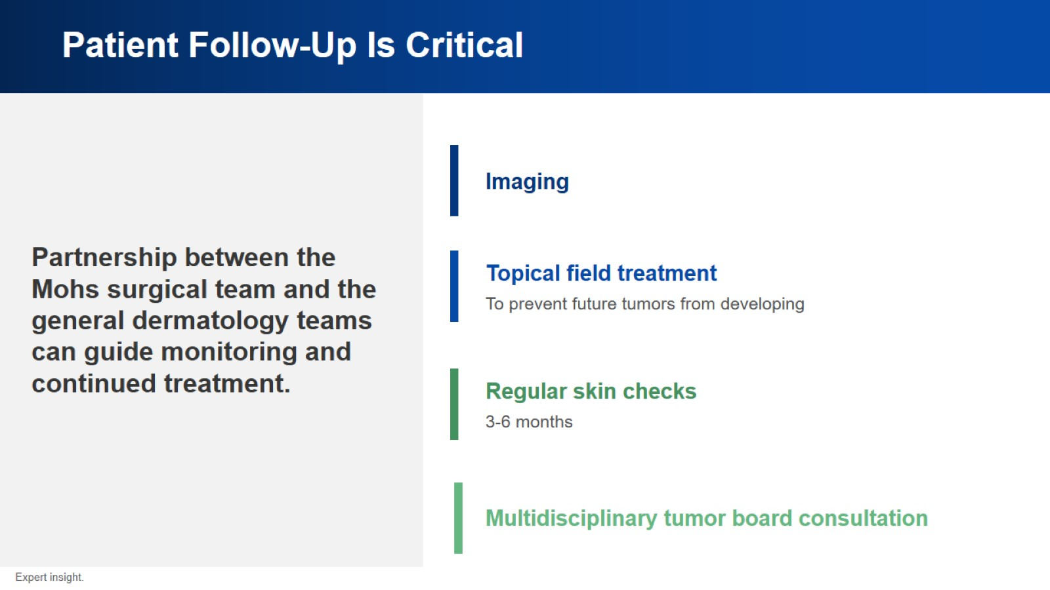
Patient Follow-Up Is Critical

Slide 15
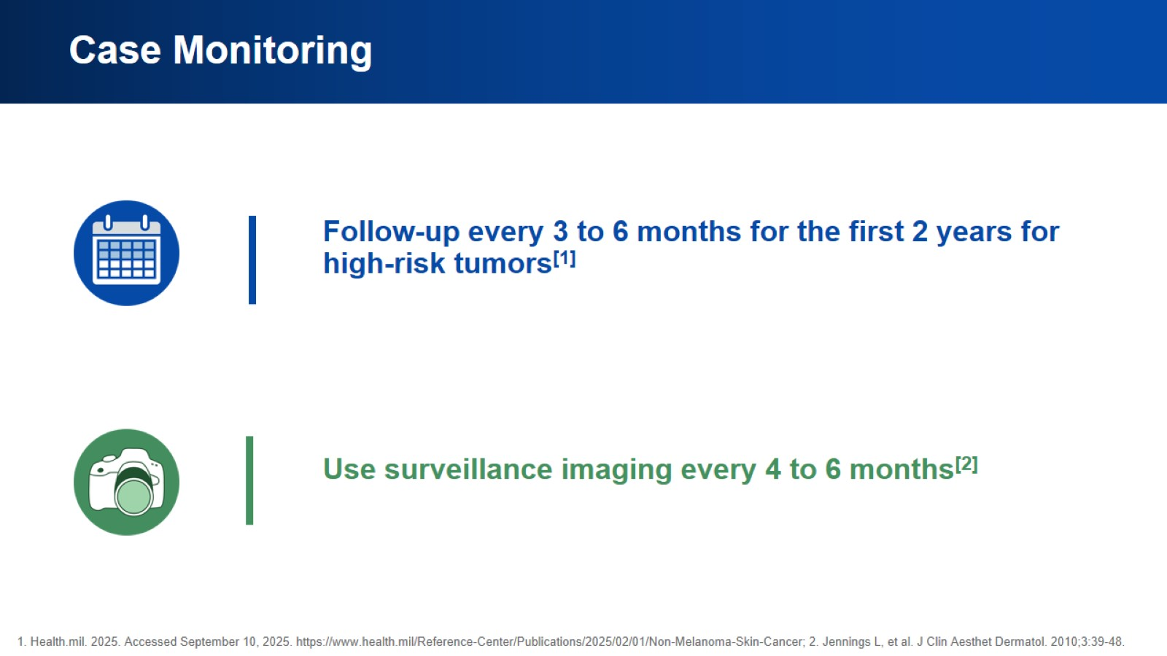
Case Monitoring

Slide 16
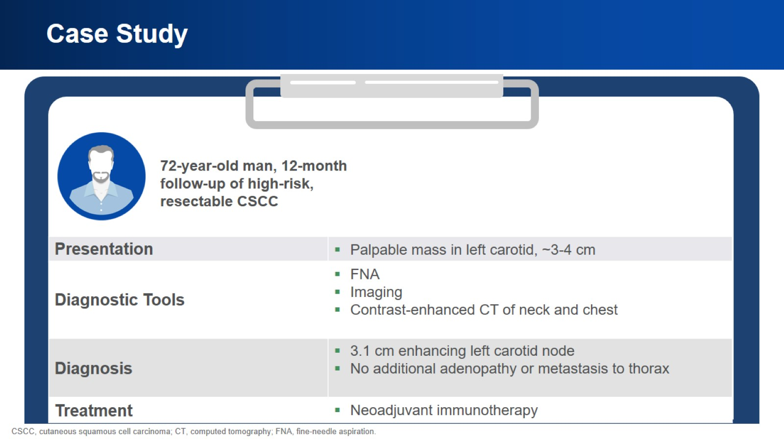
Case Study

Slide 17
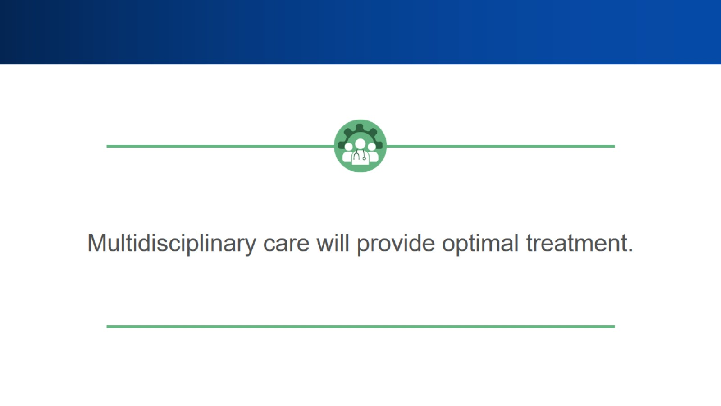

Slide 18
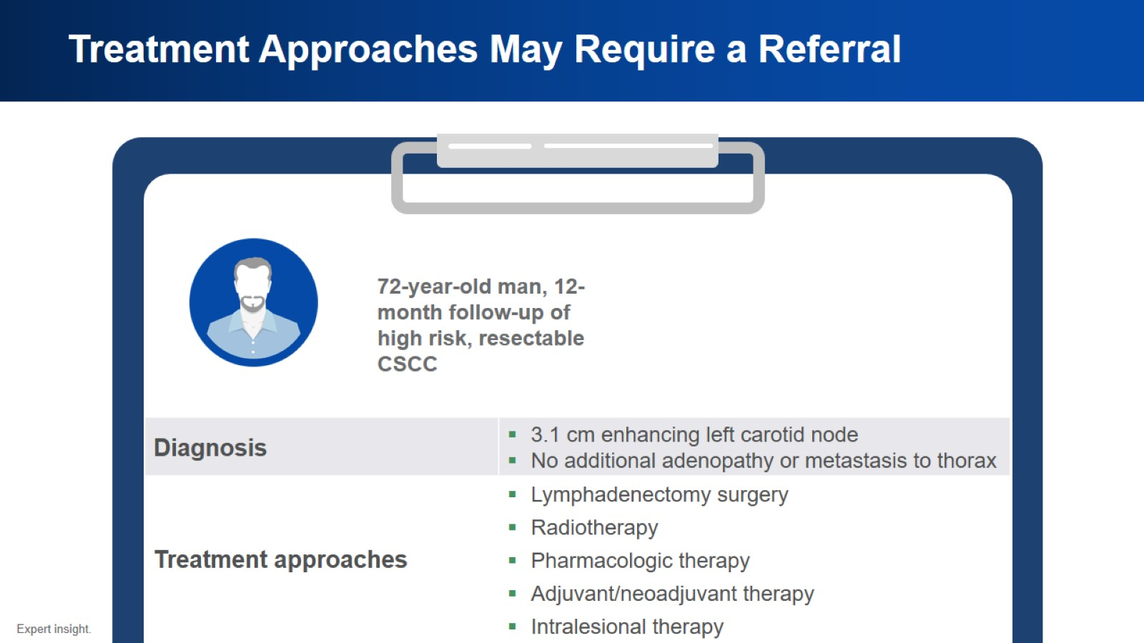
Treatment Approaches May Require a Referral

Slide 19
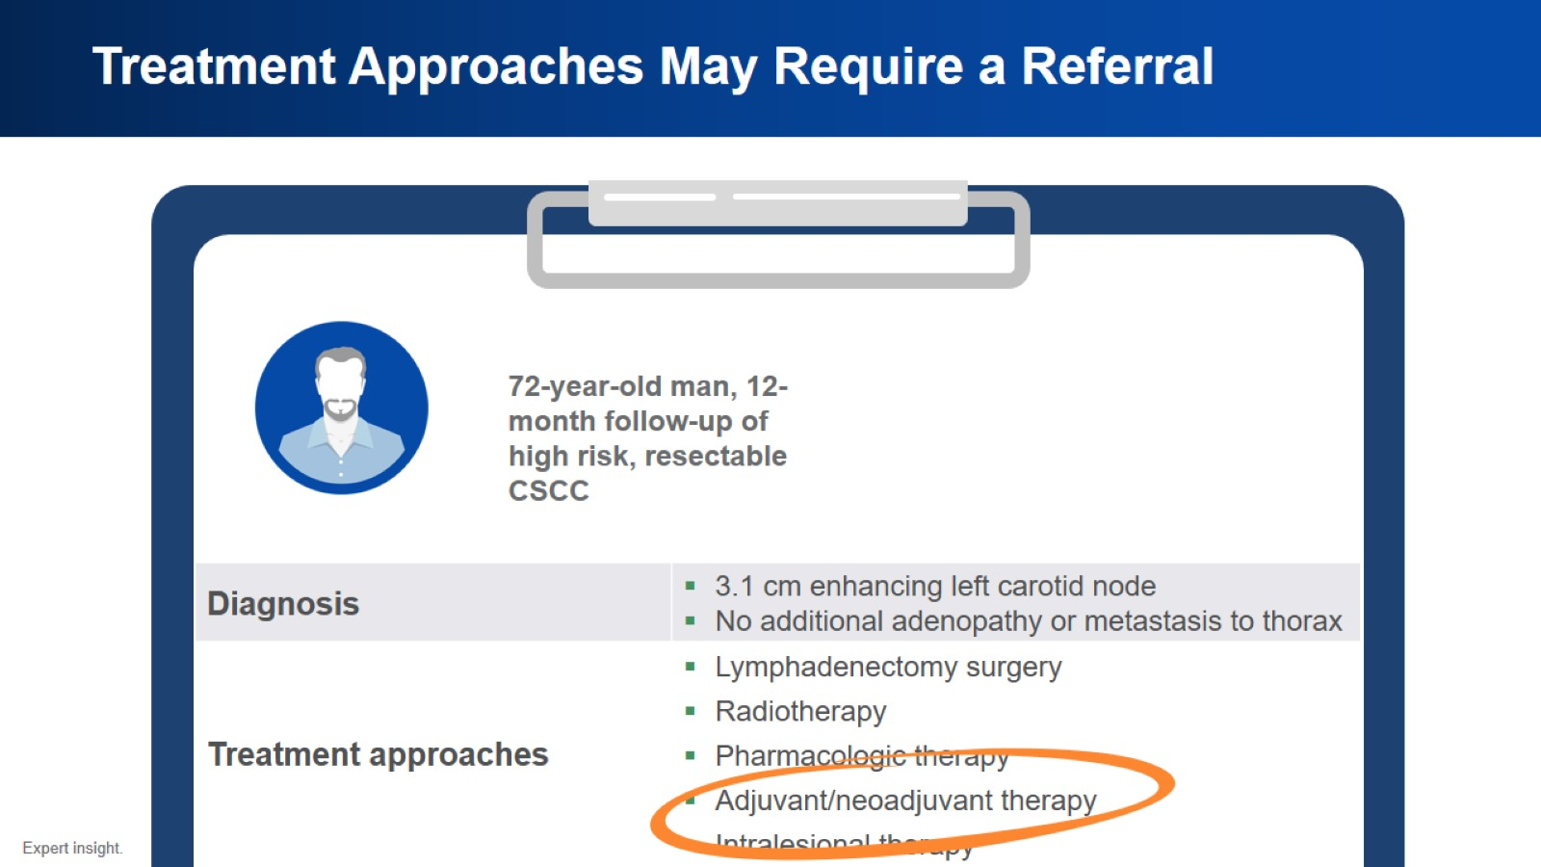
Treatment Approaches May Require a Referral

Slide 20
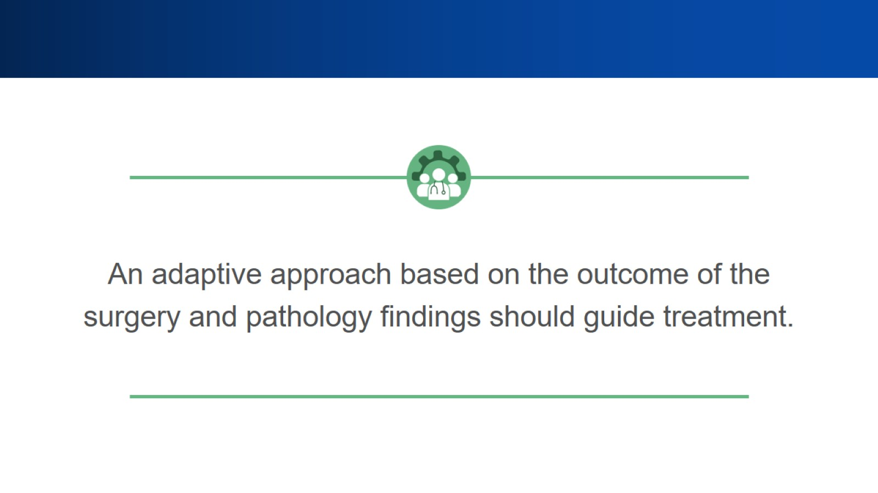

Slide 21
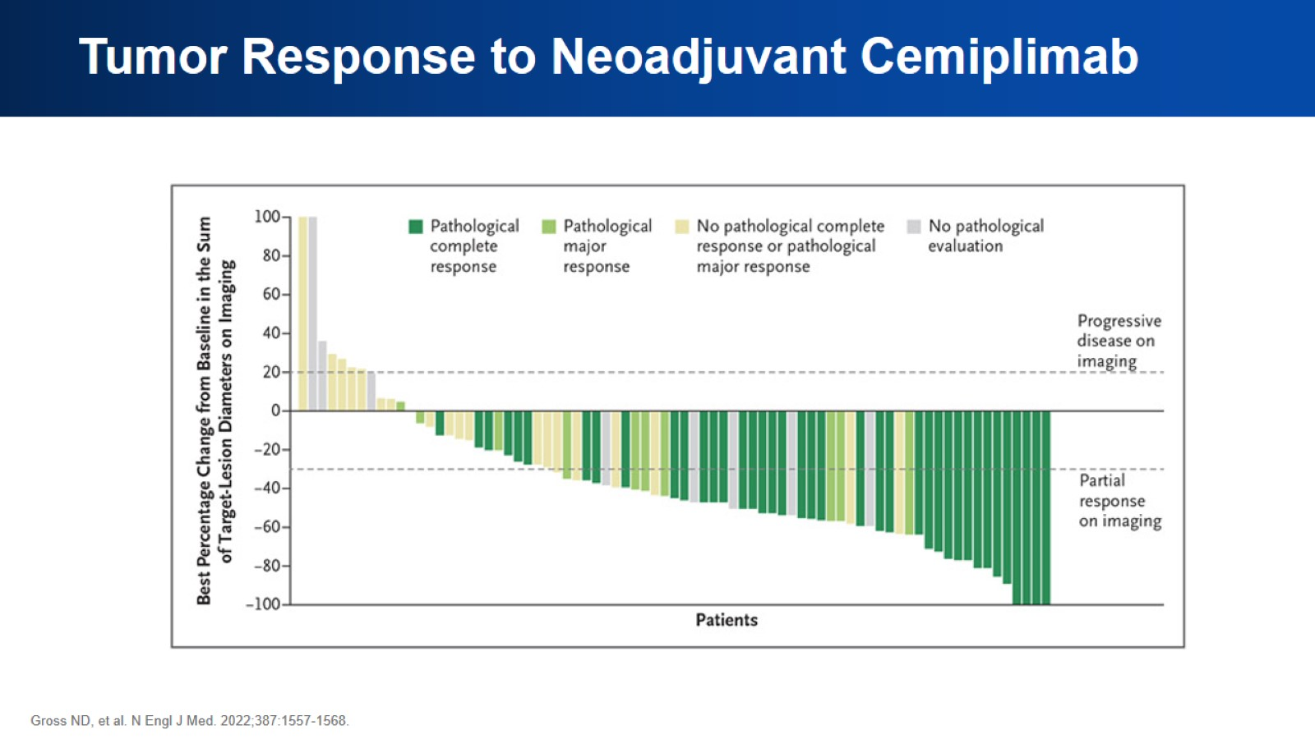
Tumor Response to Neoadjuvant Cemiplimab

Slide 22
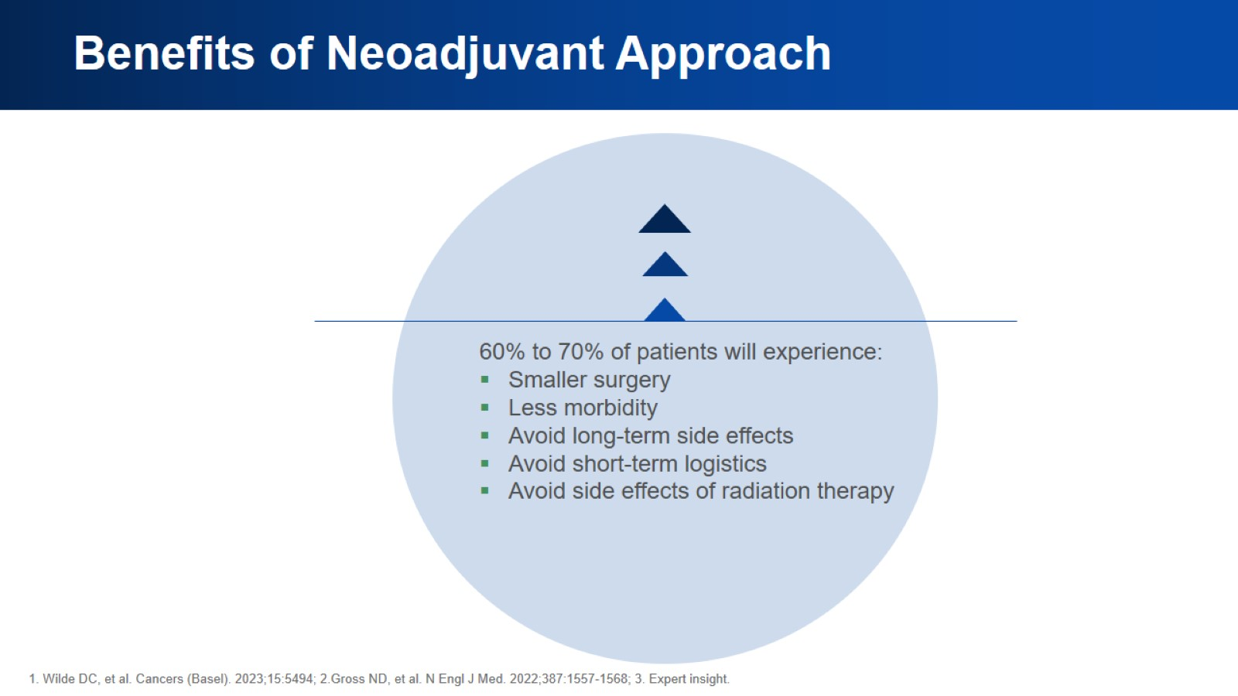
Benefits of Neoadjuvant Approach

Slide 23
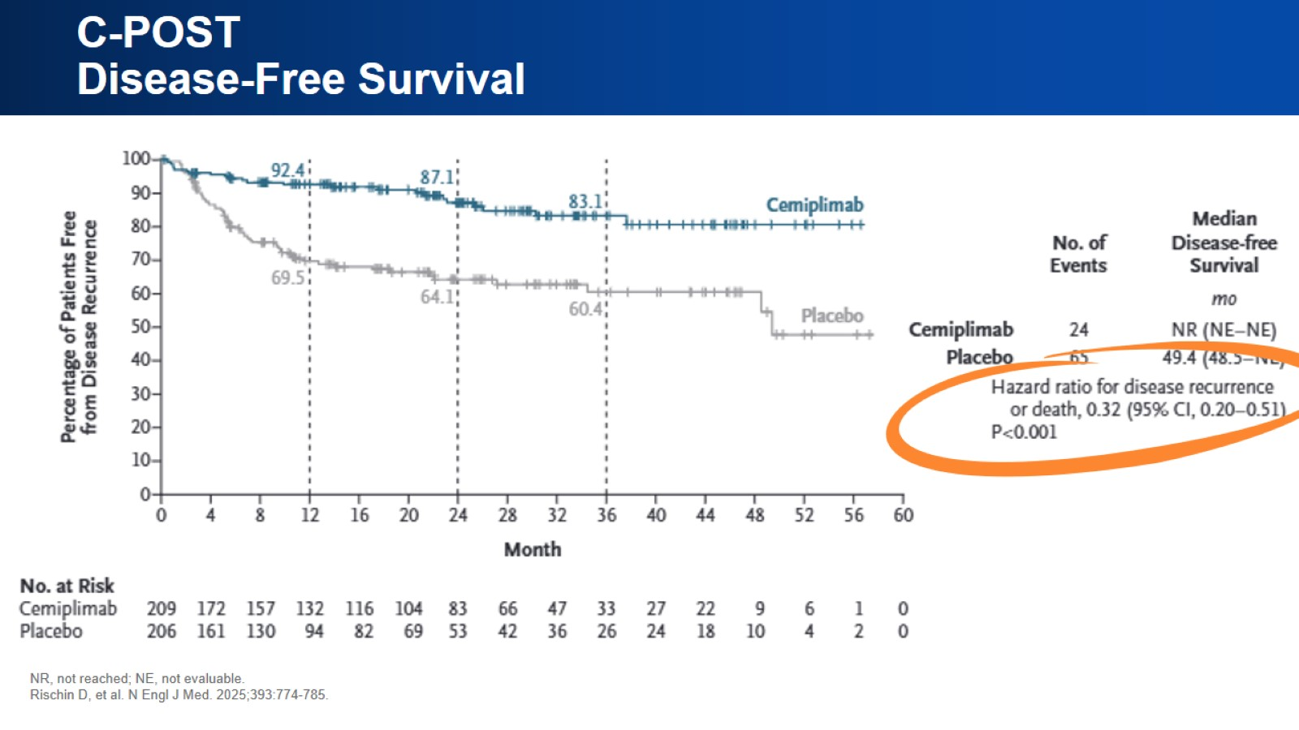
C-POST Disease-Free Survival

Slide 24
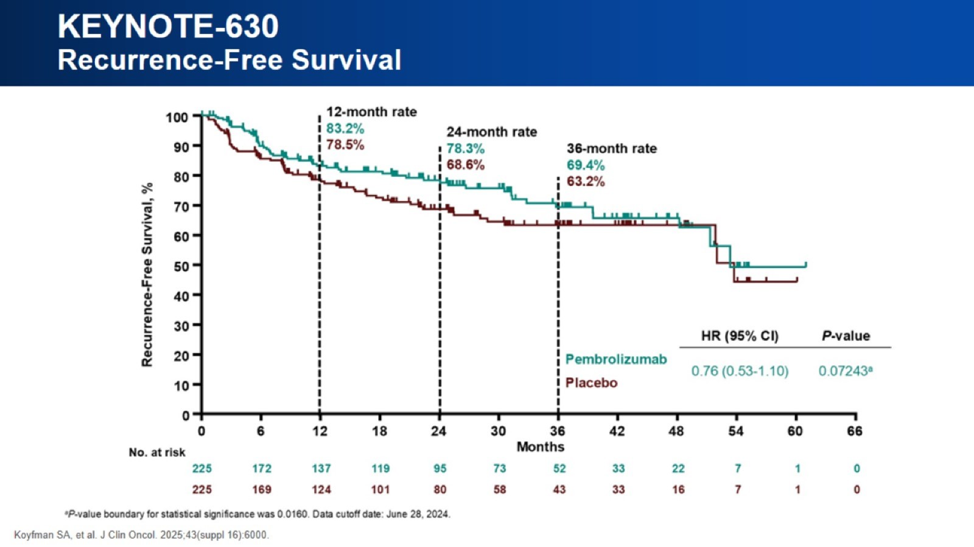
KEYNOTE-630 Recurrence-Free Survival

Slide 25
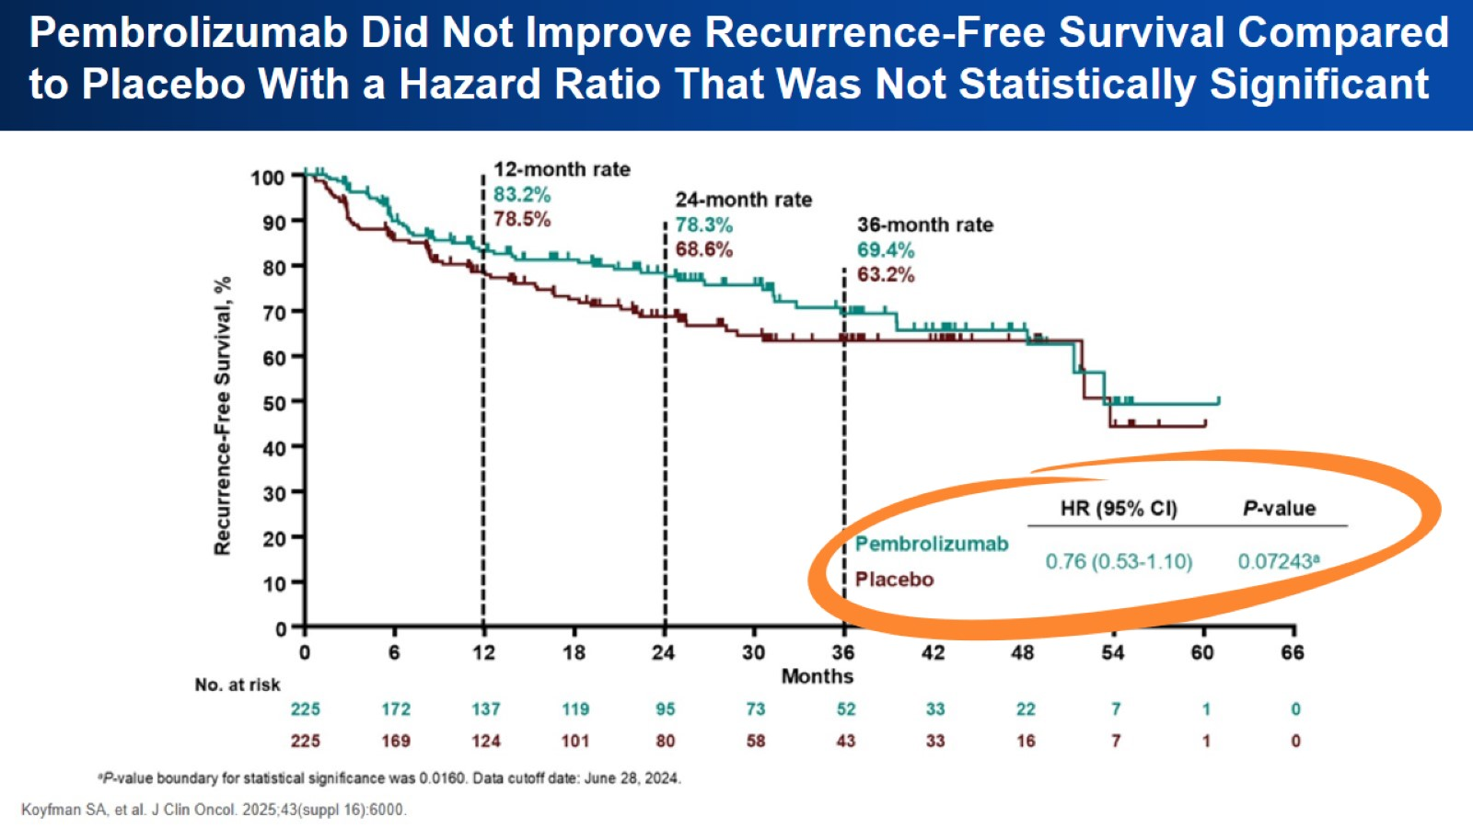
KEYNOTE-630 Recurrence-Free Survival

Slide 26
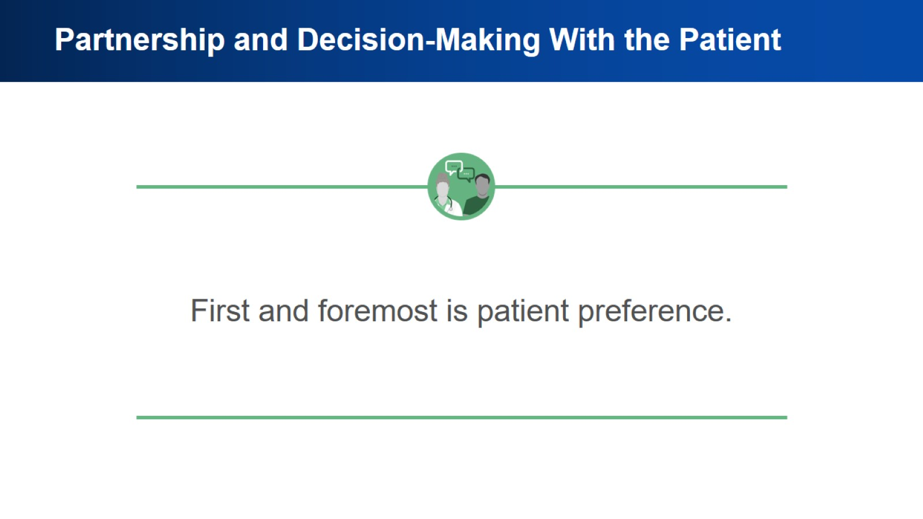
Partnership and Decision-Making With the Patient

Slide 27
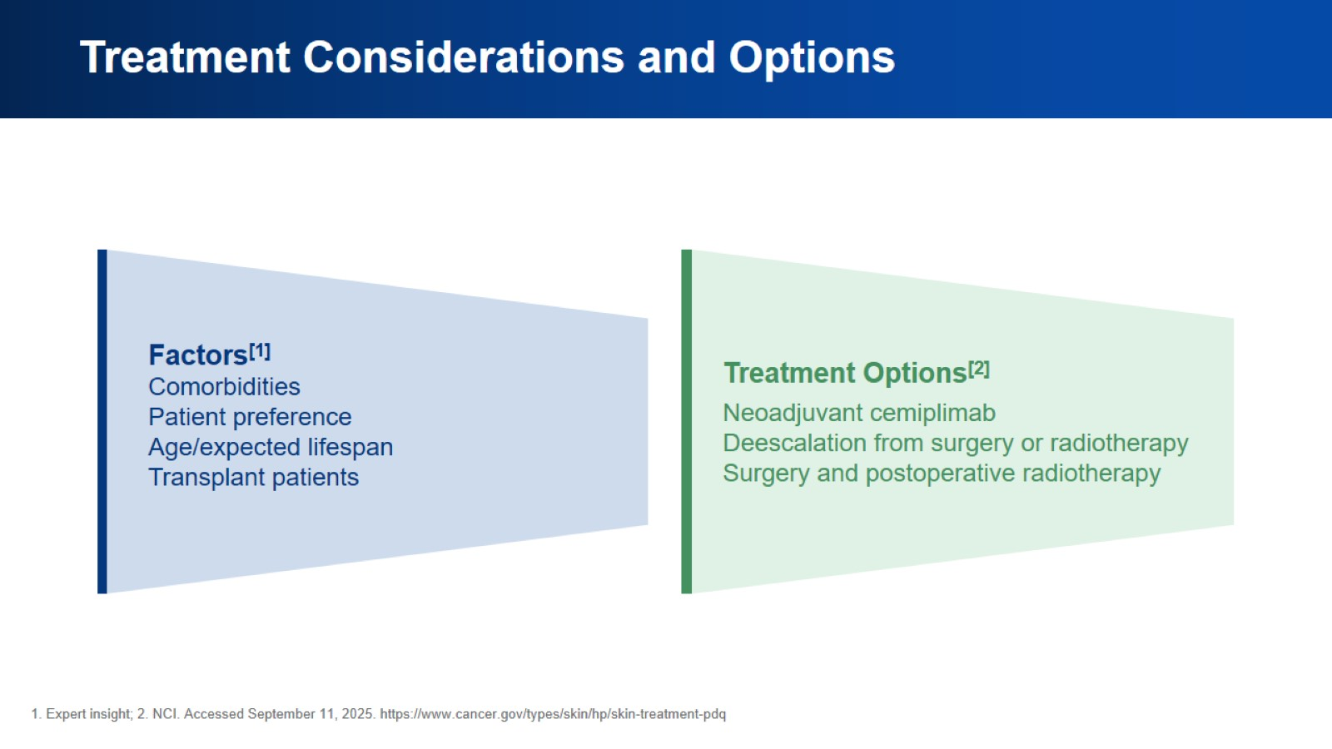
Treatment Considerations and Options

Slide 28
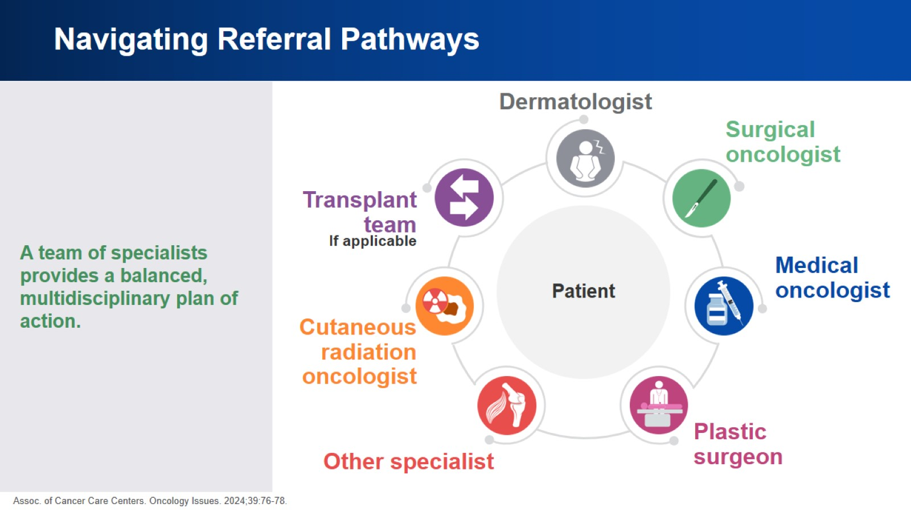
Navigating Referral Pathways

Slide 29
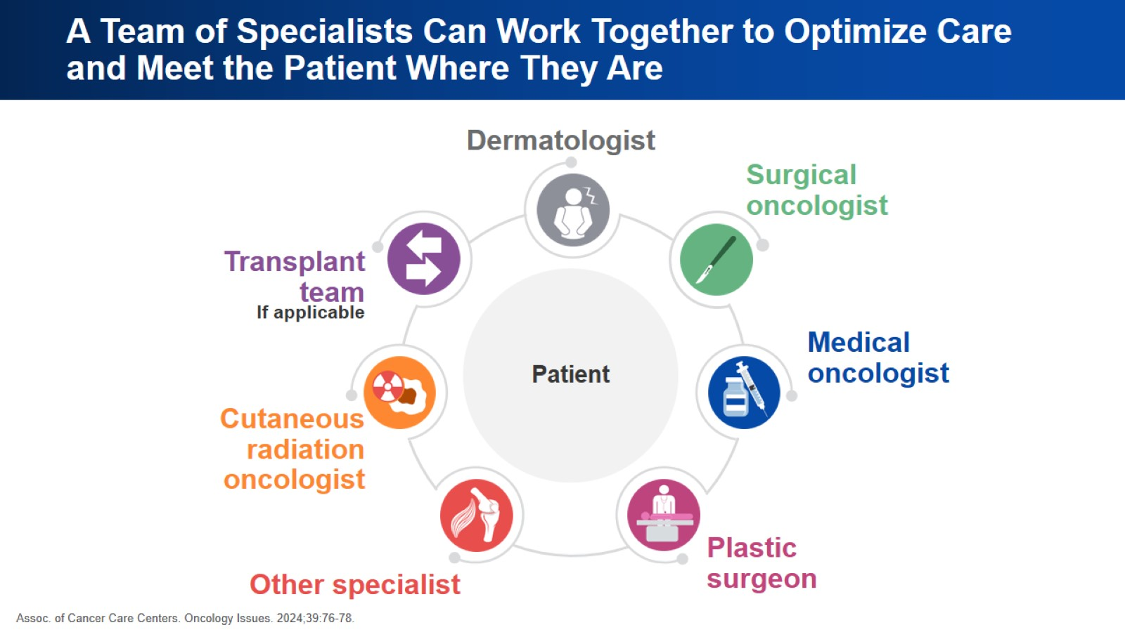
A Team of Specialists Can Work Together to Optimize Care and Meet the Patient Where They Are

Slide 30
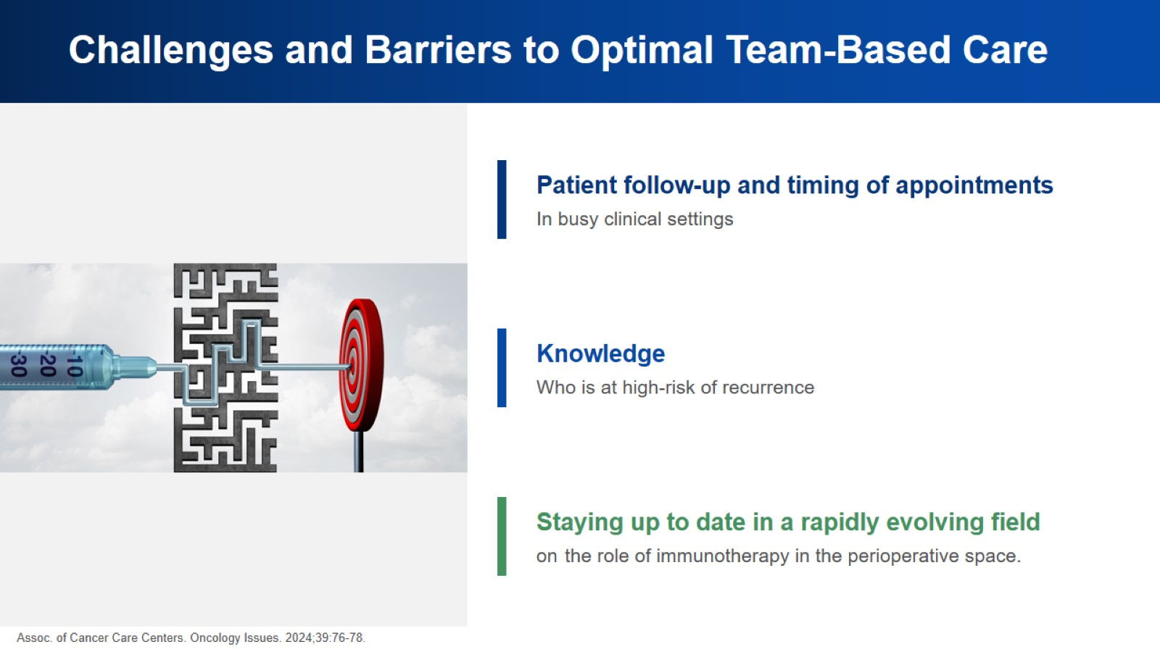
Challenges and Barriers to Optimal Team-Based Care

Slide 31
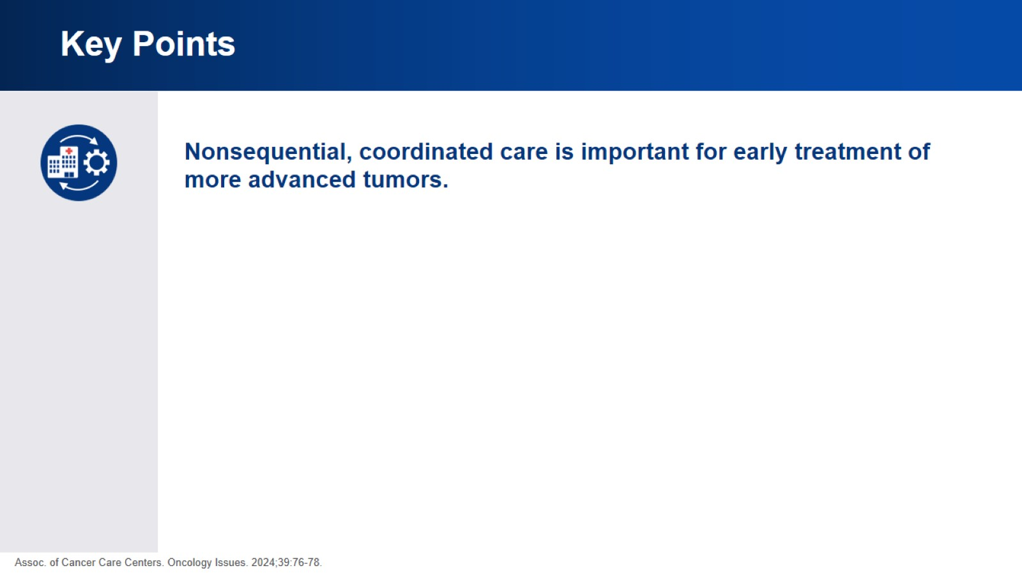
Key Points

Slide 32
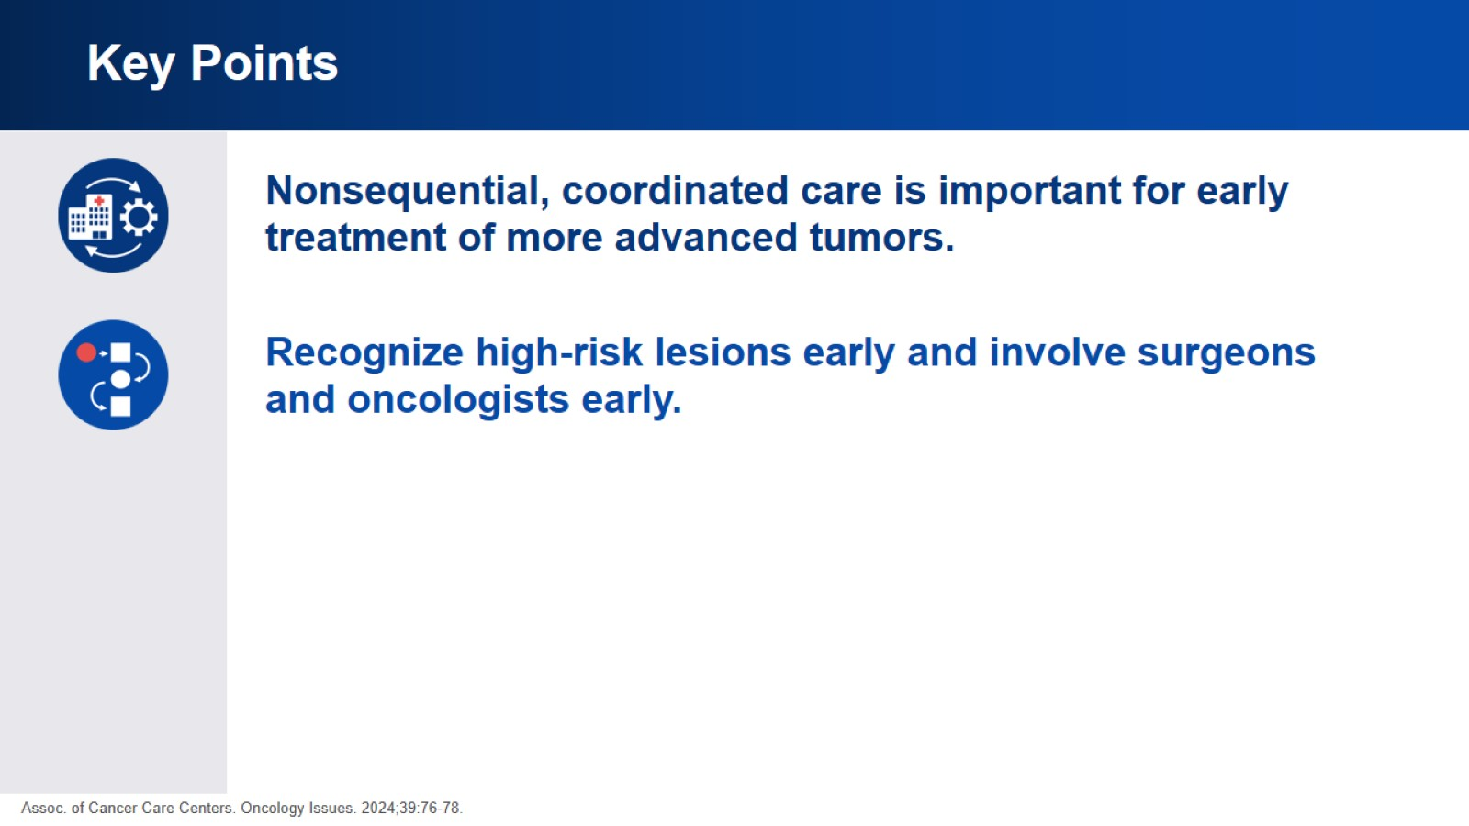
Key Points

Slide 33
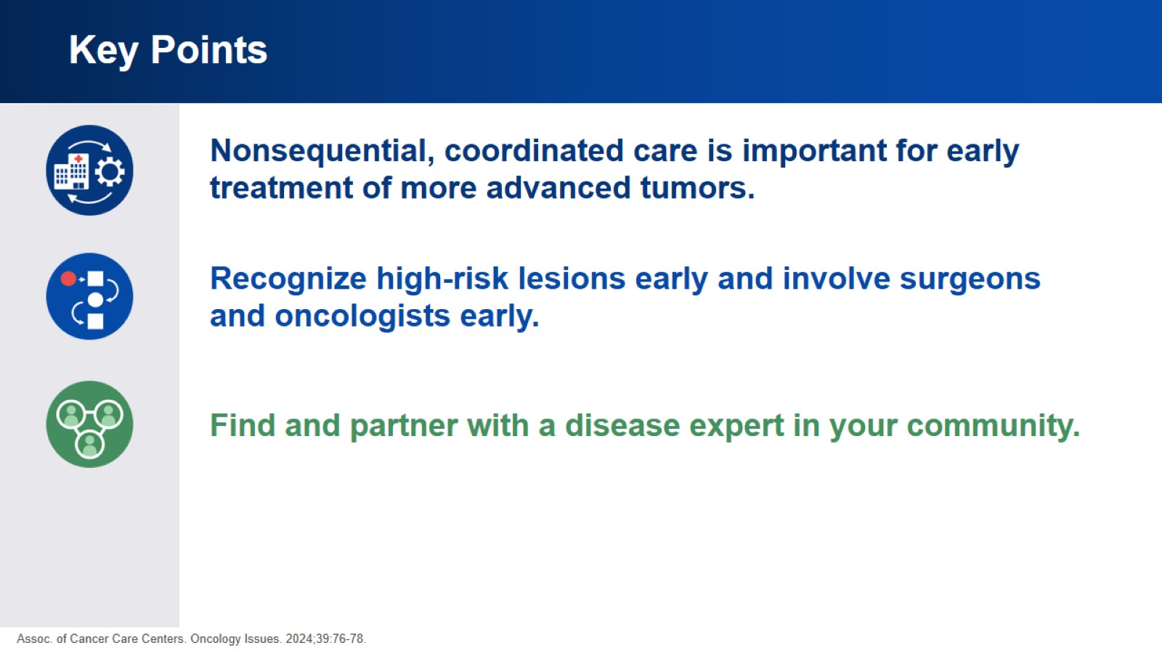
Key Points

Slide 34
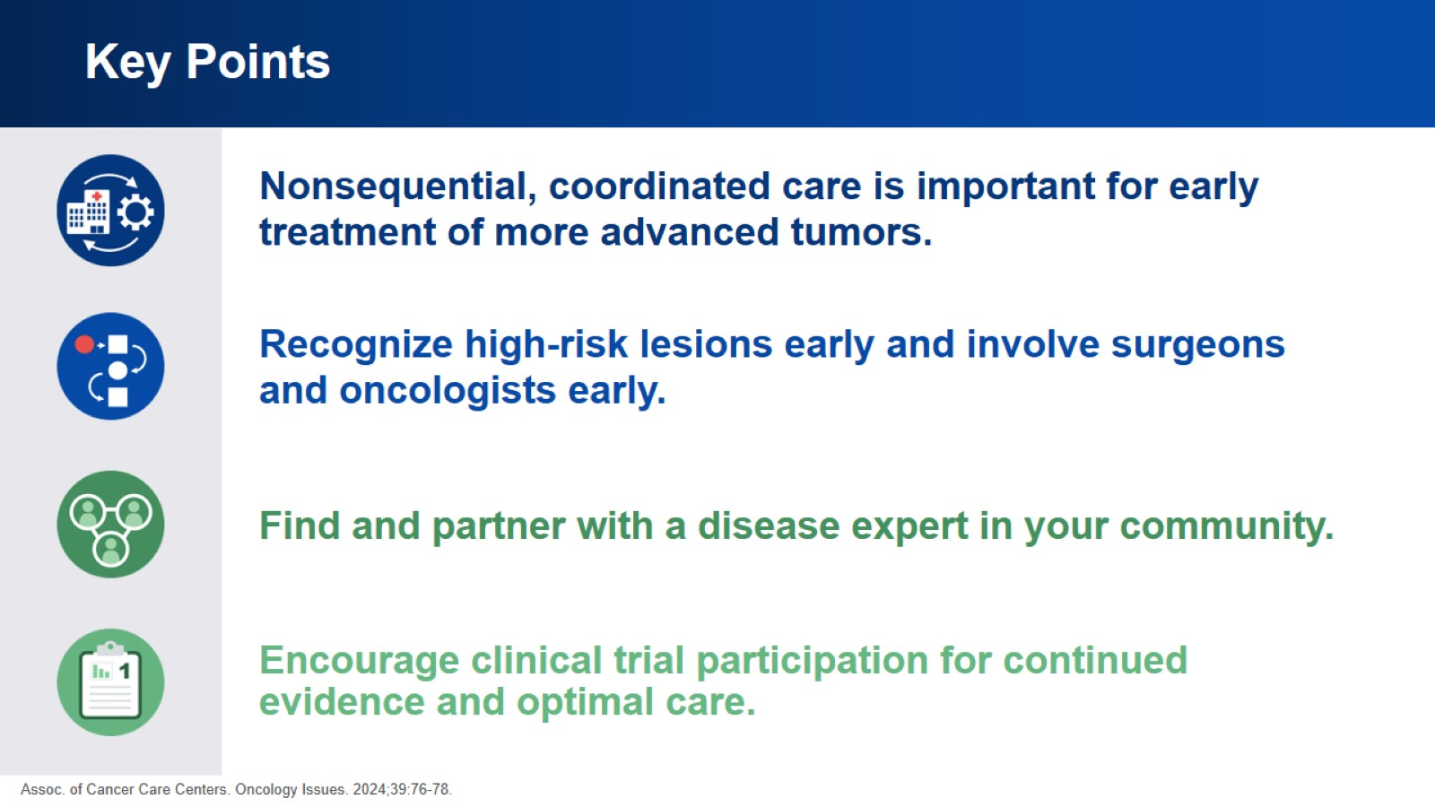
Key Points

Slide 35


