Slide 1


Slide 2
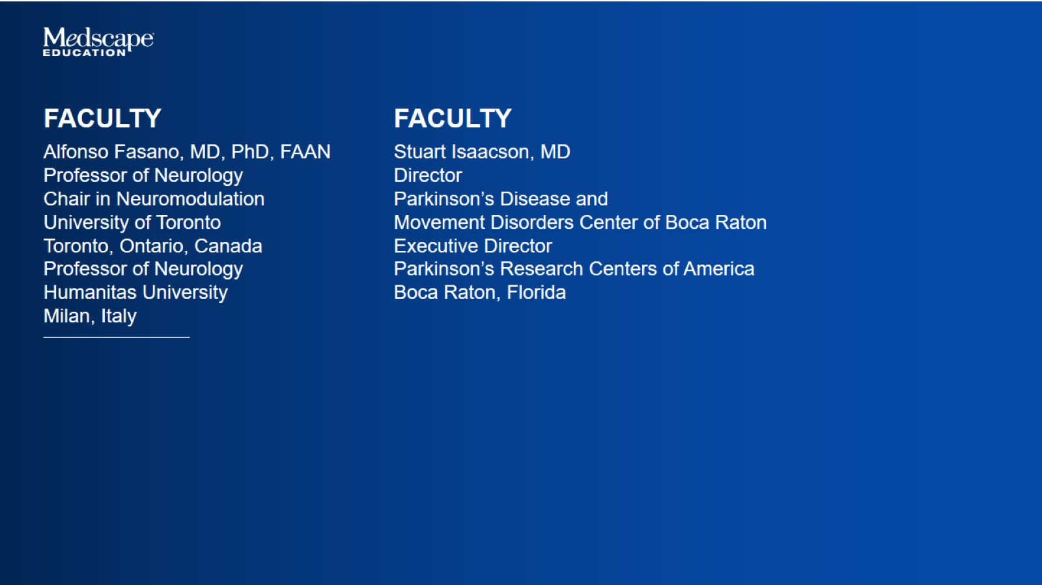

Slide 3
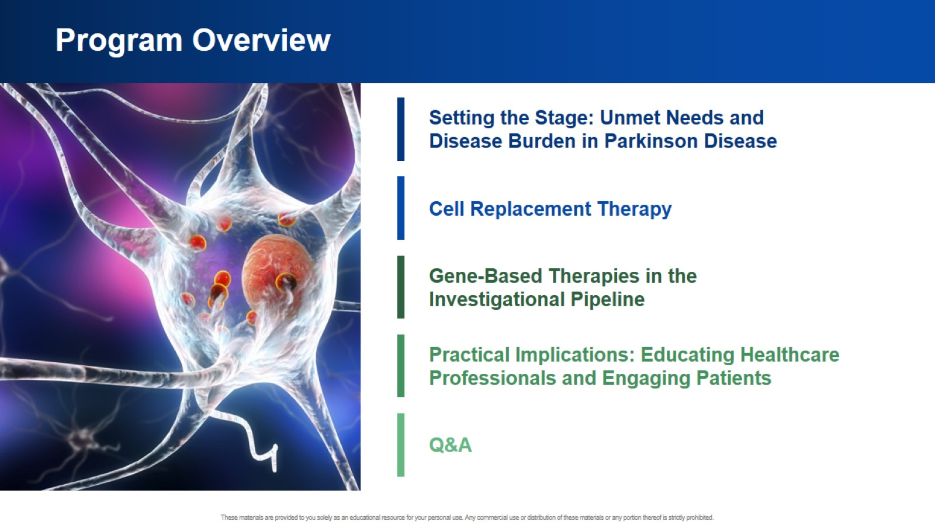
Program Overview

Slide 4

Setting the Stage

Slide 5
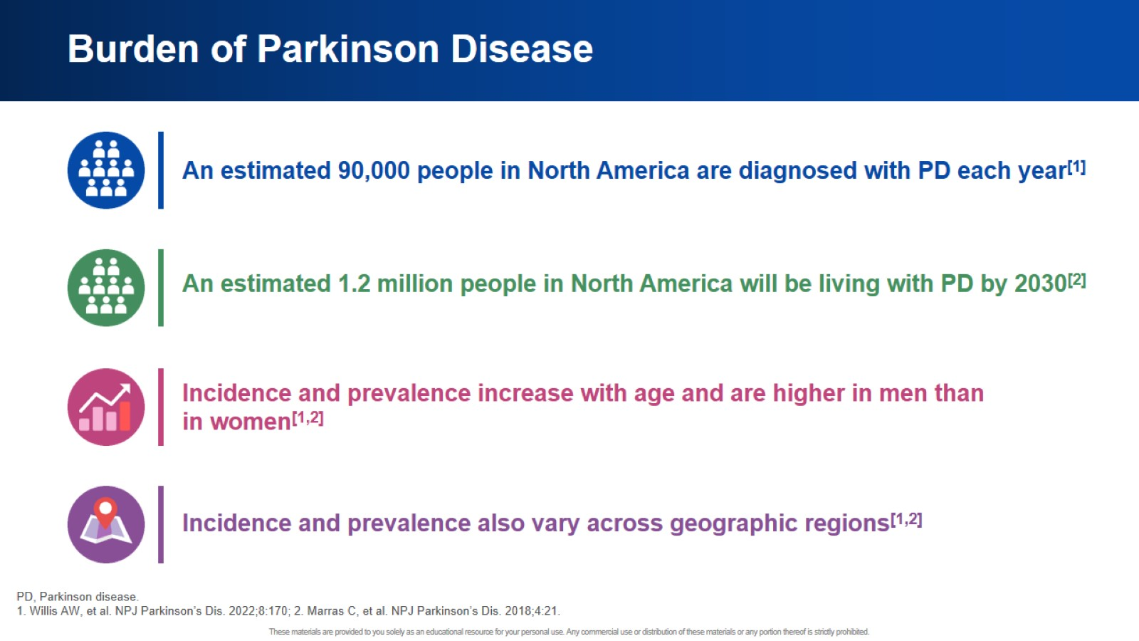
Burden of Parkinson Disease

Slide 6
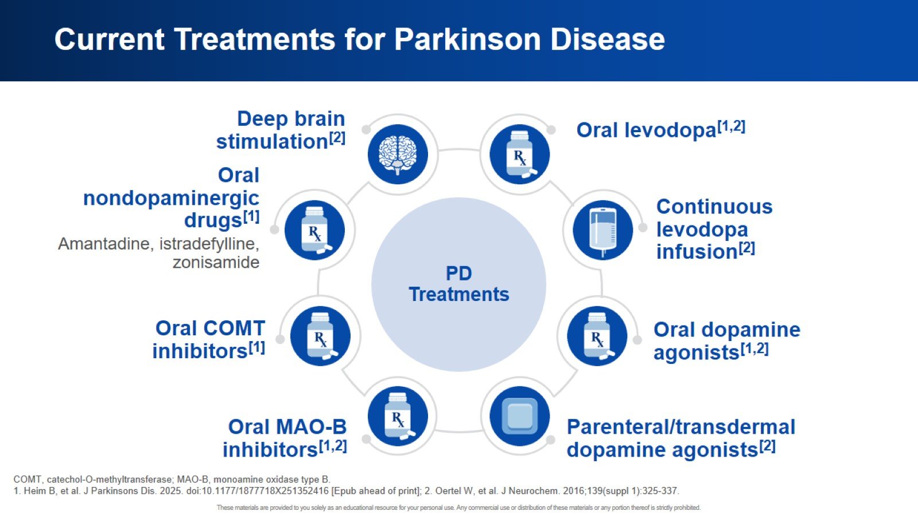
Current Treatments for Parkinson Disease

Slide 7
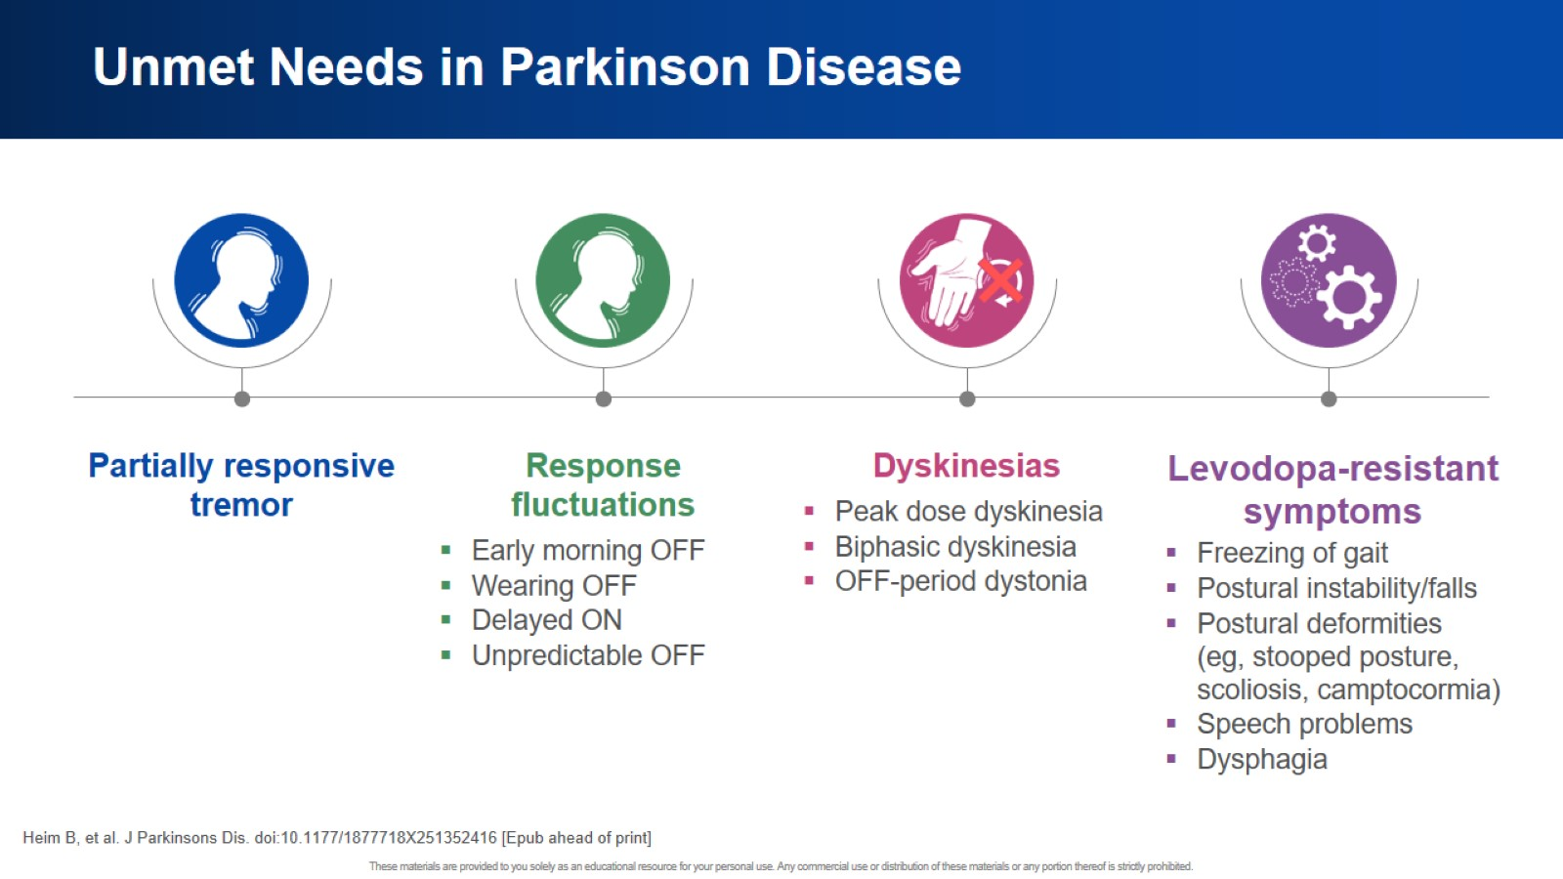
Unmet Needs in Parkinson Disease

Slide 8
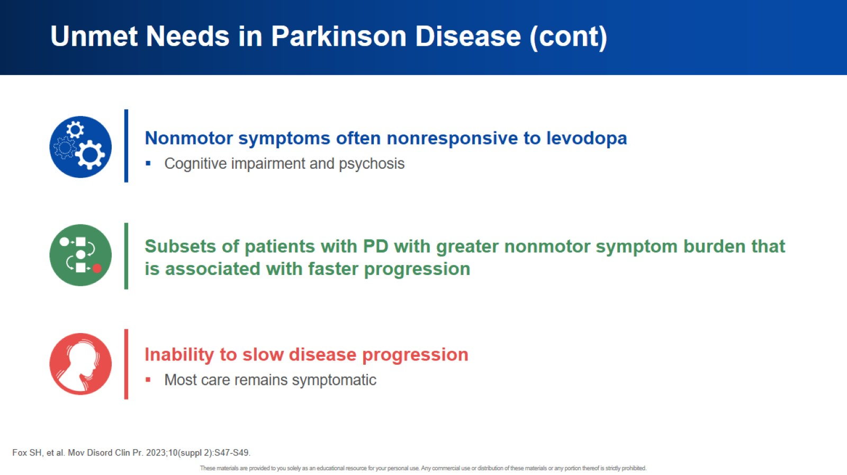
Unmet Needs in Parkinson Disease (cont)

Slide 9
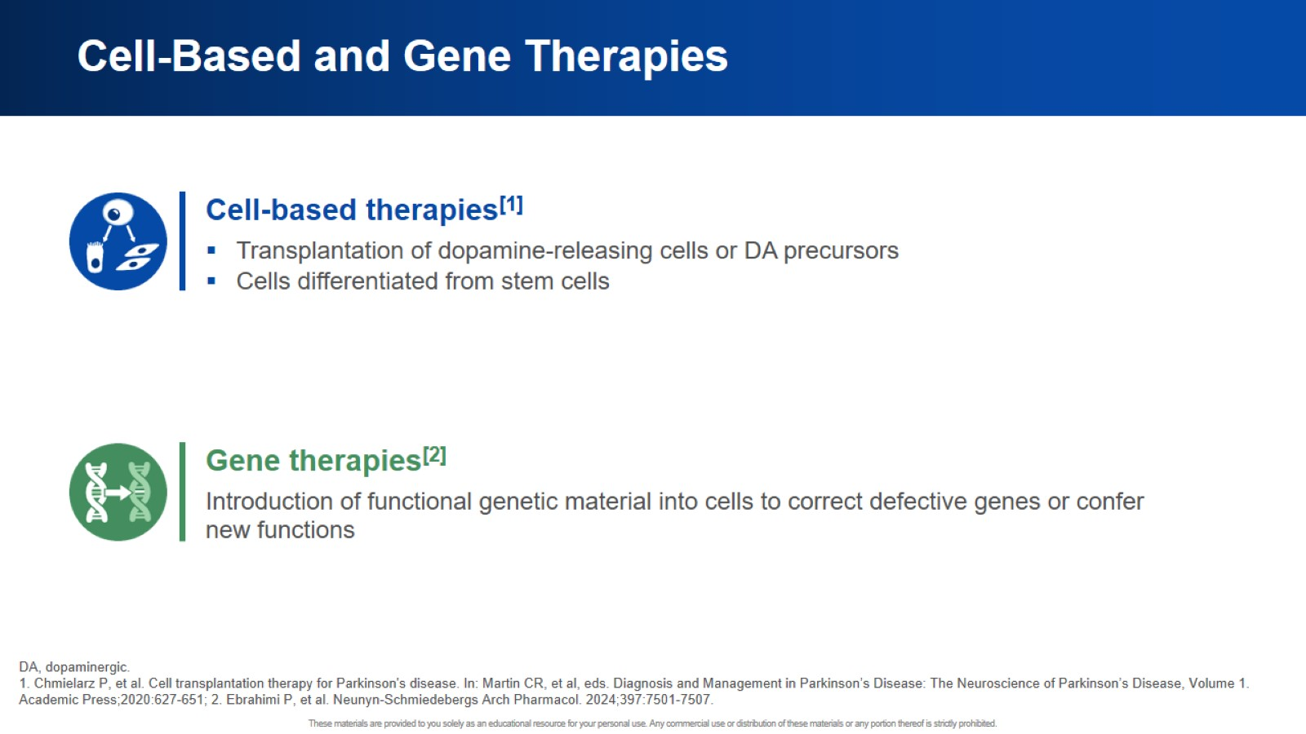
Cell-Based and Gene Therapies

Slide 10
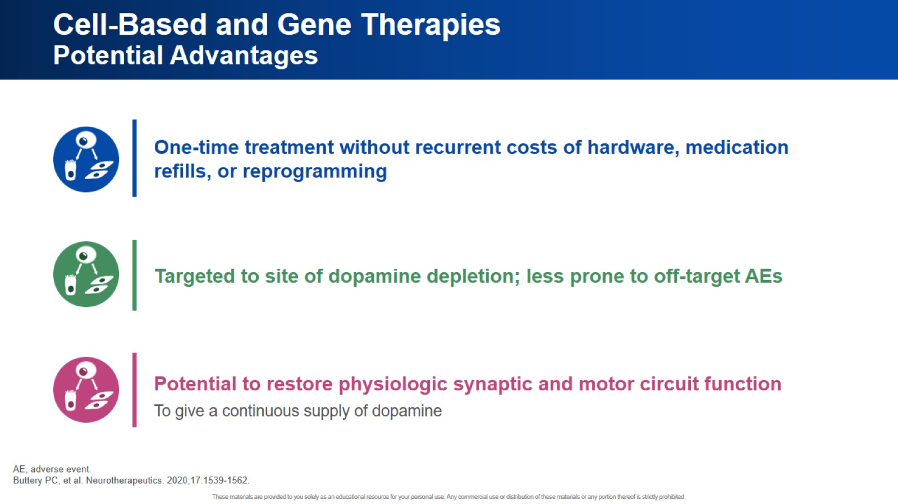
Cell-Based and Gene Therapies Potential Advantages

Slide 11

Cell Replacement Therapy

Slide 12
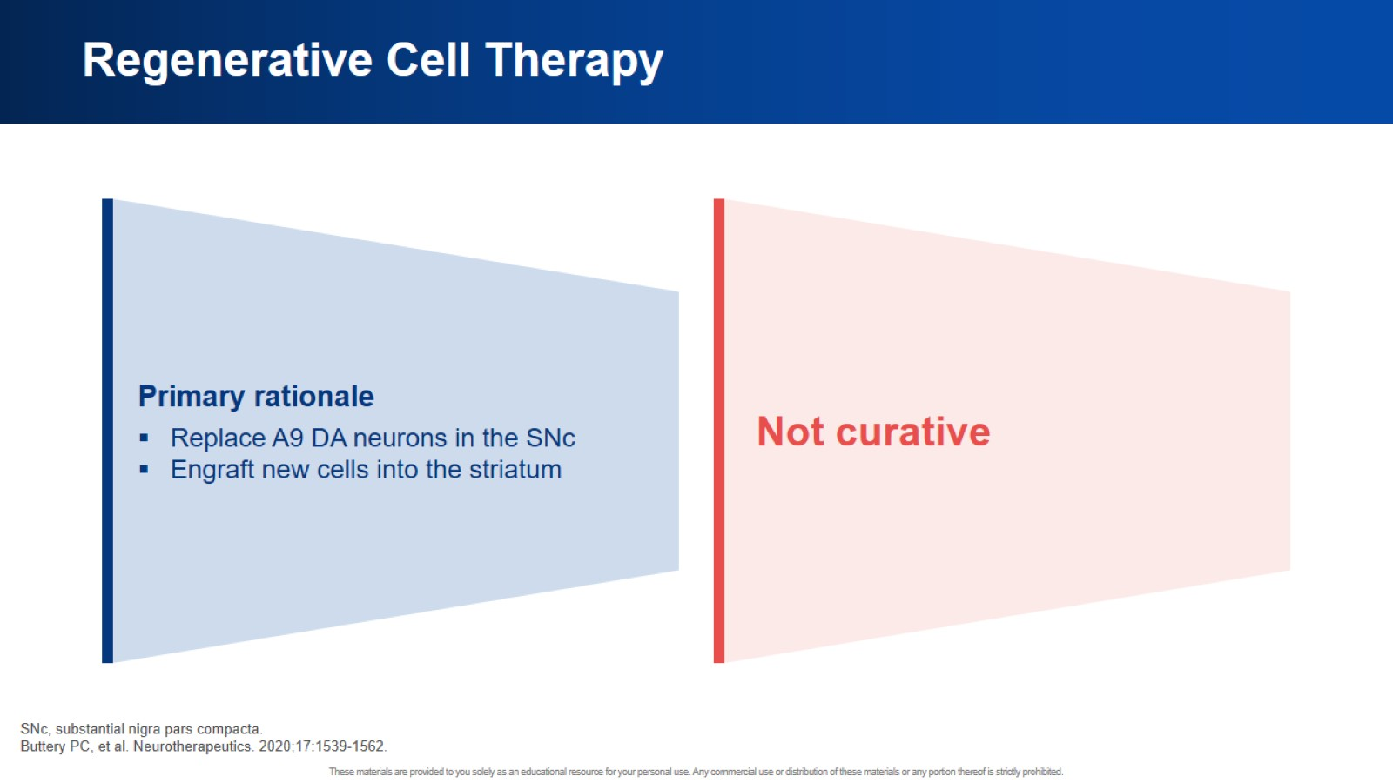
Regenerative Cell Therapy

Slide 13
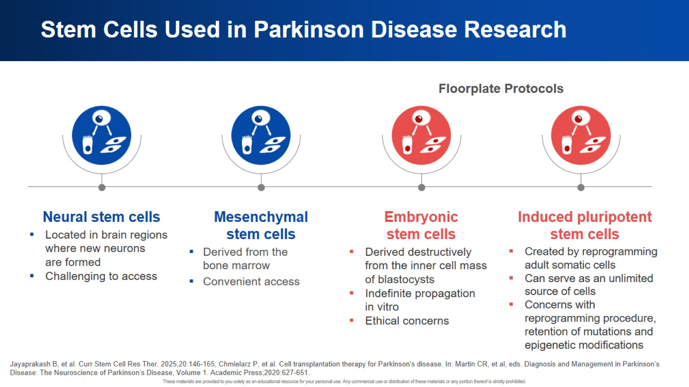
Stem Cells Used in Parkinson Disease Research

Slide 14
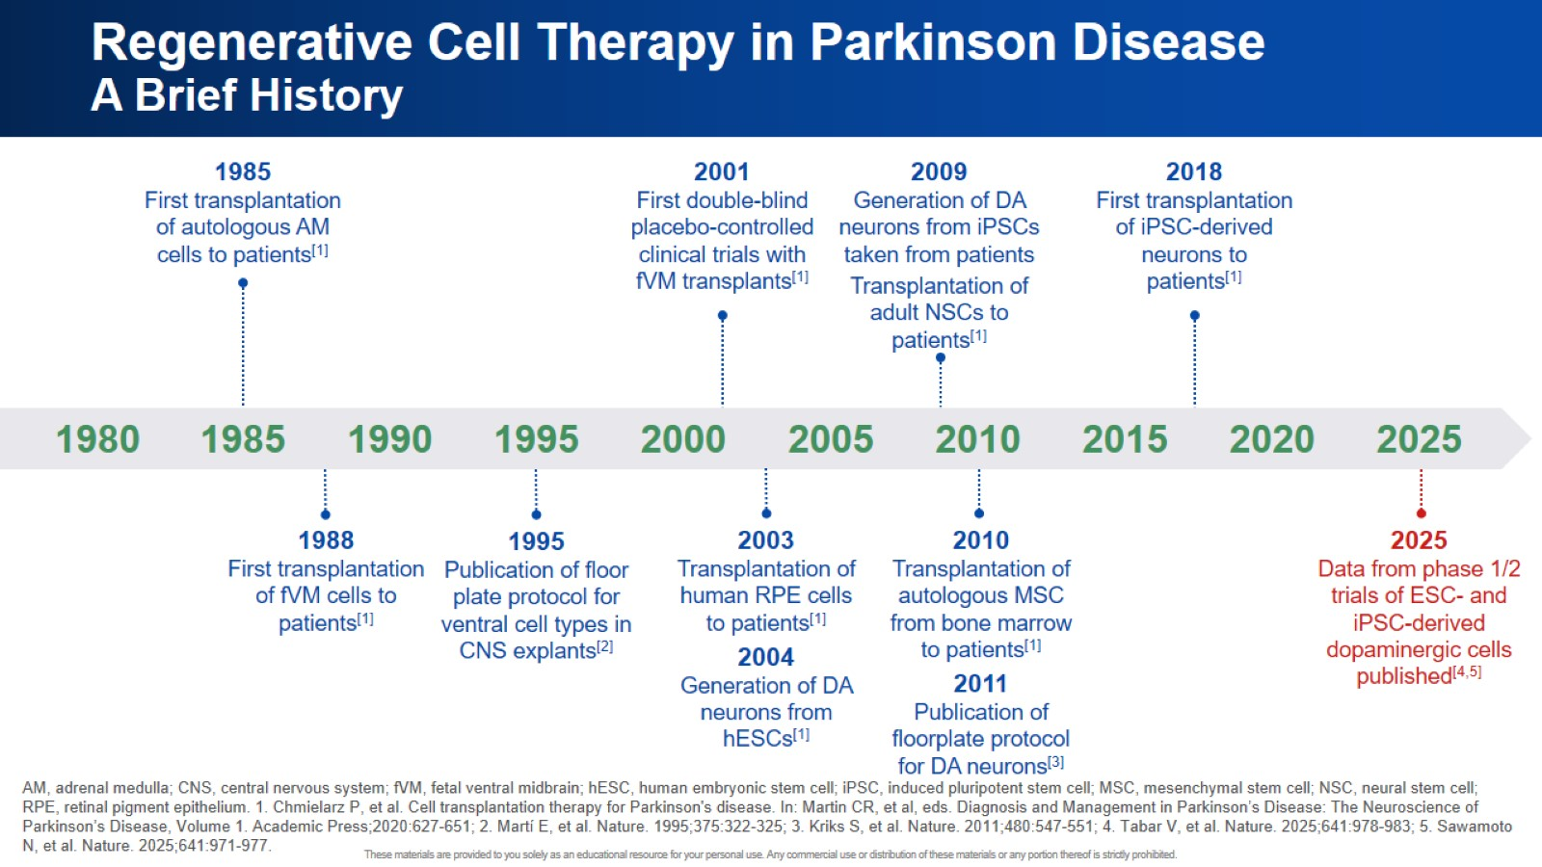
Regenerative Cell Therapy in Parkinson Disease A Brief History

Slide 15
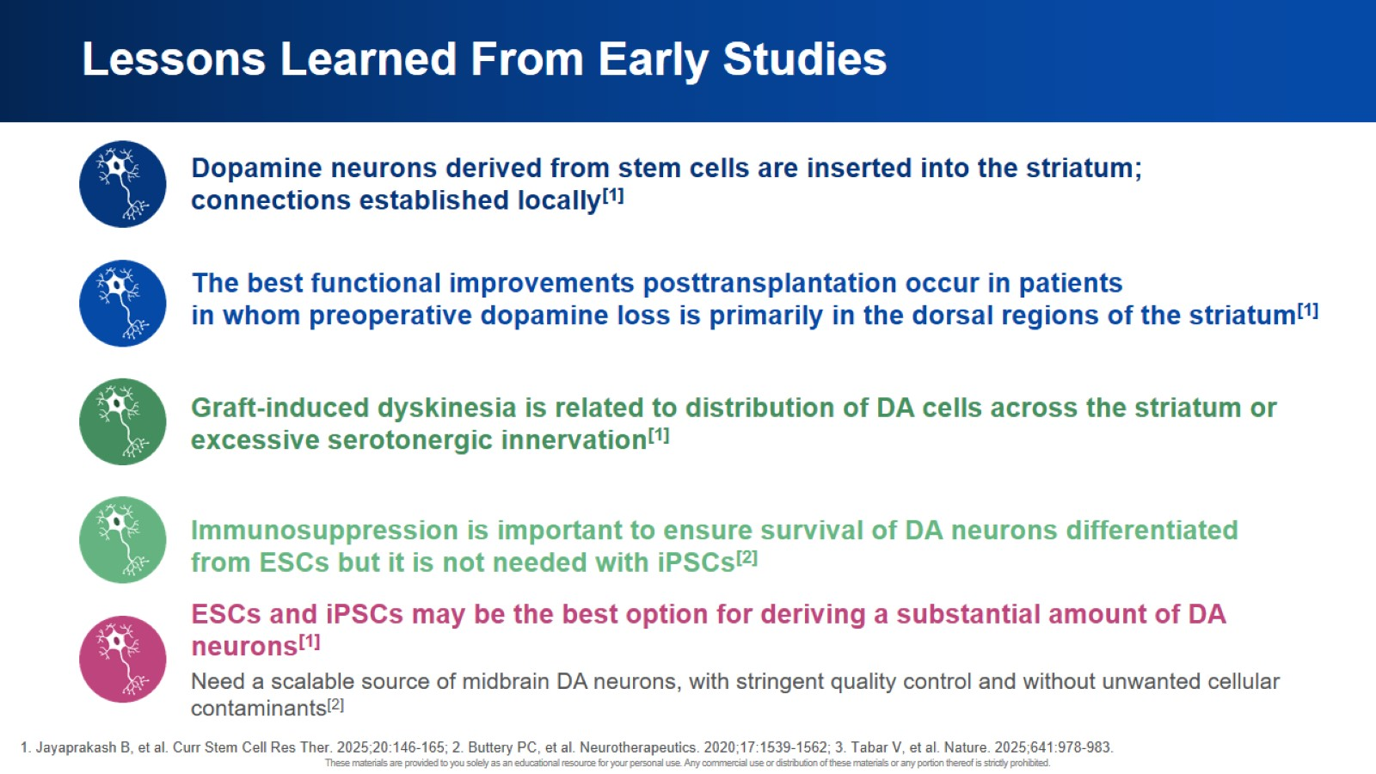
Lessons Learned From Early Studies

Slide 16
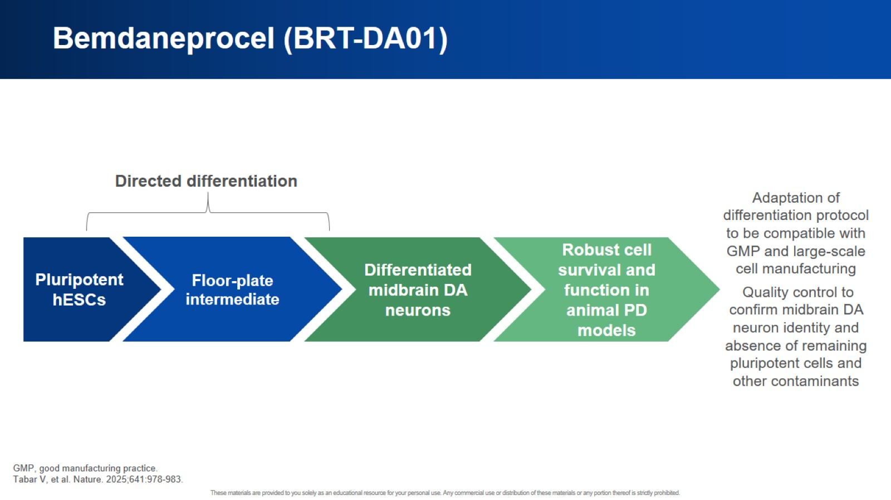
Bemdaneprocel (BRT-DA01)

Slide 17
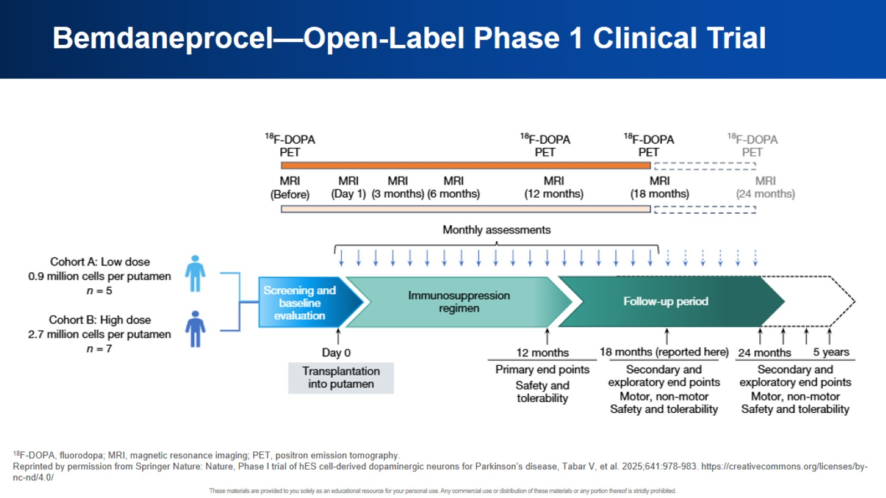
Bemdaneprocel—Open-Label Phase 1 Clinical Trial

Slide 18
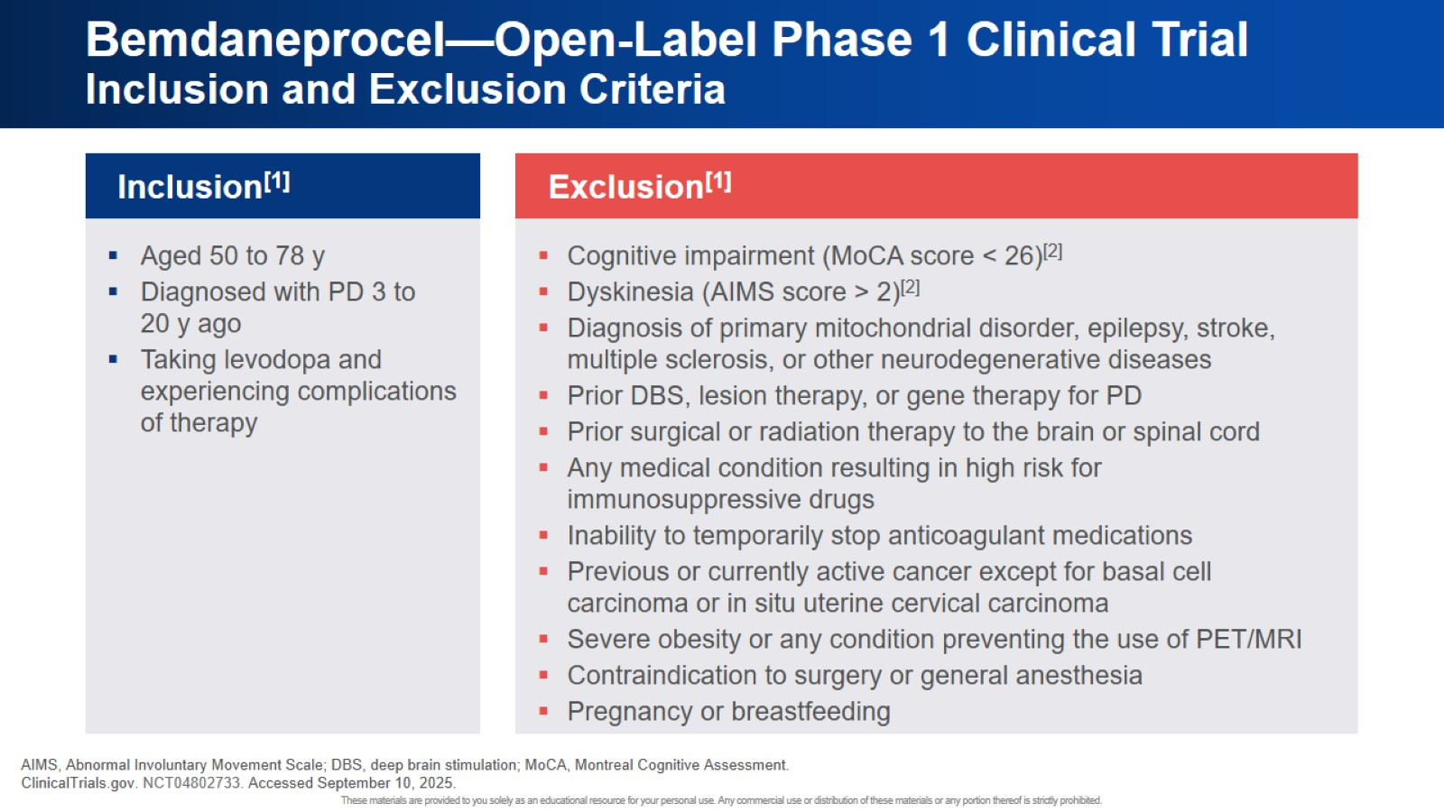
Bemdaneprocel—Open-Label Phase 1 Clinical Trial Inclusion and Exclusion Criteria

Slide 19
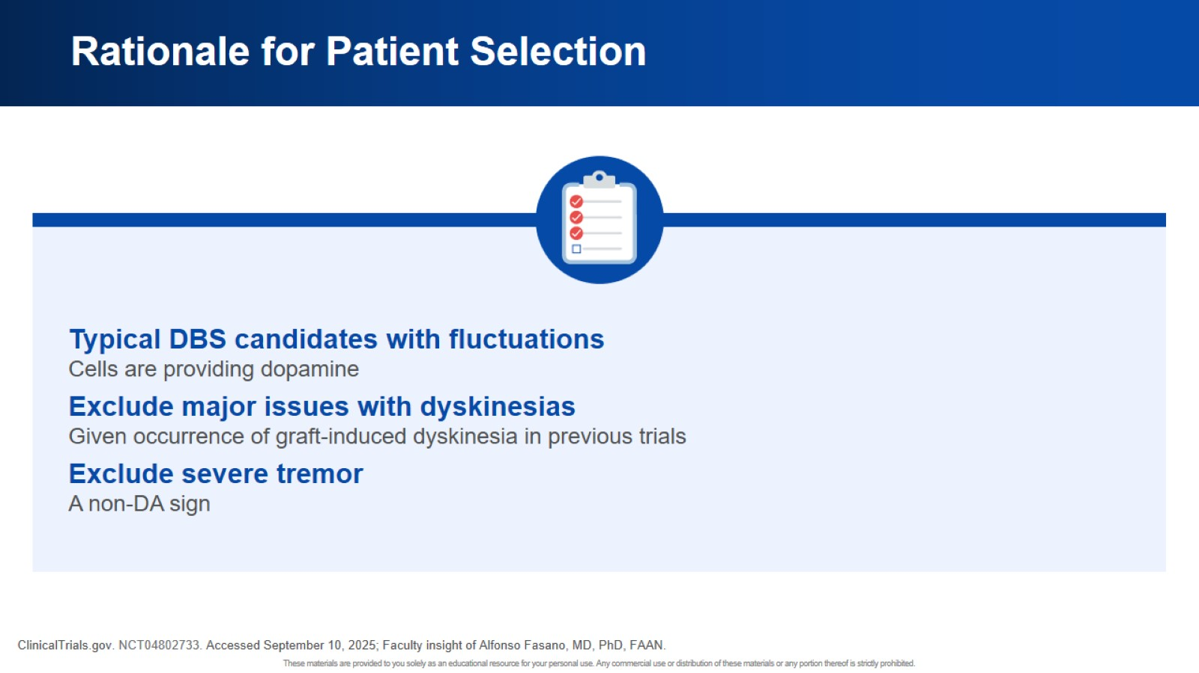
Rationale for Patient Selection

Slide 20
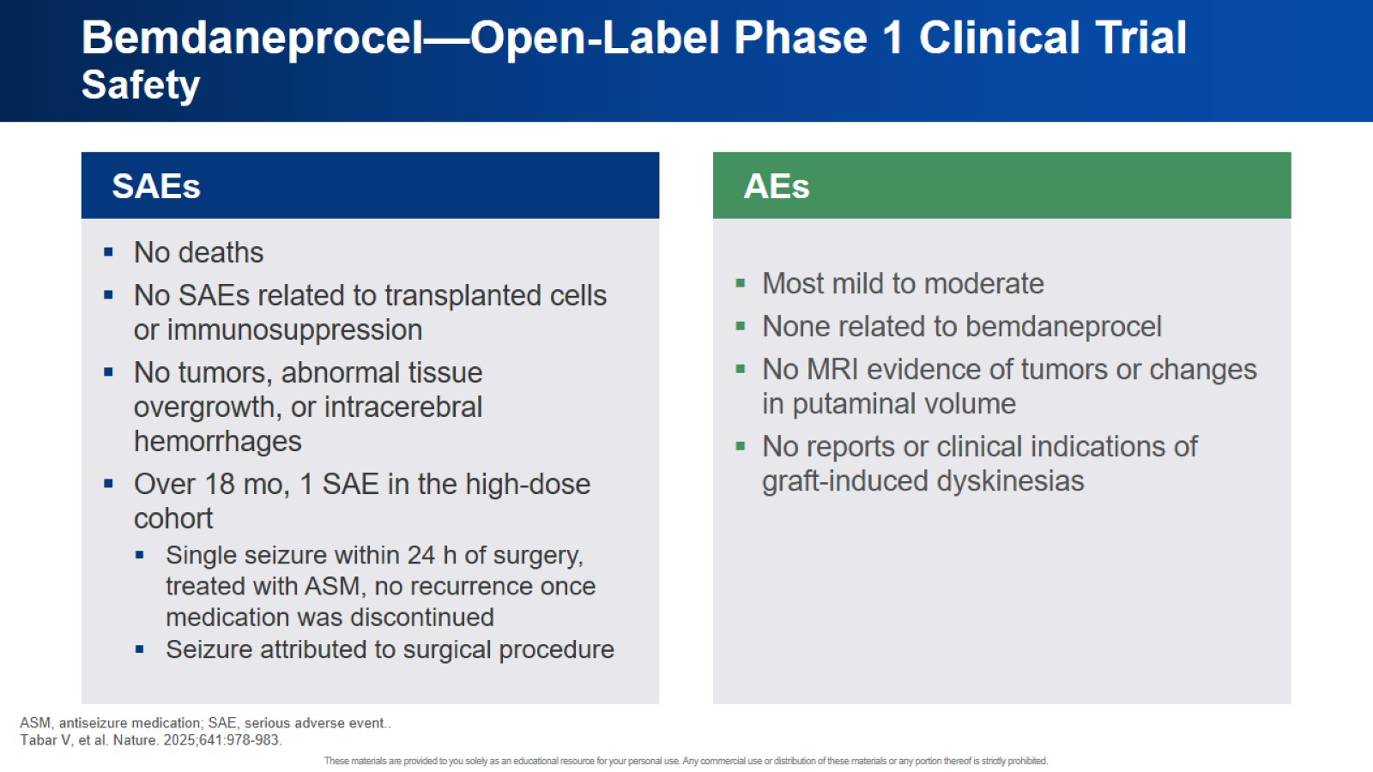
Bemdaneprocel—Open-Label Phase 1 Clinical Trial Safety

Slide 21
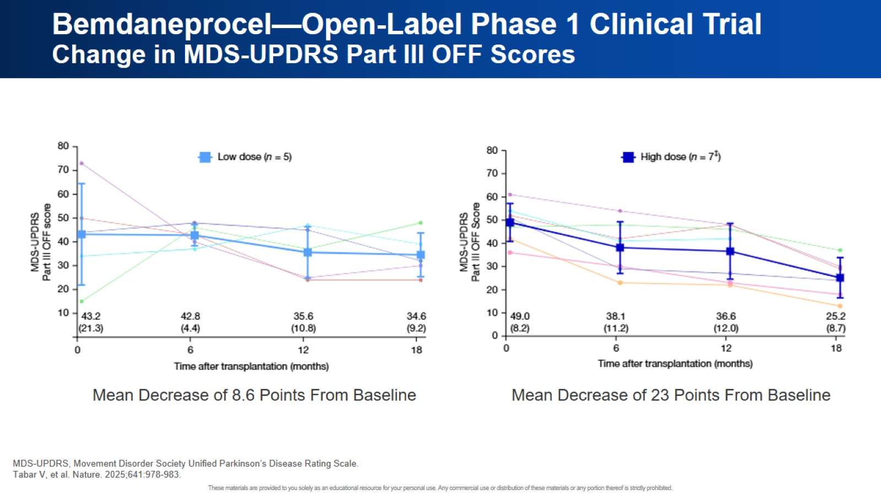
Bemdaneprocel—Open-Label Phase 1 Clinical Trial Change in MDS-UPDRS Part III OFF Scores

Slide 22
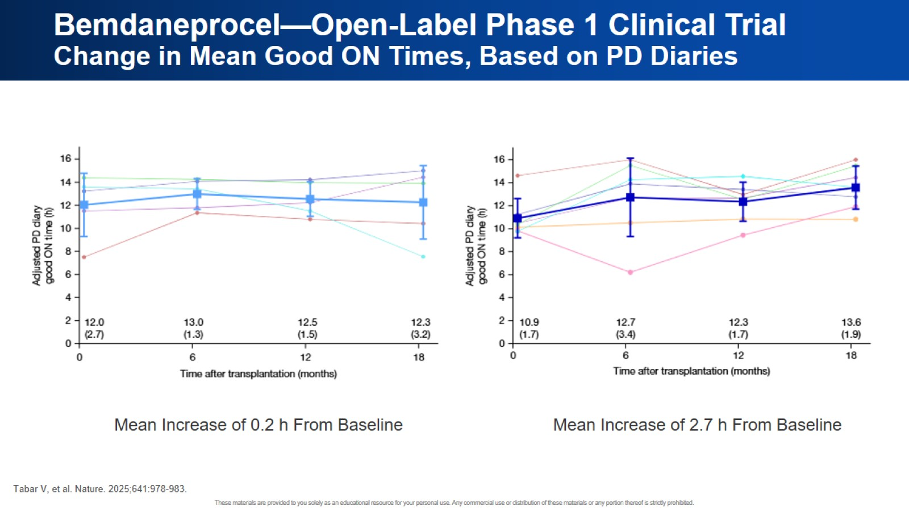
Bemdaneprocel—Open-Label Phase 1 Clinical Trial Change in Mean Good ON Times, Based on PD Diaries

Slide 23
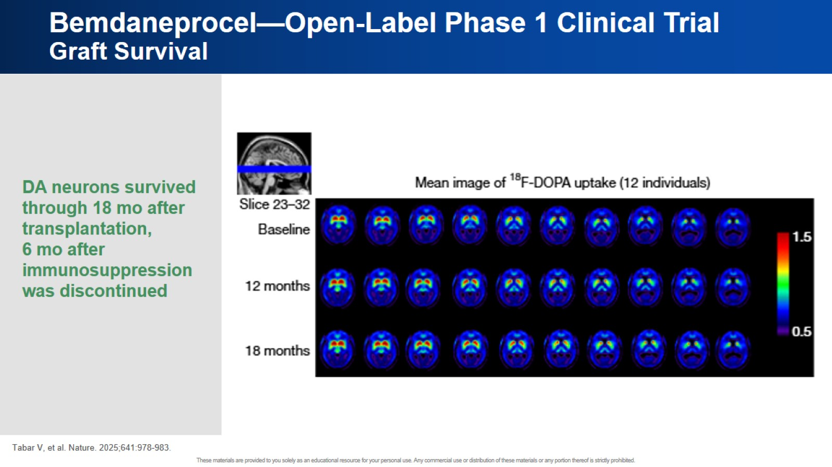
Bemdaneprocel—Open-Label Phase 1 Clinical Trial Graft Survival

Slide 24
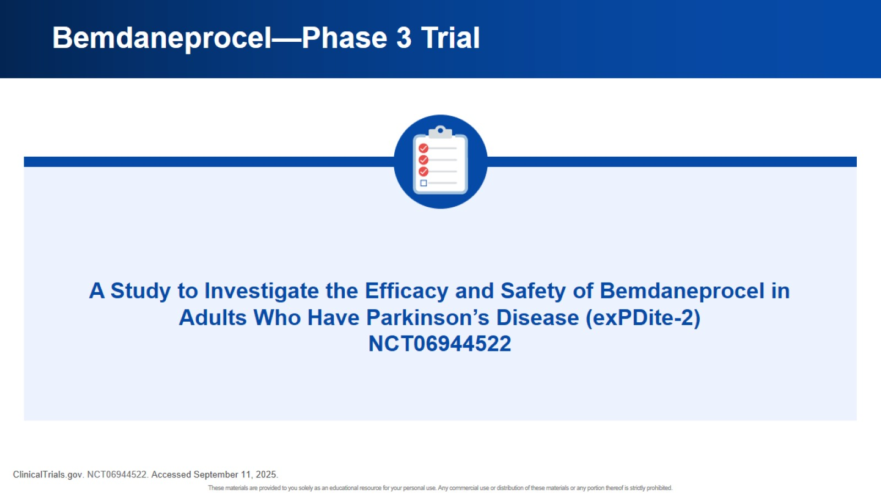
Bemdaneprocel—Phase 3 Trial

Slide 25
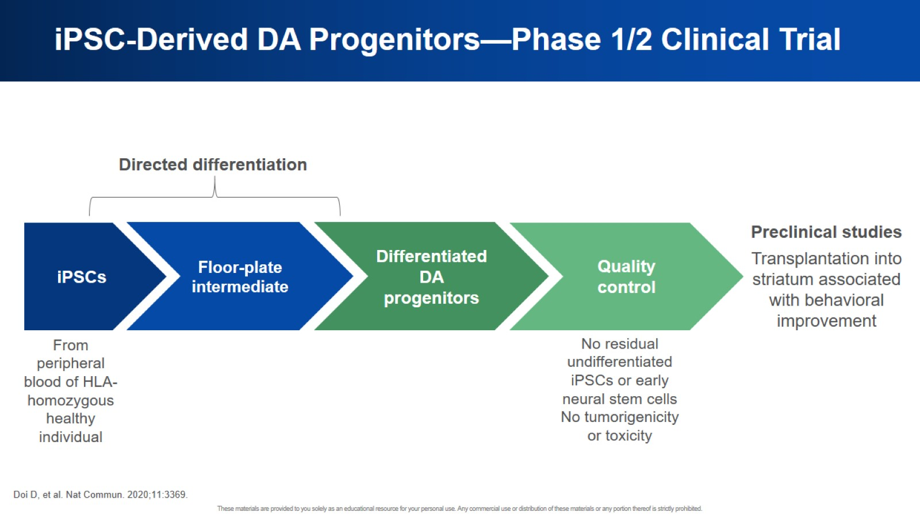
iPSC-Derived DA Progenitors—Phase 1/2 Clinical Trial

Slide 26
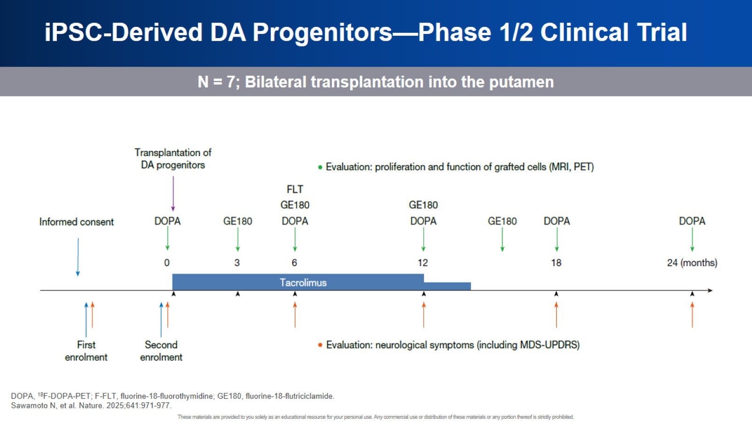
iPSC-Derived DA Progenitors—Phase 1/2 Clinical Trial

Slide 27
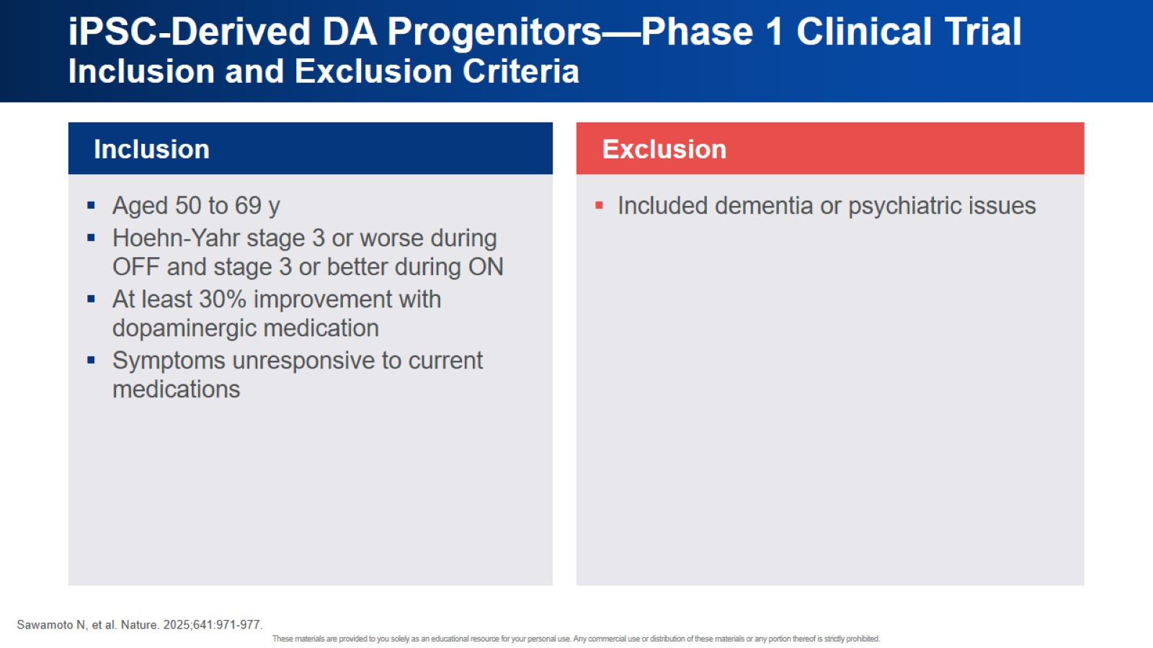
iPSC-Derived DA Progenitors—Phase 1 Clinical Trial Inclusion and Exclusion Criteria

Slide 28
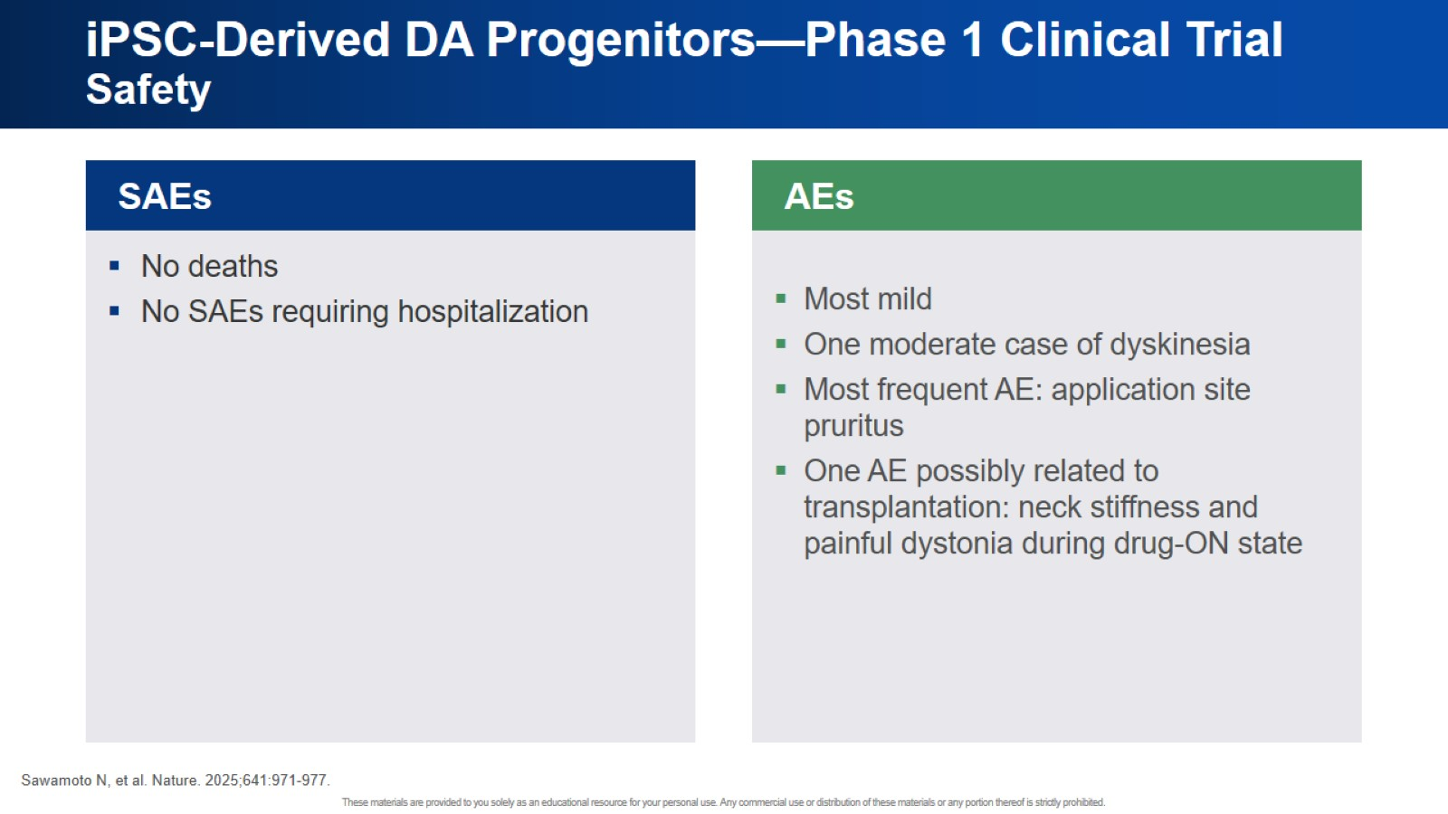
iPSC-Derived DA Progenitors—Phase 1 Clinical Trial Safety

Slide 29
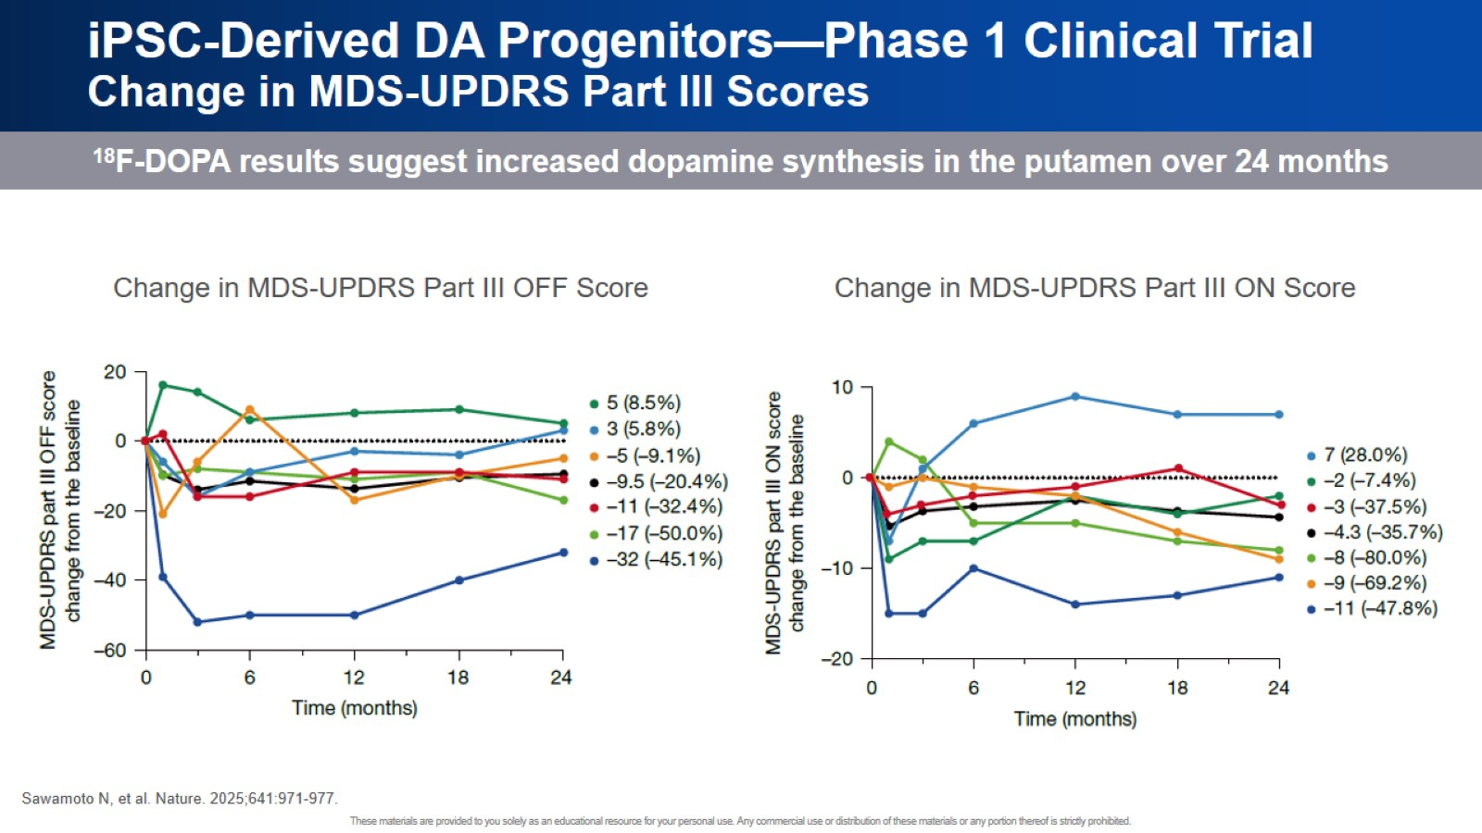
iPSC-Derived DA Progenitors—Phase 1 Clinical Trial Change in MDS-UPDRS Part III Scores

Slide 30
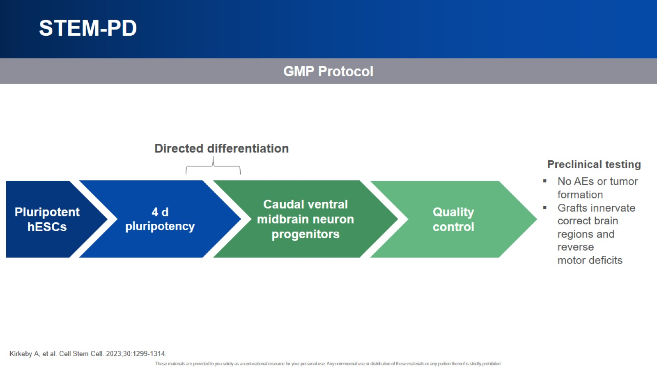
STEM-PD

Slide 31
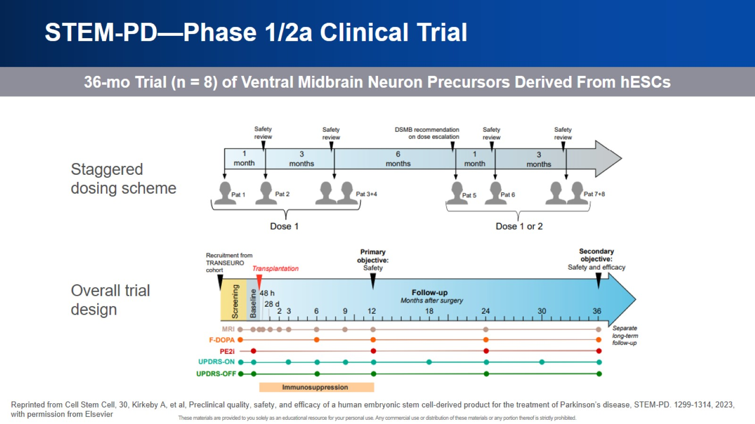
STEM-PD—Phase 1/2a Clinical Trial

Slide 32
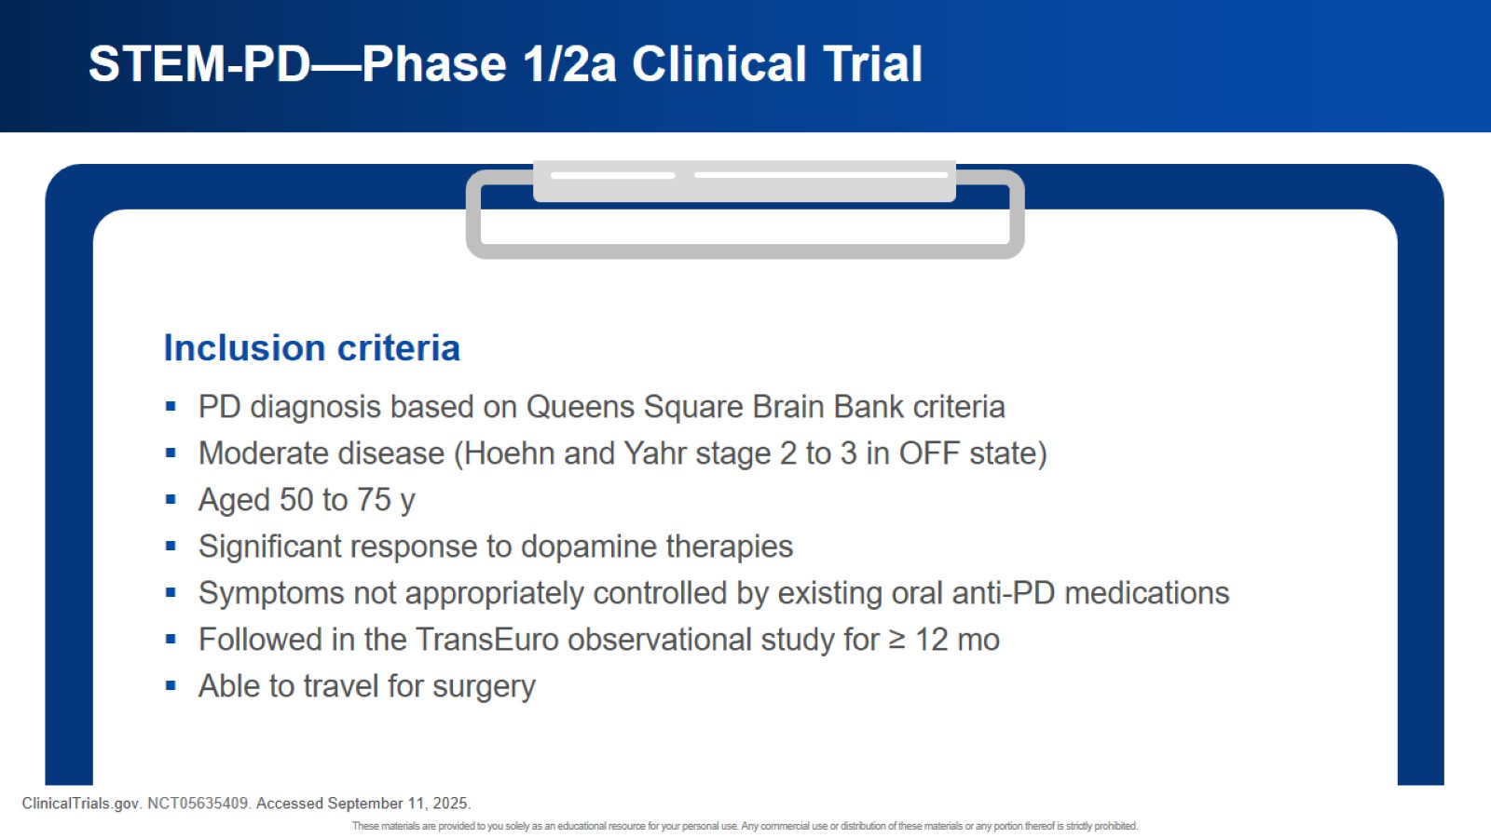
STEM-PD—Phase 1/2a Clinical Trial

Slide 33
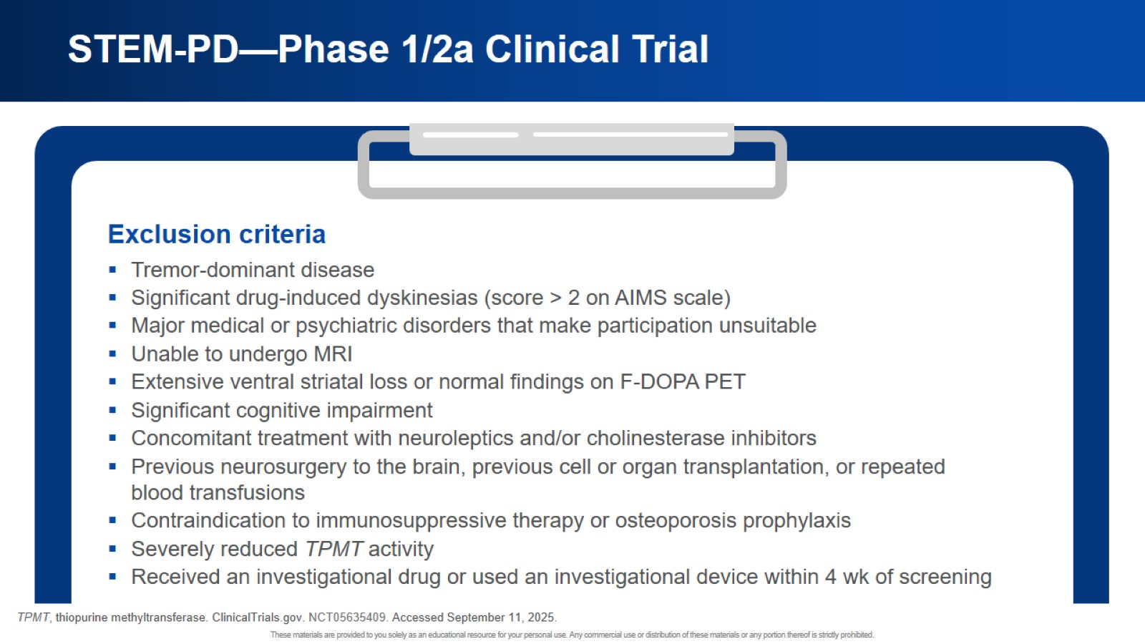
STEM-PD—Phase 1/2a Clinical Trial

Slide 34
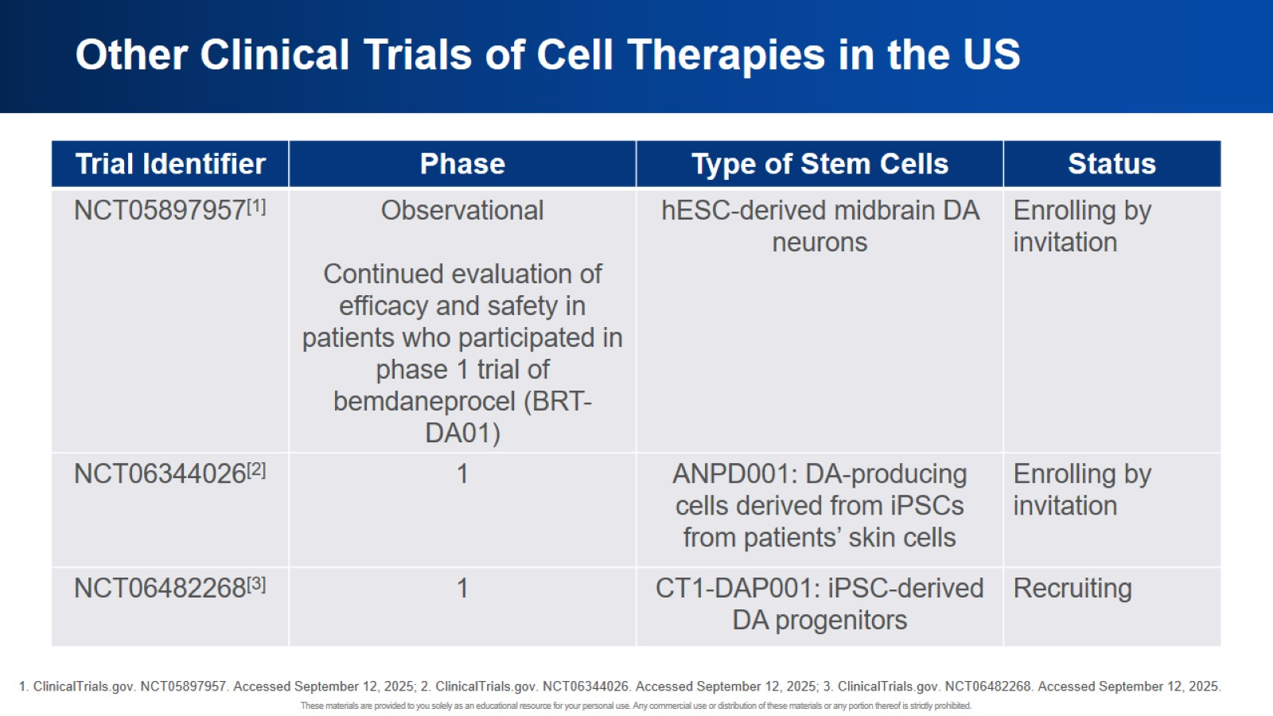
Other Clinical Trials of Cell Therapies in the US

Slide 35

Gene-Based Therapies in the Investigational Pipeline

Slide 36
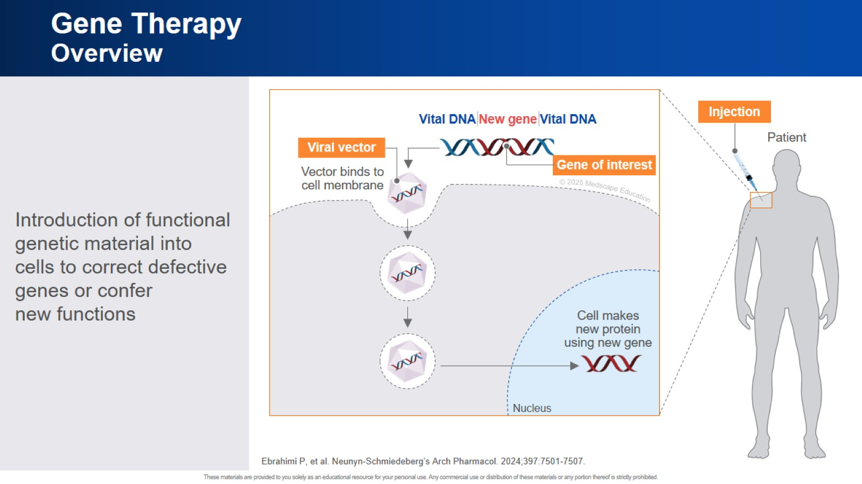
Gene Therapy Overview

Slide 37
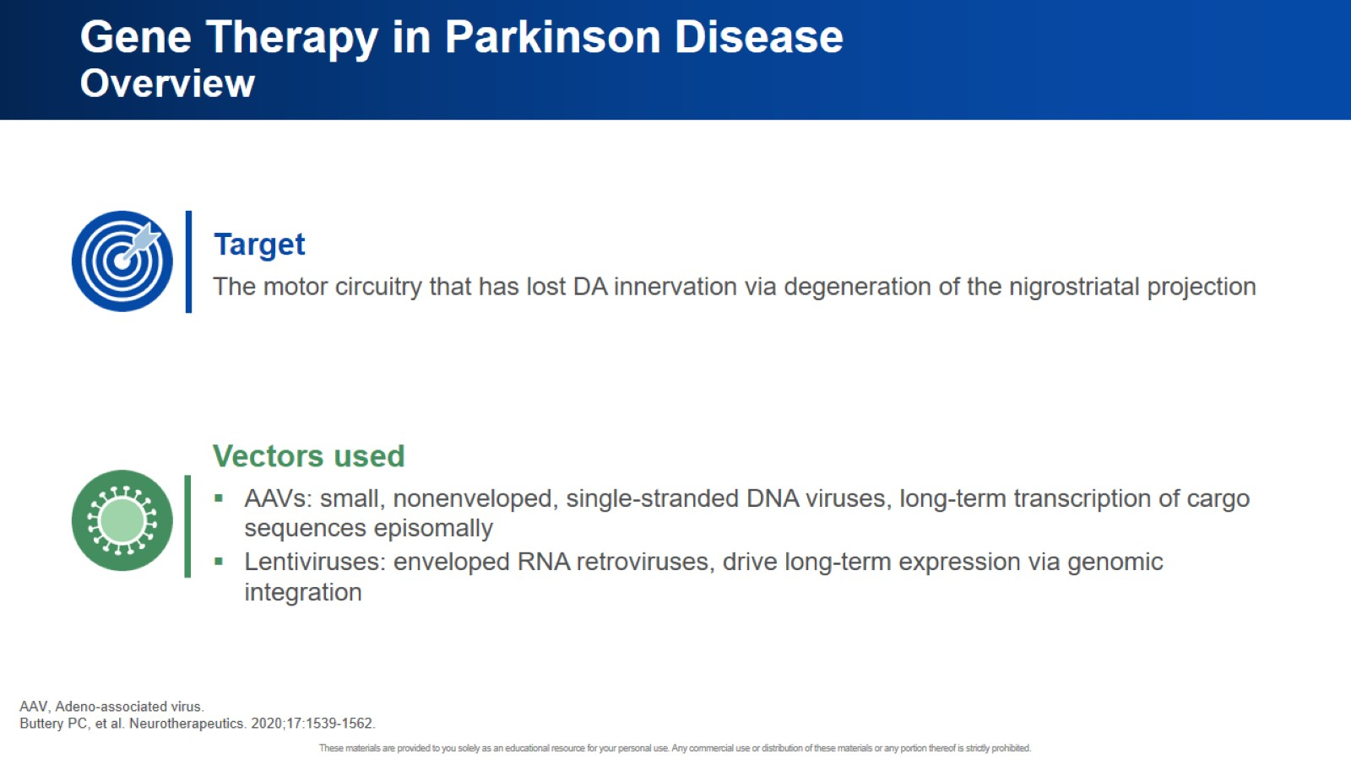
Gene Therapy in Parkinson Disease Overview

Slide 38
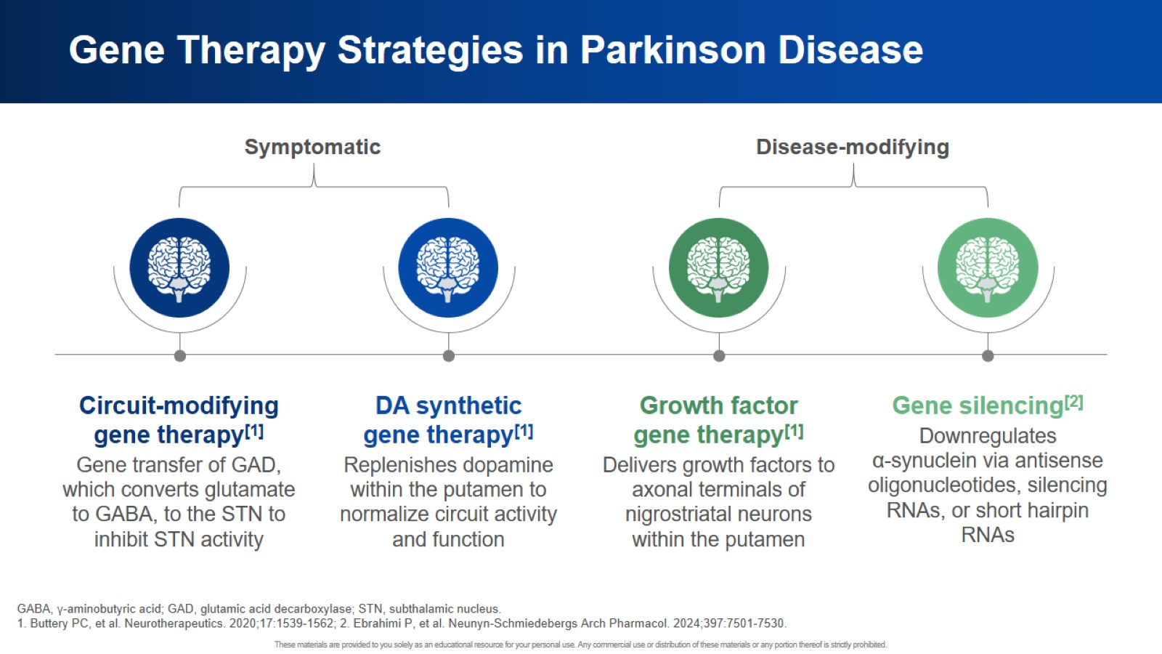
Gene Therapy Strategies in Parkinson Disease

Slide 39
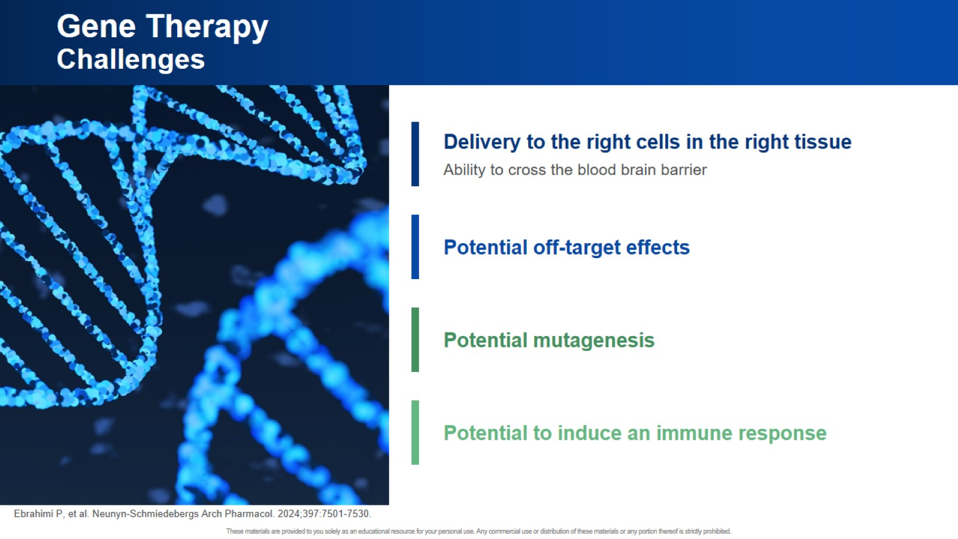
Gene Therapy Challenges

Slide 40
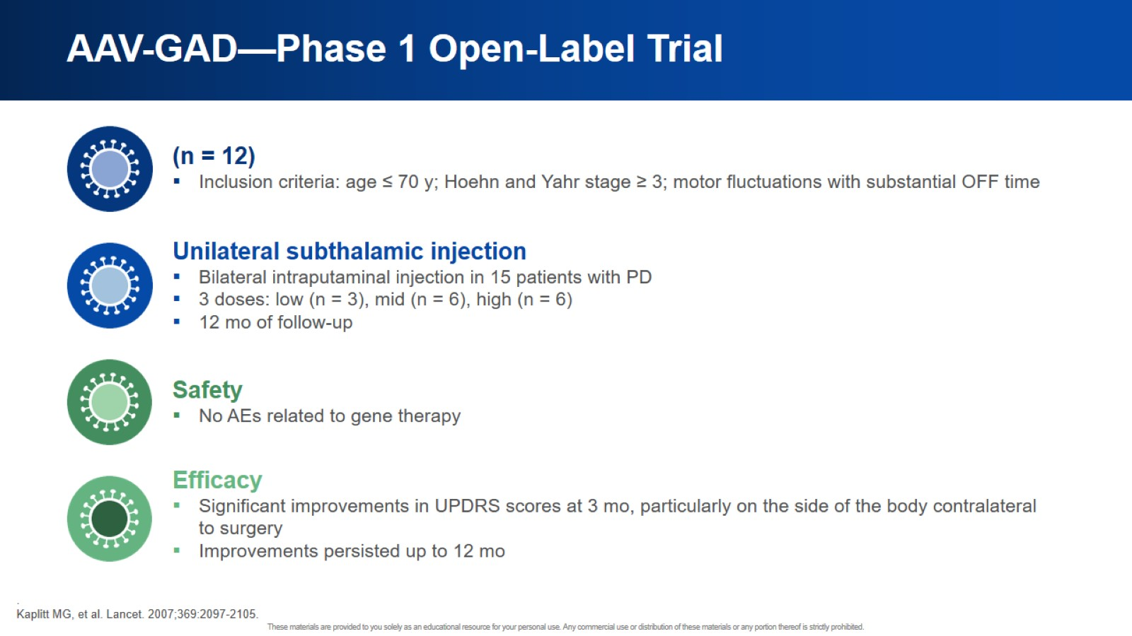
AAV-GAD—Phase 1 Open-Label Trial

Slide 41
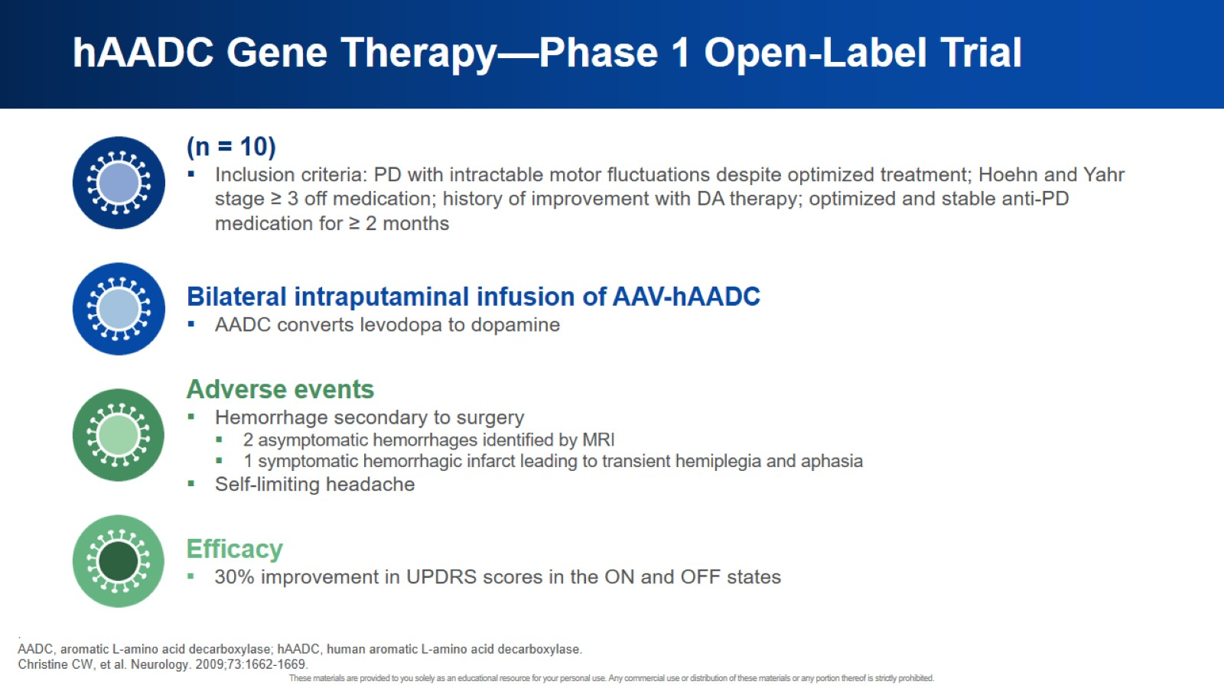
hAADC Gene Therapy—Phase 1 Open-Label Trial

Slide 42
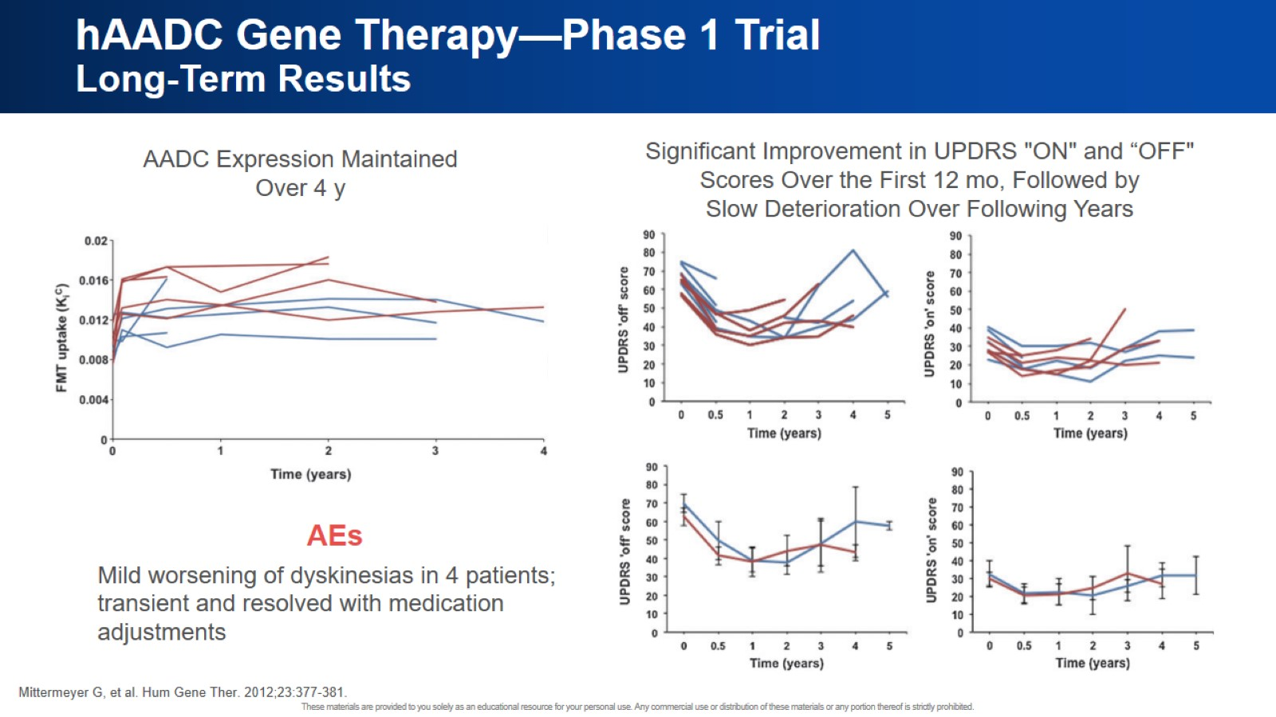
hAADC Gene Therapy—Phase 1 Trial Long-Term Results

Slide 43
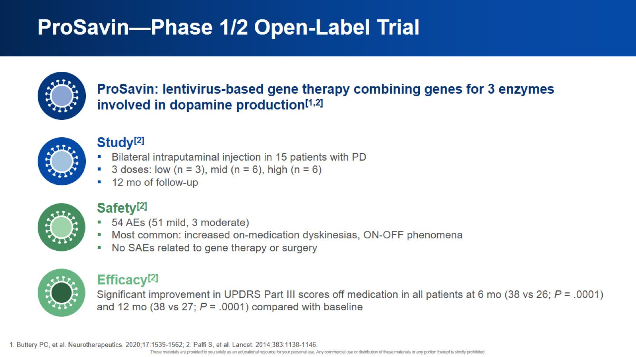
ProSavin—Phase 1/2 Open-Label Trial

Slide 44
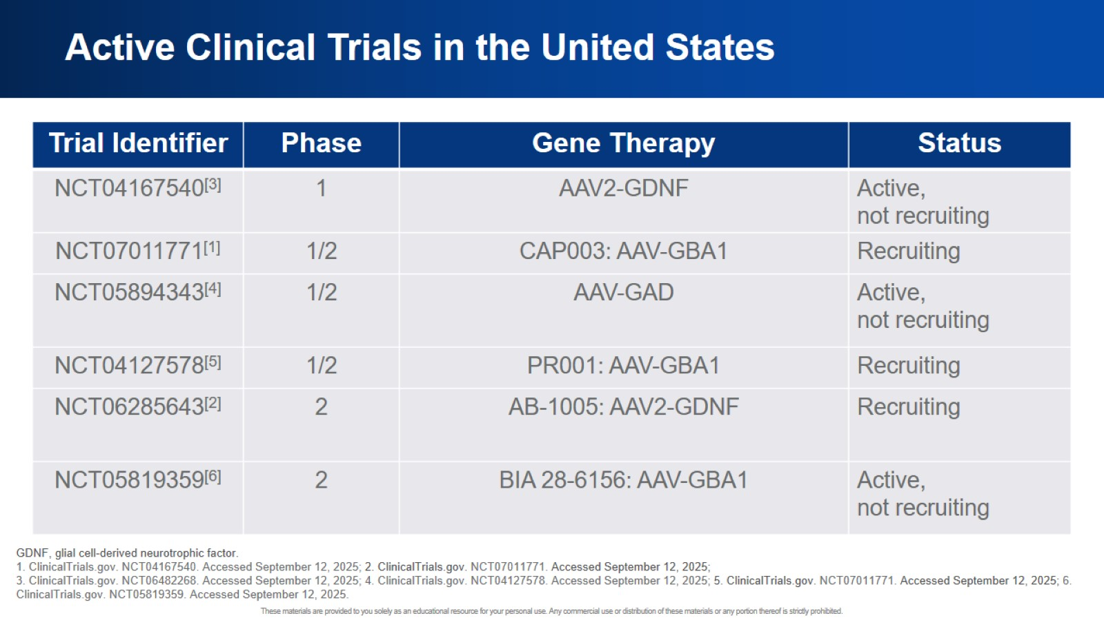
Active Clinical Trials in the United States

Slide 45

Practical Implications

Slide 46
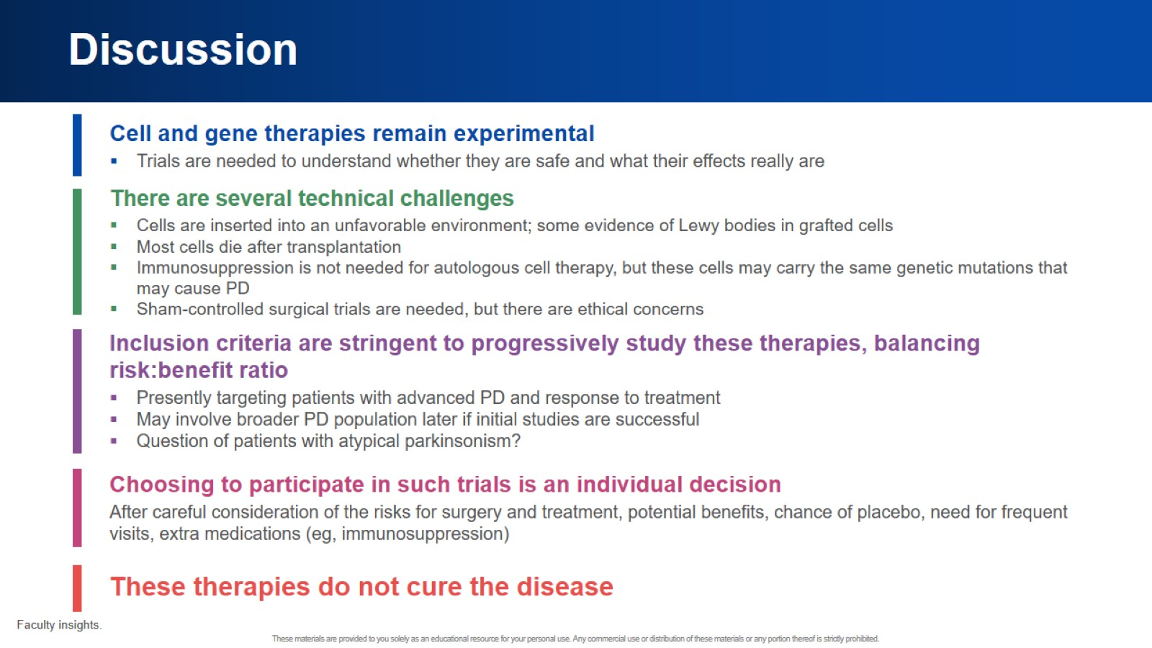
Discussion

Slide 47


