Slide 1
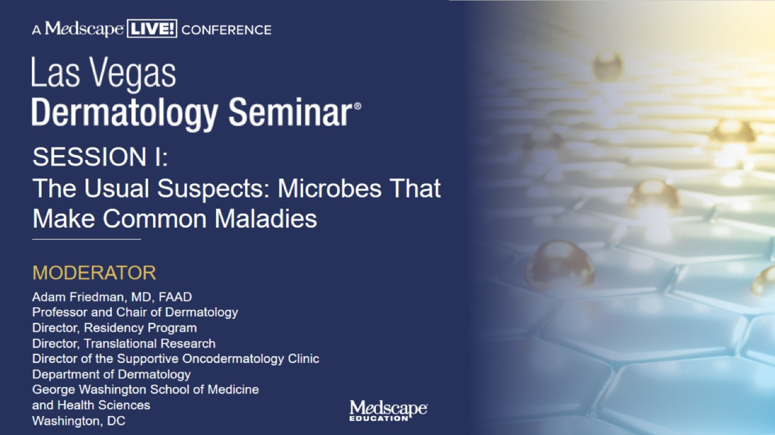

Slide 2
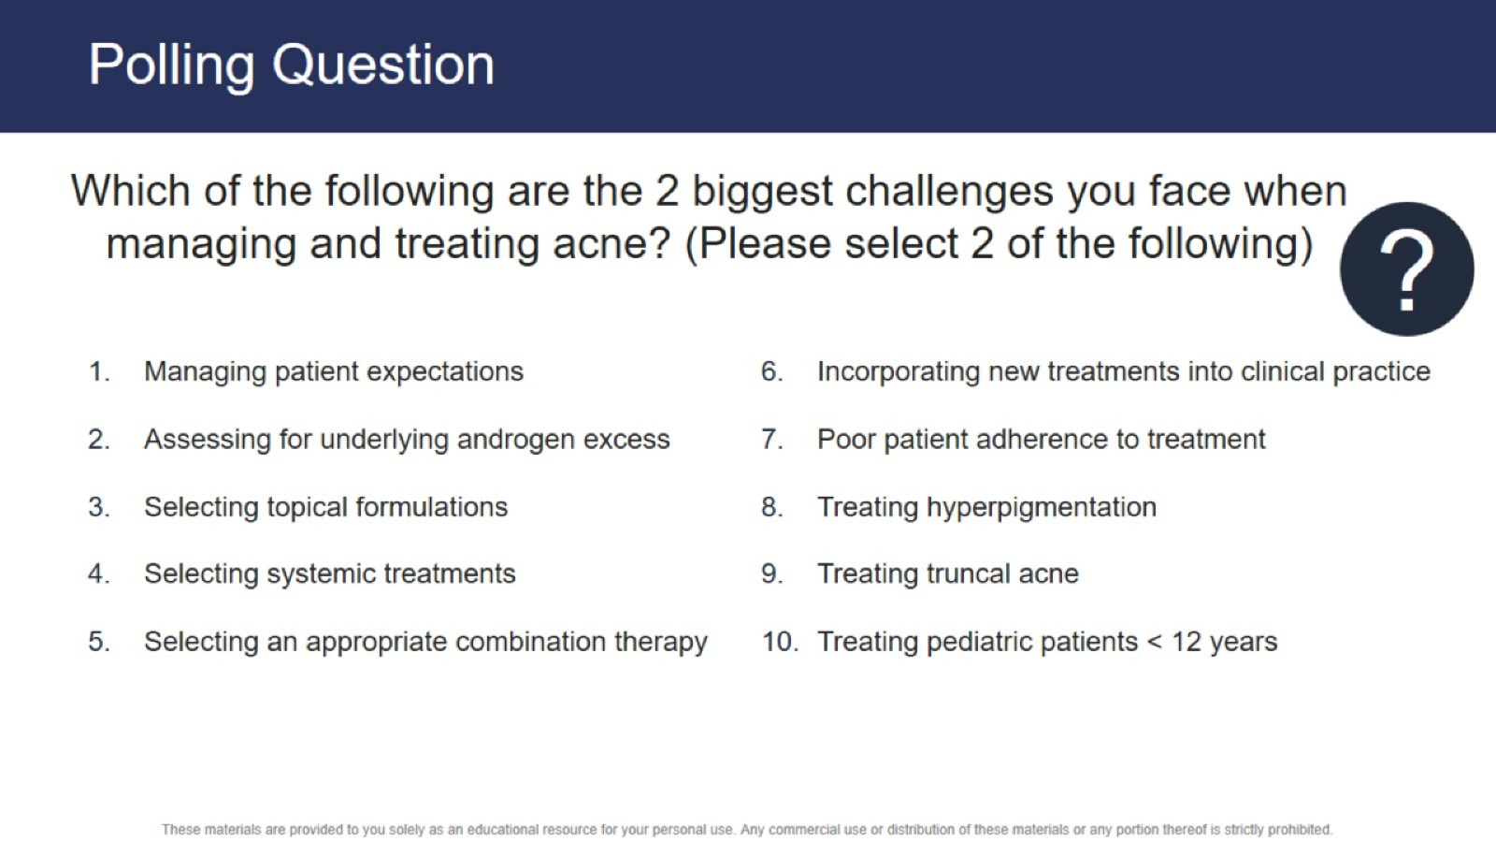
Polling Question

Slide 3
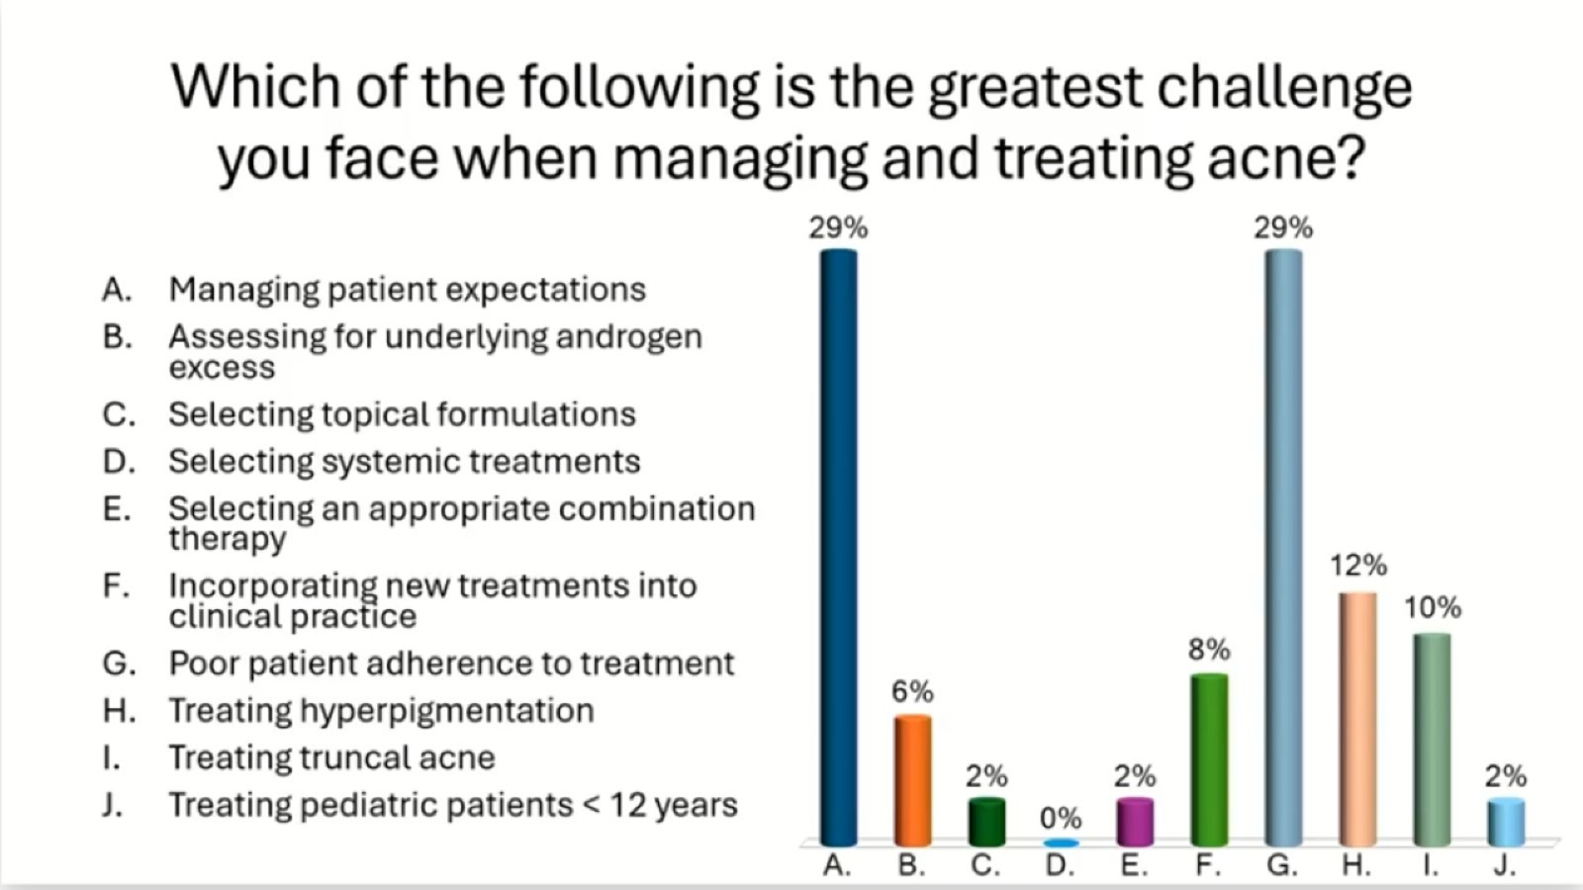

Slide 4
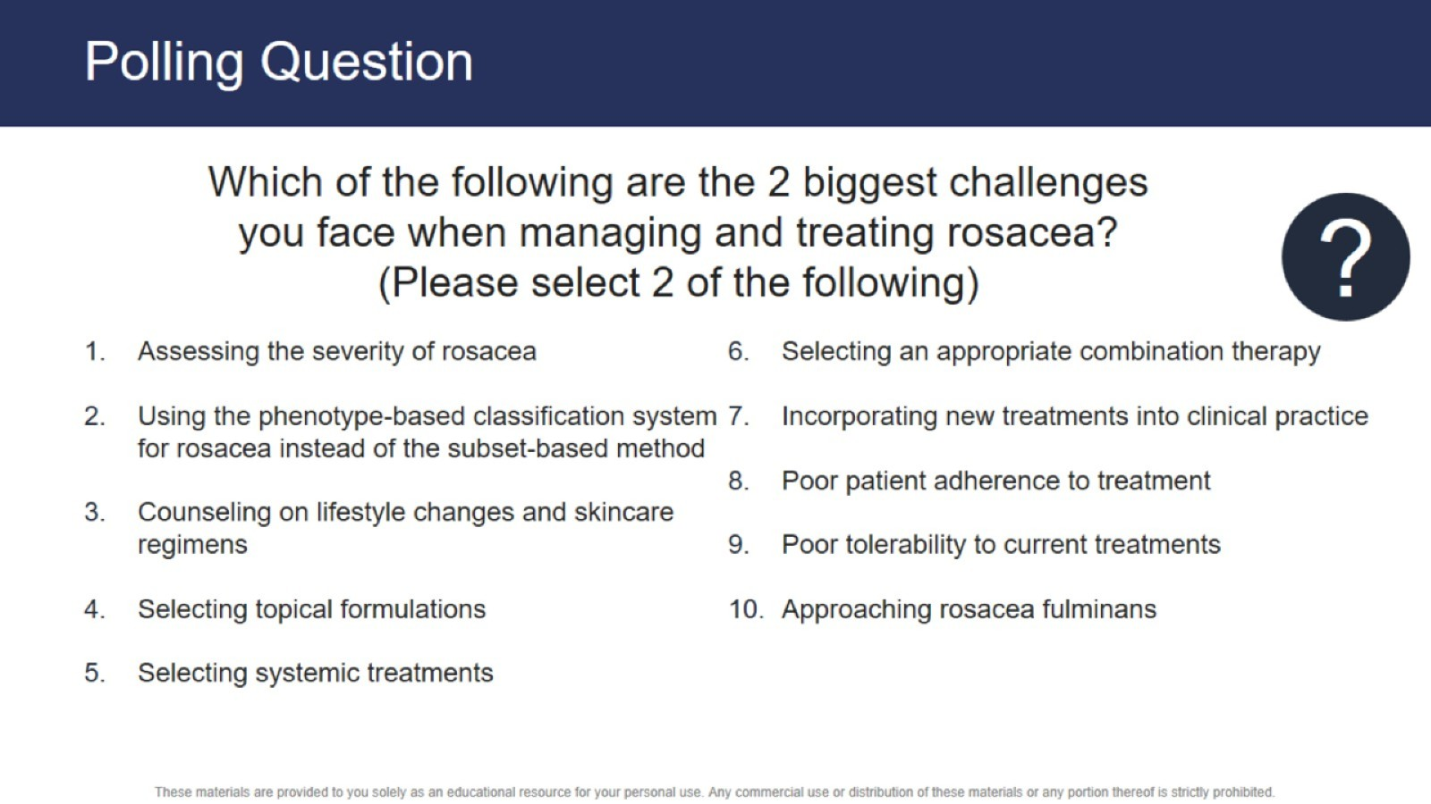
Polling Question

Slide 5
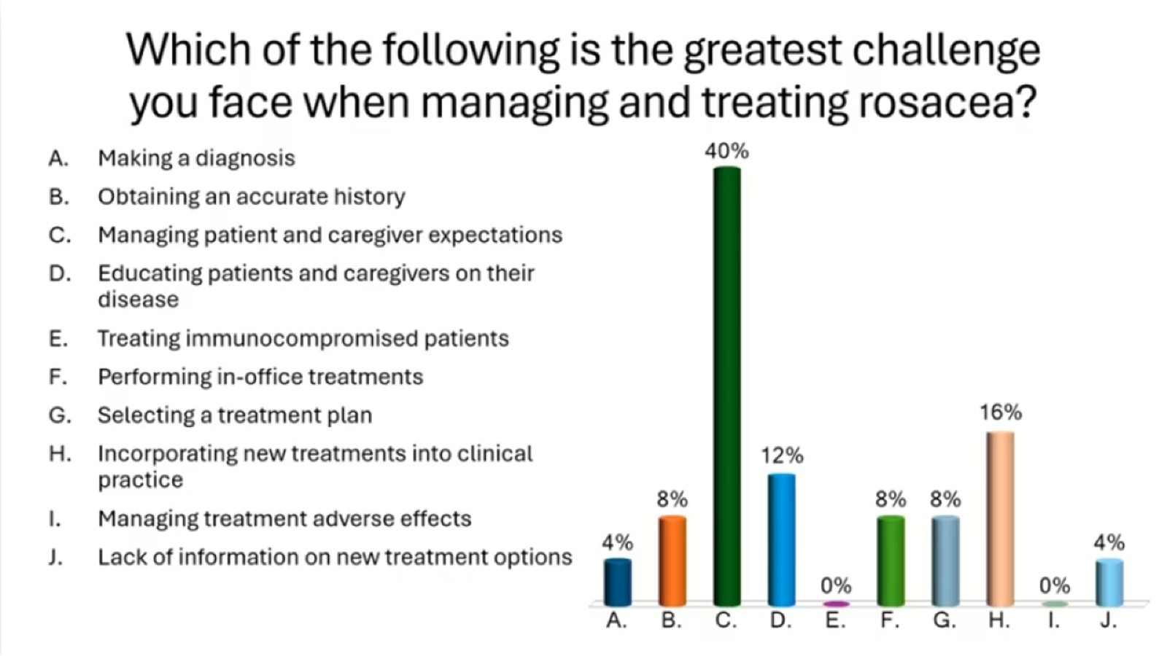

Slide 6
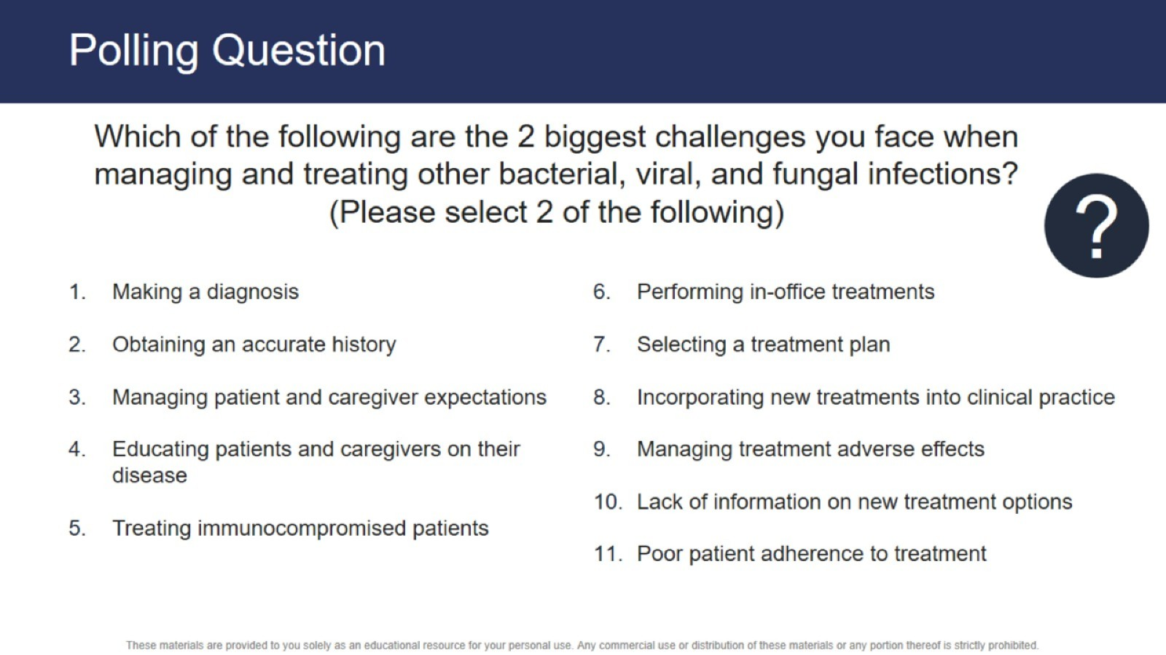
Polling Question

Slide 7
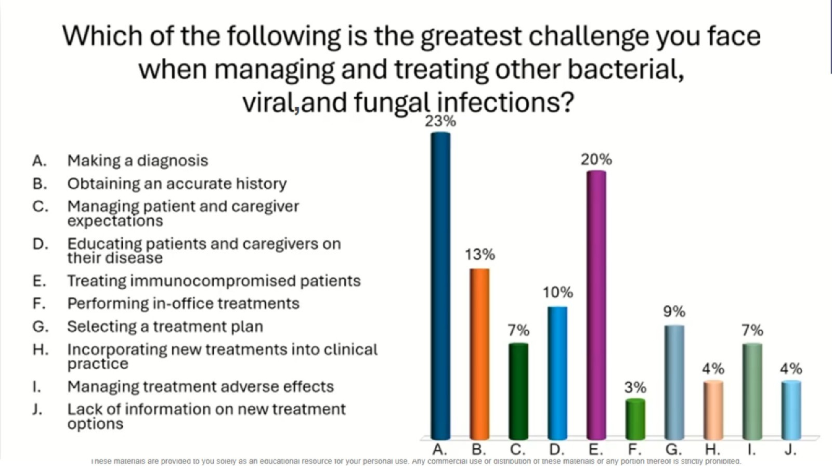

Slide 8
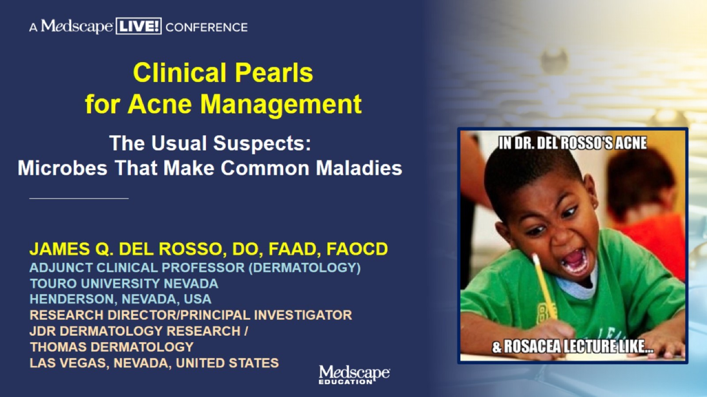
Clinical Pearls for Acne Management

Slide 9
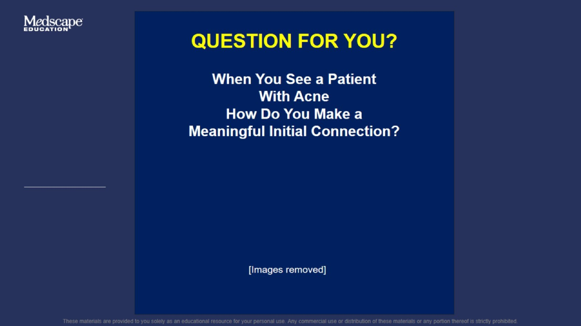

Slide 10
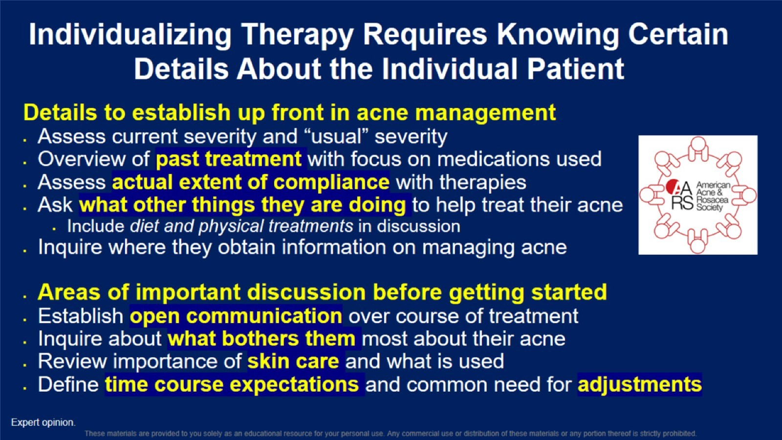
Individualizing Therapy Requires Knowing Certain Details About the Individual Patient

Slide 11
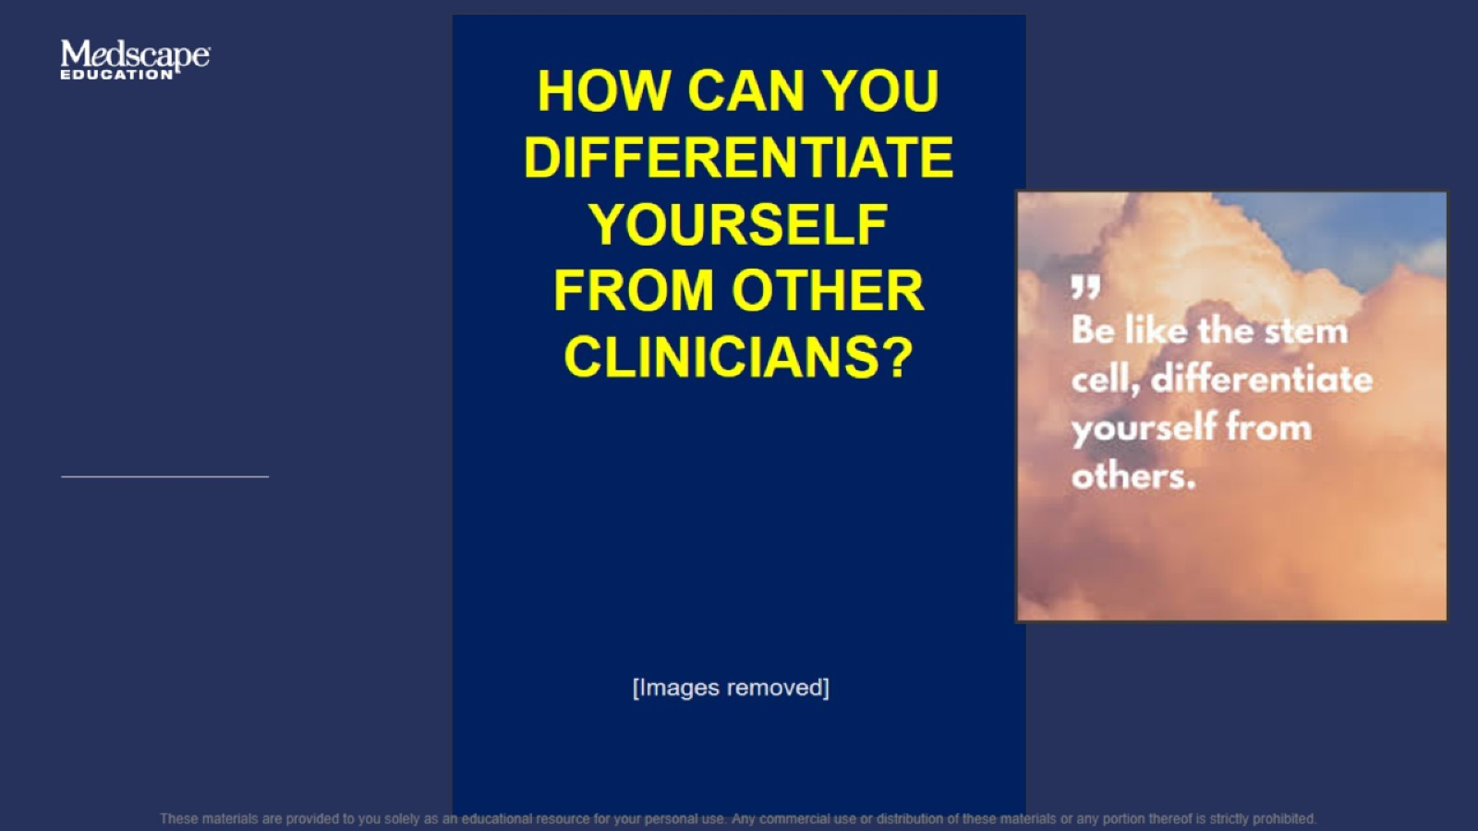

Slide 12
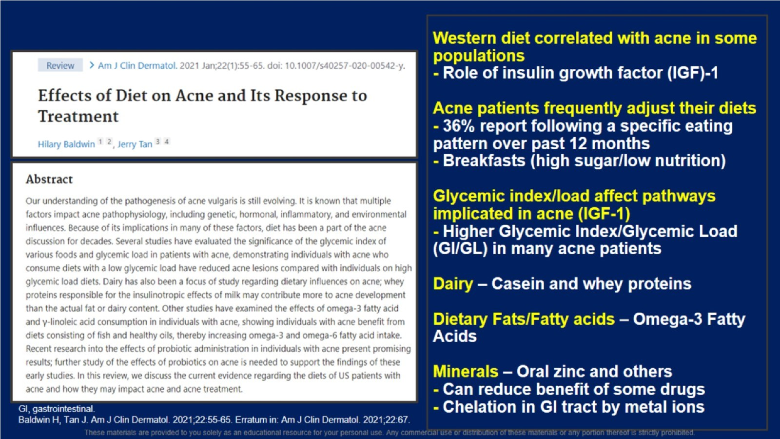
Western diet correlated with acne in some populations - Role of insulin growth factor (IGF)-1 Acne patients frequently adjust their diets - 36% report following a specific eating pattern over past 12 months - Breakfasts (high sugar/low nutrition) Glycemic index/load affect pathways implicated in acne (IGF-1) - Higher Glycemic Index/Glycemic Load (GI/GL) in many acne patients Dairy – Casein and whey proteins Dietary Fats/Fatty acids – Omega-3 Fatty Acids Minerals – Oral zinc and others - Can reduce benefit of some drugs - Chelation in GI tract by metal ions l

Slide 13
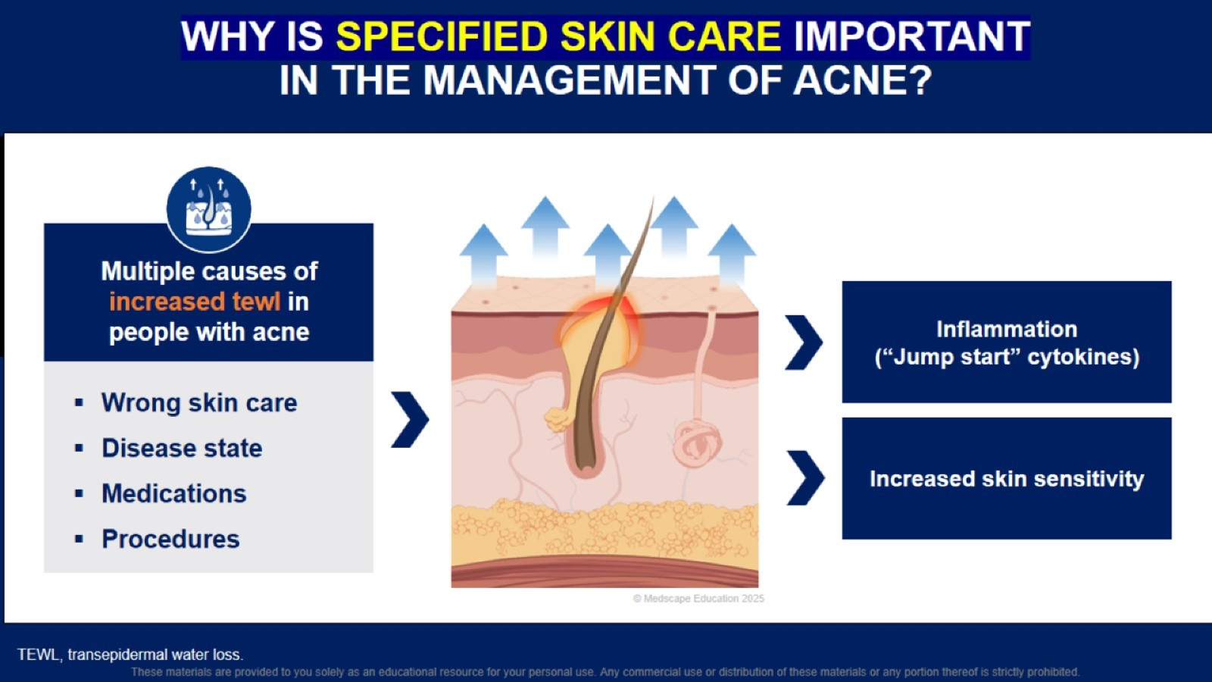
WHY IS SPECIFIED SKIN CARE IMPORTANT IN THE MANAGEMENT OF ACNE?

Slide 14
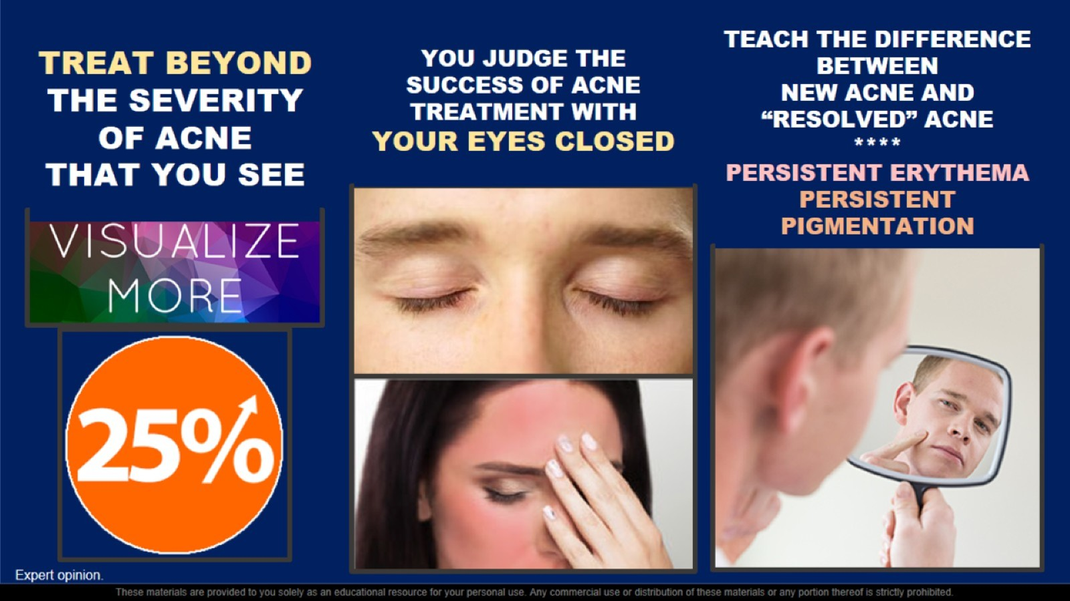

Slide 15
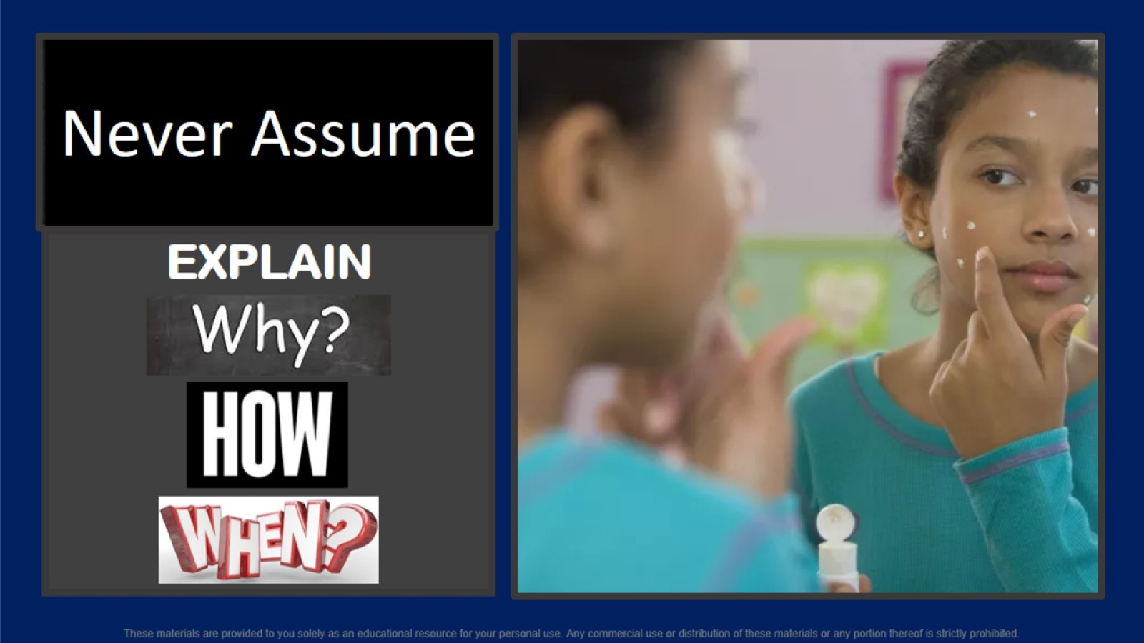

Slide 16
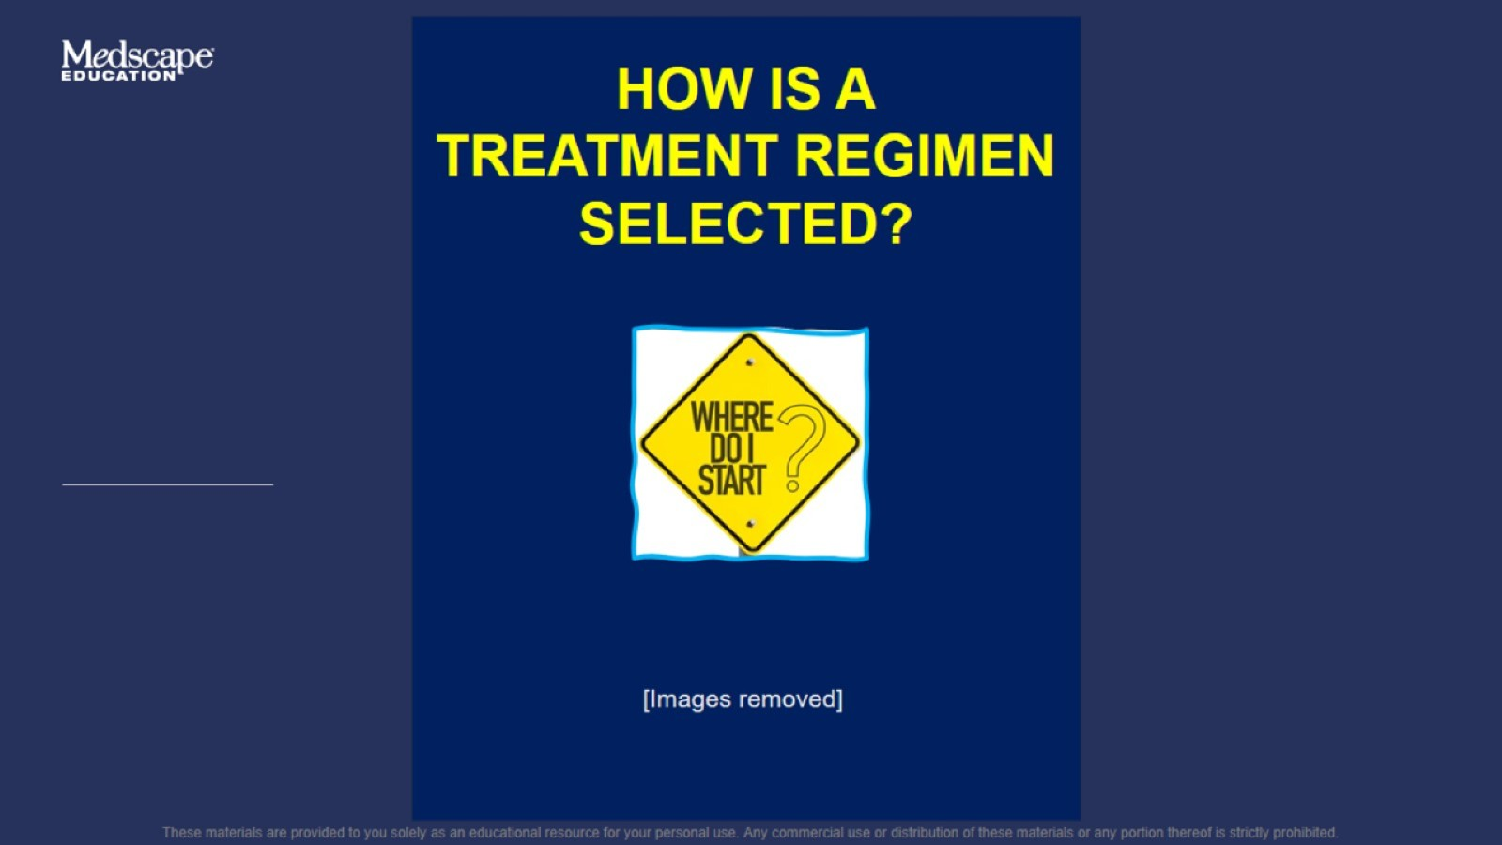

Slide 17
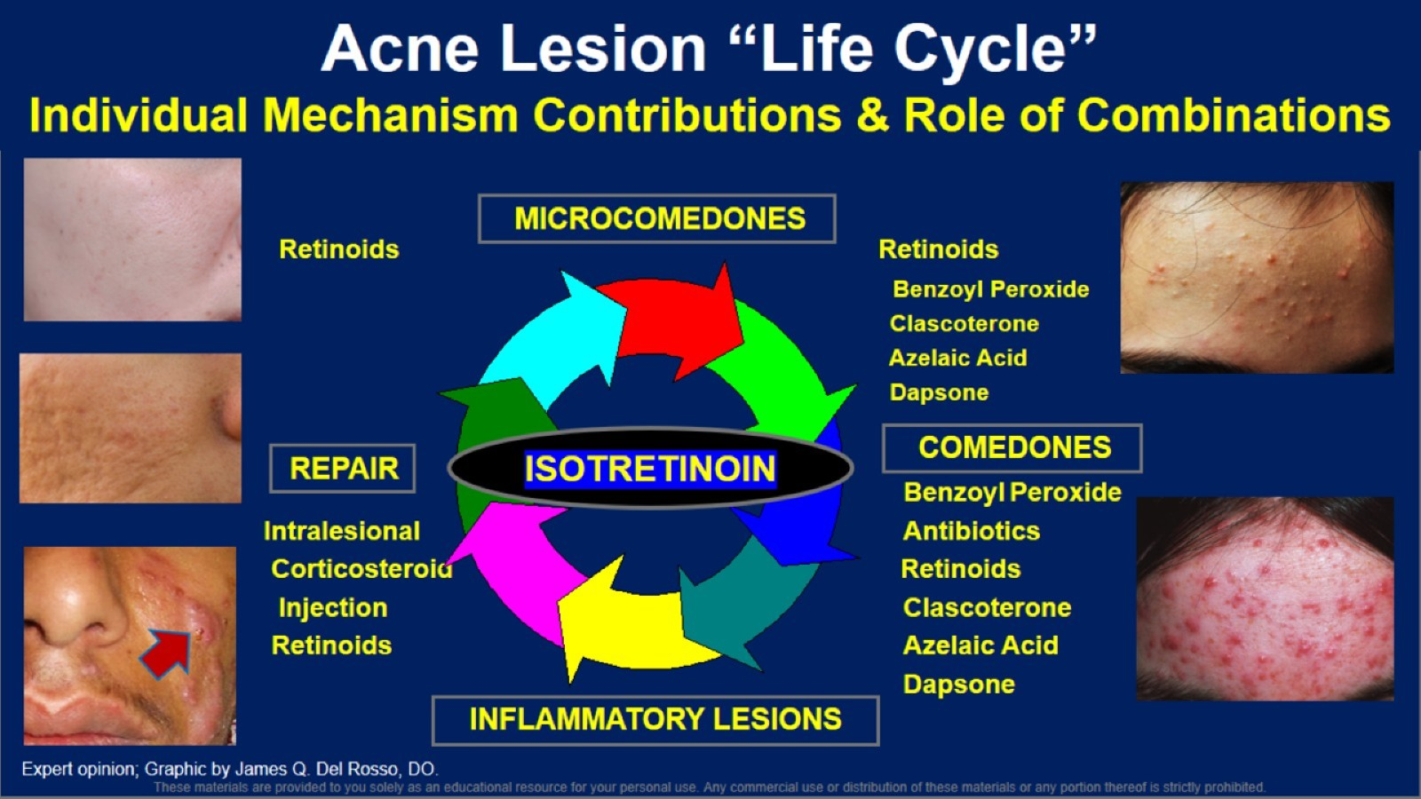

Slide 18
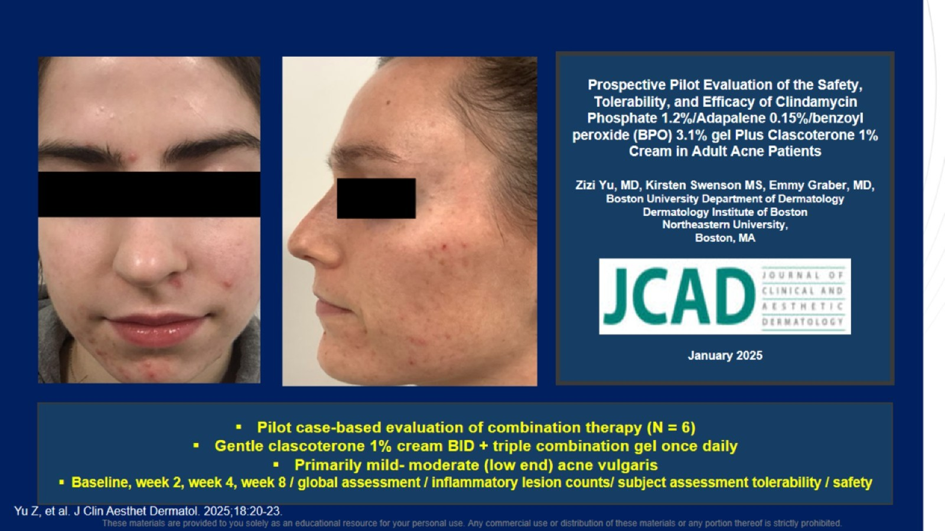

Slide 19
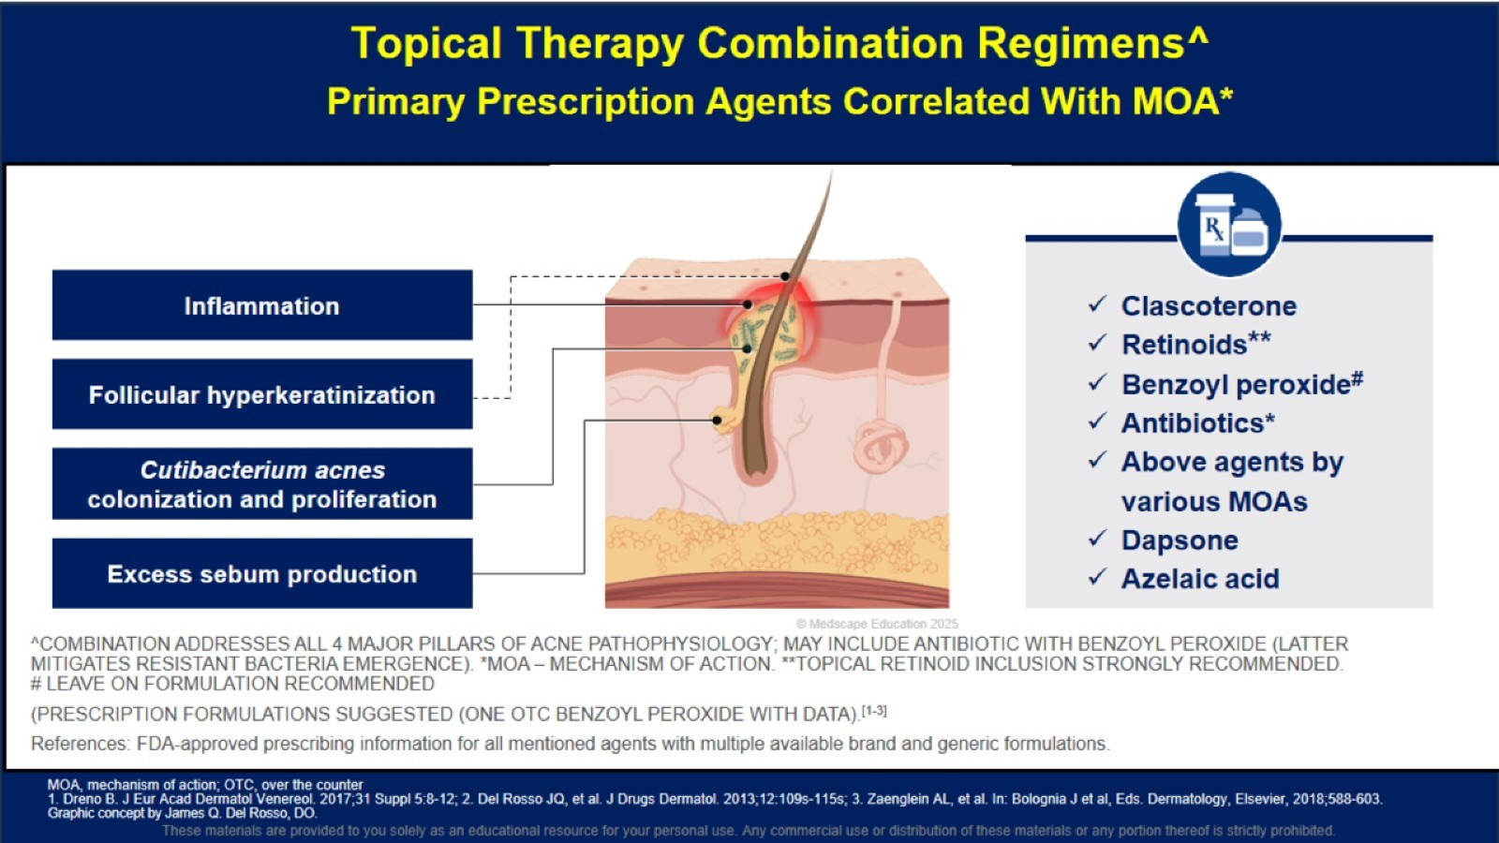
Topical Therapy Combination Regimens^ Primary Prescription Agents Correlated With MOA*

Slide 20
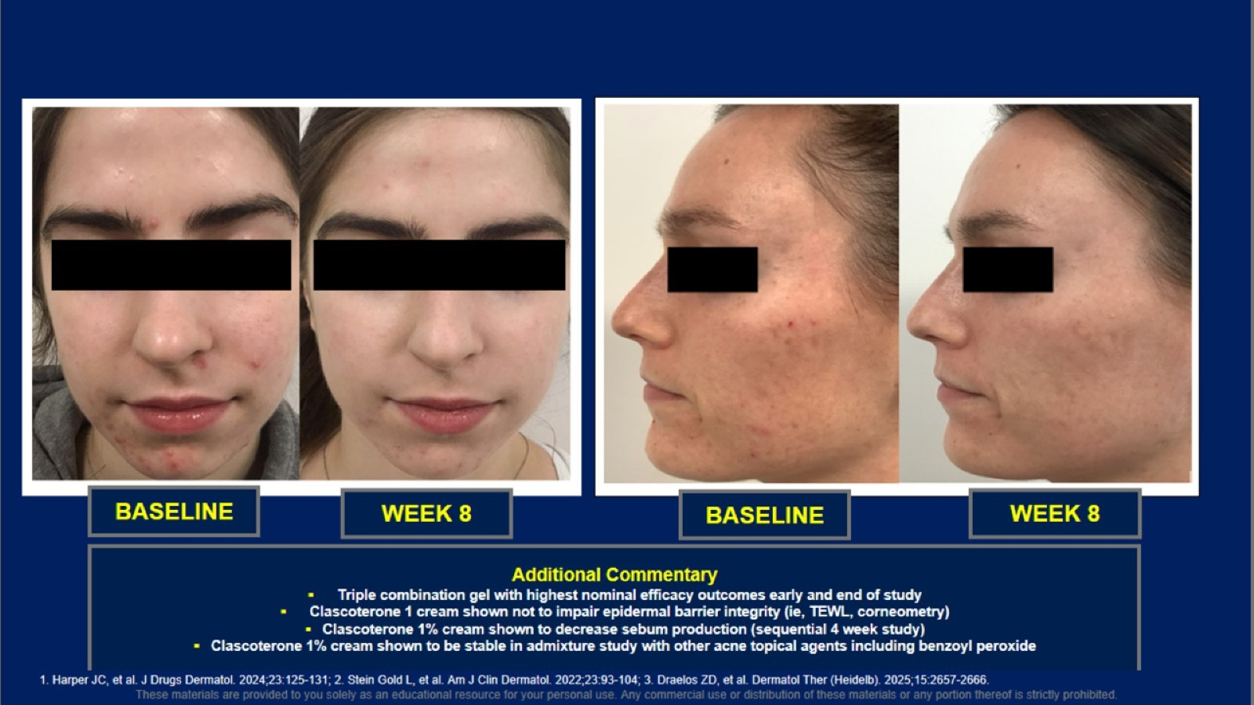

Slide 21
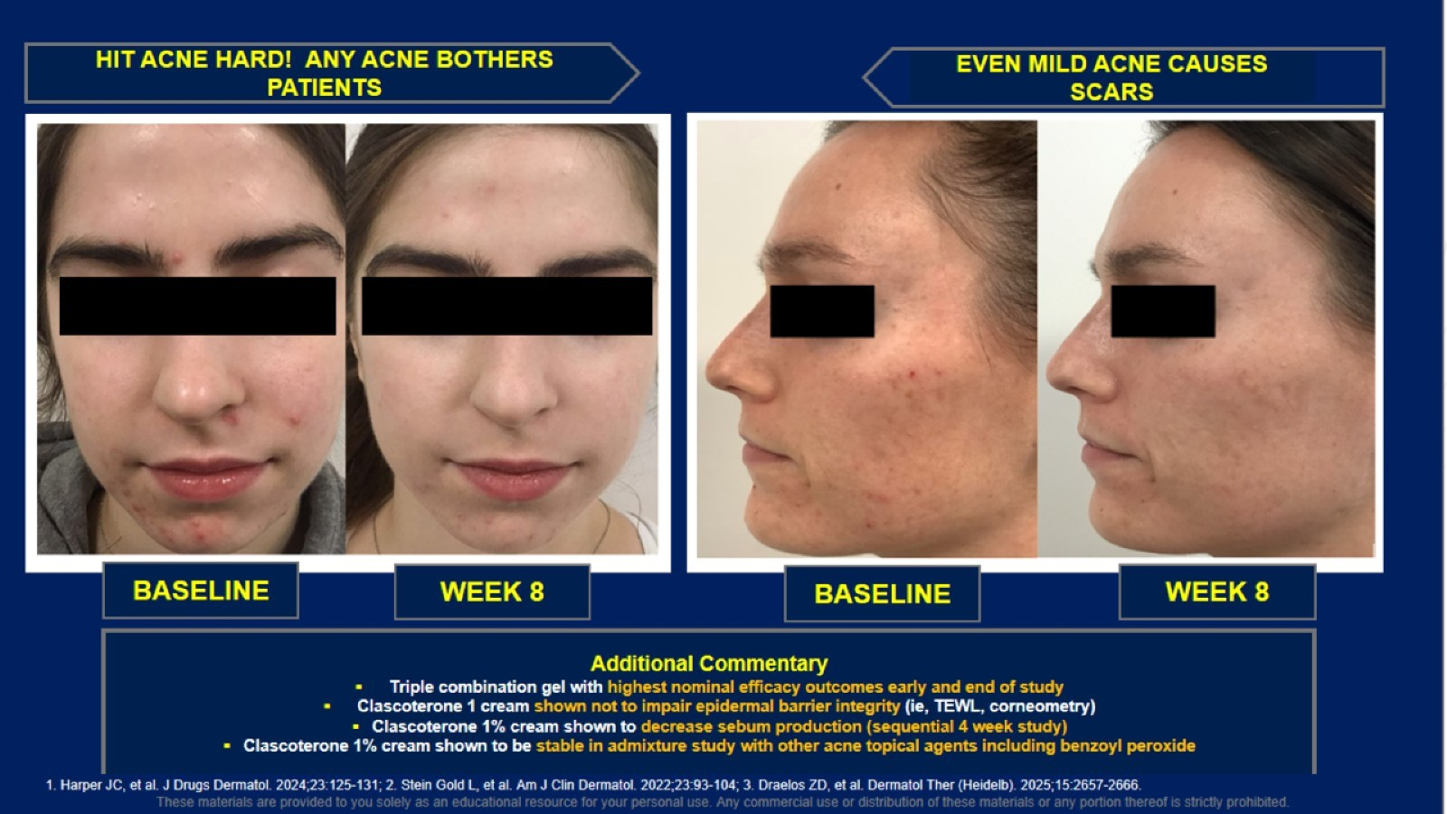

Slide 22
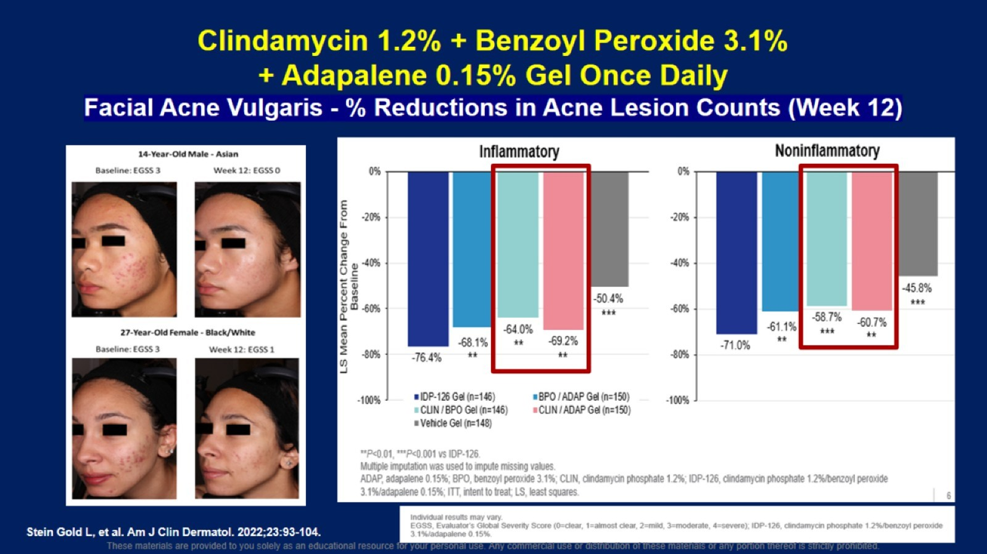

Slide 23


Slide 24

Diagnosing and Treating Cutaneous Bacterial Infections

Slide 25
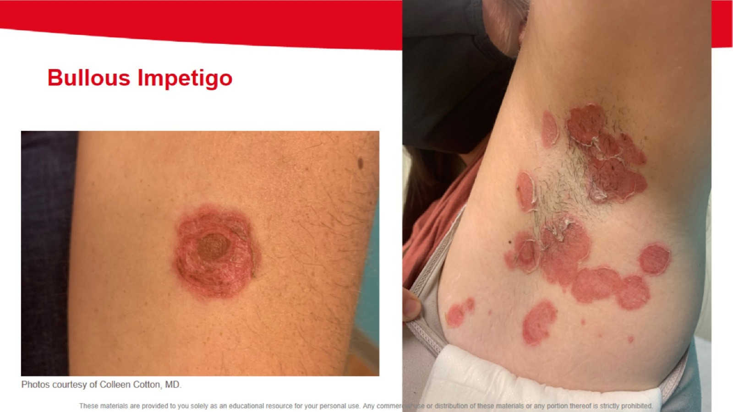

Slide 26
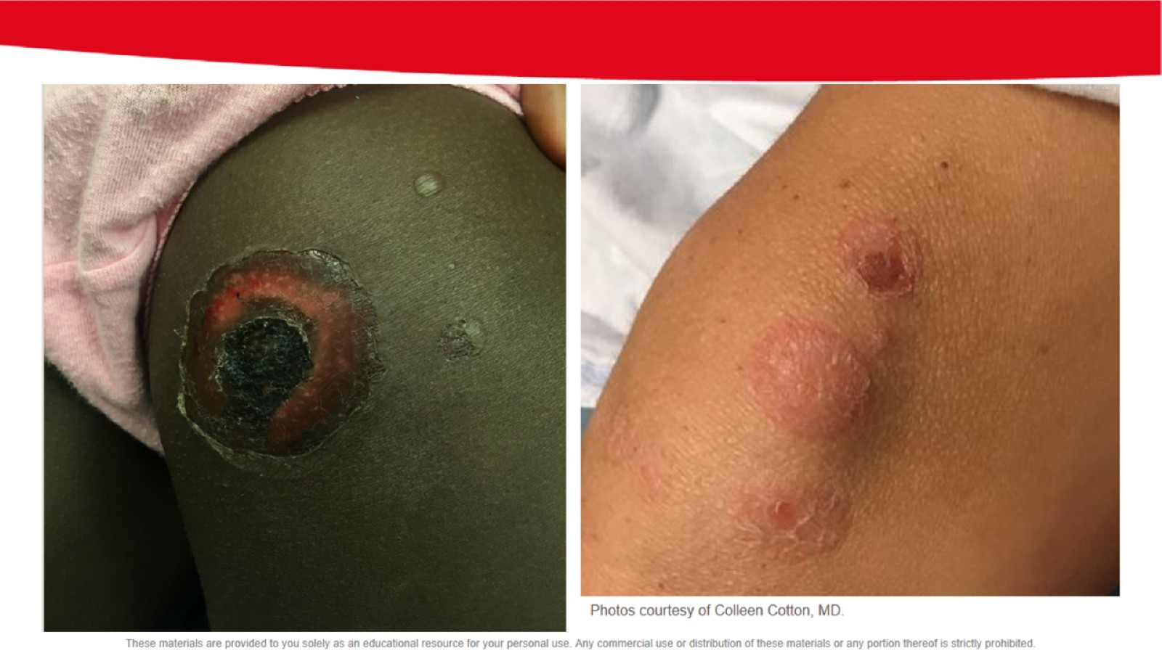

Slide 27
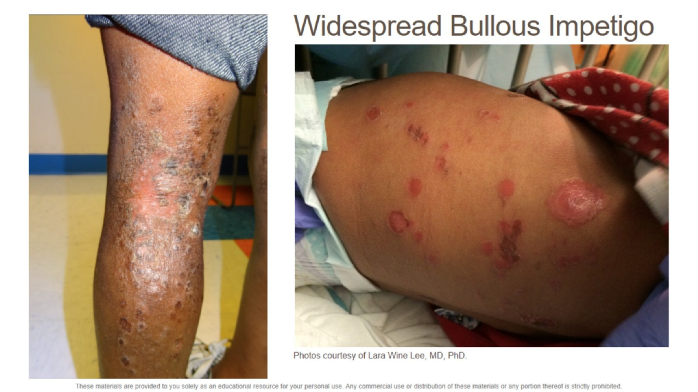
Widespread Bullous Impetigo

Slide 28
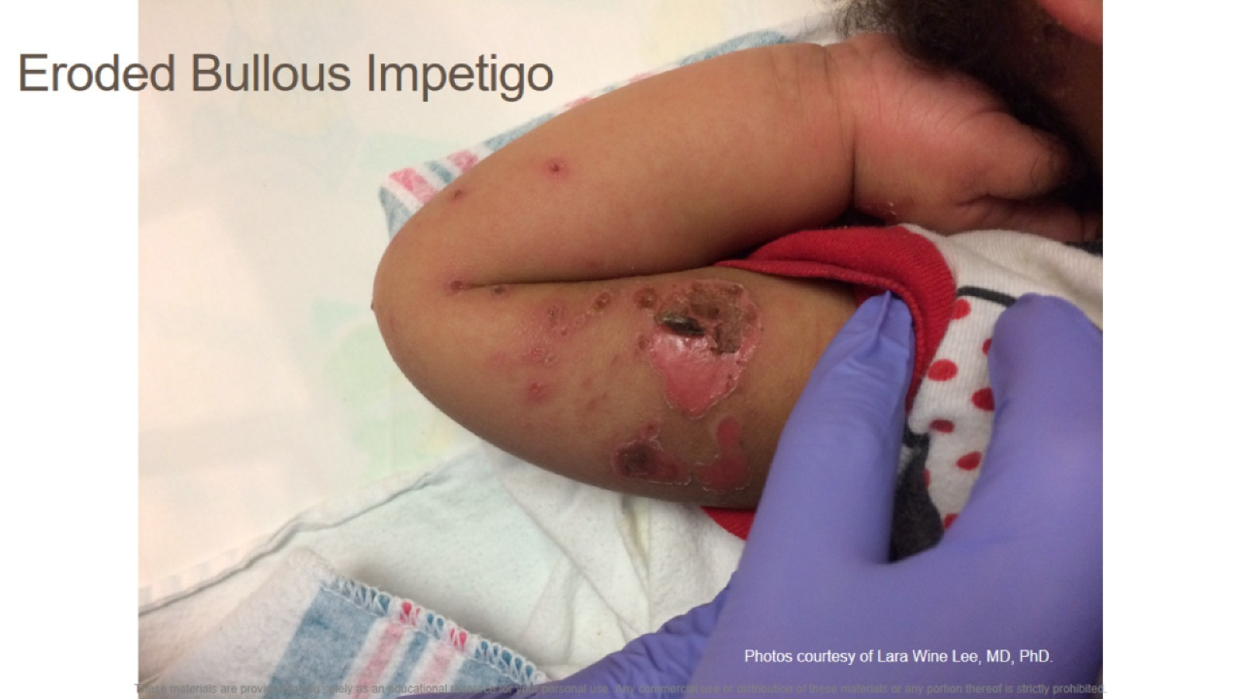
Eroded Bullous Impetigo

Slide 29
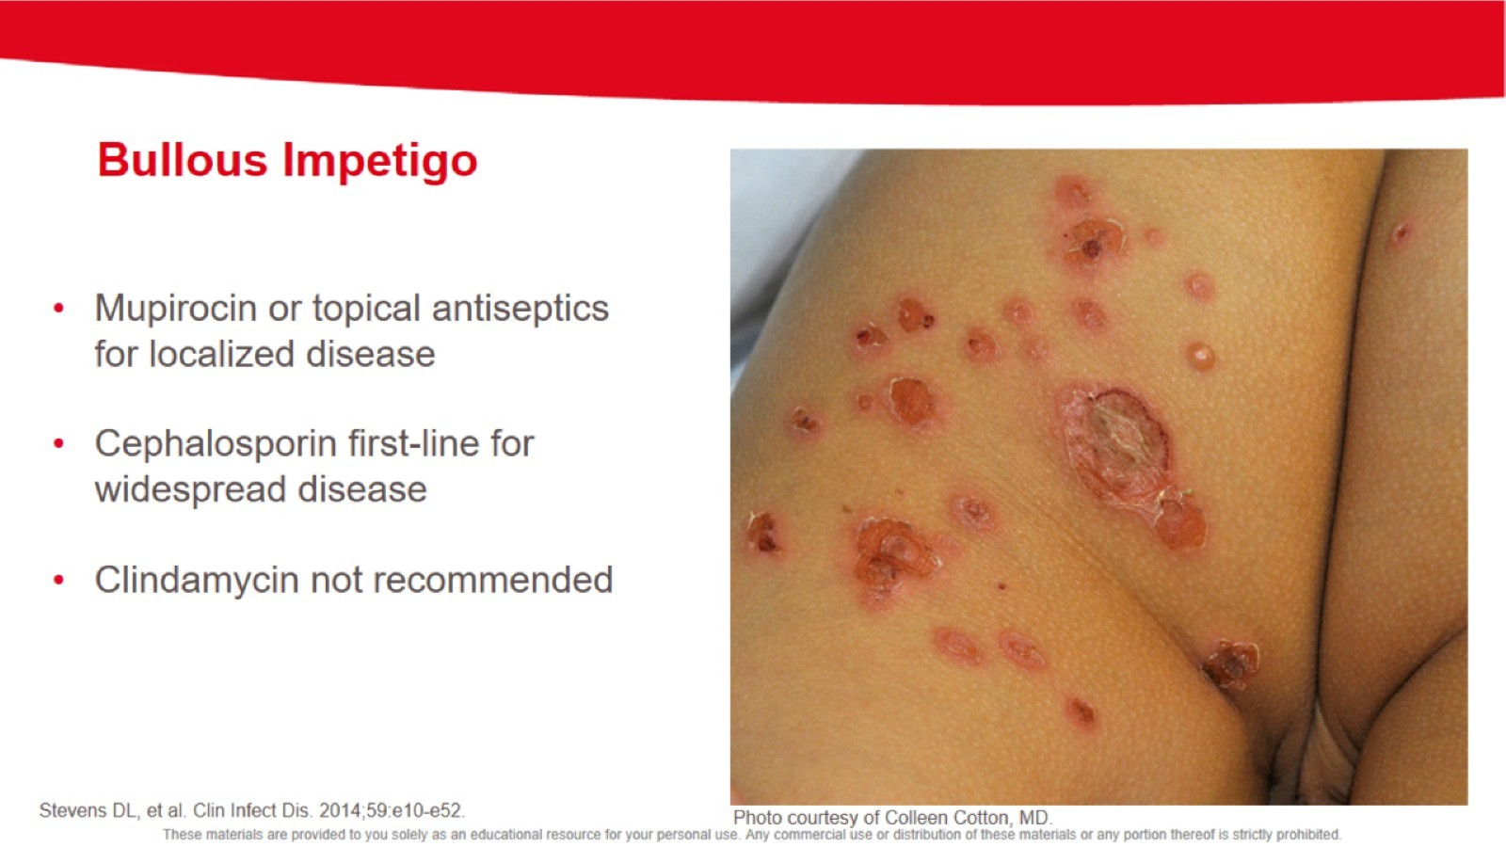

Slide 30
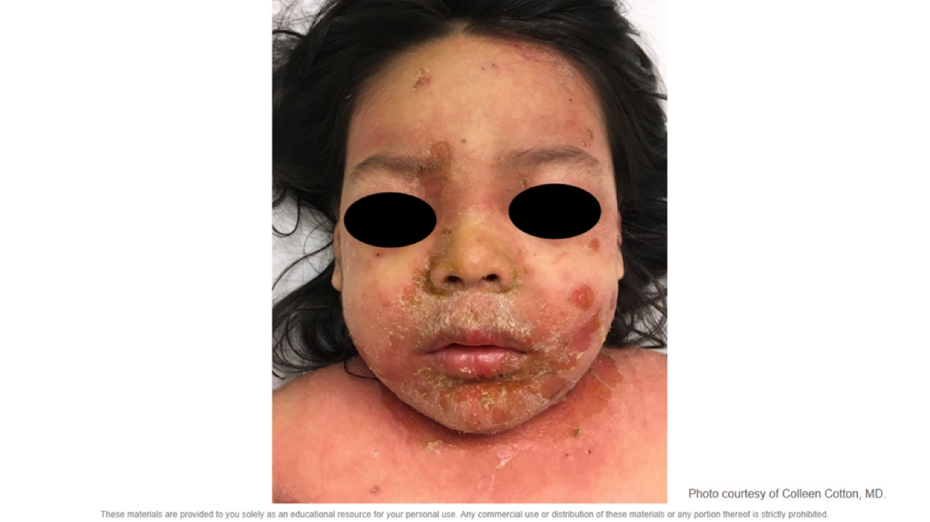

Slide 31
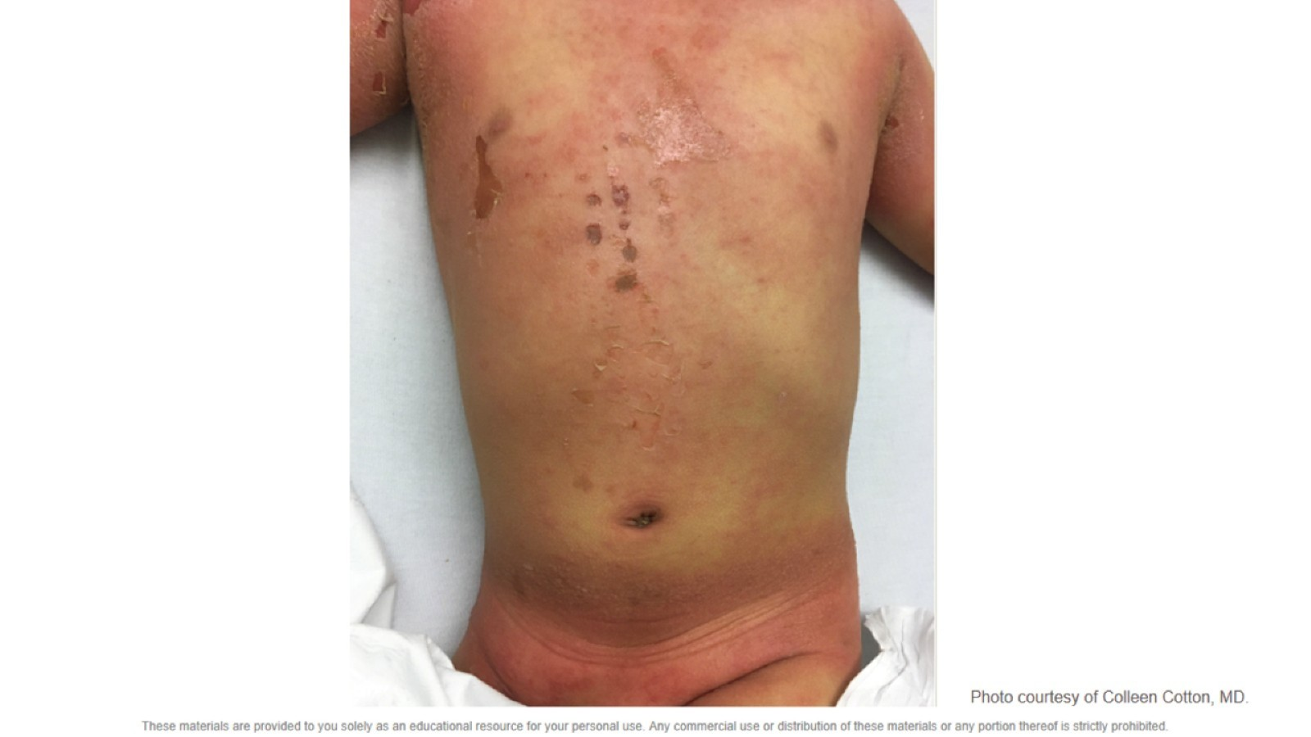

Slide 32
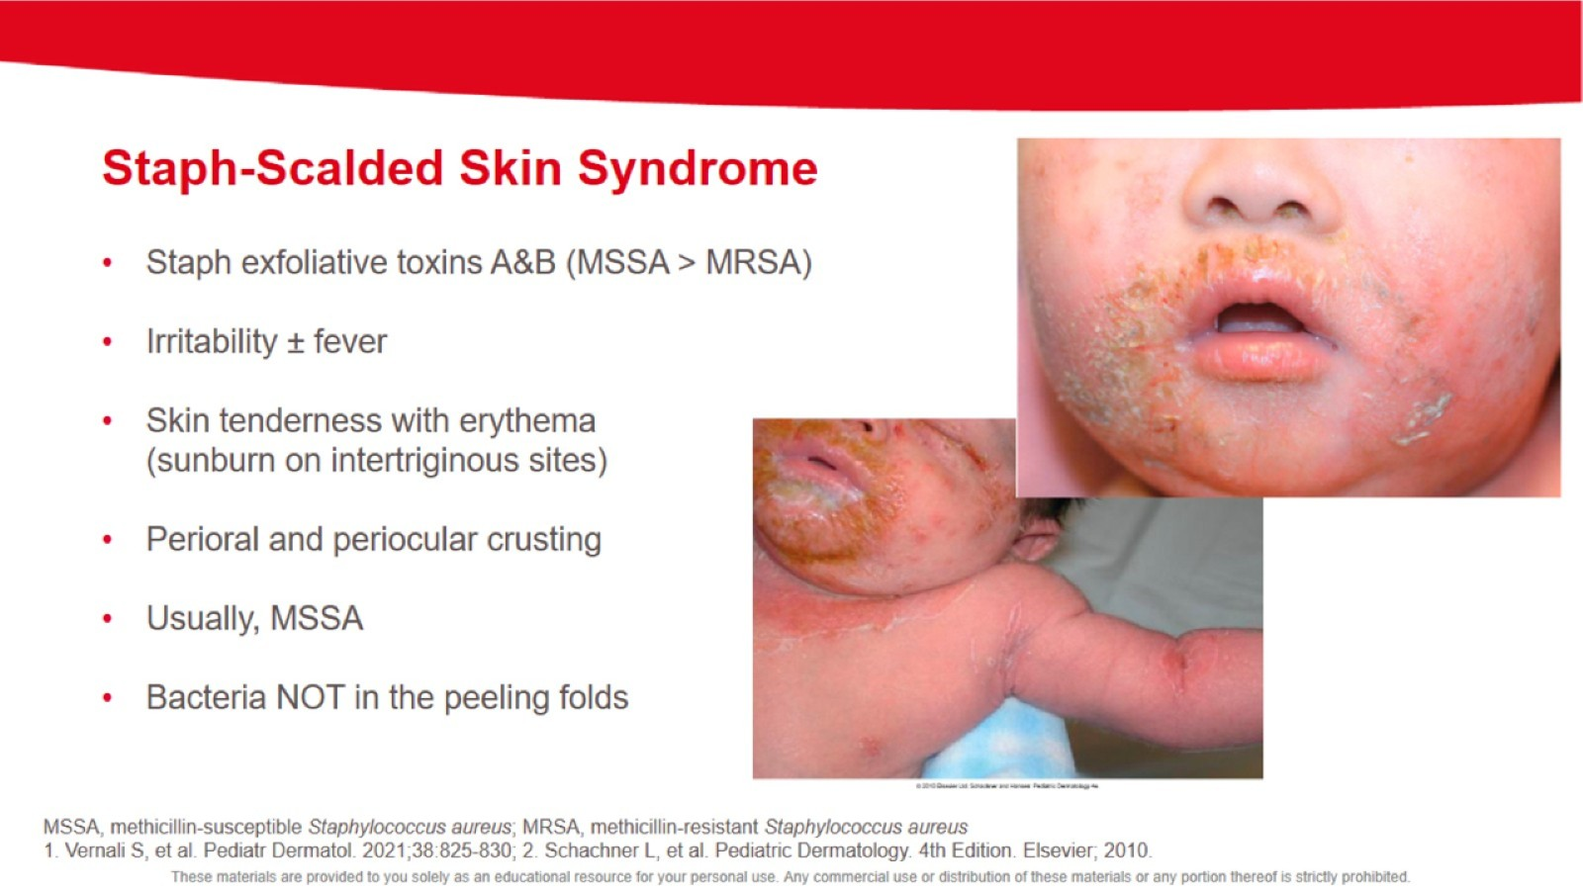

Slide 33
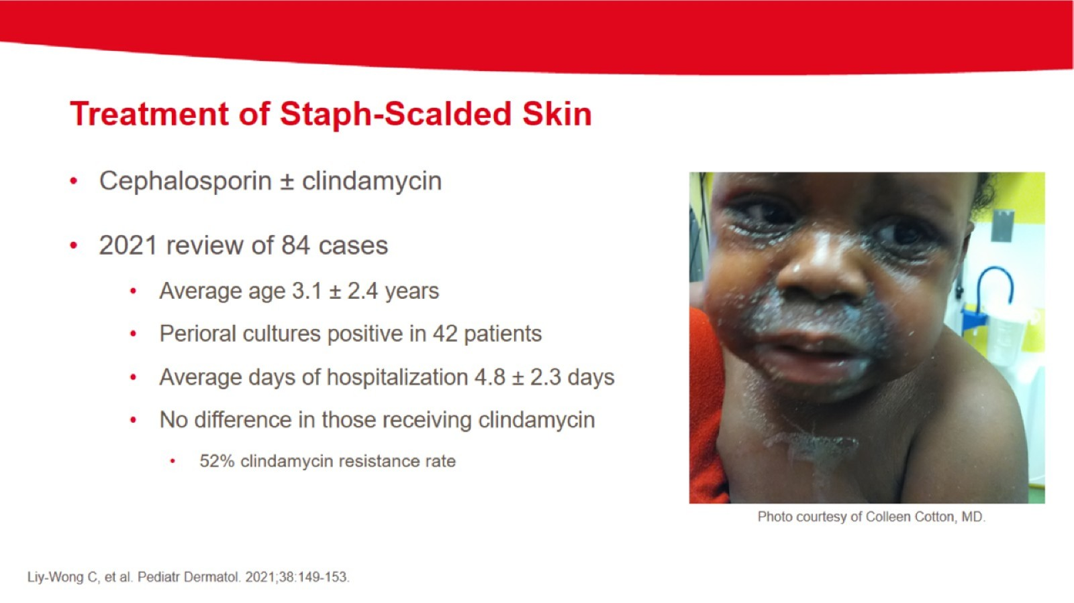

Slide 34
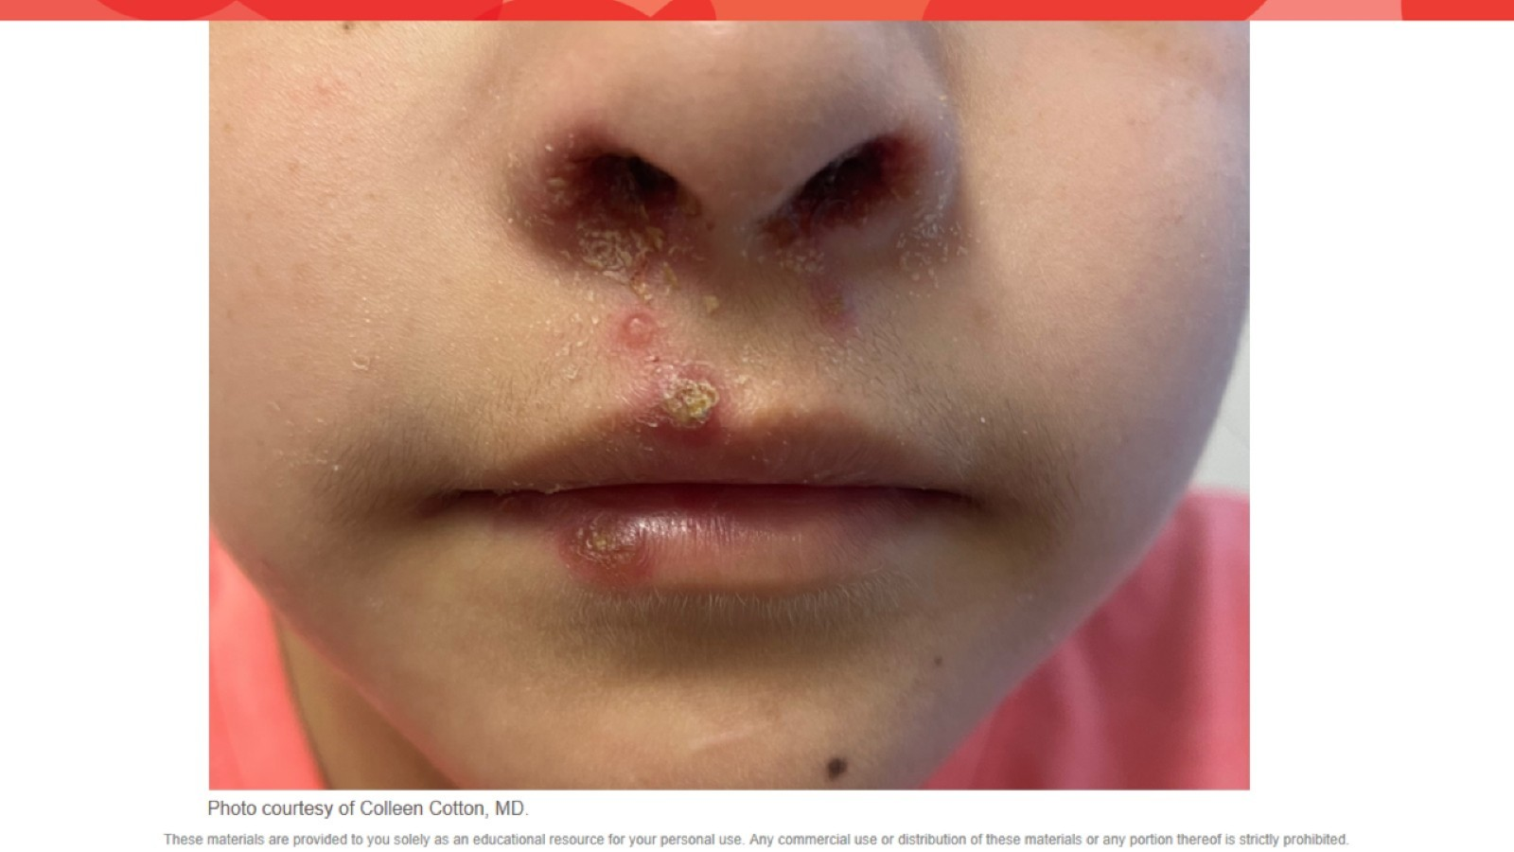

Slide 35
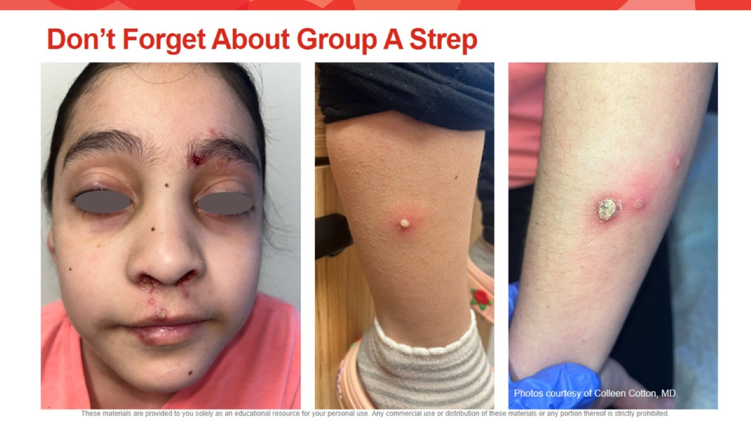
Don’t Forget About Group A Strep

Slide 36
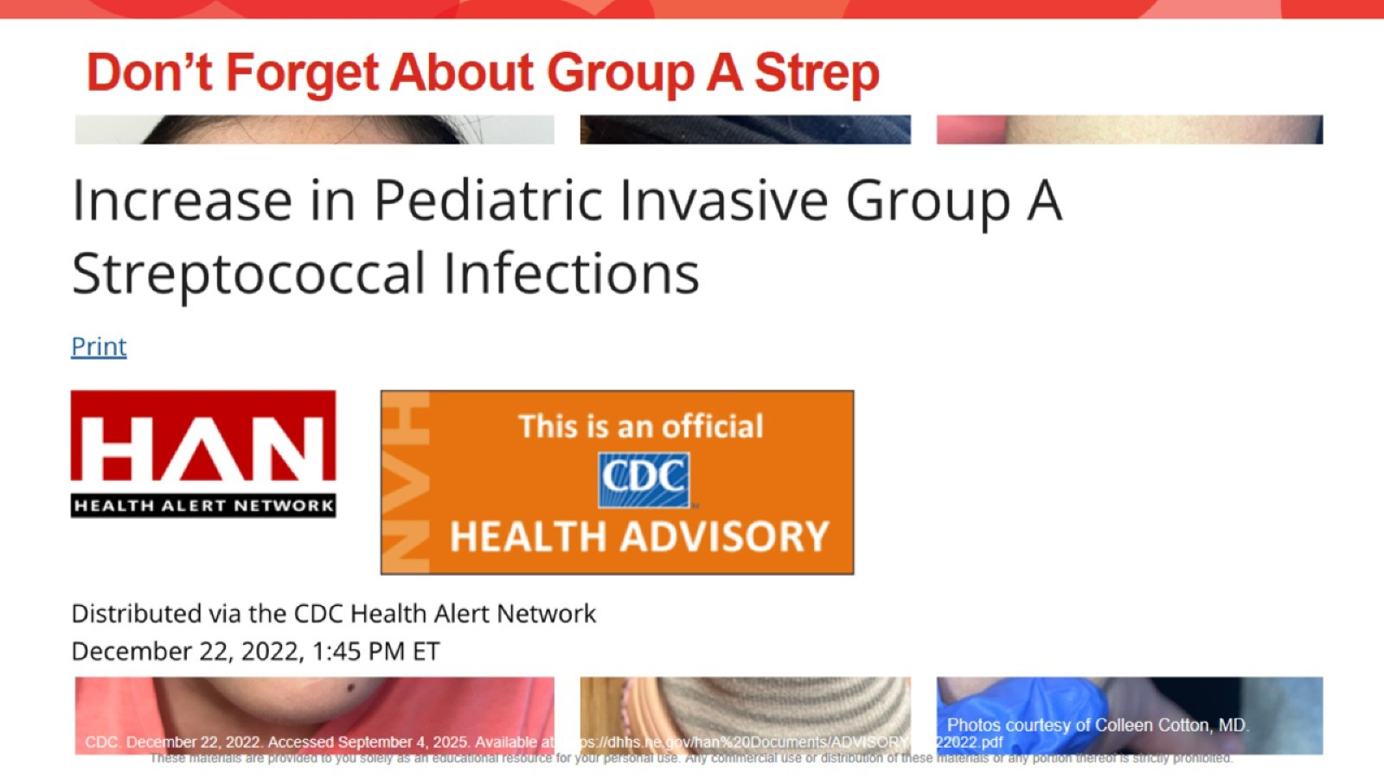
Don’t Forget About Group A Strep

Slide 37
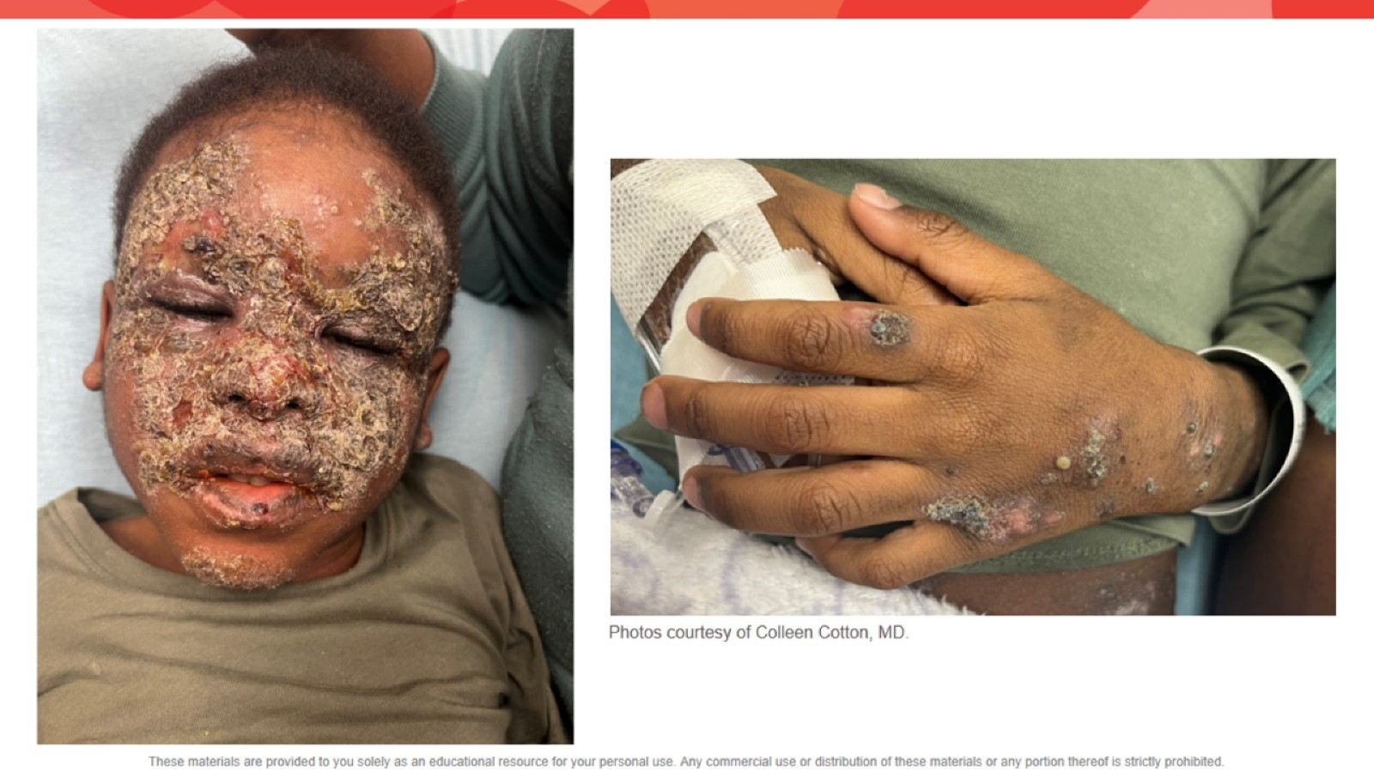

Slide 38
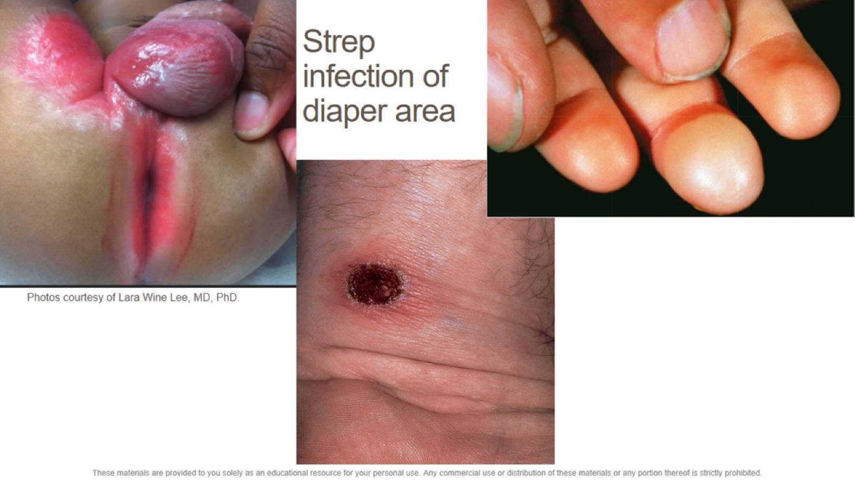
Strep infection of diaper area

Slide 39
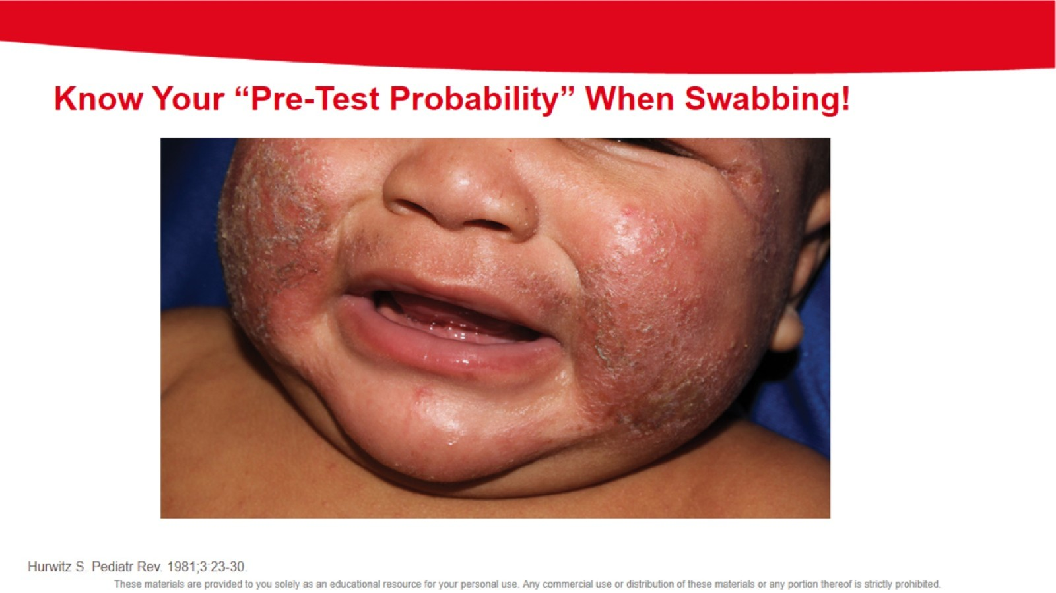

Slide 41
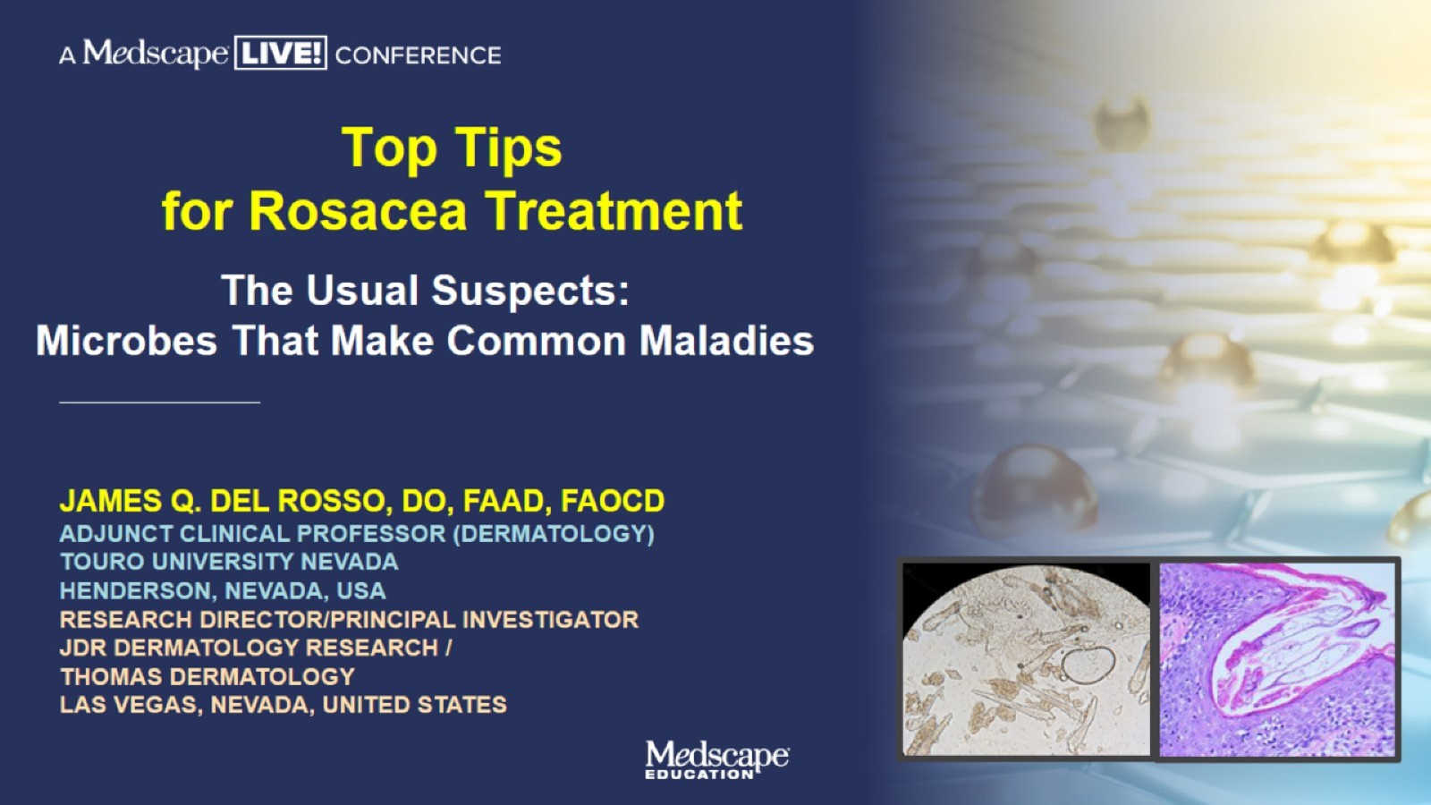
Top Tips for Rosacea Treatment

Slide 42
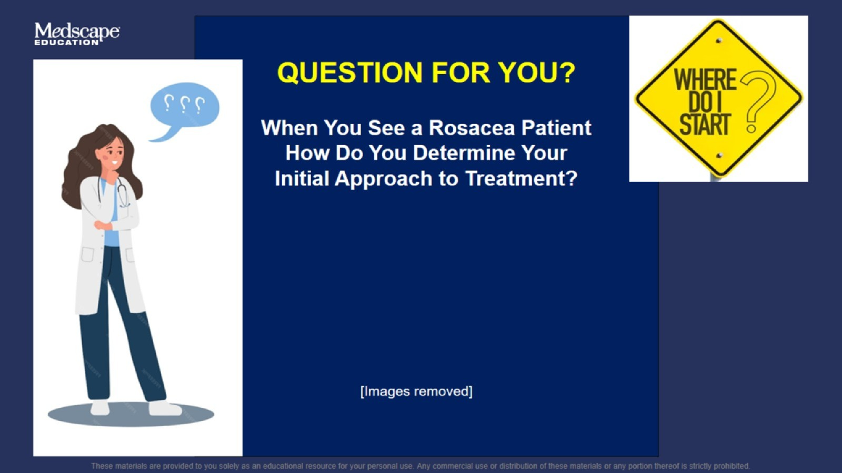

Slide 43


Slide 44
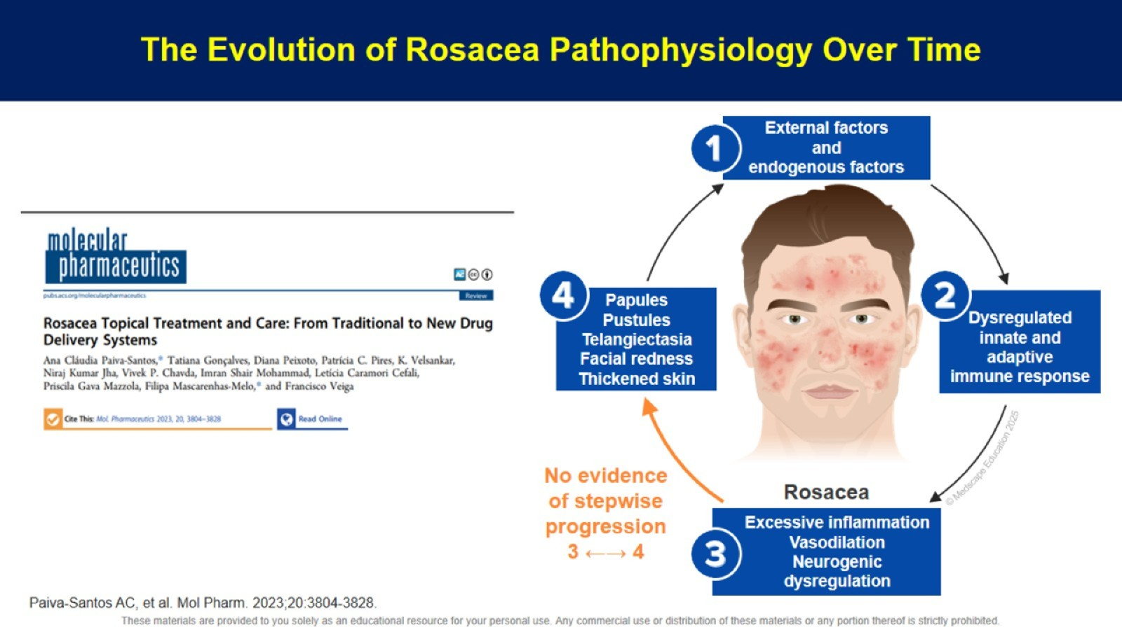
The Evolution of Rosacea Pathophysiology Over Time

Slide 45
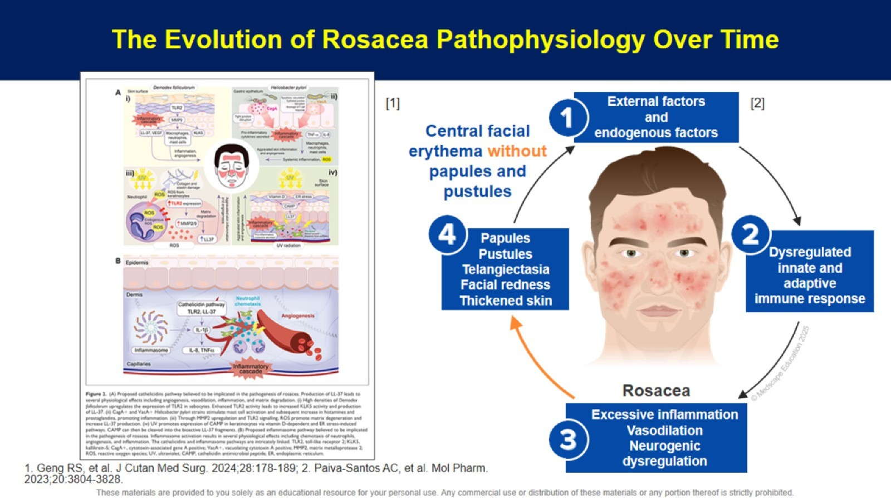

Slide 46


Slide 47
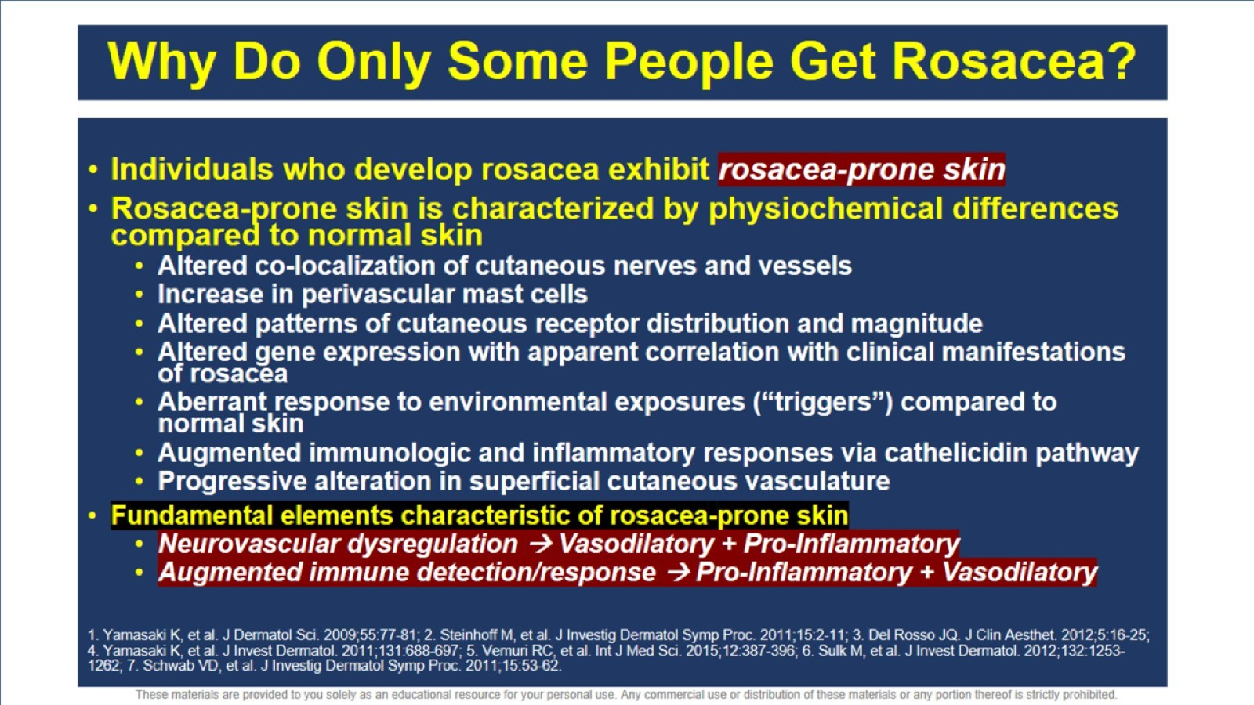
Why Do Only Some People Get Rosacea?

Slide 48
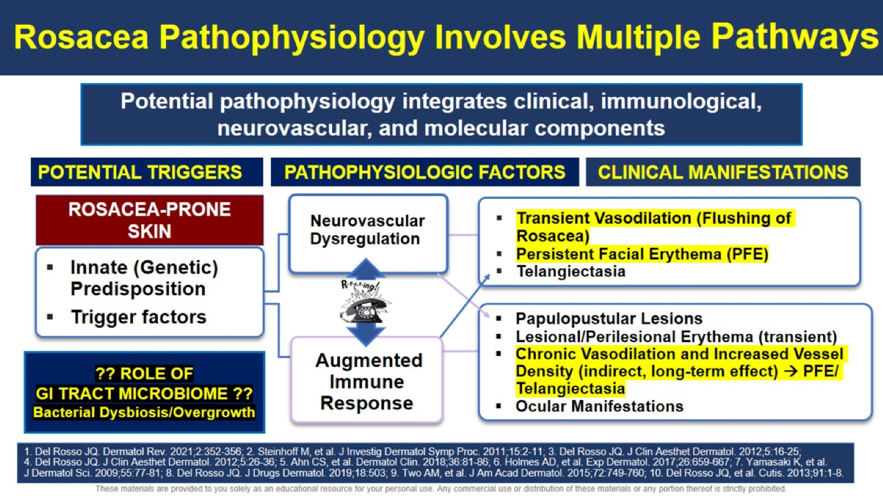
Rosacea Pathophysiology Involves Multiple Pathways

Slide 49
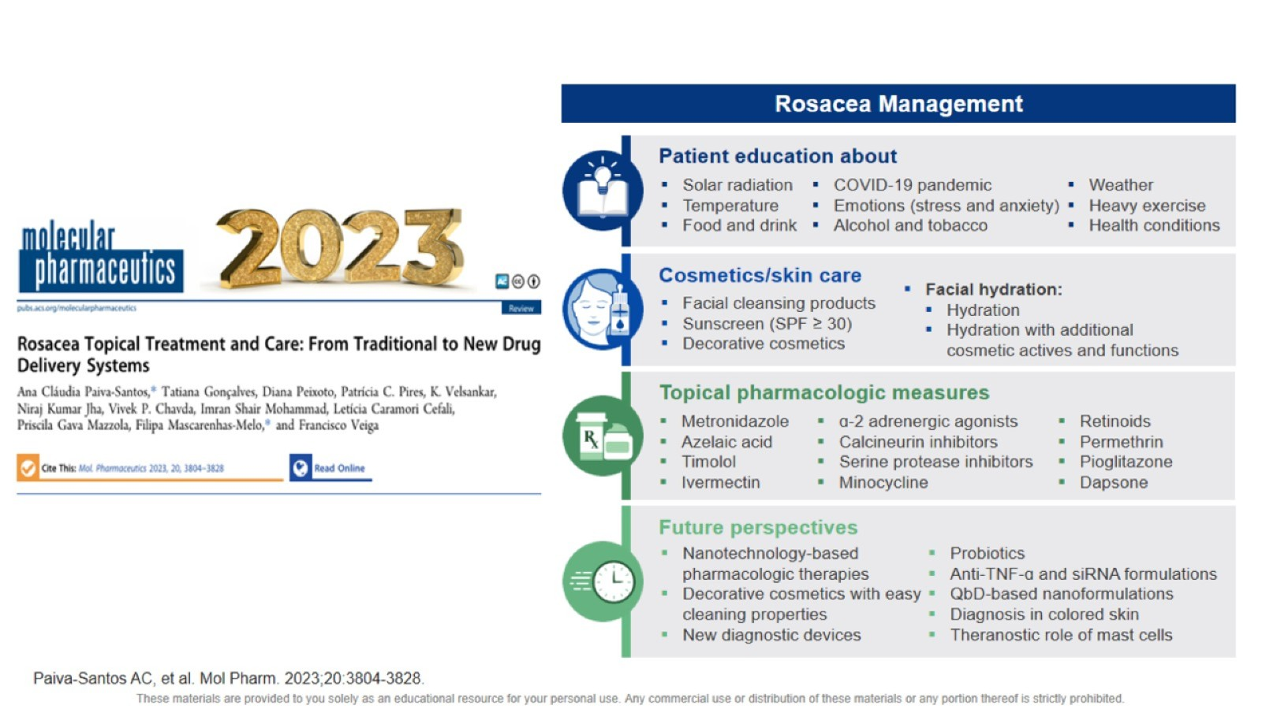

Slide 50
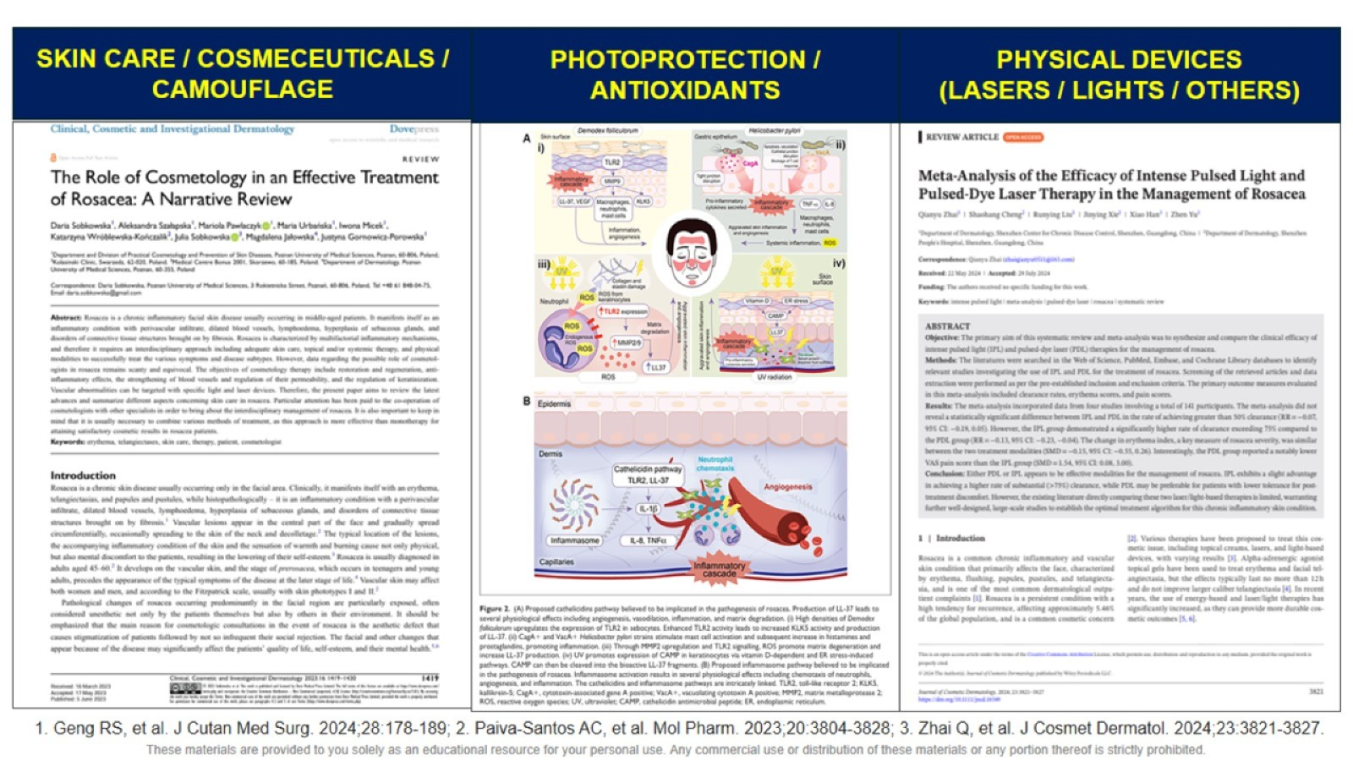

Slide 51
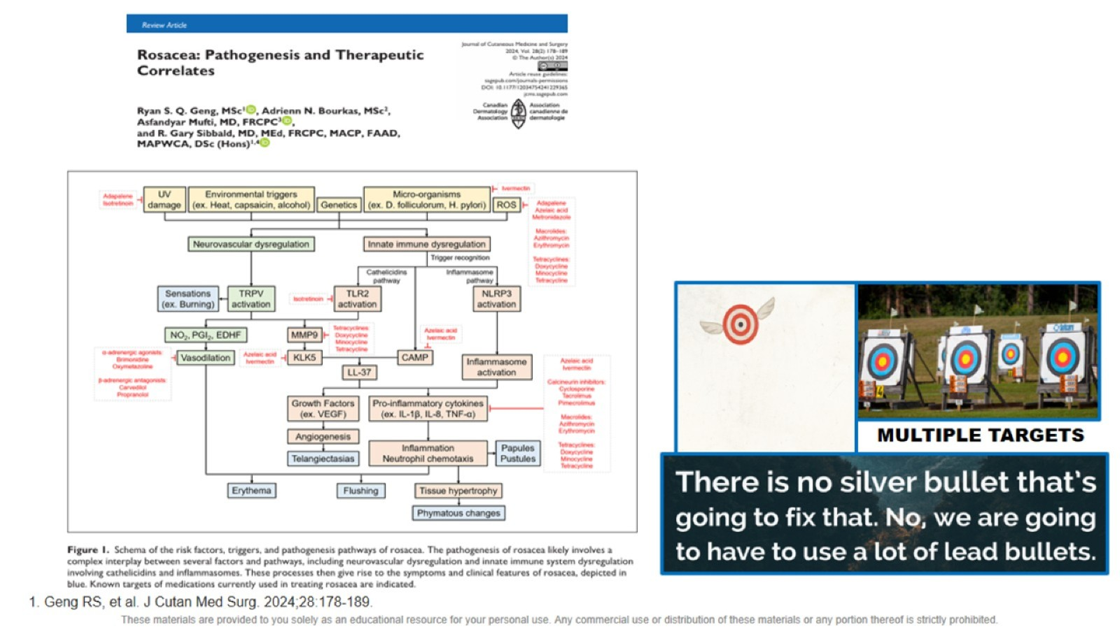

Slide 52
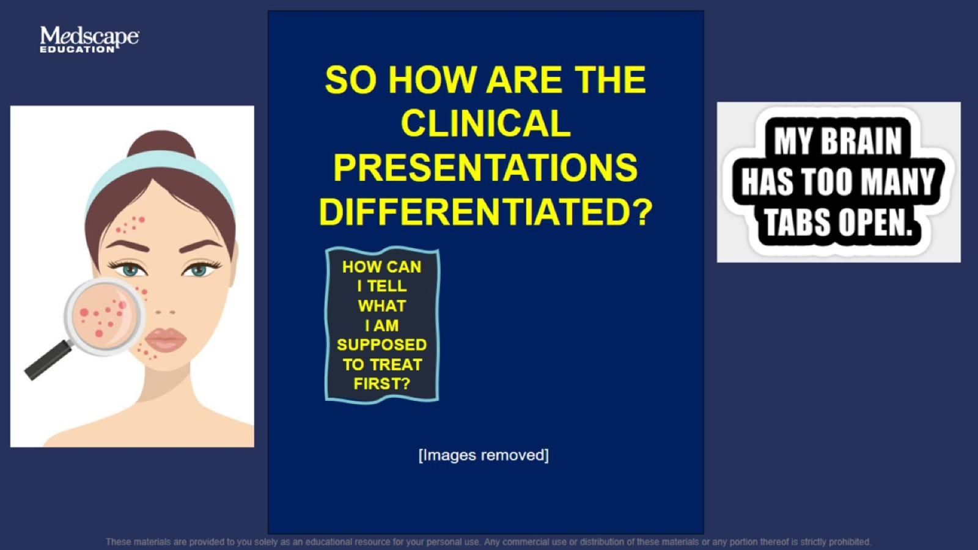

Slide 53
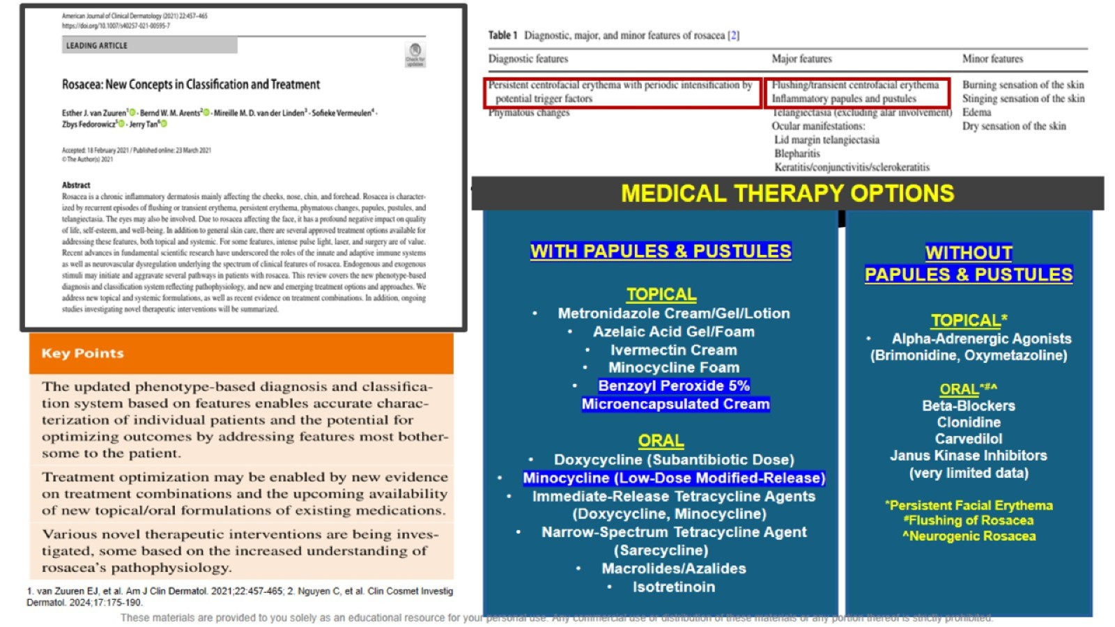

Slide 54
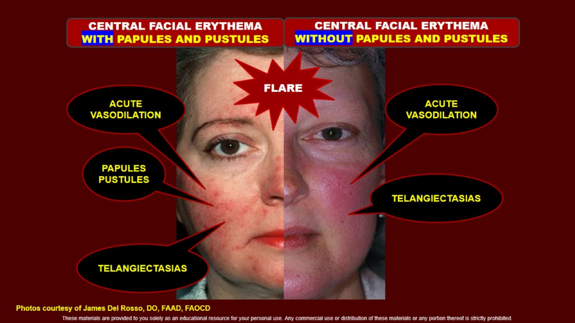

Slide 55
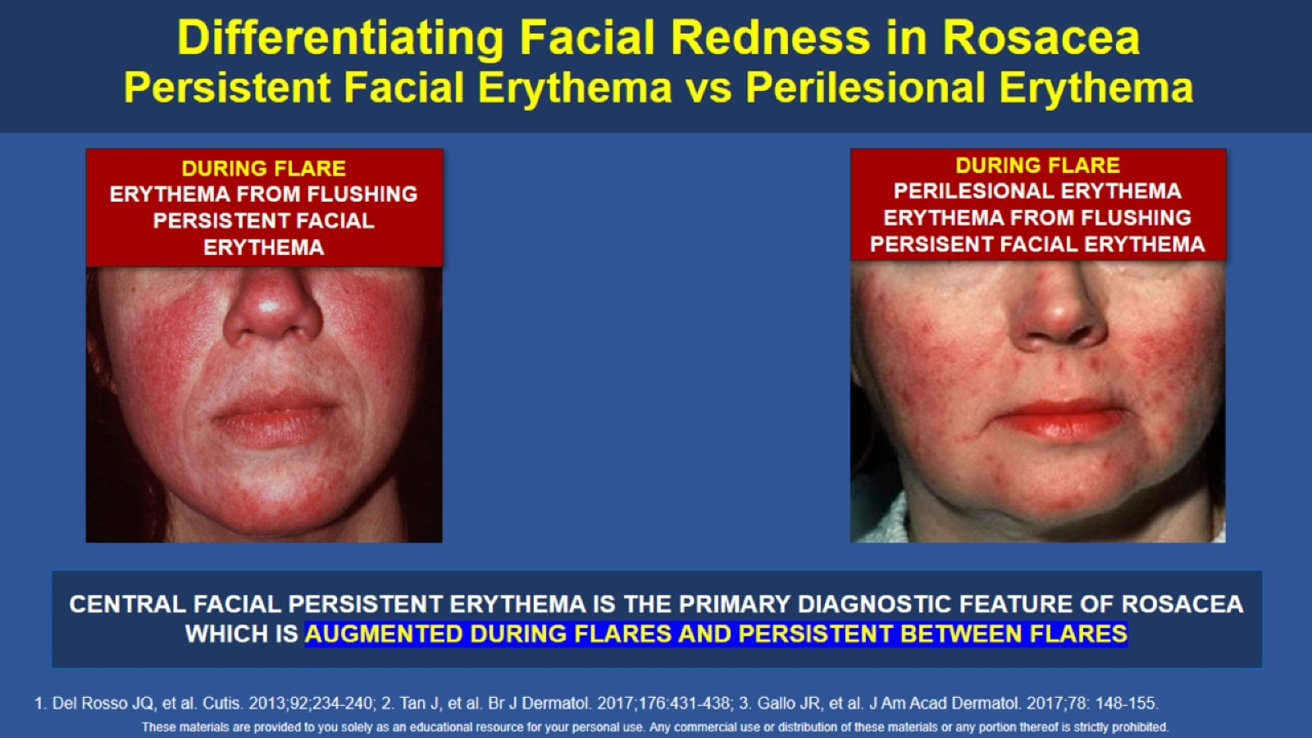
Differentiating Facial Redness in Rosacea Persistent Facial Erythema vs Perilesional Erythema

Slide 56

Differentiating Facial Redness in Rosacea Persistent Facial Erythema vs Perilesional Erythema

Slide 58

Cutaneous Fungal Infections: What’s Burning Right Now?

Slide 59

What’s New?

Slide 60


Slide 61

Climate Change, Natural Disasters, and Cutaneous Fungal Infections

Slide 62


Slide 63


Slide 64


Slide 65

KOH Positive

Slide 66

KOH Positive

Slide 67


Slide 68


Slide 69

Clear and Present Danger

Slide 70

Clear and Present Danger

Slide 71

How Do You Know??

Slide 72


Slide 73

Itching for Itraconazole

Slide 74

Itraconazole—Clinical Use

Slide 75

Itraconazole—Clinical Use

Slide 76

Even More Threatening…

Slide 77


Slide 78


Slide 79


Slide 80

Be Part of the Solution: What to Ask/Look For

Slide 81

Does Antifungal Stewardship = Financial Stewardship?

Slide 82

Mind Blown

Slide 83

Where Can We Save?

Slide 84

DDx Onychomycosis

Slide 85

Tinea Unguium Tx: What’s the Bottom Line?

Slide 86


Slide 87

Who Was Invited to This Party??

Slide 88

Please Focus on Fungal

Slide 90

Treating Viral Skin Infections

Slide 91


Slide 92

Neonatal/Perinatal HSV

Slide 93

Herpes Simplex

Slide 94


Slide 95


Slide 96


Slide 97


Slide 98


Slide 101


Slide 102


Slide 103

Dermatomal shingles

Slide 104


Slide 105

Molluscum

Slide 106

TREATMENTS

Slide 107


Slide 108

HPV

Slide 110

What Happens in Vegas Doesn’t Stay in Vegas

Slide 111

What Happens in Vegas Doesn’t Stay in Vegas

Slide 112


Slide 113


Slide 114


Slide 115


Slide 116


Slide 117


Slide 118


Slide 119


Slide 120


Slide 121


Slide 122


Slide 123


Slide 124


Slide 125

The Problem With RIME

Slide 126


Slide 127


Slide 128


Slide 129


Slide 130


Slide 131


Slide 132


Slide 133


Slide 134

Cases in Common Skin Conditions

Slide 135


Slide 136


Slide 137


Slide 138


Slide 139


Slide 140


Slide 141

Two Phase 3 Atopic Dermatitis 4-Week Trials Roflumilast 0.15% Cream Once Daily in Adults and Children Aged >6 Years of Age

Slide 142

Roflumilast 0.15% Cream for Atopic Dermatitis Pooled Data from Phase III 4-WEEK Trials Individual Patient Outcomes¹

Slide 143

Roflumilast Cream/Foam Impact on Pruritus Outcomes in All 3 Indications From Phase 3 Studies

Slide 144

Roflumilast Cream/Foam Impact on Pruritus Outcomes in All 3 Indications From Phase 3 Studies

Slide 145


Slide 146


Slide 147


Slide 149

Case

Slide 150


Slide 151

Clinical Exam

Slide 152

Clinical Exam

Slide 153

Clinical Exam

Slide 154

What Is the Most Likely Diagnosis?

Slide 155


Slide 156

Pathology Report

Slide 157

Tinea Incognito

Slide 158

Clinical Presentations

Slide 159

KOH Prep

Slide 160

Treatment

Slide 161


Slide 162


